Slide 1
Shaqaale beereed (xoolaha)
Xisaabta goobta shaqada

Slide 2
Sida agabkeena waxbarista loogu talagalay fasalka

Slide 3
Waxaan fahmi karaa sida xisaabta loogu isticmaalo shaqaalaha beeraha (xoolaha).

Slide 4
Bedka (Area) waa cabbirka dusha sare wuxuuna sheegaa tirada labajibbaaranaha (unit squares) ee loo baahan yahay si buuxda u daboosho dushaas.
Khasaarada boqolleyda (Percentage loss) waa hoos u dhaca marka la tixraaco shay lumiyo qiimo/cuf/dherer, iwm, oo la siiyo boqolkiiba tirada asalka ah.

Slide 5

Shaqaale beereed (xoolaha)
Joometri (Geometry) shaqada beeraha
Kharashyada iyo boqolleyda (Percentages)

Slide 6
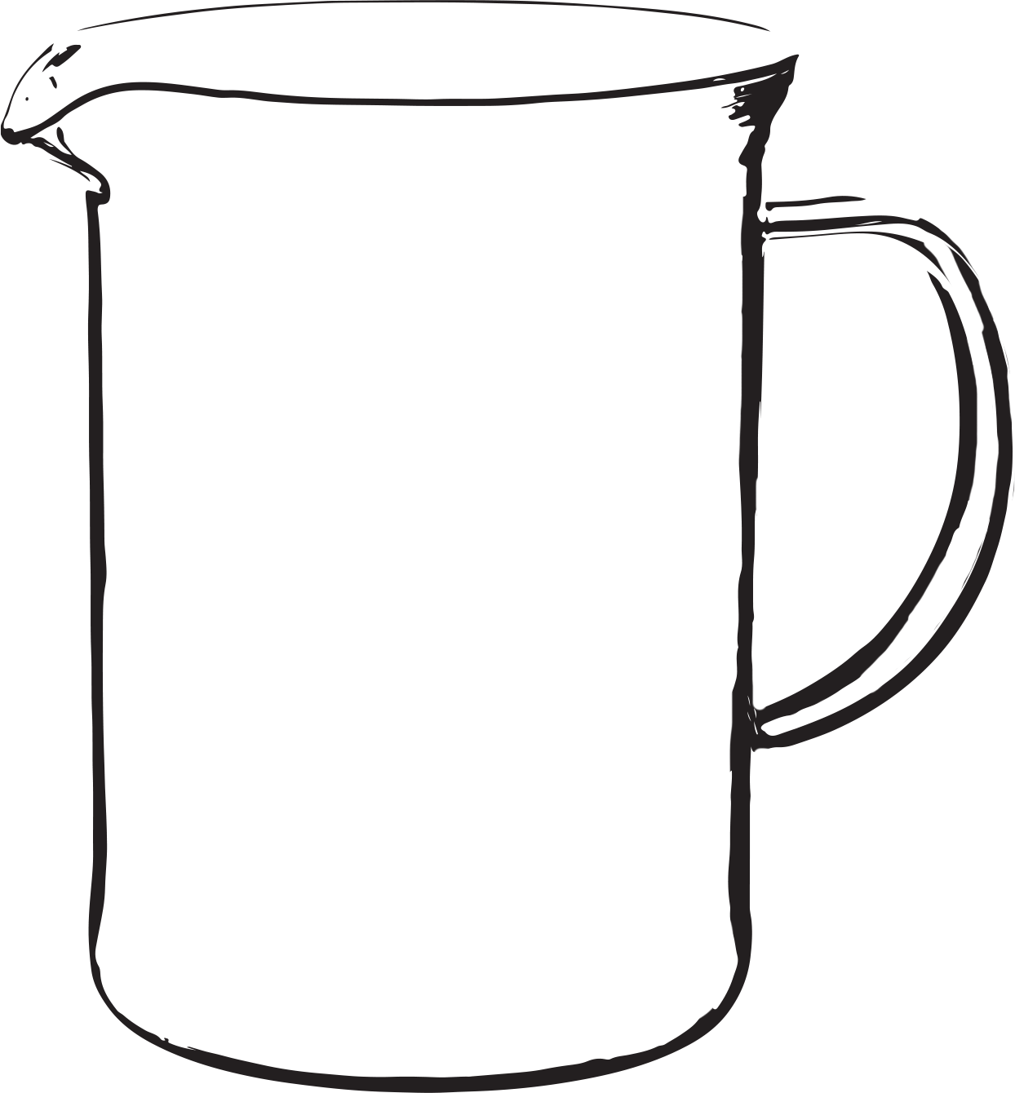
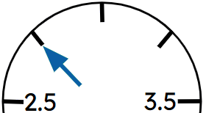
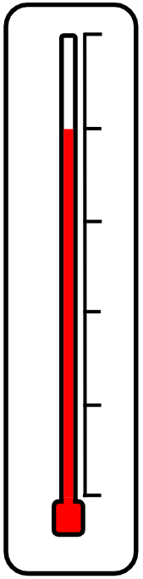
Joometri (Geometry) shaqada beeraha
Waa maxay qaybaha xisaabta ee aad u malaynaysaa in shaqaalaha beeraha ee la shaqeeya xoolaha ay isticmaalaan?
Bed (Area)
Isku dhufasho (Multiplication)
Qaybin (Division)
Boqolleyda (Percentages)
Lacag (Money)
Miisaanka iyo cabbirrada (Weights and measures)
Heerkulka (Temperature)
Waqtiga (Time)
kg
Inta lagu jiro darsigan waxaan eegi doonaa qaar badan oo ka mid ah kuwan.

Slide 7
Joometri (Geometry) shaqada beeraha
Beerale wuxuu leeyahay bakhaar cabbirkiisu yahay 10 m iyo 25 m.
Waxay rabaan inay ogaadaan inta xayawaan oo kasta ay si ammaan ah ku kaydin karaan gudaha maqalka.
Dhammaan xayawaanku waxay u baahan yihiin aag ugu yar oo kala duwan si ay ugu noolaadaan si ammaan ah oo raaxo leh.
Xayawaan | Aagga loo baahan yahay
Lo' | 10 m²
Digaag | 1 m²
Doofaar | 2.2 m²
Ido | 2 m²
Intee in le'eg oo xayawaan kasta ayaa si ammaan ah ku habboon maqalka?

Slide 8
Joometri (Geometry) shaqada beeraha
Xayawaan | Aagga loo baahan yahay
Lo' | 10 m²
Digaag | 1 m²
Doofaar | 2.2 m²
Ido | 2 m²
Intee in le'eg oo xayawaan kasta ayaa si ammaan ah ku habboon maqalka?
Maxay tahay waxa ugu horreeya ee beeralaydu u baahan yahay inuu sameeyo?
Waxay u baahan yihiin inay ogaadaan aagga maqalka.
Waa maxay aagga maqal leydi ah oo cabirkiisu yahay 10 m iyo 25 m?
10 × 25 = 250 m²

Slide 9
Joometri (Geometry) shaqada beeraha
Xayawaan | Bedka loo baahan yahay ee nolosha
Lo' | 10 m²
Digaag | 1 m²
Doofaar | 2.2 m²
Ido | 2 m²
Immisa nooc oo xayawaan ah ayaa si ammaan ah ugu habboon gudaha barn-ka?
Sidee ayay u xisaabin doonaan tirada ugu badan ee xayawaanka ay barn-ku qaadi karo?
Bedka barn-ka ÷ bedka loo baahan yahay ee nolosha
Immisa lo' ayaa barn-ku qaadi karaa?
250 ÷ 10 = 25 lo'

Slide 10
Joometri (Geometry) shaqada beeraha
Xayawaan | Bedka loo baahan yahay ee nolosha
Lo' | 10 m²
Digag | 1 m²
Doofaar | 2.2 m²
Ido | 2 m²
Bedka maqaayadda = 250 m2
Xisaabi tirada:
a) digaag
b) doofaar
c) ido
ee barn-ku qaadi karo.
a) 250 ÷ 1 = 250 digaag
b) 250 ÷ 2.2 = 113.64 (2 d.p.) = 113 doofaar
c) 250 ÷ 2 = 125 ido

Slide 11
Joometri (Geometry) shaqada beeraha
Beeruhu wuxuu heli karaa digag badan oo maqaayadda ku jira.
Ma macneheedu waa inay maqaayadda u isticmaalaan digagga si ay u helaan faa'iido ugu badan?
Maya, ma aha.
Waxa kale oo ay u baahan yihiin inay tixgeliyaan?
Qiimaha iibsashada
Qiimaha daryeelka
Qiimaha cuntada
Qiimaha jiifka (bedding)
Qiimaha tallaalka
Qiimaha wax soo saarka la iibinayo
Waxaan tixgelin doonnaa tan wareegga xiga ee barashada.

Slide 12
Joometri (Geometry) shaqada beeraha
1) Mid kasta oo ka mid ah kuwa soo socda, xisaabi tirada ugu badan ee xayawaan kasta oo si badbaado leh oo raaxo leh loogu daryeeli karo maqaayaddahan:
a)
b) c)
Jaantusyada looma sawirin qiyaas sax ah
 | Xayawaan | Bedka loo baahan yahay ee nolosha
i | Lo' | 10 m²
ii | Digag | 1 m²
iii | Doofaar | 2.2 m²
iv | Ido | 2 m²
20 m
75 m
60 m
15 m
40 m
50 m
20 m

Slide 13
Joometri (Geometry) shaqada beeraha
1) Mid kasta oo ka mid ah kuwan hoose, xisaabi tirada ugu badan ee xayawaan kasta oo si ammaan ah oo raaxo leh loogu daryeeli karo gudaha xerooyinkan:
a)
b) c)
Jaantusyada looma sawirin qiyaas sax ah
i) 150
ii) 1500
iii) 681
iv) 750
 | Xayawaan | Bedka loo baahan yahay (Required living area)
i | Lo' | 10 m²
ii | Digag | 1 m²
iii | Doofaar | 2.2 m²
iv | Ido | 2 m²
20 m
75 m
60 m
i) 250
ii) 2500
iii) 1136
iv) 1250
15 m
40 m
i) 140
iii) 636
ii) 1400
iv) 700
50 m
20 m

Slide 14
Shaqaale beeraha (xoolaha)
Joometri (Geometry) shaqada beeraha
Kharashka iyo boqolleyda (Percentages)

Slide 15
Kharashka iyo boqolleyda (Percentages)
Baar sida ay u kacdo kharashka daryeelka xoolahan mid kasta oo ka mid ah UK; lo'da caanaha, digaagga, doofaarka iyo idaha.
Waa kuwan tirooyinka baaritaankayga.
Waxaad isticmaali kartaa taaada ama tayda qaybta xigta ee darsiga.
Xoolaha | Kharashka daryeelka
Lo' caano | £3.75 maalintii
Digaag | £200 sannadkii 4 digaagood
Doofaar | £20 bishii
Ido | £95 sannadkii
Maxay noqon kartaa wax faa'iido leh in la sameeyo si loo barbardhigo kharashyadan?
Soo saar kharashka sanadkiiba xayawaankiiba.

Slide 16
Kharashyada iyo boqolleyda (Percentages)
Xayawaan | Kharashka daryeelka
Sac caano (Dairy cow) | £3.75 maalintii
Digaag | £200 sanadkii 4 digaagood
Doofaar | £20 bishii
Ido | £95 sanadkii
Waxaan ku bilaabi doonnaa sacaha.
Maxaan u baahan nahay inaan sameyno si loo xisaabiyo kharashka sanadka ee daryeelka 1 sac?
Waxaan haynaa kharashka maalintii. Sidaas darteed, waxaan u baahan nahay inaan ku dhufano tirada maalmaha sanadka.
£3.75 × 365 = £1368.75

Slide 17
Kharashyada iyo boqolleyda (Percentages)
Xayawaan | Qiimaha daryeelka
Lo'da caanaha | £1368.75 sanadkii
Digaag | £200 sanadkii 4 digaagood
Doofaar | £20 bishii
Ido | £95 sanadkii
Oo hadda digaagga.
Maxaan u baahan nahay inaan sameyno si loo xisaabiyo kharashka sanadka ee daryeelka 1 digaag?
Waxaan haynaa kharashka sanadka ee 4 digaagood. Sidaas darteed, waxaan u baahan nahay inaan u qaybino 4 si loo xisaabiyo kharashka hal digaag.
£200 ÷ 4 = £50

Slide 18
Qiimaha iyo boqolleyda (percentages)
Xayawaanka | Qiimaha daryeelka
Lo'da caanaha | £1368.75 sanadkii
Digaag | £50 sanadkii
Doofaar | £20 bishii
Ido | £95 sannadkii
Iyo doofaarradu.
Maxaan u baahan nahay inaan sameyno si aan u xisaabino qiimaha sanadka ee daryeelka 1 doofaar?
Waxaan haynaa qiimaha bishii. Sidaa darteed, waxaan u baahan nahay inaan ku dhufano 12 si aan u helno qiimaha sanadka.
£20 × 12 = £240

Slide 19
Kharashyada iyo boqolleyda
Xayawaan | Kharashka daryeelka
Lo'da caanaha | £1368.75 sannadkii
Digaag | £50 sannadkii
Doofaar | £240 sannadkii
Ido | £95 sannadkii
Ugu dambeyntii, idaha.
Maxaan u baahan nahay inaan xisaabino kharashka sannadka ee daryeelka 1 ido?
Waxba, waxaan haysannaa kharashka daryeelka 1 ido sannad.
£95

Slide 20
Kharashyada iyo boqolleyda
Xayawaan | Kharashka daryeelka sannadkii
Lo'da caanaha | £1368.75
Digaag | £50
Doofaar | £240
Ido | £95
Tani waxay ka dhigan tahay inay ugu fiican tahay in la haysto digaag.
Ma ku raacsan tahay mise waad diidaysaa? Sharax jawaabtaada.
Tiro kala duwan oo xayawaan kasta ah ayaa ku habboon gudaha barn-ka. Sidaas darteed, waxaan u baahanahay inaan helno wadarta kharashka dhammaan xayawaanka.
Sidoo kale, weli ma aanan tixgelin kharashka iibsashada iyo qiimaha wax soo saarka.

Slide 21
Kharashyada iyo boqolleyda
Xayawaan | Kharashka daryeelka sannadkii | Tirada xayawaanka
Sac caano | £1368.75 | 25
Digaag | £50 | 250
Doofaar | £240 | 113
Ido | £95 | 125
Hadda waxaan xisaabin karnaa wadarta kharashka daryeelka dhammaan xayawaanka.
Wadarta kharashka lo'da = 25 × £1368.75
= £34 218.75

Slide 22
Kharashyada iyo boqolleyda
Xayawaan | Kharashka daryeelka sannadkii | Tirada xayawaanka
Sac caano | £1368.75 | 25
Digaag | £50 | 250
Doofaar | £240 | 113
Ido | £95 | 125
Xisaabi wadarta kharashka:
a) digaagada
250 × £50 = £12 500
113 × £240 = £27 120
125 × £95 = £11 875
b) doofaarka
c) idaha

Slide 23
Kharashyada iyo boqolleyda (percentages)
Xayawaan | Wadarta kharashka daryeelka sanadkii
Lo'da caanaha | £34 218.75
Digaag | £12 500
Doofaar | £27 120
Ido | £11 875
Hadda waxaa ugu fiican in la haysto ido.
Ma ku raacsan tahay ama ma diidantahay? Sharax jawaabtaada.
Hadda waxaan u baahanahay inaan tixgelinno qiimaha wax soo saarka la iibin karo.

Slide 24
Kharashyada iyo boqolleyda (percentages)
Aan ka bilowno lo'da caanaha.
Maxay lo'da caanaha soo saartaa?
Lo'da caanaha waxay soo saartaa caano.
Waa maxay macluumaadka aan u baahanahay si aan u ogaanno faa'iidada lo'da caanaha?
Waxaan u baahanahay inaan ogaanno xaddiga caanaha ee lo'du soo saarto maalintii iyo qiimaha beeralaydu ku iibin karo.
Immisa litir oo caano ah ayaad u malaynaysaa in 1 lo' soo saarto maalintii?
Celcelis ahaan lo'da UK waxay soo saartaa 22 litir oo caano ah maalintii.

Slide 25
Kharashyada iyo boqolleyda
Tirada saca = 25
Sac kastaa wuxuu soo saaraa celcelis ahaan 22 litir oo caano ah maalintii.
U qaad qiimaha iibka litirkiisa caanuhu waa 37.6 p.
Waa imisa wadarta dakhliga (income) ee xayndaahayaga saca?
Aan bilowno xisaabinta tirada litir ee caanaha uu soo saaro hal sac sanad gudihiis.
Xisaabtee ayaan samayn doonnaa?
22 × 365 = 8030 litir

Slide 26
Kharashyada iyo boqolleyda
Tirada saca = 25
Sac kastaa wuxuu soo saaraa celcelis ahaan 22 litir oo caano ah maalintii.
U qaad qiimaha iibka litirkiisa caanuhu waa 37.6 p.
Waa imisa wadarta dakhliga (income) ee xayndaahayaga saca?
Waxaan u baahanahay inaan ogaanno wadarta tirada litir ee dhammaan xoolahayaga.
Xisaabtee ayaan samayn doonnaa?
8030 × 25 = 200 750 litir
Ugu dambeyntii, wadarta dakhliga (income) la helay.
200 750 × 0.376 = £75 482

Slide 27
Kharashyada iyo boqolleyda
Tirada digaagda = 250
Digaag kastaa wuxuu soo saaraa celcelis ahaan 300 ukun sanadkii.
U qaad qiimaha iibka darsin ukun waa 143 p darsintii.
Waa maxay wadarta dakhliga (income) ee barn-ka digaagadeena?
Tirada ukunta la soo saaray = 250 × 300 = 75 000
Waxaan u baahanahay inaan ogaano tirada guud ee darsin (dozen) ee aan iibin karno.
Xisaabtee (calculation) ayaan samayn doonnaa?
75 000 ÷ 12 = 6250 darsin (dozen)
Ugu dambeyntii, wadarta dakhliga (income) la helay.
6250 × £1.43 = £8937.50

Slide 28
Kharashyada (Costs) iyo boqolleyda (percentages)
Tirada doofaarrada = 113
Cufka (mass) celceliska ah ee jirka doofaarka waa 90 kg.
U qaad qiimaha iibka kiilogaraamka doofaarku waa £2.06 kiilogaraamkiiba.
Waa maxay wadarta dakhliga (income) ee barn-ka doofaarradeena?
Aan ku bilowno xisaabinta wadarta cufka (mass) ee xoolaheena doofaarka.
Xisaabtee (calculation) ayaan samayn doonnaa?
113 × 90 kg = 10 170 kg
Hadda, wadarta dakhliga (income) la helay.
10 170 × £2.06 = £20 950.20

Slide 29
Kharashyada (Costs) iyo boqolleyda (percentages)
Tirada idaha = 125
Cufka (mass) celceliska ah ee jirka idaha waa 18 kiilogaraam.
U qaad qiimaha iibka kiilogaraamka idaha waa £5.78 kiilogaraamkiiba.
Waa maxay wadarta dakhliga (income) ee barn-ka idaheena?
125 × 18 kg = 2250 kg
Wadarta dakhliga (income) la helay = 2250 × £5.78 = £13 005

Slide 30
Kharashyada (Costs) iyo boqolleyda (percentages)
Xayawaan | Wadarta kharashka daryeelka sannadkii | Wadarta dakhliga sannadkii
Lo'da caanaha | £34 218.75 | £75 482
Digagga | £12 500 | £8937.50
Doofaarka | £27 120 | £20 950.20
Idaha | £11 875 | £13 005
Xayawaanka kee faa'iido (profit) sameeya?
Lo'da caanaha iyo idaha.
Xayawaanka kee ugu faa'iidada badan (profitable)?
Lo'da caanaha.

Slide 31
Kharashyada iyo boqolleyda (percentages)
Xayawaan | Wadarta kharashka daryeelka sannadkii | Wadarta dakhliga sannadkii
Lo'da caanaha | £34 218.75 | £75 482
Digagga | £12 500 | £8937.50
Doofaarka | £27 120 | £20 950.20
Idaha | £11 875 | £13 005
Haddii beeralaydu go'aansado inuu doonayo inuu haysto digaag, maxay samayn karaan si ukunta ay u noqoto mid faa'iido leh (profitable)?
Waxay go'aansan karaan inay si toos ah ugu iibiyaan iibsadaha halkii ay ka iibin lahaayeen tafaariiqle (retailer). Tafaariiqle wuxuu kordhinayaa qiimaha ukunta lagu iibiyo iibsadaha si uu lacag u helo.

Slide 32
Kharashyada iyo boqolleyda (percentages)
Beeraleydu waxay eegaan qiimaha dersin ukun oo ka yimid ganacsato kala duwan.
Kuwani waa qiimaha: £3.05, £4.10, £3.60 iyo £3.15
Maxay tahay in beeraleydu ku dalacaan dersin ukun?
Waxay go'aansadeen inay isticmaalaan celceliska qiimaha 4 ganacsato.
(£3.05 + £4.10 + £3.60 + £3.15) ÷ 4
= £13.90 ÷ 4
= £3.48
Ma waxaa beeraleydu faa'iido heli doonaan hadda?

Slide 33
Kharashyada iyo boqolleyda
Xayawaan | Wadarta kharashka daryeelka sannadkii | Wadarta dakhliga sannadkii
Digag | £12 500
£21 750
6250 dersin oo la soo saaray sannad gudihiis.
Qiimaha iibka dersin kasta = £3.48
Waa maxay wadarta dakhliga hadda?
Wadarta dakhliga sannadlaha ah = 6250 × £3.48
= £21 750
Ma waxay digaggu hadda sameeyaan faa'iido?
Digaggu hadda waxay sameeyaan faa'iido.

Slide 34
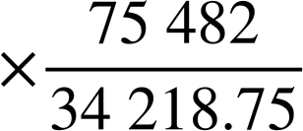
Kharashyada iyo boqolleyda
Xayawaan | Wadarta kharashka daryeelka sannadkii | Wadarta dakhliga sannadkii
Lo'da caanaha | £34 218.75 | £75 482
Digag | £12 500 | £21 750
Doofaar | £27 120 | £20 950.20
Ido | £11 875 | £13 005
Waxay go'aansadeen inaysan tixgelin doofaarrada.
Xayawaanka kale kee baa faa'iidada ugu badan?
Faa'iidada boqolleyda ee lo'da:
% | £
100 | 34 218.75
 | 75 482
Faa'iidada boqolleyda waa ≈120 %
≈220.6

Slide 35
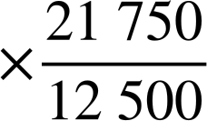
Kharashyada iyo boqolleyda
Xayawaan | Wadarta kharashka daryeelka sannadkii | Wadarta dakhliga sannadkii
Digaag | £12 500 | £21 750
Ido | £11 875 | £13 005
Xisaabi faa'iidada boqolleyda ee digaagada.
% | £
100 | 12 500
 | 21 750
174
Faa'iidada boqolleyda waa 74 %

Slide 36
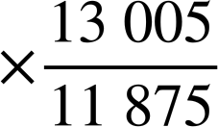
Kharashyada iyo boqolleyda
Xayawaan | Wadarta kharashka daryeelka sannadkii | Wadarta dakhliga sannadkii
Digaag | £12 500 | £21 750
Ido | £11 875 | £13 005
Xisaabi faa'iidada boqolleyda ee digaagada.
Xisaabi faa'iidada boqolleyda ee idaha.
% | £
100 | 12 500
 | 21 750
% | £
100 | 11 875
 | 13 005
174
≈109.5
Percentage profit is 74 %
Percentage profit is ≈9.5 %

Slide 37
Costs and percentages
Animal | Percentage Profit
Dairy cows | 120 %
Chickens | 74 %
Sheep | 9.5 %
Xayawaanka kale, kee baa faa'iidada ugu badan?
Lo'du waxay leedahay faa'iido badan.
Waa maxay kharashyada aan la tixgelin?
Kharashka iibsashada xayawaanka laguma darin.
Also things like: processing and packaging; wages.
Kharashyada iyo qiimaha iibku waxay is beddelaan si joogto ah, taas oo sidoo kale ka dhigaysa mid aad u adag in la hubiyo in xayawaanku faa'iido yeeshaan.
Waxaan u malaynayaa inaad ogolaan doonto in shaqaale beeralay ah oo la shaqeeya xayawaanku uu isticmaalo xisaab badan!

Slide 38
Costs and percentages
1) Beeralay ayaa go'aansaday inuu siiyo lo'da boos dheeri ah.
Kharashka daryeelka lo'da maalintii waa £4
Waxay siin doonaan lo' kasta 12 m2.
U qaad in lo' kastaa soo saarto 20 litir oo caano ah maalintii.
Qiimaha iibka litirkiiba waa 38 p.
Calculate the following:
a) Tirada lo'da uu barnigu dejin karo.
b) Qiimaha daryeelka lo'da sannadkii.
c) Dakhliga ka yimaada soosaarka caanaha.
d) Boqolleyda faa'iidada (percentage profit).
20 m
75 m

Slide 39
Kharashyada iyo boqolleyda
75 m
2) Beeraley ayaa go'aansaday inuu doonayo inuu keydo digaag.
Waxay siinayaan digaag kasta aag 15 m2 ah
Qiimaha daryeelka digaagga sannadkii waa £50
Digaag kastaa wuxuu soo saaraa celcelis ahaan 0.8 ukun maalintii.
Waxay go'aansadeen inay iibiyaan ukunta laftooda, iyagoo iibinaya 1 darsin (dozen) £3.20
Xisaabi kuwan soo socda:
a) Boqolleyda faa'iidada (percentage profit).
b) Beeraleygu wuxuu rabaa inuu sameeyo 60% faa'iido. Intee ayay u baahan yihiin inay ku dalacaan darsin ukun?
20 m

Slide 40
Kharashaadka iyo boqolleyda
1) Beeraley ayaa go'aansaday inuu doonayo inuu siiyo lo'da boos dheeri ah.
Qiimaha daryeelka lo'da maalintii waa £4
Waxay siinayaan lo' kasta 12 m2.
U qaad in lo' kastaa soo saaro 20 litir oo caano ah maalintii.
Qiimaha iibka litirkiiba waa 38 p.
Xisaabi kuwan soo socda:
a) Tirada lo'da uu barnigu dejin karo.
Bedka barniga = 1500 m2
Tirada lo'da = 1500 ÷ 12 = 125
20 m
75 m

Slide 41
Kharashaadka iyo boqolleyda
1) Beeraley ayaa go'aansaday inuu siiyo lo'da meel badan.
Kharashka daryeelka lo'da maalintii waa £4
Waxay siinayaan lo' kasta 12 m2.
U qaad in lo' kasta ay soo saarto 20 litir oo caano ah maalintii.
Qiimaha iibka litirkiiba waa 38 p.
Xisaabi kuwan soo socda:
b) Kharashka daryeelka lo'da sanadkii.
Kharashka daryeelka = 125 × 4 × 365 = £182 500
20 m
75 m

Slide 42
Kharashaadka iyo boqolleyda
1) Beeraley ayaa go'aansaday inuu siiyo lo'da meel badan.
Kharashka daryeelka lo'da maalintii waa £4
Waxay siinayaan lo' kasta 12 m2.
U qaad in lo' kasta ay soo saarto 20 litir oo caano ah maalintii.
Qiimaha iibka litirkiiba waa 38 p.
Xisaabi kuwan soo socda:
c) Dakhliga ka yimaada soosaarka caanaha.
Litirka caanaha = 125 × 20 × 365 = 912 500
Dakhliga = 912 500 × 0.38 = £346 750
20 m
75 m

Slide 43
Kharashaadka iyo boqolleyda
1) Beeraley ayaa go'aansaday inuu siiyo lo'da meel badan.
Qiimaha daryeelka sac maalintii waa £4
Waxay siinayaan sac kasta 12 m2.
U qaad in sac kastaa soo saaro 20 litir oo caano ah maalintii.
Qiimaha iibka litirkiiba caanuhu waa 38 p.
Xisaabi kuwan soo socda:
d) Boqolleyda faa'iidada (percentage profit).
20 m
75 m
% | £
100 | 182 500
 | 346 750
× 1.9
× 1.9
190
90% faa'iido ayaa la sameeyay

Slide 44
Kharashyada iyo boqolleyda
75 m
2) Beeraley ayaa go'aansaday inuu doonayo inuu haysto digaag.
Waxay siinayaan digaag kasta aag 15 m2
Qiimaha daryeelka digaagga sannadkii waa £50
Digaag kastaa wuxuu soo saaraa celcelis ahaan 0.8 ukun maalintii.
Waxay go'aansadeen inay iibiyaan ukunta laftooda, iyagoo iibinaya 1 darsin (dozen) £3.20
Xisaabi kuwan soo socda:
a) Boqolleyda faa'iidada (percentage profit).
Aagga barn-ka = 1500 m2
Tirada digaagga = 1500 ÷ 15 = 100
Qiimaha daryeelka sannadkii = 100 × 50 = £5000
Tirada ukunta sannadkii = 100 × 0.8 × 365 = 29 200
Dakhliga ukunta sannadkii = 29 200 ÷ 12 × £3.20 = £7786.67
Boqolleyda faa'iidada ≈ 55.7 %
20 m

Slide 45
Kharashyada iyo boqolleyda
75 m
2) Beeraley ayaa go'aansaday inuu doonayo inuu keydiyo digaag.
Waxay siinayaan digaag kasta aag 15 m2
Kharashka daryeelka digaagga sannadkii waa £50
Digaag kastaa wuxuu soo saaraa 0.8 ukun celcelis ahaan maalintii.
Waxay go'aansadeen inay iibiyaan ukunta laftooda. Iibinta 1 dozen £3.20
Xisaabi kuwan soo socda:
b) Beeralaygu wuxuu rabaa inuu sameeyo 60% faa'iido (profit). Immisa ayay u baahan yihiin inay ku dallacaan dozen ukun?
Kharashka daryeelka sannadkii = 100 × 50 = £5000
Tirada dozen-ka sannadkii = 29 200 ÷ 12 = 2433
Dakhliga 60% faa'iidada = £5000 × 1.6 = £8000
Qiimaha dozen kasta = £8000 ÷ 2433 = 3.2881… ≈ £3.29
20 m

Slide 46
Shaqaale beeralay (xayawaanka)
Dadka la shaqeeya xayawaanka waxay isticmaalaan qaybo badan oo xisaab ah.
E.g.
Bed (Area)
Isku dhufasho (Multiplication)
Qaybin (Division)
Boqolleyda (Percentages)
Lacag (Money)
Miisaanka iyo cabbirka (Weights and measures)
Heerkulka (Temperature)
Waqtiga (Time)
Inta lagu guda jiro darsigan waxaan eegnay sida loo hubiyo in xayawaanku leeyihiin qaddarka saxda ah ee booska ay ku noolaanayaan iyo sida qiimaha iibka iyo qiimaha iibku u saameeyaan faa'iidada (profit margins).

