Slide 1
Shaqaale beereed (dalag)
Xisaab goobta shaqada

Slide 2
Sida agabkeena waxbarid loogu talagalay fasalka

Slide 3
Waxaan fahmi karaa sida xisaabta loogu isticmaalo shaqaalaha beeraha (dalag).

Slide 4
Bedka waa cabbirka dusha oo sheegaya tirada labajibbaaranaha unug ee loo baahan yahay si buuxda u daboosho dushaas.
Qiyaas degdeg ah xisaabinta waxaa laga helaa adoo adeegsanaya qiyam qiyaas ah, oo inta badan lagu soo koobo 1 lambar muhiim ah.
Celceliska (arithmetic) ee xog tirooyin ah waa wadarta qiimaha loo qaybiyo tirada qiimaha. Waa cabbirka u dhaxaysa ee matalaya celceliska qiimaha.

Slide 5

Shaqaale beereed (dalag)
Isticmaalka beddelka warshadaha beeraha
Isticmaalka qiyaasta warshadaha beeraha

Slide 6
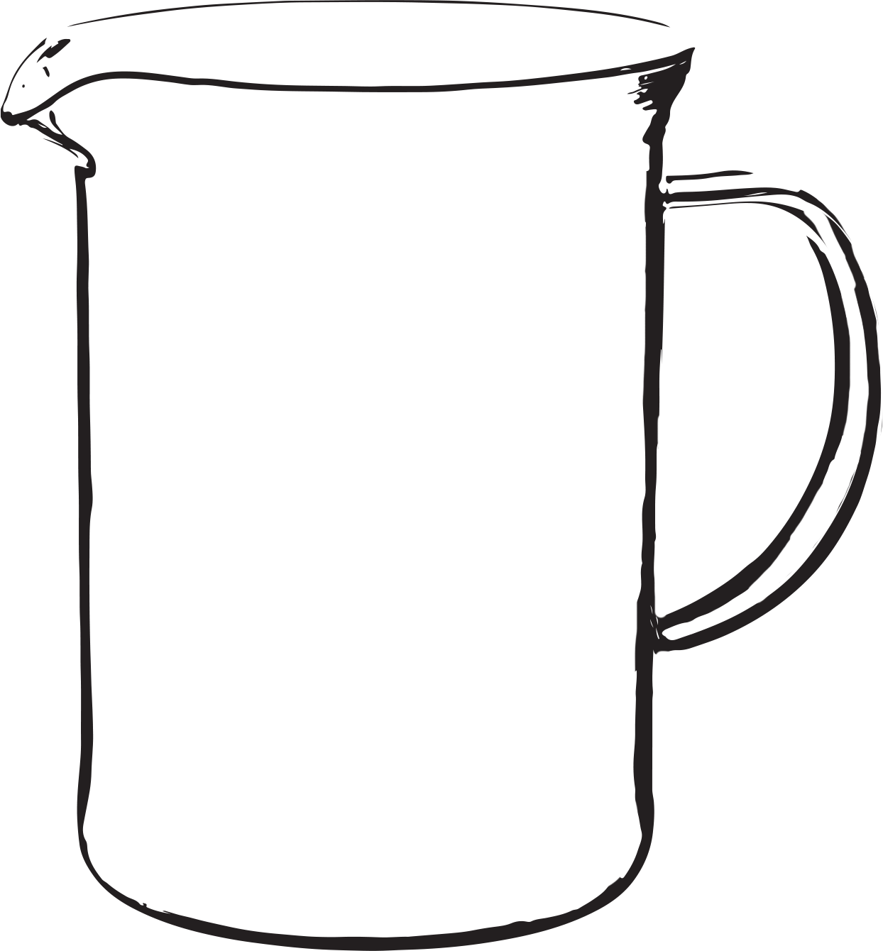
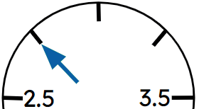
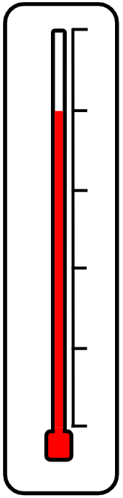
Isticmaalka beddelka warshadaha beeraha
Waa maxay qaybaha xisaabta ee aad u malaynaysaa in shaqaalaha beeraha ee la shaqeeya dalagga ay isticmaali karaan?
Bed iyo mug
Isku dhufasho iyo qaybin
Qiyaas
Lacag
Miisaan iyo cabbir
Heerkul
Waqti
Beddel
Qaab caadi ah
kg
Inta lagu guda jiro darsigan waxaan eegi doonaa qaar ka mid ah kuwan.

Slide 7
Isticmaalka beddelka (conversion) warshadaha beeraha
Ma ka fikiri kartaa halbeegyo cabbir (units) oo bedka (area) ah?
cm2
m²
km2
Kuwani waa halbeegyo aad yaqaanno isticmaalkooda.
Marka lala shaqeynayo dhulka, cabbiro kale ayaa inta badan la isticmaalaa.
Ma taqaan halbeegyo cabbir oo dhulka ah?
Acre
Hectare

Slide 8
Isticmaalka beddelka (conversion) warshadaha beeraha
Acres waa halbeeg dhul oo Imperial ah.
Hectares waa halbeeg dhul oo metric ah.
Acre wuxuu u dhigmaa 43 560 square feet.
Hectare wuxuu u dhigmaa 10 000 square metres.
Kee ka weyn yahay, acre ama hectare?
1 foot
0.3048 m
1 foot ≈ 0.3048 m
1 square foot
0.3048 m
0.092… m²
1 square foot ≈ 0.092… m2
1 foot
1 acre ≈ 43 560 × 0.092…
1 acre ≈ 4046.86 m2
Hektar waa ka weyn.

Slide 9
Isticmaalka beddelka warshadaha beeraha
U beddel 2.3 acres oo isku wareeg ah (square metres).
1 acre ≈ 4046.86 m2
Acres | m²
1 | 4046.86
2.3
× 2.3
× 2.3
9307.778

Slide 10
Isticmaalka beddelka warshadaha beeraha
U beddel 2.3 acres oo isku wareeg ah (square metres).
1 acre ≈ 4046.86 m2
U beddel 5.2 acres oo isku wareeg ah (square metres).
1 acre ≈ 4046.86 m2
Acres | m²
1 | 4046.86
2.3
Acres | m²
1 | 4046.86
5.2
× 2.3
× 2.3
× 5.2
× 5.2
9307.778
21 043.672

Slide 11
Isticmaalka beddelka warshadaha beeraha
Ingiriiska, dalagyada waxaa lagu iibiyaa tan (tonnes).
Maraykanka, dalagyada waxaa lagu iibiyaa bushels.
Waa muhiim in beeralaydu ay awoodaan inay beddelaan tan iyo bushels si ay isbarbardhigaan suuqyada.
Maadaama bushels ay tahay cabbir mug (volume) halkii cuf (mass), dalag kastaa wuxuu leeyahay qodobo beddel oo kala duwan.
Dalag | Bushel (bu) ilaa tan (t)
Barley | 1 bu = 0.021772 t
Galleyda | 1 bu = 0.0254 t
Saliid | 1 bu = 0.014515 t
Digirta Soy | 1 bu = 0.027216 t
Sarreen | 1 bu = 0.027216 t

Slide 12
Isticmaalka beddelka warshadaha beeraha
$1 = £0.78
Qiimaha iibka bushel kasta = $5.86
Qiimaha iibka halkii tan = £173
Dalag | Bushel (bu) ilaa tonne (t)
Shaciir | 1 bu = 0.021772 t
Galleyda | 1 bu = 0.0254 t
Saliid | 1 bu = 0.014515 t
Digirta Soy | 1 bu = 0.027216 t
Sarreen | 1 bu = 0.027216 t
Beeraleyda Maraykanka ama UK miyay helayaan qiimo ka fiican sarreenkooda?
Imisa bushel oo sarreen ah ayaa ku jira tan?
1 ÷ 0.027216 = 36.743…
Qiimaha dollar ee tan = 36.743… × $5.86 = $215.314…
U beddel $215.314… oo noqo pound.
215.314… × 0.78 ≈ £167.95
Beeraha UK ayaa helaya qiimo ka fiican.

Slide 13

Isticmaalka beddelka warshadaha beeraha
Dalag | Bushel (bu) ilaa tan (t)
Shaciir | 1 bu = 0.021772 t
Qiimaha ayaa ka fiican Maraykanka.
$1 = £0.78
Qiimaha iibka halkii bushel = $7.38
Qiimaha iibka halkii tan = £156
1 ÷ 0.021772 = 45.93…
Qiimaha dollar ee tan = 45.93… × $7.38 = $338.967…
338.967… × 0.78 ≈ £264.39
Beeraha Maraykanka ayaa helaya qiimo ka fiican.

Slide 14
Isticmaalka beddelka warshadaha beeraha
1) Beerta (farmer) kee baa helaya qiimaha ugu fiican ee oats?
$1 = £0.78
Qiimaha iibka bushel kasta = $3.06
Qiimaha iibka tonne kasta = £274
Dalag | Bushel (bu) ilaa tan (t)
Shaciir | 1 bu = 0.021772 t
Galle | 1 bu = 0.0254 t
Oats (Oats) | 1 bu = 0.014515 t
Soybeans (Soybeans) | 1 bu = 0.027216 t
Wheat (Wheat) | 1 bu = 0.027216 t

Slide 15
Isticmaalka beddelka (conversion) warshadaha beeraha
2) $1 = £0.78
Qiimaha iibka bushel kasta = $3.78
Waa maxay qiimaha ugu yar ee iibka tonne kasta ee corn (corn) ee UK, si qiimaha UK uga fiicnaado? Jawaabta ku qor pound-ka ugu dhow.
Dalag (Crop) | Bushel (bu) ilaa tonne (t)
Barley (Barley) | 1 bu = 0.021772 t
Corn (Corn) | 1 bu = 0.0254 t
Oats (Oats) | 1 bu = 0.014515 t
Soybeans (Soybeans) | 1 bu = 0.027216 t
Sarreen (Wheat) | 1 bu = 0.027216 t

Slide 16
Isticmaalka beddelka warshadaha beeraha
3) $1 = £0.78
Qiimaha iibka halkii tonne = £153
Waa maxay qiimaha ugu yar ee iibka halkii bushel ee soybeans ee Maraykanka, si qiimaha Maraykanku u fiicnaado? Jawaabta ku qor senti ugu dhow.
Dalag | Bushel (bu) ilaa tonne (t)
Shaciir (Barley) | 1 bu = 0.021772 t
Galleyda (Corn) | 1 bu = 0.0254 t
Oats | 1 bu = 0.014515 t
Soybeans | 1 bu = 0.027216 t
Sarreen (Wheat) | 1 bu = 0.027216 t

Slide 17
Isticmaalka beddelka warshadaha beeraha
1) Beerta beeralayda ayaa helaya qiimaha ugu fiican ee oats?
$1 = £0.78
Qiimaha iibka bushel kasta = $3.06
Qiimaha iibka tonne kasta = £274
Dalag | Bushel (bu) ilaa tonne (t)
Shaciir (Barley) | 1 bu = 0.021772 t
Galleyda | 1 bu = 0.0254 t
Oats | 1 bu = 0.014515 t
Soybeans | 1 bu = 0.027216 t
Wheat | 1 bu = 0.027216 t
1 ÷ 0.014515 = 68.894…
Qiimaha dollar ee tonne = 68.894… × $3.06 = $210.816…
210.816… × 0.78 ≈ £164.44
Beeralayda UK ayaa helaya qiimo ka fiican.

Slide 18
Isticmaalka beddelka warshadaha beeraha
2) $1 = £0.78
Qiimaha iibka bushel kasta = $3.78
Waa maxay qiimaha ugu yar ee tan (tonne) galleyda ee UK, si qiimaha UK uga fiicnaado? Jawaabta ugu dhow pound.
Dalagga | Bushel (bu) ilaa tonne (t)
Barley | 1 bu = 0.021772 t
Galleyda | 1 bu = 0.0254 t
Oats | 1 bu = 0.014515 t
Soybeans | 1 bu = 0.027216 t
Wheat | 1 bu = 0.027216 t
1 ÷ 0.0254 = 39.37…
Qiimaha dollar ee tan = 39.37… × $3.78 = $148.818…
148.818… × 0.78 = £116.078…
£117 tan (u baahan inay ka badan tahay £116)

Slide 19
Isticmaalka beddelka warshadaha beeraha
3) $1 = £0.78
Qiimaha iibka halkii tan = £153
Waa maxay qiimaha ugu yar ee iibka halkii bushel ee soybeans ee Maraykanka, si qiimaha Maraykanku u fiicnaado? Jawaabta ku bixi senti ugu dhow.
Dalag | Bushel (bu) ilaa tan (t)
Barley | 1 bu = 0.021772 t
Corn | 1 bu = 0.0254 t
Oats | 1 bu = 0.014515 t
Soybeans | 1 bu = 0.027216 t
Wheat | 1 bu = 0.027216 t
1 ÷ 0.027216 = 36.743…
Qiimaha dollar-ka halkii tan = 153 ÷ 0.78 = $196.153…
$196.153… ÷ 36.743… = $5.3385…
$5.34 halkii bushel

Slide 20
Shaqaale beeraha (dalagga)
Isticmaalka beddelka warshadaha beeraha
Isticmaalka qiyaasta warshadaha beeraha

Slide 21
Isticmaalka qiyaasta warshadaha beeraha
Si loo saadaaliyo dakhliga dalagga, beeralaydu waxay isticmaalaan qiyaas.
Si loo qiyaaso wax-soo-saarka dalagga, waxay qaadaan muunad 1 m2 oo ka mid ah meelo kala duwan oo beerta ah. Kadibna waxay helaan celceliska muunadahan si ay u bixiyaan tiro celcelis ah oo dhirta halkii mitir laba jibaaran. Tani waxay ka dhigan tahay inay markaa xisaabin karaan qiyaas tirada dhirta dhulkooda.
Waxay sidoo kale dooran doonaan geed waxayna tirin doonaan tirada xabbadaha halkii sabuul si ay u soo saaraan qiyaas.

Slide 22
Isticmaalka qiyaasta warshadaha beeraha
Beerale wuxuu leeyahay beer qamadi ah oo 12 hektar ah.
Hoos waxaa ku qoran tirada sabuulka qamadiga ee 5 muunadood oo mitir laba jibaaran kala duwan:
452, 447, 485, 478 iyo 438
Sidoo kale, halkan waxaa ku qoran tirada xabbadaha ee sabuul kasta oo qamadi ah (hal geed):
38, 42, 48, 51, 41, 53, 47, 55, 49, 56
Marka hore, waxay u baahan yihiin inay xisaabiyaan celceliska tirada sabuulka halkii mitir laba jibaaran iyo celceliska tirada xabbadaha halkii sabuul.

Slide 23
Isticmaalka qiyaasta warshadaha beeraha
Hoos waxaa ku qoran tirada sabuulka qamadiga ee 5 muunadood oo mitir laba jibaaran kala duwan:
452, 447, 485, 478 iyo 438
Sidee ku xisaabtaa celceliska?
Soo hel wadarta tirada sabuulka oo u qaybi tirada muunadaha.
Waa imisa tirada guud ee dhagaha?
452 + 447 + 485 + 478 + 438 = 2300
Celceliska tirada dhagaha mitir laba jibaaran = 2300 ÷ 5 = 460

Slide 24
Isticmaalka qiyaasta (estimation) warshadaha beeraha
Waa kuwan tirada xabbadaha (grains) ee dhag kasta oo sarreen ah:
38, 42, 48, 51, 41, 53, 47, 55, 49, 56
Waa imisa tirada guud ee xabbadaha?
38 + 42 + 48 + 51 + 41 + 53 + 47 + 55 + 49 + 56 = 480
Celceliska tirada xabbadaha dhag kasta = 480 ÷ 10 = 48

Slide 25
Isticmaalka qiyaasta (estimation) warshadaha beeraha
Beerale wuxuu leeyahay beer sarreen ah 12 hektar (hectare).
Celceliska tirada dhagaha mitir laba jibaaran = 460
Celceliska tirada xabbadaha dhag kasta = 48
Celceliska cufka (mass) xabbad = 50 mg
Qiimaha iibka tan (tonne) kasta = £173
12 hektar = 12 × 10 000 m2 = 120 000 m2
Wadarta tirada xabbadaha mitir laba jibaaran = 460 × 48 = 22 080
Wadarta tirada xabbadaha beerta
= 120 000 × 22 080
= 2.6496 × 10⁹
= 2.6496 × 10⁹ × 50
Wadarta cufka (mass) xabbadaha beerta
= 1.3248 × 1011 mg
= 132.48 tan (tonnes)
Dakhliga beerta
= 132.48 × £173
= £22 919.04

Slide 26
Isticmaalka qiyaasta (estimation) warshadaha beeraha
Beer shaciir ah oo 10 hektar
Celceliska dhagaha mitir laba jibaaran = 775
Celceliska xabbadaha dhag kasta = 25
Celceliska cufka (mass) ee xabbad = 46 mg
Qiimaha tan (tonne) kasta = £156
Xisaabi dakhliga (income) beerta shaciirta.
Tirada guud ee xabbadaha = 1.9375 × 109
Cufka guud ee xabbadaha = 1.9375 × 109 × 46 × 1 × 10−9 = 89.125 tan
Dakhliga guud = 89.125 × £156 = £13 903.50

Slide 27
Isticmaalka qiyaasta (estimation) warshadaha beeraha
1) Xisaabi dakhliga guud ee beerta sare ee 15 hektar.
Celceliska cufka (mass) ee xabbad = 41.3 mg
Qiimaha tan (tonne) kasta = £274
Tirada panicles ee mitir laba jibaaran (square metre) tijaabooyin:
412, 423, 404, 398 iyo 438
Tirada xabbadaha ee panicle kasta:
43, 49, 41, 52 iyo 50

Slide 28
Isticmaalka qiyaasta (estimation) warshadaha beeraha
1) Xisaabi dakhliga guud ee beerta sare ee 15 hektar.
Celceliska cufka (mass) ee xabbad = 41.3 mg
Qiimaha tan (tonne) kasta = £274
Tirada panicles ee mitir laba jibaaran (square metre) tijaabooyin:
412, 423, 404, 398 iyo 438
Tirada xabbadaha ee panicle kasta:
43, 49, 41, 52 iyo 50
Celceliska tirada panicles = 2075 ÷ 5 = 415
Celceliska tirada hadhuudhka panicle kasta = 235 ÷ 5 = 47
Wadarta tirada hadhuudhka = 415 × 47 × 150 000 = 2.92575 × 109
Wadarta cufka hadhuudhka = 2.92575 × 109 × 41.3 × 1 × 10−9 = 120.8… tonnes
Wadarta dakhliga = 120.8… × £274 ≈ £33 108.37

Slide 29
Shaqaale beereed (dalag)
Shaqada dalagga waxay u baahan tahay faham aad u wanaagsan oo ku saabsan sida loo beddelo unugyo kala duwan.
Tusaale: Acres iyo hectares
Hectares iyo mitir labajibbaaran
Lacagaha kala duwan
Qiyaas (Estimation) waa qayb muhiim ah oo ka mid ah shaqada dalagga. Waxay u oggolaanaysaa beeralayda inuu saadaaliyo wax soo saarka dalagga.

