Slide 1
Codsashada shuruudaha isku midnimada (congruence)
Sifooyinka joomatari: isku ekaansho (similarity) iyo aragtida Pythagoras

Slide 2
sida loo isticmaalo darasyada Oak

Slide 3
Waxaan aqoonsan karaa saddexagallo isku mid ah (congruent) oo caddayn karaa sababta ay isku mid u yihiin.

Slide 4
Haddii hal qaab si sax ah ugu habboonaado korka mid kale iyadoo la isticmaalayo wareeg (rotation), milicsi (reflection) ama turjumaad (translation), markaas qaababku waa isku mid (congruent).

Slide 5

Codsashada shuruudaha isku midnimada (congruence)
Doorashada shuruudaha saxda ah
Isku mid (congruent) ama ma aha?
Isku midnimada qarsoon (Hidden congruence)

Slide 6
Doorashada shuruudaha saxda ah
Labo saddexagal waxaa lagu caddayn karaa inay isku mid yihiin (congruent) haddii shuruudo gaar ah la codsado.
6.5 cm
3.6 cm
6.5 cm
4.9 cm
4.9 cm
3.6 cm
Kuwani waa isku mid (congruent) iyadoo la isticmaalayo SSS (dhinac-dhinac-dhinac).

Slide 7
Doorashada shuruudaha saxda ah
Labo saddexagal waxaa lagu caddayn karaa inay isku mid yihiin (congruent) haddii shuruudo gaar ah la codsado.
A
P
2.4 cm
5.3 cm
2.4 cm
89°
5.3 cm
89°
B
R
C
Q
Kuwani waa isku mid (congruent) iyadoo la isticmaalayo SAS (dhinac-xagal-dhinac).

Slide 8
Doorashada shuruudaha saxda ah
Labo saddex-xagal ayaa la caddayn karaa inay isku mid yihiin (congruent) haddii shuruudaha qaarkood la dabakhi karo.
F
A
9.2 cm
99°
99°
17°
D
17°
C
E
B
9.2 cm
Kuwani waxay isku mid yihiin (congruent) iyadoo la adeegsanayo ASA (angle-side-angle).

Slide 9
Doorashada shuruudaha saxda ah
Labo saddex-xagal ayaa la caddayn karaa inay isku mid yihiin (congruent) haddii shuruudaha qaarkood la dabakhi karo.
A
D
F
4.5 cm
71°
91°
91°
71°
4.5 cm
B
C
E
Kuwani waxay isku mid yihiin (congruent) iyadoo la adeegsanayo AAS (angle-angle-side).

Slide 10
Doorashada shuruudaha saxda ah
Labo saddex-xagal ayaa la caddayn karaa inay isku mid yihiin (congruent) haddii shuruudaha qaarkood la dabakhi karo.
K
C
21 cm
29 cm
A
B
29 cm
I
J
21 cm
Kuwani waxay isku mid yihiin (congruent) iyadoo la adeegsanayo RHS (right angle-hypotenuse-side).

Slide 11


Doorashada shuruudaha saxda ah
Kee ka mid ah kuwani ma aha shuruud (criteria) lagu caddeeyo isku midnimada (congruence) saddex-xagallada?
a
dhinac-xagal-dhinac (SAS)
b
xagal-xagal-dhinac (AAS)
c
xagal-xagal-xagal (AAA)
d
dhinac-dhinac-xagal (SSA)
e
dhinac-dhinac-dhinac (SSS)
f
xagal-dhinac-xagal (ASA)
g
xagal qumman-hypotenuse-dhinac (RHS)

Slide 12
Doorashada shuruudaha saxda ah
C
Labadan saddexagal waa isku mid (congruent). Kee ka mid ah shuruudaha ayaan u isticmaali karnaa si aan u caddeyno?
4 cm
SSS
Ma og nahay dhammaan saddexda dherer ee dhinacyada?
Maya
A
B
5 cm
SAS
Ma og nahay laba dhinac oo isku mid ah iyo xagasha u dhexaysa?
Maya
K
ASA
Ma naqaannaa laba xagal oo isku mid ah (corresponding angles) iyo hal dhinac oo isku mid ah (corresponding side)?
5 cm
RHS
Maya
Haddii ay leedahay xagal qumman (right angle), ma naqaannaa hypotenuse-ka iyo dhinac kale oo isku mid ah (corresponding side)?
I
J
4 cm
Haa
Kuwani waa isku mid (congruent) iyadoo la adeegsanayo RHS (xagal qumman-hypotenuse-dhinac).

Slide 13
Doorashada shuruudaha saxda ah (criteria)
Labadan saddex-xagal (triangles) waa isku mid (congruent). Shuruudaha (criteria) kee ayaan u isticmaali karnaa si aan tan u caddayno?
A
13°
99°
SSS
C
Ma naqaannaa dhammaan saddexda dherer ee geesaha (edge lengths)?
Maya
B
4 cm
SAS
Ma naqaannaa laba gees oo isku mid ah (corresponding edges) iyo xagasha u dhaxaysa?
Maya
ASA
D
Ma naqaannaa laba xagal oo isku mid ah (corresponding angles) iyo hal dhinac oo isku mid ah (corresponding side)?
4 cm
RHS
Haa
99°
F
Haddii ay leedahay xagal qumman (right angle), ma naqaannaa hypotenuse-ka iyo dhinac kale oo isku mid ah (corresponding side)?
E
13°
Maya
Kuwani waxay isku mid yihiin (congruent) iyadoo la adeegsanayo ASA (angle-side-angle).

Slide 14
Doorashada shuruudaha saxda ah
Labadan saddex-xagal (triangles) waa isku mid (congruent). Shuruudaha (criteria) kee ayaan u isticmaali karnaa si aan tan u caddayno?
A
13 cm
SSS
Ma og nahay dhammaan saddexda dherer ee geesaha?
Maya
27°
B
C
12 cm
SAS
Ma og nahay laba gees oo isku mid ah iyo xagasha u dhaxaysa?
Haa
ASA
O
13 cm
Ma og nahay laba xagal oo isku mid ah iyo hal gees oo isku mid ah?
RHS
Haa
27°
M
N
Haddii ay leedahay xagal qumman (right angle), ma og nahay hypotenuse-ka iyo gees kale oo isku mid ah?
12 cm
Haa
Waxaa jira macluumaad ku filan oo muujinaya kuwaan inay isku mid yihiin (congruent) iyadoo la adeegsanayo SAS ama ASA ama RHS.

Slide 15
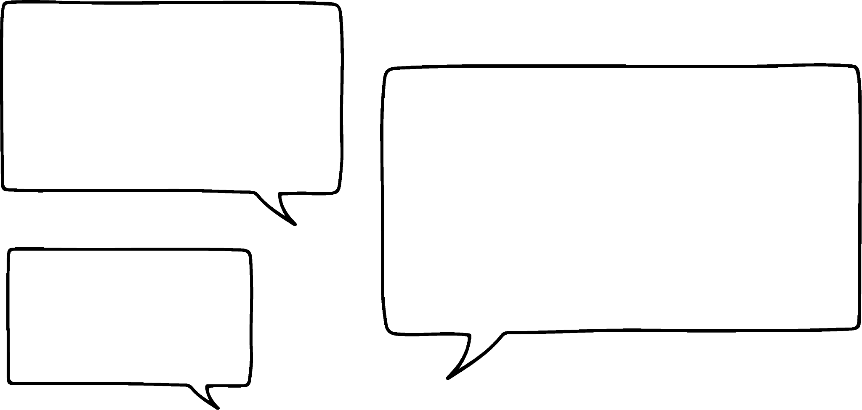

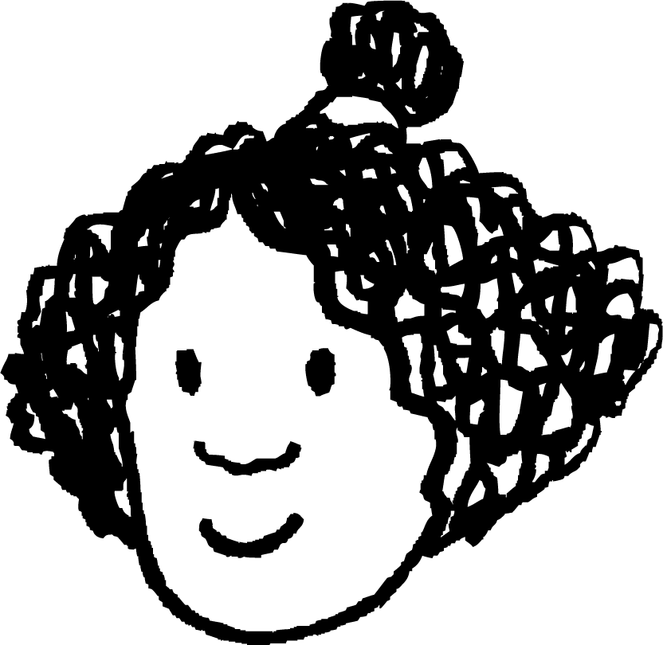

Doorashada shuruudaha saxda ah
Labadan saddexagal waa isku mid (congruent) iyadoo la adeegsanayo AAS.
7.5 cm
91°
52°
52°
Ma Isra ayaa sax ah?
Isra
7.5 cm
91°
Maya, in kastoo laba xagal (angle) iyo hal dhinac (side) laga yaqaan labada saddex-xagal (triangle); dhinacyadu isku mid (corresponding) ma aha.

Slide 16
Doorashada shuruudaha (criteria) saxda ah
Labadan saddex-xagal (triangle) waa isku qaab (congruent), laakiin way adag tahay in la arko. Shuruudaha (criteria) kee ayaan u isticmaali karnaa si aan taa u caddayno, adigoo kaliya isticmaalaya macluumaadka la bixiyay?
A
39 cm
63°
27°
Miyaan garanaynaa dhammaan saddexda cidhif (edge) dhererkooda?
Maya
B
C
SSS
36 cm
Miyaan garanaynaa laba cidhif (edge) oo isku mid ah (corresponding) iyo xagasha (angle) u dhaxaysa?
SAS
Maya
O
ASA
39 cm
Miyaan garanaynaa laba xagal (angle) oo isku mid ah (corresponding) iyo hal dhinac (side) oo isku mid ah?
15 cm
Maya
27°
63°
RHS
M
N
Haddii ay leedahay xagal qumman (right angle), miyaan garanaynaa hypotenuse-ka iyo dhinac (side) kale oo isku mid ah?
Maya
Macluumaadka la bixiyay, maxaa kale oo aan xisaabin karnaa?
Xagasha saddexaad ee labada saddexagal.

Slide 17
Doorashada shuruudaha saxda ah
Labadan saddexagal waa isku mid (congruent), laakiin ma aha mid cad. Kee ka mid ah shuruudaha ayaan u isticmaali karnaa si aan u caddeyno, adigoo isticmaalaya macluumaadka oo dhan?
A
39 cm
63°
27°
Ma og nahay dhammaan saddexda dherer ee geesaha?
Maya
B
C
SSS
36 cm
Ma og nahay laba gees oo isku mid ah iyo xagasha u dhaxaysa?
SAS
Maya
O
ASA
39 cm
Ma og nahay laba xagal oo isku mid ah iyo hal gees oo isku mid ah?
15 cm
Haa
27°
63°
RHS
M
N
Haddii ay leedahay xagal qumman, ma og nahay hypotenuse-ka iyo gees kale oo isku mid ah?
Maya
Kuwani waxay isku mid yihiin (congruent) iyadoo la adeegsanayo ASA (xagal-gees-xagal).

Slide 18
Doorashada shuruudaha saxda ah
Labadan saddexagal waa isku mid (congruent). Kee ka mid ah shuruudahan ayaan u isticmaali karnaa si aan u caddeyno?
a
SSS
52°
b
SAS
9 cm
7.1 cm
c
AAS
52°
38°
7.1 cm
9 cm
d
RHS

Slide 19
Doorashada shuruudaha saxda ah
1) Waa maxay shuruudaha (criteria) caddaynaya in labada qaybood ay isku mid yihiin (congruent)?
a)
b)
10 cm
83°
26 cm
8 cm
83°
31°
26 cm
31°
8 cm
10 cm
c)
d)
7 m
61°
100°
7 m
57°
100°
3 m
62°
57°
14 cm
3 m
14 cm

Slide 20
Doorashada shuruudaha saxda ah
1) Waa maxay shuruudaha (criteria) caddaynaya in labada qaybood ay isku mid yihiin (congruent)?
a)
b)
10 cm
AAS ama ASA
RHS
83°
26 cm
8 cm
83°
31°
26 cm
31°
8 cm
10 cm
c)
d)
7 m
AAS ama ASA
61°
100°
7 m
57°
100°
3 m
62°
57°
14 cm
3 m
SAS
14 cm

Slide 21
Ku dabaqista shuruudaha isku midnimada (congruence)
Doorashada shuruudaha saxda ah
Isku mid (Congruent) mise maya?
Isku mid qarsoon (Hidden congruence)

Slide 22
Isku mid (Congruent) mise maya?
Saddexagalladan labadan ma isku mid (congruent) yihiin?
A
X
2.4 cm
5.3 cm
2.4 cm
89°
5.3 cm
89°
B
Z
C
Y
Ma hubin karno inay isku mid (congruent) yihiin.
Inkastoo aan haysanno laba gees oo u dhigma, ma ognin in xagasha u dhaxaysa ay siman yihiin.

Slide 23
Isku mid (congruent) mise maya?
Miyay labadan saddex-xagal isku mid (congruent) yihiin?
X
A
Y
40°
3 cm
3 cm
3 cm
100°
40°
B
C
Z
Haa.
Waan ognahay in saddex-xagalka ABC uu yahay isosceles (isosceles) macluumaadka la bixiyay, marka labada xagal ee kale waa siman yihiin oo waa 40°.
Sidaas darteed, saddex-xagalladu waa isku mid (congruent) iyadoo la adeegsanayo AAS.

Slide 24
Isku mid (congruent) mise maya?
Kee ka mid ah kuwani ma aha isku mid (congruent) labada kale?
37 cm
19°
37 cm
35 cm
37 cm
12 cm
71°
71°
71°

Slide 25
Isku mid (congruent) mise maya?
1) Go'aami kee ka mid ah saddex-xagallada uu isku mid (congruent) yahay saddex-xagalka XYZ, adigoo sheegaya shuruudaha (criteria) caddaynaya. Dhammaan cidhifyadu waa sentimitir.
X
7.5
a)
b)
7.5
5
91°
91°
5
52°
52°
52°
91°
Z
Y
9.1
9.1
c)
7.5
d)
e)
91°
5
37°
52°
7.5
9.1

Slide 26
Isku mid (congruent) mise maya?
2) Go'aami kee ka mid ah saddex-xagallada uu isku mid (congruent) yahay saddex-xagalka ABC, adigoo sheegaya shuruudaha (criteria) caddaynaya. Dhammaan cidhifyadu waa sentimitir.
13
A
a)
b)
5
13
5
12
23°
C
B
12
f)
13
23°
d)
13
5
c)
23°
13
67°
12
13
e)
12
67°
67°
5

Slide 27

Isku mid (congruent) mise maya?
1) Go'aami kee ka mid ah saddex-xagallada uu isku mid (congruent) yahay saddex-xagalka XYZ, adigoo sheegaya shuruudaha (criteria) caddaynaya. Dhammaan cidhifyadu waa sentimitir.
aan isku mid ahayn
X
7.5
a)
b)
7.5
ASA
5
91°
91°
5
52°
52°
52°
91°
Z
Y
9.1
9.1
c)
7.5
d)
e)
91°
5
SAS
37°
52°
SSS
7.5
macluumaad ku filan ma aha
in la sheego
9.1

Slide 28
Isku mid ma aha?
2) Go'aami saddexagalka kuwa isku mid ah saddexagalka ABC. Sheeg shuruudaha caddaynaya. Dhammaan cidhifyadu waa sentimitir.
13
A
a)
b)
5
13
RHS
5
12
23°
C
B
12
f)
13
SSS
23°
d)
13
5
c)
23°
13
aan isku mid ahayn
67°
RHS
12
13
e)
ASA
12
ASA ama AAS
67°
67°
5

Slide 29
Codsashada shuruudaha isku midnimada
Doorashada shuruudaha saxda ah
Isku mid ma aha?
Isku midnimo qarsoon

Slide 30
Isku midnimo qarsoon
Inta badan jaantusyada ama qaababku uma muuqdaan inay ka kooban yihiin saddexagallo.
A
Tusaale ahaan shan-geesoodkan joogtada ah.
Marka aan sawirno xaglo qarsoon waxaan samayn karnaa saddexagallo.
B
E
Waxaan muujin karnaa in saddexagalka ABC uu isku mid yahay saddexagalka ADE.
C
D
AB = BC = AE = ED sababtoo ah waa geesaha shan-geesle (regular pentagon)
∠ABC = ∠AED sababtoo ah waa xaglaha gudaha ee shan-geesle (regular pentagon)
Sidaa darteed, saddex-xagalka ABC iyo saddex-xagalka ADE waa isku mid (congruent) iyadoo la adeegsanayo SAS.

Slide 31

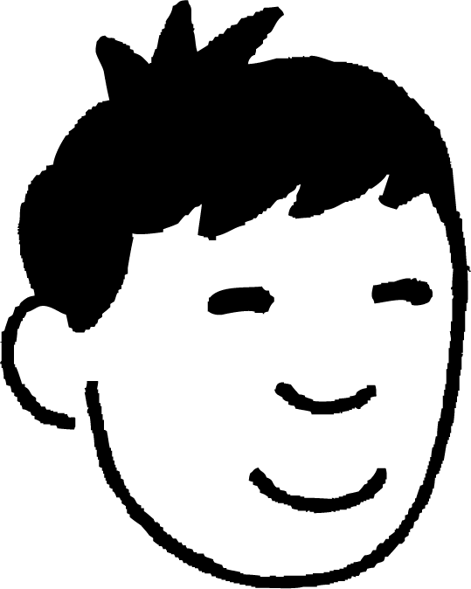
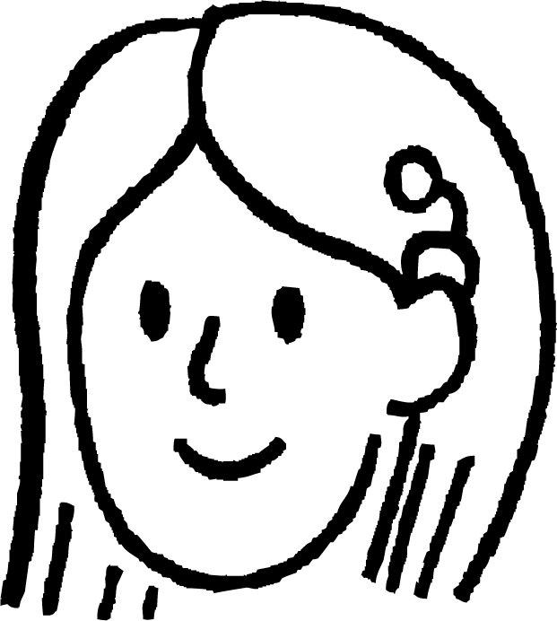

Isku-midnimo qarsoon (Hidden congruence)
ABCD iyo DEFG waa labo jibbaaran (squares). Caddee in saddex-xagalka CDG iyo ADE ay isku mid yihiin (congruent).
Ma jiraan saddex-xagal (triangles) jaantuskan.
G
F
Nuur
A
Ku dar xariiqyada (line segments) si aad u samaysato.
D
E
B
C
Suad

Slide 32
Isku-midnimo qarsoon (Hidden congruence)
ABCD iyo DEFG waa labo jibbaaran (squares). Caddee in saddex-xagalka CDG iyo ADE ay isku mid yihiin (congruent).
Haa, weli ma hubo halka laga billaabo.
G
F
Nuur
A
Aynu ku darno sifooyin (properties) kasta oo aan ognahay.
D
E
B
C
Suad

Slide 33
Isku-midnimo qarsoon (Hidden congruence)
Waan arki karaa in labada saddex-xagal (triangles) ay leeyihiin laba geesood oo isku dherer ah.
ABCD iyo DEFG waa labo jibbaaran (squares). Caddee in saddex-xagalka CDG iyo ADE ay isku mid yihiin (congruent).
G
F
Nuur
A
Waxaa intaa dheer, xagasha u dhaxaysa waa isku mid.
D
E
B
C
Suad

Slide 34
Isku ekaansho qarsoon
ABCD iyo DEFG waa labo jibbaaran (squares). Caddee in saddex-xagalka CDG iyo ADE ay isku mid yihiin (congruent).
Waa maxay ∠CDG iyo ∠ADE?
G
F
Nuur
A
Haa, labaduba waa 90° oo lagu daray ∠ADG.
D
E
B
C
Suad

Slide 35
Isku ekaansho qarsoon
ABCD iyo DEFG waa labajibbaarro. Caddee in saddexagalka CDG iyo ADE ay isku mid yihiin (congruent).
Marka waxay isku mid yihiin (congruent) iyadoo la adeegsanayo SAS!
G
F
Nuur
A
D
E
Haa!
B
C
Suad

Slide 36
Isku ekaansho qarsoon
Saddexagalka CDG wuxuu la mid yahay saddexagalka ADE iyadoo la adeegsanayo SAS.
G
F
Xaggee u dhigma ∠DAE?
∠GCD
(∠DCG)
A
D
E
B
C

Slide 37
Isku ekaansho qarsoon
Haddii la siiyo in PQRS uu yahay barbaroodle (parallelogram) iyo PT = RU. Caddee in TQ = SU.
P
T
S
Haddii aan tusi karno in saddexagalka PTQ iyo saddexagalka SUR ay isku mid yihiin (congruent), markaas waxay tusinaysaa in geesaha u dhigma ay isku dherer yihiin, sidaas darteed TQ = SU.
Q
U
R
TP = RU waa la siiyay
PQ = SR maxaa yeelay waa dhinacyada iska soo horjeeda ee barbaroodle (parallelogram)
∠TPQ = ∠SRU maxaa yeelay waa xaglaha iska soo horjeeda ee barbaroodle (parallelogram)
Saddex-xagalka PTQ wuxuu la siman yahay (congruent) saddex-xagalka SUR iyadoo la adeegsanayo SAS, sidaas darteed TQ = SU

Slide 38
Isku-dhafan qarsoon (Hidden congruence)
Dhammeysti weedhaha.
Jaantuskan, saddex-xagalka AEB iyo saddex-xagalka AGD waxaa la caddayn karaa inay isku mid yihiin (congruent) iyadoo la adeegsanayo .
Sidaas darteed, iyo
B
C
SAS
F
BE =
GD
E
G
AGD
∠AEB = ∠
A
D

Slide 39
Isku-dhafan qarsoon (Hidden congruence)
1) ABCDEFGH waa sideed-geesood joogto ah (regular octagon).
a) Caddee in saddex-xagalka ABC iyo saddex-xagalka HGF ay isku mid yihiin (congruent).
b) Waa kuwee saddex-xagallo kale oo la siman (congruent) ABC?
Jawaabaha:
A
H
B
G
C
F
D
E

Slide 40
Isku-dhafan qarsoon (Hidden congruence)
2) ABDF waa laba-geesood (square). BCD iyo DEF waa saddex-xagallo siman (equilateral triangles). Caddee in saddex-xagalka CDE iyo saddex-xagalka FDC ay isku mid yihiin (congruent).
A
F
E
B
D
C

Slide 41
Isku-dhafan qarsoon (Hidden congruence)
1) ABCDEFGH waa sideed-geesood joogto ah (regular octagon).
a) Caddee in saddex-xagalka ABC iyo saddex-xagalka HGF ay isku mid yihiin (congruent).
b) Waa kuwee saddex-xagallo kale oo la siman (congruent) ABC?
A
H
AB = BC = HG = GF sababtoo ah sideed-geesoodku waa joogto (regular)
∠ABC = ∠HGF sababtoo ah waa xaglo gudaha (interior angles) oo sideed-geesoodka joogtada ah
Saddexagalka ABC wuxuu la siman yahay saddexagalka HGF iyadoo la adeegsanayo SAS.
B
G
C
F
D
E
Saddexagallada BCD, CDE, DEF, EFG, GHA iyo HAB waxay la siman yihiin ABC

Slide 42
Siman qarsoon
2) ABDF waa labajibbaaran. BCD iyo DEF waa saddexagallo siman (equilateral). Caddee in saddexagallada CDE iyo FDC ay isku siman yihiin.
CD waa gees guud labada saddexagal
DF = DE maxaa yeelay waa geesaha isla saddexagalka siman (equilateral)
∠CDF = 90 + 60 = 150°
∠CDE = 360 - (60 + 90 + 60) = 150°
Sidaa darteed, ∠CDF = ∠CDE
A
F
E
60°
B
D
C
Sidaa darteed, saddexagalka CDE wuxuu la siman yahay saddexagalka FDC iyadoo la adeegsanayo SAS.

Slide 43
Ku adeegsiga shuruudaha simanta
Haddii mid ka mid ah shuruudaha (SSS, SAS, ASA, RHS) ay quseeyaan, markaas labada saddexagal waa isku siman yihiin.
Xaaladaha qaarkood, waxaa la isticmaali karaa in ka badan hal shuruud si loo caddeeyo simanta.
Haddii laba saddexagal la caddeeyo inay isku siman yihiin, waxaad kaloo caddeyn kartaa dhererka isku midka ah.

