Slide 1
Cilmi-yaqaanka Xiddigaha (Astrophysicist)
Xisaabta goobta shaqada (Xisaab in the workplace)

Slide 2
Sida agabkeena waxbarista loogu talagalay fasalka

Slide 3
Waxaan fahmi karaa sida xisaabta loogu isticmaalo cilmi-yaqaannada xiddigaha (astrophysicists).

Slide 4
Cilmi-yaqaanka xiddigaha (astrophysicist) wuxuu isku dayaa inuu fahmo caalamka iyo waxa ku jira isagoo adeegsanaya sharciyada fiisigiska (physics).

Slide 5

Cilmi-yaqaanka Xiddigaha (Astrophysicist)
Noqoshada cilmi-yaqaanka xiddigaha (astrophysicist)
Go'aaminta astaamaha dhulka (terrain features)

Slide 6
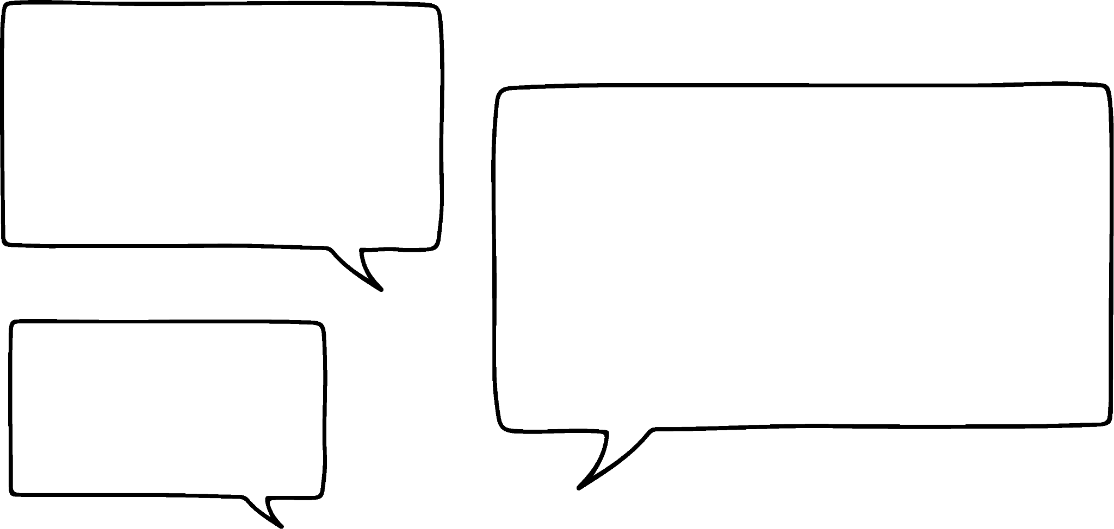
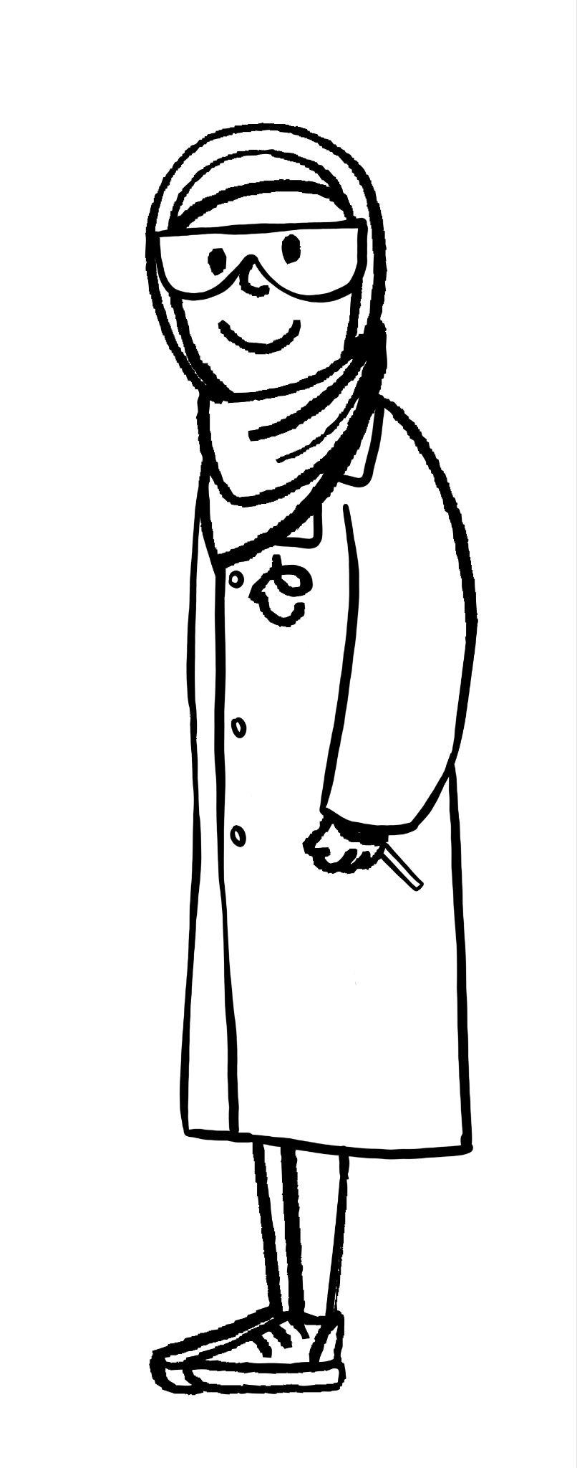
Noqoshada cilmi-yaqaanka xiddigaha (astrophysicist)
Cilmi-yaqaanka xiddigaha (astrophysicist) wuxuu isku dayaa inuu fahmo caalamka iyo waxa ku jira isagoo adeegsanaya sharciyada fiisigiska (physics).
Cilmi-yaqaanka xiddigaha (astrophysicist) wuxuu isku dayaa inuu fahmo caalamka iyo waxa ku jira isagoo adeegsanaya sharciyada fiisigiska (physics).
Waa maxay waxa ku jira caalamka?
Caasha

Slide 7
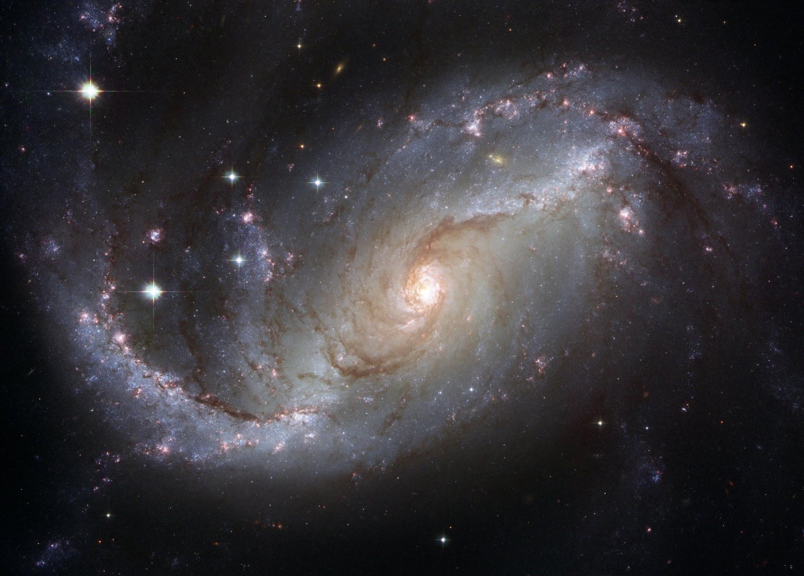
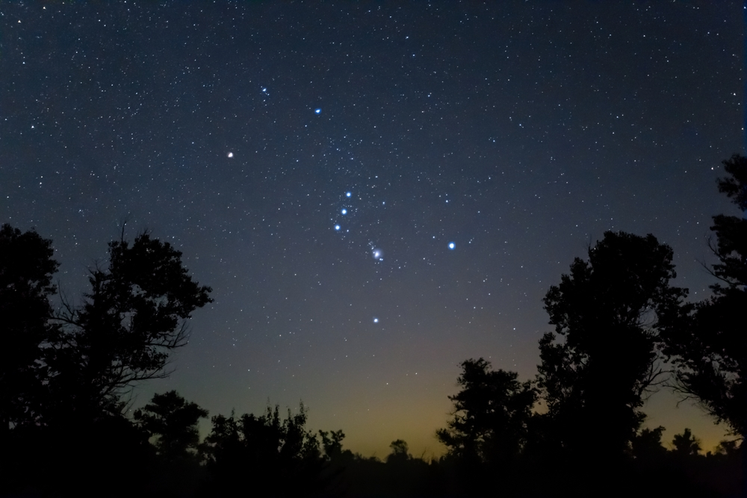
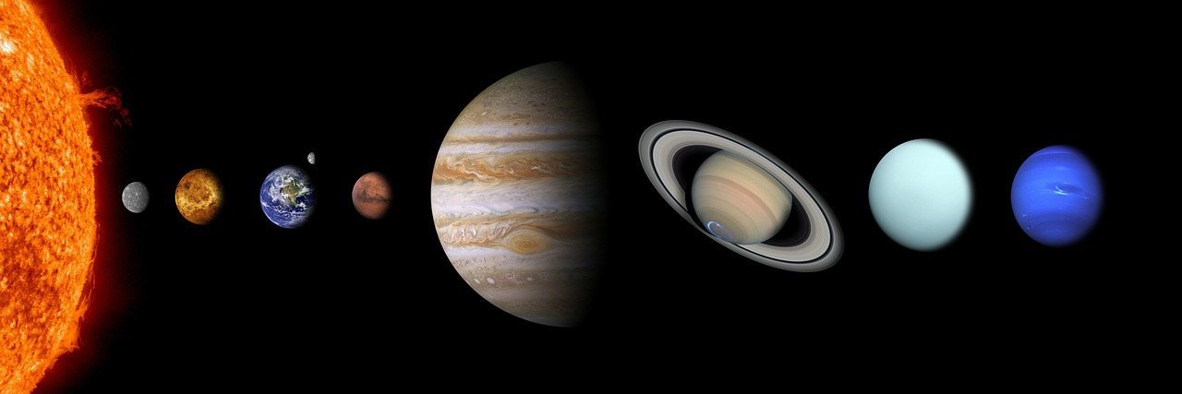
Noqoshada cilmi-yaqaanka xiddigaha (astrophysicist)
Dayaxa (Moons)
Meesha (Comets)
Asteroids (Asteroids)
Liisku wuu sii socdaa!
Galaxiyada (Galaxies)
Xiddigaha (Stars)
Meeraha (Planets)

Slide 8

Astrophysicist ahaansho
Astrophysicist wuxuu isku dayaa inuu fahmo universe-ka iyo waxa ku jira isagoo adeegsanaya:
sharciyada bayoolajiga (biology)
shuruucda chemistry-ga (laws of chemistry)
shuruucda dhaqaalaha (laws of economics)
shuruucda physics-ka (laws of physics)

Slide 9
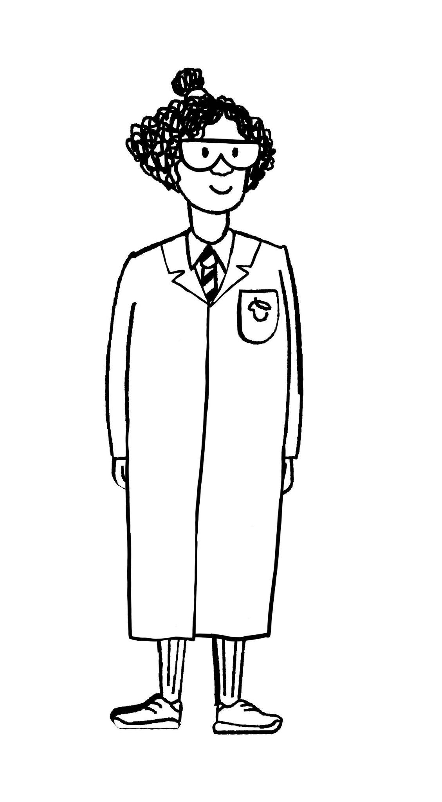
Astrophysicist ahaansho
Astrophysicists iyo astronomers ma isku mid bay yihiin?
Haa iyo maya.
Isra
Caasha

Slide 10
Astrophysicist ahaansho
Astrophysics waa laan ka mid ah astronomy-ga.
Astronomers waxay bartaan universe-ka iyagoo adeegsanaya farsamooyin indho-indhayn (observational techniques) si ay u qiimeeyaan oo u kala saaraan jirrada samada (celestial bodies) kala duwan.
Astrophysicists waxay leeyihiin diiradda dheeri ah. Waxay bartaan physics-ka universe-ka sida sida jirrada samada isu dhexgalaan ama hababka kale ee jirka (physical processes).

Slide 11
Astrophysicist ahaansho
Astrophysicists waxay inta badan u baahan yihiin inay fasiraan xogta (data). Tani waxay ku lug yeelan kartaa beddelka noocyada kala duwan ee cutubyada cabbiraadda (units of measurement) iyo isticmaalka qaaciidooyinka (formulas) si loo helo xog cusub.
Qaabka caadiga ah (standard form) ayaa laga yaabaa in la isticmaalo haddii qiimaha la qoray uu aad u weyn yahay.

Slide 12
Astrophysicist ahaansho
Qaabka caadiga ah (standard form) waa marka lambar lagu qoro qaabkan:
A × 10n (halkaas oo 0 ≤ A < 10 iyo n uu yahay tiro isku dhafan (integer)).
A × 10n (halkaas oo 1 ≤ A < 10 iyo n uu yahay tiro isku dhafan (integer)).
A × 10n (halkaas oo 1 < A ≤ 10 iyo n uu yahay tiro isku dhafan (integer)).
A × 10n (halkaas oo 0 < A ≤ 9 iyo n waa tiro (integer)).

Slide 13
Noqoshada astrophysicist
Dooro qaabka saxda ah ee loo qoro 5 834 000 000 000 qaabka caadiga ah (standard form).
5.834 × 10¹²
5 × 10¹²
5.834 × 10⁻¹²
5834 × 10⁻¹²

Slide 14
Noqoshada astrophysicist
1) Buuxi meelaha bannaan.
____ waa laan ka mid ah astronomy (xiddigiska). ____ waxay bartaan universe (caalamka) iyagoo isticmaalaya ____ ____ si ay u qiimeeyaan oo u kala saaraan ____ jirrada (bodies). Astrophysicists waxay leeyihiin diirad ____ ah. Waxay bartaan physics-ka universe (caalamka) sida siday u ____ ____ ama hababka ____ kale.
Astrophysics
bodies (jirro)
narrowed (cufan)
physical (jireed)
Astronomers (xiddigiyayaal)
celestial (cirka)
observational (indho-indhayn)
techniques (farsamooyin)

Slide 15
Noqoshada astrophysicist
2) a) Jadwalka hoose wuxuu muujinayaa masaafooyinka celceliska ee u dhow ee dhulka ilaa meelo ka mid ah meerayaasha kale ee nidaamka qorraxda. U qor masaafooyinka qaabka caadiga ah (standard form).
Laga bilaabo | Ilaa | Masaafada (km) | Qaabka caadiga ah (standard form)
Dhulka | Mercury | 91 691 000
Dhul (Earth) | Waxar (Venus) | 41 400 000
Dhul (Earth) | Farax (Mars) | 78 340 000
Dhul (Earth) | Cirjeex (Jupiter) | 628 730 000
Dhul (Earth) | Saxal (Saturn) | 1 275 000 000

Slide 16
Noqoshada cilmiga xiddigaha (astrophysicist)
2) b) Sannadkii 2021, xawaaraha ugu dheereeyay ee dayaxgacmeedku qabtay wuxuu ahaa 163 km/s. Adigoo isticmaalaya xawaarahaas iyo qaacidada
Masaafo (Distance) = Xawaare (Speed) × Waqti (Time)
Xagga (To) | Masaafo (km) | Waqti (maalmaha)
Meerkuri (Mercury) | 91 691 000
Waxar (Venus) | 41 400 000
Farax (Mars) | 78 340 000
Cirjeex (Jupiter) | 628 730 000
Saxal (Saturn) | 1 275 000 000
Xisaabi inta ay qaadanayso, maalmaha, in laga safro Dhulka (Earth) una gaaro meere kasta.
Ku soo wareeji jawaabtaada si ku habboon maalinta ugu dhow.

Slide 17
Noqoshada cilmiga xiddigaha (astrophysicist)
1) Buuxi meelaha bannaan.
Astrophysics waa laan ka mid ah astronomy.
Astronomers waxay bartaan universe iyagoo isticmaalaya farsamooyin indho-indhayn (observational techniques) si ay u qiimeeyaan (value) oo u kala saaraan jirrada samada (celestial bodies) kala duwan.
Astrophysicists waxay leeyihiin diirad dheer. Waxay bartaan physics-ka universe sida sida jirrada samada (celestial bodies) isu dhexgalaan ama hababka kale ee jirka (physical processes).

Slide 18
Ahaanshaha astrophysicist
2) a) Jadwalka hoose wuxuu muujinayaa masaafooyinka celceliska ee u dhow ee dhulka ilaa qaar ka mid ah meerayaasha kale ee nidaamka qorraxda. U qor masaafooyinka qaabka caadiga ah (standard form).
Laga bilaabo | Ilaa | Masaafo (km) | Qaabka caadiga ah (standard form)
Dhulka | Mercury | 91 691 000 | 9.1691 × 10⁷
Dhulka | Venus | 41 400 000 | 4.14 × 10⁷
Dhulka | Mars | 78 340 000 | 7.834 × 10⁷
Dhulka | Jupiter | 628 730 000 | 6.2873 × 10⁸
Dhulka | Saturn | 1 275 000 000 | 1.275 × 10⁹

Slide 19
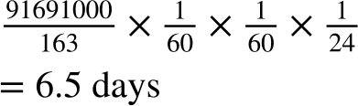
Ahaanshaha astrophysicist
2) b) Sannadkii 2021, xawaaraha ugu dheereeyay ee uu diiwaangeliyay dayaxgacmeed wuxuu ahaa 163 km/s. Adigoo isticmaalaya xawaarahaas iyo qaacidada (formula)
Masaafo (Distance) = Xawaare (Speed) × Waqti (Time)
To | Masaafo (Distance) (km) | Waqti (Time) (maalmaha)
Mercury | 91 691 000
Venus | 41 400 000
Mars | 78 340 000
Jupiter | 628 730 000
Saturn | 1 275 000 000
Waxay qaadan doontaa in ka badan 6 maalmood, marka waxaan ku soo wareejinaynaa 7 maalmood.

Slide 20
Noqoshada astrophysicist
2) b) Sannadkii 2021, xawaaraha (speed) ugu dheereeyay ee uu duuliyaha (spacecraft) qabtay wuxuu ahaa 163 km/s. Iyadoo la isticmaalayo xawaarahaas iyo qaacidada (formula)
Masaafo (Distance) = Xawaare (Speed) × Waqti (Time)
To | Masaafo (Distance) (km) | Waqti (Time) (maalmaha)
Mercury | 91 691 000 | 7
Venus | 41 400 000 | 3
Mars | 78 340 000 | 6
Jupiter | 628 730 000 | 45
Saturn | 1 275 000 000 | 91

Slide 21
Cilmi-yaaqa xiddigiska (Astrophysicist)
Noqoshada astrophysicist
Go'aaminta astaamaha dhulka (terrain features)

Slide 22
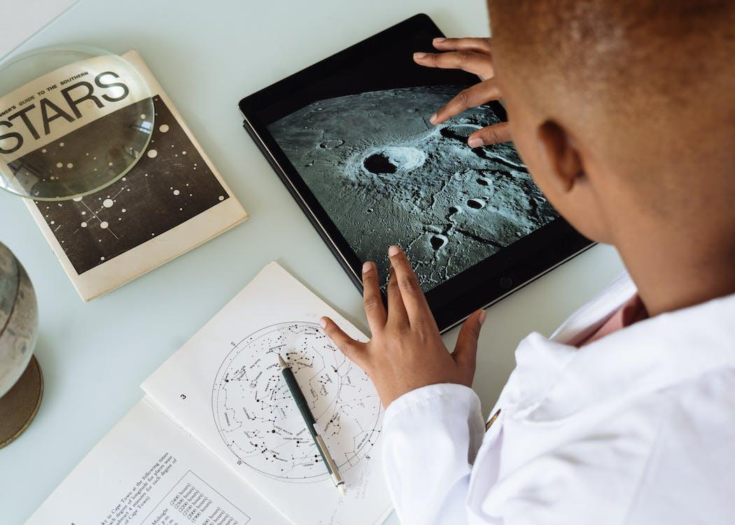
Go'aaminta astaamaha dhulka (terrain features)
Dagashadii ugu horreysay ee Dayaxa waxay dhacday 1969. Maadaama aadanuhu ay ku socon karaan Dayaxa, waxay la macno tahay in cabbiro laga qaadi karo dusha Dayaxa.
Waa kuwee cabbiro (measurements) noocee ah oo faa'iido u yeelan kara in la qoro?

Slide 23
Go'aaminta astaamaha dhulka (terrain features)
Xisaabinta dhererka astaamaha kala duwan (sida buuraha) waxaa badanaa lagu sameeyaa iyadoo la adeegsanayo laser altimeter.
Si kastaba ha ahaatee, ma aha dhammaan howlaha hawada sare (space missions) inay leeyihiin mid.
Xaaladahaas, waxaan weli ku ogaan karnaa qiyaas dhererka astaamaha kala duwan iyadoo la adeegsanayo trigonometry.

Slide 24
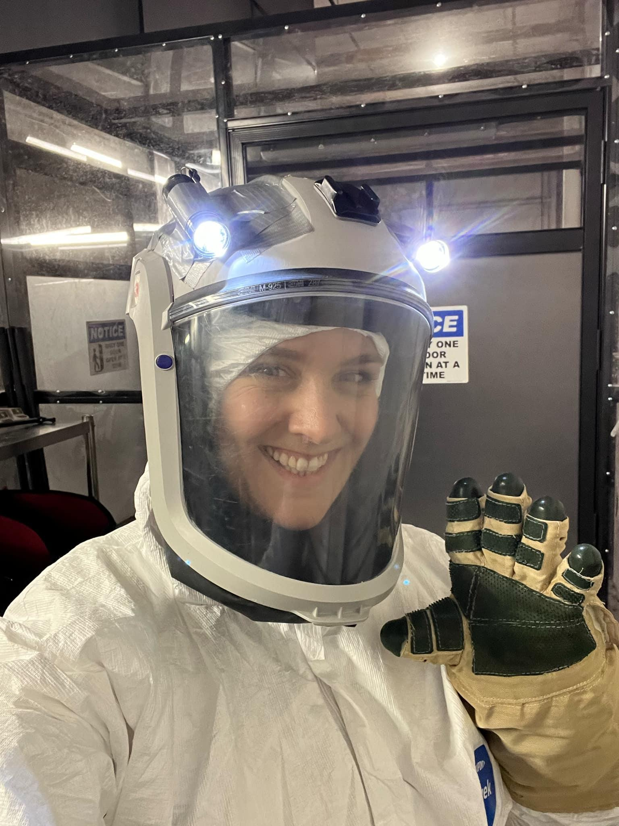
Go'aaminta astaamaha dhulka (terrain features)
Jilitaanka (Simulations) waxaa lagu samayn karaa Dhulka si loo barto astaamaha jidhka kale ee meeraha (planetary bodies).
Kani waa Professor Veronica Bray, PhD.
Iyadu waa borofisar cilmi-baaris la xiriirta (associate research professor).
Waxay u labisan tahay sidan sababtoo ah waxay la samaynaysaa jilitaan (simulation) asxaabteeda.

Slide 25
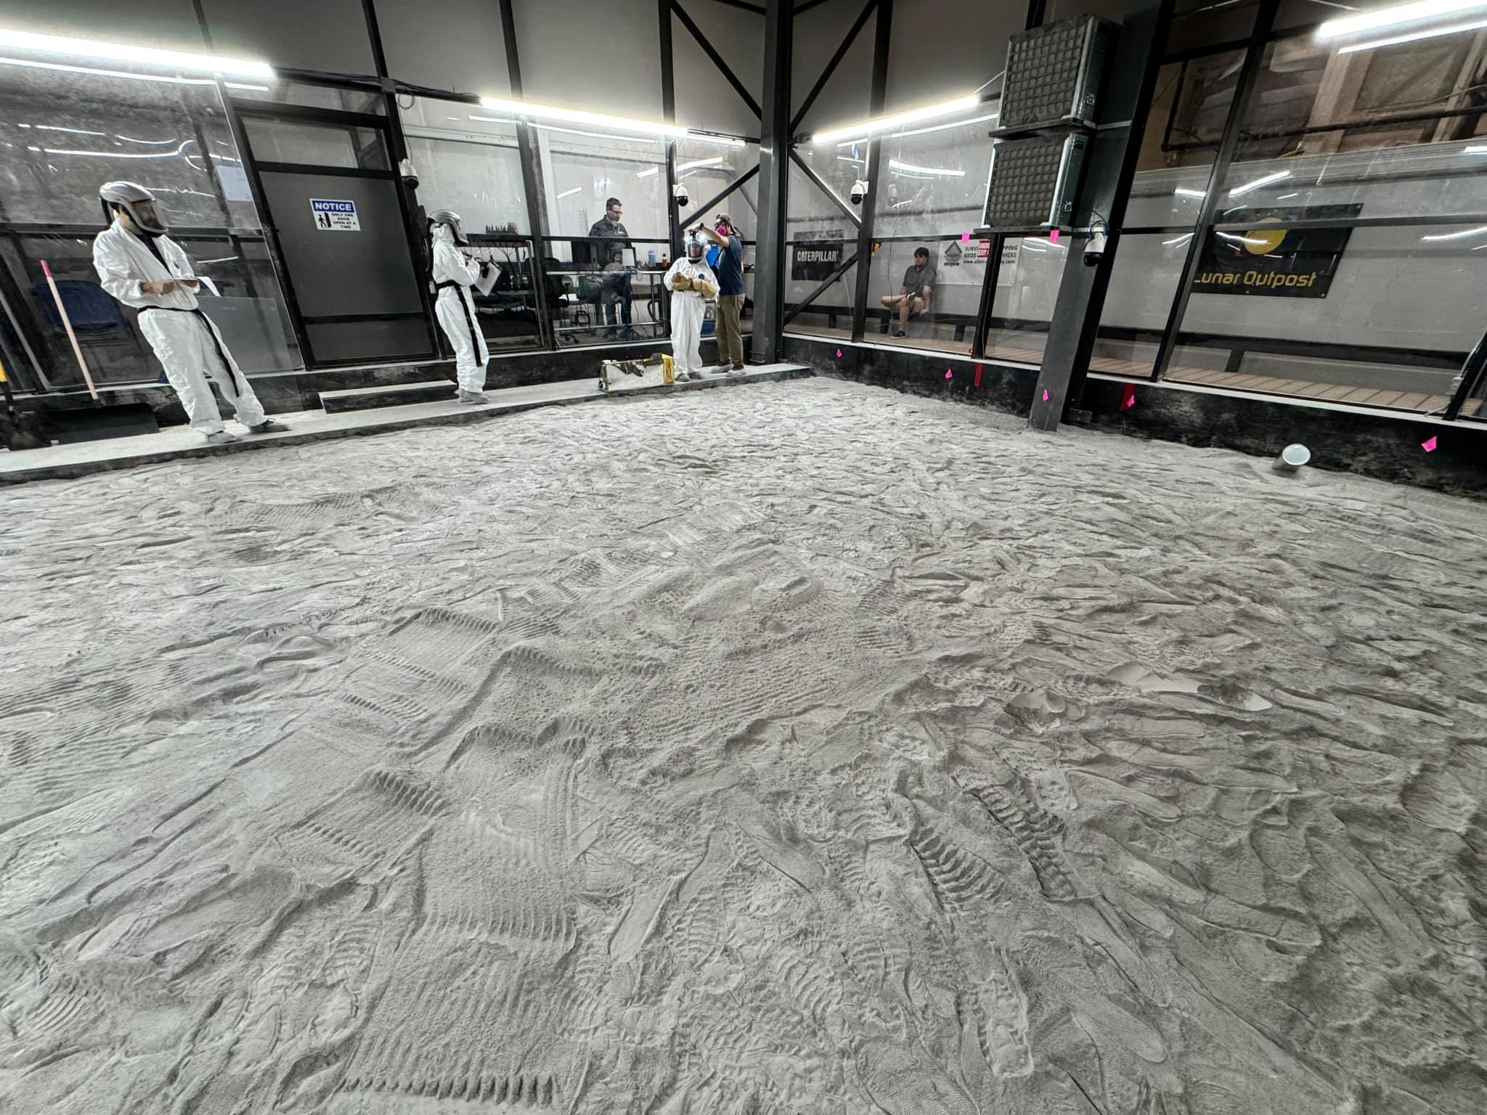
Go'aaminta astaamaha dhulka (terrain features)
Waxay jilayaan xaaladaha astronaut-ka Artemis ee Koofurta Pole ee Dayaxa.
Professor Bray iyo asxaabteeda waxay dib u abuuraysaa xaaladaha iftiinka saxda ah ee tababarka astronaut-ka.

Slide 26
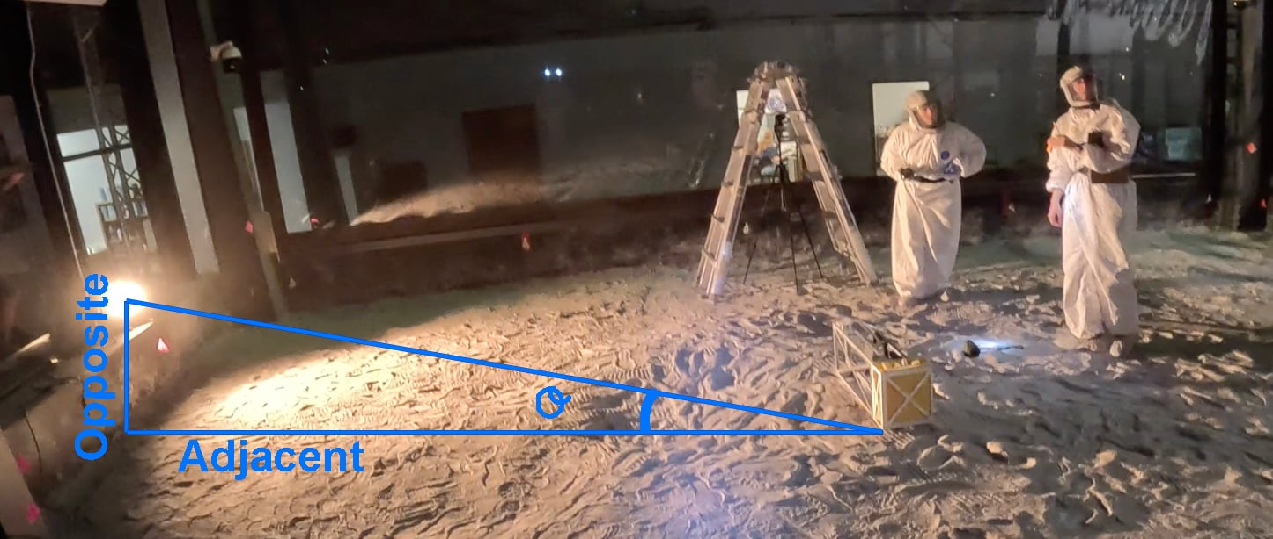
Go'aaminta astaamaha dhulka (terrain features)
Waxay u baahan yihiin inay ogaadaan xagasha qorraxda (𝜃°) si ay u xisaabiyaan saamiga saxda ah ee dhererka (opposite) isha iftiinka iyo masaafada (adjacent) ee astaamaha.

Slide 27
Go'aaminta astaamaha dhulka (terrain features)
Buuraha Dayaxa waxaa la sameeyay iyada oo loo marayo saameyn weyn oo asteroid ah. Saameyntaas waxay keentay godadka (craters) aan arki karno. Derbiyada godadka waxay noqon karaan kuwo aad u sarreeya.

Slide 28
Go'aaminta astaamaha dhulka (terrain features)
Si loo qiyaaso dhererka derbiga godka (crater wall) ee barta la doortay, waxaan u isticmaali karnaa trigonometry.
Waxaan u baahan doonnaa inaan ogaanno:
dhererka hooska (shadow)
xagasha (angle) qorraxdu ku jirto

Slide 29
Go'aaminta astaamaha dhulka (terrain features)
Sawir qaab dhimeed (sketch) wuxuu fududeyn doonaa waxa aan tixgelinayno.
Qorraxda (Sun)
iftiinka qorraxda (sunlight)
astaanta (feature)
dusha sare (surface)

Slide 30
Go'aaminta astaamaha dhulka (terrain features)
Waxaan u baahan doonnaa inaan ogaanno:
dhererka hooska (shadow)
xagasha (angle) qorraxdu ku jirto
Qorraxda (Sun)
iftiinka qorraxda (sunlight)
astaanta (feature)
𝜃°
dusha sare (surface)
hooska (shadow)

Slide 31
Go'aaminta astaamaha dhulka (terrain features)
Dhererka hooska (shadow) waxaa laga cabbiri karaa sawir ilaa inta cabbirka (scale) la ogyahay.
Xagasha (angle) qorraxda waxaa la go'aamin karaa haddii aan ogaanno goorta sawirka la duubay.

Slide 32
Go'aaminta astaamaha dhulka (terrain features)
Marka la ogaado dhererka hadhka iyo xagasha qorraxda, maxaa loo isticmaali karaa in lagu go'aamiyo dhererka astaamaha?
Qorrax (Sun)
iftiinka qorraxda (sunlight)
Aragtida Pythagoras (Pythagoras’ theorem)
astaame (feature)
Saddexagallo isku mid ah (Similar triangles)
𝜃°
hadh (shadow)
Trigonometry (Trigonometry)

Slide 33
Go'aaminta astaamaha dhulka (terrain features)
Marka xagasha qorraxdu tahay 42°, dhererka hadhka waxaa lagu qoray 7300 m. Waa maxay dhererka gidaarka godka (crater wall)?
Marka xagasha qorraxdu tahay 87°, dhererka hadhka waxaa lagu qoray 346 m. Waa maxay dhererka gidaarka godka (crater wall)?
Qorrax (Sun)
iftiinka qorraxda (sunlight)
Qorrax (Sun)
iftiinka qorraxda (sunlight)
astaame (feature)
astaame (feature)
42°
87°
7300
346
7300 × tan(42°) = 6572.9495…
≈ 6.6 km
346 × tan(87°) = 6602.0732…
≈ 6.6 km

Slide 34
Go'aaminta sifooyinka dhulka (terrain features)
1) Xisaabi qiimaha (value) (ilaa 1 d.p.) ee cabbirka aan la garanayn kiis kasta.
a) 𝜃° = 19°, a = 56 cm, b =
b) 𝜃° = 56°, a = 19 cm, b =
c) 𝜃° = 19°, b = 56 cm, a =
d) 𝜃° = 56°, b = 19 cm, a =
e) a = 56 cm, b = 19 cm, 𝜃° =
f) a = 19 cm, b = 56 cm, 𝜃° =
Loo sawirin si sax ah (Not drawn accurately)
b
𝜃°
a

Slide 35
Go'aaminta sifooyinka dhulka (terrain features)
2) Gidaarka godka (crater) ee Mars waa 1.2 km dheer. Marka uu gidaarku sameeyo hooska (shadow) dhererkiisu yahay 557 m, waa xagal intee (ilaa 1 d.p.) ayuu Qorraxdu ku jirtaa?
3) God kale oo Mars ah ayaa leh gidaar sameeya hooska dhererkiisu yahay 21 m. Tani waxay dhacdaa marka Qorraxdu xagal 67° tahay. Waa maxay dhererka (ilaa 2 d.p.) gidaarkan?

Slide 36
Go'aaminta sifooyinka dhulka (terrain features)
4) Godka ugu weyn ee dhinaca dhow ee Dayaxa waxaa loo yaqaan Clavius. Gidaarada godkani waa 6.6 km dheer.
Xisaabi saddex lamaane (pairs) oo qiimayaal ah oo xagasha Qorraxda iyo dhererka hooska u dhigma ee uu sameeyo gidaarka godka.
Tusaale: Marka xagasha Qorraxdu tahay 42°, dhererka hooska waxaa la qoraa 7300 m.
Marka xagasha Qorraxdu tahay 87°, dhererka hooska waxaa la qoraa 346 m.

Slide 37
Go'aaminta sifooyinka dhulka (terrain features)
5) Si loo xisaabiyo qiyaas (estimate) dhererka gidaarka godka, waxaan soo saarnay qaab/jaantus (model/sketch) xaaladda.
Sheeg malo (assumption) aan sameynay oo laga yaabo inay saameyso saxnaanta qiimaha aan qiyaasnay.

Slide 38
Go'aaminta astaamaha dhulka (Determining terrain features)
1) Xisaabi qiimaha (value) (ilaa 1 d.p.) ee cabbirka aan la garanayn kiis kasta.
a) 𝜃° = 19°, a = 56 cm, b = 19.3 cm
b) 𝜃° = 56°, a = 19 cm, b = 28.2 cm
c) 𝜃° = 19°, b = 56 cm, a = 162.6 cm
d) 𝜃° = 56°, b = 19 cm, a = 12.8 cm
e) a = 56 cm, b = 19 cm, 𝜃° = 18.7°
f) a = 19 cm, b = 56 cm, 𝜃° = 71.3°
Lama sawirin si sax ah (Not drawn accurately)
b
𝜃°
a

Slide 39
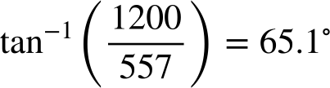
Go'aaminta astaamaha dhulka (Determining terrain features)
2) Gidaarka godka (crater) ee Mars waa 1.2 km dheer. Marka gidaarku uu tuuro hooska (shadow) dhererkiisu yahay 557 m, waa maxay xagasha (ilaa 1 d.p.) qorraxdu ku jirto?
3) God kale oo Mars ah ayaa leh gidaar hooskiisu dhererkiisu yahay 21 m. Tani waxay dhacdaa marka qorraxdu xagasha 67° tahay. Waa maxay dhererka (ilaa 2 d.p.) gidaarkan?
21 × tan(67) = 49.47 m

Slide 40
Go'aaminta astaamaha dhulka (Determining terrain features)
4) Godka ugu weyn ee dhinaca u dhow ee Dayaxa waxaa loo yaqaan Clavius. Gidaarada godkan waa 6.6 km dheer.
Xisaabi saddex lammaane oo qiimayaal ah (value) oo xagasha qorraxda iyo dhererka hooska (shadow) ee uu tuuro gidaarka godka.
Waxaa jira lammaane aan xad lahayn oo halkan ku shaqaynaya. Si aad u hubiso in qiimayaashaagu sax yihiin, samee xisaabtan:
dhererka hooska × tan(xagasha qorraxda)
Jawaabtaadu waa inay ku wareegtaa 6.6 (haddii km) ama 6600 (haddii m).

Slide 41
Go'aaminta astaamaha dhulka (Determining terrain features)
5) Si loo xisaabiyo qiyaasta dhererka gidaarka godka, waxaan soo saarnay qaab/ sawir (model/sketch) xaaladda.
Sheeg malo (assumption) aan samaynay oo laga yaabo inay saameyso saxnaanta qiimaha (value) aan qiyaasnay.
Malo suurtagal ah:
Waxaan u qaadnay in dusha meeraha ay tahay mid siman (flat) halka ay dhab ahaan qalloocan tahay (curved).

Slide 42
Cilmi-yaqaanka xiddigiska (Astrophysicist)
Cilmi-yaqaanka xiddigiska (astrophysicist) wuxuu isku dayaa inuu fahmo caalamka iyo waxa ku jira isagoo adeegsanaya sharciyada fiisigiska (physics).
Cilmi-yaqaannada xiddigiska (astrophysicists) waxay inta badan u baahan yihiin inay fasiraan xogta (data). Tani waxay ku lug yeelan kartaa beddelka noocyada kala duwan ee cutubyada cabbiraadda (units of measurement) iyo isticmaalka qaaciidooyinka (formulas) si loo helo xog cusub.
Trigonometry waxaa loo isticmaali karaa in lagu qiyaaso dhererka astaamaha dhulka ee kala duwan ee jirrada kale ee samada (celestial bodies).

