Slide 1
Dhisidda codsi ku salaysan xogta (data-driven application)
Barashada mashiinka (machine learning) iyadoo la isticmaalayo micro:bit

Slide 2
Sida agabkeena waxbarista loogu talagalay fasalka

Slide 3
Waxaan awoodi karaa inaan dhiso codsi fudud oo isticmaala saadaal (predictions) ka imanaysa moodel (model) barashada mashiinka (machine learning) si loo xakameeyo socodka barnaamijka (program flow).

Slide 4
barta aqoonsiga (recognition point)
heerka hubinta (certainty) ee keena in input uu u dhigmaasto fasalka (class)
socodka barnaamijka (program flow)
sida ay u kala horreeyaan tilmaamaha (instructions) ee barnaamijka lagu fuliyo

Slide 5

Isticmaalka saadaasha (predictions) ka imanaysa moodel (model) si loo xakameeyo barnaamij
La qabsashada barta aqoonsiga (recognition point) si loo hagaajiyo barnaamij
Dhisidda codsi ku salaysan xogta (data-driven application)

Slide 6
Isticmaalka saadaasha (predictions) ka imanaysa moodel (model) si loo xakameeyo barnaamij
Fur CreateAI.
Tag oak.link/createai
Ka sii warsh meeshii aad ka tagtay.
Ama:
  fur kalfadhigii (session) ugu dambeeyay, ama
  si wad kalfadhigii (session) aad badbaadisay daraskii hore
Fiiro: haddii aadan haysan kalfadhi (session) jira, waxaad isticmaali kartaa faylka muunada xogta (data sample file) ee la bixiyay si dheeri ah.

Slide 7
Isticmaalka saadaasha (predictions) ka imanaysa moodel (model) si loo xakameeyo barnaamij
Isticmaal blocks-ka code-ga barashada mashiinka (machine learning code blocks).
Guji badhanka buluugga ah ee 'Edit in MakeCode'.

Slide 8
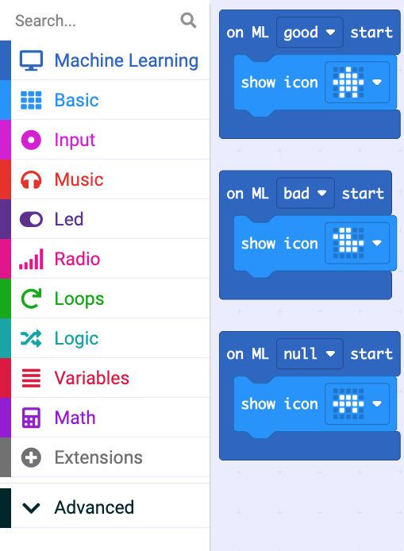
Isticmaal saadaasha (predictions) ka timaadda moodelka (model) si aad u xakamayso barnaamij (program)
Dhacdo (event) 'muuji astaanta (show icon)' ayaa lagu daray block kasta oo 'on ML start' ah.
Soo deji (download) barnaamijkaaga (program) micro:bit-kaaga.
Tijaabi (test) in barnaamijka (program) uu muujiyo astaanta (icon) saxda ah marka moodelka (model) uu saadaaliyo (predicts) in dhaqdhaqaaq (movement) kasta uu bilaabmay.
Microsoft MakeCode - Waxaa loo isticmaalay idanka Microsoft

Slide 9




Isticmaal saadaasha (predictions) ka timaadda moodelka (model) si aad u xakamayso barnaamij (program)
Astaanta (icons) la muujiyey kuma xidhna magacyada fasalka (class names).
Beddel (alter) astaanta (icons) si ay u bixiyaan jawaab celin (feedback) macno badan leh oo ku saabsan dhaqdhaqaaqa (movement) isticmaalaha.
Waxaan ku daray weji dhoola cadeynaya (smiley face) marka fasalka (class) 'good' uu saadaaliyay (predicted) moodelka (model).
Isra
Microsoft MakeCode - Waxaa loo isticmaalay idanka Microsoft

Slide 10

Isticmaal saadaasha (predictions) ka timaadda moodelka (model) si aad u xakamayso barnaamij (program)
Maxay wejiga dhoola cadeynaya (smiley face icon) u ahaa soo-saarka (output) ku habboon fasalka (class) 'good' marka loo eego astaanta (icon) caadiga ah?
Waxay ka dhigan tahay wax wanaagsan (positive).
Waxay isticmaashaa LED-yo (LEDs) yar.
Astaanta (icons) waa in laga beddelaa barnaamij (program) kasta.

Slide 11
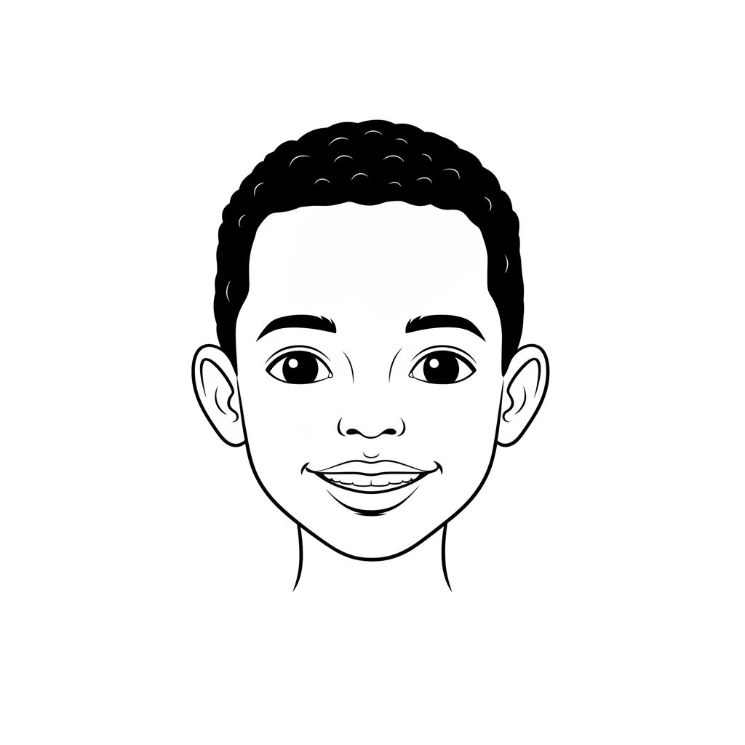

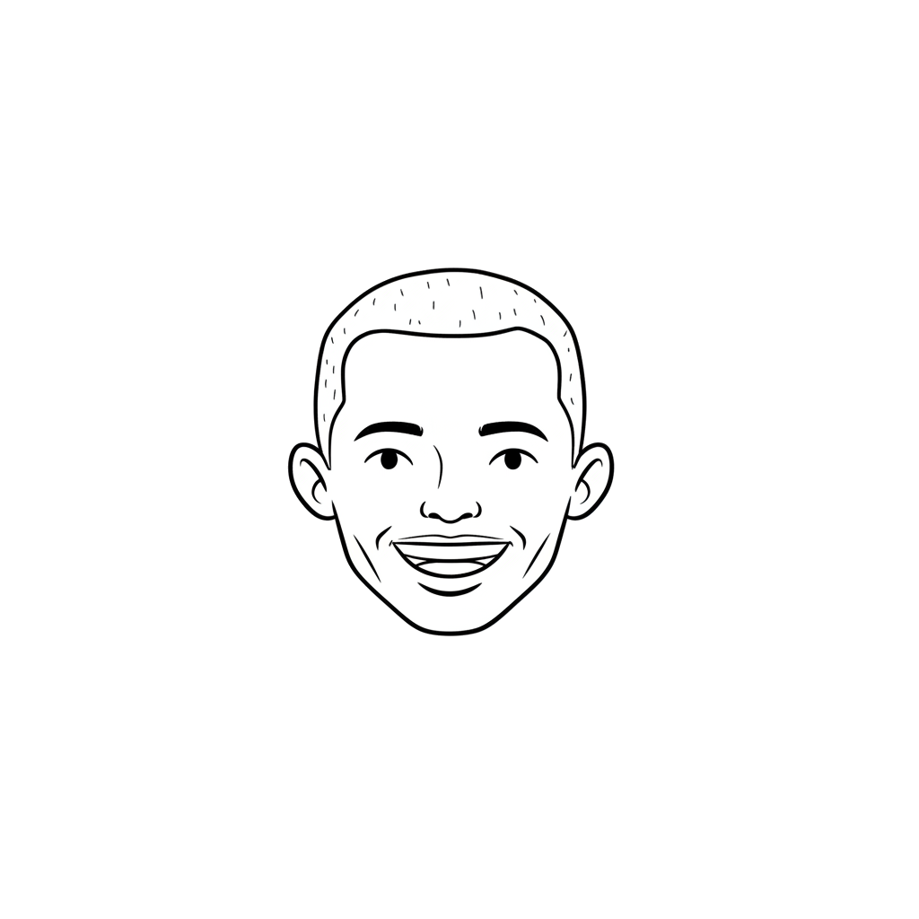

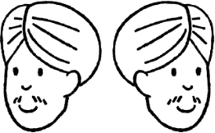
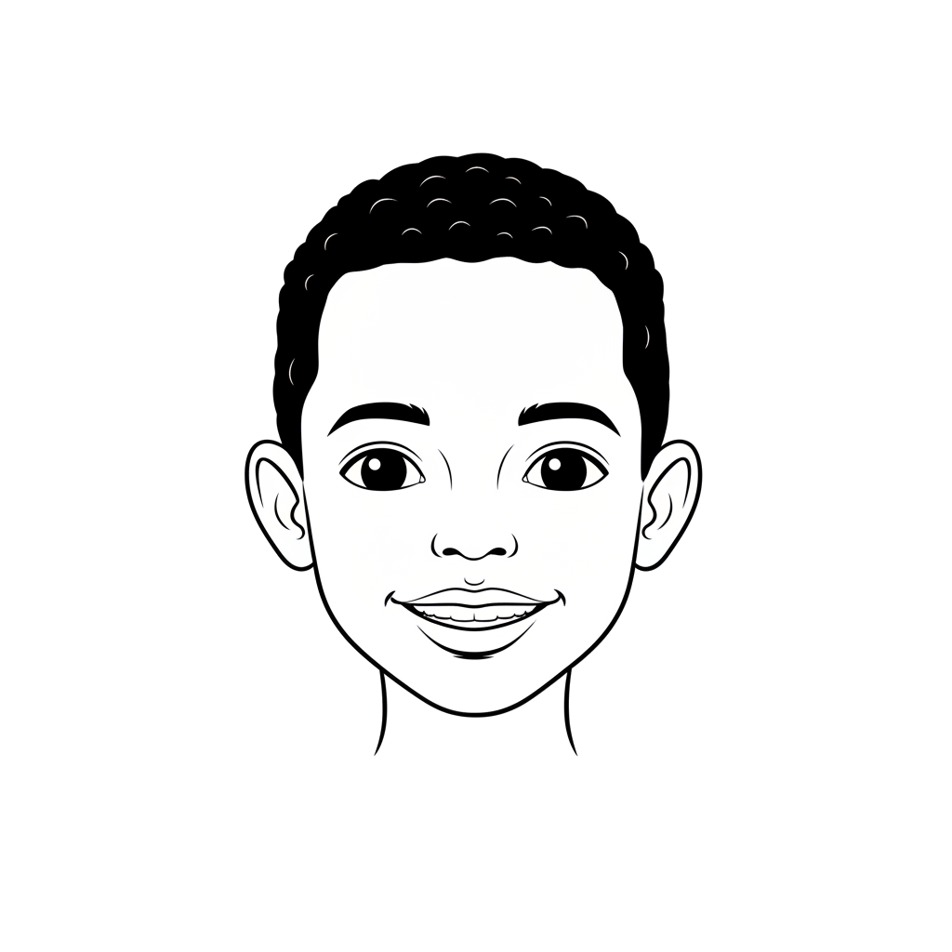

Isticmaal saadaasha (predictions) ka timaadda moodelka (model) si aad u xakamayso barnaamij (program)
LED-yada (LEDs) micro:bit waa mid ka mid ah soo-saarkiisa (outputs).
Waa maxay soo-saarka (output) kale ee micro:bit u isticmaali karo si uu ugu wargeliyo isticmaalaha dhaqdhaqaaqa (movement) 'good' ama 'bad'?
Micro:bit V2 wuxuu leeyahay ku-hadle (speaker), sidaas darteed wuxuu ciyaari karaa dhawaq (sound).
Waxaad yeelan kartaa dhawaq farxad leh oo loogu talagalay 'fiican'.
Yacquub
Cali

Slide 12
Isticmaal saadaasha model si aad u xakamayso barnaamij
LED-yadu waa wax soo saarka ugu habboon noocan codsiga.
Why?
Waxaa laga yaabaa inay adag tahay in la arko jawaabta LED-yada micro:bit inta lagu guda jiro dhaqaaqa.

Slide 13
Isticmaal saadaasha model si aad u xakamayso barnaamij
LED-yadu waa inay ahaadaan kuwo madhan haddii cod la isticmaalo.
Why?
Some users may be hearing-impaired and could be disadvantaged if the application only plays sound. Displaying an icon on the LEDs in addition to a sound would make the application more accessible.

Slide 14

Isticmaal saadaasha model si aad u xakamayso barnaamij
Ku dar wax soo saar cod oo ku habboon codsigaaga, si aad u siiso jawaab celin isticmaalayaasha ku saabsan dhaqaaqyada 'wanaagsan' iyo 'xun'.
Waxaad isticmaali kartaa blocks-ka kooxda Music.
Tijaabi ilaa aad ka helayso codad u shaqeeya isticmaalayaashaada.
Microsoft MakeCode - Loo isticmaalay idanka Microsoft

Slide 15
Isticmaal saadaasha model si aad u xakamayso barnaamij
Ku dar wax soo saar cod oo ku habboon codsigaaga, si aad u siiso jawaab celin isticmaalayaasha ku saabsan dhaqaaqyada 'wanaagsan' iyo 'xun'.
Waxaad isticmaali kartaa baloogyada kooxda Muusikada.
Tijaabi ilaa aad hesho dhawaaqyo u shaqeeya dadka adeegsada.
Qaar ka mid ah dhawaaqyada ayaa ka habboon kuwa kale.
You may need to think about the meaning users could attach to a sound or its volume in a particular environment.
Microsoft MakeCode - Loo adeegsaday idanka Microsoft

Slide 16
Isticmaal saadaal (predictions) ka timaadda moodel (model) si aad u xakamayso barnaamij (program)
Adapt recognition points to refine a program
Dhismaha codsi (application) ku salaysan xog (data)

Slide 17
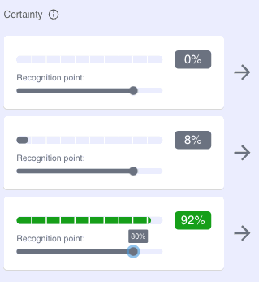
La qabsashada dhibcaha aqoonsiga (recognition points) si aad u hagaajiso barnaamij (program)
Waxaad abuurtay soosaarayaal (outputs) LED iyo dhawaq (sound) marka moodelka (model) uu saadaaliyo in dhaqdhaqaaq (movement) uu ku habboon yahay fasalka (class).
Sida caadiga ah, saadaal (prediction) waa in ay gaadho heer hubaal (certainty level) ah 80% si ay u keento in gelinta (input) ay ku habboonaato fasalka (class).
CreateAI waxay tixraacaysaa tan dhibcaha aqoonsiga (recognition point).
Waxaad beddeli kartaa dhibcaha aqoonsiga (recognition point).
© Micro:bit Educational Foundation

Slide 18

La qabsashada dhibcaha aqoonsiga (recognition points) si aad u hagaajiso barnaamij (program)
Marka dhibic aqoonsi (recognition point) la gaadho, block-ka 'is ML [ ] detected' wuxuu noqonayaa True.
Microsoft MakeCode - Waxaa loo isticmaalay idanka Microsoft

Slide 19

La qabsashada dhibcaha aqoonsiga (recognition points) si aad u hagaajiso barnaamij (program)
Waxaad sidoo kale u isticmaali kartaa hubaalnimada (certainty) (ee %) saadaasha (predictions) moodelka (model) sida qiime (value) ku jira koodhka (code) codsigaaga (application).
Microsoft MakeCode - Waxaa loo isticmaalay idanka Microsoft

Slide 20
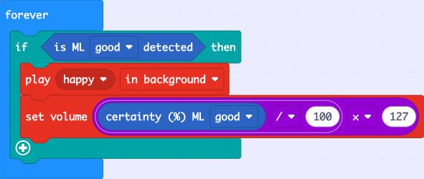
La qabsashada dhibcaha aqoonsiga (recognition points) si aad u hagaajiso barnaamij (program)
Waxaad u isticmaali kartaa block-yadan si aad u xakamayso socodka barnaamijka (program flow).
Waxaad sidoo kale u isticmaali kartaa si aad u xakamayso codka (volume) ama sarjebinta (pitch) dhawaqa (sound) (ama iftiinka (brightness) LED-yada).
Microsoft MakeCode - Waxaa loo isticmaalay idanka Microsoft

Slide 21
La qabsashada dhibcaha aqoonsiga (recognition points) si aad u hagaajiso barnaamij (program)
Isticmaal block-yada koodhka (code blocks) barashada mashiinka (machine learning).
Tijaabo (Experiment) ku beddelashada barnaamijkaaga (program) si aad uga faa'iidayso qiimaha (value) hubaalnimada (certainty) saadaasha (prediction).

Slide 22
La qabso dhibco aqoonsi (recognition points) si aad u hagaajiso barnaamij (program)
Maxaa xakameeya ciyaarista muusigga (music) ee koodhkan?
Qaybta la ogaaday waa False.
Qiimaha (value) codka (volume) waxaa lagu dejiyay iyadoo la isticmaalayo qaacido (formula) xisaabeed (mathematical).
Boqolleyda hubanti (certainty %) ee ah in waxa la geliyay uu u dhigmaan fasalka 'good' wuu ka sarreeyaa dhibcaha aqoonsiga (recognition point).
Microsoft MakeCode - Waxaa loo isticmaalay idanka Microsoft

Slide 23
La qabso dhibco aqoonsi (recognition points) si aad u hagaajiso barnaamij (program)
Waa inaad dejisaa dhibcaha aqoonsiga (recognition point) si koodhku u shaqeeyo.
Sababta?
Dhibcaha aqoonsiga (recognition point) ee caadiga ah waa 80%.

Slide 24
La qabso dhibco aqoonsi (recognition points) si aad u hagaajiso barnaamij (program)
Tijaabo (experiment) adiga oo isticmaalaya qaybaha barashada mashiinka (machine learning blocks) ee koodhkaaga si aad u dhisto codsigaaga (application).

Slide 25
Dhismaha codsi (application) ku salaysan xogta (data)
Dhacdooyinka barnaamijka (program events) waxaa la kici karaa marka dhibcaha aqoonsiga (recognition points) la gaaro.
Habka barnaamijka (program flow) waxaa la beddeli karaa adiga oo isticmaalaya qaybaha (blocks) kuwaas oo ogaada haddii dhibcaha aqoonsiga (recognition point) la gaaray, ama adiga oo isticmaalaya qiimaha hubantida (certainty values).

