Slide 1
Xisaabinta ixtimaalka (theoretical probabilities) ee shaxanka laba-geesoodka ah (laba dhacdo)
Ixtimaalka: ixtimaalka (theoretical probabilities)

Slide 2
Sida agabkeena waxbarista loogu talagalay fasalka

Slide 3
Waxaan xisaabin karaa oo isticmaali karaa ixtimaalka (theoretical probabilities) ee dhacdooyinka isku-dhafan iyadoo la isticmaalayo shaxanka laba-geesoodka ah (2 dhacdo).

Slide 4
Ixtimaalka (theoretical probability) waa ixtimaal ku salaysan tirinta tirada natiijooyinka la doonayo ee meel muunad ah halkaas oo dhammaan natiijooyinka shaqsigu ay isku ekaansho yihiin.

Slide 5

Xisaabinta ixtimaalka (theoretical probabilities) ee shaxanka laba-geesoodka ah (laba dhacdo)
Ixtimaalka (theoretical probabilities)
Ixtimaalka dhacdooyinka isku-dhafan

Slide 6
Ixtimaalka (theoretical probabilities)
Xirmo kaarar ah waxaa ku jira tirooyinka 1 ilaa 10.
Kaararka waxaa loo kala saari karaa tirooyin khariijin (odd) iyo tirooyin siman (even) iyadoo la isticmaalayo shax.
1
2
3
4
5
6
7
8
9
10
khariijin (odd) | siman (even)
1
3
5
2
4
6
7
9
8
10

Slide 7
Ixtimaalka (theoretical probabilities)
Kaararka waxaa sidoo kale loo kala saari karaa tirooyin jibbaar (square numbers) iyo kuwa aan jibbaar ahayn iyadoo la isticmaalayo shax.
1
2
3
4
5
6
7
8
9
10
khariijin (odd) | siman (even)
jibbaar (square) | aan jibbaar ahayn (not square)
1
3
5
2
4
6
1
4
2
3
5
6
7
9
8
10
9
7
8
10

Slide 8
Ixtimaalka (theoretical probabilities)
Labada shax waa la isku dari karaa.
1
2
3
4
5
6
7
8
9
10
kisi (odd) | xataa (even)
jibbaar (square) | aan jibbaar ahayn (not square)
1
3
5
2
4
6
1
4
2
3
5
6
7
9
8
10
9
7
8
10

Slide 9
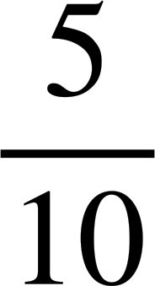
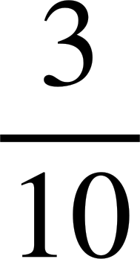
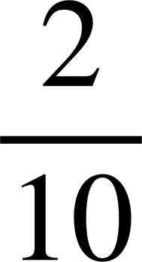
Ixtimaalka aragtida (Theoretical probabilities)
Labada shax waa la isku dari karaa.
1
2
3
4
5
6
7
8
9
10
Kaar baa laga soo doortay xirmada si aan kala sooc lahayn.
jibbaaran (square)
aan jibbaaranayn (not square)
P(kisi) =
kisi (odd)
1
9
3
5
7
P(jibbaaran) =
xataa (even)
4
2
6
8
10
P(kisi iyo jibbaaran) =

Slide 10









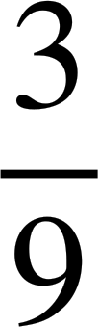
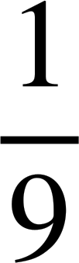
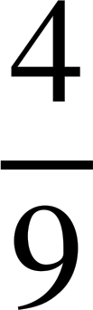
Ixtimaalka aragtida (Theoretical probabilities)
Cabitaannadan waxaa loo kala saaray shaxda natiijada (outcome table) iyadoo loo eegayo haddii ay leeyihiin gacan ama baloog.
A
B
C
D
E
F
G
H
I
gacan (handle)
gacan la'aan (no handle)
Cabitaan baa la soo doortay si aan kala sooc lahayn.
B
F
D
E
P(gacan la'aan iyo baloog) =
baloog (straw)
C
H
I
P(gacan iyo baloog la'aan) =
baloog la'aan (no straw)
A
G
P(gacan iyo shabaq) =

Slide 11

Suurtogalnimada aragtida (Theoretical probabilities)
Wareegga waa la wareejiyay hal mar.
Waa maxay suurtogalnimada inuu ku soo degto lambar khudmo ah iyo qaybiyaha 10?
qaybiyaha 10
aan qaybiyaha 10 ahayn
5
1
xitaa (even)
2
4
4
2
3
khudmo (odd)
1
3
5
P(khudmo iyo qaybiyaha 10) =

Slide 12
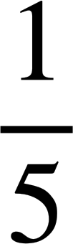
Suurtogalnimada aragtida (Theoretical probabilities)
Wareegga waa la wareejiyay hal mar.
Waa maxay suurtogalnimada inuu ku soo degto lambar xitaa ah oo aan qaybiyaha 10 ahayn?
qaybiyaha 10
aan qaybiyaha 10 ahayn
5
1
xitaa (even)
2
4
4
2
3
khudmo (odd)
1
3
5
P(xitaa iyo aan qaybiyaha 10 ahayn) =

Slide 13
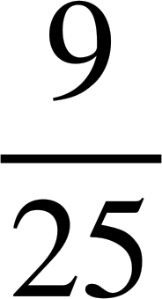
Ixtimaalka aragtida (Theoretical probabilities)
Ciyaar baa la ciyaarayaa halkaas oo ciyaartoydu ku wareejiyaan wareegga laba jeer oo ay helaan wadarta lambarradooda.
Shaxda natiijada waxay tusinaysaa wadarta suurtogalka ah.
5
1
4
2
3
wareeg 1
A = {xitaa (even)}
B = {in ka badan 5}
1
2
3
4
5
P(A iyo B) = {xataa (even) iyo in ka badan 5}
1
2
3
4
5
6
2
3
4
5
6
7
=
wareeg 2
3
4
5
6
7
8
4
5
6
7
8
9
5
6
7
8
9
10

Slide 14
Ixtimaalka aragtida (Theoretical probabilities)
Waxaan u isticmaali karnaa jaantuska natiijada si aan u abuurno jaantus laba-geesood ah labada dhacdo A = {xataa (even)} iyo B = {in ka badan 5}.
5
1
4
2
Marka aan gelinno inta jeer ee dhacdo (frequencies), waxaan si hufan u heli karnaa ixtimaalka dhacdooyinka A iyo B.
3
wareeg 1
1
2
3
4
5
B
ma aha B
wadarta
1
2
3
4
5
6
2
3
4
5
6
7
A
9
4
13
wareeg 2
3
4
5
6
7
8
ma aha A
6
6
12
4
5
6
7
8
9
5
6
7
8
9
10
wadarta
15
10
25

Slide 15
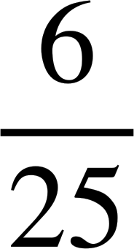
Ixtimaalka aragtida (Theoretical probabilities)
Waa la ciyaarayaa ciyaar halkaas oo ciyaartoydu ku wareejiyaan wareejiyaha (spinner) laba jeer oo ay helaan wadarta tirooyinkooda.
5
1
4
2
A = {xataa (even)}
B = {in ka badan 5}
3
B
ma aha B
wadarta
Waa maxay ixtimaalka in wadartu aysan ahayn xataa (even) oo ay ka badantahay 5?
A
9
4
13
ma aha A
6
6
12
wadarta
15
10
25
Waa maxay ixtimaalka in wadartu aysan ahayn xataa (even) oo aysan ka badnayn 5?

Slide 16
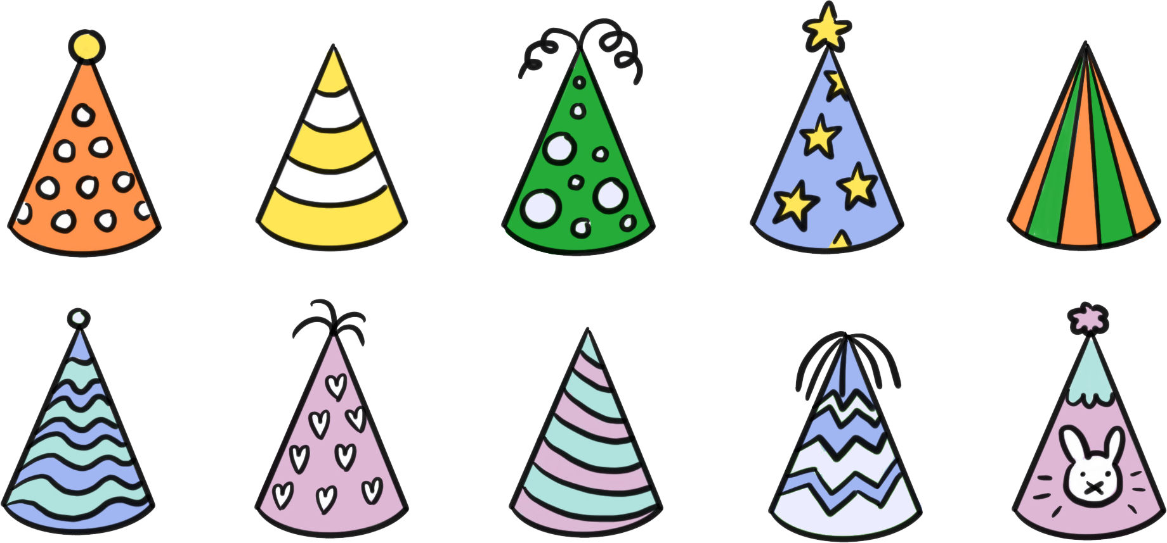
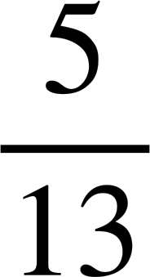
Itimaalka aragtida (Theoretical probabilities)
Qaar ka mid ah koofiyadaha xafladaha ayaa lagu kala saaray shaxda natiijada (outcome table) iyadoo lagu salaynayo laba dhacdo, haddii ay xariijimo leeyihiin iyo haddii ay dusha sare leeyihiin.
xariijimo la'aan
Haddii koofiyad xaflad si random ah loo doorto, waa maxay itimaalka (probability) in aanay xariijimo lahayn oo ay dusha sare leedahay?
xariijimo leh
wadarta
dusha sare leh
4
5
9
dusha sare la'aan
2
2
4
wadarta
6
7
13

Slide 17
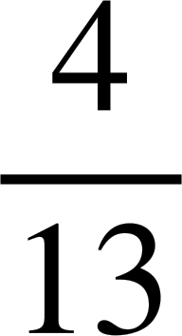
Itimaalka aragtida (Theoretical probabilities)
Qaar ka mid ah koofiyadaha xafladaha ayaa lagu kala saaray shaxda natiijada (outcome table) iyadoo lagu salaynayo laba dhacdo, haddii ay xariijimo leeyihiin iyo haddii ay dusha sare leeyihiin.
xariijimo la'aan
Haddii koofiyad xaflad si random ah loo doorto, waa maxay itimaalka (probability) in ay xariijimo leedahay oo ay dusha sare leedahay?
xariijimo leh
wadarta
dusha sare leh
4
5
9
dusha sare la'aan
2
2
4
wadarta
6
7
13

Slide 18
Itimaalka aragtida (Theoretical probabilities)
1) Wareeggan (spinner) ayaa hal mar la wareejin doonaa.
a) Buuxi shaxda natiijada (outcome table) labada dhacdo: ka yar 12 iyo tiro asal ah (prime).
4
5
2
7
20
8
16
10
13
11
ka yar 12
aan ka yarayn 12
b) Raadi P(ka yar 12 iyo tiro koowaad)
tiro koowaad (prime)
c) Raadi P(aan ahayn tiro koowaad iyo aan ka yarayn 12)
aan ahayn tiro koowaad
d) Raadi P(tiro koowaad iyo aan ka yarayn 12)

Slide 19
Itimaalka aragtiga (Theoretical probabilities)
2) Wareegtan (spinner) waxaa la wareegi doonaa laba jeer ka dibna wax soo saarka (product) labada lambar waa la helaa.
5
1
a) Buuxi shaxda natiijada si aad u muujiso wax soo saarka suurtagalka ah.
4
2
3
wareeg 1
1
2
3
4
5
b) Raadi P(iskaaran (square) iyo qayb ka mid ah 36)
1
2
wareeg 2
3
c) Raadi P(xitaa (even) iyo ka yar 18)
4
5

Slide 20
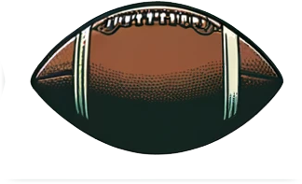

Itimaalka aragtiga (Theoretical probabilities)
3) Shaxdan laba-geesoodka ah waxay muujinaysaa inta jeer ee kubbadaha ciyaaraha qaarkood loo kala saaray qaabkooda iyo inay leeyihiin tolmo dusha korkooda iyo in kale.
tusaale: kubbadda cagta Maraykanka ma aha wareegsan laakiin waxay leedahay tolmo, halka kubbadda golf-ku ay tahay wareegsan laakiin aan lahayn tolmo.
aan wareegsanayn
Kubad si random ah ayaa loo xushay.
wareegsan
wadarta
a) Raadi P(wareegsan (spherical) iyo leh tolmo (stitching))
tolmo
4
1
5
aan tolmo lahayn
11
2
13
b) Raadi P(wareegsan iyo aan lahayn tolmo)
wadarta
15
3
18

Slide 21
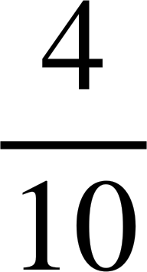
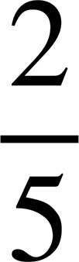
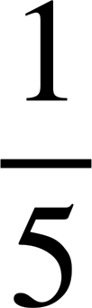

Ixtimaalka aragtida (Theoretical probabilities)
1) Wareegtan (spinner) hal mar ayaa la wareejin doonaa.
a) Buuxi shaxda natiijada labada dhacdo: ka yar 12 iyo tiro kooban (prime).
4
5
2
7
20
8
16
10
13
11
ka yar 12
aan ka yarayn 12
b) Raadi P(ka yar 12 iyo tiro kooban)
2
5
7
13
= = = 0.4 = 40%
tiro kooban (prime)
11
c) Raadi P(aan tiro kooban ahayn iyo aan ka yarayn 12)
aan tiro kooban ahayn
4
8
16
= = = 0.2 = 20%
10
20
d) Raadi P(tiro kooban iyo aan ka yarayn 12)
= = 0.1 = 10%

Slide 22
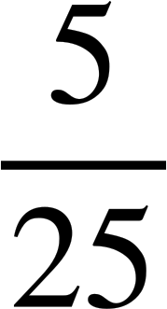
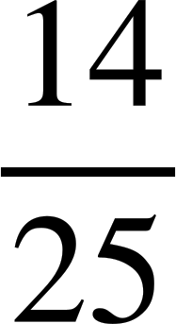
Ixtimaalka aragtida (Theoretical probabilities)
2) Wareegtan (spinner) laba jeer ayaa la wareejin doonaa, ka dibna isku dhufashada labada lambar ayaa la helayaa.
5
1
a) Buuxi shaxda natiijada si aad u muujiso isku dhufashada suurtagalka ah.
4
2
3
wareejinta 1
1
2
3
4
5
b) Raadi P(iska wareeg (square) iyo qaybiyaha 36)
1
1
2
3
4
5
2
4
6
8
10
= = = 0.2 = 20%
2
wareejinta 2
3
3
6
9
12
15
c) Raadi P(xitaa (even) iyo ka yar 18)
4
4
8
12
16
20
5
5
10
15
20
25
= = 0.56 = 56%

Slide 23
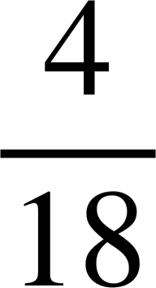
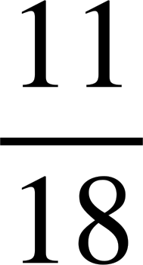
Ixtimaalka aragtida (Theoretical probabilities)
3) Jadwalkan laba-geesoodka ah wuxuu muujinayaa inta jeer ee kubbadaha ciyaaraha qaarkood loo kala saaray qaabkooda iyo haddii ay leeyihiin tolidda (stitching) dusha.
tusaale ahaan, kubbadda american football ma aha spherical laakiin waxay leedahay tolidda (stitching), halka kubbadda golf-ka ay tahay spherical laakiin aan lahayn tolidda (stitching).
aan spherical ahayn
Kubbad ayaa si random ah loo doortay.
spherical
wadarta
a) Raadi P(wareegsan (spherical) iyo leh tolmo)
tolidda (stitching)
4
1
5
tolidda (stitching) la'aan
11
2
13
b) Raadi P(spherical oo aan lahayn tolidda (stitching))
wadarta
15
3
18

Slide 24
Xisaabinta icmaalka aragtida (theoretical probabilities) laga soo qaaday jadwalka laba-geesoodka ah (two-way tables) (laba dhacdo)
Ictimaalka aragtida (Theoretical probabilities)
Ictimaalka dhacdooyinka isku-dhafan (Probabilities for combined events)

Slide 25
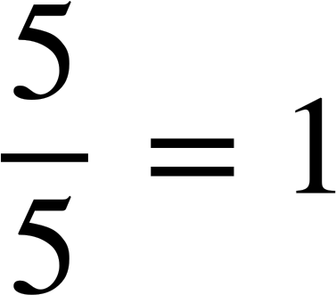
Ictimaalka dhacdooyinka isku-dhafan (Probabilities for combined events)
Wareegga (spinner) ayaa hal mar la wareejiyay.
aan ahayn qaybiyaha (factor) 10
qaybiyaha (factor) 10
5
1
xataa (even)
2
4
4
2
3
5
3
kis (odd)
1
Waa maxay icmaalka (probability) in natiijadu tahay xataa (even) ama kis (odd)?

Slide 26
Ictimaalka dhacdooyinka isku-dhafan (Probabilities for combined events)
Wareegga (spinner) ayaa hal mar la wareejiyay.
ma aha faktor 10
faktor 10
5
1
xataa (even)
2
4
4
2
3
5
3
khariij (odd)
1
Waa maxay itimaalka (probability) in natiijadu tahay xataa iyo faktor 10 ama khariij iyo aan ahayn faktor 10?

Slide 27
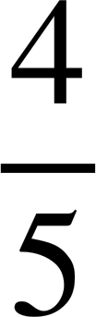
Itimaalka (Probabilities) dhacdooyinka isku dhafan
Wareegga (spinner) waa la mariyay hal mar.
ma aha faktor 10
faktor 10
5
1
xataa (even)
2
4
4
2
3
5
3
khariij (odd)
1
Waa maxay itimaalka in natiijadu tahay xataa iyo aan ahayn faktor 10 ama khariij?

Slide 28
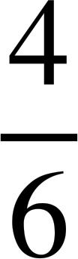
Itimaalka (Probabilities) dhacdooyinka isku dhafan
Wareegga (spinner) waa la mariyay hal mar.
ma aha faktor 8
faktor 8
6
1
5
2
xataa (even)
2
4
6
guul (win)
khasaaro (lose)
4
3
khariij (odd)
1
3
5
Waa maxay itimaalka in natiijadu tahay khariij iyo faktor 8 ama xataa?

Slide 29
Itimaalka (Probabilities) dhacdooyinka isku dhafan
Wareegga waa la wareejiyay hal mar.
ma aha qaybiyaha 8
qaybiyaha 8
6
1
5
2
xitaa (even)
2
4
6
guul
khasaare
4
3
khafif (odd)
1
3
5
Waa maxay ixtimaalka (probability) in natiijadu tahay khafif ama xitaa oo aan ahayn qaybiyaha 8?

Slide 30
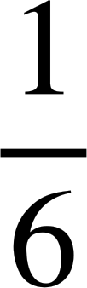
Ixtimaalka (Probabilities) ee dhacdooyinka isku dhafan
Cabdi iyo Saciid waxay ciyaarayaan ciyaar wareeggan.
Cabdi wuxuu helayaa dhibic haddii wareeggu ku soo degto qaybiyaha 10.
6
1
Saciid wuxuu helayaa dhibic haddii wareeggu ku soo degto tiro xitaa.
5
2
Cabdi ma helayo dhibic
Cabdi wuxuu helayaa dhibic
guul
khasaare
4
3
Saciid wuxuu helayaa dhibic
Waa maxay ixtimaalka in Cabdi iyo Saciid ay helaan dhibic?
2
6
4
Saciid ma helayo dhibic
5
1
3

Slide 31

Ixtimaalka (Probabilities) ee dhacdooyinka isku dhafan
Cabdi iyo Saciid waxay ciyaarayaan ciyaar wareeggan.
Cabdi wuxuu helayaa dhibic haddii wareeggu (spinner) ku soo dego qayb ka mid ah 10.
6
1
Saciid wuxuu helayaa dhibic haddii wareeggu ku soo dego tiro siman (even number).
5
2
Cabdi ma helo dhibic
Cabdi wuxuu helayaa dhibic
guul
khasaare
4
3
Saciid wuxuu helayaa dhibic
Waa maxay itimaalka (probability) in Cabdi ama Saciid helaan dhibic?
2
6
4
Saciid ma helo dhibic
5
1
3
Cabdi wuxuu heli karaa dhibic, Saciidna ma helo
Saciid wuxuu heli karaa dhibic, Cabdina ma helo
Cabdi iyo Saciid labaduba waxay heli karaan dhibic

Slide 32

Itimaallada (Probabilities) dhacdooyinka isku dhafan
Kee ka mid ah kuwan soo socda wuxuu buuxiyaa natiijo (outcome) ah tiro siman ama qayb ka mid ah 50?
Natiijadu waa tiro siman oo aan ahayn qayb ka mid ah 50
Natiijadu waa tiro siman oo ah qayb ka mid ah 50
Natiijadu waa tiro khariijad (odd) oo aan ahayn qayb ka mid ah 50
Natiijadu waa tiro khariijad oo ah qayb ka mid ah 50

Slide 33
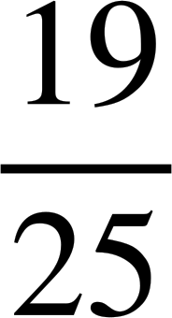
Itimaallada dhacdooyinka isku dhafan
Ciyaar baa la ciyaarayaa halkaas oo ciyaartoydu ku wareejiyaan (spinner) laba jeer oo ay helaan wadarta (sum) tirooyinkooda.
5
1
4
2
A = {xataa (even)}
B = {in ka badan 5}
3
B
ma aha B
wadarta
Waa maxay itimaalka (probability) in wadartu tahay xataa ama in ka badan 5?
A
9
4
13
ma aha A
6
6
12
wadarta
15
10
25

Slide 34
Itimaallada (Probabilities) dhacdooyinka isku-dhafan (combined events)
Ciyaar baa la ciyaarayaa halkaas oo ciyaartoydu ku wareejiyaan (spinner) laba jeer oo ay helaan wadarta (sum) tirooyinkooda.
5
1
4
2
A = {xataa (even)}
B = {in ka badan 5}
3
B
ma aha B
wadarta (total)
Waa maxay itimaalka (probability) in wadartu tahay xataa ama in ka badan 5?
A
9
4
13
ma aha A
6
6
12
wadarta (total)
15
10
25
Waa maxay itimaalka in wadartu tahay xataa oo aan ka badnayn 5 ama in ka badan 5?

Slide 35
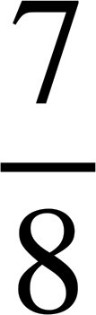
Itimaallada (Probabilities) dhacdooyinka isku-dhafan (combined events)
Dheg (dice) 8-dhinac leh, oo leh tirooyinka 1 ilaa 8.
Waa maxay itimaalka marka la rogrogo (rolled) inay ku soo degto qaybiyaha (factor) 8 (F) ama tiro kisi (odd number) (O)?
F
ma aha F
wadarta (total)
O
1
3
4
ma aha O
3
1
4
wadarta (total)
4
4
8

Slide 36
Itimaallada (Probabilities) dhacdooyinka isku-dhafan (combined events)
1) Jadwalkan natiijada wuxuu muujinayaa meesha muunadda {1, 2, 3, 4, 5, 6, 7, 8, 9}.
ma aha qaybiyaha 18
qaybiyaha 18
Natiijo ayaa si random ah loo xulayaa.
Raadi itimaalka inay tahay:
xitaa (even)
2
6
4 8
a) xitaa (even) iyo qaybiyaha 18 ama khayaali (odd)
khayaali (odd)
1
3
9
5
7
b) khayaali (odd) iyo qaybiyaha 18 ama xitaa (even)
c) qaybiyaha 18 ama xitaa (even) iyo ma aha qaybiyaha 18
d) ma aha qaybiyaha 18 ama xitaa (even)

Slide 37
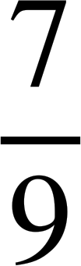
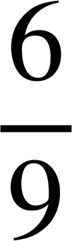
Itimaallada dhacdooyinka isku dhafan
1) Jadwalkan natiijada wuxuu muujinayaa meesha muunadda {1, 2, 3, 4, 5, 6, 7, 8, 9}.
ma aha qaybiyaha 18
qaybiyaha 18
Natiijo ayaa si random ah loo xulayaa.
Raadi itimaalka inay tahay:
xitaa (even)
2
6
4 8
a) xitaa (even) iyo qaybiyaha 18 ama khayaali (odd)
khayaali (odd)
1
3
9
5
7
b) khayaali (odd) iyo qaybiyaha 18 ama xitaa (even)
c) qaybiyaha 18 ama xitaa (even) iyo ma aha qaybiyaha 18
d) ma aha qaybiyaha (factor) 18 ama xataa

Slide 38
Calculating theoretical probabilities from two-way tables (two events)
Miisaska natiijada waxaa loo isticmaali karaa in lagu helo ixtimaalka aragtida ee dhacdooyinka isku dhafan (theoretical probabilities).
In some combinations, an outcome appears in both and therefore is only included once.

