Slide 1
Xisaabinta ixtimaalka (theoretical probabilities) ee jaantusyada Venn (hal dhacdo)
Ixtimaalka: ixtimaalka (theoretical probabilities)

Slide 2
Sida agabkeena waxbarista loogu talagalay fasalka

Slide 3
Waxaan ka heli karaa ixtimaalka (theoretical probabilities) jaantuska Venn oo muujinaya natiijooyinka suurtagalka ah ee hal dhacdo.

Slide 4
Jaantusyada Venn waa matalaad loo isticmaalo qaabaynta su'aalaha tirakoobka/ixtimaalka. Caadi ahaan goobo ayaa loo isticmaalaa inay matalaan dhacdooyinka.
Ixtimaalka (theoretical probability) waa ixtimaal ku salaysan tirinta tirada natiijooyinka la doonayo ee booska muunadda (sample space) halkaas oo dhammaan natiijooyinka shaqsiga ah ay isku ekaansho yihiin.

Slide 5

Xisaabinta ixtimaalka (theoretical probabilities) ee jaantusyada Venn (hal dhacdo)
Ixtimaalka (theoretical probabilities) ee jaantusyada Venn
Isbarbardhigga ixtimaalka

Slide 6
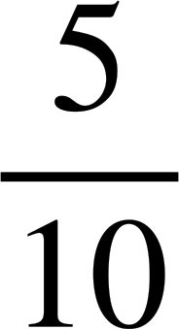
Ixtimaalka (theoretical probabilities) ee jaantusyada Venn
Jaantuska Venn wuxuu muujinayaa booska muunadda (sample space), oo loo kala saaray laba dhacdo.
Haddii dhammaan natiijooyinka ay isku ekaansho yihiin in la doorto, waa maxay ixtimaalka in natiijo ka mid ah dhacdada A la doorto?
ξ
A
B
1
6
2
4
natiijooyinka dhacdada A
5
P(A) =
8
10
natiijooyinka booska muunadda (sample space)
7
9
3
ixtimaalka dhacdo A

Slide 7
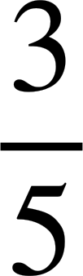
Ixtimaalka (theoretical probabilities) ee jaantusyada Venn
Isticmaalka jaantuska Venn waxaan sheegi karnaa itimaalka dhacdooyinka keli ah.
ξ
F
S
natiijooyinka dhacdada F
Cali
Suad
P(F) =
natiijooyinka booska muunadda
Caasha
Nuur
itimaalka in ardaygu barto Faransiis
Layla
Laba dhacdo waa:
F = {barashada Faransiiska}
S = {barashada Isbaanishka}

Slide 8
Itimaalka aragtida ee jaantusyada Venn
Isticmaalka jaantuska Venn waxaan sheegi karnaa itimaalka dhacdooyinka keli ah.
ξ
F
S
natiijooyinka aan ku jirin dhacdada S
Cali
Suad
P(ma S) =
natiijooyinka booska muunadda
Caasha
Nuur
itimaalka in ardaygu aanu baran Isbaanish
Layla
Laba dhacdo waa:
F = {barta Faransiis}
S = {barta Isbaanish}

Slide 9
Itimaalka aragtida ee jaantusyada Venn
Isticmaal jaantuska Venn si aad u xisaabiso itimaalka.
ξ = {1, 2, 3, 4, 5, 6, 7, 8, 9, 10}
5
P(B) =
A
B
10
1
4
2
6
5
10
8
9
7
3

Slide 10
Itimaalka (probability) aragtida ee jaantusyada Venn
Isticmaal jaantuska Venn si aad u xisaabiso itimaalka (probability).
ξ = {1, 2, 3, 4, 5, 6, 7, 8, 9, 10}
6
P(not A) =
A
B
10
1
4
2
6
5
10
8
9
7
3

Slide 11
Itimaalka (probability) aragtida ee jaantusyada Venn
Laba natiijood oo ka mid ah booska muunadda ayaa ka maqan jaantuska Venn.
ξ = {1, 2, 3, 4, 5, 6, 7, 8, 9, 10, 11, 12}
Waa kuwee labada?
2 iyo 12
A
B
5
Iyada oo aan la garanayn natiijooyinka dhacdo kasta, ma aanan ku dari karin jaantuska.
9
1
3
7
4
8
6
10
Haddii aan ognahay itimaalka (probability) doorashada natiijo ka mid ah dhacdo kasta, ma caawin kartaa in lagu meeleeyo jaantuska Venn?
11

Slide 12

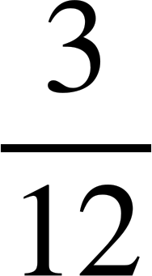

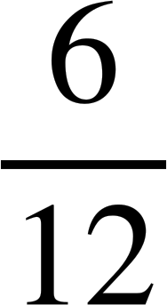
Itimaalka (probability) aragtida ee jaantusyada Venn
✕ 3
Marka la eego
Waxaa horey u jiray 3 natiijo oo ku jira dhacdada A.
ξ = {1, 2, 3, 4, 5, 6, 7, 8, 9, 10, 11, 12}
=
P(A) =
A
B
5
✕ 3
9
1
3
7
✕ 6
4
8
Waxaa loo baahan yahay in ay jiraan 6 natiijo oo ku jira dhacdada B.
6
10
P(B) =
=
11
✕ 6
Sidaas darteed natiijooyinka maqan 2 iyo 12 waa natiijooyinka dhacdada B.

Slide 13
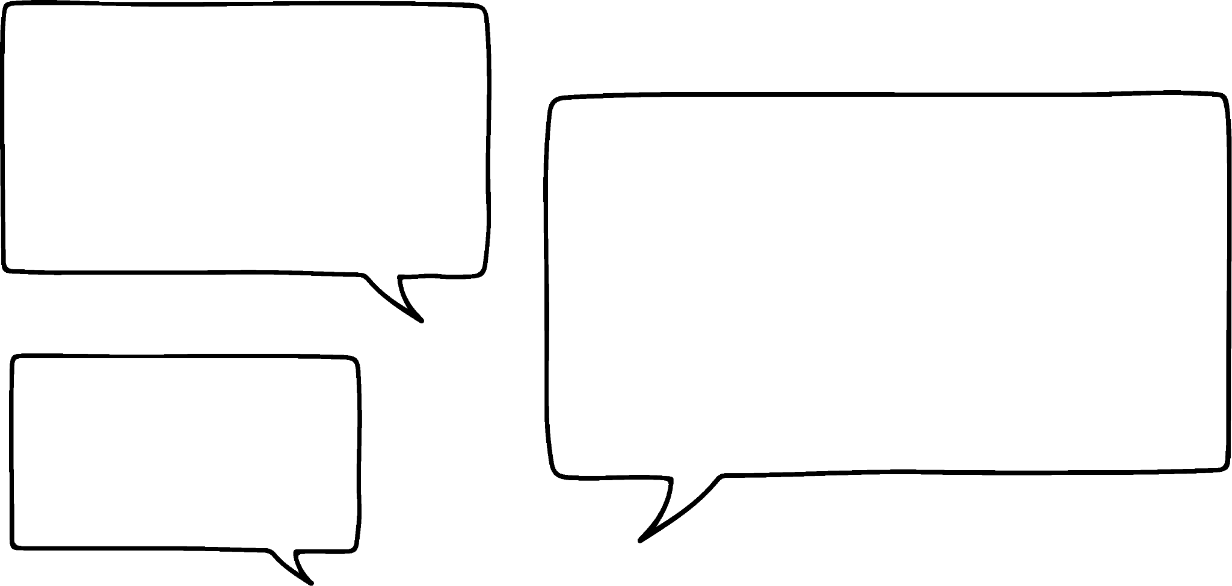






Itimaalka (probability) aragtida ee jaantusyada Venn
Taas macneheedu waa natiijooyinka 2 iyo 12 waxay u baahan yihiin inay ku jiraan meel kasta oo ka mid ah goobada dhacdada B.
ξ = {1, 2, 3, 4, 5, 6, 7, 8, 9, 10, 11, 12}
A
B
5
1
2
9
7
3
Ma aha meel kasta! Dhacdada A waxay horey u leedahay 3 natiijo, waa inay ku jiraan goobta B kaliya.
4
8
12
Cali
6
10
11
Layla

Slide 14
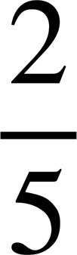
Itimaalka (probability) aragtida ee jaantusyada Venn
Marka la eego:
ξ = {Axmed, Nuur, Yacquub, Saciid, Isra}
A
B
P(A) =
Isra
Yacquub
Axmed
P(B) =
Saciid
Dhamaystir jaantuska Venn (Venn diagram).
Nuur

Slide 15
Ixtimaalka aragtida (Theoretical probabilities) ee jaantusyada Venn
Jaantuskan Venn wuxuu muujinayaa tirada natiijooyinka (outcomes) ee dhacdo kasta (event).
ξ
Imisa natiijo (outcome) ayaa ka jira booska muunadda (sample space)?
A
B
5 + 3 + 3 + 4 = 15
5
3
3
Imisa natiijo (outcome) ayaa ka jira dhacdada A (event A)?
5 + 3 = 8
4
Imisa natiijo (outcome) ayaa ku jira oo kaliya dhacdada B (event B)?
3
Imisa natiijo (outcome) ayaan ku jirin dhacdada A (event A)?
3 + 4 = 7

Slide 16
Ixtimaalka aragtida (Theoretical probabilities) ee jaantusyada Venn
Jaantuskan Venn wuxuu muujinayaa tirada natiijooyinka (outcomes) ee dhacdo kasta (event).
ξ
Imisa natiijo (outcome) ayaan ku jirin dhacdada B (event B)?
A
B
12
7
9
12 + 5 = 17
5

Slide 17
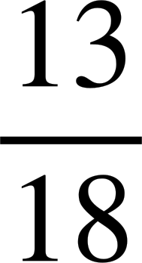
Ixtimaalka aragtida (Theoretical probabilities) ee jaantusyada Venn
Jaantuskan Venn wuxuu muujinayaa tirada natiijooyinka (outcomes) ee dhacdo kasta (event). Waxaa jira 18 natiijo (outcome) oo ku jira booska muunadda (sample space).
Waxaa ka maqan qaar ka mid ah tirooyinka.
ξ
A
B
2
3
3
Marka la eego in
P(ma aha A) =
10
waxay ka dhigan tahay in tirada natiijooyinka (outcomes) ee gobolka (region) u taagan oo kaliya B ay tahay 3.
Marka 2 natiijo (outcome) ee u dambeeya waxay ku jiraan gobolka (region) u taagan oo kaliya dhacdada A (event A).

Slide 18
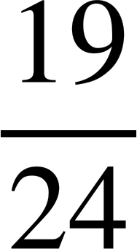
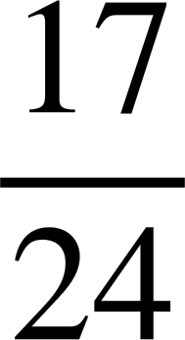
Ixtimaalka aragtida (Theoretical probabilities) ee jaantusyada Venn
Jaantuskan Venn wuxuu muujinayaa tirada natiijooyinka dhacdo kasta. Meesha muunaddu waxay leedahay 24 natiijo.
La siiyay:
ξ
A
B
P(not B) =
13
4
1
P(A) =
6
Dhammeystir jaantuska Venn.

Slide 19
Ixtimaalka aragtida (Theoretical probabilities) ee jaantusyada Venn
1) Isticmaal jaantuska Venn si aad u qorto ixtimaallada.
ξ = {1, 2, 3, 4, 5, 6, 7, 8}
a) P(A) =
A
B
1
2
b) P(B) =
4
6
5
8
c) P(not B) =
3
7
d) P(only A) =

Slide 20
Ixtimaalka aragtida (Theoretical probabilities) ee jaantusyada Venn
2) Isticmaal jaantuska Venn si aad u qorto ixtimaallada.
ξ
a) P(A) =
A
B
6
2
5
10
b) P(B) =
8
4
1
c) P(C) =
7
d) P(only B) =
C
9
3
e) P(not C) =

Slide 21
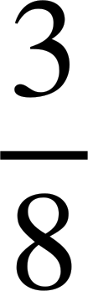
Ixtimaalka aragtida (Theoretical probabilities) ee jaantusyada Venn
3)
a) Dhammeystir jaantuska Venn adigoo la siiyay ixtimaalladan.
ξ = {tirooyin (integers) 1 ilaa 8 oo ay ku jiraan}
A
B
7
1
2
P(A) =
5
6
8
4
P(B) =
b) Soo saar P(only A)

Slide 22
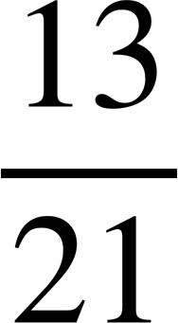
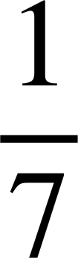
Ixtimaalka aragtida (Theoretical probabilities) ee jaantusyada Venn
4) Jaantuskan Venn wuxuu muujinayaa tirada natiijooyinka dhacdo kasta.
Waxaa jira 21 natiijo oo ku yaal meesha muunaddu.
Dhammeystir jaantuska Venn adigoo la siiyay ixtimaalladan.
ξ
A
B
7
P(not A) =
P(kaliya A) =

Slide 23
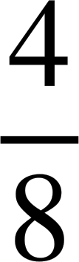
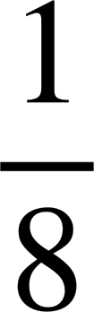
Itimaalka aragtida (Theoretical probabilities) ee jaantusyada Venn (Venn diagrams)
1) Isticmaal jaantuska Venn (Venn diagram) si aad u qorto itimaalka (probabilities).
ξ = {1, 2, 3, 4, 5, 6, 7, 8}
a) P(A) =
= = 50% = 0.5
A
B
1
2
b) P(B) =
= = 50% = 0.5
4
6
5
8
c) P(ma aha B) =
= = 50% = 0.5
3
7
d) P(kaliya A) =
= 12.5% = 0.125

Slide 24
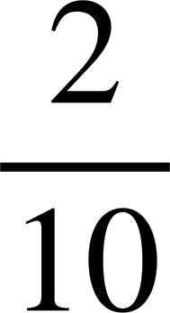
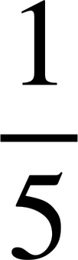

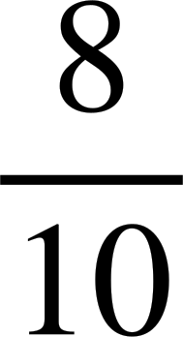
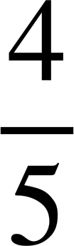
Itimaalka aragtida (Theoretical probabilities) ee jaantusyada Venn (Venn diagrams)
2) Isticmaal jaantuska Venn (Venn diagram) si aad u qorto itimaalka (probabilities).
ξ
a) P(A) =
= = 50% = 0.5
A
B
6
2
5
10
b) P(B) =
= = 50% = 0.5
8
4
1
c) P(C) =
= = 20% = 0.2
7
d) P(kaliya B) =
= 10% = 0.1
C
9
3
e) P(ma aha C) =
= = 80% = 0.8

Slide 25
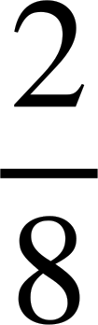
Itimaalka aragtida (Theoretical probabilities) ee jaantusyada Venn (Venn diagrams)
3)
a) Dhammaystir jaantuska Venn (Venn diagram) adigoo ku saleynaya itimaalkan (probabilities).
ξ = {tirsanayaasha (integers) 1 ilaa 8 oo ay ku jiraan}
A
B
7
1
2
P(A) =
5
6
3
8
4
P(B) =
b) Soo saar P(kaliya A)
= = 25% = 0.25

Slide 26
Itimaalka aragtida (Theoretical probabilities) ee jaantusyada Venn (Venn diagrams)
4) Jaantuskan Venn (Venn diagram) wuxuu muujinayaa tirada natiijooyinka (outcomes) ee dhacdo kasta.
Waxaa jira 21 natiijo (outcomes) oo ku jira booska muunadda (sample space).
Dhammaystir jaantuska Venn (Venn diagram) adigoo ku saleynaya itimaalkan (probabilities).
ξ
A
B
3
5
7
6
P(ma aha A) =
P(kaliya A) =

Slide 27
Xisaabinta itimaalka aragtida (Theoretical probabilities) ee jaantusyada Venn (Venn diagrams) (hal dhacdo)
Itimaalka aragtida (Theoretical probabilities) ee jaantusyada Venn (Venn diagrams)
Isbarbardhigga itimaalka (Comparing probabilities)

Slide 28
Isbarbardhigga ixtimaalka (probabilities)
Caasha iyo Suad waxay ciyaarayaan laba ciyaarood oo kala duwan. Tirada natiijooyinka ayaa ku muujisan labada jaantus ee Venn.
Caasha waa ku guuleysataa haddii ay doorato natiijo ka mid ah dhacdada A ee ciyaar kasta, Suadna waa ku guuleysataa haddii ay doorato natiijo ka mid ah dhacdada B ee ciyaar kasta.
Ciyaarta 1
Ciyaarta 2
ξ
ξ
A
B
A
B
3
1
6
2
1
4
10
5
Ciyaar tee ayay Caasha tahay inay ciyaarto?

Slide 29




Isbarbardhigga ixtimaalka (probabilities)
Ciyaarta 1
Ciyaarta 2
ξ
ξ
A
B
A
B
3
1
6
2
1
4
10
5
Ciyaar tee ayay Caasha tahay inay ciyaarto?
Ciyaarta 2, sababtoo ah P(A) = 0.25, halka ciyaarta 1, P(A) = 0.2
Ciyaarta 1, waxaa jira 4 natiijo oo dhacdada A ah, marka la barbardhigo 3 ee ciyaarta 2.
Yacquub
Nuur
Yaa aad ku raacsan tahay?

Slide 30
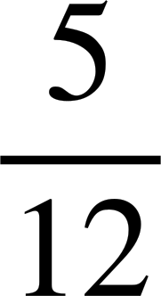
Isbarbardhigga ixtimaalka (probabilities)
Ciyaarta 1
Ciyaarta 2
ξ
ξ
A
B
A
B
3
1
6
2
1
4
10
5
Ciyaar tee ayay Suad tahay inay ciyaarto?
Ciyaartii 1aad, Suad waxay leedahay fursad 35% ah oo ay ku guuleysato. Ciyaartii 2aad waxay leedahay fursad oo ay ku guuleysato.
Haa, waxaan u baahanahay inaan eego fursadda doorashada natiijo ka mid ah dhacdada B.
Yacquub
Nuur

Slide 31
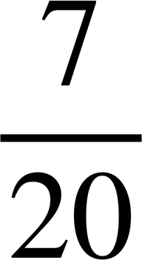
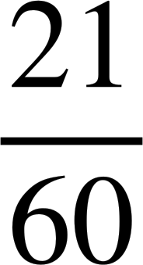
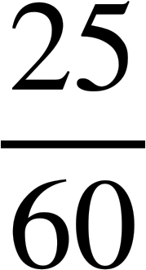
Barbardhigista ixtimaalka (probabilities)
Ciyaartii 1aad
Ciyaartii 2aad
ξ
ξ
A
B
A
B
3
1
6
2
1
4
10
5
Ciyaartee ayay Suad tahay inay ciyaarto?
35% waxay la mid tahay
Kee weyn yahay, 35% ama ?
Si loo barbardhigo jajabyo (fractions), waxaan isticmaali karnaa hooseeye guud (common denominator).
=
<
=
Yacquub
Suad waxay u badan tahay inay ku guuleysato ciyaarta 2aad.

Slide 32
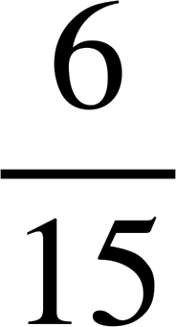
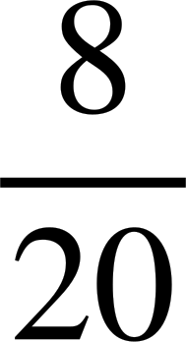
Barbardhigista ixtimaalka (probabilities)
Ciyaartii 1aad
Ciyaartii 2aad
ξ
ξ
A
B
A
B
5
2
3
4
2
4
10
5
Ciyaartee ayaad u badan tahay inaad ka doorato natiijo (outcome) ka tirsan dhacdada A (event A)?
Ciyaartii 1aad: P(A) =
Ciyaartii 2aad: P(A) = = =
Ciyaartii 2aad

Slide 33
Barbardhigista ixtimaalka (probabilities)
1) Barbardhigi ixtimaalka (probabilities) ka imanaya jaantus kasta oo Venn (Venn diagram). Jaantusyada Venn waxay muujinayaan tirada natiijooyinka (outcomes).
Venn 1
Venn 2
ξ
ξ
A
B
A
B
8
3
7
5
3
6
12
6
a) P(A)
b) P(kaliya A)
c) P(ma B)

Slide 34
Isbarbardhigga itimaalka
2) Isbarbardhig itimaalka Venn diagram kasta. Venn diagrams waxay muujinayaan tirada natiijooyinka.
Venn 1
Venn 2
ξ
ξ
A
B
A
B
3
8
3
7
8
3
1
4
2
1
1
3
6
6
C
C
a) P(A)
b) P(C)
c) P(ma B)

Slide 35
Isbarbardhigga itimaalka
3) Buuxi Venn diagram labaad tirada natiijooyinka si aad ugu dhowdahay inaad doorato natiijo ka mid ah dhacdada B ee Venn 2.
Venn 1
Venn 2
ξ
ξ
A
B
A
B
7
2
9
5
4
12
10

Slide 36
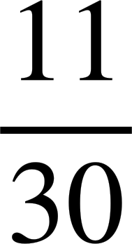

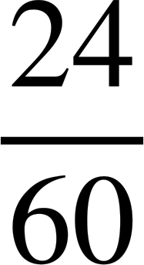
Isbarbardhigga itimaalka
1) Isbarbardhig itimaalka Venn diagram kasta. Venn diagrams waxay muujinayaan tirada natiijooyinka.
Venn 1
Venn 2
ξ
ξ
A
B
A
B
8
3
7
5
3
6
12
6
a) P(A)
Venn 1:
P(A) = =
Venn 2:
P(A) = =
Marka dhacdada A ayaa ku dhowdahay Venn 2.

Slide 37
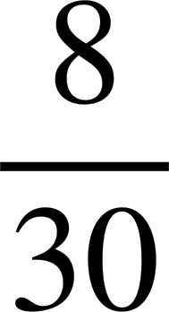
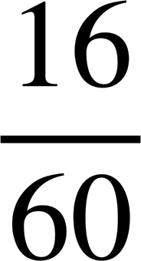
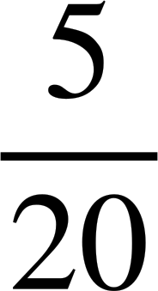
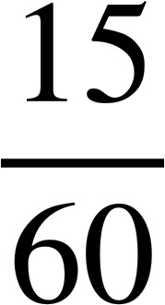
Isbarbardhigga itimaalka
1) Isbarbardhig itimaalka Venn diagram kasta. Venn diagrams waxay muujinayaan tirada natiijooyinka.
Venn 1
Venn 2
ξ
ξ
A
B
A
B
8
3
7
5
3
6
12
6
b) P(kaliya A)
Venn 1:
P(kaliya A) = =
Venn 2:
P(kaliya A) = =
Marka dhacdada A oo keliya ayaa u badan Venn 1.

Slide 38


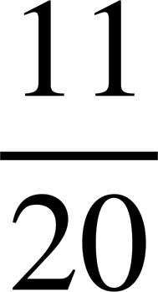
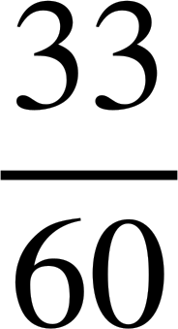
Isbarbardhigga itimaalka (probabilities)
1) Isbarbardhig itimaalka (probabilities) jaantus kasta oo Venn ah. Jaantusyada Venn waxay muujinayaan tirada natiijooyinka (outcomes).
Venn 1
Venn 2
ξ
ξ
A
B
A
B
8
3
7
5
3
6
12
6
c) P(ma aha B)
Venn 1:
P(ma aha B) = =
Venn 2:
P(ma aha B) = =
Marka dhacdada ma aha B ayaa u badan Venn 1.

Slide 39
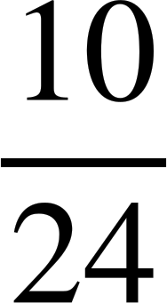
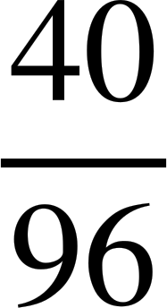
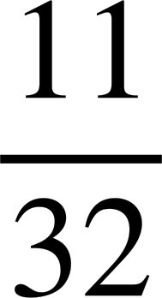
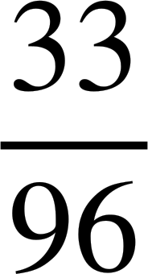
Isbarbardhigga itimaalka (probabilities)
2) Isbarbardhig itimaalka (probabilities) jaantus kasta oo Venn ah. Jaantusyada Venn waxay muujinayaan tirada natiijooyinka (outcomes).
Venn 1
Venn 2
ξ
ξ
A
B
A
B
3
8
3
7
8
3
1
4
2
1
1
3
6
6
C
C
a) P(A)
Venn 1:
P(A) = =
Venn 2:
P(A) = =
Marka dhacdada A ayaa u badan Venn 1.

Slide 40


Isbarbardhigga ixtimaalka (probabilities)
2) Isbarbardhig ixtimaalka (probabilities) ee Venn diagram kasta. Venn diagrams-ku waxay muujinayaan tirada natiijooyinka (outcomes).
Venn 1
Venn 2
ξ
ξ
A
B
A
B
3
8
3
7
8
3
1
4
2
1
1
3
6
6
C
C
b) P(C)
Venn 1:
P(C) = =
Venn 2:
P(C) = =
Marka dhacdada (event) C waxay u badan tahay Venn 1.

Slide 41
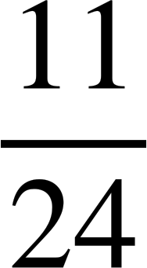
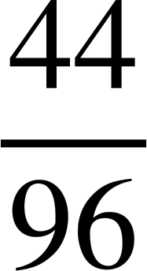
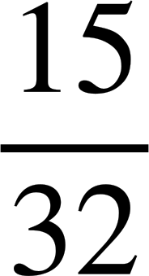
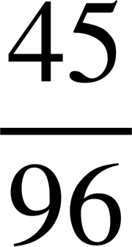
Isbarbardhigga ixtimaalka (probabilities)
2) Isbarbardhig ixtimaalka (probabilities) ee Venn diagram kasta. Venn diagrams-ku waxay muujinayaan tirada natiijooyinka (outcomes).
Venn 1
Venn 2
ξ
ξ
A
B
A
B
3
8
3
7
8
3
1
4
2
1
1
3
6
6
C
C
c) P(not B)
Venn 1:
P(not B) = =
Venn 2:
P(not B) = =
Marka dhacdada (event) B ee aan ahayn waxay u badan tahay Venn 2.

Slide 42
Isbarbardhigga ixtimaalka (probabilities)
3) Buuxi Venn diagram-ka labaad ee tirada natiijooyinka (outcomes) si aad ugu badan tahay inaad ka doorato natiijo (outcome) dhacdada (event) B ee Venn 2.
Venn 1
Venn 2
ξ
ξ
A
B
A
B
7
2
9
5
4
5
12
10
Tiro kasta oo ka weyn 4

Slide 43
Xisaabinta ixtimaalka (theoretical probabilities) jaantusyada Venn (Venn diagrams) (hal dhacdo (event))
Waxaa laga heli karaa ixtimaalka (theoretical probabilities) dhacdooyinka (events) iyadoo la isticmaalayo jaantuska Venn (Venn diagram).
Waxaa suurtogal ah in la xisaabiyo halka natiijooyinka (outcomes) maqan ay ku habboon yihiin jaantuska Venn (Venn diagram) haddii ixtimaalka (probabilities) dhacdooyin (events) ku filan la ogyahay.

