Slide 1
Catering
Xisaab goobta shaqada

Slide 2
Sida agabkeena waxbarista loogu talagalay fasalka

Slide 3
Waxaan fahmi karaa sida xisaabta loogu isticmaalo warshadaha catering-ka.

Slide 4
Halbeegyada mitirka waxay ku salaysan yihiin halbeegyada caadiga ah ee mitir, garaam iyo litir.
Khasaarada boqolleyda (Percentage loss) waa hoos u dhaca marka laga hadlayo shay lumiyo qiimo/cuf/dherer, iwm. waxaana loo soo bandhigaa boqolkiiba tirada asalka ah.

Slide 5

Catering
Qiyaasaha (Measures) catering-ka
Boqolleyda (Percentages) catering-ka

Slide 6
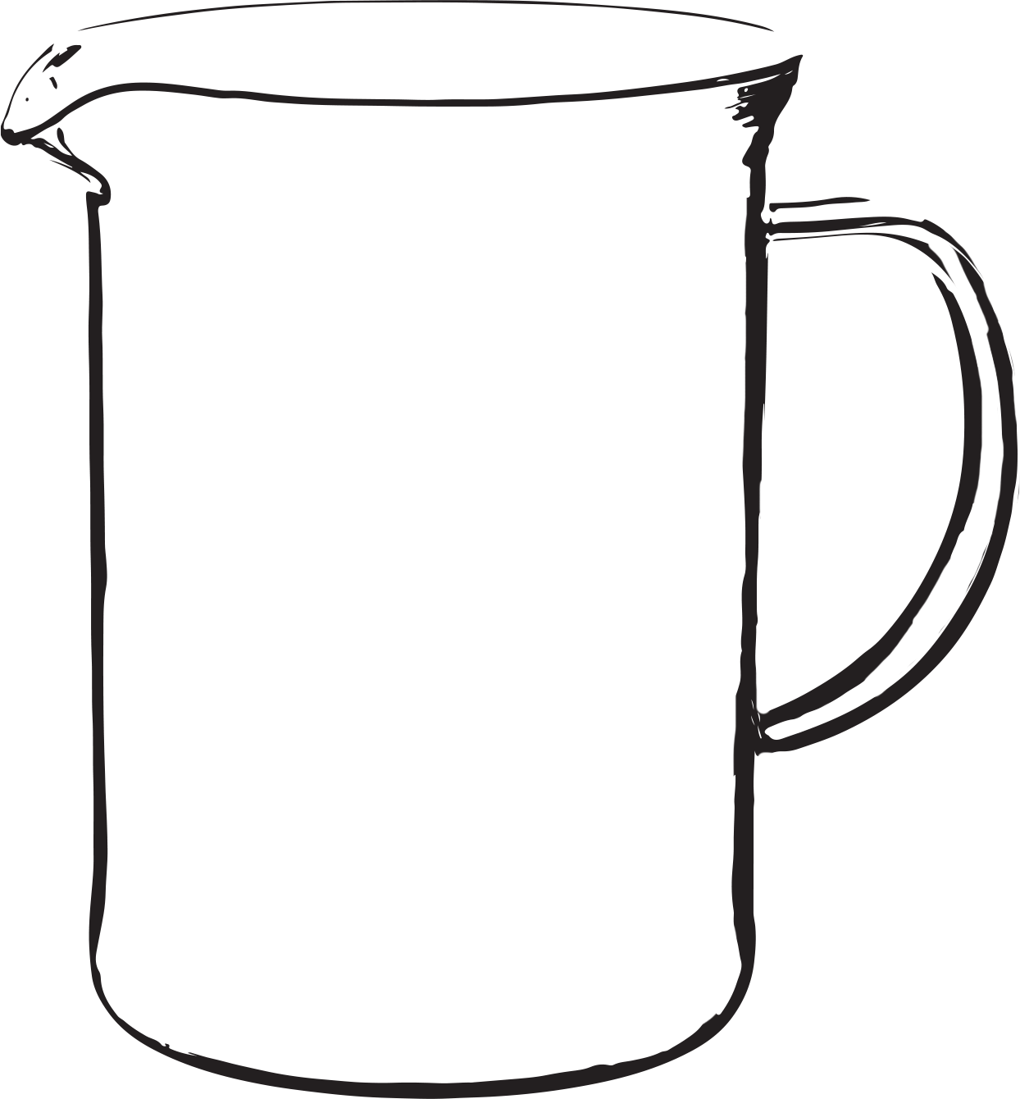
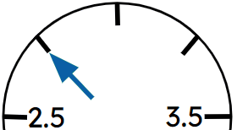

Qiyaasaha (Measures) catering-ka
Waa maxay qaybaha xisaabta ee aad u malaynaysaa in caterer-ku isticmaalo?
Qiyaasaha (Measures)
Lacagta (Money)
Beddelka (Conversions)
Saami (Proportion)
Boqolleyda (Percentages)
Saamiga (Ratio)
Heerkulka (Temperature)
kg
Inta lagu jiro darsigan waxaan eegi doonaa inta badan kuwaas.

Slide 7
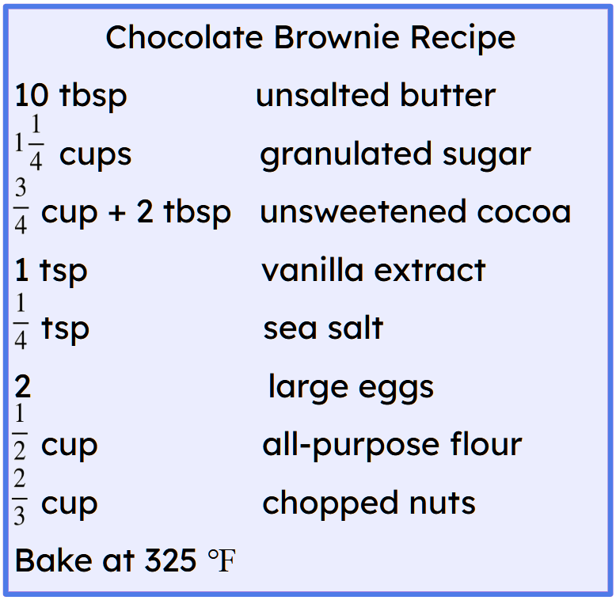
Qiyaasaha (Measures) catering-ka
Inta badan cunto karinta (recipes) waxay ku qoran yihiin ereyo Mareykan ah.
Maamulaha cuntada wuxuu u baahan yahay inuu u beddelo cabbiraadahan halbeegyada mitirka (metric).

Slide 8

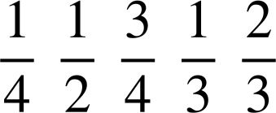
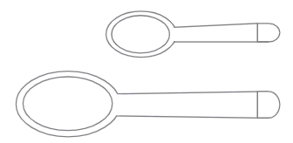
Measures in catering
1 gram ≈ ^{th} tbsp
1 cup
1 cup
tsp
5 ml
tbsp
3 tsp
Ma jiraan macluumaad ku filan oo lagu beddelo dhammaan cabbiraadaha halbeegyada mitirka? (Garaam iyo millilitir)
Maya. Qaadada iyo qaadada weyn waa la beddeli karaa, laakiin cabbiraadaha koobka (cup) ma aha.

Slide 9
Measures in catering
1 gram ≈ ^{th} tbsp
1 cup
1 cup
tsp
5 ml
tbsp
3 tsp
Waa maxay macluumaadka kale ee aad u baahan tahay si aad ugu beddesho cabbiraadaha koobka halbeegyada mitirka?
Macluumaad ku saabsan awoodda koobka (cup).

Slide 10
Cabbiraadaha cuntada (Measures in catering)
1 garaam ≈ th qad (tbsp)
1 koob (cup)
1 koob (cup)
1 koob = 16 qad (tbsp)
tsp
5 ml
qad (tbsp)
3 qad (tsp)
Ma jiraan macluumaad ku filan oo lagu beddelo dhammaan cabbiraadaha koobka ee halbeegyada mitirka?
Haa.
U beddel dhammaan cabbiraadaha koobka iyo qadaha ee halbeegyada mitirka.

Slide 11
Cabbiraadaha cuntada (Measures in catering)
Ka hor inta aanu soo marin beddelkaas, aan ka fikirno kuwa alaabta ah ee loo baahan yahay in lagu beddelo garaam iyo kuwa millilitir.
Waa maxay garaam? Waa cabbir mitir ah oo maxay?
Garaam waa cabbir mitir ah oo cufnaanta (mass). (Alaabta adag)

Slide 12
Cabbiraadaha cuntada (Measures in catering)
Ka hor inta aanu soo marin beddelkaas, aan ka fikirno kuwa alaabta ah ee loo baahan yahay in lagu beddelo garaam iyo kuwa millilitir.
Waa maxay millilitir? Waa cabbir mitir ah oo maxay?
Millilitir waa cabbir mitir ah oo awoodda (capacity). (Dareeraha)

Slide 13
Cabbiraadaha cuntada (Measures in catering)
Kee ka mid ah alaabta brownie ee aan ku qiyaasi doonaa garaam?
Subag (Butter)
Sonkor (Sugar)
Kooko (Cocoa)
Cusbo badeed (Sea salt)
Buri (Flour)
Low (Nuts)
Waa kee walxaha brownie-ga ee ku qiyaasi doono millilitir (millilitres)?
Soo-saarka faanili (Vanilla extract)

Slide 14
Qiyaasaha cuntada (Measures in catering)
1 gram ≈ th tbsp
16 tbsp
1 cup
1 cup
224 g
1 cup = 16 tbsp
12 qaado (tbsp)
168 g
8 tbsp
112 g
tsp
5 ml
≈ 4.7 garaam (grams)
4 tbsp
56 g
tbsp
≈ 14 garaam (grams)
3 tsp
Laga bilaabo qiyaasaha cufka (mass).
U beddel dhammaan qiyaasaha koob iyo qaaddo oo u beddel garaam (grams).

Slide 15
Qiyaasaha cuntada (catering)
1 garaam ≈ th qaado (tbsp)
224 g
1 koob (cup)
16 qaado (tbsp)
1 koob (cup)
1 koob = 16 qaado (tbsp)
168 g
112 g
qaado yar (tsp)
5 ml
≈ 4.7 garaam (grams)
56 g
qaado (tbsp)
≈ 14 garaam (grams)
3 qaado yar (tsp)
Hadda qiyaasaha koobka loo qaybiyay saddex meelood.
Maxay tani dhib u keeni kartaa?
3 ma aha qaybiyaha 16.

Slide 16
Qiyaasaha cuntada (catering)
1 gram ≈ th tbsp
224 g
1 koob (cup)
225.6 g
1 koob (cup)
48 tsp
16 tbsp
1 cup = 16 tbsp
168 g
32 tsp
150.4 g
112 g
qaado yar (tsp)
5 ml
16 tsp
≈ 4.7 grams
75.2 g
56 g
qaado (tbsp)
≈ 14 grams
3 tsp
Waa maxay milan (solution) dhibaatadan?
Isticmaal qaaddo yar (teaspoon) halkii qaaddo weyn (tablespoon).

Slide 17
Cabbiraadaha cuntada diyaarinta (catering)
1 gram ≈ th tbsp
225.6 g
1 koob (cup)
224 g
1 cup
1 cup = 16 tbsp
150.4 g
149.3 g
tsp
5 ml
75.2 g
≈ 4.7 grams
74.7 g
tbsp
≈ 14 garaam (grams)
3 tsp
Aan aragno waxa dhaca haddii aan isticmaalo xaqiiqda ah in 1 cup = 224 grams.
Maxay cabbirada wax yar u kala duwan yihiin?

Slide 18
Cabbirrada cuntada (catering)
1 garaam ≈ th tbsp (qaaddo weyn)
225.6 g
225 g
1 koob (cup)
224 g
225 g
1 koob (cup)
1 koob (cup) = 16 tbsp (qaaddo weyn)
150.4 g
150 g
149.3 g
150 g
tsp (qaaddo yar)
5 ml
75.2 g
75 g
≈ 4.7 garaam (grams)
74.7 g
75 g
tbsp (qaaddo weyn)
≈ 14 garaam (grams)
3 tsp (qaaddo yar)
Maxay cabbirada wax yar u kala duwan yihiin?
Kuwani waa qiyam qiyaas ah.
Waa maxay cabbirka ugu habboon ee la isticmaali lahaa?

Slide 19
Cabbirrada cuntada (catering)
1 gram ≈ th tbsp
16 tbsp
1 koob (cup)
1 koob (cup)
240 ml
1 cup = 16 tbsp
12 tbsp
180 ml
8 tbsp
120 ml
tsp (qaaddo yar)
5 ml
4 tbsp
60 ml
tbsp (qaaddo weyn)
15 ml
3 tsp
Laga bilaabo cabbirada awoodda (capacity).
U beddel dhammaan cabbirada koob iyo qaaddo millilitir (millilitres).

Slide 20
Cabbirada cuntada (Measures in catering)
1 garaam ≈ th qaado (tbsp)
240 ml
1 cup
240 ml
1 cup
1 koob = 16 qaado (tbsp)
180 ml
160 ml
120 ml
tsp
5 ml
80 ml
60 ml
tbsp
14 garaam
3 tsp
Hadda cabbirka koobka loo qaybiyay saddex meelood.

Slide 21
Cabbirrada cuntada (catering)
Koobabka waxaa loo beddeli karaa garaam ama millilitir. Heerka beddelka aan halkan isticmaalnay waa hal heer beddel.
Hase yeeshee, heerka beddelku wuu ku kala duwanaan karaa waxa aan cabbireyno, waxaana muhiim ah in aan taas ogaanno.

Slide 22
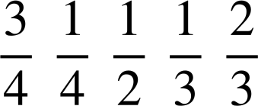
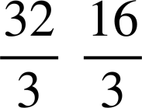
Cabbirrada cuntada (catering)
Buuxi cabbirrada maqan.
Koobab (Cups) | Qaado (Tablespoons) | Qaado yar (Teaspoons) | Garaam (Grams) | Millilitir (Millilitres)
1 | 16 | 48 | g | ml
 | 12 |  | ≈ g | 180 ml
 |  |  | 150 g | ml
 |  | 24 | ≈ g | 120 ml
 |  |  | g | 80 ml
 |  | 12 | 56 g | ml

Slide 23
Cabbirrada cuntada (Measures in catering)
Buuxi cabbirrada maqan.
Koobab (Cups) | Qaaddo weyn (Tablespoons) | Qaaddo yar (Teaspoons) | Garaam (Grams) | Mililitir (Millilitres)
1 | 16 | 48 | 224 ama 225 g | 240 ml
 | 12 | 36 | ≈ 168 g | 180 ml
 |  | 32 | 150 g | 160 ml
 | 8 | 24 | ≈ 112 g | 120 ml
 |  | 16 | 75 g | 80 ml
 | 4 | 12 | 56 g | 60 ml

Slide 24
Cabbirrada cuntada (Measures in catering)
Hadda waxaan u rogi karnaa maaddooyinka ku jira cuntada (recipe).
Subag (Butter) = 10 × 14 = 140 g
Sonkor = 224 + 56 = 280 g
Kooko = 168 + 2 × 14 = 196 g
Faanayl = 5 ml
Cusbo (salt) = 5 ÷ 4 = 1.25 g
Bur = 112 g ama 112.5 g
Lowska = 150 g
Ma hadda waxaan dubi karnaa brownies-ka?
Foornada UK waxay isticmaalaan ℃ ma ahan ℉.

Slide 25

Qiyaasaha cuntada (catering)
Si ℉ loogu beddelo ℃
Kala jar 32, ku dhufo
(325 − 32) ×
= 163 ℃ (tiro dhammays tiran)

Slide 26
Qiyaasaha cuntada (catering)
Si ℉ loogu beddelo ℃
Kala jar 32, ku dhufo
Si ℉ loogu beddelo ℃
Kala jar 32, ku dhufo
U beddel 260 ℉ oo noqo ℃.
Jawaabta ku bixi tiro dhammays tiran.
U beddel 450 ℉ oo noqo ℃.
Jawaabta ku bixi tiro dhammays tiran.
(260 − 32) ×
= 127 ℃
(450 − 32) ×
= 232 ℃

Slide 27

Qiyaasaha cuntada (catering)
420 ℉ = 402 ℃ (tiro dhan u dhow)
Waa maxay qaladka aad u malaynaysaa in la sameeyay?
Nidaamka hawlgallada (order of operations) waa khalad. Markaad xisaabiyaha (calculator) ku gelinayso, geli:
(420 − 32) × = 216 ℃

Slide 28



Cabbiraadaha cuntada diyaarinta (catering)
1) U beddel cunto karinta (recipes) iyo heerkulka foornada soo socda unugyada UK.
Cunto karinta Canjeelada (Pancake Recipe)
b) Cunto karinta Scone-ka (Scone Recipe)
1 koob oo bur ah
2 tbsp sonkor
2 tsp budada foornada (baking powder)
1 qadar cusbo (salt)
1 koob caano
2 tbsp subag la dhalaaliyay
1 ukun weyn
3 koob oo bur ah
koob sonkor (caster sugar)
2 tsp budada foornada (baking powder)
koob subag la jileciyay
koob caano
Heerkulka foornada 392 ℉

Slide 29
Cabbiraadaha cuntada diyaarinta (catering)
1) U beddel cunto karinta (recipes) iyo heerkulka foornada soo socda unugyada UK.
a) Cunto Karinta (Pancake Recipe)
1 koob bur (flour) 225 g ama 224 g
2 qaado (tbsp) sonkor (sugar) 28 g
2 qaado yar (tsp) budada foosha (baking powder) 9 g
1 taabasho cusbo (salt)
1 koob caano (milk) 240 ml
2 qaado (tbsp) subag dhalaalay (melted butter) 28 g
1 ukun weyn (large egg)
b) Cunto Karinta Scone (Scone Recipe)
3 koob oo bur (flour) 675 g ama 672 g
koob sonkor (caster sugar) 56 g
2 qaado yar (tsp) budada foosha (baking powder) 9 g
koob subag jilicsan (softened butter) 112 g
koob caano (milk) 320 ml
Heerkulka foornada (Oven temperature) 200 ℃

Slide 30
Cuntada (Catering)
Qiyaasaha cuntada (Measures in catering)
Boqolleyda cuntada (Percentages in catering)

Slide 31
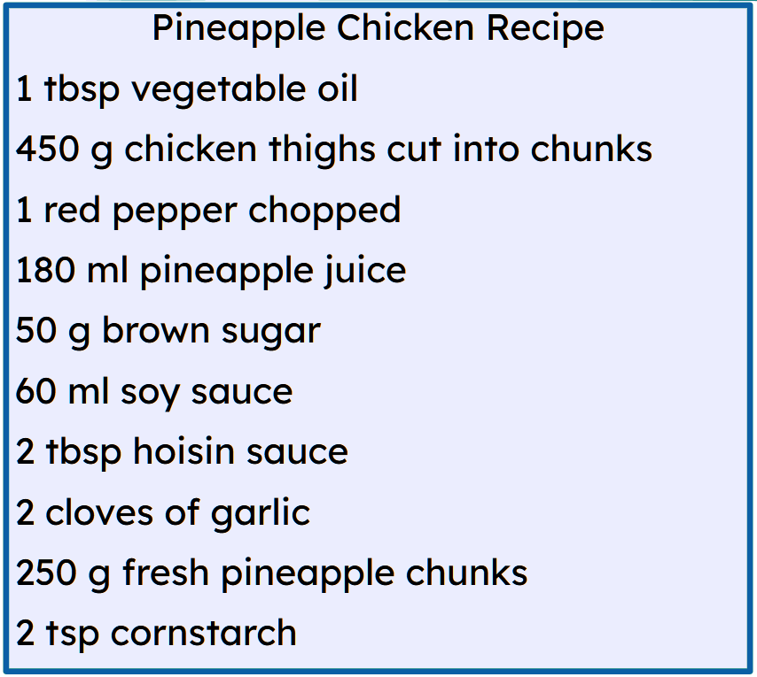
Boqolleyda cuntada (Percentages in catering)
Cuntooyinka qaarkood waxay u baahan yihiin diyaarin ka hor inta aan loo isticmaalin cunto karinta (recipe).
Ma u malaynaysaa in mid ka mid ah maaddooyinka (ingredients) ee cunto karintan (recipe) uu soo saari doono qashin?
Basbaaska cas (red pepper), bowdada digaagga (chicken thighs), toonta (garlic) iyo xabo qamadi (pineapple chunks).

Slide 32
Boqolleyda (Percentages) ee cuntada (catering)
In kastoo basbaaska iyo toonta ay soo saaraan qashin (wastage), tani ma saamayso cuntada (recipe).
Qashinka (wastage) digaaga iyo cananaasta waa in la tixgeliyaa, si kastaba ha ahaatee.
Cunto-kariyeyaashu (caterers) waxay isticmaalaan boqolleyda (percentages) si ay u ogaadaan inta alaab ee gaarka ah ay u baahan yihiin inay iibsadaan cuntada (recipes).

Slide 33
Boqolleyda (Percentages) ee cuntada (catering)
Cuntada Cananaasta iyo Digaagga (Pineapple Chicken Recipe)
450 g oo ah bawdooyin digaag oo la jarjaray
250 g oo ah xabbado cananaas oo cusub
Marka alaabta la nadiifiyo, la gooyo, oo la qaybiyo, waxaa loo yaqaan Qaybta La Cuni Karo (Edible Portion - EP). EP waa muhiim sababtoo ah waxay muujinaysaa tirada dhabta ah ee loo baahan yahay iyo qiimaha dhabta ah ee cuntada.
Cunto-kariyeyaashu (caterers) waxay isticmaalaan qiimaha boqolleyda soosaarka (percentage yield) si ay u xisaabiyaan EP.
Cunto (Food) | Boqolleyda soosaarka (Percentage yield)
Bawdooyin digaag (Chicken thighs) | 79 %
Cananaas (Pineapple) | 52%

Slide 34
Boqolleyda (Percentages) ee cuntada (catering)
Waxaa jira jaantusyo (tables) oo cunto-kariyeyaasha (chefs) iyo cunto-kariyeyaasha (caterers) ay isticmaali karaan kuwaas oo bixiya celcelis boqolleyda soosaarka (average percentage yield).
Si kastaba ha ahaatee, qaar badan waxay xisaabiyaan kuwooda iyagoo ku salaynaya qalabka (equipment), tayada (quality), iyo isticmaalka la doonayo ee alaabta (ingredients).
Sideed u malaynaysaa in boqolleyda soosaarka (percentage yield) la xisaabiyo?
Miisaam cufka (mass) alaabta la iibsaday. Diyaari alaabta oo dib u miisaam.
Boqolleyda soosaarka (Percentage yield) = cufka (mass) alaabta la diyaariyey × 100
cufka (mass) alaabta la iibsaday

Slide 35
Boqolleyda (Percentages) ee cuntada (catering)
Boqolkiiba wax-soo-saarka (Percentage yield) = cufka (mass) alaabta la diyaariyey × 100
cufka (mass) alaabta la iibsaday
Cunto-kariye (chef) ayaa diyaariya 5 kg oo kale ah.
Alaabta la diyaariyey waxay leedahay cuf (mass) dhan 3.7 kg.
Waa maxay boqolkiiba (percentage) wax-soo-saarka (yield)?
Boqolkiiba wax-soo-saarka (Percentage yield) = 3.7 × 100
5
= 74 %

Slide 36
Boqolleyda (Percentages) ee cuntada (catering)
Waa maxay boqolkiiba wax-soo-saarka (percentage yield) ee cunto-kariye (chef) iibsaday 20 kg oo batate macaan (sweet potatoes) ah, kadib diyaarintii uu u haysto 16 kg oo batate macaan ah?
Waa maxay boqolkiiba wax-soo-saarka (percentage yield) ee cunto-kariye (chef) iibsaday 4 kg oo boqoshaada (mushrooms) ah, kadib diyaarintii uu u haysto 3.88 kg oo boqoshaada ah?
% wax-soo-saarka (yield) = 16 × 100
20
% wax-soo-saarka (yield) = 3.88 × 100
4
= 80 %
= 97 %

Slide 37
Boqolleyda (Percentages) ee cuntada (catering)
Cuntada Cananaas iyo Digaag (Pineapple Chicken Recipe)
450 g oo bawdyo digaag ah oo la jarjaray
250 g oo cananaas (pineapple) ah oo la jarjaray
Cuntada (Food) | Boqolkiiba wax-soo-saarka (Percentage yield)
Bawdyada digaaga (Chicken thighs) | 79 %
Cananaas (Pineapple) | 52%
79 % wax-soo-saarka (yield) macnaheedu waa kaliya 79 % ee cufka (mass) la iibsaday ayaa la isticmaali karaa.
Immisa cuf (weight) oo bawdyo digaag ah ayaa loo baahan yahay in la iibsado si 450 g uu ugu hadho kadib diyaarinta?
EP = 79 % ee cufka (mass) la iibsaday
450 g = 0.79 × cufka iibsiga (purchase mass)
Cufka iibsiga (purchase mass) = 450 ÷ 0.79
= 569.6 g (1 d.p.)
= 570 g (garamka ugu dhow)

Slide 38
Boqolleyda (Percentages) ee cuntada diyaarinta
Cuntada Cananaas & Digaag (Pineapple Chicken Recipe)
450 g oo ah jajabyo bowdada digaaga (chicken thighs cut into chunks)
250 g oo ah jajabyo cananaas cusub (fresh pineapple chunks)
Cuntada (Food) | Boqolleyda waxsoosaarka (Percentage yield)
Bowdada digaaga (Chicken thighs) | 79 %
Cananaas (Pineapple) | 52%
Immisa cuf (weight) oo cananaas (pineapple) ah ayaa loo baahan yahay in la iibsado si 250 g uu u hadho ka dib diyaarinta?
EP = 52 % ee cufka iibsiga (purchase mass)
250 g = 0.52 × cufka iibsiga (purchase mass)
Cufka iibsiga (purchase mass) = 250 ÷ 0.52
= 480.8 g (1 d.p.)
= 481 g (garamka ugu dhow)

Slide 39
Boqolleyda (Percentages) ee cuntada diyaarinta
Boqolleyda waxsoosaarka (Percentage yield) ee butternut squash waa 66 %.
Makhaayad (restaurant) ayaa u baahan 10 kg oo butternut squash ah si ay maraq (soup) uga sameeyaan.
Immisa kiilogaraam (kilograms) oo butternut squash ah ayay u baahan yihiin inay iibsadaan?
Jawaabta ku bixi hal meelood oo jajab tobanle (1 decimal place).
Boqolleyda waxsoosaarka (Percentage yield) ee basasha (onion) waa 89 %.
Makhaayad u baahan tahay 5 kg oo basasha ah si ay u samayso maraq.
Imisa kiiloogaraam oo basasha ah ayay u baahan yihiin inay iibsadaan?
Jawaabta ku bixi 1 meel tobanle.
10 kg = 0.66 × cufka iibka (purchase mass)
Cufka iibka (purchase mass) = 10 ÷ 0.66
= 15.2 kg
5 kg = 0.89 × cufka iibka (purchase mass)
Cufka iibka (purchase mass) = 5 ÷ 0.89 = 5.61…
= 5.7 kg*

Slide 40
Boqolleyda (Percentages) ee cuntada
* Maxaan ku soo wareejinay kor, ee aan hoos u dhigin?
Haddii makhaayadu iibsato 5.6 kg oo basasha ah, taas waxay keeni doontaa 4.984 kg ka dib diyaarinta.
Makhaayadu waxay u baahan tahay 5 kg.
Sidaa darteed waxaan ku soo wareejinay kor si aan u hubinno inaan ku filan nahay.
Boqolleyda wax soo saarka (percentage yield) ee basasha waa 89%.
Makhaayad u baahan tahay 5 kg oo basasha ah si ay u samayso maraq.
Imisa kiiloogaraam oo basasha ah ayay u baahan yihiin inay iibsadaan?
Jawaabta ku bixi 1 meel tobanle.
5 kg = 0.89 × cufka iibka (purchase mass)
Cufka iibka (purchase mass) = 5 ÷ 0.89 = 5.61…
= 5.7 kg*

Slide 41
Boqolleyda (Percentages) ee cuntada
1) Xisaabi cufka iibsiga si aad u hesho 1 kg oo ah cuntada kasta oo ku qoran shaxda.
(Jawaabahaaga ku bixi garaamka ugu dhow)
Cunto (Food) | Boqolleyda wax-soo-saarka (Percentage yield) | Xisaabinta (Calculation) | Cufka iibsiga (Mass to purchase)
Hilib lo'da (Beef) | 80 %
Kamaambaro (Cauliflower) | 55 %
Basal dhir (Leeks) | 75 %
Parsnips | 85 %
Salmon dhan (Whole salmon) | 70 %

Slide 42
Boqolleyda cuntada (Percentages in catering)
2)
Cunto (Food) | % wax-soo-saarka (% yield) | Qiimaha kg kasta (Cost per kg)
Kaabash (Cabbage) | 79 % | £1.50
Karoos (Carrots) | 97 % | 77 p
Seleri (Celery) | 75 % | £3.60
Basal (Onions) | 89 % | £1.07
Baradho (Potatoes) | 81 % | £1.55
Khudradda Maraqa (5 qaybood)
560 g basasha la jarjaray
350 g karootada la jarjaray
450 g seleriga la jarjaray
620 g baradho
1.27 kg kaabaj
a) Xisaabi cufka (garaamka ugu dhow) khudrad kasta oo makhaayadda u baahan tahay inay iibsato si ay u hubiso inay samayn karto 50 qaybood oo maraq ah.

Slide 43
Boqolleyda (Percentages) ee cuntada
2)
Cuntada | % soosaarka (yield) | Qiimaha kiiloogaraamkiiba
Kaabaj | 79 % | £1.50
Karooto | 97 % | 77 p
Seleri | 75 % | £3.60
Basal | 89 % | £1.07
Baradho | 81 % | £1.55
Khudaarta Maraqda (5 qaybood)
560 g basasha la jarjaray
350 g karootada la jarjaray
450 g seleriga la jarjaray
620 g baradho
1.27 kg kaabaj
b) Haddii qiimuhu u dhigmaan cufka (mass), waa imisa qiimaha lagu iibsado khudaarta lagama maarmaanka ah? (Ku soo wareeji ilaa pennieska ugu dhow.)

Slide 44
Boqolleyda (Percentages) ee cuntada
2)
Cuntada (Food) | % soosaar (yield) | Qiimaha kiiloogaraamkiiba (Cost per kg)
Kaabash (Cabbage) | 79 % | £1.50
Karuus (Carrots) | 97 % | 77 p
Seleri (Celery) | 75 % | £3.60
Basal (Onions) | 89 % | £1.07
Baradho (Potatoes) | 81 % | £1.55
Khudaarta Maraqa (5 qaybood)
560 g oo basal la jarjaray
350 g oo karuus la jarjaray
450 g oo seleri la jarjaray
620 g oo baradho ah
1.27 kg oo kaabash ah
c) Immisa ayaad u malaynaysaa in makhaayaddu ku dalacdo baaqil maraq (soup)?

Slide 45
Boqolleyda (Percentages) adeegga cuntada
1) Xisaabi culeyska iibsiga (purchase mass) si aad u hesho 1 kg oo cunto kasta ah oo ku jirta shaxda.
(Jawaabaha u dhoweeya garaamka ugu dhow)
Cuntada (Food) | Boqolleyda soosaarka (Percentage yield) | Xisaabinta (Calculation) | Culeyska iibsiga (Mass to purchase)
Hilib lo'eed (Beef) | 80 % | 1 ÷ 0.8 | 1.250 kg
Kaluunka (Cauliflower) | 55 % | 1 ÷ 0.55 | 1.819 kg*
Basal (Leeks) | 75 % | 1 ÷ 0.75 | 1.334 kg*
Parsnips | 85 % | 1 ÷ 0.85 | 1.177 kg*
Kalluunka salmon (Whole salmon) | 70 % | 1 ÷ 0.7 | 1.429 kg

Slide 46
Boqolleyda (Percentages) ee cuntada (catering)
2)
Cuntada (Food) | Iibka (Purchase) | % soosaarka (yield) | Qiimaha kg kasta (Cost per kg)
Kaabash (Cabbage) | 16.076 kg | 79 % | £1.50
Karuus (Carrots) | 3.609 kg | 97 % | 77 p
Seleri (Celery) | 6 kg | 75 % | £3.60
Basal (Onions) | 6.293 kg | 89 % | £1.07
Baradho (Potatoes) | 7.655 kg | 81 % | £1.55
Khudaarta Maraqa (50 qaybood)
5.6 kg basal la jarjaray
3.5 kg karooto la jarjaray
4.5 kg celery la jarjaray
6.2 kg baradho (potatoes)
12.7 kg kaabaj (cabbage)
a) Xisaabi cufka (mass) (ilaa garaamka ugu dhow) ee khudrad kasta oo makhaayaddu u baahan tahay inay iibsato si ay u hubiso inay samayn karto 50 qaybood oo maraq ah.

Slide 47
Boqolleyda (Percentages) cuntada diyaarinta
2)
Khudaarta Maraqa (50 qaybood)
5.6 kg basal la jarjaray
3.5 kg karooto la jarjaray
4.5 kg celery la jarjaray
6.2 kg baradho (potatoes)
12.7 kg kaabaj (cabbage)
Cuntada (Food) | Iibka (Purchase) | Qiimaha kg kasta (Cost per kg) | Wadarta qiimaha (Total cost)
Kaabaj (Cabbage) | 16.076 kg | £1.50 | £24.12
Karooto (Carrots) | 3.609 kg | 77 p | £2.78
Seleri (Celery) | 6 kg | £3.60 | £21.60
Basal (Onions) | 6.293 kg | £1.07 | £6.74
Baradho (Potatoes) | 7.655 kg | £1.55 | £11.87
b) Haddii qiimuhu u dhigmayo cufka (mass), waa imisa qiimaha lagu iibsanayo khudaarta lagama maarmaanka ah? (Ku soo wareeji senti ugu dhow.)
Wadarta qiimaha = £67.11

Slide 48
Boqolleyda (Percentages) ee cuntada
2)
Cunto (Food) | Iibsi (Purchase) | Qiimaha kiilogaraamkiiba (Cost per kg) | Wadarta qiimaha (Total cost)
Kobs (Cabbage) | 16.076 kg | £1.50 | £24.12
Karuun (Carrots) | 3.609 kg | 77 p | £2.78
Saliq (Celery) | 6 kg | £3.60 | £21.60
Basal (Onions) | 6.293 kg | £1.07 | £6.74
Baradho (Potatoes) | 7.655 kg | £1.55 | £11.87
Khudaarta Maraq (50 qaybood)
5.6 kg basal la jarjaray
3.5 kg karooto la jarjaray
4.5 kg seleri la jarjaray
6.2 kg baradho
12.7 kg kaabash
c) Immisa ayaad u malaynaysaa in makhaayaddu ku dalacdo baaquli maraq? Wadarta qiimaha = £67.11 Qiimaha qayb kasta = £1.35
Si kastaba, tani ma tixgelinayso maaddooyinka kale, kharashka shaqaalaha & tamarta ama qadarka faa'iidada aad rabto inaad sameysid.

Slide 49
Cunto karinta (Catering)
Waa lagama maarmaan in la beddelo cabbirada US iyo kuwa mitirka (metric) marka la isticmaalayo cunto karinta (recipes).
Cunto karinta (recipes) US waxay isticmaashaa koob iyo qaaddo (cups and spoons) halka UK ay isticmaasho garaam (grams) iyo kiilogaraam (kilograms). (Waxaa laga yaabaa inaad aragto cunto karinta (recipes) hore oo UK oo isticmaalaysa rodol (pounds) iyo wiqiyad (ounces).)
Caterers waxay isticmaalaan boqolleyda dhalidda (percentage yields) marka ay xisaabinayaan alaabta la iibsanayo, sababtoo ah tani waxay tixgelisaa qashinka (wastage) alaabta.

