Slide 1
Beddelka mawduuca si uu ugu habboonaado duruufaha
Tibaaxaha iyo qaaciidooyinka

Slide 2
Sida agabkeena waxbarista loogu talagalay fasalka

Slide 3
Waxaan qiimeyn (value) karaa mashaakic kala duwan si aan u ogaado marka dib-habaynta qaaciidada ay faa'iido leedahay.

Slide 4


Mawduuca isla'egta/qaaciidada waa doorsoome (variable) lagu muujiyay doorsoomayaal kale. Waa inuu leeyahay jibbaar (exponent) 1 iyo isku-dhufasho (coefficient) 1.
Tusaale ahaan, a waa mawduuca qaaciidadan
laakiin, a2 ma aha mawduuca qaaciidadan

Slide 5

Beddelka mawduuca si uu ugu habboonaado duruufaha
Dib-habaynta tillaabooyinka isku-darka iyo isku-dhufashada
Dib-habaynta isla'egyada si loo helo jiirada (gradient)

Slide 6
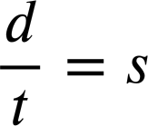
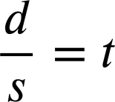
Dib-habaynta tillaabooyinka isku-darka iyo isku-dhufashada
Xiriirrada isku-dhufashada waxaa dib loo habayn karaa qoys xaqiiqooyin ah.
Haddii 4 × 5 = 20 markaas…
20 ÷ 5 = 4
5 × 4 = 20
20 ÷ 4 = 5
Waxaan si la mid ah u dib u habayn karnaa qaaciidada isku-dhufashada.
xawaaraha (speed) × waqtiga (time) = masaafada (distance)
s × t = d
d ÷ t = s
t × s = d
d ÷ s = t

Slide 7
Dib-habaynta tillaabooyinka isku-darka iyo isku-dhufashada
Doorsoomaha (variable) aan doonayno inaan xisaabino ayaa go'aamiya dib-habaynta aan isticmaalno.
s × t = d
t × s = d
Gaari wuxuu ku socdaa 50 mph saddex saacadood. Immisa ayuu ku safray?
Waxaan doonaynaa inaan ogaanno masaafada (distance) marka waxaan u baahanahay dib-habayn ay masaafadu tahay mawduuca.

Slide 8
Dib-habaynta tillaabooyinka isku-darka iyo isku-dhufashada
Doorsoomaha (variable) aan doonayno inaan xisaabino ayaa go'aamiya dib-habaynta aan isticmaalno.
s × t = d
t × s = d
Gaari wuxuu ku socdaa 50 mph saddex saacadood. Immisa ayuu ku safray?
s × t = d
50 × 3 = d
d = 150 miles

Slide 9
Dib-u-habaynta tillaabooyinka isku-dhafka iyo isku-dhufashada
Doorsoomaha (variable) aan dooneyno inaan xisaabino ayaa go'aamiya dib-u-habaynta (rearrangement) aan isticmaaleyno.
s × t = d
t × s = d
Diyaarad waa inay duusho 6000 miles waxayna ku socotaa 400 mph. Intee ayay soconaysaa safarku?
Waxaan dooneynaa inaan ogaanno waqtiga (time) marka waxaan u baahanahay dib-u-habayn (rearrangement) ay waqtigu (time) yahay mawduuca (subject).

Slide 10
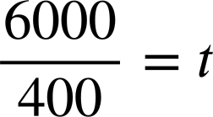
Dib-u-habaynta tillaabooyinka isku-dhafka iyo isku-dhufashada
Doorsoomaha (variable) aan dooneyno inaan xisaabino ayaa go'aamiya dib-u-habaynta (rearrangement) aan isticmaaleyno.
s × t = d
t × s = d
Diyaarad waa inay duusho 6000 miles waxayna ku socotaa 400 mph. Intee ayay soconaysaa safarku?
t = 15 hours

Slide 11
Dib-u-habaynta tillaabooyinka isku-dhafka iyo isku-dhufashada
Fiisikiska (Physics) waxaa laga yaabaa inaad la kulanto qaaciddo (formula) loogu talagalay xisaabinta karaar (acceleration) ee walax (particle).
karaar (acceleration) = xawaaraha ugu dambeeya (final velocity) − xawaaraha bilowga (initial velocity)
waqtiga (time)

Slide 12
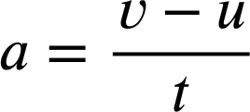
Dib-u-habaynta tillaabooyinka isku-dhafka iyo isku-dhufashada
Fiisikiska (Physics) waxaa laga yaabaa inaad la kulanto qaaciddo (formula) loogu talagalay xisaabinta karaar (acceleration) ee walax (particle).
karaar (acceleration) (a) = xawaaraha ugu dambeeya (final velocity) (v) − xawaaraha bilowga (initial velocity) (u)
waqtiga (time) (t)
Qaabkan (format), oo karaar (acceleration) (a) yahay mawduuca (subject), wuxuu ku fiican yahay xisaabinta karaar (acceleration) haddii aad taqaanid xawaaraha ugu dambeeya (final velocity) (v), xawaaraha bilowga (initial velocity) (u), iyo waqtiga (time) (t).

Slide 13
Dib-u-habaynta tillaabooyinka isku-dhafka iyo isku-dhufashada
Fiisikiska (Physics) waxaa laga yaabaa inaad la kulanto qaaciddo (formula) loogu talagalay xisaabinta karaar (acceleration) ee walax (particle).
karaar (acceleration) (a) = xawaaraha ugu dambeeya (final velocity) (v) − xawaaraha bilowga (initial velocity) (u)
waqtiga (time) (t)
Laakin sidee haddii aan ognahay a, u, iyo t oo aan rabno in aan ogaanno v, xawaaraha ugu dambeeya?

Slide 14


Dib-u-habaynta tillaabooyinka isku darka iyo isku dhufashada
Waxaan ka dhigi karnaa v mawduuca si loogu muujiyo marka loo eego doorsoomayaasha kale.
v hadda waa mawduuca. Waxaan ku beddeli karnaa doorsoomayaasha kale si dhakhso ah u helno qiimihiisa.

Slide 15





Dib-u-habaynta tillaabooyinka isku darka iyo isku dhufashada
Kee ka mid ah dib-u-habayntan ayaa noqon kara mid faa'iido leh haddii aan ognahay a, v, iyo t oo aan rabno in aan ogaanno u, xawaaraha bilowga ah?
Haddii aan rabno in aan ogaanno u, waxaan rabnaa in u noqdo mawduuca.
Ma aha dib-u-habayn sax ah.

Slide 16
Dib-u-habaynta tillaabooyinka isku darka iyo isku dhufashada
Ma aha oo kaliya xisaabta iyo fiisigiska inaan ku aragno qaaciidooyinka.
Break-Even waa qaaciido muhiim ah oo ganacsi, gaar ahaan ganacsatada cusub.
kharashyada go'an
Tirada Break-Even =
qiimaha iibka − kharashka doorsooma ee hal unug
Heerka Break-Even waa tirada unugyada uu ganacsigu u baahan yahay inuu iibiyo si uu u bilaabo inuu faa'iido sameeyo.

Slide 17
Dib-u-habaynta tillaabooyinka isku darka iyo isku dhufashada
Tusaale, waxaad furtaa dukaan qaxwo ah oo kharashka bilowga ah £16 000. Markaad shaqeysid, waxaad iibisaa kulli kafee £3 waxayna kugu kacaan £1 inaad soo saarto. Goormaad gaari doontaa Break-Even?
kharashyada go'an
Tirada Break-Even =
qiimaha iibka − kharashka doorsooma ee hal unug
£16 000
£16 000
Tirada Break-Even =
=
= 8 000 unug
£3 − £1
£2
Ma iibin kartaa 8 000 oo koofiyadood? Intee ayay qaadanaysaa?

Slide 18
Dib-u-habaynta tillaabooyinka isku-darka iyo isku-dhufashada (Rearranging additive and multiplicative steps)
Laakiin, sidee haddii aad taqaanay tirooyinka unugyada aad iibin karto?
kharashyada go'an (fixed costs)
Tirada Dakhli-la’aanta (Break-Even Quantity) =
qiimaha iibinta (selling price) − kharashka doorsooma ee hal unug (variable cost per unit)
qiimaha iibinta (selling price) − kharashka doorsooma ee hal unug (variable cost per unit)
Haddii aad taqaanay tiradaas, iyo kharashyadaaga go'an (fixed costs), iyo kharashkaaga doorsooma ee hal unug (variable cost per unit), waxaad xisaabin kartaa qiimaha iibinta (selling price) ee aad u baahan tahay inaad ku dallacdo si aad faa'iido u hesho.
Haddii aad taqaanay tiradaas, iyo kharashyadaaga go'an (fixed costs), iyo kharashkaaga doorsooma ee hal unug (variable cost per unit), waxaad xisaabin kartaa qiimaha iibinta (selling price) ee aad u baahan tahay inaad ku dallacdo si aad faa'iido u hesho.

Slide 19
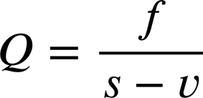
Dib-u-habaynta tillaabooyinka isku-darka iyo isku-dhufashada (Rearranging additive and multiplicative steps)
Si taas loo sameeyo waxaan u baahanahay inaan ka dhigno 'qiimaha iibinta (selling price)' mawduuca (subject) qaacidada.
kharashyada go'an (fixed costs)
Tirada Dakhli-la’aanta (Break-Even Quantity) =
qiimaha iibinta (selling price) − kharashka doorsooma ee hal unug (variable cost per unit)

Slide 20

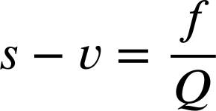
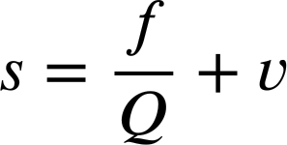
Dib-u-habaynta tillaabooyinka isku-darka iyo isku-dhufashada (Rearranging additive and multiplicative steps)
Si taas loo sameeyo waxaan u baahanahay inaan ka dhigno 'qiimaha iibinta (selling price)' mawduuca (subject) qaacidada.
Qiimaha iibinta (selling price) (s) hadda waa mawduuca (subject).

Slide 21
Dib-u-habaynta tillaabooyinka isku-darka iyo isku-dhufashada (Rearranging additive and multiplicative steps)
Hadda waxaan xisaabin karnaa qiimaha aan u baahanahay inaan ku iibinno hal unug si aan u bilowno faa'iidada.
kharashyada go'an (fixed costs)
qiimaha iibinta (selling price) =
− kharashka doorsooma ee hal unug (variable cost per unit)
Tirada Break-Even (Break-Even Quantity)
Qiimaha iibinta (selling price) (s) hadda waa mawduuca (subject).

Slide 22
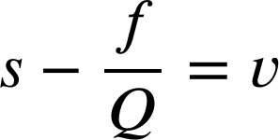
Dib-u-habaynta tillaabooyinka isku darka iyo isku dhufashada
Kontoroolka kharashka waa curiye (element) aad muhiim u ah ganacsiga.
Dib-u-habi qaacidada break-even si aad uga dhigto 'Kharashka kala duwan ee halbeegga (v)' mawduuca.

Slide 23
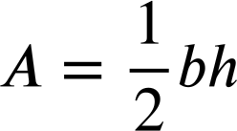
Dib-u-habaynta tillaabooyinka isku darka iyo isku dhufashada
1) a) Dib-u-habi qaacidada wareegga goobada si ay u noqoto mid waxtar badan oo lagu helo radius (radius) haddii aad taqaan wareegga.
C
r
C = 2πr
b) Dib-u-habi qaacidada bedka saddexagalka si ay u noqoto mid waxtar badan oo lagu helo joogga (height) haddii aad taqaan bedka iyo saldhigga.
Joogga (Height)
Saldhigga (Base)

Slide 24
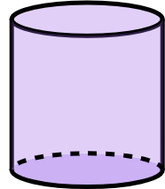
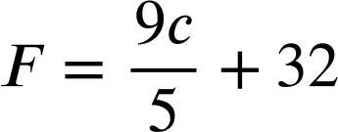
Dib-u-habaynta tillaabooyinka isku darka iyo isku dhufashada
1) c) Dib-u-habi qaacidada bedka dusha sare ee dhululubada si ay u noqoto mid waxtar badan oo lagu helo joogga (height) haddii aad taqaan bedka dusha sare iyo radius (radius).
r
h
A = 2πr2 + 2πrh
2) Kani waa qaacidada loogu beddelo Celsius Fahrenheit.
Muuji laba siyaabood oo aad dib-u-habayn karto qaacidada si ay u beddesho Fahrenheit Celsius.

Slide 25
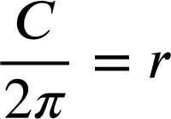
Dib-u-habaynta tillaabooyinka isku darka iyo isku dhufashada
1) a) Dib-u-habi qaacidada wareegga goobada si ay u noqoto mid waxtar badan oo lagu helo radius (radius) haddii aad taqaan wareegga.
1) a) Dib-u-habi qaacidada wareegga goobada si ay u noqoto mid waxtar badan oo lagu helo radius (radius) haddii aad taqaan wareegga.
C
r
C = 2πr
r, waxa aan rabno inaan helno, ayaa hadda ah mawduuca.

Slide 26

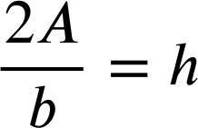
Dib-u-habaynta tillaabooyinka isku darka iyo isku dhufashada
1) b) Dib-u-habi qaacidada bedka saddexagalka si ay u noqoto mid waxtar badan oo lagu helo joogga (height) haddii aad taqaan bedka iyo saldhigga.
1) b) Dib u habayn (rearrange) qaacidada (formula) bedka (area) saddex-xagalka (triangle) si ay ugu hufnaato helista joogga (height) haddii aad taqaanid bedka (area) iyo sal (base).
Joogga (Height)
Sal (Base)
h, waxa aan la garanayn (unknown) ee aan rabno inaan helno, ayaa hadda ah mawduuca (subject).

Slide 27
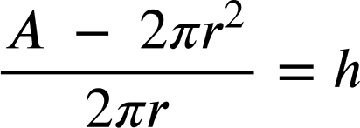
Dib u habaynta (rearranging) tillaabooyinka isku-darka (additive) iyo isku-dhufashada (multiplicative)
1) c) Dib u habayn (rearrange) qaacidada (formula) bedka dusha (surface area) dhululubada (cylinder) si ay ugu hufnaato helista joogga (height) haddii aad taqaanid bedka dusha (surface area) iyo gacan-dheerka (radius).
r
1) c) Dib u habayn (rearrange) qaacidada (formula) bedka dusha (surface area) dhululubada (cylinder) si ay ugu hufnaato helista joogga (height) haddii aad taqaanid bedka dusha (surface area) iyo gacan-dheerka (radius).
h
A = 2πr2 + 2πrh
A − 2πr2 = 2πrh
h, waxa aan la garanayn (unknown) ee aan rabno inaan helno, ayaa hadda ah mawduuca (subject).

Slide 28
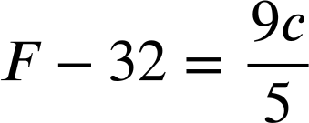



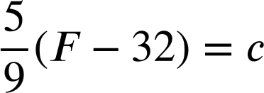
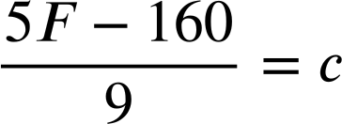
Dib u habaynta (rearranging) tillaabooyinka isku-darka (additive) iyo isku-dhufashada (multiplicative)
2) Kani waa qaacidada (formula) loogu beddelo (convert) Celsius Fahrenheit.
Tus laba qaab oo dib u habayn (rearrange) qaacidada (formula) si ay ugu beddesho (convert) Fahrenheit Celsius.
Tallaabada koowaad (Step one):
×5 dhammaan qaybaha (all terms)
Tallaabada koowaad (Step one):
−32 labada dhinac (both sides)

Slide 29
Beddelka mawduuca (subject) si uu ugu habboonaado macnaha (context)
Dib u habaynta (rearranging) tillaabooyinka isku-darka (additive) iyo isku-dhufashada (multiplicative)
Dib u habaynta (rearranging) isleegyada (equations) si loo helo jiirada (gradient)

Slide 30
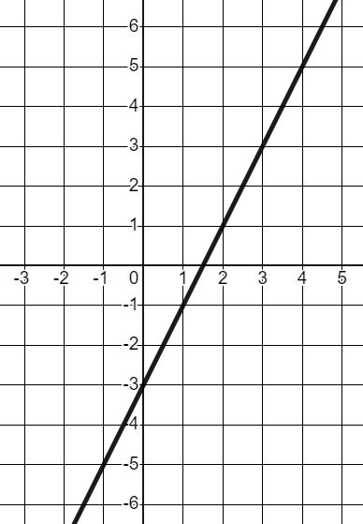
Dib u habaynta (rearranging) isleegyada (equations) si loo helo jiirada (gradient)
Haddii aan haysanno isleeg (linear equation) qaabka y = mx + c, waxaa jira astaamo muhiim ah (key features) oo aan si dhakhso ah u arki karno.
y
Isleegga toosan (linear equation) y = 2x − 3
Jiiro (gradient) ah 2
Goys-y (y-intercept) ah (0,−3)
x

Slide 31
Dib-u-habaynta isla'egyada si loo helo jiirada (gradient)
Haddii aan haysanno isla'eg toosan oo qaabka y = mx + c ah, waxaa jira astaamo muhiim ah oo aan si dhakhso ah u arki karno.
y
Qaabka y = mx + c
Jiirada (gradient) (m)
Goys-y (y-intercept) (c)
x
y waa mawduuca (subject).

Slide 32
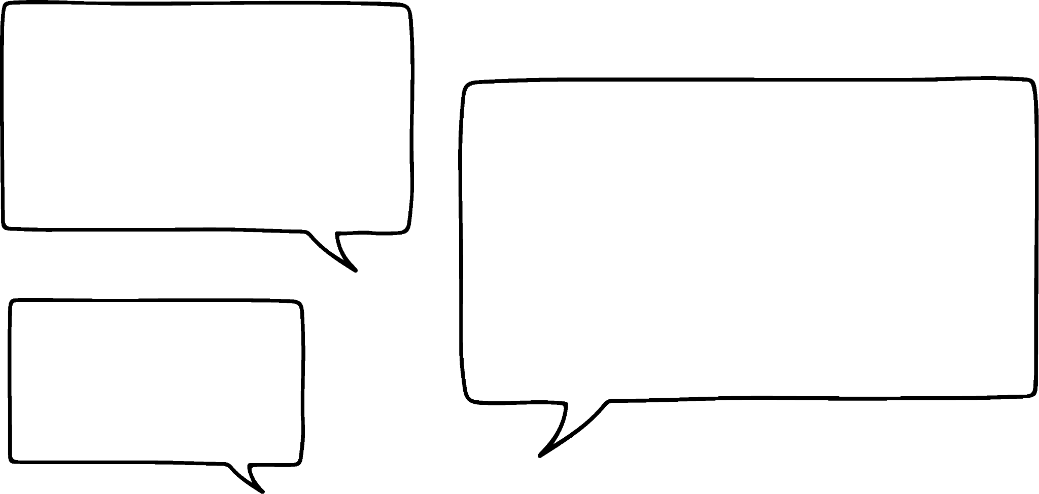



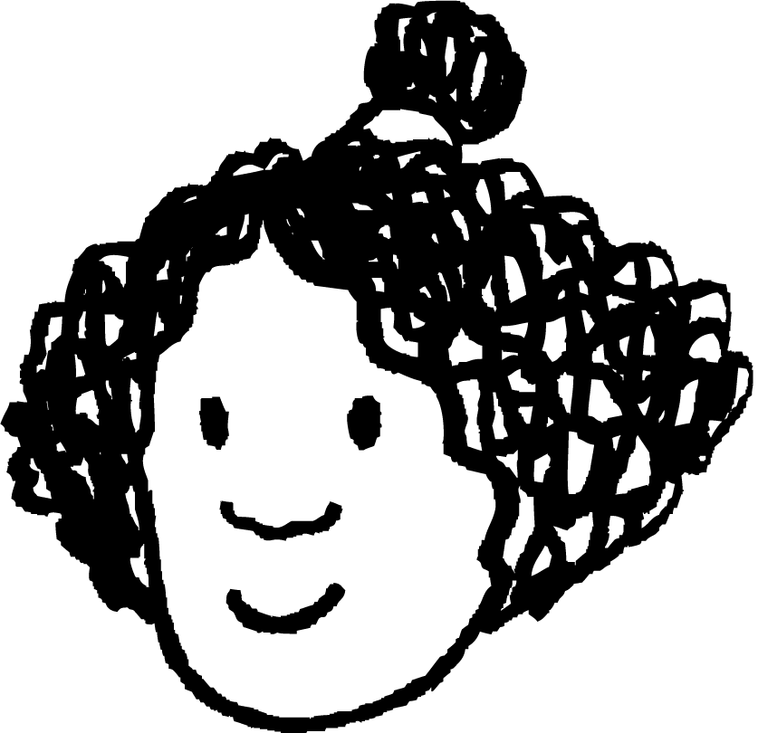

Dib-u-habaynta isla'egyada si loo helo jiirada (gradient)
Mararka qaarkood waxaan arkaynaa isla'egyo toosan oo qaabka ax + by = c ah
Qaabkan, jiirada (gradient) ma aha mid sahlan in la arko.
Caasha, Isra iyo Axmed waxay ka hadlayaan isla'egta 4x + 5y = 40
Waxaan u malaynayaa in jiirada (gradient) ay tahay 4 sababtoo ah waa isku-dhufashada (coefficient) x
Waxaan u malaynayaa inay noqon doonto 40 ÷ 5, ama 40 ÷ 4
Waxaan u malaynayaa in jiirada (gradient) laga yaabo inay tahay 5, isku-dhufashada (coefficient) y markan.
Maxaad u malaynaysaa?

Slide 33
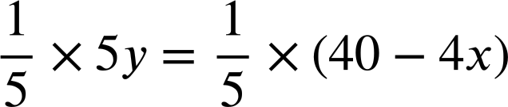
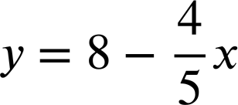

Dib-u-habaynta isla'egyada si loo helo jiirada (gradient)
Isla'egta 4x + 5y = 40
4x + 5y = 40
5y = 40 − 4x
Haddii aan y ka dhigno mawduuca (subject), waxaan ogaan doonnaa waa maxay jiirada (gradient).
Iyadoo y hadda yahay mawduuca (subject), waxaan arki karnaa in jiirada (gradient) ay tahay

Slide 34
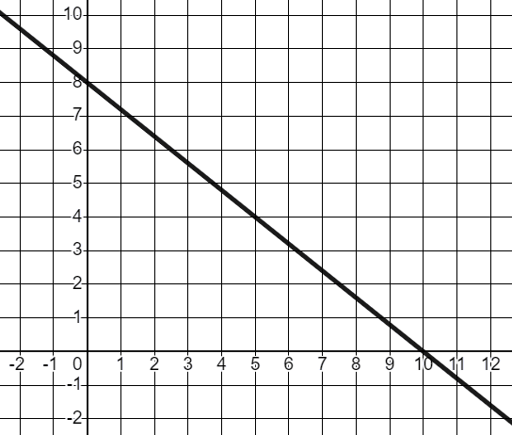
Dib-u-habaynta isla'egyada si loo helo jiirada (gradient)
Isla'egta 4x + 5y = 40
4x + 5y = 40
y
5y = 40 − 4x
5
−4
Jiirada (The gradient)
x
Jiirada-y (y-intercept) (0, 8)

Slide 35
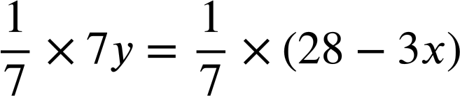
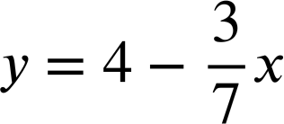

Dib u habaynta isla'egyada si loo helo jiirada (gradient)
Soo saar jiirada (gradient) iyo jiirada-y (y-intercept) ee isla'egta hoose adigoo dib u habeynaya si y u noqdo mawduuca.
3x + 7y = 28
7y = 28 − 3x
Jiirada (Gradient) , jiirada-y (y-intercept) (0, 4)

Slide 36
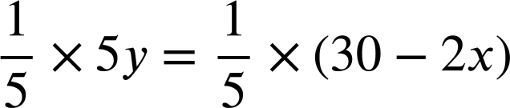
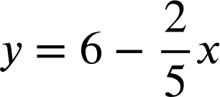

Dib u habaynta isla'egyada si loo helo jiirada (gradient)
Soo saar jiirada (gradient) iyo jiirada-y (y-intercept) ee isla'egta hoose adigoo dib u habeynaya si y u noqdo mawduuca.
Soo saar jiirada (gradient) iyo jiirada-y (y-intercept) ee isla'egta hoose adigoo dib u habeynaya si y u noqdo mawduuca.
3x + 7y = 28
2x + 5y = 30
7y = 28 − 3x
5y = 30 − 2x
Jiirada (Gradient) , jiirada-y (y-intercept) (0, 4)
Jiirada (Gradient) , jiirada-y (y-intercept) (0, 6)

Slide 37
Dib u habaynta isla'egyada si loo helo jiirada (gradient)
1) Soo saar jiirada (gradient) iyo jiirada-y (y-intercept) ee khadadka ay bixiyaan isla'egyadan adigoo dib u habeynaya si y u noqdo mawduuca.
a) x + 4y = 12
b) 2x + 6y = −18
c) 8x − 2y = 15

Slide 38
Dib u habaynta isla'egyada si loo helo jiirada (gradient)
2) Dib u habeey qaabkan guud ee isla'egta toosan (linear equation) si y u noqdo mawduuca oo hel tibaax (expression) jiirada (gradient) iyo jiirada-y (y-intercept) marka qaabkan ku jirto.
ax + by = c

Slide 39
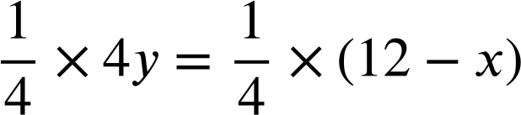
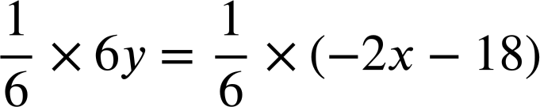
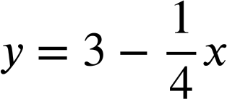
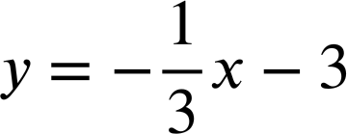


Dib u habaynta isla'egyada si loo helo jiirada (gradient)
1) Soo saar jiirada (gradient) iyo jiirada-y (y-intercept) ee khadadka ay bixiyaan isla'egyadan adigoo dib u habeynaya si y u noqdo mawduuca.
a) x + 4y = 12
b) 2x + 6y = −18
4y = 12 − x
6y = −2x − 18
Jiirada (Gradient) , jiirada-y (y-intercept) (0, 3)
Jiirada (Gradient) , jiirada-y (y-intercept) (0,−3)

Slide 40
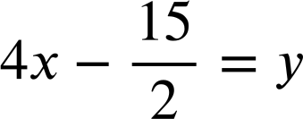
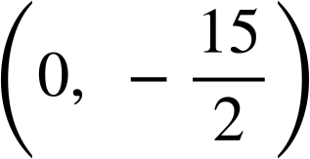
Dib u habaynta isla'egyada si loo helo jiirada (gradient)
1) Soo saar jiirada (gradient) iyo jiirada-y (y-intercept) ee khadadka ay bixiyaan isla'egyadan adigoo dib u habeynaya si y u noqdo mawduuca.
c) 8x − 2y = 15
8x = 15 + 2y
8x − 15 = 2y
Jiirada (Gradient) 4, jiirada-y (y-intercept)

Slide 41

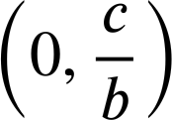
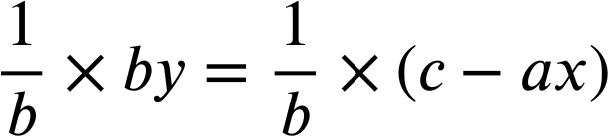
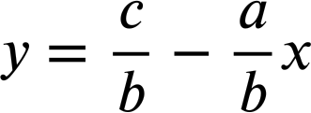
Dib u habaynta isla'egyada si loo helo jiirada (gradient)
2) Dib u habayn qaabkan guud ee isla'egta toosan si y (subject) uga dhahdid oo hel tibaax (expression) jiirada (gradient) iyo y-intercept marka qaabkan ku jirto.
ax + by = c
Qaabka ax + by = c jiirada (gradient) waa
iyo y-intercept waa
by = c − ax

Slide 42
Bedelka mawduuca (subject) si uu ugu habboonaado macnaha (context)
Dib u habaynta waxay faa'iido u yeelan kartaa iyadoo ku xiran waxa aan raadineyno ee qaacidada (formula) ku jira.
Tani way isbedeli doontaa iyadoo ku xiran macnaha (context).
Bedelka mawduuca (subject) wuxuu u baahan yahay xirfado la mid ah xallinta isla'egta.

