Slide 1
Beddelka mawduuca iyadoo la adeegsanayo qaacidada (formula) adag
Tibaaxaha iyo qaacidada (formula)

Slide 2
Sida agabkeena waxbarista loogu talagalay fasalka

Slide 3
Waxaan fahmi karaa fahanka hawlgallada (operations) rogaal-celinta ah ee qaacidada (formula) adag si aan uga dhigo doorsoome (variable) gaar ah mawduuca.

Slide 4


Mawduuca isla'egta (equation)/qaacidada (formula) waa doorsoome (variable) lagu muujiyay doorsoomayaal kale. Waa inuu leeyahay jibbaar (exponent) 1 iyo isugeyn (coefficient) 1.
Tusaale ahaan, a waa mawduuca qaacidada (formula) tan
laakiin, a2 ma aha mawduuca qaacidada (formula) tan

Slide 5

Beddelka mawduuca iyadoo la adeegsanayo qaacidada (formula) adag
Beddelka mawduuca laba tillaabo
Dib-u-habaynta qaacidada (formula) adag

Slide 6
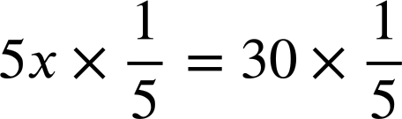
Beddelka mawduuca laba tillaabo
Dib-u-habaynta waa xirfad muhiim ah xisaabta. Waxay naga caawisaa xaalado badan.
Tusaale ahaan, sida aan u xallino isla'egtan (equation).
5x + 12 = 42
Waxaan isku dayaynaa inaan go'doomino x
5x + 12 − 12 = 42 − 12
Hawlgalka (operation) isku mid ah labada dhinac si loo ilaaliyo sinnaanta (equality)
5x = 42 − 12
Dib-u-habayn ka mid ah 5x + 12 = 42
5x = 30
RHS la fududeeyay laakiin x weli lama go'doomin
Ku dhufo labada dhinac isku-dhafka (reciprocal) ee 5
x = 6
x hadda waa go'doon

Slide 7

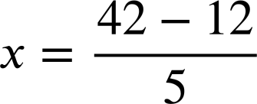
Beddelka mawduuca laba tillaabo
Dib-u-habaynta waa xirfad muhiim ah xisaabta. Waxay naga caawisaa xaalado badan.
Tusaale ahaan, sida aan u xallino isla'egtan (equation).
5x + 12 = 42
Waxaan qabanay laba hawlgal rogan (inverse operations) oo ah −12 iyo si aan u go'doominno x
5x = 42 − 12
Dib-u-habayn (rearrangement) ah 5x + 12 = 42
Dib-u-habayn (rearrangement) ah 5x = 42 − 12 taas oo…
Dib-u-habayn (rearrangement) ah 5x = 42 − 12 taas oo… x hadda waa mawduuca (subject).
Marka dib-u-habayn (rearrangement) la sameynayo, mawduuca (subject) inta badan waxaa loo fahmi karaa inuu yahay tirada aan la garanayn ee aad raadinayso qiimeheeda (value).

Slide 8
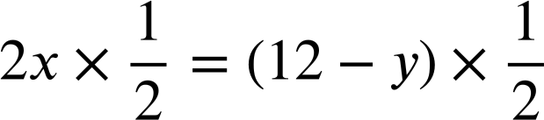
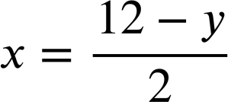
Beddelidda mawduuca (subject) laba tillaabo
Marka dib-u-habayn (rearrangement) la sameynayo, had iyo jeer ma raadinayno qiime (value) la siiyay, sida milan (solution) isla'egta (equation).
Tusaale ahaan, shaqada toosan (linear function) 2x + y = 12
Qaabkani wuxuu noo sahlayaa inaan si hufan u sawirno khadka (graph the line).
(0, 12)
(6, 0)
Xiriir kasta oo isku-dar (additive) ah sidaan waxaan si dhakhso leh u arki karnaa afar habayn (arrangements).
2x + y = 12
y = 12 − 2x
Iyadoo y yahay mawduuca (subject), waxaan si degdeg ah u ogaanaynaa jiirada (gradient), −2
y + 2x = 12
2x = 12 − y
Iyadoo x yahay mawduuca (subject), waxaan si hufan u heli karnaa isku-duwayaasha x (x coordinate) haddii aan ognahay y

Slide 9
Beddelidda mawduuca (subject) laba tillaabo
Shaqada toosan (linear function) 3x + y = 15, ka dhig y mawduuca (subject).
Ikhtiyaarka koowaad:
Hawlgalada rogan (inverse operations).
Ikhtiyaarka labaad:
Afarta habayn (arrangements) ee xiriirkan isku-dar (additive) ah.
3x + y = 15
3x + y = 15
3x = 15 − y
3x + y − 3x = 15 − 3x
y + 3x = 15
y = 15 − 3x
y = 15 − 3x

Slide 10
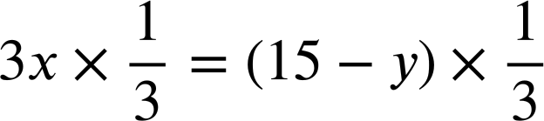
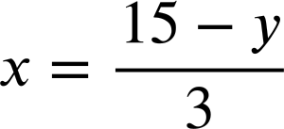
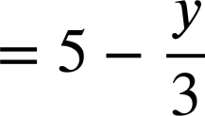
Beddelidda mawduuca (subject) laba tillaabo
Shaqada toosan (linear function) 3x + y = 15, isticmaal hawlgalada rogan (inverse operations) si aad uga dhigto x mawduuca (subject).
3x + y = 15
3x + y − y = 15 − y
Rogaha (inverse) + y
3x = 15 − y
Rogaha (inverse) ×3

Slide 11
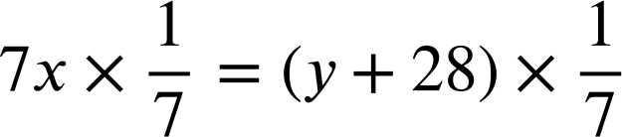
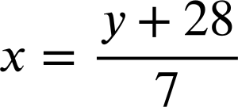
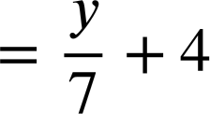
Beddelka mawduuca (subject) oo leh laba tillaabo
Hawsha tooska ah (linear function) 3x + y = 15, isticmaal hawlgallo rogaal (inverse operations) si x uga dhigto mawduuca (subject).
Hawsha tooska ah (linear function) 7x − y = 28, isticmaal hawlgallo rogaal (inverse operations) si x uga dhigto mawduuca (subject).
3x + y = 15
7x − y = 28
3x + y − y = 15 − y
7x − y + y = 28 + y
3x = 15 − y
7x = 28 + y

Slide 12
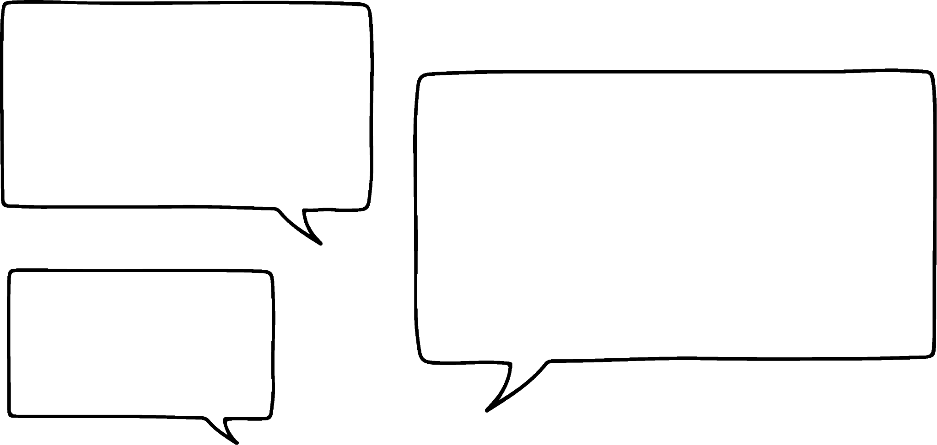



Beddelka mawduuca (subject) oo leh laba tillaabo
Axmed iyo Caasha waxay qorayaan qaaciido (formula).
Qaaciidda (formula) koowaad: d lagu daro 5 ka dib loo qaybiyo 2 wuxuu ka dhigayaa e
Qaaciidda (formula) labaad: d loo qaybiyo 2 ka dib lagu daro 5 wuxuu ka dhigayaa e
Waxaan u malaynayaa inaan heli doonno laba qaaciido (formula) oo aad u kala duwan!
Labadooduba waxay yiraahdaan, "lagu daro 5" iyo "loo qaybiyo 2" marka waxaan u malaynayaa inaan heli doonno isku qaaciido (formula).
Yaa aad la raacsan tahay?

Slide 13
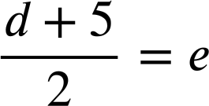
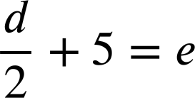
Beddelka mawduuca (subject) oo leh laba tillaabo
Axmed iyo Caasha waxay qorayaan qaaciido (formula).
Qaaciidda (formula) koowaad: d lagu daro 5 ka dib loo qaybiyo 2 wuxuu ka dhigayaa e
Qaaciidda (formula) labaad: d loo qaybiyo 2 ka dib lagu daro 5 wuxuu ka dhigayaa e
Waxaan u malaynayaa inaan heli doonno laba qaaciido (formula) oo aad u kala duwan!
Labadooduba waxay yiraahdaan, "lagu daro 5" iyo "loo qaybiyo 2" marka waxaan u malaynayaa inaan heli doonno isku qaaciido (formula).
Mahadsanid Caasha! Hadda waxaan arki karaa in nidaamku (order) muhiim yahay.

Slide 14
Beddelka mawduuca (subject) oo leh laba tillaabo
Nidaamku (order) wuxuu muhiim noqon doonaa marka aan dib u habeynayno qaaciidadan (formula).
Qaaciidda (formula) koowaad: d lagu daro 5 ka dib loo qaybiyo 2 wuxuu ka dhigayaa e
Qaaciidda (formula) labaad: d loo qaybiyo 2 ka dib lagu daro 5 wuxuu ka dhigayaa e
Haddii aan doonayno in d uga dhigno mawduuca (subject), hawlgallada rogaal (inverse operations) ee labaduba waa −5 iyo ×2 laakiin nidaamka (order) aan ku dabaqno waa muhiim.

Slide 15
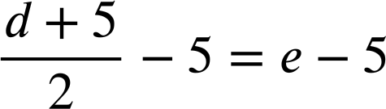
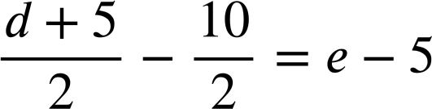
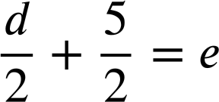
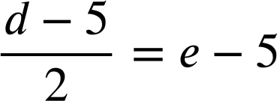
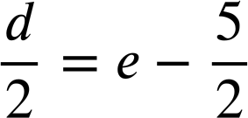
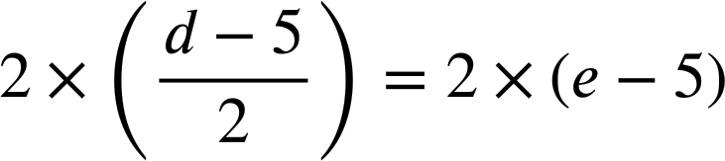
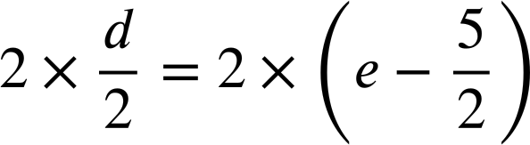


Beddelka mawduuca (subject) laba tillaabo (steps) ah
Qaaciddada (Formula) koowaad:
Tani waxay ahayd mid aan waxtar lahayn, sababtoo ah kani dhab ahaan ma aha 5
−5 marka hore

Slide 16
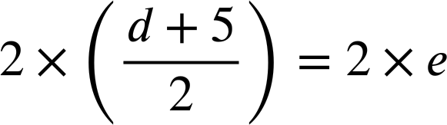

Beddelka mawduuca (subject) laba tillaabo (steps) ah
Qaaciddada (Formula) koowaad:
×2 marka hore
Habkani aad buu waxtar u badan yahay!
Marka dib loo habeeynayo isleegyada (equations) iyo qaaciddooyinka (formula) ay ku jiraan jajab (fractions), waxaa caqli gal ah in laga fikiro sida loo soconayo.

Slide 17
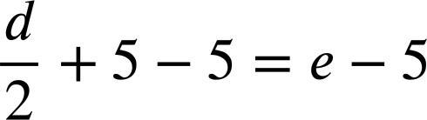
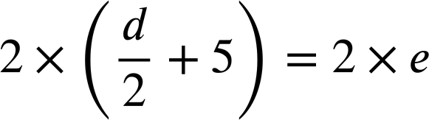
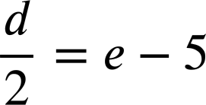

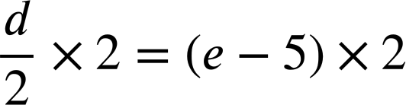



Beddelka mawduuca (subject) laba tillaabo (steps) ah
Qaaciddada (Formula) labaad:
−5 marka hore
×2 marka hore
Hubi inaad ku dhufato (multiply) dhammaan ereyada (terms) 2
Ma jiro farqi weyn oo waxtar (efficiency) ah oo u dhexeeya labada hab.

Slide 18
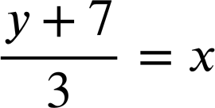

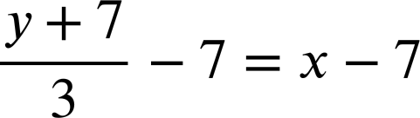

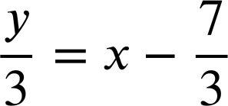


Beddelka mawduuca (subject) laba tillaabo (steps) ah
Waa maxay tillaabada (step) ugu waxtarka badan ee marka hore la qaado marka dib loo habeeynayo qaaciddadan (formula)?
−7 labada dhinac (both sides)
Aad u waxtar darro!
labada dhinac (both sides)
Waxay shaqeyn doontaa, laakiin ma aha tan ugu waxtarka badan.
×3 labada dhinac (both sides)
Aad bay u hufan tahay!

Slide 19
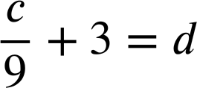
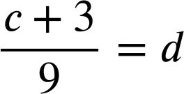
Beddelka mawduuca laba tillaabo
1) Dib u habee qaacidada kasta si c uu noqdo mawduuca.
a)
6c + 7 = 19
b)
3c + 8 = d
c)
3d − c = 19
d)
d − 3c = 19
e)
f)

Slide 20
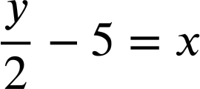
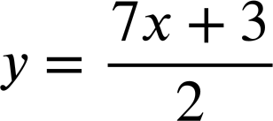


Beddelka mawduuca laba tillaabo
2) Laura waxay dib u habaynaysay isla'egyadan si y uu noqdo mawduuca.
a)
2y + 3x = 18
b)
c)
2y + 3 = 7x
2y = 18 − 3x
2y = 7x + 3
y − 5 = 2x
Waxaan hubiyay jawaabahayga oo dhammaantood waa qalad. Ma i caawin kartaa inaan arko halka aan ku qaldamay?
y = 2x + 5
In each case circle Laura’s errors and write a sentence to explain what she should do differently.

Slide 21
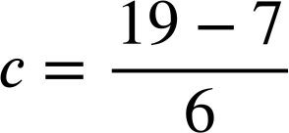
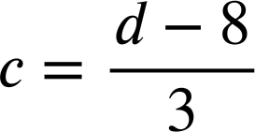
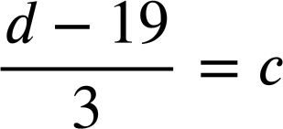
Beddelka mawduuca laba tillaabo
1) Dib u habee qaacidada kasta si c uu noqdo mawduuca.
a)
6c + 7 = 19
b)
3c + 8 = d
6c = 19 − 7
3c = d − 8
c)
3d − c = 19
d)
d − 3c = 19
d = 19 + 3c
3d = 19 + c
d − 19 = 3c
3d − 19 = c

Slide 22
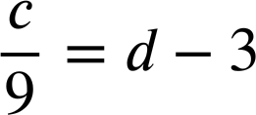




Beddelka mawduuca laba tillaabo
1) Dib u habee qaacidada kasta si c uu noqdo mawduuca.
e)
f)

Slide 23
Beddelka mawduuca laba tillaabo
2) Laura waxay dib u habaynaysay isla'egyadan si y uu noqdo mawduuca.
a)
2y + 3x = 18
b)
c)
2y + 3 = 7x
2y = 18 − 3x
2y = 7x + 3
y − 5 = 2x
Si y uu noqdo mawduuca, koeffisiyentku waa inuu ahaadaa 1. U qaybi labada dhinac 2
y = 2x + 5
Markaad labada dhinac ku dhufato 2, hubi inaad ku dhufato dhammaan ereyada. Sadarkaani waa inuu akhriyaa y − 10 = 2x
Waxaad ula jeeday inaad ku darto −3 labada dhinac

Slide 24
Beddelka mawduuca qaacidada adag
Beddelka mawduuca laba tillaabo
Rearranging more complex formulae

Slide 25
Rearranging more complex formula
Qaar ka mid ah qaacidadaha aan u baahan nahay inaan dib u habeyno waxay ku lug yeelan doonaan jibbaarada (exponents).
Tusaale ahaan, ka dhig x mawduuca.
y = x² + 5
Kiiskan si ka duwan uma dhaqanno. Weli waxaan isticmaalnaa hawlgallo rogaal-celin (inverse operations).

Slide 26


Dib u habeynta qaaciidooyinka (formula) adag
Qaar ka mid ah qaaciidooyinka (formula) aan dib u habeynayno waxay ku lug yeelan doonaan jibbaarayaal (exponents).
Tusaale ahaan, x ka dhig mawduuca (subject).
y = x² + 5
y − 5 = x²
+(−5) labada dhinac.
Marka xigta waxaan u baahanahay rogaal-celinta (inverse) labajibbaaran (squaring).
x hadda waa mawduuca (subject).

Slide 27


Dib u habeynta qaaciidooyinka (formula) adag
Layla waxay dib u habeynaysaa isla'egtan (equation) si x uga dhigto mawduuca (subject).
y = x² − 9
y + 9 = x²
16 + 9 = 25
Tani ma isla'eg (equation) baa?
Rogaal-celinta (inverse) labajibbaaran (squaring) waa xidid labajibbaaran (square root), marka ma samayn karaa tan?
Ma aqaan laakiin waxaan ku tijaabin karnaa tusaale tiro (numerical example).

Slide 28

Dib u habeynta qaaciidooyinka (formula) adag
Layla waxay dib u habeynaysaa isla'egtan (equation) si x uga dhigto mawduuca (subject).
y = x² − 9
y + 9 = x²
16 + 9 = 25
Marka, xididka (root) eray kasta (term) qaadi karo. Waa inaan isku ururiyaa (group).
4 + 3 ≠ 5
Marka, y + 9 = x2 wuxuu noqdaa

Slide 29
Dib u habeynta qaaciidooyinka (formula) adag
Layla waxay dib u habeynaysaa isla'egtan (equation) si x uga dhigto mawduuca (subject).
y = x² − 9
y + 9 = x²
Waa fiican tahay. Mahadsanid Caasha!
Marka, y + 9 = x2 wuxuu noqdaa

Slide 30


Dib u habeynta qaaciidooyinka (formula) adag
x ka dhig mawduuca (subject).
y = x² + 7
y − 7 = x²
Samee x uu yahay mawduuca (subject).
y = x³ − 7
y + 7 = x³
Xidid saddex (Cube root), rogaal celinta saddex jibaarista (cubing).

Slide 31


Dib-u-habaynta qaacidada (formula) adag
Samee x uu yahay mawduuca (subject).
Samee x uu yahay mawduuca (subject).
y = x² + 7
y = x² + z
y − 7 = x²
y − z = x²
Samee x uu yahay mawduuca (subject).
Samee x uu yahay mawduuca (subject).
y = x³ − 7
y = x⁴ − 1
y + 7 = x³
y + 1 = x⁴

Slide 32
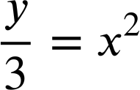

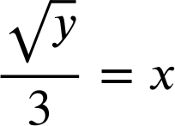
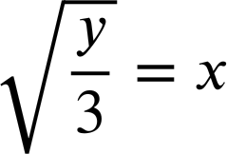
Dib-u-habaynta qaacidada (formula) adag
Marka ereyga leh jibbaar (exponent) aan ahayn 1 uu leeyahay isku-dhufasho (coefficient) aan ahayn 1, markaas nidaamku runtii waa muhiim.
Tusaale ahaan, samee x uu yahay mawduuca (subject).
y = 3x²
y = 3x²
Ma kani…
ama…
Kee ayaa sax ah?

Slide 33
Dib-u-habaynta qaacidada (formula) adag
Fahamka tibaaxda (expression) 3x2 waa faa'iido leh inuu naga caawiyo fahamka sababta dib-u-habayntan (rearrangement) ay sax u tahay.
3x²
Ma kani x laba jibaaran (squared) ka dib lagu dhuftey 3?
y = 3x²
Ama, x lagu dhuftey 3 ka dib laba jibaaran (squared)?

Slide 34
Dib-u-habaynta qaacidada (formula) adag
Fahamka tibaaxda (expression) 3x2 waa faa'iido leh inuu naga caawiyo fahamka sababta dib-u-habayntan (rearrangement) ay sax u tahay.
3x²
Ma kani x laba jibaaran (squared) ka dib lagu dhuftey 3?
y = 3x²
÷3
x
laba jibaaran (squared)
×3
3x²
Jidhka laba jibaaran (Square root)
x
Xidid laba jibaaran (Square root)
÷3
3x²

Slide 35
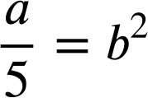
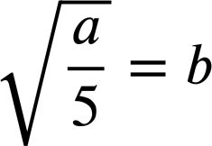
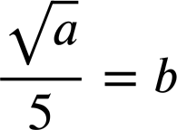
Habaynta qaacido aad u adag (Rearranging more complex formula)
Kee waa habaynta saxda ah ee qaacidadaan si b u noqdo mawduuca?
a = 5b²
a = 5b²
÷5 waa tillaabada koowaad ee saxda ah laakiin jibbaarka b waa inuu ahaadaa 1

Slide 36
Habaynta qaacido aad u adag (Rearranging more complex formula)
Ka dhiga x mawduuca waa ka duwan yahay qaacidadan.
y = (3x)²
x
×3
laba jibaaran (squared)
(3x)²
x
÷3
Jidhka laba jibaaran (Square root)
(3x)²

Slide 37

Habaynta qaacido aad u adag (Rearranging more complex formula)
Kee waa habaynta saxda ah ee qaacidadaan si b u noqdo mawduuca?
a = (5b)²
a = (5b)²
Jidhka laba jibaaran (Square root) waa tillaabada koowaad ee saxda ah laakiin jibbaarka b waa inuu ahaadaa 1

Slide 38
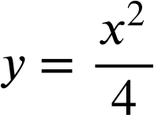
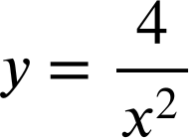



Habaynta qaacido aad u adag (Rearranging more complex formula)
1) Habayn qaacido kasta si x u noqdo mawduuca.
a)
y = 4x²
b)
y = (4x)²
c)
y = 4x² + 1
d)
y = 4(x² + 1)
e)
f)
g)
h)
i)

Slide 39
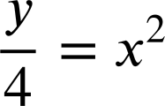

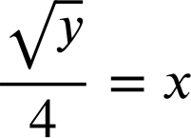
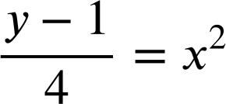
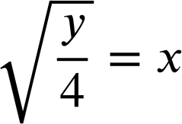
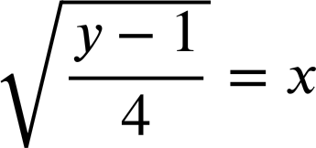
Habaynta qaacido aad u adag (Rearranging more complex formula)
1) Habayn qaacido kasta si x u noqdo mawduuca.
a)
y = 4x²
b)
y = (4x)²
c)
y = 4x² + 1
y − 1= 4x²

Slide 40
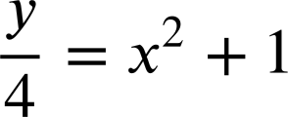







Habaynta qaacido aad u adag (Rearranging more complex formula)
1) Habayn qaacido kasta si x u noqdo mawduuca.
d)
y = 4(x² + 1)
e)
f)

Slide 41






Habaynta qaacido aad u adag (Rearranging more complex formula)
1) Habayn qaacido kasta si x u noqdo mawduuca.
g)
h)
i)

Slide 42

Bedelida mawduuca qaacido aad u adag (Changing the subject with more complex formula)
Waxaan ku dabaqi karnaa fahamka hawlgallada rogaal celiska ah (inverse operations) qaacido adag si aan uga dhigno doorsoome gaar ah mawduuca.
Tusaale ahaan, si e uga dhigno mawduuca qaacidadan, waxaan ka jareynaa 8 labada dhinac, ka dibna u qaybinaynaa labada dhinac 5.
5e + 8 = d
5e = d − 8

