Slide 1
Beddelka mawduuca iyadoo la adeegsanayo qaacidada fudud (simple formula)
Tibaaxaha iyo qaacidooyinka (Expressions and formulae)

Slide 2
Sida agabkeena waxbarista loogu talagalay fasalka

Slide 3
Waxaan awoodi karaa inaan ku dabaqo fahanka hawlgallada rogaal-celinta (inverse operations) qaacido fudud si aan uga dhigo doorsoome gaar ah mawduuca.

Slide 4


Mawduuca isla'egta/qaacidada waa doorsoome lagu muujiyo doorsoomayaasha kale. Waa inuu leeyahay jibbaar (exponent) 1 iyo isugeyn (coefficient) 1.
Tusaale ahaan, a waa mawduuca qaacidadan
laakiin, a2 ma aha mawduuca qaacidadan

Slide 5

Beddelka mawduuca iyadoo la adeegsanayo qaacidada fudud (simple formula)
Aqoonsiga mawduuca qaacidada
Beddelka mawduuca qaacidada fudud

Slide 6
Aqoonsiga mawduuca qaacidada
Dib-u-habaynta isla'egyada iyo qaacidooyinka waa xirfad qiimo leh xagga xisaabta.
4 + 6 = 10
Kani waa 10 oo lagu muujiyey 4 iyo 6
4 = 10 − 6
Sidee u ekaanaysaa 4 oo lagu muujiyey 10 iyo 6?
6 = 10 − 4
Sidee u ekaanaysaa 6 oo lagu muujiyey 10 iyo 4?

Slide 7
Aqoonsiga mawduuca qaacidada
Waxaan guud uga dhigi karnaa qaanuunka dib-u-habaynta xiriirrada isku-darka (additive relationships).
Haddii a + b = c markaas…
a = c − b
a oo lagu muujiyey c iyo b
Qaabkan, a waa mawduuca isla'egta.
b = c − a
b oo lagu muujiyey c iyo a
Qaabkan, b waa mawduuca isla'egta.

Slide 8
Aqoonsiga mawduuca (subject) ee qaacidada (formula)
Mawduuca (subject) isla'egta/qaacidada waa doorsoome (variable) loo qoray iyadoo la eegayo doorsoomayaasha kale. Waa inuu leeyahay jibbaar (exponent) 1 iyo isweyneeye (coefficient) 1.
a = c − b
a waxaa loo qoray iyadoo la eegayo c iyo b
Qaabkan, a waa mawduuca (subject) isla'egta (equation).
b = c − a
b waxaa loo qoray iyadoo la eegayo c iyo a
Qaabkan, b waa mawduuca (subject) isla'egta (equation).

Slide 9
Aqoonsiga mawduuca (subject) ee qaacidada (formula)
Mawduuca (subject) isla'egta/qaacidada waa doorsoome (variable) loo qoray iyadoo la eegayo doorsoomayaasha kale. Waa inuu leeyahay jibbaar (exponent) 1 iyo isweyneeye (coefficient) 1.
Xalli y + 35 = 78
35 + y = 78
y = 78 − 35
35 = 78 − y
Qaabkan, y waa mawduuca (subject) isla'egta (equation).
Marka la eego isla'egtan, waxaanu xisaabin karnaa tirada aan la garanayn (unknown) isla markiiba, sababtoo ah waa mawduuca (subject).
y = 43

Slide 10
Aqoonsiga mawduuca (subject) ee qaacidada (formula)
Gudbinta (generalisation) xiriirrada isku-darka (additive relationships).
Qaabkan, a waa mawduuca (subject) isla'egta (equation).
Qaabkan, b waa mawduuca (subject) isla'egta (equation).
Haddaba, waa maxay mawduuca (subject) qaabka asalka ah?
Jawaabaha:
a + b = c
b + a = c
a = c − b
b = c − a

Slide 11
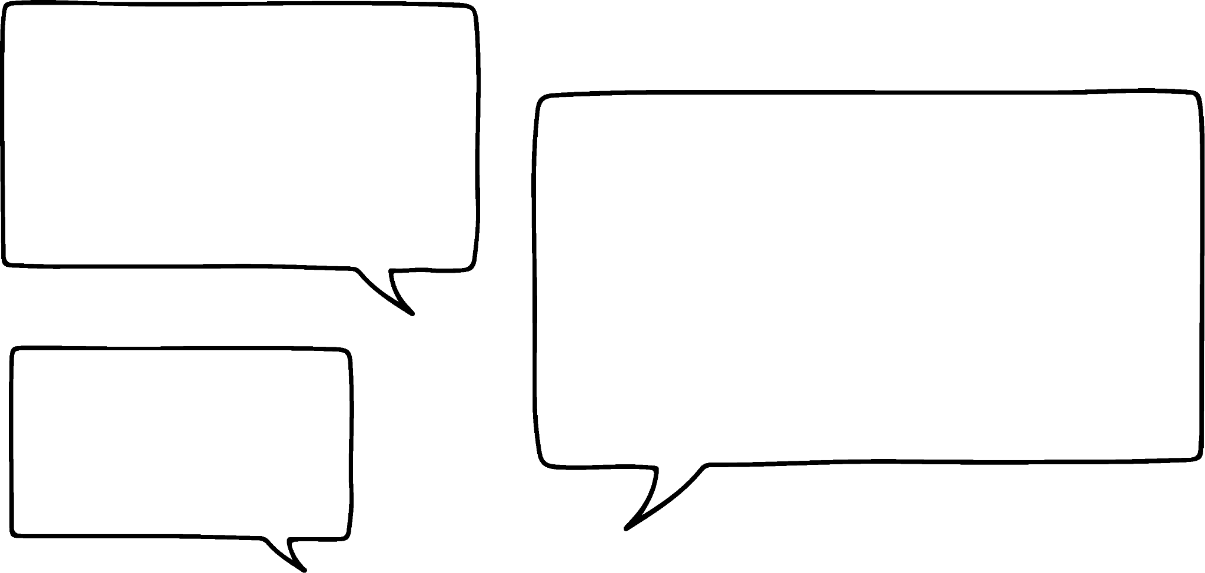



Aqoonsiga mawduuca (subject) ee qaacidada (formula)
Gudbinta (generalisation) xiriirrada isku-darka (additive relationships).
a + b = c
Waxaan u malaynayaa in a uu yahay mawduuca (subject), sababtoo ah waa shayga 1aad ee dhinaca bidix (LHS).
Ma raacsan tahay?
Cali
Haddaba, waa maxay mawduuca (subject) qaabka asalka ah?

Slide 12





Aqoonsiga mawduuca qaacidada (formula)
Guud ahaan xiriirka isku darka (additive relationships).
a + b = c
Waxaan u malaynayaa in a uu yahay mawduuca sababtoo ah waa shayga 1aad ee dhinaca bidix (LHS).
Ee fiiri qeexida mawduuca mar kale Andeep.
Andeep
Mawduuca isla'egta/qaacidada waa doorsoome (variable) lagu muujiyay doorsoomayaasha kale. Waa inuu leeyahay jibbaar (exponent) 1 iyo isugeyn (coefficient) 1
Sofia

Slide 13
Aqoonsiga mawduuca qaacidada (formula)
Guud ahaan xiriirka isku darka (additive relationships).
Mawduucu waa inuu ahaadaa c sababtoo ah kani waa c lagu muujiyay doorsoomayaasha kale.
a + b = c
Si fiican ayaad u saxday Andeep! c waa mawduuca.
Mawduucu wuxuu joogi karaa dhinaca bidix ama midig.
Andeep
Mawduuca isla'egta/qaacidada waa doorsoome (variable) lagu muujiyay doorsoomayaasha kale. Waa inuu leeyahay jibbaar (exponent) 1 iyo isugeyn (coefficient) 1
Sofia

Slide 14
Aqoonsiga mawduuca qaacidada (formula)
a² + b² = c²
b² + a² = c²
Waxaan bartay saddexagalka qumman (right-angle triangles) dhowaan oo waxaan arkay qaacidadan.
a² = c² − b²
b² = c² − a²
Marka waxaan dib u habayn karaa xiriirkan sidan.
Haa. Waa sax. Waxaad dib u habayn kartaa sidii xiriir kasta oo isku darka ah.
Andeep
Sofia

Slide 15


Aqoonsashada mawduuca (subject) ee qaacidada (formula)
a² + b² = c²
b² + a² = c²
Marka waxaan yeelan karaa c2 mawduuc.
a² = c² − b²
b² = c² − a²
Ama waxaan ka dhigi karaa a2 mawduuca (subject). Waxay ku xiran tahay waxa aan doonayo inaan xisaabiyo.
Aynu dib u hubinno qeexidaas mawduuca (subject) Cali.
Cali
Mawduuca (subject) ee isla'egta/qaacidada waa doorsoome (variable) lagu muujiyay iyadoo la eegayo doorsoomayaasha kale. Waa inuu leeyahay jibbaar (exponent) 1 ah iyo isweyneeye (coefficient) 1 ah
Suad

Slide 16
Aqoonsashada mawduuca (subject) ee qaacidada (formula)
a² + b² = c²
b² + a² = c²
Hadda waan arkay! Ma u yeeri karno a2 mawduuca (subject) sababtoo ah ma laha jibbaar (exponent) 1 ah
a² = c² − b²
b² = c² − a²
Waa hagaag. Mawduucu (subject) waa inuu leeyahay jibbaar (exponent) 1 ah iyo isweyneeye (coefficient) 1 ah
Cali
Mawduuca (subject) ee isla'egta/qaacidada waa doorsoome (variable) lagu muujiyay iyadoo la eegayo doorsoomayaasha kale. Waa inuu leeyahay jibbaar (exponent) 1 ah iyo isweyneeye (coefficient) 1 ah
Suad

Slide 17


Aqoonsashada mawduuca (subject) ee qaacidada (formula)
Midkee ka mid ah habayntan dib-u-habaynta isla'egta x + y = z ayaa y yahay mawduuca (subject)?
x + y = z
x = z − y
y + x = z
y = z − x
Kaliya habaynta (rearrangement) halkaas oo y lagu muujiyay iyadoo la eegayo doorsoomayaasha kale.

Slide 18
Aqoonsashada mawduuca (subject) ee qaacidada (formula)
Midkee ka mid ah habayntan dib-u-habaynta isla'egta x + y = z ayaa z yahay mawduuca (subject)?
x + y = z
z waxaa lagu muujiyay iyadoo la eegayo doorsoomayaasha kale. Mawduucu (subject) wuxuu ku yaali karaa dhinaca midig (RHS) ee isla'egta ama qaacidada.
x = z − y
y + x = z
z waxaa lagu muujiyay iyadoo la eegayo doorsoomayaasha kale. Mawduucu (subject) wuxuu ku yaali karaa dhinaca midig (RHS) ee isla'egta ama qaacidada.
y = z − x

Slide 19
Aqoonsashada mawduuca (subject) ee qaacidada (formula)
Isla'egta 5y2 = x + 7 mawduucu (subject) waa 5y2
Waxaan u baahanahay inaan sii hagaajinno ilaa y uu keligiis noqdo.
5y2 ma aha mawduuca (subject) sababtoo ah ma laha jibbaar (exponent) 1 ama isku-dhufasho (coefficient) 1
5y2 waa mawduuca (subject) sababtoo ah waxaa lagu muujiyay iyadoo la eegayo doorsoomayaasha kale.

Slide 20
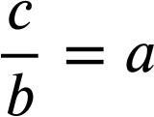
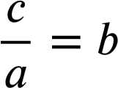
Aqoonsashada mawduuca (subject) ee qaacidada (formula)
Waxaan sidoo kale aqoonsan karnaa mawduuca (subject) xiriirka isku dhufashada (multiplicative).
Haddii 4 × 8 = 32 markaa…
32 ÷ 8 = 4
8 × 4 = 32
32 ÷ 4 = 8
Guud ahaan (generalisation) xiriirka isku dhufashada (multiplicative).
a × b = c
b × a = c

Slide 21
Aqoonsashada mawduuca (subject) ee qaacidada (formula)
Waxaan sidoo kale aqoonsan karnaa mawduuca (subject) xiriirka isku dhufashada (multiplicative).
a × b = c
Qaabkan c waa mawduuca (subject) ee isla'egta (equation).
Qaabkan a waa mawduuca (subject) ee isla'egta (equation).
b × a = c
Qaabkan c waa mawduuca (subject) ee isla'egta (equation).
Qaabkan b waa mawduuca (subject) ee isla'egta (equation).

Slide 22
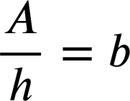
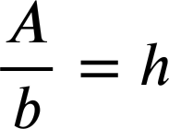
Aqoonsashada mawduuca (subject) ee qaacidada (formula)
Hagaajinta kasta ee qaacidada (formula), aqoonso doorsoome (variable) kaas oo ah mawduuca (subject).
A = b × h
h
A waa mawduuca (subject).
b
b waa mawduuca (subject).
A = h × b
A waa mawduuca (subject).
h waa mawduuca (subject).

Slide 23


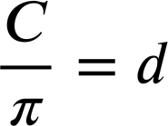
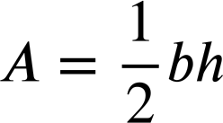
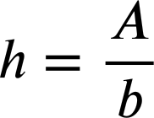
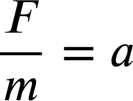


Aqoonsashada mawduuca (subject) ee qaacidada (formula)
1) Aqoonso mawduuca (subject) mid kasta oo ka mid ah qaacidada/isla'egyadan.
a)
b)
c)
d)
e)
f)
g)
h)

Slide 24

Aqoonsashada mawduuca (subject) ee qaacidada (formula)
2) Caasha waxay xallinaysaa isla'egta (equation) 85 − 3x = 17
Isle'egta (equation) waxaa loo habayn karaa qaababkan:
85 − 3x = 17
85 − 17 = 3x
85 = 17 + 3x
85 = 3x + 17
Qaabka 85 − 17 = 3x ayaa ah habaynta ugu fiican, sababtoo ah 3x waa mawduuca (subject).
Qor jumlad sharraxaysa waxa khaldan ee ku jira hadalka Caasha.

Slide 25
Aqoonsashada mawduuca (subject) ee qaaciddada (formula)
1) Ku aqoonsado mawduuca (subject) mid kasta oo ka mid ah qaaciddooyinkan/isle'egyahan (formula/equations).
a)
b)
c)
d)
e)
f)
g)
h)

Slide 26
Aqoonsashada mawduuca (subject) ee qaaciddada (formula)
2) Caasha waxay xallinaysaa isle'egta (equation) 85 − 3x = 17
Isle'egta (equation) waxaa loo habayn karaa qaababkan:
85 − 3x = 17
85 − 17 = 3x
85 = 17 + 3x
85 = 3x + 17
Qaabka 85 − 17 = 3x ayaa ah habaynta ugu fiican, sababtoo ah 3x waa mawduuca (subject).
Waxaa laga yaabaa inaad qortay:
Inkasta oo 85 − 17 = 3x uu yahay qaabka ugu fiican ee laga xalliyo, ma ugu yeeri karno 3x mawduuca (subject) sababtoo ah isugeeyaha (coefficient) waa 3 ma aha 1

Slide 27
Beddelka mawduuca (subject) ee qaaciddada (formula) fudud
Aqoonsashada mawduuca (subject) ee qaaciddada (formula)
Beddelka mawduuca (subject) ee qaaciddada (formula) fudud

Slide 28
Beddelka mawduuca (subject) ee qaaciddada (formula) fudud
Waxaan u habayn karnaa isle'egyada (equations) iyo qaaciddooyinka (formula) iyadoo la isticmaalayo hawlgallo rogan (inverse operations).
x + 12 = 37
Waa maxay rogaha (inverse) +12?
Tibaaxaha (expressions) dhinac kasta waxay ahaanayaan kuwo siman sababtoo ah waxaan ku sameynay hawlgallo isku mid ah labada dhinac.
x + 12 + (−12) = 37 + (−12)
x = 37 − 12
x hadda waa mawduuca (subject) isle'egta (equation).
x = 25
Laga soo bilaabo booskan waxaan haysannaa xalka (solution).

Slide 29
Beddelka mawduuca (subject) ee qaaciddada (formula) fudud
Waxaan u habayn karnaa isle'egyada (equations) iyo qaaciddooyinka (formula) iyadoo la isticmaalayo hawlgallo rogan (inverse operations).
x − 2.7 = 8.1
Waa maxay rogaal (inverse) ee −2.7?
Tibaaxaha dhinac kasta waxay ahaanayaan siman (equal) sababtoo ah waxaan ku samaynay isla hawlgalka (operation) labada dhinac.
x − 2.7 + 2.7 = 8.1 + 2.7
x = 8.1 + 2.7
x hadda waa mawduuca (subject) isla'egta (equation).
Laga bilaabo booskan waxaan haynaa milan (solution).
x = 10.8

Slide 30
Beddelka mawduuca (subject) qaacidada (formula) fudud
Mararka qaarkood waxaan u baahan doonnaa inaan isticmaalno hawlgallo (operations) badan.
17 − y = 4
17 − y + y = 4 + y
17 = 4 + y
17 + (−4) = 4 + y + (−4)
17 − 4 = y
y hadda waa mawduuca (subject) isla'egta (equation).
13 = y
Milan (solution).

Slide 31
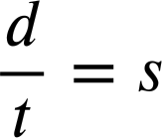
Beddelka mawduuca (subject) qaacidada (formula) fudud
Waxaan dib u habayn karnaa xiriirrada isku dhufashada (multiplicative) iyadoo la isticmaalayo mabaadi'da (principles) isku midka ah.
d = s × t
Rogaalka (inverse) ee × t
Hawlgalka (operation) isku midka ah labada dhinac si loo ilaaliyo simaanta (equality).
d ÷ t = s × t ÷ t
s hadda waa mawduuca (subject) qaacidada (formula).
Waxaan ku bilownay d oo lagu muujiyey s iyo t waxaanan ku dhamaynay aragti kala duwan; s oo lagu muujiyey d iyo t

Slide 32
Beddelka mawduuca (subject) qaacidada (formula) fudud
Amarka (command) aad badanaa ku arki doonto aljebrada (algebra) waa:
Ka dhig s mawduuca (subject) qaacidada (formula).
d = s × t
d hadda waa mawduuca (subject).
d ÷ t = s × t ÷ t
Hawlgalka (operation) rogaalka (inverse) si loo go'doomiyo s
Adigoo dib u habaynaya waxaan ka dhignay s mawduuca (subject) qaacidada (formula).

Slide 33
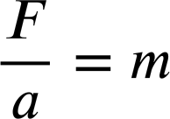
Beddelka mawduuca (subject) qaacidada (formula) fudud
Ka dhig x mawduuca (subject):
x + y = 10
x + y + (−y) = 10 + (−y)
x = 10 − y
Ka dhig m mawduuca (subject):
F = m × a
F ÷ a = m × a ÷ a

Slide 34
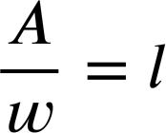
Beddelidda mawduuca (subject) ee qaaciddada (formula) fudud
Ka dhig x mawduuca (subject):
Ka dhig y mawduuca (subject):
x + y = 10
x + y = 8
x + y + (−y) = 10 + (−y)
x + y + (−x) = 8 + (−x)
x = 10 − y
y = 8 − x
Ka dhig m mawduuca (subject):
Ka dhig l mawduuca (subject):
F = m × a
A = l × w
F ÷ a = m × a ÷ a
A ÷ w = l × w ÷ w

Slide 35
Beddelidda mawduuca (subject) ee qaaciddada (formula) fudud
1) Isla'eg/isla'egta (equation/formula) kasta, beddel mawduuca (subject) sida lagu amray.
a) Ka dhig x mawduuca (subject).
b) Ka dhig l mawduuca (subject).
x − 2.7 = 8.1
P = 3l
c) Ka dhig y mawduuca (subject).
d) Ka dhig w mawduuca (subject).
17 − y = 4
A = l × w
e) Ka dhig u mawduuca (subject).
f) Ka dhig r mawduuca (subject).
v = u + at
C = 2πr

Slide 36
Beddelidda mawduuca (subject) ee qaaciddada (formula) fudud
2) Dib u habeey (Rearrange) qaaciddadan (formula) sida lagu amray.
F − E + V = 2
a) Ka dhig F mawduuca (subject).
b) Ka dhig V mawduuca (subject).
c) Ka dhig E mawduuca (subject).

Slide 37
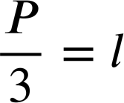
Beddelidda mawduuca (subject) ee qaaciddada (formula) fudud
1) Isla'eg/isla'egta (equation/formula) kasta, beddel mawduuca (subject) sida lagu amray.
a) Ka dhig x mawduuca.
b) Ka dhig l mawduuca.
x − 2.7 = 8.1
P = 3l
x − 2.7 + 2.7 = 8.1 + 2.7
P ÷ 3 = 3× l ÷ 3
x = 8.1 + 2.7
x = 10.8

Slide 38
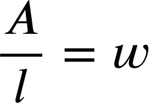
Beddelka mawduuca qaacidada fudud
1) Isla'eg/kacsi kasta beddel mawduuca sida lagu amray.
c) Ka dhig y mawduuca.
d) Ka dhig w mawduuca.
17 − y = 4
A = l × w
17 − y + y = 4 + y
A ÷ l = l × w ÷ l
17 = 4 + y
17 − 4 = 4 + y − 4
17 − 4 = y
13 = y

Slide 39
Beddelka mawduuca qaacidada fudud
1) Isla'eg/kacsi kasta beddel mawduuca sida lagu amray.
c) Ka dhig y mawduuca.
Markaad si badan ku tababarto waxaad awoodi doontaa inaad si degdeg ah u aragto qoyska dib-u-habaynta markaad aragto isla'eg qaabkan.
17 − y = 4
17 − y + y = 4 + y
17 = 4 + y
17 − y = 4
4 + y = 17
17 − 4 = 4 + y − 4
17 − 4 = y
y + 4 = 17
17 − 4 = y
Ogsoonow 4 iyo y ayaa isweydaarsaday meelaha.
13 = y

Slide 40
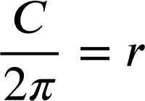
Beddelka mawduuca qaacidada fudud
1) Isla'eg/kacsi kasta beddel mawduuca sida lagu amray.
e) Ka dhig u mawduuca.
f) Ka dhig r mawduuca.
v = u + at
C = 2πr
v − at = u + at − at
C ÷ 2π = 2πr ÷ 2π
v − at = u

Slide 41
Beddelka mawduuca qaacidada fudud
2) Dib u habayn qaacidadan sida lagu amray.
F − E + V = 2
a) Ka dhig F mawduuca.
F − E + V = 2
F − E + V + E − V = 2 + E − V
F = 2 + E − V
b) Ka dhig V mawduuca.
F − E + V = 2
F − E + V + E − F = 2 + E − F
V = 2 + E − F
c) E ka dhig mawduuca (subject).

Slide 42
Bedelida mawduuca (subject) ee qaacidada (formula) fudud
2) Dib u habeey qaacidadaan (formula) sida lagu amray.
F − E + V = 2
a) F ka dhig mawduuca (subject).
F = 2 + E − V
b) V ka dhig mawduuca (subject).
V = 2 + E − F
c) E ka dhig mawduuca (subject).
F − E + V = 2
F − E + V + E = 2 + E
F + V = 2 + E
F + V − 2 = 2 + E − 2
F + V − 2 = E

Slide 43
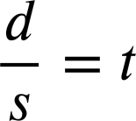
Bedelida mawduuca (subject) ee qaacidada (formula) fudud
Waxaan ku dabaqi karnaa hawlgallo rogaal (inverse operations) qaacidada (formula) fudud si aan uga dhigno doorsoome (variable) gaar ah mawduuca (subject).
Tusaale ahaan, qaacidadan d waa mawduuca (subject).
d = s × t
Rogaalka ×s wuxuu ka dhigi doonaa t mawduuca (subject).
d ÷ s = s × t ÷ s
Waxaa jiri doona waqtiyo ay tani runtii faa'iido u yeelan doonto.

