Slide 1
Hubinta iyo sii xoojinta fahamka sharciga is-beddelka (commutative law)
Qaabka caadiga ah (Standard form)

Slide 2
Sida agabkeena waxbarista loogu talagalay fasalka

Slide 3
Waxaan sheegi karaa sharciga is-beddelka (commutative law) oo aan u isticmaali karaa si hufan.

Slide 4

Marka tiro lagu dhufo nafteeda marar badan, waxaa loo qori karaa si fudud qaab jibbaar ah (exponential form).
e.g.
e.g.

Slide 5
Hawl (operation) waa is-beddel (commutative) haddii qiimaha ay ku shaqeyso lagu qori karo hab kasta iyada oo aan isbeddelin xisaabta.
Tusaale
Tusaale
Tusaale aan ahayn
3 + 4 =
4 + 3
7 ✕ 2 =
2 ✕ 7
10 − 2 ≠
2 − 10

Slide 6
Tiro asal ah (prime number) waa tiro dhammaystiran oo ka weyn hal oo leh 2 qaybiyeyaal (factors). Dhammaan tirooyinka ka weyn 1 waa isku-dhafan (composite) ama asal (prime).
Qaybiyeyaasha asalka ah (prime factors) waa qaybiyeyaasha tiro ee laftoodu asal yihiin.
Qaybinta asal ahaaneed (prime factorisation) waa hab lagu helo qaybiyeyaasha asalka ah ee tiro la siiyay.

Slide 7

Hubinta iyo sii xoojinta fahamka sharciga is-beddelka (commutative law)
Dib u eegista wax soo saarka qaybiyeyaasha asalka ah
Isticmaalka wax soo saarka qaybiyeyaasha asalka ah

Slide 8
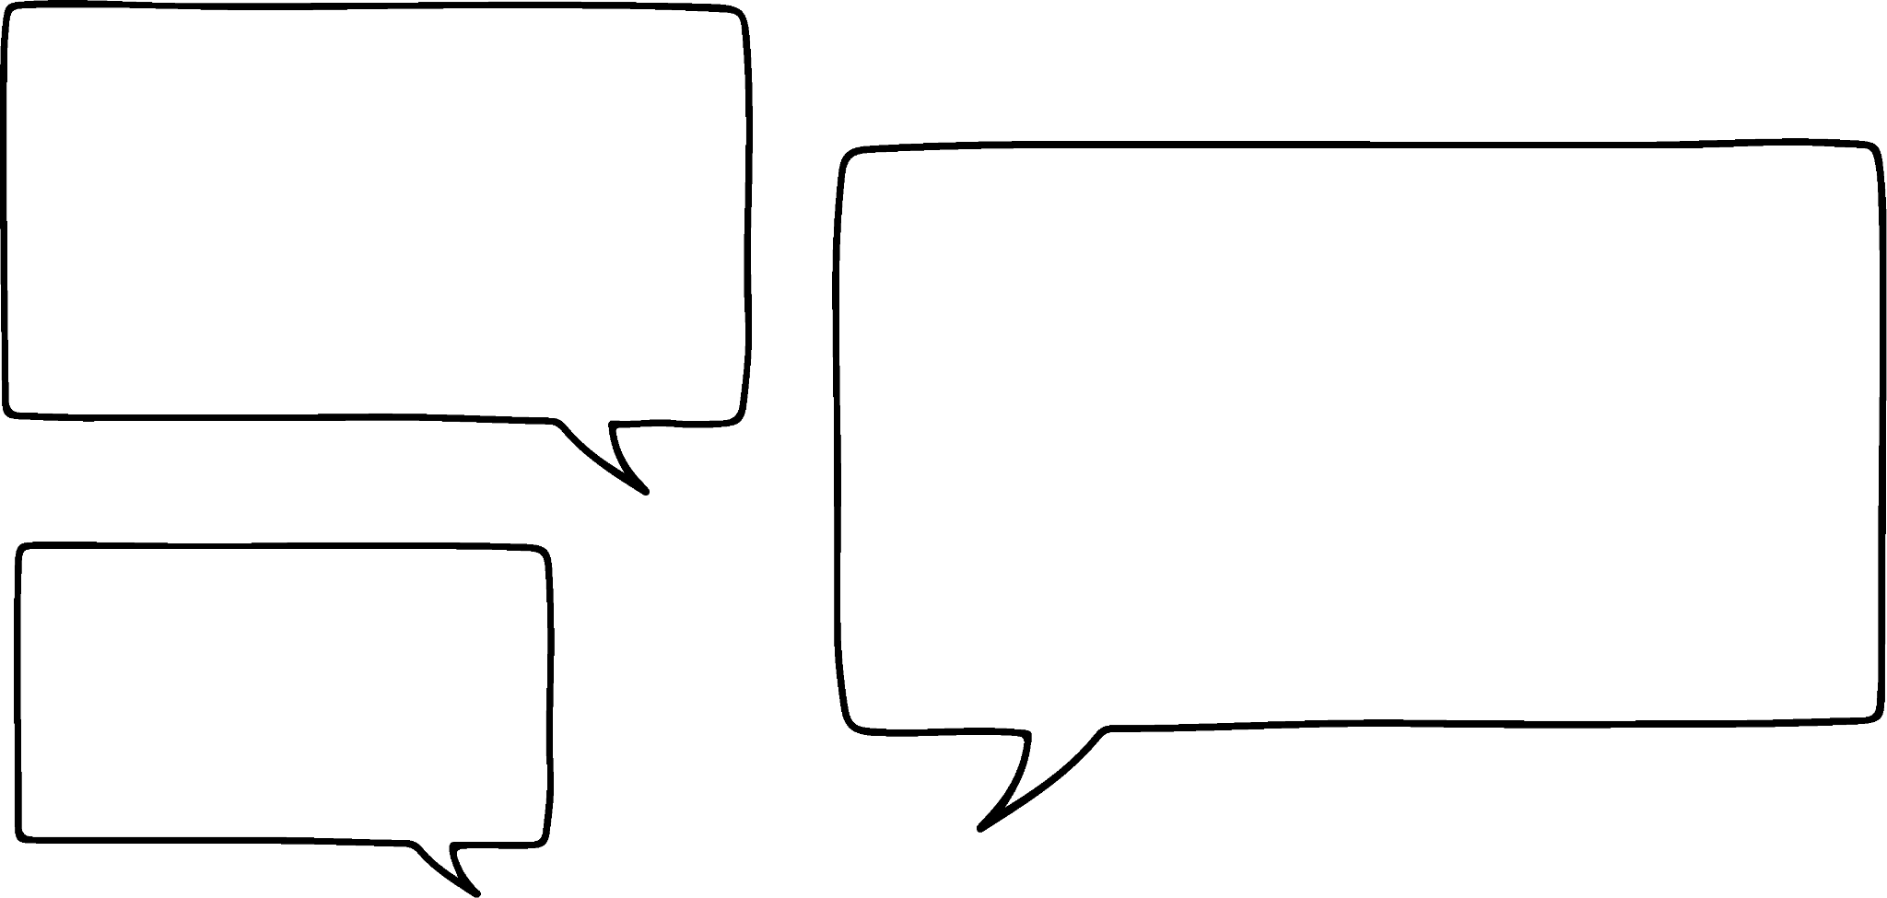





Dib u eegista wax soo saarka qaybiyeyaasha asalka ah
Suad iyo Axmed waxay ku tababbarayaan qorista tirooyinka sida wax soo saar gaar ah oo qaybiyeyaashooda asalka ah.
600 oo loo qoro sida wax soo saar qaybiyeyaashiisa asalka ah waa
2 × 2 × 2 × 3 × 5 × 5
600 oo loo qoro sida wax soo saar qaybiyeyaashiisa asalka ah waa
2³ × 3 × 5²
Yaa sax?
Labadooduba waa sax yihiin.
Axmed wuxuu ku qoray tan iyadoo la adeegsanayo qoraalka tusaha (index notation).
Suad
Axmed

Slide 9

Dib u eegista soosaarka cunsuriyeyaasha tirada (product of prime factors)
Qoraalka tusaha (index notation) waa marka aan u qorno isku dhufashada soo noqnoqota anagoo adeegsanayna sal-dhig (base) iyo jibbaar (exponent).
Jibbaaruhu (exponent) waa 4
Tani waxay ka dhigan tahay
Sal-dhiggu (base) waa 7
7 ✕ 7 ✕ 7 ✕ 7

Slide 10

Dib u eegista soosaarka cunsuriyeyaasha tirada (product of prime factors)
Mid ka mid ah kuwan soo socda ayaa si sax ah u muujinaya 2 × 2 × 3 × 3 × 3 × 5 × 7 iyadoo la adeegsanayo qoraalka tusaha (index notation)?
2² × 3³ × 35
2³ × 3³ × 5 × 7
2² × 3³ × 5 × 7

Slide 11
Dib u eegista soosaarka cunsuriyeyaasha tirada (product of prime factors)
U qor 1260 sida soosaar cunsuriyeyaasha tirada (product of prime factors)
1260
= 126 × 10
= 2 × 63 × 2 × 5
= 2 × 7 × 9 × 2 × 5
= 2 × 7 × 3 × 3 × 2 × 5
= 2 × 2 × 3 × 3 × 5 × 7
= 2² × 3² × 5 × 7

Slide 12
Dib u eegista soosaarka cunsuriyeyaasha tirada (product of prime factors)
U qor 250 sida soosaarka cunsuriyeyaasheeda tirada (product of its prime factors).
U qor 360 sida soosaarka cunsuriyeyaasheeda tirada (product of its prime factors).
250
= 25 × 10
360
= 36 × 10
= 5 × 5 × 2 × 5
= 6 × 6 × 2 × 5
= 2 × 5³
= 2 × 3 × 2 × 3 × 2 × 5
= 2³ × 3² × 5

Slide 13
Dib u eegista soosaarka cunsuriyeyaasha tirada (product of prime factors)
360 = 2³ × 3² × 5
Waxaan u isticmaali karnaa tan si aan ugu qorno tirooyin kale sida soosaarka cunsuriyeyaashooda tirada (product of their prime factors) iyadoon aan ku celcelin habka bilowga ah.
720
= 360 × 2
3600
= 360 × 10
= 2³ × 3² × 5
× 2
= 2³ × 3² × 5
× 2 × 5
= 2⁴ × 3² × 5
= 2⁴ × 3² × 5²

Slide 14
Dib u eegista soosaarka cunsuriyeyaasha tirada (product of prime factors)
Saddexda tiro ee si fudud loo heli karo iyadoo la adeegsanayo 120 oo loo qoray sida soosaarka cunsuriyeyaasheeda tirada (product of its prime factors)?
2400
480
90
360

Slide 15
Dib u eegista soosaarka cunsuriyeyaasha tirada (product of prime factors)
Aan isku dayno labo kale:
450 = 2 × 3² × 5²
1800
= 450 × 4
= 2 × 3² × 5²
× 2²
= 2 × 2² × 3² × 5²
= 2³ × 3² × 5²
1800 oo loo qoray sida soosaarka cunsuriyeyaasheeda tirada (product of its prime factors) waa 23 × 32 × 52

Slide 16
Dib u eegista soosaarka cunsuriyeyaasha tirada (product of prime factors)
Aan isku dayno labo kale:
450 = 2 × 3² × 5²
150
= 450 ÷ 3
= 2 × 3² × 5²
÷ 3
= 2 × 3² ÷ 3 × 5²
= 2 × 3 × 5²
150 oo loo qoro sida tirooyin asaasi ah waa 2 × 3 × 52

Slide 17
Dib u eegis ku saabsan tirooyin asaasi ah
Adigoo isticmaalaya 225 = 32 × 52, u qor 900 sida tirooyin asaasi ah.
900
= 225 × 4
= 3² × 5²
× 2²
= 2² × 3² × 5²
900 oo loo qoro sida tirooyin asaasi ah waa 22 × 32 × 52

Slide 18
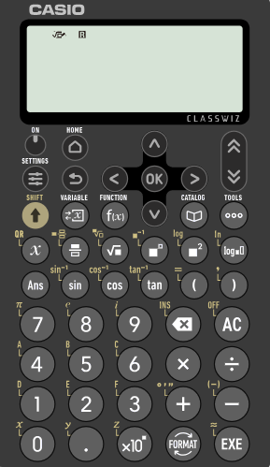
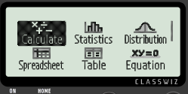

Dib u eegis ku saabsan tirooyin asaasi ah
Waxaan sidoo kale isticmaali karnaa xisaabiyeyaasha sayniska si aan u hubinno kala-goynta tirooyinka asaasiga ah.
Waa kan Casio fx-991EX.
Marka hore, hubi in 'Calculate' la muujiyey.
Kadib riix 'EXE'

Slide 19
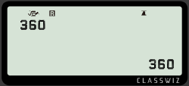
Dib u eegis ku saabsan tirooyin asaasi ah
Aan hubinno kala-goynta tirooyinka asaasiga ah ee 360
Ku qor 360 oo riix 'EXE'

Slide 20
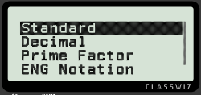

Dib u eegis ku saabsan tirooyin asaasi ah
Aan hubinno kala-goynta tirooyinka asaasiga ah ee 360
Ku qor 360 oo riix 'EXE'
Kadib dooro 'FORMAT'

Slide 21
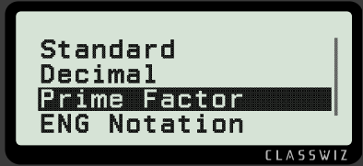

Dib u eegis ku saabsan tirooyin asaasi ah
Hoos u dhaadhac ilaa 'Prime Factor' la muujiyey.
Kadib riix 'EXE' mar kale

Slide 22
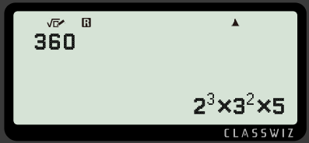
Dib u eegis ku saabsan tirooyin asaasi ah
Tani waxay muujin doontaa tirada sida tirooyin asaasi ah.
360 = 2³ × 3² × 5

Slide 23
Dib u eegista tirooyinka (product) ee tirooyinka asaasiga ah (prime factors)
1) Ku qor kuwan sida tirooyin (product) oo ah tirooyin asaasi ah (prime factors), adigoon isticmaalin xisaabiyaha (calculator).
a) 200
b) 196
c) 378
d) 308
e) 23 400

Slide 24
Dib u eegista tirooyinka (product) ee tirooyinka asaasiga ah (prime factors)
2) Isticmaal 60 = 22 × 3 × 5 si aad ugu qorto kuwan, adigoon isticmaalin xisaabiyaha (calculator), sida tirooyin (product) oo ah tirooyin asaasi ah (prime factors).
a) 120
b) 180
c) 300
d) 600
e) 6000
f) 4200
g) 30

Slide 25
Dib u eegista tirooyinka (product) ee tirooyinka asaasiga ah (prime factors)
1) Ku qor kuwan sida tirooyin (product) oo ah tirooyin asaasi ah (prime factors), adigoon isticmaalin xisaabiyaha (calculator).
a) 200
b) 196
c) 378
d) 308
e) 23 400
2³ × 5²
2² × 7²
2 × 3³ × 7
2² × 7 × 11
2³ × 3² × 5²× 13

Slide 26
Dib u eegista tirooyinka (product) ee tirooyinka asaasiga ah (prime factors)
2) Isticmaal 60 = 22 × 3 × 5 si aad ugu qorto kuwan, adigoon isticmaalin xisaabiyaha (calculator), sida tirooyin (product) oo ah tirooyin asaasi ah (prime factors).
a) 120
b) 180
c) 300
d) 600
e) 6000
f) 4200
g) 30
= 60 × 2 = 2² × 3 × 5 × 2 = 2³ × 3 × 5
= 60 × 3 = 2² × 3 × 5 × 3 = 2² × 3² × 5
= 60 × 5 = 2² × 3 × 5 × 5 = 2² × 3 × 5²
= 60 × 10 = 2² × 3 × 5 × 2 × 5 = 2³ × 3 × 5²
= 60 × 100 = 2² × 3 × 5 × 2² × 5² = 2⁴ × 3 × 5³
= 60 × 70 = 2² × 3 × 5 × 7 × 10 = 2² × 3 × 5 × 7 × 2 × 5
= 2³ × 3 × 5² × 7
= 60 ÷ 2 = 2² × 3 × 5 ÷ 2 = 2 × 3 × 5

Slide 27
Hubinta iyo sii xoojinta fahamka sharciga isbeddelka (commutative law)
Dib u eegista tirooyinka (product) ee tirooyinka asaasiga ah (prime factors)
Isticmaalka tirooyinka (product) ee tirooyinka asaasiga ah (prime factors)

Slide 28



Isticmaalka tirooyinka (product) ee tirooyinka asaasiga ah (prime factors)
Layla iyo Yacquub waxay ka hadlayaan sida loo xisaabiyo 35 × 22
Ma isticmaali karnaa tirooyinka (products) ee tirooyinka asaasiga ah (prime factors) si aan u fududayno xisaabinta?
Waxaan u qori karnaa labadoodaba sida tirooyin (products). Laakiin, ma fududaynaysaa?
Layla
Yacquub
Maxaad u malaynaysaa?
Aynu eegno.

Slide 29
Isticmaalka tirooyinka (product) ee tirooyinka asaasiga ah (prime factors)
35 iyo 22 waxaa loo qoray sida tirooyin (product) oo ah tirooyinkooda asaasiga ah (prime factors):
35 = 5 × 7
22 = 2 × 11
35 × 22 = 5 × 7 × 2 × 11
35 × 22 = 5 × 2 × 7 × 11
35 × 22 = 10 × 77
35 × 22 = 770
Waxaan dib u habeyn karnaa xisaabtan adigoo isticmaalaya sharciga is-beddelka (commutative law).
Waxaa fiican in la isku daro 2 iyo 5, maxaa yeelay wax soo saarkoodu waa 10
Waxaan la yaabanahay in ay had iyo jeer fududayn doonto xisaabta.
Taasi dhab ahaan way fududaysay xisaabtaas.
Layla
Yacquub

Slide 30
Isticmaalka wax soo saarka tirada asaasiga ah (prime factors)
Ma qorista 105 iyo 231 sida wax soo saarka tirada asaasiga ah waxay fududayn kartaa xisaabtan: 105 × 231?
105 = 5 × 21
= 5 × 3 × 7
231 = 3 × 77
= 3 × 7 × 11
105 × 231 = 5 × 3 × 7 × 3 × 7 × 11
Ma arki karo lammaane aan fududayn karo xisaabtan.
Yacquub

Slide 31
Isticmaalka wax soo saarka tirada asaasiga ah
Aan eegno tirooyinka asaasiga ah ee ay u badan tahay inaan aragno oo aan go'aamino lammaanaha faa'iidada leh ee fududayn kara xisaabta.
Ma xusuusan kartaa 8da tiro asaasi ah ee ugu horreeya?
2, 3, 5, 7, 11, 13, 17, 19, …
Haa, hab fudud oo lagu dhufan karo 9 waa in lagu dhufato 10 kadibna laga jarro mid ka mid ah qiimaha.
Waxay ila tahay in 2 iyo 5 ay yihiin kaliya lammaanaha faa'iidada leh.
Haddii ay jiraan laba 3, taasi waxay noqon kartaa faa'iido, maxaa yeelay wax soo saarkoodu waa 9
Layla
Yacquub

Slide 32
Isticmaalka wax soo saarka tirada asaasiga ah
Xisaabi 33 × 21
33 = 3 × 11
21 = 3 × 7
33 × 21 = 3 × 11 × 3 × 7
dib u habeyn adigoo isticmaalaya sharciga is-beddelka
33 × 21 = 3 × 3 × 11 × 7
33 × 21 = 9 × 77
= 10 × 77 − 1 × 77
= 770 − 77
= 693

Slide 33
Isticmaalka wax soo saarka tirada asaasiga ah
Xisaabi 42 × 75 adigoo isticmaalaya tirooyinka asaasiga ah.
42 = 2 × 21
= 2 × 3 × 7
75 = 3 × 25
= 3 × 5 × 5
42 × 75 = 2 × 3 × 7 × 3 × 5 × 5
dib u habayn iyadoo la adeegsanayo sharciga is-beddelka (commutative law)
42 × 75 = 2 × 5 × 3 × 3 × 7 × 5
= 10 × 9 × 35
= 10 × (10 × 35 − 1 × 35)
= 10 × (350 − 35)
= 10 × 315 = 3150

Slide 34
Isticmaalka tirooyinka asaasiga ah (product of prime factors)
Xisaabi 36 × 175 adigoo isticmaalaya tirooyinka asaasiga ah.
36 = 2² × 3²
175 = 5² × 7
36 × 175 = 2² × 3² × 5² × 7
= 2 × 2 × 3 × 3 × 5 × 5 × 7
= 2 × 5 × 2 × 5 × 3 × 3 × 7
= 10 × 10 × 9 × 7
= 100 × 63
= 6300

Slide 35
Isticmaalka tirooyinka asaasiga ah
42 = 2 × 3 × 7 308 = 2² × 7 × 11 35 = 5 × 7
195 = 3 × 5 × 13 90 = 2 × 3² × 5 198 = 2 × 3² × 11
1) Isticmaal tirooyinka asaasiga ah ee kor ku xusan si aad u xisaabiso kuwan soo socda:
a) 42 × 90
b) 198 × 42
c) 198 × 35
d) 90 × 308
e) 195 × 198

Slide 36
Isticmaalka tirooyinka asaasiga ah
42 = 2 × 3 × 7 308 = 2² × 7 × 11 35 = 5 × 7
195 = 3 × 5 × 13 90 = 2 × 3² × 5 198 = 2 × 3² × 11
1) Isticmaal tirooyinka asaasiga ah ee kor ku xusan si aad u xisaabiso kuwan soo socda:
a) 42 × 90
b) 198 × 42
c) 198 × 35
d) 90 × 308
e) 195 × 198
3780
8316
6930
27 720
38 610

Slide 37
Hubinta iyo sii xoojinta fahamka sharciga is-beddelka
Dhammaan tirooyinka isku-dhafan (composite numbers) waxaa loo qori karaa tirooyin asaasi ah oo gaar ah. Tusaale:
Tirooyinka asaasiga ah waxaa loo qori karaa si hufan iyadoo la adeegsanayo qoraalka tusmada (index notation). Tusaale:
Sharciga is-beddelka iyo tirooyinka asaasiga ah waxaa loo isticmaali karaa si fudud loogu helo tirooyinka isku dhufashada marka maskaxda lagu xisaabinayo.
52
= 2 × 26
= 2 × 2 × 13
52
= 2² × 13

