Slide 1
Hubinta iyo xaqiijinta xallinta isla'egyada toosan (linear equations)
Tibaaxaha iyo qaaciidooyinka (expressions and formulae)

Slide 2
Sida loo isticmaalo darasyada Oak

Slide 3
Waxaan xallin karaa isla'egyada ku lug leh qawska (brackets).

Slide 4
Isku-dhafka (additive inverse) ee lambarku waa lambar, marka lagu daro lambarka asalka ah, wuxuu keenaa wadar 0.
Isdhaafka (reciprocal) waa isku-dhafka isku dhufashada (multiplicative inverse) ee lambar kasta oo aan eber ahayn. Lambar kasta oo aan eber ahayn oo lagu dhufto isdhaafka wuxuu la mid yahay 1
Erayada isku midka ah (like terms) waa erayo leh isku nooc doorsoomeyaal (variables) iyo jibbaarada (exponents) u dhigma.

Slide 5

Hubinta iyo xaqiijinta xallinta isla'egyada toosan (linear equations)
Xallinta isla'egyada ku lug leh tibaax qaws leh (bracketed expression)
Xallinta isla'egyada leh qawsyo badan (multiple brackets)

Slide 6
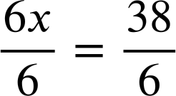
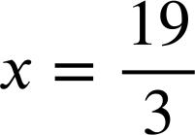
Xallinta isla'egyada ku lug leh tibaax qaws leh (bracketed expression)
Markaan aragno isla'egyada leh qawsyo (brackets) waxaan ballaarin karnaa qawska si aan u xallinno.
6(x − 1) | = | 32
6x − 6 | = | 32
6x − 6 + 6 | = | 32 + 6
6x | = | 38
6(x − 1) | = | 32
6x − 6 | = | 32
6x − 6 + 6 | = | 32 + 6
6(x − 1) | = | 32
6x − 6 | = | 32
6(x − 1) | = | 32
6 × x + 6 × −1 = 6x − 6
Qaabkani wuxuu u eeg yahay mid aad u yaqaan. Halkan waxaan ka xallin karnaa adoo wax ka beddelaya.
Isku-dhafka (additive inverse) ee −6 waa +6
Marka jawaabtu aanay ahayn tiro dhammaystiran (integer) waxaa ugu fudud inaad jawaabta uga tagto jajab (fraction). Waxaa faa'iido leh in jajabka loo qoro qaabkiisa ugu fudud.

Slide 7

Xallinta isla'egyada ku lug leh tibaax qaws leh (bracketed expression)
Xalli isla'egtan adoo ballaarinaya qawska (brackets).
Xalli isla'egtan adoo ballaarinaya qawska (brackets).
3(2x + 8) | = | 6
6x + 24 | = | 6
6x | = | −18
x | = | −3
3(2x + 8) | = | 6
6x + 24 | = | 6
6x | = | −18
3(2x + 8) | = | 6
6x + 24 | = | 6
3(2x + 8) | = | 6
4(3x + 20) | = | 20
12x + 80 | = | 20
12x | = | −60
x | = | −5
4(3x + 20) | = | 20
12x + 80 | = | 20
12x | = | −60
4(3x + 20) | = | 20
12x + 80 | = | 20
4(3x + 20) | = | 20
Hubi xalka adoo beddelaya (substitution).
Hubi xalka adoo beddelaya (substitution).
3(2(−3) + 8) | = | 6
3(−6+ 8) | = | 6
3(2) | = | 6
3(2(−3) + 8) | = | 6
3(−6+ 8) | = | 6
3(2(−3) + 8) | = | 6
4(3(−5) + 20) | = | 20
4(−15 + 20) | = | 20
4(5) | = | 20

Slide 8
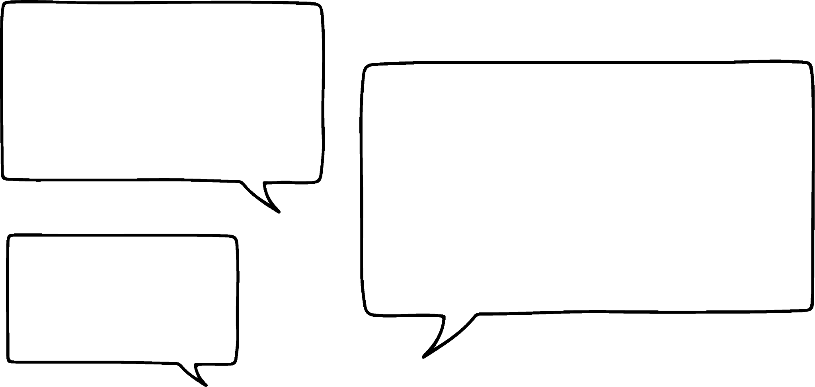



Xallinta isla'egyada ku lug leh tibaax qaws leh (bracketed expression)
Waxaan u malaynayaa inaan arkay hab ka dhaqsi badan su'aashaas dambe.
4(3x + 20) = 20
Ma arki kartaa waxa Nuur arkay?
4 waa qeybiye guud (common factor) oo ah tibaaxaha labada dhinac ee isla'egta (equation)
Nuur
Halka aan ku aragno qeybiyeyaasha guud (common factors), u qaybinta isku-dhufashada (coefficient) qawska (bracket) waxay noqon kartaa milan (solution) ugu dhaqsaha badan.
4(3x + 20) | = | 20
3x + 20 | = | 5
3x | = | −15
x | = | −5
4(3x + 20) | = | 20
3x + 20 | = | 5
3x | = | −15
4(3x + 20) | = | 20
3x + 20 | = | 5
Labada dhinacba waxaa loo qaybiyay 4

Slide 9
Xallinta isla'egyada (equations) ku lug leh tibaax qaws leh (bracketed expression)
Nuur wuxuu xallinayaa isla'egyo (equations) dheeri ah oo leh qawsyo (brackets).
Marka hore balaadhin (expanding):
Marka hore ku dhufasho is-daba-rog (reciprocal):
3(x − 2) | = | 15
3x − 6 | = | 15
3x | = | 21
x | = | 7
3(x − 2) | = | 15
3(x − 2) | = | 15
x − 2 | = | 5
x | = | 7
3(x − 2) | = | 15
Waxaan la yaabanahay habkee u fududan doono tusaalahan.

Slide 10
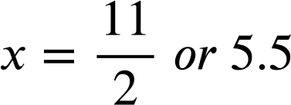
Xallinta isla'egyada (equations) ku lug leh tibaax qaws leh (bracketed expression)
Nuur wuxuu xallinayaa isla'egyo (equations) dheeri ah oo leh qawsyo (brackets).
Marka hore balaadhin (expanding):
Marka hore ku dhufasho is-daba-rog (reciprocal):
8(x − 3) | = | 20
8x − 24 | = | 20
8x | = | 44
8(x − 3) | = | 20
8(x − 3) | = | 20
8x − 24 | = | 20
8(x − 3) | = | 20
Waxaan u malaynayaa inaan helay tusaale ay balaadhinta qawsyada (brackets) ku fududaan doonto.

Slide 11
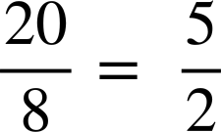
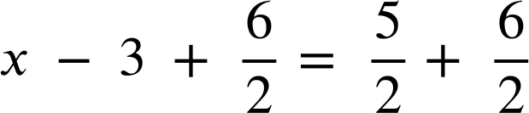
Xallinta isla'egyada (equations) ku lug leh tibaax qaws leh (bracketed expression)
Nuur wuxuu xallinayaa isla'egyo (equations) dheeri ah oo leh qawsyo (brackets).
Marka hore balaadhin (expanding):
Marka hore ku dhufasho is-daba-rog (reciprocal):
8(x − 3) | = | 20
8x − 24 | = | 20
8x | = | 44
8(x − 3) | = | 20
x − 3 | =
Qaybinta marka hore waxay la timid xisaabo badan oo jajab (fractions) ah. Waa doorasho shaqsiyeed (personal preference) habka aad ugu fududan tahay su'aal kasta.

Slide 12
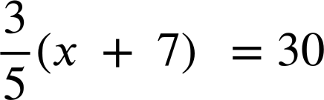
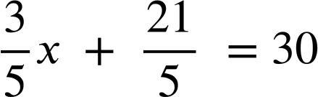
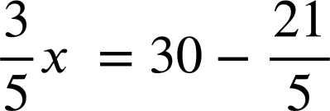
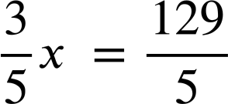
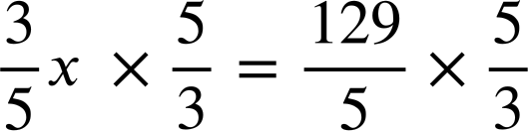

Xallinta isla'egyada (equations) ku lug leh tibaax qaws leh (bracketed expression)
Marka isku-dhufashada (coefficient) qawska (bracket) ay tahay jajab (fraction), balaadhinta qawska (bracket) waxay noqon kartaa mid waqti badan qaadata oo u horseedi karta xisaabo adag.

Slide 13

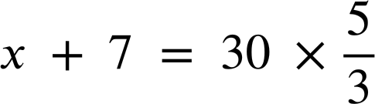

Xallinta isla'egyada (equations) ee ku lug leh tibaax qaws leh (bracketed expression)
Isku day inaad xallisid isla'egtan (equation) adigoo u qaybinaya labada dhinac ee isla'egta (equation)
Xusuusnow, u qaybinta jajab (fraction) waxay la mid tahay ku dhufashada isku-dhafka (reciprocal).
Taasi way ka fududayd in la balaadhiyo qawska (brackets) marka hore.

Slide 14
Xallinta isla'egyada (equations) ee ku lug leh tibaax qaws leh (bracketed expression)
Isla'egta (equation) 5(x + 4) = 50 waa in lagu xalliyaa balaadhinta qawska (brackets) marka hore.
Dhammaan isla'egyada (equations) way fududahay in la xalliyo haddii aad marka hore u qaybiso koeffisiyenta (coefficient) qawska (bracket).
5 iyo 50 waxay leeyihiin qaybiye guud (common factor) sidaas darteed u qaybinta koeffisiyenta (coefficient) qawska (bracket) ayaa laga yaabaa inay fududahay.

Slide 15

Xallinta isla'egyada (equations) ee ku lug leh tibaax qaws leh (bracketed expression)
Tallaabada koowaad ee keentay in isla'egta (equation) 7(x + 3) = 32 ay fududaato waa kee?
Balaadhinta qawska (brackets)
Ku darista 3 labada dhinac
Ku dhufashada labada dhinac
U qaybinta labada dhinac 7

Slide 16


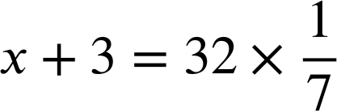
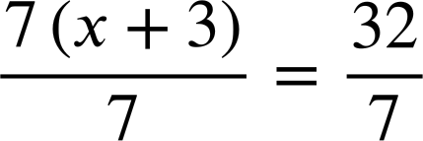
Xallinta isla'egyada (equations) ee ku lug leh tibaax qaws leh (bracketed expression)
Tallaabada koowaad ee keentay in isla'egta (equation) 7(x + 3) = 32 ay fududaato waa kee?
Balaadhinta qawska (brackets) ayaa ugu shaqeysa xaaladdan.
Ku darista 3 kama caawinayso xallinta isla'egta (equation).
Ku dhufashada toddobaad (seventh) iyo u qaybinta 7 waa isku mid. Labaduba waxay naga caawinayaan xallinta isla'egta (equation), laakiin 7 ma aha qaybiye (factor) 32, sidaas darteed habkani wuxuu u baahan doonaa xisaab jajab (fraction) dheeri ah.

Slide 17
Xallinta isla'egyada (equations) ee ku lug leh tibaax qaws leh (bracketed expression)
1) Soo hel qaladka (mistake) ee hab kasta si loo xalliyo isla'eg (equation) ku lug leh qaws (brackets).
a)
b)
c)
5(x + 10) | = | 55
5x + 10 | = | 55
5x | = | 45
x | = | 9
2(4x + 10) | = | 18
2x + 5 | = | 9
2x | = | 4
x | = | 2
7(x − 3) | = | 42
x − 3 | = | 6
x | = | 3

Slide 18


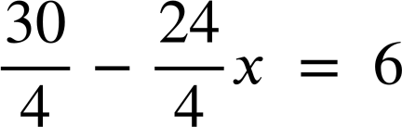
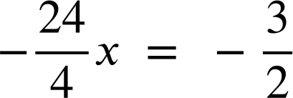
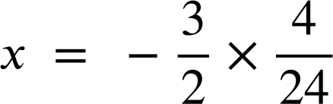
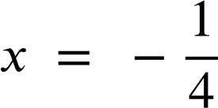
Xallinta isla'egyada (equations) ee ku lug leh tibaax qaws leh (bracketed expression)
1) Ka hel qaladka hab kasta oo lagu xalliyo isla'eg (equation) oo ay ku jiraan qawsyo (brackets).
d)
e)
f)
5(3x + 2) | = | 14
8x + 10 | = | 14
8x | = | 4
x | = | 2
(2x − 5) | = | 15
2x − 5 | = | 3
2x | = | 8
x | = | 4
(10 − 8x) | = | 6

Slide 19
Xallinta isla'egyada (equations) oo ay ku jiraan tibaax qawsan (bracketed expression)
2a) Ku xalli isla'egtan (equation) adigoo isticmaalaya labada hab, oo qor jumlad isbarbardhigaysa waxtarka hababka.
Marka hore balaadhi (Expanding first):
Marka hore ku dhufo isdhaafsiga (Multiplying by the reciprocal first):
6(x − 9) | = | 21
6(x − 9) | = | 15

Slide 20
Xallinta isla'egyada (equations) oo ay ku jiraan tibaax qawsan (bracketed expression)
2b) Ku xalli isla'egtan (equation) adigoo isticmaalaya labada hab, oo qor jumlad isbarbardhigaysa waxtarka hababka.
Marka hore balaadhi (Expanding first):
Marka hore ku dhufo isdhaafsiga (Multiplying by the reciprocal first):
15(4x + 7) | = | 45
15(4x + 7) | = | 45

Slide 21
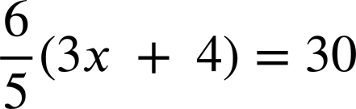
Xallinta isla'egyada (equations) oo ay ku jiraan tibaax qawsan (bracketed expression)
2c) Ku xalli isla'egtan (equation) adigoo isticmaalaya labada hab, oo qor jumlad isbarbardhigaysa waxtarka hababka.
Marka hore balaadhi (Expanding first):
Marka hore ku dhufo isdhaafsiga (Multiplying by the reciprocal first):

Slide 22
Xallinta isla'egyada (equations) oo ay ku jiraan tibaax qawsan (bracketed expression)
1) Ka hel qaladka hab kasta oo lagu xalliyo isla'eg (equation) oo ay ku jiraan qawsyo (brackets).
a)
b)
c)
5(x + 10) | = | 55
5x + 10 | = | 55
5x | = | 45
x | = | 9
2(4x + 10) | = | 18
2x + 5 | = | 9
2x | = | 4
x | = | 2
7(x − 3) | = | 42
x − 3 | = | 6
x | = | 3
Rogga isugeynta (additive inverse) ee −3 waa + 3, sidaas darteed 3 waa in lagu daraa labada dhinac. Safka 3aad waa inuu ahaado x = 6 + 3 ama x = 9
Qawsyada (brackets) si sax ah looma balaadhin (expanded).
Safka labaad waa inuu ahaado 5x + 50 = 55
Marka LHS loo qaybiyo 2, waa in aan la qaybinin qaybaha ku jira qawska (bracket). Safka labaad waa inuu ahaado 4x + 10 = 9

Slide 23
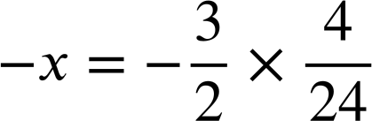
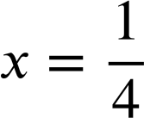
Xallinta isla'egyada (equations) oo ay ku jiraan tibaax qawsan (bracketed expression)
1) Ka hel qaladka hab kasta oo lagu xalliyo isla'eg (equation) oo ay ku jiraan qawsyo (brackets).
d)
e)
f)
5(3x + 2) | = | 14
8x + 10 | = | 14
8x | = | 4
x | = | 2
(2x − 5) | = | 15
2x − 5 | = | 3
2x | = | 8
x | = | 4
(10 − 8x) | = | 6
Qawsyada (brackets) si sax ah looma balaadhin (expanded); 5 iyo 3 waa in la isku dhuftey, oo aan lagu darin. Safka labaad waa inuu ahaado 15x + 10 = 55
Isdhaafsiga (reciprocal) ee saddex meelood waa saddex.
Tallaabada koowaad waa in lagu dhuftey 3, ee looma qaybiyo 3.
Waxay fududaan lahayd in marka hore lagu dhuftey isdhaafsiga (reciprocal).

Slide 24
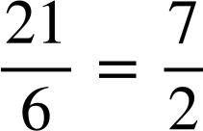
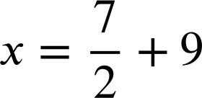
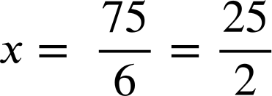
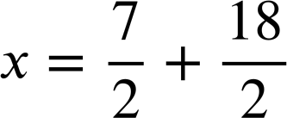
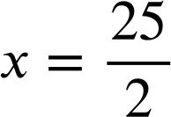
Xallinta isla'egyada ku lug leh tibaax qaws ah (bracketed expression)
2a) Xalliso isla'egtan adigoo isticmaalaya labada hab, waxaadna qortaa jumlad isbarbardhigaysa waxtarka hababka.
Marka hore balaadhin (expanding):
Marka hore ku dhufasho isdhaafsiga (reciprocal):
6(x − 9) | = | 21
6x − 54 | = | 21
6x | = | 75
6(x − 9) | = | 21
x − 9 | =
Habka labaad wuxuu u baahan yahay xirfado jajab (fractions) badan, marka habka koowaad ayaa u badan inuu waxtar badan yahay.

Slide 25
Xallinta isla'egyada ku lug leh tibaax qaws ah (bracketed expression)
2b) Xalliso isla'egtan adigoo isticmaalaya labada hab, waxaadna qortaa jumlad isbarbardhigaysa waxtarka hababka.
Marka hore balaadhin (expanding):
Marka hore ku dhufasho isdhaafsiga (reciprocal):
15(4x + 7) | = | 45
60x + 105 | = | 45
60x | = | −60
x | = | −1
15(4x + 7) | = | 45
4x + 7 | = | 3
4x | = | −4
x | = | −1
Tani waa doorasho shakhsiyeed. Labada tibaaxood waxay leeyihiin qaybiye (factor) guud oo ah 15, marka marka hore u qaybinta 15 waxay ka dhigaysaa qiimaha kuwa yaryar oo laga yaabo inay fududaato in lala shaqeeyo marka loo barbardhigo balaadhinta qawska (brackets) marka hore.

Slide 26
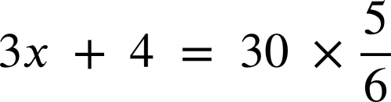








Xallinta isla'egyada ku lug leh tibaax qaws ah (bracketed expression)
2c) Xalliso isla'egtan adigoo isticmaalaya labada hab, waxaadna qortaa jumlad isbarbardhigaysa waxtarka hababka.
Marka hore balaadhin (expanding):
Marka hore ku dhufasho isdhaafsiga (reciprocal):
Waa fududahay in marka hore la 'furfuro' (undo) tillaabada isku dhufashada (multiplicative), sababtoo ah waa tiro dhammaystiran (integer)

Slide 27
Hubinta iyo xaqiijinta xallinta isla'egyada toosan (linear equations)
Xallinta isla'egyada ku lug leh tibaax qaws ah (bracketed expression)
Xallinta isla'egyada leh qawsyo (brackets) badan

Slide 28
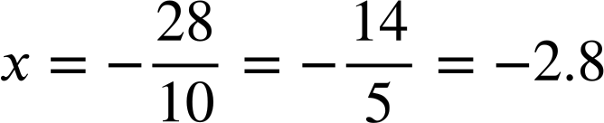
Xallinta isla'egyada leh qawsyo (brackets) badan
Waxaan xallin karnaa isle'egyada (equations) leh kuwa aan la aqoon (unknowns) labada dhinac.
Tusaale ahaan
6(x + 3) | = | −2(2x + 5)
6x + 18 | = | −4x − 10
6x + 18 + 4x | = | −4x − 10 + 4x
10x + 18 | = | − 10
10x | = | − 28
6(x + 3) | = | −2(2x + 5)
6x + 18 | = | −4x − 10
6x + 18 + 4x | = | −4x − 10 + 4x
10x + 18 | = | − 10
6(x + 3) | = | −2(2x + 5)
6x + 18 | = | −4x − 10
6x + 18 + 4x | = | −4x − 10 + 4x
6(x + 3) | = | −2(2x + 5)
6x + 18 | = | −4x − 10
6(x + 3) | = | −2(2x + 5)
Waxaan ku bilaabi karnaa kordhinta (expanding) qawsyada (brackets).
Ku dar rogaal celinta isugeynta (additive inverse) ee −4x
Xalli isle'egta (equation) laba-tallaabo ee ka dhalatay.

Slide 29

Xallinta isle'egyada (equations) leh qawsyo (brackets) badan
Cabdi
Cabdi wuxuu isku dayaa xallinta isle'egtan (equation).
Ma sharixi kartaa waxa uu sameeyay tallaabo kasta?
2(3 − 2x) | = | 6(x + 5)
6 − 4x | = | 6x + 30
6 − 10x | = | 30
−10x | = | 24
−x | = | 2.4
x | = | −2.4
Kordhiyey (expanded) labada qaws (brackets)
Ku daray −6x labada dhinac
Ku daray −6 labada dhinac
U qaybiyey (divided) labada dhinac 10
Ku dhuftey/ u qaybiyey (multiplied/ divided) labada dhinac −1
Ma jiraa wax aad si kale u samayn lahayd?

Slide 30
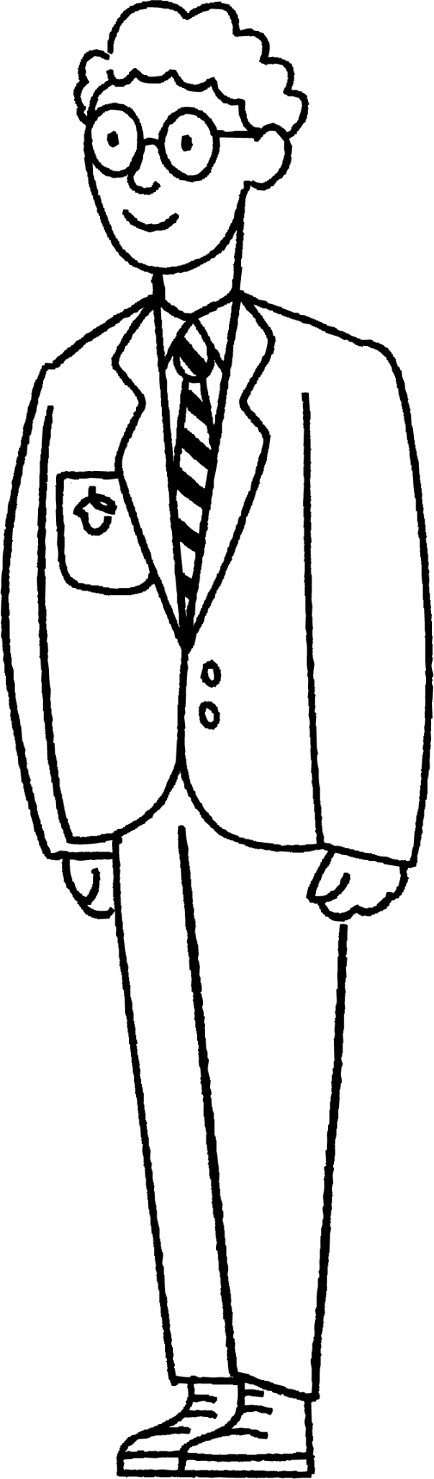
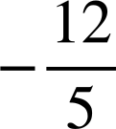
Xallinta isle'egyada (equations) leh qawsyo (brackets) badan
2(3 − 2x) | = | 6(x + 5)
1(3 − 2x) | = | 3(x + 5)
3 − 2x | = | 3x + 15
3 | = | 5x + 15
−12 | = | 5x
 | = | x
Waxaa jira qaybiye guud (common factor) labada dhinac ee isle'egta (equation). Maxaa dhacaya haddii aan ku bilaabo u qaybinta (dividing) 2?
2(3 − 2x) | = | 6(x + 5)
1(3 − 2x) | = | 3(x + 5)
3 − 2x | = | 3x + 15
3 | = | 5x + 15
−12 | = | 5x
2(3 − 2x) | = | 6(x + 5)
1(3 − 2x) | = | 3(x + 5)
3 − 2x | = | 3x + 15
3 | = | 5x + 15
2(3 − 2x) | = | 6(x + 5)
1(3 − 2x) | = | 3(x + 5)
3 − 2x | = | 3x + 15
2(3 − 2x) | = | 6(x + 5)
1(3 − 2x) | = | 3(x + 5)
2(3 − 2x) | = | 6(x + 5)
Axmed
Waxaan ku darayaa 2x markaas dhammaan qaybuhu waa kuwa togan (positive).
Maxaad samayn lahayd xiga?
Xulashooyin badan: 'ku dar 2x' ama 'ku dar −3' ama 'ku dar −15' ama 'ku dar −3x'

Slide 31
Xallinta isleegyada (equations) leh qawsyo (brackets) badan
Xalli isle'egta (equation)
Xalli isla'egta (equation)
3(6 − 4x) | = | 4(2x − 5)
18 − 12x | = | 8x − 20
18 | = | 20x − 20
38 | = | 20x
19 | = | 10x
1.9 | = | x
3(6 − 4x) | = | 4(2x − 5)
18 − 12x | = | 8x − 20
18 | = | 20x − 20
38 | = | 20x
19 | = | 10x
3(6 − 4x) | = | 4(2x − 5)
18 − 12x | = | 8x − 20
18 | = | 20x − 20
38 | = | 20x
3(6 − 4x) | = | 4(2x − 5)
18 − 12x | = | 8x − 20
18 | = | 20x − 20
3(6 − 4x) | = | 4(2x − 5)
18 − 12x | = | 8x − 20
3(6 − 4x) | = | 4(2x − 5)
8(5 − x) | = | 7(2x + 1)
40 − 8x | = | 14x + 7
40 | = | 22x + 7
33 | = | 22x
3 | = | 2x
1.5 | = | x
8(5 − x) | = | 7(2x + 1)
40 − 8x | = | 14x + 7
40 | = | 22x + 7
33 | = | 22x
3 | = | 2x
8(5 − x) | = | 7(2x + 1)
40 − 8x | = | 14x + 7
40 | = | 22x + 7
33 | = | 22x
8(5 − x) | = | 7(2x + 1)
40 − 8x | = | 14x + 7
40 | = | 22x + 7
8(5 − x) | = | 7(2x + 1)
40 − 8x | = | 14x + 7
8(5 − x) | = | 7(2x + 1)

Slide 32

Xallinta isleegyada (equations) leh qawsyo (brackets) badan
Kee ka mid ah isleegyadan (equations) waa la fududeyn karaa ka hor xallinta?
Tibaaxyo (expressions) isku mid ah oo ah (x − 8)
7(x − 8) − 5(x − 8) | = | 24
2(x − 8) | = | 24
5(x − 3) + 2(x + 3) | = | 24
(x − 3) iyo (x + 3) ma aha tibaaxyo (expressions) isku mid ah.
2(2x + 1) − (2x + 1) | = | 24
Tibaaxyo (expressions) isku mid ah oo ah (2x + 1)
2x + 1 | = | 24
3(2x + 7) | = | 3(x + 2)
Labada dhinacba waa loo qaybin karaa 3

Slide 33
Xallinta isleegyada (equations) leh qawsyo (brackets) badan
1) Xallinta (solutions) isleegyada (equations) waa la siiyay. Buuxi tillaabooyinka si aad u muujiso sida loo gaaro jawaabahan.
a)
b)
c)
5(x + 6) | = | 7(9x − 4)
x | = | 1
2(4x − 5) | = | −6(3x − 7)
x | = | 2
8(x − 5) + 3(x + 5) | = | 8
x | = | 3

Slide 34
Xallinta isleegyada (equations) leh qawsyo (brackets) badan
1) Xallinta (solutions) isleegyada (equations) waa la siiyay. Buuxi tillaabooyinka si aad u muujiso sida loo gaaro jawaabahan.
d)
e)
f)
4(3x − 1) − 2(3x − 1) | = | 22
x | = | 4
2(4x − 9) − 4(3 − 2x) | = | 50
x | = | 5
3(2(x + 4)+5) | = | 75
x | = | 6

Slide 35
Xallinta isleegyada (equations) leh qawsyo (brackets) badan
2) Xalli isleegyadan (equations) laba jeer. Marka hore, balaadhi (expand) qawsyada (brackets), marka labaad, fududee ka hor balaadhinta (expanding).
Qor jumlad si aad u barbar dhigto waxtarka (efficiency).
4(x + 5) + 3(x + 5) | = | 14
21 + 3(2x − 3) | = | 7(2x − 3) − 5(2x − 3)
a)
b)

Slide 36
Xallinta isleegyada (equations) leh qawsyo (brackets) badan
1) Xallinta (solutions) isleegyada (equations) waa la siiyay. Buuxi tillaabooyinka si aad u muujiso sida loo gaaro jawaabahan. Habab kale ayaa sidoo kale noqon kara kuwo sax ah.
a)
b)
c)
5(x + 6) | = | 7(9x − 4)
5x + 30 | = | 63x − 28
30 | = | 58x − 28
58 | = | 58x
x | = | 1
2(4x − 5) | = | −6(3x − 7)
4x − 5 | = | −3(3x − 7)
4x − 5 | = | −9x + 21
13x | = | 26
x | = | 2
8(x − 5) + 3(x + 5) | = | 8
8x − 40 + 3x + 15 | = | 8
11x − 25 | = | 8
11x | = | 33
x | = | 3

Slide 37
Xallinta isleegyada (equations) leh qawsyo (brackets) badan
1) Xallinta (solutions) isleegyada (equations) waa la siiyay. Buuxi tillaabooyinka si aad u muujiso sida loo gaaro jawaabahan. Habab kale ayaa sidoo kale noqon kara kuwo sax ah.
d)
e)
f)
3(2(x + 4)+5) | = | 75
3(2x + 8 + 5) | = | 75
3(2x + 13) | = | 75
2x + 13 | = | 25
2x | = | 12
x | = | 6
4(3x − 1) − 2(3x − 1) | = | 22
2(3x − 1) | = | 22
3x − 1 | = | 11
3x | = | 12
x | = | 4
2(4x − 9) − 4(3 − 2x) | = | 50
8x − 18 − 12 + 8x | = | 50
16x − 30 | = | 50
16x | = | 80
x | = | 5

Slide 38
Xallinta isleegyada (equations) leh qawsyo (brackets) badan
2) Xalli isleegyadan (equations) laba jeer. Marka hore, balaadhi (expand) qawsyada (brackets), marka labaad, fududee ka hor balaadhinta (expanding).
Qor jumlad si aad u barbar dhigto waxtarka (efficiency).
a)
4(x + 5) + 3(x + 5) | = | 14
4x + 20 + 3x + 15 | = | 14
7x + 35 | = | 14
7x | = | −21
x | = | −3
4(x + 5) + 3(x + 5) | = | 14
7(x + 5) | = | 14
x + 5 | = | 2
x | = | −3
Tusaale: Labada habba waxay ahaayeen kuwo waxtar leh (efficient). Fududaynta (simplifying) marka hore waxay ka dhigtay in la arko qaybiye guud (common factor) oo meesha ka saaray tallaabo (step).

Slide 39
Xallinta isleegyada (equations) leh qawsyo (brackets) badan
2b) Xalli isleegyadan (equations) laba jeer. Marka hore adoo balaadhinaya (expanding) marka hore, marka labaad adoo fududaynaya (simplifying) ka hor balaadhinta (expanding).
Qor jumlad (sentence) si aad u barbardhigto waxtarka (efficiency).
21 + 3(2x − 3) | = | 7(2x − 3) − 3(2x − 3)
21 + 6x − 9 | = | 14x − 21 − 6x + 9
6x + 12 | = | 8x − 12
12 | = | 2x − 12
24 | = | 2x
x | = | 12
21 + 3(2x − 3) | = | 7(2x − 3) − 3(2x − 3)
21 + 3(2x − 3) | = | 4(2x − 3)
21 | = | 2x − 3
24 | = | 2x
x | = | 12
Tusaale: Fududaynta (simplifying) marka hore waxay u muuqatay mid waxtar leh (efficient). Ma aysan ahayn lagama maarmaan in la balaadhiyo qawsyada (brackets) waxaana loo baahnayd tirooyin taban (negative numbers) oo yar.

Slide 40
Hubinta iyo xaqiijinta xallinta isleegyada toosan (linear equations)
Isleegyada (equations) ay ku jiraan qaws (bracket) lagu dhuftey (multiplied) eray (term) waxaa lagu xallin karaa laba siyood.
Haddii eraygu (term) yahay mid joogto ah (constant) iyo qaybiye (factor) eray kasta oo kale, markaas qaybinta (dividing) marka hore ayaa laga yaabaa inay tahay tan ugu fudud. Haddii kale, balaadhinta (expanding) qawsyada (brackets) ayaa laga yaabaa inay tahay tan ugu fudud.
Isleegyada (equations) leh qawsyo (brackets) badan oo la isku daray (added together) waa la xallin karaa.
Waxay noqon kartaa mid waxtar leh (helpful) in la raadiyo qaybiyeyaasha guud (common factors) ama tibaaxaha isku midka ah (identical expressions) si loo fududeeyo (simplify) ka hor xallinta (solving).

