Slide 1
Hubinta iyo xoojinta fahamka taxanaha aan tooska ahayn (non-linear sequences)
Muuqaallo garaafeed (Graphical representations)

Slide 2
Sida agabkeena waxbarista loogu talagalay fasalka

Slide 3
Waxaan qirayaa in aysan taxanaha oo dhami toos ahayn (linear).

Slide 4
Taxane xisaabeed (arithmetic) ama toos ah (linear) waa taxane uu farqiga u dhexeeya erayada is xiga yahay joogto.
E.g. 10, 12, 14, 16, 18,...
E.g. 10, 12, 15, 19, 24,...
Kani waa taxane xisaabeed (arithmetic sequence) leh farqi guud oo +2
+2
+2
+2
+2
Kani ma aha taxane xisaabeed (arithmetic sequence) sababtoo ah ma jiro farqi guud oo u dhexeeya erayada is xiga.
+2
+3
+4
+5
Taxane joomatari (geometric sequence) waa taxane leh xiriir isku dhufasho joogto ah oo u dhexeeya erayada is xiga.

Slide 5

Hubinta iyo xoojinta fahamka taxanaha aan tooska ahayn (non-linear sequences)
Taxanaha xisaabeed iyo joomatari (Arithmetic and geometric sequences)
Noocyo kale oo taxane ah

Slide 6
Taxanaha xisaabeed iyo joomatari (Arithmetic and geometric sequences)
Maxaad ka dareensan tahay taxanahan?
3, 6, 9, 12, 15, …
Waa bilowga jadwalka 3, 5, iyo 9.
5, 10, 15, 20, 25, …
Dhammaantood waxay leeyihiin farqi guud oo isku dhufasho ah oo u dhexeeya erayada is xiga.
9, 18, 27, 36, 45, …

Slide 7
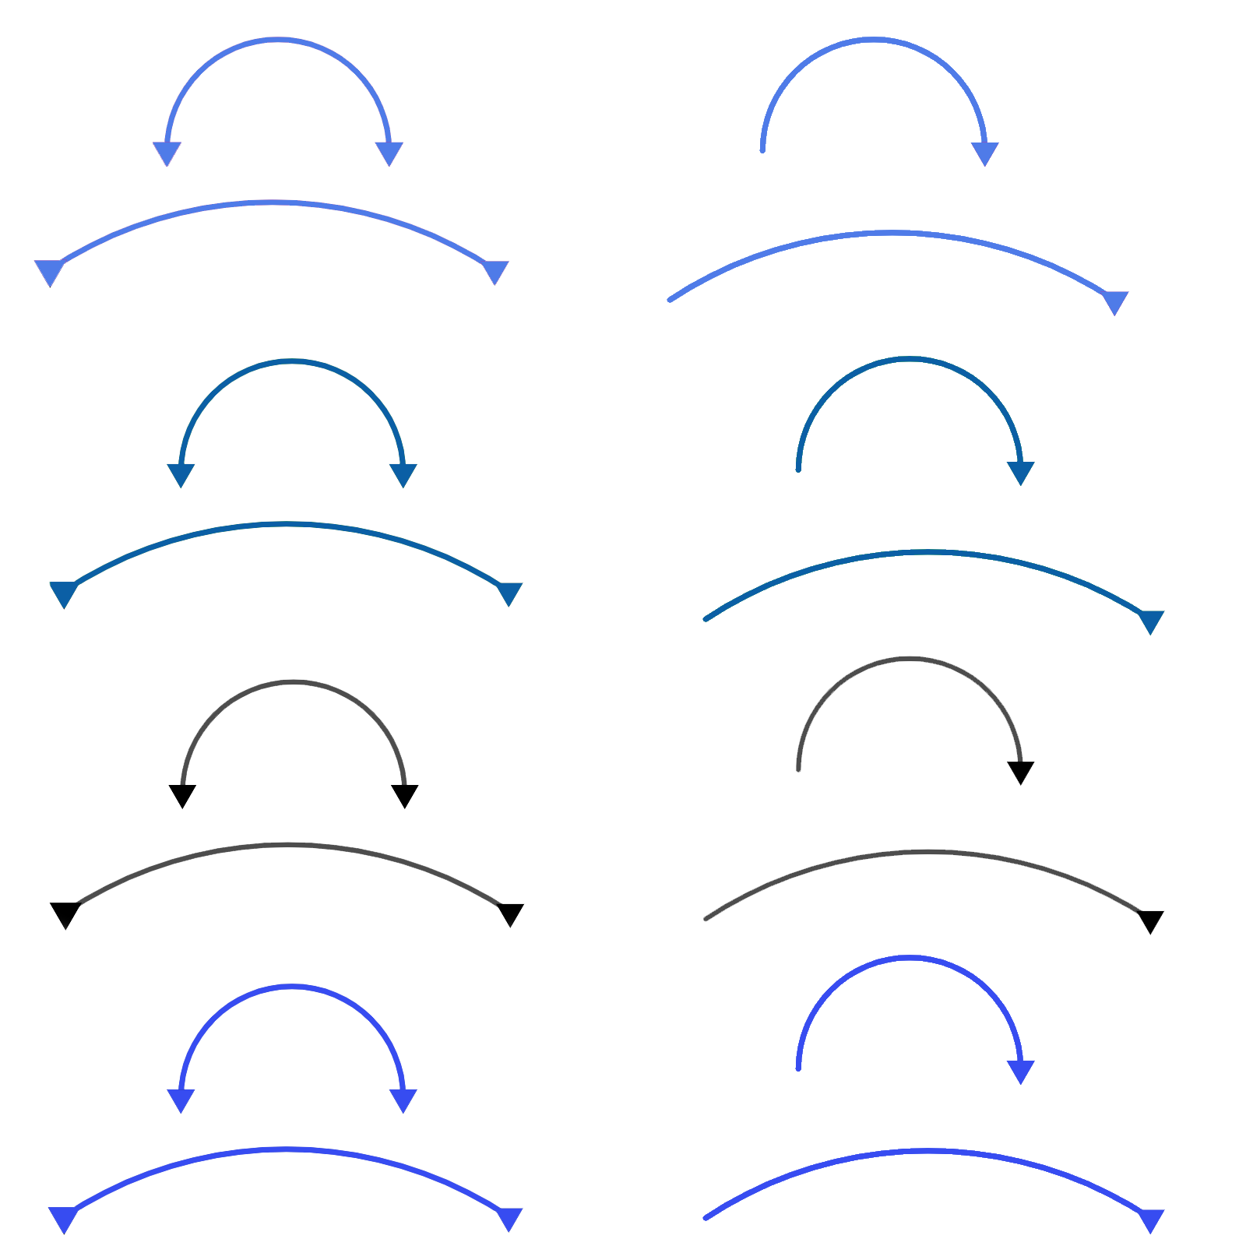
Taxanaha xisaabeed iyo joomatari (Arithmetic and geometric sequences)
Maxaad ka dareensan tahay taxanahan?
3, 6, 9, 12, 15, …
Waa bilowga jadwalka 3, 5, iyo 9.
+3
+3
+3
+3
5, 10, 15, 20, 25, …
+5
+5
+5
+5
Dhammaantood waxay leeyihiin farqi guud oo isku dhufasho ah oo u dhexeeya erayada is xiga.
9, 18, 27, 36, 45, …
+9
+9
+9
+9

Slide 8
Taxanaha xisaabeed iyo joomatari (Arithmetic and geometric sequences)
Maxaa dhacaya haddii aan erayada wax ka beddelno?
3, 6, 9, 12, 15, …
Ku dar 10 eray kasta
13, 16, 19, 22, 25, …
+3
+3
+3
+3
Ka jar 4 xubin kasta (Minus 4 from each term)
5, 10, 15, 20, 25, …
1, 6, 11, 16, 21, …
+5
+5
+5
+5
Ku dhufo xubinta kasta 2 (Multiply each term by 2)
9, 18, 27, 36, 45, …
18, 36, 54, 72, 90, …
+9
+9
+9
+9
Maxaad ka dareentaa taxanahan (sequences)?

Slide 9
Taxanaha xisaabeed iyo joomatari (Arithmetic and geometric sequences)
Weli waxay leeyihiin kala-duwanaansho guud oo isku-dar ah oo xubin-ilaa-xubin ah (common, additive term-to-term difference).
3, 6, 9, 12, 15, …
Ku dar 10 xubin kasta (Add 10 to each term)
13, 16, 19, 22, 25, …
+3
+3
+3
+3
+3
+3
+3
+3
Ka jar 4 xubin kasta (Minus 4 from each term)
5, 10, 15, 20, 25, …
1, 6, 11, 16, 21, …
+5
+5
+5
+5
+5
+5
+5
+5
Ku dhufo xubinta kasta 2 (Multiply each term by 2)
9, 18, 27, 36, 45, …
18, 36, 54, 72, 90, …
+9
+9
+9
+9
+18
+18
+18
+18
Maxaad ka dareentaa taxanahan (sequences)?

Slide 10
Taxanaha xisaabeed iyo joomatari (Arithmetic and geometric sequences)
Taxanaha leh kala-duwanaansho guud oo isku-dar ah (Sequences with a common, additive difference)
ee u dhexeeya xubnaha waxaa loo yaqaan taxanaha xisaabeed (toosan) (arithmetic (linear) sequences).
3, 6, 9, 12, 15, …
13, 16, 19, 22, 25, …
+3
+3
+3
+3
+3
+3
+3
+3
5, 10, 15, 20, 25, …
1, 6, 11, 16, 21, …
+5
+5
+5
+5
+5
+5
+5
+5
9, 18, 27, 36, 45, …
18, 36, 54, 72, 90, …
+9
+9
+9
+9
+18
+18
+18
+18

Slide 11
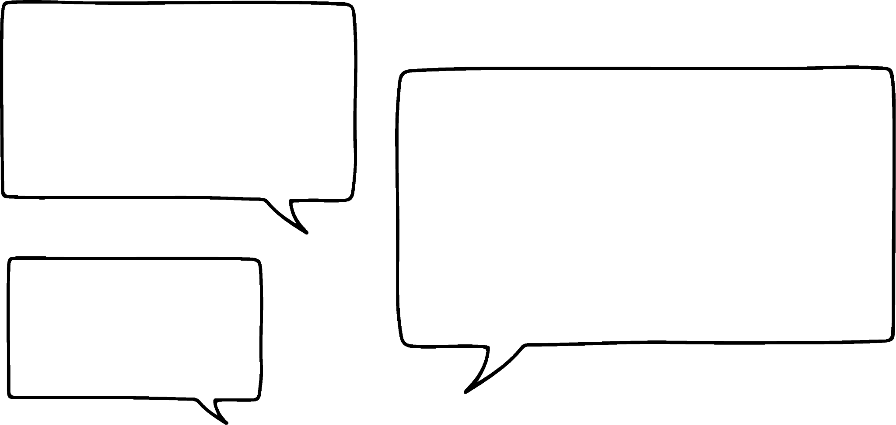


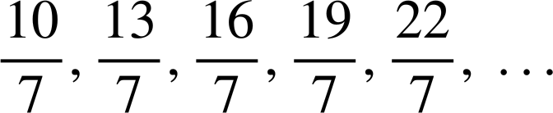

Taxanaha xisaabeed iyo joomatari (Arithmetic and geometric sequences)
Cabdi iyo Caasha ayaa ka wada hadlaya taxanahan (sequences).
Waxa aan illaa hadda aragnay, waxaan u malaynayaa in taxanaha xisaabeed (arithmetic sequences) ay ku jiraan tirooyin dhammaystiran (whole numbers) oo keliya, sidaas darteed taxanahan ma noqon karaan kuwo xisaabeed (arithmetic).
5, 1, −3, −7, −11, …
−30, −27, −24, −21, −18, …
Ma ku raacsan tahay Cabdi (Do you agree with Lucas)?

Slide 12

Taxanaha xisaabeed iyo joomatari (Arithmetic and geometric sequences)
Cabdi iyo Caasha ayaa ka wada hadlaya taxanahan (sequences).
Waxa aan illaa hadda aragnay, waxaan u malaynayaa in taxanaha xisaabeed (arithmetic sequences) ay ku jiraan tirooyin dhammaystiran (whole numbers) oo keliya, sidaas darteed taxanahan ma noqon karaan kuwo xisaabeed (arithmetic).
5, 1, −3, −7, −11, …
−4
−4
−4
−4
−30, −27, −24, −21, −18, …
Aynu dib u eegno qeexida taxanaha xisaabeed (arithmetic sequence) Cabdi.
+3
+3
+3
+3
Taxanaha leh kala-duwanaansho guud oo isku-dar ah (Sequences with a common, additive difference)
ee u dhexeeya xubnaha waxaa loo yaqaan taxanaha xisaabeed (arithmetic sequences).

Slide 13
Taxanaha xisaabeed iyo joomatari (Arithmetic and geometric sequences)
Cabdi iyo Caasha waxay ka hadlayaan taxanahan.
Waan qaldanaa! Kuwani waa taxanayaal xisaabeed (arithmetic sequences). Farqiga guud (common difference) wuxuu noqon karaa jajab (fraction), ama taban (negative)!
5, 1, −3, −7, −11, …
−4
−4
−4
−4
−30, −27, −24, −21, −18, …
Aan eegno qeexida taxanaha xisaabeed (arithmetic sequence) mar kale Cabdi.
+3
+3
+3
+3
Taxanayaasha leh farqi guud (common difference) oo isku darka ah
ee u dhexeeya xubnaha waxaa loo yaqaan taxanayaal xisaabeed (arithmetic sequences).

Slide 14

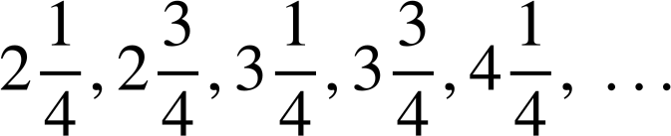

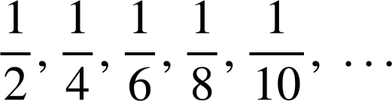

Taxanaha xisaabeed iyo joomatari (Arithmetic and geometric sequences)
Kee ka mid ah taxanahan waa xisaabeed (arithmetic)?
Xisaabeed (Arithmetic) -
Farqi guud (common difference) oo ah +6
Xisaabeed (Arithmetic) -
Farqi guud (common difference) oo ah +0.05
Xisaabeed (Arithmetic) -
Farqi guud (common difference) oo ah
Ma aha xisaabeed (Not arithmetic) -
Ma jiro farqi guud (common difference)
−9, −3, 3, 9, 15, …
1.34, 1.39, 1.44, 1.49, 1.54, …

Slide 15

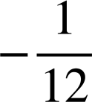
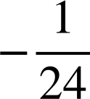
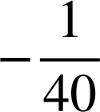
Taxanaha xisaabeed iyo joomatari (Arithmetic and geometric sequences)
Kee ka mid ah taxanahan waa xisaabeed (arithmetic)?
Ma aha xisaabeed (Not arithmetic) -
Ma jiro farqi guud (common difference)
−9, −3, 3, 9, 15, …
1.34, 1.39, 1.44, 1.49, 1.54, …

Slide 16
Taxanaha xisaabeed iyo joomatari (Arithmetic and geometric sequences)
Cabdi iyo Caasha waxay eegayaan nooc kale oo taxane ah.
2, 6, 18, 54, 162, …
×3
×3
×3
×3
Ma arki kartaa xiriirka isku dhufashada (multiplicative relationship) ee u dhexeeya ereyada halkan?
Haa. Waa ×3
Waxaan ugu yeernaa tiro-dhufashadan (multiplier) saamiga guud (common ratio).
Taxanaha joomatari (geometric sequences), xiriirka joogtada ah ee isku dhufashada (multiplicative relationship) ee u dhexeeya ereyada isku xiga waxaa loo yaqaan saamiga guud (common ratio).

Slide 17
Taxanaha xisaabeed iyo joomatari (Arithmetic and geometric sequences)
Saami guud (common ratio) oo ah 6
U qaybi erey kasta ereyga hore si aad u hesho saamiga guud (common ratio).
1237, 7422, 44 532, 267 192, 1 603 152, …
×6
×6
×6
×6
1 603 152 ÷ 267 192 = 6
267 192 ÷ 44 532 = 6
44 532 ÷ 7422 = 6
7422 ÷ 1237 = 6

Slide 18


Taxanaha xisaabeed iyo joomatari (Arithmetic and geometric sequences)
Saami guud (common ratio) oo ah
U qaybi erey kasta ereyga hore si aad u hesho saamiga guud (common ratio).
768, 576, 432, 324, 243, …
243 ÷ 324 =
324 ÷ 432 =
432 ÷ 576 =
576 ÷ 768 =

Slide 19
Taxanaha xisaabeed iyo joomatari (Arithmetic and geometric sequences)
1) Kala saar taxanahan (sequences) kuwa xisaabeed (arithmetic) iyo kuwa joomatari (geometric).
a) −4, −2, 0, 2, …
b) 2, 4, 8, 16, …
c) −4, 4, 12, 20, …
d) 4, 12, 36, 108, …
e) 36, 24, 12, 0, …
f) 108, 36, 12, 4, …
g) 1, −2, 4, −8, …
h) 1, −2, −5, −8, …

Slide 20

Taxanaha xisaabeed iyo joomatari (Arithmetic and geometric sequences)
2) Soo hel ereyga 1aad iyo 4aad ee taxanahan (sequences) oo qarsoon.
a) Taxanaha xisaabeed (arithmetic sequence) −9, 9, 27, 45, …
b) Taxanaha joomatari (geometric sequence) 3, 9, 27, 81, …
c) Taxanaha xisaabeed (arithmetic sequence) 7, 4, 1, −2, …
d) Taxanaha joomatari (geometric sequence) 16, 4, 1, , …

Slide 21

Farqiga guud (Common difference) +2
Farqiga guud (Common difference) −12
Xisaabeed (Arithmetic)
Farqiga guud (Common difference) +8
Farqiga guud (Common difference) −3
Saamiga guud (Common ratio) 2
Saamiga guud (Common ratio)
Joomatari (Geometric)
Saamiga guud (Common ratio) 3
Saamiga guud (Common ratio) −2
Taxanaha xisaabeed iyo joomatari (Arithmetic and geometric sequences)
1) Kala saar taxanahan (sequences) kuwa xisaabeed (arithmetic) iyo kuwa joomatari (geometric).
a) −4, −2, 0, 2, …
e) 36, 24, 12, 0, …
c) −4, 4, 12, 20, …
h) 1, −2, −5, −8, …
b) 2, 4, 8, 16, …
f) 108, 36, 12, 4, …
d) 4, 12, 36, 108, …
g) 1, −2, 4, −8, …

Slide 22

Taxanaha xisaabeed iyo joomatari (Arithmetic and geometric sequences)
2) Raadi xubnaha 1aad iyo 4aad ee la qariyey ee taxanahan.
a) Taxanaha xisaabeed (arithmetic sequence) −9, 9, 27, 45, …
+18
+18
+18
b) Taxanaha joomatari (geometric sequence) 3, 9, 27, 81, …
×3
×3
×3
c) Taxanaha xisaabeed (arithmetic sequence) 7, 4, 1, −2, …
−3
−3
−3
d) Taxanaha joomatari (geometric sequence) 16, 4, 1, , …

Slide 23
Hubinta iyo xoojinta fahamka taxanaha aan tooska ahayn (non-linear sequences)
Taxanaha xisaabeed iyo joomatari (Arithmetic and geometric sequences)
Noocyada kale ee taxanaha (Other types of sequences)

Slide 24
Noocyada kale ee taxanaha (Other types of sequences)
Caasha iyo Yacquub waxay bartaan taxane kale.
1, 4, 9, 16, 25, …
Waan caawin karaa! Qaabkaas waa tirooyinkayaga laba jibaaran (square numbers)!
1² = 1
2² = 4
3² = 9
4² = 16
Waan ku adkanahay helista xubinta 5aad halkan. Taxanahan ma laha farqi guud (common difference) iyo saami guud (common ratio) midna.
Marka kan xiga waa 52 Taasi waa 25. Mahadsanid Cabdi!

Slide 25
Noocyada kale ee taxanayaasha (sequences)
Caasha iyo Yacquub waxay baranayaan taxane kale (sequence).
1, 4, 9, 16, 25, …
+3
+5
+7
+9
+2
+2
+2
Tani waa mid xiiso leh. Kala duwanaanshaha xilli-ilaa-xilli (term-to-term differences) waxay leeyihiin kala duwanaansho guud (common difference)!
Dhammaan taxanayaasha (sequences) ma laha kala duwanaansho guud (common difference) ama saami guud (common ratio). Waxaa jira taxane kale oo aan ahayn kuwa xisaabeed (arithmetic) iyo kuwa joomatari (geometric).

Slide 26
Noocyada kale ee taxanayaasha (sequences)
Caasha iyo Yacquub waxay baranayaan taxane kale (sequence).
1, 4, 9, 16, 25, …
+3
+5
+7
+9
Si ka duwan taxanayaasha xisaabeed (arithmetic sequences) ee leh kala duwanaanshaha koowaad ee guud (common first difference), qaar ka mid ah taxanayaashu waxay leeyihiin kala duwanaansho labaad oo guud (common second difference).
Si ka duwan taxanayaasha xisaabeed (arithmetic sequences) ee leh kala duwanaanshaha koowaad ee guud (common first difference), qaar ka mid ah taxanayaashu waxay leeyihiin kala duwanaansho labaad oo guud (common second difference).
+2
+2
+2
Dhammaan taxanayaasha (sequences) ma laha kala duwanaansho guud (common difference) ama saami guud (common ratio). Waxaa jira taxane kale oo aan ahayn kuwa xisaabeed (arithmetic) iyo kuwa joomatari (geometric).

Slide 27
Noocyada kale ee taxanayaasha (sequences)
Tirooyinka saddex-xagalka (triangular numbers) waxay leeyihiin sifadaas la mid ah.
1, 4, 9, 16, 25, …
1, 3, 6, 10, 15, …
+3
+5
+7
+9
+2
+3
+4
+5
+2
+2
+2
+1
+1
+1
Kala duwanaansho labaad oo guud (common second difference) ah oo ah +1

Slide 28
Noocyada kale ee taxanayaasha (sequences)
Caasha iyo Cabdi waxay tijaabinayaan (experiment) taxanayaashan gaarka ah.
1, 4, 9, 16, 25, …
1, 3, 6, 10, 15, …
+3
+5
+7
+9
+2
+3
+4
+5
+2
+2
+2
+1
+1
+1
Waxaan ku dhufanayaa (multiply) tirooyinka laba-jibbaaran (square numbers) −2
Waxaan ku darayaa (add) −5 tirooyinka saddex-xagalka (triangular numbers).
−2,−8,−18,−32,−50, …
−4,−2, 1, 5, 10, …
Maxaad u arkaysaa?

Slide 29
Noocyada kale ee taxanayaasha (sequences)
Caasha iyo Cabdi waxay tijaabinayaan (experiment) taxanayaashan gaarka ah.
1, 4, 9, 16, 25, …
1, 3, 6, 10, 15, …
+3
+5
+7
+9
+2
+3
+4
+5
+2
+2
+2
+1
+1
+1
Waxaan ku dhufanayaa (multiply) tirooyinka laba-jibbaaran (square numbers) −2
Waxaan ku darayaa (add) −5 tirooyinka saddex-xagalka (triangular numbers).
−2,−8,−18,−32,−50, …
−4,−2, 1, 5, 10, …
−6
−10
−14
−18
+2
+3
+4
+5
−4
−4
−4
+1
+1
+1

Slide 30
Noocyo kale oo taxane ah
Caasha iyo Cabdi waxay tijaabo (experiment) ku sameeyaan taxanahan gaarka ah.
1, 4, 9, 16, 25, …
1, 3, 6, 10, 15, …
+3
+5
+7
+9
+2
+3
+4
+5
+2
+2
+2
+1
+1
+1
Weli waxaan helnaa farqi labaad oo guud (common second difference)!
Weli waxaan helaynaa kala duwanaansho labaad oo guud (common second difference)!
−2,−8,−18,−32,−50, …
−4,−2, 1, 5, 10, …
−6
−10
−14
−18
+2
+3
+4
+5
−4
−4
−4
+1
+1
+1

Slide 31
Noocyo kale oo taxane ah
Kee ka mid ah taxanahan ayaa leh farqi labaad oo guud (common second difference)?
Farqi labaad oo guud (common second difference) +20
Farqi koowaad oo guud (common first difference)
Farqi labaad oo guud (common second difference) +3
10, 40, 90, 160, 250, …
+30
+50
+70
+90
+20
+20
+20
15, 40, 65, 90, 115, …
+25
+25
+25
+25
4, 10, 19, 31, 46, …
+6
+9
+12
+15
+3
+3
+3

Slide 32
Noocyo kale oo taxane ah
Caasha iyo Cabdi waxay baaraan taxane kale oo gaar ah.
1, 8, 27, 64, 125, …
+7
+19
+37
+61
Haddii tirooyinka labajibbaaran (square numbers) iyo saddexagalka (triangular numbers) ay leeyihiin farqi labaad oo guud (common second difference), waxaan la yaabanahay waxa aan ka heli doonno tirooyinka saddex jibaaran (cube numbers).
+12
+18
+24
+6
+6
Wow! Farqi saddexaad oo guud (common third difference)! Taasi waa qurux.
Tirooyinkayaga saddex jibaaran (cube numbers), iyo taxanaha la xiriira, waxay leeyihiin farqi saddexaad oo guud (common third difference).

Slide 33
Noocyo kale oo taxane ah
Raadi farqi saddexaad oo guud (common third difference) ee taxankan.
5, 8, 18, 40, 79, …
+3
+10
+22
+39
+7
+12
+17
+5
+5

Slide 34
Noocyo kale oo taxane ah
1) Garto kee ka mid ah taxanahan ayaa leh farqi labaad oo guud (common second difference), iyo kee ayaa leh farqi saddexaad oo guud (common third difference).
a) 1, 2, 12, 31, 59, …
b) 1, 2, 5, 11, 21, …
c) 100, 95, 86, 65, 24, …
d) −68, −66, −54, −32, 0, …

Slide 35
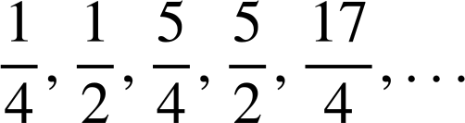
Noocyo kale oo taxane ah
2) Marka la eego in taxanahan ay leeyihiin farqi labaad oo guud (common second difference), raadi xubnaha maqan.
a) 1, 5, 11, 19, 29, …
b) 12, 14, 23, 39, 62, …
c) 0, 20, 36, 48, 56, …
d)

Slide 36


Noocyo kale oo taxane ah
3) Yacquub wuxuu baarayaa saddexdan taxane.
a) 12, 20, 28, 36, 42, …
Waxaan arkaa saddex taxane oo kordhaya, halkaasoo xubnuhu had iyo jeer kor u kici doonaan.
b) 12, 20, 30, 42, 56, …
c) 56, 70, 82, 92, 100, …
Bayaanka Yacquub waa run buuxda ma aha. Baadh taxanaha (sequences) oo fiiri haddii aad heli karto iskhilaafka (contradiction).

Slide 37
Kala duwanaansho saddexaad oo guud (common third difference) +1
Kala duwanaansho labaad oo guud (common second difference) +9
Kala duwanaansho saddexaad oo guud (common third difference) −8
Kala duwanaansho labaad oo guud (common second difference) +10
Noocyada kale ee taxanaha (sequences)
1) Gee ka mid ah taxanahan (sequences) leh kala duwanaansho labaad oo guud (common second difference), iyo kuwa leh kala duwanaansho saddexaad oo guud (common third difference).
a) 1, 2, 12, 31, 59, …
b) 1, 2, 5, 11, 21, …
+1
+10
+19
+28
+1
+3
+6
+10
+9
+9
+9
+2
+3
+4
+1
+1
c) 100, 95, 86, 65, 24, …
d) −68, −66, −54, −32, 0, …
−5
−9
−21
−41
+2
+12
+22
+32
−4
−12
−20
+10
+10
+10
−8
−8

Slide 38




Noocyada kale ee taxanaha (sequences)
2) Marka la eego in taxanahan (sequences) ay leeyihiin kala duwanaansho labaad oo guud (common second difference), hel xubnaha maqan (missing terms).
a) 1, 5, 11, 19, 29, …
b) 12, 14, 23, 39, 62, …
+4
+6
+8
+10
+2
+9
+16
+23
+2
+2
+2
+7
+7
+7
c) 0, 20, 36, 48, 56, …
d)
+20
+16
+12
+8
−4
−4
−4

Slide 39
Noocyada kale ee taxanaha (sequences)
3) Yacquub wuxuu baarayaa saddexdan taxane (sequences).
a) 12, 20, 28, 36, 44, …
Waxaan arkayaa saddex taxane oo kordhaya (increasing sequences) oo xubnuhu had iyo jeer kor u kici doonaan.
b) 12, 20, 30, 42, 56, …
c) 56, 70, 82, 92, 100, …
Bayaanka Yacquub waa run buuxda ma aha. Baadh taxanaha (sequences) oo fiiri haddii aad heli karto iskhilaafka (contradiction).

Slide 40
Taxane xisaabeed (arithmetic sequence), kala duwanaansho guud oo togan (positive common difference). Xubnuhu weligood kor u kici doonaan.
Kala duwanaansho labaad oo togan (positive second difference) oo si joogto ah u kordhinaysa kala duwanaanshaha koowaad (first difference). Xubnuhu weligood kor u kici doonaan.
Kala duwanaansho labaad oo taban (negative second difference) oo yaraynaysa kala duwanaanshaha koowaad (first difference).
Noocyada kale ee taxanaha (sequences)
3) Yacquub wuxuu baarayaa saddexdan taxane (sequences).
a) 12, 20, 28, 36, 44,
a) 12, 20, 28, 36, 44, 52, 60, 68, 76, 84, …
+8
+8
+8
+8
+8
+8
+8
+8
+8
b) 12, 20, 30, 42, 56,
b) 12, 20, 30, 42, 56, 82, 100, 120, 142, …
+8
+10
+12
+14
+16
+18
+20
+22
+2
+2
+2
+2
+2
+2
+2
c) 56, 70, 82, 92, 100,
+14
+12
+10
+8
−2
−2
−2

Slide 41
Noocyada kale ee taxanaha (sequences)
3) Yacquub wuxuu baarayaa saddexdan taxane (sequences).
Wow! Taxane (sequence) oo kordhayay (increasing) ka dibna bilaabay inuu yaraado (decreasing)!
a) 12, 20, 28, 36, 44,
a) 12, 20, 28, 36, 44, 52, 60, 68, 76, 84, …
+8
+8
+8
+8
+8
+8
+8
+8
+8
b) 12, 20, 30, 42, 56,
Taasi waa mid qurux badan!
b) 12, 20, 30, 42, 56, 82, 100, 120, 142, …
+8
+10
+12
+14
+16
+18
+20
+22
+2
+2
+2
+2
+2
+2
+2
c) 56, 70, 82, 92, 100, 106, 110, 112, 112, 110, 106, 100, 92, …
c) 56, 70, 82, 92, 100,
c) 56, 70, 82, 92, 100,
c) 56, 70, 82, 92, 100, 106, 110, 112, 112,
+14
+12
+10
+8
+6
+4
+2
+0
−2
−4
−6
−8
−2
−2
−2
−2
−2
−2
−2
−2
−2
−2
−2

Slide 42
Hubinta iyo xoojinta fahamka taxanayaasha aan tooska ahayn (non-linear sequences)
Taxanayaal leh farqi isku mid ah oo lagu daro xilli-ilaa-xilli waa xisaabeed (arithmetic), sidoo kale loo yaqaan toosan (linear).
Taxanayaal leh xiriir isku dhufasho oo ka dhexeeya xilli-ilaa-xilli waa joomatari (geometric).
Waxaan qaddarin karnaa in aysan dhammaan taxanayaashu ahayn xisaabeed (arithmetic) ama joomatari (geometric); waxaa jira noocyo kale oo taxane ah oo leh astaamo kale.

