Slide 1
Hubinta iyo xaqiijinta fahamka saddexagallada isku midka ah (similar triangles)
Trigonometry

Slide 2
Sida agabkeena waxbarista loo qaabeeyey fasalka

Slide 3
Waxaan garan karaa in qaababka isku midka ah (similar shapes) ay leeyihiin dhinacyo isku saami ah (proportion) laakiin cabbirka xaglaha (angles) waa la ilaaliyaa.

Slide 4
Laba qaab (shapes) waa isku mid (similar) haddii farqiga ugu weyn ee u dhexeeya ay tahay cabbirkooda. Dhererka dhinacyadoodu waa isku saami (proportion).
Weyneyn (Enlargement) waa isbeddel (transformation) keenaya isbeddel cabbirka.
Qiyaasta weyneyn (Scale factor) waa tirada lagu dhufto qaababka isku midka ah (similar shapes) oo qeexaysa inta uu qaabku ka weyn yahay kan kale.

Slide 5

Hubinta iyo xaqiijinta fahamka saddexagallada isku midka ah (similar triangles)
Aqoonsiga saddexagallada isku midka ah (similar triangles)
Helista dhererka maqan ee saddexagallada isku midka ah (similar triangles)

Slide 6
Aqoonsiga saddexagallada isku midka ah (similar triangles)
Marka qaab la weyneeyo (enlarged), xaglaha (angles) ma beddelmaan.
Sidaas darteed, qaababka isku midka ah (similar shapes) waxay leeyihiin xaglo (angles) isku mid ah.
53°
5 m
53°
3 m
37°
37°
4 m

Slide 7
Aqoonsiga saddexagallada isku midka ah (similar triangles)
Marka qaab la weyneeyo (enlarged), dhererka ayaa laga yaabaa inuu beddelmo. Tani waxay ku xiran tahay qiyaasta weyneyn (scale factor).
Sidaas darteed, qaababka isku midka ah (similar shapes) waxay yeelan karaan dhererro kala duwan.
× 2
53°
10 m
5 m
53°
3 m
× 2
6 m
37°
37°
4 m
× 2
8 m

Slide 8
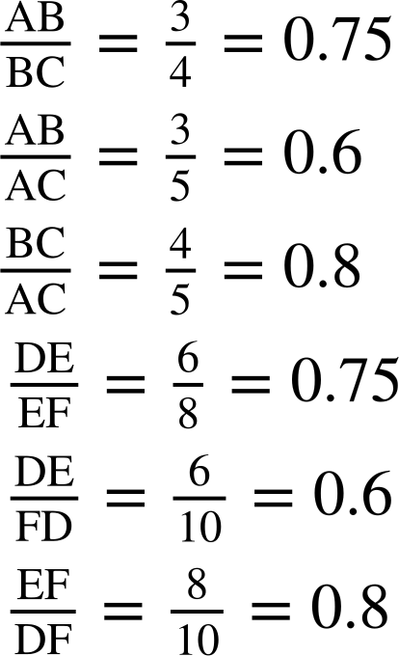
Aqoonsiga saddexagallada isku midka ah (similar triangles)
Marka qaab la weyneeyo (enlarged), saamiyada (proportions) u dhexeeya labada dherer kama beddelmaan.
Sidaas darteed, qaababka isku midka ah (similar shapes) waxay leeyihiin dhererro isku saami ah (proportions).
× 0.6
× 0.6
53°
10 m
5 m
53°
3 m
6 m
37°
37°
× 0.8
4 m
× 0.75
8 m
× 0.75
× 0.8

Slide 9
Aqoonsiga saddexagallada isku midka ah (similar triangles)
Shuruudaha saddexagallada isku eg (congruent triangles) waxaa loo isticmaali karaa in lagu muujiyo in dhererrada iyo xaglaha aan la garanayn ay go'an yihiin cabbirada la yaqaan.
Shuruudahan waa la habeyn karaa si loo go'aamiyo isku ekaanshaha (similarity) saddexagallada.
SSS
ASA
AAS
RHS
5 m
5 m
5 m
3 m
53°
53°
3 m
3 m
37°
37°
4 m
5 m
5 m
5 m
3 m
53°
53°
3 m
3 m
37°
37°
4 m

Slide 10
Aqoonsashada saddexagallada isku eg (similar triangles)
Shuruudaha saddexagallada isku midka ah (congruent triangles) waxaa loo isticmaali karaa in la muujiyo in dhererka iyo xaglaha aan la aqoon ay go'an yihiin cabbirada la yaqaan.
Shuruudahan waa la habeyn karaa si loo go'aamiyo isku ekaanshaha (similarity) saddexagallada.
Dhererku way kala duwan yihiin laakiin lammaanaha dhererka ayaa isku saami (proportions) ah.
SSS
ASA
AAS
RHS
5 m
5 m
5 m
3 m
53°
53°
3 m
3 m
37°
37°
4 m
10 m
10 m
10 m
53°
53°
6 m
6 m
6 m
37°
37°
8 m

Slide 11
Aqoonsashada saddexagallada isku eg (similar triangles)
Isku ekaanshaha (similarity) saddexagallada waxaa sidoo kale lagu go'aamin karaa saddexda xagal oo dhan.
Marka laba saddexagal isku eg yihiin (similar), waxay leeyihiin xaglo isku mid ah.
Marka laba saddexagal ay leeyihiin xaglo isku mid ah, waxay isku eg yihiin (similar).

Slide 12
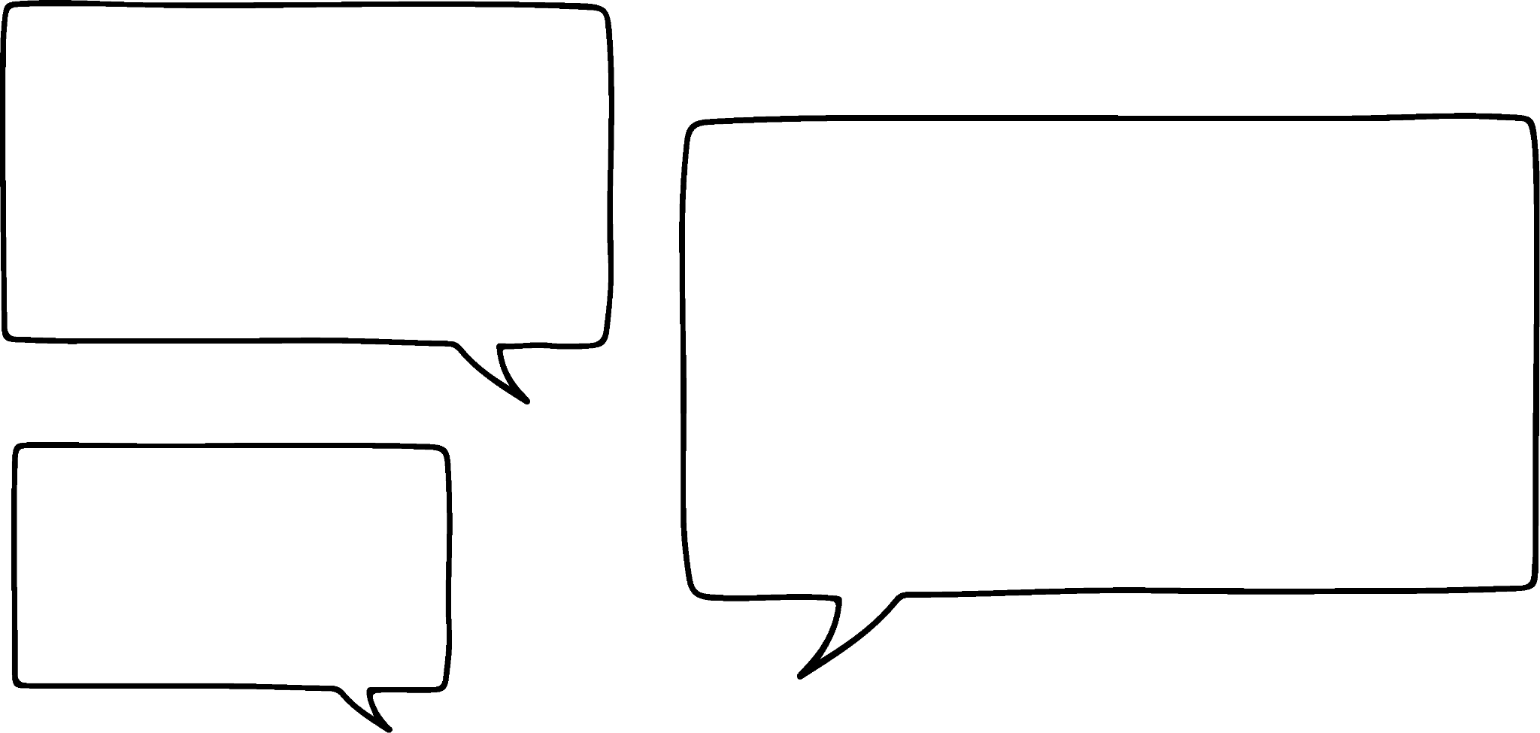


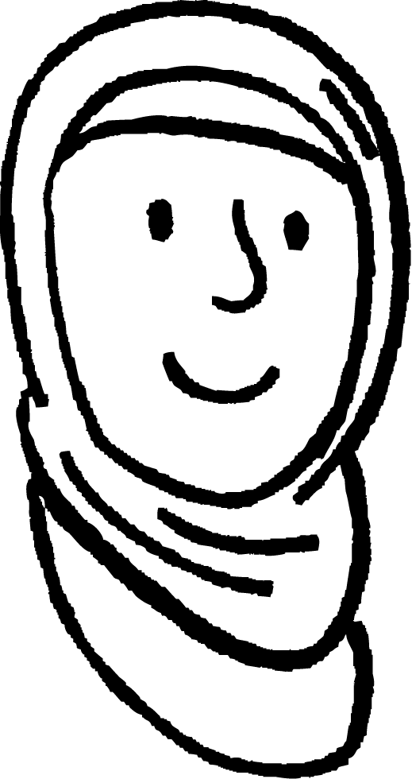
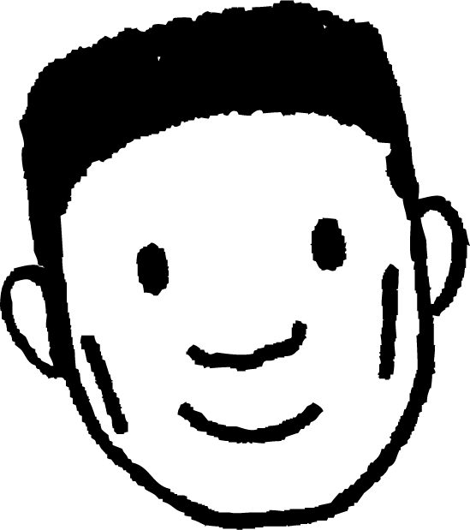


Aqoonsashada saddexagallada isku eg (similar triangles)
Ma jiraan macluumaad ku filan oo lagu ogaan karo in saddexagalladu isku mid yihiin?
Sidee ayaan u ogaan karnaa isku ekaansho (similarity) iyada oo aanan ognayn in xagluhu isku mid yihiin?
× 0.8
5 cm
× 0.625
4 cm
8 cm
Waxaan heli karnaa saamiyada (proportions) u dhexeeya labada dherer oo saddexagalka ah.
× 0.5
Caasha
7.5 cm
6 cm
5 ÷ 8 = 0.625
4 ÷ 8 = 0.5
4 ÷ 5 = 0.8
12 cm
Cabdi

Slide 13
Aqoonsiga saddexagallada isku midka ah (similar triangles)
Ma jiraan macluumaad ku filan oo lagu ogaan karo in saddexagalladu isku mid yihiin?
Dhererka saddexagalladu waa isku saami (proportions), markaa xagluhu waa inay isku mid ahaadaan.
× 0.8
5 cm
× 0.625
4 cm
8 cm
× 0.8
Ka dibna hubi in saamiyadaas laga heli karo saddexagalka kale.
× 0.5
Caasha
7.5 cm
6 cm
5 ÷ 8 = 0.625
4 ÷ 8 = 0.5
4 ÷ 5 = 0.8
12 cm
× 0.5
× 0.625
Cabdi

Slide 14

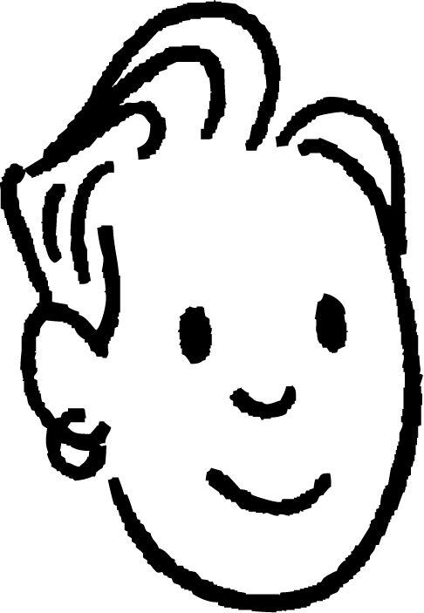
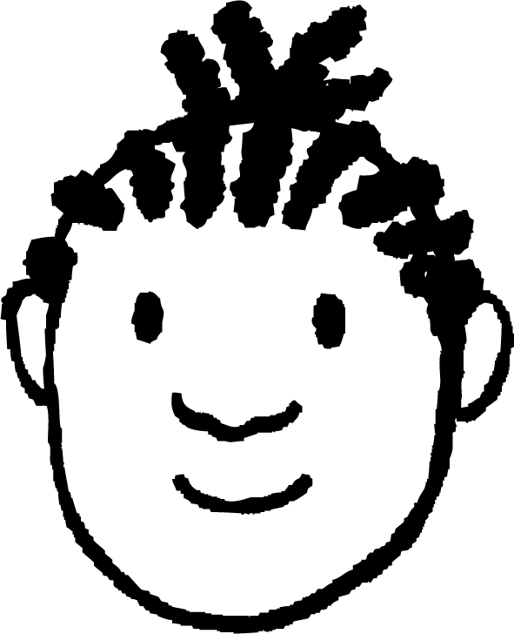

Aqoonsiga saddexagallada isku midka ah (similar triangles)
Ma jiraan macluumaad ku filan oo lagu ogaan karo in saddexagalladu isku mid yihiin?
Sidee ayaan u ogaan karnaa isku ekaansho (similarity) iyada oo aanan ognayn dherer kasta?
45°
45°
Labada saddexagal waxay leeyihiin xaglo isku mid ah, sidaas darteed dhererkoodu waa inuu ahaadaa isku saami (proportion). Marka waa isku mid yihiin.
83°
Yacquub
52°
83°
52°
Saciid

Slide 15
Aqoonsashada saddex-xagalka isku midka ah (Identifying similar triangles)
Ma jiraan macluumaad ku filan oo lagu go'aamin karo in saddex-xagallada (triangles) ay isku mid yihiin (similar)?
Waxaan ognahay laba xagal oo keliya markan. Miyaan wali go'aamin karnaa isku midnimada (similarity)?
Waxaan arki karnaa laba ka mid ah xaglaha (angles) ayaa isku mid ah saddex-xagal kasta. Taas macneheedu waa in xagalka (angle) saddexaad uu sidoo kale isku mid yahay. Waxaan hubin karnaa anagoo helayna xagasha (angle) maqan mid kasta.
30°
75°
75°
Yacquub
Marka, saddex-xagalladu (triangles) waa isku mid (similar).
30°
Saciid

Slide 16
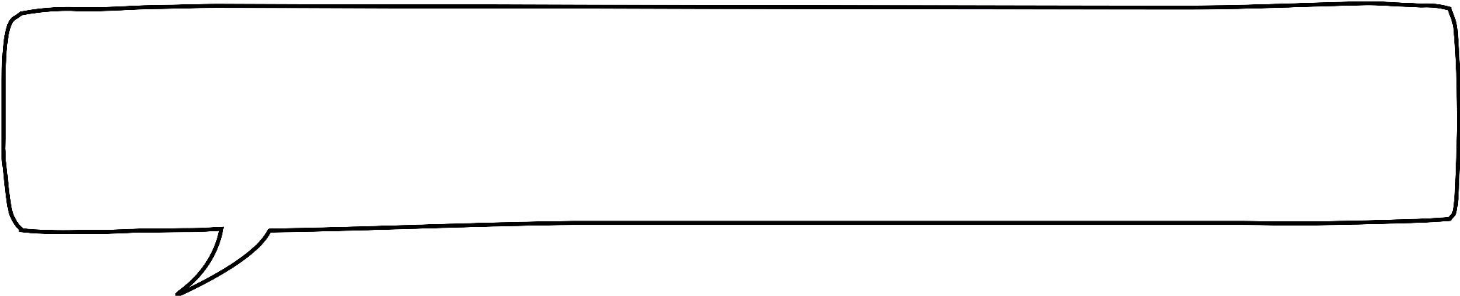
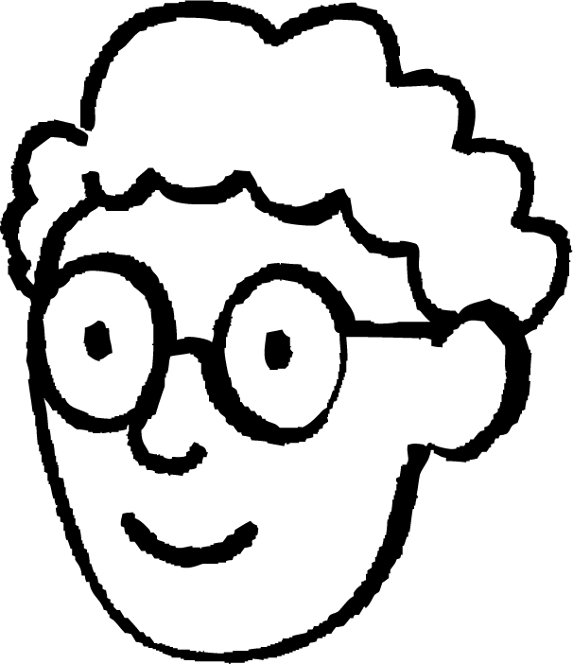
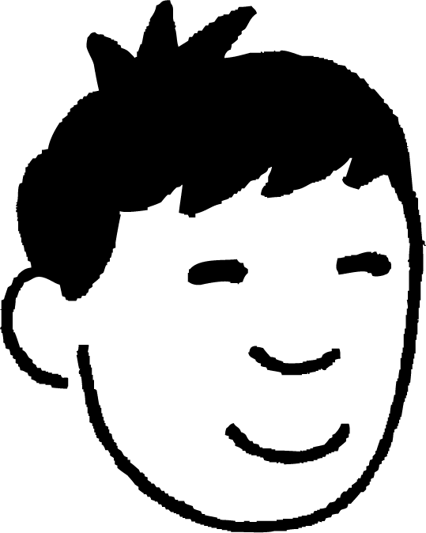

Aqoonsashada saddex-xagalka isku midka ah (Identifying similar triangles)
Ma jiraan macluumaad ku filan oo lagu go'aamin karo in saddex-xagallada (triangles) ay isku mid yihiin (similar)?
Waxaan haysannaa xagal qumman (right-angle) waxaana naqaan dhererka (lengths) hypotenuse-ka iyo dhinac kale (RHS).
6 m
4 m
Haddii dhererka (lengths) isku mid ahaan lahaa, markaas waxaan caddayn karnaa inay isku mid yihiin (congruent).
Nuur
Taasi waxay ka dhigan tahay in saddex-xagallada (triangles) ay leeyihiin xaglo (angles) isku mid ah oo uu jiro hal dherer (length) oo keliya oo suurtogal ah oo cidhifka (edge) saddexaad.
12 m
Axmed
6 m
8 m
4 m
Layla

Slide 17
Aqoonsashada saddex-xagalka isku midka ah (Identifying similar triangles)
Ma jiraan macluumaad ku filan oo lagu go'aamin karo in saddex-xagallada (triangles) ay isku mid yihiin (similar)?
Laba dherer (lengths) oo la yaqaan oo ka mid ah saddex-xagalka (triangle) weyn ayaa labanlaab ah dhererkooda (lengths) u dhigma ee saddex-xagalka (triangle) yar.
6 m
4 m
Waxaan u isticmaali karnaa RHS si aan u ogaano in ay jirto hal dherer (length) oo keliya oo suurtogal ah oo loogu talagalay cidhifka (edge) haray ee saddexagalka weyn.
x m
× 2
× 2
Nuur
× 2
12 m
Sidaa darteed cidhifkani (edge) waa inuu sidoo kale laba jibaar ku yahay dhererka (length) cidhifkiisa u dhigma.
Axmed
8 m
2x m
Layla

Slide 18
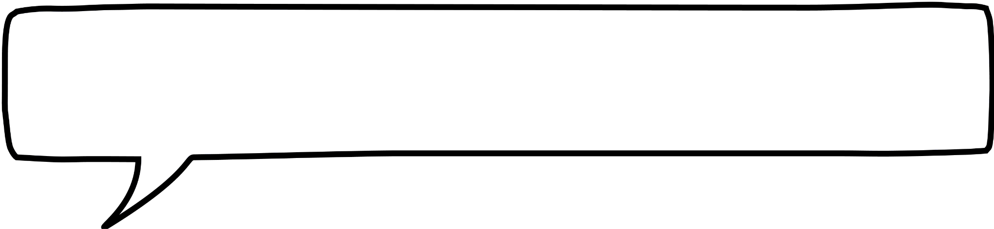
Aqoonsiga saddexagallada isku midka ah (similar triangles)
Ma jiraan macluumaad ku filan oo lagu ogaan karo in saddexagalladu ay isku mid yihiin (similar)?
6 m
Saddexagalladu waa isku mid yihiin (similar)!
4 m
Saddexagalladu waa isku mid yihiin (similar)!
Nuur
12 m
Saddexagalladu waa isku mid yihiin (similar)!
Axmed
8 m
Layla

Slide 19

Aqoonsiga saddexagallada isku midka ah (similar triangles)
Yaa run ah?
6 m
Saddexagalladu waa isku mid yihiin (similar).
30°
Saddexagalladu ma aha kuwa isku mid ah (similar).
30°
9 m
Ma jiraan macluumaad ku filan oo lagu ogaan karo isku midnimada (similarity).

Slide 20
Aqoonsiga saddexagallada isku midka ah (similar triangles)
Yaa run ah?
12 m
6 m
Saddexagalladu waa isku mid yihiin (similar).
Saddexagalladu ma aha kuwa isku mid ah (similar).
9 m
Ma jiraan macluumaad ku filan oo lagu ogaan karo isku midnimada (similarity).
18 m

Slide 21
Aqoonsiga saddex-xagallada isku midka ah (similar triangles)
Yaa run ah?
12 m
6 m
Saddex-xagalladu waa isku mid (similar).
30°
30°
Saddex-xagalladu ma aha isku mid (similar).
30°
30°
9 m
Ma jiro macluumaad ku filan oo lagu go'aamiyo isku midnimada (similarity).
18 m

Slide 22
Aqoonsiga saddex-xagallada isku midka ah (similar triangles)
1) Saddex-xagal kasta, ku qor calaamad (tick) haddii uu la mid yahay △ABC, iskutallaab (cross) haddii aanu la mid ahayn, iyo su'aal (question mark) haddii aysan jirin macluumaad ku filan oo lagu go'aamiyo isku midnimada (similarity). Jaantusyada si sax ah looma sawirin, dhererka oo dhami waa isku halbeeg (same units).
A
a)
b)
c)
55
50
45
30
35
21
37°
37°
37°
C
B
28
32
40
44
d)
e)
f)
g)
60
37°
52
48
48
37°
60
39

Slide 23
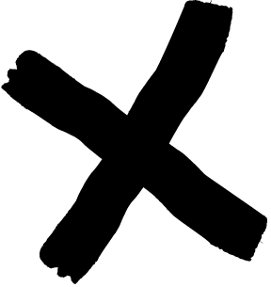
Aqoonsiga saddex-xagallada isku midka ah (similar triangles)
1) Saddex-xagal kasta, ku qor calaamad (tick) haddii uu la mid yahay △ABC, iskutallaab (cross) haddii aanu la mid ahayn, iyo su'aal (question mark) haddii aysan jirin macluumaad ku filan oo lagu go'aamiyo isku midnimada (similarity). Jaantusyada si sax ah looma sawirin, dhererka oo dhami waa isku halbeeg (same units).
A
a)
b)
c)
55
50
45
30
35
21
37°
37°
37°
C
B
28
32
40
44
d)
e)
f)
g)
60
37°
52
48
48
?
37°
60
39

Slide 24
Hubinta iyo xoojinta fahamka saddex-xagallada isku midka ah (similar triangles)
Aqoonsiga saddex-xagallada isku midka ah (similar triangles)
Helista dhererka maqan iyadoo la adeegsanayo saddex-xagallada isku midka ah (similar triangles)

Slide 25

Helista dhererka maqan iyadoo la adeegsanayo saddex-xagallada isku midka ah (similar triangles)
Laba saddex-xagal ee hoose waa isku mid (similar).
Tan waxaa lagu caddayn karaa iyadoo la helo xagasha (angle) hadhay.
Haddii dherer labaad laga ogaado hal saddex-xagal, dhererka u dhigma (corresponding length) ee saddex-xagalka kale waxaa laga heli karaa iyadoo la adeegsanayo sababaynta saami (proportional reasoning).
Habka 1aad (Method 1):
= 1.25
× 1.25
20 m
16 m
60°
60°
× 1.25
y m
y = 8 × 1.25
= 10
8 m
30°
30°

Slide 26

Helista dhererka maqan iyadoo la adeegsanayo saddex-xagallada isku midka ah (similar triangles)
Laba saddex-xagal ee hoose waa isku mid (similar).
Tan waxaa lagu caddayn karaa iyadoo la helo xagasha (angle) hadhay.
Haddii dherer labaad laga ogaado hal saddex-xagal, dhererka u dhigma (corresponding length) ee saddex-xagalka kale waxaa laga heli karaa iyadoo la adeegsanayo sababaynta saami (proportional reasoning).
Habka 2aad (Method 2):
× 0.5
= 0.5
× 0.5
20 m
16 m
8 m
y m
y = 20 × 0.5
= 10
30°
30°

Slide 27
Helista dhererka maqan ee saddexagallada isku qaabka (similar triangles)
Cabbiraadaha isku dhufashada (scale factors) iyo tiro-dhufashada (multipliers) gudaha saddex-xagallada ayaa noqon kara kuwa fudud in la helo marka ay jirto gees (edge) dhererkeedu yahay 1 halbeeg (unit).
Tusaale: hel qiimaha (value) x iyo y.
Habka 1aad:
x = 0.87 × 20
= 17.4
× 20
20 m
1
y m
× 20
0.5
y = 0.5 × 20
= 10
30°
30°
0.87
× 20
x m

Slide 28
Helista dhererka maqan ee saddexagallada isku qaabka (similar triangles)
Qiyaasaha (scale factors) iyo isku dhufashada (multipliers) gudaha saddexagallada way fududaan karaan in la helo marka ay jirto gees dhererkiisu yahay 1 halbeeg (unit).
Tusaale: hel qiimaha (value) x iyo y.
Habka 2aad:
× 0.5
x = 20 × 0.87
= 17.4
× 0.5
20 m
1
y m
0.5
× 0.87
× 0.87
y = 20 × 0.5
= 10
30°
30°
0.87
x m

Slide 29
Helista dhererka maqan ee saddexagallada isku qaabka (similar triangles)
Maadaama mid ka mid ah saddexagallada uu leeyahay gees dhererkiisu yahay 1 halbeeg (unit), waxaa laga yaabaa inay fududaato in la arko xiriirka saamiyada (proportional relationships) gudaha saddexagallada halkii laga xisaabin lahaa qiyaasta (scale factor) ee u dhexeeya saddexagallada.
Hawlaha rogaal celiska (inverse operations) ayaa loo isticmaali karaa in lagu helo qiimaha (value) x.
× 0.5
× 0.5
x m
12 m
1
÷ 0.5
0.5
x = 12 ÷ 0.5
= 24
30°
30°

Slide 30
Helista dhererka maqan ee saddexagallada isku qaabka (similar triangles)
Hel qiimaha (value) y.
12 ÷ 10 = 1.2
y = 7.5 × 1.2
= 9
× 0.75
× 0.75
× 1.2
12 m
ama
10 cm
y m
7.5 m
× 1.2
7.5 ÷ 10 = 0.75
y = 12 × 0.75
= 9
49°
49°

Slide 31
Helista dhererka maqan ee saddexagallada isku qaabka (similar triangles)
Hel qiimaha (value) x.
x = 0.7 × 12
= 8.4
× 12
12 m
ama
1
× 0.7
x = 0.7 × 12
= 8.4
× 0.7
49°
49°
× 12
x m
0.7

Slide 32
Helista dhererka maqan ee saddexagallada isku qaabka (similar triangles)
Hel qiimaha (value) x.
x = 12 ÷ 0.7
= 17.1
x m
÷ 0.7
1
× 0.7
× 0.7
49°
49°
0.7
12 m

Slide 33
Helista dhererka maqan ee saddexagallada isku qaabka (similar triangles)
Marka saddexagal la weyneeyo (enlarged), isku dhufashada (multipliers) ee u dhexeeya lammaaneyaasha dhererka ayaa isku midi ahaanaya.
Tan waxaa la arki karaa marka saddexagallada la isku dhex geliyo (nested) iyo marka si gooni ah loo sawiro.
× 0.5
1
0.5
30°
4
× 0.5
3
× 0.5
× 0.5
4
2
× 0.5
2
2
× 0.5
1.5
1
1
0.5
30°
30°

Slide 34
Helista dhererka (lengths) maqan iyadoo la isticmaalayo saddex-xagallo isku mid ah (similar triangles)
Laba saddex-xagal oo isku mid ah (similar triangles) ayaa laga samayn karaa hal saddex-xagal iyadoo la qaado cabbiro (measurements) qayb ka mid ah geesihiisa.
x m
x m
÷ 0.75
1 m
× 0.75
1 m
× 0.75
0.75 m
3.9 m
3.15 m
0.75 m
3.9 m
3.9 m
x = 3.95 ÷ 0.75 = 5.27

Slide 35
Helista dhererka (lengths) maqan iyadoo la isticmaalayo saddex-xagallo isku mid ah (similar triangles)
Tiir dheer ayaa taagan oo ay xadhiggu hayaan. Saciid wuxuu doonayaa inuu ogaado dhererka tiirka.
Ma qiyaasi karo dhammaan tiirka ama xadhigga oo dhan.
x m

Slide 36
Helista dhererka (lengths) maqan iyadoo la isticmaalayo saddex-xagallo isku mid ah (similar triangles)
Tiir dheer ayaa taagan oo ay xadhiggu hayaan. Saciid wuxuu doonayaa inuu ogaado dhererka tiirka.
Ma qiyaasi karo dhammaan tiirka ama xadhigga oo dhan.
Laakiin waxaan qiyaasi karaa masaafada (distance) dhulka.
x m
8 m
Sidee bay saddex-xagallo isku mid ah (similar triangles) uga caawin karaan Saciid dhibaatadan?

Slide 37
Helista dhererka (lengths) maqan iyadoo la isticmaalayo saddex-xagallo isku mid ah (similar triangles)
Tiir dheer ayaa taagan oo ay xadhiggu hayaan. Saciid wuxuu doonayaa inuu ogaado dhererka tiirka.
Waxaan qiyaasi karaa 1 m dhulka laga bilaabo halka xadhiggu taabto.
Halkaas, waxaan qiyaasi karaa masaafada (distance) toosan (vertical) ee u dhaxaysa xadhigga iyo dhulka.
x m
0.75 m
1 m
8 m

Slide 38
Helista dhererka (lengths) maqan iyadoo la isticmaalayo saddex-xagallo isku mid ah (similar triangles)
Tiir dheer ayaa taagan oo ay xadhiggu hayaan. Saciid wuxuu doonayaa inuu ogaado dhererka tiirka.
Waxaan markaas helayaa laba saddex-xagal oo isku mid ah (similar triangles) oo is-dhex-galay (nested), kuwaas oo aan u isticmaali karo inaan helo dhererka tiirka.
x m
0.75 m
x = 8 × 0.75
= 6
1 m
× 0.75
8 m
× 0.75
Tiirku waa 6 m dheer.

Slide 39
Helista dhererka (lengths) maqan iyadoo la isticmaalayo saddex-xagallo isku mid ah (similar triangles)
Waa maxay qiimaha (value) x?
2.2
x m
3.2
4 m
1 m
4
0.8 m
5

Slide 40
Helista dhererka (lengths) maqan iyadoo la isticmaalayo saddex-xagallo isku mid ah (similar triangles)
1) Dhererka (lengths) oo dhan waxaa lagu bixiyay cm. Soo hel qiimaha (values) aan la aqoon.
1
2
24°
0.4
1.5
d
24°
b
e
24°
24°
2.5
0.9
a
c
1.2
24°
1.8
66°
j
f
1.8
24°
24°
h
1.8
i
g

Slide 41
Helista dhererka (lengths) maqan iyadoo la isticmaalayo saddexagallo (triangles) isku mid ah (similar)
2) Raadi qiimaha (value) x, y iyo z.
z m
1.4 m
x m
1 m
0.55 m
11 m
1 m
0.7 m
y m
1.4 m

Slide 42
Helista dhererka (lengths) maqan iyadoo la isticmaalayo saddexagallo (triangles) isku mid ah (similar)
1) Dhammaan dhererka (lengths) waxaa lagu bixiyay cm. Raadi qiimaha (value) aan la garanayn.
1
2
24°
0.4
1.5
d
24°
b
e
24°
24°
2.5
0.9
a
c
a = 1.35
b = 0.6
c = 1.8
d = 0.8
e = 1
1.2
24°
1.8
66°
j
f
1.8
24°
24°
h
1.8
i
g
f = 1.62
g = 2
h = 4.5
i = 3
j = 2.7

Slide 43
Helista dhererka (lengths) maqan iyadoo la isticmaalayo saddexagallo (triangles) isku mid ah (similar)
2) Raadi qiimaha (value) x, y iyo z.
z m
1.4 m
x m
1 m
0.55 m
11 m
1 m
0.7 m
y m
1.4 m
x = 6.6
y = 0.98
z = 2

Slide 44
Hubinta iyo xoojinta fahamka saddexagallada (triangles) isku midka ah (similar)
Weyneyn (Enlargement) waa isbeddel (transformation) keena isbeddel xagga cabbirka.
Marka shay la weyneeyo, sawirku waa isku mid (similar). Dhererka (lengths) waa isbedeli karaa laakiin saamiyada (proportions) gudaha qaabku waa go'an. Xaglaha (angles) ma isbedelaan.
Sida saddexagallada (triangles) isku eg (congruent), ma aha dhammaan dhererka (lengths) iyo xaglaha (angles) in la ogaado si loo go'aamiyo in laba saddexagal (triangles) ay isku mid (similar) yihiin.
Haddii laba saddexagal (triangles) ay leeyihiin xaglo (angles) isku mid ah, markaas waa isku mid (similar).
Xiriirka saamiyeed (proportional relationship) ee u dhexeeya saddexagallada (triangles) isku midka ah (similar) iyo gudaha saddexagallada (triangles) isku midka ah (similar) waxaa loo isticmaali karaa in lagu helo dhererka (lengths) maqan.

