Slide 1
Hubinta iyo xoojinta fahamka sharciga qaybinta (distributive law) ee ereyada aljabrada (algebraic terms)
Tibaaxaha iyo qaaciidooyinka (Expressions and formulae)

Slide 2
sida loo isticmaalo darasyada Oak

Slide 3
Waxaan isticmaali karaa sharciga qaybinta (distributive law) si aan ugu dhufto tibaax (expression) hal qayb (term).

Slide 4
Sharciga qaybinta (distributive law) wuxuu sheegayaa in ku dhufashada wadarta (sum) ay la mid tahay ku dhufashada mid kasta oo ka mid ah (addend) iyo isku darka natiijada.
Tusaalooyin (Examples)
12 × (4 + 3)
12 × 7 = 84
12 × (4 − 3)
12 × (4 + (−3))
12 × 1 = 12
Isticmaalka sharciga qaybinta (distributive law)
12 × ( 4 + 3 )
Isticmaalka sharciga qaybinta (distributive law)
12 × (4 + (−3))
48
(−36)
= 12
48
+
+
36
= 84

Slide 5

Hubinta iyo xoojinta fahamka sharciga qaybinta (distributive law) ee ereyada aljabrada (algebraic terms)
Ku dhufashada tibaaxaha (expressions) hal qayb (term)
Ku dhufashada iyo fududaynta tibaaxaha badan (multiple expressions)

Slide 6
Ku dhufashada tibaaxaha (expressions) hal qayb (term)
Waxaad ku dhufan kartaa tibaaxaha (expressions) oo ay ku jiraan ereyada aljabrada (algebraic terms).
Waxaad isticmaali kartaa ama sawiri kartaa algebra tiles si aad tan u sahamiso.
x
1
1
1
1
Tusaale (Example)
x
1
1
1
1
5(x + 4)
x
1
1
1
1
x
1
1
1
1
Tani waxay ka dhigan tahay in tibaaxa (expression) ku jira qawska (brackets) lagu dhufanayo 5.
x
1
1
1
1
Sidaa darteed, waxaan dhisi karnaa ama sawiri karnaa matalaad (representation) tibaaxda x + 4
oo ku dhufo 5 (samee 5 nuqul).

Slide 7
Ku dhufashada tibaaxaha (expressions) eray (term)
Waxaad sidoo kale ku dhufan kartaa tibaaxaha (expressions) oo ay ku jiraan ereyada aljabrada (algebraic terms).
Waxaad isticmaali kartaa ama sawiri kartaa algebra tiles si aad tan u sahamiso.
x
1
1
1
1
Tusaale (Example)
x
1
1
1
1
+
5x
20
5(x + 4)
≡
x
1
1
1
1
x
1
1
1
1
x
1
1
1
1
Maxay tani inoo tusinaysaa in 5(x + 4) u dhigma (equivalent)?

Slide 8
Ku dhufashada tibaaxaha (expressions) eray (term)
Isticmaalka sifada qaybinta (distributive property) ee ku dhufashada isugeynta (addition) waxay u dhigantaa:
x + 4
Tusaale (Example)
5x
20
5(x + 4)
5 × (x + 4)
x
1
1
1
1
≡
x
1
1
1
1
5 × x
+
5 × 4
5
x
1
1
1
1
+
5x
20
x
1
1
1
1
x
1
1
1
1
Marka aan u kala bixino qawska (brackets) sidan oo kale, waxaan ugu yeernaa natiijada qaabka la fidiyay (expanded form) ee tibaaxaha (expression).

Slide 9
Ku dhufashada tibaaxaha (expressions) eray (term)
Ka digtoonow markaad ku dhufanayso erayada taban (negative terms).
Tiles-ka aljabrada (algebra tiles) waxay faa'iido u yeelan karaan in lagu qaabeeyo kuwan bilowga.
Tusaale (Example)
3
3(x − 4)
x
−1
−1
−1
−1
x
−1
−1
−1
−1
Waxaad dhisi kartaa tibaaxaha (expression) ku jira qawska (brackets), x − 4 oo la mid ah x + (−4) oo samayn 3 nuqul (copies).
x
−1
−1
−1
−1
Marka 3(x − 4) waxay u dhigantaa 3x + (−12) ama 3x −12

Slide 10
Ku dhufashada tibaaxaha (expressions) eray (term)
Ka digtoonow markaad ku dhufanayso erayada taban (negative terms).
Tiles-ka aljabrada (algebra tiles) waxay faa'iido u yeelan karaan in lagu qaabeeyo kuwan bilowga.
Tusaale (Example)
x + (−4)
3(x − 4)
3 × (x + (−4))
≡
−1
−1
−1
−1
3x
−12
+
x
3 × x
3 × −4
3
x
−1
−1
−1
−1
+
3x
(−12)
x
−1
−1
−1
−1
≡ 3x − 12
Ama isticmaal sifada qaybinta (distributive property) iyo qaabka bedka (area model) si aad u kala bixiso qawska (bracket).

Slide 11
Ku dhufashada tibaaxaha (expressions) eray (term)
Dhammeystir qaabka bedka (area model) si aad u muujiso fidinta (expansion) ee 4(2x + 10)
x
x
2x,
10,
,
,
,
40,
4,
8x,
,
,
4(2x + 10) ≡
8x + 40

Slide 12
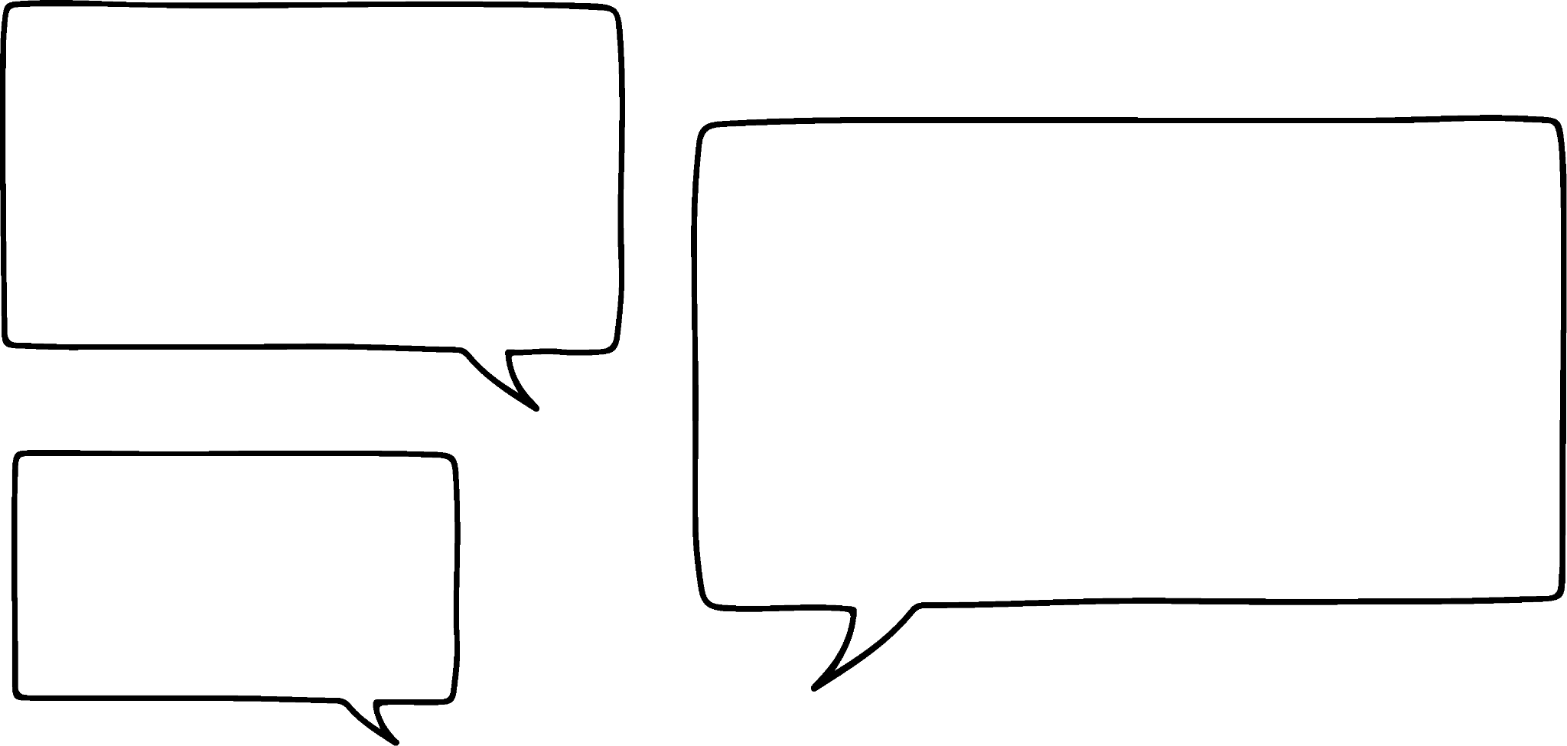



Ku dhufashada tibaaxaha (expressions) eray (term)
Waxaan isticmaali karnaa isla habka marka tirada lagu dhufanayso (multiplier) ay tahay mid taban (negative).
Isticmaal xirfadahaaga tirooyinka taban (negative numbers) si ay kuu caawiyaan.
Tusaale (Example)
5x + 1
−8(5x + 1)
−8 × (5x + 1)
≡
−40x
−8
+
−8 × 5x
−8 × 1
−8
≡ −40x
+
(−8)
≡ −40x − 8
Sidee bay u ekaan doontaa qaabka la fidiyay ee −8(5x − 1)?
Caasha

Slide 13
Ku dhufashada tibaaxaha (expressions) hal xubin (term)
Sidee bay u ekaan doontaa qaabka la fidiyay ee −8(5x − 1)?
Ka fikir waxa dhacaya marka aan ku dhufano laba qiime (value) oo taban.
Caasha
5x + (−1)
−8(5x − 1)
≡ −8 × (5x − 1)
+
−40x
8
−8 × 5x
−8 × −1
−8
≡ −40x + 8

Slide 14
Ku dhufashada tibaaxaha (expressions) hal xubin (term)
Caasha
Caasha waxay isku dayday inay fidiso −3(20 − 2x)
20,
2x,
−20
−2x
−3,
−2x
−2x
Waa maxay khaladaadka ay samaysay?
−3(20 − 2x) ≡ −20 + − 6x,
Kaalay iyada si ay u hesho jawaabta saxda ah.

Slide 15
Ku dhufashada tibaaxaha (expressions) hal xubin (term)
Caasha
Caasha waxay isku dayday inay fidiso −3(20 − 2x)
20,
2x,
−20
−2x
−3,
−2x
−2x
−3(20 − 2x) ≡ −20 + − 6x,
Waa maxay khaladaadka ay samaysay?
Iyadu kuma dhufsan 20 × −3
Baarka sare waa inuu yiraahdaa −2x, ma aha 2x. Qiime (value) taban oo lagu dhuftey qiime (value) taban wuxuu soo saari doonaa qiime (value) togan.

Slide 16
Ku dhufashada tibaaxaha (expressions) hal xubin (term)
Caasha
Caasha waxay isku dayday inay fidiso −3(20 − 2x)
Kaalay iyada si ay u hesho jawaabta saxda ah.
20 +
−2x,
−60
x
x
−3,
x
x
x
x
−3(20 − 2x) ≡ −60 + 6x,

Slide 17
Ku dhufashada tibaaxaha (expressions) eray (term)
Qaabka bedka (area model) wuxuu kaloo kaa caawin karaa fahamka ku dhufashada hal doorsoome (variable). Tusaale ahaan, si loo fidiyo qawskaan x(x + 5)
Maadaama aynaan aqoonin qiimaha (value) x, ma samayn karno x nuqul oo nuqullo ah.
x
1
1
1
1
1

Slide 18
Ku dhufashada tibaaxaha (expressions) eray (term)
Qaabka bedka (area model) wuxuu kaloo kaa caawin karaa fahamka ku dhufashada doorsoomaha (variable). Tusaale, si loo furo qawska (bracket) x(x + 5)
Si kastaba ha ahaatee, waxaan isticmaali karnaa qaabka bedka (area model) si aan u muujinno taranta (product) x iyo (x + 5)
x + 5
x
1
1
1
1
1
?
x²
5x
x
x × 5 ≡ 5x
x
x
x × x ≡ x²
x
x
x
x
x
x(x + 5) ≡ (x × x) + (x × 5)
≡ x² + 5x
x + 5
Wejiga (tiles) agagaarka geesaha leydigu (rectangle) waxay ahaayeen hagaha dhererka (lengths) aan ku dhufanaynay, mana qayb ka aha taranta (product), markaa waa laga saari karaa hadda.

Slide 19
Ku dhufashada tibaaxaha (expressions) eray (term)
Isticmaal qaabka bedka (area model) si aad u qorto 4x(2x − 3) qaabka la fiday (expanded form)
Isticmaal qaabka bedka (area model) si aad u qorto 2x(3x − 1) qaabka la fiday (expanded form)
x
x
−3
x
x
x
−1
2x + (−3)
3x +(−1)
x²
x²
4x(2x − 3) ≡
8x² − 12x
x²
x²
x²
x
−x
x
−x
−x
−x
2x
x²
x²
x²
x²
x²
x
−x
−x
4x
−x
x
−x
x²
x²
x
−x
−x
−x
x²
x²
x
−x
2x(3x − 1) ≡ 6x² − 2x
−x
−x

Slide 20
Ku dhufashada tibaaxaha (expressions) eray (term)
Tibaaxda (expression) ku jirta qawska (bracket) waxay ka koobnaan kartaa tiro kasta oo erayo (terms) ah.
x(2x + 15 − y)
2x + 15 + (−y)
2x²
15x
−xy
x × y waxaa loo qoraa xy
x × −y ≡ −xy
x²
x²
−xy
x
x
x
x
x
x
x
x
x
x
x
x
x
x
x
x
x(2x + 15 − y) ≡ 2x2 + 15x − xy

Slide 21
Ku dhufashada tibaaxaha (expressions) eray (term)
Isticmaal qaabka bedka (area model) si aad u qorto 5x(7 − 6x + 2z) qaabka la fiday (expanded form)
Isticmaal qaabka bedka (area model) si aad u qorto 10x(12 + 5y − 9x) qaabka la fiday (expanded form)
7 + (−6x) + 2z
12 + 5y + (−9x)
35x
−30x²
10xz
120x
50xy
−90x²
5x
10x
5x(7 − 6x + 2z)
≡ 5x × 7 + 5x × −6x + 5x × 2z
10x(12 + 5y − 9x)
≡10x × 12 + 10x × 5y + 10x × −9x
≡ 35x − 30x2 + 10xz
≡ 120x + 50xy − 90x2

Slide 22
Ku dhufashada tibaaxaha (expressions) hal xubin (term)
1) Isticmaal moodellada bedka (area models) si aad u qorto tibaaxahan qaab ballaaran (expanded form)
2x + 6
6 + 6
,
,
,
,
3
3
a) 3(2x + 6) ≡ ,
c) 3(6 − 2x) ≡ ,
2x + −6
2x + −6
,
,
,
,
3
,
b) 3(2x − 6) ≡ ,
d) −3(2x − 6) ≡ ,

Slide 23
Ku dhufashada tibaaxaha (expressions) hal xubin (term)
2) Isticmaal moodellada bedka (area models) si aad u qorto tibaaxahan qaab ballaaran (expanded form)
x + 10
2x + 10
,
,
,
,
x
x
a) x(x + 10) ≡ ,
c) x(2x + 10) ≡ ,
2x + 10
x + 10
,
,
,
,
2x
2x
b) 2x(x + 10) ≡ ,
d) 2x(2x + 10) ≡ ,

Slide 24
Ku dhufashada tibaaxaha (expressions) hal xubin (term)
3) Qor mid kasta oo ka mid ah kuwan qaab ballaaran (expanded form).
a) 5(x + 4)
b) 5(2x + 4)
c) 5(2x − 4)
d) 10(2x − 4)
e) 10(4 − 2x)
f) 10(−2x + 4)
g) −10(−2x + 4)
h) 5x(x + 4)
i) 5x(2x + 4)
j) 5x(2 + 4x)
k) 5x(2 − 4x)
l) −5x(2 − 4x)
m) −5x(2 − 4x + y)
n) −5x(2 − 4x) + y

Slide 25
Ku dhufashada tibaaxaha (expressions) hal xubin (term)
1) Isticmaal moodellada bedka (area models) si aad u qorto tibaaxahan qaab ballaaran (expanded form)
2x + 6
6 + −2x
6x
18
18
−6x
3
3
a) 3(2x + 6) ≡ 6x + 18
c) 3(6 − 2x) ≡ 18 − 6x ≡ −6x + 18
2x + −6
2x + −6
6x
−18
−6x
18
3
−3
b) 3(2x − 6) ≡ 6x − 18
d) −3(2x − 6) ≡ −6x + 18 ≡ 18 − 6x

Slide 26
Ku dhufashada tibaaxaha (expressions) hal xubin (term)
2) Isticmaal moodellada bedka (area models) si aad u qorto tibaaxahan qaab ballaaran (expanded form)
x + 10
2x + 10
x²
10x
2x²
10x
x
x
a) x(x + 10) ≡ x² + 10x
c) x(2x + 10) ≡ 2x² + 10x
2x + 10
x + 10
2x²
20x
4x²
20x
2x
2x
b) 2x(x + 10) ≡ 2x² + 20x
d) 2x(2x + 10) ≡ 4x² + 20x

Slide 27
Ku dhufashada tibaaxaha (expressions) hal xubin (term)
3) Qor mid kasta oo ka mid ah kuwan qaab ballaaran (expanded form).
a) 5(x + 4) ≡ 5x + 20
b) 5(2x + 4) ≡ 10x + 20
c) 5(2x − 4) ≡ 10x − 20
d) 10(2x − 4) ≡ 20x − 40
e) 10(4 − 2x) ≡ 40 − 20x
f) 10(−2x + 4)≡ 40 − 20x ≡ −20x + 40
g) −10(−2x + 4) ≡ 20x − 40
h) 5x(x + 4) ≡ 5x² + 20x
i) 5x(2x + 4) ≡ 10x² + 20x
j) 5x(2 + 4x) ≡ 10x + 20x²
k) 5x(2 − 4x) ≡ 10x − 20x²
l) −5x(2 − 4x) ≡ −10x + 20x²
m) −5x(2 − 4x + y) ≡ −10x + 20x2− 5xy
n) −5x(2 − 4x) + y ≡ −10x + 20x² + y

Slide 28
Hubinta iyo xoojinta fahamka sharciga qaybinta (distributive law) ee xubnaha aljabrada (algebraic terms)
Ku dhufashada tibaaxaha (expressions) hal xubin (term)
Ku dhufashada iyo fududaynta tibaaxaha (expressions) badan

Slide 29
Ku dhufashada iyo fududaynta tibaaxaha (expressions) badan
Waxaan ku fidin karnaa (expand) qawsyo (brackets) badan isla tibaax.
Tusaale ahaan 5(2x + 7) + 3(x − 3)
5(2x + 7) + 3(x − 3)
≡ 10x + 35 + 3(x − 3)
Fidi (expand) qawska (bracket) koowaad
≡ 10x + 35 + 3x − 9
Fidi (expand) qawska (bracket) labaad
≡ 10x + 3x + 35 − 9
Kooxi wada ereyada isku midka ah (like terms)
≡ 13x + 26
Fududee adigoo ku daraya ereyada isku midka ah (like terms)

Slide 30

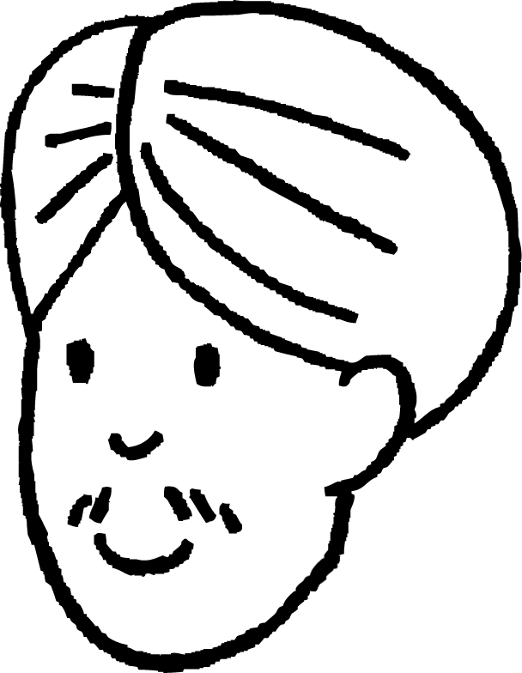

Isku dhufashada iyo fududeynta tibaaxo badan (multiple expressions)
Cali wuxuu doonayaa inuu u qoro tibaaxda (expression) 2x(5 − y) + 7y(x + 1) qaab ballaaran (expanded form)
Uma maleynayo inaan fududeyn karo tibaaxdan (expression) sababtoo ah ma jiri doonaan ereyo isku mid ah (like terms).
Ma raacsan tahay?
Aynu isku dayno.
Cali
2x(5 − y) + 7y(x + 1)
Markaan isku dhufano laba doorsoome (variables) waxaan u qornaa si xarfo ahaan u kala horreeya (alphabetical order) si ay u fududaato inaan aragno ereyada isku midka ah (like terms)
≡ 10x − 2xy + 7xy + 7y
≡ 10x + 5xy + 7y
Cali waa khalad, waxaa jiray hal lammaane oo ereyo isku mid ah (like terms).

Slide 31
Isku dhufashada iyo fududeynta tibaaxo badan (multiple expressions)
Waxaan ballaarin karnaa (expand) tibaaxaha (expressions) oo leh hal tibaax qawsan (bracketed expression) laga jaray mid kale.
Tusaale ahaan x(3x − 5) − 2x(2x − 1)
Go'doominta qawska labaad (second bracket):
(4x² − 2x)
2x(2x − 1) ≡ 4x² − 2x
≡ 3x² − 5x −
Tani waxay la mid tahay ku darista rogaal celinta isugeynta (additive inverse) ee tibaaxda (expression).
Waa inaan hubinaa inaan ka jarnay tibaaxda (expression) oo dhan
x²
x²
−x²
x²
−x
−x
−x²
−x
x²
−x
x
−x
x²
−x
x²
x
−x²
x²
−x²
−x

Slide 32
Isku dhufashada iyo fududeynta tibaaxo badan (multiple expressions)
x²
x²
−x²
x²
−x
−x
−x²
−x
x²
−x
x
−x
x²
−x
x²
x
−x²
x²
−x²
−x
(4x² − 2x)
≡ 3x² − 5x −
≡ 3x² − 5x + (−4x²) + 2x
≡ 3x² + (−4x²) − 5x + 2x
Ururinta ereyada isku midka ah (like terms),
≡ −x² − 3x
iyo fududeynta, waxay naga tagaysaa −x2 − 3x

Slide 33
Isku dhufashada iyo fududeynta tibaaxo badan (multiple expressions)
Iyada oo aan lahayn tiles-ka waxaad u qori kartaa sidan:
Tusaale ahaan x(3x − 5) − 2x(2x − 1)
≡ x(3x − 5) + −2x(2x − 1)
Kala saarida labada qaws (brackets)
≡ 3x² − 5x + −4x² + 2x
Fidinta (expanding) mid kasta si gooni ah, xusuusnow inaad ku dhufato −2x kan labaad.
≡ 3x² + −4x² − 5x + 2x
Ururinta ereyada la midka ah (like terms) iyo fududaynta, waxay nagu reebaysaa, −x2 − 3x
≡ −x² − 3x

Slide 34
Dhufashada iyo fududaynta tibaaxaha (expressions) badan
Sharciga qaybinta (distributive law) waxaa lagu dabaqi karaa tibaax kasta oo qaws (bracket) ku jira.
4.6(8 − 3x) + 5.4(8 − 3x)
Dhufashada labada tibaax (expressions) jajab tobanle (decimals) kala duwan waxay qaadanaysaa waqti
Waxaan u malaynayaa inaan arki karo hab fudud
Cali
Caasha
Maxaad u malaynaysaa in Caasha ay aragtay?
Labada qaws (brackets) waa isku mid marka waa la midayn karaa (unitised) waxaana lagu dari karaa isku dhufashada (multipliers). Tani waxay si gaar ah faa'iido u leedahay maadaama 4.6 + 5.4 = 10

Slide 35
Dhufashada iyo fududaynta tibaaxaha (expressions) badan
Isticmaalka habka Caasha:
4.6(8 − 3x) + 5.4(8 − 3x)
Sababtoo ah qawsyada (brackets) waa isku mid waxaan u qori karnaa hal isku dhufasho (multiplier).
≡ (4.6 + 5.4) (8 − 3x)
≡ 10(8 − 3x)
≡ 80 − 30x

Slide 36

Dhufashada iyo fududaynta tibaaxaha (expressions) badan
Arag qaladka (mistake) su'aal kasta:
Fidi 5(x + 6) + 7(x + 4)
5x + 6 + 7x + 4
12x + 10
a
c
Fidi −4(3x − 1) + 5(2 − x)
−12x − 4 + 10 − 5x
− 17x + 6
Fidi 7(12 − 5x) − (12 − 5x)
94 − 35x − 12 − 5x
82 − 40x
b
Fidi 2(3x + 8) − 5(x + 11)
6x + 16 − 5x + 55
x + 71
d

Slide 37
Isku dhufashada iyo fududaynta tibaaxaha badan (Multiplying and simplifying multiple expressions)
Ka day qaladka su'aasha kasta:
Balaadhi 5(x + 6) + 7(x + 4)
5x + 6 + 7x + 4
12x + 10
a
Qawska (brackets) si sax ah looma balaadhin, eray kasta oo ku jira qawska waa in lagu dhufto erayga ka baxsan qawska.
b
Balaadhi 2(3x + 8) − 5(x + 11)
6x + 16 − 5x + 55
x + 71
Dhammaan qawska labaad waa la kala goynayaa, markaa 55 waa in laga gooyaa 16, laguma darayo 16.

Slide 38
Isku dhufashada iyo fududaynta tibaaxaha badan (Multiplying and simplifying multiple expressions)
Ka day qaladka su'aasha kasta:
c
Balaadhi −4(3x − 1) + 5(2 − x)
−12x − 4 + 10 − 5x
− 17x + 6
−4 × −1 = 4 (ma aha −4)
7 × 12 = 84 (ma aha 94)
d
Balaadhi 7(12 − 5x) − (12 − 5x)
94 − 35x − 12 − 5x
82 − 40x
Dhammaan qawska labaad waa in la kala gooyaa. Kala goynta 5x taban (negative 5x) waxay la mid tahay ku darista 5x.
Labada qaws waa isku mid, markaa waxaa loo qori karaa 6(12 − 5x) ka hor balaadhinta.

Slide 39
Isku dhufashada iyo fududaynta tibaaxaha badan (Multiplying and simplifying multiple expressions)
Balaadhi oo fududee halkii ay suurtagal tahay.
a) 4(2x + 6) + 5(x + 2)
b) 7(x − 5) + 2(x + 13)
c) x(2x + 1) + 6(5x − 3)
d) 5x(3x + 7) − x(3x + 7)
4x(2y + 7) − 2(3x − 4)
3(4y + 7x) − 2(4y + 7x)
−5x(8y − 7x) − (yx − 10x)

Slide 40
Isku dhufashada iyo fududaynta tibaaxaha badan (Multiplying and simplifying multiple expressions)
2) Afarta tibaaxood oo dhan waa isku mid (equivalent). Buuxi erayada maqan.
5(2x − 3) + 4(2x + 5)
2(3x + 4) + 3(3x + )
5( − 1) − 5(x − 2)
7(3x + 1) − (3x + 1)

Slide 41
Isku dhufashada iyo fududaynta tibaaxaha badan (Multiplying and simplifying multiple expressions)
Balaadhi oo fududee halkii ay suurtagal tahay.
a) 4(2x + 6) + 5(x + 2)
b) 7(x − 5) + 2(x + 13)
c) x(2x + 1) + 6(5x − 3)
d) 5x(3x + 7) − x(3x + 7)
8x + 24 + 5x + 10
13x + 34
4x(2y + 7) − 2(3x − 4)
3(4y + 7x) − 2(4y + 7x)
−5x(8y − 7x) − (yx − 10x)
8xy + 28x − 6x + 8
8xy + 22x + 8
.
7x − 35 + 2x + 26
9x − 9
4y + 7x
2x² + x + 30x − 18
2x² + 31x − 18
.
−40xy + 35x2 − yx − (−10x)
−40xy + 35x2 − yx + 10x
15x² + 35x − 3x² − 7x
12x² + 28x
35x2 − 41xy + 10x

Slide 42
Isku dhufashada iyo fududaynta tibaaxaha badan (Multiplying and simplifying multiple expressions)
2) Afartaan tibaaxood oo dhami waa isku mid (equivalent). Buuxi xubnaha maqan.
7(x − 3) + 4(2x + 6.5)
2(3x + 4) + 3(3x + )
5( − 1) − 5(x − 2)
7(3x + 1) − (3x + 1)
≡ 7x − 21 + 8x + 26
≡ 15x + 5
−1
≡ 6x + 8 + 9x + ?
? = −3
4x
≡ ? − 5 − 5x + 10
? = 20x
2
≡ 15x + 5
≡ 5(3x + 1)

Slide 43
Hubinta iyo xoojinta fahamka sharciga qaybinta (distributive law) ee xubnaha aljabrada (algebraic terms)
Waxaan u isticmaali karnaa moodellada aagga (area models) si aan u muujinno sida sharciga qaybinta (distributive law) u shaqeeyo.
Markaad ku dhufanayso xubin (term) tibaax (expression) Tusaale: 5x(x + 2) waa in xubin kasta oo ku jirta qawska (bracket) lagu dhufteeyo xubinta ka baxsan qawska.
Tibaaxda ku jirta qawska waxay ka koobnaan kartaa tiro xubnood (terms) ah.
Marka tibaaxdu ka kooban tahay qawsyo badan (brackets) waa la fidi karaa (expand) waxaana la isku dari karaa xubnaha isku midka ah (like terms) si loo fududeeyo tibaaxda.
5x ( x + 2 )
≡ 5x² + 10x

