Slide 1
Hubinta fahamka taxanaha xisaabeed (arithmetic sequences)
Xiriirrada aan tooska ahayn (non-linear relationships)

Slide 2
Sida loo isticmaalo darasyada Oak

Slide 3
Waxaan qiimeyn (value) karaa in eray kasta oo ku jira taxanaha xisaabeed (arithmetic sequence) lagu muujin karo marka loo eego booskiisa taxanaha oo aan soo saari karo eray kasta.

Slide 4
Taxane xisaabeed (arithmetic) (ama toosan) waa taxane uu farqiga u dhexeeya erayada isku xiga yahay mid joogto ah.
E.g. 10, 12, 14, 16, 18,...
E.g. 10, 12, 15, 19, 24,...
Kani waa taxane xisaabeed (arithmetic sequence) oo leh farqi guud (common difference) oo ah +2
+2
+2
+2
+2
Kani ma aha taxane xisaabeed (arithmetic sequence) sababtoo ah ma jiro farqi guud (common difference) oo u dhexeeya erayada isku xiga.
+2
+3
+4
+5
Erayga nth ee taxanaha waa booska erayga taxanaha halkaas oo n u taagan yahay lambarka erayga. Tusaale, haddii n = 10 tani waxay ka dhigan tahay erayga 10aad ee taxanaha.

Slide 5

Hubinta fahamka taxanaha xisaabeed (arithmetic sequences)
Aqoonsiga taxanaha xisaabeed (arithmetic sequences)
Soo saarista taxanaha xisaabeed (arithmetic sequences)
Matalaadda taxanaha xisaabeed (arithmetic sequences)

Slide 6
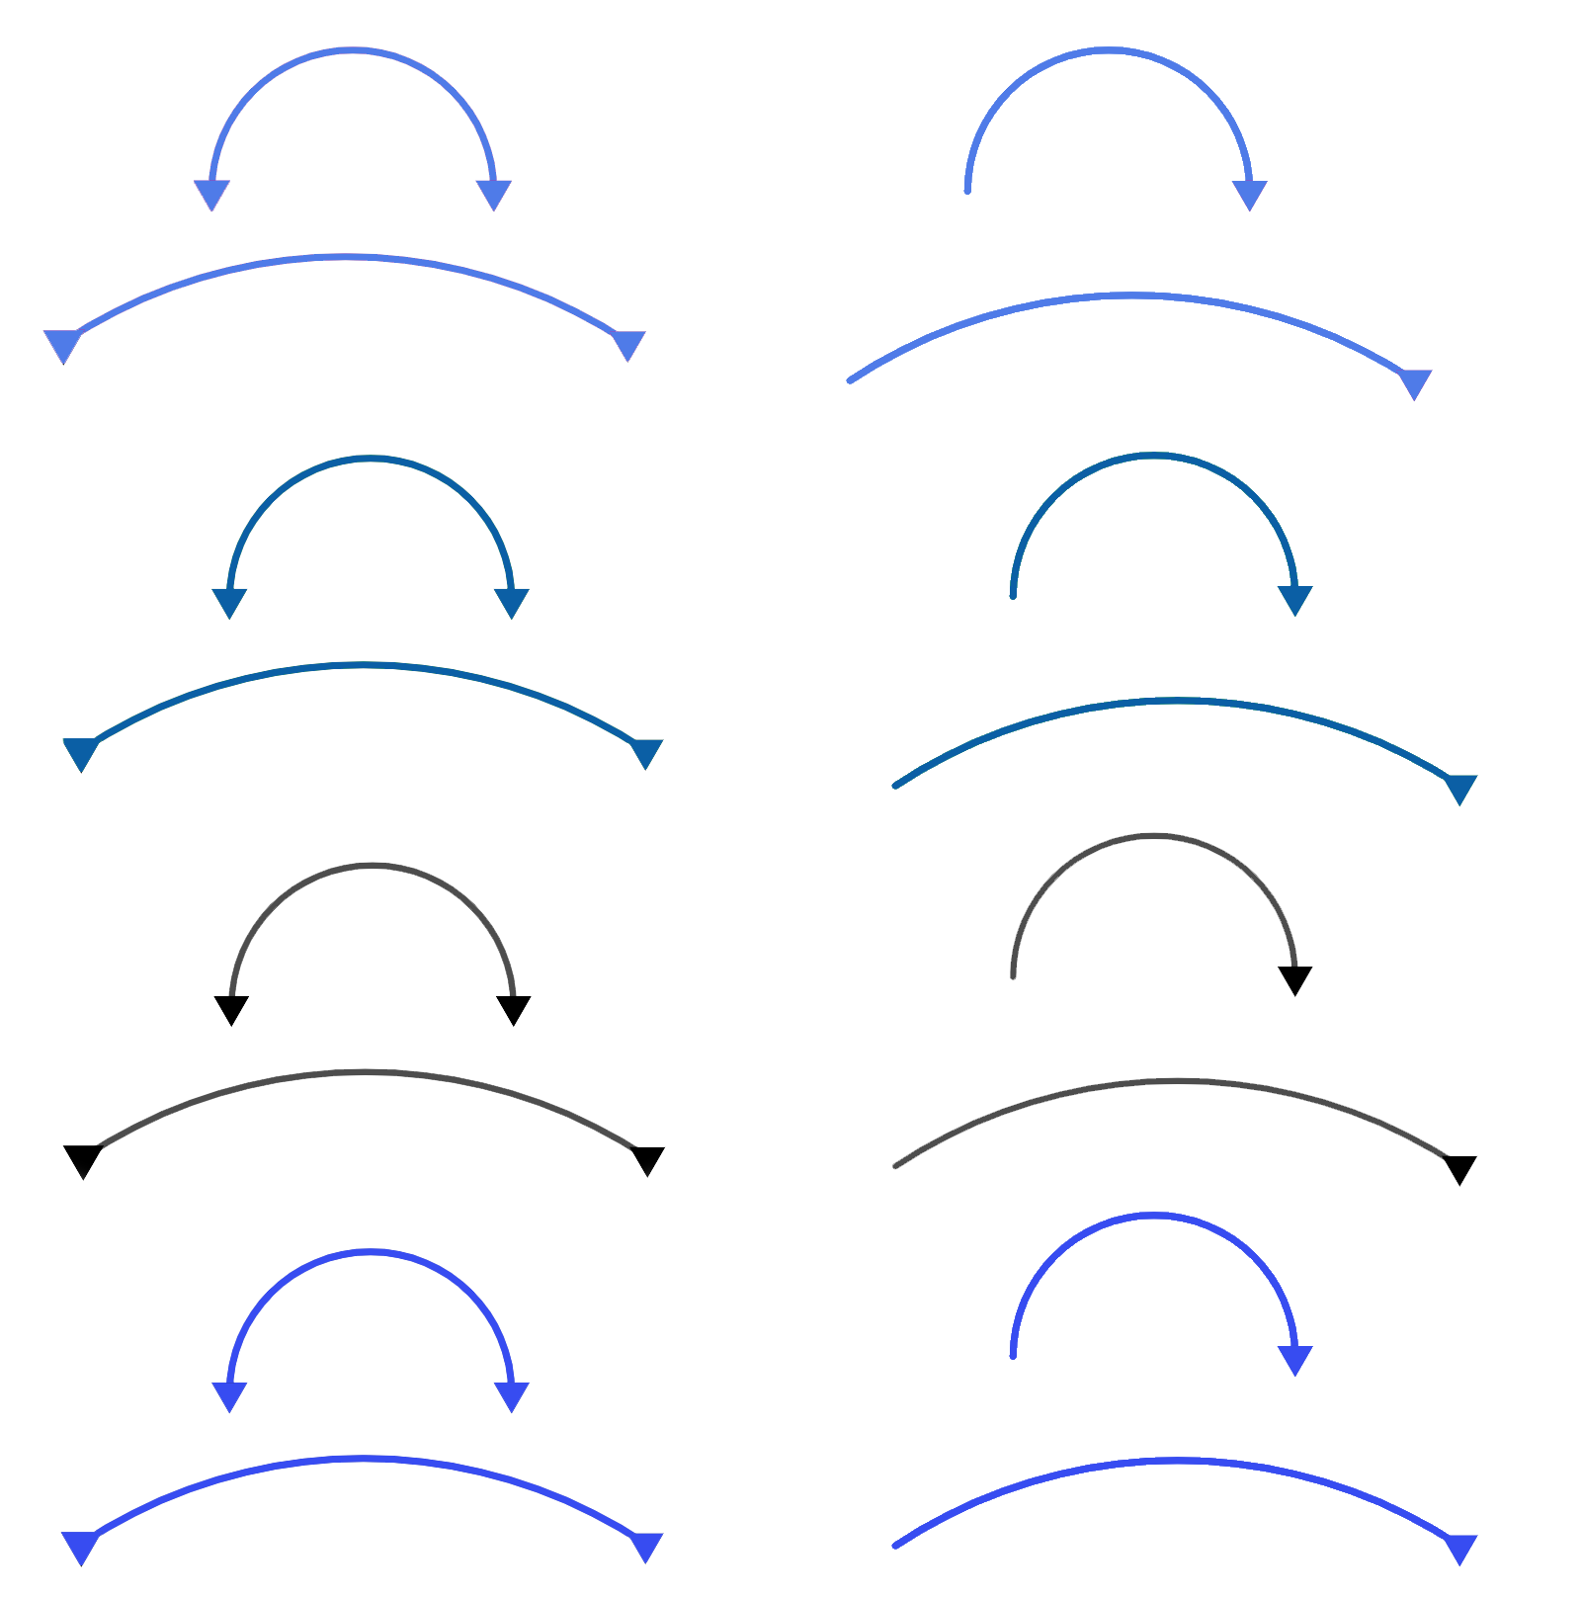
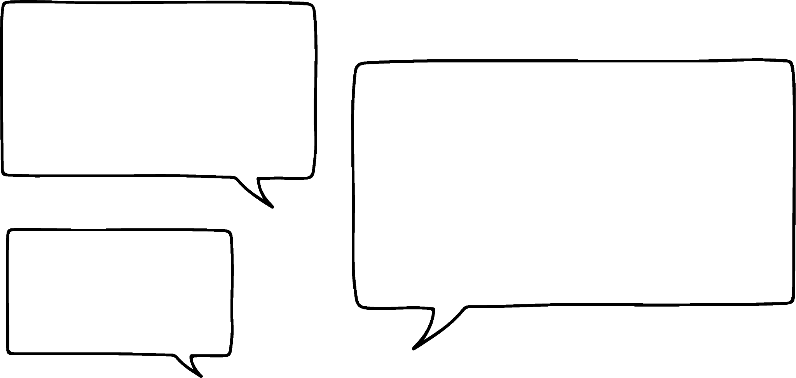
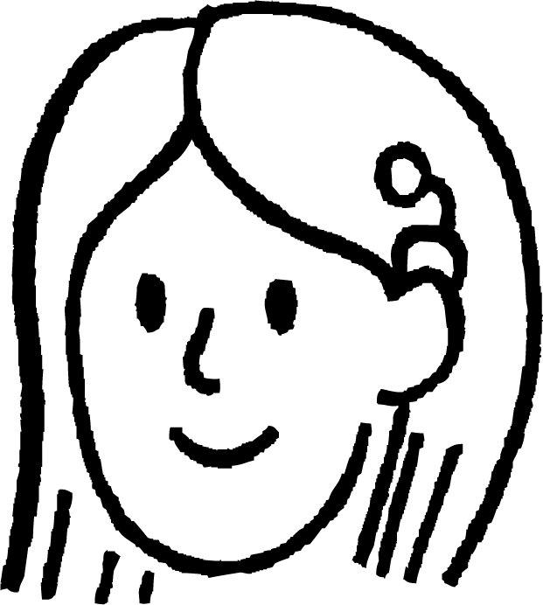
Aqoonsiga taxanaha xisaabeed (arithmetic sequences)
Suad waxay eegaysaa taxano tirooyin ah.
6, 11, 16, 21, 26, …
+5
+5
+5
+5
Inkastoo kuwani ay yihiin taxano kala duwan, waxaan arki karaa wax ay wadaagaan.
19, 23, 27, 31, 35, …
+4
+4
+4
+4
51, 58, 65, 72, 79, …
Dhammaan saddexda taxane waxay kordhaan tillaabooyin siman markasta
+7
+7
+7
+7

Slide 7
Aqoonsiga taxanaha xisaabeed (arithmetic sequences)
Suad waxay eegaysaa taxano tirooyin ah.
6, 11, 16, 21, 26, …
+5
+5
+5
+5
Taxanaha leh farqi guud (common difference) waxaa loo yaqaan taxanaha xisaabeed (arithmetic sequences). Waxa kale oo laga yaabaa inaad maqasho iyaga oo loo yaqaan taxanaha toosan (linear sequences).
19, 23, 27, 31, 35, …
+4
+4
+4
+4
51, 58, 65, 72, 79, …
+7
+7
+7
+7

Slide 8


Aqoonsiga taxanaha xisaabeed (arithmetic sequences)
Suad waxay tijaabinaysaa Cabdi ee ku saabsan taxanaha xisaabeed (arithmetic sequences).
a) 1, 8, 15, 22, 29, …
b) 64, 84, 104, 124, 144, …
c) 29, 24, 19, 14, 9, …
d) 16, 21, 31, 36, 46, …
Mid ka mid ah taxanahan ma aha tiroxiriir (arithmetic). Keeba ayaad u malaynaysaa?
Waxaan u malaynayaa waa c) sababtoo ah tan ayaa hoos u socota (decreasing).
Ma raalli tihiin Cabdi?

Slide 9
Aqoonsiga tiroxiriirrada (arithmetic sequences)
Suad ayaa tijaabinaysa Cabdi tiroxiriirrada (arithmetic sequences).
a) 1, 8, 15, 22, 29, …
b) 64, 84, 104, 124, 144, …
+7
+7
+7
+7
+20
+20
+20
+20
c) 29, 24, 19, 14, 9, …
d) 16, 21, 31, 36, 46, …
−5
−5
−5
−5
+5
+10
+5
+10
Aynu eegno kala duwanaanshaha eray-ka-eray (term-to-term differences) Cabdi.
Waxaan u malaynayaa inaan ra'yigayga beddelay. Ma d) baa aan ahayn tiroxiriir (arithmetic)?
Haa Cabdi! Taasi waa sax!

Slide 10
Aqoonsiga tiroxiriirrada (arithmetic sequences)
Suad ayaa tijaabinaysa Cabdi tiroxiriirrada (arithmetic sequences).
a) 1, 8, 15, 22, 29, …
b) 64, 84, 104, 124, 144, …
+7
+7
+7
+7
+20
+20
+20
+20
c) 29, 24, 19, 14, 9, …
d) 16, 21, 31, 36, 46, …
−5
−5
−5
−5
+5
+10
+5
+10
Tiroxiriirrada (Sequences) a), b) iyo c) waa tiroxiriir (arithmetic); dhammaantood waxay leeyihiin kala duwanaansho guud (common difference). Ma khaldan c) inay leedahay kala duwanaansho guud taban (negative common difference).
d) ma aha tiroxiriir (arithmetic). Kala duwanaanshuhu (differences) ma go'an.

Slide 11


Aqoonsiga tiroxiriirrada (arithmetic sequences)
Kee ka mid ah kuwanu waa tiroxiriir (arithmetic sequences)?
73, 61, 49, 37, 25, …
Tiroxiriir (Arithmetic sequence) oo leh kala duwanaansho guud (common difference) −12
−12
−12
−12
−12
−13, −9, −5, −1, 3, …
Tiroxiriir (Arithmetic sequence) oo leh kala duwanaansho guud (common difference) +4
+4
+4
+4
+4
−15, −9, −4, 0, 3, …
Ma aha tiroxiriir (Not arithmetic).
Ma leh kala duwanaansho guud (common difference).
+6
+5
+4
+3

Slide 12
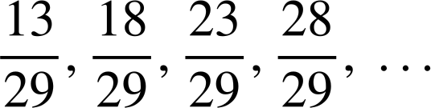
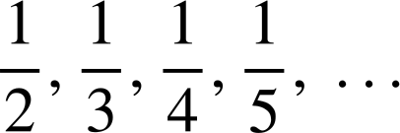
Aqoonsiga tiroxiriirrada (arithmetic sequences)
1) Ku calaamadee taxanahan mid waa 'tiroxiriir (arithmetic)' ama 'ma aha tiroxiriir (not arithmetic)'.
a) 9, 13, 17, 21, 25, …
b) 37, 31, 25, 19, 13, …
c) −70, −68, −66, −64, −62, …
d) 35, 31, 26, 20, 13, …
e) 12.6, 13.7, 14.8, 15.9 …
f) 3, 6, 12, 24, 48, …
g)
h)

Slide 13
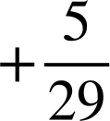

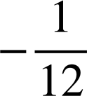
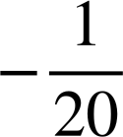
Aqoonsiga tiroxiriirrada (arithmetic sequences)
1) Ku calaamadee taxanahan mid waa 'tiroxiriir (arithmetic)' ama 'ma aha tiroxiriir (not arithmetic)'.
a) 9, 13, 17, 21, 25, …
b) 37, 31, 25, 19, 13, …
+4
+4
+4
+4
Tiroxiriir (Arithmetic)
−6
−6
−6
−6
Xisabi (Arithmetic)
c) −70, −68, −66, −64, −62, …
d) 35, 31, 26, 20, 13, …
+2
+2
+2
+2
Xisabi (Arithmetic)
−4
−5
−6
−7
Ma aha xisabi (Not arithmetic)
e) 12.6, 13.7, 14.8, 15.9 …
f) 3, 6, 12, 24, 48, …
+1.1
+1.1
+1.1
Xisabi (Arithmetic)
Ma aha xisabi (Not arithmetic)
+3
+6
+12
+24
g)
h)
Xisabi (Arithmetic)
Ma aha xisabi (Not arithmetic)

Slide 14
Hubinta fahamka taxanaha xisabiga (Checking understanding of arithmetic sequences)
Aqoonsiga taxanaha xisabiga (Identifying arithmetic sequences)
Abuurista taxanaha xisabiga (Generating arithmetic sequences)
Matalaadda taxanaha xisabiga (Representations of arithmetic sequences)

Slide 15
Abuurista taxanaha xisabiga (Generating arithmetic sequences)
Taxanaha xisabigu waxa lagu muujin karaa xiriirka ka dhexeeya nambarka term-ka (n) iyo qiimaha term-ka (T).
Nambarka term-ka (n) | 1 | 2 | 3 | 4 | 5
Qiimaha term-ka (T) | 3 | 6 | 9 | 12 | 15
Marka taxanaha 3, 6, 9, 12, 15, … n = 1, T = 3
Term-ka booska koowaad ee taxanaha wuxuu leeyahay qiime 3

Slide 16
Abuurista taxanaha xisabiga (Generating arithmetic sequences)
Taxanaha xisabigu waxa lagu muujin karaa xiriirka ka dhexeeya nambarka term-ka (n) iyo qiimaha term-ka (T).
Nambarka term-ka (n) | 1 | 2 | 3 | 4 | 5
Qiimaha term-ka (T) | 3 | 6 | 9 | 12 | 15
Marka n = 5, T = 15
Ereyga booska shanaad wuxuu leeyahay qiime (value) ah 15

Slide 17
Abuurista taxanaha xisaabta (arithmetic sequences)
Marka laga hadlayo taxanaha 3, 6, 9, 12, 15, … waxaa jira xiriir cad oo u dhexeeya nambarka ereyga (n) iyo qiimaha ereyga (T).
Nambarka ereyga (n) | 1 | 2 | 3 | 4 | 5
Ereyga (T) | 3 | 6 | 9 | 12 | 15
×3
Qiimaha ereyga (T) waa had iyo jeer saddex jeer nambarka ereyga (n)
Tan waxaa loo qoraa si ka fudud sida nth term ah 3n

Slide 18
Abuurista taxanaha xisaabta (arithmetic sequences)
Marka laga hadlayo taxanaha 5, 10, 15, 20, 25, … waxaa jira xiriir cad oo u dhexeeya nambarka ereyga (n) iyo qiimaha ereyga (T).
Nambarka ereyga (n) | 1 | 2 | 3 | 4 | 5
Ereyga (T) | 5 | 10 | 15 | 20 | 25
×5
Qiimaha ereyga (T) waa had iyo jeer shan jeer nambarka ereyga (n)
Tan waxaa loo qoraa si ka fudud sida nth term ah 5n

Slide 19
Abuurista taxanaha xisaabta (arithmetic sequences)
nth term, kiiskan 5n, wuxuu noo saamaxayaa inaan helno erey kasta oo taxanaha ah iyadoo la beddelayo (substitution).
Nambarka ereyga (n) | 1 | 2 | 3 | 4 | 5 | 10 | 50 | 100
Ereyga (T) | 5 | 10 | 15 | 20 | 25 | 50 | 250 | 500
×5
Marka n = 10, T = 5n = 5(10) = 50
Marka n = 50, T = 5(50) = 250
Marka n = 100, T = 5(100) = 500

Slide 20
Abuurista taxanaha xisaabta (arithmetic sequences)
Mararka qaarkood xiriirka, nth term, wuxuu noqon karaa laba-tallaabo (two-step).
Nambarka term-ka (n) | 1 | 2 | 3 | 4 | 5
Term-ka (T) | 5 | 9 | 13 | 17 | 21
×4 +1
Qiimaha term-ka (T) waa afar jeer nambarka term-ka (n) oo lagu daray hal.
Marka n = 1
T = 4n + 1 = 4(1) + 1 = 5
Marka n = 2
T = 4n + 1 = 4(2) + 1 = 9

Slide 21
Abuurista taxanaha xisaabeed (arithmetic sequences)
Raadi shanta term ee ugu horreeya, iyo term-ka 50aad ee taxanaha 2n + 5
Nambarka term-ka (n) | 1 | 2 | 3 | 4 | 5 | 50
Term-ka (T) | 7 | 9 | 11 | 13 | 15 | 105
×2 +5
Marka n = 1
T = 2n + 5 = 2(1) + 5 = 7
Marka n = 2
T = 2n + 5 = 2(2) + 5 = 9

Slide 22
Hubinta fahamka taxanaha xisaabeed (arithmetic sequences)
1) Raadi shanta term ee ugu horreeya ee afartan taxane:
a) 3n + 7
Nambarka term-ka (n) | 1 | 2 | 3 | 4 | 5
Term-ka (T)
b) 3n − 7
Nambarka term-ka (n) | 1 | 2 | 3 | 4 | 5
Term-ka (T)
c) 0.3n + 7
Nambarka term-ka (n) | 1 | 2 | 3 | 4 | 5
Term-ka (T)
d) 7 − 3n
Nambarka term-ka (n) | 1 | 2 | 3 | 4 | 5
Term-ka (T)

Slide 23
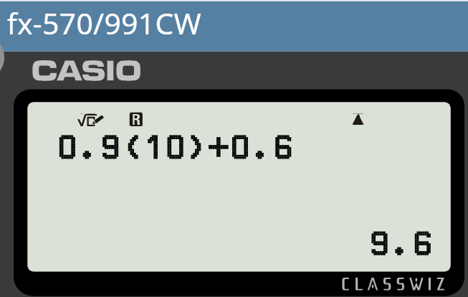
Hubinta fahamka taxanaha xisaabeed (arithmetic sequences)
2) Raadi term-ka 10aad, 50aad, iyo 100aad ee taxanahan.
a) 9n + 6
Waxaa laga yaabaa inaad u doorato inaad isticmaasho xisaabiyahaaga (calculator) qaar.
b) 9n − 6
c) 0.9n + 0.6
d) 6 − 9n

Slide 24
Hubinta fahamka taxanaha xisaabeed (arithmetic sequences)
1) Soo hel shanta erey ee ugu horreeya ee afartan taxane (sequences):
a) 3n + 7
Nambarka Ereyga (Term number) (n) | 1 | 2 | 3 | 4 | 5
Ereyga (Term) (T)
Nambarka Ereyga (Term number) (n) | 1 | 2 | 3 | 4 | 5
Ereyga (Term) (T) | 10 | 13 | 16 | 19 | 22
b) 3n − 7
Nambarka Ereyga (Term number) (n) | 1 | 2 | 3 | 4 | 5
Ereyga (Term) (T)
Nambarka Ereyga (Term number) (n) | 1 | 2 | 3 | 4 | 5
Ereyga (Term) (T) | −4 | −1 | 2 | 5 | 8
c) 0.3n + 7
Nambarka Ereyga (Term number) (n) | 1 | 2 | 3 | 4 | 5
Ereyga (Term) (T)
Nambarka Ereyga (Term number) (n) | 1 | 2 | 3 | 4 | 5
Ereyga (Term) (T) | 7.3 | 7.6 | 7.9 | 8.2 | 8.5
d) 7 − 3n
Nambarka Ereyga (Term number) (n) | 1 | 2 | 3 | 4 | 5
Ereyga (Term) (T)
Nambarka Ereyga (Term number) (n) | 1 | 2 | 3 | 4 | 5
Ereyga (Term) (T) | 4 | 1 | −2 | −5 | −8

Slide 25
Hubinta fahamka taxanaha xisaabeed (arithmetic sequences)
2) Soo hel ereyada 10aad, 50aad, iyo 100aad ee taxanahan (sequences).
a) 9n + 6
n = 10, T = 9n + 6 = 9(10) + 6 = 96
n = 50, T = 9n + 6 = 9(50) + 6 = 456
n = 100, T = 9n + 6 = 9(100) + 6 = 906
b) 9n − 6
n = 10, T = 9n − 6 = 9(10) − 6 = 84
n = 50, T = 9n − 6 = 9(50) − 6 = 444
n = 100, T = 9n − 6 = 9(100) − 6 = 894

Slide 26
Hubinta fahamka tixaha xisaabeed (arithmetic sequences)
2) Raadi 10aad, 50aad, iyo 100aad ee tixdan.
c) 0.9n + 0.6
n = 10, T = 0.9n + 0.6 = 0.9(10) + 0.6 = 9.6
n = 50, T = 0.9n + 0.6 = 0.9(50) + 0.6 = 45.6
n = 100, T = 0.9n + 0.6 = 0.9(100) + 0.6 = 90.6
d) 6 − 9n
n = 10, T = 6 − 9n = 6 − 9(10) = −84
n = 50, T = 6 − 9n = 6 − 9(50) = −444
n = 100, T = 6 − 9n = 6 − 9(100) = −894

Slide 27
Hubinta fahamka tixaha xisaabeed (arithmetic sequences)
Aqoonsiga tixaha xisaabeed (arithmetic sequences)
Abuurista tixaha xisaabeed (arithmetic sequences)
Matalaadda tixaha xisaabeed (arithmetic sequences)

Slide 28
Matalaadda tixaha xisaabeed (arithmetic sequences)
Sidee u kordheysaa qaabkan?...
,
,
,
, …
Si joogto ah ugu darista saddex tiro (counters) mar kasta.
Qaabka xiga wuxuu noqon lahaa qaabka afraad…
…oo lagu daray saddex kale.

Slide 29
Matalaadda tixaha xisaabeed (arithmetic sequences)
Tani waa tusaale ka mid ah matalaadda muuqaalka ah ee tixda xisaabeed (arithmetic sequence).
,
,
,
,
, …
2,
5,
8,
11,
14,
+3
+3
+3
+3

Slide 30
Matalaadda tixaha xisaabeed (arithmetic sequences)
Habaynta isla tixdan sidan waxay noo tusinaysaa wax ku saabsan qaabdhismeedka hoose ee tixaha xisaabeed (arithmetic sequences).
Waxaad si fudud u arki kartaa farqiga joogtada ah ee isku darka…
Waxaadna arki kartaa sababta loogu yaqaan tixaha toosan (linear sequences).

Slide 31
Matalaadda tixaha xisaabeed (arithmetic sequences)
Waxaan arki lahayn isla qaabka toosan (linear) haddii aan tixda ku sawirno garaaf ahaan.
Nambarka tixda (n) | 1 | 2 | 3 | 4 | 5
Tixda (T) | 2 | 5 | 8 | 11 | 14
Waxaan ku sawiri karnaa kuwan iyagoo ku calaamadaynaya dhidibada ‘Qiimaha tixda (T)’ iyo ‘Nambarka tixda (n)’.

Slide 32
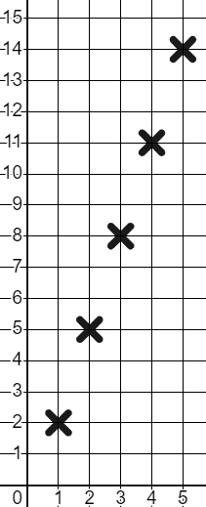
Matallaadka (Representations) taxanaha xisaabeed (arithmetic sequences)
Waxaan arki karnaa qaab-dhismeedka toosan (linear structure) isku mid ah haddii aan taxanaha (sequence) sawirno garaaf ahaan.
Qiimaha xubinta (Term value) (T)
Nambarka xubinta (Term number) (n) | 1 | 2 | 3 | 4 | 5
Xubin (Term) (T) | 2 | 5 | 8 | 11 | 14
Waxaan sawiri karnaa kuwan iyadoo calaamadaynayna dhidibada (axes) 'Qiimaha xubinta (Term value) (T)' iyo 'Nambarka xubinta (Term number) (n)'.
Nambarka xubinta (Term number) (n)

Slide 33
Matallaadka (Representations) taxanaha xisaabeed (arithmetic sequences)
Waxaan arki karnaa qaab-dhismeedka toosan (linear structure) isku mid ah haddii aan taxanaha (sequence) sawirno garaaf ahaan.
Qiimaha xubinta (Term value) (T)
Nambarka xubinta (Term number) (n) | 1 | 2 | 3 | 4 | 5
Xubin (Term) (T) | 2 | 5 | 8 | 11 | 14
Inkasta oo aan arki karno in dhibcuhu (points) is toosiyaan…
Waxaan sawirnaa oo kaliya isku-duwayaasha (coordinates), ma sawirno xariiqda toosan (straight line) halkan, in kastoo ay tahay hab fiican oo lagu hubiyo taxane toosan (linear sequence).
Nambarka xubinta (Term number) (n)

Slide 34
Matallaadka (Representations) taxanaha xisaabeed (arithmetic sequences)
Taxanahan (sequence) wuxuu sawiri doonaa dhibco (points) xariiq toosan (straight line) ah.
Nambarka xubinta (Term number) (n) | 1 | 2 | 3 | 4 | 5
Xubin (Term) (T) | 10 | 16 | 22 | 28 | 34
10, 16, 22, 28, 34, … waa taxane xisaabeed (arithmetic sequence) sidaas darteed waa toosan (linear); dhibcuhu (points) way is toosi doonaan.
Dhibcuhu (points) waxay noqon karaan meel kasta. Ma aha daruuri inay xariiq toosan (straight line) ku jiraan.

Slide 35
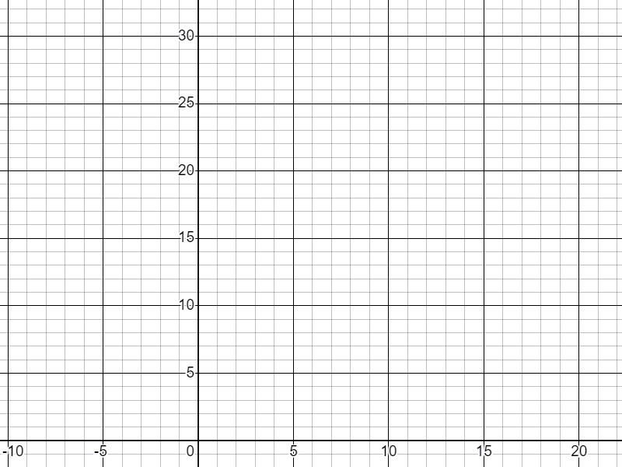


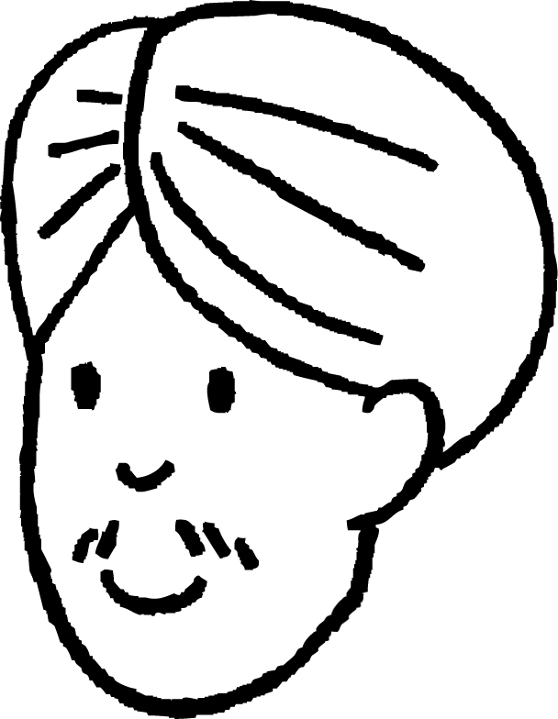

Matalaadyada isku xigxiga xisaabeed (Representations of arithmetic sequences)
Cali iyo Layla waxay isku dayayaan inay sawiraan taxanaha xisaabeed (arithmetic sequence).
34, 28, 22, 16, 10, …
Qiimaha ereyga (T) (Term value (T))
Isku xigxigani wuxuu yeelan doonaa ereyo taban (negative terms) sidaas darteed lama sawiri karo.
Ma ku raacsan tahay Cali?
Nambarka ereyga (n) (Term number (n))

Slide 36
Matalaadyada isku xigxiga xisaabeed (Representations of arithmetic sequences)
Cali iyo Layla waxay isku dayayaan inay sawiraan isku xigxiga xisaabeed (arithmetic sequence) oo ka bilaabmaya:
34, 28, 22, 16, 10, …
Qiimaha ereyga (T) (Term value (T))
34, 28, 22, 16, 10, 4, −2, −8, −14, …
Isku xigxigani wuxuu yeelan doonaa ereyo taban (negative terms) sidaas darteed lama sawiri karo.
Waxaad sax tahay, waxaa jiri doonaa ereyo taban (negative terms). Laakiin, waxaan ku sawiri karnaa rubuca 4aad (4th quadrant).
Waxaad sax tahay, waxaa jiri doona ereyo taban (negative terms).
Nambarka ereyga (n) (Term number (n))

Slide 37
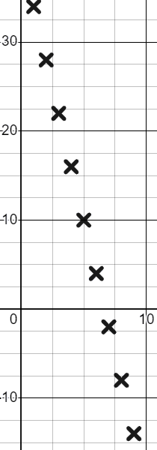
Matalaadyada isku xigxiga xisaabeed (Representations of arithmetic sequences)
Cali iyo Layla waxay isku dayayaan inay sawiraan isku xigxiga xisaabeed (arithmetic sequence) oo ka bilaabmaya:
34, 28, 22, 16, 10, 4, −2, −8, −14, …
Qiimaha ereyga (T) (Term value (T))
Waa la sawiri karaa! Kaliya waxaan isticmaalnaa rubuca 4aad (4th quadrant). Mahadsanid Layla!
Nambarka ereyga (n) (Term number (n))
Waxaad sax tahay, waxaa jiri doonaa ereyo taban (negative terms). Laakiin, waxaan ku sawiri karnaa rubuca 4aad (4th quadrant).

Slide 38
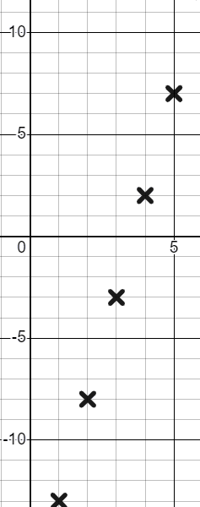
Matalaadyada isku xigxiga xisaabeed (Representations of arithmetic sequences)
T
Ereyada taban (negative terms) ee isku xigxiga −13,−8,−3, 2, 7 … lama sawiri karo.
n
Qiimaha isku xigxiga xisaabeed (arithmetic sequence) waa inay ahaadaan kuwo togan (positive) si loo sawiro.
Waa la sawiri karaa iyadoo la isticmaalayo rubuca 4aad (4th quadrant).

Slide 39
Matixyada (Representations) taxanaha xisaabeed (arithmetic sequences)
1) Sawir muuqaal ah u sawir shanta erey ee ugu horreeya ee taxanahan:
a) 5, 7, 9, 11,13, …
b) 21,17,13, 9, 5
c) 5n + 1

Slide 40
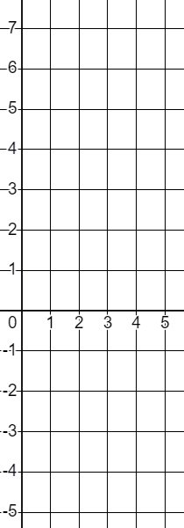
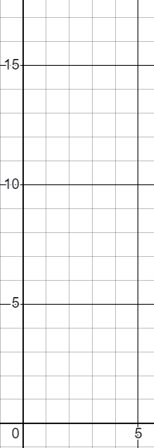
Matixyada (Representations) taxanaha xisaabeed (arithmetic sequences)
2) Qorshee (Plot) shanta erey ee ugu horreeya ee taxanahan:
T
a) 4n − 3
T
b) 10 − 3n
n | 1 | 2 | 3 | 4 | 5
T
n | 1 | 2 | 3 | 4 | 5
T
n
n

Slide 41


Matixyada (Representations) taxanaha xisaabeed (arithmetic sequences)
1) Sawir muuqaal ah u sawir shanta erey ee ugu horreeya ee taxanahan:
a) 5, 7, 9, 11,13, …
b) 13,10, 7, 4, 1
c) 5n + 1
Tusaalooyinka sida ay u ekaan karaan:
n | 1 | 2 | 3 | 4 | 5
T | 6 | 11 | 16 | 21 | 26
Xaalad kasta, qaabka toosan (linear structure) ee taxanaha (sequence) waa la muujiyey.

Slide 42
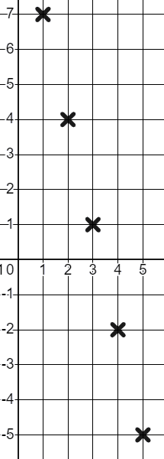
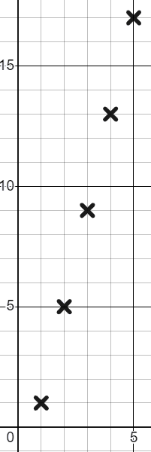
Matixyada (Representations) taxanaha xisaabeed (arithmetic sequences)
2) Qorshee (Plot) shanta erey ee ugu horreeya ee taxanahan:
T
a) 4n − 3
b) 10 − 3n
T
n | 1 | 2 | 3 | 4 | 5
T | 1 | 5 | 9 | 13 | 17
n | 1 | 2 | 3 | 4 | 5
T
n | 1 | 2 | 3 | 4 | 5
T
n | 1 | 2 | 3 | 4 | 5
T | 7 | 4 | 1 | −2 | −5
n
n

Slide 43
Hubinta fahamka taxanaha xisaabeed (arithmetic sequences)
Erey kasta oo ku jira taxane xisaabeed (arithmetic sequence) waxaa loo qeexi karaa iyadoo la eegayo booskiisa taxanaha (sequence), waxaana soo saari karnaa erey kasta adoo isticmaalaya nth term (nth term).
Tusaale ahaan, taxanaha (sequence) 7n − 5, ereyga 1aad waa
7(1) − 5 = 2 halka ereyga 10aad uu yahay 7(10) − 5 = 65

