Slide 1
Hubinta fahamka isku ekaanshaha (congruence)
Sifooyinka joomatari (geometrical properties) iyo aragtida Pythagoras

Slide 2
Sida loo isticmaalo darasyada Oak

Slide 3
Waxaan awoodaa inaan turjumo (translate), milicsado (reflect), iyo wareejiyo (rotate) qaab.

Slide 4
Haddii qaab uu si sax ah ugu habboonaado korka qaab kale iyadoo la adeegsanayo wareejin (rotation), milicsi (reflection), ama turjumaad (translation), markaas qaababku waa isku ekaansho (congruent).
Wareejinta (rotation) shay waa u jeedinta shay qadar go'an iyo agagaar dhibic go'an (loo yaqaan xarunta wareejinta), iyada oo aan sawirka la jeedin ama cabbirkiisa aan la beddelin.
Shay ayaa la milicsadaa markii loo rogo khad go'an (loo yaqaan khadka milicsiga), iyada oo aan sawirka la jeedin ama cabbirkiisa aan la beddelin.
Turjumaad (translation) waa isbeddel (transformation) kaas oo dhibic kasta oo qaabka u dhaqaaqo masaafo isku mid ah jihada isku mid ah.
Weyneyn (enlargement) waa isbeddel (transformation) keena isbeddel cabbirka.

Slide 5

Hubinta fahamka isku ekaanshaha (congruence)
Isbeddellada (transformations) ee isku ekaanshaha (congruence)
Aqoonsiga macluumaadka maqan ee qaababka isku ekaanshaha (congruent)

Slide 6
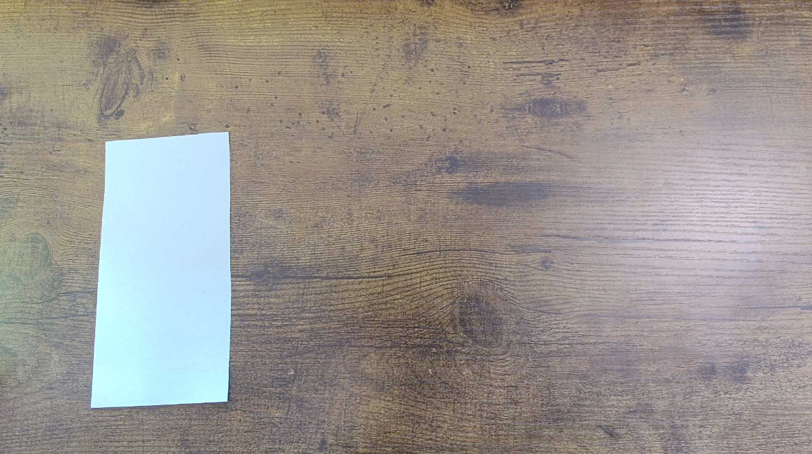
Isbeddellada (transformations) ee isku ekaanshaha (congruence)
Laydi warqad ah ayaa la saaray miis. Cali, Isra, Yacquub, Layla iyo Suad waxay ka wada hadlaan waxa ay ku samayn karaan qaabka.

Slide 7
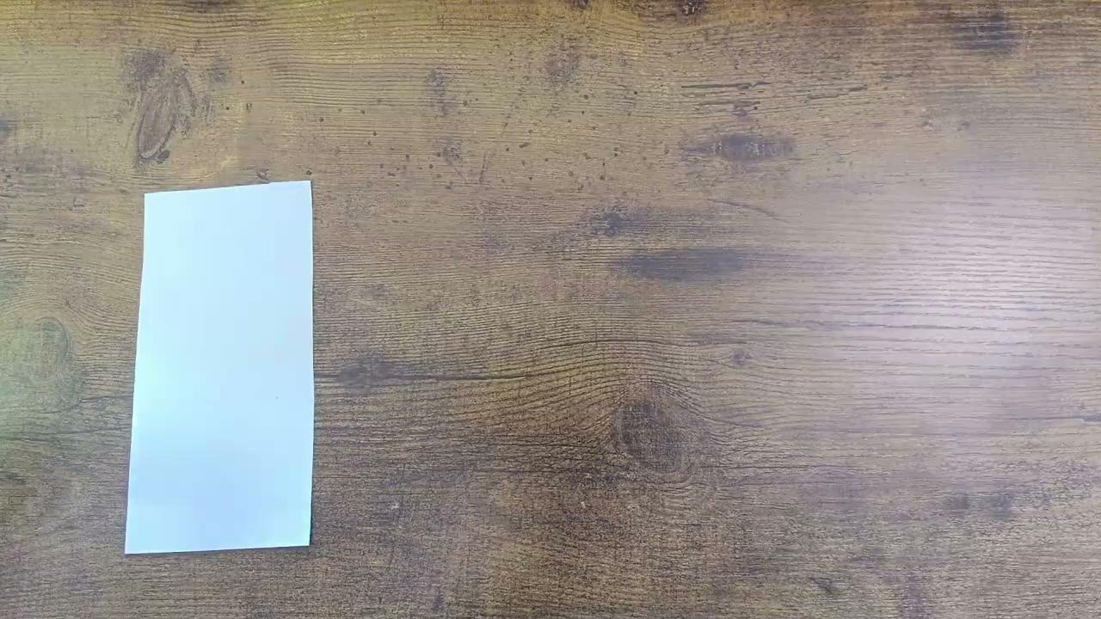
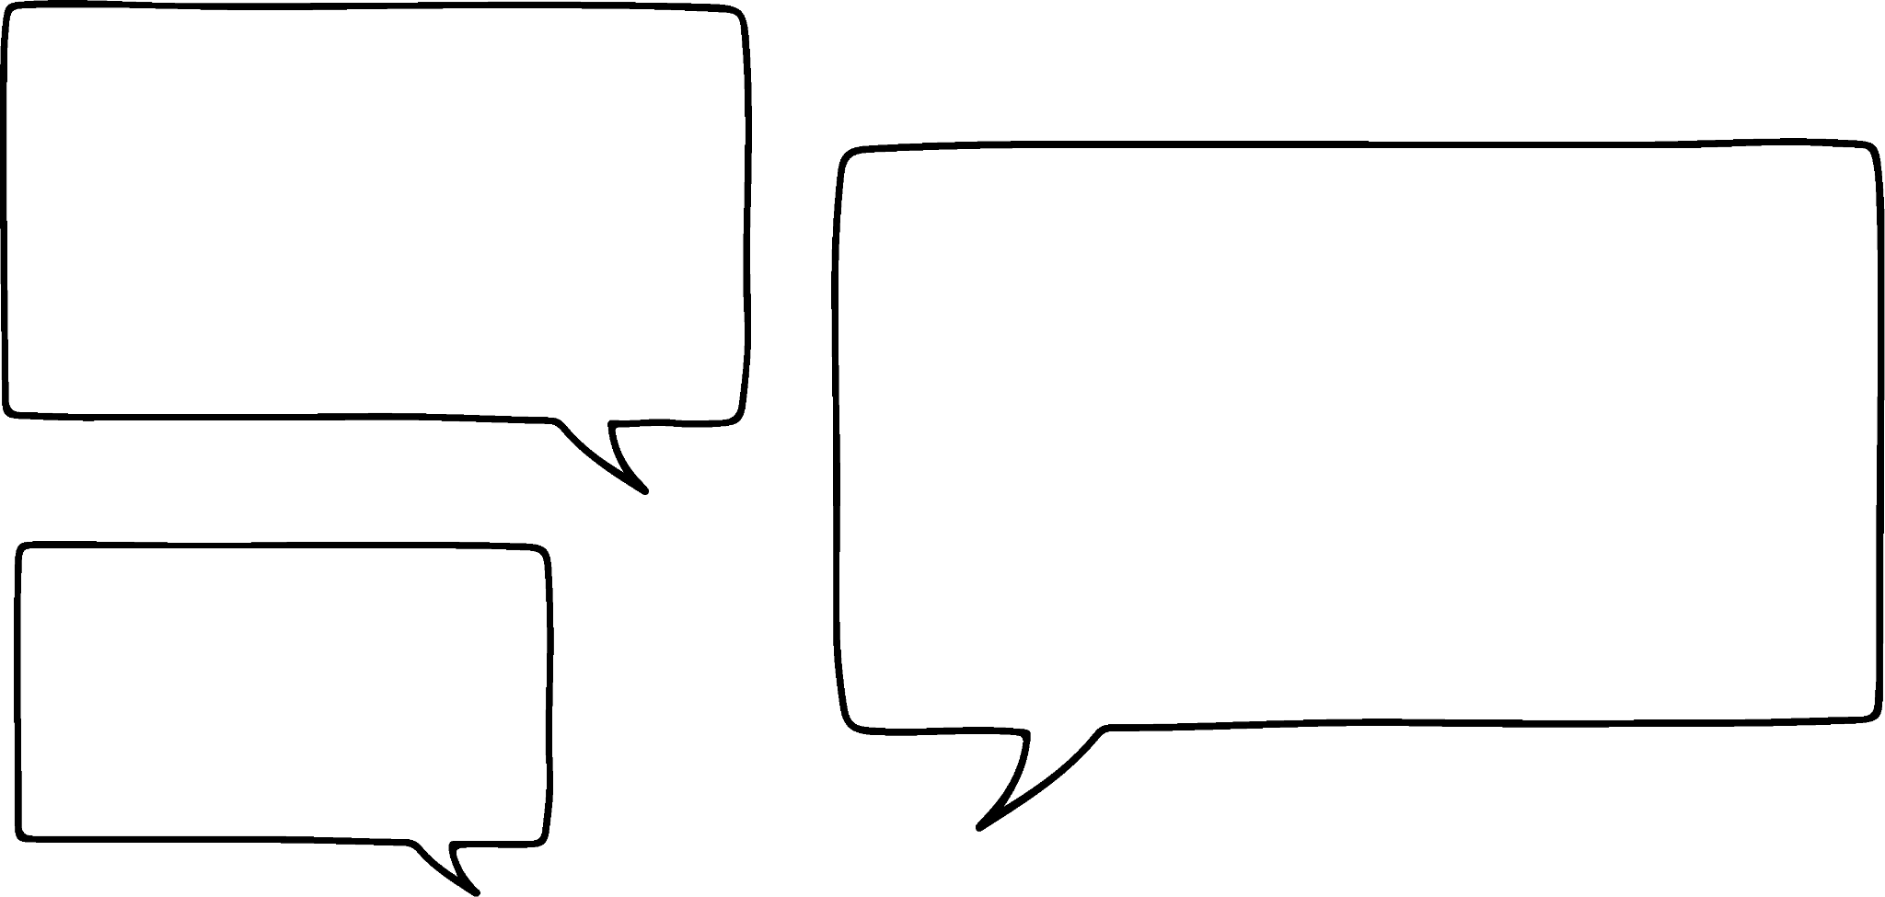

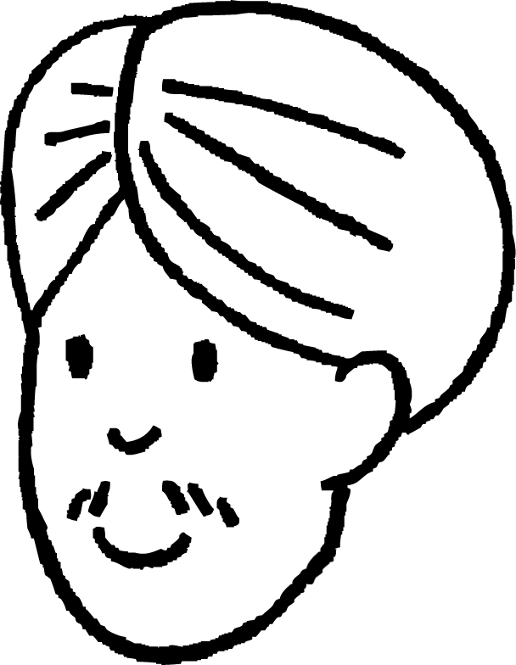

Isbeddellada (transformations) ee isku ekaanshaha (congruence)
Laydi warqad ah ayaa la saaray miis. Cali, Isra, Yacquub, Layla iyo Suad waxay ka wada hadlaan waxa ay ku samayn karaan qaabka.
Waxaan dhaqaajin karnaa laydiga.
Tani waxay noqon doontaa turjumaad (translation).
Cali

Slide 8
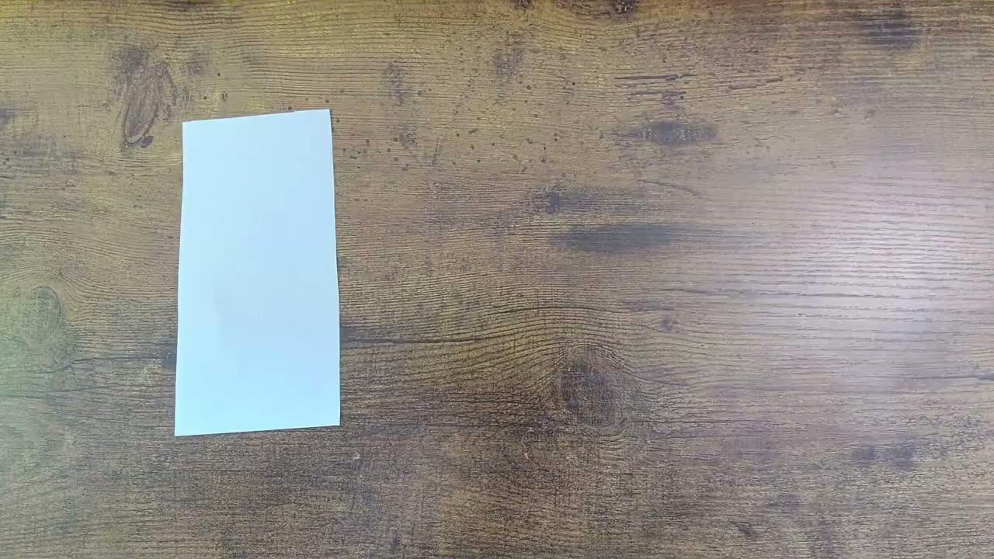

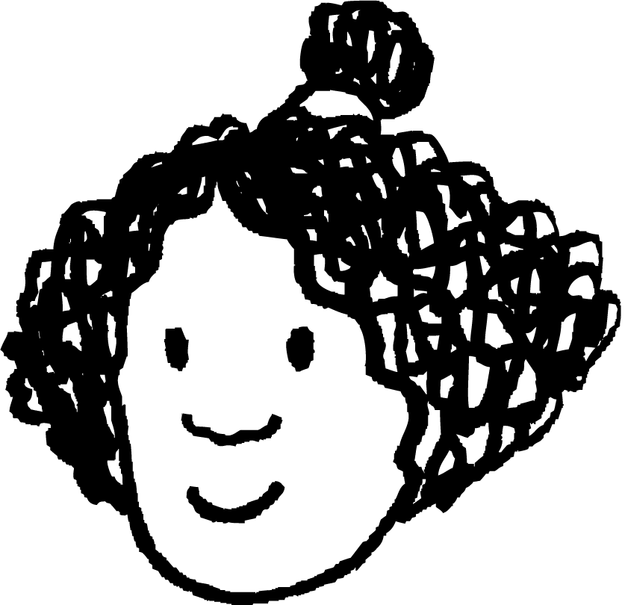

Isbeddellada (transformations) ee isku ekaanshaha (congruence)
Laydi warqad ah ayaa la saaray miis. Cali, Isra, Yacquub, Layla iyo Suad waxay ka wada hadlaan waxa ay ku samayn karaan qaabka.
Waan rogi karnaa leydiga (rectangle).
Tani waxay noqonaysaa milicsi (reflection).
Isra

Slide 9
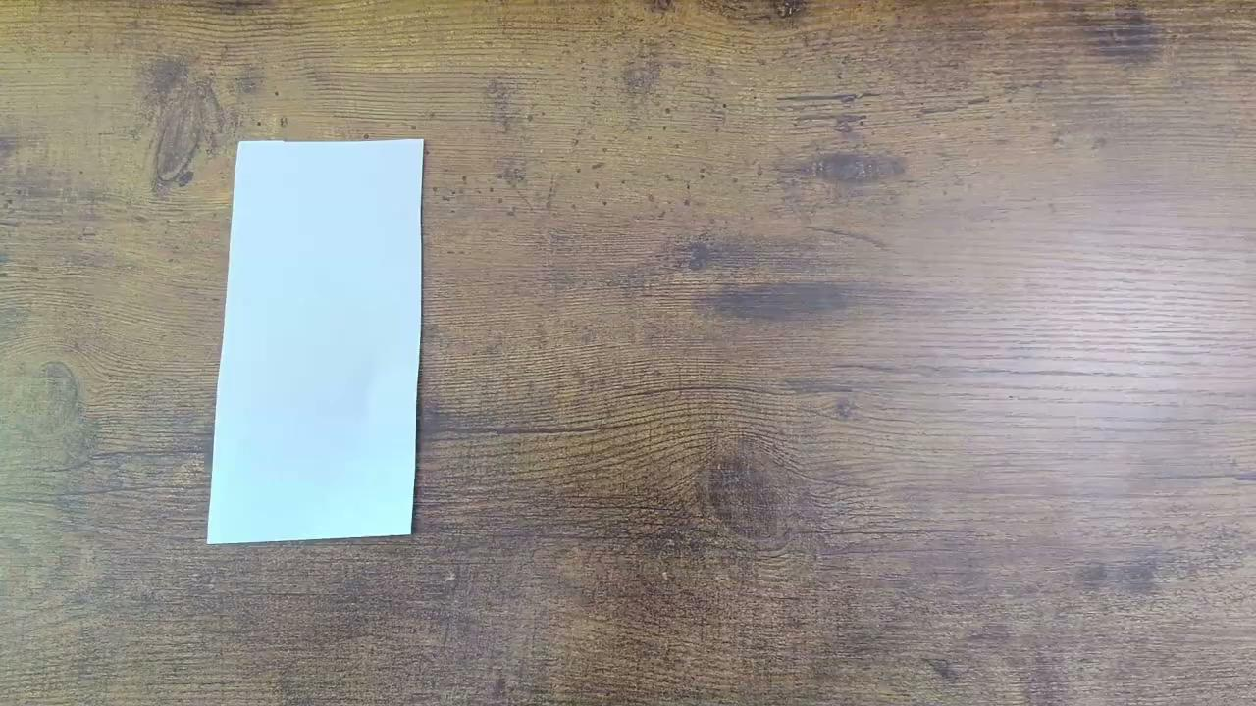
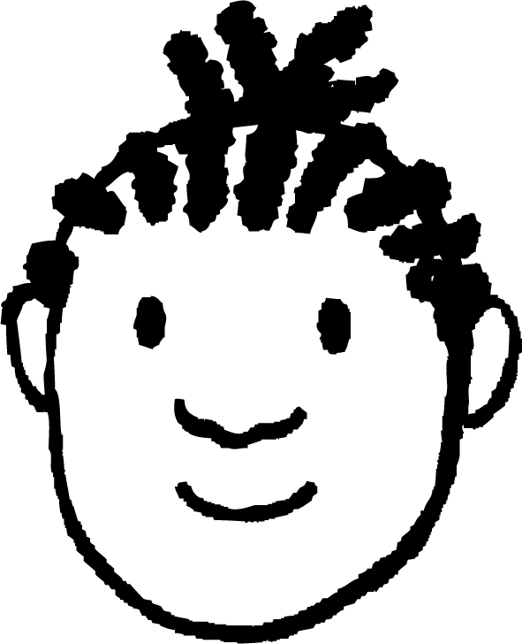
Isbeddello (Transformations) leh isku ekaansho (congruence)
Leydi (rectangle) warqad ah ayaa miis la saaray. Cali, Isra, Yacquub, Layla iyo Suad ayaa ka hadlaya waxay ku samayn karaan qaabka.
Waan leexin karnaa leydiga (rectangle).
Tani waxay noqonaysaa wareeg (rotation).
Yacquub

Slide 10
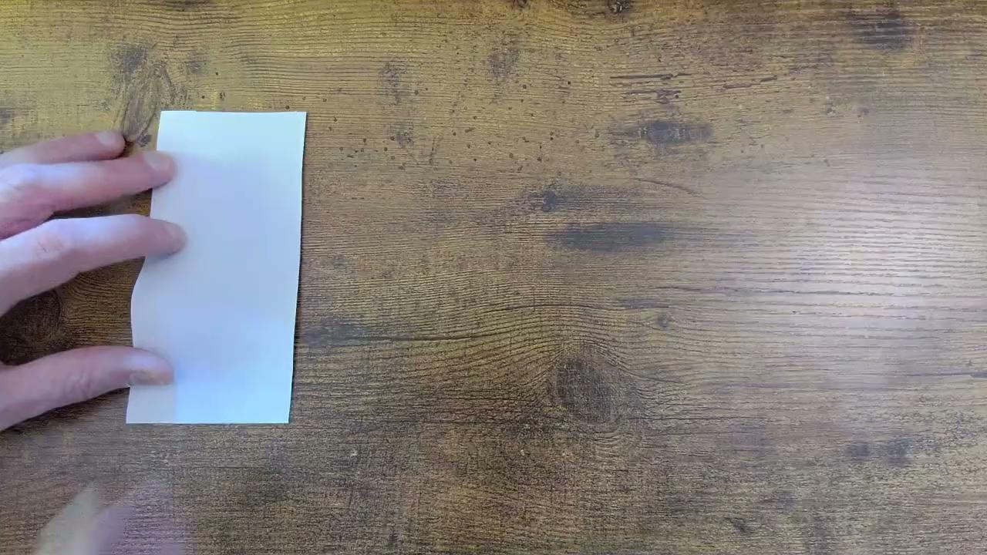

Isbeddello (Transformations) leh isku ekaansho (congruence)
Leydi (rectangle) warqad ah ayaa miis la saaray. Cali, Isra, Yacquub, Layla iyo Suad ayaa ka hadlaya waxay ku samayn karaan qaabka.
Waanu gooyn karnaa leydi (rectangle) yar oo la mid ah.
Tani waxay noqonaysaa weyneyn (enlargement).
Layla

Slide 11
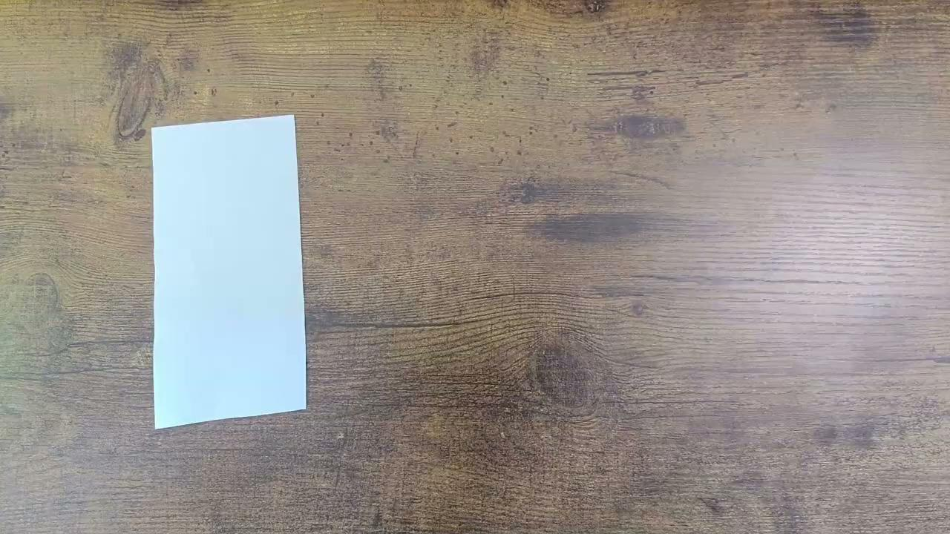

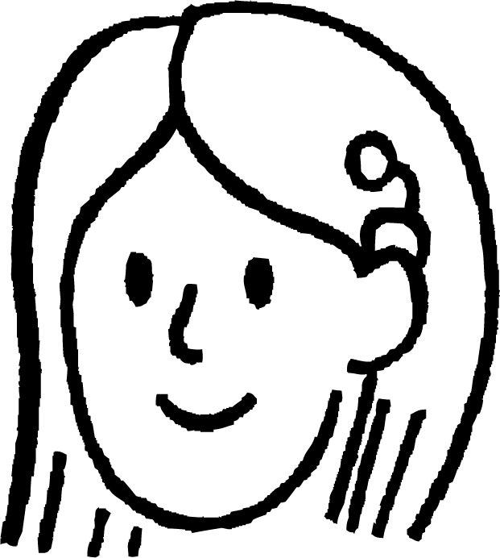

Isbeddello (Transformations) leh isku ekaansho (congruence)
Leydi (rectangle) warqad ah ayaa miis la saaray. Cali, Isra, Yacquub, Layla iyo Suad ayaa ka hadlaya waxay ku samayn karaan qaabka.
Waanu gooyn karnaa qaab ka duwan.
Tani ma aha isbeddel (transformation) caadi ah.
Suad

Slide 12


Isbeddello (Transformations) leh isku ekaansho (congruence)
Cali wuxuu ka fikirayaa saamaynta ficil kasta uu ku yeesho qaabka.
gudbin (translation)
milicsi (reflection)
wareeg (rotation)
Weyneyn (Enlargement)
Beddel qaabka
Falalka qaarkood waxay beddelaan dhererka, qaarna waxay beddelaan xaglaha.
Falalkee ayaa ilaaliya dhererka iyo xaglaha labadaba?

Slide 13
Isbeddellada leh isku midnimo (congruence)
Qaababka leh dherer iyo xaglo isku mid ah waa isku mid (congruent).
lamaanaha qaababka isku midka ah:
lamaanaha qaababka aan isku midka ahayn:

Slide 14
Isbeddellada leh isku midnimo (congruence)
Qaababka leh dherer iyo xaglo isku mid ah waa isku mid (congruent).
lamaanaha qaababka isku midka ah:
Tani waxay ka dhigan tahay in tarjumaad (translation), milicsi (reflection) iyo wareeg (rotation) ay had iyo jeer soo saaraan sawir isku mid ah shayga.
Isra

Slide 15
Isbeddellada leh isku midnimo (congruence)
Labada qaab waa isku mid (congruent).
3 cm
5 cm
3 cm
5 cm
Qaababku waxay leeyihiin dherer isku mid ah.
Qaababku waxay leeyihiin xaglo kala duwan.

Slide 16
Isbeddellada (Transformations) ee isku midnimada (congruence)
Labada qaab waa isku mid (congruent).
3 cm
5 cm
6 cm
Qaababku waxay leeyihiin dherer kala duwan.
10 cm
Qaababku waxay leeyihiin xaglo isku mid ah.

Slide 17
Isbeddellada (Transformations) ee isku midnimada (congruence)
Labada qaab waa isku mid (congruent).
3 cm
5 cm
3 cm
Qaababku waxay leeyihiin dherer iyo xaglo isku mid ah.
5 cm
Qaababku waxay ku jiraan jihooyin kala duwan.

Slide 18
Isbeddellada (Transformations) ee isku midnimada (congruence)
Isbeddellada (Transformations) kee ayaa had iyo jeer keena sawir (image) la mid ah (congruent) shayga asalka ah?
Weyneyn (Enlargement)
Milicsi (Reflection)
Wareejin (Rotation)
Gudbin (Translation)

Slide 19
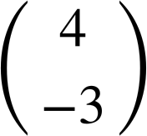
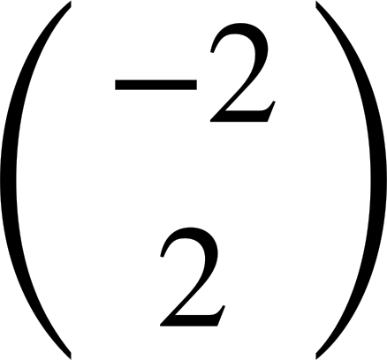
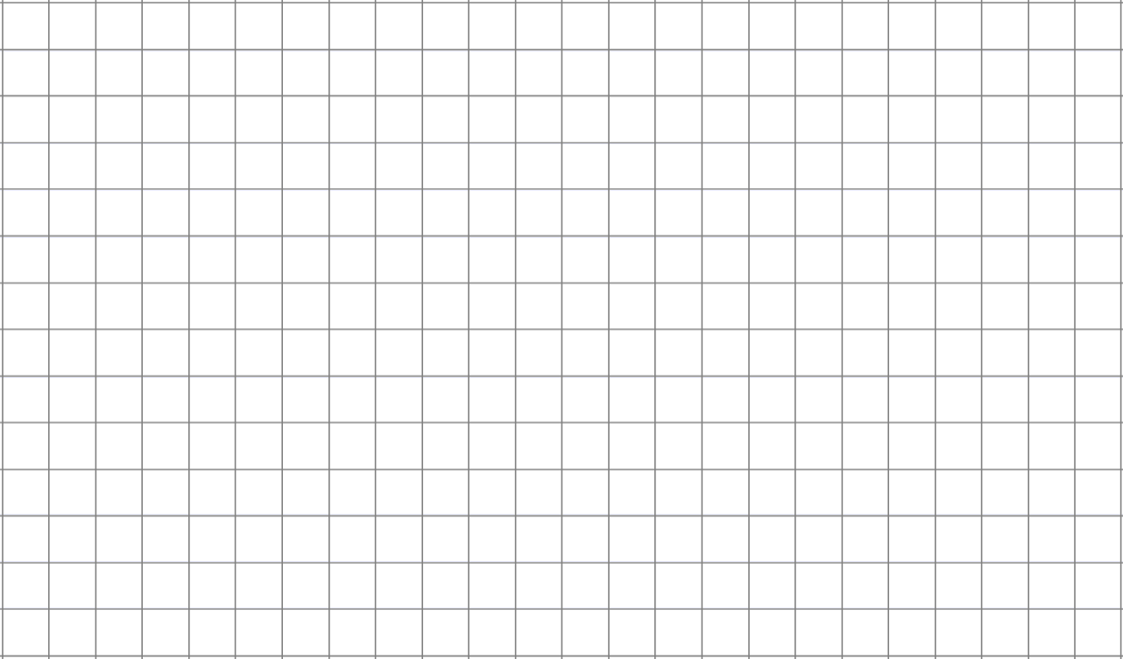
Isbeddellada (Transformations) ee isku midnimada (congruence)
Soo saar qaab isku mid ah (congruent) adoo gudbinaya (translating) shayga .
Soo saar qaab isku mid ah (congruent) adigoo u guurinaya shayga (object) .

Slide 20
Isbeddellada (Transformations) ee isku midnimada (congruence)
Soo saar qaab isku mid ah (congruent) adigoo ka milicsanaya shayga (object) khadka.
Soo saar qaab isku mid ah (congruent) adigoo ka milicsanaya shayga (object) khadka.

Slide 21
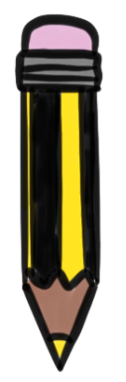
Isbeddellada (Transformations) ee isku midnimada (congruence)
Soo saar qaab isku mid ah (congruent) adigoo wareejinaya shayga (object) 90° saacad (clockwise) agagaarka barta.
Soo saar qaab isku mid ah (congruent) adigoo wareejinaya shayga (object) 90° ka soo horjeeda saacadda (anticlockwise) agagaarka barta.

Slide 22
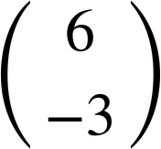
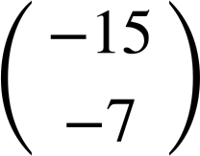
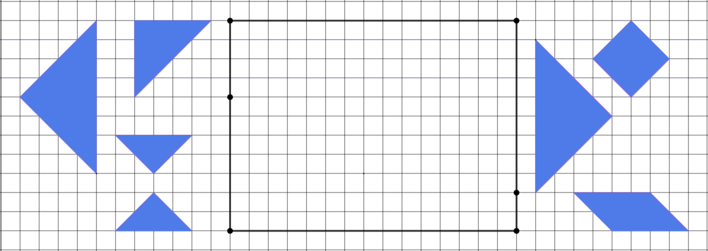
Isbeddellada (Transformations) ee isku midnimada (congruence)
1)
a) Milicsi A korka PT.
b) Wareeji B 180° agagaarka U.
c) Guuri C .
d) Milicsi D korka PT.
e) Guuri E .
f) Wareeji F 90° ka soo horjeeda saacadda (anticlockwise) agagaarka R.
g) Milicsi G korka QS.
P
Q
B
E
A
U
F
C
R
D
G
T
S

Slide 23
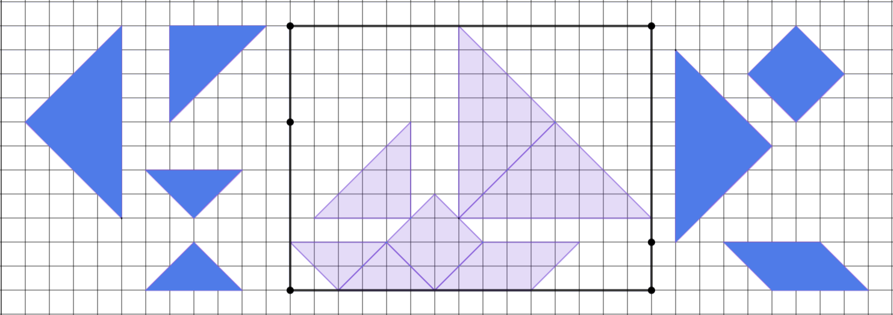
Isbeddellada (Transformations) ee isku midnimada (congruence)
1)
a) Milicsi A korka PT.
b) Wareeji B 180° agagaarka U.
c) Guuri C .
d) Milicsi D korka PT.
e) Guuri E .
f) Wareeji F 90° saacad-darro ah oo ku wareegsan R.
g) Ka milicsan G korka QS.
P
Q
B
E
A
U
F
C
R
D
G
T
S

Slide 24
Hubinta fahamka isku-ekaanshaha (congruence)
Isbeddellada (Transformations) oo leh isku-ekaansho (congruence)
Aqoonsashada macluumaadka maqan ee qaababka isku-ekaanshaha (congruent)

Slide 25
Aqoonsashada macluumaadka maqan ee qaababka isku-ekaanshaha (congruent)
Milicsiga (Reflection), wareejinta (rotation) iyo turjumaadda (translation) had iyo jeer waxay soo saaraan sawir la mid ah (congruent) shayga.
Marka laba qaab isku-ekaansho (congruent) yihiin, dhererkooda iyo xaglohooduba waa isku mid.
Boo'aha (positions) iyo jihada (orientation) dhererka iyo xaglaha way kala duwanaan karaan, laakiin weli waxay ilaalinayaan isku nidaamka.

Slide 26
Aqoonsashada macluumaadka maqan ee qaababka isku-ekaanshaha (congruent)
Qaababka A iyo B waa isku-ekaansho (congruent).
Qaababka C iyo D waa isku-ekaansho (congruent).
5
5
13
67°
5
118°
118°
C
23°
17
17
15
A
15
B
12
13
67°
62°
62°
5
D
23°
13
13
12
Waa maxay isbeddelka (transformation) uu A ugu qoro B?
Waa maxay isbeddelka (transformation) uu C ugu qoro D?
turjumaad (translation)
turjumaad (translation)
Ku calaamadee qaabka B dhererkiisa iyo xaglaha maqan.
Ku calaamadee qaabka D dhererkiisa iyo xaglaha maqan.

Slide 27
Aqoonsashada macluumaadka maqan ee qaababka isku-ekaanshaha (congruent)
Qaababka A iyo B waa isku-ekaansho (congruent).
Qaababka C iyo D waa isku-ekaansho (congruent).
5
5
13
67°
5
118°
118°
C
23°
17
17
15
A
B
15
12
12
62°
62°
23°
D
5
13
13
67°
13
Waa beddelkeedee (transformation) oo A ku saabsan B?
Waa beddelkeedee (transformation) oo C ku saabsan D?
milicsi (reflection)
milicsi (reflection)
Ku calaamadee qaabka B dhererkiisa iyo xaglaha maqan.
Ku calaamadee qaabka D dhererkiisa iyo xaglaha ka maqan.

Slide 28
Aqoonsiga macluumaadka ka maqan ee qaababka isku midka ah
Qaababka A iyo B waa isku mid (congruent).
Qaababka C iyo D waa isku mid (congruent).
5
15
13
67°
5
118°
5
C
B
118°
23°
17
13
15
A
12
62°
17
12
62°
23°
5
D
13
67°
13
Waa beddelkeedee (transformation) oo A ku saabsan B?
Waa beddelkeedee (transformation) oo C ku saabsan D?
wareeg (rotation)
wareeg (rotation)
Ku calaamadee qaabka B dhererkiisa iyo xaglaha ka maqan.
Ku calaamadee qaabka D dhererkiisa iyo xaglaha ka maqan.

Slide 29
Aqoonsiga macluumaadka ka maqan ee qaababka isku midka ah
1) Shanta saddexagal waa isku mid (congruent).
a) Waa beddelkeedee (transformation) oo A ku saabsan B?
37°
B
5
4
b) Waa beddelkeedee (transformation) oo B ku saabsan C?
A
53°
c) Waa beddelkeedee (transformation) oo C ku saabsan D?
3
C
d) Waa beddelkeedee (transformation) oo D ku saabsan E?
E
D
e) Waa beddelkeedee (transformation) oo E ku saabsan A?
f) Ku calaamadee dhererka iyo xaglaha ka maqan ee saddexagallada B ilaa E.

Slide 30
Aqoonsashada macluumaadka maqan ee qaababka isku qaabka ah (congruent shapes)
2) Afarta geesoodle (quadrilaterals) waa isku qaab (congruent). Isbeddellada (transformations) qaab kasta u beddelaya qaabka xiga ayaa hoos ku qoran.
2.99
89°
92°
3.99
A
4
B
C
D
88°
91°
3
A ↦ B: guur (translation)
B ↦ C: milicsi (reflection)
C ↦ D: wareeg (rotation) 180°
a) Ku calaamadee dhererka (lengths) iyo xaglaha (angles) maqan ee qaababka B ilaa D.
b) Waa maxay isbeddel (transformation) lagu dabaqi karo qaabka D si loo abuuro sawir (image) la jihaysan (orientation) la mid ah qaabka A?

Slide 31
Aqoonsashada macluumaadka maqan ee qaababka isku qaabka ah (congruent shapes)
1) Shanta saddex-xagal (triangles) waa isku qaab (congruent).
4
a) Waa maxay isbeddel (transformation) A u beddelaya B?
37°
37°
B
wareeg (rotation)
3
5
53°
5
4
b) Waa maxay isbeddel (transformation) B u beddelaya C?
A
milicsi (reflection)
53°
5
53°
c) Waa maxay isbeddel (transformation) C u beddelaya D?
3
C
3
guur (translation)
37°
4
d) Waa maxay isbeddel (transformation) D u beddelaya E?
5
53°
53°
5
milicsi (reflection)
3
3
E
D
e) Waa maxay isbeddel (transformation) E u beddelaya A?
37°
37°
wareeg (rotation)
4
4
f) Ku calaamadee dhererka (lengths) iyo xaglaha (angles) maqan ee saddex-xagallada B ilaa E.

Slide 32
Aqoonsashada macluumaadka maqan ee qaababka isku qaabka ah (congruent shapes)
2) Afarta geesoodle (quadrilaterals) waa isku qaab (congruent). Isbeddellada (transformations) qaab kasta u beddelaya qaabka xiga ayaa hoos ku qoran.
2.99
2.99
2.99
3
89°
92°
89°
92°
92°
89°
88°
91°
3.99
A
4
3.99
B
4
4
C
3.99
3.99
D
4
88°
91°
88°
91°
91°
88°
89°
92°
3
3
3
2.99
A ↦ B: guur (translation)
B ↦ C: milicsi (reflection)
C ↦ D: wareeg (rotation) 180°
a) Ku calaamadi dhererka iyo xaglaha ka maqan ee qaababka B ilaa D.
b) Waa maxay isbeddel (transformation) lagu dabaqi karo qaabka D si loo abuuro sawir isku jiho ah sida qaabka A?
milicsi (reflection) (iyada oo loo marayo xariiq toosan)

Slide 33
Hubinta fahamka isku midnimada (congruence)
Guur (translation), milicsi (reflection) iyo wareeg (rotation) waxay soo saaraan sawir isku mid ah (congruent) shayga.
Marka laba qaab ay isku mid yihiin (congruent), waxay leeyihiin dherer iyo xaglo isku mid ah.
Guur (translation) wuxuu ku lug leeyahay dhaqaaqinta qaab si loo abuuro sawir isku mid ah (congruent).
Wareeg (rotation) wuxuu ku lug leeyahay u leexinta qaab agagaarka barta la qeexay si loo abuuro sawir isku mid ah (congruent).
Milicsi (reflection) wuxuu ku lug leeyahay rogida qaab si loo abuuro sawir isku mid ah (congruent).

