Slide 1
Hubinta fahamka isku ekaanshaha (similarity)
Sifooyinka joomatari (geometrical properties) iyo aragtida Pythagoras (Pythagoras’ theorem)

Slide 2
sida loo isticmaalo darasyada Oak

Slide 3
Waxaan weyneyn (enlarge) karaa qaab (shape) waxaana sheegi karaa waxa isbeddelaya iyo waxa aan isbeddelin (invariant).

Slide 4
Shayga (object) waa jaantuska bilowga ah ka hor inta aan la isbeddelin (transformation).
Sawirka (image) waa jaantuska ka soo baxa ka dib marka la isbeddelo (transformation).
Laba qaab (shape) waa isku mid (similar) haddii kala duwanaanshaha kaliya ee u dhexeeya ay tahay cabbirkooda. Dhererka dhinacyadoodu waa isku saami (proportions).
Qiyaasta weyneyn (scale factor) waa tirada lagu dhufto (multiplier) ee u dhaxaysa qaababka isku midka ah (similar shapes), oo qeexaysa sida uu u weyn yahay qaabka marka loo barbardhigo kan kale.
Sifo (property) ee qaabka waa mid aan isbeddelin (invariant) haddii sifadaas aan isbeddelin ka dib marka qaabka la isbeddelo.

Slide 5

Hubinta fahamka isku ekaanshaha (similarity)
Hubinta fahamka weyneyn (enlargement)
Hubinta fahamka isku ekaanshaha (similarity)

Slide 6
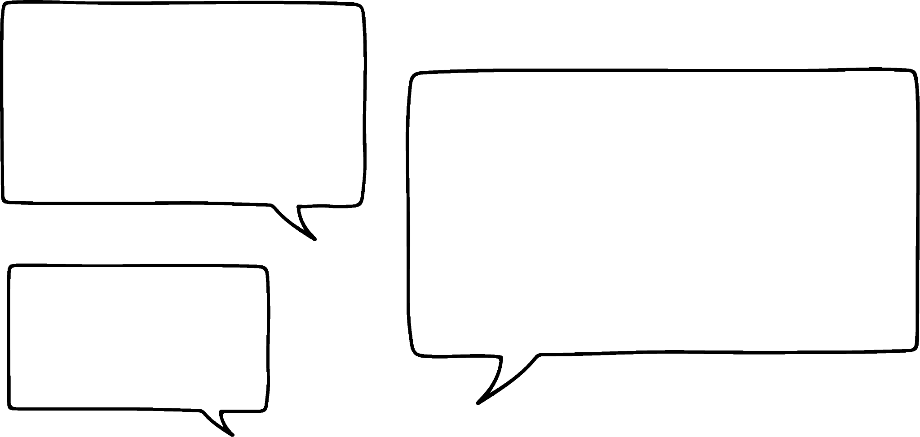

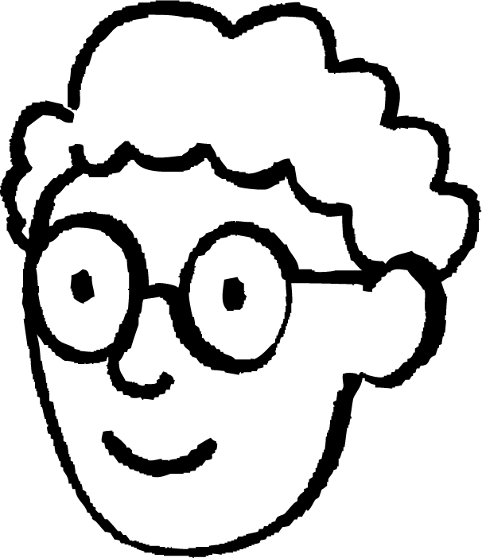

Hubinta fahamka weyneyn (enlargement)
Shaygan (object) waxaa lagu weyneeyey (enlarged) qiyaasta weyneyn (scale factor) 3 si loo abuuro sawirka (image).
Axmed wuxuu cabbiraa dhererka shayga (object).
Wuxuu ku dhow yahay inuu cabbiro dhererka sawirka (image). Maxaa uu filan karaa?
12 cm
Dherer kasta oo sawirka (image) ku yaal wuxuu noqon doonaa 3 jeer dhererkiisa u dhigma shayga (object).
× 3
15 cm
9 cm
4 cm
× 3
× 3
3 cm
5 cm
Axmed
shay (object)
sawir (image)

Slide 7



Hubinta fahamka weyneyn (enlargement)
Shayga (object) waxaa lagu weyneeyey (enlarged) qodob cabbir (scale factor) 3 si loo abuuro sawirka (image).
Axmed wuxuu cabbiraa xaglaha (angles) shayga (object).
Wuxuu ku dhow yahay inuu cabbiro xaglaha (angles) sawirka (image). Maxay tahay inuu filo?
Xaglaha (angles) sawirka (image) mid kasta wuxuu noqon doonaa 3 jeer xaggiisa u dhigma shayga (object).
Laakiin taasi waxay ka dhigi doontaa xaglaha (angles) sawirka (image) inay isugeyn ka badan 180°. Taasi sax ma noqon karto.
shay (object)
37°
sawir (image)
Axmed
Layla
53°

Slide 8
Hubinta fahamka weyneyn (enlargement)
Marka qaab (shape) la weyneeyo (enlarged) dhererka (lengths) ayaa laga yaabaa inuu isbeddelo, laakiin xaglaha (angles) ma isbeddelaan.
Hubinno faa'iido leh:
Saddexagalka (triangles) labaduba waa xagal-qumman (right-angled).
37°
Saddexagalka (triangles) labaduba waxay ka kooban yihiin laba xagal fiiqan (acute angles).
shay (object)
Xaglaha (angles) saddexagal (triangle) kasta wuxuu isugeyn yahay 180°.
37°
sawir (image)
53°
53°

Slide 9


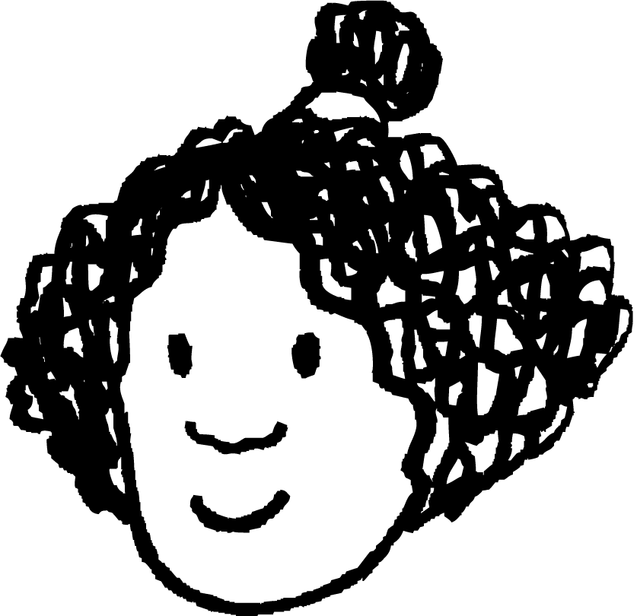
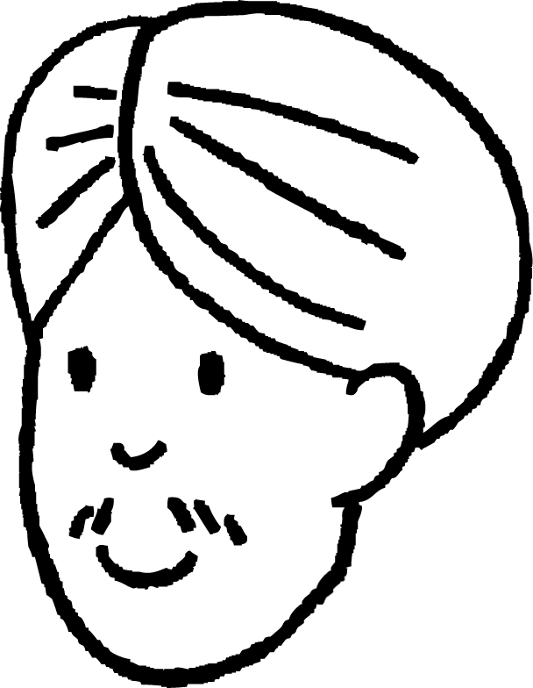


Hubinta fahamka weyneyn (enlargement)
Mid ka mid ah qaababka waa weyneyn (enlargement) kan kale.
Sidee loo xisaabin karaa isku-dhufashada (scale factor)?
Waxaan xisaabin karnaa isku-dhufashada (scale factor) adoo u qaybinaya laba dherer oo isku mid ah.
Nidaamka qaybinta wuxuu ku xiran yahay qaabka uu yahay shayga (object) iyo kan uu yahay sawirka (image).
10 cm
B
5 cm
A
6 cm
3 cm
Cali
Isra

Slide 10
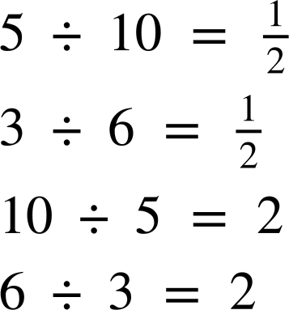
Hubinta fahamka weyneyn (enlargement)
Mid ka mid ah qaababka waa weyneyn (enlargement) kan kale.
Sidee loo xisaabin karaa isku-dhufashada (scale factor)?
Haddii A uu yahay shayga (object) iyo B uu yahay sawirka (image):
Haddii B uu yahay shayga (object) iyo A uu yahay sawirka (image):
10 cm
B
5 cm
A
6 cm
isku-dhufashada (scale factor) = 2
isku-dhufashada (scale factor) =
3 cm

Slide 11
Hubinta fahamka weyneyn (enlargement)
Shayga waxaa lagu weyneeyay (enlarged) iyadoo la adeegsaday cabbir (scale factor) 5 si loo abuuro sawirka. Waa maxay qiimaha (value) x?
x mm
6 mm
x = 6 × 5
= 30

Slide 12
Hubinta fahamka weyneyn (enlargement)
Shayga waxaa lagu weyneeyay (enlarged) iyadoo la adeegsaday cabbir (scale factor) 0.5 si loo abuuro sawirka. Waa maxay qiimaha (value) x?
x°
70°
x = 70. Cabbirka xaglaha (angle sizes) waa la ilaaliyaa inta lagu jiro weyneynta (enlargement).

Slide 13
Hubinta fahamka weyneyn (enlargement)
1) a) Weynee (enlarge) shayga iyadoo la adeegsado cabbir (scale factor) 3 oo laga bilaabo barta la calaamadeeyay.
b) Isticmaal xisaabiyaha (ruler) si aad u qiyaasto dhammaan dhererka (lengths) ee qaab kasta, oo hubi in dherer kasta oo sawirka ku yaal uu yahay 3 jeer dhererkiisa u dhigma ee shayga.
c) Isticmaal xagalbeere (protractor) si aad u qiyaasto dhammaan xaglaha (angles) ee qaab kasta, oo hubi in xagal kasta oo sawirka ku yaal uu la mid yahay xagalkiisa u dhigma ee shayga.

Slide 14
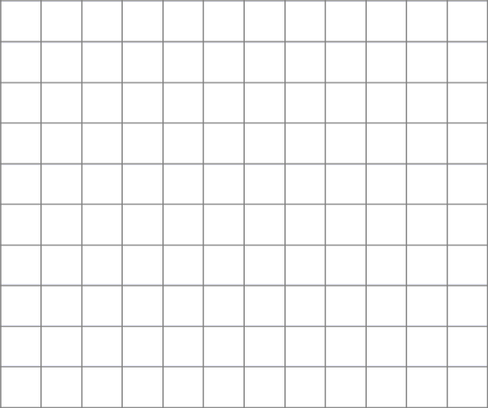
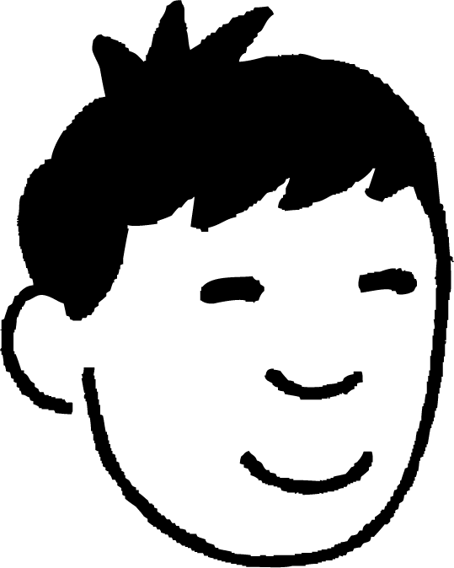
Hubinta fahamka weyneyn (enlargement)
2) Nuur wuxuu rabaa inuu weyneeyo (enlarge) qaabka iyadoo la adeegsado cabbir (scale factor) 2. Wuxuu u baahan yahay inuu si taxaddar leh u doorto xarunta weyneynta (centre of enlargement) si dhammaan sawirka uu ugu sii jiro shabagga (grid).
Soo hel dhammaan dhibcaha (points) ee Nuur u isticmaali karo xarunta weyneynta (centre of enlargement).

Slide 15
Hubinta fahamka weyneyn (enlargement)
1) a) Weynee (enlarge) shayga iyadoo la adeegsado cabbir (scale factor) 3 oo laga bilaabo barta la calaamadeeyay.
Hubi: geeska hoose ee bidix ee sawirka waa inuu si toos ah uga hooseeyaa geeska hoose ee midig ee shayga.

Slide 16

Hubinta fahamka weyneyn (enlargement)
b) Isticmaal xisaabiyaha (ruler) si aad u qiyaasto dhammaan dhererka (lengths) ee qaab kasta, oo hubi in dherer kasta oo sawirka ku yaal uu yahay 3 jeer dhererkiisa u dhigma ee shayga.
Dhererku wuu kala duwanaan karaa iyadoo ku xiran daabacaadda.
Tusaale isku darka dhererka:
Hubi:
15 ÷ 5 = 3
12 ÷ 4 = 3
9 ÷ 3 = 3
15 cm
5 cm
9 cm
3 cm
4 cm
12 cm

Slide 17
Hubinta fahamka weyneyn (enlargement)
c) Isticmaal protractor (protractor) si aad u cabbirto dhammaan xaglaha (angles) ee qaab kasta oo hubi in xagal kasta oo sawirka (image) ku jira uu la mid yahay xaggiisa u dhigma ee shayga (object).
Haddii xaashida shaqada (worksheet) lagu daabacay si saami ah, xagluhu waa inay la mid noqdaan kuwa hoose.
Xagluhu way kala duwanaan karaan haddii saamiyada (proportions) aan la ilaalin.
Hubi:
Xaglaha (angles) ee sawirka (image) waxay la mid yihiin xaglahooda u dhigma ee shayga (object).
53°
15 cm
5 cm
9 cm
53°
3 cm
Hubin dheeri ah:
37°
53 + 90 + 37 = 180 Xaglaha (angles) ee saddexagal kasta waa isku 180°.
4 cm
37°
12 cm

Slide 18
Hubinta fahamka weyneyn (enlargement)
2) Nuur wuxuu rabaa inuu weyneeyo (enlarge) qaabka isagoo isticmaalaya qiyaas weyneyn (scale factor) 2. Wuxuu u baahan yahay inuu si taxaddar leh u doorto xarunta weyneyn (centre of enlargement) si sawirka (image) oo dhan uu ugu sii jiro shabkada (grid).
Soo hel dhammaan dhibcaha (points) ee Nuur u isticmaali karo xarunta weyneyn (centre of enlargement).
Sawirku wuxuu ku sii jiraa shabkada marka la isticmaalo xarun kasta oo weyneyn (enlargement) ah oo ku taal goobtan.
🖇mujejis (demonstration) is-dhexgal ah

Slide 19
Hubinta fahamka isku ekaanshaha (similarity)
Hubinta fahamka weyneyn (enlargement)
Hubinta fahamka isku ekaanshaha (similarity)

Slide 20
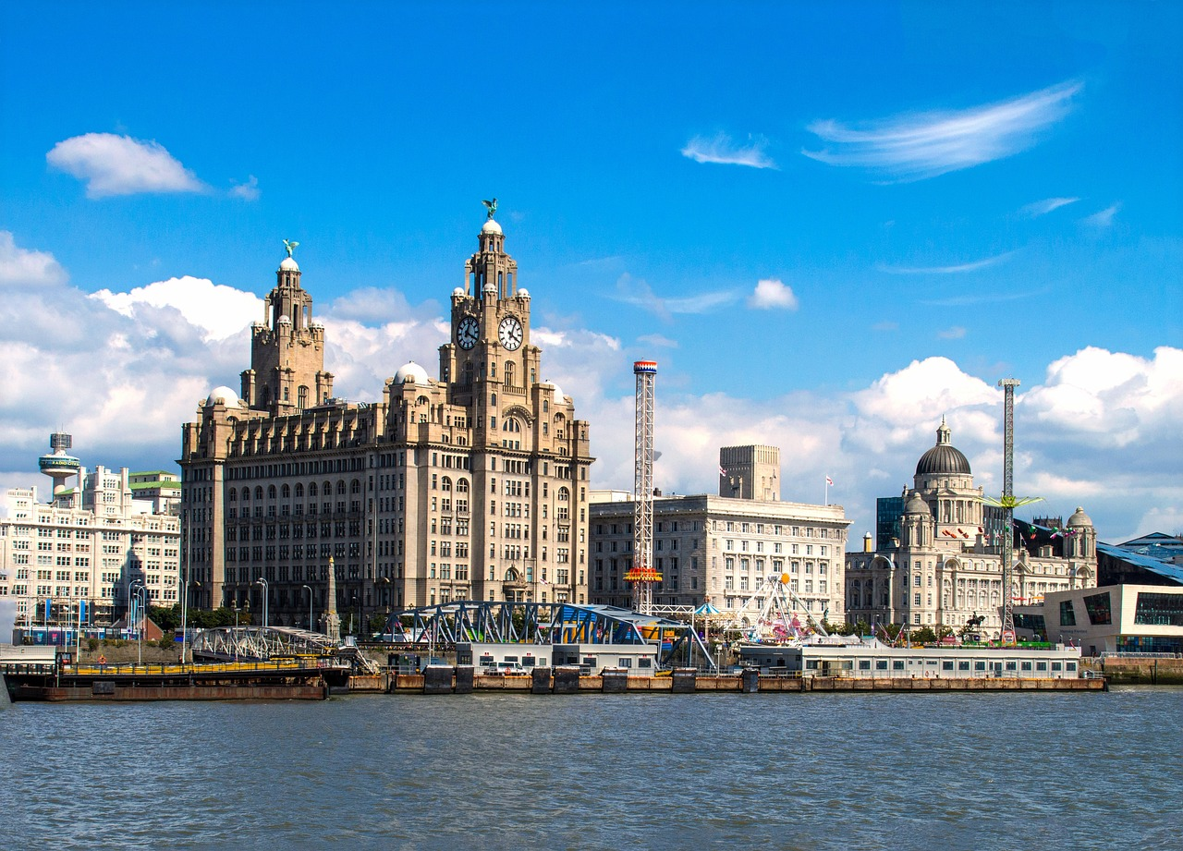
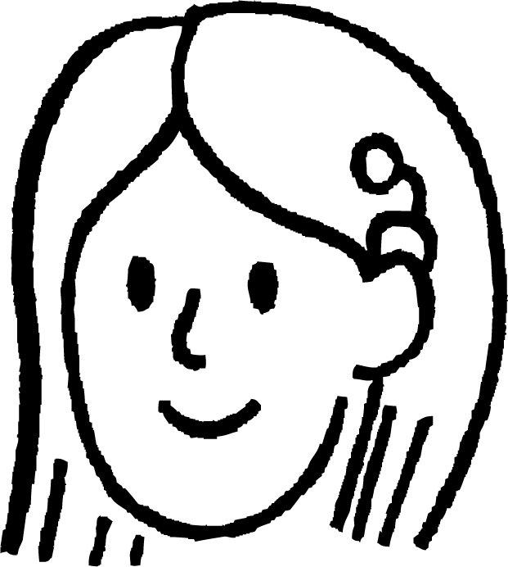
Hubinta fahamka isku ekaanshaha (similarity)
Kani waa sawir magaalada Liverpool.
Suad iyo Nuur labaduba waxay koobiyeeyeen sawirka oo way weyneeyeen.
Maxay sawirka Nuur u eg yahay mid qalloocan?
sawirkii asalka ahaa
koobiga Suad
koobiga Nuur

Slide 21
Hubinta fahamka isku ekaanshaha (similarity)
Marka shay la weyneeyo (enlarged) si loo abuuro sawir, shayga iyo sawirku waa isku mid (similar).
Laba qaab (shape) waa isku mid (similar) haddii dhererradoodu isku saami (proportion) yihiin.
Qaababku (shapes) waa isku mid (similar) sababtoo ah…
saamiyada (ratios) u dhexeeya dhererrada qaab kasta waa isku mid (equivalent).
8
4
× 1.5
4 : 6
8 : 12
× 2
× 2
6
12
× 1.5

Slide 22
Hubinta fahamka isku ekaanshaha (similarity)
Marka shay la weyneeyo (enlarged) si loo abuuro sawir, shayga iyo sawirku waa isku mid (similar).
Laba qaab (shape) waa isku mid (similar) haddii dhererradoodu isku saami (proportion) yihiin.
Qaababku isku mid (similar) ma aha sababtoo ah…
saamiyada (ratios) u dhexeeya dhererrada qaab kasta ma aha kuwa isku mid (equivalent).
8
4
× 1.5
4 : 6
8 : 6
× 2
× 1
6
6
× 0.75

Slide 23
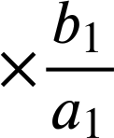
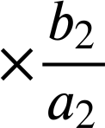
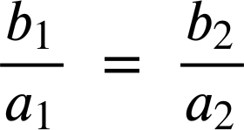
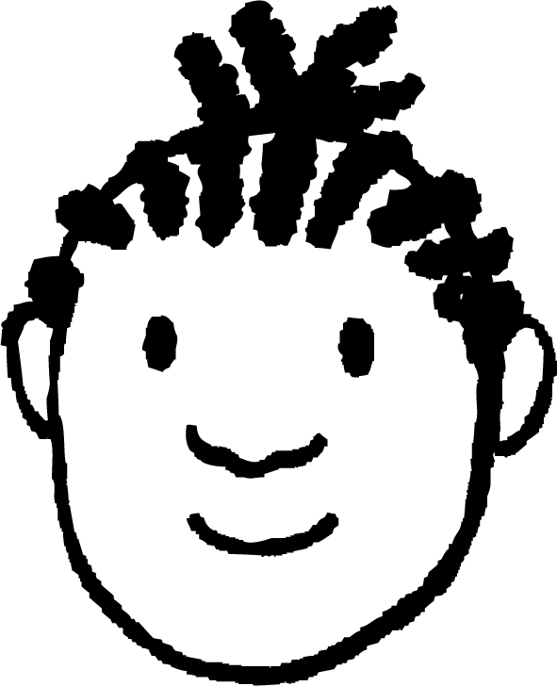
Hubinta fahamka isku midnimada (similarity)
Gobollo (circles) oo dhan miyay isku mid (similar) yihiin?
Sidee ku caddayn kartaa jawaabtaada?
Gacan-radius (radius) ee goobo (circle) wuxuu leeyahay dherer isku mid ah dhinac kasta.
b₁
a₁
Marka isku dhufashada (multipliers) ee u dhaxaysa gacanka-radius (radii) ee u dhigma waxay noqonayaan kuwo isku mid ah.
a₂
b₂
Yacquub

Slide 24
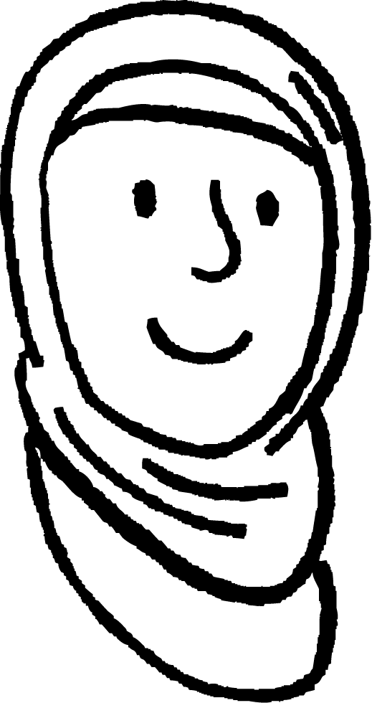
Hubinta fahamka isku midnimada (similarity)
Gobollo (circles) oo dhan miyay isku mid (similar) yihiin?
Sidee ku caddayn kartaa jawaabtaada?
Gacan-radius (radius) ee goobo (circle) wuxuu leeyahay dherer isku mid ah dhinac kasta.
Marka isku dhufashada (multipliers) ee u dhaxaysa gacanka-radius (radii) ee goobo kasta waa isku mid yihiin. Waxay had iyo jeer yihiin 1.
b₁
a₁
× 1
a₂
× 1
b₂
Caasha

Slide 25
Hubinta fahamka isku midnimada (similarity)
Gobollo (circles) oo dhan miyay isku mid (similar) yihiin?
Sidee ku caddayn kartaa jawaabtaada?
Saamiga (ratio) ee u dhexeeya dhexroorka (diameter) iyo wareegga (circumference) ee goobo kasta waa isku mid had iyo jeer.
× π
× π
Nuur

Slide 26
Hubinta fahamka isku midnimada (similarity)
Laba qaab (shapes) waa isku mid (similar) haddii dhererkoodu yahay isku saami (proportion). Jihada (orientation) qaababka way ka duwanaan kartaa.
12 cm
Qaababku waa isku mid (similar), taas oo macnaheedu yahay…
37°
isku dhufashada (multipliers) ee u dhaxaysa dhererka isku midka ah waa siman yihiin.
saamiyada (ratios) ee u dhexeeya dhererka qaab kasta waa isku mid (equivalent).
xaglaha isku midka ah (corresponding angles) waa siman yihiin.
37°
9 cm
15 cm
5 cm
4 cm
53°
9 ÷ 3 = 3
12 ÷ 4 = 3
15 ÷ 5 = 3
3 : 4 : 5
9 : 12 : 15
53°
3 cm
Xagluhu waa invariant (invariant) inta lagu jiro weyneyn (enlargement).

Slide 27
Hubinta fahamka isku midnimada (similarity)
Qaabkee ayaa la mid ah saddexagalka T?
9 cm
6 cm
T
11 cm
12 cm
4 cm
14 cm
3 cm
6 cm
3 cm
8 cm
2 cm
4 cm

Slide 28

Hubinta fahamka isku midnimada (similarity)
Labada qaab ee hoose waa isku mid (similar). Raadi dhererka maqan.
caleen (scale factor):
18 ÷ 12 =
13 cm
12 cm
dhinaca ugu dheer:
13 × = 19.5
5 cm
19.5 cm
dhinaca ugu gaaban:
7.5 cm
7.5 ÷ = 5
18 cm

Slide 29
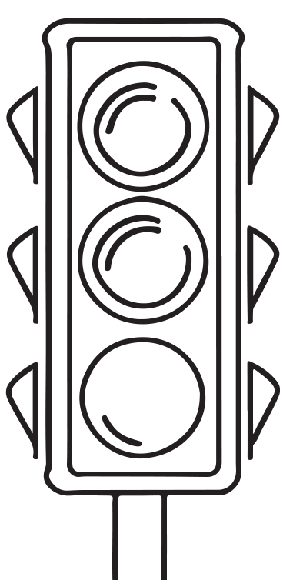
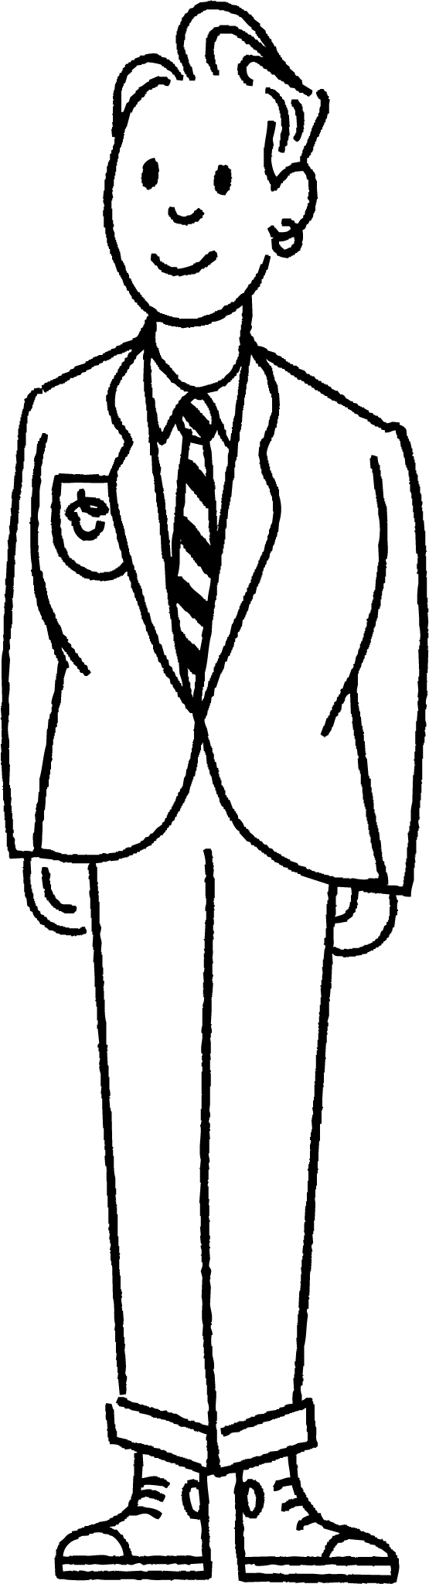
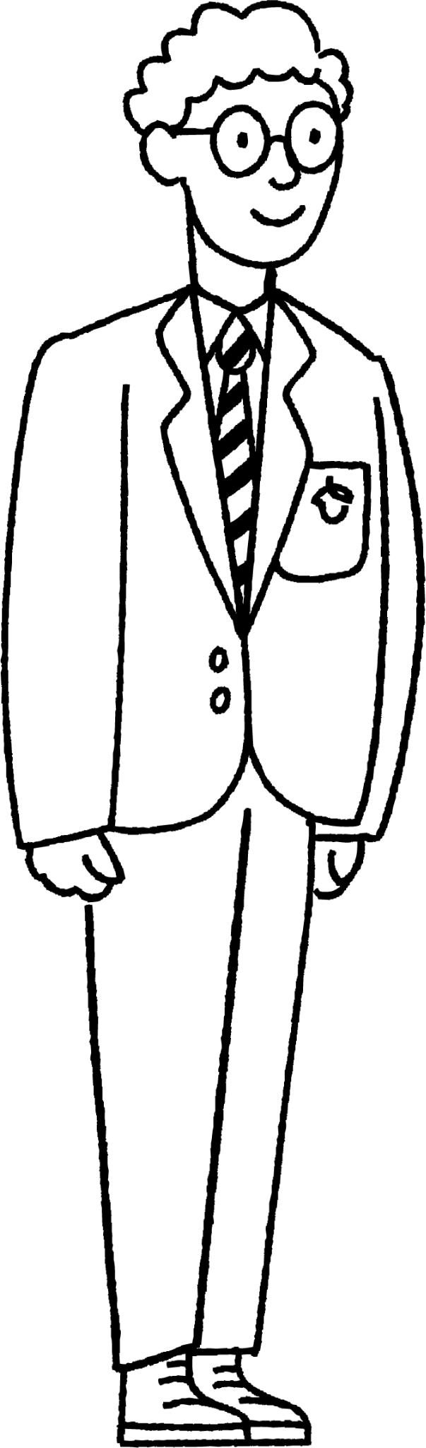


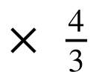
Hubinta fahamka isku midnimada (similarity)
Axmed iyo Saciid waxay qiyaasayaan dhererka nalalka taraafikada maalin qorrax leh.
Sidee ayay u samayn karaan iyagoo isticmaalaya qaabab isku mid ah (similar shapes)?
Haddii aan ognahay dhererka Axmed, waxaan qiyaasi karnaa dhererka nalalka taraafikada adigoo cabbiraya hooska (shadows).
4 m
?
156 cm
117 cm
3 m

Slide 30

Hubinta fahamka isku midnimada (similarity)
Labada qaab waa isku mid (similar). Raadi qiimaha (value) x.
20 ÷ 8 =
x = 4 ×
= 10
Habka 1 (Method 1) Inta u dhaxaysa qaababka (Between shapes)
4 cm
Habka 2 (Method 2) Inta u dhaxaysa dhinacyada isku qaabka (Between sides of same shape)
20 cm
10 cm
4 × 2 = 8
x × 2 = 20
x = 10
x cm
8 cm
12 cm

Slide 31
Hubinta fahamka isku ekaanshaha (similarity)
1) Isticmaal isku ekaanshaha (similarity) si aad u hesho dhererka maqan.
a)
b)
70 inches
140 inches
?
148 cm
370 cm
?
15.25 m

Slide 32
Hubinta fahamka isku ekaanshaha (similarity)
2) a) Isku dar saddexagal kasta (triangle) iyo saddexagalkiisa isku eg (similar triangle). b) Raadi qiyaasta isku ekaanshaha (scale factor) inta u dhaxaysa labada saddexagal ee isku eg.
29
10
5
12.5
10.5
7.5
D
A
12
C
B
14.5
13
10
20
21
34
5
G
3
4
39
F
15
E
30
15
16
8
H
36
17

Slide 33
Hubinta fahamka isku ekaanshaha (similarity)
1) Isticmaal isku ekaanshaha (similarity) si aad u hesho dhererka maqan.
a)
b)
70 inches
140 inches
6.1 m
148 cm
370 cm
35 inches
15.25 m

Slide 34
Hubinta fahamka isku ekaanshaha (similarity)
2) a) Isku dar saddexagal kasta (triangle) iyo saddexagalkiisa isku eg (similar triangle). b) Raadi qiyaasta isku ekaanshaha (scale factor) inta u dhaxaysa labada saddexagal ee isku eg.
29
10
5
12.5
10.5
7.5
D
A
12
C
B
14.5
13
10
20
21
34
5
G
3
4
39
F
15
E
30
15
16
8
H
36
17

Slide 35

Hubinta fahamka isku ekaanshaha (similarity)
2) a) Isku dar saddexagal kasta oo leh saddexagalkiisa isku eg (similar triangle). b) Raadi qiyaasta (scale factor) ee u dhaxaysa labada saddexagal ee isku eg.
5
39
12
A
15
E
13
36
A iyo E
qiyaasta (scale factor) 3 ama

Slide 36

Hubinta fahamka isku ekaanshaha (similarity)
2) a) Isku dar saddexagal kasta oo leh saddexagalkiisa isku eg (similar triangle). b) Raadi qiyaasta (scale factor) ee u dhaxaysa labada saddexagal ee isku eg.
29
10
B
D
10.5
20
21
14.5
B iyo D
qiyaasta (scale factor) 2 ama

Slide 37
Hubinta fahamka isku ekaanshaha (similarity)
2) a) Isku dar saddexagal kasta oo leh saddexagalkiisa isku eg (similar triangle). b) Raadi qiyaasta (scale factor) ee u dhaxaysa labada saddexagal ee isku eg.
12.5
5
7.5
3
C
G
4
10
C iyo G
qiyaasta (scale factor) ama

Slide 38
Hubinta fahamka isku ekaanshaha (similarity)
2) a) Isku dar saddexagal kasta oo leh saddexagalkiisa isku eg (similar triangle). b) Raadi qiyaasta (scale factor) ee u dhaxaysa labada saddexagal ee isku eg.
34
15
H
8
F
F
30
17
16
F iyo H
qiyaasta (scale factor) 2 ama

Slide 39
Hubinta fahamka isku ekaanshaha (similarity)
Weyneyn (Enlargement) macneheedu waa isbeddel cabbirka.
Dhererka xariiqyada (lines) ayaa laga yaabaa inay isbeddelaan marka la weyneeyo (enlarged).
Xaglaha (angles) gudaha shayga kama isbeddelaan marka la weyneeyo (enlarged).
Marka shay la weyneeyo (enlarged), sawirku waa isku eg (similar).
Jihada (orientations) ee qaababka isku eg (similar shapes) way ku kala duwanaan karaan.

