Slide 1
Qaaciidooyin kiimiko (Chemical formulae)
Atoms, curiye (elements) iyo isku-dhafan (compounds)

Slide 2
sida loo isticmaalo darasyada Oak

Slide 3
Waxaan awoodi karaa inaan isticmaalo astaamaha kiimikada (chemical symbols) si aan u qoro qaaciidooyin kiimiko (chemical formulae) curiye (elements) iyo isku-dhafan (compounds).

Slide 4
astaanta kiimikada (chemical symbol)
qaacidada kiimikada (chemical formula)

Slide 5
Astaanta kiimikada (chemical symbol) waa hal ama laba xaraf oo loo isticmaalo in lagu matalo curiye (element) kiimiko. Xarafka koowaad had iyo jeer waa xaraf weyn, tusaale ahaan bromine waa Br iyo carbon waa C.
Qaacidada kiimikada (chemical formula) waa matalaad tirada atoms ama saamiga atoms ee curiye (element) kasta oo ku jira walax, tusaale ahaan H2O waa biyo (water) oo leh 2 atom hydrogen iyo 1 atom oxygen.

Slide 6

Qaaciidooyin kiimiko (Chemical formulae)
Matalista isku-dhafan (compounds) iyadoo la isticmaalayo astaamaha kiimikada (chemical symbols)
Kala duwanaanshaha isku-dhafan (compounds)

Slide 7

Matalista isku-dhafan (compounds) iyadoo la isticmaalayo astaamaha kiimikada (chemical symbols)
Qaacidada kiimikada (chemical formula) ee isku-dhafan (compound) waxay ka kooban tahay astaamaha iyo tirooyinka atom kasta oo curiye (element).
Tusaale ahaan, carbon monoxide, CO, wuxuu ka kooban yahay hal atom oxygen oo ku xidhan (kiimiko ahaan ku biirsan) atom carbon.
Midabo kala duwan ayaa loo isticmaalaa in lagu matalo atoms kala duwan si aad u kala saari kartid.
C
O
Waxaa jira saami 1:1 ah oo C ilaa O atoms.

Slide 8



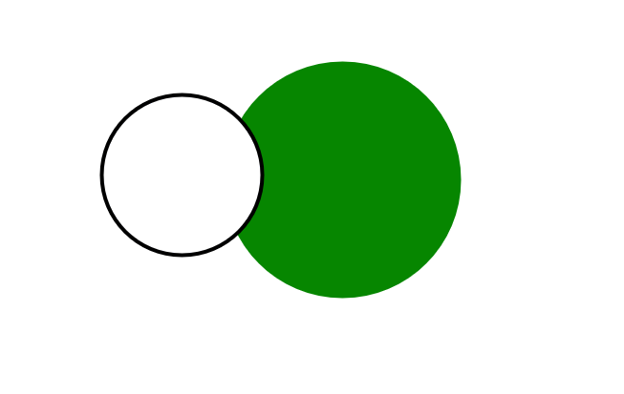
Matalista isku-dhafan (compounds) iyadoo la isticmaalayo astaamaha kiimikada (chemical symbols)
Curiyayaal (Elements) ...
Xeryo (Compounds) ...
waxaa ku jira hal nooc oo atam (atom) ah.
waxay ka kooban yihiin laba ama in ka badan noocyo kala duwan oo atom ah.
N
N
N
N
O
H
Cl
O
O
O
N₂
O₂
MAYA
HCl
2 atam (atom) nitrogen
2 atam (atom) oxygen
1 atam (atom) nitrogen
1 atam (atom) oxygen
1 atom hydrogen
1 atom chlorine

Slide 9


Matixinta xeryaha (compounds) iyadoo la isticmaalayo calaamadaha kiimikada (chemical symbols)
Kuwee ka mid ah kuwan soo socda ayaa matalaya xeryo (compounds)?
Na
C
O
Cl
H
Cl
Li

Slide 10
Matixinta xeryaha (compounds) iyadoo la isticmaalayo calaamadaha kiimikada (chemical symbols)
Tirooyinka hoose (subscript numbers) ee qaaciddada (formula) waxay kuu sheegaan inta atam (atom) ee curiyaha (element) ku jira unug (molecule).
H₂S
CH4
laba atam (atom) oo hydrogen ah
hal atam (atom) oo sulfur ah
hal atam (atom) oo carbon ah
afar atam oo hydrogen ah
Saamiga (ratio) 2:1 ee hydrogen ilaa sulfur
Saamiga (ratio) 1:4 ee carbon ilaa hydrogen
O

Slide 11
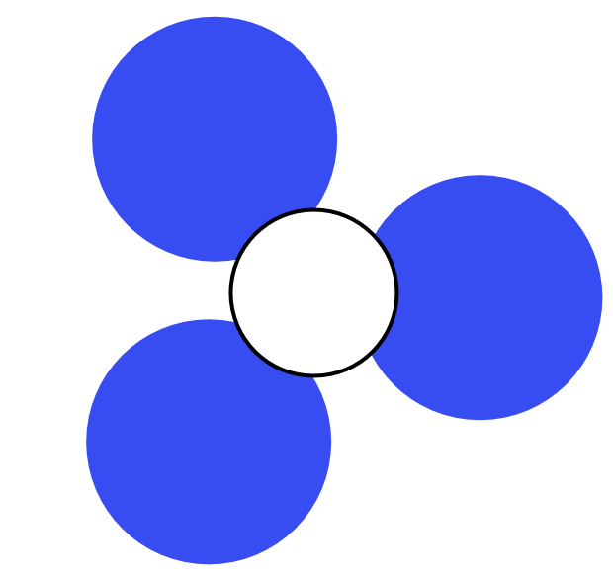
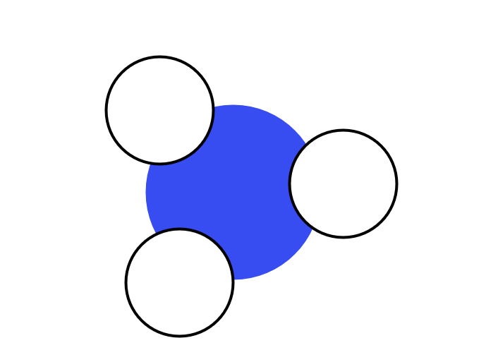
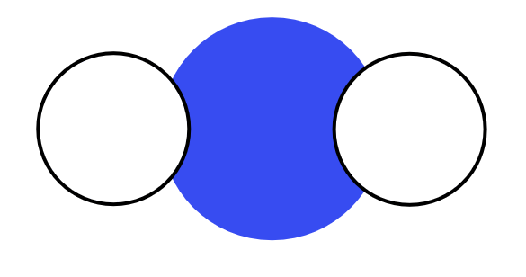
Matixinta xeryahooda iyadoo la adeegsanayo astaamaha kiimikada
Jaantus kee baa muujinaya ammonia (NH3)?
N
H
H
N
H
H
N
N
H
N
H

Slide 12
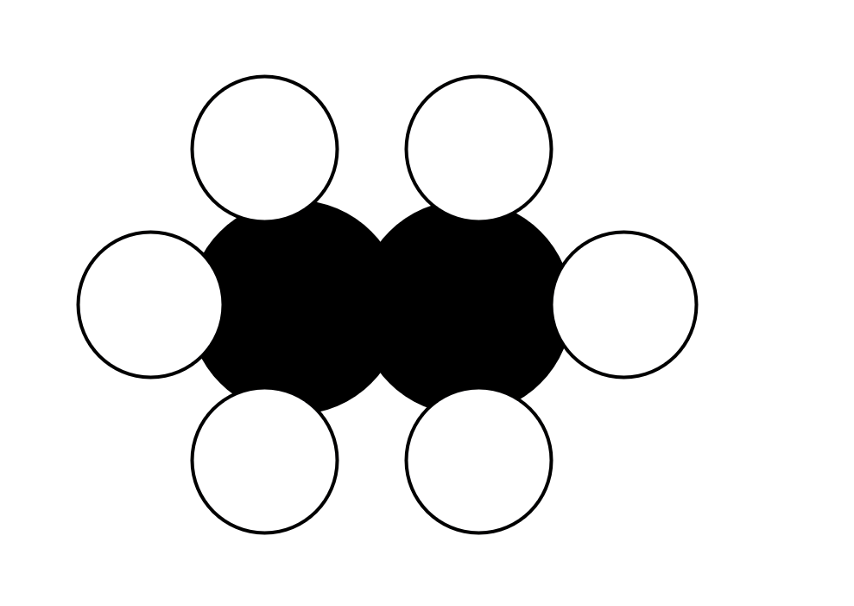
Matixinta xeryahooda iyadoo la adeegsanayo astaamaha kiimikada
Waa maxay qaacidada (formula) xarunta hoos ku muujisan?
H
H
CH3
H
C
C
H
C₂H₆
H
H
C²H⁶

Slide 13
Matixinta xeryahooda iyadoo la adeegsanayo astaamaha kiimikada
Waa maxay qaacidada (formula) saxda ah ee carbon dioxide?
CO2
O
C
CO2
O
C²O
carbon dioxide
C₂O

Slide 14
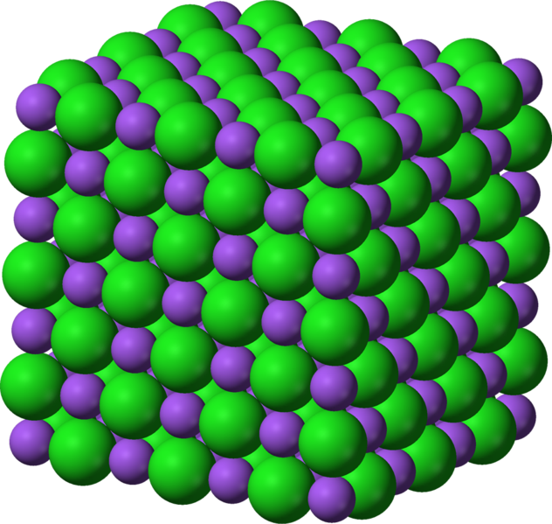
Matixinta xeryahooda iyadoo la adeegsanayo astaamaha kiimikada
Xeryaho qaarkood waxay sameeyaan qaabab waaweyn (giant structures).
Tusaale ahaan:
sodium chloride
atamka sodium
atamka chlorine
NaCl = 1:1 saami
Qaacidada (formula) waxay bixisaa saamiga curiyeyaasha (elements) ee xarunta ku jira.

Slide 15
Matixinta xeryahooda iyadoo la adeegsanayo astaamaha kiimikada
Buuxi shaxda macluumaadka.
qaacidada xarunta (compound formula) | calaamadaha atamka ee iskudhafka (compound) | tirada nooc kasta oo atam ah ee iskudhafka (compound) | saamiga atamka ee iskudhafka (compound)
KBr | K, Br | 1 K, 1 Br | 1:1
NaCl
N₂O
C₃H₈
CuSO4
 | H,S,O |  | 2:1:4

Slide 16
Matabaxinta iskudhafka (compounds) iyadoo la isticmaalayo calaamadaha kiimikada (chemical symbols)
qaciidada iskudhafka (compound formula) | calaamadaha curiyayaasha (elements) ee iskudhafka (compound) | tirada nooc kasta oo atam ah ee iskudhafka (compound) | saamiga curiyayaasha (elements) ee iskudhafka (compound)
KBr | K, Br | 1 K, 1 Br | 1:1
NaCl
N₂O
C₃H₈
CuSO4
 | H, S, O |  | 2:1:4
Na, Cl
1 Na, 1 Cl
1:1
N, O
2 N, 1 O
2:1
C, H
3 C, 8 H
3:8
Cu, S, O
1 Cu, 1 S, 4 O
1:1:4
H2SO4
2 H, 1 S, 4 O

Slide 17
Qaaciidooyinka kiimikada (chemical formulae)
Matalida xeryahooda iyadoo la isticmaalayo calaamadaha kiimikada (chemical symbols)
Kala duwanaanshaha xeryahooda (compounds)

Slide 18




Kala duwanaanshaha xeryahooda (compounds)
Xeryahooda qaarkood waxay ka kooban yihiin atomo isku mid ah kuwa xeryaha kale laakiin saami (ratio) kala duwan.
Xeryahan kala duwani waxay yeelan doonaan sifooyin (properties) kala duwan.
Tusaale ahaan: H2O iyo H2O2
daxaleysi (corrosive)
H₂O
H₂O₂
waxyeello leh (harmful)
biyo (water)
hydrogen peroxide

Slide 19
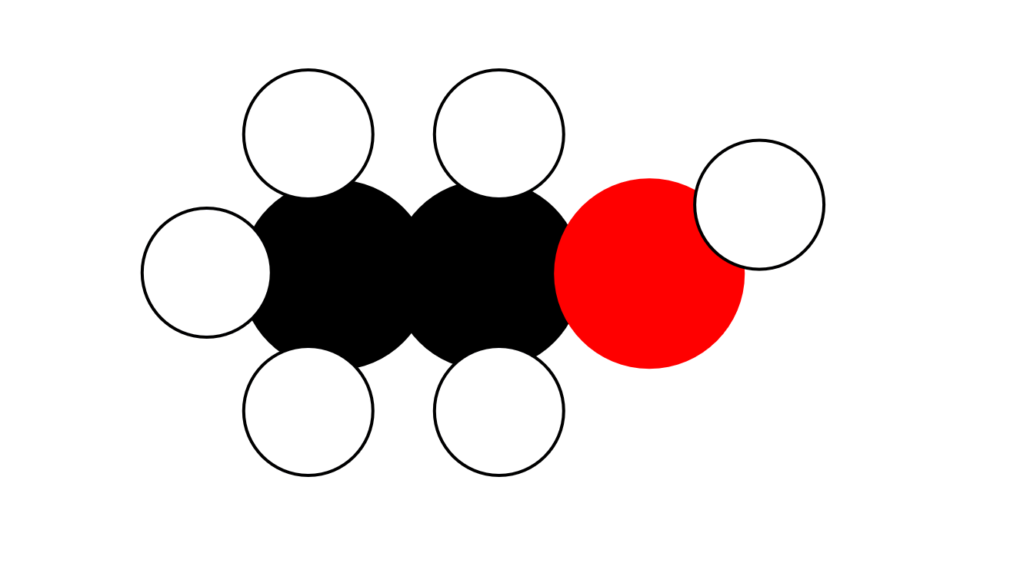
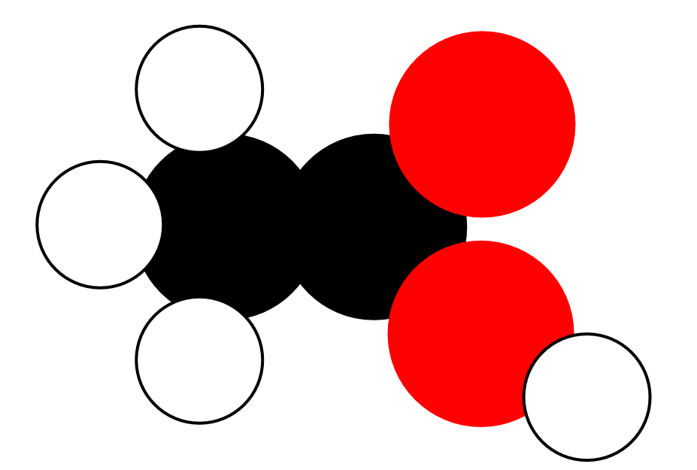
Kala duwanaanshaha xeryahooda (compounds)
Ethanol (C2H6O) iyo ethanoic acid (C2H4O2) waxay leeyihiin curiyeyaal isku mid ah; carbon, hydrogen, iyo oxygen, laakiin saami (ratio) kala duwan. Maadaama ay yihiin xeryaho kala duwan, sifooyinkooda jireed iyo kiimikada (physical and chemical properties) way kala duwan yihiin.
H
H
H
O
H
H
C
C
O
H
C
C
H
O
H
H
H
ethanol
ethanoic acid
bogga karkarinta (boiling point) 78°C
cufnaanta (density) 0.8 g/cm3
guban kara (flammable)
bogga karkarinta (boiling point) 118°C
cufnaanta (density) 1.1 g/cm3
guban kara (flammable)

Slide 20
Kala duwanaanshaha xidhmooyinka (compounds)
Xidhmo (compound) kee (ama kuwa) ayaa ka kooban atam (atoms) isku mid ah oo saami (ratio) kala duwan leh?
CO2
CH2O
SO2
C₂H₆O

Slide 21
Kala duwanaanshaha xidhmooyinka (compounds)
Xidhmo (compounds) kala duwan oo ka kooban curiyeyaasha (elements) isku mid ah ayaa had iyo jeer lahaan doona sifooyin kiimiko (chemical) iyo jireed (physical) isku mid ah.
Xidhmo (compounds) leh saami (ratio) kala duwan oo curiyeyaasha (elements) isku mid ah ayaa lahaan doona sifooyin u eg kuwa curiyeyaasha (elements) gaarka ah.
Xidhmo (compounds) leh saami (ratio) kala duwan oo curiyeyaasha (elements) isku mid ah ayaa u dhaqmi doona si kala duwan.

Slide 22



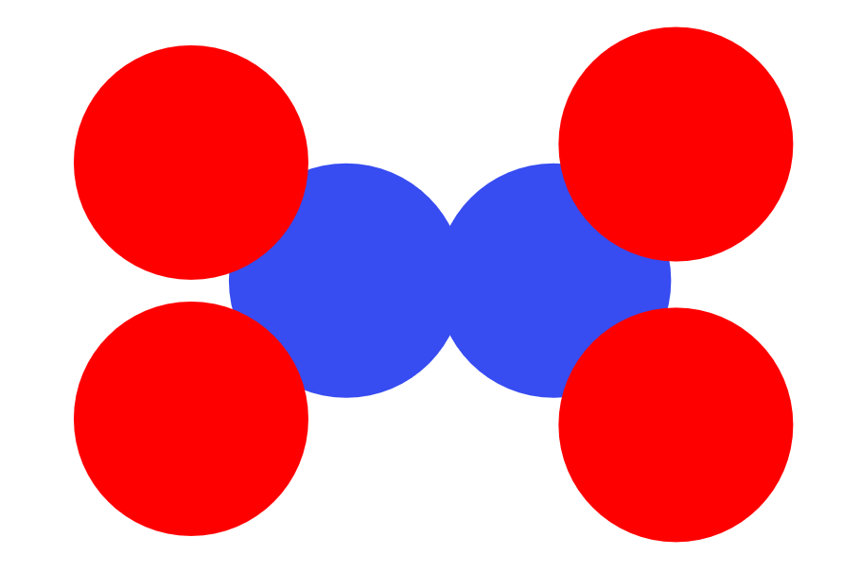
Kala duwanaanshaha xidhmooyinka (compounds)
Saddexda xidhmo (compound) ee ka kooban curiyeyaasha (elements) isku mid ah oo ku xidhan saami (ratio) kala duwan waa kuwee?
Magacaw curiyeyaasha (elements) ku jira xidhmooyinka (compounds) aad dooratay.
Qor qaaciidooyinka (formulae) xidhmooyinka (compounds).
O
O
N
N
a
b
O
C
O
c
O
N
O
O
O
H
H
O
H
O
N
N
N
H
H
C
C
H
d
O
O
e
f
H
H
H

Slide 23

Kala duwanaanshaha xidhmooyinka (compounds)
Saddexda xidhmo (compound) ee ka kooban curiyeyaasha (elements) isku mid ah oo ku xidhan saami (ratio) kala duwan waa kuwee?
Magacaw curiyeyaasha (elements) ku jira xidhmooyinka (compounds) aad dooratay.
Qor qaaciidooyinka (formulae) xidhmooyinka (compounds).
a, c iyo d
nitrojiin (nitrogen) (N) iyo oksijiin (oxygen) (O)
NO, NO2, N2O4
O
O
N
c
N
a
b
O
C
O
O
N
O
O
O
H
H
O
O
H
N
N
N
H
H
C
C
H
d
O
O
e
f
H
H
H

Slide 24









Kala duwanaanshaha xidhmooyinka (compounds)
Six fikradaha ardayga ee ku saabsan iskudhisyada (compounds).
Carbonic acid (H2CO3), glucose (C6H12O6) iyo ethanol (C2H6O) dhamaantood waxay ka kooban yihiin curiyeyaasha (elements) nitrogen, cobalt, osmium iyo hydrogen.
Haddii iskudhisyadu (compounds) ay ka kooban yihiin curiyeyaasha (elements) isku mid ah oo saami (ratios) kala duwan, waxay yeelan doonaan astaamo (properties) isku mid ah.
Qaar ka mid ah iskudhisyada (compounds) waxay ka kooban yihiin curiyeyaasha (elements) isku mid ah oo siyaabo kala duwan ugu xiran.
Saciid
Nuur
Caasha

Slide 25

Kala duwanaanshaha iskudhisyada (compounds)
Six fikradaha ardayga ee ku saabsan iskudhisyada (compounds).
Haddii iskudhisyada (compounds) ay ka kooban yihiin curiyeyaasha (elements) isku mid ah oo saami (ratios) kala duwan, waxay yeelan doonaan astaamo (properties) kala duwan.
Carbonic acid (H2CO3), glucose (C6H12O6) iyo ethanol (C2H6O) dhamaantood waxay ka kooban yihiin curiyeyaasha (elements) carbon, oxygen iyo hydrogen.
Qaar ka mid ah iskudhisyada (compounds) waxay ka kooban yihiin curiyeyaasha (elements) isku mid ah oo siyaabo kala duwan ugu xiran (bonded).
Saciid
Nuur
Caasha

Slide 26
Qaacidooyinka kiimikada (Chemical formulae)
Astaamaha (symbols) curiye kasta (element) oo uu ka kooban yahay walaxdu waxay ka muuqdaan qaacidada kiimikada (chemical formula).
Tirooyinka hoose (subscript numbers) ee qaacidada waxay kuu sheegaan inta atom (atoms) ee curiyaha (element) ku jira molecule-ka.
Iskudhis (compound) kasta oo kala duwan wuxuu ka kooban yahay isku darka curiyeyaasha (elements) oo kala duwan.
Qaar ka mid ah iskudhisyada (compounds) waxay ka kooban yihiin curiyeyaasha (elements) isku mid ah laakiin saami (ratio) kala duwan.

