Slide 1
Falgal (reaction) kiimiko: asiidh iyo karboonayt bir ah
Asiidhyada iyo salalka

Slide 2
Sida ilaha waxbarista ee loogu talagalay fasalka

Slide 3
Waxaan qeexi karaa waxa dhaca marka karboonayt bir ah uu la falgalo (reaction) asiidh, waxaana qori karaa isla'egyo kiimiko oo qeexaya falalladan.

Slide 4
tijaabo (experiment) kiimiko
biyo nuurad (limewater)
roob asiidh (acid rain)
nabaad-guur kiimiko (chemical weathering)

Slide 5
Tijaabo (experiment) kiimiko waa marka falgal (reaction) kiimiko la sameeyo si loo ogaado joogitaanka walax.
Biyo nuurad (limewater) waa milan (solution) aan midab lahayn oo loo isticmaalo in lagu tijaabiyo carbon dioxide. Waxay isu beddeshaa cad / caano cad marka carbon dioxide lagu buunbuuniyo.
Roob asiidh (acid rain) waa biyo (water) roob oo ka asiidh badan caadiga ah sababtoo ah wasakhowga hawada, oo inta badan keena sulfur dioxide iyo nitrogen oxides.
Nabaad-guur kiimiko (chemical weathering) waa marka dhagaxyada la jajabiyo isbeddel kiimiko, tusaale ahaan falgal (reaction) leh roob asiidh (acid rain).

Slide 6

Falgal (reaction) kiimiko: asiidh iyo karboonayt bir ah
Karboonaytyada birta (metal carbonates)
Tijaabo (experiment) kiimiko oo loogu talagalay carbon dioxide
Roob asiidh (acid rain)

Slide 7
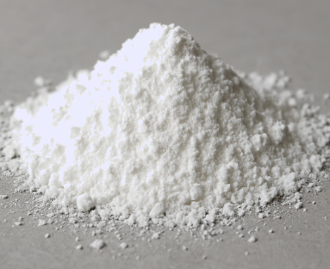
Karboonaytyada birta (metal carbonates)
Karboonaytyada birta (metal carbonates) waa cusbo (salt) ka kooban bir iyo koox karboonayt.
tusaale: karboonaytka zinc
Koox karboonayt waxay ka kooban tahay hal atom karboon iyo saddex atom oksijiin oo isku xidhan.
Qaacidada kiimikada ee karboonaytka zinc waa ZnCO3
bir (zinc)
kooxda karbonat-ka (carbonate group)

Slide 8

Karbonat-yada birta (Metal carbonates)
Kee ka mid ah xeryahooda ayaa leh qaaciddo kiimiko oo sax ah oo karbonat-ka (carbonates) ah?
CaCO3
MgCO2
K2CO3
CaSO4

Slide 9
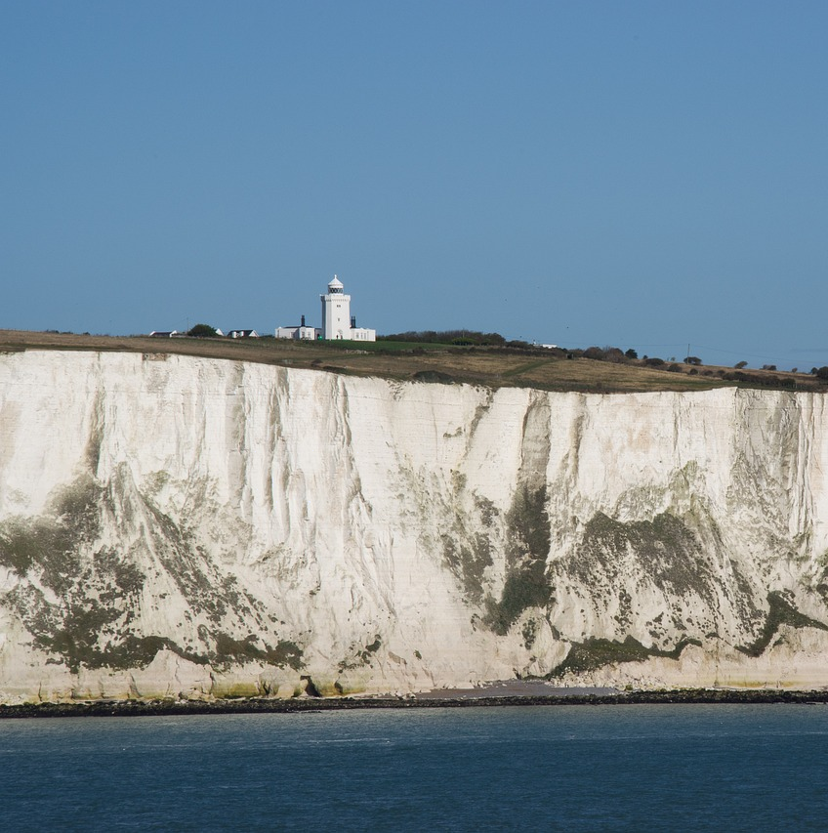
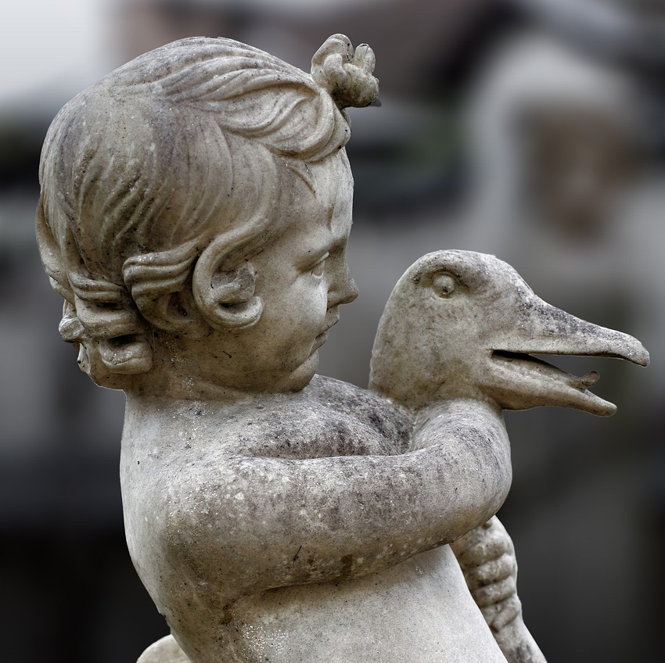
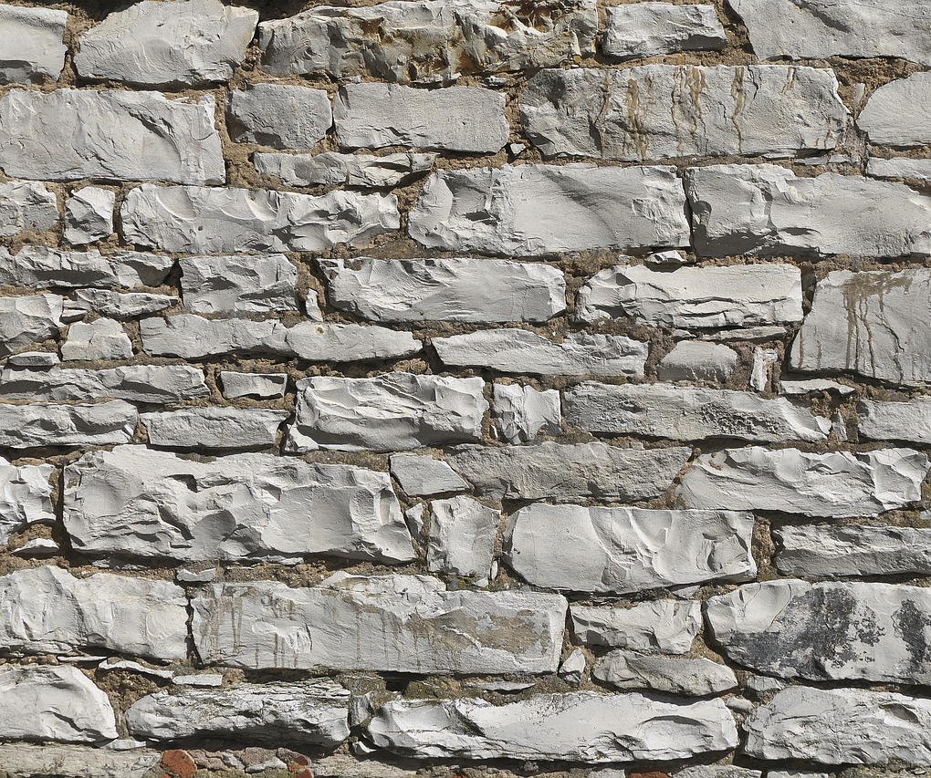
Karbonat-yada birta (Metal carbonates)
Karbonat-ka kalshiyamka (Calcium carbonate) (CaCO3) waa xeryaha ugu weyn ee chalk iyo marble-ka.
jiinka chalk-ka cad ee Dover
taallo marble ah
derbi ka samaysan limestone

Slide 10
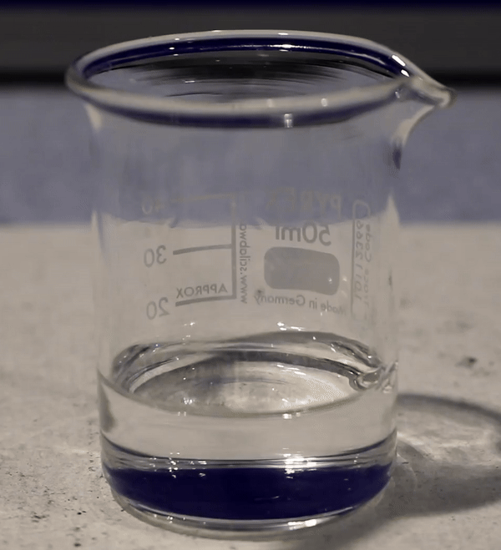
Karbonat-yada birta (Metal carbonates)
Marka karbonat-yada birta ay falgalaan (react) asiidhyada, waxay soo saaraan cusbo bir ah (metal salt), biyo (water) iyo carbon dioxide.
Gaaska carbon dioxide waxaa loo arki karaa sida xumbo / kacsanaan (effervescence) ee isku dhafka falgalka (reaction mixture).
tusaale: karbonat-ka kalshiyamka (calcium carbonate) iyo asiidh sulfurik (sulfuric acid)

Slide 11
Karbonat-yada birta (Metal carbonates)
Marka karbonat-yada birta ay falgalaan (react) asiidhyada, waxaa soo baxa cusbo bir ah (metal salt), biyo (water) iyo carbon dioxide.
Isle'eg guud (General equation):
karbonat bir ah (metal carbonate) + asiidh (acid) → cusbo bir ah (metal salt) + biyo (water) + carbon dioxide

Slide 12
Karbonat-yada birta (Metal carbonates)
Nooca carbonate-ka birta iyo aashitada la isticmaalo ayaa go'aamiya cusbada birta (metal salt) la sameeyo.
magaca aashitada (acid) | dhammaadka magaca cusbada birta (metal salt)
hydrochloric | chloride
sulfuric | sulfate
nitric | nitrate
karbonat-ka naxaasta (copper carbonate) + asiidh nitric (nitric acid) → nitrate naxaas ah (copper nitrate) + biyo (water) + carbon dioxide

Slide 13
Carbonates-ka birta (Metal carbonates)
zinc carbonate + hydrochloric acid → zinc chloride + biyo (water) + carbon dioxide
Isticmaal macluumaadka jaantuska si aad u magacowdo cusbada (salt) lagu soo saaray falgalyada (reactions).
magaca aashitada (acid) | dhammaadka magaca cusbada birta (metal salt)
hydrochloric | chloride
sulfuric | sulfate
nitric | nitrate
lead carbonate + sulfuric acid → __________+ biyo (water) + carbon dioxide
Jawaabaha:
iron carbonate + nitric acid → __________ + biyo (water) + carbon dioxide
lead sulfate
iron nitrate (iron nitrate)

Slide 14
Bir carbonates (Metal carbonates)
Waa maxay gaaska (gas) la soo saaro marka bir carbonate (metal carbonate) ay falgal (reaction) ku sameyso asiidh (acid)?
biyo (water)
hydrogen (hydrogen)
oxygen (oxygen)
carbon dioxide (carbon dioxide)

Slide 15
Bir carbonates (Metal carbonates)
Dooro waxyaabaha (products) la soo saaro marka potassium carbonate iyo sulfuric acid ay falgalaan (react).
potassium sulfuric, biyo (water) iyo carbon dioxide
potassium sulfate, biyo (water) iyo carbon dioxide
sodium sulfate, biyo (water) iyo carbon dioxide
potassium sulfate, carbon dioxide iyo hydrogen

Slide 16
Bir carbonates (Metal carbonates)
Isle'egyada calaamadaha (Symbol equations) oo ay ku jiraan calaamadaha xaaladda (state symbols) ayaa loo qori karaa falgalka (reaction) carbonates iyo acids.
zinc carbonate (zinc carbonate)
+
hydrochloric acid (hydrochloric acid)
→
zinc chloride
+
carbon dioxide
+
biyo (water)
_{(s)}
_{(aq)}
_{(aq)}
_{(l)}
_{(g)}
ZnCO3
_{(s)}
2HCl
_{(aq)}
→ ZnCl2
_{(aq)}
_{(l)}
_{(g)}
H₂O
CO2

Slide 17
Metal carbonates
Zinc carbonate reacting with different acids:
zinc carbonate + nitric acid → zinc nitrate + biyo (water) + carbon dioxide
ZnCO3
2HNO3
→ Zn(NO3)2
H₂O
CO2
zinc carbonate + sulfuric acid → zinc sulfate + biyo (water) + carbon dioxide
ZnCO3
H2SO4
→ ZnSO4
H₂O
CO2

Slide 18
Metal carbonates
Marka magnesium carbonate (MgCO3) iyo hydrochloric acid (HCl) ay falgalaan (reaction), carbon dioxide, biyo (water) iyo cusbo (salt) bir ah ayaa la sameeya. Waa maxay qaacidada kiimikada ee cusbada (salt) birta ah ee la sameeyay?
MgCl2
ZnCl2
MgSO4

Slide 19
Carbonates birta (Metal carbonates)
Dhamaystir fal-celiyeyaasha (reactants) ama badeecadaha (products) ee isleegyada ereyada ee soo socda oo muujinaya falgal (reaction) u dhexeeya carbonates kala duwan iyo acids. Isticmaal macluumaadka ku jira shaxda si ay kuu caawiso.
magaca acid-ka | magaca cusbada birta (metal salt) dhammaadkeeda
hydrochloric | chloride
sulfuric | sulfate
nitric | nitrate
tin carbonate + sulfuric acid →
→ lead sulfate + biyo (water) + carbon dioxide
lead carbonate + nitric acid →

Slide 20
Carbonates birta (Metal carbonates)
Dhamaystir fal-celiyeyaasha (reactants) ama badeecadaha (products) ee isleegyada ereyada ee soo socda oo muujinaya falgal (reaction) u dhexeeya carbonates iyo acids. Isticmaal macluumaadka ku jira shaxda si ay kuu caawiso.
magaca acid-ka | magaca cusbada birta (metal salt) dhammaadkeeda
hydrochloric | chloride
sulfurik (sulfuric) | sulfate (sulfate)
nitrik (nitric) | nitrate (nitrate)
tin carbonate + sulfuric acid →
tin sulfate + biyo (water) + carbon dioxide
lead carbonate + sulfuric acid
→ lead sulfate + biyo (water) + carbon dioxide
lead carbonate + nitric acid →
lead nitrate + biyo (water) + carbon dioxide

Slide 21
Metal carbonates
Isticmaal macluumaadka jaantuska si aad u buuxiso isla'egyada marka potassium carbonate (K2CO3 (s)) uu la falgalo (reaction) asiidhyo kala duwan. Ku dar astaamaha xaaladda (state symbols) reactants iyo products. Isla'egyada waa dheeli-tiran (balanced) adiga.
magaca cusbada (name of salt) | calaamadda kiimikada ee cusbada (chemical symbol for salt) | ku milma biyo (soluble in water)
potassium sulphate | K2SO4 | haa
potassium chloride | KCl | haa
potassium nitrate | KNO3 | haa
K2CO3 + 2HCl → 2__________ + H2O + CO2
K2CO3 + 2HNO3 → 2__________ + H2O + CO2
K2CO3 + H2SO4 → __________ + H2O + CO2

Slide 22
Carbonates birta (Metal carbonates)
Isticmaal macluumaadka jaantuska si aad u buuxiso isla'egyada marka potassium carbonate (K2CO3 (s)) uu la falgalo (reaction) asiidhyo kala duwan. Ku dar astaamaha xaaladda (state symbols) reactants iyo products. Isla'egyada waa dheeli-tiran (balanced) adiga.
magaca cusbada (salt) | calaamadda kiimikada cusbada (salt) | ku mili biyo (water)
potassium sulphate | K2SO4 | haa
potassium chloride | KCl | haa
potassium nitrate | KNO3 | haa
_{(s)}
_{(aq)}
KCl
_{(aq)}
K2CO3 + 2HCl → 2 + H2O + CO2
_{(l)}
_{(g)}
K2CO3 + 2HNO3 → 2 + H2O + CO2
_{(s)}
_{(aq)}
KNO3
_{(l)}
_{(g)}
_{(aq)}
K2CO3 + H2SO4 → + H2O + CO2
_{(s)}
_{(aq)}
K2SO4
_{(aq)}
_{(l)}
_{(g)}

Slide 23
Falgal kiimik: acid iyo karboonayt birta
Karboonayt birta (Metal carbonates)
Tijaabada kiimikada ee carbon dioxide
Roobka acid-ka ah

Slide 24
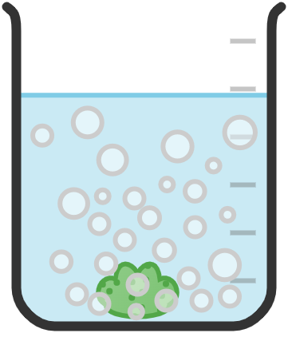
Tijaabada kiimikada ee carbon dioxide
Marka karboonayt iyo acid ay falgalaan waxay soo saaraan xumbo gaas carbon dioxide ah.
Gaas carbon dioxide waa gaas aan ur lahayn, aan midab lahayn, taas macneheedu waa waxaad u baahan tahay hab lagu garto.
gaas carbon dioxide
karboonayt naxaasta (copper carbonate)
hydrochloric acid
Si loo xaqiijiyo in gaasku yahay carbon dioxide waxaan samayn karnaa tijaabo kiimik.

Slide 25
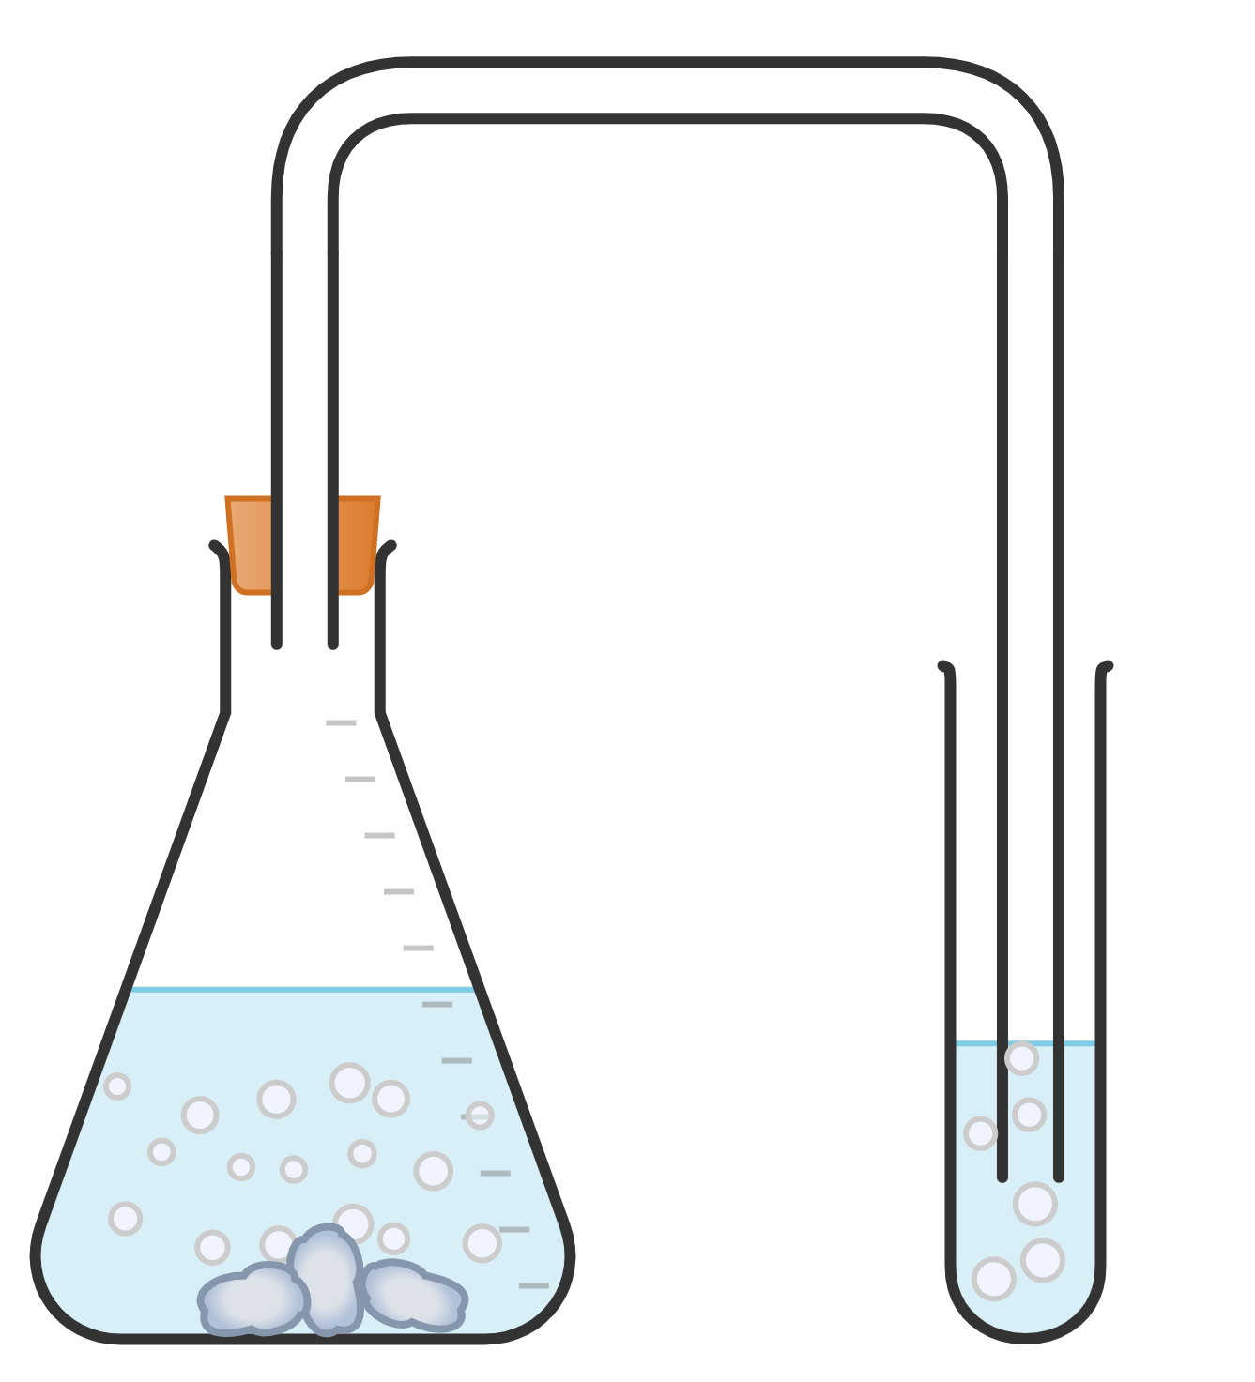
Tijaabada kiimikada ee carbon dioxide
Tijaabada kiimikada ee gaas carbon dioxide waa in gaaska lagu mariyo biyo nuurad (limewater):
tuubada gudbinta (delivery tube)
carbon dioxide waxuu u rogi doonaa milan (solution) midab la'aanta ah mid daruur ah / caano cad (cloudy / milky white solution)
haddii gaasku uusan ahayn carbon dioxide, milan (solution) wuxuu ku sii jiri doonaa midab la'aan
bung
biyo nuurad (limewater) waxay isu beddeshaa midab la'aan ilaa daruuro / caano
hydrochloric acid
calcium carbonate

Slide 26
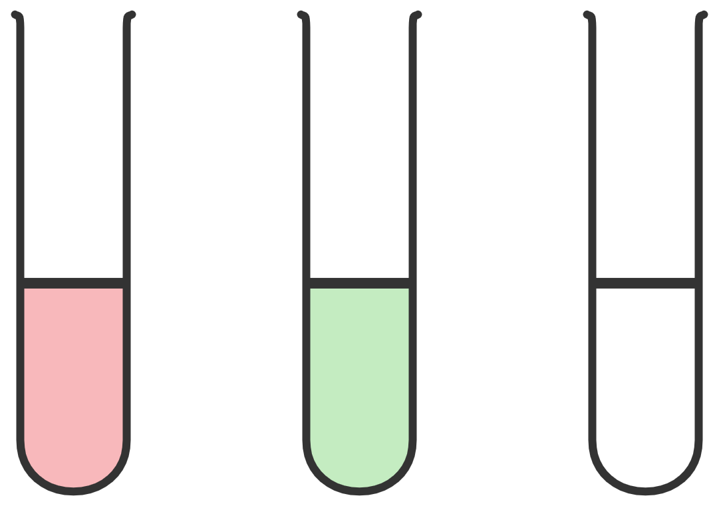
Tijaabinta kiimikada ee carbon dioxide (Chemical test for carbon dioxide)
Maxay u ekaan doontaa biyaha nuuradda (limewater) ka dib marka gaaska carbon dioxide lagu buuniyo (bubbled) dhexdeeda?
guduud (red)
cagaar (green)
daruur cad (cloudy white)

Slide 27
Tijaabinta kiimikada ee carbon dioxide (Chemical test for carbon dioxide)
Haddii aad gaas kasta ku buuniso (bubble) biyaha nuuradda (limewater), had iyo jeer waxay u rogmi doonaan daruur cad / caano cad (cloudy / milky white).
Haddii gaasku yahay hydrogen, wuxuu u rogmi doonaa daruur cad / caano cad (cloudy / milky white).
Haddii gaasku yahay carbon dioxide, wuxuu u rogmi doonaa daruur cad / caano cad (cloudy / milky white).

Slide 28
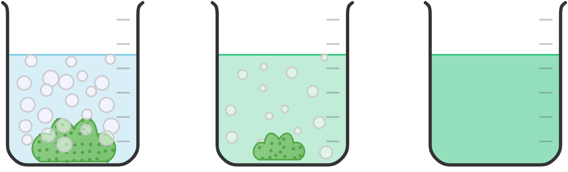
Tijaabinta kiimikada ee carbon dioxide (Chemical test for carbon dioxide)
Marka carbonates iyo acid (acid) ay falgalaan (react), carbonate wuxuu yarayn doonaa cabbirkiisa (size) wuxuuna ugu dambeyn noqon doonaa mid aan la arki karin marka uu dhammaan falgalay (reacted).
Cusbada birta (metal salt) la soo saaray:
waa milmi kara (is soluble)
sidaas darteed wuxuu milmi doonaa si uu u sameeyo milan cusbo bir ah (metal salt solution).
milan cusbo naxaas (copper chloride solution)
copper carbonate
bilowga falgalka (start of reaction)
inta lagu jiro falgalka (during reaction)
falgalka ka dib (after reaction)
Milan cusbo birta (metal salt solution) la soo saaray wuxuu noqon karaa mid midab leh ama midab la'aan, waxay ku xiran tahay cusbada birta la soo saaray.

Slide 29
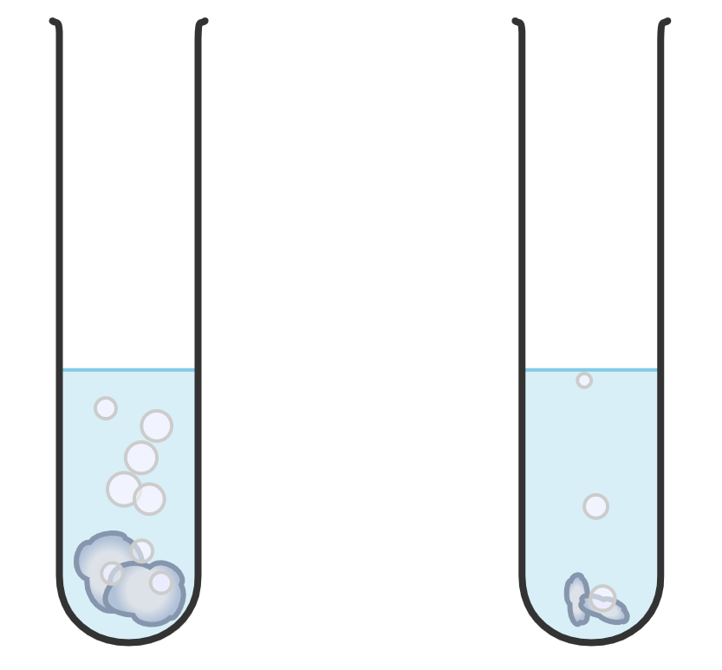
Tijaabo kiimiko (Chemical test) ee kaarboon laba-ogsaydh (carbon dioxide)
Alaabta nadiifinta ee ku salaysan asiidh (acid) waa inaan waligeed loo isticmaalin dusha marmarka (marble).
Ardaydu waxay dhigeen qayb marmar (marble) gudaha tuubo tijaabo ah oo ay ku jirto asiidh hydrochloric (hydrochloric acid).
xumbo (bubbles)
Ardaydu waxay arkayeen in xumbo (bubbles) ay sameeyeen iyo in marmarku (marble) uu yaraaday.
asiidh hydrochloric (hydrochloric acid)
marmar (marble)

Slide 30
Tijaabo kiimiko (Chemical test) ee kaarboon laba-ogsaydh (carbon dioxide)
Sharax waxa ku dhacay tuubada tijaabada.
xumbo (bubbles)
Marmarku (marble) wuxuu ku milmay asiidhka (acid).
C
Falgal kiimiko (chemical reaction) wuxuu sameeyaa walax cusub oo milmi karta (soluble).
D
Marmarku (marble) wuxuu isu beddelaa xaaladda gaaska (gas state).
asiidh hydrochloric (hydrochloric acid)
Asiidhku (acid) wuxuu cunay marmarka (marble).
marmar (marble)
Falgal kiimiko (chemical reaction) wuxuu sameeyay walax cusub oo milmi karta (soluble).
Marmarku (marble) wuxuu isu beddelay xaaladda gaaska (gas state).

Slide 31
Chemical test for carbon dioxide
Samee tijaabo sida hoos ku cad, ku dar calcium carbonate hydrochloric acid oo tijaabi gaasta carbon dioxide. Qor waxa aad aragto.
delivery tube
bung
hydrochloric acid
calcium carbonate
limewater
(colourless)

Slide 32
Chemical test for carbon dioxide
Waa inaad aragtaa waxyaabahan soo socda:
effervescing / fizzing of calcium carbonate
calcium carbonate reduces in size / gets used up
biyaha lime waxay iska beddelaan midab la'aan ilaa caano / cad oo daruuraysan
delivery tube
bung
hydrochloric acid
calcium carbonate
limewater
(colourless)

Slide 33


Chemical test for carbon dioxide
Izzy waxay samaynaysay tijaabo si ay u tijaabiso gaasta ay soo saaraan saddex isku dhaf oo falgal oo kala duwan.
Waxay ogtahay in gaasta carbon dioxide (carbon dioxide gas) laga soo saaro falgalka (reaction) A iyo C, laakiin aan laga soo saarin falgalka (reaction) B. Buuxi shaxdeeda natiijooyinka si aad u qeexdo waxa ay filayso inay aragto.
Reaction mixture | midabka biyaha lime-ka ka hor inta aan gaas lagu buufin | midabka biyaha lime-ka ka dib marka gaas lagu buufiyo
A | midab la'aan (colourless)
B
C |  | daruur / caddaan caano ah (cloudy / milky white)

Slide 34
Tijaabada kiimikada ee carbon dioxide (Chemical test for carbon dioxide)
Isra waxay samaynaysay tijaabo (experiment) si ay u tijaabiso gaasta ay soo saareen saddex falgal (reaction) oo kala duwan. Waxay ogtahay in gaasta carbon dioxide (carbon dioxide gas) laga soo saaro falgalka (reaction) A iyo C, laakiin aan laga soo saarin falgalka (reaction) B. Buuxi shaxdeeda natiijooyinka si aad u qeexdo waxa ay filayso inay aragto.
Falgal (reaction) isku dhafan | midabka biyaha lime-ka ka hor inta aan gaas lagu buufin | midabka biyaha lime-ka ka dib marka gaas lagu buufiyo
A | midab la'aan (colourless)
B
C |  | daruur / caddaan caano ah (cloudy / milky white)
daruur / caddaan caano ah (cloudy / milky white)
midab la'aan (colourless)
midab la'aan (colourless)
midab la'aan (colourless)

Slide 35
Tijaabada kiimikada ee carbon dioxide (Chemical test for carbon dioxide)
Qeex tijaabada gaasta ee carbon dioxide (gas test for carbon dioxide).
Ku dar faahfaahin ku saabsan:
tijaabo togan halkaas oo carbon dioxide (carbon dioxide) uu joogo
tijaabo taban halkaas oo gaasta la soo saaray uusan ahayn carbon dioxide (carbon dioxide)

Slide 36
Tijaabada kiimikada (Chemical test) ee carbon dioxide (carbon dioxide)
Qeex tijaabada gaasta ee carbon dioxide (gas test for carbon dioxide).
Ku dar faahfaahin:
tijaabo (experiment) togan oo ah meesha carbon dioxide (carbon dioxide) uu joogo
tijaabo (experiment) diidmo ah oo ah meesha gaaska la soo saaray uusan ahayn carbon dioxide (carbon dioxide)
Gaaska waa in lagu afuufaa biyo nuurad (limewater) oo la fiiriyaa midabka biyaha nuurad (limewater).
Haddii biyaha nuurad (limewater) ay iska beddelaan midab la'aan ilaa caano / daruuro, gaasku waa carbon dioxide (carbon dioxide).
Haddii biyaha nuurad (limewater) ay sii ahaadaan midab la'aan, gaasku ma aha carbon dioxide (carbon dioxide).

Slide 37
Falgalyada kiimikada (Chemical reactions): aashito (acid) iyo karbonate birta (metal carbonate)
Karbonateyada birta (Metal carbonates)
Tijaabada kiimikada (Chemical test) ee carbon dioxide (carbon dioxide)
Roobka aashito (Acid rain)

Slide 38
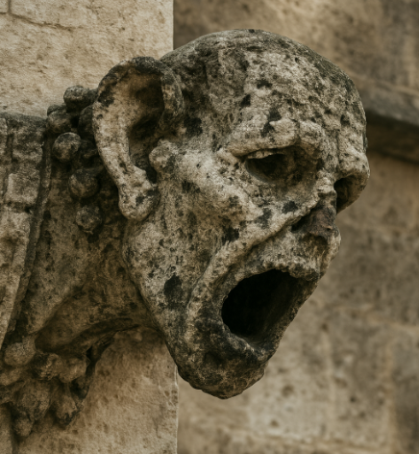
Roobka aashito (Acid rain)
Biyaha roobku (Rain water) inta badan waxay yihiin kuwo aashito (acidic) yar, marka ay ka aashito (acidic) badan yihiin caadiga waxaa loo yaqaan roob aashito (acid rain). Roobka aashito (Acid rain) wuxuu leeyahay pH ≤5.6.
Roobka aashito (Acid rain) iyo biyaha roobku (rain water) labaduba waxay la falgalaan (react) karbonateyada (carbonates) taasoo keenta cimilada kiimikada (chemical weathering).
Falgan (reaction) kani waa mid gaabis ah oo dhaca sanado badan. Cimilada kiimikada (Chemical weathering) waxaa laga arki karaa dabeecadda iyo dhismayaasha iyo taallooyinka qadiimiga ah.
gargoyle oo ay cimilaysay roob aashito (acid rain)

Slide 39
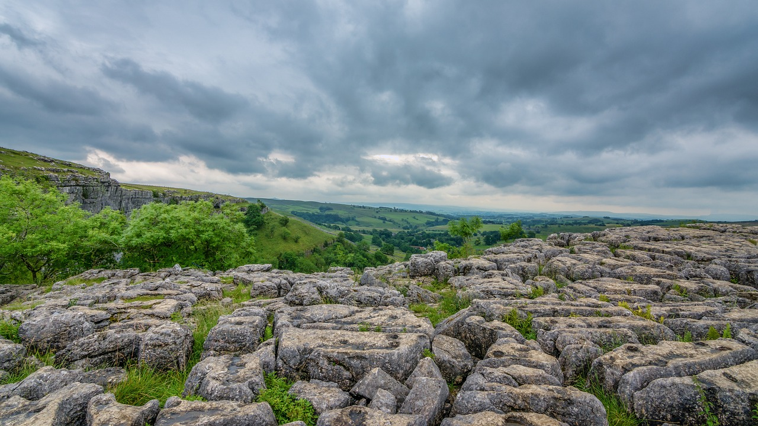
Roobka aashito (Acid rain)
Marble (Marble) iyo limestone (limestone) waxay ka samaysan yihiin calcium carbonate (CaCO3):
roobka aashito (acid rain) wuxuu la falgalaa (reacts) CaCO3
cusbo (salt) calcium, biyo (water) iyo carbon dioxide (carbon dioxide) ayaa la soo saaraa
qaar ka mid ah calcium carbonate (calcium carbonate) ee ku jira marble (marble) / limestone (limestone) ayaa la isticmaalaa.
dhagaxnuug (limestone) oo cimiloobay (weathered)
Marka roob aashito (acid rain) dhaco, falgan (reaction) kani wuxuu dhacaa si dhakhso ah isagoo keena cimilo kiimikada (chemical weathering) oo ka badan biyaha roobka (rainwater)

Slide 40
Roobka ashitada (acid rain)
Dooro erayga ku dhammaystira jumlada.
Biyo (water) roobku caadi ahaan waxay yihiin kuwo …
ashito (acidic).
dhexdhexaad (neutral).
alkali (alkaline).

Slide 41
Roobka ashitada (acid rain)
Saamaynta roobka ashitada (acid rain) waxaa lagu arki karaa dhismayaasha / taallooyinka marble / dhagaxnuug (limestone) gudaha usbuuc?
Roobka ashitada (acid rain) wuxuu leeyahay pH aad u hooseeya oo ah 1-2, sidaas darteed cimiloobidda (weathering) waxay qaadataa in ka badan bilo badan.
Roobka ashitada (acid rain) wuxuu leeyahay pH ka yar 5.6, sidaas darteed cimiloobidda (weathering) waxay qaadataa sannado badan.

Slide 42

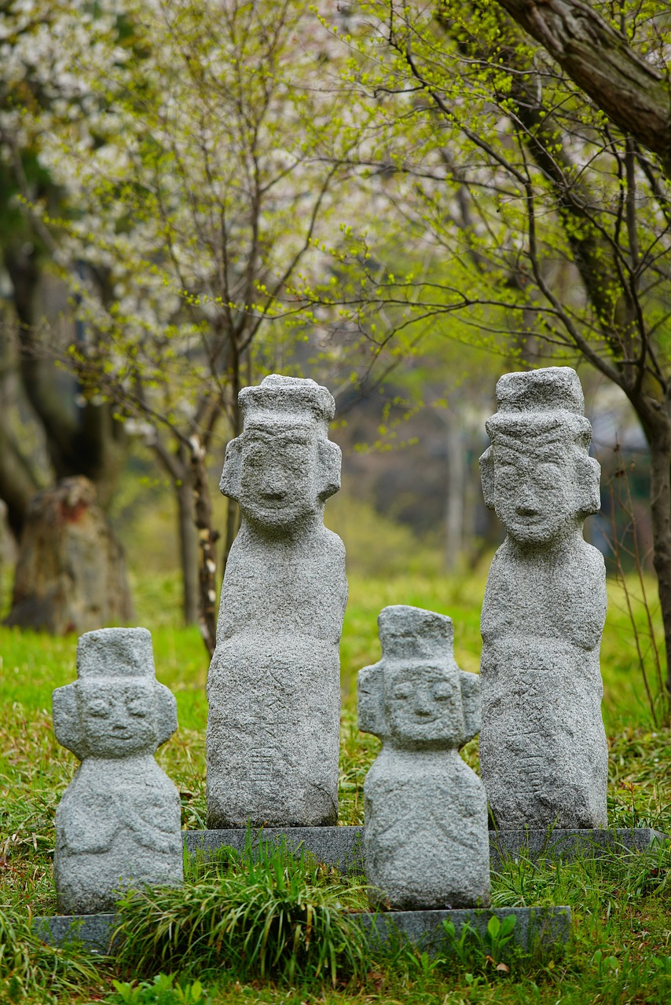

Roobka ashitada (acid rain)
Cabdi wuxuu fasax ku tagay wuxuuna doonayaa inuu ogaado waxa ku dhacay dhagaxii ka 'baxay' taallooyinka sawirka. Wuxuu sheegay in tusaaluhu (tour guide) u sheegay in taallooyinku ka samaysan yihiin dhagaxnuug (limestone), laakiin waxay lahaayeen qaabab cad sannado badan ka hor.
U sharax Cabdi waxa ku dhacay taallooyinka.

Slide 43
Roobka ashitada (acid rain)
Jawaabahaaga waxaa ka mid noqon kara:
Dhagaxnuuggu (limestone) wuxuu ka samaysan yahay calcium carbonate.
Calcium carbonate wuxuu la falgalaa (reacts) ashitada (acids) si uu u sameeyo cusbo (salt) bir ah, biyo (water) iyo carbon dioxide.
Cusbada (salt) birta ah ee la sameeyo waxay ku milmi kartaa (soluble) biyaha (water) sidaas darteed waxay ku milmi doontaa (dissolve) roobka.
Waqti ka dib, calcium carbonate-ka ku jira taallada wuxuu la falgali doonaa (react) roobka ashitada (acid rain) wuxuuna ku dhammaan doonaa falgalka (reaction) sidaas darteed wuxuu mari doonaa cimiloobid kiimiko (chemical weathering).

Slide 44


Roobka ashitada (acid rain)
Layla waxay qorshaynaysaa tijaabo (experiment) si ay u ogaato in xabbad marble ay heshay ay saameeyaan roobka ashitada (acid rain) oo ay cimiloobi doonto (weathered).
Qorshaha tijaabada (experiment) ee Layla:
Uruuri biyo (water) roob ah.
Buuxi weel (beaker) biyahaas roobka.
Dhig dhagaxa marmarka (marble) gudaha biyaha roobka.
Ka tag toddobaad.
Fiiri dhagaxa marmarka si aad u aragto haddii uu yaraaday oo raadi xumbo (bubbles) soo baxaysa.
Ma u malaynaysaa in tijaabada (experiment) ee Layla ay shaqeyn doonto?
Qiimee tijaabada (experiment) ee Layla.

Slide 45
Roobka aashinka (acid rain)
Jawaabahaaga waxaa laga yaabaa inay ka mid yihiin:
Tijaabada (experiment) ee Layla ma shaqeyn doonto / ma siin doonto natiijooyin.
Roobka laga yaabaa inuusan aashin (acidic) ku filnayn inuu noqdo roob aashin (acid rain).
Waqti ku filan maaha in la arko saamaynta roobka aashinka (acid rain) - waxay u baahan tahay sanooyin.
Roob aashin (acid rain) ku filan maaha - kaliya hal weel (beaker) ayaa la isticmaalay marka la barbardhigo roob badan oo ku jira habka cimilada (weathering process).
Fal-galka (reaction) dhacaya aad buu u gaabiyaa, marka lama filanayo in la arko xumbo (bubbles) ama isbeddel weyn oo ku yimaada cabbirka dhagaxa marmarka (marble) ee iyada.

Slide 46
Fal-gallada kiimikada (chemical reactions): aashinnada (acids) iyo kaarboonayt birta (metal carbonate)
Koox ka kooban hal atamka kaarboon (carbon atom) iyo saddex atamka oksijiin (oxygen atoms) oo isku xidhan waxaa loo yaqaan kooxda kaarboonayt (carbonate group) (CO3).
Kaarboonayt bir ah (metal carbonate) + aash (acid) → cusbo bir ah (metal salt) + biyo (water) + kaarboon laba-oksaydh (carbon dioxide)
Tijaabada kiimikada (chemical test) ee gaaska kaarboon laba-oksaydh (carbon dioxide gas) waa in lagu mariyo biyo nuurad (limewater) sababtoo ah waxay u rogtaa milanka (solution) daruuro (cloudy/milky).
Biyaha roobka (rain water) badanaa waxay yihiin aashin (acidic) yar, markay tahay ≤pH 5.6 waxaa loo yaqaan roob aashin (acid rain).
Roobka aashinka (acid rain) wuxuu ka sii dhakhso badan yahay biyaha roobka (rainwater) fal-galka (reaction) dhagaxa marmarka (marble) si loo soo saaro cusbo (salt), biyo (water) iyo kaarboon laba-oksaydh (carbon dioxide), isagoo cunayaa qaar ka mid ah dhagaxa marmarka.

