Slide 1
Falgal (reaction) kiimiko: asiidh iyo bir
Asiidhyada iyo salalka

Slide 2
Sida agabkeena waxbarista loogu talagalay fasalka

Slide 3
Waxaan qeexi karaa waxa dhaca marka asiidh la falgalo (reaction) bir, waxaana qori karaa isla'egyo ereyo iyo calaamad ah oo ku saabsan falalka (reactions)as

Slide 4
xumbo-bixin (effervescence)
tijaabo kiimiko (chemical test)
daxal (corrosion)
asiidh (acid)
cusbo (salt) bir

Slide 5
Xumbo-bixin (effervescence), ama xumbo, waa marka goobo gaas laga soo saaro dareere.
Tijaabo kiimiko (chemical test) waa marka falgal (reaction) kiimiko la sameeyo si loo ogaado joogitaanka walax.
Daxal (corrosion) waa marka bir la xirxiro sababtoo ah falgal (reaction) kiimiko.
Asiidh (acid) waa milan (solution) leh pH ka yar 7.
Cusbo (salt) bir waa iskudhis ka kooban bir iyo aan-bir ahayn.

Slide 6

Falgal (reaction) kiimiko: asiidh iyo bir
Falalka (reactions) asiidh iyo bir
Tijaabinta hydrogen

Slide 7
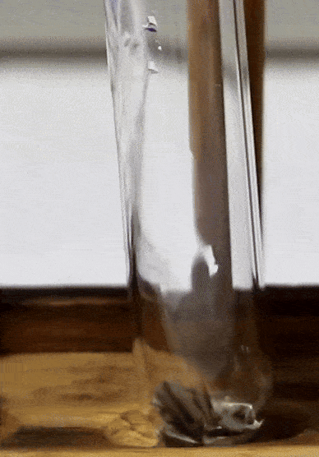
Falalka (reactions) asiidh iyo bir
Biraha kala duwan waxay leeyihiin falgal (reaction) kala duwan oo asiidhyada ah.
Waxaad isbarbardhigi kartaa falgalnimada (reactivity) adiga oo eegaya:
  heerka sameynta goobo ama xumbo-bixin (effervescence)
  Heer-kulka isku-dhafka falgal (reaction mixture) (wuu kordhi karaa maadaama fal-galku (reaction) yahay kul bixiye (exothermic))
  U fiirso daxalka birta (marka birta la xiro oo ay weyneyn (size) ka yaraato).
falgal (reaction) u dhaxeeya magnesium iyo asiidh

Slide 8

Falgalada (reactions) aashitada (acid) iyo birta
Sidee ku arki lahayd in gaas (gas) laga soo saarayo falgal (reaction)? Dooro dhammaan kuwa khuseeya.
waxaad arki lahayd xumboyin (bubbles) oo ka samaysmaya dareeraha (liquid)
dareeruhu (liquid) wuu beddeli lahaa midabka
dareeruhu (liquid) wuu hurdin lahaa (effervescing)
dareeruhu (liquid) wuu bilaabi lahaa inuu xumbo (fizz)

Slide 9
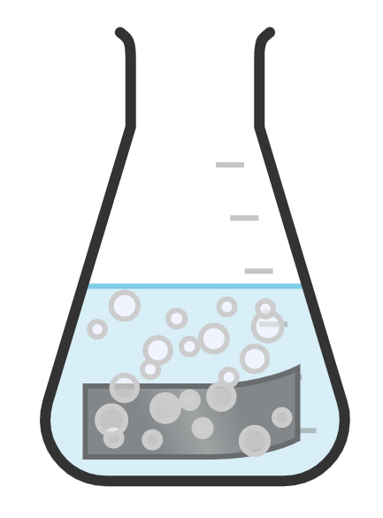

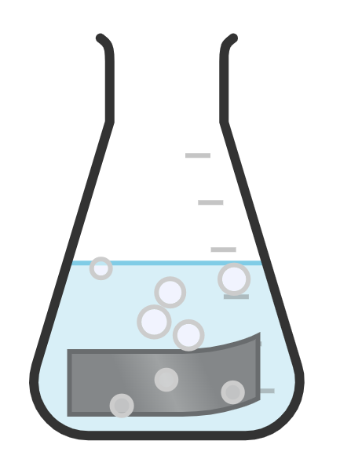
Falgalada (reactions) aashitada (acid) iyo birta
Birtee baa ugu fal-celin (reactive) badan?

Slide 10
Falgalada (reactions) aashitada (acid) iyo birta
Marka bir ku falceliso (reacts) aashitada (acid) waxa soo baxa (products) waa:
cusbo (salt) bir ah oo ku milanta (soluble) isku-dhafka falgal (reaction mixture)
gaaska (gas) haydrojiin (hydrogen) kaas oo loo arki karo xumbo (bubbles) gudaha isku-dhafka falgal (reaction mixture).
Isle'egta (equation) guud:
bir + aashito (acid) → cusbo (salt) bir ah + haydrojiin (hydrogen)
tusaale: magnesium + nitric acid → magnesium nitrate + hydrogen

Slide 11
Falgalada (reactions) aashitada (acid) iyo birta
Waa maxay isle'egta (equation) guud ee falcelinta (reaction) u dhaxaysa bir iyo aashito (acid)?
bir → aashito (acid) + cusbo (salt) bir ah + haydrojiin (hydrogen)
bir + aashito (acid) → cusbo (salt) bir ah + haydrojiin (hydrogen)
bir + aashito (acid) → cusbo (salt) bir ah + kaarboon-labo-oksisaydh (carbon dioxide)
bir + asiid + hydrogen → cusbo bir (metal salt)

Slide 12
Falgal (reaction) asiid iyo bir
Asiidyo kala duwan waxay soo saareen noocyo kala duwan oo cusbo bir (metal salt) ah:
magaca asiid | dhammaadka magaca cusbada birta | qaacidada kiimikada ee asiid
hydrochloric | chloride | HCl
sulfuric | sulfate | H2SO4
nitric | nitrate | HNO3
tusaale: magnesium + hydrochloric acid → magnesium chloride + hydrogen
tusaale: iron + sulfuric acid → iron sulfate + hydrogen

Slide 13
Falgal (reaction) asiid iyo bir
Isla'egta kiimikada ee falgalka (reaction) birta iyo asiidka waa la qori karaa.
magaca aashitada (name of acid) | magaca dhamaadka cusbada birta (name of metal salt ending) | qaacidada kiimikada ee aashitada (chemical formula of acid)
hydrochloric | chloride | HCl
sulfuric | sulfate | H2SO4
nitric | nitrate | HNO3
tusaale: magnesium + hydrochloric acid → magnesium chloride + hydrogen
Mg
+
2HCl
→
MgCl2
+
H₂
tusaale: iron + sulfuric acid → iron sulfate + hydrogen
Fe
+
H2SO4
→
FeSO4
+
H₂

Slide 14
Falgalka (reaction) aashitada (acid) iyo birta (metal)
zinc + nitric acid → zinc chloride + oxygen
Aashitada nitric (nitric acid) iyo biraha (metals) way falgalaan (react) si ay u sameeyaan nitrates birta (metal nitrates) iyo hydrogen.
Aashitada nitric (nitric acid) iyo zinc waxay falgalaan (react) si ay u sameeyaan chlorides birta (metal chlorides) iyo carbon dioxide.

Slide 15
Falgalada (reaction) asiidhka iyo birta
Isle'egta calaamadda (symbol equation) ee falgalka (reaction) u dhexeeya zinc (Zn) iyo aashitada hydrochloric (hydrochloric acid) (HCl) si loo soo saaro zinc chloride (ZnCl2) iyo gaaska hydrogen (H2) waa …
Zn + 2HCl → ZnCl2 + H2O
Zn + H2SO4→ ZnCl2 + H2
Zn + 2HCl → ZnCl2 + H2

Slide 16

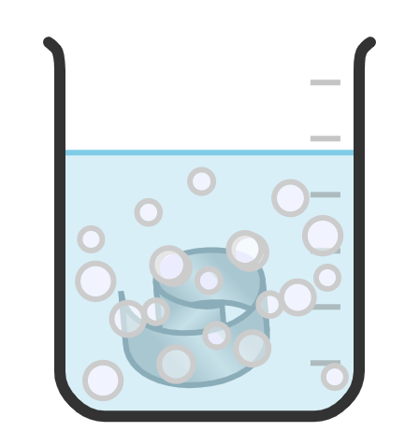
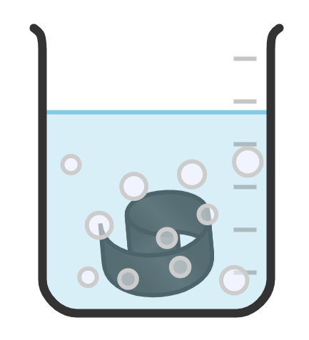
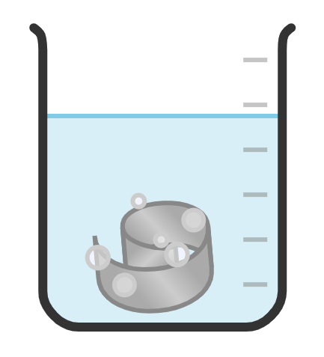
Falgalada (reaction) asiidhka iyo birta
Ardaydu waa inay isticmaalaan jaantusyada macluumaadka ee agabyada dheeraadka ah si ay u dhammaystiraan hawsha A.
U kala horree birta kala duwan ee la falgasha asiidhka, laga bilaabo tan ugu falgalka badan ilaa tan ugu yar.
birta A
birta B
birta C
birta D
Sharax sida aad u go'aamisay nidaamka falgalka (reactivity).
Magacaab gaaska (gas) la soo saaray.
Maxaa kale oo aad samayn kartid si aad u qiimeyso falgalka (reactivity) biraha?

Slide 17
Falgalada (reaction) asiidhka iyo birta
U kala saar birta kala duwan ee la falgasha acid (acid), laga bilaabo tan ugu falgalka badan ilaa tan ugu yar.
birta B
birta C
birta D
birta A
Sharax sida aad u go'aamisay nidaamka falgalka (reactivity).
Marka uu badan yahay xumbaynta / fizzing, markaas birta ayaa ah tan ugu falgalka badan (reactive).
Magacaab gaaska (gas) la soo saaray.
hydrogen
Wax kale oo aad samayn karto si aad u qiimeyso falgalka (reactivity) birta?
Waxaad cabbiri kartaa heerkulka isku dhafka falgalka (reaction mixture). Marka heerkulku sare u kaco, birta ayaa ah mid aad u falgalka badan.

Slide 18
Falgalada (reactions) acid iyo birta
5) Buuxi ereyada maqan ee isla'egyada ereyada (word equations) ee soo socda. Isticmaal jaantuska macluumaadka si ay kuu caawiso.
magaca acid (acid) | magaca dhammaadka cusbada (metal salt)
hydrochloric | chloride
sulfuric | sulfate
nitric | nitrate
zinc + sulfuric acid → __________ sulfate + hydrogen
magnesium + nitric acid → __________ __________ + hydrogen
__________ + __________ acid → lead sulfate + __________
zinc + hydrochloric acid → zinc chloride + __________
iron + __________ acid → __________ chloride + __________

Slide 19
Falgalada (reactions) acid iyo birta
5) Buuxi ereyada maqan ee isla'egyada ereyada (word equations) ee soo socda. Isticmaal jaantuska macluumaadka si ay kuu caawiso.
name of acid | name of metal salt ending
hydrochloric | chloride
sulfuric | sulfate
nitric | nitrate
zinc + sulfuric acid → __________ sulfate + hydrogen
magnesium + nitric acid → __________ __________ + hydrogen
__________ + __________ acid → lead sulfate + __________
zinc + hydrochloric acid → zinc chloride + __________
iron + __________ acid → __________ chloride + __________
zinc
magnesium
nitrate
lead
sulfuric
hydrogen
hydrogen
hydrochloric
iron
hydrogen

Slide 20
Falcelinta (reactions) aashinka (acid) iyo birta (metal)
6) Dhammaystir isleegyada calaamadaha (symbol equations) jawaabahaaga qaybta 5 (hoos ku qoran).
zinc + sulfuric acid → zinc sulfate + hydrogen
b) magnesium + nitric acid → magnesium nitrate + hydrogen
c) lead + sulfuric acid → lead sulfate + hydrogen
Zn + → ZnSO4 + H2
__________ + 2HNO3 → Mg(NO3)2 + __________
Pb + __________ → PbSO4 + __________

Slide 21
Falcelinta (reactions) aashinka (acid) iyo birta (metal)
6) Dhammaystir isleegyada calaamadaha (symbol equations) jawaabahaaga qaybta 5 (hoos ku qoran).
zinc + hydrochloric acid → zinc chloride + hydrogen
e) iron + hydrochloric acid → iron chloride + hydrogen
Zn + 2__________→ ZnCl2 + __________
__________ + 2__________ → FeCl2 + H2

Slide 22
Falcelinta (reactions) aashinka (acid) iyo birta (metal)
6) Dhammaystir isleegyada calaamadaha (symbol equations) jawaabahaaga qaybta 5 (hoos ku qoran).
zinc + sulfuric acid → zinc sulfate + hydrogen
b) magnesium + nitric acid → magnesium nitrate + hydrogen
c) lead + sulfuric acid → lead sulfate + hydrogen
H2SO4
Zn + → ZnSO4 + H2
Mg
H₂
+ 2HNO3 → Mg(NO3)2 +
H2SO4
Pb + → PbSO4 +
H₂

Slide 23
Falgalada (reactions) asiidhka iyo birta
6) Dhammeysti isla'egyada calaamadda ee jawaabahaaga qaybta 5 (hoos ku qoran).
zinc + hydrochloric acid → zinc chloride + hydrogen
e) iron + hydrochloric acid → iron chloride + hydrogen
Zn + 2 → ZnCl2 +
+ 2 → FeCl2 + H2
Jawaabaha:
H₂
HCl
Fe
HCl

Slide 24
Falgalada (reactions) kiimikada: asiidh iyo bir
Falgalada (reactions) asiidhka iyo birta
Tijaabinta hydrogen

Slide 25

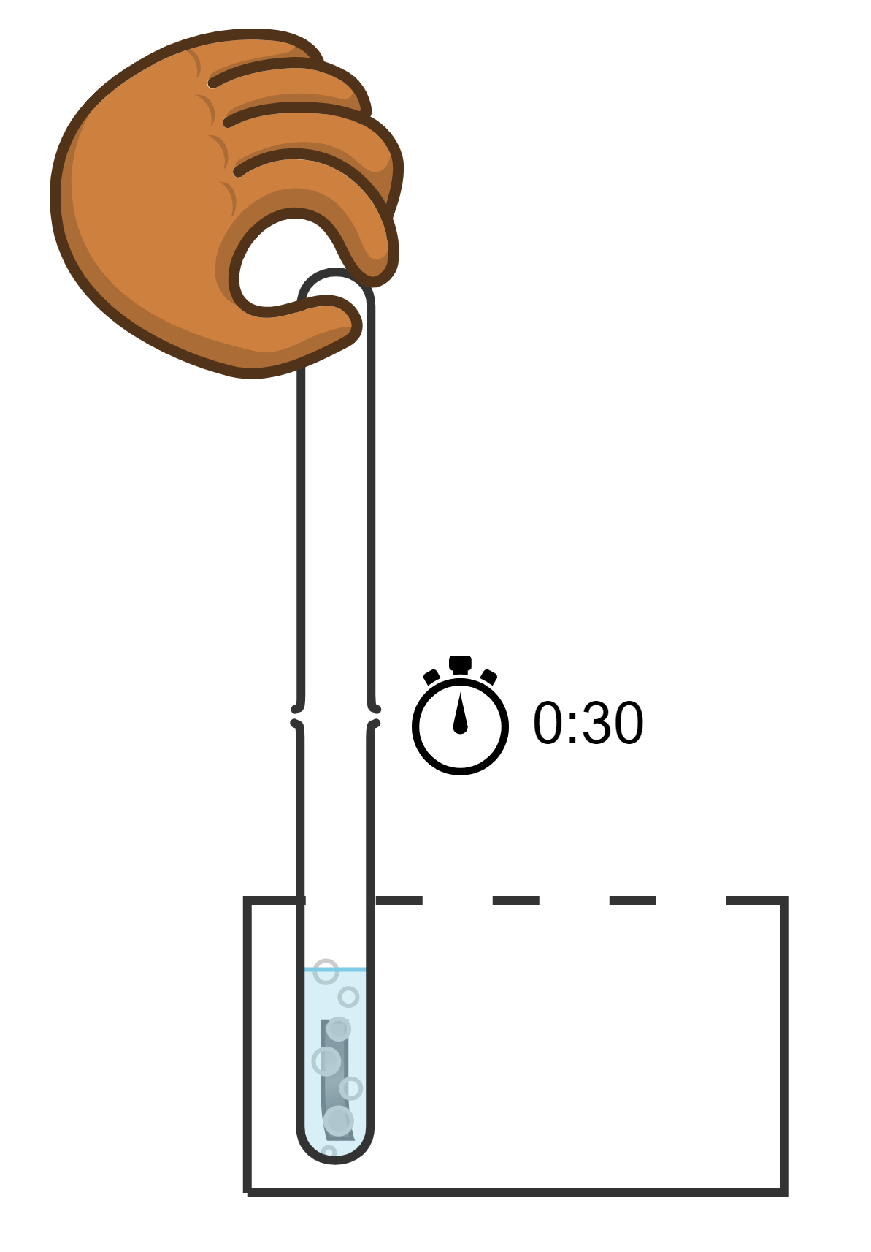
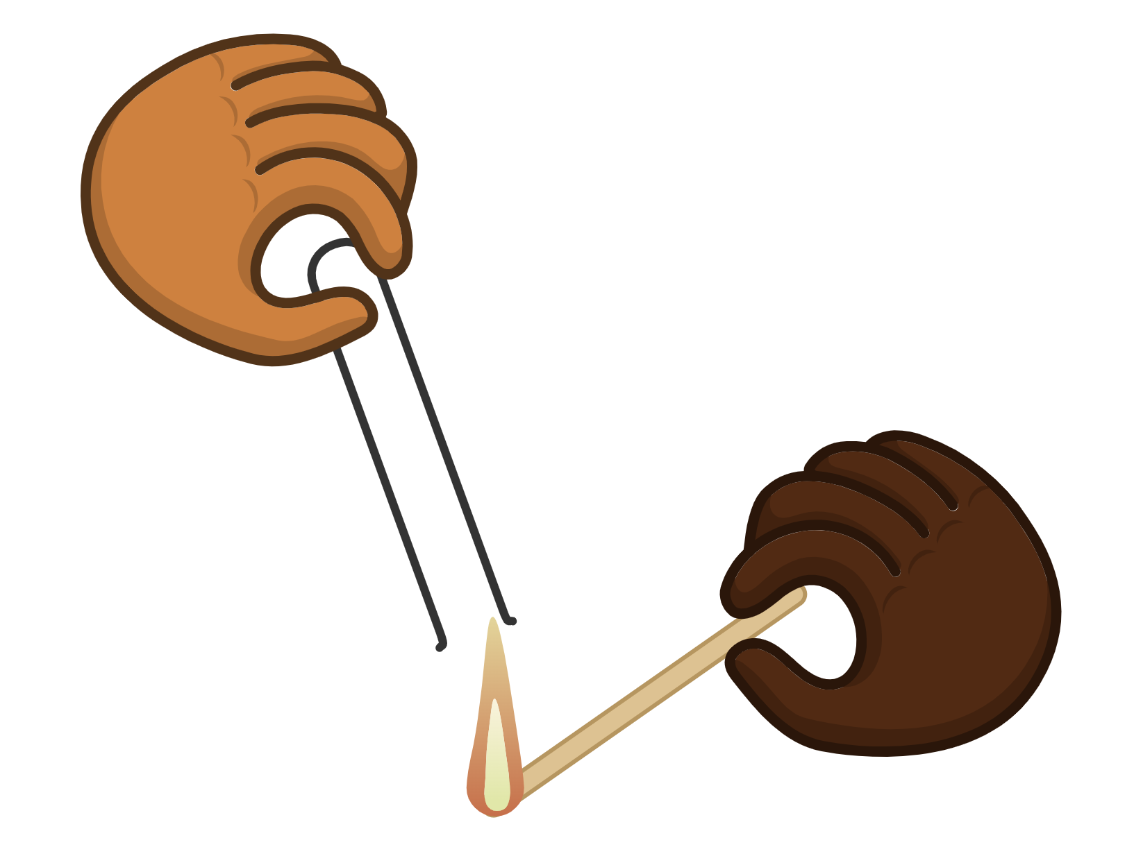
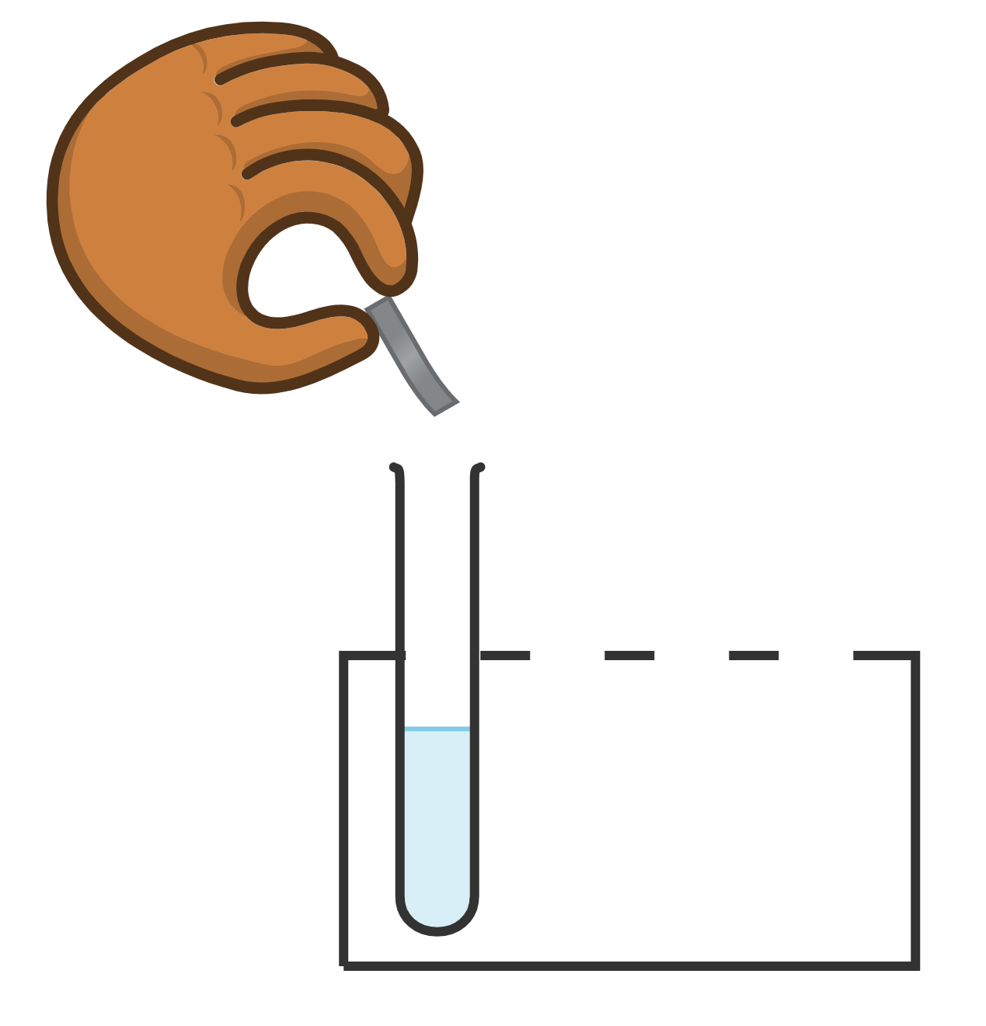
Tijaabinta hydrogen
Tijaabinta kiimikada ee gaaska hydrogen waa in la soo bandhigo qori shidan (lit splint), kaas oo sameyn doona dhawaaq 'squeaky pop'.
Dhagayso dhawaaqa 'pop' oo dhuug ah (Listen for a squeaky pop)
Ku dar birta asiidhka.
Haayo tuubo tijaabo oo madhan oo kor ku hay isku darka falgalka (reaction mixture).
bir (metal)
asiidh (acid)
lamaan (partner)
Weydii saaxiibkaaga inuu qori shidan (lit splint) ku hayo meel u dhow furitaanka tuubada.

Slide 26

Tijaabinta hydrogen (Testing for hydrogen)
Qaar ka mid ah falgalyada (reactions) u dhexeeya aashitada (acids) iyo biraha (metals), waa kul bixiye (exothermic). Waxay soo daayaan kul (heat) ku filan si:
waxaad dareemi kartaa kororka heerkulka (temperature increase) dhexda tuubbada tijaabada (test tube)
ama waxaad ku qiyaasi kartaa iyadoo la isticmaalayo heer-kulbeeg (thermometer).

Slide 27
Tijaabinta hydrogen (Testing for hydrogen)
Waa maxay tijaabada kiimikada (chemical test) ee gaasta hydrogen (hydrogen gas)?
Geli qoryo dhalaalaysa oo dab la' (glowing splint) gudaha tuubbada tijaabada (test tube) oo fiiri haddii ay soo hurdo (relights).
Hawo-maree (Bubble) gaaska (gas) biyo nuurad (lime water) oo fiiri haddii biyaha nuurad (lime water) ay iska caddeeyaan (goes cloudy).
U hay qoryo ololaysa (lit splint) meel u dhow furitaanka tuubbada tijaabada (test tube opening), dhagayso dhawaaqa 'pop' oo dhuug ah (squeaky pop).
Geli xabbo qoyan oo warqad litmus buluug ah (damp piece of blue litmus paper) gudaha tuubbada tijaabada (test tube) oo fiiri haddii ay caddeyso (bleaches).

Slide 28
Tijaabinta hydrogen (Testing for hydrogen)
Falgalyada (reactions) qaarkood ee u dhexeeya aashitada (acids) iyo biraha (metals) ayaa ah kuwo kul bixiye (exothermic) oo aad u badan oo waxaad …
maqli kartaa kororka heerkulka (temperature increase) tuubbada tijaabada (test tube) iyadoo la dhawaaqayo 'pop' oo dhuug ah (squeaky pop).
dareemi kartaa hoos u dhaca heerkulka (temperature decrease) dhexda tuubbada tijaabada (test tube).
dareemi kartaa kororka heerkulka (temperature increase) dhexda tuubbada tijaabada (test tube).

Slide 29
Tijaabinta hydrogen (Testing for hydrogen)
Ka falceli (React) aashitada hydrochloric (hydrochloric acid) bir kala duwan (different metals) oo duub indho-indheyntaada (observations). Buuxi miiska natiijooyinka (results table).
magaca birta (name of metal) | indho-indheyn (observations) | tijaabada hydrogen ee togan (positive hydrogen gas test) | nidaamka falcelinta 1 = ugu falcelinta badan
naxaas (copper)
magnesium
bir (iron)
zinc
Habka:
2. Haay tuubo tijaabo oo madhan korka isku darka falgal (reaction).
3. Taabo dibadda tuubada tijaabada si aad u ogaatid kororka heerkulka.
4. Tijaabi gaaska la soo ururiyay iyadoo la isticmaalayo qori shidan.
5. Dhageyso dhawaaqa 'squeaky pop'.
Ku dar birta asiidhka.

Slide 30
Tijaabinta hydrogen
magaca birta | ilaalinta (observations) | tijaabinta togan ee gaaska hydrogen | nidaamka falcelinta 1 = ugu falcelinta badan
naxaas (copper)
magnesium
bir (iron)
zinc
Nidaami falcelinta iyadoo lagu salaynayo ilaalinta. 1 = ugu falcelinta badan, 4 = ugu yar.
Qor isla'egyada erayada iyo calaamadaha ee falgal kasta oo dhaca.

Slide 31
Tijaabinta haydarojiin (hydrogen)
Natiijooyinkaagu waxay u ekaan karaan kuwan:
magaca birta (metal) | indho-indhayn (observations) | tijaabinta haydarojiin (hydrogen) ee togan | heerka falcelinta (reactivity) 1 = ugu falcelin badan
naxaas (copper)
magnesium (magnesium)
bir (iron)
zinc (zinc)
xumbo (bubbles) ma samaysmin, falgal (reaction) ma jiro
maya
4 - ugu falcelin yar
xumbo (bubbles) badan ayaa samaysmay, tuubada tijaabada (test tube) way kululaataa
haa - dhawaaq 'squeaky pop' ayaa la maqlay
1 - ugu falcelin badan
xumbo (bubbles) yaryar oo badan ayaa la soo saaray
maya
2/3
xumbo (bubbles) ayaa ka samaysmay dusha sare ee zinc (zinc)
maya
2/3

Slide 32
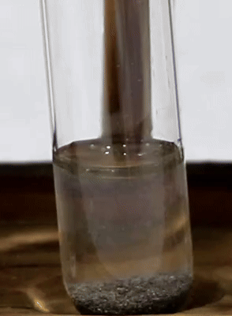
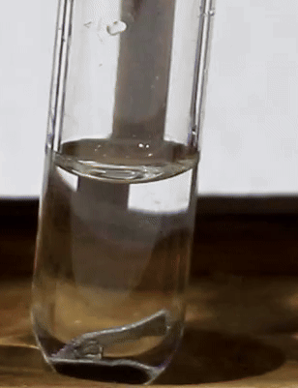
Tijaabinta haydarojiin (hydrogen)
Marka la eego heerka falcelinta (reactivity), way adag tahay in la arko midka ugu falcelin badan ee zinc (zinc) iyo birta (iron) dhexdooda. Qodobo kale sida cabbirka jajabyada birta (metal) ayaa saameyn ku yeelan doona xawaaraha falcelinta (reactivity).
qaybo yaryar, xumbo badan oo soo baxaya
bir (iron)
zinc (zinc)
qaybo waaweyn, xumbo ku taal dusha sare

Slide 33
Tijaabinta hydrogen (hydrogen)
Isla'egyada falgalada (reactions) ayaa hoos ku qoran. In kasta oo laga yaabo inaadan awoodin inaad sameyso tijaabo kiimiko oo togan oo hydrogen (hydrogen) ah, xumbadu waxay xaqiijinaysaa in gaas la soo saaray - laakiin kuma filna si uu u siiyo 'squeaky pop'.
magnesium + hydrochloric acid → magnesium chloride + hydrogen
Mg + 2HCl→ MgCl2 + H2
iron + hydrochloric acid → iron chloride + hydrogen
Fe + 2HCl→ FeCl2 + H2
zinc + hydrochloric acid → zinc chloride + hydrogen
Zn + 2HCl→ ZnCl2 + H2
copper + hydrochloric acid → ma jiro falgal (reaction)

Slide 34
Falgalada (reactions) kiimikada: asiidh (acid) iyo bir (metal)
Marka bir (metal) ay la falgasho asiidh (acid), xumbo ayaa laga yaabaa inay soo baxaan, waa kul bixiye (exothermic) oo birta (metal) way yaraataa (wey baaba'daa).
Biraha (metals) kala duwan waxay leeyihiin falgal (reaction) kala duwan oo ay la yeeshaan asiidhyada (acids).
Marka bir (metal) ay la falgasho asiidh (acid), waxa soo baxa cusbo bir ah (metal salt) iyo gaas hydrogen (hydrogen).
Isla'egta erayada ee bir (metal) iyo asiidh (acid) falgal (reaction) waa: bir (metal) + asiidh (acid) → cusbo bir ah (metal salt) + hydrogen (hydrogen).
Tijaabinta hydrogen (hydrogen) waa in la soo bandhigo laan shidan, taasoo samayn doonta 'squeaky pop' gudaha hydrogen (hydrogen).

