Slide 1
Falgal (reaction) kiimiko: gubasho (combustion)
Fahanka falgal (reaction) kiimiko

Slide 2
Sida agabkeena waxbarista loogu talagalay fasalka

Slide 3
Waxaan qeexi karaa hababka gubashada (combustion) iyo gubista, waana magacaabi karaa waxyaabaha ka soo baxa falgal (reaction)kan.

Slide 4
gubasho (combustion)
oksaydh (oxidation)
gubis (burning)
shidaal (fuel)
molecule (molecule)

Slide 5
Gubashada (combustion), shidaalku (fuel) wuxuu la falgalaa oksijiin (oxygen) si uu u sii daayo tamar, wuxuuna u baahan yahay shidaal (fuel), oksijiin (oxygen) iyo kulayl si uu u bilaabo falgal (reaction)ka.
Oksaydh (oxidation) waa nooc ka mid ah falgal (reaction) ka halkaasoo oksijiin (oxygen) uu ku xidhmaa curiyeyaasha fal-celiyeyaasha.
Gubistu (burning) waa nooc ka mid ah gubashada (combustion) halkaasoo walxuhu la falgalaan oksijiin (oxygen) oo ay soo saaraan olol muuqda.
Shidaalku (fuel) waa walax sii daysa tamarteeda kaydsan markay marayso gubasho (combustion).
Molecule (molecule) wuxuu ka kooban yahay laba ama in ka badan oo atom (atom) ah oo si kiimiko ah isugu xidhan. Kuwani badanaa waa atom (atom) aan bir ahayn.

Slide 6

Falgal (reaction) kiimiko: gubasho (combustion)
Gubis (burning) iyo gubasho (combustion)
Isla'egyada gubashada (combustion)

Slide 7
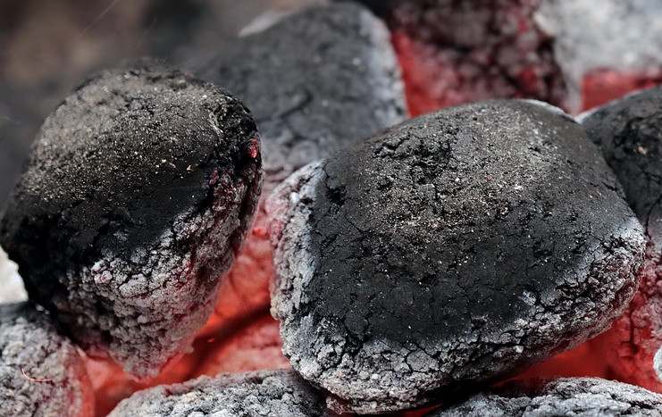
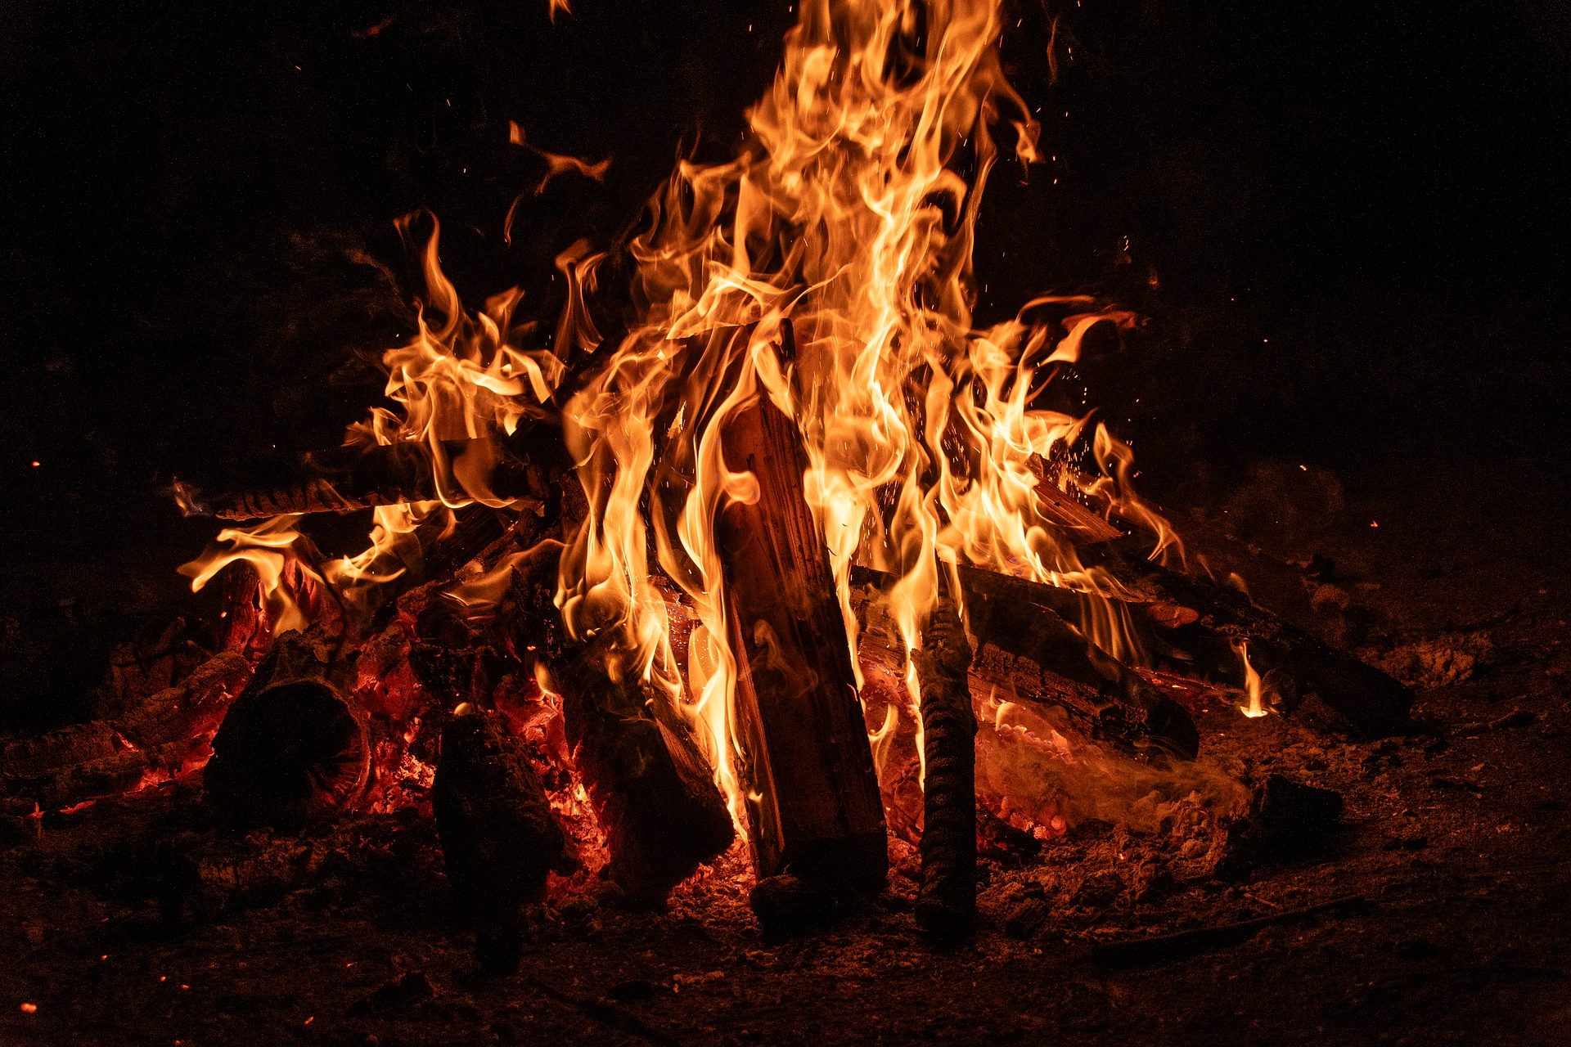
Gubis (burning) iyo gubasho (combustion)
Gubashadu (combustion) waa falgal (reaction) kiimiko.
Si uu u dhaco, gubashadu (combustion) waxay u baahan tahay:
shidaal (fuel)
oksijiin (oxygen)
kulayl (heat)
dab xero oo gubanaya (a campfire burning)
Gubis (burning):
waa falgal (reaction) gubasho (combustion)
halkaasoo dab ama olol la soo saaro
Gubashada dhuxusha (Combustion of charcoal):
oksaydhayshii (oxidation) waa socotaa
olol ma leh (no flames)
ma gubanayo (not burning)

Slide 8
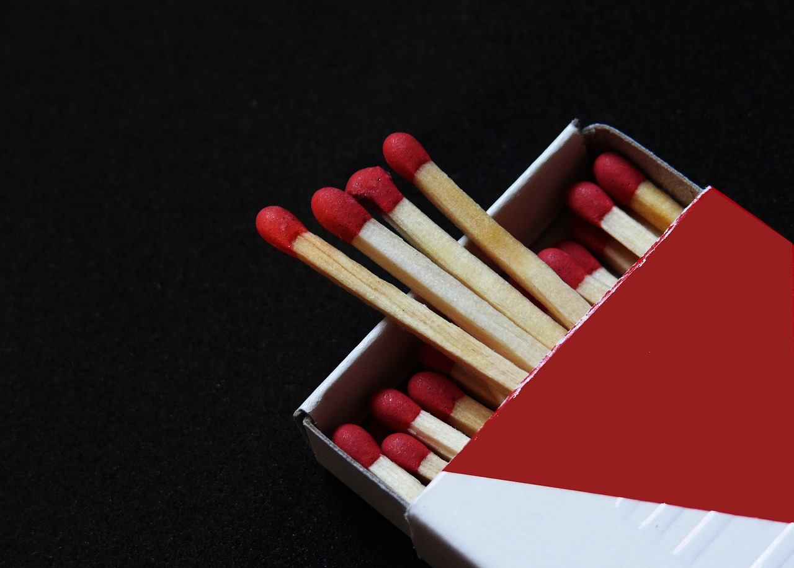
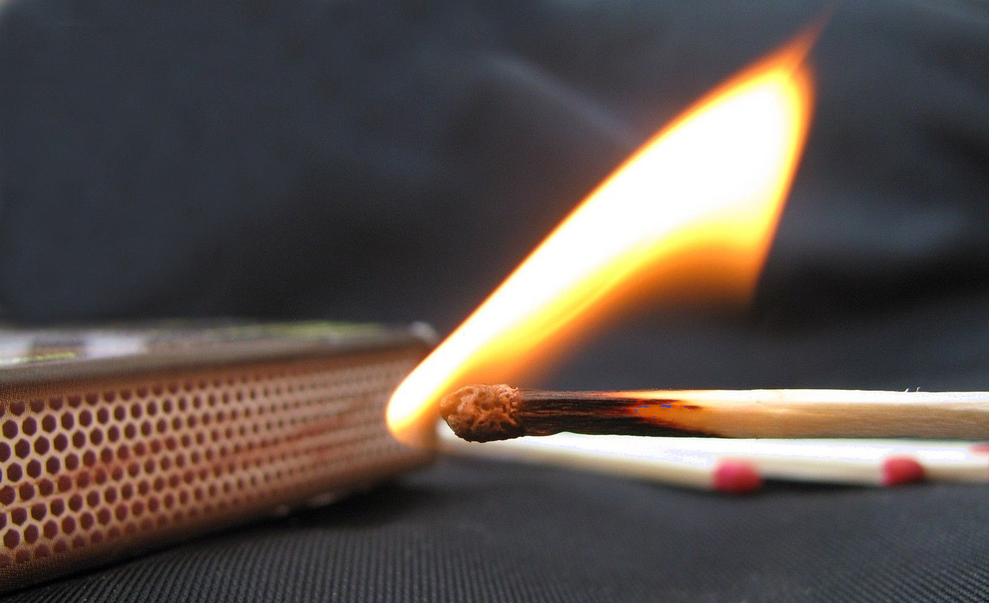
Gubasho iyo gubid (Burning and combustion)
Falgalo (reactions) badan waxay u baahan yihiin kulayl (heat) si loo bilaabo.
Shidaal-qabad (Safety matches) way iftiimaan marka kulaylka (heat) ka yimaada is-xoqidda (friction) dusha qallafani uu keeno falgal (reaction) u dhexeeya kiimikooyinka (chemicals) madaxa shidaal-qabadka iyo kiimikada (chemical) dusha qallafan.
shidaal-qabad (safety matches)
shidaal-qabad (safety matches) oo la xoqay

Slide 9

Gubasho iyo gubid (Burning and combustion)
Saddex-xagalka dabka (fire triangle) waxaa loo isticmaalaa in lagu muujiyo waxyaabaha loo baahan yahay si gubashadu (combustion) u dhacdo:
shidaal (fuel)
oksijiin (oxygen)
kulayl (heat)
shidaal (fuel)
oksijiin (oxygen)
Haddii mid ka mid ah 'dhinacyada' saddex-xagalka laga saaro:
fal-galka gubashada (combustion reaction) wuu joogsan doonaa
dabka / gubashadu way joogsan doontaa.
kuleyl (heat)
saddexagalka dabka (fire triangle)

Slide 10

Gubasho iyo gubid (Burning and combustion)
Waa maxay saddexda shay ee loo baahan yahay si gubasho (combustion) u dhacdo?
olol, shidaal (fuel), oksijiin (oxygen)
olol, shidaal (fuel), carbon dioxide
kuleyl (heat), oksijiin (oxygen), olol
kuleyl (heat), oksijiin (oxygen), shidaal (fuel)

Slide 11
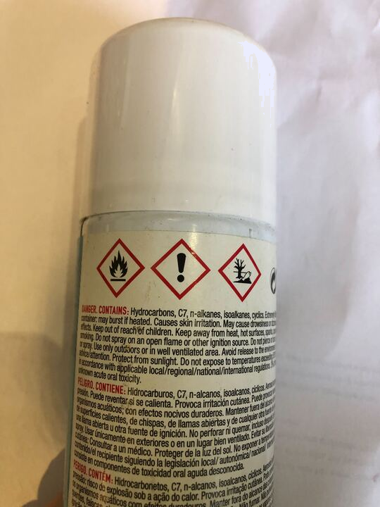
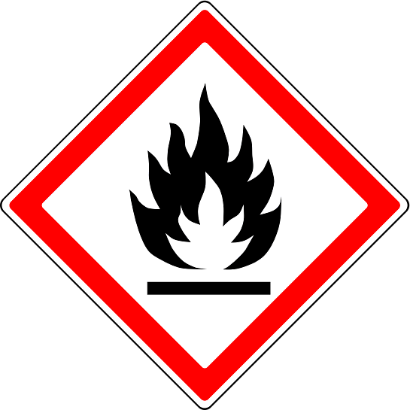

Gubasho iyo gubid (Burning and combustion)
Walxaha (shidaalka) si fudud u qabsada dabka waxaa loo calaamadeeyaa inay yihiin kuwo ololi kara (flammable).
shidaal (fuel)
oksijiin (oxygen)
kuleyl (heat)
Tusaale ahaan, buufintan ka fogee kuleylka (heat) si aad uga fogaato dab.
calaamadda khatarta ee ololka (flammable)
buufin biyaha ka ilaaliya kabaha (trainer waterproofing spray can)
Calaamadaha khatarta waxay naga caawiyaan inaan nabadgelyo joogno adoo qaadaya tallaabooyin ka hortagaya shilalka.

Slide 12
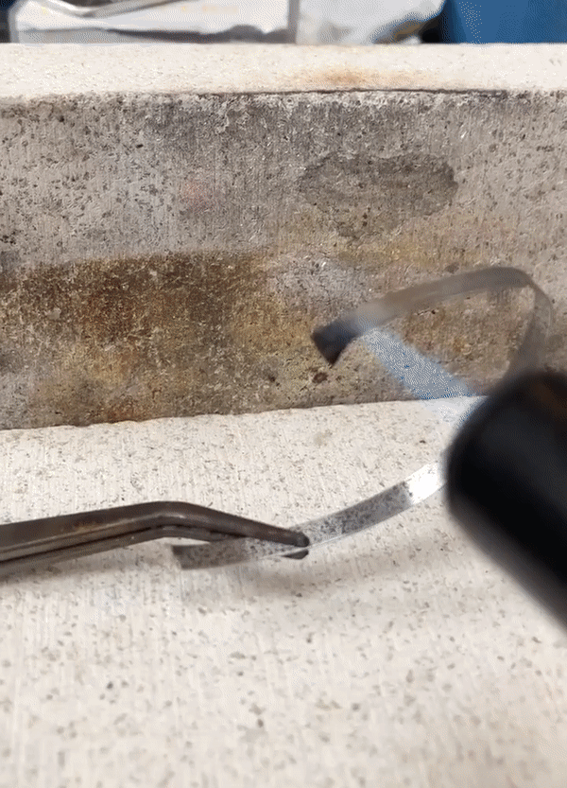
Gubasho iyo gubid (Burning and combustion)
Qadarka kuleylka (heat) ee loo baahan yahay gubashada (combustion) wuu kala duwan yahay.
Magnesium wuxuu u baahan yahay kuleyl (heat) ka yimaada blow torch ama Bunsen burner si uu u bilaabo falgal (reaction) leh oksijiin (oxygen).
Marka falgalku bilaabmo, wuxuu sii socdaa isagoon u baahnayn ilaha kulaylka bilowga ah.
Falgalku wuxuu joogsan doonaa marka 'shidaalka' ama ogsijiinta la isticmaalo.
fuel
oxygen
heat
magnesium reacting with oxygen

Slide 13
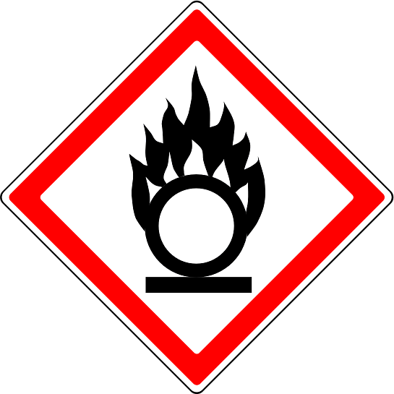
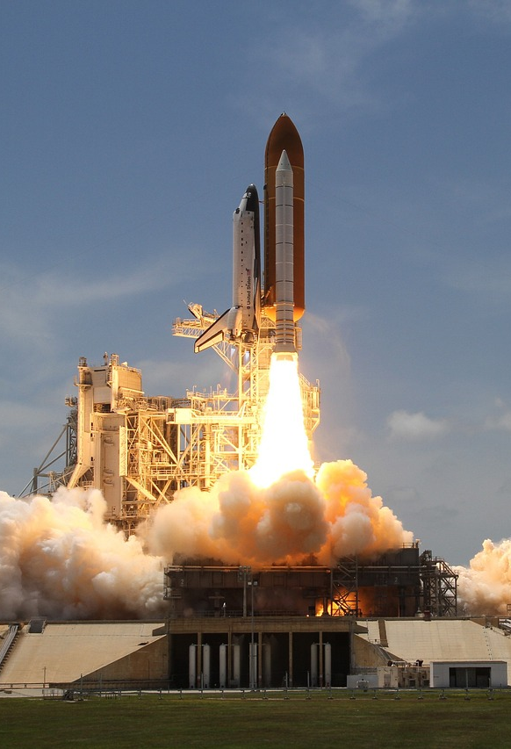
Burning and combustion
Ogsijiinta loo baahan yahay falgal gubasho (combustion) had iyo jeer kama imaado hawada.
Tusaale ahaan, gantaallada waxay isticmaalaan kiimikooyin oksidayn (oxidising) si ay u bixiyaan ogsijiinta loo baahan yahay gubashada.
hazard symbol for oxidising
Calaamadaha khatarta waxaa loo isticmaalaa in lagu muujiyo walxaha bixin kara ogsijiin falgal.
rocket burning fuel

Slide 14
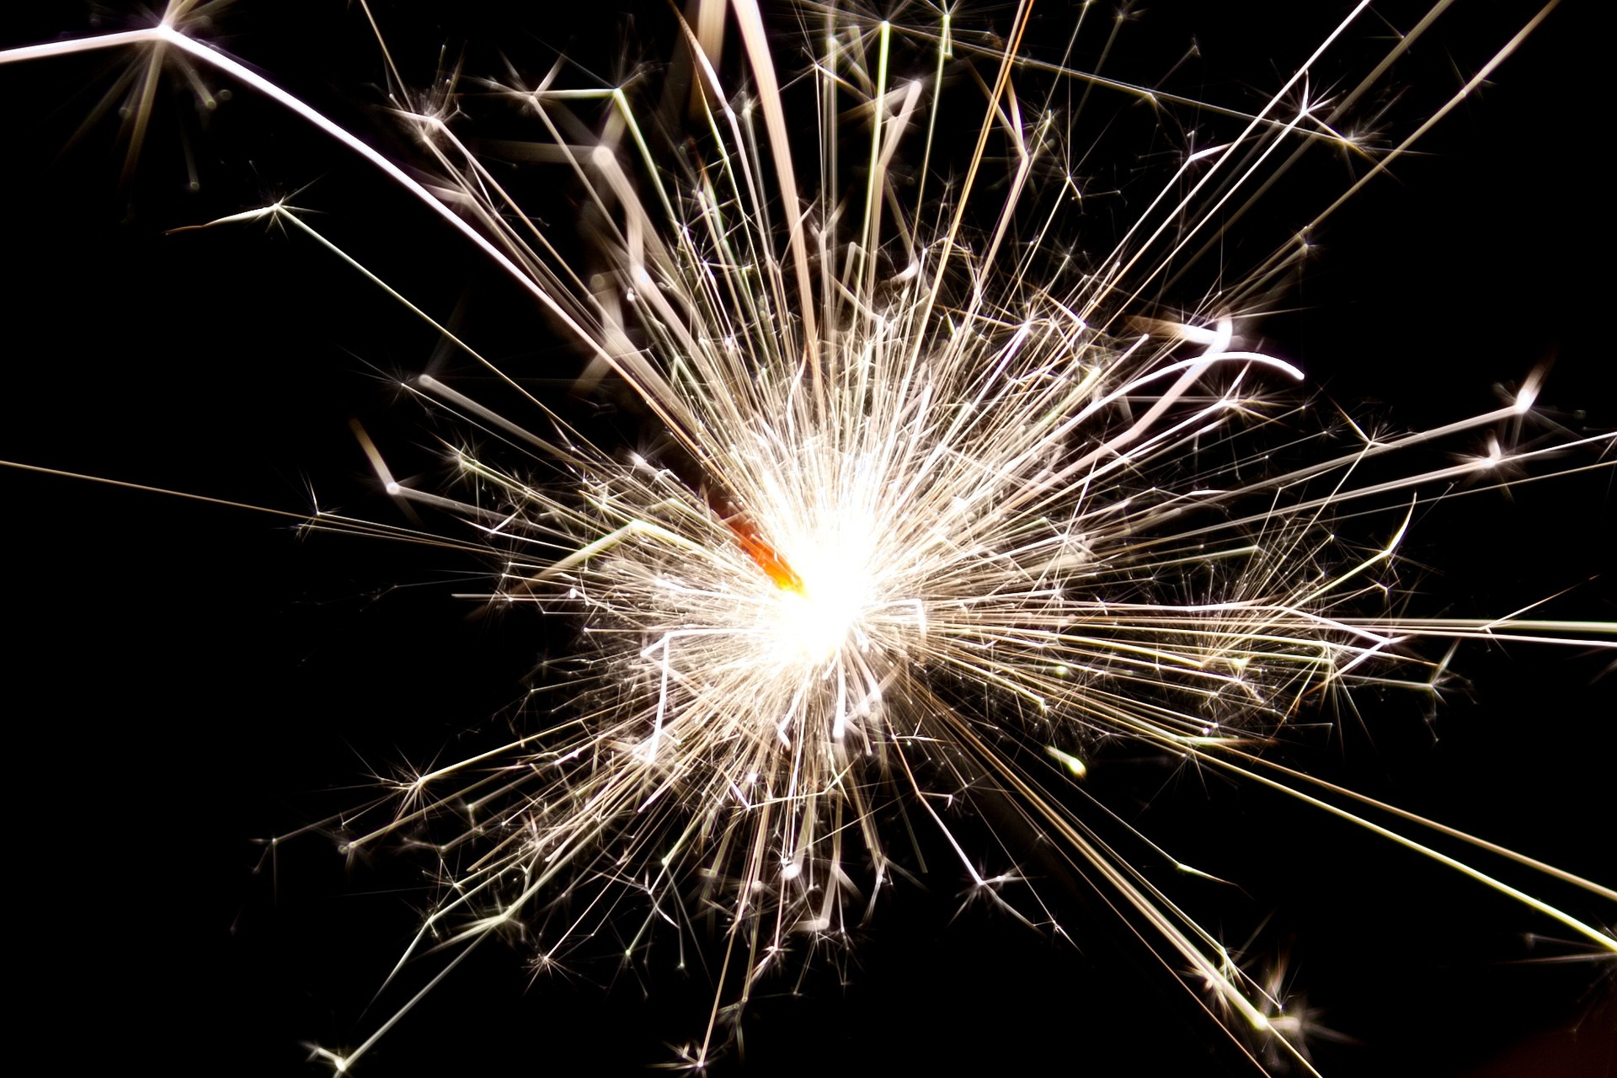
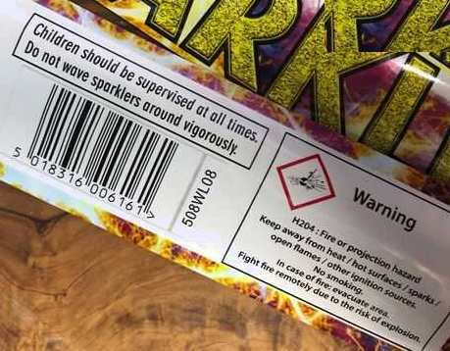
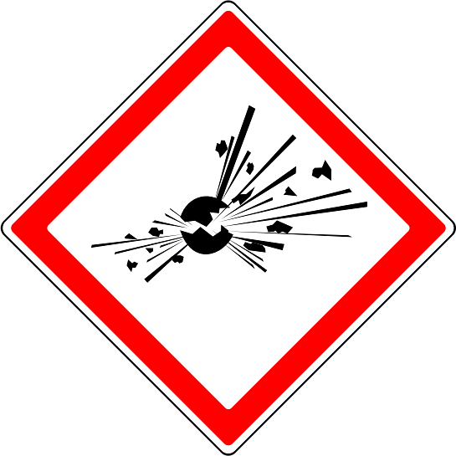
Burning and combustion
Qarax waa halka falgalka gubashadu uu si aad u degdeg ah u dhaco.
a sparkler burning
calaamadda khatarta ee khatarta qaraxa

Slide 15
Burning and combustion
Kulaylka ka yimaada blow torch ama Bunsen burner ayaa loo baahan yahay in lagu bilaabo dhammaan falgalka gubashada.
Falgalada qaarkood waxay dhacaan kaliya kulaylka isku dhaca, tusaale ahaan, tarrakh.
Fireworks had iyo jeer waxay u baahan yihiin in lagu shido Bunsen burner.

Slide 16
Burning and combustion
Waa kee sawirka saxda ah ee saddexagalka dabka (fire triangle)?
dab (fire)
shidaal (fuel)
shidaal (fuel)
oksijiin (oxygen)
oksijiin (oxygen)
kaarboon laba ogsaydh (carbon dioxide)
kulayl (heat)
kulayl (heat)
kulayl (heat)

Slide 17
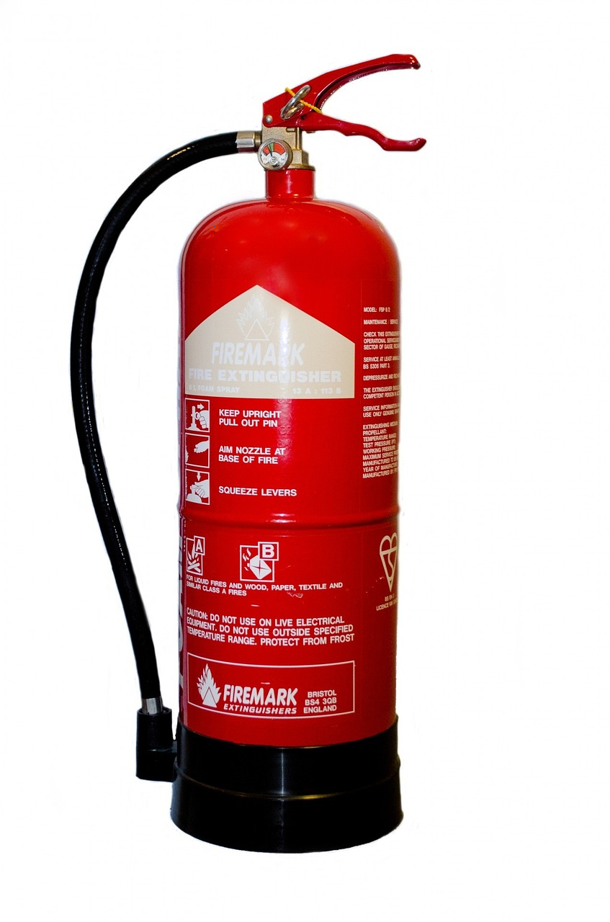
Gubasho iyo ololid (Burning and combustion)
Dab-demiyayaashu waxay damiyaan dabka iyagoo ka saaraya mid ama in ka badan:
shidaal (fuel)
oksijiin (oxygen)
kulayl (heat)
shidaal (fuel)
oksijiin (oxygen)
kulayl (heat)
Tusaale ahaan, biyo (water) ku shubista dab:
qaboojisaa shidaalka (fuel)
ka saaraysaa kulaylka (heat) dabka.

Slide 18
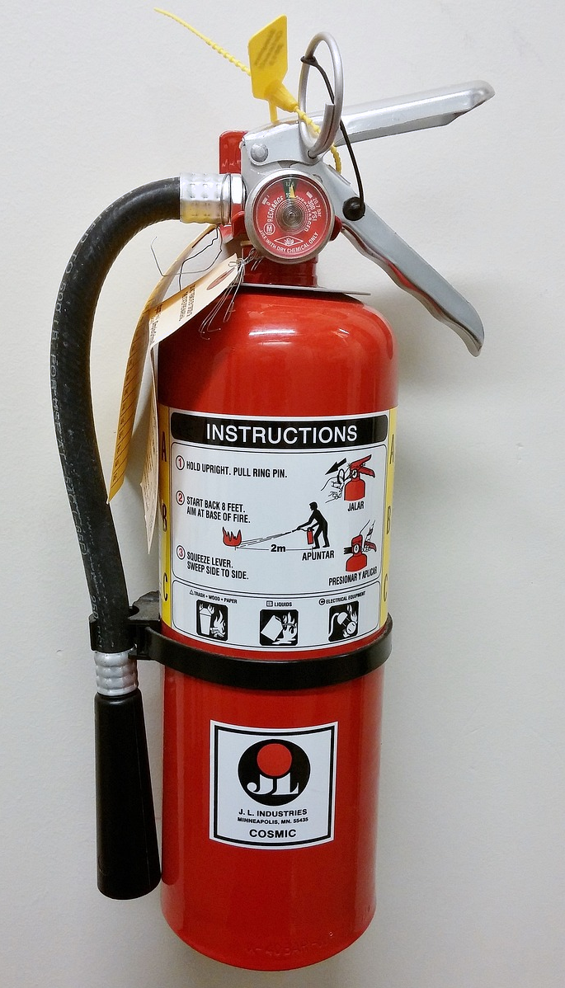
Gubasho iyo ololid (Burning and combustion)
Qaar ka mid ah dab-demiyayaashu waxay damiyaan dabka iyagoo ka saaraya laba ama saddex ‘dhinac’ oo ka mid ah saddexagalka dabka (fire triangle):
Tusaale ahaan, dab-demiyaha kaarboon laba-oksaydh (carbon dioxide extinguisher):
wuxuu oksijiinta (oxygen) dabka ka saaraa
wuxuu qaboojiyaa shidaalka (fuel) oo kulaylka (heat) dabka ka saaraa.
shidaal (fuel)
oksijiin (oxygen)
kulayl (heat)
Saarista xumbo dabka batroolka:
wuxuu daboolaa dareeraha gubanaya lakab xumbo ah, isagoo meesha ka saaraya sahayda oksijiinta (oxygen)
wuxuu ka hortagaa sii daynta uumiga guban kara (shidaal/fuel)
wuxuu qaboojiyaa shidaalka (fuel) oo kulaylka (heat) dabka ka saaraa.

Slide 19
Gubasho iyo gubid (Burning and combustion)
Saarista biyaha (water) dabka waxay meesha ka saartaa …
kulaylka (heat).
oksijiinta (oxygen).
shidaalka (fuel).

Slide 20
Gubasho iyo gubid (Burning and combustion)
Waa summadee khatarta (hazard symbol) ee saxda ah oo la dhigi lahaa walaxda ilo oksijiin (oxygen) ah?

Slide 21
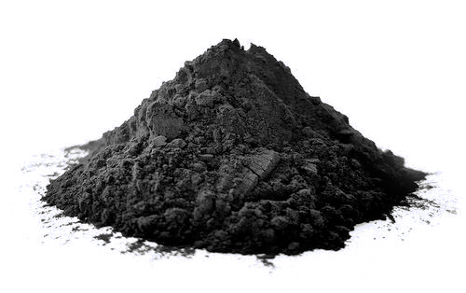

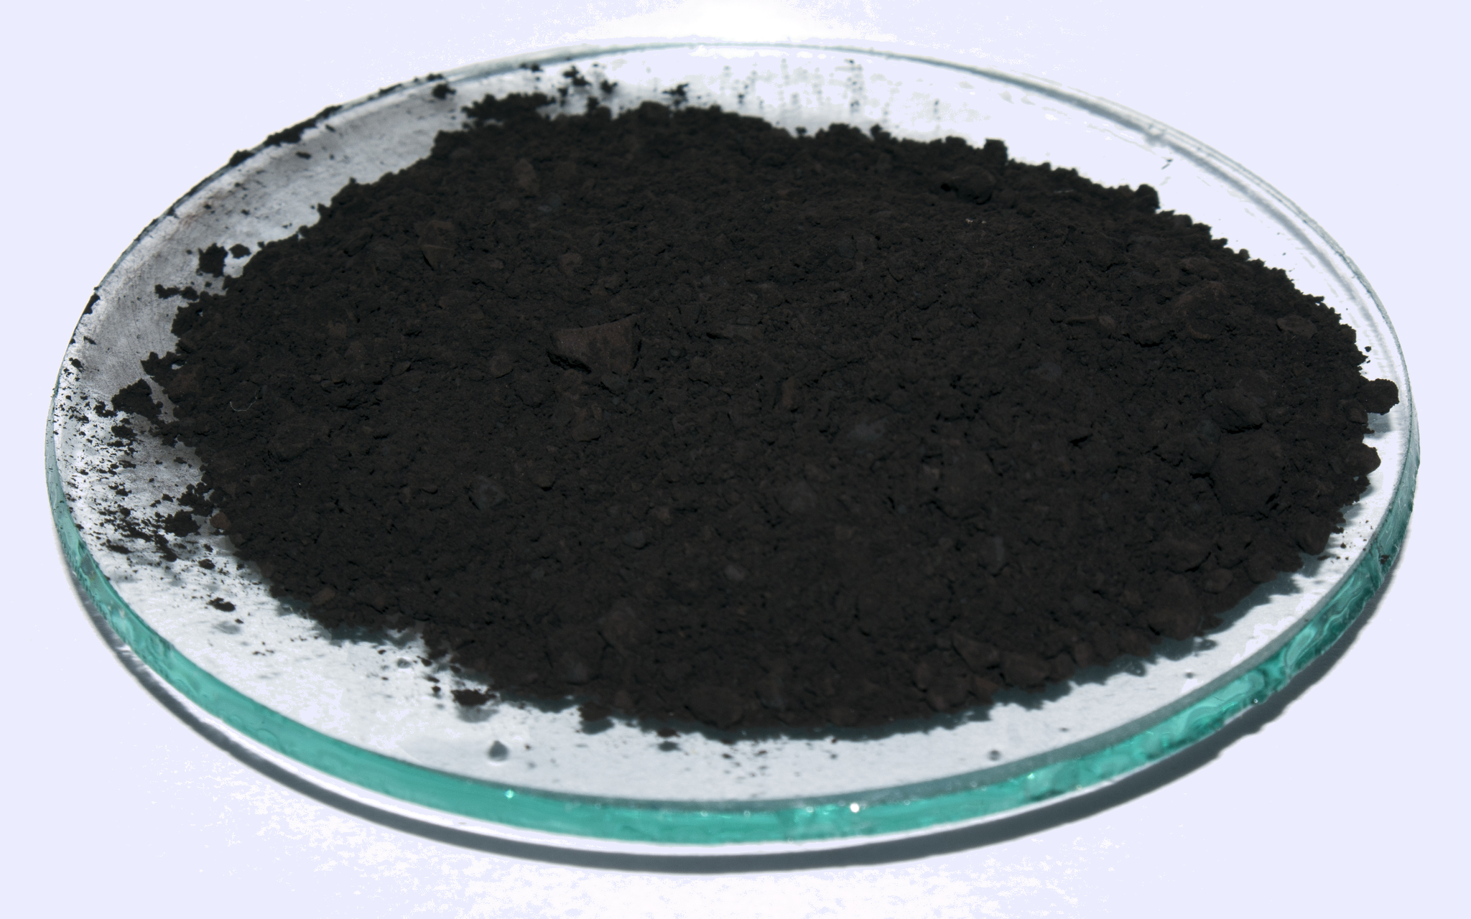
Gubasho iyo gubid (Burning and combustion)
Budadan madow waxay ka samaysan tahay kaarboon (carbon). Kaarboonku (Carbon) wuu gubi karaa.
Naxaas (Copper) waxay la falgashaa oksijiin (oxygen) si ay u samayso naxaas-oksaydh (copper oxide).
Budadan madow waa naxaas-oksaydh (copper oxide).
Naxaas-oksaydh (copper oxide) ma gubtaa? Sababaha ugu jawaabta.
a
b
c
waxaa loo baahan yahay macluumaad dheeri ah
Jawaabaha:
haa
maya
a
Kaarboon firfircoon oo budo ah" by کربن پارس oo shatiyaysan CC BY-SA 4.0
"Copper(II) oxide, CuO" by Adam Rędzikowski oo shatiyaysan CC-BY-SA-3.0

Slide 22
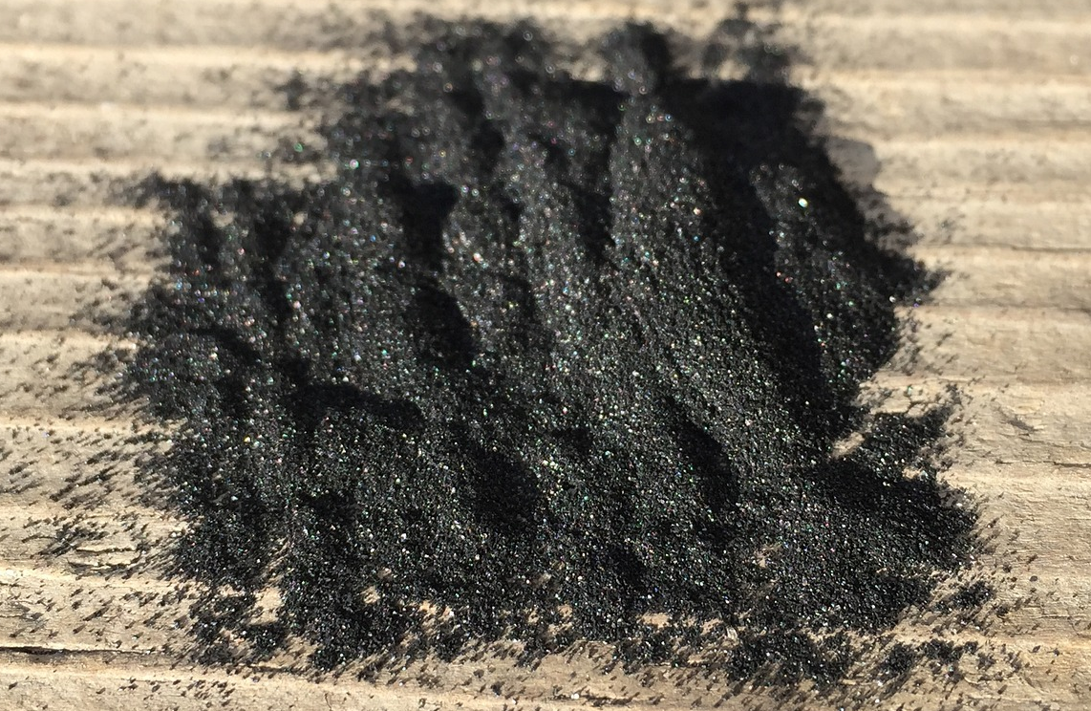
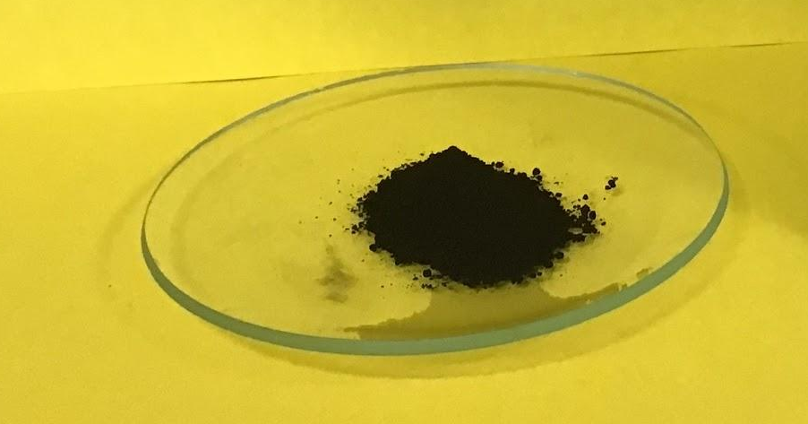
Gubasho (Burning) iyo gubid (combustion)
Budadan madow waxay ka samaysan tahay kaarboon (carbon). Kaarboon (carbon) waa uu gubi karaa.
Naxaas (Copper) waxay la falgashaa oksijiin (oxygen) si ay u samayso naxaas-oksaydh (copper oxide).
Budadan madow waa naxaas-oksaydh (copper oxide).
Naxaas-oksaydh (copper oxide) ma gubtaa? Sababaha ugu jawaabta.
a
b
c
macluumaad dheeri ah ayaa loo baahan yahay
Naxaas-oksaydh (copper oxide) ma gubto, sababtoo ah naxaasta (copper) horey ayay ula falgashatay oksijiin (oxygen).
Jawaabaha:
haa
maya
a

Slide 23







Gubasho (Burning) iyo gubid (combustion)
Ardaydu waxay ka hadlayaan gubashada (combustion) iyo gubista (burning). Sheeg haddii weedhuhu ay yihiin kaliya gubis (burning), kaliya gubasho (combustion), ama labadaba.
Oolol (flames) waa la arkaa.
Waa falgal (reaction) la oksijiin (oxygen).
Oolol (flames) lama arko.
Waxyaabo aan ahayn oksaydh (oxide) mararka qaarkood waa la sameeyaa.
Oksaydh (oxide) had iyo jeer waa la soo saaraa.
Cabdi
Layla

Slide 24
Gubid iyo gubasho (Burning and combustion)
Ardaydu waxay ka hadlayaan gubasho (combustion) iyo gubid (burning). Sheeg haddii weedhaha ay yihiin kaliya gubid (burning), kaliya gubasho (combustion), ama labadaba gubid iyo gubasho.
Olol (flames) waa la arkaa.
Waa falgal (reaction) oksijiin (oxygen) la.
Olol (flames) lama arko.
Wax soo saar (products) aan ahayn oksaydhyaasha (oxides) mararka qaarkood waa la sameeyaa.
Oksaydh (oxide) had iyo jeer waa la soo saaraa.
Cabdi
Layla
Jawaabaha:
labadaba
kaliya gubasho (combustion)
kaliya gubid (burning)
labadaba
labadaba

Slide 25
Gubid iyo gubasho (Burning and combustion)
Ku calaamadee dhinacyada saddex-xagalka dabka (fire triangle).
__________
__________
__________

Slide 26
Gubid iyo gubasho (Burning and combustion)
Ku calaamadee dhinacyada saddex-xagalka dabka (fire triangle).
shidaal (fuel)
oksijiin (oxygen)
kulayl (heat)

Slide 27
Gubasho iyo ololid (combustion)
Ku xidh weedhaha ku saabsan dab-demisyada qaybta (qaybaha) saddexagalka dabka ee ay meesha ka saarayaan.
Dab-demis xumbo (foam) ahi wuxuu soo saaraa xumbo qaboojisa shidaalka (fuel) oo sameeya lakab sare oo dabka ah, sidoo kale wuxuu joojiyaa shidaalka (fuel) inuu sameeyo uumiga.
shidaal (fuel)
Dab-demis biyo (water) ku shuban ahi wuxuu qaboojiyaa shidaalka (fuel) dabka.
kulayl (heat)
oksijiin (oxygen)
Dab-demis carbon dioxide ahi wuxuu sameeyaa lakab gaas aan ololi karin oo dabka korkiisa ah oo qaboojiya shidaalka (fuel).

Slide 28
Gubasho iyo ololid (combustion)
Ku xidh weedhaha ku saabsan dab-demisyada qaybta (qaybaha) saddexagalka dabka ee ay meesha ka saarayaan.
Dab-demis xumbo (foam) ahi wuxuu soo saaraa xumbo qaboojisa shidaalka (fuel) oo sameeya lakab sare oo dabka ah, sidoo kale wuxuu joojiyaa shidaalka (fuel) inuu sameeyo uumiga.
shidaal (fuel)
Dab-demis biyo (water) ku shuban ahi wuxuu qaboojiyaa shidaalka (fuel) dabka.
kulayl (heat)
oksijiin (oxygen)
Dab-demis carbon dioxide ahi wuxuu sameeyaa lakab gaas aan ololi karin oo dabka korkiisa ah oo qaboojiya shidaalka (fuel).

Slide 29
Falgal (reaction) kiimiko: ololid (combustion)
Gubasho iyo ololid (combustion)
Isla'egyada ololka (combustion equations)

Slide 30
Isla'egyada ololka (combustion equations)
Shidaal (fuel) badan waxay ka kooban yihiin carbon iyo hydrogen:
waxay ka kooban yihiin oo kaliya atamka hydrogen iyo carbon
kuwan waxaa loo yaqaan shidaalka hydrocarbon (hydrocarbon fuels)
tusaale: methane, propane, petrol (badanaa octane).
Isla'egta guud ee shidaalka (fuel) hydrocarbon gubanaya waa:
shidaalka hydrocarbon (hydrocarbon fuel) + oksijiin (oxygen) → carbon dioxide + biyo (water)
tusaale: ethane + oksijiin (oxygen) → carbon dioxide + biyo (water)
2C2H6 + 7O2 → 4CO2 + 6H2O

Slide 31
Isleegyada gubashada (Combustion equations)
Biyo (Water) waxaa inta badan lagu sameeyaa falgal (reaction) kiimiko haddii atamka oksijiin (oxygen) iyo hydrogen ay joogaan.
tusaale: Kuleyliyaha gaasta (gas boiler):
methane + oksijiin (oxygen) → carbon dioxide + biyo (water)
CH4 + 2O2 → CO2 + 2H2O
Carbon dioxide waxaa inta badan lagu sameeyaa falgal (reaction) kiimiko haddii atamka oksijiin (oxygen) iyo carbon ay joogaan.

Slide 32
Isleegyada gubashada (Combustion equations)
Falgal (reaction) kee/kee ayaad filanaysaa inaad biyo (water) ku aragto badeecad ahaan?
C₂H₄ + O₂
H₂S + O₂
Na + O2
Al + O2

Slide 33
Isleegyada gubashada (Combustion equations)
Falgal (reaction) kee/kee ayaad filanaysaa inaad carbon dioxide ku aragto badeecad ahaan?
C₈H₁₀+ O₂
H₂S + O₂
CH3OH + O2
Al + O2

Slide 34


Isleegyada gubashada (Combustion equations)
Carbon dioxide iyo biyo (water):
waa unugyo yaryar (molecules)
si fudud u samaysma
waxay leeyihiin xiriir adag oo ka dhexeeya atomkooda.
H
H
O
C
O
O
unugga (molecule) carbon dioxide
unugga (molecule) biyo (water)

Slide 35
Isla'egyada gubashada (Combustion equations)
Raadi bayaanka saxda ah ee ku saabsan carbon dioxide iyo biyo (water).
Waxay leeyihiin xiriir adag oo ka dhexeeya atomkooda.
Waxay leeyihiin xiriir daciif ah oo ka dhexeeya atomkooda.
Waa unugyo (molecules) waaweyn oo adag inay samaysmaan.
Waa unugyo (molecules) yaryar oo fudud inay samaysmaan.

Slide 36
Isla'egyada gubashada (Combustion equations)
Isku xir bayaannada erayada muhiimka ah. Waxaad isticmaali kartaa erayada muhiimka ah in ka badan hal mar.
badanaa waxay ku samaysma falgal (reaction) kiimiko haddii atamka (atoms) oksijiin (oxygen) iyo hydrogen (hydrogen) ay joogaan
biyo (water)
waxa uu samaysmaa marka walax ay falgasho (react) oksijiin (oxygen)
si dhakhso ah u dhaca ama sannado badan
oksaydhaysi (oxidation)
unug (molecule) yar, si fudud u samaysma, oo leh xiriir adag oo ka dhexeeya atomka
oksaydh (oxide)
habka falgalka (reacting) oksijiin (oxygen)
carbon dioxide
inta badan waxa uu ku samaysmaa falgal (reaction) kiimiko haddii ay joogaan oksijiin (oxygen) iyo atomka kaarboon

Slide 37
Isleegyada gubashada (Combustion equations)
Isku xidh weedhaha iyo erayada muhiimka ah. Waxaad u isticmaali kartaa erayada muhiimka ah in ka badan hal mar.
badanaa waxay ku samaysma falgal (reaction) kiimiko haddii atamka (atoms) oksijiin (oxygen) iyo hydrogen (hydrogen) ay joogaan
biyo (water)
waxay samaysmaa marka walax (substance) la falgasho (reacts) oksijiin (oxygen)
waxay dhacdaa si degdeg ah ama sanado badan
oksaydhays (oxidation)
molekyul (molecule) yar oo si fudud u samaysma oo leh xidhiidho (bonds) adag oo u dhexeeya atamka (atoms)
oksaydh (oxide)
habka la falgalka (reacting) oksijiin (oxygen)
kaarboon laba-oksaydh (carbon dioxide)
badanaa waxay ku samaysma falgal (reaction) kiimiko haddii atamka (atoms) oksijiin (oxygen) iyo kaarboon (carbon) ay joogaan

Slide 38
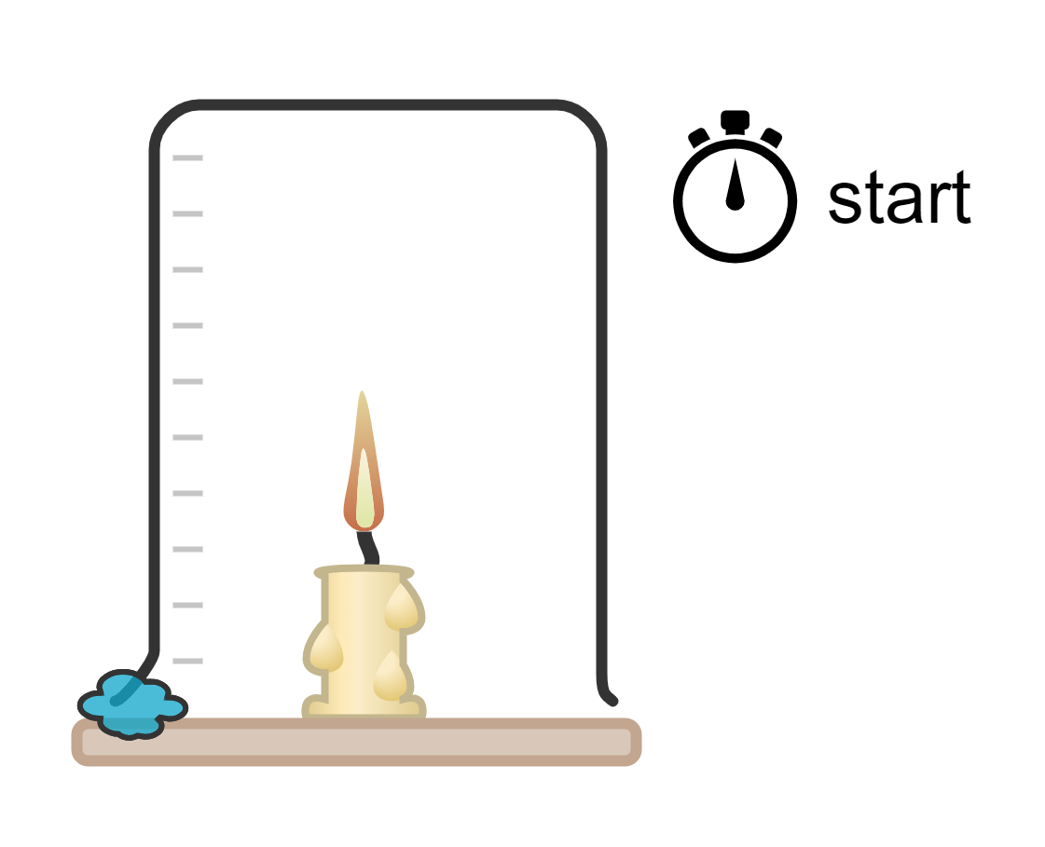
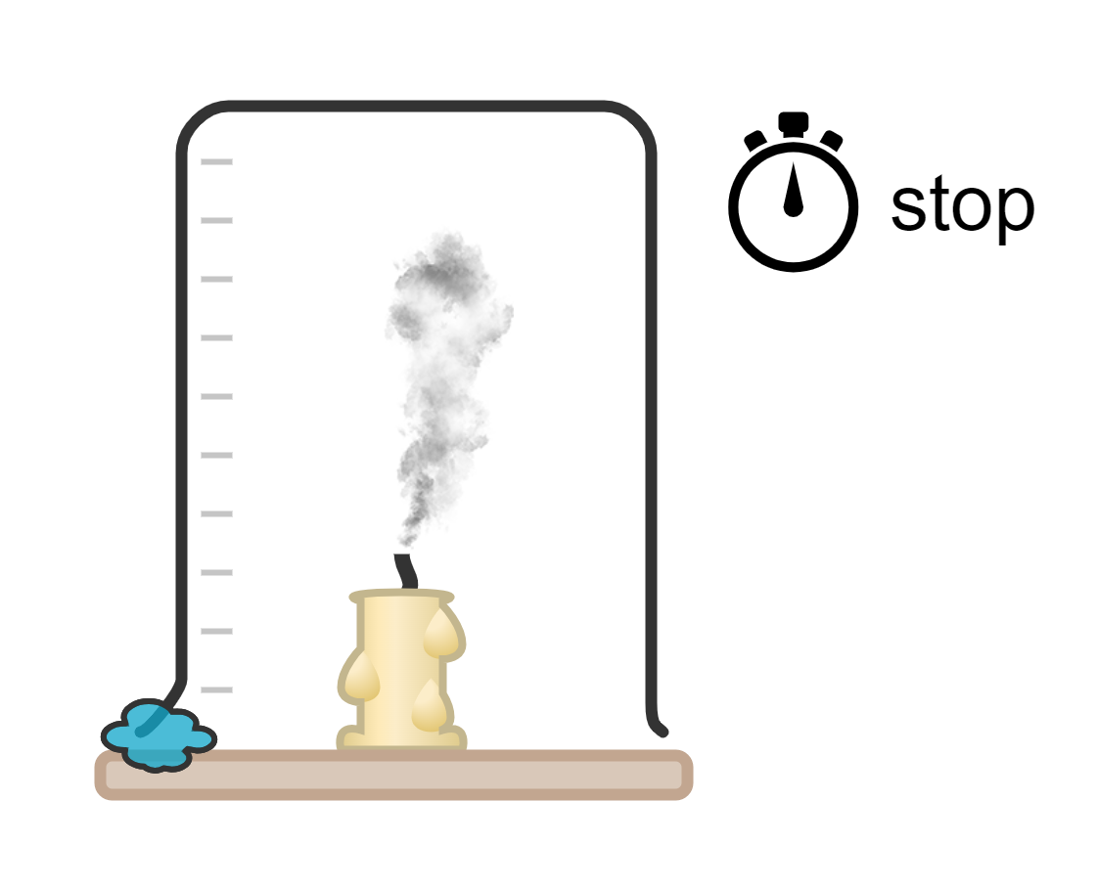
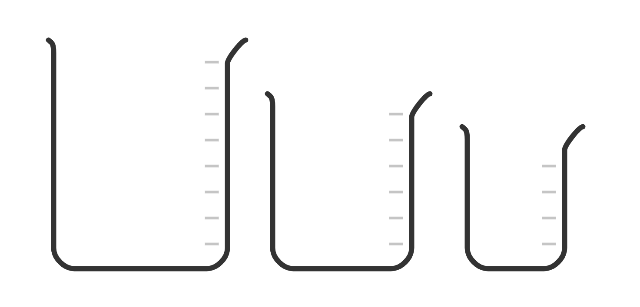
Isleegyada gubashada (Combustion equations)
2) Samee tijaabo (experiment) si aad u baarto sida wakhtiga gubashada
shumac (candle) uu isu beddelo mugga (volume) hawada / oksijiin (oxygen).
Tallaabada 2: Joogi saacadda joogsiga (stopwatch) marka shumaca (candle) uu damo. Qor natiijadaada.
weel (beaker)
shumac (candle)
xabagta (adhesive putty)
dusimo kuleyl (heat resistant mat)
Tallaabada 1: Shid shumaca (candle) oo bilaabi saacadda joogsiga (stopwatch) isla marka weelka (beaker) la dul saaro.
Tallaabo 3: Ku celi tijaabada (experiment) koobab (beakers) oo cabbir kala duwan leh.

Slide 39
Isla'egyada gubashada (Combustion equations)
Kani waa miis natiijo (results table) oo aad isticmaali karto.
cabbirka koobka (cm3) | waqtiga ay qaadatay shumaca si uu u bakhti (s)

Slide 40
Isla'egyada gubashada (Combustion equations)
3) Qor gabagabo (conclusion) tijaabadaada.
Shumaca ugu dheer gubtay wuxuu ku jiray koobka __________ sababtoo ah …
Shumaca wuu bakhtiyey markii …

Slide 41
Isla'egyada gubashada (Combustion equations)
3) Qor gabagabo (conclusion) tijaabadaada.
Shumaca ugu dheer gubtay wuxuu ku jiray
koobka sababtoo ah …
Shumaca wuu bakhtiyey markii …
ugu weyn / mug gaar ah oo la xuso, tusaale ahaan 1000 cm3
waxaa jiray qiyaasta ugu badan ee oksijiin (oxygen) oo diyaar u ah shumaca inuu gubo.
dhammaan oksijiinka (oxygen) waa la isticmaalay falgalka (reaction) gubashada.

Slide 42
Falgal (reaction) kiimiko: gubasho (combustion)
Erayga 'gubasho' wuxuu qeexayaa falgalka (reaction) walxaha iyo oksijiin (oxygen), waxaana badanaa loo adeegsadaa in lagu tilmaamo ololka la arki karo.
Biyo (water) ayaa inta badan lagu sameeyaa falgal (reaction) kiimiko haddii ay jiraan atamka oksijiin (oxygen) iyo hydrogen.
Carbon dioxide ayaa inta badan lagu sameeyaa falgal (reaction) kiimiko haddii ay jiraan atamka oksijiin (oxygen) iyo carbon.
Carbon dioxide iyo biyo (water) labaduba waxay ka kooban yihiin molecules yaryar oo si fudud u sameeya xidhmo (bonds) adag.

