Slide 1
Falgal kiimiko: burbur (decomposition)
Fahanka falgal kiimiko (chemical reactions)

Slide 2
Sida agabkeena waxbarista loogu talagalay fasalka

Slide 3
Waxaan qiyaasi karaa waxa dhaca inta lagu jiro falgal burbur (decomposition), iyo qorista isla'egta kiimikada si aan u muujiyo.

Slide 4
burbur (decompose)
burbur (decomposition)

Slide 5
Marka walax burburto waxay maraysaa falgal burbur (decomposition reaction).
Falgal burbur (decomposition reaction) waa nooc falgal ah oo xarun falgaleed (reactant) u burburto laba ama in ka badan oo wax soo saar ah (products).

Slide 6

Falgal kiimiko: burbur (decomposition)
Falgal burbur (decomposition reactions)
Baaritaanka burburka karbonatka birta (metal carbonate decomposition)

Slide 7
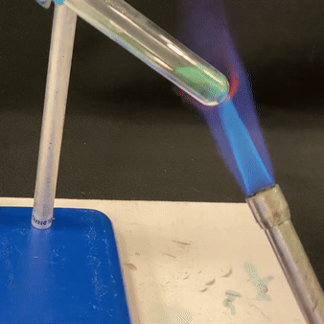
Falgal burbur (decomposition reactions)
Mararka qaarkood, hal falgale (reactant) wuxuu soo saaraa in ka badan hal wax soo saar.
Burburka xarun (compound) ee u noqda walxo fudud waxaa loo yaqaan burbur (decomposition).
oksaydh naxaas (copper oxide)
kaarboon labo ogsaydh (carbon dioxide)
+
burbur kulayl (thermal decomposition) ee karbonat naxaas (copper carbonate)
Jawaabaha:
falgale (reactant)
wax soo saar (products)
→
karbonat naxaas (copper carbonate)

Slide 8
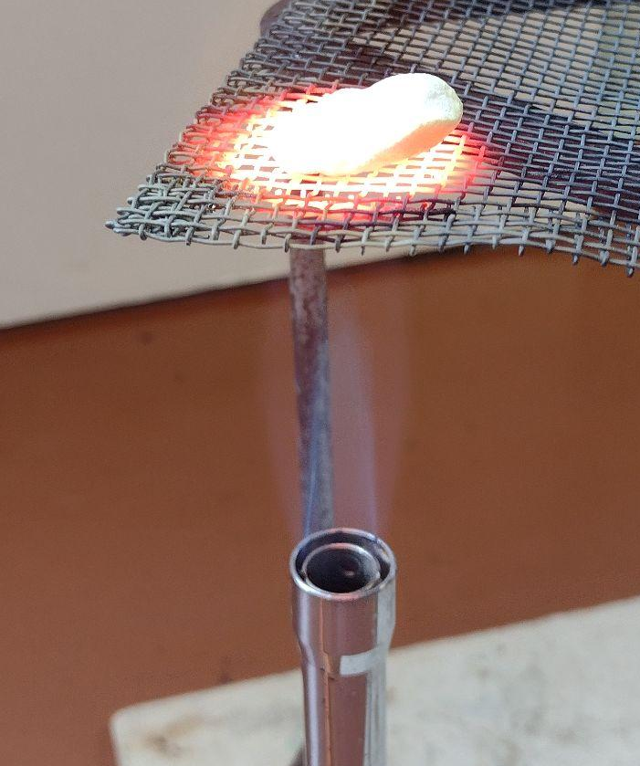
Falgal burbur (decomposition reactions)
Marka karbonat birta (metal carbonates) ay burburaan kulayl, waxay caadi ahaan sameeyaan oksaydh birta (metal oxides) iyo gaas kaarboon labo ogsaydh (carbon dioxide).
kuleyl (heat)
kaalshiyam kaarboonayt (calcium carbonate) kaalshiyam oksaydh (calcium oxide) + kaarboon laba oksaydh (carbon dioxide)
Falgalyada (reactions) burburka (decomposition) waxaa badanaa bilaaba kuleyl (heat), iftiin (light), ama koronto (electricity).
Gelinta (input) bilowda falgalka burburka (decomposition reaction) waxaa lagu daraa isla'egta kiimikada (chemical equation) kor fallaarta (arrow).
burburka kuleylka (thermal decomposition) ee kaalshiyam kaarboonayt (calcium carbonate)

Slide 9
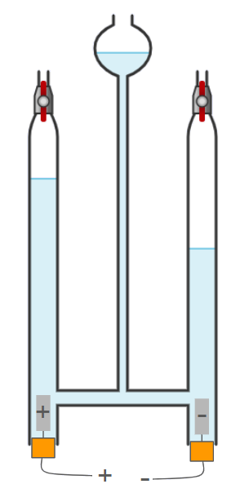
Falgalyada burburka (Decomposition reactions)
Walxaha (substances) qaarkood waxay maraan falgalyada burburka (decomposition reactions) marka koronto (electricity) la adeegsado.
H2O + H2SO4
O₂ (g)
biyo (water) haydarojiin (hydrogen) + oksajiin (oxygen)
H₂ (g)
2H₂O _{(l)} 2H_{2 (g)} + O_{2 (g)}
Jawaabaha:
koronto (electricity)
koronto (electricity)

Slide 10
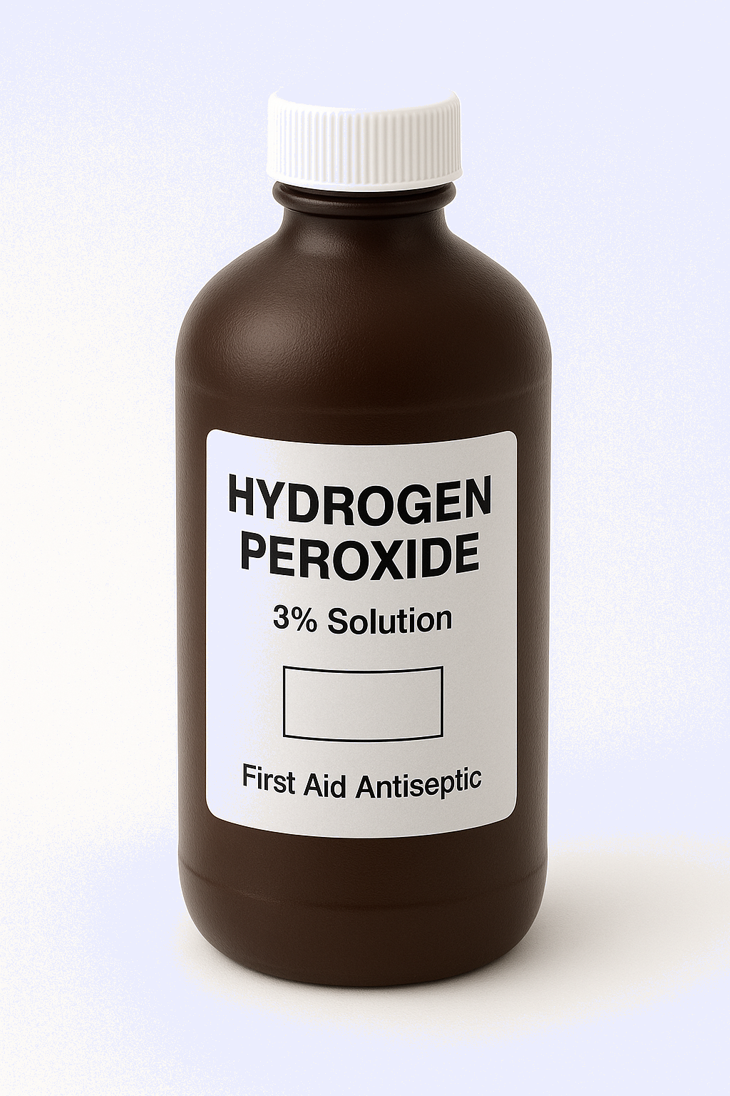
Falgalyada burburka (Decomposition reactions)
Walxaha (substances) kale waxay maraan falgalyada burburka (decomposition reactions) marka iftiin (light) joogo.
iftiin (light)
haydarojiin peroksaydh (hydrogen peroxide) biyo (water) + oksajiin (oxygen)
iftiin (light)
2H₂O_{2 (l)} 2H₂O _{(l)} + O_{2 (g)}

Slide 11

Falgalyada burburka (Decomposition reactions)
Kee u dhigma sida ugu fiican sharaxaadda falgalka burburka (decomposition reaction)?
Laba ama in ka badan oo badeecado (products) ah ayaa isku dara markay falgalaan si ay u sameeyaan hal falceliye (reactant).
Hal falceliye (reactant) ayaa burbura si uu u sameeyo laba ama in ka badan oo badeecado (products) ah.
Laba falceliye (reactants) ayaa sameeya laba ama in ka badan oo badeecado (products) ah.

Slide 12
Falgal (reaction) burbur (decomposition)
Habka kaliya ee lagu bilaabo falgal (reaction) burbur (decomposition) waa in iftiin lagu dhalaaliyo walaxda falgasha (reactant).
Falgalka burburka (decomposition reaction) wuxuu kaloo bilaabi karaa kuleylinta (heating) falceliyaha (reactant) ama iyadoo la mariyo koronto (electrical current) dhexdiisa.
Waxaa jira laba hab oo keliya oo falgal (reaction) burbur (decomposition) uu ku bilaabmi karo; iftiin lagu dhalaaliyo walaxda falgasha (reactant) ama koronto (electric current) lagu dhex mariyo walaxda falgasha (reactant).

Slide 13










Falgal (reaction) burbur (decomposition)
Sixi hadalada ardayda.
Falgal (reaction) burbur (decomposition) caadi ahaan waxay u baahan yihiin ____________, iftiin, ama __________ si ay u dhacaan.
Falgal (reaction) burbur (decomposition) waxay ku lug leedahay laba xaroor (compounds) oo falgala si ay u sameeyaan laba ama in ka badan oo wax soo saar ah (products).
Nuur
Yacquub
Marka karboonayt (carbonate) birta qudhunta marka la kululeeyo, waxay caadi ahaan sameeyaan oksaydh (oxide) birta iyo gaas oksijiin (oxygen gas).
Suad

Slide 14
Falgal (reaction) burbur (decomposition)
Sixi hadalada ardayda.
Falgal (reaction) burbur (decomposition) caadi ahaan waxay u baahan yihiin , iftiin, ama si ay u dhacaan.
Falgal (reaction) burbur (decomposition) waxay ku lug leedahay laba xaroor (compounds) oo falgala
hal xarun oo keli ah (a single compound)
si ay u sameeyaan laba ama in ka badan oo wax soo saar ah (products).
kala-jajab (breaking down)
Nuur
Yacquub
Marka karboonayt (carbonate) birta qudhunta marka la kululeeyo, waxay caadi ahaan sameeyaan oksaydh (oxide) birta iyo gaas oksijiin (oxygen gas).
Jawaabaha:
Suad
koronto (electricity)
kulayl (heat)
kala-burbur (decompose)
carbon dioxide

Slide 15
Fal-gallo kiimiko: kala-burbur (Chemical reactions: decomposition)
Fal-gallo kala-burbur (Decomposition reactions)
Baaritaan kala-burburka birta kaarboonatayda (Investigating metal carbonate decomposition)

Slide 16
Baaritaan kala-burburka birta kaarboonatayda (Investigating metal carbonate decomposition)
Biraha kaarboonatuhu waxay ku kala-burbutaan heerar kala duwan marka la kululeeyo (Metal carbonates undergo thermal decomposition at different rates).
Kaarboonate naxaas ahi wuxuu si dhaqso ah u kala-burburaa isagoo soo saara oksaydh naxaas ah iyo carbon dioxide (Copper carbonate decomposes quite quickly to produce copper oxide and carbon dioxide).
Marka kala-burburku uu dheeraado:
xarunta birta ayaa ah mid deggan (the more stable the metal compound)
xidhiidhka u dhexeeya birta iyo kaarboonatayda wuu xooggan yahay (the stronger the bonding between the metal and the carbonate).
kaarboonate naxaas ah (copper carbonate)
oksaydh naxaas ah (copper oxide)
carbon dioxide
→
+
kaarboonate naxaas ah (copper carbonate)
Biyo nuurade (Limewater) ayaa loo isticmaalaa in lagu tijaabiyo soo-saarka carbon dioxide (Limewater is used to test for the production of carbon dioxide)

Slide 17
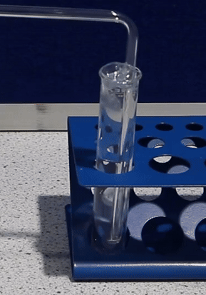
Baaritaan kala-burburka birta kaarboonatayda (Investigating metal carbonate decomposition)
Tijaabada gaasta carbon dioxide:
gaaska ku afuuf biyaha nuuradda (bubble the gas through limewater)
biyaha nuuraddu waxay ka beddelaan midab la'aan (colourless) oo ay noqdaan daruuro / caddaan (limewater changes from colourless to cloudy / white)
haddii biyo (water) limewater uu ahaado mid aan midab lahayn, gaasku ma aha carbon dioxide.
carbon dioxide oo lagu buunbuuninayo biyo (water) limewater

Slide 18
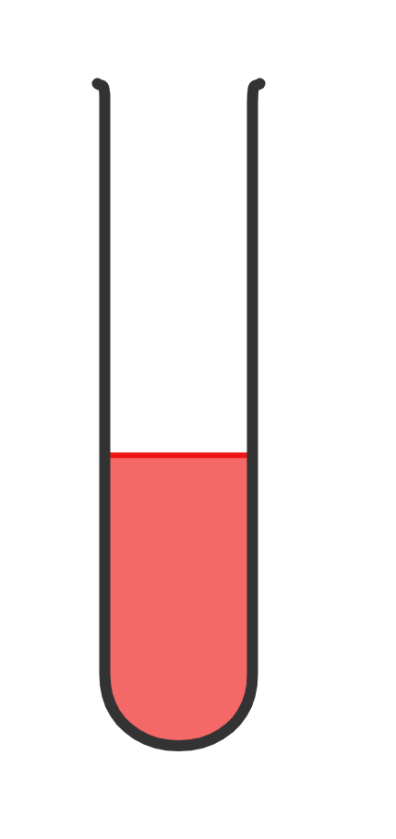

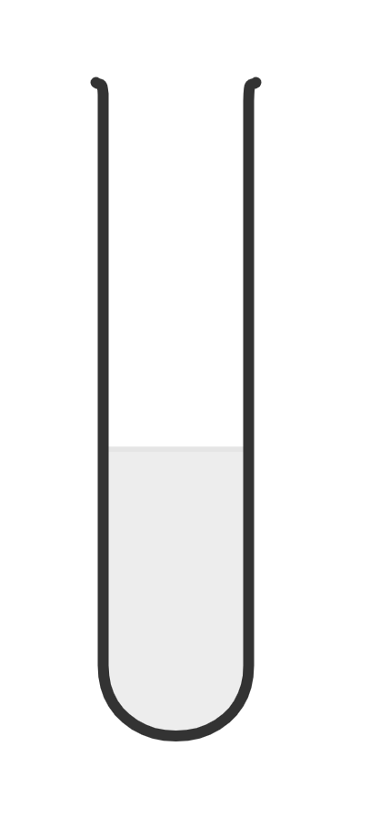
Baaritaanka burburka (decomposition) ee metal carbonate
Limewater waxaa lagu buunbuuniyay carbon dioxide waxaana isbeddelay midab aan lahayn ilaa …
guduud (red)
cagaar (green)
cad (white)

Slide 19
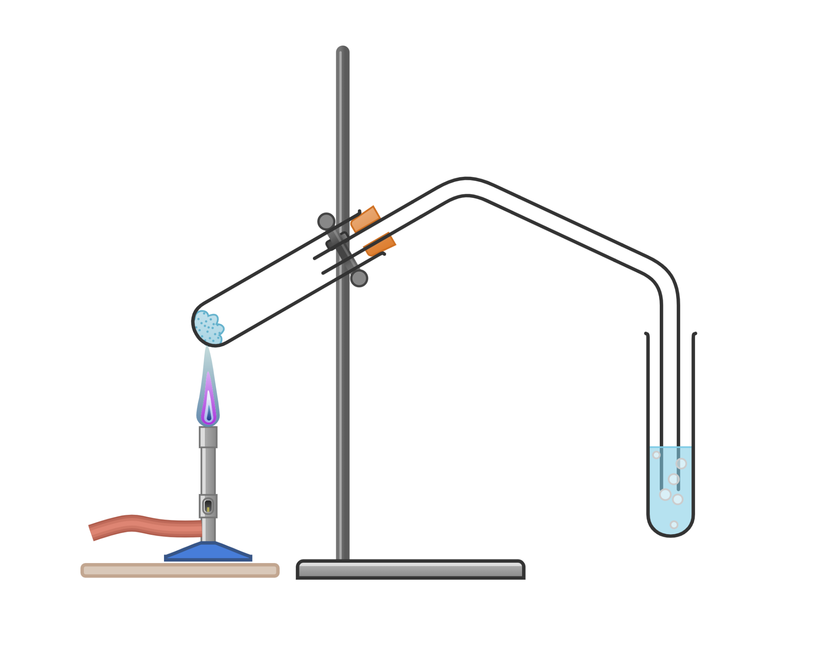
Baaritaanka burburka (decomposition) ee metal carbonate
Waxaad isticmaali kartaa qalabkan si aad u aragto sida sahlan ee metal carbonates ay u yimaadaan falgal (reaction) burbur (decomposition).
qabasho iyo taageere (clamp and stand)
tuubo karin (boiling tube)
dabool (bung)
metal carbonate
tuubo gaarsiin (delivery tube)
Bunsen burner
xumbooyin carbon dioxide
jiirar kulayl adag (heat resistant mat)
biyo (water) limewater

Slide 20
Baaritaanka burburka (decomposition) ee metal carbonate
Qaybtee qalabka ayaa gaarsiisa gaaska soo saaray ilaa biyo (water) limewater?
tuubo tijaabo (test tube)
dabool (bung)
tuubada gudbinta (delivery tube)
biyo nuurad (limewater)

Slide 21
Baarista burburka karboonaytka birta (metal carbonate decomposition)
Magacaw qalabka loo isticmaalo in lagu kululeeyo karboonaytka birta (metal carbonate).
qabteeye iyo taageere (clamp and stand)
dusimo celis kulka (heat resistant mat)
shidaha Bunsen (Bunsen burner)

Slide 22
Baarista burburka karboonaytka birta (metal carbonate decomposition)
Habka burburka karboonaytka birta (metal carbonates) tijaabo (experiment):
Tallaabada 1: Ku rid qaaddo weyn oo karboonayt bir ah (metal carbonate) tuubbo karin (boiling tube). Fiiri oo qor midabka karboonaytka birta (metal carbonate).
Tallaabada 4: Fiiri oo qor midabka biyaha nuurad (limewater) si loo garto haddii gaaska carbon dioxide (carbon dioxide gas) la sii daayo.
Tallaabada 5: Ku celi karboonaytka birta (metal carbonates) kale iyo biyo nuurad (limewater) cusub.
Tallaabada 2: Ku rid furinka (bung) oo leh tuubada gudbinta (delivery tube) tuubbada karin (boiling tube), hubi in dhamaadka kale ee tuubada gudbinta (delivery tube) uu ku jiro tuubbada tijaabada (test tube) hoosta heerka biyaha nuurad (limewater).
Tallaabada 3: Kululee karboonaytka birta (metal carbonate) si tartiib ah marka hore, ka dib si xoog leh. Fiiri oo qor isbeddelka midabka.

Slide 23
Baarista burburka karboonaytka birta (metal carbonate decomposition)
Kani waa miis natiijo (results table) aad isticmaali karto.
karboonayt bir (metal carbonate) | midabka kululeynta ka hor (colour before heating) | midabka kululeynta ka dib (colour after heating) | xumbo gaas la arkay (gas bubbles observed) | fudaydka burburka (ease of decomposition)
karboonayt naxaas (copper carbonate)
lead carbonate (lead carbonate)
zinc carbonate (zinc carbonate)
sodium carbonate (sodium carbonate)
potassium carbonate (potassium carbonate)

Slide 24
Baaritaanka burburka (decomposition) ee carbonate-ga birta
Natiijooyinkaagu waxay la mid noqon karaan kuwan:
carbonate-ga birta (metal carbonate) | midabka kulkaynta ka hor (colour before heating) | midabka kulkaynta ka dib (colour after heating) | xumbo gaas ah oo la arkay (gas bubbles observed) | sahlanaanta burburka (ease of decomposition)
copper carbonate (copper carbonate)
lead carbonate (lead carbonate)
zinc carbonate (zinc carbonate)
sodium carbonate (sodium carbonate)
potassium carbonate (potassium carbonate)
caddaan (white)
jaalle (yellow)
haa
2 - fudud
jaalle marka uu kulul yahay (yellow when hot)
caddaan markuu qabow yahay
caddaan (white)
haa
3 - fudud xoogaa
caddaan
caddaan
maya
falgal (reaction) ma jiro
Jawaabaha:
caddaan
caddaan
maya
falgal (reaction) ma jiro
cagaar (green)
madow (black)
haa
1 - aad u fudud

Slide 25
Baaritaanka karbonat (carbonate) birta (metal) oo burburaya (decomposition)
Qor gabagabo (conclusion) tijaabadaada (experiment). Waxaad isticmaali kartaa bilowgan weedha:
Karbonatka (carbonate) birta (metal) ugu yar xasillooni (stable) wuxuu ahaa __________, waxaan tan u ogaaday sababtoo ah waxaan arkay …
Karbonatka (carbonate) birta (metal) ugu xasillooni (stable) badnaa wuxuu ahaa __________, waxaan tan u ogaaday sababtoo ah waxaan arkay …

Slide 26
Baaritaanka karbonat (carbonate) birta (metal) oo burburaya (decomposition)
Qor gabagabo (conclusion) tijaabadaada (experiment). Waxaad isticmaali kartaa bilowgan weedha:
Karbonatka (carbonate) birta (metal) ugu yar xasillooni (stable) wuxuu ahaa , waxaan tan u ogaaday sababtoo ah waxaan arkay …
gaas carbon dioxide (carbon dioxide) si degdeg ah ayaa loo soo saaray
biyo lime (limewater) si degdeg ah ayuu midab u beddelay
copper carbonate (copper carbonate) si degdeg ah ayuu uga beddelay cagaar madow.
Kaarboonaytka (carbonate) birta (metal) ee ugu xasilloon wuxuu ahaa
sodium carbonate (sodium carbonate) / potassium carbonate (potassium carbonate)
gaas carbon dioxide (carbon dioxide) lama soo saarin
biyo lime (limewater) midabkiisa ma beddelin
midab beddelka kaarboonaytka (carbonate) lama arkay.
Jawaabaha:
copper carbonate (copper carbonate)
Waxaan tan uga ogahay inaan arkay …

Slide 27
Baaritaanka (Investigating) burburka kaarboonaytka birta (metal carbonate decomposition)
Qor isla'egta (equations) erayada ee falgalada (reactions) dhacay.
Qor isla'egta (equations) astaamaha ee falgalada (reactions) dhacay, ku dar xaaladaha (states) maadada. Isticmaal macluumaadka ku jira shaxda si ay kuu caawiso.
magaca isku darka (compound) | qaacidada isku darka (compound formula)
copper carbonate (copper carbonate) | CuCO3
copper oxide (copper oxide) | CuO
lead carbonate (lead carbonate) | PbCO3
lead oxide (lead oxide) | PbO
zinc carbonate (zinc carbonate) | ZnCO3
zinc oxide (zinc oxide) | ZnO

Slide 28
Baaritaanka kala-goynta (decomposition) karboonaytka (carbonate) birta
Qor isle'egyada ereyada ee falgalyada (reactions) dhacay.
Qor isle'egyada calaamadaha ee falgalyada (reactions) dhacay, ku dar xaaladaha walxaha (states of matter).
kuleyl (heat)
copper carbonate (s) → copper oxide (s) + carbon dioxide (g)
kuleyl (heat)
CuCO3 (s) → CuO(s) + CO2 (g)
kuleyl (heat)
lead carbonate (s) → lead oxide (s) + carbon dioxide (g)
kuleyl (heat)
PbCO3 (s) → PbO(s) + CO2 (g)
kuleyl (heat)
zinc carbonate (s) → zinc oxide (s) + carbon dioxide (g)
kuleyl (heat)
ZnCO3 (s) → ZnO(s) + CO2 (g)

Slide 29
Falgal kiimiko (chemical reactions): burbur (decomposition)
Falgalyada kala-goynta (Decomposition reactions) waxay ku lug leeyihiin hal xarun oo kala goysa laba ama in ka badan oo alaab ah (products).
Falgalyada kala-goynta (Decomposition reactions) waxay inta badan u baahan yihiin kuleyl (heat), iftiin (light), ama koronto (electricity), si ay u dhacaan.
Marka ay birta kaarboonaytyadu (metal carbonates) ku burburaan (decompose) kuleylka, waxay caadi ahaan sameeyaan bir-oksaydh (metal oxide) iyo gaas kaarboon laba-oksaydh (carbon dioxide).

