Slide 1
Falgal kiimiko: dhexdhexaadin (neutralisation)
Aashito iyo sal (bases)

Slide 2
Sida ilaha waxbaridda loogu talagalay fasalka

Slide 3
Waxaan qeexi karaa waxa dhaca inta lagu jiro falgal dhexdhexaadin (neutralisation reaction) waxaana qori karaa isla'egyo erayo iyo calaamad ah oo matalaya falgal dhexdhexaadin oo kala duwan.

Slide 4
dhexdhexaadin (neutralisation)
Marka falgal kiimiko (chemical reaction) u dhaxeeyo aashito iyo sal (base) si loo soo saaro milan dhexdhexaad (neutral solution) (pH 7) oo ah cusbo bir ah (metal salt) iyo biyo (water).
cusbo bir (metal salt)
Xarun (compound) la sameeyo marka aashito la falgasho sal (base).
milan aqueous (aqueous solution) (aq)
Waxa la sameeyaa marka walax lagu milo biyo (water).

Slide 5

Falgal kiimiko: dhexdhexaadin (neutralisation)
Dhexdhexaadin (Neutralisation)
Isla'egyada dhexdhexaadinta (Neutralisation equations)

Slide 6
Dhexdhexaadin (Neutralisation)
pH-ga milan (solution) waa la kordhin karaa ama yarayn karaa marka lagu daro aashito ama sal/alkali. Waxaa lagu arki karaa iyadoo lagu daro indicator.
pH decreased by adding an acid
pH increased by adding a base/alkali
guduud (red)
oranji (orange)
jaalle (yellow)
cagaar (green)
buluug (blue)
guduudan (purple)
aashito (acidic)
neutral
alkaline
1
2
3
4
5
6
7
8
9
10
11
12
13
14
pH dhexdhexaad ah adoo ku daraya xaddi saxan oo asiidh iyo sal/alkali

Slide 7

Neutralisation
When acids and bases/alkalis are mixed in the correct quantities a neutral solution is made.
Acids and bases/alkalis in correct quantities will react to form a neutral pH 7 solution.
Acids and bases/alkalis in correct quantities will react to form a neutral pH 1 solution.

Slide 8
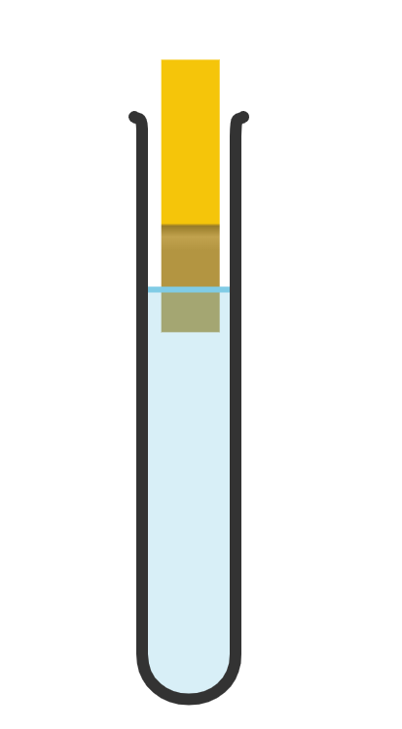
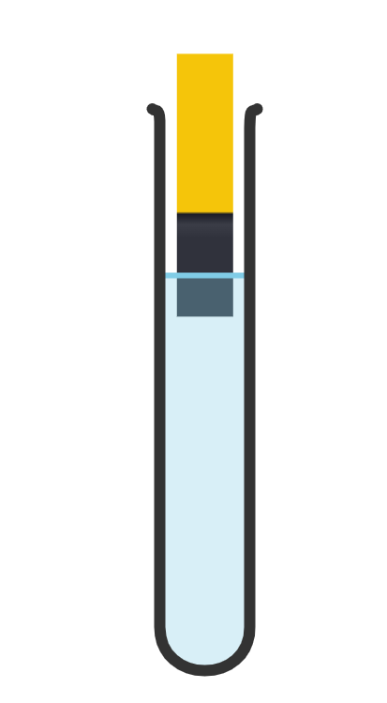
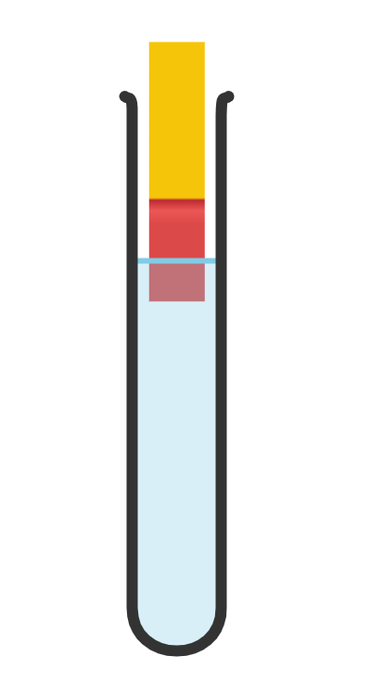
Neutralisation
Which test tube contains a neutral solution?
green
blue
red

Slide 9
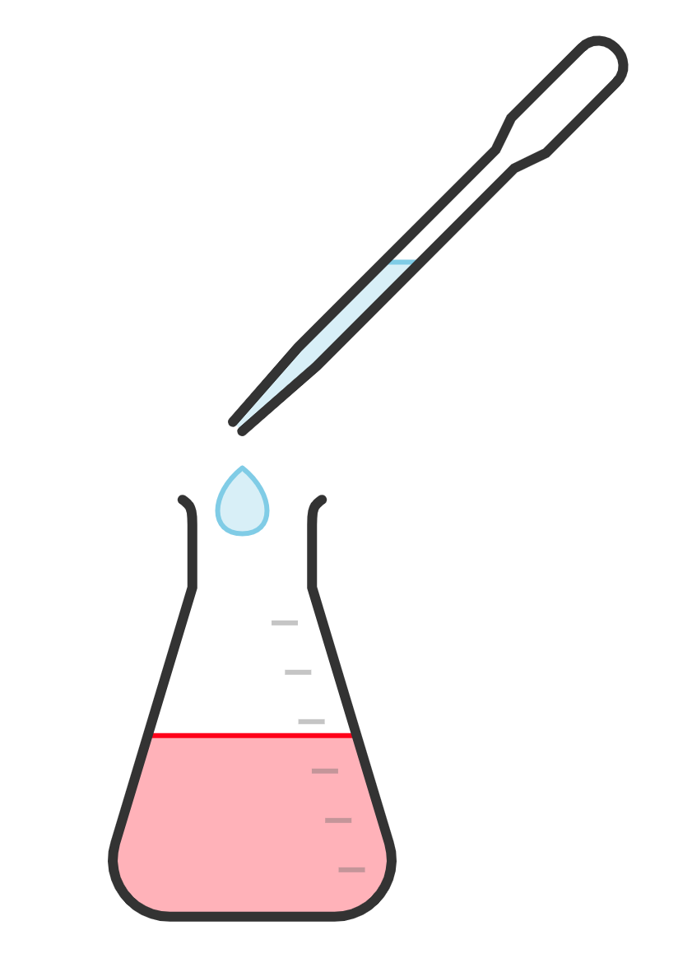

Neutralisation
Si loo dhexdhexaadiyo asiidh, alkali waa la dari karaa.
alkali (alkali)
milan (solution) dhexdhexaad (neutral)
pH-ga milanka (solution) ayaa kordhay.
aashito (acid) oo lagu daray universal indicator
dhexdhexaadin (neutralisation)
guduud (red)
cagaar (green)
red
orange
yellow
green
blue
purple
aashito (acidic)
dhexdhexaad (neutral)
alkali (alkaline)
1
2
3
4
5
6
7
8
9
10
11
12
13
14

Slide 10
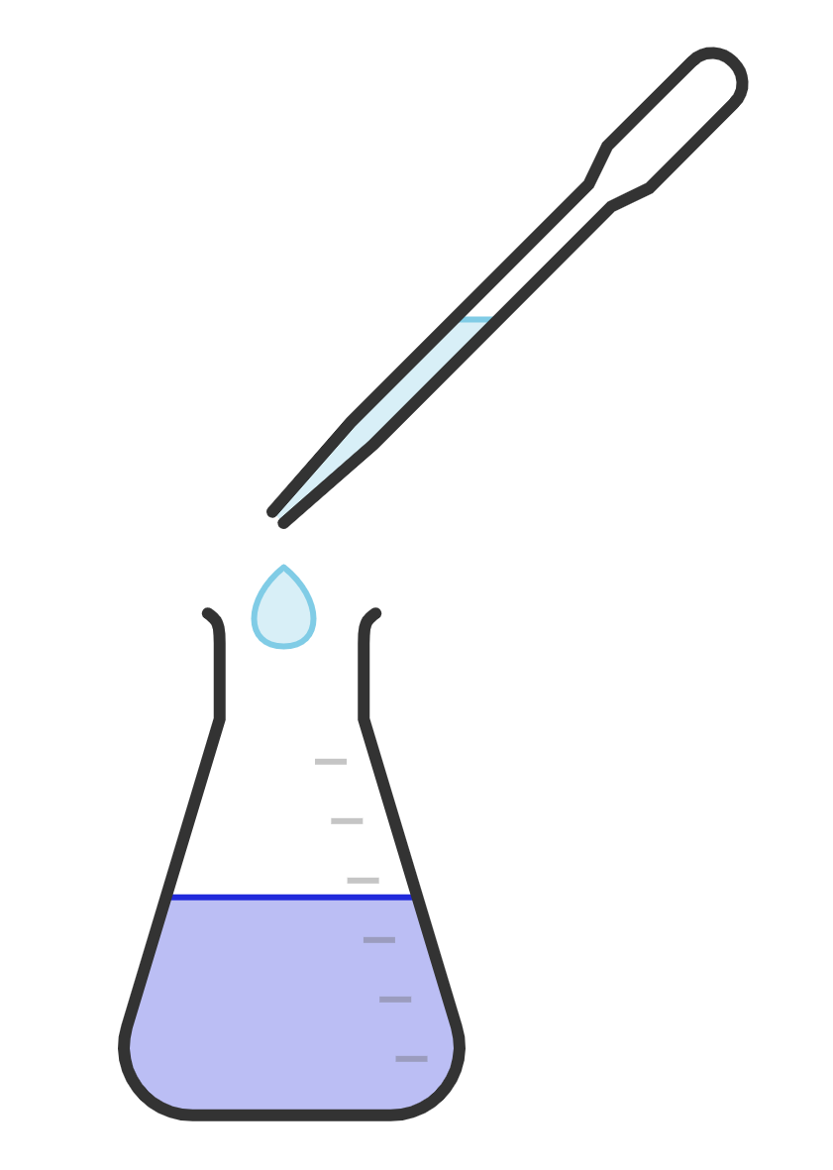
Dhexdhexaadin (Neutralisation)
Si loo dhexdhexaadiyo alkali (alkali) waxaa lagu dari karaa aashito (acid).
aashito (acid)
milan dhex-dhexaad (neutral solution)
alkali (alkali) oo lagu daray universal indicator (universal indicator)
dhex-dhexaadin (neutralisation)
pH-ga milanka (solution) ayaa hoos u dhacay.
buluug (blue)
cagaar (green)
guduud (red)
oranji (orange)
jaalle (yellow)
cagaar (green)
buluug (blue)
guduudan (purple)
aashito (acidic)
dhexdhexaad (neutral)
alkali (alkaline)
1
2
3
4
5
6
7
8
9
10
11
12
13
14

Slide 11

Dhex-dhexaadin (Neutralisation)
Maxaa loo baahan yahay in lagu daro milankan si loo dhex-dhexaadiyo (neutralise)?
aashito (acid)
alkali (alkali)
orani (orange)
milan dhex-dhexaad (neutral solution)

Slide 12

Dhex-dhexaadin (Neutralisation)
Maxaa ku dhici doona pH-ga milankan marka la dhex-dhexaadiyo (neutralised)?
kordhinta pH 7
hoos u dhaca pH 7
guduud-madow (purple)
kordhinta pH 12

Slide 13
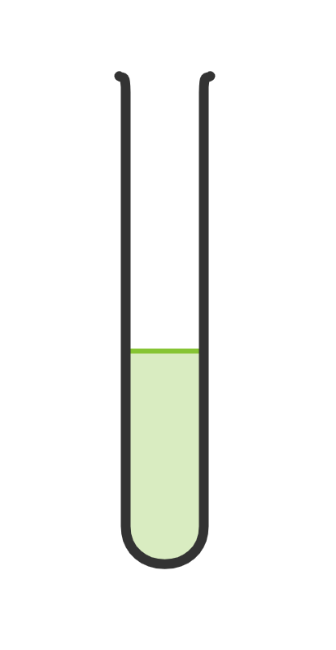
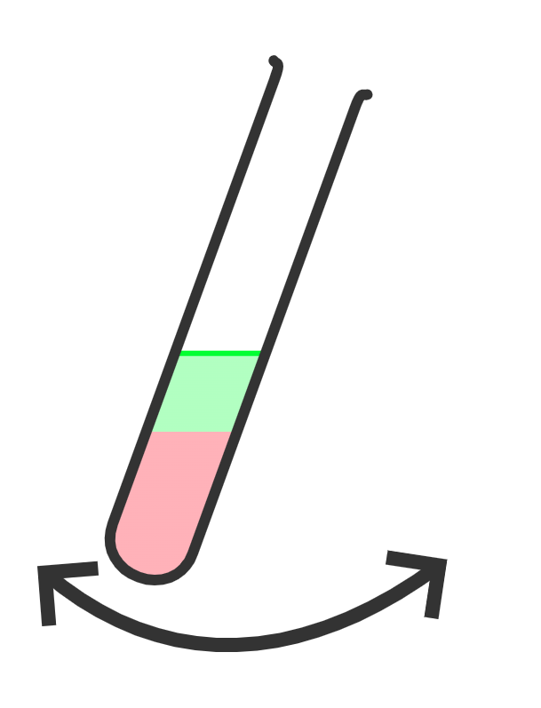
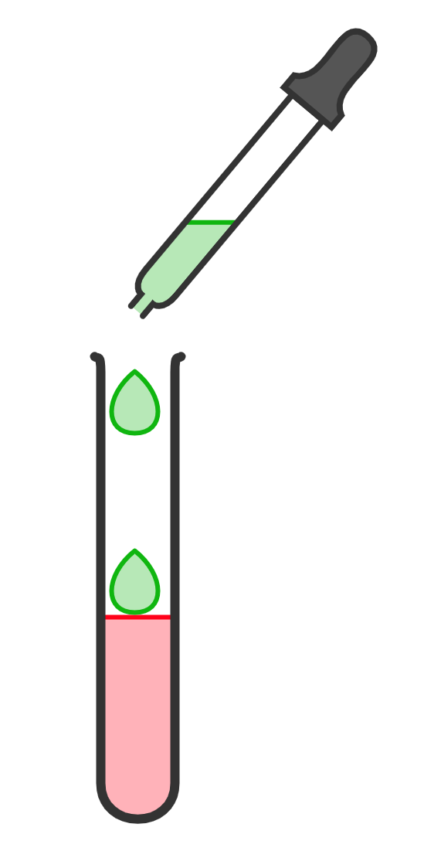
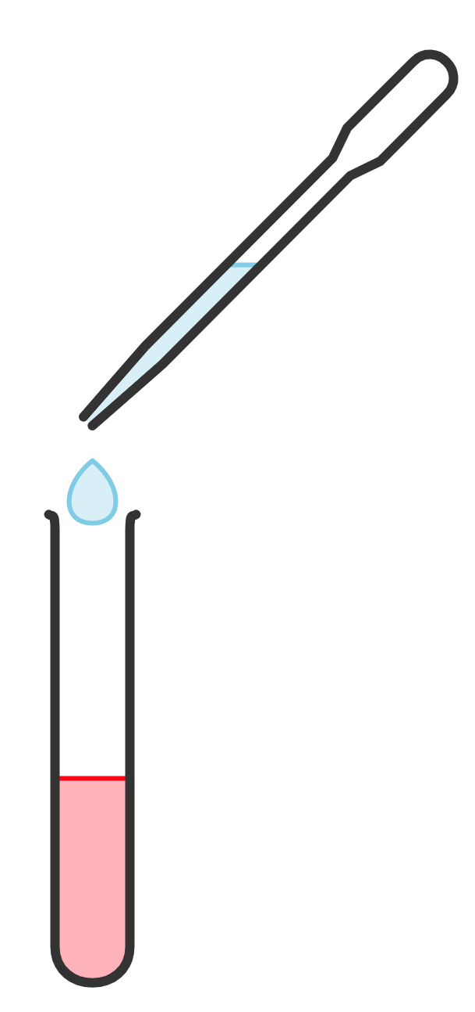
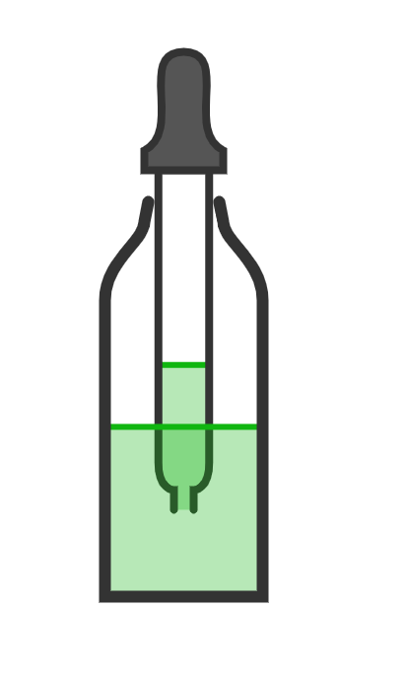
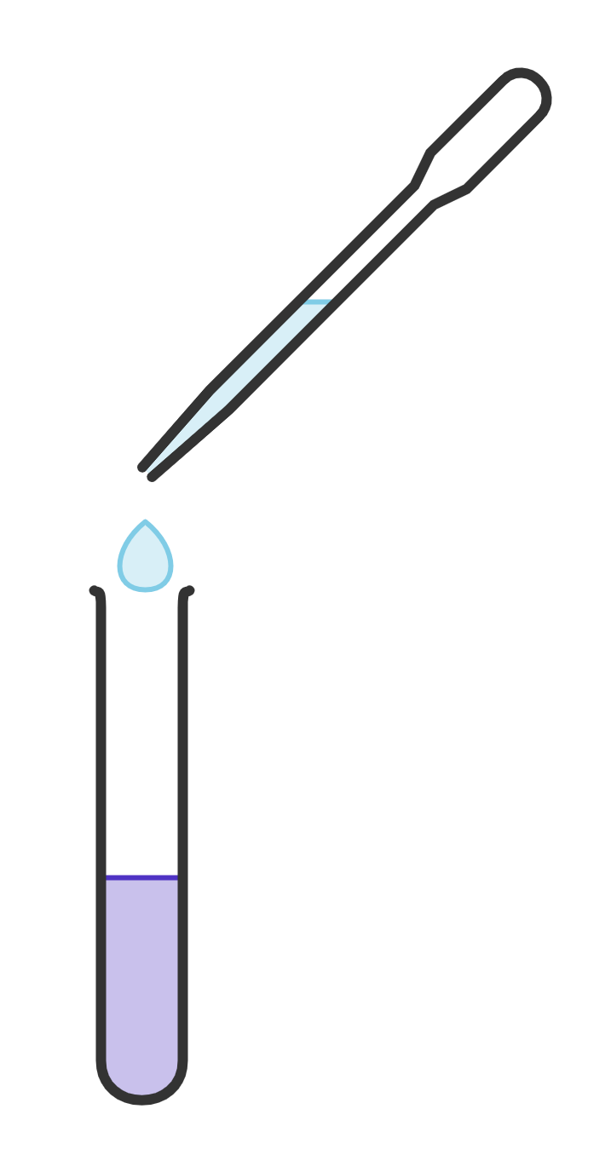
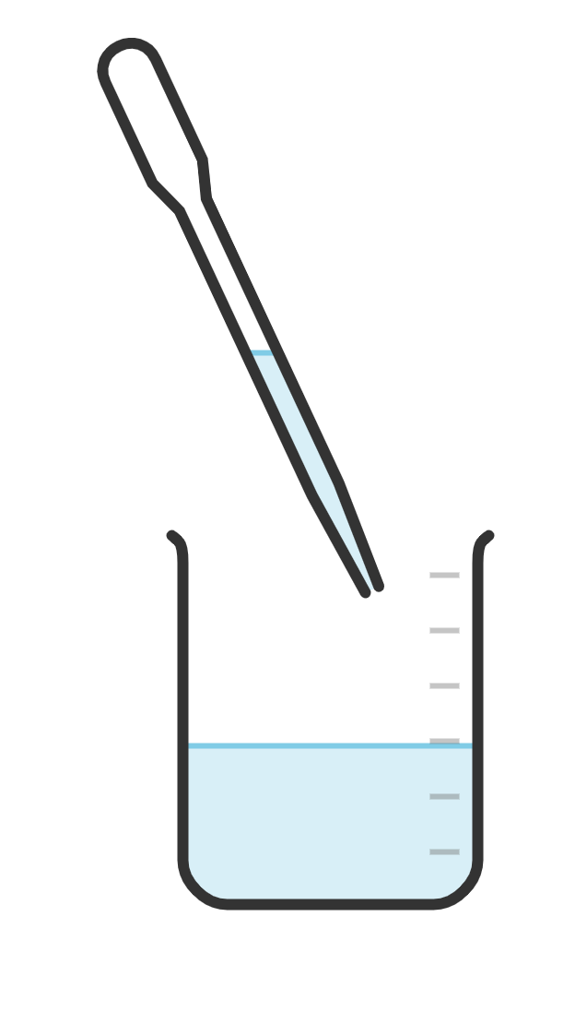
Dhex-dhexaadin (Neutralisation)
1) Waxaa la siin doonaa aashito (acid) waxaadna isticmaali doontaa alkali (alkali) si aad u dhex-dhexaadiso (neutralise).
milan universal indicator (universal indicator solution)
Tallaabada 2: ku dar 1 dhibic oo alkali ah acid-ka.
Fiiro: ku dar dhibco acid ah haddii milan (solution)-kaagu noqdo alkaline.
alkali
Tallaabada 4: ku celi tallaabooyinka 2 iyo 3 ilaa aad gaadho pH 7, oo ah milan (solution) cagaaran oo dhexdhexaad ah.
aashito (acid)
Tallaabada 3: isku qas milan (solution) adigoo ruxaya test tube-ka dhinac ilaa dhinac.
acid
Tallaabada 1: ku dar 2-3 dhibco oo ah universal indicator solution (milan (solution) indhaha) ee acid-ka.
alkali

Slide 14
Dhexdhexaadin (Neutralisation)
Hambalyo haddii aad gaadhsiiyay milan (solution) cagaaran oo dhexdhexaad ah; waxaad samaysay milan (solution) cusbo (salt) milmi kara iyo biyo (water).

Slide 15
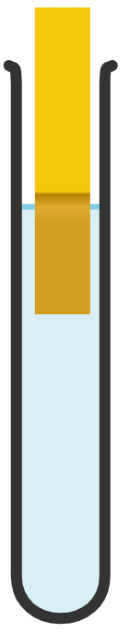

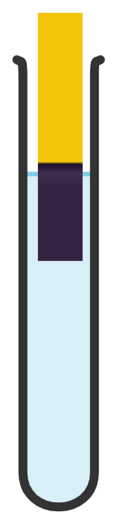

Dhexdhexaadin (Neutralisation)
Maxaad ku dari lahayd milan (solution)-ka si aad u dhexdhexaaddo? Dooro acid ama alkali.
a)
Milan (solution) casaan ah marka universal indicator lagu daro.
universal indicator paper
blue litmus paper
f)
c)
d)
e)
casaan
jaalle
casaan
guduud
g)
b)
Milan (solution) ka beddela universal indicator paper buluug.
Milan (solution) kaas oo red litmus paper u beddela buluug marka lagu daro.

Slide 16
Dhexdhexaadin (Neutralisation)
Maxaad ku dari lahayd milan (solution)-ka si aad u dhexdhexaaddo? Dooro acid ama alkali.
a)
Milan (solution) midabkiisu guduud (red) yahay marka tilmaame guud (universal indicator) lagu daro.
warqad tilmaame guud (universal indicator paper)
warqad litmus buluug (blue litmus paper)
f)
c)
d)
e)
guduud (red)
alkali (alkali)
alkali (alkali)
jaalle (yellow)
guduud (red)
guduud-madow (purple)
g)
ashito (acid)
b)
Milan (solution) ka beddela warqadda tilmaame guud (universal indicator paper) buluug (blue).
Milan (solution) kaas oo warqad litmus guduud (red litmus paper) u beddesha buluug (blue) marka lagu daro.
alkali (alkali)
alkali (alkali)
ashito (acid)
ashito (acid)

Slide 17
Falgal kiimiko: dhexdhexaadin (Chemical reactions: neutralisation)
Dhexdhexaadin (Neutralisation)
Isle'egyada dhexdhexaadinta (Neutralisation equations)

Slide 18
Isle'egyada dhexdhexaadinta (Neutralisation equations)
Isle'egyada kiimikada waxaad ku kartaa:
aqoonso xaaladda walax kasta
isticmaal markaad qorayso isla'eg eray ama calaamad
Xaaladaha walabku waa:
adag (s)
dareere (l)
gaas (g)
milan (aq)

Slide 19
Isla'egyada dhexdhexaadinta (Neutralisation)
Sida loo qoro xaaladaha walabka:
Waa inay:
loo qoro xarfo yaryar
loo qoro hoos (subscript)
ku dar qaws (brackets)
tusaale: sodium hydroxide adag (NaOH) waxaa loo qori doonaa
sodium hydroxide (s)
NaOH (s)
tusaale: carbon dioxide gaas waxaa loo qori doonaa
carbon dioxide(g)
CO2 (g)
tusaale: sodium hydroxide (NaOH) milan (solution) waxaa loo qori doonaa
sodium hydroxide (aq)
NaOH (aq)

Slide 20
Isla'egta neutralisation
Waa sidee habka saxda ah ee loo isticmaalo astaanta gobolka ee milan (solution) copper sulfate? Dooro jawaabta saxda ah.
copper sulfate (AQ)
copper sulfate (aq)
copper sulfate (aq)
copper sulfate aq

Slide 21
Isla'egta neutralisation
Habka saxda ah ee loo qoro astaanta gobolka ee sodium chloride adag (NaCl) waa NaCl (aq).
Astaanta gobolka ee adag waa (s), waa inay noqotaa xarfo yaryar, gudaha qawska, iyo subscript.
Astaanta gobolka ee adag waa (S), waa inay noqotaa xarfo waaweyn, gudaha qawska, iyo superscript.

Slide 22
Isla'egta neutralisation
Marka ay dhacdo falgal (reaction) neutralisation, isla'egta guud waa:
acid + base → metal salt + biyo (water)
Tusaale: neutralisation ee hydrochloric acid iyo sodium hydroxide milan (solution) waa:
hydrochloric acid + sodium hydroxide → sodium chloride + biyo (water)
Jawaabaha:
_{(aq)}
_{(aq)}
_{(aq)}
_{(l)}
HCl
NaOH
→ NaCl
H₂O
_{(aq)}
_{(aq)}
_{(aq)}
_{(l)}

Slide 23
Isla'egyada neutralisation
Waa maxay isla'egta guud ee falgalka (reaction) u dhexeeya asiidh iyo sal (base) si loo soo saaro cusbo (salt) macdan ah iyo biyo (water)?
asiidh + sal (base) → milan (solution) + biyo (water)
asiidh + sal (base) → cusbo (salt) macdan + hydrogen
asiidh + sal (base) → cusbo (salt) macdan + biyo (water)

Slide 24
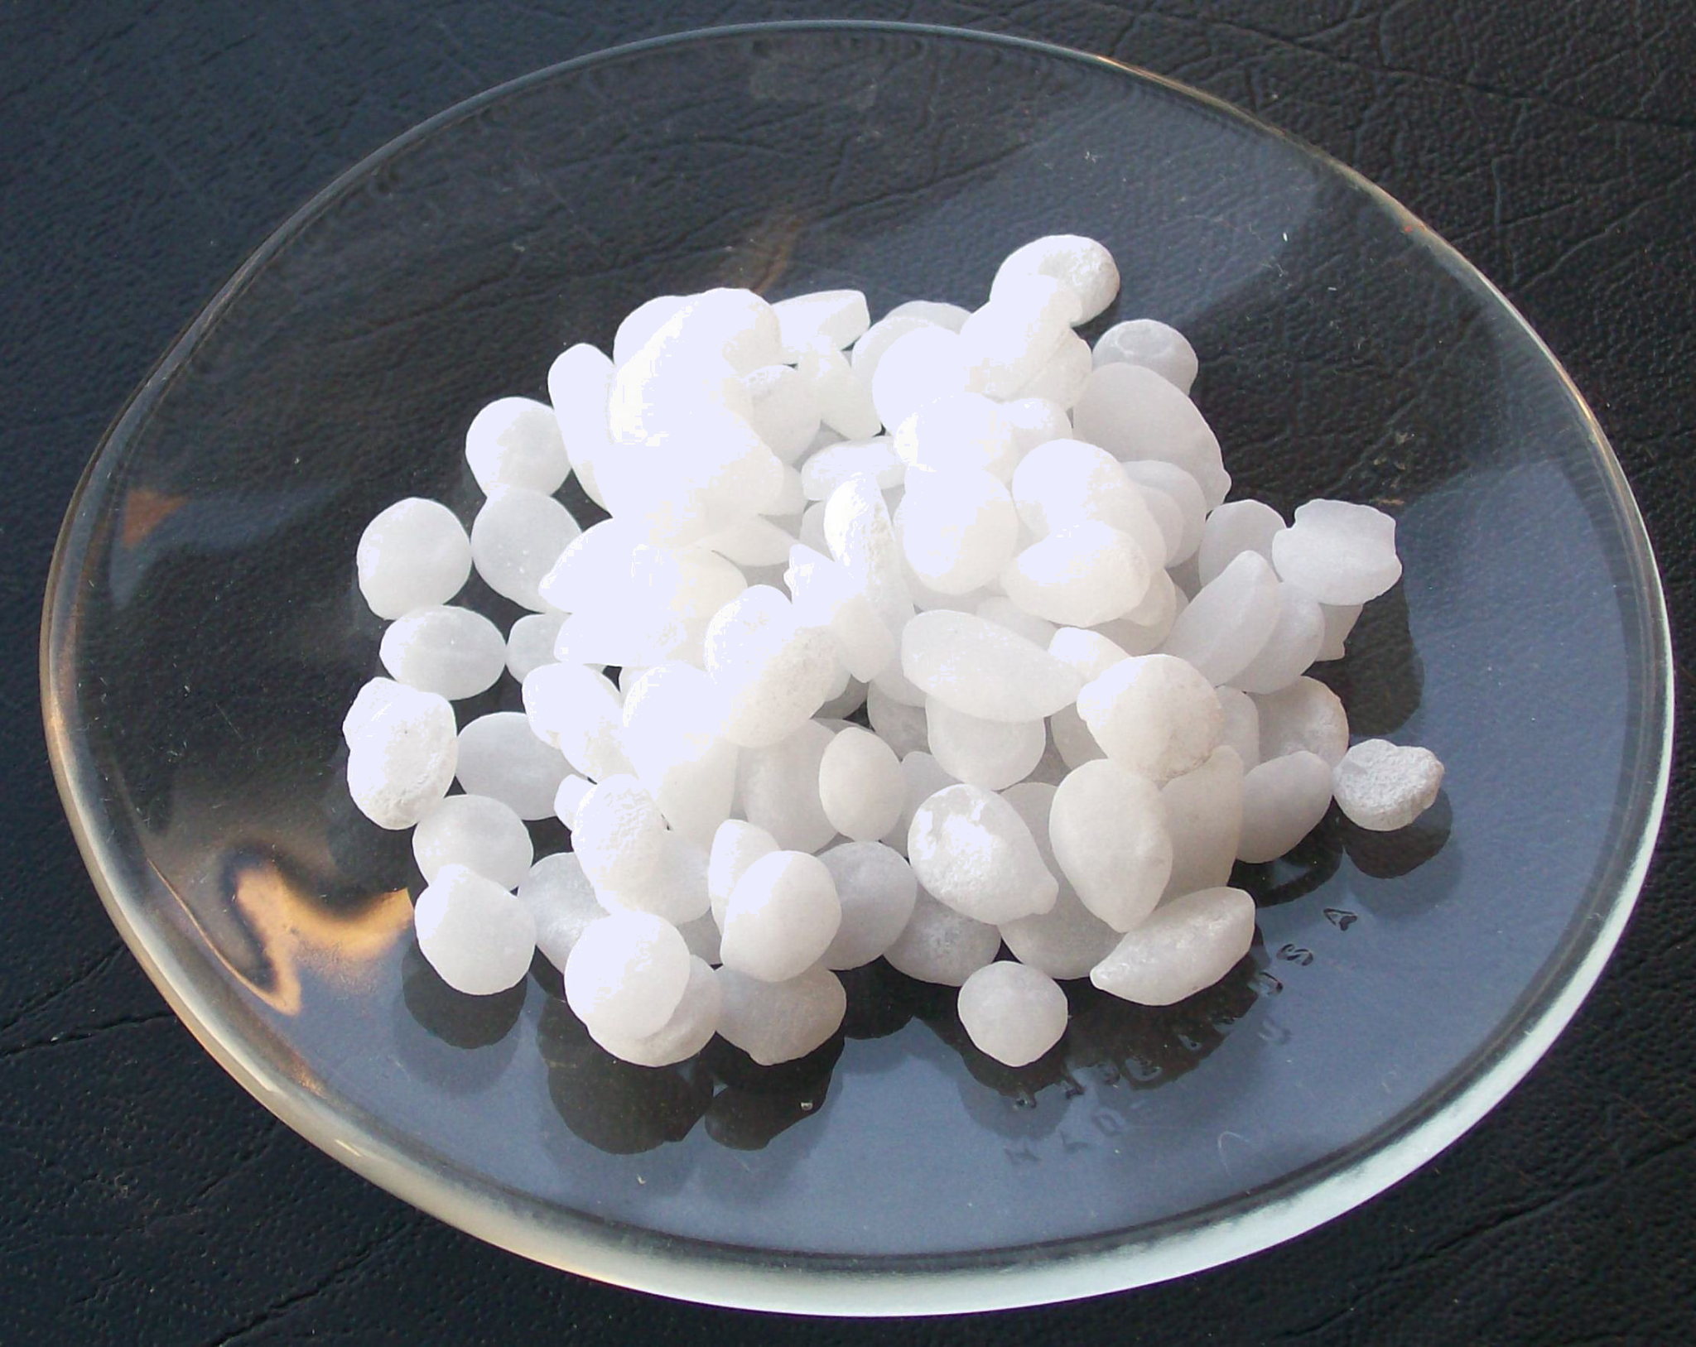
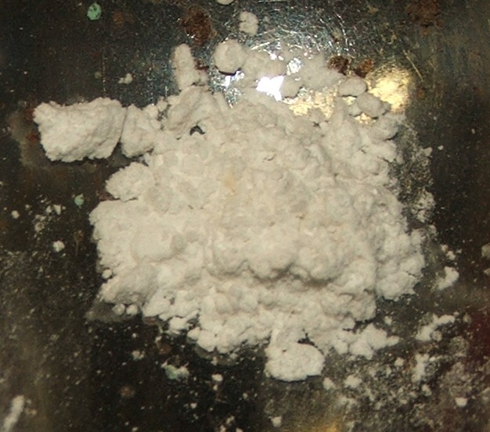
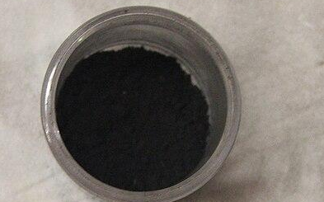
Isla'egyada neutralisation
Oxides iyo hydroxides macdan ee caadiga ah waa sal (base).
Sodium hydroxide, calcium oxide iyo copper oxide waa sal (base) caadi ah oo neutralise gareyn doona asiidh.
sodium hydroxide
calcium oxide
copper oxide

Slide 25
Isla'egyada neutralisation
Waa maxay walax noqon karta sal (base)?
carbon dioxide
magnesium oxide
copper sulphate

Slide 26
Isla'egyada neutralisation
Falgal (reaction) neutralisation, cusbada (salt) la sameeyay waxaa loo magacaabaa macdanta (sal-ka) iyo asiidhka la isticmaalay.
magaca asiidhka | magaca dhammaadka cusbada (salt) macdanta
hydrochloric | chloride
sulfuric | sulfate
nitric | nitrate
hydrochloric acid + sodium hydroxide → sodium chloride + water

Slide 27
Neutralisation equations
Waa kee cusbada birta ee laga samayn karo falgalka dhexdhexaadinta ee magnesium oxide iyo sulfuric acid?
magnesium sulfuric
iron sulfate
magnesium nitrate
magnesium sulfate

Slide 28
Neutralisation equations
Sida loo qoro astaamaha xaaladda ee isla'egta erayada falgalka dhexdhexaadinta.
cusbo bir (metal salt)
+ water
acid (acid)
base (base)
→
_{(aq)}
_{(aq)}
_{(aq)}
_{(l)}
always a solution in the school laboratory
wuxuu noqon karaa adag ama milan - macluumaad dheeri ah ayaa loo baahan yahay
wuxuu noqon karaa adag ama milan - macluumaad dheeri ah ayaa loo baahan yahay
always a liquid at room temperature

Slide 29
Isla'egta neutralisation (Neutralisation equations)
Dhamaystir jumlada. Acids-ka loo isticmaalo shaybaarka dugsiga waa…
had iyo jeer ku jira milan (solution) oo leh astaanta gobolka (aq).
had iyo jeer ku jira milan (solution) oo leh astaanta gobolka (l).
had iyo jeer waa dareere oo leh astaanta gobolka (l).
had iyo jeer waa adke oo leh astaanta gobolka (s).

Slide 30
Isla'egta neutralisation (Neutralisation equations)
Falgal neutralisation (reaction), cusbada birta (metal salt) ee la sameeyo waxaa loo magacaabaa birta (laga soo qaaday base) iyo acid-ka la isticmaalay.
magaca acid-ka | qaacidada kiimikada ee acid-ka | dhammaadka magaca cusbada birta (metal salt) | qaacidada kiimikada ee dhammaadka cusbada birta (metal salt)
hydrochloric | HCl | kloraydh (chloride) | Cl
sulfurik (sulfuric) | H2SO4 | sulfate (sulfate) | SO4
nitrik (nitric) | HNO3 | nitrate (nitrate) | NO3
hydrochloric acid + sodium hydroxide → sodium chloride + biyo (water)
HCl
+
NaOH
→
NaCl
+
H₂O

Slide 31
Isleegyada dhexdhexaadinta (Neutralisation equations)
Waa maxay qaacidada (formula) cusbada (salt) birta laga sameeyay falgalka (reaction) dhexdhexaadinta (neutralisation) ee u dhexeeya zinc oxide (ZnO) iyo sulfuric acid (H2SO4)?
MgSO4
ZnSO4
ZnNO3

Slide 32
Isleegyada dhexdhexaadinta (Neutralisation equations)
Qor calaamadaha xaaladda (state symbols) ee isleegga calaamadda (symbol equation) lagu sharraxay erayo: Falgalka dhexdhexaadinta (neutralisation reaction) wuxuu ka dhex dhacaa sulfuric acid iyo potassium hydroxide milan (solution), oo soo saara potassium sulfate milmi kara (soluble) iyo biyo (water).
_{(aq)}
_{(aq)}
_{(aq)}
_{(l)}
H2SO4 + 2KOH → K2SO4 +2H2O
Qor calaamadaha xaaladda (state symbols) ee isleegga calaamadda (symbol equation) lagu sharraxay erayo: Falgalka dhexdhexaadinta (neutralisation reaction) wuxuu ka dhex dhacaa hydrochloric acid iyo silver hydroxide milan (solution), oo soo saara silver chloride aan milmin (insoluble) iyo biyo (water).
HCl + AgOH → AgCl + H2O
_{(aq)}
_{(aq)}
_{(s)}
_{(l)}

Slide 33
Isla'egyada neutralisation (Neutralisation equations)
Waa kee qaacidada (formula) cusbada (salt) birta laga sameeyay potassium hydroxide (KOH) iyo nitric acid (HNO3)?
Jawaabaha:
MgCl
PNO3
KNO3

Slide 34
Isla'egyada neutralisation (Neutralisation equations)
Sumadda (state symbol) biyaha (water) heerkulka qolka waa…
H₂O_{(s)}
H₂O_{(g)}
H₂O_{(l)}
H2O(aq)

Slide 35
Isla'egyada neutralisation (Neutralisation equations)
Isku dhig walaxda (substance) iyo xaaladda (state) si sax ah loogu muujiyey.
state (xaalad)
tusaale
CuO(s)
CaCO3 (s)
LiCl2(s)
aqueous (milan)
Hg(L)
HCl(aq)
KOH(AQ)
gas (gaas)
liquid (dareere)
H_{2(g)}
Ar g
He(g)
solid (adag)
H2SO4 (aq)
NaOH (Aq)
H₂O_{(l)}

Slide 36
Isla'egta dhexdhexaadinta (Neutralisation equations)
Isku xidh xaaladda (state) iyo walaxda si sax ah oo ku matalaysa xaaladdaas.
xaalad (state)
tusaale
CuO(s)
CaCO3 (s)
LiCl2(s)
aqueous (biyo-milan)
Hg(L)
HCl(aq)
KOH(AQ)
gaas (gas)
dareere (liquid)
H_{2(g)}
Ar g
He(g)
adag (solid)
H2SO4 (aq)
NaOH (Aq)
H₂O_{(l)}

Slide 37









Isla'egta dhexdhexaadinta (Neutralisation equations)
Saxi qodobadan.
Falgal (reaction) (gubasho / dhexdhexaadin) ah, cusbada (salt) la sameeyo waxaa loogu magac daraa birta ku jirta saldhigga iyo asiidhka la isticmaalay.
Marka la isticmaalo asiidhka hydrochloric, cusbada (salt) birta ah ee la sameeyo waxaa loo yaqaan sulfate birta.
Yacquub
Zinc oxide waxay la falgashaa asiidhka nitric si ay u samayso cusbo (salt) loo yaqaan magnesium nitrate.
Caasha
Cabdi

Slide 38
Isla'egta dhexdhexaadinta (Neutralisation equations)
2)
Falgal (reaction) dhexdhexaadin ah, cusbada (salt) la sameeyo waxaa loogu magac daraa birta ku jirta saldhigga iyo asiidhka la isticmaalay.
Marka la isticmaalo asiidhka hydrochloric, cusbada (salt) birta ah ee la sameeyo waxaa loo yaqaan chloride birta. Sidoo kale la aqbali karo: Marka la isticmaalo asiidhka sulfuric, cusbada (salt) birta ah ee la sameeyo waxaa loo yaqaan sulfate birta.
Caasha
Yacquub
Zinc oxide waxay la falgashaa asiidhka nitric si ay u samayso cusbo (salt) loo yaqaan zinc nitrate.
Sidoo kale la aqbali karo: magnesium oxide waxay la falgashaa asiidhka nitric si ay u samayso cusbo (salt) loo yaqaan magnesium nitrate.
Cabdi

Slide 39
Isla'egta dhexdhexaadinta (Neutralisation equations)
Magacaw cusbada (salt) birta ah ee la sameeyo marka hydroxide birta iyo oxide birta ay la falgalaan asiidhka.
magaca asiidhka | name of metal salt ending
hydrochloric | chloride
sulfuric | sulfate
nitric | nitrate
magnesium oxide and nitric acid
potassium hydroxide and sulfuric acid
zinc oxide and hydrochloric acid
lead hydroxide and hydrochloric acid
lithium hydroxide and sulfuric acid

Slide 40
Neutralisation equations
Magacaw cusbada birta ee la sameeyo marka hydroxide-yada birta iyo oxide-yada birta ay la falgalaan asiidhyada.
name of acid | name of metal salt ending
hydrochloric | klorayd (chloride)
salfuurik (sulfuric) | salfayt (sulfate)
nitrik (nitric) | nitrayt (nitrate)
magnesium oxide and nitric acid
potassium hydroxide and sulfuric acid
zinc oxide and hydrochloric acid
lead hydroxide and hydrochloric acid
lithium hydroxide and sulfuric acid
magnesium nitrate
potassium sulfate
zinc chloride
lead chloride
lithium sulfate

Slide 41
Isla'egyada dhexdhexaadinta (Neutralisation equations)
Dhammeysti isla'egyada oo ku dar calaamadaha xaaladda (state symbols) ee maqan iyadoo la isticmaalayo astaamaha kiimikada saxda ah. Isticmaal macluumaadka ku jira jaantusyada si ay kuu caawiyaan.
HCl(aq) + KOH(s) → KCl(aq) + __________
2__________ + Ca(OH)2(aq) → CaCl2(aq) + 2H2O(l)
__________ + ZnO(s) → ZnSO4(aq)+ __________
2HCl(aq) + __________O(aq) → CaCl2(aq) + __________
__________ + Zn(OH)2(s)→ ZnSO4(aq) + 2__________
2__________ + __________O(s) → Zn(NO3)2(aq) + H2O(l)

Slide 42
Neutralisation equations
Dhammeysti isla'egyada adoo isticmaalaya astaamaha kiimikada saxda ah.
HCl_{(aq)} + KOH_{(s)} → KCl_{(aq)} + H₂O_{(l)}
HCl(aq) + KOH(s) → KCl(aq) + _________
2HCl_{(aq)} + Ca(OH)_{2(aq)} → CaCl_{2(aq)} + 2H₂O_{(l)}
2__________ + Ca(OH)_{2(aq)} → CaCl_{2(aq)} + 2H₂O_{(l)}
H₂SO_{4 (aq)} + ZnO_{(s)} → ZnSO_{4(aq)}+ H₂O_{(l)}
__________ + ZnO_{(s)} → ZnSO_{4(aq)}+ __________
2HCl_{(aq)} + CaO_{(aq)} → CaCl_{2(aq)} + H₂O_{(l)}
2HCl_{(aq)} + __________O_{(aq)} → CaCl_{2(aq)} + __________
H₂SO_{4 (aq)} + Zn(OH)_{2(s)}→ ZnSO_{4(aq)} + 2H₂O_{(l)}
__________ + Zn(OH)2(s)→ ZnSO4(aq) + 2__________
2HNO3 (aq) + ZnO(s) → Zn(NO3)2(aq) + H2O(l)
2__________ + __________O(s) → Zn(NO3)2(aq) + H2O(l)

Slide 43
Chemical reactions: neutralisation
In chemical equations (s), (l), (g) and (aq) identify the state of each substance as solid, liquid, gas or in solution.
Neutralisation reaction general equation is:
base + acid → metal salt + water
Sodium hydroxide wuxuu leeyahay formula NaOH(aq) iyo hydrochloric acid wuxuu leeyahay formula HCl(aq)
In a neutralisation reaction, the salt formed is named after the metal (from the base) and acid used.
Salalka caadiga ah waxaa ka mid ah oxide-yada birta iyo hydroxide-yada tusaale ahaan CuO iyo KOH.

