Slide 1
Falgal (reaction) kiimiko: oksaydhays (oxidation)
Fahanka falgal (reaction) kiimiko

Slide 2
Sida agabkeena waxbarista loogu talagalay fasalka

Slide 3
Waxaan qiyaasi karaa falgal (reaction) oksaydhays (oxidation), oo ay ku jiraan gubasho iyo miridhku, waxaana magacaabaa waxsoosaarka qaar ka mid ah falgal (reaction) oksaydhays (oxidation).

Slide 4
oksaydhays (oxidation)
oksaydh (oxide)
miridh (rusting)
daxaleys (corrosion)

Slide 5
Oksaydhays (oxidation) waa nooc ka mid ah falgal (reaction) kaas oo oksijiin (oxygen) ku xidhma curiyeyaasha fal-celiyeyaasha.
Oksaydh (oxide) waa iskudhis ka kooban oksijiin (oxygen) kaas oo la sameeyo inta lagu jiro falgal (reaction) oksaydhays (oxidation).
Miridh (rusting) waxaa loola jeedaa daxaleys (corrosion) birta ama birta (steel), marka ay joogaan biyo (water) iyo oksijiin (oxygen).
Daxaleys (corrosion) waa marka bir yaraato cabbirkiisa sababtoo ah falgal (reaction) kiimiko.

Slide 6

Falgal (reaction) kiimiko: oksaydhays (oxidation)
Oksaydhays (oxidation)
Miridh (rusting)

Slide 7
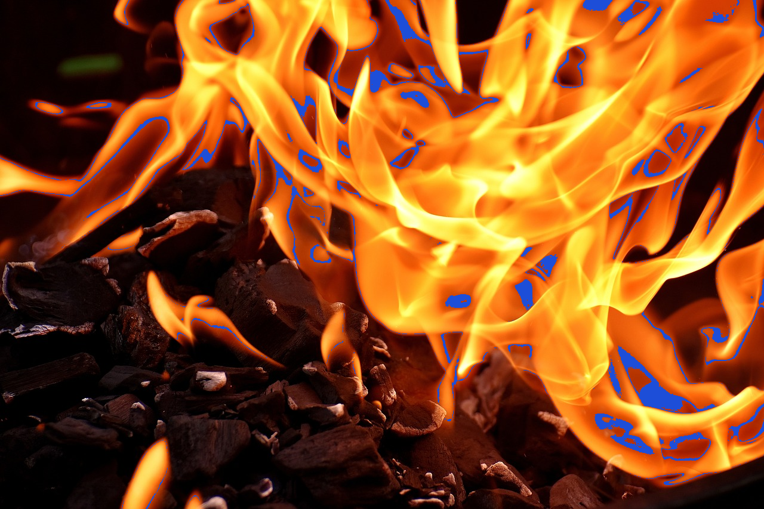
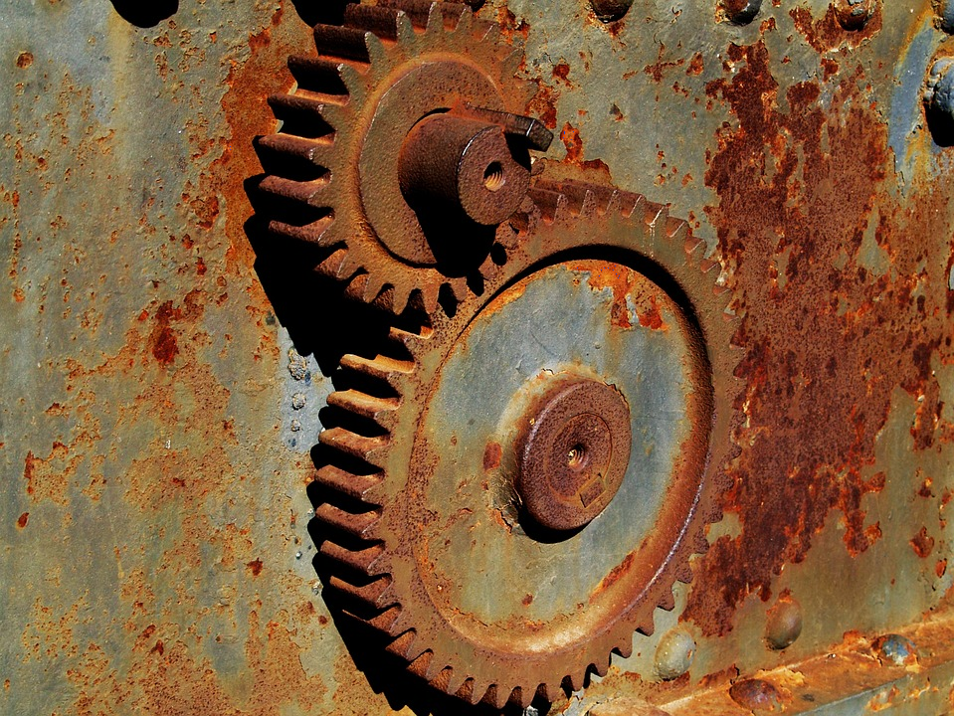
Oksaydhays (oxidation)
Oksaydhays (oxidation) waa marka walax falceliso oo ay ku biirto oksijiin (oxygen), tusaale ahaan gubasho iyo miridh (rusting).
qoryo gubanaya
agabyo miridhsan

Slide 8
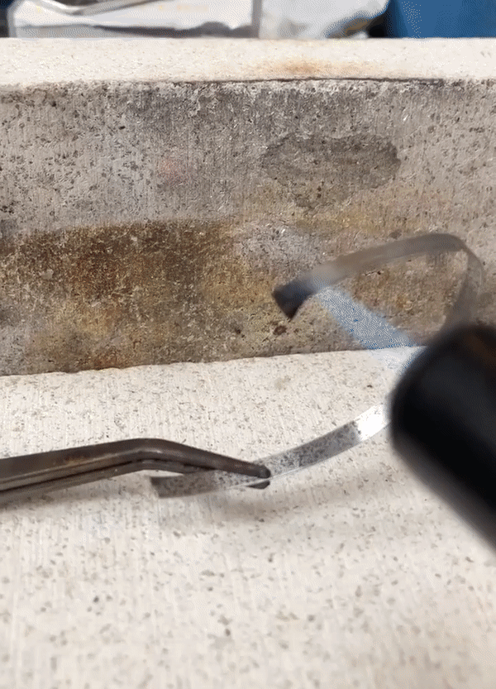
Oksaydhays (oxidation)
Marka biraha ay falceliyaan oksijiin (oxygen) waxay soo saaraan oksaydh (oxide) bir ah.
Isle'eg guud (General equation):
bir (metal) + oxygen → bir oxide (metal oxide)
magnesium + oxygen → magnesium oxide
aluminium + oxygen → aluminium oxide
sodium + oxygen → sodium oxide
gubista magnesium (burning magnesium)

Slide 9

Oxidation (Oxidation)
Dhammeysti weedha. Oxidation (Oxidation) waa marka shay uu falgal (reaction) la sameeyo …
carbon dioxide.
nitrogen.
oxygen.
oxides.

Slide 10
Oxidation (Oxidation)
Magacaw badeecada (product) la sameeyo marka birta lithium ay falgal (reaction) la sameyso oxygen.
lithium oxygen
lithium oxide
magnesium oxide
lithium carbonate

Slide 11
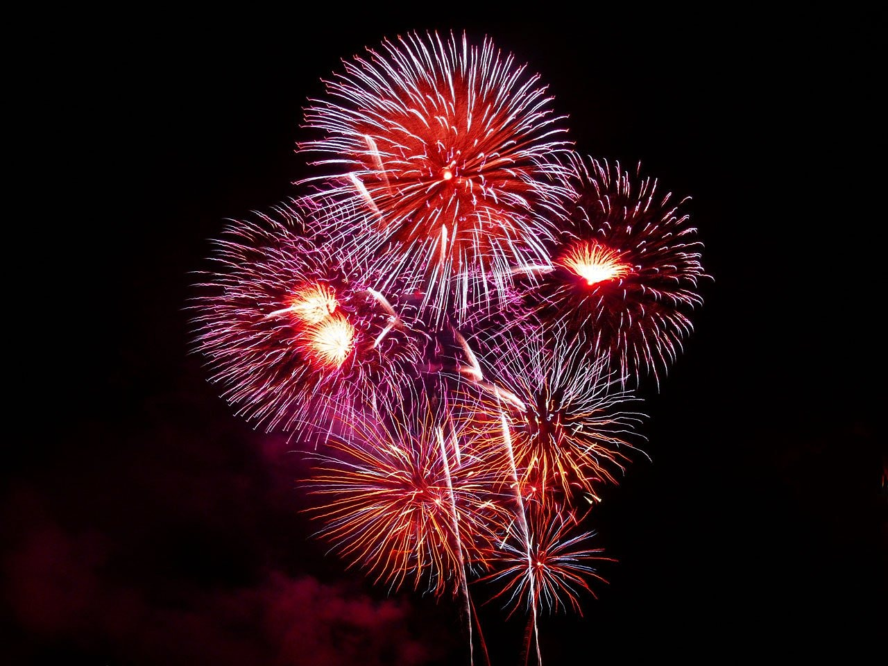
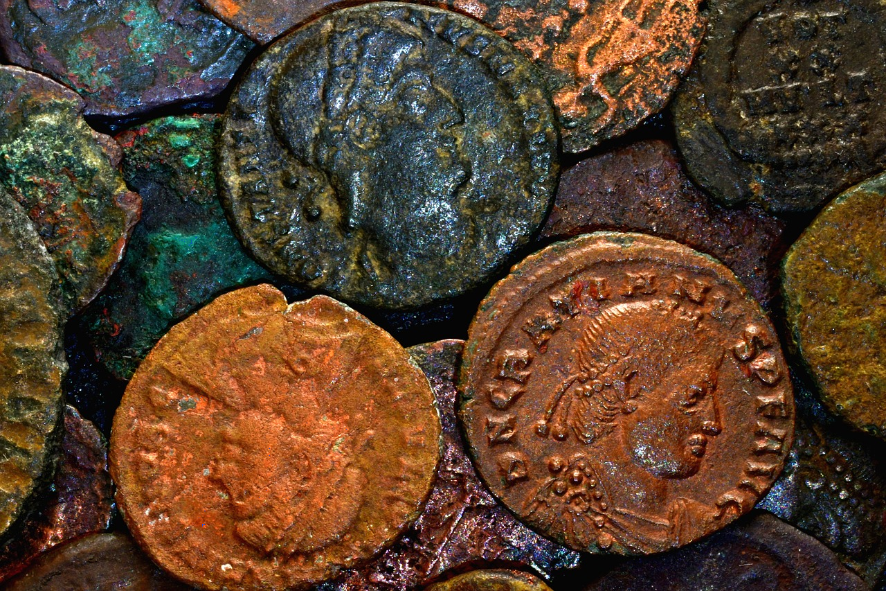
Oxidation (Oxidation)
Xawaaraha (speed/rate) falgalka oxidation (oxidation reaction) wuu kala duwanaan karaa. Xawaaraha oxidation (oxidation rate) wuxuu noqon karaa mid aad u degdeg badan (tusaale, ilbiriqsi gudahood) ama mid aad u gaabiya (tusaale, sannado badan).
rasaasta (fireworks) oo gubanaysa (combusting)
Qadaadiicda naxaasta (copper coins) ee Roomaanka ah oo oxidised (oxidised)

Slide 12
Oksaydhaysi (Oxidation)
Dhammeysti weedha. Oxidation (Oxidation) wuxuu dhacaa …
heerar gaabis ah.
heerar kala duwan.
heerar degdeg ah.

Slide 13
Oksaydhaysi (Oxidation)
Curuuraha aan bir ahayn waxay mari karaan oksaydhaysi (oxidation) si ay u soo saaraan oksaydh aan bir ahayn.
kaarboon + oksijiin → kaarboon laba-oksaydh
C + O2→ CO2
nitrojiin + oksijiin → nitrojiin laba-oksaydh
N2 + 2O2→ 2NO2

Slide 14
Oksaydhaysi (Oxidation)
Xeryahooda aan bir ahayn sidoo kale waxay mari karaan oksaydhaysi (oxidation) si ay u soo saaraan oksaydhyo iyo xeryo kale.
Biyuhu (water) waa oksaydh (oxide) oo hydrogen ah.
meyaane + oksijiin → kaarboon laba-oksaydh + biyo (water)
CH4+ 2O2→ CO2 + 2H2O
etanol + oksijiin → ethanoic acid + biyo (water)
C2H5OH + O2→ CH3COOH + H2O

Slide 15
Oksaydhaysi (Oxidation)
Atamka aan bir ahayn, tirada atamka oksijiin waxaa lagu muujiyaa magaca oksaydhka.
tirada atamka oksijiin ee oksaydhka | horgale (prefix) | tusaale | qaacidada (formula)
1 | mono | carbon monoxide (carbon monoxide) | CO
2 | di | carbon dioxide (carbon dioxide) | CO2
3 | tri | sulfur trioxide (sulfur trioxide) | SO3
4 | tetr | dinitrogen tetroxide (dinitrogen tetroxide) | N₂O₄
5 | pent | arsenic pentoxide (arsenic pentoxide) | As2O5

Slide 16
Oksaydhaysi (Oxidation)
Maxay noqon doontaa walaxda (substance) la soo saaro marka birta (non-metal) sulfur ay la falgasho (react) oksijiin (oxygen)?
sulfur oksijiin (sulfur oxygen)
sulfur dioxide (sulfur dioxide)
carbon dioxide (carbon dioxide)
sulfide dioxide (sulfide dioxide)

Slide 17
Oksaydhays (Oxidation)
Haanta gaaska (gas jar) waxaa ku jira oksijiin (oxygen) saafi ah. Qayb yar oo sulfur ah oo la kululeeyay ayaa la geliyaa haanta gaaska. Sulfur-ku wuxuu gubaa (burns) si dhalaalaya. Waa maxay walaxda (substance) (ama walxaha) la soo saaro?
CO2 + H2O
SO2 kaliya
CO2 + H2O + SO2

Slide 18
Oksaydhays (Oxidation)
Dooro bayaanka/ka saxda ah. Biyo (water) waxay ka kooban yihiin laba atom oo hydrogen ah oo ku xidhan hal atom oo oxygen ah.
Biyo (water) waxay leeyihiin formula H2O marka waa oxide.
Biyo (water) ma aha oxide.
Biyo (water) waxay leeyihiin formula H2O marka waxaa loo yaqaan hydrogen dioxide.
Biyo (water) waxay leeyihiin formula H2O2 marka waa oxide.

Slide 19
Oksaydhays (Oxidation)
Waxaa jira 5 atom oo oxygen ah oo ku jira phosphorus trioxide oo leh formula P2O5.
Horgale (prefix) 'tri' macneheedu waa saddex, magacu waa inuu ahaado diphosphorus pentoxide maadaama ay jiraan 5 atom oo oxygen ah oo ku xidhan 2 atom oo phosphorus ah.
Horgale (prefix) 'di' macneheedu waa 2, magacu waa inuu ahaado pentaphosphorus dioxide maadaama ay jiraan 2 atom oo oxygen ah oo ku xidhan 5 atom oo phosphorus ah.

Slide 20
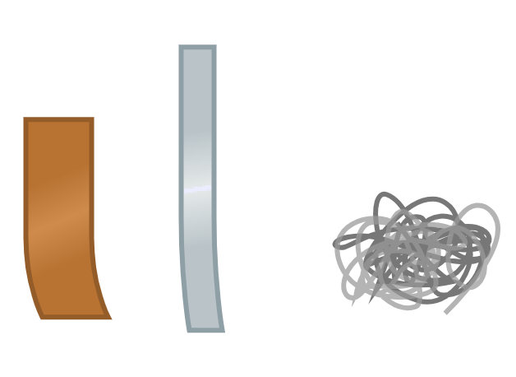
Oksaydhays (Oxidation)
a) Dhammeystir tijaabada (experiment) oksaydhayska (oxidation). Macallinkaagu wuxuu ku siin doonaa saddex muunad oo bir ah si aad u tijaabiso.
Tallaabada 1: Fiiri muuqaalka muunadda birta oo ku qor jaantuska natiijooyinka.
magnesium
copper (naxaas)
iron (bir)

Slide 21
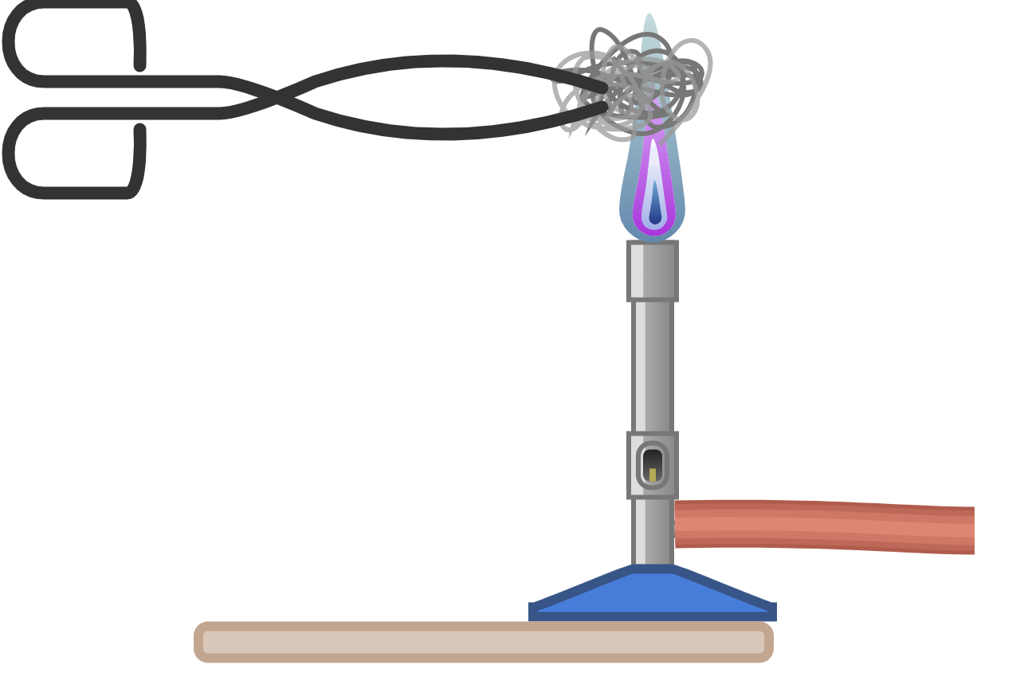
Oksaydhays (Oxidation)
a) Dhammeystir tijaabada (experiment) oksaydhayska (oxidation). Macallinkaagu wuxuu ku siin doonaa saddex muunad oo bir ah si aad u tijaabiso.
Tallaabada 2: Kululee muunada birta (metal sample) ololka buluugga ah ee shidaalka Bunsen (Bunsen burner flame) oo qor indho-indhaynta (observations) miiska natiijooyinkaaga (results table).
muunada birta (metal sample)
Tallaabada 3: Ka saar wax-soo-saarka (product) ololka, fiiri muuqaalkiisa oo ku qor miiska natiijooyinkaaga (results table).
qabato (tongs)
shidaalka Bunsen (Bunsen burner)
dusimo (heat resistant mat)
Tallaabada 4: Ku celi tallaabooyinka 2 iyo 3 muunadaha birta (metal samples) ee haray.

Slide 22
Oksaydhaysi (Oxidation)
Buuxi miiska natiijooyinka (results table).
muunada birta (metal sample) | indho-indhaynta (observation) ka hor kuleylinta | indho-indhaynta (observation) inta lagu jiro kuleylinta | indho-indhaynta (observation) ka dib kuleylinta
bir (iron)
magnesium (magnesium)
naxaas (copper)

Slide 23
Oksaydhaysi (Oxidation)
a) iyo b) Natiijooyinkaagu waxay la mid noqon karaan kuwan:
muunada birta (metal sample) | indho-indhaynta (observation) ka hor kuleylinta | indho-indhaynta (observation) inta lagu jiro kuleylinta | indho-indhaynta (observation) ka dib kuleylinta
bir (iron)
magnesium (magnesium)
naxaas (copper)
bir cawlan oo 'suuf' ah
wuxuu iftiimiyaa cas / oranji, dhimbilo oranji ah ayaa soo baxa
wuu burburaa
birta waa madoobaataa
xariijimo bir ah oo dhalaalaysa oo cawlan
wuxuu ku gubtaa olol cad oo dhalaalaya
bud cad / dambas ayaa samaysma
xariijimo dhalaalaysa oo oranji / bunni / naxaas (copper) ah
wuxuu iftiimiyaa cas dhalaalaya
ma dhalaaliyo mana gubto
midab madow / cawlan madow
waa laga xaaqi karaa korka si loo muujiyo birta naxaasta (copper)

Slide 24
Oksaydhaysi (Oxidation)
Isku xidh isleegyada ereyada ee falgalyada oxidation (oxidation).
bir (iron) + oxygen →
copper oxide (copper oxide)
magnesium + oxygen →
carbon dioxide (carbon dioxide)
naxaas (copper) + oxygen →
iron oxide (iron oxide)
phosphorous + oxygen →
magnesium oxide (magnesium oxide)
kaarboon (carbon) + oxygen →
sulfur dioxide (sulfur dioxide)
sulfur + oxygen →
phosphorous pentoxide (phosphorous pentoxide)

Slide 25
Oxidation (Oxidation)
Isku xidh isleegyada ereyada ee falgalyada oxidation (oxidation).
iron + oxygen →
copper oxide (copper oxide)
magnesium + oxygen →
carbon dioxide (carbon dioxide)
copper + oxygen →
iron oxide (iron oxide)
phosphorous + oxygen →
magnesium oxide (magnesium oxide)
carbon + oxygen →
sulfur dioxide (sulfur dioxide)
sulfur + oxygen →
phosphorous pentoxide (phosphorous pentoxide)

Slide 26
Falgal kiimiko: oksaydh (oxidation)
Oxidation (Oxidation)
Miridh (Rusting)

Slide 27
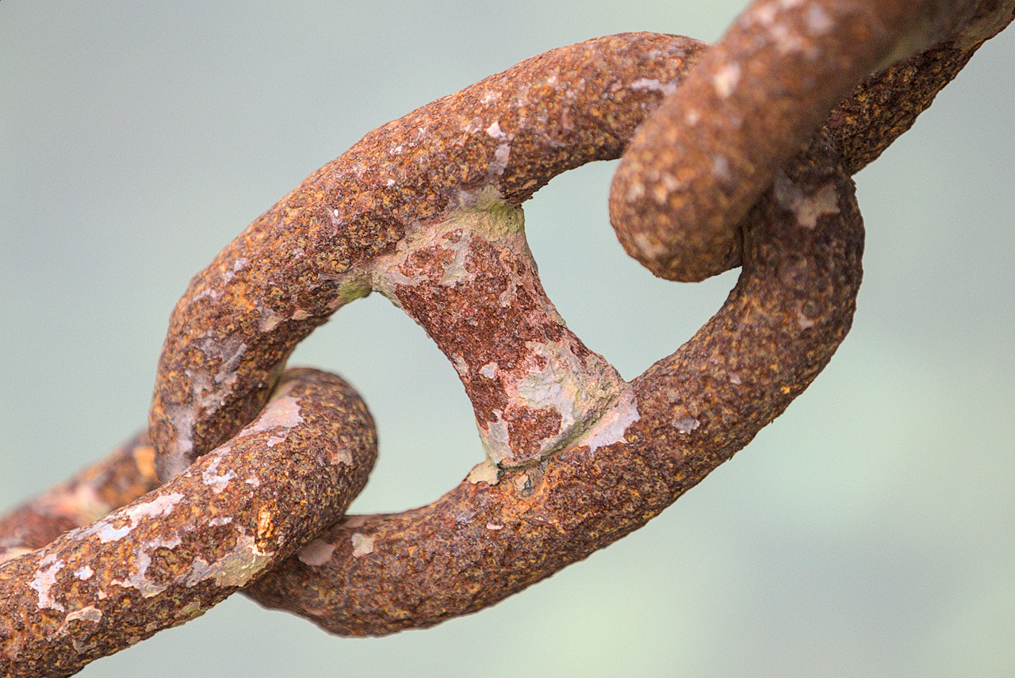
Miridh (Rusting)
Miridhku waa falgal oksaydh (oxidation) ka sii adag oo ka dhex dhaca birta, oksijiinta iyo biyaha (water).
Miridh (Rusting):
waa taxane falgal (reactions)
magaca kiimikada miridhku waa oksaydh bir (iron oxide)
qaacidada miridhku waa Fe2​O3​
waa nooc gaar ah oo daxal (corrosion)
dusha birta waxaa dhaawaca falgal kiimiko (chemical reaction)
bir (iron) + oksijiin (oxygen) + biyo (water) → oksaydh bir (iron oxide) (miridh)

Slide 28
Miridh (Rusting)
Magacow labada fal-celin ee loo baahan yahay si birta u miridho.
oksijiin (oxygen) iyo kaarboon laba ogsaydh (carbon dioxide)
oksijiin (oxygen) iyo biyo (water)
biyo (water) iyo kaarboon laba ogsaydh (carbon dioxide)

Slide 29
Miridh (Rusting)
Habka miridhku (rusting) wuxuu daxaleeyaa (corrodes) birta (iron) iyo isku dhafyo badan oo bir ah oo ay ku jirto birta, tusaale ahaan, steel.
bir (iron) + oksijiin (oxygen) + biyo (water) → miridh (rust)
Si loo joojiyo ama loo yareeyo miridhka, birta waxaa lagu daweyn karaa:
rinji (painting)
saliid (oiling)
dahaar bir kale (coating with another metal)
beddelidda isku dhafka birta (changing the mixture of the metal)
joogteeya neefsashada (oxygen) iyo biyaha (water) inay taabtaan birta (iron)

Slide 30

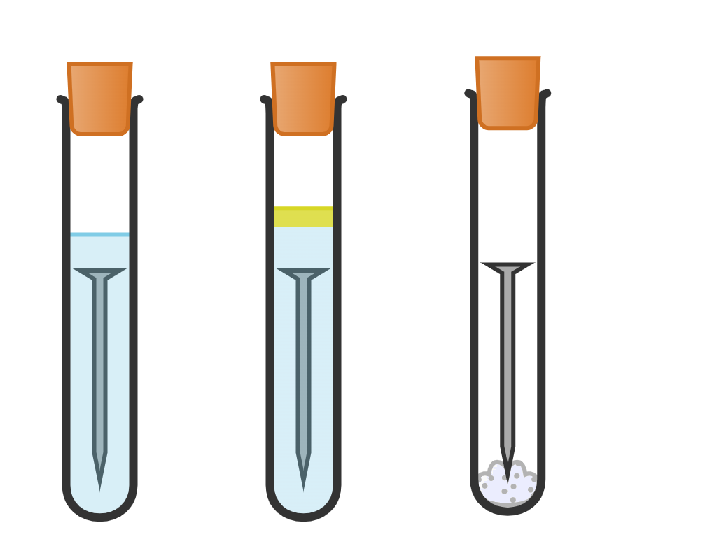
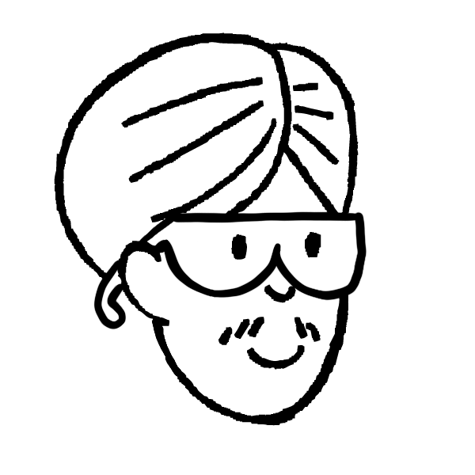
Miridhku (Rusting)
Cali wuxuu qorsheeyay tijaabo (experiment) si loo go'aamiyo waxa birta (iron) miridhka (rust) keena. Wuxuu diyaariyay tuubooyinka tijaabada (test tubes) soo socda wuxuuna uga tagay laba toddobaad.
saliid (oil) (joogteysa hawada inay biyaha (water) gasho)
hawada (air) ay ku jirto neefsashada (oxygen)
A
B
C
hawal qallalan (dry air) oo ay ku jirto neefsashada (oxygen)
ciddiy bir ah (iron nail)
anhydrous calcium chloride (ka saara biyaha (water) hawada (air))
biyo (water) la karkariyey oo la miiray (boiled distilled water) (ma jiro neefsasho (oxygen) ku milan)

Slide 31

Miridhku (Rusting)
Saadaali (Predict) waxa Cali ku arki doono tuubo kasta oo tijaabada (test tube) ah.
tuubada tijaabada (test tube) | biyo (water) | neefsashada (oxygen) | indha-indhaynta (observations) laba toddobaad ka dib
A
B
C
A
B
C
Qor gunaanad (conclusion) tijaabada (experiment) Cali.

Slide 32
Miridhku (Rusting)
Saadaali waxa Cali uu ku arki doono tuubo kasta oo tijaabo (experiment) ah.
tuubada tijaabada (test tube) | biyo (water) | neefsashada (oxygen) | ilaalinta laba usbuuc ka dib
A
B
C
cusharka (nail) ayaa mirmeen (rust)
A
B
C
mir (rust) kuma jiro cushka (nail)
mir (rust) kuma jiro cushka (nail)
Qor gabagabo (conclusion) tijaabada (experiment) Cali.
Si mirmeen (rusting) u dhaco, biyo (water) iyo oksijiin (oxygen) labaduba waa inay joogaan.

Slide 33
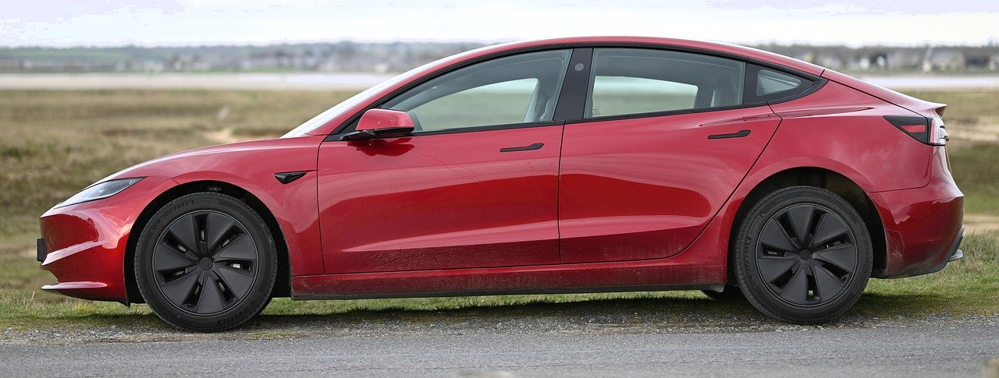
Mirmeen (Rusting)
Baabuur waxaa laga sameeyaa bir (steel) oo ah bir (iron) ku salaysan, sidaas darteed waa la rinjiyeeyaa si aanu u mirmin (rust).
Sharax sida rinjiyeynta baabuurka uga joojiso mirmeen (rusting).
Sharax waxa dhici doona haddii baabuurka la xoqo, ku dar nooca falgalka (reaction) ee dhaca.

Slide 34
Mirmeen (Rusting)
2) Baabuur waxaa laga sameeyaa bir (steel) oo ah bir (iron) bir ah (metal) sidaas darteedna waa la rinjiyeeyaa si looga hortago inay daxalto (rust).
Sharax sida rinjiyeynta baabuurka uga hortagto daxalka (rusting).
Sharax waxa dhici lahaa haddii baabuurka xoqmo (scratched), ku dar nooca falgalka (reaction) ee dhaca.
Jawaabtaadu waa inay ku jirtaa:
Rinjigu wuxuu …
ka joojin oksijiin (oxygen) hawada iyo biyo (water) roobka
falgalka (reacting) birta (iron)
maxaa yeelay biyo (water) iyo oksijiin (oxygen) labaduba ayaa loo baahan yahay si birta (iron) u miranto.
b) Haddii baabuurka la xoqo …
oksijiin (oxygen) hawada iyo biyo (water) roobka
waxay la falgali doonaan birta (iron)
oo keeni doona mirmeen (rust).
Kani waa falgal oksidayn (oxidation reaction).

Slide 35
Falgal (Chemical reactions): oksideyshin (oxidation)
Marka shay (substance) falgalo (reacts) si uu ula midoobo oksijiin (oxygen), waxaa loo yaqaan oksideyshin (oxidation).
Tusaalooyinka oksideyshinta (oxidation) waa gubasho (combustion) iyo daxalto (rusting).
Mid ka mid ah alaabta (products) oksideyshinta (oxidation) had iyo jeer waa oksaydh (oxide), laakiin alaabta kale way kala duwan yihiin.
Daxalto (Rusting) waxay u baahan tahay oksijiin (oxygen) iyo biyo (water) labadaba inay joogaan.
Daxalta (Rusting) waxaa la joojin karaa iyadoo la dahaadho (coating) dusha birta (iron) birta ah (metal).

