Slide 1
Falgal (reaction) kiimiko: roobab (precipitation)
Fahanka falgal (reaction) kiimiko

Slide 2

Sida agabkeena waxbarista loogu talagalay fasalka
Darsigani wuxuu ku darayaa agab dheeri ah oo laga soo dejin karo bogga darsiga.
Isticmaal agabkan slides-ka ay ku jirto astaanta buugga furan.

Slide 3
roobab (precipitation)
roob (precipitate)
milan (solution) aqueous (aq)
aan milmi karin (insoluble)
falanqaynta kiimikada tayada (chemical qualitative analysis)

Slide 4
Roobab (precipitation) waa habka roob (precipitate) loo sameeyo.
Roob (precipitate) waa adag aan milmi karin (insoluble) oo ka sameysma marka laba milan (solution) ay falgalaan.
Milan (solution) aqueous (aq) waxaa la sameeyaa marka walax ku milan biyo (water).
Aan milmi karin (insoluble) waa qaab lagu qeexo walax aan ku milmi doonin milane gaar ah.
Falanqaynta kiimikada tayada (chemical qualitative analysis) waa tijaabo kiimiko oo xaqiijisa joogitaanka walax, kumana sheego inta walaxda ay tahay.

Slide 5
Waxaan qeexi karaa waxa dhacaya inta lagu jiro falgal (reaction) roobab (precipitation), iyo qorista isla'egta kiimikada ee muujinaysa.

Slide 6

Falgal (reaction) kiimiko: roobab (precipitation)
Falgal (reaction) roobab (precipitation)
Isticmaalka falgal (reaction) roobab (precipitation)

Slide 7
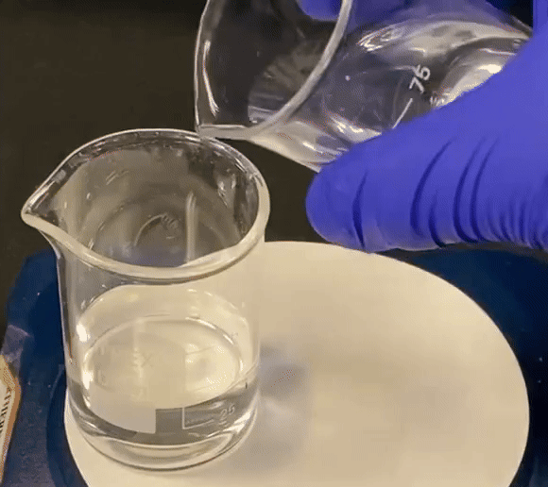
Falgal (reaction) roobab (precipitation)
Falgal (reaction) roobab (precipitation) waxay dhacaan marka laba milan (solution) ay isku daraan si ay u sameeyaan shey adag oo aan milmi karin (insoluble).
Muujinta roob (precipitate) waa caddayn in falgal (reaction) kiimiko uu dhacay.
samaynta raareedka rasaasta iodide (lead iodide precipitate forming)

Slide 8
Falgalyada raareedka (Precipitation reactions)
Isku darka milanka (solution) nitrate-ka rasaasta (lead nitrate) iyo potassium iodide (potassium iodide) wuxuu keenaa samaynta raareed (precipitate) huruud ah oo ah rasaasta iodide (lead iodide) iyo milan (solution) ah potassium nitrate (potassium nitrate).
Astaamaha xaaladda (state symbols) waxaa loo isticmaali karaa in lagu garto haddii falgal (reaction) uu soo saaray raareed (precipitate).
nitrate-ka rasaasta (aq) (lead nitrate(aq)) + potassium iodide (aq) (potassium iodide(aq)) → rasaasta iodide (s) (lead iodide(s)) + potassium nitrate (aq) (potassium nitrate(aq))
Pb(NO3)2(aq)+2KI(aq)→PbI2(s)+ 2KNO3(aq)
wuxuu muujinayaa in adke (solid) la sameeyay

Slide 9

Falgalyada raareedka (Precipitation reactions)
Waa maxay xaaladda walaxda (state of matter) ee raareedka (precipitate)?
adke (s) (solid (s))
dareere (l) (liquid (l))
neef (g) (gas (g))
milan (aq) (solution (aq))

Slide 10
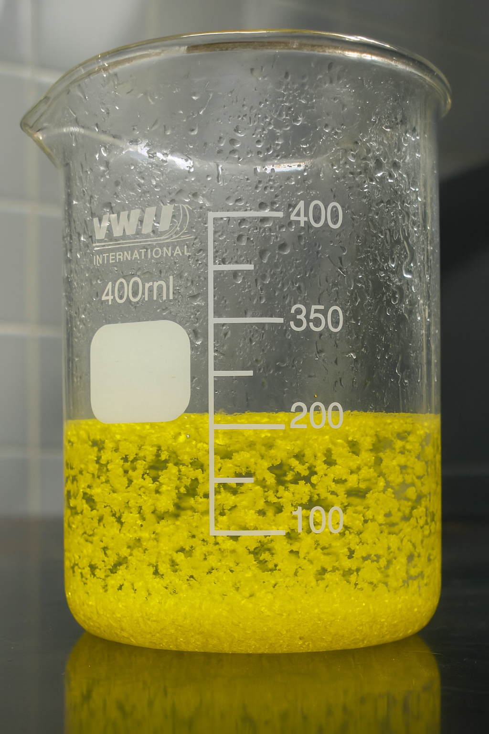
Falgalyada raareedka (Precipitation reactions)
Maaddaama raareedka (precipitate) uu yahay adke (solid), wuxuu u degi doonaa gunta weelka (container) waqti ka dib.
Marka raareed (precipitate) uu sameeyo, wuxuu:
wuxuu ka dhigi doonaa milanka (solution) la sameeyay mid daruuroobay/madhan (cloudy/opaque)
wuxuu noqon karaa cad ama midab leh

Slide 11
Falgalyada raareedka (Precipitation reactions)
Astaamaha xaaladda (state symbols) waxaa loo isticmaali karaa in lagu garto falgal raareed (precipitation reaction).
Walax leh astaanta xaaladda (aq) (state symbol (aq)) waa raareed (precipitate).
Walax leh astaanta xaaladda (s) (state symbol (s)) waa raareed (precipitate).

Slide 12
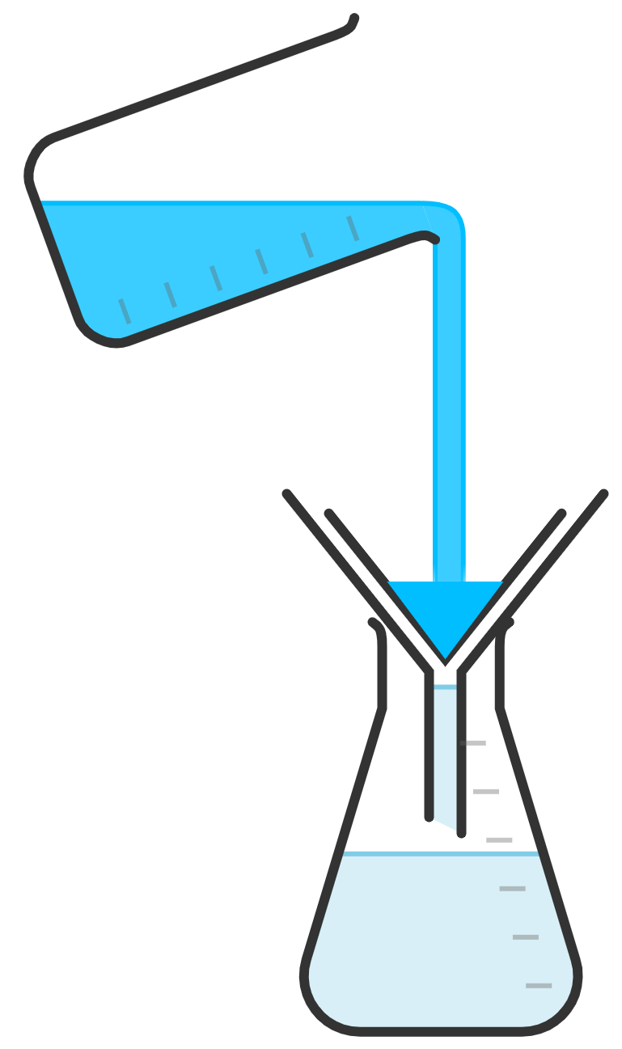
Falgal (reaction) precipitation
Si loo ururiyo precipitate-ka waxaan isticmaali karnaa filtration.
falgal (reaction) isku dhafan
beaker
precipitate
filter paper
funnel
conical flask
filtrate

Slide 13
Falgal (reaction) precipitation
Waa maxay habka loo kala saaro precipitate-ka iyo falgal (reaction) isku dhafan?
militaanka (dissolving)
precipitation
distillation
filtration

Slide 14
Falgal (reaction) precipitation
1) Aqoonso falgal (reaction) precipitation-ka:
silver chloride (s)
sodium nitrate (aq)
+
silver nitrate (aq) + sodium chloride (aq) →
sodium chloride (aq)
hydrochloric acid (aq) + sodium hydroxide (aq) →
+
biyo (water) (l)
barium sulfate (s)
sodium chloride (aq)
barium chloride (aq) + sodium sulfate (aq)→
+
potassium nitrate (aq)
biyo (water) (l)
nitric acid (aq) + potassium hydroxide (aq) →
+
2) Sharax sida aad u aqoonsatay falgalalka roobabka (precipitation reactions).

Slide 15

Falgalalka roobabka (Precipitation reactions)
1) Aqoonso falgalalka roobabka (precipitation reactions).
silver nitrate (aq) + sodium chloride (aq) →
hydrochloric acid (aq) + sodium hydroxide (aq) →
barium chloride (aq) + sodium sulfate (aq)→
nitric acid (aq) + potassium hydroxide (aq) →
Jawaabaha:
silver chloride (s)
sodium nitrate (aq)
+
sodium chloride (aq)
+
biyo (water) (l)
sodium chloride (aq)
barium sulfate (s)
+
potassium nitrate (aq)
biyo (water) (l)
+

Slide 16
Falgal roobab (Precipitation reactions)
2) Sharax sida aad u aqoonsatay falgal roobab (precipitation reactions).
Falgal roobab (precipitation reaction) dhexdiisa:
adag (solid) had iyo jeer waa la sameeyaa
isle'egta (equation), badeecada leh calaamadda xaaladda (s) waxay noqon doontaa roobka (precipitate)

Slide 17
Falgal roobab (Precipitation reactions)
Dhammeystir qaybaha maqan ee isle'egyada ereyada iyo calaamadaha ee ku muujisan sanduuqa falgal roobab (precipitation reactions) soo socda. Ku dar calaamadaha xaaladda (state symbols). Isticmaal macluumaadka shaxda xeryahooda (compounds table) ee qalabka dheeraadka ah.
a) | ammonium sulfate (aq) | + | calcium nitrate (aq) | → |  | + | ammonium nitrate (aq)
 |  | + | Ca(NO3)2(aq) | → | CaSO4(s) | + | 2NH4NO3(aq)
b) | calcium nitrate (aq) | + |  | → | potassium nitrate (aq) | + | calcium fluoride (s)
 | Ca(NO3)2(aq) | + | 2KF(aq) | → | 2KNO3(aq) | +

Slide 18
Falgal roobab (Precipitation reactions)
Dhammeystir qaybaha maqan ee isle'egyada ereyada iyo calaamadaha ee ku muujisan sanduuqa falgal roobab (precipitation reactions) soo socda. Ku dar calaamadaha xaaladda (state symbols). Isticmaal macluumaadka shaxda xeryahooda (compounds table) ee qalabka dheeraadka ah.
c) | zinc chloride (aq) | + | sodium sulfide (aq) | → |  | + | sodium chloride (aq)
 | ZnCl2(aq) | + |  | → | ZnS(s) | + | 2NaCl(aq)
d) | copper sulfate (aq) | + | sodium hydroxide(aq) | → | sodium sulfate (aq) | + | copper hydroxide (s)
 |  | + | 2NaOH(aq) | → |  | +

Slide 19
Falcelinta roobabka (Precipitation reactions)
Dhammeystir qaybaha maqan ee isla'egyada ereyada iyo calaamadaha ee uu muujinayo sanduuqa falcelinta roobabka (precipitation reactions). Ku dar calaamadaha xaaladda (state symbols). Isticmaal macluumaadka ka jira shaxda xeryahooda (compounds table) ee agabka dheeraadka ah.
e) | iron chloride (aq) | + |  | → | iron hydroxide (s) | + | sodium chloride (aq)
 |  | + | 3NaOH(aq) | → |  | + | 3NaCl(aq)
f) | sodium carbonate (aq) | + |  | → | copper carbonate(s) | +
 | Na2CO3(aq) | + | CuCl2(aq) | → |  | + | 2NaCl(aq)

Slide 20
Falgalalka roobabka (Precipitation reactions)
Dhammeysti qaybaha maqan ee isla'egyada ereyada iyo calaamadaha ee falgalalka (reactions) roobabka (precipitation). Ku dar calaamadaha xaaladda (state symbols). Isticmaal macluumaadka shaxda xeryahooda (compounds) ee qalabka dheeraadka ah.
a) | ammonium sulfate (aq) | + | calcium nitrate (aq) | → |  | + | ammonium nitrate (aq)
 |  | + | Ca(NO3)2(aq) | → | CaSO4(s) | + | 2NH4NO3(aq)
b) | calcium nitrate (aq) | + |  | → | potassium nitrate (aq) | + | calcium fluoride (s)
 | Ca(NO3)2(aq) | + | 2KF(aq) | → | 2KNO3(aq) | +
calcium sulfate (s)
(NH4)2SO4(aq)
potassium fluoride (aq)
CaF2(s)

Slide 21
Falgalalka roobabka (Precipitation reactions)
Dhammeysti qaybaha maqan ee isla'egyada ereyada iyo calaamadaha ee falgalalka (reactions) roobabka (precipitation). Ku dar calaamadaha xaaladda (state symbols). Isticmaal macluumaadka shaxda xeryahooda (compounds) ee qalabka dheeraadka ah.
c) | zinc chloride (aq) | + | sodium sulfide (aq) | → |  | + | sodium chloride (aq)
 | ZnCl2(aq) | + |  | → | ZnS(s) | + | 2NaCl(aq)
d) | copper sulfate (aq) | + | sodium hydroxide(aq) | → | sodium sulfate (aq) | + | copper hydroxide (s)
 |  | + | 2NaOH(aq) | → |  | +
zinc sulfide (s)
Na2S(aq)
CuSO4(aq)
Na2SO4(aq)
Cu(OH)2(s)

Slide 22
Falgal (reaction) roobabka (precipitation)
Buuxi qaybaha maqan ee isla'egyada ereyada iyo calaamadaha ee falgal (reaction) roobabka (precipitation) soo socda. Ku dar calaamadaha xaaladda (state symbols). Isticmaal macluumaadka shaxda xeryahooda (compounds table) ee qalabka dheeraadka ah.
sodium hydroxide (aq)
e) | iron chloride (aq) | + |  | → | iron hydroxide (s) | + | sodium chloride (aq)
 |  | + | 3NaOH(aq) | → |  | + | 3NaCl(aq)
f) | sodium carbonate (aq) | + |  | → | copper carbonate(s) | +
 | Na2CO3(aq) | + | CuCl2(aq) | → |  | + | 2NaCl(aq)
FeCl3(aq)
Fe(OH)3(s)
copper chloride (aq)
sodium chloride (aq)
CuCO3(s)

Slide 23
Falgal kiimiko: roobab (Chemical reactions: precipitation)
Falgal roobab (Precipitation reactions)
Isticmaalka falgal roobab (Uses of precipitation reactions)

Slide 24
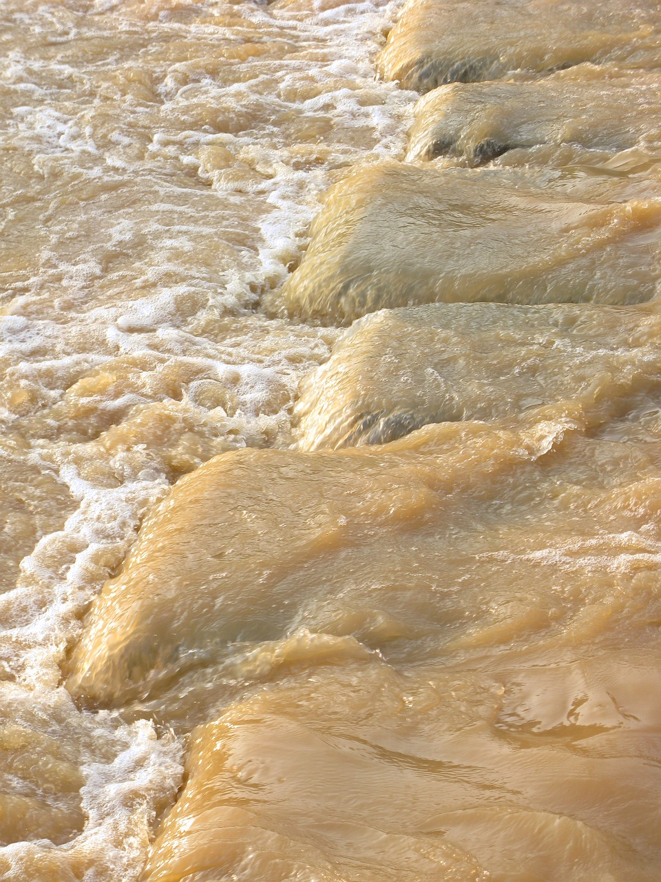
Isticmaalka falgal roobab (Uses of precipitation reactions)
Falgal roobab (Precipitation reactions) waxaa loo isticmaalaa daawaynta biyaha (water).
Biyaha (water) waxaa ku jira walxo milmay oo aan loo baahnayn oo ka dhigi kara biyaha (water) aan ammaan u ahayn cabitaanka, tusaale ahaan xeryaha rasaasta (lead) iyo naxaasta (copper).
Falgal roobab (Precipitation reactions):
waxay ka caawiyaan ka saarista walxahan aan loo baahnayn ee biyaha (water) ku jira
waxay sameeyaan xeryo aan milmi karin (insoluble compounds) oo lagu saari karo shaandhayn (filtration)
biyaha (water) wabiga ah ee aan la daawayn
Biyaha (water) waxay u baahan yihiin habayn dheeri ah ka hor inta aanay ammaan u ahayn cabitaanka, tusaale ahaan jeermiska iyadoo lagu daro koloriin (chlorine).

Slide 25
Isticmaalka falgalyada roobabka (precipitation reactions)
Heerarka sare ee xeryaha rasaasta (lead), naxaasta (copper) iyo cadmium ee biyaha (water) la cabbo waxay noqon karaan sun (toxic).
Waa laga saari karaa iyadoo la adeegsanayo roobab (precipitation):
Xarunta rasaasta (lead compound) waxay la falgashaa sodium hydroxide.
Tani waxay samaysaa roobab cad oo aan milmi karin (white insoluble precipitate), oo ah hydroxide-ka rasaasta (lead hydroxide).
Roobabka (precipitate) waa laga saari karaa iyadoo la adeegsanayo shaandhayn (filtration).
Tani waxay ka tagtaa biyaha (water) kuwa ammaan u ah cabista.
Pb(NO3)2(aq)+2NaOH(aq)→Pb(OH)2(s)+2NaNO3(aq)

Slide 26
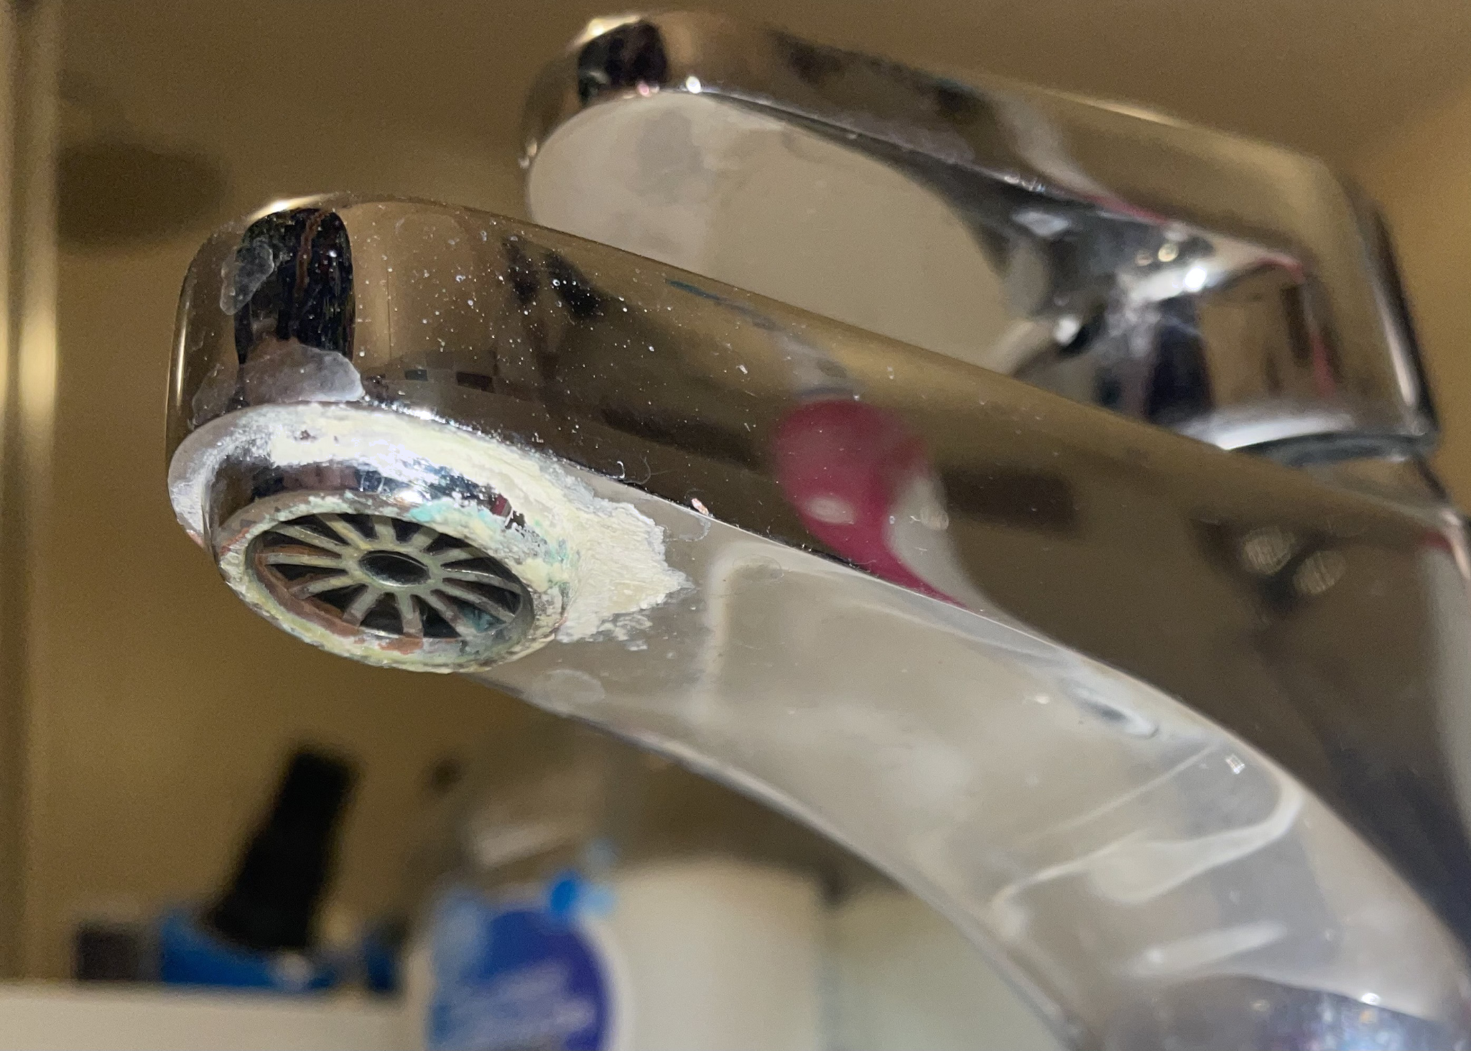
Isticmaalka falgalyada roobabka (precipitation reactions)
Biyaha adag (Hard water) waa dhibaato meelaha juqraafiga qaarkood, taasoo keenta:
cagaar (limescale) oo ku jira kettles, tuubooyinka biyaha iyo qasabadaha
dhadhan biyo oo ka duwan biyaha jilicsan (soft water)
xumbo saabuun (soap scum)
cagaar (limescale) oo ku yaal qasabad
Waxaa sidoo kale loo baahan yahay saabuun dheeri ah si loo sameeyo xumbo / goobo wanaagsan oo lagu maydho.

Slide 27
Isticmaalka falgalyada roobabka (precipitation reactions)
Biyaha adag (Hard water) waxaa sababa xeryahooda calcium iyo magnesium ee ku jira biyaha (water).
Roobabka la sameeyay (calcium carbonate iyo magnesium hydroxide) waa laga saari karaa iyadoo la adeegsanayo shaandhayn (filtration).
Tani waxay yaraynaysaa dhibaatooyinka isticmaalkeeda waxayna ka dhigaysaa biyaha (water) kuwa dhadhankoodu fiican yahay oo la cabbo.
CaCl2(aq) + Na2CO3(aq) → CaCO3(s) + 2NaCl(aq)
MgSO4 (aq)+NaOH(aq)→Mg(OH)2 (s)+Na2SO4(aq)

Slide 28
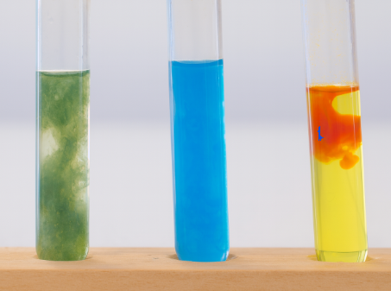
Isticmaalka falgalyada roobabka (precipitation reactions)
Falgalyada roobabka (Precipitation reactions):
waxay gartaa haddii walaxdu joogto
waxaa loo isticmaali karaa tijaabo kiimiko oo tayo (qualitative test)
uma muujinayaan inta walaxda ah ee joogta
Ku darista sodium hydroxide milan (solution) ee biro kala duwan ayaa sababi doonta in roobab (precipitates) sameeyaan.
Tusaale: midab buluug ah wuxuu muujinayaa in xarun naxaas ah ay joogto.
falgal roobab (precipitation reactions)

Slide 29
Isticmaalka falgal roobab (precipitation reactions)
Soo koobida midabada roobka (precipitate):
midabka roobka (precipitate) | xarun bir ah oo ku jirta milanka (solution)
cadaan | aluminium / calcium / magnesium / lead
buluug | naxaas (copper)
cagaar / bunni | bir (iron)
falgal roobab (precipitation reactions)
Tijaabooyin dheeri ah ayaa loo baahan doonaa si loo kala saaro farqiga u dhexeeya roobabka cad (white precipitates).

Slide 30
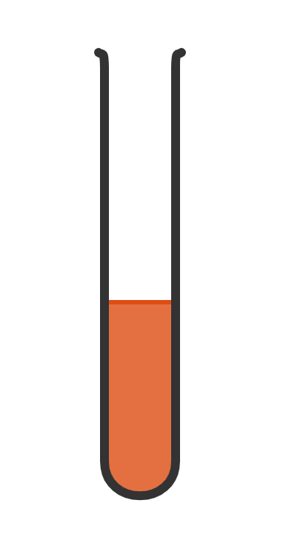

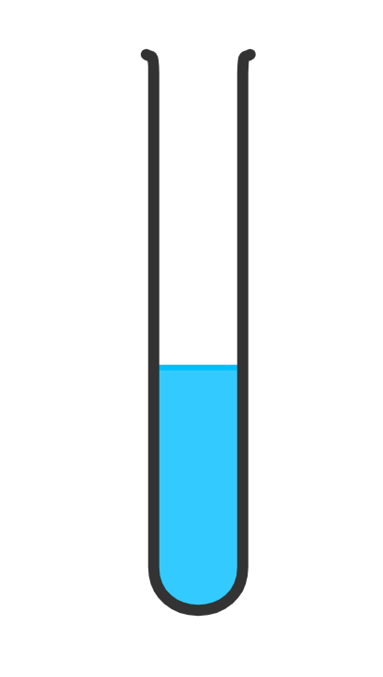
Isticmaalka falgal roobab (precipitation reactions)
Tubal (test tube) kee ayaa ku jira xarun naxaas ah?

Slide 31



Isticmaalka falgal roobab (precipitation reactions)
Waa kuwee xarunno bir ah oo laga heli karo muunadaha biyaha (water) ee Axmed?
Waxaan ku daray sodium hydroxide (sodium hydroxide) shay kasta oo aan arkay kuwan soo socda:
shayga A wuxuu sameeyay huruud cagaaran (green precipitate)
shayga B wuxuu sameeyay huruud cad (white precipitate)
shayga C wuxuu sameeyay huruud buluug (blue precipitate)
shayga D wuxuu sameeyay huruud bunni (brown precipitate)
shayga E ma samaysan huruud (precipitate)
Axmed

Slide 32
Isticmaalka falgalyada huruudda (uses of precipitation reactions)
Waa maxay xarumaha birta (metal compounds) ee laga heli karo shayga biyaha (water samples) ee Axmed?
shay (sample) | midabka huruudda (colour of precipitate) | birta xarunteeda (metal compound present)
A | cagaar (green)
B | cad (white)
C | buluug (blue)
D | bunni (brown)
E | huruud (precipitate) lama samayn
iron (iron)
aluminium / calcium / magnesium (aluminium / calcium / magnesium)
copper (copper)
iron (iron)
aluminium / calcium / magnesium / lead / copper / iron ma joogaan
Axmed

Slide 33
Isticmaalka falgalyada roobabka (precipitation reactions)
Sharax sababta Axmed uusan u cabbin biyihiisa ka dib marka uu ka saaro xeryaha birta (metal compounds) sida precipitates.
Axmed wuxuu booqdaa saaxiibkiis ee London halkaas oo ay leeyihiin biyo adag (hard water). Sharax sababta biyuhu u dhadhamiyaan si ka duwan oo tax dhibaatooyinka ay biyuhu keeni karaan.
Axmed

Slide 34
Isticmaalka falgalyada roobabka (precipitation reactions)
Sharax sababta Axmed uusan u cabbin biyihiisa ka dib marka uu ka saaro xeryaha birta (metal compounds) sida precipitates.
Ma ogaan lahaa haddii uu ka saaray dhammaan xeryaha birta (metal compounds) maxaa yeelay tijaabooyinku waa kuwo tayo (qualitative) ah.
Biyuhu waxay u baahan yihiin habayn dheeri ah si loo hubiyo inay ammaan u yihiin cabitaanka, tusaale ahaan ku darista chlorine si loo nadiifiyo.

Slide 35
Isticmaalka falgalyada roobabka (precipitation reactions)
Axmed wuxuu booqdaa saaxiibkiis ee London halkaas oo ay leeyihiin biyo adag (hard water). Sharax sababta biyuhu u dhadhamiyaan si ka duwan oo tax dhibaatooyinka ay biyuhu keeni karaan.
Biyuhu waa kuwo adag (hard), waxaa keena xeryaha calcium iyo magnesium ee ku jira biyaha. Tani waxay siisaa biyaha dhadhan ka duwan biyaha jilicsan (soft water).
Dhibaatooyinka:
limescale (dhagaxa lime) ee gudaha kettles, qasabadaha, tuubooyinka kulul iwm.
xumbo saabuun (soap scum) marka la dhaqayo
loo baahan yahay in la isticmaalo saabuun badan si loo helo xumbo / goobo

Slide 36
Isticmaalka falgalyada roobabka (precipitation reactions)
Samee aqoonsigaaga shayga (identification of substances) shaqo gacmeed. Macallinkaagu wuxuu ku siin doonaa xalal aan la aqoon (unknown solutions) si aad u tijaabiso.
muunad | midabka precipitate | xarunta birta (metal compound) ee joogta
F
G
H
I
J

Slide 37
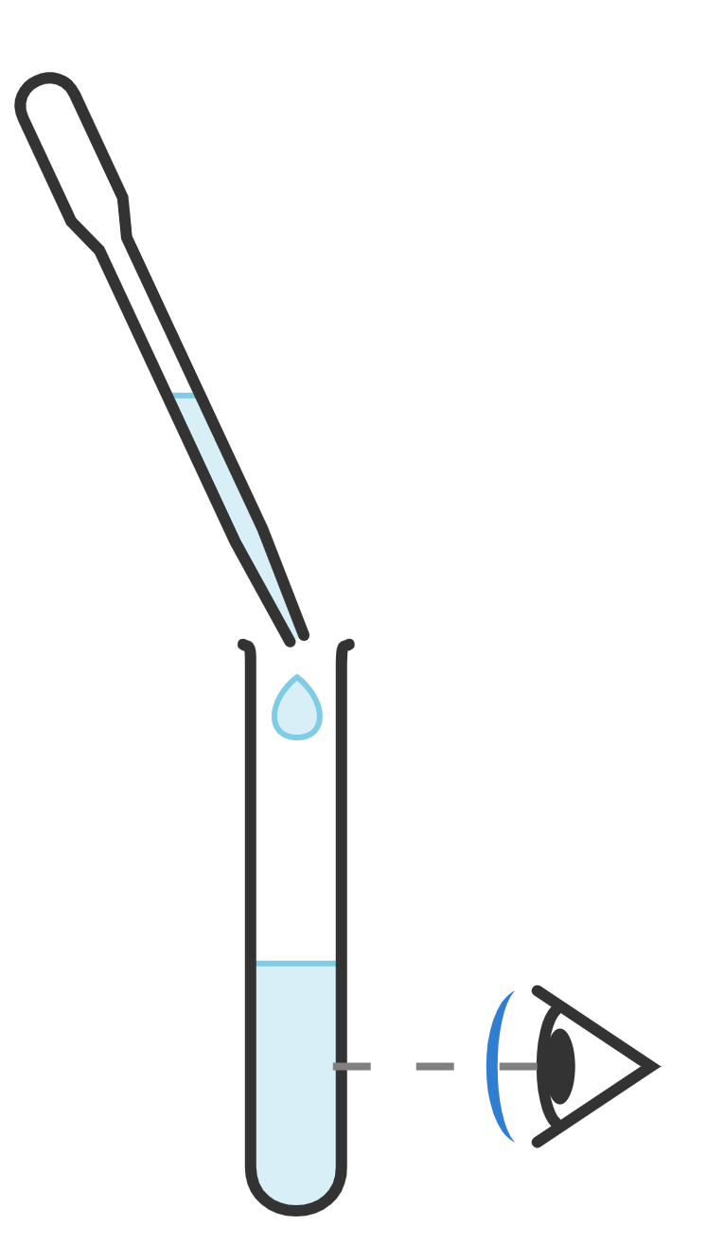
Isticmaalka falgalyada roobabka (precipitation reactions)
Samee aqoonsigaaga shayga (identification of substances) shaqo gacmeed. Macallinkaagu wuxuu ku siin doonaa xalal aan la aqoon (unknown solutions) si aad u tijaabiso.
pipette
sodium hydroxide
Habka (Method)
Ku dar milan (solution) sodium hydroxide milanka tijaabada.
Fiiri in roobab (precipitate) uu sameeyo.
Ku qor natiijooyinkaaga miiska natiijooyinka.
milkan tijaabada (test solution)

Slide 38
Isticmaalka falgalyada roobabka (precipitation reactions)
Natiijooyinkaaga waxay u ekaan karaan kuwa Axmed.
muunad (sample) | midabka roobabka (precipitate) | xarun bir ah oo joogta (metal compound present)
F
G
H
I
J
blue
copper
ma jiro aluminium / calcium / magnesium / lead / copper / iron
ma jiro roobab (precipitate)
brown
iron
white
aluminium / calcium / magnesium / lead
cagaar
iron

Slide 39
Falgal (reaction) kiimiko: roob-abuur
Falgal (reaction) roob-abuurku wuxuu dhacaa marka laba milan (solution) isku daraan si ay u sameeyaan adke aan milmi karin.
Muujinta roob-abuurka ayaa caddayn ah in falgal (reaction) kiimiko dhacay.
Falgal (reaction) roob-abuurku waxay muhiim u yihiin daawaynta biyaha (water), si looga saaro walxaha aan loo baahnayn biyaha (water).
Falgal (reaction) roob-abuurku waxaa loo isticmaalaa falanqaynta tayada, si loo ogaado joogitaanka walxaha qaarkood ee milan (solution) dhexdiisa.

