Slide 1
Doorashada hab ku habboon helista dhererka saddexagalka
Trigonometry (Xisaabta saddexagalka)

Slide 2
Sida agabkeena waxbarid loogu talagalay fasalka

Slide 3
Waxaan dooran karaa habka ku habboon si aan u helo dhinaca maqan ee saddexagal qumman (right-angled triangle).

Slide 4
Saamiyada trigonometric (trigonometric ratios) waa saamiyo u dhexeeya laba dherer oo saddexagal qumman ah:
sin(θ°) = opposite (ka soo horjeeda) cos(θ°) = adjacent (ku xiga) tan(θ°) = opposite (ka soo horjeeda)
hypotenuse (dhinaca ugu dheer) hypotenuse (dhinaca ugu dheer) adjacent (ku xiga)

Slide 5

Doorashada hab ku habboon helista dhererka saddexagalka
Trigonometry (Xisaabta saddexagalka) iyo waxa aan ahayn
Isticmaalka dhabta ah ee trigonometry (Xisaabta saddexagalka)

Slide 6
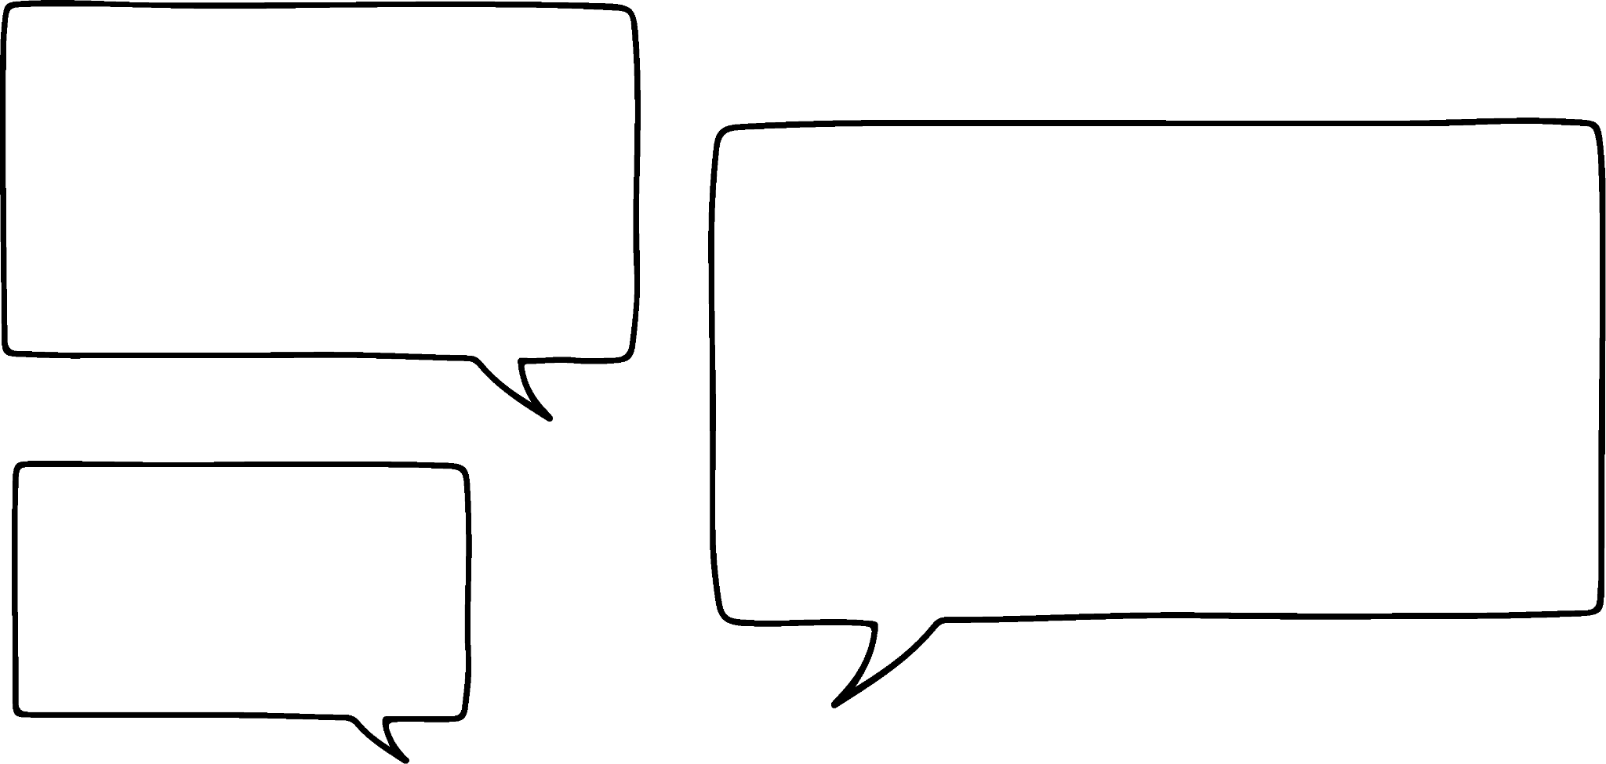


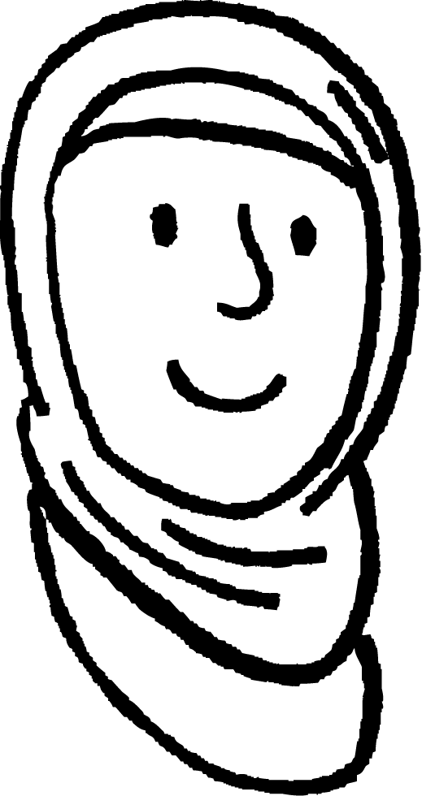
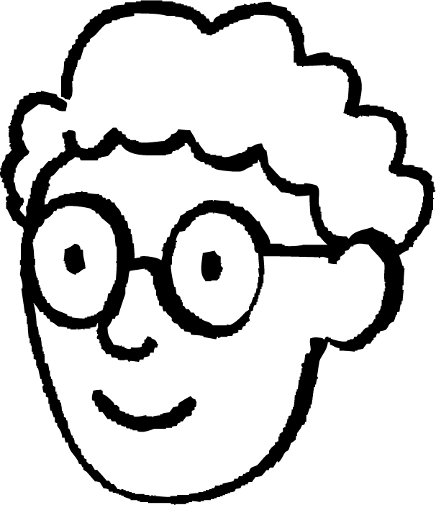


Trigonometry (Xisaabta saddexagalka) iyo waxa aan ahayn
Axmed iyo Caasha waxay ka hadlayaan sida ay u heli lahaayeen wareega (perimeter) saddexagalkan.
15 cm
Marka waxaan u baahanahay inaan xisaabino cidhifka saddexaad marka hore.
Wareega (perimeter) waa wadarta cidhifyada.
53.1°
9 cm
Caasha
Axmed

Slide 7
Trigonometry (Xisaabta saddexagalka) iyo waxa aan ahayn
Axmed iyo Caasha waxay ka hadlayaan sida ay u heli lahaayeen wareega (perimeter) saddexagalkan.
Cidhifka saddexaad ha ahaado x, kaas oo ka soo horjeeda xagasha la siiyay. Waan ogahay dhererka hypotenuse (hypotenuse) marka waxaan isticmaali doonaa sine (sine).
15 cm
x cm
x = 15 × sin(53.1°) = 12.0 cm
53.1°
Wareegga (Perimeter) = 15 + 9 + 12 = 36 cm
9 cm
Caasha
Axmed

Slide 8
Trigonometry (Trigonometry) ama maya
Axmed iyo Caasha waxay ka wada hadlayaan sida ay u heli lahaayeen wareegga (perimeter) saddexagalkan.
Waxaan isticmaali lahaa aragtida Pythagoras (Pythagoras’ theorem) si aan u xisaabiyo dhererka x.
15 cm
15² = 9² + x²
x cm
x² = 15² - 9² = 144
x = 12 cm
53.1°
Wareegga (Perimeter) = 15 + 9 + 12 = 36 cm
9 cm
Caasha
Axmed

Slide 9

Trigonometry (Trigonometry) ama maya
Macluumaadka la siiyay, waxaad awoodi lahayd…
16 cm
…isticmaalka trigonometry (trigonometry) si loo xisaabiyo labada dherer ee cidhifyada kale
50°
…isticmaalka Aragtida Pythagoras (Pythagoras’ Theorem) si loo xisaabiyo labada dherer ee cidhifyada kale
…xisaabinta xagasha saddexaad ee saddexagalka

Slide 10
Trigonometry (Trigonometry) ama ma aha
Si loo xisaabiyo wareegga (perimeter) saddexagalkaan, waxaan u baahanahay inaan ogaano dhererka cidhifka saddexaad.
Aragtida Pythagoras (Pythagoras’ theorem) iyo hawlo trigonometric (trigonometric functions) waxay u baahan yihiin saddexagallo qumman (right-angled triangles).
16 cm
35°
Xaggee ayaa saddexagal qumman (right-angled triangle) laga abuuri karaa?
9 cm
Kordhinta cidhifka saldhiga (base edge) iyo soo dejin khad toosan (perpendicular line).
16 cm
35°

Slide 11
Trigonometry (Trigonometry) ama ma aha
Si loo xisaabiyo wareegga (perimeter) saddexagalkaan, waxaan u baahanahay inaan ogaano dhererka cidhifka saddexaad.
Aragtida Pythagoras (Pythagoras’ theorem) iyo hawlo trigonometric (trigonometric functions) waxay u baahan yihiin saddexagallo qumman (right-angled triangles).
16 cm
35°
Hadda shaqada sine (sine function) ayaa loo isticmaali karaa in lagu xisaabiyo dhinaca ka soo horjeeda (opposite), dhererka tooska ah (vertical height).
9 cm
16 cm
h = 16 × sin(35°) = 9.177…
h cm
35°

Slide 12
Trigonometry (Trigonometry) ama ma aha
Si loo xisaabiyo wareegga (perimeter) saddexagalkaan, waxaan u baahanahay inaan ogaano dhererka cidhifka saddexaad.
Aragtida Pythagoras (Pythagoras’ theorem) iyo hawlo trigonometric (trigonometric functions) waxay u baahan yihiin saddexagallo qumman (right-angled triangles).
16 cm
9.17… cm
35°
Qaaciddada (theorem) Pythagoras, shaqada cosine (cosine function) ama shaqada tangent (tangent function) ayaa loo isticmaali karaa xisaabinta dhererka x.
9 cm
16 cm
9.17… cm
x = 16 × cos(35°) = 13.10…
35°
x cm

Slide 13
Trigonometry (Trigonometry) ama maya
Si loo xisaabiyo wareegga (perimeter) saddexagalkaan, waxaan u baahanahay inaan ogaano dhererka cidhifka saddexaad.
Qaaciddada (theorem) Pythagoras iyo shaqooyinka trigonometric (trigonometric functions) waxay u baahan yihiin saddexagallo qumman (right-angled triangles).
16 cm
y cm
9.17… cm
35°
Markaas qaaciddada (theorem) Pythagoras ayaa loo isticmaali karaa xisaabinta dhererka cidhifka saddexaad.
9 cm
4.10… cm
y² = 4.10…² + 9.17…²
16 cm
y² = 101.084…
9.17… cm
Wareeg (Perimeter) = 10.05 + 16 + 9 = 35.05 cm (2 d.p.)
y = 10.05…
35°
13.10… cm

Slide 14
Trigonometry (Trigonometry) ama maya
Khadadka dheeraadka ah (additional lines) ee ugu faa'iidada badan xisaabinta dhererka cidhifka saddexaad ee saddexagalka waa kuwee?
8 cm
8 cm
8 cm
21°
5 cm
21°
5 cm
21°
5 cm

Slide 15
Trigonometry (Trigonometry) ama ma aha
Jaantuskan wuxuu ka kooban yahay saddex xagal, ma heli kartaa?
Iyadoo diiradda la saarayo saddexagalkan, waxaan xisaabin karnaa dhererka cidhifka saddexaad adigoo isticmaalaya aragtida Pythagoras (Pythagoras’ theorem).
x cm
14 cm
65°
a cm
14² = 9² + a²
a² = 14² - 9²
31°
a² = 196 - 81 = 115
9 cm
a = 10.72…

Slide 16
Trigonometry (Trigonometry) ama ma aha
Jaantuskan wuxuu ka kooban yahay saddex xagal, ma heli kartaa?
Hadda adigoo isticmaalaya saddexagalkan qumman, shaqada tangent (tangent function) waxaa loo isticmaali karaa in lagu xisaabiyo dhererka dhinaca ka soo horjeeda.
x cm
14 cm
65°
10.72… cm
b cm
b = 9 × tan(31°) = 5.41 cm
5.40… cm
31°
Taas oo u oggolaanaysa in x la xisaabiyo.
9 cm
x = 10.72… - 5.40…
= 5.316 (3 d.p.)

Slide 17
Trigonometry (Trigonometry) ama maya
Kee ka mid ah xisaabahaan ayaa sax ah si loo helo a?
a² = 18² - 14²
18 cm
65°
a cm
a = 18 × cos(65°)
14 cm
a = 18 × sin(25°)
a = 14 ÷ tan(65°)

Slide 18
Trigonometry (Trigonometry) ama maya
1) Xisaabi x ee saddex-xagal kasta.
a)
b)
c) Wareeggu waa 1.2 m
x cm
x cm
x cm
30 cm
30 cm
30°
40 cm
40 cm
40 cm

Slide 19
Trigonometry (Trigonometry) ama maya
2) Xisaabi x ee saddex-xagal kasta, jawaabtaada ku qor meel tobanle oo keliya.
a)
b)
x cm
28 cm
x cm
8°
73°
19°
72°
24 cm
12.8 cm

Slide 20
Trigonometry (Trigonometry) ama ma aha
3) Soo saar wareegga (perimeter) saddexagalkaan, jawaabta ku bixi hal meel jajab tobanle (1 decimal place).
24 cm
21°
15 cm

Slide 21
Trigonometry (Trigonometry) ama ma aha
1) Xisaabi x ee saddexagal kasta.
a)
b)
c) Wareeggu (perimeter) waa 1.2 m
x cm
x cm
x cm
30 cm
30 cm
30°
40 cm
40 cm
40 cm
40
x² = 40² + 30²
x + 40 + 30 = 120
x =
cos(30°)
x² = 2500
x + 70 = 120
x = 46.2 (1 d.p.)
x = 50
x = 50

Slide 22
Trigonometry (Trigonometry) ama ma aha
2) X ku xisaab saddex-xagal kasta, jawaabtaada ku bixi 1 meel tobanle (1 decimal place).
a)
24
y =
x cm
tan(73°)
28 cm
y = 7.33…
8°
73°
y cm
28² = 24² + (x + 7.33…)²
28² - 24² = (x + 7.33…)²
24 cm
208 = (x + 7.33…)²
14.42… = x + 7.33…
7.1 = x (1 d.p.)

Slide 23
Trigonometry (Trigonometry) ama maya
2) X ku xisaab saddex-xagal kasta, jawaabtaada ku bixi 1 meel tobanle (1 decimal place).
b)
12.8
x =
cos(37°)
x cm
x = 16.0
19°
72°
18°
12.8 cm

Slide 24
Trigonometry (Trigonometry) ama maya
3) Wareega (perimeter) saddex-xagalkan ku xisaab, jawaabtaada ku bixi 1 meel tobanle (1 decimal place).
24 cm
Wareeg (Perimeter)
= 11.3 + 15 + 24 = 50.3 cm
21°
15 cm
x cm
a cm
a = 15cos(21°)
x² = b² + (24 - a)²
21°
b cm
= 14.00…
x² = 5.37…² + 10²
15 cm
b = 15sin(21°)
x² = 128.822…
= 5.37…
x = 11.3499…

Slide 25
Doorashada hab ku habboon ee lagu helo dhererka saddexagalka
Trigonometry (Trigonometry) ama ma aha
Isticmaalka dhabta ah ee trigonometry-ga

Slide 26
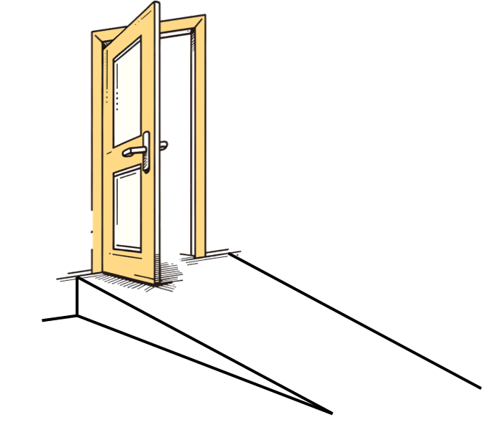
Isticmaalka dhabta ah ee trigonometry-ga
Waa in la dhisaa jid (ramp) oo ka baxsan dukaan si loogu helo cursiyaasha (wheelchair). Jiirada (incline) kama badnaan karto 4.8°. Salka albaabka wuxuu dhererkiisu yahay 34 cm. Intee ayay u jiri doontaa dukaanka bilowga jidka?
Iyadoo loo malaynayo in gidaarka dukaanku uu yahay mid toosan (perpendicular) dhulka. Waxaa loo isticmaali karaa shaqada tangent (tangent function) si loo go'aamiyo dhererka ku xiga (adjacent length).
34
d =
= 404.9
tan(4.8°)
34 cm
4.8°
Bilowga jidka (ramp) wuxuu u jiraa qiyaastii 4.05 mitir dukaanka.
d cm

Slide 27
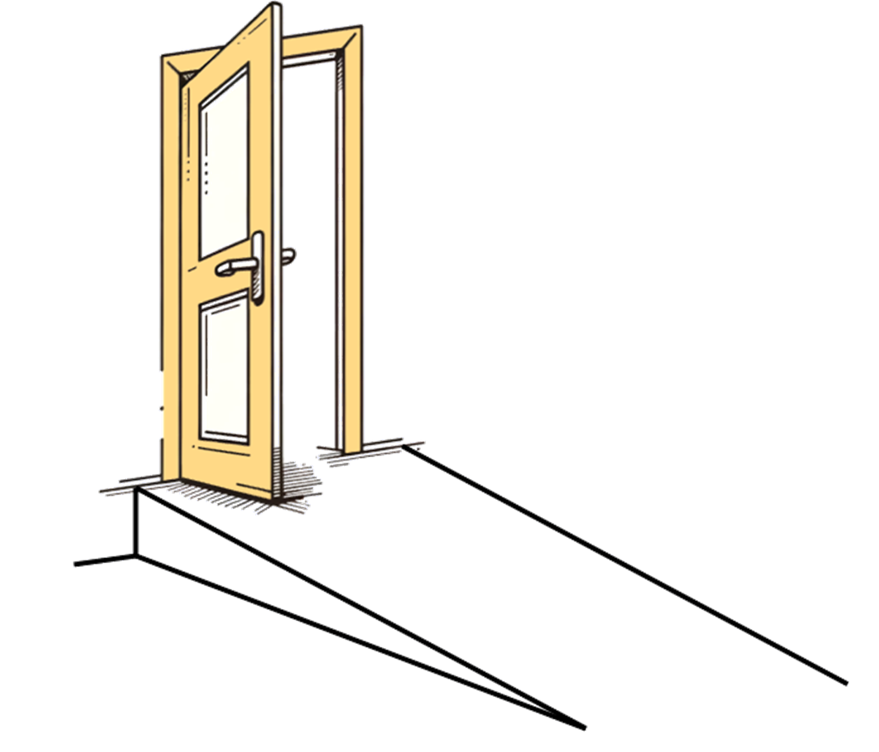
Isticmaalka dhabta ah ee trigonometry-ga
Waa in la dhisaa jid (ramp) oo ka baxsan dukaan kale si loogu helo cursiyaasha (wheelchair). Jiirada (incline) weli kama badnaan karto 4.8°. Salka albaabkani wuxuu dhererkiisu yahay 30 cm. Immisa ayuu dhererkiisu yahay jidku?
30
d =
= 358.51…
d cm
sin(4.8°)
30 cm
4.8°
Jidku wuxuu dhererkiisu yahay 3.59 mitir.

Slide 28
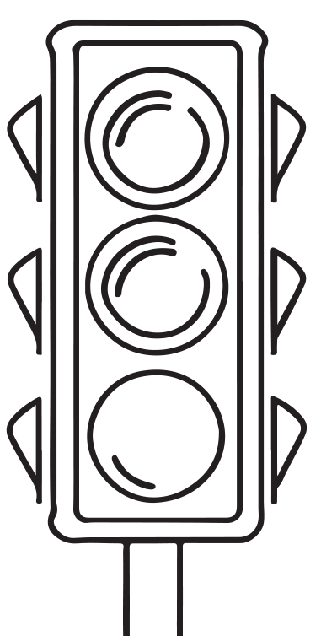
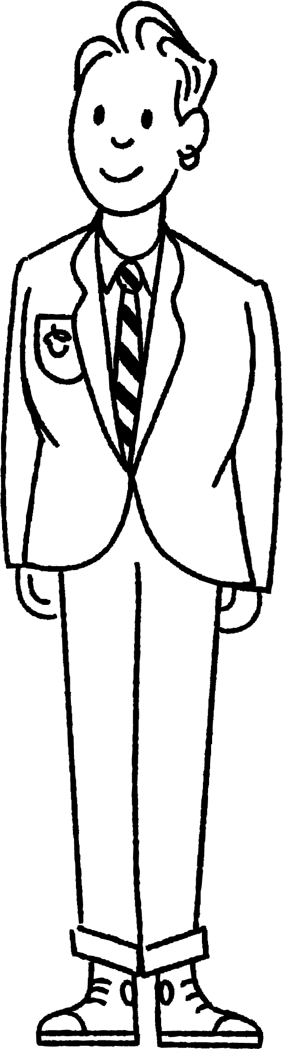
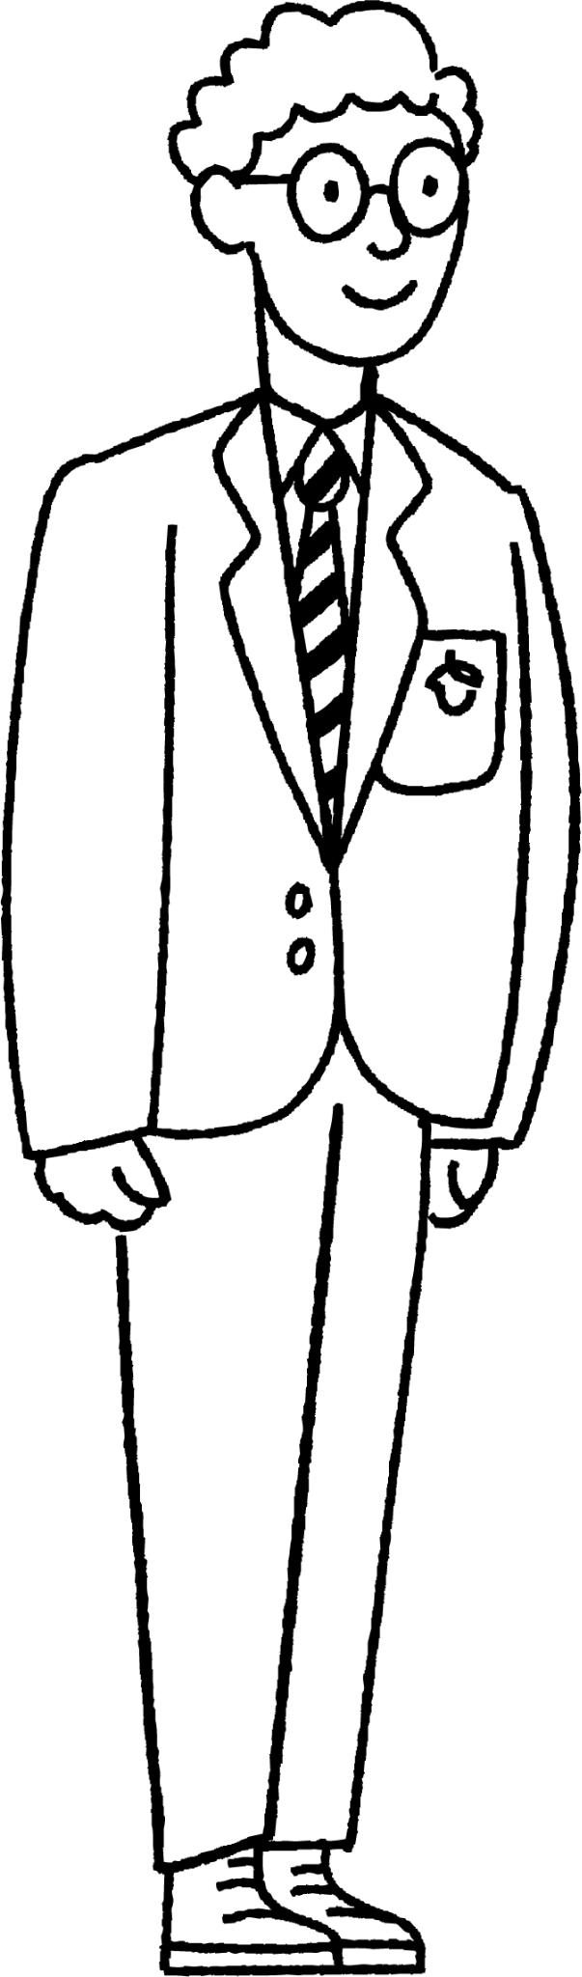
Isticmaalka dhabta ah ee trigonometry-ga
Axmed iyo Saciid waxay qiyaasayaan dhererka nalalka taraafigga.
Sidee ayay u samayn karaan iyagoo isticmaalaya trigonometry?
Haddii aan ognahay dhererka Axmed oo aan cabbirno xagasha (angle) ilaa sare ee nalalka taraafigga laga bilaabo heerka indhihiisa, waxaan isticmaali karnaa trigonometry.
h m
52°
Qalab loo yaqaan 'clinometer' ayaa cabbiri kara xagasha (angle).
156 cm
3 m

Slide 29
Adeegsiga dhabta ah ee trigonometry
Axmed iyo Saciid waxay qiyaasayaan dhererka nalalka taraafigga.
Sidee bay u samayn karaan iyagoo adeegsanaya trigonometry?
x = 3 × tan(52°) = 3.839…
x m
h = 3.83… + 1.56
= 5.4 (1 d.p.)
h m
52°
3 m
156 cm
3 m

Slide 30
Adeegsiga dhabta ah ee trigonometry
Buuxi meelaha bannaan si aad u qiyaasto dhererka nalka taraafiggan.
x = × tan(52°) = m
2
2.55…
x m
h = 2.55… + 1.56
= m
h m
52°
4.12
2 m
156 cm
2 m

Slide 31
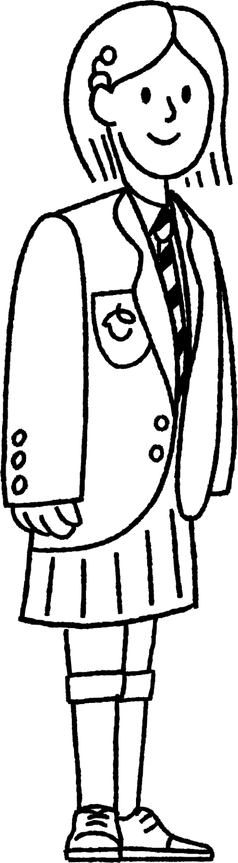
Adeegsiga dhabta ah ee trigonometry
Suad waxay taagan tahay dusha shan (cliff), 60 m oo ka sarreeya heerka badda. Waxay arki kartaa laba calaamad (buoys) oo toos ah horteeda. Xagasha hoos-u-dhaca (angles of depression) ee calaamadahan waa 47º iyo 32º siday u kala horreeyaan. Suad waxay rabta inay qiyaasto inta u dhaxaysa labada calaamad.
32°
15°
Maxay 1.35 m u taagan tahay?
Waa dhererka Suad ilaa heerka indhaheeda.
(60 + 1.35) m
d m

Slide 32
Adeegsiga dhabta ah ee trigonometry
Suad waxay taagan tahay dusha shan (cliff), 60 m oo ka sarreeya heerka badda. Waxay arki kartaa laba calaamad (buoys) oo toos ah horteeda. Xagasha hoos-u-dhaca (angles of depression) ee calaamadahan waa 47º iyo 32º siday u kala horreeyaan. Suad waxay rabta inay qiyaasto inta u dhaxaysa labada calaamad.
32°
Nooc fudud oo jaantuskan ah ayaa halkan faa'iido yeelan doona.
15°
(60 + 1.35) m
d m

Slide 33
Adeegsiga dhabta ah ee trigonometry
Suad waxay taagan tahay dusha shan (cliff), 60 m oo ka sarreeya heerka badda. Waxay arki kartaa laba calaamad (buoys) oo toos ah horteeda. Xagasha hoos-u-dhaca (angles of depression) ee calaamadahan waa 47º iyo 32º siday u kala horreeyaan. Suad waxay rabta inay qiyaasto inta u dhaxaysa labada calaamad.
x = 61.35 × tan((43 + 15)°) = 98.18
15°
y = 61.35 × tan(43°) = 57.21
58°
43°
61.35 m
x m
98.18 m
y m
d m
57.21 m

Slide 34
Adeegsiga dhabta ah ee trigonometry
Suad waxay taagan tahay dusha sare ee jiir, 60 m oo ka sarreysa heerka badda. Waxay arki kartaa laba calaamadood oo toos ah horteeda. Xaglaha hoos-u-dhaca ee calaamadahan waa 47º iyo 32º siday u kala horreeyaan. Suad waxay rabtaa inay qiyaasto inta u dhaxaysa labada calaamadood.
x = 61.35 × tan((43 + 15)°) = 98.18
15°
y = 61.35 × tan(43°) = 57.21
43°
61.35 m
d = x - y = 98.18 - 57.21 = 40.97
Calaamaduhu waxay u kala fog yihiin 40.97 m.
98.18 m
d m
57.21 m
40.97 m

Slide 35
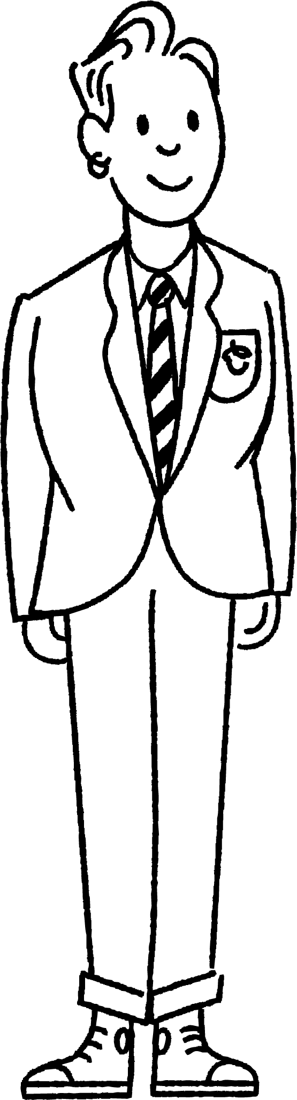
Isticmaalka dhabta ah ee trigonometry
Saciid wuxuu taagan yahay dusha sare ee jiir, 60 m oo ka sarreysa heerka badda. Waxay arki karaan laba calaamadood oo toos ah hortooda. Xaglaha hoos-u-dhaca ee calaamadahan waa 46º iyo 32º siday u kala horreeyaan.
32°
x°
14°
Waa imisa cabbirka x?
46 - 32 = 14

Slide 36

Isticmaalka dhabta ah ee trigonometry
Waxay rabaan inay xisaabiyaan masaafada, d m, ee u dhaxaysa labada calaamadood.
Labada saddexagal ee ay isticmaali doonaan xisabintooda waa kuwee?
32°
14°
d m
Jawaabaha:
32°
46°
58°
14°
31°
44°
a
b
c

Slide 37
Isticmaalka dhabta ah ee trigonometry
Jiirku wuxuu dhererkiisu yahay 60 m, waxaana jira 1.63 m ilaa heerka indhaha Saciid.
44°
58°
masaafada calaamadda koowaad, x m
Dhammeystir xisaabinta si aad u hesho masaafada toosan ee calaamadda ugu dhow.
x = 61.63 × tan(44°) = 59.52 m (2dp)

Slide 38
Isticmaalka dhabta ah ee trigonometry
Masaafada calaamadda koowaad waa 59.515.. m, masaafada calaamadda labaadna waa 98.628… m.
44°
58°
59.515… m
98.628… m
Waa imisa masaafada u dhaxaysa labada calaamadood, ilaa mitirka ugu dhow?
d = 98.628… - 59.515… = 39 m

Slide 39
Isticmaalka dhabta ah ee trigonometry
1) Waa la dhisayaa jidka loo yaqaan 'ramp' oo ka baxsan guri. Qaybta hoose ee albaabku waa 42 cm oo ka sarreysa dhulka. Xagasha u dhaxaysa ramp-ka iyo dhulka waa inaysan ka badnayn 4.8° Waa imisa dhererka ugu yar ee ramp-ka?
2) Nin taagan oo ku taal webi-banka wuxuu arkayaa geed gaar ah oo ku yaal banka ka soo horjeeda. Kadib wuxuu socdaa 60 mitir oo toos ah oo dhinaca webi-banka. Markuu dib u eego, wuxuu arki karaa in xagasha u dhaxaysa khadka socodkiisa iyo khadka geedka ay tahay 32º. Imisa ayay ballac tahay webiga?

Slide 40
Isticmaalka dhabta ah ee trigonometry
3) Tiir dhererkiisu yahay 7 m waxaa lagu xidhay siligyo taageero. Siligyada waxaa lagu shubay xariiq toosan. Siligyada kore waxay la sameeyaan xagal 31° sagxadda, siligyada gudahana waxay la sameeyaan xagal laba jibaaran. Immisa ayay kala fog yihiin siligyadu?
7 m
31°
d m

Slide 41
Isticmaalka dhabta ah ee trigonometry
1) Jid loo dhisayaa guri ka baxsan. Gunta hoose ee albaabku waa 42 cm ka sarraysa sagxadda. Xagasha u dhaxaysa jidka iyo dhulka waa inaysan ka badnayn 4.8°. Waa maxay dhererka ugu yar ee jidka?
m cm
42 cm
4.8°
42
m = = 501.9
sin(4.8°)
Jidka dhererkiisu waa ugu yaraan 501.9 cm ama 5.02 m.

Slide 42
Isticmaalka dhabta ah ee trigonometry
2) Nin taagan oo daanta webiga ku yaal wuxuu arkayaa geed gaar ah daanta kale. Kadib wuxuu socdaa 60 m oo toosan daanta webiga. Markuu dib u eego, wuxuu arkaa in xagasha u dhaxaysa dariiqiisa iyo xariiqda geedka ay tahay 32°. Immisa buu webigu u ballaaran yahay?
r = 60 × tan(32°)
r m
r = 37.5
32°
Webigu wuxuu ballaaran yahay 37.5 m.
60 m

Slide 43
Isticmaalka dhabta ah ee trigonometry
3) Tiir dhererkiisu yahay 7 m waxaa lagu xidhay siligyo taageero. Siligyada waxaa lagu shubay xariiq toosan. Siligyada kore waxay la sameeyaan xagal 31° sagxadda, siligyada gudahana waxay la sameeyaan xagal laba jibaaran. Immisa ayay kala fog yihiin siligyadu?
7 m
7 m
31°
31°
d m
7
tan(31°)
= 11.65 m
7 m
d = 11.65 - 3.72 = 7.93
7
62°
tan(62°)
= 3.72 m
Siligyadu waxay kala fog yihiin 7.93 m.

Slide 44
Doorashada hab ku habboon helista dhererka saddex-xagalka
Trigonometry waxaa loo isticmaali karaa xaalado badan oo dhab ah. Inta badan waxaa loo isticmaalaa iyadoo lala shaqeynayo aragtida Pythagoras.
Waxaa loo isticmaalaa in lagu xisaabiyo ama lagu qiyaaso dhererka shay weyn, halka cabbirkoodu aanu macquul ahayn.

