Slide 1
Doorashada saamiga saxda ah ee trigonometry (trigonometric ratio)
Trigonometry

Slide 2
Sida agabkeena waxbarista loogu talagalay fasalka

Slide 3
Waxaan dooran karaa saamiga trigonometric (trigonometric ratio) ku habboon si aan u xalliyo dhibaatooyinka saddexagalka qumman (right-angled triangles).

Slide 4
Saamiyada trigonometric (trigonometric ratios) waa saamiyada u dhexeeya labada dherer ee saddexagalka qumman (right-angled triangle):
sin(θ°) = ka soo horjeeda (opposite) cos(θ°) = ku xiga (adjacent) tan(θ°) = ka soo horjeeda (opposite)
hypotenuse hypotenuse adjacent

Slide 5

Doorashada saamiga saxda ah ee trigonometry (trigonometric ratio)
Doorashada shaqada trigonometric (trigonometric function) saxda ah
Isticmaalka saamiyada (ratios)

Slide 6
Doorashada shaqada trigonometric (trigonometric function) saxda ah
Saddexagalka, xiriirka saamiyeed (proportional relationship) ee u dhexeeya labada dhinac waxaa go'aamiya xaglaha.
Mid kasta oo ka mid ah shaqooyinka trigonometric (sine, cosine, tangent) waxay helaan isku dhufashada (multiplier) u dhexeeya labada dhinac ee saddexagalka qumman (right-angled triangle) marka la eego mid ka mid ah xaglaha kale.
× sin(𝜃°)
hyp
hyp
opp
× cos(𝜃°)
opp
𝜃°
𝜃°
𝜃°
adj
adj
× tan(𝜃°)

Slide 7
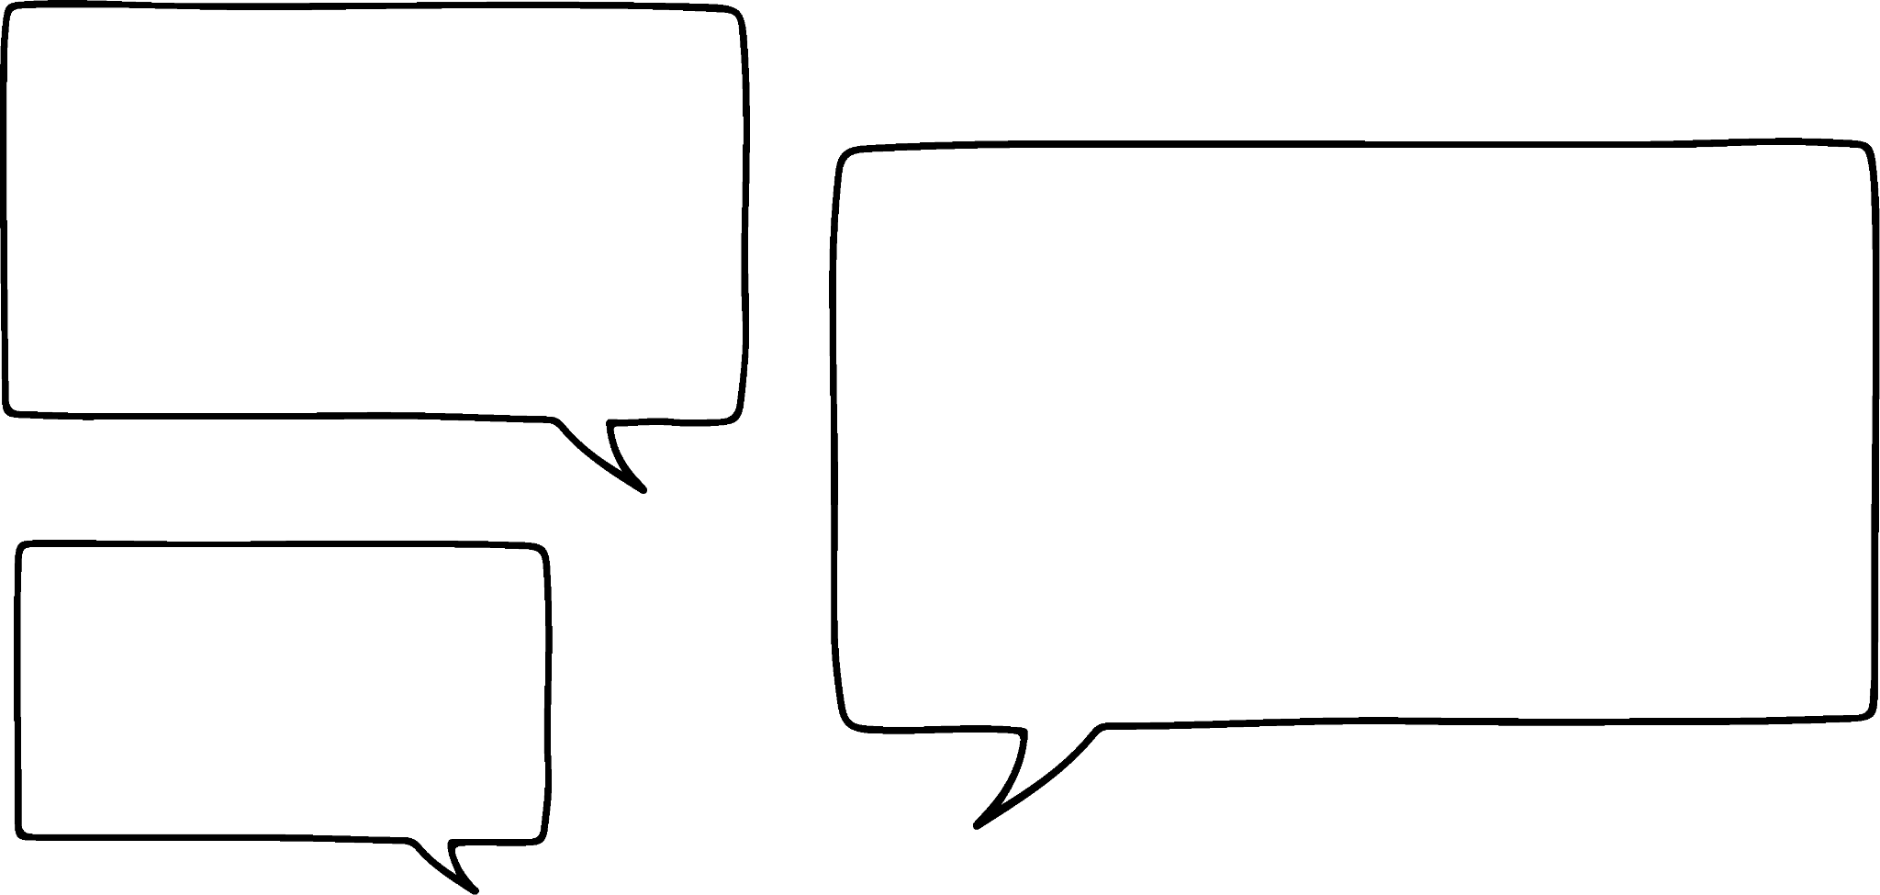


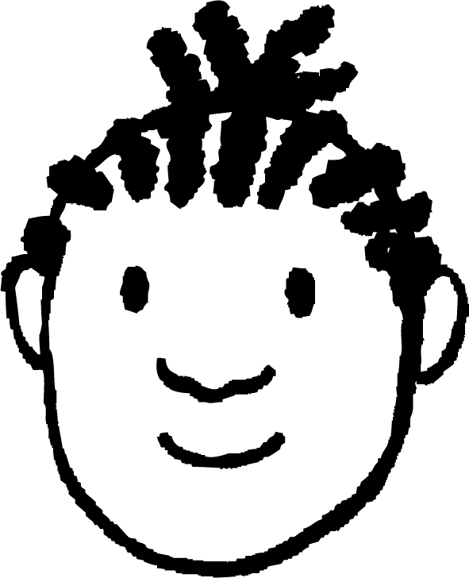
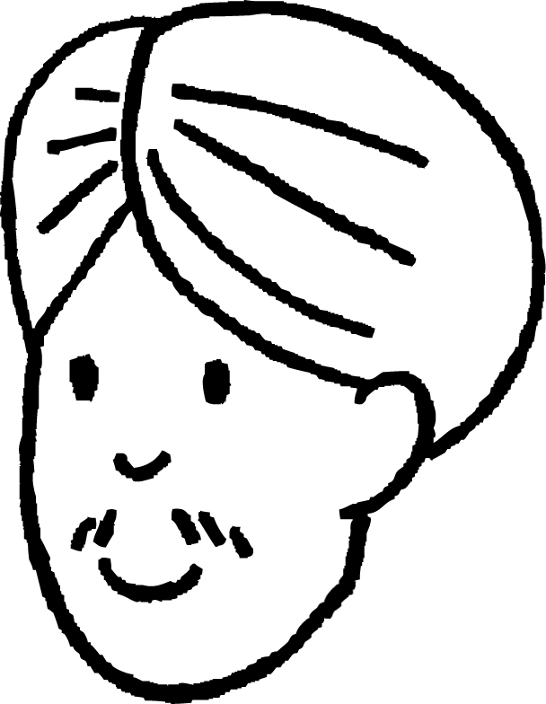


Doorashada farsamada saxda ah (trigonometric function)
Farsamada (trigonometric function) ee noocee ayaan u isticmaali karnaa si aan u xisaabino qiimaha (value) x?
x cm
58°
Sine - 6 cm waa dhinaca ka soo horjeeda (opposite) 58° iyo x waa hypotenuse.
32°
6 cm
Maya, cosine - 6 cm waa dhinaca ku xiga (adjacent) 90° iyo 32° iyo x waa hypotenuse.
Yacquub
Yaa aad la raacsan tahay?
Labadooduba waa sax yihiin. Waxay doorteen inay isticmaalaan xagal diirad (focus angle) oo kala duwan.
Cali

Slide 8
Doorashada farsamada saxda ah (trigonometric function)
Farsamada (trigonometric function) ee noocee ayaan u isticmaali karnaa si aan u xisaabino qiimaha (value) x?
x cm
58°
6
sin(58°) =
32°
x
6
6 cm
x =
sin(58°)
6
cos(32°) =
x
x = 7.1 cm (1dp)
6
x =
cos(32°)
x = 7.1 cm (1dp)
Yacquub
Labaduba waxay si sax ah u xisaabiyaan x.
Cali

Slide 9

Doorashada shaqada trigonometric (trigonometric function) ee saxda ah
Haddii 26° uu yahay xagasha diiradda (focus angle), doorashada shaqada trigonometric (trigonometric function) ee aad isticmaali doonto si aad u xisaabiso qiimaha (value) x?
9.2 cm
64°
sine
26°
x cm
cosine
tangent

Slide 10
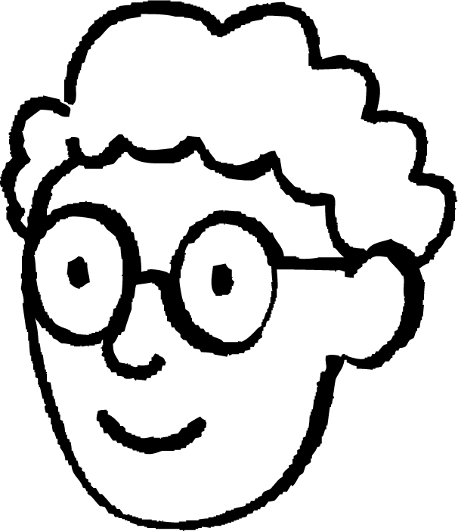
Doorashada shaqada trigonometric (trigonometric function) ee saxda ah
Marka la eego macluumaadkan, waa kuwee hababka loo isticmaali karo si loo xisaabiyo qiimaha (value) x?
h cm
x cm
58°
32°
Waxaan isticmaali lahaa sine, si aan u xisaabiyo dhererka hypotenuse, ka dibna mar kale sine si aan u xisaabiyo x.
6 cm
6
x
sin(58°) =
sin(32°) =
h
7.07…
6
h =
x =
7.07… × sin(32°)
sin(58°)
h = 7.07…
= 7.1 (1dp)
= 3.7 (1dp)
Axmed

Slide 11

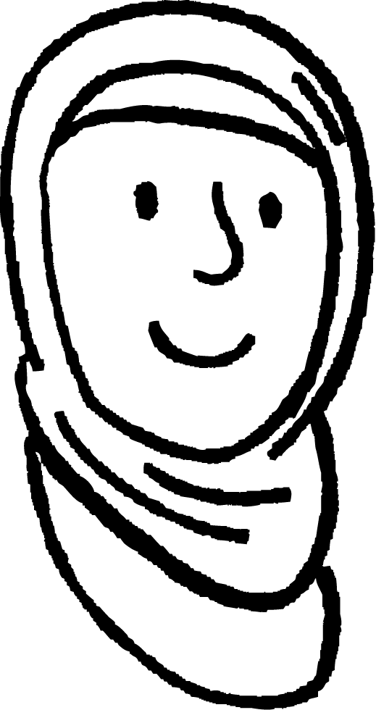

Doorashada shaqada trigonometric-ka saxda ah (Choosing the correct trigonometric function)
Marka la eego macluumaadkan, waa kuwee hababka loo isticmaali karo si loo xisaabiyo qiimaha (value) x?
h cm
x cm
58°
Waxaan isticmaali lahaa cosine (cosine), si aan u xisaabiyo dhererka hypotenuse-ka (hypotenuse), ka dibna isticmaal sine (sine) si aan u xisaabiyo x.
32°
6 cm
6
x
cos(32°) =
sin(32°) =
h
7.07…
6
h =
x =
7.07… × sin(32°)
cos(32°)
h = 7.0750…
= 7.1 (1dp)
x = 3.7 (1dp)
Caasha

Slide 12
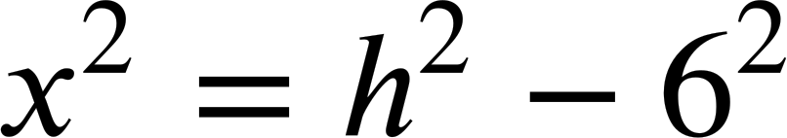

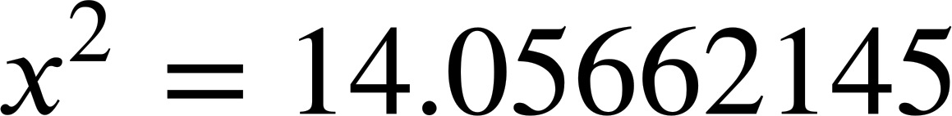
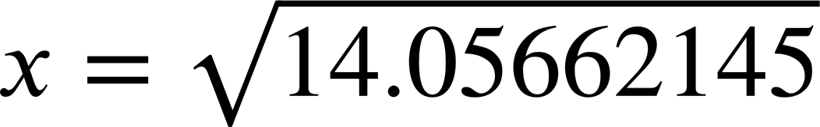
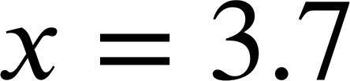
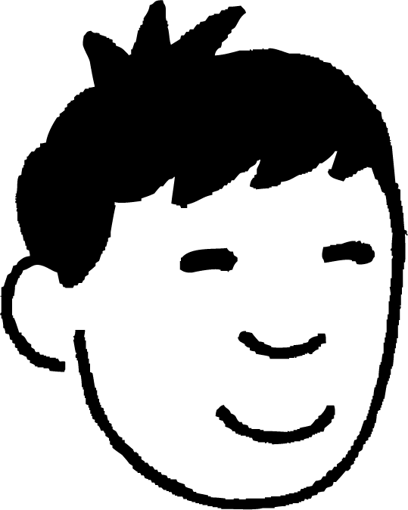
Doorashada shaqada trigonometric-ka saxda ah (Choosing the correct trigonometric function)
Marka la eego macluumaadkan, waa maxay hababka loo isticmaali karo si loo xisaabiyo dhererka x?
h cm
x cm
58°
32°
Waxaan isticmaali lahaa cosine (cosine) ama sine (sine), si aan u xisaabiyo dhererka hypotenuse-ka (hypotenuse), ka dibna isticmaal Aragtida Pythagoras (Pythagoras’ Theorem).
6 cm
6
cos(32°) =
h
6
h =
cos(32°)
h = 7.07…
= 7.1 (1dp)
(1d.p.)
Nuur

Slide 13
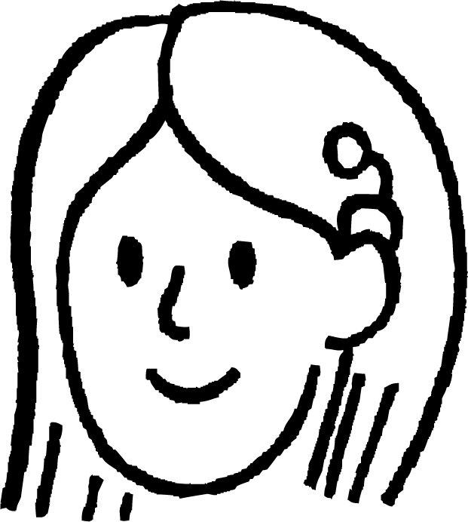
Doorashada shaqada trigonometric (trigonometric function) ee saxda ah
Markay macluumaadkani yihiin, waa kuwee hababka loo isticmaali karo si loo xisaabiyo dhererka x?
x cm
58°
32°
6 cm
x
tan(32°) =
Waxaan kaliya isticmaali lahaa tangent (tangent) si aan u helo x.
6
x = 6 × tan(32°)
x = 3.7 (1dp)
Suad

Slide 14

Doorashada shaqada trigonometric (trigonometric function) ee saxda ah
Habka ugu waxtarka badan ee loo xisaabiyo x waa isticmaalka shaqada tangent (tangent function).
x cm
58°
Ma dhammaan hababkani waa isku mid (equivalent) baa?
32°
6 cm
x
6
6
tan(32°) =
tan(32°) =
tan(58°) =
6
x
x
Haddii xagasha diiradda la saaro ay tahay 32°, markaas opposite (ka soo horjeeda) waa x cm, adjacent (ku xiga) waa 6 cm.
Haddii xagasha diiradda la saaro ay tahay 58°, markaas opposite (ka soo horjeeda) waa 6 cm, adjacent (ku xiga) waa x cm.
Marka la isticmaalo shaqada tangent (tangent function), waxaa muhiim ah in la hubiyo in 'opposite' (ka soo horjeeda) ee xagasha la doortay loo qaybiyo 'adjacent' (ku xiga).

Slide 15
Doorashada shaqada trigonometric (trigonometric function) ee saxda ah
Dhammeystir isla'egta (equation).
71°
4 cm
19°
x
tan ( °) =
71
x cm
4

Slide 16



Doorashada shaqada trigonometric-ga saxda ah
Habka ugu waxtarka badan ee loo xisaabiyo x halkan waa isticmaalka sine function, laakiin ma jiraa qaab kale?
14.1 cm
x cm
63°
Xagasha saddexaad ee saddex-xagalkan waxaa loo xisaabin karaa 63°, markaas geeska lagu calaamadeeyay x waa kuwa ku xiga (adjacent) xagasha saddexaad, waxaana loo isticmaali karaa cosine (cosine) beddelkeeda.
27°
Tani had iyo jeer waa sidaas oo kale, waxayna u shaqeysaa jihada kale sidoo kale.
x
x
sin(27°) =
cos(90° - 27°) =
14.1
14.1
x
cos(63°) =
14.1
Layla

Slide 17
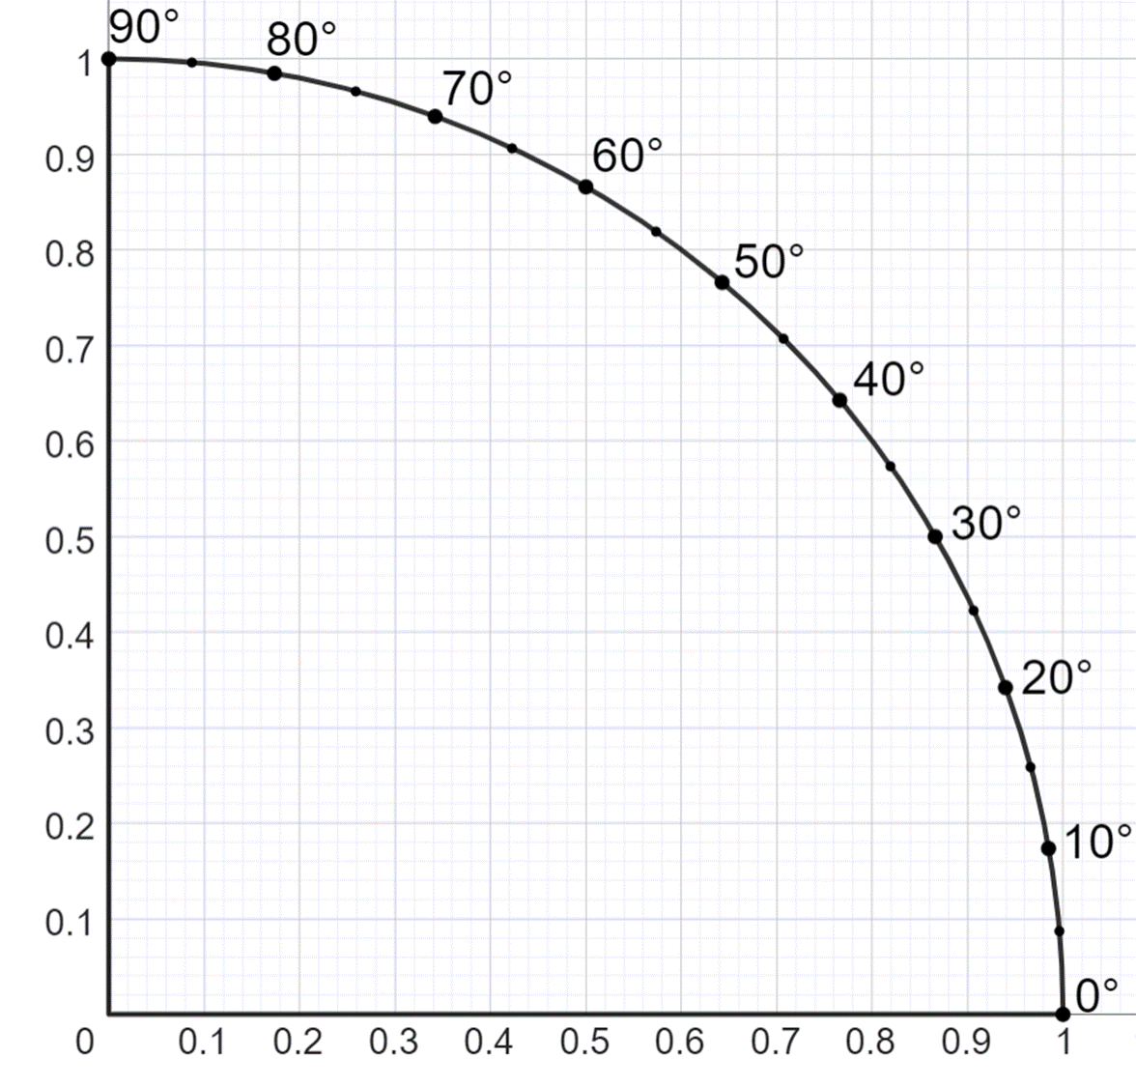
Doorashada shaqada trigonometric-ga saxda ah
1 cm
63°
x cm
27°
Waxan tan ku arki karnaa goobta halbeegga (unit circle).
sin(63°)
Geeso iska soo horjeeda (Opposite edges) ee leexleex (rectangle) waa siman yihiin.
sin(27°) = cos(63°)
cos(63°)
sin(27°)
63°
sin(63°) = cos(27°)
27°
cos(27°)

Slide 18
Doorashada shaqada trigonometric-ga saxda ah
(90 - 𝜃)°
1 cm
𝜃°
sin((90 - 𝜃)°)
Guud ahaan,
sin(𝜃°) = cos(90° - 𝜃°)
cos((90 - 𝜃)°)
sin(𝜃°)
(90 - 𝜃)°
sin(90° - 𝜃°) = cos(𝜃°)
𝜃°
cos(𝜃°)

Slide 19
Doorashada shaqada trigonometric-ga saxda ah
Saddex xagal kasta oo qumman (right-angled), haddii la siiyo laba dherer oo gees ah ama hal gees iyo hal xagal oo kale, dhammaan saddexda shaqo ee trigonometric-ga waa la isticmaali karaa.
Si kastaba ha ahaatee, mid ayaa caadi ahaan ka waxtar badan labada kale su'aasha kasta.
Marka la eego macluumaadkan oo la weydiisto in la xisaabiyo qiimaha 𝜃 iyadoo la isticmaalayo sine waxay noqon doontaa habka ugu waxtarka badan.
30 cm
12 cm
𝜃°

Slide 20
Doorashada shaqada trigonometric-ga saxda ah
Shaqada trigonometric-ga ee ugu fiican su'aashan waa kee?
sine
3.8 cm
29°
x cm
cosine
tangent

Slide 21

Doorashada shaqada trigonometric-ka ee saxda ah (Choosing the correct trigonometric function)
1) Kala saar saddexagalladan shaxda, iyadoo la eegayo shaqada trigonometric-ka ugu habboon (most efficient trigonometric function).
x cm
b
a
5.3 cm
33°
sine (sine)
cosine (cosine)
tangent (tangent)
29°
9 cm
x cm
17 m
𝜃°
8 m
3 cm
d
1.8 cm
c
𝜃°
x cm
5 cm
70°
f
31°
e
x cm
4 cm

Slide 22
Doorashada shaqada trigonometric-ka ee saxda ah (Choosing the correct trigonometric function)
2) Isku dhig isla'egta (equation) iyo saddexagalka saxda ah.
𝜃°
𝜃°
30 cm
30 cm
𝜃°
30 cm
20 cm
20 cm
20 cm
20
20
20
sin(𝜃°) =
cos(𝜃°) =
tan(𝜃°) =
30
30
30

Slide 23
Doorashada shaqada trigonometric-ga saxda ah (Choosing the correct trigonometric function)
1) Kala saar saddexagalladan (triangles) shaxda, iyadoo la tixgelinayo shaqada trigonometric-ga ugu habboon.
x cm
a
b
sine
cosine
tangent
5.3 cm
33°
29°
9 cm
c
b
a
x cm
17 m
𝜃°
8 m
e
d
f
3 cm
d
1.8 cm
c
𝜃°
x cm
5 cm
70°
f
31°
e
x cm
4 cm

Slide 24
Doorashada shaqada trigonometric-ga saxda ah (Choosing the correct trigonometric function)
2) Ku xiriir isla'egta (equation) saddexagalka saxda ah.
𝜃°
𝜃°
30 cm
30 cm
𝜃°
30 cm
20 cm
20 cm
20 cm
20
20
20
sin(𝜃°) =
cos(𝜃°) =
tan(𝜃°) =
30
30
30

Slide 25
Doorashada saamiga trigonometric (trigonometric ratio) ee saxda ah
Doorashada shaqada trigonometric (trigonometric function) ee saxda ah
Isticmaalka saamiyada (ratios)

Slide 26
Isticmaalka saamiyada (ratios)
Shaqooyinka trigonometric (trigonometric functions) waxay u oggolaadaan xisaabinta xagal (angle) ama dhererka dhinaca (edge length).
Isticmaalka saddexagalka qeexida (definition triangle).
10 cm
1 cm
34°
34°
× 10
cos(34°) cm
t cm
adj | cos(34°) | t
hyp | 1 | 10
Xisaabi dhererka t, ilaa 1 d.p.
× cos(34°)
t = 10 × cos(34°)
× 10
t = 8.3 cm

Slide 27
Isticmaalka saamiyada (Using the ratios)
Hawlaha trigonometric-ga waxay u oggolaadaan in xagal ama dhererka gees la xisaabiyo.
Isticmaalka qaacidada (Using the formula).
10 cm
adj
cos(𝜃°) =
hyp
34°
t
t cm
cos(34°) =
10
Xisaabi dhererka t, ilaa 1 d.p.
t = 10 × cos(34°)
t = 8.3 cm

Slide 28
Isticmaalka saamiyada (Using the ratios)
Raadi qiimaha x, ilaa 1 d.p.
Raadi qiimaha y, ilaa 1 d.p.
6 cm
x cm
y cm
41°
29°
× 6
4 cm
× 4
opp (opp) | sin(41°) | x
hyp (hyp) | 1 | 6
× sin(41°)
opp (opp) | tan(29°) | y
adj (adj) | 1 | 4
× tan(29°)
x = 6 × sin(41°)
y = 4 × tan(29°)
x = 3.9 cm
y = 2.2 cm

Slide 29
Isticmaal saamiga (ratios)
Raadi qiimaha (value) x, ilaa 1 d.p.
Raadi qiimaha (value) y, ilaa 1 d.p.
7 cm
x cm
y cm
43°
30°
5 cm
x
sin(43°) =
y
7
tan(30°) =
5
x = 7 × sin(43°)
y = 5 × tan(30°)
Jawaabaha:
x = 4.8 cm
y = 2.9 cm

Slide 30
Isticmaalka saamiyada (ratios)
Mid kasta oo ka mid ah saamiyada (ratios) wuxuu ku darayaa laba gees. Sida aan u xisaabino waxay ku xiran tahay geeska ay yihiin.
Isticmaalka saddexagalka qeexida (definition triangle).
Raadi dhererka m, ilaa 1 d.p.
1 cm
sin(41°) cm
m cm
41°
6 cm
×
6
41°
sin(41°)
sin(41°) | 6
1 | m
× sin(41°)
÷ sin(41°)
6
m =
= 9.1 cm
sin(41°)
×
6
sin(41°)

Slide 31
Isticmaalka saamiyada (ratios)
Mid kasta oo ka mid ah saamiyada (ratios) wuxuu ku darayaa laba gees. Sida aan u xisaabino waxay ku xiran tahay geeska ay yihiin.
Isticmaal qaacidada (formula).
Soo hel dhererka m, ilaa 1 d.p.
opp
sin(𝜃°) =
m cm
hyp
6 cm
6
sin(41°) =
41°
m
m × sin(41°) = 6
6
m =
= 9.1 cm
sin(41°)

Slide 32
Isticmaal saamiga (ratios)
Soo hel qiimaha (value) x ilaa 1 d.p.
Soo hel qiimaha (value) y ilaa 1 d.p.
y cm
5 cm
29°
34°
x cm
8 cm
tan(29°) | 5
1 | x
× cos(34°)
÷ cos(34°)
cos(34°) | 8
1 | y
× tan(29°)
÷ tan(29°)
5
8
x =
= 9.0
y =
= 9.6
tan(29°)
cos(34°)
Dhinaca lagu calaamadeeyay x waa 9.0 cm dhererkiisu (1 d.p.).
Dhinaca y waa 9.6 cm dhererkiisu (1 d.p.).

Slide 33
Isticmaalka saamiyada (ratios)
Xagasha sidoo kale waa la xisaabin karaa haddii labada gees la ogaado.
Raadi 𝜃, ilaa darajo ugu dhow.
Isticmaalka saddexagalka qeexida (definition triangle).
tan(𝜃°) cm
6 cm
𝜃°
𝜃°
× 11
1 cm
11 cm
tan(𝜃°) | 6
1 | 11
11tan(𝜃°) = 6
6
tan(𝜃°) =
× 11
11
6
𝜃° = tan-1( )
11
𝜃° = 29°

Slide 34
Isticmaalka saamiyada (ratios)
Xagasha (angle) waxaa sidoo kale la xisaabin karaa haddii labada gees (edges) la yaqaan.
Raadi 𝜃, ilaa darajada (degree) ugu dhow.
Isticmaalka qaacidada (formula).
opp
6 cm
tan(𝜃°) =
adj
𝜃°
6
tan(𝜃°) =
11 cm
11
6
𝜃° = tan-1( )
11
𝜃° = 29°

Slide 35
Isticmaalka saamiyada (ratios)
Raadi cabbirka (size) 𝜃, ilaa darajada (degree) ugu dhow.
Raadi cabbirka (size) 𝜃, ilaa darajada (degree) ugu dhow.
12 cm
7 cm
3.5 cm
𝜃°
𝜃°
9 cm
× 12
× 7
cos(𝜃°) | 9
1 | 12
sin(𝜃°) | 3.5
1 | 7
12cos(𝜃°) = 9
7sin(𝜃°) = 3.5
cos(𝜃°) = 0.75
sin(𝜃°) = 0.5
× 12
× 7
𝜃° = cos-1(0.75)
𝜃° = sin-1(0.5)
𝜃° = 41°
𝜃° = 30°

Slide 36
Isticmaal saamiyada (ratios)
1) Xisaabi dhererka geeska lagu calaamadeeyay x, adigoo ku celinaya jawaabaha 1d.p.
Jaantusyada looma sawirin qiyaas (scale)
a)
b)
c)
x cm
6 cm
17 cm
63°
27°
71°
7 cm
x cm
g)
x cm
x cm
e)
f)
57°
d)
x cm
6 cm
11 cm
59°
72°
x cm
79°
x cm
4 cm
8 cm

Slide 37
Isticmaal saamiyada (ratios)
2) Xisaabi cabbirka xagasha lagu calaamadeeyay 𝜃, adigoo ku celinaya jawaabta 1d.p.
Jaantusyada looma sawirin qiyaas (scale)
a)
b)
c)
9 cm
6.1 cm
12 cm
𝜃°
𝜃°
𝜃°
8 cm
6.8 cm
g)
4.5 cm
𝜃°
e)
f)
5.5 cm
d)
13 cm
8.8 cm
𝜃°
3 cm
𝜃°
11 cm
𝜃°
2.2 cm
7.9 cm
7.1 cm

Slide 38
Isticmaalka saamiga (ratios)
3) Xisaabi cabbirka xagasha lagu calaamadeeyay 𝜃 ama cidhifka lagu calaamadeeyay y, adigoo ku siinaya jawaabtaada 1d.p.
Jaantusyada looma sawirin miisaan (scale)
a)
b)
y cm
4 m
𝜃°
24°
9 m
6 cm
c)
d)
29°
32 mm
8.5 cm
42°
y cm
y mm

Slide 39
Isticmaalka saamiga (ratios)
1) Xisaabi dhererka geeska lagu calaamadeeyay x, adigoo ku celinaya jawaabtaada 1d.p.
Jaantusyada looma sawirin qiyaas (scale)
a)
b)
c)
7.9 cm
6 cm
17 cm
63°
27°
71°
7 cm
6.7 cm
12.9 cm
g)
5.5 cm
e)
f)
57°
d)
9.3 cm
6 cm
11 cm
59°
72°
1.1 cm
79°
9.2 cm
4 cm
8 cm

Slide 40
Isticmaal saamiyada (ratios)
2) Xisaabi cabbirka xagasha lagu calaamadeeyay 𝜃, adigoo ku celinaya jawaabtaada 1d.p.
Jaantusyada looma sawirin qiyaas (scale)
a)
b)
c)
9 cm
6.1 cm
12 cm
26.2°
27.3°
29.3°
65.4°
8 cm
6.8 cm
g)
4.5 cm
e)
f)
5.5 cm
d)
13 cm
8.8 cm
63.9°
3 cm
11 cm
25.0°
2.2 cm
32.2°
7.9 cm
7.1 cm

Slide 41
Isticmaalka saamiga (ratios)
3) Xisaabi cabbirka xagasha lagu calaamadeeyay 𝜃 ama cidhifka lagu calaamadeeyay y, kuna soo celi jawaabtaada 1d.p.
Jaantusyada looma sawirin cabbir (scale)
a)
b)
6.6 cm
4 m
24.0°
24°
9 m
6 cm
c)
d)
29°
32 mm
8.5 cm
42°
4.7 cm
47.8 mm

Slide 42
Doorashada saamiga saxda ah ee trigonometric (trigonometric ratio)
Saamiyada trigonometric-ga (trigonometric ratios) waxay qeexayaan xiriirka saamiyeed ee u dhexeeya laba dherer oo ku yaal saddex-xagal quman (right-angled triangle) iyadoo lagu salaynayo cabbirka xagasha diiradda la saaray.
Go'aaminta saamiga (ratio) la isticmaalo waa tillaabada koowaad ee lagu jawaabo su'aasha trigonometry-ga.
Mararka qaarkood waxa aad u baahan tahay in aad xisaabiso laguma gaaro xisaab kaliya, marka tixgeli waxa aad ku xisaabin karto macluumaadka la siiyay marka hore. Tixgeli saxnaanta (accuracy), hana ku soo wareejin (round) ilaa jawaabta kama dambaysta ah.

