Slide 1
Isbedelka cimilada iyo soosaarka cuntada
Isbedelka cimilada iyo kala-duwanaanshaha noolaha (biodiversity)

Slide 2
Sida agabkeena waxbarista loogu talagalay fasalka

Slide 3
Waxaan sharxi karaa sida soosaarka cuntada uu u saameeyo isbedelka cimilada oo uu uga qayb qaato, iyo sida isbeddelka cuntada uu uga caawin karo xaddididda isbedelka cimilada.

Slide 4
kulaylka caalamiga ah (global warming)
kororka heerkulka dusha sare ee dhulka
gaasaska aqalka dhirta (greenhouse gases)
gaasaska jawiga kuwaas oo ka dhigaya inuu ka diirran yahay sidii ay ahaan lahaayeen iyaga la'aantood
bixin (emission)
siideynta gaasaska aqalka dhirta (greenhouse gases) ee jawiga
isbedelka cimilada (climate change)
isbedelka muddada dheer ee qaababka cimilada
raadka kaarboonka (carbon footprint)
wadarta guud ee gaasaska aqalka dhirta (greenhouse gases) ee hawsha sii daysa

Slide 5

Isbedelka cimilada iyo soosaarka cuntada
Soosaarka cuntada iyo bixinta (emission) gaasaska aqalka dhirta (greenhouse gases)
Beddelka cuntada si loo yareeyo isbedelka cimilada

Slide 6
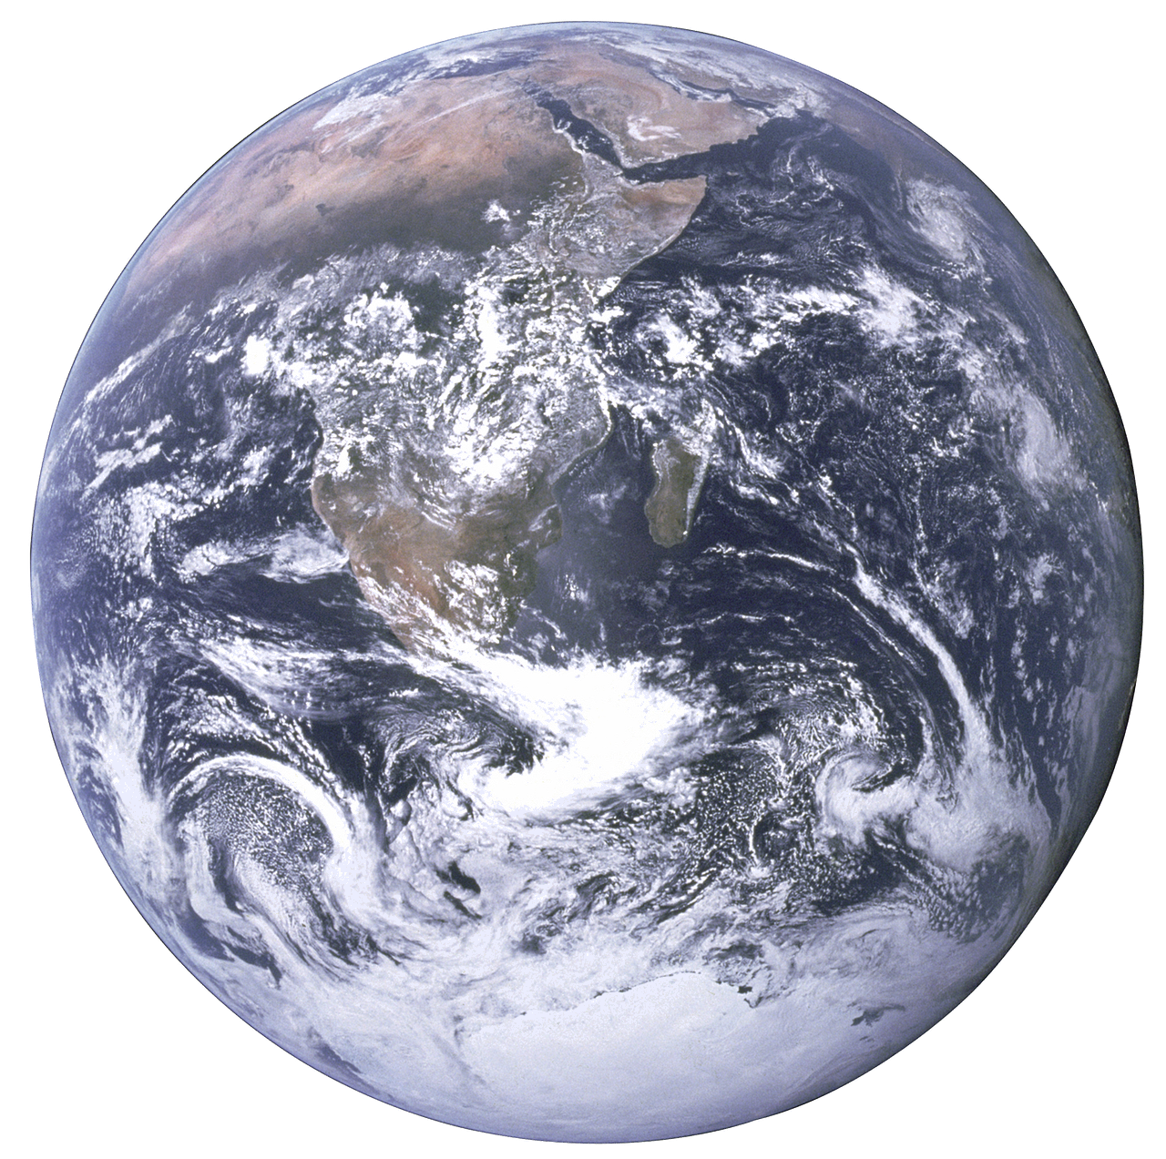
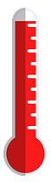
Soosaarka cuntada iyo bixinta (emission) gaasaska aqalka dhirta (greenhouse gases)
Tirada dadka dhulka ayaa ka badan 8 bilyan oo qof.
Soosaarista cunto ku filan oo loogu talagalay dhammaan dadkaasi ayaa horeba caqabad u ah.
Si kastaba ha ahaatee, heerkulka dusha sare ee dhulka ayaa sidoo kale sii kordhaya.
Kulaylka caalamiga ah wuxuu ka dhigayaa soo saarista cunto ku filan mid aad u adag.
dhulka (planet Earth)

Slide 7
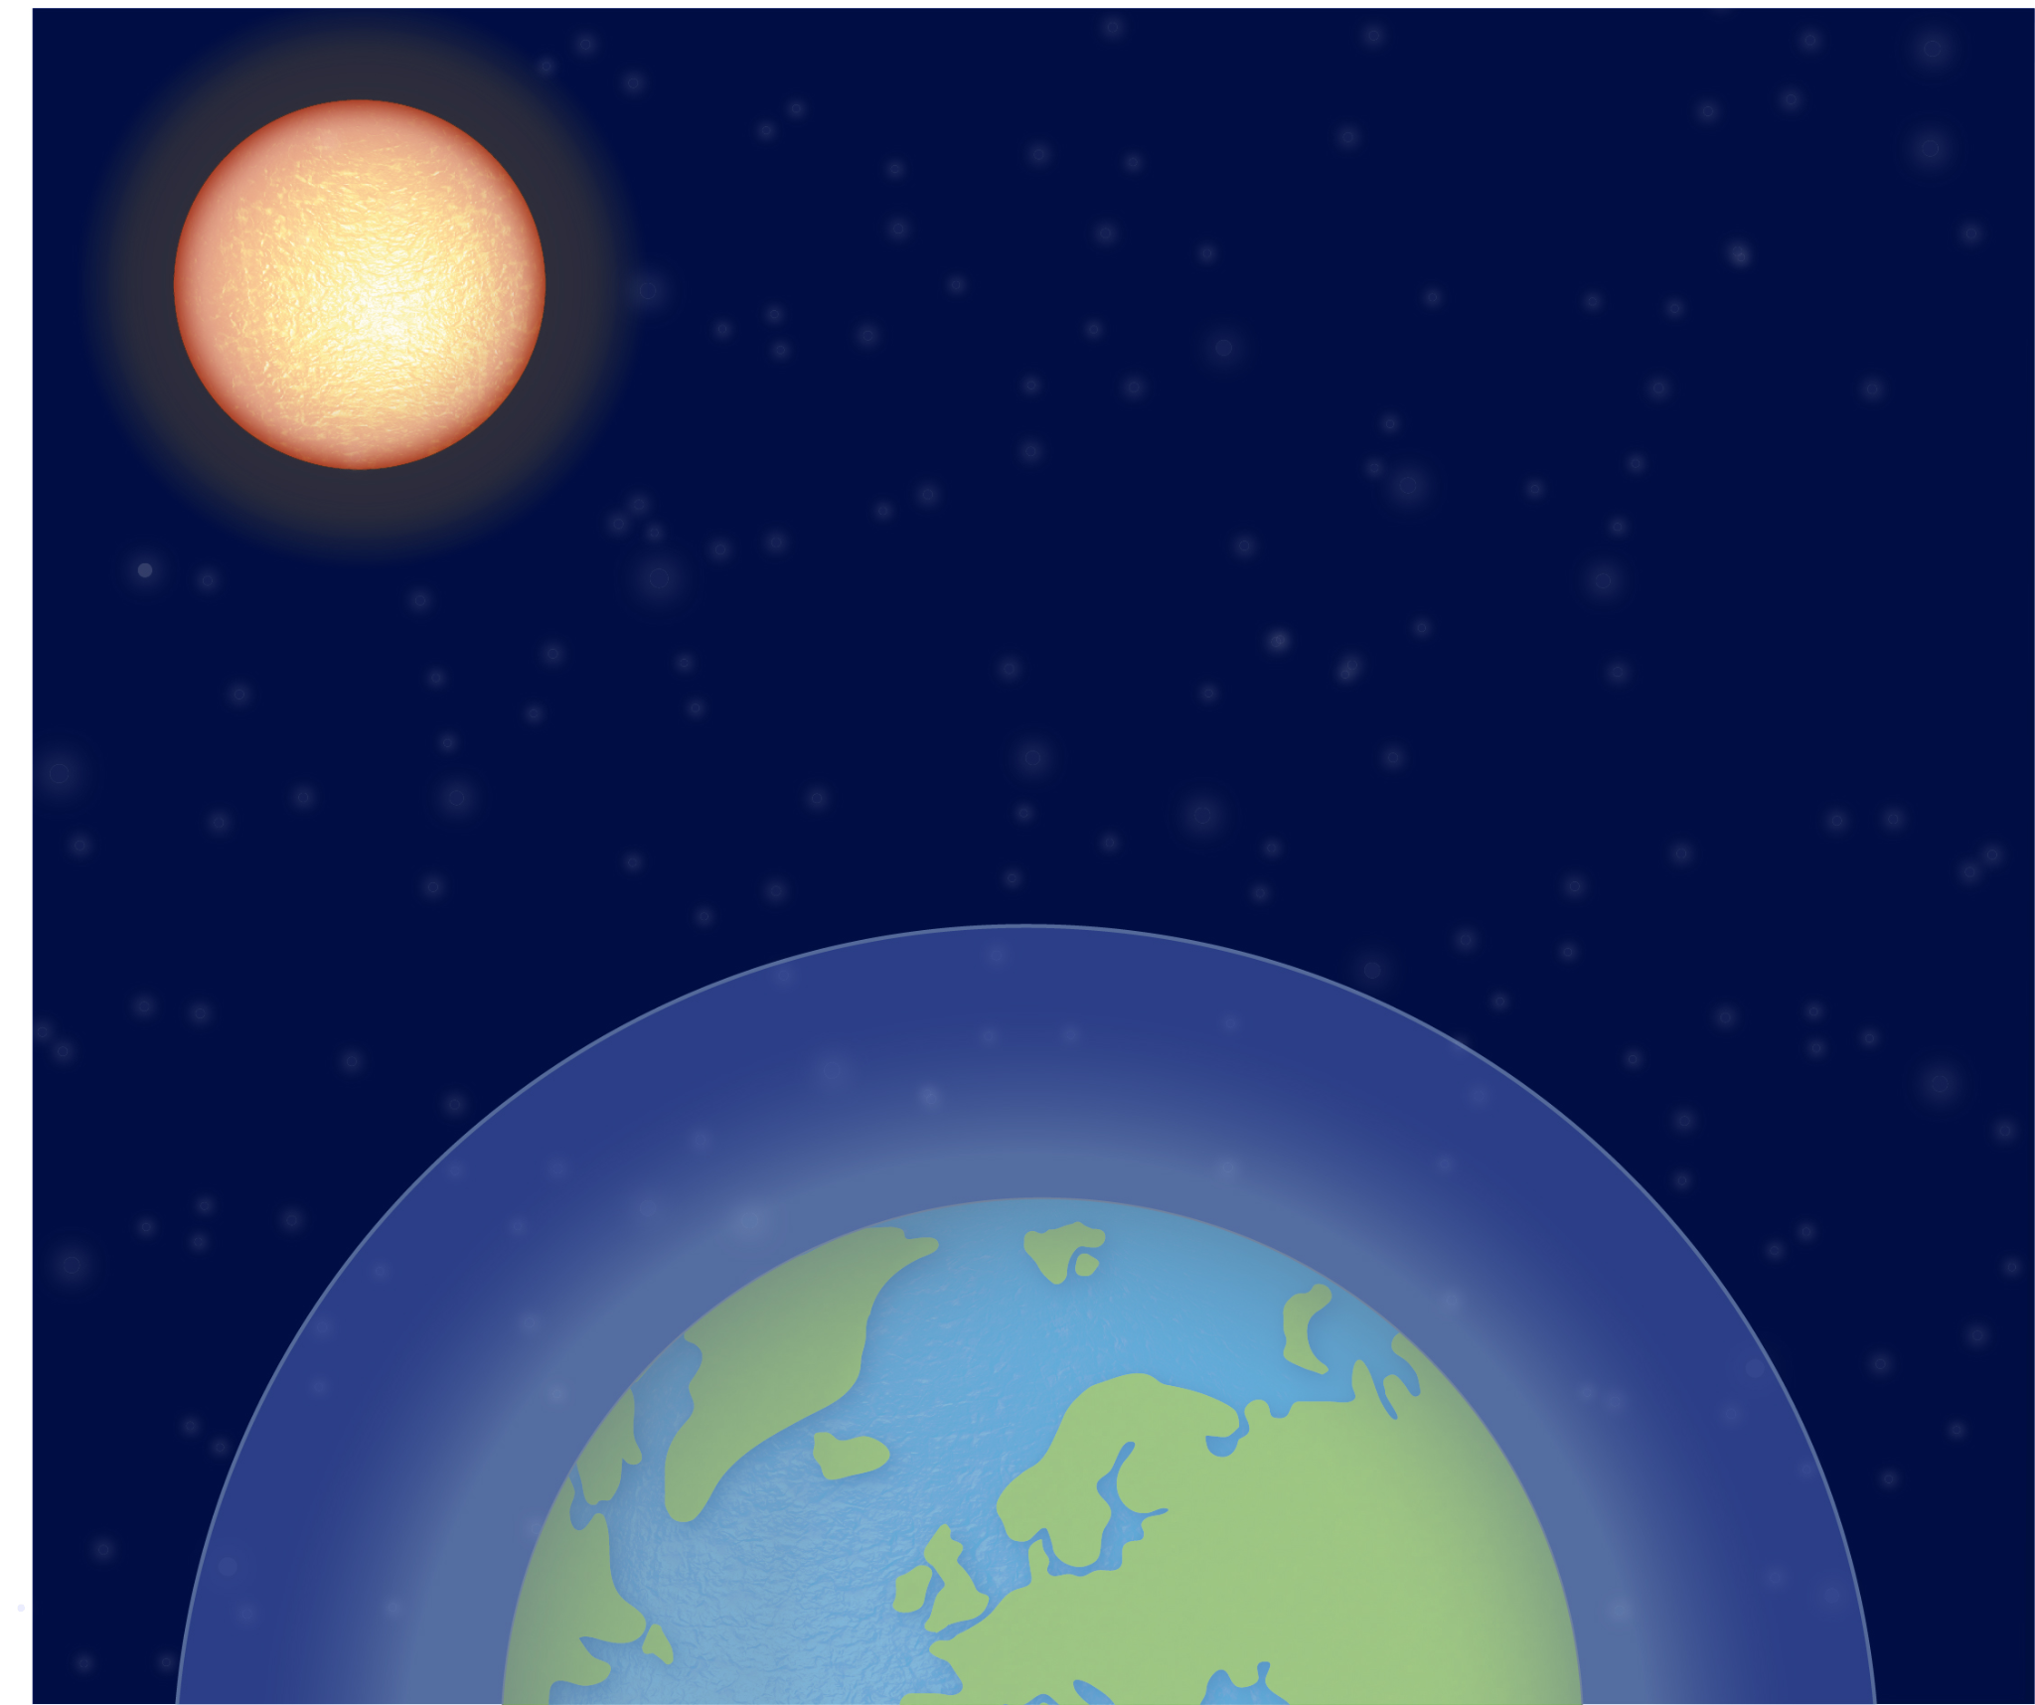
Soo saarista cuntada iyo bixinta (emission) gaasaska aqalka dhirta lagu koriyo (greenhouse gases)
Gaasaska aqalka dhirta lagu koriyo (greenhouse gases) ee jawiga (atmosphere) ku jira waxay ka dhigaan jawiga (atmosphere) iyo Dhulka (Earth) kuwo ka diiran sidii ay ahaan lahaayeen la'aantooda.
Tani waa saamaynta aqalka dhirta lagu koriyo (greenhouse effect).
gaasaska aqalka dhirta lagu koriyo (greenhouse gases)
jawiga (atmosphere)
99% saynisyahano ayaa aaminsan in bixinta (emission) gaasaska aqalka dhirta lagu koriyo (greenhouse gases) ee ka timaadda hawlgallada aadanaha ay xoojisay saamaynta aqalka dhirta lagu koriyo (greenhouse effect), taasoo keentay kulaylka caalamiga ah iyo isbeddelka cimilada.
Dhulka (Earth)

Slide 8
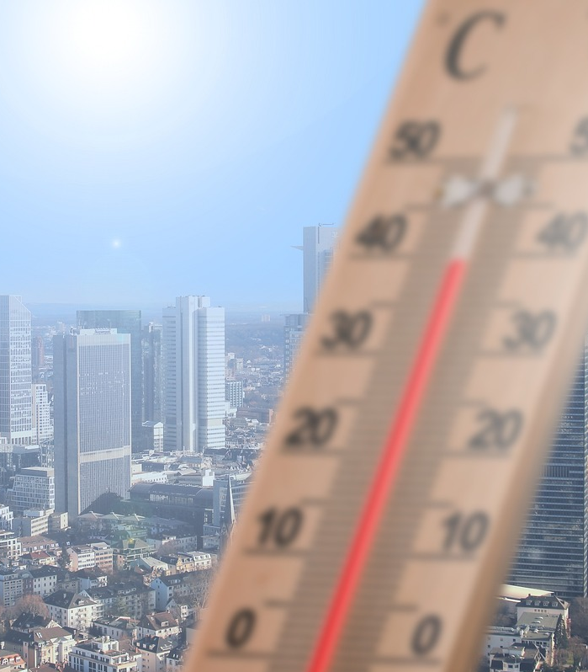
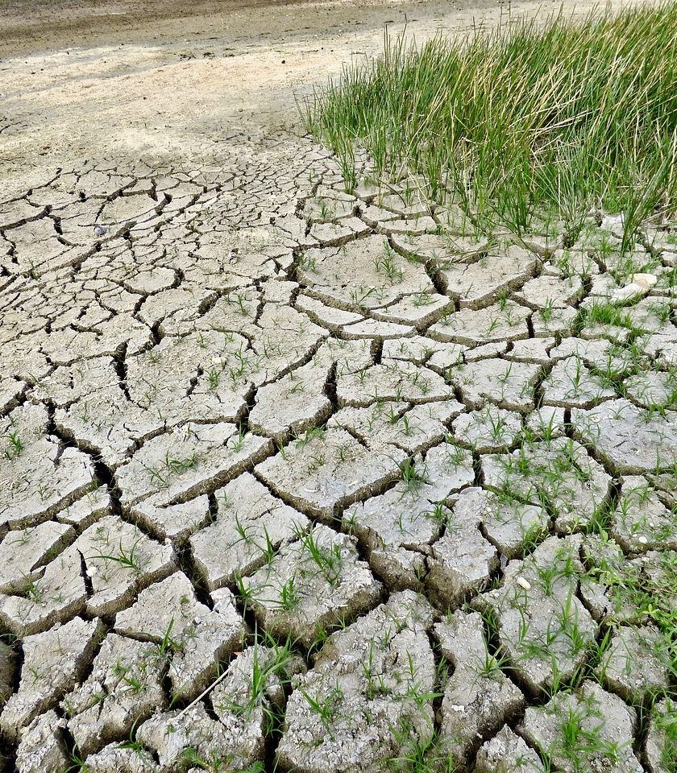
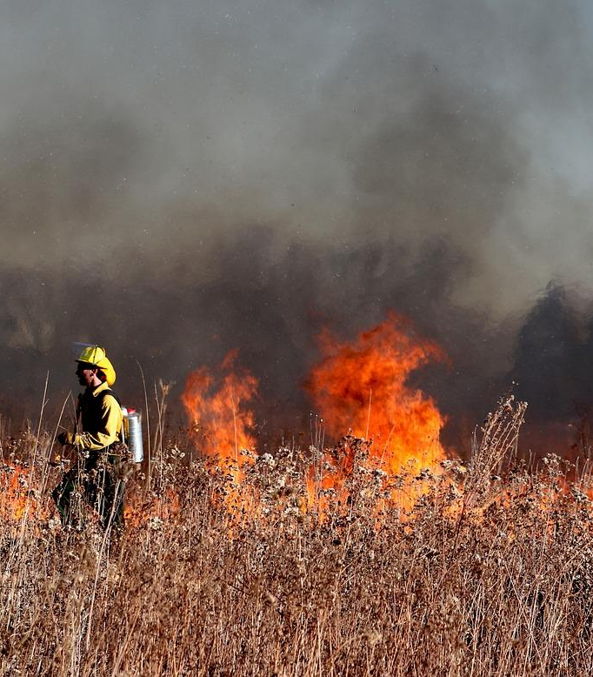
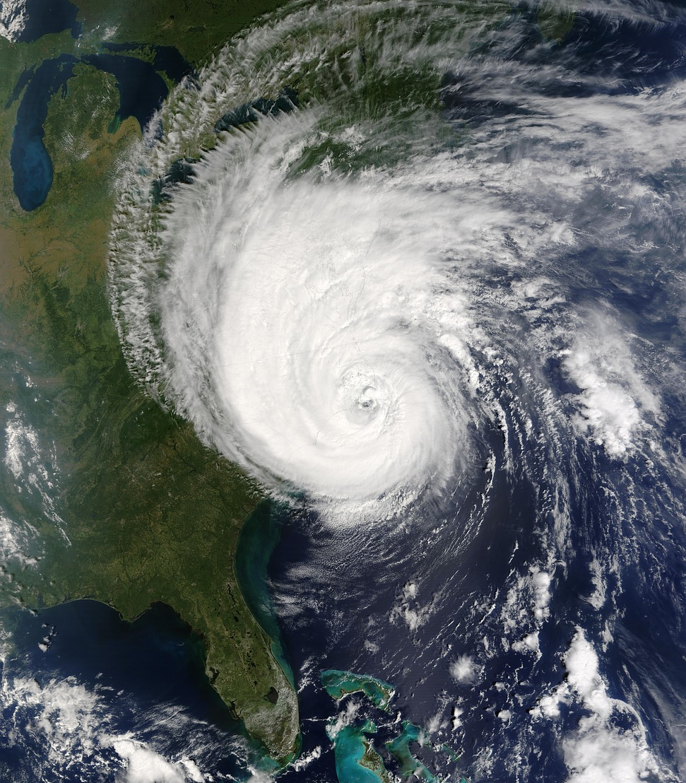
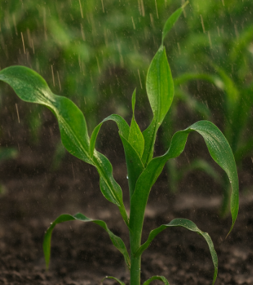
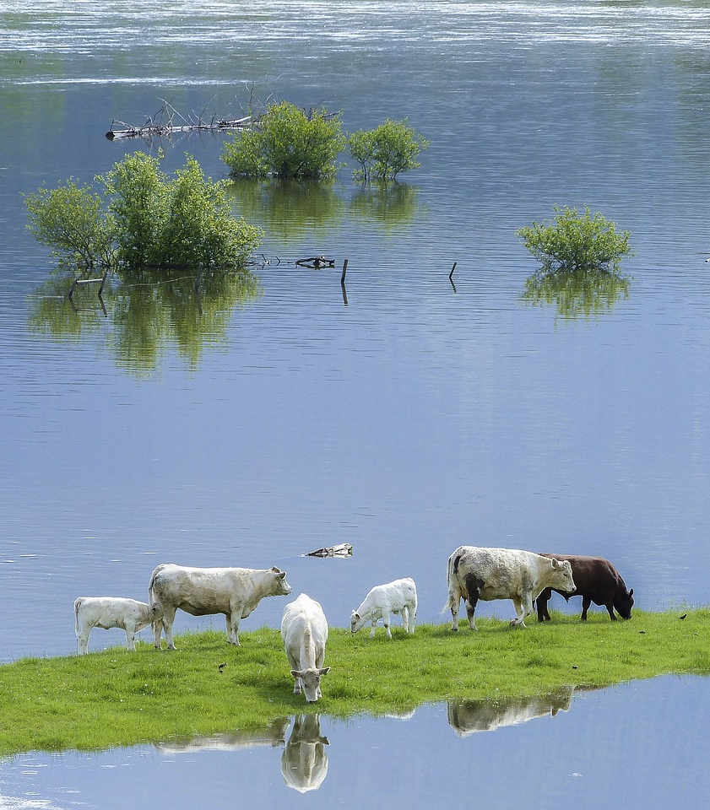
Soo saarista cuntada iyo bixinta (emission) gaasaska aqalka dhirta lagu koriyo (greenhouse gases)
Marka isbeddelka cimiladu sii socdo, dhacdooyinka cimilada xad-dhaafka ah waxay noqdaan kuwa soo noqnoqda.
Tani waxay ka dhigaysaa soo saarista cunto ku filan qof kasta mid aad u adag.
Meelaha qaarkood waxay la kulmi doonaan mowjado kulayl oo badan, taasoo keenta abaaraha iyo dabka duurka.
Meelaha kale waxay la kulmi doonaan duufaanno iyo roobab culus oo badan, taasoo kordhinaysa khatarta daadadka.

Slide 9

Soo saarista cuntada iyo bixinta (emission) gaasaska aqalka dhirta lagu koriyo (greenhouse gases)
Isbeddelka cimiladu wuxuu ka dhigan yahay in meel kasta oo aan cuntada ka soo saarno ay kululaan doonto oo engegaan doonto.
Sababta?
Isbeddelka cimiladu waa isbeddel muddo-dheer ah oo ku yimaada qaababka cimilada. Meelaha qaarkood way kululaan doonaan oo way engegi doonaan, laakiin meelaha kale waxay yeelan doonaan duufaanno, roobab iyo daadad soo noqnoqda.

Slide 10
Soo saarista cuntada iyo bixinta (emission) gaasaska aqalka dhirta lagu koriyo (greenhouse gases)
Soo saarista cuntada lafteedu waa hawl aadanaha oo gacan ka geysata isbedelka cimilada.
Soo saarista cuntadu waxay ku lug leedahay heerar badan oo keena bixin (emission)
gaasaska aqalka dhirta lagu koriyo (greenhouse gases), oo ay ku jiraan:
Isbeddelka isticmaalka dhulka (Land use change)
kaarboon laba-ogsaydh (carbon dioxide) oo ka yimaadda xaalufinta kaynta si loo nadiifiyo dhulka beeralayda
Beeraha (Farming)
methane ka yimaada lo'da (methane from cows)
carbon dioxide (carbon dioxide) ka yimaada bacriminta iyo mashiinada beeraha
Quudinta xoolaha (Feeding animals)
carbon dioxide (carbon dioxide) ka yimaada bacriminta iyo mashiinada beeraha

Slide 11
Soo saarista cuntada iyo sii daynta gaasaska aqalka dhirta (greenhouse gas emissions)
Iyo sidoo kale:
Habaynta (Processing)
carbon dioxide (carbon dioxide) ka yimaada koronto ku soo saarista cuntada ceeriin si loo rogo alaab la cuni karo
Gaadiidka (Transport)
carbon dioxide (carbon dioxide) ka yimaada gubista shidaalka fosil iyo koronto ku soo saarista gaadiidka cuntada
Tafaariiqda (Retail)
carbon dioxide (carbon dioxide) ka yimaada koronto ku soo saarista qaboojinta iyo baahiyaha kale ee tamarta ee dukaamada
Baakadaynta (Packaging)
carbon dioxide (carbon dioxide) ka yimaada soo saarista iyo qashin ku tuurista agabka baakadaha cuntada

Slide 12
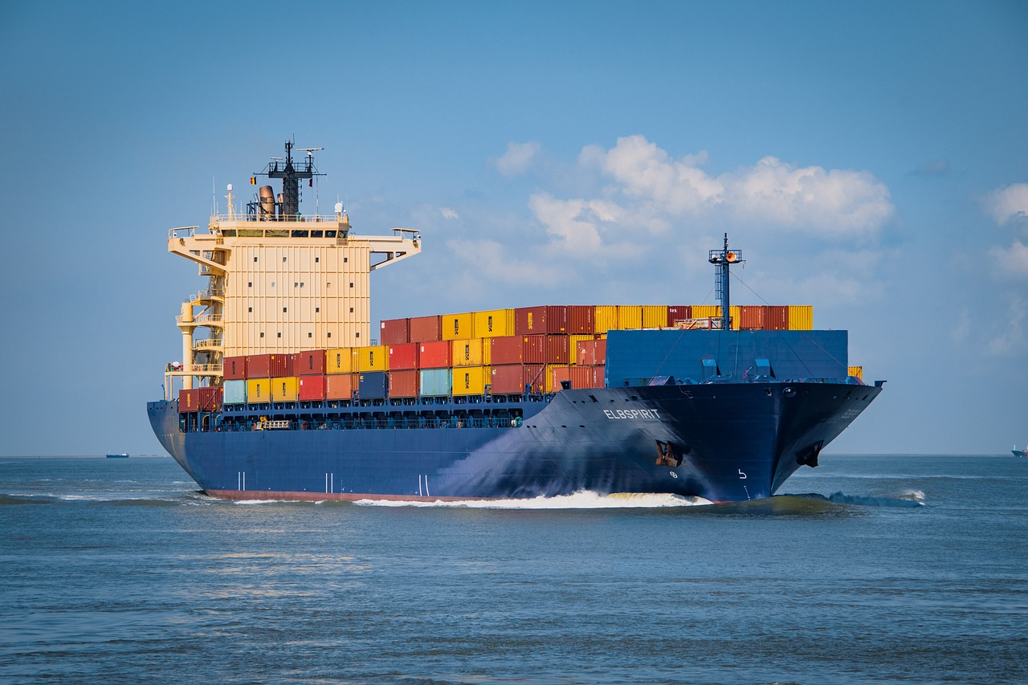
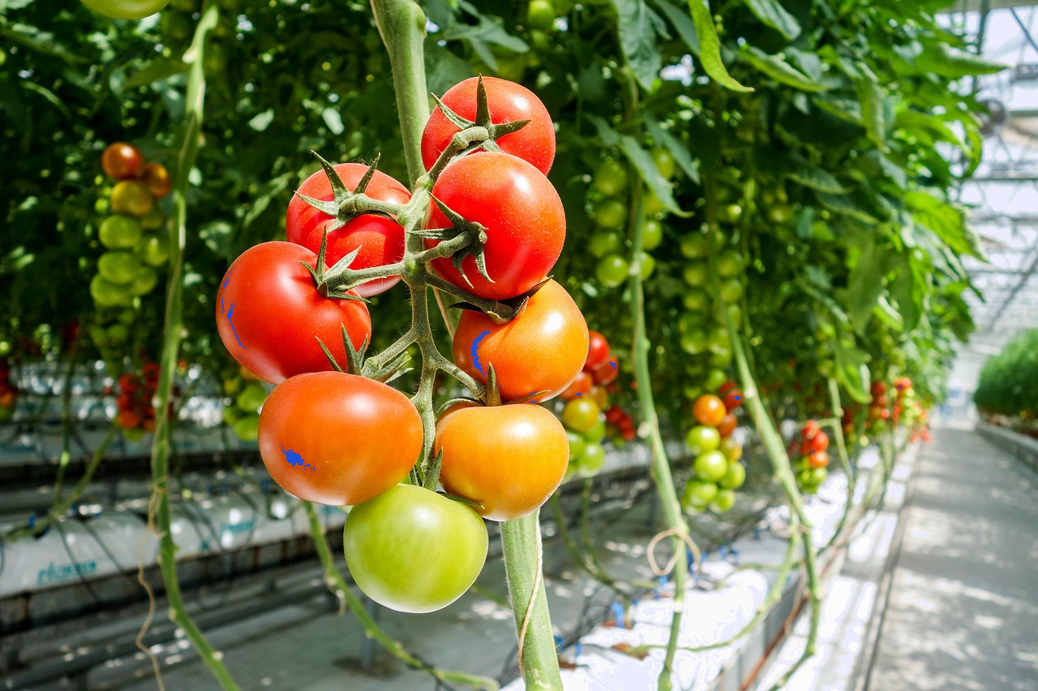
Soo saarista cuntada iyo sii daynta gaasaska aqalka dhirta (greenhouse gas emissions)
Marxaladaha kala duwan ee soo saarista cuntada waxay ku kala duwan yihiin xaddiga bixinta (emission) ee raadka kaarboonka (carbon footprint) cuntada.
Sii daynta gaasaska aqalka dhirta (greenhouse gas emissions) ee soo saarista 1 kg oo yaanyo ah waa:
Beerashada: 0.71 kg
Gaadiidka (Transport): 0.18 kg
Baakadaynta (Packaging): 0.15 kg
Isbedelka isticmaalka dhulka: 0.37 kg
Habaynta (Processing): 0.01 kg
Tafaariiqda (Retail): 0.02 kg
Yaanyada waxaa lagu beeri karaa bannaanka dalalka kulul.
Si loo beero yaanyo ganacsi ahaan gudaha UK, waa in la isticmaalaa aqalka lagu beero ee kulul (heated greenhouse).
Bixinta (emission) gaadiidka ee UK waa qayb yar oo ka mid ah wadarta raadka kaarboonka (carbon footprint).
Tani waxay si weyn u kordhin kartaa bixinta (emission) beerashada.
Xigashada xogta: “Waxaad rabtaa inaad yarayso raadka kaarboonka ee cuntadaada? Diirnaa waxa aad cunaysid, ee ma aha in cuntadaadu tahay mid maxalli ah” (Our World In Data)

Slide 13

Soo saarista cuntada iyo bixinta (emission) gaasaska aqalka dhirta lagu beero (greenhouse gas emissions)
Waa maxay marxaladaha soo saarista cuntada ee ku lug leh bixinta (emission) gaasaska aqalka dhirta lagu beero (greenhouse gas emissions)?
a
isbeddelka isticmaalka dhulka (land use change)
e
gaadiidka (transport)
b
beerashada (farming)
f
tafariiqda (retail)
c
quudinta xoolaha (feeding animals)
g
baakadaynta (packaging)
d
habaynta (processing)

Slide 14


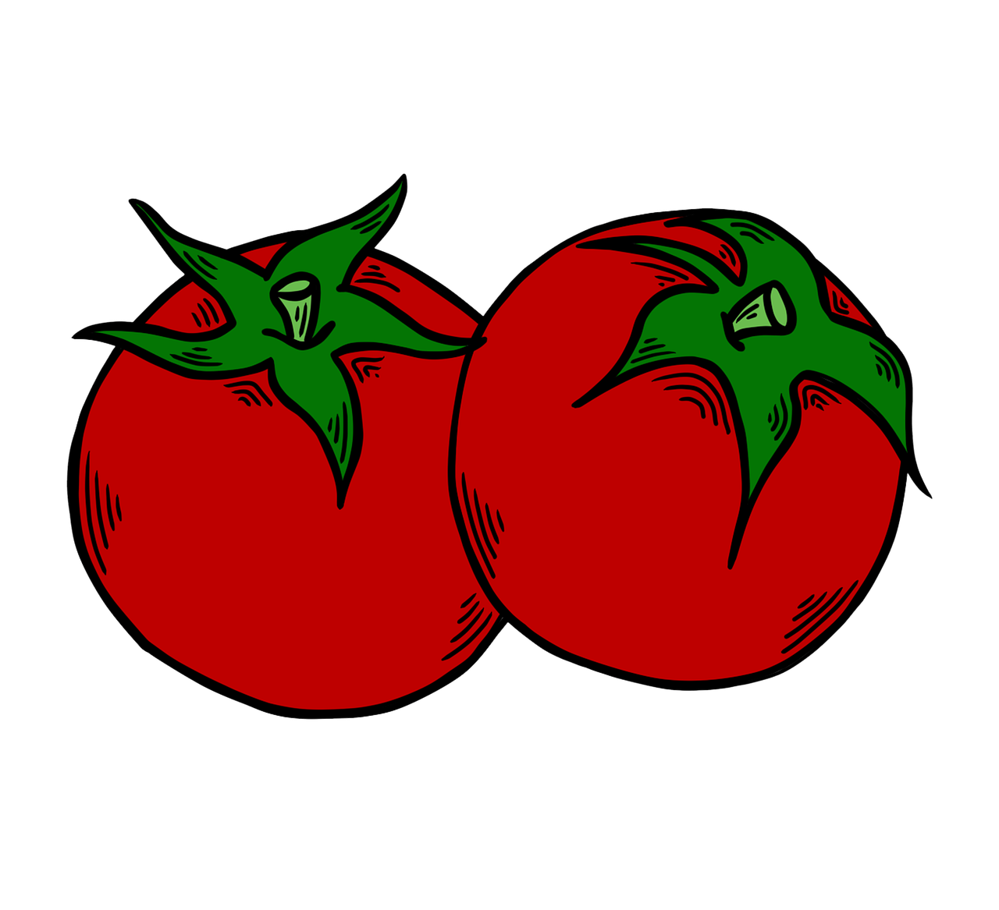


Soo saarista cuntada iyo bixinta (emission) gaasaska aqalka dhirta lagu beero (greenhouse gas emissions)
Dukaanka weyn, eeddo Isra waxay dooran kartaa yaanyo lagu beero Spain ama UK.
Waxaan maqlay in cuntada gudaha laga soo iibsado ay tahay tan ugu fiican. Marka waxaan iibsan doonaa yaanyada lagu beero UK. Waxay yeelan doonaan bixin (emission) ka yar kuwii laga soo diray Spain qorraxda leh.
U sharax eeddo Isra sababta wadarta bixinta (emission) uga sarreyso yaanyada lagu beero UK.

Slide 15
Soo saarista cuntada iyo bixinta (emission) gaasaska aqalka dhirta lagu beero (greenhouse gas emissions)
U sharax eeddo Izzy sababta wadarta bixinta (emission) ay uga sarreysi karto yaanyada lagu beero UK.
Waxaa laga yaabaa inaad tidhi:
Isbania waxay ku filan tahay kulayl si loogu beero yaanyo bannaanka.
Gaadiidka loo keenayo UK waa qayb yar oo ka mid ah bixinta (emission).
Yaanyada lagu beero UK waxaa laga yaabaa in lagu beero aqalka lagu koriyo ee la kululeeyo.
Tani waxay keentaa koror weyn oo ku yimaada bixinta (emission) inta lagu jiro heerka beerashada.
Waxaa muhiim ah in laga fikiro bixinta (emission) ee ka timaadda dhammaan heerarka wax soo saarka cuntada, ma aha oo kaliya gaadiidka.

Slide 16
Isbedelka cimilada iyo wax soo saarka cuntada
Wax soo saarka cuntada iyo bixinta gaasaska aqalka dhirta (greenhouse gas emissions)
Bedelka cuntooyinka si loo yareeyo isbedelka cimilada

Slide 17
Bedelka cuntooyinka si loo yareeyo isbedelka cimilada
Si noo caawiso inaynu sii wadno soo saarista cuntada qof walba, waa inaynu xaddidnaa isbedelka cimilada.
Si taas loo sameeyo, waa inaynu yareynaa bixinta (emission) gaasaska aqalka dhirta (greenhouse gases) - oo ay ku jiraan kuwa ka yimaada wax soo saarka cuntada laftiisa.
Yaraynta bixinta (emission) ee hawsha waxaa loo yaqaan decarbonisation.
Laakiin intooda badan ma aha kuwa mas'uul ka ah wax soo saarka cuntada. Maxaan qof ahaan u qaban karnaa?
Dhulka (planet Earth)

Slide 18
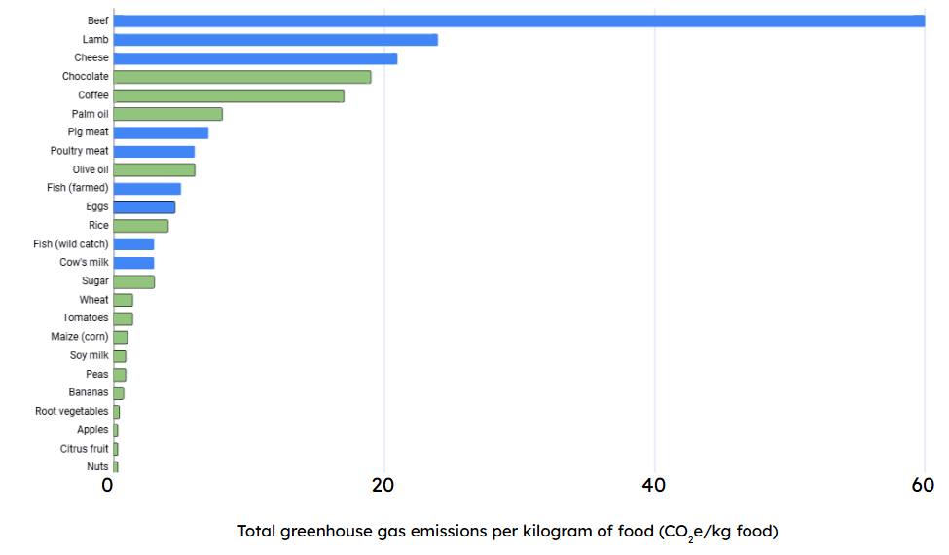
Bedelka cuntooyinka si loo yareeyo isbedelka cimilada
Habka ugu fiican ee lagu yareeyo bixinta (emission) waa in la cuno
yar
hilib (meat)
iyo
Hilibka (Meats)
waxay u muuqdaan inay leeyihiin
badan
khudaar & qudaar (fruit & vegetables)
raad kaarboon oo sare oo bixin (emission) ah marka loo eego
beddelkeeda.
khudradda iyo miraha (fruits and vegetables).
Haddii aan iibsanno oo cunno hilib (meat) yar, soosaarayaasha cuntadu waxay soo saari doonaan wax ka yar, taas oo yarayn doonta bixinta (emission).
Xigashada xogta: “Waxaad rabtaa inaad yarayso raadka kaarboonka cuntadaada? Diirrad saar waxa aad cunto, ma aha in cuntadaadu tahay mid maxalli ah” (Our World In Data)

Slide 19
Beddelidda cuntooyinka si loo yareeyo isbeddelka cimilada
Dhammeysti jumladaha.
Waxaad uun ka dooran kartaa ereyada:
khudaar (fruit) hilib (meat) qudaar (vegetables)
Habka ugu fiican ee lagu yareeyo bixinta (emission) gaaska aqalka dhirta ah ee ka timaadda waxaad cuntid waa in la beddelo __________ oo la isticmaalo __________ iyo __________ .
hilib (meat)
khudaar (fruit)
qudaar (vegetables)

Slide 20
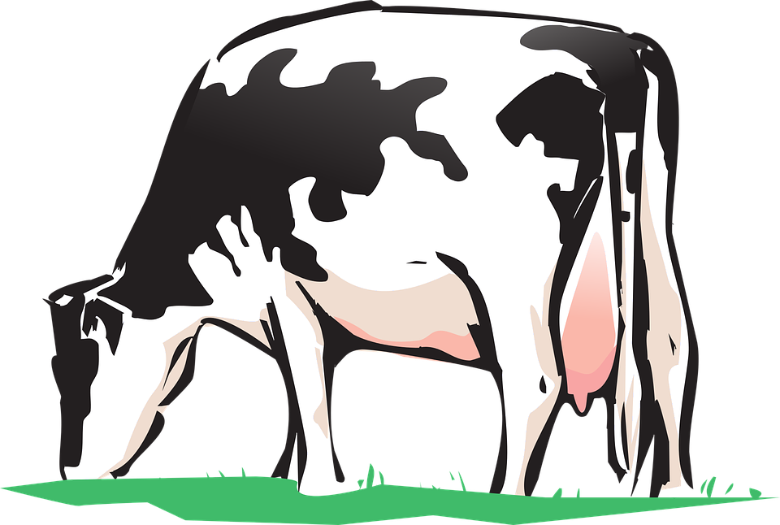
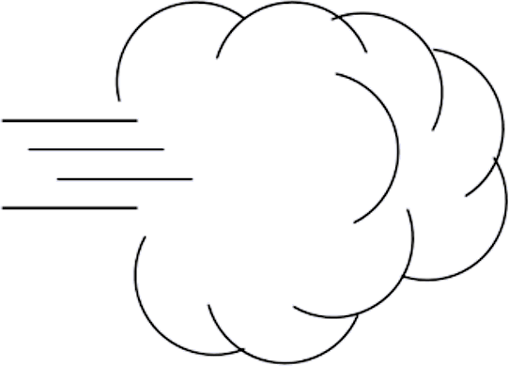
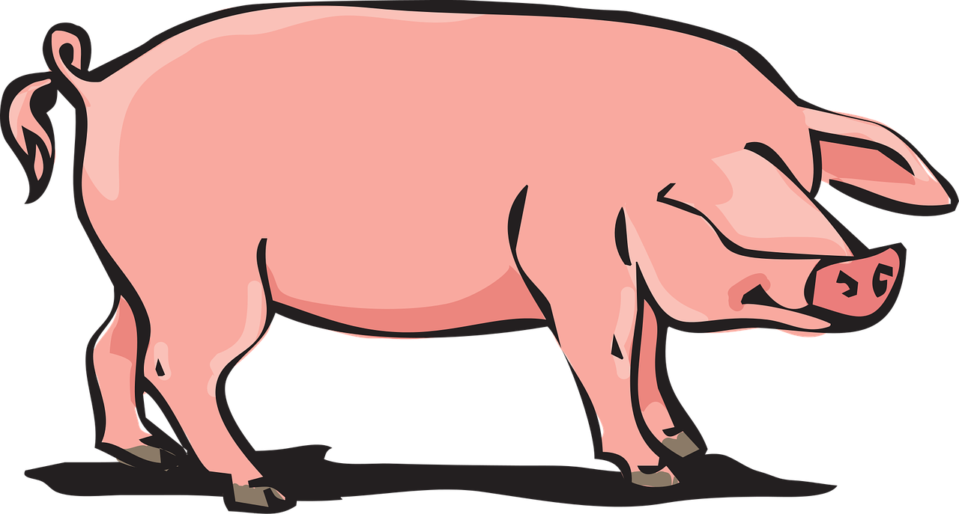
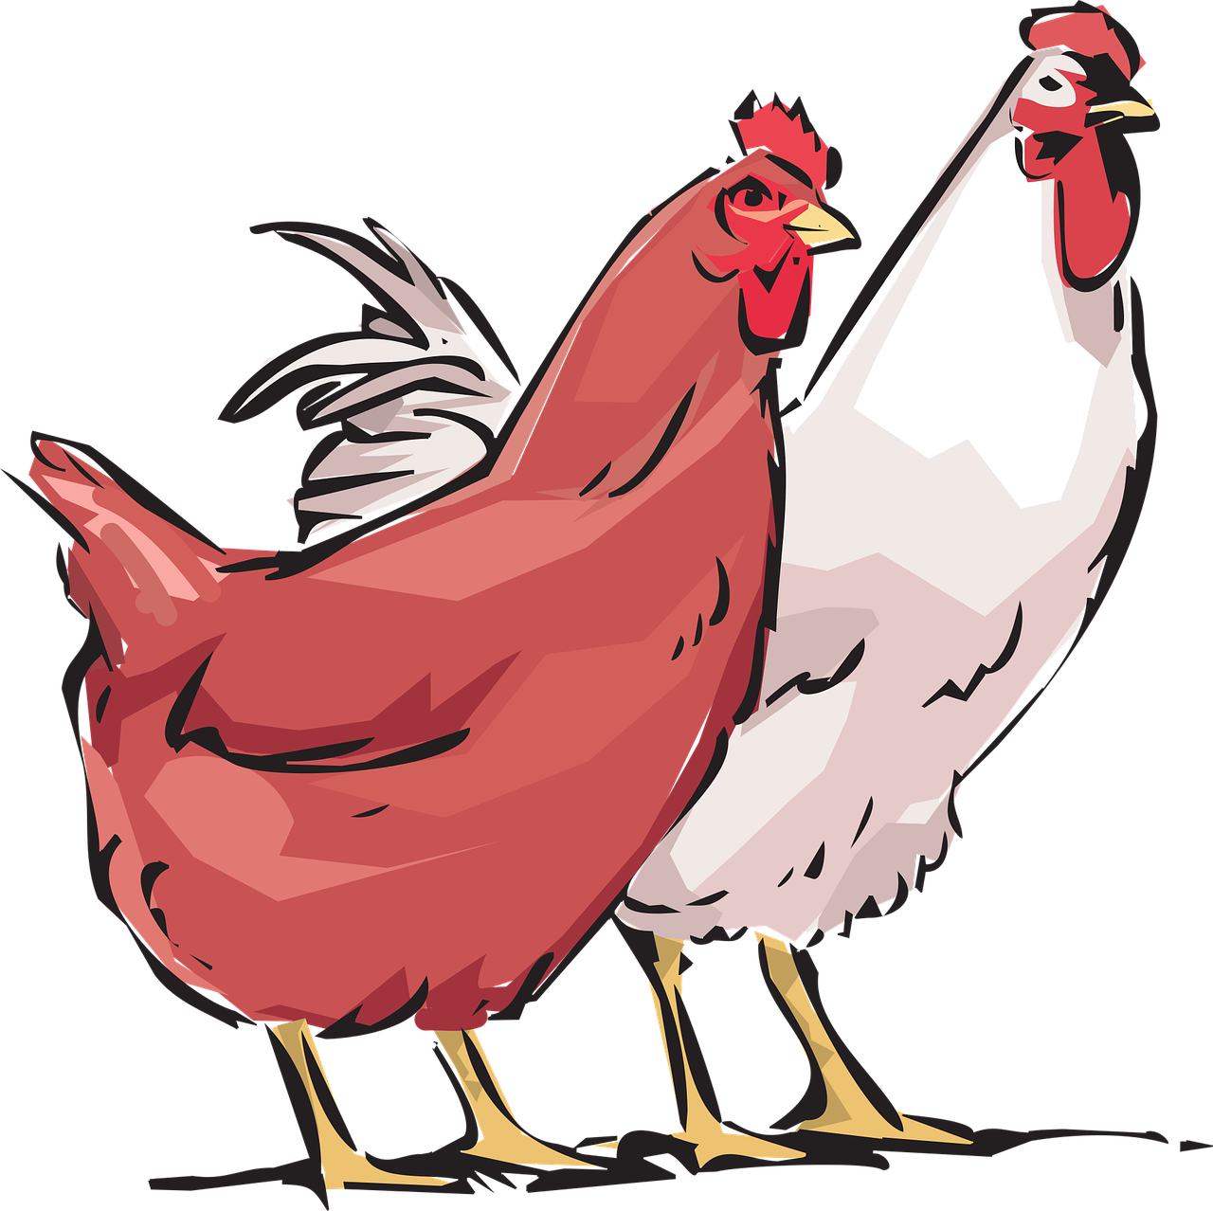
Beddelidda cuntooyinka si loo yareeyo isbeddelka cimilada
Lo'da iyo iduhu
Lo'da iyo iduhu waa xayawaan ruminant ah - waxay cunaan caws oo soo saaraan methane (methane).
Haddii aan cunno hilib (meat), waxaan samayn karnaa doorashooyin caqli-gal ah si aan u yareyno bixinta (emission).
Methane (Methane) waa gaas aqalka dhirta ah oo xoog badan ka badan carbon dioxide (carbon dioxide).
Doofaarro iyo digaag
Doofaarka iyo digaaggu ma aha ruminants, marka bixinta (emission) heerka beerashadu waa ka hooseysaa.
Ilaha xogta: “Waxaad doonaysaa inaad yarayso raadka kaarboonka ee cuntadaada? Diirtooga waxaad cunaysid, ma aha in cuntadaadu tahay mid maxalli ah” (Our World In Data)

Slide 21
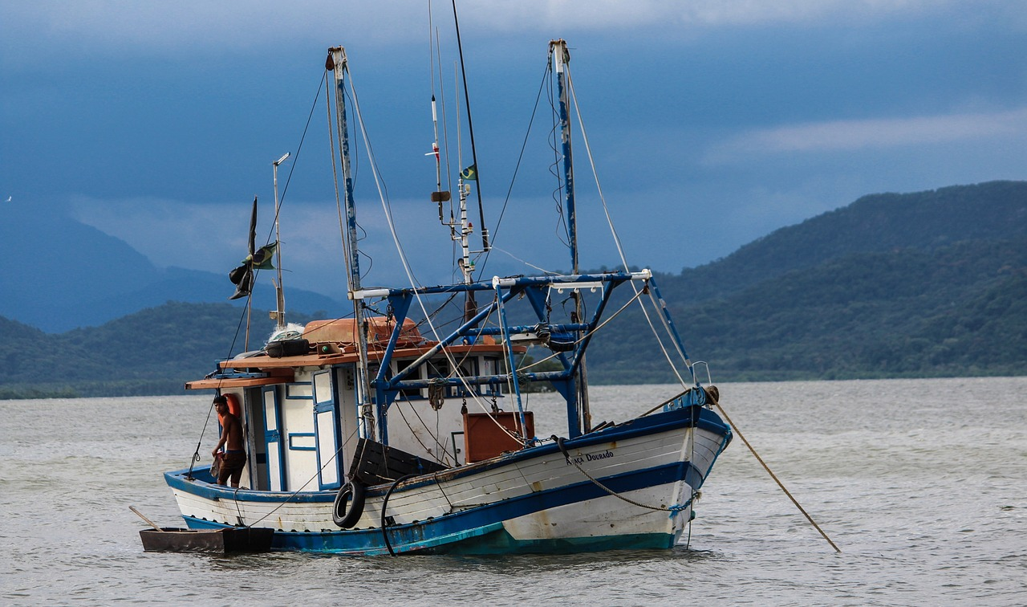
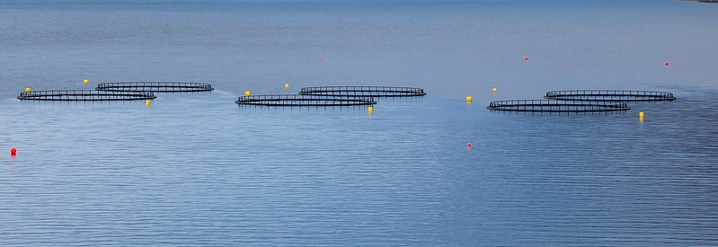
Beddelka cuntooyinka si loo yareeyo isbedelka cimilada
Bixinta (emission) ayaa ka hooseysa kalluunka marka loo eego hilibka kale.
Bixinta (emission) beerashada ee kalluunka duurjoogta ah waxay ka imanaysaa maraakiibta kalluumeysiga.
kalluun duurjoog ah
Bixinta (emission) beerashada iyo wadarta raadka kaarboonka ayaa ka sarreeya kalluunka lagu soo koriyo beeraha kalluunka.
Ilaha xogta: “Waxaad doonaysaa inaad yarayso raadka kaarboonka ee cuntadaada? Diirtooga waxaad cunaysid, ma aha in cuntadaadu tahay mid maxalli ah” (Our World In Data)

Slide 22
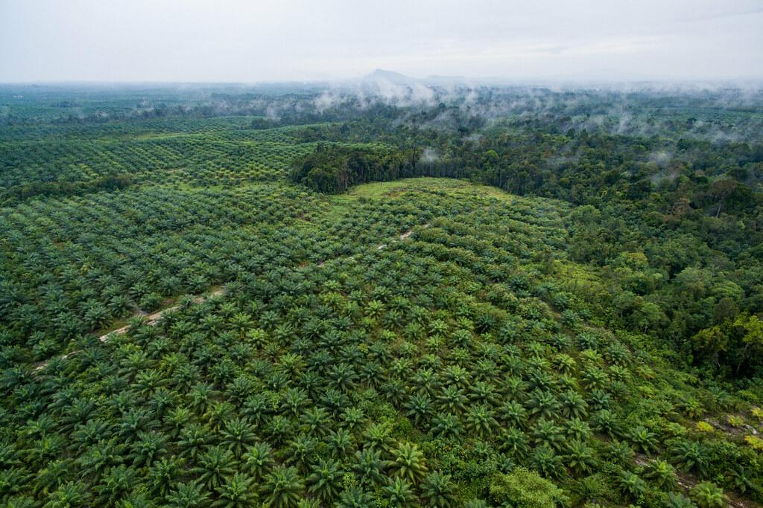
Beddelka cuntooyinka si loo yareeyo isbedelka cimilada
Qaar ka mid ah alaabta dhirta laga sameeyo, bixinta (emission) ka timaadda isbedelka isticmaalka dhulka ayaa ah qayb aad u saraysa oo ka mid ah wadarta raadka kaarboonka.
Tani waa sababta oo ah dalagyada waxaa lagu beeraa beeraha lagu abuuray xaalufinta kaymaha.
beerta saliidda timirta
Ilaha xogta: “Waxaad doonaysaa inaad yarayso raadka kaarboonka ee cuntadaada? Diirtooga waxaad cunaysid, ma aha in cuntadaadu tahay mid maxalli ah” (Our World In Data)

Slide 23
Beddelka cuntooyinka si loo yareeyo isbedelka cimilada
Laga bilaabo kan ugu hooseeya, dhig cuntooyinkan sida ay u kala horreeyaan laga bilaabo kan ugu hooseeya ilaa kan ugu sarreeya raadka kaarboonka.
a
Cunto ka kooban kalluun beer ah iyo khudaar.
3
b
Cunto badan oo hilib lo'da iyo hilib lax ah.
5
c
Cunto ka kooban digaag iyo khudaar.
4
d
Cunto ka kooban khudaar, miro iyo lowska.
1
e
Cunto ka kooban kalluun duurjoog ah iyo khudaar.
2

Slide 24

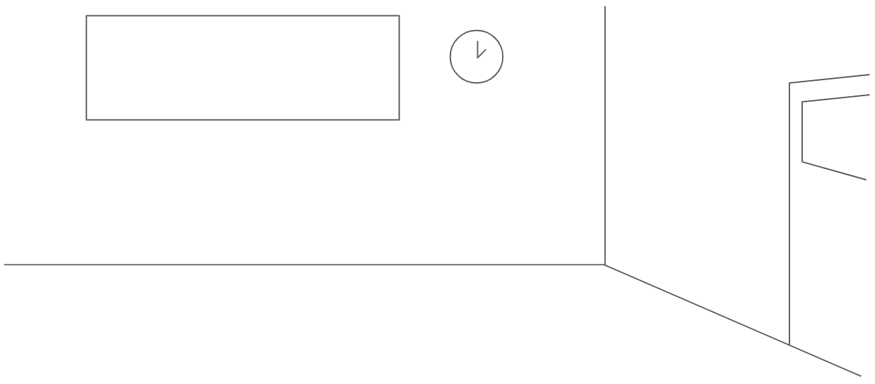
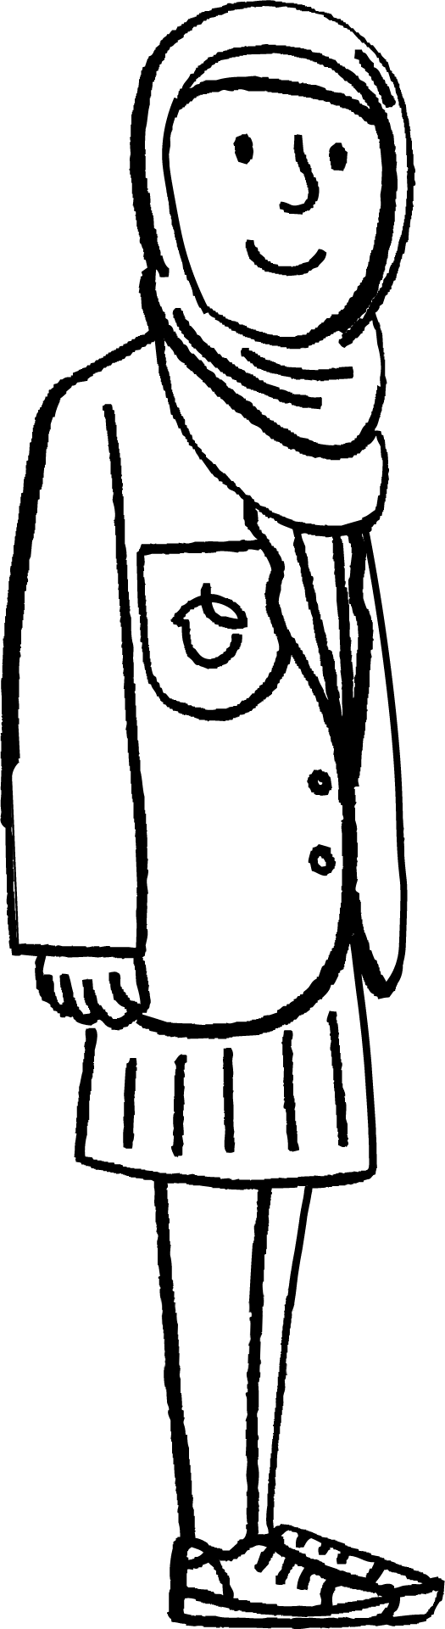
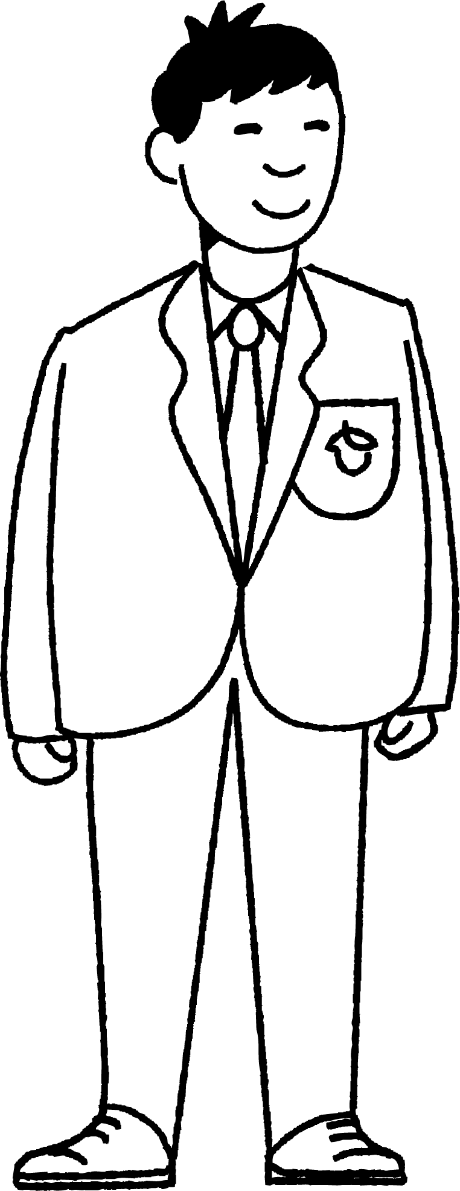
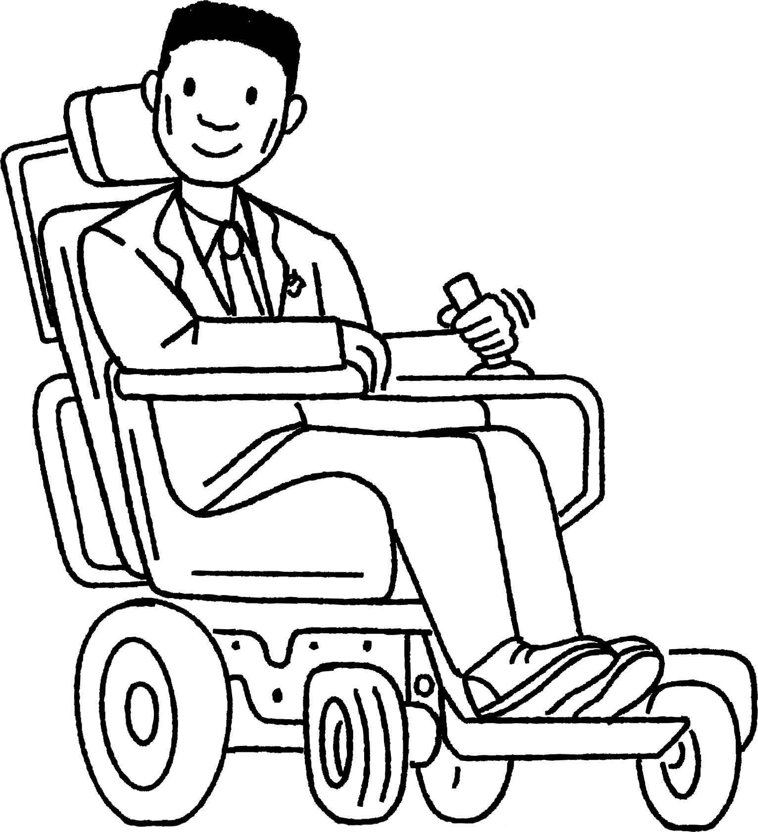
Beddelka cuntooyinka si loo yareeyo isbedelka cimilada
Ma lihin ikhtiyaar cuntada aan guriga ku cunno. Waa inaan cunno waxa la siiyo! Marka maxaan qaban karnaa si aan u yareyno raadka kaarboon (carbon footprint) ee cuntadeenna?
Kaalay ardayda si ay u qoraan warqad ay u diraan waalidkood si ay u sharxaan sababta isbeddelka cuntadoodu u kici karo xaddidda isbedelka cimilada.

Slide 25
Beddelidda cuntada si loo yareeyo isbeddelka cimilada (climate change)
Kaalay ardayda si ay u qoraan warqad waalidkood oo sharxaysa sababta beddelka cuntadoodu uga caawin karo xaddididda isbeddelka cimilada (climate change).
Fikradaha laga yaabo inaad ku dartay warqadda:
Bixinta (emission) gaasaska aqalka dhirta (greenhouse gases) ee soosaarka cuntada ayaa gacan ka geysanaya isbeddelka cimilada (climate change), taasoo ka dhigaysa cuntada mid adag in la soo saaro.
Beddelka cuntada ayaa kaa caawin kara yaraynta bixinta (emissions).
Hilibka lo'da (beef) ayaa leh bixinta (emissions) ugu sarreysa, waxaana ku xiga hilibka laxda (lamb), ka dibna digaagga (poultry), ka dibna kalluunka (fish).
Beddelidda hilibka khudaarta, miraha iyo lowska ayaa kaa caawinaysa yaraynta bixinta (emissions) iyo xaddididda isbeddelka cimilada (climate change).

Slide 26
Isbeddelka cimilada (climate change) iyo soosaarka cuntada
Soosaarka cuntada ayaa khatar ku jira sababtoo ah kulaylka caalamiga (global warming) iyo
isbeddelka cimilada (climate change).
Isbeddelka cimilada (climate change) wuxuu ka dhigayaa dhacdooyinka cimilada xad-dhaafka ah (extreme weather events) kuwo ka badan, taasina waxay ka dhigaysaa soosaarka cuntada mid caqabad badan.
Bixinta (emissions) gaasaska aqalka dhirta (greenhouse gases) ee isbeddelka isticmaalka dhulka (land use change), beerashada, quudinta xoolaha, gaadiidka, tafaariiqda iyo baakadaynta ayaa ku kordhisa raadka kaarboon (carbon footprint) ee cuntooyinka.
Beddelka cuntadeenna ayaa naga caawin kara yaraynta bixinta (emissions) ee soosaarka cuntada iyo xaddididda isbeddelka cimilada (climate change).
Isbarbardhigga xogta bixinta (emissions data) ee cuntooyinka kala duwan ayaa naga caawinaya fahamka saamaynta doorashooyinka cuntada.

