Slide 1
Isbarbardhigga matalaadyo badan si loo xisaabiyo ixtimaalka (probability) aragtida ee dhacdooyinka isku dhafan
Ixtimaalka (Probability): ixtimaalka aragtida

Slide 2
Sida agabyadayada waxbarista loogu talagalay fasalka

Slide 3
Waxaan awood u leeyahay inaan isbarbardhigo oo aan ka soo horjeediyo waxtarka matalaadyo kala duwan marka la xisaabinayo ixtimaalka (probability) aragtida ee dhacdooyinka isku dhafan.

Slide 4
Laha kasta oo ka mid ah geedka ixtimaalka (probability tree) wuxuu muujinayaa natiijo suurtagal ah oo ka timaadda dhacdo ama marxalad tijaabo ah, iyadoo la raaciyo ixtimaalka (probability) dhacdooyinkaas.
Meel saami ah (sample space) waa dhammaan natiijooyinka suurtagalka ah ee tijaabo. Jaantuska meel saami ah (sample space diagram) waa hab habaysan oo lagu soo saaro meel saami ah.
Jaantusyada Venn (Venn diagrams) waa matalaad loo isticmaalo qaabaynta su'aalaha tirakoobka/ixtimaalka. Caadi ahaan goobo ayaa loo isticmaalaa inay matalaan dhacdooyinka.

Slide 5

Isbarbardhigga matalaadyo badan si loo xisaabiyo ixtimaalka (probability) aragtida ee dhacdooyinka isku dhafan
Muujinta tijaabooyin laba heer ah oo ku kala duwan jaantusyo
Qoraallo ku saabsan dhacdooyinka jaantusyo kala duwan

Slide 6
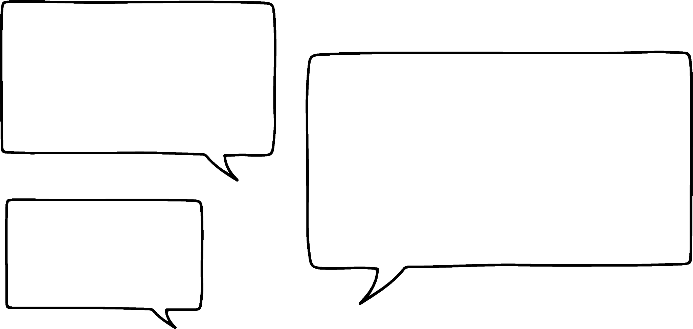



Muujinta tijaabooyin laba heer ah oo ku kala duwan jaantusyo
Tijaabo: wareegiyaha 1 iyo wareegiyaha 2 ayaa la wareejiyay hal mar midkiiba.
Waan ogahay sida loo helo ixtimaalka (probability) natiijo kasta oo ka mid ah tijaabadan aniga oo isticmaalaya shaxda natiijooyinka!
B
A
B
A
A
natiijooyinka wareegiyaha 1
Nuur
A
A
B
 | A | A | A | A | A | B | B | B
X
X
Y
 | A | A | A | A | A | B | B | B
X | X A | X A | X A | X A | X A | X B | X B | X B
X | X A | X A | X A | X A | X A | X B | X B | X B
Y | Y A | Y A | Y A | Y A | Y A | Y B | Y B | Y B
wareegiyaha 1
X
Y
X
natiijooyinka wareegiyaha 2
meel saami ah (sample space) ee tijaabadan laba heerka ah
wareegiyaha 2

Slide 7








Muujinta tijaabooyin laba-wareeg ah oo jaantusyo kala duwan laga soo qaatay
Tijaabo: wareejiyaha 1 iyo wareejiyaha 2 ayaa hal mar la wareejin doonaa mid kasta.
Isla tijaabada laba-wareeg ah waxaa lagu muujin karaa geed itimaal (probability tree).
Lakab kasta oo laamo ah wuxuu u taagan yahay hal wareeg oo tijaabada ah.
natiijooyinka wareegiyaha 2
natiijooyinka wareegiyaha 1
meel saami (sample space)
B
A
X
AX
B
A
A
A
A
A
B
AY
Itimaalka (probability) natiijo kasta oo ku jirta meesha saami (sample space) waa isku dhufashada itimaalka (probability) labada laamood ee u horseeda natiijadaas.
wareejiyaha 1
Y
X
BX
X
Y
B
X
Y
BY
wareejiyaha 2

Slide 8
Muujinta tijaabooyin laba-wareeg ah oo jaantusyo kala duwan laga soo qaatay
Tijaabo: wareejiyaha 1 iyo wareejiyaha 2 ayaa hal mar la wareejin doonaa mid kasta.
Waxaan sidoo kale ka heli karnaa itimaalada (probabilities) meesha saami (sample space) ah.
meel saami (sample space)
B
A
X
AX
B
A
P(X iyo A) =
A
A
A
A
B
Y
AY
wareejiyaha 1
X
BX
X
Y
B
X
Y
BY
wareejiyaha 2

Slide 9

Muujinta tijaabooyin laba-wareeg ah oo ku kala duwan jaantusyo (diagrams)
Tijaabo: wareejinta 1 iyo wareejinta 2 ayaa midba midka kale la wareejin doonaa hal mar.
Waxaan sidoo kale ka heli karnaa itimaalka (probabilities) meeshan muunadda (sample space).
meesha muunadda (sample space)
B
A
X
AX
B
A
P(X ama A) =
A
A
A
A
B
+
+
=
Y
AY
wareejinta 1
X
BX
X
Y
B
X
Y
BY
wareejinta 2

Slide 10
Muujinta tijaabooyin laba-wareeg ah oo ku kala duwan jaantusyo (diagrams)
Laakiin shaxda natiijada (outcome table) ayaa sidoo kale aad ugu fiican inay muujiso halka itimaalka (probability) kasta uu ka yimid.
Waxaan u malaynayaa in aan ka door bidayo geedka itimaalka (probability tree), sababtoo ah waxaad si toos ah u arki kartaa itimaallada (probabilities)…
X
AX
Nuur
A
 | A | A | A | A | A | B | B | B
X | X A | X A | X A | X A | X A | X B | X B | X B
X | X A | X A | X A | X A | X A | X B | X B | X B
Y | Y A | Y A | Y A | Y A | Y A | Y B | Y B | Y B
Y
AY
X
BX
B
Y
BY

Slide 11


Muujinta tijaabooyin laba- marxaleed oo ku kala duwan jaantusyo kala duwan
Xaggee baa bannaanka shayga (sample space) lagu muujiyey dhacdada “ama X ama B, laakiin labadaba maya”?
Waa maxay itimaalka (probability) dhacdadan?
+
=
X
AX
A
 | A | A | A | A | A | B | B | B
X | X A | X A | X A | X A | X A | X B | X B | X B
X | X A | X A | X A | X A | X A | X B | X B | X B
Y | Y A | Y A | Y A | Y A | Y A | Y B | Y B | Y B
Y
AY
X
BX
B
Y
BY

Slide 12

Muujinta tijaabooyin laba- marxaleed oo ku kala duwan jaantusyo kala duwan
Labadan jaantus waxay muujinayaan isku tijaabo: wareejinta laba wareejiye (spinner) hal mar midkiiba.
Natiijooyinka wareejin kasta waa la isku geeyaa (added together).
Adigoo isticmaalaya shaxda natiijooyinka (outcome table), waa maxay labada itimaal (probability) ee la geliyo labada laamood (branches)?
5
2
 | 5 | 5 | 5 | 9 | 9 | 9 | 9
2 | 7 | 7 | 7 | 11 | 11 | 11 | 11
4 | 9 | 9 | 9 | 13 | 13 | 13 | 13
4 | 9 | 9 | 9 | 13 | 13 | 13 | 13
9
5
4
9

Slide 13


Muujinta tijaabooyin laba- marxaleed oo ku kala duwan jaantusyo kala duwan
Waa maxay labada jajab (fractions) ee ay tahay in la isku dhufo (multiplied) si loo helo itimaalka (probability) helista 9?
5
7
×
=
2
 | 5 | 5 | 5 | 9 | 9 | 9 | 9
2 | 7 | 7 | 7 | 11 | 11 | 11 | 11
4 | 9 | 9 | 9 | 13 | 13 | 13 | 13
4 | 9 | 9 | 9 | 13 | 13 | 13 | 13
9
11
5
9
4
9
13

Slide 14
Muujinta tijaabooyin laba- marxaleed oo ku kala duwan jaantusyo kala duwan
Imisa natiijo (outcomes) ayaa shaxda ku jira oo ah 9?
6 ka mid ah 21 natiijo (outcomes) waa 9
5
7
2
 | 5 | 5 | 5 | 9 | 9 | 9 | 9
2 | 7 | 7 | 7 | 11 | 11 | 11 | 11
4 | 9 | 9 | 9 | 13 | 13 | 13 | 13
4 | 9 | 9 | 9 | 13 | 13 | 13 | 13
9
11
5
9
4
9
13

Slide 15





Muujinta tijaabooyin laba- marxaleed oo ku kala duwan jaantusyo kala duwan
a
Imisa natiijo (outcomes) ayaa ah tiro koowaad (prime)?
Dhammaan toddobada (sevens), kow iyo tobanka (elevens), iyo saddex iyo tobanka (thirteens) waa tiro koowaad (prime). Waxaa jira 15 natiijo oo tiro koowaad ah.
b
Waa maxay itimaalka (probability) natiijadu tahay tiro koowaad (prime number)?
5
7
+
+
=
2
 | 5 | 5 | 5 | 9 | 9 | 9 | 9
2 | 7 | 7 | 7 | 11 | 11 | 11 | 11
4 | 9 | 9 | 9 | 13 | 13 | 13 | 13
4 | 9 | 9 | 9 | 13 | 13 | 13 | 13
9
11
5
9
4
9
13

Slide 16
Muujinta tijaabooyin laba- marxaleed oo ku kala duwan jaantusyo kala duwan
Inkastoo aan doorbido geedaha itimaalka (probability trees) haddii ay jiraan natiijooyin badan oo soo noqnoqda marxalad tijaabo ah…
B
A
B
A
X
A
A
A
B
A
wareejiyaha 1aad (spinner 1)
Y
Nuur
X
X
Y
X
B
wareejiyaha 2aad (spinner 2)
Y

Slide 17
Muujinta tijaabooyinka laba-heer ah iyadoo la adeegsanayo jaantusyo kala duwan
Haddii heer kasta uu leeyahay natiijooyin (outcomes) gaar ah, geedku wuu ka adkaan doonaa in la sawiro marka loo eego shaxda natiijooyinka (outcome table)!
D
A
C
B
A
X
Y
wareegiyaha 1 (spinner 1)
Z
Nuur
X
 | X | Y | Z
A | A X | A Y | A Z
B | B X | B Y | B Z
C | C X | C Y | C Z
D | D X | D Y | D Z
B
Y
Z
Z
Y
X
C
Y
X
Z
wareegiyaha 2 (spinner 2)
D
X
Y
Z

Slide 18

Muujinta tijaabooyinka laba-heer ah iyadoo la adeegsanayo jaantusyo kala duwan
Dheeshi (dice) 4-dhinac leh waxay leedahay tirooyin (integers) 1 ilaa 4.
Wareegiyuhu (spinner) wuxuu leeyahay natiijooyin (outcomes): {3, 3, 3, 4, 4}
Tijaabo (Trial): dheesha (dice) waa la rogaa hal mar, wareegiyana (spinner) waa la wareejiyaa hal mar.
Kee ka mid ah bayaanadaan ayaa ah sababo ku habboon oo loogu doorto in tijaabadan lagu muujiyo shaxda natiijooyinka (outcome table) ama geedka itimaalka (probability tree)?
a
Shaxda natiijooyinka (outcome table), sababtoo ah waxaa jira 4 natiijooyin (outcomes) oo gaar ah dheesha (dice).
b
Geedka itimaalka (probability tree), sababtoo ah waxaa jira natiijooyin (outcomes) badan oo soo noqnoqda wareegiyaha (spinner).
Labaduba waa sababo macquul ah oo loogu doorto jaantus midka kale.

Slide 19

Muujinta tijaabooyinka laba-heer ah iyadoo la adeegsanayo jaantusyo kala duwan
2
7
1) Tijaabo (Trial): wareegiyahan (spinner) waa la wareejiyaa laba jeer, natiijooyinka (outcomes) kasta waa la isku dhuftey.
a) Buuxi shaxda natiijooyinka (outcome table) iyo geedka itimaalka (probability tree) ee tijaabadan.
2
7
2
2
wareegiyaha (spinner)
 | 2 | 2 | 2 | 2 | 7 | 7
2
2
2
2
7
7
b) Ku wareeji itimaalka (probabilities) iyo natiijooyinka (outcomes) ee dhacdada "tiro siman (even number)".
c) Raadi
P(multiple of 7)
2
7

Slide 20
Muujinta tijaabooyin laba-wareeg ah oo ku kala duwan jaantusyo
2) Tijaabo (Trial): wareegiyaha A iyo B waa la wareejiyaa hal mar mid kasta. Natiijooyinka (outcomes) waa la isku geeyaa.
4
 |  | wareegiyaha A (spinner A)
 |  | 1 | 1 | 1 | 2 | 2 | 3 | 3 | 3
 | 4 | 5 | 5 | 5 | 6 | 6 | 7 | 7 | 7
 | 5 | 6 | 6 | 6 | 7 | 7 | 8 | 8 | 8
 | 5 | 6 | 6 | 6 | 7 | 7 | 8 | 8 | 8
1
5
wareegga B (spinner B)
4
a) Isticmaal shaxda natiijada (outcome table) si aad u dhamaystirto geedka itimaalka (probability tree).
2
5
b) Immisa natiijooyin tiro-mutuxan (prime) ayaa jira?
4
c) Raadi P(6 ama 8) adigoo isticmaalaya geedka itimaalka (probability tree).
3
5

Slide 21





Muujinta tijaabooyin laba-wareeg ah oo ku kala duwan jaantusyo
2
7
1) Tijaabo: wareeggan (spinner) waa la wareejiyaa laba jeer, natiijooyinka kasta waa la isku dhufanayaa.
a) Dhamaystir shaxda natiijada (outcome table) iyo geedka itimaalka (probability tree) tijaabadan.
2
7
2
2
wareegga (spinner)
 | 2 | 2 | 2 | 2 | 7 | 7
2 | 4 | 4 | 4 | 4 | 14 | 14
2 | 4 | 4 | 4 | 4 | 14 | 14
2 | 4 | 4 | 4 | 4 | 14 | 14
2 | 4 | 4 | 4 | 4 | 14 | 14
7 | 14 | 14 | 14 | 14 | 49 | 49
7 | 14 | 14 | 14 | 14 | 49 | 49
b) Ku wareeji (circle) itimaallada (probabilities) iyo natiijooyinka dhacdada "tiro siman (even number)".
c) Raadi
P(tiro-islaboodhka 7) (multiple of 7)
2
4
2
7
14
2
14
7
7
49

Slide 22




Muujinta tijaabooyin laba-wareeg ah oo ku kala duwan jaantusyo
2) Tijaabo: wareegga A iyo B ayaa la wareejiyay hal mar midkiiba. Natiijooyinka waa la isku darayaa.
4
5
 |  | wareegga A (spinner A)
 |  | 1 | 1 | 1 | 2 | 2 | 3 | 3 | 3
 | 4 | 5 | 5 | 5 | 6 | 6 | 7 | 7 | 7
 | 5 | 6 | 6 | 6 | 7 | 7 | 8 | 8 | 8
 | 5 | 6 | 6 | 6 | 7 | 7 | 8 | 8 | 8
1
5
6
wareegga B (spinner B)
4
6
a) Isticmaal shaxda natiijada (outcome table) si aad u dhamaystirto geedka itimaalka (probability tree).
2
5
7
b) Immisa natiijooyin tiro-mutuxan (prime) ayaa jira?
10 natiijooyin tiro-mutuxan (prime)
4
7
c) Raadi P(6 ama 8) adigoo isticmaalaya geedka itimaalka (probability tree).
3
+
+
=
8
5

Slide 23
Isbarbardhigga matalaadyo badan si loo xisaabiyo itimaallada (probabilities) aragtida (theoretical) ee dhacdooyinka isku-dhafan (combined events)
Muujinta tijaabooyin laba-wareeg ah oo ku kala duwan jaantusyo
Bayaanno (Statements) ee dhacdooyinka (events) ee jaantusyo kala duwan

Slide 24
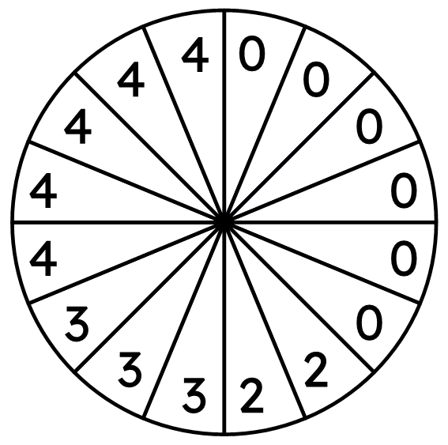
Bayaanno (Statements) ee dhacdooyinka (events) ee jaantusyo kala duwan
Dhacdooyinka (Events): Saciid waa guuleystay, Axmed waa guuleystay
Si loo muujiyo dhacdooyinkan geedka itimaalka (probability tree), waa inaan marka hore u kala saarno natiijooyinka dhacdo kasta laba kooxood (sida geedka natiijada (outcome tree)):
Saciid waa guuleystay
dhacdo 1 (Saciid waa guuleystay)
Wareeggan (spinner) ayaa hal mar la wareejiyay.
Haddii ay ku soo degto:
2
2
4
4
4
4
4
2 ama 4 - Saciid waa guuleystay
3 ama 4 - Axmed waa guuleystay
0 - guul ma jirto
Saciid ma guuleysan
0
0
0
0
0
0
3
3
3

Slide 25
Bayaanno (Statements) ee dhacdooyinka (events) ee jaantusyo kala duwan
dhacdo 2 (Axmed waa guuleystay)
Axmed waa guuleystay
4
4
4
4
4
Saciid waa guuleystay
Wareeggan (spinner) ayaa hal mar la wareejiyay.
Haddii ay ku soo degto:
2
2
4
4
Axmed ma guuleysan
4
4
4
2
2
Axmed waa guuleystay
2 ama 4 - Saciid waa guuleystay
3 ama 4 - Axmed waa guuleystay
0 - guul ma jirto
3
3
3
Saciid ma guuleysan
0
0
0
0
0
Axmed ma guuleysan
0
3
3
3
0
0
0
0
0
0

Slide 26
Oraahda dhacdooyinka ee jaantusyada kala duwan
Dhacdooyinkan isku mid ah waxaa lagu muujin karaa jaantuska Venn (Venn diagram).
Waxaan muujin karnaa natiijo kasta oo gaar ah oo ka timid wareejiyaha (spinner) oo loo kala saaray dhacdooyin kala duwan…
Wareejiyahan (spinner) hal mar ayaa la wareejin doonaa.
Haddii uu ku soo degto:
ξ
Saciid waa guuleystay
Axmed waa guuleystay
2
4
3
4
3
4
4
2 ama 4 - Saciid waa guuleystay
3 ama 4 - Axmed waa guuleystay
0 - guul ma jirto
2
3
4
0
0
0
0
0
0

Slide 27
Oraahda dhacdooyinka ee jaantusyada kala duwan
Dhacdooyinkan isku mid ah waxaa lagu muujin karaa nooc kale oo jaantuska Venn (Venn diagram) ah.
Waxaan muujin karnaa tirada natiijooyinka ee dhacdo kasta.
Wareejiyahan (spinner) hal mar ayaa la wareejin doonaa.
Haddii ay ku soo degto:
ξ
Saciid waa guuleystay
Axmed waa guuleystay
5
3
2
2 ama 4 - Saciid waa guuleystay
3 ama 4 - Axmed waa guuleystay
0 - guul ma jirto
6

Slide 28




Bayaannada dhacdooyinka (events) ee jaantusyada kala duwan
Raadi P(Saciid ama Axmed wuu guuleystaa)
Axmed wuu guuleystaa
4
4
4
4
4
Saciid wuu guuleystaa
Axmed ma guuleysto
2
2
ξ
Saciid wuu guuleystaa
Axmed wuu guuleystaa
Axmed wuu guuleystaa
3
3
3
Saciid ma guuleysto
Axmed ma guuleysto
5
3
0
0
0
0
0
0
2
P(Saciid ama Axmed wuu guuleystaa) =
+
+
=
6

Slide 29
Bayaannada dhacdooyinka (events) ee jaantusyada kala duwan
Raadi P(Saciid ama Axmed wuu guuleystaa)
Axmed wuu guuleystaa
10 natiijo (outcomes) ee labada dhacdo (event) midkood
4
4
4
4
4
Saciid wuu guuleystaa
+
+
=
oo ka mid ah wadarta 16 natiijo (outcomes) ee booska muunadda (sample space)
Axmed ma guuleysto
2
2
ξ
Saciid wuu guuleystaa
Axmed wuu guuleystaa
Axmed wuu guuleystaa
3
3
3
Saciid ma guuleysto
Axmed ma guuleysto
5
3
0
0
0
0
0
0
2
P(Saciid ama Axmed waa guuleystaan) =
+
+
=
6

Slide 30
Oraacyo dhacdooyinka kala duwan ee jaantusyada kala duwan
Jaantuskan Venn wuxuu muujinayaa natiijooyinka shaqsiyeed ee wareejiye (oo leh natiijooyin soo noqnoqday).
Dhacdooyin: tiro koowaad (prime number) iyo tiro badan oo 5 (multiple of 5)
ξ
tiro koowaad (prime)
tiro badan oo 5 (multiple of 5)
(M5)
2
Imisa natiijo oo shaqsiyeed ayaa ku jira jaantuskan Venn?
2
5
2
10
3
10
7
14 natiijo
4
6
8
8
9
4

Slide 31





Oraacyo dhacdooyinka kala duwan ee jaantusyada kala duwan
Jaantuskan Venn wuxuu muujinayaa natiijooyinka shaqsiyeed ee wareejiye (oo leh natiijooyin soo noqnoqday).
Dhacdooyin: tiro koowaad (prime number) iyo tiro badan oo 5 (multiple of 5)
Soo hel P(tiro koowaad (prime) ama M5) =
M5
ξ
tiro koowaad (prime)
tiro badan oo 5 (multiple of 5)
(M5)
tiro koowaad (prime)
2
ma aha M5 (not M5)
2
5
2
10
3
10
M5
7
ma aha tiro koowaad (not prime)
4
6
8
8
9
4
ma aha M5 (not M5)

Slide 32
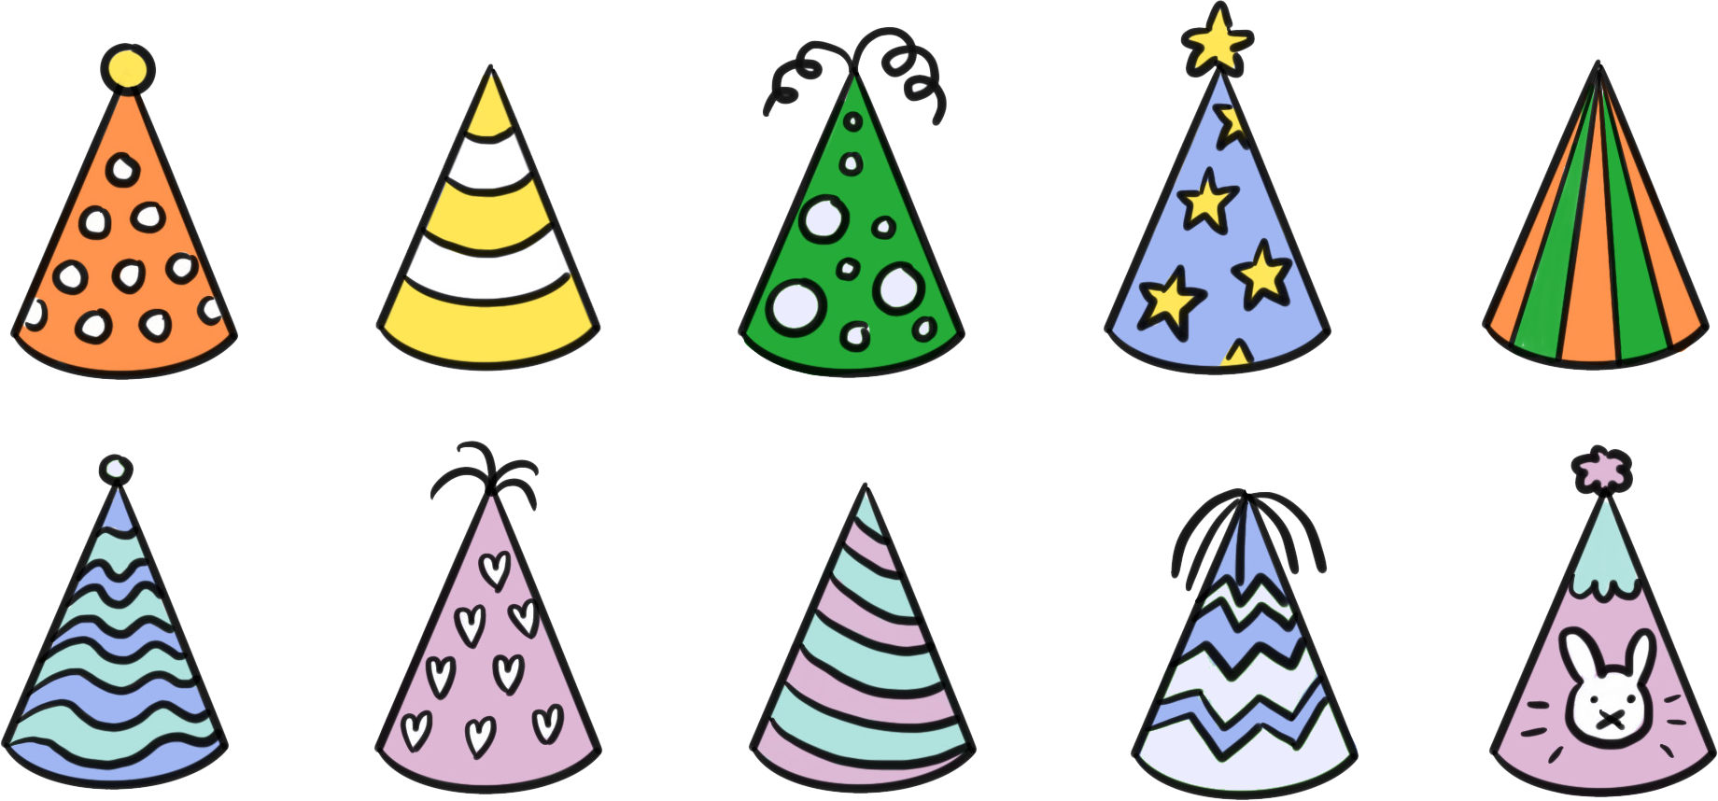










Qoraallo ku saabsan dhacdooyinka jaantusyada kala duwan
Shaxda natiijada laba-geesoodka ah waxay la wadaagtaa waxyaabo badan oo la mid ah jaantuska Venn.
Tijaabo: alaab si random ah ayaa loo doortaa.
Dhacdooyinka: alaabtu waa orso, alaabtu waxay leedahay koofiyad.
Shaxda natiijadu waxay muujinaysaa natiijooyinka shaqsiga ah ee tijaabada.
Sidee loo isticmaali karaa shaxda natiijada si loo dhammeeyo jaantuska Venn oo muujinaya tirada natiijooyinka ee dhacdo kasta?
 | koofiyad (hat) | koofiyad la'aan (no hat)
orso (bear)
orso ma aha (not a bear)
ξ
orso (bear)
koofiyad (hat)
5
4
3
1

Slide 33




Qoraallo ku saabsan dhacdooyinka jaantusyada kala duwan
Qaybtee ka mid ah shaxda natiijada iyo jaantuska Venn ayaa muujinaysa dhacdada doorashada alaabta ah orso ama xidhata koofiyad?
P(orso ama koofiyad) =
+
+
=
 | koofiyad (hat) | koofiyad la'aan (no hat)
orso (bear)
orso ma aha (not a bear)
ξ
orso (bear)
koofiyad (hat)
5
4
3
1
tirada natiijooyinka ee dhacdo kasta

Slide 34
Qoraallo ku saabsan dhacdooyinka jaantusyada kala duwan
Tijaabo (Trial): si kadis ah uga soo xulo kaar (card) oo lambar ku qoran yahay
Dhacdooyin (Events): kaar (card) wuxuu muujinayaa tiro sinnaan (even number), kaar (card) wuxuu muujinayaa tiro 3-la dhufasho (multiple of 3)
Isticmaal jaantuska Venn (Venn diagram) ee saxda ah si aad u aqoonsato qaybta shaxda natiijada (outcome table) ee kaar (card) ka maqan tahay. Soo jeedi qiime (value) suurtagal ah oo kaar (card)kaas ah.
Kisi dhufasho 3 (Odd multiple of 3). Tusaale: 9, 21, 27, 33, 39, 45, 51, 57, 63, 69, …
 | 3-la dhufasho (M3) | ma aha M3 (not M3)
sinnaan (even)
kisi (odd)
ξ
sinnaan (even)
M3
6
36
4
16
78
18
5
3
4
10
22
3
19
2
15
7
99
tirada natiijooyinka ee dhacdo kasta

Slide 35



Odhaahyo (Statements) ku saabsan dhacdooyinka (events) jaantusyo (diagrams) kala duwan
Soo hel suurtagalnimada (probability) ee:
a
P(M3)
b
P(M3 iyo ma aha sinnaan)
c
P(M3 iyo sinnaan)
 | 3-la dhufasho (M3) | ma aha M3 (not M3)
sinnaan (even)
kisi (odd)
ξ
sinnaan (even)
M3
6
36
4
16
78
18
5
3
4
10
22
3
21
19
2
15
7
99
tirada natiijooyinka (number of outcomes) dhacdo (event) kasta

Slide 36

Odhaahyo (Statements) ku saabsan dhacdooyinka (events) jaantusyo (diagrams) kala duwan
Raadi itimaalka (probability) ee:
d
P(even)
e
P(M3 ama even)
f
P(midna M3 iyo even)
 | tiro badan oo 3 (M3) | ma aha M3
xitaa (even)
khafif (odd)
ξ
sinnaan (even)
M3
6
36
4
16
78
18
5
3
4
10
22
3
21
19
2
15
7
99
tirada natiijooyinka (number of outcomes) dhacdo (event) kasta

Slide 37
Qoraallo ku saabsan dhacdooyinka jaantusyada kala duwan
1) Tijaabo (Trial): wareeg (spinner) ayaa la mariyaa hal mar.
Dhacdooyinka (Events): wareeggu wuxuu ku degayaa qayb ka mid ah 100 (F100) ama tiro badan oo 5 (M5).
a) Isticmaal jaantuska natiijooyinka (outcome table) si aad u buuxiso jaantuska Venn (Venn diagram) oo muujinaya tirada natiijooyinka dhacdo kasta.
 | (M5) | ma aha M5
F100
ma aha F100
Raadi itimaalladan (probabilities):
b) P(M5 iyo F100)
c) P(M5)
d) P(M5 ama F100)
5
20
ξ
F100
M5
1
2
25
10
50
4
15
35
3
7
11
75
1005
16
21
33

Slide 38

Qoraallo ku saabsan dhacdooyinka jaantusyada kala duwan
2) Tijaabo (Trial): doorashada nambar random (random number) oo ka mid ah ciyaar ka dhacda suuqa (fair).
Dhacdooyinka (Events): Isra ayaa guuleysata, Nuur ayaa guuleysta
a) Isticmaal jaantuska Venn (Venn diagram) oo muujinaya tirada natiijooyinka ee Isra ama Nuur guuleystaan si aad u buuxiso geedka itimaalka (probability tree).
Nuur
waa guuleystay
Soo hel itimaalkaan (probabilities):
b) P(Isra waa guuleysatay)
c) P(kaliya Nuur waa guuleystay)
d) P(mid kasta oo guuleysta)
ξ
Isra ayaa guuleysata
Nuur waa guuleystay
Isra waa guuleysatay
Nuur
waa guuldaraystay
4
1
7
Nuur
waa guuleystay
20
Isra waa guuldaraysatay
Nuur
waa guuldaraystay

Slide 39
Oraahyo (Statements) dhacdooyinka (events) ee ku kala duwan jaantusyada (diagrams) kala duwan
3) Tijaabo (Trial): wareeg (spinner) ayaa la mariyaa hal mar.
Dhacdooyinka (Events): wareeggu wuxuu ku dhacaa tiro labajibbaaran (square number) ama tiro siman (even number).
a) Dhammeey geedka itimaalka (probability tree) oo leh itimaallo iyo dhacdooyin, iyo sidoo kale dhammeey shaxda natiijooyinka (outcome table) oo leh hal natiijo oo maqan.
jibbaar (square)
Raadi:
b) P(jibbaar)
c) P(jibbaar ama xamaasi)
d) P(jibbaar ama xamaasi, laakiin ma aha labadaba)
 | labajibbaaran (square) | aan labajibbaaranayn (not square)
siman (even)
khayaali (odd)
xamaasi (even)
0
4
16
ma aha (not)
jibbaar (square)
2
6
10
36
84
100
22
38
60
144
196
3
5
13
1
9
21
35
45
25
49
57
69
80
ma aha (not)
jibbaar (square)

Slide 40



Qoraallo ku saabsan dhacdooyinka jaantusyada kala duwan
1) Tijaabo: wareeg (spinner) la mariyey hal mar.
Dhacdooyinka: wareeggu wuxuu ku soo degayaa qayb ka mid ah 100 (F100) ama tiro badan oo 5 (M5).
a) Isticmaal shaxda natiijada si aad u buuxiso jaantuska Venn oo muujinaya tirada natiijooyinka dhacdo kasta.
 | (M5) | ma aha M5
F100
ma aha F100
Raadi suurtogallada (probabilities) aan:
b) P(M5 iyo F100)
c) P(M5)
d) P(M5 ama F100)
5
20
ξ
F100
M5
1
2
25
10
50
4
3
5
4
15
35
3
7
11
16
21
33
6
75
1005

Slide 41





Oraacyada dhacdooyinka (events) ee jaantusyada kala duwan
2) Tijaabo: doorasho nambar random ah oo ka mid ah ciyaar ka dhacda suuqa.
Dhacdooyinka: Isra waa guul, Nuur waa guul
a) Isticmaal jaantuska Venn (Venn diagram) oo muujinaya tirada natiijooyinka (outcomes) ee keena in Isra ama Nuur guuleystaan, si aad u dhamaystirto geedka itimaalka (probability tree).
Nuur
waa guuleysataa
Soo hel itimaalkan (probabilities):
b) P(Isra waa guuleysataa)
c) P(kaliya Nuur waa guuleysataa)
d) P(mid kasta oo guuleysta)
ξ
Isra waa guuleysataa
Nuur waa guuleysataa
Isra waa guuleysataa
Nuur
waa guul-dareysaa
4
1
7
Nuur
waa guuleysataa
20
Isra waa guul-dareysaa
Nuur
waa guul-dareysaa

Slide 42
Oraacyada dhacdooyinka (events) ee jaantusyada kala duwan
3) Tijaabo (Trial): wareejiyaha (spinner) ayaa la wareejiyaa hal mar.
Dhacdooyinka (Events): wareejiyuhu wuxuu ku soo degayaa tiro laba jibaaran (square number) ama tiro siman (even number).
a) Dhamaystir labadaba geedka itimaalka (probability tree) oo leh itimaallo iyo dhacdooyin, iyo dhamaystir shaxda natiijooyinka (outcome table) oo leh hal natiijo oo maqan oo suurtagal ah.
jibbaarane (square)
 | jibbaarane (square) | aan jibbaarane ahayn (not square)
xigto (even)
khafif (odd)
xigto (even)
Natiijadii maqan waxay ahayd tiro khafif ah oo aan jibbaarane ahayn.
Tusaale ahaan:
7, 11, 15, 17, 19, 23, …
0
4
16
ma aha (not)
jibbaarane (square)
2
6
10
36
84
100
22
38
60
144
196
jibbaarane (square)
3
5
13
1
9
khafif (odd)
21
35
45
25
49
57
69
80
ma aha (not)
jibbaarane (square)

Slide 43
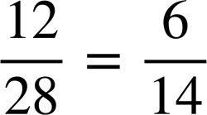
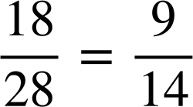
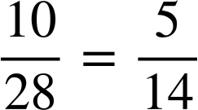
Qoraallo ku saabsan dhacdooyinka jaantusyada kala duwan
3) Tijaabo: wareeg (spinner) hal mar la wareejiyo.
Dhacdooyinka: wareeggu wuxuu ku degayaa tiro jibbaarane (square number) ama tiro xigto (even number).
a) Buuxi labada geedka itimaalka (probability tree) oo leh itimaallo iyo dhacdooyin, iyo buuxi shaxda natiijada oo leh hal natiijo maqan oo suurtogal ah.
jibbaaran (square)
Raadi:
b) P(jibbaaran) (P(square))
c) P(ama jibbaaran ama xataa) (P(either square or even))
d) P(ama jibbaaran ama xataa, laakiin labadaba ma aha) (P(either square or even, but not both))
 | jibbaarane (square) | aan jibbaarane ahayn (not square)
xigto (even)
khafif (odd)
xataa (even)
0
4
16
ma aha (not)
jibbaaran (square)
2
6
10
36
84
100
22
38
60
144
196
jibbaaran (square)
3
5
13
1
9
khatar (odd)
21
35
45
25
49
57
69
80
17
ma aha (not)
jibbaaran (square)

Slide 44
Isbarbardhigga matallo badan (multiple representations) si loo xisaabiyo ixtimaalka (probabilities) aragtida (theoretical) ee dhacdooyinka (events) isku-dhafan (combined)
Natiijooyinka tijaabada laba-tallaabo waxaa lagu muujin karaa shaxda natiijada (outcome table), iyadoo ixtimaalka (probabilities) laga xisaabinayo booska muunadda (sample space).
Natiijooyinka iyo ixtimaalka (probabilities) tijaabada laba-tallaabo waxaa lagu muujin karaa geed ixtimaal (probability tree) oo leh laba lakab oo laamo ah.
Natiijooyinka iyo ixtimaalka (probabilities) laba dhacdo (events) (oo ay ku jiraan oraahyada iyo/ama) waxaa lagu muujin karaa shaxda natiijada (outcome table), geed ixtimaal (probability tree), iyo noocyo kala duwan oo jaantus Venn (Venn diagram) ah.

