Slide 1
Isbarbardhigga matalaadaha natiijooyinka in ka badan laba dhacdo
Itimaalka (Probability): natiijooyinka suurtagalka ah

Slide 2
Sida agabkeena waxbarista loogu talagalay fasalka

Slide 3
Waxaan aqoonsan karaa natiijada isku midka ah dhammaan matalaadaha kala duwan.

Slide 4
Shaxda natiijooyinka (Natiijada table) waa shax muujisa dhammaan natiijooyinka suurtagalka ah.
Jaantusyada geedka (Tree diagrams) waa matalaad loo isticmaalo qaabaynta su'aalaha tirakoobka/itimaalka. Laamuhu waxay matalaan dhacdooyin ama natiijooyin kala duwan.
Laan kasta oo ka mid ah geedka natiijooyinka waxay muujisaa natiijo suurtagal ah oo ka timid dhacdo ama heer tijaabo ah. Geedka natiijooyinka oo dhamaystiran wuxuu muujiyaa dhammaan natiijooyinka suurtagalka ah.
Jaantusyada Venn (Venn diagrams) waa matalaad loo isticmaalo qaabaynta su'aalaha tirakoobka/itimaalka. Caadi ahaan goobo ayaa loo isticmaalaa inay matalaan dhacdooyinka.

Slide 5

Isbarbardhigga matalaadaha natiijooyinka in ka badan laba dhacdo
Isticmaalka jaantusyo kala duwan oo loogu talagalay dhacdooyin badan
Tijaabooyin heerar badan leh oo leh liisaska iyo geedaha natiijooyinka

Slide 6
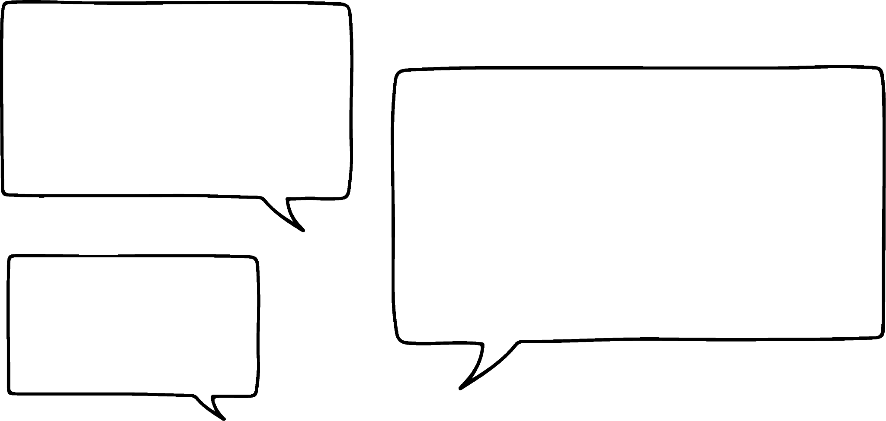

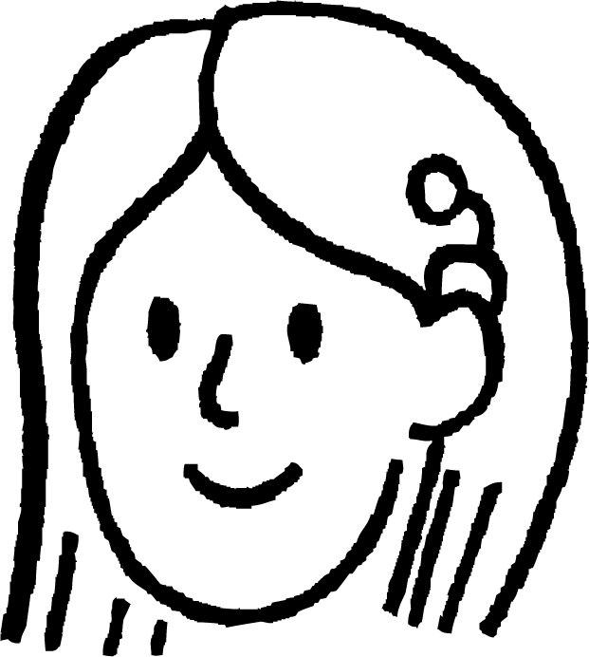

Isticmaalka jaantusyo kala duwan oo loogu talagalay dhacdooyin badan
30
3
Isticmaalka shaxda natiijooyinka ayaa aad ugu fiican kala soocista natiijooyinka spinner-ka ee laba dhacdo!
15
5
10
6
8
7
spinner
Suad waxay wareejin doontaa spinner-kan oo tixgelin doontaa natiijooyin kala duwan oo uu spinner-ku ku degi karo.
Suad
 | M3 | ma aha M3
M5 | 15, 30 | 5, 10
ma aha M5 | 3, 6 | 7, 8
Tusaale ahaan, shaxdan dhacdooyinka waxay muujinaysaa natiijooyinka ay yihiin tirooyin 3 (M3) iyo tirooyin 5 (M5).

Slide 7



Isticmaalka jaantusyo kala duwan oo loogu talagalay dhacdooyin badan
30
3
Ma hubo, sababtoo ah...
15
5
Safafka (rows) waxay muujinayaan hal dhacdo (event),
10
6
tiirarka (columns)na waxay muujinayaan mid labaad.
8
7
Sidee ku muujin kartaa dhacdo saddexaad (third event)?
wareejiye (spinner)
Laakiin maxaa dhacaya haddii aad sidoo kale rabto inaad natiijooyinka u kala saarto iyadoo loo eegayo inay yihiin kuwa qallafsan (odd) ama siman (even)?
Sidee buu u ekaan lahaa shaxda natiijada (outcome table)?
Suad
 | M3 | ma aha M3
M5 | 15, 30 | 5, 10
ma aha M5 | 3, 6 | 7, 8
Nuur

Slide 8
Isticmaalka jaantusyo (diagrams) kala duwan oo loogu talagalay dhacdooyin badan (multiple events)
30
3
 | M3 | ma aha M3
M5 | 15, 30 | 5, 10
ma aha M5 | 3, 6 | 7, 8
15
5
Shaxda natiijada (outcome table) waxay u kala saari kartaa natiijooyinka kaliya laba dhacdo oo kala duwan.
10
6
8
7
wareejiye (spinner)
M5
M3
qallafsan (odd)
ma aha M5
M3
M5
M5
ma aha
M3
ma aha M5
M5
M3
siman (even)
ma aha M5
M5
khayaali (odd)
ma aha
M3
ma aha M5
Jaantuska Venn ee leh saddex goobo ayaa sidoo kale muujin kara saddex dhacdo.
Halka geed natiijeed (outcome tree) oo leh saddex lakab oo laamo (three layers of branches) uu muujin karo saddex dhacdo.

Slide 9
Isticmaalka jaantusyo kala duwan oo loogu talagalay dhacdooyin badan
M5
15
M3
M5
M3
30
ma aha M5
khayaali (odd)
M5
5
ma aha
M3
5
ma aha M5
M5
30
7
M3
ma aha M5
khayaali (odd)
xitaa (even)
M5
10
ma aha
M3
ma aha M5
Si loo wareeji natiijada jaantus kale, waa in aan eegno halka ay ku taallo jaantuska hadda.
Jawaabaha:
3
7
6
8

Slide 10

Isticmaalka jaantusyo kala duwan oo loogu talagalay dhacdooyin badan
M5
15
M3
M5
M3
30
ma aha M5
3
khayaali (odd)
M5
5
15
ma aha
M3
5
ma aha M5
7
M5
30
7
M3
ma aha M5
6
kisi (odd)
xitaa (even)
M5
10
ma aha
M3
ma aha M5
8
Natiijada 15 ee geedka natiijada (outcome tree) waa…
kisi (odd)
Sidaas darteed 15 waxay geli doontaa isgoyska (intersection) saddexda goobo ee jaantuska Venn.
tiro 3 u qaybsan (multiple of 3)
tiro 5 u qaybsan (multiple of 5)

Slide 11

Isticmaalka jaantusyo kala duwan oo loogu talagalay dhacdooyin badan (multiple events)
M5
15
M3
M5
M3
30
ma aha M5
3
kisi (odd)
M5
5
5
15
ma aha
M3
5
ma aha M5
7
M5
30
7
M3
ma aha M5
6
kisi (odd)
xataa (even)
M5
10
ma aha
M3
ma aha M5
8
Halka natiijada 5 ee jaantuska Venn ay tahay…
kisi (odd)
Sidaas darteed 5 waxay ku jiri doontaa dhamaadka laamaha soo socda:
kisi (odd) → ma aha M3 → M5
ma aha tiro 3 ku dhufan (multiple of 3)
tiro 5 u qaybsan (multiple of 5)

Slide 12

Isticmaal jaantusyo kala duwan dhacdooyin badan (multiple events)
M5
15
M3
M5
M3
30
ma aha M5
3
khafif (odd)
M5
5
5
15
ma aha
M3
5
ma aha M5
7
a
M5
30
M3
b
7
ma aha M5
6
khafif (odd)
xataa (even)
c
M5
10
ma aha
M3
ma aha M5
8
d
Halkee ayay natiijada 30 (Venn diagram) ku tagi doontaa geedka natiijada (outcome tree)?

Slide 13
Isticmaal jaantusyo kala duwan dhacdooyin badan (multiple events)
1) Isticmaal geedka natiijada si sax ah loo buuxiyay, buuxi jaantuska Venn ee aan dhammaystirnayn.
ka badan 100
125
khafif (odd)
cube (tiro saddex jibaaran)
cube
100 ama ka yar
1, 27
8
ka badan 100
755
ma aha
cube (tiro saddex jibaaran)
100 ama ka yar
7
ka badan 100
216
cube
100 ama ka yar
8, 64
ka badan 100
108
ma aha
cube
100 ama ka yar
72
ka badan 100
Jawaabaha:
khafif (odd)
xataa (even)

Slide 14
Isticmaalka jaantusyo kala duwan oo loogu talagalay dhacdooyin badan
2) Jaantuska Venn iyo geedka natiijada labaduba waxay matalaan isku dhacdooyin isku mid ah oo loogu talagalay wareeg.
Buuxi dhammaan natiijooyinka maqan ee labada matalaad.
m8
faktor (factor) ee 360
(f360)
tiro badan oo 8 (multiple of 8)
(m8)
f360
ma aha m8
2d
8
m8
180
ma aha
f360
ma aha m8
90
m8
f360
ma aha m8
61
ma aha 2d
m8
104
2 lambar
(2d)
ma aha
f360
ma aha m8
Jawaabaha:
24
16
8
3,
7,

Slide 15
Isticmaalka jaantusyo kala duwan oo loogu talagalay dhacdooyin badan
3) Halka hal shax natiijadu aysan muujin karin saddex dhacdo oo ka mid ah tijaabo, laba shax oo natiijo ah ayaa kara.
Buuxi dhammaan natiijooyinka maqan ee labada shax natiijada iyo jaantuska Venn labadaba.
 | madax
 | guul | khasaare
guduud | Caasha
aan guduud |  | Saciid
guul
 | dabo
 | guul | khasaare
guduud | Cabdi
aan guduud |  | Layla
Jawaabaha:
madax
Nuur
Isra
Yacquub
guduud
Cali

Slide 16
Isticmaalka jaantusyo kala duwan oo loogu talagalay dhacdooyin badan
1) Isticmaal geedka natiijada si sax ah loo buuxiyey, buuxi jaantuska Venn ee aan dhammaystirnayn.
in ka badan 100
125
kis (odd)
cube
cube (Cube)
100 ama ka yar
1, 27
1
8
kis (odd)
7
27
in ka badan 100
755
64
ma aha
cube
100 ama ka yar
7
125
in ka badan 100
216
755
216
cube
100 ama ka yar
8, 64
xataa (even)
in ka badan 100
108
72
108
ma aha
cube
100 ama ka yar
72
in ka badan 100

Slide 17
Isticmaal jaantusyo kala duwan oo loogu talagalay dhacdooyin badan
2) Jaantuska Venn iyo geedka natiijada labaduba waxay u taagan yihiin isku dhacdooyin oo ah spinner.
Buuxi dhammaan natiijooyinka maqan ee labada matalaad.
m8
24
factor (Factor) ee 360
(f360)
multiple (Multiple) ee 8
(m8)
f360
ma aha m8
90
3
2d
8
m8
16
180
ma aha
f360
24
ma aha m8
61
90
16
m8
8
f360
ma aha m8
3, 180
7
61
ma aha 2d
m8
104
2 lambar
(2d)
ma aha
f360
ma aha m8
7, 104

Slide 18
Isticmaalka jaantusyo kala duwan oo loogu talagalay dhacdooyin badan (multiple events)
3) Halka hal shax natiijo (outcome table) aysan muujin karin saddex dhacdo oo ka yimid tijaabo (trial), laba shax natiijo ayaa kara.
Buuxi dhammaan natiijooyinka maqan labada shax natiijo iyo jaantuska Venn (Venn diagram).
 | madax
 | guul | khasaare
guduud | Caasha | Yacquub
ma aha guduud (red) | Nuur | Saciid
guul (win)
 | dabo (tails)
 | guul (win) | guuldarro (lose)
guduud (red) | Cabdi | Cali
ma aha guduud (red) | Isra | Layla
Layla
Jawaabaha:
madax (heads)
Nuur
Isra
Saciid
Caasha
Yacquub
Cabdi
guduud (red)
Cali

Slide 19
Isbarbardhig matalaadyada natiijooyinka in ka badan laba dhacdo
Isticmaal jaantusyo kala duwan dhacdooyin badan
Tijaabooyin heerar badan oo leh liis iyo geedo natiijo (outcome trees)

Slide 20

Tijaabooyin heerar badan oo leh liis iyo geedo natiijo (outcome trees)
Marka, markaan kala saareyno saddex dhacdo oo tijaabo ah, waxaan isticmaali karnaa:
Laakiin ma isticmaali karnaa labada jaantus markaan si nidaamsan u taxayno natiijooyinka tijaabo saddex heer ah?
Jaantusyada Venn (Venn diagrams)
iyo geedo natiijo (outcome trees).
Nuur
Suad
Sida rogista lacagtan (coin) caddaaladda ah saddex jeer?

Slide 21
Tijaabooyin heerar badan oo leh liis iyo geedo natiijo (outcome trees)
lacag (coin) = {madax, dabo}
Waxaa suurtogal ah in la isticmaalo geed natiijo (outcome tree) si nidaamsan loo taxo dhammaan natiijooyinka tijaabo saddex marxaladood ah.
marxaladda 1
(flip 1)
marxaladda 2
(flip 2)
marxaladda 3
(flip 3)
booska tusaalaha (sample space)
H
HHH
H
Lakab kasta oo laamo ah wuxuu matalaa heer.
Marka, waxaa suurtogal ah in lagu daro lakabyo dheeri ah oo loogu talagalay tijaabo afar ama shan marxaladood ah.
T
HHT
H
H
HTH
T
T
HTT
H
THH
H
Booska tusaalaha (sample space) ee laga sameeyay geedka natiijada waa liis dhammaan isku-dhafka suurtogalka ah ee saddex jeer oo lacag la tuuray.
T
THT
T
H
TTH
T
T
TTT

Slide 22
Tijaabooyin badan oo marxalado leh oo leh liisyo iyo geedo natiijo (outcome trees)
lacag = {madax, dabo}
Si kastaba ha ahaatee, ma suurtogalna in la isticmaalo jaantus Venn (Venn diagram) si nidaamsan loo helo dhammaan natiijooyinka tijaabo saddex marxaladood ah.
H
H
Sababtoo ah jaantuska Venn (Venn diagram) wuxuu ka caawin badan yahay marka la kala saarayo natiijooyinka hore loo yaqaan.
H

Slide 23
Tijaabooyin heerar badan leh oo leh liis iyo geedo natiijo
Oh, marka waxaad kaliya ku tusin kartaa tijaabooyin saddex-heer ah iyadoo la adeegsanayo geed natiijo?
Waa had iyo jeer ikhtiyaar inaad qorto liis natiijooyin, ilaa aad si nidaamsan u samayn karto.
Oh, dabcan!
Xulashooyinka kee ayaad u malaynaysaa inuu ka fiican yahay: geedo natiijo ama liis?
Uma malaynayo inay jirto jawaab sax ah, waxay ku xirnaan doontaa su'aasha.
Waxaa ugu fiican inaad ku tababarto labadaba.
Nuur
Suad
A
B
A
B
C
wareegga 1
wareegga 2
qadaadiic

Slide 24
Tijaabooyin heerar badan leh oo leh liis iyo geedo natiijo
Su'aashan hubinta, waa inaad qortaa liis natiijooyin ka dibna dhammaystirtaa geedka natiijada.
Haddii aad haysato saaxiib kuu dhow, weydii inuu sameeyo mid ka mid ah, adiga oo sameynaya kan kale.

Slide 25
Tijaabooyin heerar badan leh oo leh liis iyo geedo natiijo
meel muunad (sample space)
Wareeg kasta waa la wareegi doonaa hal mar, qadaadiicdana waa la tuuri doonaa hal mar.
Qor dhammaan natiijooyinka tijaabadan adigoo qoraya liis iyo/ama buuxinaya geedka natiijadan.
A
madaxa
AA madaxa
dabada
AA dabada
A
B
madaxa
AB madaxa
dabada
AB dabada
C
madaxa
AC madaxa
dabada
AC dabada
A
madaxa
BA madaxa
dabada
BA dabada
A
B
B
A
B
B
madaxa
BB madaxa
C
dabada
BB dabada
wareegga 1
wareegga 2
qadaadiic
C
madaxa
Madaxii BC
dabada
Dabadii BC

Slide 26
Tijaabooyin heerar badan leh oo leh liisaska iyo geedaha natiijooyinka
Waxaan bilaabay inaan qoro liiska natiijooyinka cunto saddex-cunno ah, laakiin hadda waan ku xannibanahay.
Liiska natiijooyinka ee Nuur ilaa hadda
G C I
S P B
G L B
S C B
G P B
???
Nuur
Ma suurtagal tahay in la isticmaalo geed natiijooyin ah si loo dhammaystiro liiska oo loo saxo qaladaadayga?

Slide 27
Tijaabooyin heerar badan leh oo leh liisaska iyo geedaha natiijooyinka
Haddii aan rabno inaan abuurno meel muunad ah (sample space) oo dhammaan natiijooyinka ka yimaada liis aan dhammaystirnayn, waa inaan u qaadano in natiijo kasta oo heer kasta ah ay mar hore ku xusan tahay meel liiska.
Liiska natiijooyinka ee Nuur ilaa hadda
G C I
S P B
G L B
S C B
G P B
???
Tusaale ahaan, waa inaan u qaadano in labada bilow (starters) kaliya ay yihiin S (salad) iyo G (gyoza dumplings).

Slide 28
Tijaabooyin heerar badan leh oo leh liisaska iyo geedaha natiijooyinka
Aynu dhisno lakab kasta oo ka mid ah laamaha. Waxaan ku bilaabi karnaa bilowga halkaas oo aan ku hayno doorashooyinka (G) Gyoza ama S (Salad).
bilowga (starters)
cuntada weyn (mains)
macmacaanka (desserts)
G C I
S P B
G L B
S C B
G P B
???
C
I
B
P
I
G
B
L
I
B
C
I
B
S
P
I
B
L
I
B

Slide 29
Tijaabooyin heerar badan leh oo leh liisaska iyo geedaha natiijooyinka
Waa suurtagal in la qaato liis aan dhammaystirnayn oo natiijooyin ah oo la abuuro meel muunad ah (sample space) oo dhammaan natiijooyinka iyadoo la isticmaalayo geed natiijooyin.
G C I
S P B
G L B
S C B
G P B
???
boos muunad (sample space)
I
GCI
C
B
GCB
I
GPI
G
P
B
GPB
L
I
GLI
B
GLB
I
SCI
C
B
SCB
S
I
SPI
P
B
SPB
L
I
SLI
B
SLB

Slide 30
Tijaabooyin heerar badan leh oo leh liis iyo geedo natiijo (outcome trees)
Liiskani wuxuu muujinayaa qayb ka mid ah liiska natiijooyinka tijaabo saddex heer ah. Suad waxay rabtaa inay tijaabadan ku muujiso geed natiijo (outcome tree).
D 1 T
B 2 T
C 2 H
A 1 T
Immisa laan (branch) ayay leedahay lakabka koowaad ee geedka natiijada?
A
B
4 laan (branches)
C
D

Slide 31
Tijaabooyin heerar badan leh oo leh liis iyo geedo natiijo (outcome trees)
Liiskani wuxuu muujinayaa qayb ka mid ah liiska natiijooyinka tijaabo saddex heer ah. Suad waxay rabtaa inay tijaabadan ku muujiso geed natiijo (outcome tree).
D 1 T
B 2 T
C 2 H
A 1 T
Immisa laan (branch), guud ahaan, ayay tahay inay ku jiraan lakabkan?
A
B
8 laan (branches), guud ahaan.
Heerka labaad ee tijaabadan, waxaa jira laba natiijo oo keliya (1 iyo 2).
Sidaa darteed, waxaa jira laba laan (branches) oo ka soo baxa mid kasta oo ka mid ah afarta laan ee heerka 1aad.
C
D

Slide 32
Tijaabooyin heerar badan leh oo leh liis iyo geedo natiijo (outcome trees)
1) Cuntada saddex cunno (three-course meal) waxay ka kooban tahay hal bilow (starter), hal cunto weyn (main), iyo hal macmacaan (dessert).
Adigoo abuuraya geed natiijo (outcome tree), tax dhammaan cuntooyinka saddexda-cunno ee suurtogalka ah.
Cuntooyinka bilowga
Maraq Yaanyo (Tomato Soup)
Rooti Toos (Garlic Bread)
Cuntooyinka weyn
Baasto Carbonara (Pasta Carbonara)
Rooti Kalluun (Fish Pie)
Gnocchi Isbinaash (Spinach Gnocchi)
Macmacaan
Jalaato Fanil (Vanilla Ice Cream)
Keeg Shukulaato (Chocolate Cake)
Banana Split
2) Cuntada laba cunno (two-course meal) waxay ka kooban tahay mid ka mid ah:
hal cunno bilow ah iyo hal cunno weyn
hal cunno weyn iyo hal macmacaan
Abuur laba liis oo natiijooyin ah si aad u hesho dhammaan suurtogalnimada cuntada laba cunno (two course meals).
3) Immisa cunto saddex-cunno ayaa ka badan cuntooyinka laba-cunno?

Slide 33
Tijaabooyin heerar badan leh oo leh liis iyo geedo natiijo (outcome trees)
4) Isra waxay bilowday inay qorto liis natiijooyin tijaabo saddex heer ah.
Natiijo kasta oo ka mid ah heer kasta oo tijaabada ah waxaa lagu matalay ugu yaraan hal mar liiska Isra ee aan dhammaystirnayn.
Sawir oo dhammaystir geed natiijo (outcome tree) si aad u abuurto meel muunad (sample space) dhammaan natiijooyinka.
4 A T
4 R T
1 F T
7 R H
7 A H
7 K H

Slide 34
Tijaabooyin heerar badan leh oo leh liis iyo geedo natiijo (outcome trees)
1) Cunto saddex-cunno waxay ka kooban tahay hal cunno bilow ah, hal cunno weyn, iyo hal macmacaan.
V
TPV
P
C
TPC
B
TPB
Bilowga (Starters)
Maraq Yaanyo (Tomato Soup)
Rooti Toon (Garlic Bread)
Cuntada Weyn (Mains)
Pasta Carbonara
Rooti Kalluun (Fish Pie)
Spinach Gnocchi
Macmacaanka (Desserts)
Jalaato Vanilla (Vanilla Ice Cream)
Keega Shukulaato (Chocolate Cake)
Moos la Kala Qaybiyey (Banana Split)
V
TFV
T
F
C
TFC
B
TFB
V
TSV
booska tijaabada (sample space)
18 natiijo (outcomes)
S
C
TSC
B
TSB
V
GPV
P
C
GPC
B
GPB
V
GFV
G
F
C
GFC
B
GFB
V
GSV
S
C
GSC
B
GSB

Slide 35
Tijaabooyin heerar badan leh oo leh liisaska iyo geedaha natiijada
2) Cunto laba-cunto ah waxaa laga sameeyaa mid ka mid ah:
bilow (starter)
cunto weyn (main)
cunto weyn (main)
macmacaan (dessert)
Bilowga
Maraq Yaanyo
Rooti Toos
Cuntooyinka Waaweyn
Baasta Carbonara
Rooti Kalluun
Gnocchi Isbinaaj
Macmacaan
Jalaato Fanil
Keeg Shukulaato
Banana Split
hal bilow (starter) iyo hal cunto weyn (main)
hal cunto weyn (main) iyo hal macmacaan (dessert)
T | P
T | F
T | S
G | P
G | F
G | S
P | V
P | C
P | B
F | V
F | C
F | B
S | V
S | C
S | B
Samee laba liis oo natiijooyin ah si aad u hesho dhammaan cuntooyinka laba-cunto ee suurtagalka ah.
6 + 9 = 15 natiijooyin (outcomes)

Slide 36
Tijaabooyin heerar badan leh oo leh liis iyo geed natiijo (outcome tree)
3) Immisa cunto saddex-cunto ah ayaa ka badan cuntooyinka laba-cunto ah?
Bilowga (Starters)
Maraq Yaanyo (Tomato Soup)
Rooti Toon (Garlic Bread)
Cuntooyinka Waaweyn (Mains)
Baasto Carbonara (Pasta Carbonara)
Rooti Kalluun (Fish Pie)
Isbinaaj Gnocchi (Spinach Gnocchi)
Macmacaanka (Desserts)
Jalaato Fanili (Vanilla Ice Cream)
Keeg Shukulaato (Chocolate Cake)
Moos Jalaato (Banana Split)
Waxaa jiray 18 cunto saddex-cunto ah, halka ay jireen 15 cunto laba-cunto ah.
Waxaa jiray 3 cunto oo dheeri ah oo seddex qaybood ah.

Slide 37
Tijaabooyin heerar badan leh oo leh liis iyo geedo natiijooyin
4) Isra waxay bilowday inay qorto liiska natiijooyinka tijaabo saddex heer ah.
Natiijo kasta oo ka mid ah heer kasta oo tijaabada ah waxaa lagu muujiyay ugu yaraan hal mar liiska Isra ee aan dhammaystirnayn.
Sawir oo dhammaystir geed natiijooyin ah si aad u abuurto meel saami ah oo dhammaan natiijooyinka.
4 A T
4 R T
1 F T
7 R H
7 A H
7 K H

Slide 38
Tijaabooyin heerar badan leh oo leh liis iyo geedo natiijooyin
1AH
1AT
1FH
1FT
1KH
1KT
1RH
1RT
4AH
4AT
4FH
4FT
4KH
4KT
4RH
4RT
7AH
7AT
7FH
7FT
7KH
7KT
7RH
7RT
1AH
1AT
1FH
1FT
1KH
1KT
1RH
1RT
4AH
4AT
4FH
4FT
4KH
4KT
4RH
4RT
7AH
7AT
7FH
7FT
7KH
7KT
7RH
7RT
Waa kuwan 24 natiijada.
Waxaa jiray:
seddex natiijo oo heerka koowaad ee dhacdada
afar natiijo oo heerka labaad ee dhacdada
laba natiijo oo heerka saddexaad ee dhacdada

Slide 39
Isbarbardhigga matalaadaha natiijooyinka in ka badan laba dhacdo
Geedaha natiijada (outcome trees) oo leh saddex lakab oo laamo ah iyo jaantusyada Venn (Venn diagrams) oo leh saddex goobo ayaa labadaba loo isticmaali karaa in lagu kala saaro natiijooyinka tijaabo saddex dhacdo.
Inkastoo shaxda natiijada (outcome table) aan loo isticmaali karin tan, laba shax oo natiijo ah ayaa la isticmaali karaa.
Hase yeeshee, jaantusyada Venn (Venn diagrams) looma isticmaali karo in si nidaamsan loo qoro natiijooyinka tijaabo laba ama saddex heer ah.
Liisaska iyo geedaha natiijada (outcome trees) waxaa loo isticmaali karaa in si nidaamsan loo qoro natiijooyinka tijaabooyinka heerar badan leh, iyo geed natiijada ayaa loo isticmaali karaa in lagu dhammaystiro liis aan dhammaystirnayn oo natiijooyin ah.

