Slide 1
Isbarbardhigga matalaadaha natiijooyinka laba dhacdo
Itimaalka (Probability): natiijooyinka suurtagalka ah

Slide 2
Sida agabkeena waxbarista loogu talagalay fasalka

Slide 3
Waxaan aqoonsan karaa natiijada isku midka ah dhammaan matalaadaha kala duwan.

Slide 4
Shaxda natiijooyinka (outcome table) waa shax muujinaysa dhammaan natiijooyinka suurtagalka ah.
Jaantusyada geedka (tree diagrams) waa matalaad loo isticmaalo sawirka su'aalaha tirakoobka/itimaalka. Laamuhu waxay matalaan dhacdooyin ama natiijooyin kala duwan.
Jaantusyada Venn (Venn diagrams) waa matalaad loo isticmaalo sawirka su'aalaha tirakoobka/itimaalka. Caadi ahaan goobo ayaa loo isticmaalaa inay matalaan dhacdooyinka.
Laan kasta oo ka mid ah geedka natiijooyinka waxay muujinaysaa natiijo suurtagal ah oo ka timid dhacdo ama heer tijaabo ah. Geedka natiijooyinka oo dhamaystiran wuxuu muujinayaa dhammaan natiijooyinka suurtagalka ah.

Slide 5

Isbarbardhigga matalaadaha natiijooyinka laba dhacdo
Gudbinta macluumaadka jaantusyada dhexdooda
Isticmaalka jaantusyo badan

Slide 6
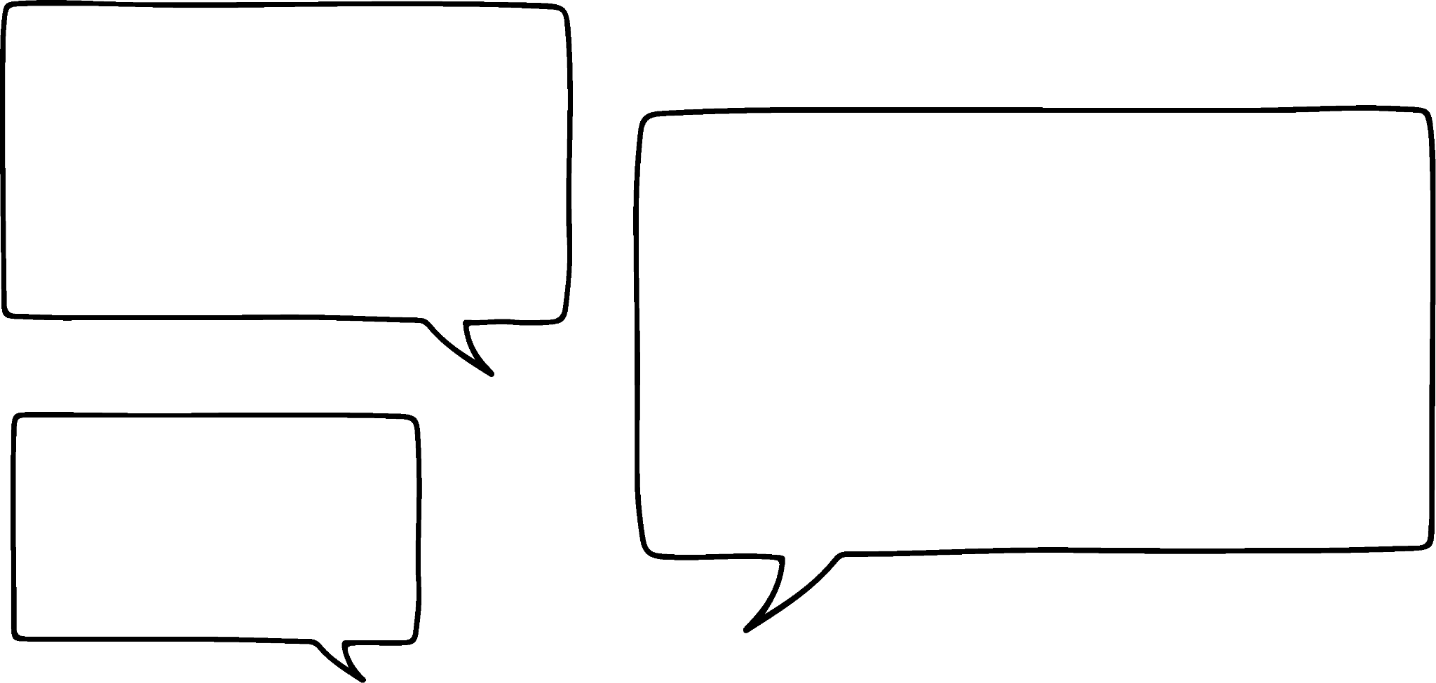



Gudbinta macluumaadka jaantusyada dhexdooda
Bilowga (Starters)
Maraq Yaanyo (T)
Rooti Toon (G)
Cuntooyinka waaweyn (Mains)
Baasto Carbonara (P)
Buste Kalluun (F)
Gnocchi Isbinaaj (S)
Waxaan awood u leeyahay inaan qaato macluumaadka heerarka dhacdada, sida doorashada bilowga iyo cuntada weyn ee liiska…
Nuur
Nuur wuxuu dooran doonaa bilow iyo cunto weyn.
Waa maxay natiijooyinka suurtagalka ah ee xulashadooda?

Slide 7
Gudbinta macluumaadka u dhexeeya jaantusyada
Bilowga (Starters)
Maraq Yaanyo (T)
Rooti Toos (G)
Cuntada Guud (Mains)
Pasta Carbonara (P)
Fuurad Kalluun (F)
Spinach Gnocchi (S)
TP
TF
TS
GP
GF
GS
Oo liis garayso dhammaan natiijooyinka suurtagalka ah,
ama ku dheji miiska natiijooyinka,
ama geedka natiijooyinka…
booska muunadda (sample space)
P
TP
TF
TS
GP
GF
GS
Nuur
T
F
 | P | F | S
T | TP | TF | TS
G | GP | GF | GS
S
P
G
F
S

Slide 8

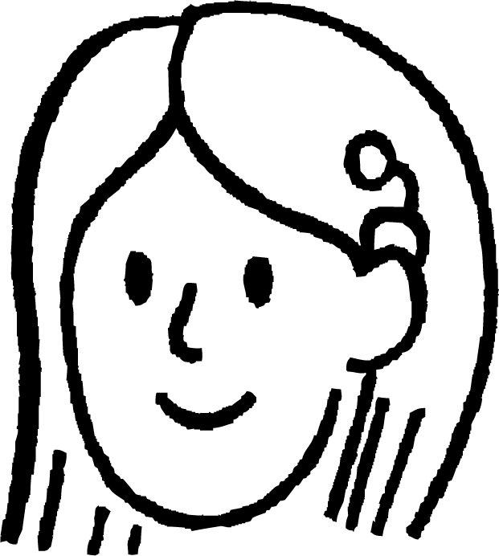


Gudbinta macluumaadka jaantusyada dhexdooda
Waxaan u malaynayaa haa.
Waxaad isticmaali kartaa madaxyada (headers) shaxda natiijada (outcome table) si aad u ogaato walxaha liiska cuntada.
Tusaale ahaan…
Laakiin ma suurtagal baa in jaantus mid kale oo aan dhamaystirnayn lagu dhammaystiro, iyada oo aan liiska cuntada (menu) aanu caawin?
TP
TS
GF
Nuur
Suad
 | P | F | S
T | TP | TF | TS
G | GP | GF | GS
FP

Slide 9
Gudbinta macluumaadka u dhaxaysa jaantusyada
Iyo cinwaannadan lakabka labaad ee laamaha.
Waan ogahay tan sababtoo ah waxaa jira saddex laamood iyo saddex cinwaan.
Waa qabow!
Marka waxaan u isticmaali karaa cinwaannadan lakabka koowaad ee laamaha…
Waa sax!
Hadda geedka natiijadaagu waa buuxsamay, waxaad sidoo kale dhammaystiri kartaa meesha muunadda (sample space).
Cinwaannadani waxay kuu sheegayaan cuntada bilowga ah,
halka cinwaannadani ay kuu sheegayaan cuntada ugu weyn.
P
TP
TS
GF
Nuur
Suad
T
F
TF
 | P | F | S
T | TP | TF | TS
G | GP | GF | GS
S
P
GP
G
F
S
GS

Slide 10

Ka wareejinta macluumaadka jaantusyada dhexdooda
Lacag ayaa la tuuray, iyo wareeg (spinner) ayaa la wareejin doonaa.
Shaxda natiijada iyo geedka natiijada labaduba waxay muujinayaan isku tijaabo.
Maxaa geli lahaa labada meelood ee bannaan ee geedka natiijada?
madax
 | 1 | 7 | 9
madax | h1 | h7 | h9
dabo | t1 | t7 | t9
a
9
dabo
b
Madaxa iyo dabada waxay u kala socon karaan labada dhinac.

Slide 11
Ka wareejinta macluumaadka jaantusyada dhexdooda
Lacag ayaa la tuuray, iyo wareeg (spinner) ayaa la wareejin doonaa.
Shaxda natiijada iyo geedka natiijada labaduba waxay muujinayaan isku tijaabo.
Maxaa geli lahaa labada meelood ee bannaan ee geedka natiijada?
1
a
h
7
 | 1 | 7 | 9
madax | h1 | h7 | h9
dabo | t1 | t7 | t9
b
9
t
1 iyo 7 waxay u kala socon karaan labada dhinac.

Slide 12

Gudbinta macluumaadka jaantusyada dhexdooda
Waxaa suurtogal ah in jaantus saxan oo keliya la isticmaalo si loo hubiyo qaladaadka jaantus kale oo si qaldan loo buuxiyay.
ξ
Axmed wuu wareejin doonaa wareeg (spinner) oo natiijooyinku yihiin:
{1, 2, 3, 4, 6, 7, 9, 10}
siman (even)
qaybiye (factor)
18
Axmed
4
6
9
Axmed wuxuu tixgelinayaa dhacdada in wareeggu ku soo degto tiro siman (even number) iyo dhacdada in ay ku soo degto qaybiye (factor) 18.
Axmed wuxuu dhacdooyinkan si sax ah u muujiyay jaantuskan Venn.
2
10
3
1
7

Slide 13

Gudbinta macluumaadka jaantusyada dhexdooda
Axmed wuxuu wareejin doonaa wareeg (spinner) oo natiijooyinku yihiin:
{1, 2, 3, 4, 6, 7, 9, 10}
qaybiye (factor) 18
siman (even)
2, 4, 8
aan ahayn qaybiye (factor) 18
10
Nuur wuxuu wareejin doonaa isla wareegga Axmed, laakiin wuxuu dhacdooyinka tijaabada ku muujinayaa geed natiijoed (outcome tree).
qaybiye (factor) 18
dhiciso (odd)
1, 3, 6, 9
aan ahayn qaybiye (factor) 18
7
Nuur

Slide 14
Gudbinta macluumaadka jaantusyada dhexdooda
ξ
qaybiyaha 18
xitaa (even)
qaybiyayaal (factors)
ee 18
siman (even)
2, 4, 8
6
ma aha qaybiyaha 18
4
9
10
2
10
3
qaybiyaha 18
dhiciso (odd)
1
1, 3, 6, 9
7
ma aha qaybiyaha 18
7
Jaantuska Venn ee Axmed waa sax buuxa, halka geedka natiijada ee Nuur uusan ahayn.
Markaad isbarbardhigto labada jaantus, hel saddexda qalad ee Nuur.
Axmed
Nuur

Slide 15

Gudbinta macluumaadka jaantusyada dhexdooda
ξ
qaybiyaha 18
xitaa (even)
qaybiyayaal (factors)
ee 18
xitaa (even)
2, 4, 8
6
ma aha qaybiyaha 18
4
9
10
2
10
3
qaybiyaha 18
khayaali (odd)
1
1, 3, 6, 9
7
ma aha qaybiyaha 18
7
6 waa xitaa (even), ma aha kisi (odd).
8 ma aha qayb (factor) 18, mana aha natiijo (outcome) spinner-ka.
Axmed
4 waa xitaa (even) laakiin ma aha qayb (factor) 18.
Jun

Slide 16
Transferring information between diagrams
ξ
factor of 18
even
factors
of 18
even
2, 6
6
not factor of 18
4
9
4, 10
2
10
3
factor of 18
odd
1
1, 3, 9
7
not factor of 18
7
Jun wuxuu saxay geedka natiijada (outcome tree).
All outcomes are in the correct location.
Alex
Jun

Slide 17
Gudbinta macluumaadka u dhexeeya jaantusyada
Andeep wuxuu ku duubi doonaa xabad (dice) oo leh tirooyin (integers) 20 ilaa 29.
Andeep iyo Laura waxay eegaan dhacdooyinka (events) in xabaddu ku dhacdo tiro kisi (odd) iyo tiro ka badan 7 (multiple of 7).
Andeep correctly shows the outcomes of these events on an outcome table, but Laura makes three mistakes in her Venn diagram.
Natiijo (outcome) kee ee jaantuska Venn (Venn diagram) waa in aanu gabi ahaanba ku jirin?
 | tiro badan (multiple) oo 7 | ma aha tiro badan oo 7
khayaali (odd) | 21 | 23, 25, 27, 29
xigto (even) | 28 | 20, 22, 24, 26
ξ
khayaali (odd)
tiro badan oo 7 (multiple of 7)
23
25
21
27
14
28
29
20
22
24

Slide 18
Gudbinta macluumaadka u dhexeeya jaantusyada
Cali wuxuu ku tuurayaa sac (dice) oo leh tirooyin 20 ilaa 29.
Cali iyo Layla waxay eegaan dhacdooyinka sac ku soo baxo tiro khayaali ah iyo tiro badan oo 7.
Cali wuxuu si sax ah u muujiyaa natiijooyinka dhacdooyinkan shaxda natiijada, laakiin Layla waxay sameysaa saddex qalad jaantuska Venn.
Natiijooyinka jaantuska Venn kee baa meel khaldan?
 | tiro badan (multiple) oo 7 | ma aha tiro badan oo 7
khayaali (odd) | 21 | 23, 25, 27, 29
xigto (even) | 28 | 20, 22, 24, 26
Jawaabaha:
ξ
tiro badan oo 7 (multiple of 7)
khayaali (odd)
23
25
21
27
28
29
20
22
24

Slide 19
Gudbinta macluumaadka u dhexeeya jaantusyada
Cali wuxuu ku tuurayaa sac (dice) oo leh tirooyin 20 ilaa 29.
Cali iyo Layla waxay eegaan dhacdooyinka sac ku soo baxo tiro khayaali ah iyo tiro badan oo 7.
Cali wuxuu si sax ah u muujiyay natiijooyinka dhacdooyinkan miiska natiijooyinka, laakiin Layla waxay ku sameysay saddex qalad jaantuskeeda Venn.
Natiijooyinka jaantuska Venn waa maxay ka maqan?
 | tiro badan (multiple) oo 7 ah | ma aha tiro badan oo 7
kisi (odd) | 21 | 23, 25, 27, 29
xataa (even) | 28 | 20, 22, 24, 26
Jawaabaha:
ξ
tiro badan oo 7 (multiple of 7)
kisi (odd)
23
25
21
28
27
29
26
20
22
24

Slide 20
Gudbinta macluumaadka u dhexeeya jaantusyada
1) Yacquub iyo Layla waxay soo gudbiyeen shaqo guri oo muujinaysa natiijooyinka laba dhacdo oo ka yimid tijaabo iyadoo la adeegsanayo matalaado kala duwan.
Isticmaal miiska natiijooyinka ee Yacquub si sax ah u qoran si aad ugo gooyso qalad kasta oo ku jira geedka natiijooyinka oo u qor waxa qaldan ee geedka natiijooyinka.
1, 3
 | qaybiye (factor) oo 45 (F45) | ma aha qaybiye (factor) oo 45
tiro koowaad (prime) | 3, 5 | 7, 23
ma aha tiro koowaad (prime) | 1, 9, 15, 45 | 12
F45
tiro koowaad (prime)
ma aha F45
5, 23
9, 15, 45
ma aha tiro koowaad (prime)
F45
ma aha F45
12, 21

Slide 21
Gudbinta macluumaadka jaantusyada dhexdooda
2) Geedkan natiijooyinka wuxuu si sax ah u muujinayaa laba dhacdo oo ka yimid tijaabada wareejinta wareegto leh 8 natiijood.
Isticmaal geedkan natiijada si aad u buuxiso jaantuska Venn ee muujinaya isku tijaabo.
khayaali (odd)
169, 625
ξ
jibbaar (square)
xitaa (even)
jibbaar (square)
xitaa (even)
400, 784
khayaali (odd)
89, 111
aan jibbaar ahayn
xitaa (even)
772, 1000

Slide 22
Gudbinta macluumaadka jaantusyada dhexdooda
3) Geedka natiijada iyo shaxda natiijadu waxay muujinayaan isku tijaabo laba heer ah: laba wareeg (spinners) oo la wareejiyay (mid kasta hal mar) iyo natiijooyinkooda oo la isku daray.
Labada jaantusba waa sax, laakiin waxaa ka maqan macluumaad qaar.
Shaxda natiijadu waxay muujinaysaa meesha natiijooyinka ka dib isku darka. Buuxi labada jaantus.
4
-1
+ |  |  | 3
 |  | 8 | 10

Slide 23
Gudbinta macluumaadka jaantusyada dhexdooda
1)
1 ma aha tiro asal ah (prime number).
5 sidoo kale waa qaybiye (factor) 45.
7 waa maqan - waa inay tahay tiro asal ah oo aan ahayn qaybiyaha 45.
21 waa in laga saaro, maadaama aysan ahayn natiijada tijaabada.
1, 3
 | qaybiye (factor) 45 (F45) | aan qaybiye ahayn 45
asal (prime) | 3, 5 | 7, 23
ma aha tiro koowaad (prime) | 1, 9, 15, 45 | 12
F45
tiro koowaad (prime)
ma aha F45
5, 23
9, 15, 45
ma aha tiro koowaad (prime)
F45
ma aha F45
12, 21

Slide 24
Gudbinta macluumaadka u dhexeeya jaantusyada
2) Geedka natiijada (outcome tree) wuxuu si sax ah u muujinayaa laba dhacdo oo ka mid ah tijaabada lagu wareejinayo wareejiye (spinner) leh 8 natiijo.
Isticmaal geedkan natiijada si aad u dhamaystirto jaantuska Venn (Venn diagram) oo muujinaya isla tijaabada.
kis (odd)
labajibbaaran (square)
xig (even)
ma aha labajibbaaran (square)
kis (odd)
xig (even)
Jawaabaha:
169, 625
ξ
labajibbaaran (square)
xig (even)
400, 784
169
772
400
625
1000
89, 111
784
772, 1000
89
111

Slide 25
Gudbinta macluumaadka u dhexeeya jaantusyada
3) Geedka natiijada (outcome tree) iyo shaxda natiijada (outcome table) waxay muujinayaan isla tijaabada laba-heerka ah: laba wareejiye (spinners) oo la wareejiyo (mid kasta hal mar) natiijooyinkoodana la isku daro.
Jaantusyada labaduba waa sax yihiin, laakiin waxaa ka maqan xog qaar.
Shaxda natiijada waxay muujinaysaa booska muunadda (sample space) natiijooyinka kadib isku-darka. Dhamaystir labada jaantus.
4
-1
7
+ | -1 | 1 | 3
4 | 3 | 5 | 7
7 | 6 | 8 | 10
4
1
7
4
3
7

Slide 26
Isbarbardhigga matalaadaha natiijooyinka laba dhacdo
Gudbinta macluumaadka u dhexeeya jaantusyada
Isticmaalka jaantusyo badan

Slide 27
Isticmaalka jaantusyo badan
F
A
Laakiin waa adag tahay in la doorto.
Goorma ayuu jaantus ka fiican yahay mid kale?
E
B
Waa wax aad faa'iido u leh inaad haysato jaantusyo kala duwan oo badan!
D
C
wareegga 1
Nuur
15
1
Suad
Oo ma waxaa had iyo jeer suurtagal ah in la isticmaalo jaantus kasta xaalad kasta?
9
4
8
wareegga 2
Axmed

Slide 28
Isticmaalka jaantusyo badan
A
B
C
D
E
F
F
A
A, 15
E, 15
F, 15
E, 1
C, 8
D, 15
F, 9
A, 4
E, 4
F, 4
B, 8
D, 1
A, 8
D, 9
C, 4
A, 9
B, 15
E, 9
C, 15
D, 4
A, 1
F, 1
B, 1
D, 8
F, 8
C, 1
E, 8
C, 9
B, 4
Liisaska waa kuwo aad fudud haddii ay jiraan natiijooyin yar oo keliya...
Laakiin waxaan u arkayaa samaynta liis mid aad u adag haddii ay jiraan natiijooyin badan oo heer kasta oo tijaabo ah!
E
B
D
C
wareegga 1
B, 9
15
1
Suad
9
4
8
Waa aad u adag tahay in la ogaado haddii aan seegay natiijo.
wareegga 2

Slide 29
Isticmaalka jaantusyo badan
F
A
Oo sawiridda geed natiijooyin ah waxay noqon kartaa mid aad u adag haddii ay jiraan laamo badan!
E
B
D
C
wareegga 1
15
1
Suad
9
4
8
wareegga 2

Slide 30
Isticmaalka jaantusyo badan (diagrams)
F
A
Waan ogahay inay weli suurtogal tahay in la qoro natiijooyinka oo dhan iyadoo la isticmaalayo liis ama geed natiijo (outcome tree)…
E
B
D
C
wareejiyaha 1 (spinner 1)
 | A | B | C | D | E
1 | A1 | B1 | C1 | D1 | E1
4 | A4 | B4 | C4 | D4 | E4
8 | A8 | B8 | C8 | D8 | E8
9 | A9 | B9 | C9 | D9 | E9
15 | A15 | B15 | C15 | D15 | E15
15
1
Suad
9
4
8
Laakiin waxaan doorbidaa inaan sawiro miis natiijo (outcome table).
wareejiyaha 2 (spinner 2)

Slide 31
Isticmaalka jaantusyo badan (diagrams)
Jaantusyada Venn (Venn diagrams) waa kuwa aan ugu jeclahay…
F
A
… Hmm, laakiin ma suurtogal baa in la sawiro mid labadan wareejiye (spinner)?
E
B
D
C
ξ
wareejiyaha 1 (spinner 1)
Axmed
15
1
Waxaan u malaynayaa inaad jaantuska Venn (Venn diagram) u isticmaali karto oo keliya noocyada su'aalaha gaarka ah.
9
4
8
wareejiyaha 2 (spinner 2)
Nuur

Slide 32
Isticmaalka jaantusyo badan (diagrams)
Jaantusyada Venn (Venn diagrams) aad bay u waxtar u leeyihiin kala-saarista natiijooyinka tijaabada (trial) dhacdooyinka (events).
Tusaale ahaan, wareejiyaha 2 (spinner 2) ayaa la wareejin doonaa hal mar. Waa maxay natiijooyinka dhacdooyinka (events) ah in wareejiyuhu ku soo degto lambar siman (even) ama labajibbaaran (square)?
F
A
E
B
D
C
wareejiyaha 1 (spinner 1)
15
1
9
4
8
wareejiyaha 2 (spinner 2)
Jawaabaha:
ξ
labajibbaaran (square)
siman (even)
1
4
8
9
15

Slide 33
Isticmaalka jaantusyo badan
Si kastaba ha ahaatee, jaantusyada Venn ma aha kuwo waxtar u leh in si nidaamsan loo qoro dhammaan natiijooyinka tijaabo laba heer ah.
Tusaale ahaan, ma jiro hab nidaamsan oo lagu qoro dhammaan natiijooyinka jaantuska Venn haddii spinner 1 iyo spinner 2 la wareejiyo hal mar mid kasta.
F
A
E
B
D
C
spinner 1
15
1
Xagee ayay natiijada {A8} ku tagi doontaa jaantuskan Venn?
ξ
9
4
spinner 1
spinner 2
8
spinner 2
???

Slide 34

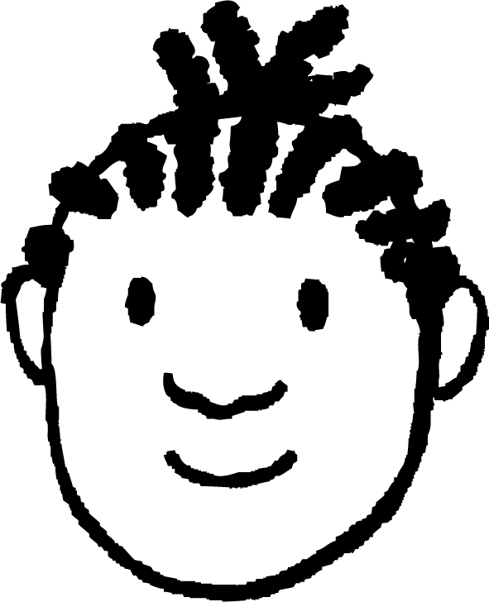
Isticmaalka jaantusyo badan
10
1
Yacquub wuxuu wareeji doonaa spinner-ka oo wuxuu duubi doonaa dies-kan caadiga ah ee 6 dhinac ah oo tirooyinka 1 ilaa 6 ku qoran yihiin wejigiisa.
Kee mid ka mid ah kuwan ayaa Yacquub u isticmaali karaa si nidaamsan u qoro dhammaan natiijooyinka tijaabadan laba heer ah?
9
3
7
5
Yacquub
spinner
a
liis
b
jaantuska natiijada
Jaantusyada Venn ma aha kuwo waxtar u leh si nidaamsan loo qoro natiijooyinka tijaabo laba heer ah ama ka badan.
c
geedka natiijada
d
jaantuska Venn
dice

Slide 35
Isticmaalka jaantusyo badan
9
-8
Yacquub wuu wareejiyaa wareejiyahan (spinner) wuxuuna tixgelinayaa dhacdooyinka ah in wareejiyuhu ku soo degto tiro taban (negative number) iyo tiro kisi (odd number).
Midkee ka mid ah kuwani ayuu Yacquub u isticmaali karaa si uu si nidaamsan ugu qoro dhammaan natiijooyinka labadan dhacdo?
8
-4
4
-1
2
1
Yacquub
spinner
a
b
jadwalka natiijooyinka (outcome table)
Kuwani oo dhami waxay kaa caawiyaan kala-saarista natiijooyinka dhacdooyin kala duwan.
c
geedka natiijooyinka (outcome tree)
Jawaabaha:
d
liis
jaantuska Venn (Venn diagram)

Slide 36
Isticmaalka jaantusyo badan (multiple diagrams)
1) Yacquub wuu wareejiyaa wareejiyahan (spinner) wuxuuna tixgelinayaa dhacdooyinka ah in wareejiyuhu ku soo degto tiro taban (negative number) iyo tiro kisi (odd number).
a) Buuxi jaantus kasta oo labadan dhacdo ah.
b) Qor jumlad sharraxaysa jaantuska aad doorbidayso.
9
-8
8
-4
4
-1
2
1
wareeg (spinner)
 | taban (negative) | togan (positive)
kisi (odd)
xigsi (even)
taban (negative)
togan
Jawaabaha:
ξ
taban (negative)
kisi (odd)
kisi (odd)
xigsi (even)
kisi (odd)
xigsi (even)

Slide 37
Isticmaalka jaantusyo badan
2) Suad waxay dooran doontaa cunto bilow ah iyo cunto weyn.
a) Adigoo dooranaya laba matalaad oo kala duwan, qor natiijooyinka suurtagalka ah ee cuntada Suad.
Cuntooyinka bilowga
Maraq Leek
Rooti Prawn
Cuntooyinka weyn
Lasagne Hilibka Lo'da
Bastada Adhiga (Shepherd's Pie)
Burger Digaag
Curry Yaanyo
b) Qor jumlad sharraxaysa sababta aad u dooratay labadaas matalaad.

Slide 38
Isticmaalka jaantusyo badan
1) Yacquub wuxuu wareejin doonaa wareeggan (spinner) wuxuuna tixgelin doonaa dhacdooyinka in wareeggu ku soo degayo tiro taban iyo tiro khayaali ah.
a) Buuxi jaantus kasta oo loogu talagalay labadan dhacdo.
b) Qor jumlad sharraxaysa jaantuska aad doorbidayso.
9
-8
8
-4
4
-1
2
1
wareejiye (spinner)
ξ
taban (negative)
kisi (odd)
 | taban | togan
khayaali (odd) | -1 | 1, 9
xigsi (even) | -4, -8 | 2, 4, 8
kisi (odd)
-1
1
-8
taban (negative)
-1
xigsi (even)
-4, -8
9
-4
kisi (odd)
1, 9
2
4
8
toon (positive)
xigsi (even)
2, 4, 8

Slide 39
Isticmaalka jaantusyo badan (multiple diagrams)
2) Suad waxay dooran doontaa cunto bilow ah iyo cunto weyn.
a) Adoo dooranaya laba matalaad oo kala duwan, qor natiijooyinka suurtagalka ah ee cuntada Suad.
Matalaadahan ayaa laga yaabaa in la doorto:
liis (listing), shax natiijo (outcome table), iyo
geed natiijo (outcome tree)
Halkan waxaa ah tusaale shax natiijo (outcome table) oo matalaysa tijaabadan laba-tallaabo ah.
Cuntooyinka bilowga (Starters)
Maraq Leek (Leek Soup)
Rooti Prawn (Prawn Toast)
Cuntooyinka weyn (Mains)
Lasagne Hilib (Beef Lasagne)
Bastada Adhiga (Shepherd's Pie)
Burger Digaag (Chicken Burger)
Curry Yaanyo (Tomato Curry)
 | B | S | C | T
L | LB | LS | LC | LT
P | PB | PS | PC | PT
b) Qor jumlad sharraxaysa sababta aad u dooratay labadaas matalaad.

Slide 40
Isticmaal jaantusyo badan (multiple diagrams)
2) Suad waxay dooran doontaa cunto bilow ah iyo cunto weyn.
b) Qor jumlad sharraxaysa sababta aad u dooratay labada matalaad (representations).
Cuntooyinka Bilowga (Starters)
Maraq Lees (Leek Soup)
Rooti Prawn (Prawn Toast)
Cuntooyinka Waaweyn (Mains)
Lasagne Hilib (Beef Lasagne)
Bastada Adhiga (Shepherd's Pie)
Burger Digaag (Chicken Burger)
Curry Yaanyo (Tomato Curry)
Liiska (List) - tirada isku-dhafka suurtogalka ah waa yar tahay, liisaskuna way fudud yihiin in la qoro.
Shaxda natiijada/geedka (Natiijada table/tree) - waxay fududeysaa in la arko inaan helay dhammaan isku-dhafka suurtogalka ah.

Slide 41
Isbarbardhigga matalaadaha natiijooyinka laba dhacdo (events)
Waa suurtogal in macluumaadka laga wareejiyo jaantus liisaya natiijooyinka tijaabo ama laba dhacdo jaantus kale.
Liisaska (Lists), shaxda natiijada, iyo geedka natiijada (outcome trees) dhammaantood waxaa loo isticmaali karaa si nidaamsan in liis la sameeyo dhammaan natiijooyinka suurtogalka ah ee tijaabo laba-tallaabo ah (two-stage trial).
Inkasta oo jaantusyadani dhammaantood loo isticmaali karo tijaabo kasta oo laba-tallaabo ah, jaantus mid ah ayaa laga yaabaa in laga doorbido mid kale iyadoo ku xiran duruufaha.
Liisaska (Lists), shaxda natiijada, geedka natiijada (outcome trees), iyo jaantusyada Venn (Venn diagrams) dhammaantood waxaa loo isticmaali karaa in natiijooyinka tijaabo loo kala saaro dhacdooyin (events).

