Slide 1
Isbarbardhigga wareegyada taxan iyo kuwa barbar socda
Iska caabinta (Resistance) iyo wareegyada barbar socda

Slide 2
Sida agabkeena waxbarasho loogu talagalay fasalka

Slide 3
Waxaan isbarbardhigi karaa sifooyinka wareegyada taxan iyo kuwa barbar socda ee leh qaybo isku mid ah.

Slide 4
wareeg taxan (series circuit)
wareeg leh hal loop
current
heerka socodka charge-ka ee wareegga
danab (voltage)
cabirka 'riixista' ee unugga korantadu siinayo charges-ka
wareeg barbar socda (parallel circuit)
wareeg leh isgoysyada u horseeda loops kala duwan

Slide 5

Isbarbardhigga wareegyada taxan iyo kuwa barbar socda
Current iyo danab (voltage) ee wareeg taxan
Ku darista qaybo laamaha
Ku darista laamo wareeg barbar socda

Slide 6
Current iyo danab (voltage) ee wareeg taxan
Kani waa wareeg taxan.
Waxaa jira hal loop.
Current-ku waa isku mid meel kasta oo loop-ka ah.

Slide 7
Current iyo danab (voltage) ee wareeg taxan
Ku darista qaybo meel kasta oo wareegga ah waxay kordhin doontaa iska caabinta (resistance) waxayna sababi doontaa in current-ka ku yaraado.
Mar labaad, korontada (current) hoos u dhacday waxay isku mid ku tahay meel kasta oo wareegga (circuit) ah.

Slide 8

Korontada (Current) iyo danabka (Voltage) ee wareegga taxanaha (series circuit)
Maxay samaynaysaa ku darista qaybaha (components) wareegga taxanaha (series circuit) ah?
waxay kordhisaa korontada (current)
waxay kordhisaa danabka (voltage)
waxay kordhisaa iska caabinta (resistance)

Slide 9
Korontada (Current) iyo danabka (Voltage) ee wareegga taxanaha (series circuit)
Ku darista unug (cell) kale baytariga (battery) waxay keenaysaa in korontadu (current) kordho.
Korontada (current) kordhay waxay isku mid ku tahay meel kasta oo wareegga (loop) ah.

Slide 10
Korontada (Current) iyo danabka (Voltage) ee wareegga taxanaha (series circuit)
Koronto (current) intee le'eg ayay baytari (battery) laba unug (cell) 1.5 V ah ku abuuri doontaa wareegga taxanaha (series circuit) haddii unug (cell) 1.5 V uu keeno koronto (current) 0.2 A?
0.2 A
0.4 A
1.5 A
3.0 A

Slide 11
Korontada (Current) iyo danabka (Voltage) ee wareegga taxanaha (series circuit)
Unuggu (cell) wuxuu bixiyaa danab (voltage) 3.0 V ah si uu korontada (current) ugu riixo (push) nalka (bulb) dhexdiisa.
3.0 V
Danabka (voltage) nalka (bulb) ku yaal waa 3.0 V.
V
3.0 V

Slide 12
Korontada (Current) iyo danabka (Voltage) ee wareegga taxanaha (series circuit)
Unugga (cell) 3.0 V ah wuxuu korontada (current) u riixi (push) karaa laba nal (bulb) dhexdooda.
Iska caabintu (resistance) hadda waa ka sareeysaa, laakiin unuggu (cell) sii riixi (push) kari maayo si adag.
3.0 V
Nalku (bulbs) waa iftiin yar yihiin (dimmer).
V
V
1.5 V
1.5 V
Danabka (voltage) nalkasta (bulb) ku yaal waa 1.5 V (1.5 + 1.5 = 3.0).

Slide 13
Korontada (Current) iyo danabka (Voltage) ee wareegga taxanaha (series circuit)
Isticmaalka baytari (battery) laba unug (cell) ah wuxuu nalka (bulb) u iftiimin doonaa si dhalaal badan (brightly).
3.0 V
3.0 V
Danabka (voltage) nalka (bulb) ku yaal hadda waa 6.0 V.
V
6.0 V

Slide 14
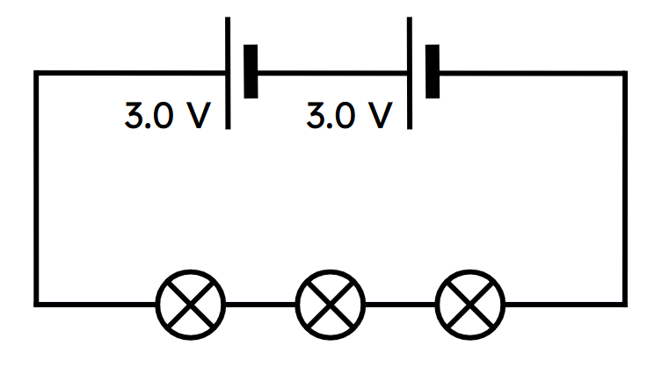
Current iyo danab (voltage) ee wareegga taxanaha ah (series circuit)
Waa maxay danab (voltage) ku yaalla mid ka mid ah nalalkan isku midka ah?
1.5 V
2.0 V
3.0 V
6.0 V

Slide 15
Current iyo danab (voltage) ee wareegga taxanaha ah (series circuit)
Sharax waxa ku dhacaya current, iska caabinta (resistance) iyo danab (voltage) ee wareegga taxanaha ah (series circuit) xaaladahan soo socda.
Tirada qaybaha (laakiin ma aha unugyada korantada) waa la kordhiyay.
Tirada unugyada korantada waa la kordhiyay.

Slide 16
Current iyo danab (voltage) ee wareegga taxanaha ah (series circuit)
Tirada qaybaha (laakiin ma aha unugyada korantada) waa la kordhiyay.
Iska caabinta (resistance) wuu kordhi doonaa, current-ka qulquli kara wuu yaraan doonaa.
Danabka (voltage) ka imanaya unugyada wuxuu ahaan doonaa isku mid.
2) Tirada unugyada korantada waa la kordhiyay.
Danabka (voltage) ka imanaya unugyada wuu kordhi doonaa, current-ka qulquli doona wuu kordhi doonaa.
Iska caabinta (resistance) ee qaybaha waxay ahaan doontaa isku mid.

Slide 17
Isbarbardhigga wareegyada taxanaha iyo kuwa barbar socda
Current iyo danab (voltage) ee wareegga taxanaha ah (series circuit)
Ku darista qaybo laan (branch)
Ku darista laamo (branches) wareegga barbar socda (parallel circuit)

Slide 18
Ku darista qaybo laan (branch)
Wareegyada taxanaha ah waa la isku dari karaa si ay u sameeyaan wareeg barbar socda (parallel circuit).
hal wareeg taxane ah (series circuit)

Slide 19
Ku darista qaybo laan (branch)
Wareegyada taxanaha ah waa la isku dari karaa si ay u sameeyaan wareeg barbar socda (parallel circuit).
wareeg kale oo taxane ah (series circuit)

Slide 20
Ku darida qaybaha (components) laanta
Wareegyada taxanaha (series circuits) waa la isku dari karaa si loo sameeyo wareeg barbar socda (parallel circuit).
Wareegga barbar socda (parallel circuit) wuxuu u dhaqmaa sidii wareegyo taxane ah oo kala duwan oo la isku daray.
hal wareeg oo taxane ah (series circuit)
wareeg kale oo taxane ah (series circuit)

Slide 21
Ku darida qaybaha (components) laanta
Wareeggan barbar socda (parallel circuit), danabka (voltage) unugga korontadu wuxuu la mid yahay danabka (voltage) laan kasta.
3.0 V
3.0 V
Labada laanba waxay leeyihiin 3.0 V oo dhexdooda ah.
3.0 V

Slide 22
Ku darida qaybaha (components) laanta
Maaddaama danabka (voltage) laan kasta uu isku mid yahay, haddana korontada (current) sidoo kale way isku mid noqon doontaa.
0.4 A
Laan kastaa waxay yeelan doontaa 0.2 A oo dhex maraya.
(0.2 + 0.2 = 0.4)
0.2 A
0.2 A

Slide 23
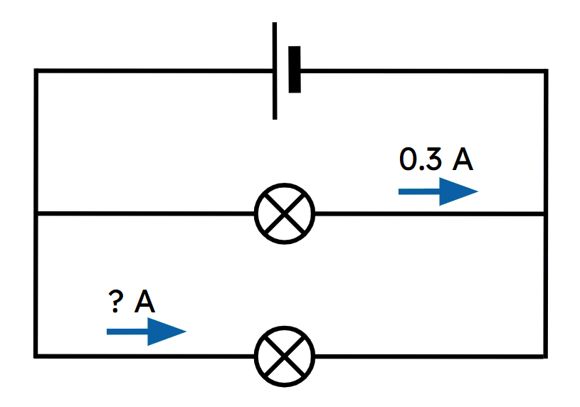
Ku darida qaybaha (components) laanta
Waa maxay korontada (current) ku socota nalka hoose? Nalkeedu waa isku mid.
0.1 A
0.2 A
0.3 A
0.4 A

Slide 24
Ku darida qaybaha (components) laanta
Tirada iyo nooca qaybaha (components) laan kasta kuma saameeyaan danabka (voltage), sababtoo ah laamuhu waxay si toos ah ugu xiran yihiin unugga korontada.
3.0 V
3.0 V
Laamuhu weli waxay leeyihiin 3.0 V oo dhexdooda ah.
3.0 V

Slide 25
Ku darida qaybaha (components) laanta
Qaybaha (components) laanta waxay 'wadaagaan' danabka (voltage).
Kordhinta tirada qaybaha (components) laanta waxay yaraynaysaa danabka (voltage) qayb kasta.
Nalkeedani mid kastaa wuxuu helaa 1.5 V
(1.5 + 1.5 = 3.0).
3.0 V
3.0 V
1.5 V
1.5 V

Slide 26
Adding components to a branch
Laanta labada nal leh waxay yeelan doontaa iska caabin (resistance) sare, sidaas darteedna waxay yeelan doontaa koronto (current) hoose.
high current
low current

Slide 27
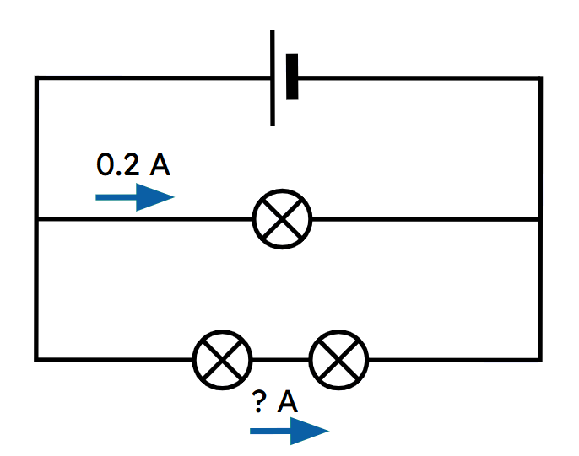
Adding components to a branch
Waa maxay hadda (current) ku socda nalalka hoose? Nalalku waa isku mid.
0.1 A
0.2 A
0.3 A
0.4 A

Slide 28
Adding components to a branch
Laanta nalal badan leh waxay yeelan doontaa iska caabin (resistance) sare, sidaas darteed waxay yeelan doontaa hadda (current) hoose.
Ku darista nalka kale waxay sii yarayn doontaa hadda (current).
The current in this branch remains the same.
lower current

Slide 29
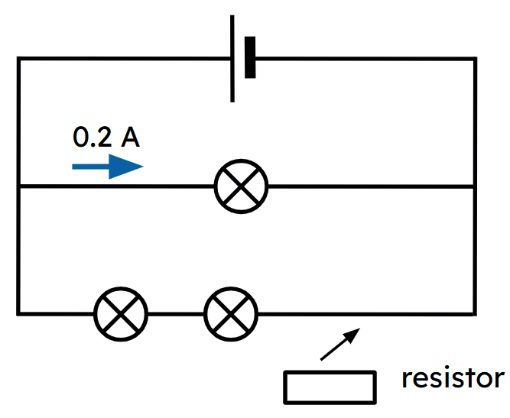
Adding components to a branch
If a resistor is added to the lower branch in series, the current flowing through the single bulb will remain at 0.2 A.
Korantada (voltage) ku taal laanta hal nalka ah waa isku mid.
Laanta hoose waxay leedahay iska caabin (resistance) sare.

Slide 30
Adding components to a branch
Wareegyada barbar (parallel) waxay leeyihiin faa'iidooyin marka loo eego wareegyada taxane (series).
3.0 V
3.0 V
Nalalkan mid kastaa wuxuu leeyahay koronto (voltage) sare (3.0 V) oo waa iftiin badan.
Nalalkan mid kastaa wuxuu leeyahay koronto (voltage) hoose (1.5 V) oo waa iftiin yar.

Slide 31
Adding components to a branch
Wareegyada barbar (parallel) waxay leeyihiin faa'iidooyin marka loo eego wareegyada taxane (series).
3.0 V
3.0 V
Haddii mid ka mid ah nalalkan uu qarxo, kan kale wuxuu weli shidi doonaa.
Haddii mid ka mid ah nalalkan uu qarxo, kan kale wuxuu joogsan doonaa shaqada.

Slide 32
Ku darista qaybaha laanta (branch)
Si kastaba ha ahaatee, koronto (current) badan ayaa ku qulqulaya unugga korantada ee wareegga barbar-socda (parallel circuit).
3.0 V
3.0 V
Unugga korantada wuxuu si dhakhso leh u dhamaan doonaa tamartiisa.
Unugga korantada wuxuu qaadanayaa waqti dheer inta uusan tamartiisa ka dhamaan.

Slide 33
Ku darista qaybaha laanta (branch)
Mid ka mid ah weedhahan ma aha faa'iidada wareegga barbar-socda (parallel circuit) marka la barbar dhigo wareegga taxanaha ah (series circuit) ee laba nal?
haddii hal nal uu qarxo, kan kale wuxuu shaqeeyaa wareegga barbar-socda
nalalka ku jira wareegga barbar-socda way ka iftiimi badan yihiin
koronto (current) sare ayaa ku qulqulaya unugga
nalalka wareegga barbar-socda waxay helayaan danab (voltage) sare

Slide 34
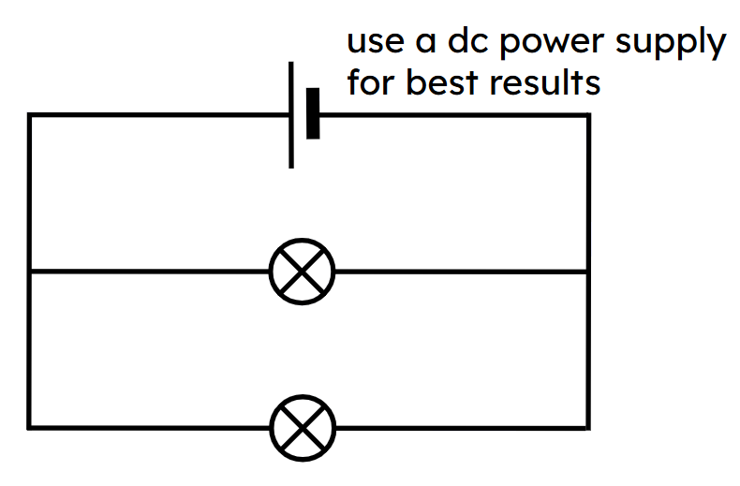
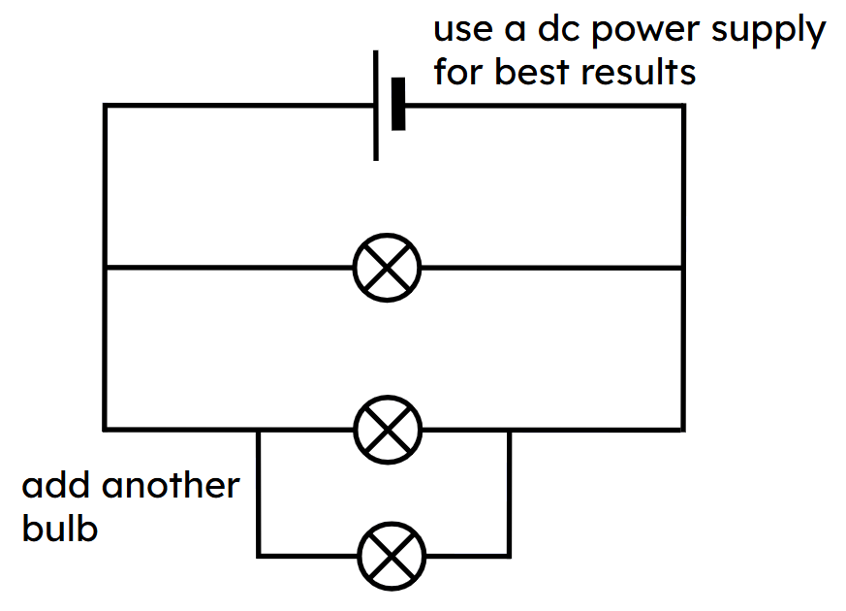
Ku darista qaybaha laanta (branch)
1) Dhis wareegga la muujiyey oo cabbir danabka (voltages) nalalka iyo korontada (current) iyaga dhex mara.
2) Ku dar nal kale oo barbar-socda (parallel), sida la muujiyey, oo cabbir danabka (voltages) nalalka iyo korontada (current) iyaga dhex mara.

Slide 35
Ku darista qaybaha laanta (branch)
Natiijooyin tusaale ahaan:
2)
1.5 V 0.2 A
1.5 V 0.2 A
Nalalka waxay had iyo jeer lahaayeen danab (voltage) 1.5 V oo iyaga dhex mara, koronto (current) 0.2 A ayaa iyaga dhex qulqulaysa.
Iftiinkoodu wuxuu ahaa mid isku mid ah.
1.5 V 0.2 A
1.5 V 0.2 A
1.5 V 0.2 A

Slide 36
Isbarbardhigga wareegyada taxanaha (series) iyo barbar-socda (parallel)
Koronto (current) iyo danab (voltage) wareegga taxanaha ah (series circuit)
Ku darista qaybaha laanta (branch)
Ku darista laamaha (branches) wareegga barbar-socda (parallel circuit)

Slide 37
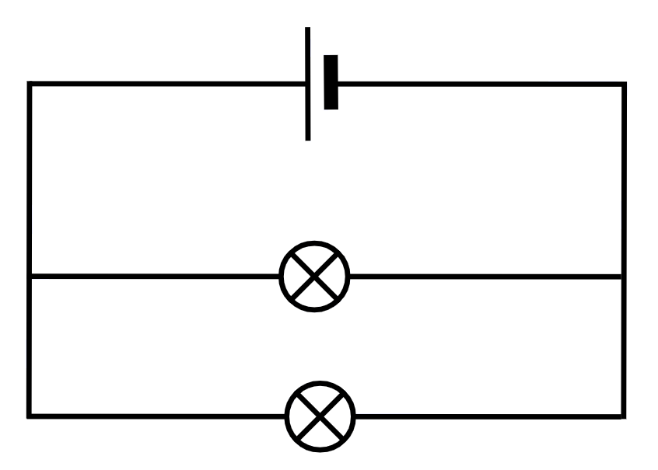
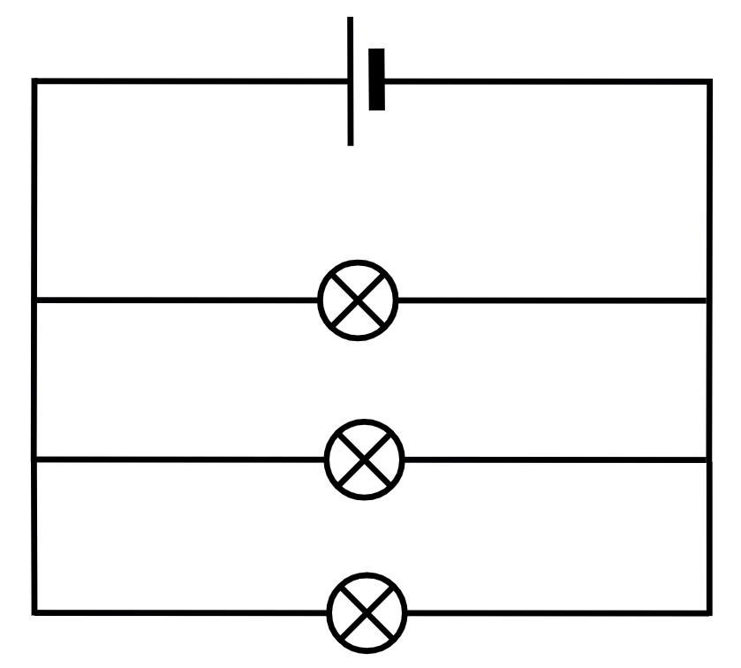
Ku darista laamo wareegga barbar socda (parallel circuit)
Nal la mid ah ayaa lagu dari karaa wareegga barbar-socda (parallel circuit) laan (branch) kale.
Nalalka cusub iyo kuwii hore waxay ku sii jiraan iftiin isku mid ah.
Sababtoo ah nalalka waxay leeyihiin danab (voltage) isku mid ah oo dhex mara, sidaas darteed waxaa dhex mari doona hadda (current) isku mid ah.

Slide 38
Ku darista laamo wareegga barbar socda (parallel circuit)
Haddii laam kasta uu 0.2 A ku qulqulo, wadarta hadda (total current) la qaadi doono way ka duwan tahay.
0.4 A
0.6 A
0.2 A
0.2 A
0.2 A
0.2 A
wadarta hadda (total current)
0.2 + 0.2 = 0.4 A
0.2 A
wadarta hadda (total current)
0.2 + 0.2 + 0.2 = 0.6 A

Slide 39
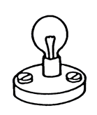
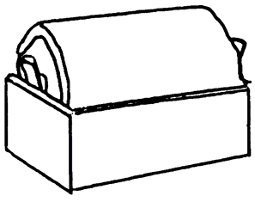
Ku darista laamo wareegga barbar socda (parallel circuit)
Kordhinta tirada wareegyada (loops) ee wareegga waxay keentaa in hadda (current) badan uu dhex maro unugga korantada (electrical cell).
Hadda (current) sare waxay si dhakhso ah u dhamayn doontaa kaydka tamarta unugga korantada.

Slide 40
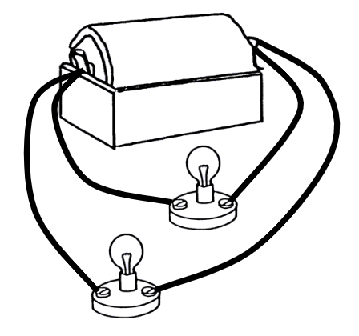
Ku darista laamo wareegga barbar socda (parallel circuit)
Ku darista wareegyo (loops) dheeri ah oo leh nalal wareegga kama saameyn doonto hadda (current) ee wareegyada asalka ah. U qaad in unugga korantadu si fiican u shaqeeyo.
Wareeg kasta oo dheeri ah wuxuu keenaa hadda (current) badan inuu ku qulqulo unugga.
Wareeg kastaa wuxuu la mid yahay wareeg taxane (series circuit) oo gooni ah oo si toos ah ugu xiran unugga.

Slide 41
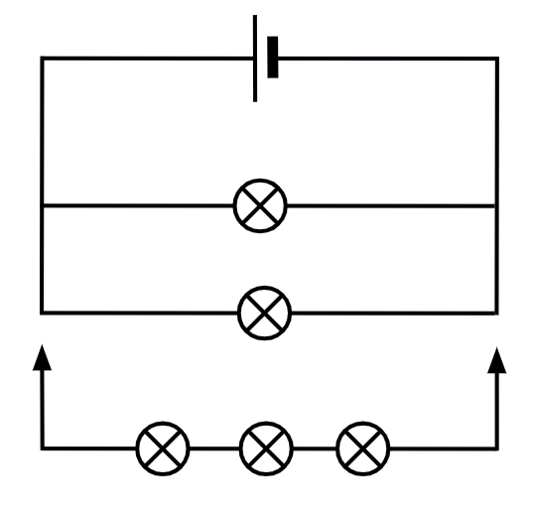



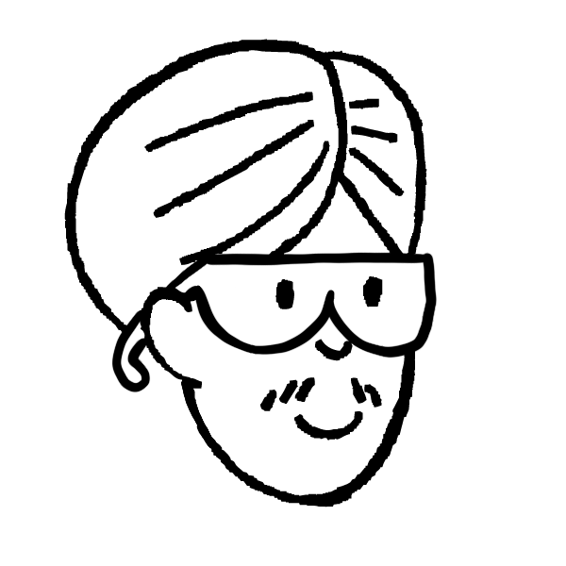
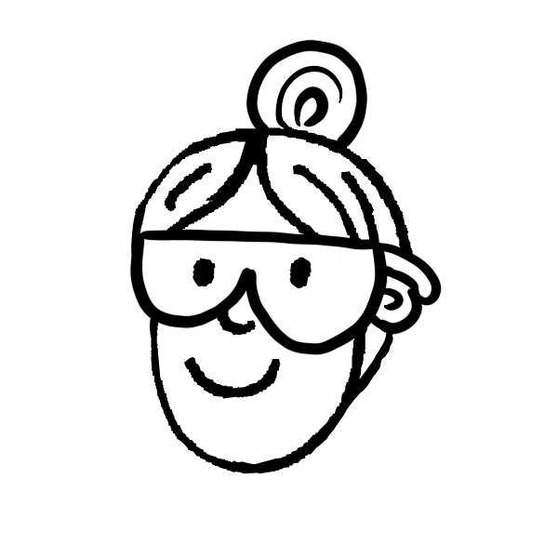
Ku darista laamo wareegga barbar socda (parallel circuit)
Cali iyo Layla waxay isku dayayaan inay saadaaliyaan waxa dhici doona haddii ay ku daraan laan leh saddex nalal wareeggan barbar socda.
Ku darista laanta saddexda nalal waxay ka dhigaysaa dhammaan nalalka kuwo gudcur ah.
Marka laan leh saddex nalal lagu daro, dhammaan nalalku waxay noqon doonaan kuwo iftiin isku mid ah.
Sheeg qofka saxda ah ama qaldan, oo sharax sababta adigoo sheegaya waxa dhici doona iska caabinta (resistance), hadda (current) iyo danabka (voltage).

Slide 42
Ku darista laamo (branches) wareeg (circuit) barbar socda (parallel)
Sheeg cidda saxan ama qalad, oo sharax sababta adigoo sheegaya waxa ku dhici doona korantada (current), korantada (voltage) iyo iska caabbinta (resistance).
Cali iyo Layla labaduba waa qaldan yihiin.
Nalalka keliya ee laamaha asalka ah waxay ku sii jiri doonaan iftiin isku mid ah, laakiin saddexda nalal ee la daray waxay noqon doonaan kuwo gudcur ah.
Hadda (current) dhex maraysa, iyo danabka (voltage) ku yaalla, nalalka keliya waxay ku sii jiri doonaan isku mid.
Korantada (current) ku socota laanta (branch) saddex nal (bulbs) leh way yarayn doontaa, korantada (voltage) waxaa wadaagi doona saddexda nal, sidaas darteed way yarayn doontaa.
Iska caabbinta (resistance) guud ee wareegga (circuit) way yarayn doontaa, sababtoo ah waxaa jira wareeg (loop) kale, taas oo macneheedu yahay in unugga korantada (electrical cell) uu qaadi doono koronto (current) badan.

Slide 43
Isbarbardhigga wareegyada (circuits) taxan (series) iyo barbar socda (parallel)
Wareegga (circuit) taxan (series), korantada (current) waa isku mid meel kasta oo wareegga (loop) ku jirta.
Ku darista qaybaha (components) wareegga (loop) waxay kordhin doontaa iska caabbinta (resistance) oo sababi doonta in korantada (current) yaraato.
Qaybaha (components) lagu daray taxan (series) waxay wadaagi doonaan korantada (voltage), sidaas darteed qayb kastaa waxay helaysaa koronto (voltage) yar.
Wareegyada (circuits) barbar socda (parallel), laan (branch) kastaa waxay helaysaa isku koronto (voltage), korantada (current) ku socota unugga korantada (electrical cell) ama batteriga (battery) way kordheysaa. Tamarta ku jirta unugga korantada (ama batteriga) way si dhakhso leh u dhammaan doontaa.
Nalalka (bulbs) ku jira wareegyada (circuits) barbar socda (parallel) way ka iftiin badan yihiin kuwa wareegyada (circuits) taxan (series), haddii hal nal (bulb) ku dhaco wareegga (circuit) barbar socda (parallel), kuwa kale wali way shaqeeyaan.

