Slide 1
Moodhyello adag iyo midabbo
Animation 3D

Slide 2
Sida agabkeena waxbarista loogu talagalay fasalka

Slide 3
Waxaan awoodi karaa inaan abuuro oo faahfaahiyo moodhyello 3D adag.

Slide 4
weji (face)
dusha ka kooban saddex ama in ka badan oo geesood
gees (vertex)
bar meesha ay laba ama in ka badan oo geesood ama xariiqo ku kulmaan
gees (edge)
xariiq isku xira laba geesood (vertices)
kala bixi (extrude)
in la beddelo qaab 2D oo loo sameeyo shay 3D adoo ku fidinaya jid ama jiho

Slide 5

Moodhyello adag iyo midabbo
Kala bixi (extrude) qaabka tafatirka
Ku dar wejiyo adoo adeegsanaya gooyn loop ah

Slide 6
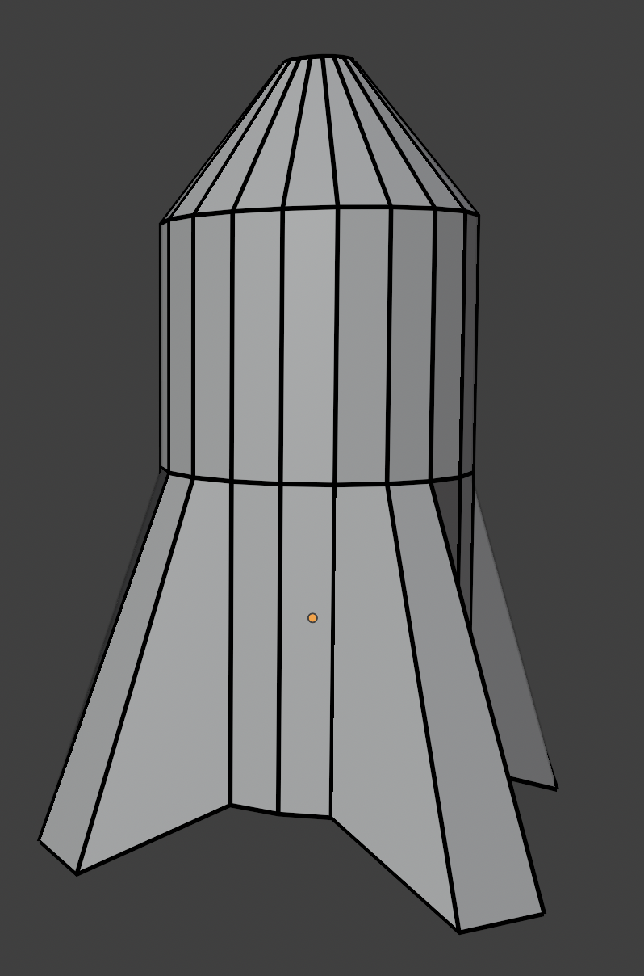
Kala bixi (extrude) qaabka tafatirka
Fiiri moodhelka 3D ee hoose. Ma arki kartaa weji, gees ama geesood?

Slide 7
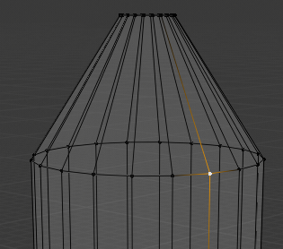
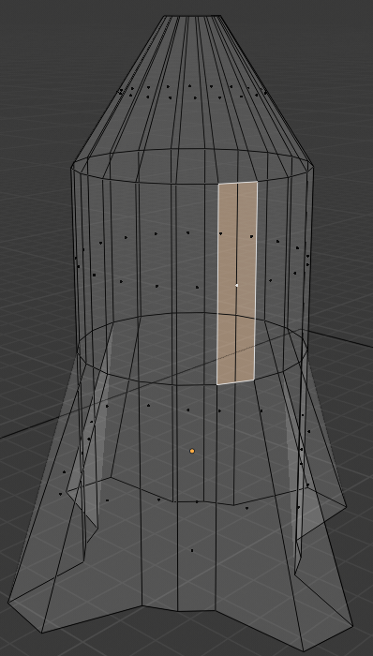
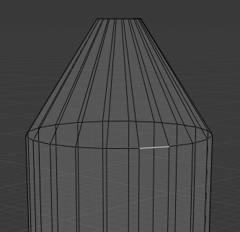
Kala bixi (extrude) qaabka tafatirka
Fiiri moodhelka 3D ee hoose. Ma arki kartaa weji, gees ama geesood?
Gees (vertex): bar meesha ay laba ama in ka badan oo geesood ku kulmaan
Gees (Edge): khad isku xira laba geesood (vertices)
Weji: dusha ka kooban saddex ama in ka badan oo geesood
Dhammaan moodhyada 3D waxay ka kooban yihiin geesood (vertices), geeso (edges) iyo wejiyo (faces).

Slide 8
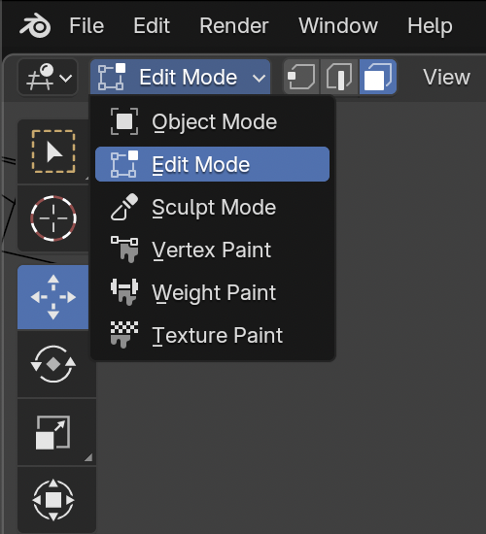
Bixi (Extrude) qaabka tafatirka (edit mode)
Blender dhexdiisa, waxaa suurtogal ah in la beddelo qaababka shaqada ee kala duwan.
Darsigan, inta badan shaqada qaabaynta waxaa lagu qaban doonaa qaabka tafatirka (edit mode).
Fiiro gaar ah: Waa muhiim inaad ku soo noqoto qaabka shayga (object mode) si aad u dhaqaajiso qaybaha oo aad ugu darto qaababka moodooyinka.
Blender Foundation – www.blender.org

Slide 9
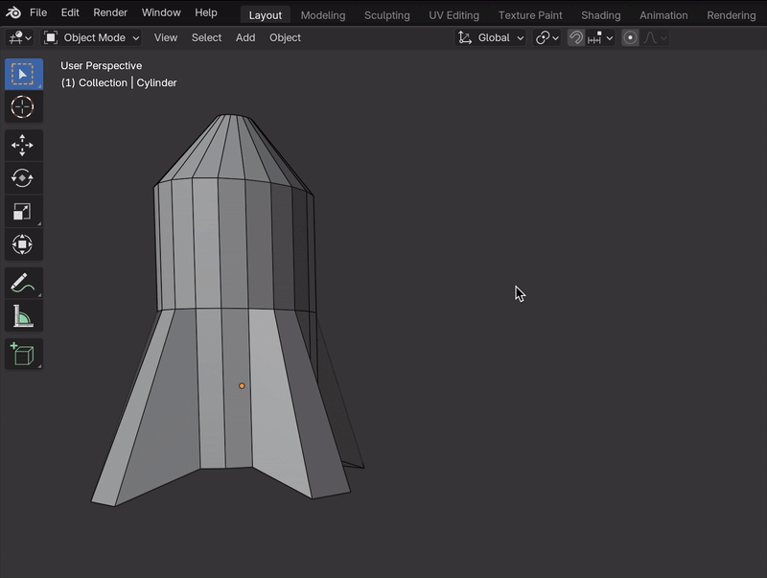
Bixi (Extrude) qaabka tafatirka (edit mode)
Waa fududahay in la beddelo qaababka shaqada Blender dhexdiisa.
Si loo beddelo qaababka:
dooro shay (object)
guji taabka isdhexgalka shayga (object interaction tab)
guji qaabka la doonayo
Blender Foundation – www.blender.org

Slide 10
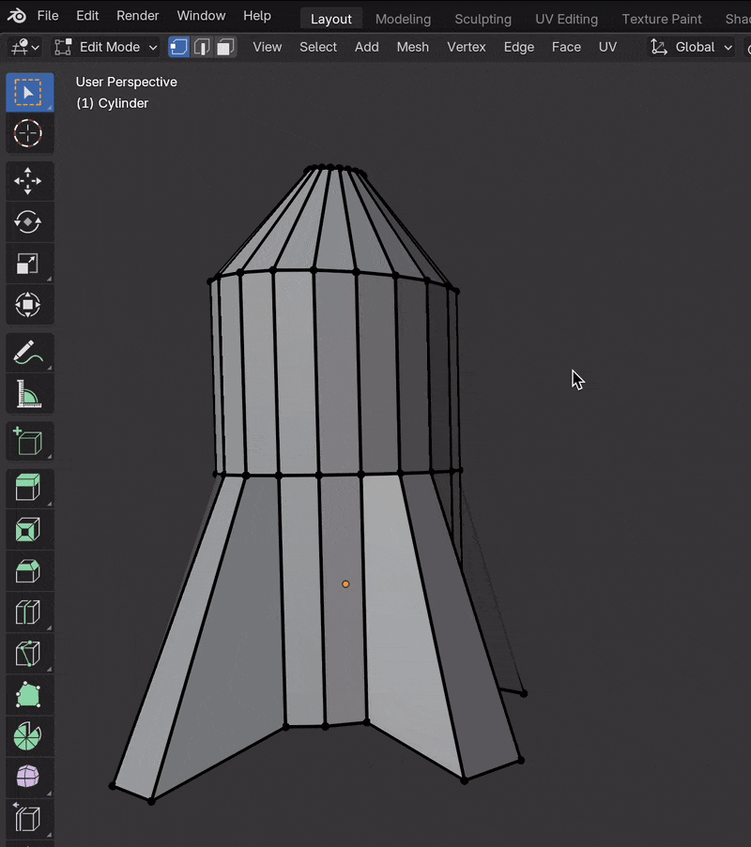
Bixi (Extrude) qaabka tafatirka (edit mode)
Qaabka tafatirka (edit mode), geesaha (vertices), geesaha (edges) iyo wejiyada (faces) waa la dooran karaa adigoo gujinaya astaamaha (icons) ee xagga sare.
Qalab cusub ayaa ka soo bixi doona dhinaca bidix ee shaashadda.
Qalabka waxaa loo isticmaali karaa in lagu beddelo geesaha (vertices), geesaha (edges) iyo wejiyada (faces) la doortay.
Qaabka tafatirka (edit mode) wuxuu ka caawiyaa qaabaynta (modellers) inay abuuraan moodooyin (models) aad u adag.
Blender Foundation – www.blender.org

Slide 11
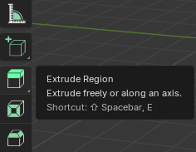
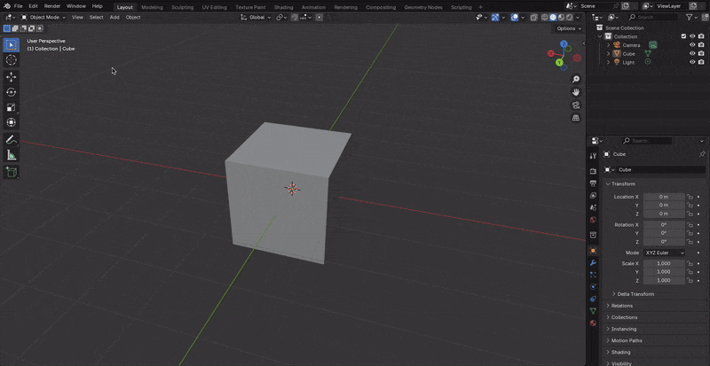
Bixi (Extrude) qaabka tafatirka (edit mode)
Extruding waa marka qaab 2D la fidiyo jid ama jiho si loogu daro joomatari 3D shay.
Blender dhexdiisa, weji (face) waa la dooran karaa qaabka tafatirka (edit mode) ka dibna waa la bixin karaa (extrude) dhinaca (axis) ah.
Blender Foundation – www.blender.org

Slide 12
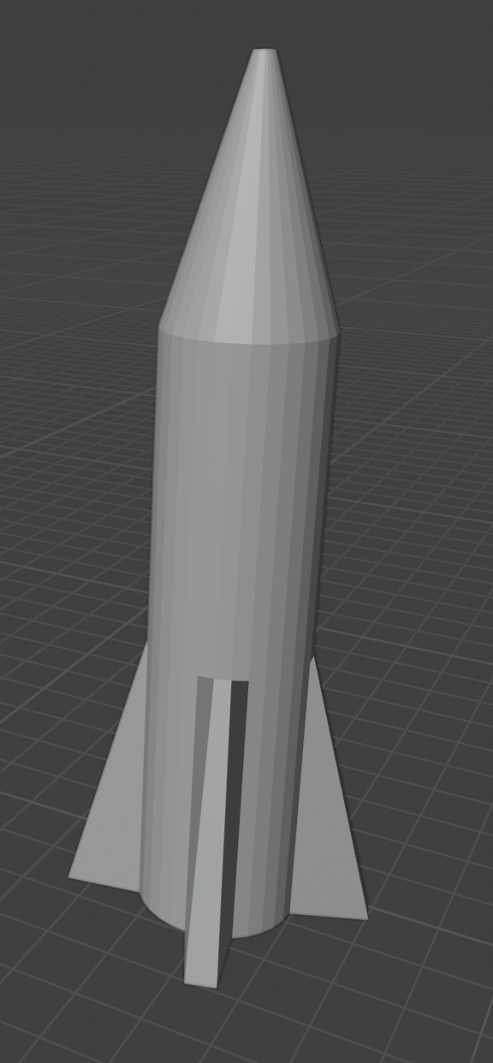
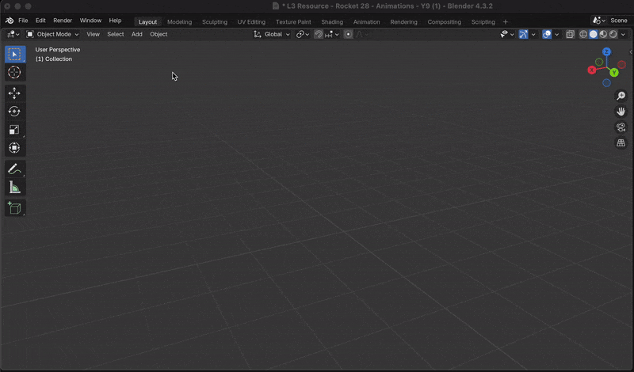
Extrude qaabka tafatirka
Gantaal ayaa lagu qaabayn karaa marka hore ku dar qaab dhismo (cylinder) fudud qaabka shayga.
Blender Foundation – www.blender.org

Slide 13
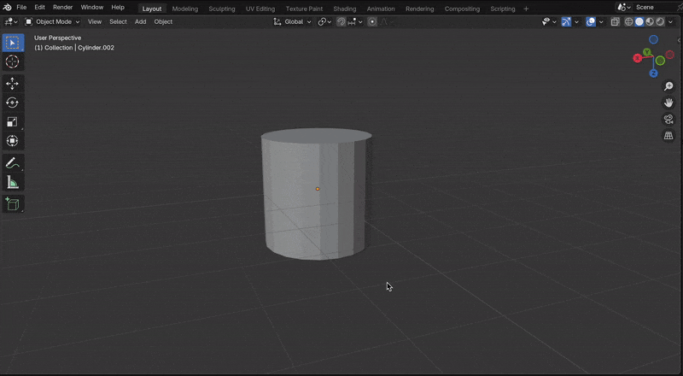
Extrude qaabka tafatirka
Fins waxaa lagu dari karaa qaabka tafatirka adoo ku fidinaya afar gees oo cylinder-ka ah.
Qalabka xulista geeska waa in la doortaa.
Hayo furaha Shift si aad u xulato geeso badan.
Afar gees ayaa la xulay oo lagu fidiyay iyadoo la isticmaalayo furaha S.
Blender Foundation – www.blender.org

Slide 14
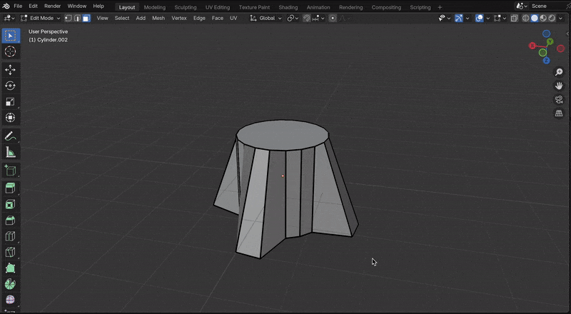
Extrude qaabka tafatirka
Jirka gantaalka waxaa lagu dari karaa adoo xulaya wejiga sare oo extruding ah.
Si aad u extrudeeysid:
xulo weji
riix furaha E
jiid gacanta dhidibka
Fiiro gaar ah: qalabka xulista wejiga waa in la hawlgeliyo si loo xulo weji oo loo extrudeeysto dhidibka.
Blender Foundation – www.blender.org

Slide 15
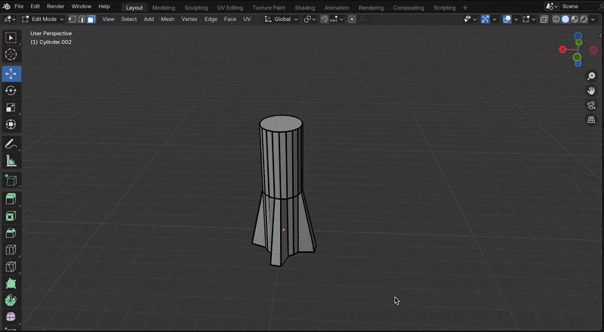
Extrude qaabka tafatirka
San (nose) waxaa lagu dari karaa adoo xulaya wejiga sare, extruding, ka dibna fidinta wejiga si loo abuuro dhibic.
Si aad u fidisid weji:
dooro wejiga (face)
riix furaha S
dhaqaaji mouse-ka
Blender Foundation – www.blender.org

Slide 16
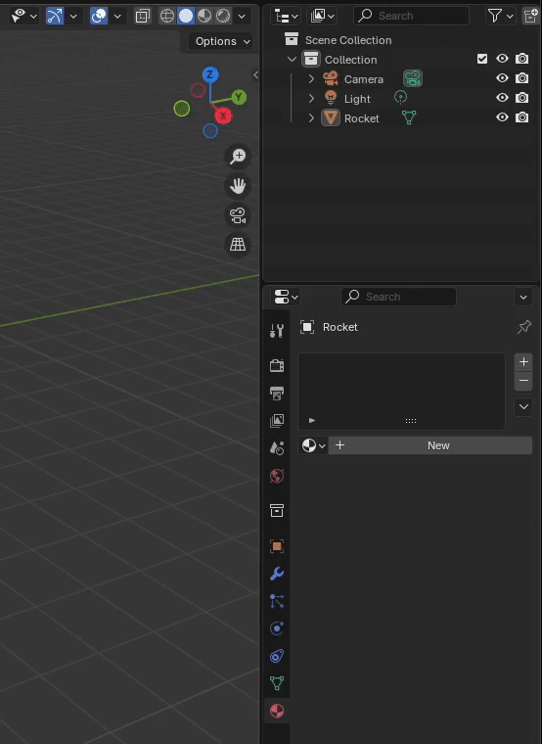
Extrude qaabka tafatirka (edit mode)
Waxaa la abuuri karaa agab (materials) jirka, sanka iyo baalasha.
Waa fiican tahay in la siiyo agabka (materials) magacyo macquul ah.
Tani waxay ka dhigaysaa agabka (materials) mid fudud oo la aqoonsan karo oo la isticmaali karo.
Blender Foundation – www.blender.org

Slide 17
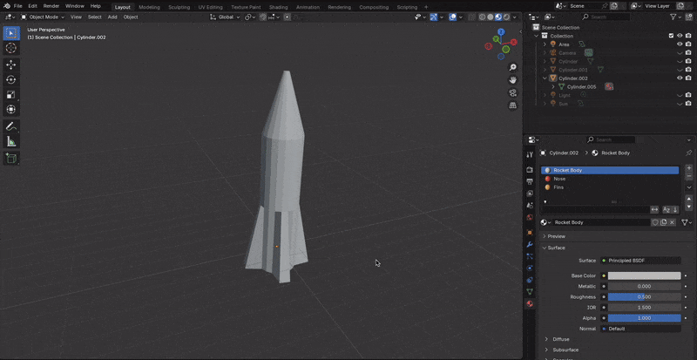
Extrude qaabka tafatirka (edit mode)
Qaabka tafatirka (edit mode), midabka wejiga (face) shaqsi ama kooxo weji ah waa la dooran karaa oo la beddeli karaa.
Talo: Haysii furaha Shift si aad u doorato wejiyo (faces) badan.
Xusuusnow inaad riixdo Assign.
Blender Foundation – www.blender.org

Slide 18

Extrude qaabka tafatirka (edit mode)
Qalabkee ayaa loo isticmaali karaa in lagu beddelo qaab 2D ah shay 3D ah iyadoo lagu fidinayo waddo ama jihada?
extrude
render
loop cut
bevel

Slide 19
Extrude qaabka tafatirka (edit mode)
Blender-ka, qaabkee (mode) ayaad isticmaali lahayd si aad midab ugu dartid wejiyada (faces) shayga (model)?
qaabka shayga (object mode)
qaabka tafatirka (edit mode)
qaabka soo-saarka (render mode)
Blender Foundation – www.blender.org

Slide 20
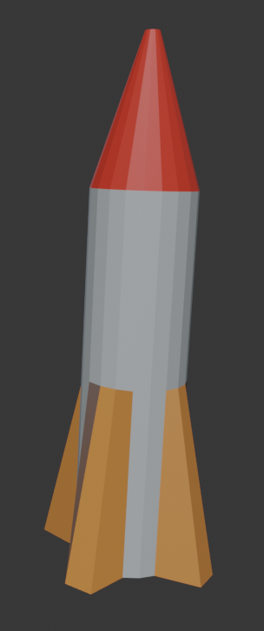
Bixi (Extrude) qaabka tafatirka (edit mode)
Samee shaygaaga 3D ee gantaalka (space rocket).
Ku dar qaabka 3D ee dhululubo (cylinder) qaabka shayga (object mode), ka dibna isticmaal qaabka tafatirka (edit mode) si aad ugu darto baalasha (fins) iyo koofiyadda (nose cone).
Samee oo ku dar agabyada (materials) gantaalka si aad u siiso midab iyo faahfaahin.
Isticmaal xirfadahaaga modeling-ga si aad ugu darto faahfaahin dheeri ah sida boosters-ka.
Talo: Isticmaal farsamooyinka aad ku baratay darsigan si aad u sameysid gantaalkaaga, laakiin noqo hal-abuur oo ka dhig mid adiga kuu gaar ah.

Slide 21
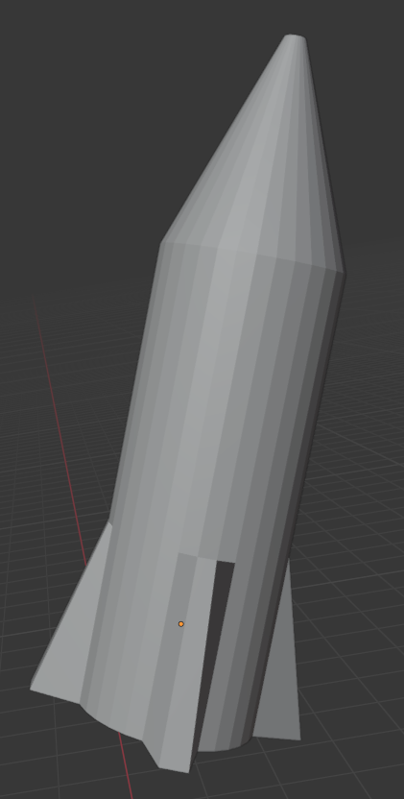
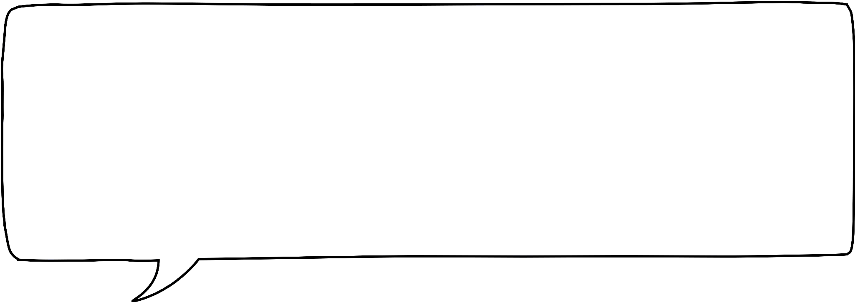
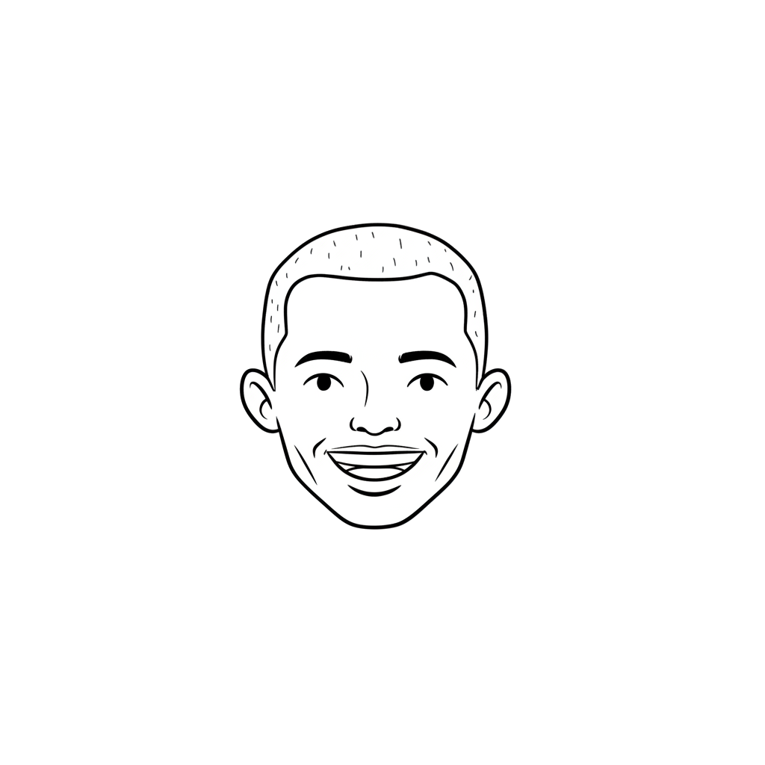
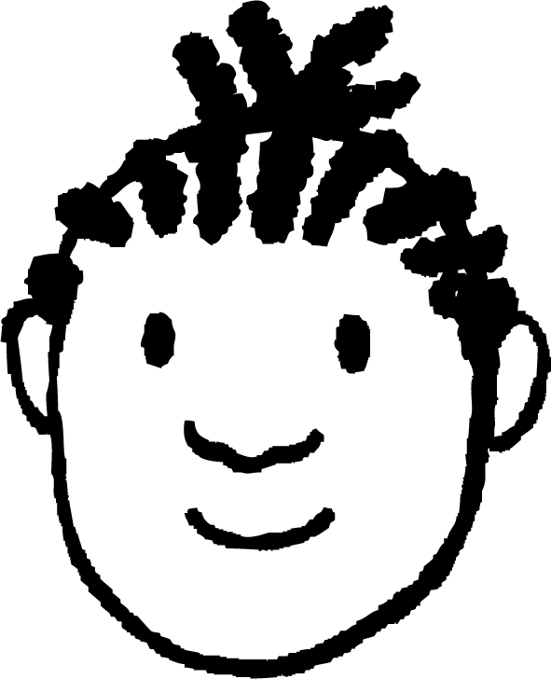

Bixi (Extrude) qaabka tafatirka (edit mode)
Ku dar qaabka 3D ee dhululubo (cylinder) qaabka shayga (object mode), ka dibna isticmaal qaabka tafatirka (edit mode) si aad ugu darto baalasha (fins) iyo koofiyadda (nose cone).
Waxaan ku daray dhululubo (cylinder) qaabka shayga (object mode) oo waxaan sameeyay baalasha (fins) adigoo balaadhiyay afar geesood (edges) qaabka tafatirka (edit mode). Way fududayd in aan bixiyo (extrude) jidhka iyo koofiyadda (nose) wejiga sare (top face) adigoo riixaya furaha E. Waxaan riixay furaha S si aan u cabbiro (scale) dhamaadka koofiyadda (cone) ilaa dhibic.
Yacquub

Slide 22
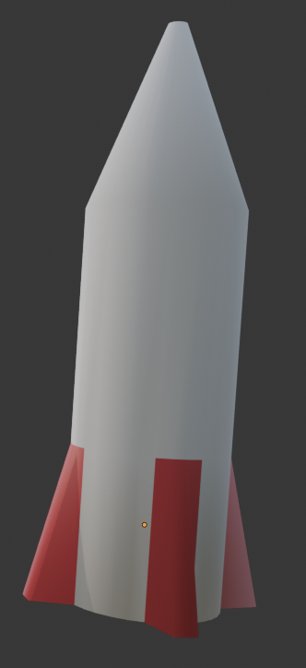
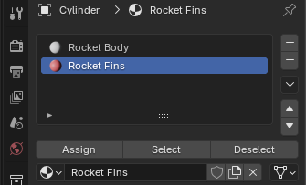
Bixi (Extrude) qaabka tafatirka (edit mode)
2) Samee oo ku dar agabyada (materials) gantaalka si aad u siiso midab iyo
faahfaahin.
Waxaan sameeyay laba agab (materials) oo waxaan ku daray jidhka gantaalka iyo baalasha (fins). Sidoo kale, waxaan ku riixay midig (right-click) gantaalka qaabka shayga (object mode) oo waxaan doortay shade smooth si uu u yeesho muuqaal dhab ah.
Yacquub
Blender Foundation – www.blender.org

Slide 23
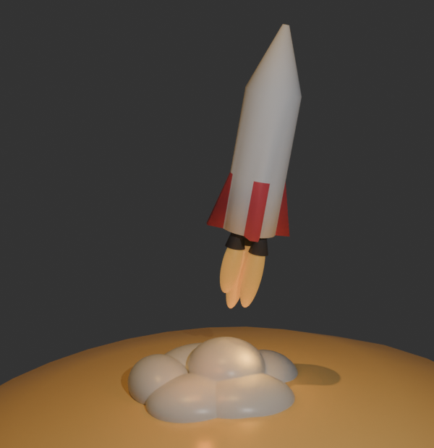
Bixi (Extrude) qaabka tafatirka (edit mode)
3) Isticmaal xirfadahaaga modeling-ga si aad ugu darto faahfaahin dheeri ah sida boosters-ka.
Waxaan haystay waqti dheeri ah, marka waxaan ku daray saddex koofiyadood oo kor u qaadaya (boosters) oo waxaan cabbirey (scaled) qaar ka mid ah goobooyinka (spheres) si ay u noqdaan olol iyo qiiq. Sidoo kale waxaan abuuray meeraha (planet) anigoo weyneynaya (scaling up) goobo (sphere) ilaa cabbir aad u weyn.
Waxaan qaaday sawir (screenshot) ka soo baxay daawashada (rendered viewport), oo waxaan aad ugu faraxsanahay gantaalkayga (rocket)!
Yacquub

Slide 24
Moodeello (Models) adag iyo midabyo (colours)
Soo bixi (Extrude) qaabka tafatirka (edit mode)
Ku dar wejiyo (faces) iyadoo la isticmaalayo gooyn wareeg ah (loop cut)

Slide 25
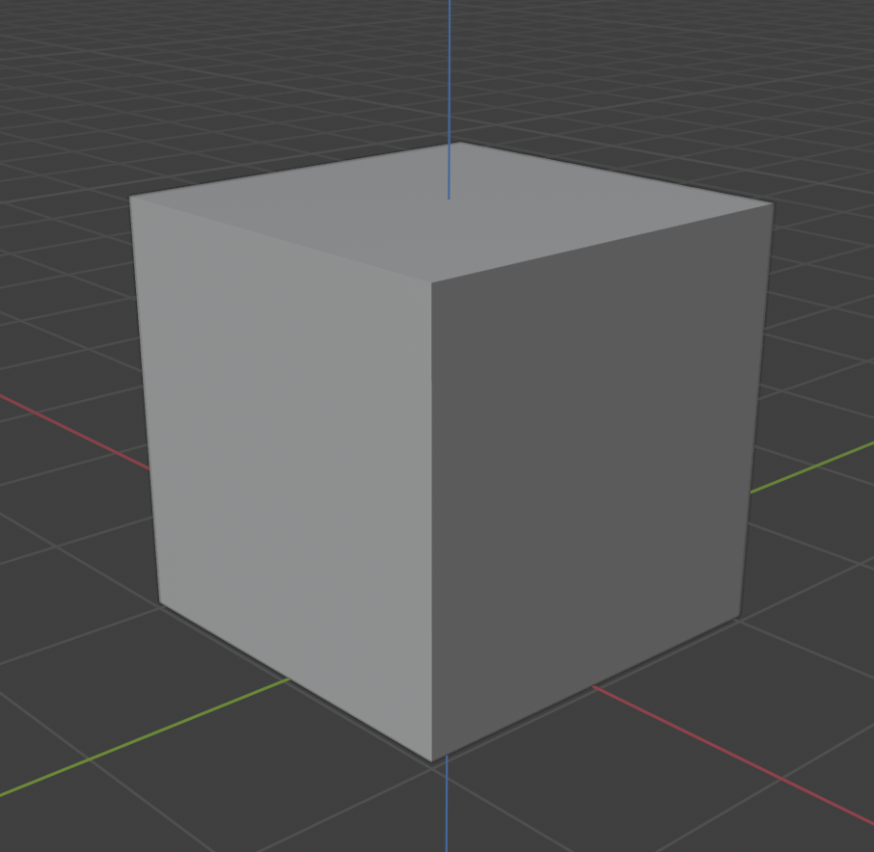
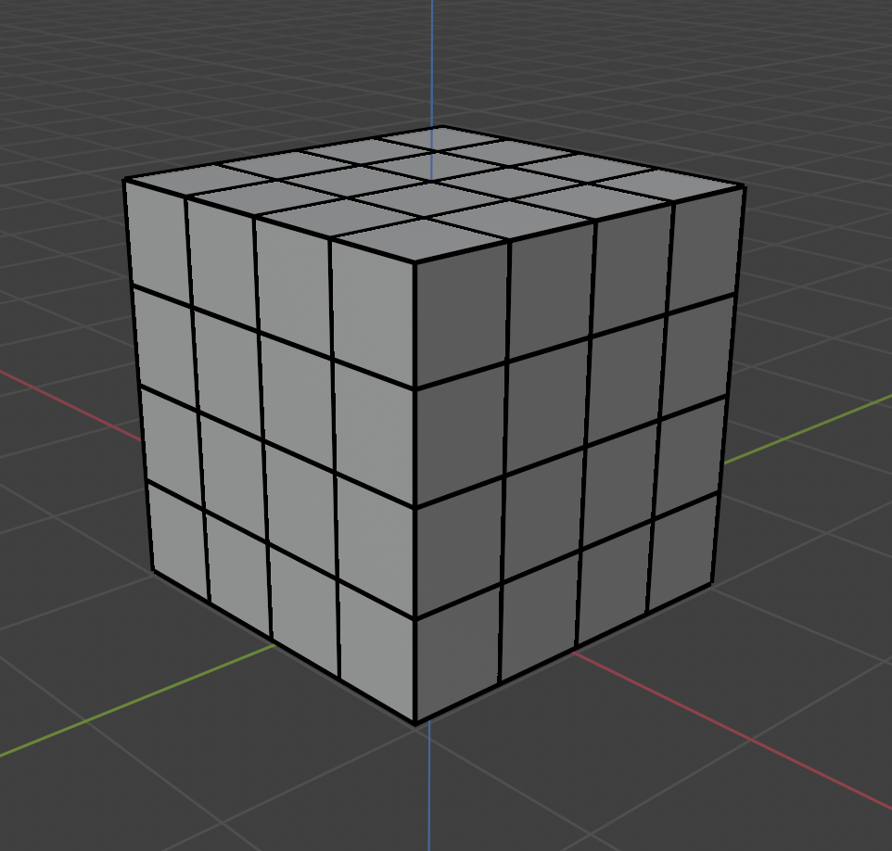
Ku dar wejiyo (faces) iyadoo la isticmaalayo gooyn wareeg ah (loop cut)
Fiiri sawirada hoose.
Labaduba waa cube (3D cubes), laakiin sidee ayay u kala duwan yihiin cube-yada?
Dheeraad ah vertices, edges iyo faces ayaa lagu daray cube-ka midigta.

Slide 26
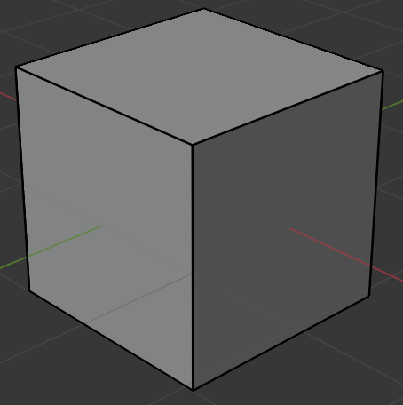
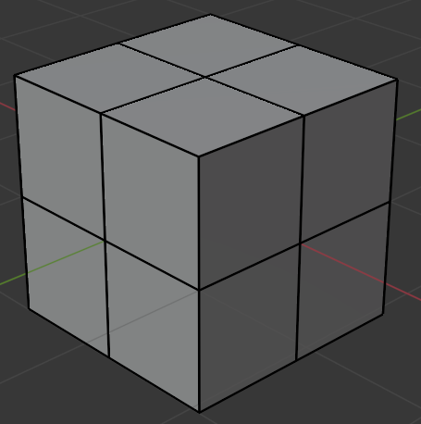
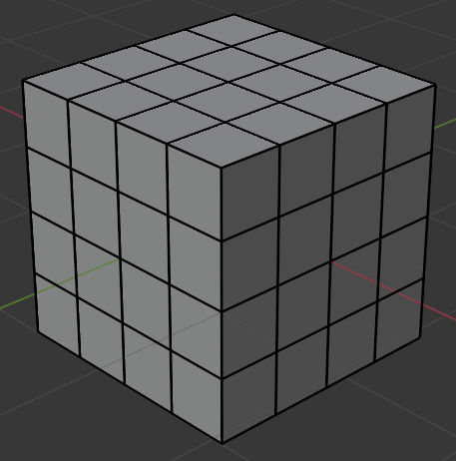
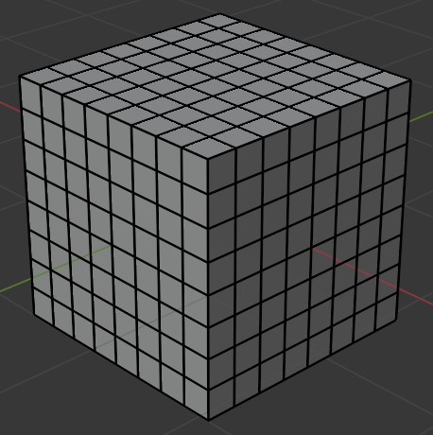
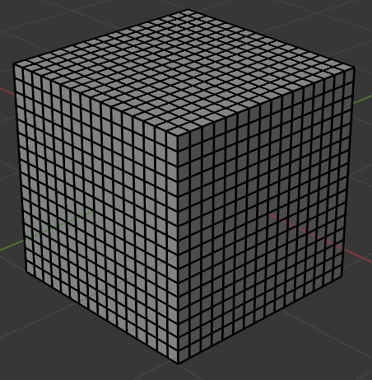
Ku dar wejiyo (faces) iyadoo la isticmaalayo gooyn wareeg ah (loop cut)
Habka lagu daro dheeraad ah vertices, edges iyo faces moodeelka (model) waxaa loo yaqaan subdividing.
1 subdivide
2 subdivides
3 subdivides
4 subdivides
Subdividing shay (object) wuxuu kordhiyaa tirada vertices, edges iyo faces.
Tani waxay u oggolaan kartaa in la abuuro moodeello (models) aad u adag oo faahfaahsan.

Slide 27
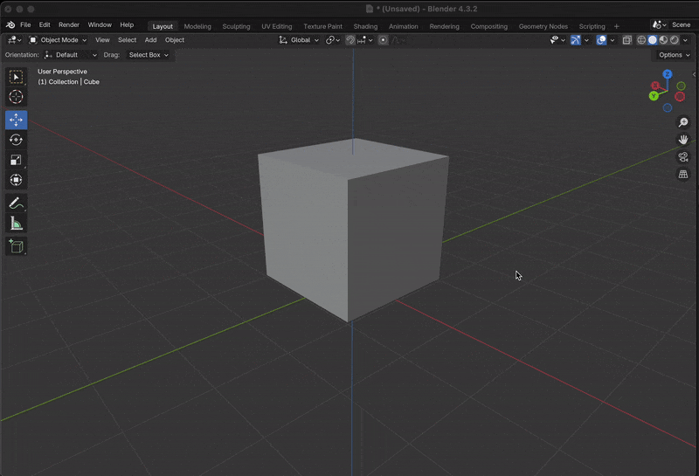
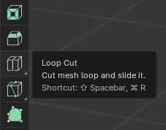
Ku dar wejiyo (faces) iyadoo la isticmaalayo gooyn wareeg ah (loop cut)
Qalabka gooyn wareeg ah (loop cut tool) waxaa loo isticmaali karaa in lagu subdivide gareeyo shay (object).
Ogsoonow in qalabka gooyn wareeg ah (loop cut tool) laga helo qaabka tafatirka (edit mode).
Blender Foundation – www.blender.org

Slide 28
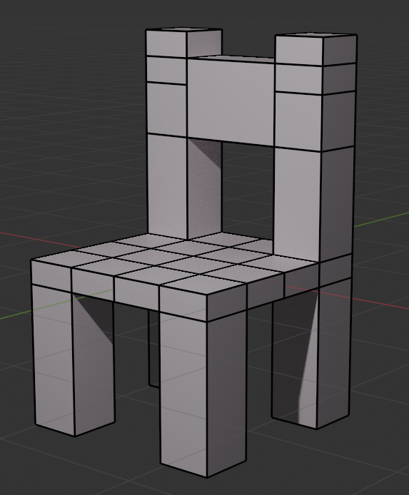
Ku dar wejiyo (faces) iyadoo la isticmaalayo gooyn wareeg ah (loop cut)
Qalabka goynta loop-ka waxaa loo isticmaali karaa in lagu caawiyo abuurista moodel 3D oo kursi ah.

Slide 29
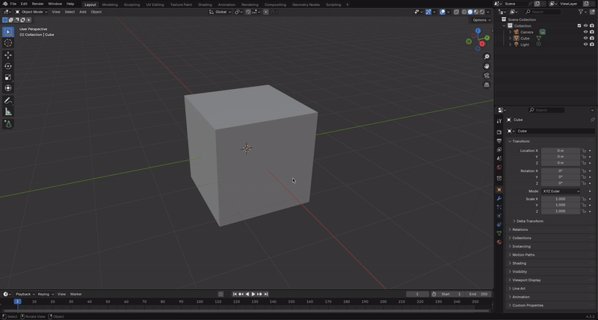

Ku dar wejiyada goynta loop-ka
Cube-ga waxaa lagu cabbiri karaa (scale) si uu u sameeyo saldhigga kursiga.
Talo: Waxaad isticmaali kartaa qalabka cabbirka (scale) adigoo gujinaya astaanta cabbirka
ama adigoo riixaya furaha S.
Blender Foundation – www.blender.org

Slide 30
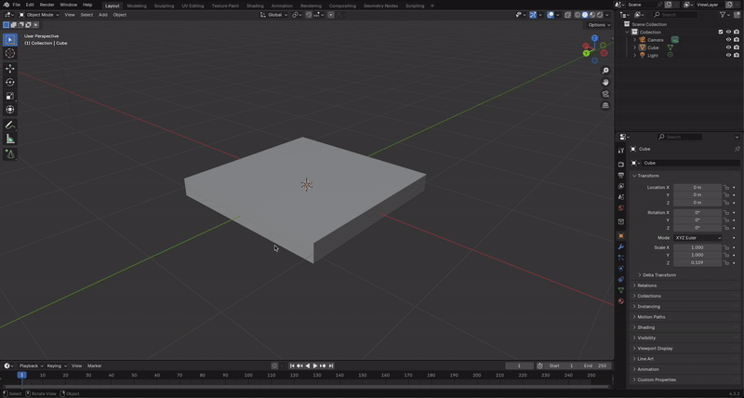

Ku dar wejiyada goynta loop-ka
Saldhigga waxaa loo qaybin karaa qaybo iyadoo la isticmaalayo qalabka goynta loop-ka.
Talo: Waxaad dooran kartaa qalabka goynta loop-ka adigoo gujinaya astaanta
ama adigoo riixaya Ctrl + R wada.
Blender Foundation – www.blender.org

Slide 31
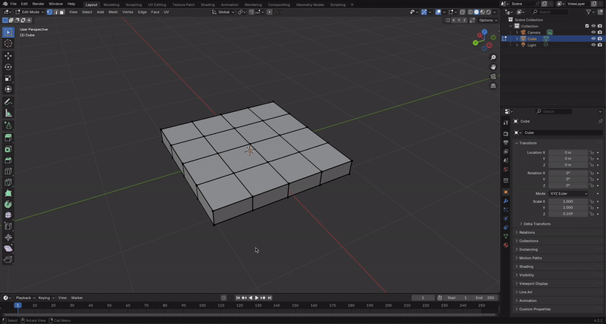

Ku dar wejiyada goynta loop-ka
Lugaha waxaa lagu abuuri karaa iyadoo la xusho oo la soo bixiyo (extrude) afar weji oo ku yaal saldhigga.
Talo: Waxaad dooran kartaa qalabka soo-bixinta (extrude) adigoo gujinaya astaanta
ama adigoo riixaya furaha E.
Blender Foundation – www.blender.org

Slide 32
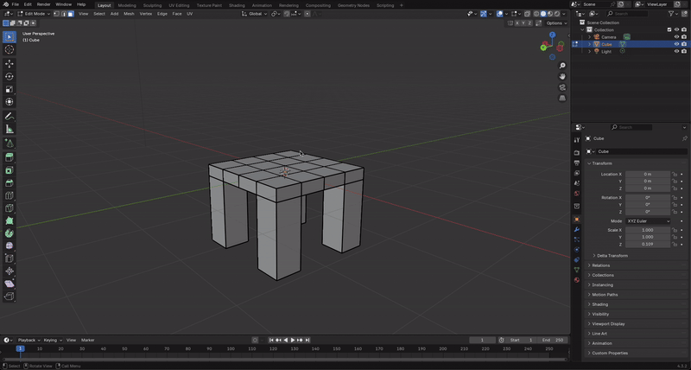
Ku dar wejiyada goynta loop-ka
Tiirarka dambe ee kursiga waxaa lagu abuuri karaa iyadoo la soo bixiyo (extrude) laba weji oo wada jira.
Talo: Hays furaha Shift si aad u doorato wejiyo badan.
Blender Foundation – www.blender.org

Slide 33
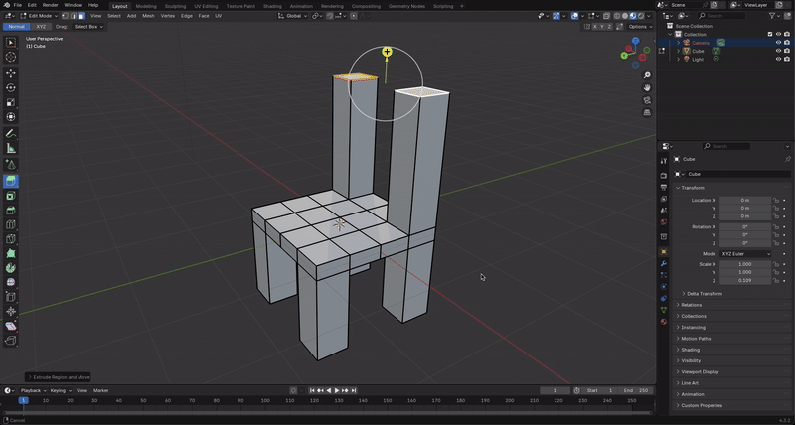
Ku dar wejiyada goynta loop-ka
Gooyn (Loop cut) ayaa lagu dari karaa tiirarka dambe.
Wajiyada (faces) dheeraadka ah waxaa loo isticmaali karaa in lagu caawiyo samaynta taageerada dambe.
Blender Foundation – www.blender.org

Slide 34
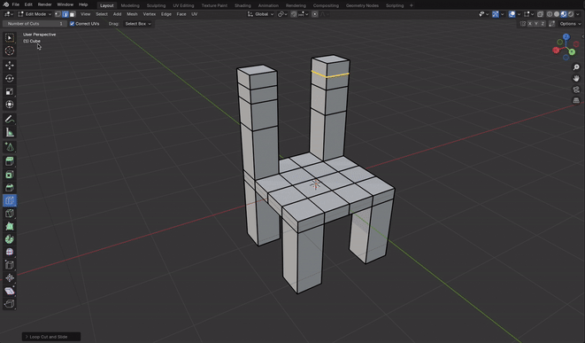
Ku dar wajiyo (faces) adigoo isticmaalaya gooyn (loop cut)
Wajiyada (faces) waa la tirtiri karaa, waxaana la abuuri karaa wajiyo cusub oo u dhexeeya geesaha (edges).
Talo: Wajiyada (faces) waxaa lagu dari karaa laba gees (edges) oo la doortay adigoo riixaya furaha F.
Blender Foundation – www.blender.org

Slide 35
Ku dar wajiyo (faces) adigoo isticmaalaya gooyn (loop cut)
Summad (icon) kee baad gujin lahayd si aad u doorato qalabka gooynta (loop cut tool)?
Blender Foundation – www.blender.org

Slide 36
Ku dar wajiyo (faces) adigoo isticmaalaya gooyn (loop cut)
Furahee baad riixin lahayd si aad u abuurto wajig (face) u dhexeeya laba gees (edges)?
X
R
F

Slide 37
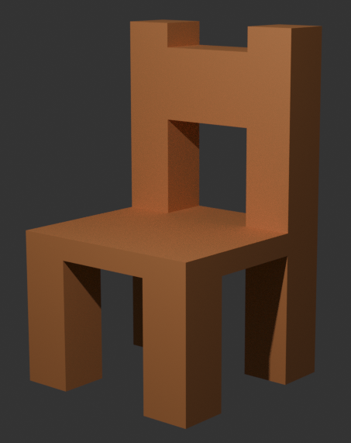
Ku dar wajiyo (faces) adigoo isticmaalaya gooyn (loop cut)
Samee qaabkaaga 3D ee kursiga.
Ka bilow qaabkaaga cube (cube) fudud, ka dibna isticmaal qaabka tafatirka (edit mode) si aad ugu darto lugaha iyo dhabarka.
Abuur oo ku dar agab (materials) kursiga si aad u wanaajiso tayada qaabkaaga.
Talo: Isticmaal farsamooyinka aad ku baratay darsigan si aad u abuurto kursigaaga, laakiin noqo mid hal-abuur leh oo ka dhig mid kuu gaar ah.

Slide 38
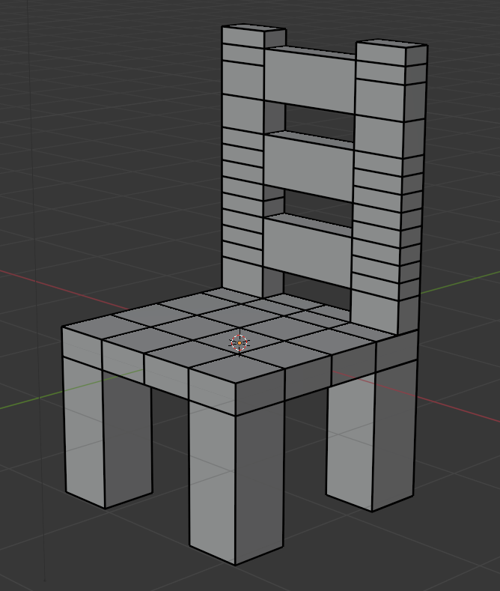
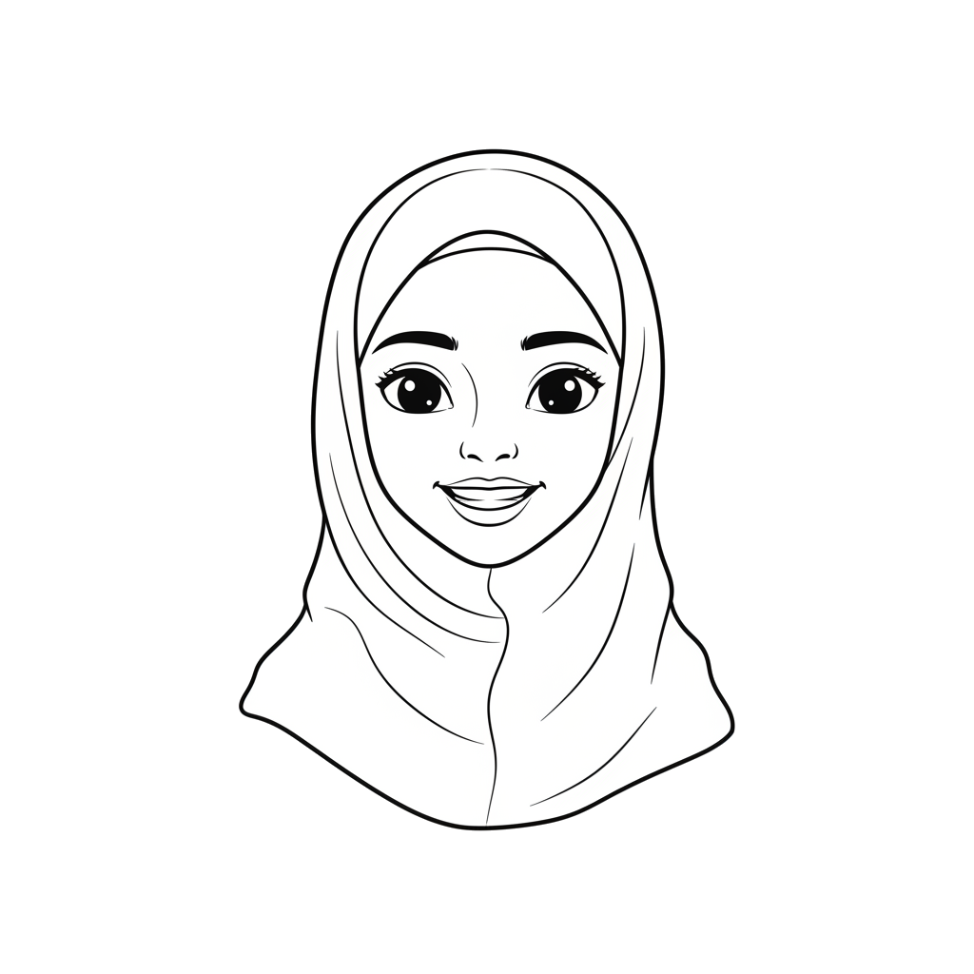

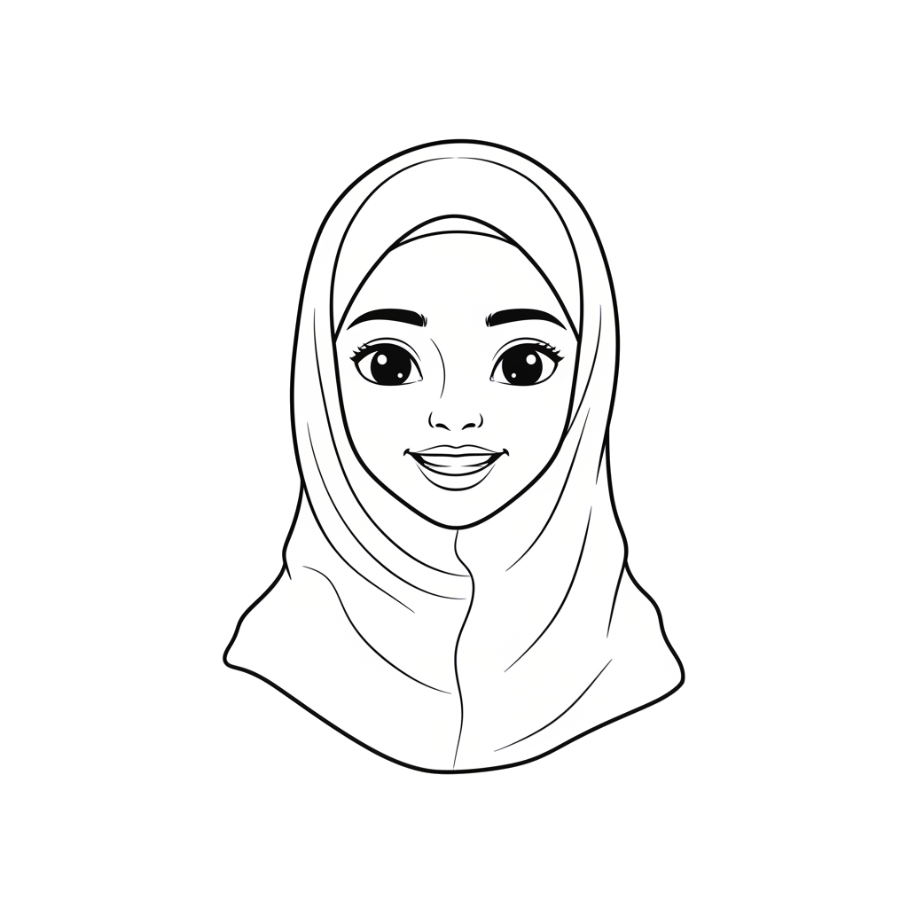
Ku dar wajiyo (faces) adigoo isticmaalaya gooyn (loop cut)
Ka bilow qaabkaaga cube (cube) fudud, ka dibna isticmaal qaabka tafatirka (edit mode) si aad ugu darto lugaha iyo dhabarka.
Waxaan cabbirey (scale) cube-ga, ka dibna waxaan isticmaalay qalabka gooynta (loop cut tool) si aan u kala qaybiyo dusha qaybo. Kadibna waxaan soo bixiyey (extrude) lugaha iyo dhabarka wajiyada (faces). Waxaan ku daray taageerooyin dheeri ah oo dhabarka ah anigoo tirtiraya wajiyo (faces) ka dibna ku daraya kuwo cusub oo u dhexeeya geesaha (edges).
Caasha

Slide 39
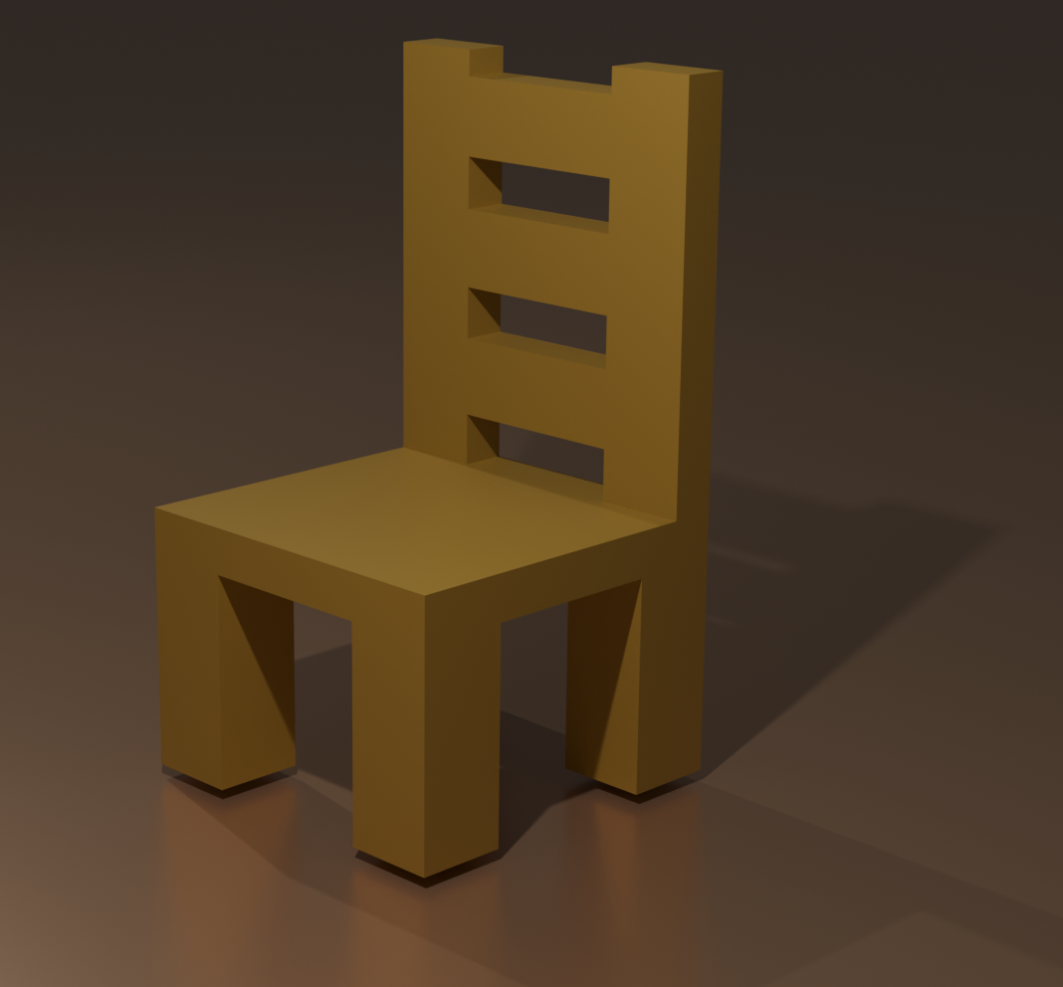
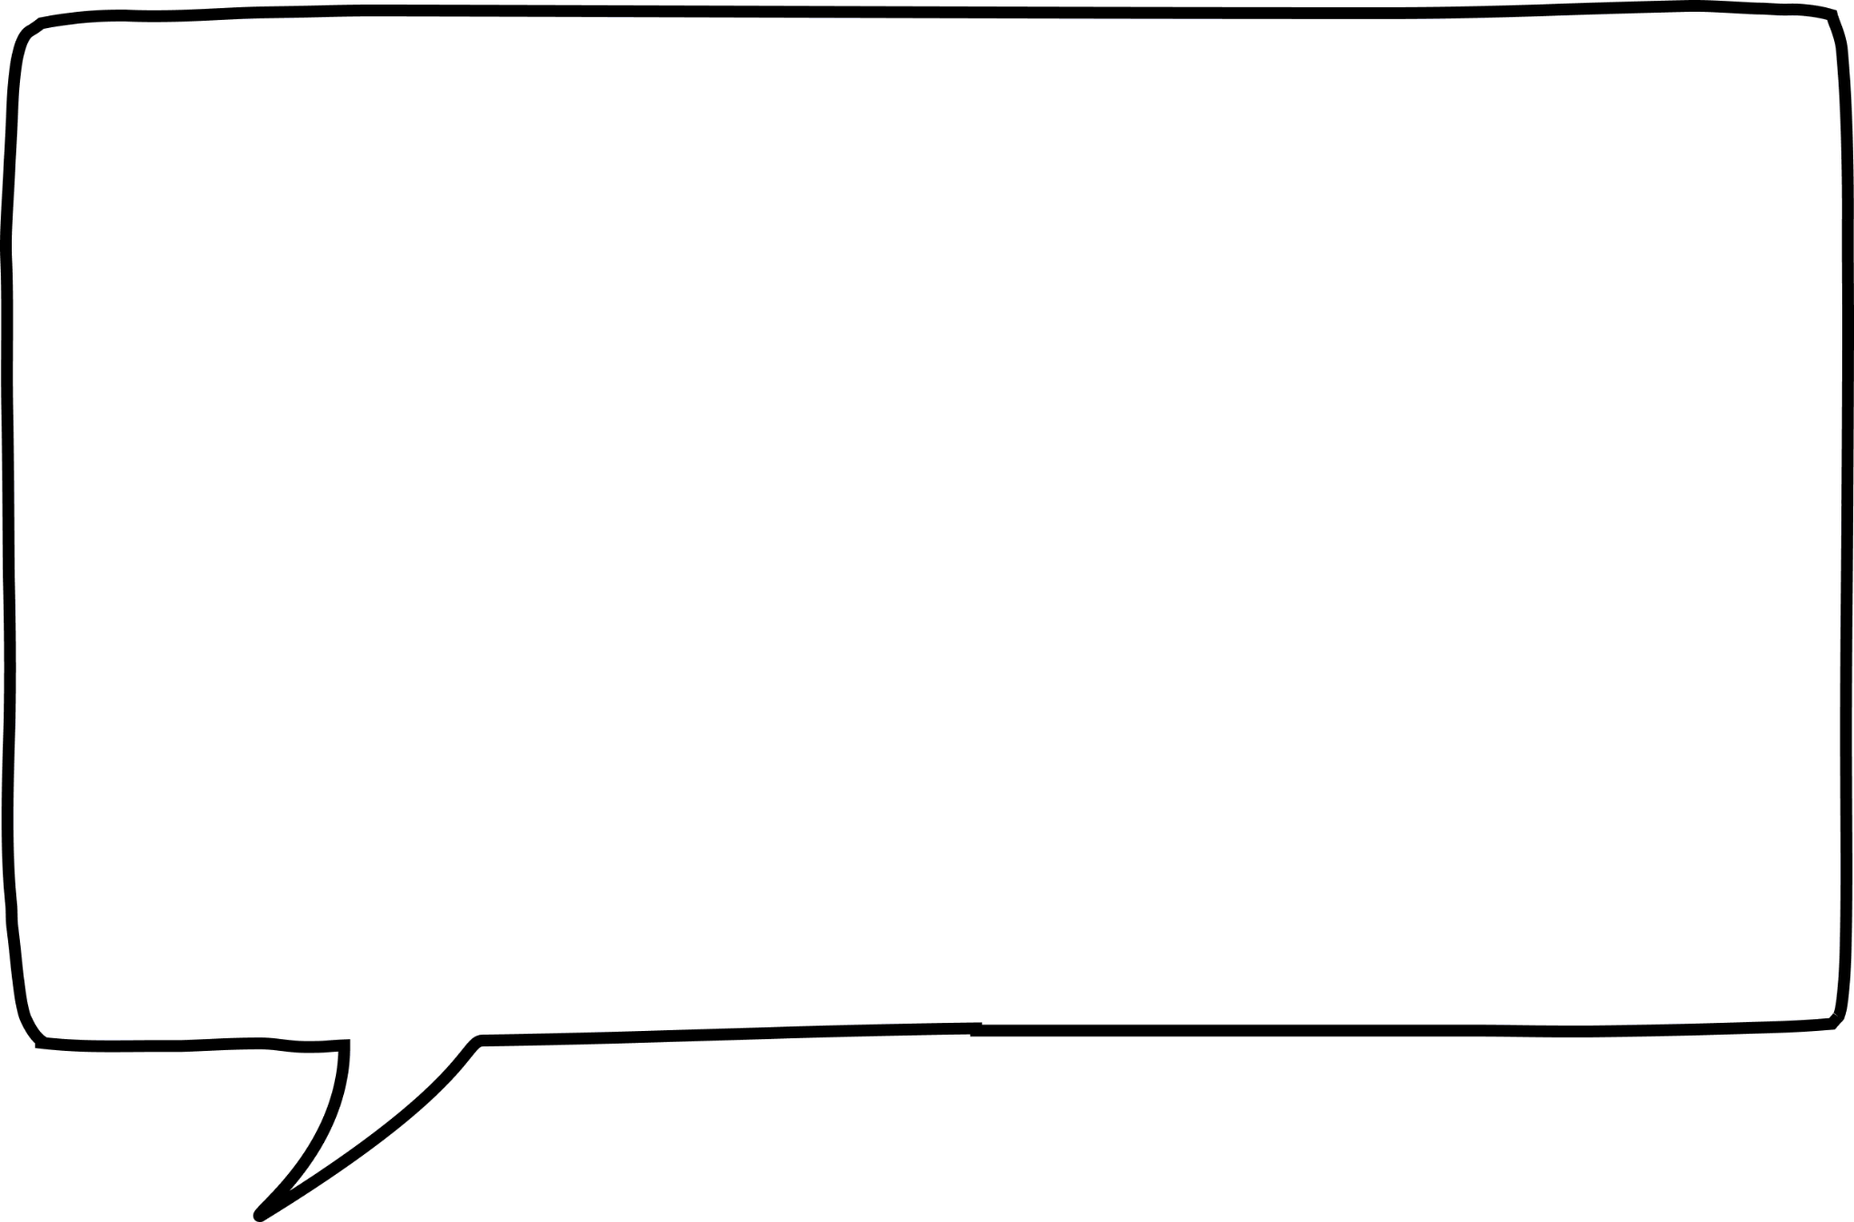
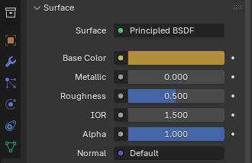
Ku dar wejiyada (faces) adigoo isticmaalaya loop cut
2) Abuur oo ku dar agab (materials) kursiga si aad u wanaajiso tayada
ee moodelkaaga.
Waxaan sameeyay material (material) midab bunni dhexdhexaad ah oo aan ku daray kursiga. Waxaan qaaday sawir (screenshot) kursiga ugu dambeeya ee aragtida rendered. Aad ayaan ugu faanaa moodelkeyga 3D!
Caasha
Blender Foundation – www.blender.org

Slide 40
Moodello adag iyo midabyo
Qaababka 2D waxaa lagu kordhin karaa (extrude) jid (path) si loo abuuro shay 3D.
Qalabka loop cut waxaa loo isticmaali karaa in lagu kala qaybiyo dusha moodellada.
Vertices, edges iyo faces waxaa lagu beddeli karaa qaabka edit (edit mode).
Qalabka modeling ee dheeraadka ah waxaa laga heli karaa qaabka edit (edit mode).

