Slide 1
Isku ekaanshaha qaababka
Sifooyinka joomatari iyo aragtida Pythagoras

Slide 2
sida loo isticmaalo darasyada Oak

Slide 3
Waxaan garan karaa in qaababka isku ekaanshaha leh dhererka dhinacyada iyo cabbirka xaglaha labadaba la ilaaliyo.

Slide 4
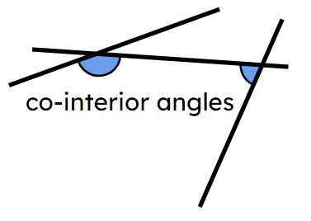
Haddii qaab uu si sax ah ugu habboonaado korka qaab kale iyadoo la adeegsanayo wareeg (rotation), milicsi (reflection), ama turjumaad (translation), markaas qaababku waa isku ekaansho (congruent).
Xaglaha co-interior waxay ku yaalliin dhinaca isku midka ah ee khadka transversal iyo dhexdooda labada khad ee kale.

Slide 5

Isku ekaanshaha qaababka
Aqoonsiga isku ekaanshaha
Xallinta mashaakilaadka qaababka isku ekaanshaha leh

Slide 6
Aqoonsiga isku ekaanshaha
Qaababka leh dhererka iyo xaglaha isku midka ah waa isku ekaansho (congruent).
Marka qaababku aan isku ekaansho ahayn, waxay yihiin kuwa aan isku ekaansho ahayn (incongruent).
80 mm
88 mm
70°
110°
70°
110°
70 mm
70 mm
77 mm
77 mm
110°
70°
110°
70°
80 mm
88 mm
Qaababkani waxay leeyihiin xaglaha isku midka ah laakiin ma aha isku ekaansho (incongruent) sababtoo ah dhererka way kala duwan yihiin.

Slide 7
Aqoonsiga isku ekaanshaha
Qaababka leh dherer iyo xaglo isku mid ah waa isku mid (congruent).
Marka qaababku aan isku mid ahayn, waa kuwo aan isku mid ahayn (incongruent).
80 mm
80 mm
70°
110°
65°
105°
70 mm
70 mm
70 mm
70 mm
110°
70°
65°
105°
80 mm
80 mm
Qaababkani waxay leeyihiin dherer isku mid ah laakiin ma aha isku mid (incongruent) sababtoo ah xagluhu way kala duwan yihiin.

Slide 8
Aqoonsiga isku midnimada (congruence)
Qaababka leh dherer iyo xaglo isku mid ah waa isku mid (congruent).
Marka qaababku aan isku mid ahayn, waa kuwo aan isku mid ahayn (incongruent).
70 mm
80 mm
110°
70°
70°
110°
80 mm
70 mm
70 mm
80 mm
110°
70°
70°
110°
80 mm
70 mm
Qaababkani waxay ku jiraan jihooyin kala duwan laakiin waa isku mid (congruent) sababtoo ah waxay leeyihiin dherer iyo xaglo isku mid ah.

Slide 9

Isbeddellada (Transformations) ee isku midnimada (congruence)
2 cm
Laba qaab waa isku mid (congruent).
98°
124°
5 cm
6 cm
82°
56°
6 cm
2.2 m
98°
124°
Qaababku waxay leeyihiin xaglaha isku midka ah.
5.5 m
6.6 m
Qaababku waxay leeyihiin dherer kala duwan.
82°
56°
6.6 cm

Slide 10
Isbeddellada (Transformations) ee isku midnimada (congruence)
2 cm
Laba qaab waa isku mid (congruent).
98°
124°
5 cm
6 cm
82°
56°
6 cm
2 cm
124°
98°
Qaababku waxay leeyihiin dherer iyo xaglo isku mid ah.
6 cm
5 cm
56°
82°
Qaababku waxay ku jiraan jihooyin kala duwan.
6 cm

Slide 11
Aqoonsiga isku-dhigma (congruence)
Qaababka leh dherer iyo xaglo isku mid ah waa isku-dhigma (congruent).
Dhammaan dhererka iyo xaglaha looma baahna in la ogaado si loo go'aamiyo isku-dhigma (congruence).
Xaqiiqooyinka ku saabsan xaglaha iyo dhererka siman ayaa laga yaabaa in loo isticmaalo si loo xisaabiyo cabbirada maqan ee qaabka.
Isku-dhigma (congruence) waa la go'aamin karaa haddii macluumaad ku filan la ogyahay si loo hubiyo inaysan jirin fursado kale.

Slide 12
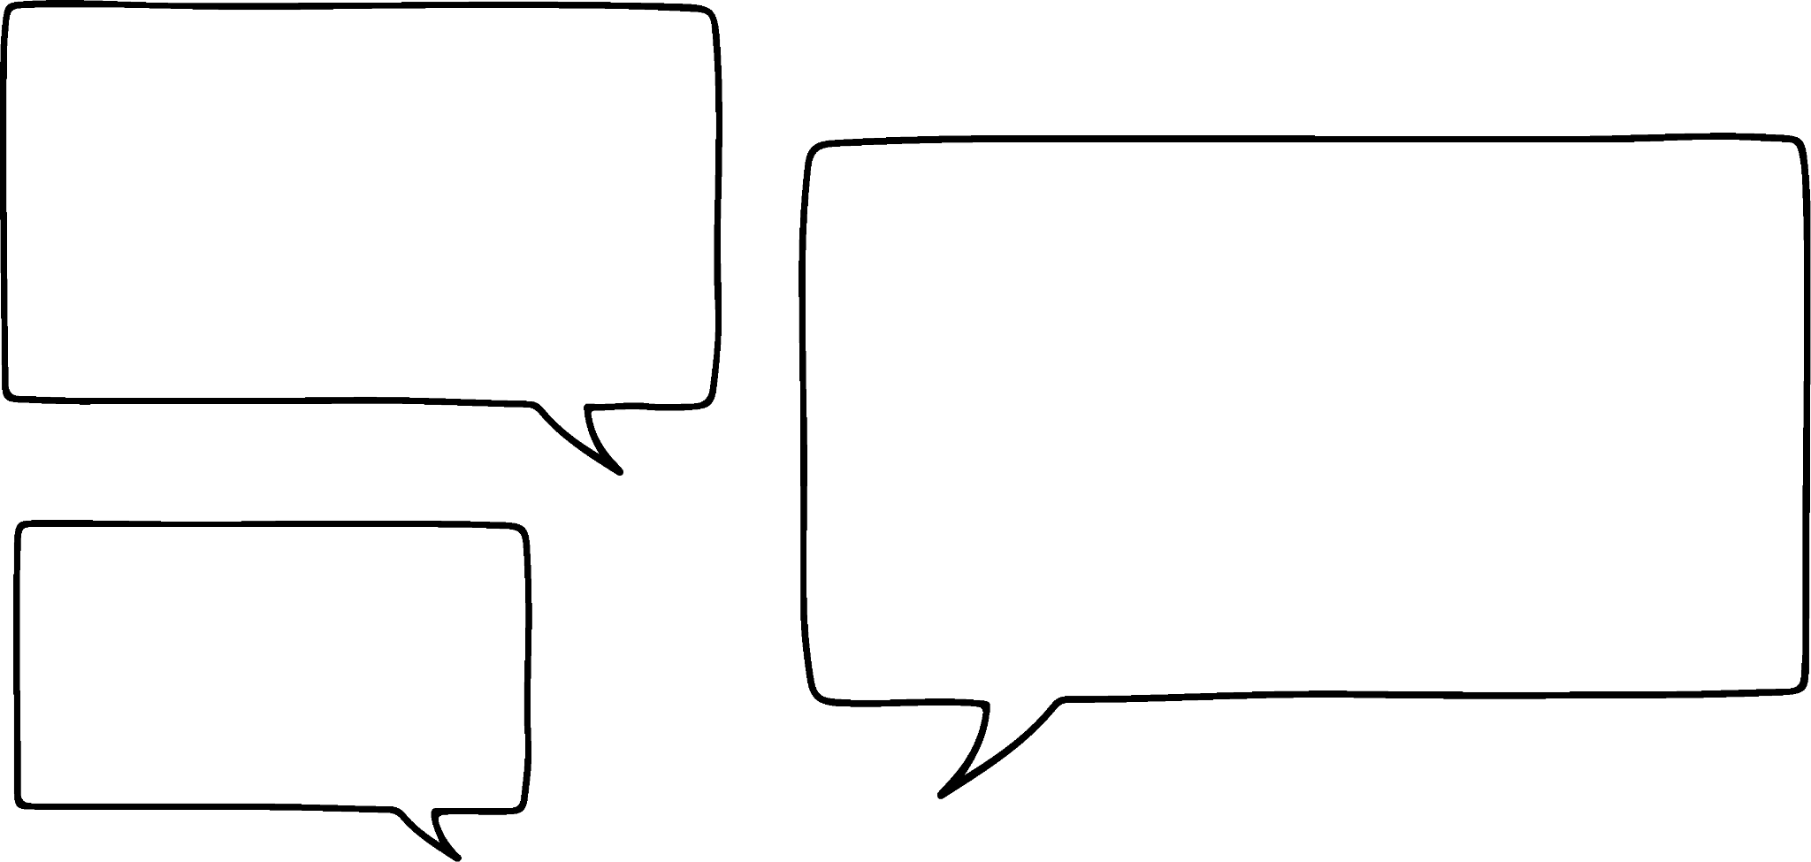


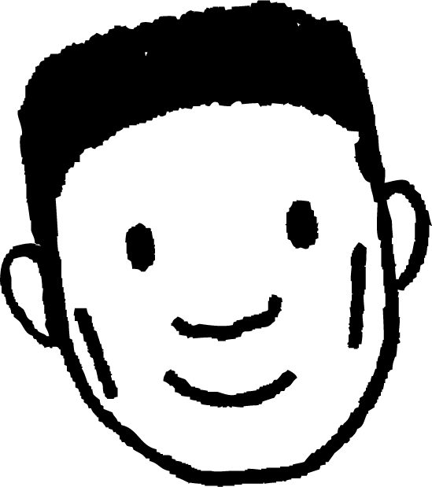
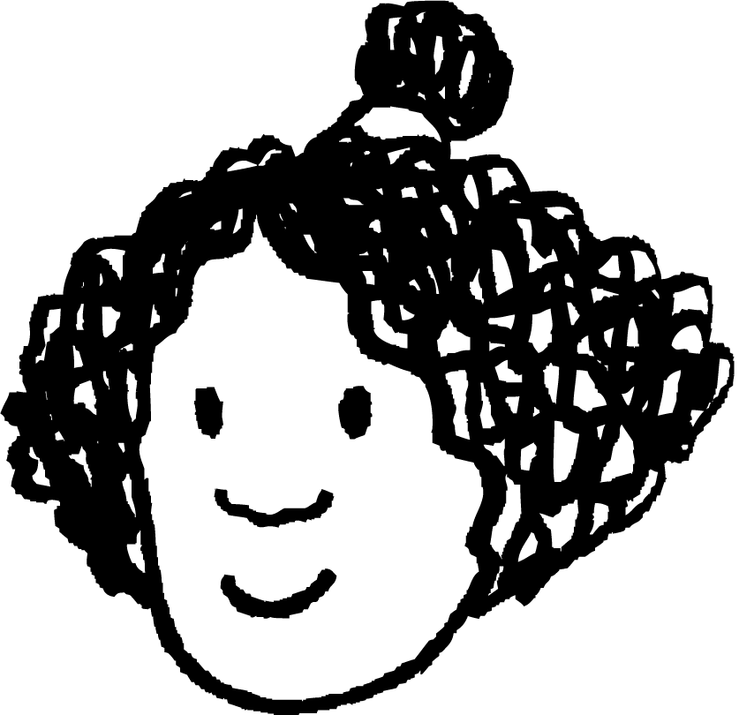


Aqoonsiga isku-dhigma (congruence)
Ma jiraa macluumaad ku filan oo lagu go'aamin karo in qaababkani isku-dhigma (congruent) yihiin?
Waxaan arkaa in dhammaan xaglaha ay isku mid yihiin labada qaab, laakiin ma aqaano dhererka.
Sidaas darteed, ma jiro macluumaad ku filan oo lagu go'aamin karo inay isku-dhigma (congruent) yihiin.
6 cm
B
F
Cabdi
A
E
127°
127°
10 cm
8 cm
Isra
53°
53°
D
C
H
G
12 cm

Slide 13
Aqoonsiga isku-dhigma (congruence)
Maxaa dhacaya haddii aan idiin sheego dhammaan dhererrada? Ma go'aamin kartaan haddii ay siman yihiin (congruent) hadda?
Waxaan arkaa in dhammaan xaglaha iyo dhererka ay isku mid yihiin qaab kasta.
Sidaas darteed, haa, hadda waan hubaa inay isku-dhigma (congruent) yihiin.
6 cm
B
6 cm
F
Cabdi
A
E
127°
127°
10 cm
10 cm
8 cm
8 cm
Isra
53°
53°
D
C
H
G
12 cm
12 cm

Slide 14
Aqoonsiga simanaanta (congruence)
Waxaan ka saaray ∠EFG.
Waxaan xisaabin karaa ∠EFG adoo ka jaraya saddexda xagal ee hadhay 360°.
Miyaa wali jira macluumaad ku filan oo lagu go'aamiyo simanaanta (congruence)?
Marka, haa, wali waan hubsan karaa inay siman yihiin (congruent).
6 cm
B
6 cm
F
Cabdi
A
E
127°
10 cm
10 cm
8 cm
8 cm
Isra
53°
53°
D
C
H
G
12 cm
12 cm

Slide 15
Aqoonsiga isku-dhigmaanta (congruence)
Maxaa dhacaya haddii aan sidoo kale ka saaro ∠HEF?
Waxaan arkaa in laba dhinac oo ka mid ah ay isbarbar yihiin. Waxaan isticmaali karaa xaqiiqda ah in xaglaha co-interior ay isku yimaadaan 180° si aan u xisaabiyo labada xaglood ee maqan.
Ma wali waxaa jira macluumaad ku filan oo lagu go'aamin karo isku-dhigmaanta (congruence)?
Marka, haa, wali waan hubsan karaa inay isku-dhigmaan (congruent) yihiin.
6 cm
B
6 cm
F
Cabdi
A
E
127°
10 cm
10 cm
8 cm
8 cm
Isra
53°
53°
D
C
H
G
12 cm
12 cm

Slide 16
Aqoonsiga isku-dhigmaanta (congruence)
Maxaa dhacaya haddii aan sidoo kale ka saaro ∠GHE?
Ma wali waxaa jira macluumaad ku filan oo lagu go'aamin karo isku-dhigmaanta (congruence)?
6 cm
B
6 cm
F
Cabdi
A
E
127°
10 cm
10 cm
8 cm
8 cm
Isra
53°
53°
D
C
H
G
12 cm
12 cm

Slide 17
Aqoonsiga isku-dhigmaanta (congruence)
Hagaag, waxaan xisaabin karaa ∠GHE adigoo isticmaalaya xaglaha gudaha ee isku-xiga (co-interior angles) ee u dhexeeya sadarrada isbarbar socda.
6 cm
B
F
Cabdi
A
127°
127°
10 cm
10 cm
8 cm
Isra
53°
D
C
G
12 cm

Slide 18
Aqoonsiga isku-dhigmaanta (congruence)
Kadib, haddii aan sawiro EF oo ah 6 cm iyo GH oo ah 12 cm…
…waxaa jira hal hab oo keliya oo lagu sawiro dhererka 8 cm ee hadhay.
6 cm
B
6 cm
F
Cabdi
A
E
127°
127°
10 cm
10 cm
8 cm
8 cm
Isra
53°
53°
D
C
H
G
12 cm
12 cm

Slide 19
Aqoonsiga isku-dhigma (congruence)
Haa, waa sax. Tan weli waa macluumaad ku filan oo lagu go'aamin karo isku-dhigma (congruence).
6 cm
B
6 cm
F
Cabdi
A
E
127°
10 cm
10 cm
8 cm
8 cm
Isra
53°
53°
D
C
H
G
12 cm
12 cm

Slide 20
Aqoonsiga isku-dhigma (congruence)
Hadii aan ka saaro dhererka EH?
Sida hore, waxaan xisaabin karaa xagasha co-interior oo sawiri karaa saddex geesood oo aan aqoon. Markaas ma aha wax aan fiirsado in aan ogaado dhererka EH, sababtoo ah waxaa jira hal meel oo ay tegi karto.
Ma jiraan macluumaad ku filan oo lagu go'aamin karo isku midnimada (congruence)?
Haa, sidaas darteed, waxaan weli hubsan karaa inay isku mid yihiin (congruent).
6 cm
B
6 cm
F
Cabdi
A
E
127°
127°
10 cm
10 cm
8 cm
Isra
53°
53°
D
C
H
G
12 cm
12 cm

Slide 21
Aqoonsiga isku midnimada (congruence)
Hadii aan ka saaro calaamadaha isbarbar socda (parallel)?
Taas macnaheedu waa ma xisaabin karo ∠EFG.
Hadda waxaa jira ikhtiyaar loogu talagalay habka EF u socon karo, taas oo saameyn ku yeelan karta dhererka EH.
Ma wali waxaa jira macluumaad ku filan oo lagu go'aamin karo isku-xidhnaan (congruence)?
Sidaas darteed, maya, ma hubin karo inay isku mid yihiin (congruent).
6 cm
B
6 cm
F
Cabdi
A
E
6 cm
E
127°
10 cm
10 cm
8 cm
Isra
53°
53°
D
C
H
G
12 cm
12 cm

Slide 22
Aqoonsiga isku-xidhnaanta (congruence)
Soo hel cabbirka saddexda xagal gudaha ee hadhay.
B
A
80°
∠DAB = 100°
∠ABC = 80°
∠BCD = 100°
100°
100°
80°
C
D

Slide 23
Aqoonsiga isku-xidhnaanta (congruence)
Waa suurtagal in la xisaabiyo dhammaan xaglaha gudaha ee hadhay ee qaabkan.
75°
Ma jiro macluumaad ku filan oo ku yaal jaantuska si loo isticmaalo xaqiiqooyin xagal (angle facts) oo ku saabsan xaglaha maqan.
Xaqiiqooyinka ku saabsan xaglaha wada-jira (co-interior angles) ayaa loo isticmaali karaa in lagu xisaabiyo xaglaha hadhay.

Slide 24
Aqoonsiga isku-xidhnaanta (congruence)
Ma jiraa macluumaad ku filan oo lagu go'aamin karo in qaababku isku-xidhan yihiin (congruent)? Sharax sababta.
8 cm
113°
113°
113°
113°
13 cm
13 cm
67°
67°
67°
67°
18 cm
Maya. Isku-xidhnaanta (congruence) lama go'aamin karo iyada oo aan la garanayn dhererka (tusaale, qaabka kale wuxuu noqon karaa weyneyn (enlargement) kan kale).

Slide 25
Aqoonsiga isku midnimada (congruence)
Ma jiraan macluumaad ku filan oo lagu ogaan karo in qaababku isku mid yihiin (congruent)? Sharax sababta.
8 cm
8 cm
113°
113°
113°
113°
13 cm
13 cm
13 cm
67°
67°
67°
67°
18 cm
18 cm
Haa. Calaamadaha xariijimaha ee geesaha waxay muujinayaan in dhererka maqan uu yahay 13 cm. Sidaas darteed, waxaan ognahay in dhammaan dhererka iyo xaglaha qaab kasta ay isku mid yihiin.

Slide 26
Aqoonsiga isku midnimada (congruence)
Ma jiraan macluumaad ku filan oo lagu ogaan karo in qaababku isku mid yihiin (congruent)? Sharax sababta.
8 cm
8 cm
113°
113°
13 cm
13 cm
13 cm
67°
67°
67°
18 cm
18 cm
Haa. Waxaan ognahay in dhererka maqan uu yahay 13 cm. Xaglaha isku-dhafka ah (co-interior) iyo summetri (symmetry) ayaa loo isticmaali karaa in lagu helo dhammaan xaglaha haray.

Slide 27
Aqoonsiga isku midnimada (congruence)
1) Qaababka hoose waxay ka kooban yihiin saddex lammaane oo qaabab isku mid ah (congruent). Isku xir qaababka isku midka ah. Waxaad isticmaali kartaa xisaabta (ruler) iyo xagalbeeg (protractor) si aad u go'aamiso isku midnimada.
B
C
D
A
F
E

Slide 28
Aqoonsiga isku midnimada (congruence)
2) Kee ka mid ah qaababka ayaa leh macluumaad ku filan oo lagu ogaan karo inuu isku mid yahay qaabka A? Calaamadee qaababka lagu go'aamin karo isku midnimada. Jaantusyada (diagrams) ma aha kuwo si sax ah loo sawiray, dhammaan dhererka waxay ku jiraan halbeeg isku mid ah.
5
112°
68°
112°
68°
4
A
4
B
C
4
D
4
68°
112°
68°
112°
68°
5
5
5
5
5
112°
E
4
F
4
G
4
H
4
68°
68°
112°
68°
112°
68°
112°
5
5
5
5

Slide 29
Aqoonsiga isku midnimada (congruence)
1) Qaababka hoose waxay ka kooban yihiin saddex lammaane oo qaabab isku mid ah (congruent). Isku xidh qaababka isku midka ah. Waxaad isticmaali kartaa xisaabiyaha (ruler) iyo xajmigooda (protractor) si aad u go'aamiso isku midnimada (congruence).
A iyo F
B iyo E
C iyo D
B
C
D
A
F
E

Slide 30
Aqoonsiga isku midnimada (congruence)
2) Qaababkee ayaa ka kooban macluumaad ku filan oo lagu ogaan karo inay la isku mid yihiin (congruent) qaabka A? Calaamadee qaababka isku midnimada (congruence) laga ogaan karo. Jaantusyada si sax ah looma sawirin, dhammaan dhererka waxay ku jiraan halbeeg isku mid ah.
5
112°
68°
112°
68°
4
A
4
B
C
4
D
4
68°
112°
68°
112°
68°
5
5
5
5
5
112°
E
4
F
4
G
4
H
4
68°
68°
112°
68°
112°
68°
112°
5
5
5
5

Slide 31
Isku midnimada (congruence) qaababka
Aqoonsiga isku midnimada (congruence)
Xallinta mashaakilaadka qaababka isku midka ah (congruent shapes)

Slide 32
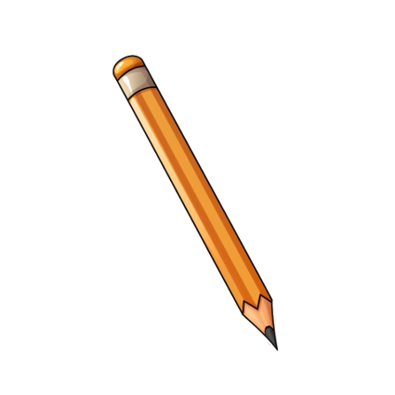


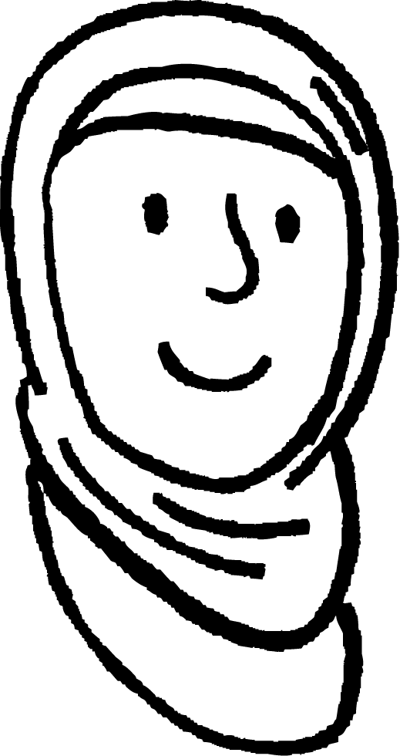
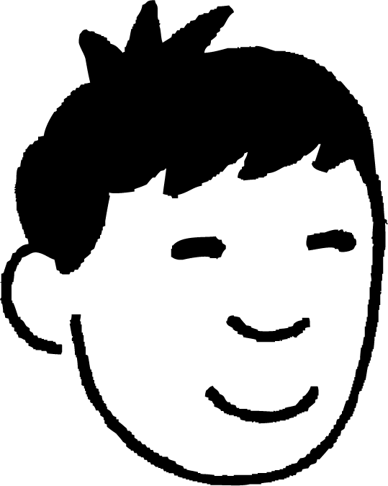
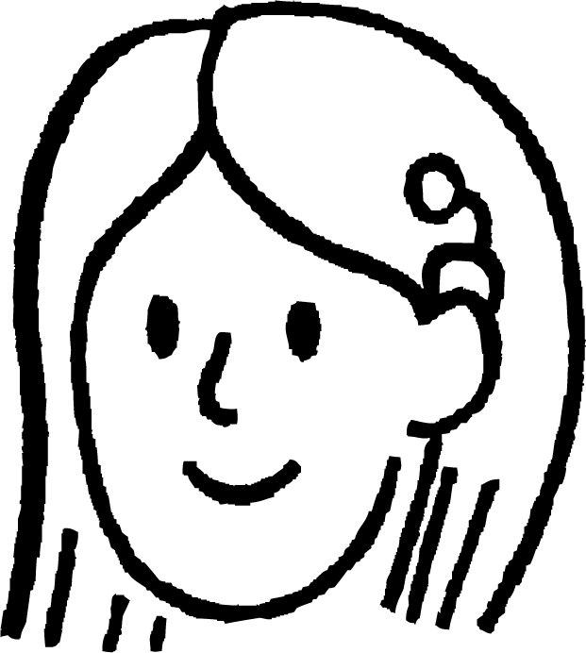


Xallinta mashaakilaadka isku midnimada (congruence)
Sawir leydi (rectangle).
Dul saar qalinkaaga leydiga si uu u kala qaybiyo laba qaab.
Labada qaab ma isku mid (congruent) baa?
Waxaan u malaynayaa in labada qaab ay had iyo jeer isku mid (congruent) yihiin.
Waxaan u malaynayaa inay waligood isku mid (congruent) noqon karin.
Waxaan u malaynayaa inay mararka qaarkood isku mid (congruent) yihiin, mararka qaarkoodna aan isku mid ahayn.
Caasha
Nuur
Suad
Yaa aad la raacsan tahay?

Slide 33
Xallinta dhibaatooyinka isku ekaanshaha (congruence)
Maxay Caasha u qaldan tahay?
tusaale qaabab aan isku ekeyn:
Waxaan u malaynayaa in labada qaab ay had iyo jeer isku ekaan doonaan.
saddexagal iyo trapezium
Caasha

Slide 34
Xallinta dhibaatooyinka isku ekaanshaha (congruence)
Maxay Caasha khalad u tahay?
tusaale qaabab aan isku ekeyn:
Waxaan u malaynayaa in labada qaab ay had iyo jeer isku ekaan doonaan.
laba trapezium laakiin dhererka tooska ah oo kala duwan
Caasha

Slide 35
Xallinta dhibaatooyinka isku ekaanshaha (congruence)
Maxay Nuur khalad u tahay?
tusaale qaabab isku ekeyn:
Waxaan u malaynayaa inay waligood isku ekaan karin.
laba saddexagal xagal qumman (right-angled)
Geesaha iska soo horjeeda ee leydigu waa isku dherer.
Nuur
Geesaha iska soo horjeeda ee leydigu waa isbarbar yaal, xaglaha beddelka ah ee khadadka isbarbar yaalna waa isku qiyaas.

Slide 36
Xallinta dhibaatooyinka isku ekaanshaha (congruence)
Maxay Nuur khalad u tahay?
tusaale qaabab isku mid ah (congruent shapes):
Waxaan u malaynayaa inaanay waligood noqon karin kuwo isku mid ah (congruent).
laba trapezium oo dhererka tooska ah isku mid yihiin
Labaduba waxay ka kooban yihiin laba xagal qumman (right angles) iyo xaglo isdaba joog ah (alternate angles) oo ku yaalla khadadka barbar socda (parallel lines) oo isku mid ah.
Nuur

Slide 37
Xallinta mashaakilaadka isku midnimada (congruence)
Labada qaab mararka qaarkood waa isku mid (congruent).
isku mid (congruent)
aan isku mid ahayn (incongruent)
Waxaan u malaynayaa inay mararka qaarkood noqon karaan kuwo isku mid (congruent) iyo mararka qaarkoodna maya.
Suad
Xaaladee bay qaababku isku mid (congruent) yihiin?

Slide 38
Xallinta mashaakilaadka isku midnimada (congruence)
Xaaladee bay qaababku isku mid (congruent) yihiin?
isku mid (congruent):
aan isku mid ahayn (incongruent):
Qaababku waxay isku mid (congruent) yihiin marka qalinka (pencil) uu dhex maro xarunta leyliga (centre of the rectangle).

Slide 39
Xallinta mashaakilaadka isku midnimada (congruence)
1) Su'aal kasta, sawir leyl (rectangle) ka dibna u kala qaybi sida tilmaamaha.
a) U kala qaybi leyliga (rectangle) laba qaab oo aan isku mid ahayn (incongruent).
b) U kala qaybi leyliga (rectangle) laba qaab oo isku mid ah (congruent).
c) U kala qaybi leyliga (rectangle) saddex qaab oo aan isku mid ahayn (incongruent).
d) U kala qaybi leyliga (rectangle) saddex qaab oo isku mid ah (congruent).
e) U kala qaybi leydiga si laba qaab ay isku mid u yihiin (congruent) kan kalena uu ka duwan yahay (incongruent).
f) U kala qaybi leydiga afar qaab oo ka duwan (incongruent).
g) U kala qaybi leydiga afar qaab oo isku mid ah (congruent).
h) U kala qaybi leydiga laba lammaane oo qaabab isku mid ah (congruent).

Slide 40
Xallinta mashaakilaadka isku midnimada (congruence)
1) Su'aal kasta, sawir leydi ka dibna u kala qaybi sida tilmaamaha lagu sheegay.
a) U kala qaybi leydiga laba qaab oo ka duwan (incongruent).
b) U kala qaybi leydiga laba qaab oo isku mid ah (congruent).
tusaalooyin:
tusaalooyin:

Slide 41
Xallinta mashaakilaadka isku midnimada (congruence)
1) Su'aal kasta, sawir leydi ka dibna u kala qaybi sida tilmaamaha lagu sheegay.
c) U kala qaybi leydiga saddex qaab oo ka duwan (incongruent).
d) U kala qaybi leydiga saddex qaab oo isku mid ah (congruent).
e) U kala qaybi leydiga si laba qaab ay isku mid u yihiin (congruent) kan kalena uu ka duwan yahay (incongruent).
tusaalooyin:
tusaalooyin:
tusaalooyin:

Slide 42
Xallinta mashaakilaadka isku midnimada (congruence)
1) Su'aal kasta, sawir leydi ka dibna u kala qaybi sida tilmaamaha lagu sheegay.
f) U kala qaybi leydiga afar qaab oo ka duwan (incongruent).
g) U kala qaybi leydiga afar qaab oo isku mid ah (congruent).
h) U kala qaybi leydiga laba lammaane oo qaabab isku mid ah (congruent).
tusaalooyin:
tusaalooyin:
tusaalooyin:

Slide 43
Isku midnimo (Congruence) ee qaababka
Haddii hal qaab si sax ah ugu habboonaan karo kan kale iyadoo la isticmaalayo wareejin (rotation), milicsi (reflection), ama turjumaad (translation), markaas qaababku waa isku mid (congruent).
Qaababka leh dherer iyo xaglo isku mid ah waa isku mid (congruent).
Isku midnimo (congruence) macneheedu ma aha in jihada (orientation) ay tahay mid isku mid ah.
Dhererka iyo xaglaha maqan ayaa laga yaabaa in la xisaabiyo si loo go'aamiyo isku midnimada (congruence).
Dhammaan dhererka looma baahna in la ogaado si loo go'aamiyo isku midnimada (congruence).

