Slide 1
Isku mid (Congruent) ama isku qaab (Similar) ama midna
Sifooyin joomatari (Geometrical properties) iyo aragtida Pythagoras (Pythagoras’ theorem)

Slide 2
sida loo isticmaalo darasyada Oak

Slide 3
Waxaan go'aamin karaa in qaababku yihiin isku qaab (Similar), isku mid (Congruent), ama midna.

Slide 4
Laba qaab waa isku qaab (Similar) haddii farqiga kaliya ee u dhexeeya uu yahay cabbirkooda. Dhererka dhinacyadoodu waa isku saami (proportions).
Haddii qaab uu si sax ah ugu habboonaado korka mid kale iyadoo la adeegsanayo wareeg (rotation), milicsi (reflection), ama guur (translation), markaas qaababku waa isku mid (Congruent).

Slide 5

Isku mid (Congruent) ama isku qaab (Similar) ama midna
Kala soocida isku qaabka (Similarity) iyo isku midnimada (Congruence)
Hubinta isku qaabka (Similarity) iyo isku midnimada (Congruence)

Slide 6
Kala soocida isku qaabka (Similarity) iyo isku midnimada (Congruence)
Marka laba qaab ay yihiin isku mid (Congruent), xagluhu waa isku mid qaab kasta, iyo dhererku waa isku mid qaab kasta.
Marka laba qaab ay yihiin isku qaab (Similar), xagluhu waa isku mid qaab kasta, iyo dhererku waa isku saami (proportions).
Qaabka A (Shape A)
isku mid (Congruent) leh Qaabka A
la mid ah Qaabka A (similar to Shape A)
4 cm
37°
5 cm
37°
53°
4 cm
10 cm
3 cm
6 cm
53°
53°
5 cm
37°
3 cm
8 cm

Slide 7
Kala saarista isku ekaanshaha (similarity) iyo isku midnimada (congruence)
Haddii laba qaab ay isku mid yihiin (congruent) markaas waxay sidoo kale yihiin kuwo isku eeg (similar).
Haddii laba qaab ay isku eeg yihiin (similar) markaas daruuri ma aha inay isku mid yihiin (congruent).
Qaababka isku eeg (similar) waxay isku mid noqdaan (congruent) oo keliya haddii qodobka miisaanka (scale factor) u dhexeeya uu yahay 1.
Qaabka A (Shape A)
la mid ah Qaabka A (congruent to Shape A)
la mid ah Qaabka A (similar to Shape A)
sidoo kale la mid ah Qaabka A (also similar to Shape A)
aan la mid ahayn Qaabka A (incongruent to Shape A)
× 1
4 cm
37°
5 cm
× 1
37°
53°
4 cm
10 cm
3 cm
6 cm
53°
53°
5 cm
37°
3 cm
× 1
8 cm

Slide 8
Kala saarista isku ekaanshaha (similarity) iyo isku midnimada (congruence)
Dhammaan lammaanaha qaababka isku midka ah (congruent) sidoo kale waa kuwo isku eeg (similar), laakiin qaar ka mid ah lammaanaha qaababka isku eeg (similar) ayaa sidoo kale isku mid ah (congruent).
Sheegista in qaababku yihiin isku mid (congruent) waxay sidoo kale tusinaysaa inay yihiin kuwa la mid ah (similar). Sidaa darteed, waxaa ku filan in la sheego in qaababku yihiin isku mid (congruent) iyada oo aan la sheegin inay sidoo kale yihiin kuwa la mid ah (similar).
Laba qaab oo sidoo kale ma noqon karaan kuwa isku mid ah (congruent) iyo kuwa la mid ah (similar) midna.
la mid ah (similar)
midna isku mid (congruent) ma aha, midna la mid (similar) ma aha
isku mid (congruent)

Slide 9
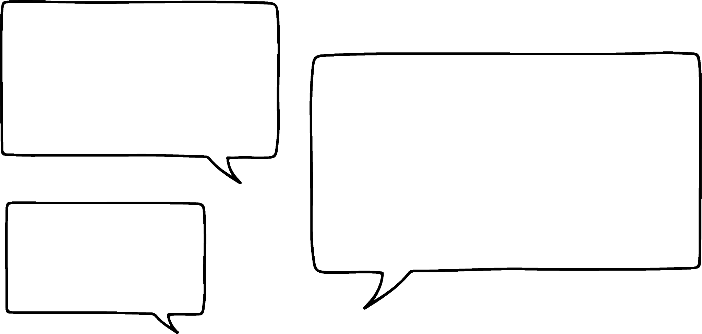

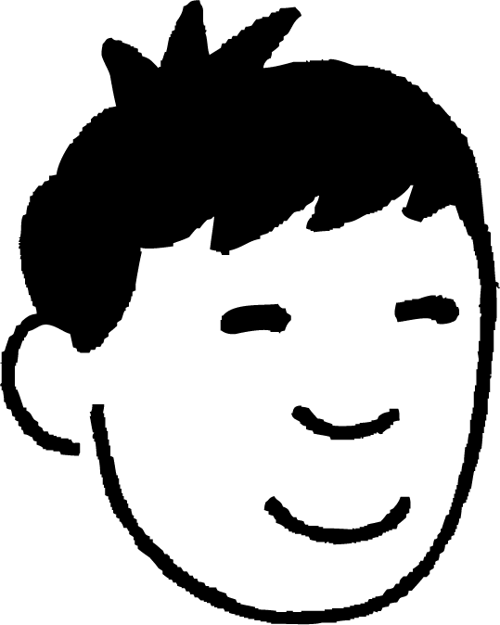

Kala soocida isku midnimada (congruence) iyo la midnimada (similarity)
Qaababkani ma yihiin isku mid (congruent), la mid (similar), ama midna?
Ma khusaynayso in jihooyinku kala duwan yihiin.
Labaduba waa isku barbarro (parallelograms) oo leh dherer iyo xaglo isku mid ah. Sidaa darteed, waa isku mid (congruent).
75°
105°
75°
105°
8 cm
75°
105°
105°
10 cm
10 cm
75°
8 cm
Nuur

Slide 10



Kala soocida isku midnimada (congruence) iyo la midnimada (similarity)
Qaababkani ma yihiin isku mid (congruent), la mid (similar), ama midna?
Ma aha isku mid (congruent) sababtoo ah dhererka way kala duwan yihiin. Mid ka mid ah qaababku waa weyneyn (enlargement) kan kale, sidaa darteed waa la mid (similar).
105°
75°
75°
8 cm
105°
4 cm
105°
75°
105°
75°
5 cm
10 cm
Layla

Slide 11
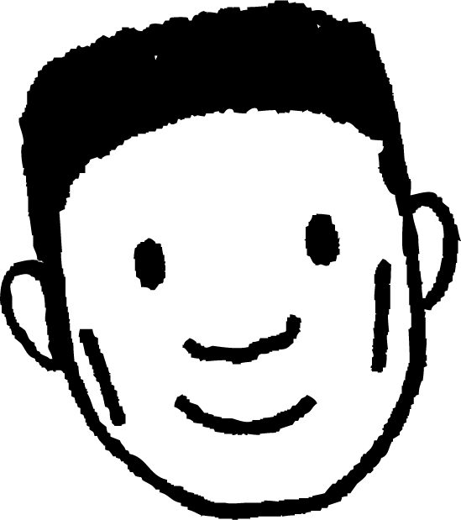
Kala saarista isku midnimada (similarity) iyo isku eegnimada (congruence)
Ma qaababkani waa isku eeg (congruent), isku mid (similar), ama midna?
60°
105°
75°
8 cm
120°
Xagluhu way kala duwan yihiin, marka ma aha isku eeg (congruent) mana aha isku mid (similar).
120°
10 cm
75°
105°
10 cm
60°
8 cm
Cabdi

Slide 12
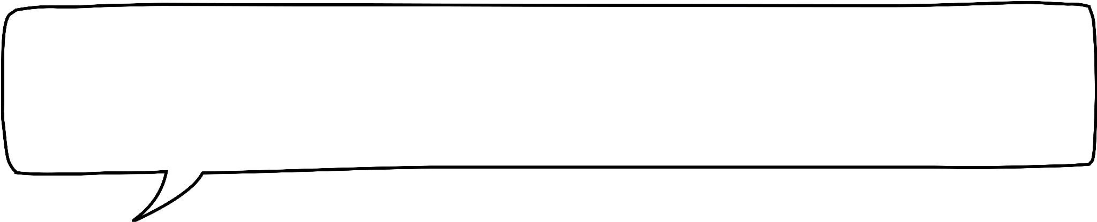

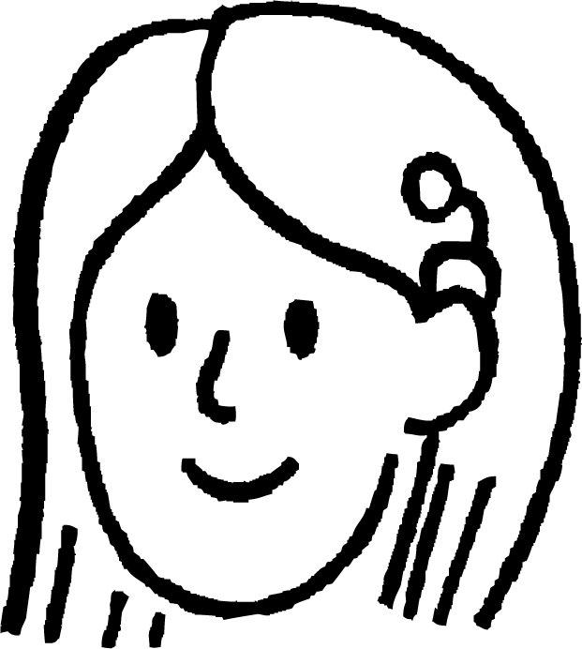
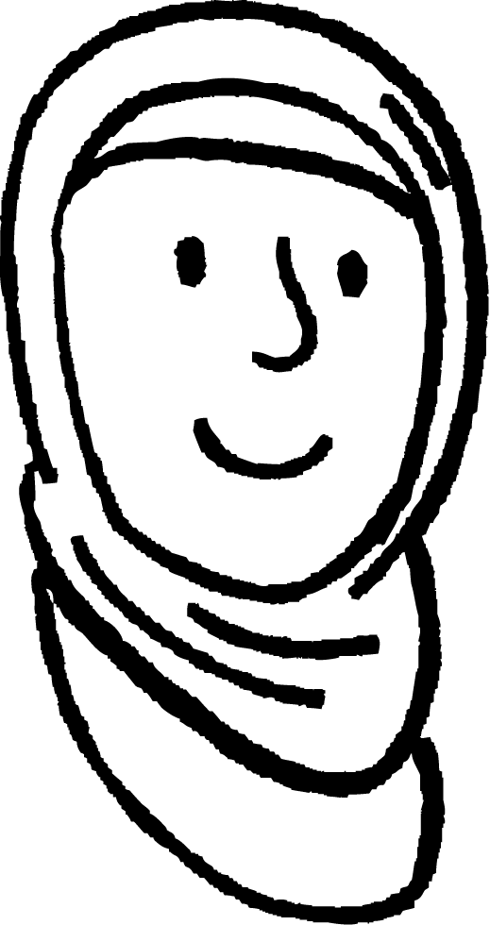

Kala saarista isku midnimada (similarity) iyo isku eegnimada (congruence)
Ma qaababkani waa isku eeg (congruent), isku mid (similar), ama midna?
Xagluhu waa isku mid laakiin dhererku waa kala duwan yahay. Taasi ma macneheedu waa inay isku mid (similar) yihiin?
105°
75°
105°
75°
8 cm
8 cm
75°
105°
75°
105°
10 cm
8 cm
Suad
Dhererku isku saami (proportion) kuma wada jiraan, marka ma aha isku mid (similar). Ma aha isku eeg (congruent) mana aha isku mid (similar).
Caasha

Slide 13

Kala saarista isku midnimada (similarity) iyo isku eegnimada (congruence)
Labada qaab waa .
Buuxi meesha bannaan.
4 cm
100°
100°
5 cm
5 cm
isku eeg (congruent)
80°
80°
6 cm
isku mid (similar)
5 cm
80°
6 cm
100°
midna isku mid (congruent) ma aha, midna isku mid (similar) ma aha
4 cm
80°
100°
5 cm

Slide 14
Kala soocida isku mid (similarity) iyo isku mid (congruence)
Laba qaab ee waa .
Buuxi meesha bannaan.
4 cm
100°
100°
5 cm
5 cm
isku mid (congruent)
80°
80°
6 cm
isku mid (similar)
6 cm
100°
100°
5 cm
5 cm
midna isku mid (congruent) ma aha, midna isku mid (similar) ma aha
80°
80°
8 cm

Slide 15
Kala soocida isku ekaanshaha (similarity) iyo isku qaabnimo (congruence)
Labada qaab waa .
Buuxi meesha bannaan.
4 cm
100°
100°
5 cm
5 cm
isku qaab (congruent)
80°
80°
6 cm
isku ekaansho (similar)
3 cm
80°
80°
midna isku qaab (congruent) ma aha, midna isku ekaansho (similar) ma aha
2.5 cm
2.5 cm
100°
100°
2 cm

Slide 16
Kala soocida isku ekaanshaha (similarity) iyo isku qaabnimo (congruence)
1) Qaab kasta la barbar dhig Qaabka A oo ku qor xuruufta B ilaa F jaantuska Venn (Venn diagram).
2 cm
C
isku qaab (congruent) A
isku ekaansho (similar) A
3 cm
6 cm
A
5 cm
B
4 cm
D
4 cm
3 cm
6 cm
6 cm
E
midna isku qaab (congruent) A ma aha, midna isku ekaansho (similar) A ma aha
6 cm
F
4 cm
9 cm

Slide 17

Kala saarida isku ekaanshaha (similarity) iyo isku qaabka (congruence)
2) Macluumaadku wuxuu qeexayaa shan leydi oo isku xiran, oo leh geesaha A ilaa L.
LC waa xariiq toosan oo leh
dherer 2 halbeeg.
Barta F waxay ka hoosaysaa barta C, CF = 2LC.
LCFI waa leydi (rectangle).
KLIJ wuxuu la siman yahay (congruent) LCFI.
ABCL wuxuu la siman yahay (congruent) LCFI.
CDEF wuxuu la mid yahay (similar) LCFI laakiin
ma aha isku mid (congruent).
FGHI wuxuu la mid yahay (similar) LCFI laakiin
ma aha isku mid (congruent).
Isticmaal macluumaadka si aad ugu sawirto dhibcaha A ilaa L shabkada oo aad u sawirto shan leexleex (rectangle).
L
C

Slide 18
Kala saarida isku ekaanshaha (similarity) iyo isku qaabka (congruence)
1) Isbarbardhig qaab kasta (shape) iyo Qaabka A, kadibna ku qor xarfaha B ilaa F jaantuska Venn.
2 cm
C
isku qaab (congruent) A
isku ekaansho (similar) A
3 cm
6 cm
A
5 cm
B
B
4 cm
C
D
E
D
4 cm
3 cm
F
6 cm
6 cm
E
midna isku qaab (congruent) kuma eka (similar) A
6 cm
F
4 cm
9 cm

Slide 19
Kala soocida isku midnimada (congruence) iyo la midnimada (similarity)
2) Macluumaadka ayaa qeexaya shan leexleex (rectangle) oo isku xidhan, oo leh geesaha (vertices) dhibcaha A ilaa L.
LC waa xariijin jiif (horizontal line) oo dhererkeedu yahay 2 halbeeg (unit).
Dhibicda F waxay ka hooseysaa Dhibicda C, CF = 2LC.
LCFI waa leydi (rectangle).
KLIJ waa isku mid (congruent) LCFI.
ABCL waa isku mid (congruent) LCFI.
CDEF waa la mid (similar) LCFI laakiin ma aha isku mid (congruent).
FGHI waa la mid (similar) LCFI laakiin ma aha isku mid (congruent).
Isticmaal macluumaadka si aad ugu calaamaddo dhibcaha A ilaa L shabakadda (grid) oo aad u sawirto shanta leydi (rectangles).
A
B
K
L
C
D
I
F
J
E
H
G

Slide 20
Kala soocida isku midnimada (congruence) iyo la midnimada (similarity)
2) Macluumaadku wuxuu qeexayaa shan leydi (rectangles) oo isku xiran, oo leh geesaha A ilaa L.
LC waa xariiq toosan (horizontal line) oo dhererkiisu yahay 2 cutub (units).
Dhibicda F waxay ka hooseysaa dhibicda C iyo CF = 2LC.
LCFI waa leydi (rectangle).
KLIJ waa isku mid (congruent) LCFI.
ABCL waa isku mid (congruent) LCFI.
CDEF waa la mid (similar) LCFI laakiin ma aha isku mid (congruent).
FGHI waa la mid (similar) LCFI laakiin ma aha isku mid (congruent).
Isticmaal macluumaadka si aad ugu calaamaddo dhibcaha A ilaa L shabakadda (grid) oo aad u sawirto shanta leydi (rectangles).
A
B
K
L
C
D
H
G
I
F
Xalalka kale waa suurtagal haddii leydi (rectangles) is-dul-saraan, DE waa go'an sababtoo ah booska shabakadda (grid).
J
E
H
G

Slide 21
Isku mid (congruent) ama la mid (similar) ama midna
Kala soocida isku midnimada (congruence) iyo la midnimada (similarity)
Hubinta la midnimada (similarity) iyo isku midnimada (congruence)

Slide 22

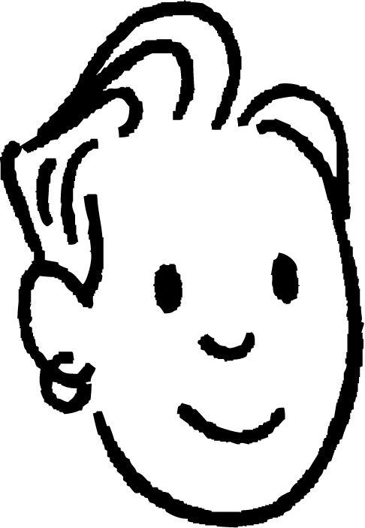

Hubinta isku-xidhnaanta (congruence) iyo isku-ekaanta (similarity)
isku-xidhnaan (congruence)
la midnimo (similarity)
Haddii laba qaab isku-xidhnaan (congruent) yihiin markaas…
Haddii laba qaab isku-ekaanta (similar) yihiin markaas…
xagluhu waa isku mid
xagluhu waa isku mid
xagluhu waa isku nidaam
xagluhu waa isku nidaam
dhererka (lengths) waa isku mid
dhererka (lengths) waa isku saami (proportions)
Haddii laba qaab xaglo kala duwan leeyihiin markaas waxaan ka reebi karnaa isku-xidhnaanta (congruence) iyo isku-ekaanta (similarity) labadaba.
Saciid

Slide 23
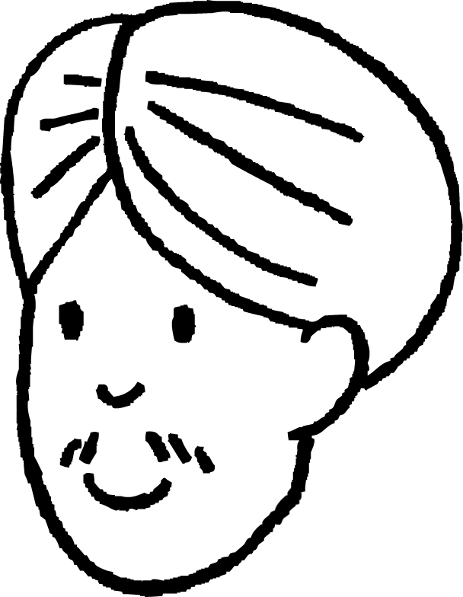
Hubinta isku-xidhnaanta (congruence) iyo isku-ekaanta (similarity)
Miis (table) ayaa loo isticmaali karaa in lagu hubiyo in laba qaab ay leeyihiin isku xaglo isku nidaam ah.
100°
100°
100°
80°
Halkan waxaa ah xagal 100° iyo 80°. Marka kuwani waxay geli karaan halkan miiska (table).
A
B
80°
80°
80°
100°
qaab A xaglaha
qaab B xaglaha
100°
100°
80°
80°
100°
80°
Cali

Slide 24
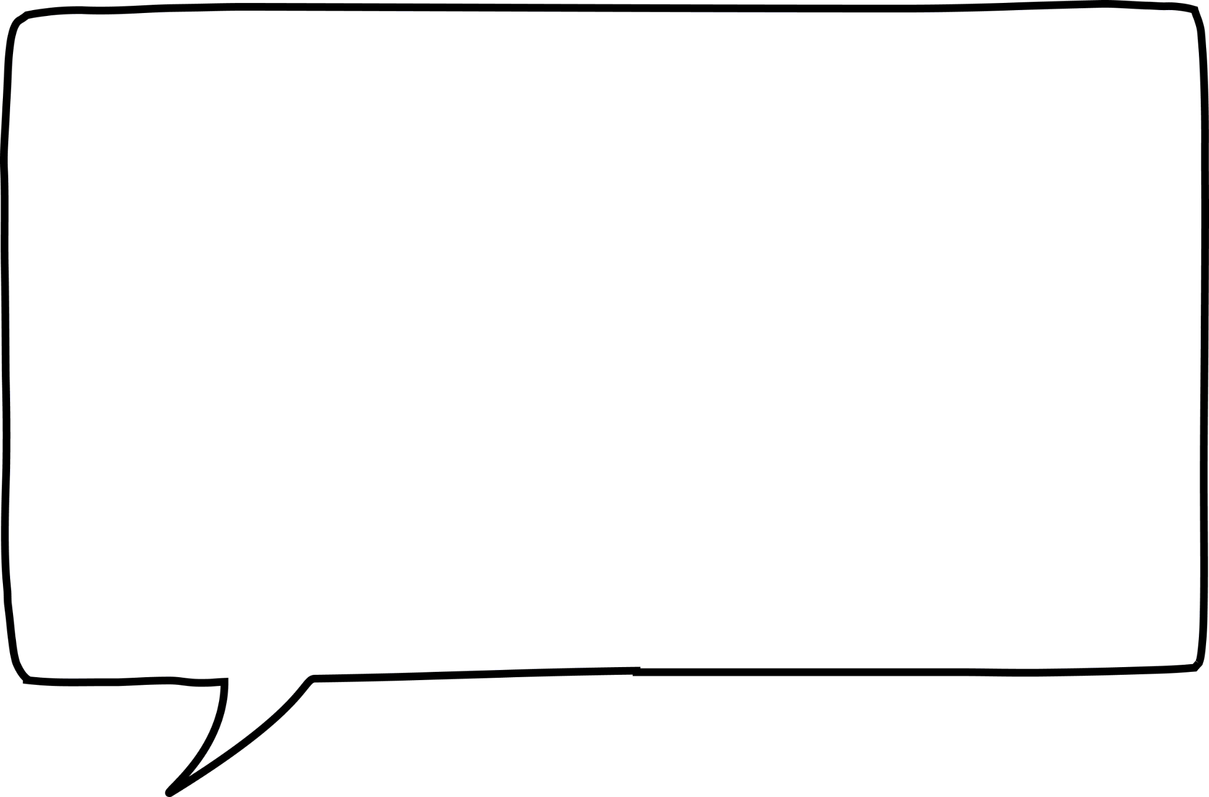
Hubinta isku-xidhnaanta (congruence) iyo isku-ekaanta (similarity)
Miis (table) ayaa loo isticmaali karaa in lagu hubiyo in laba qaab ay leeyihiin isku xaglo isku nidaam ah.
Laakiin markaa xaglaha kale isma eka.
100°
100°
100°
80°
Qaabka A wuxuu leeyahay xaglo isku xiga oo isku mid ah, laakiin qaabka B ma laha.
A
B
80°
80°
80°
100°
qaab A xaglaha
qaab B xaglaha
100°
100°
80°
80°
80°
100°
80°
100°
Xagluhu waa isku mid, laakiin isku hanaan ma aha. Sidaas darteed qaababku ma aha kuwo isku mid ah (congruent) iyo kuwo isku ekaansho (similar) ah midna.
Cali

Slide 25
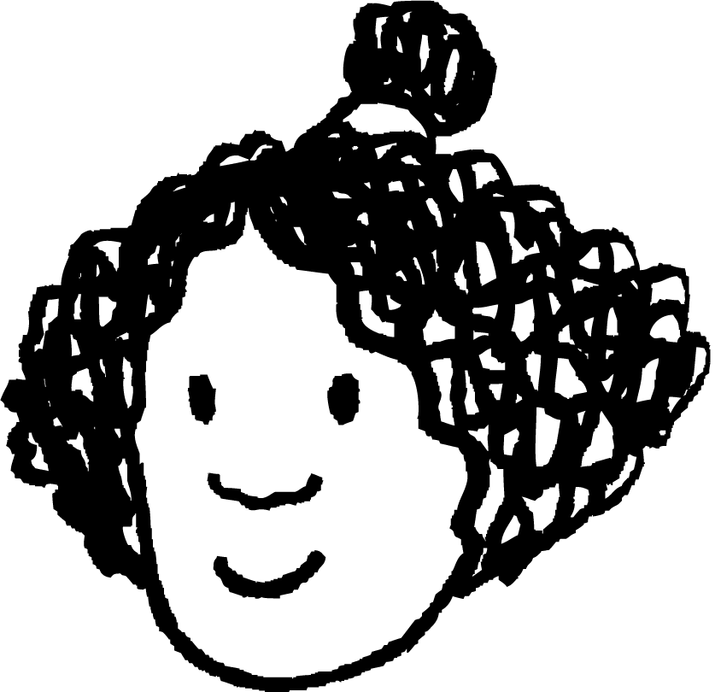
Hubinta isku ekaanshaha (similarity) iyo isku midnimada (congruence)
Miis (table) ayaa loo isticmaali karaa in lagu hubiyo in laba qaab ay leeyihiin xaglo isku mid ah oo isku hanaan ah.
Halkan waxaa ah laba xagal oo isku xiga oo 100° ah.
100°
100°
80°
80°
B
Waxaan ku dari karaa kuwan miiska marka hore, ka dibna buuxin karaa inta kale.
A
80°
80°
100°
100°
xagasha qaabka A
xagasha qaabka B
100°
100°
80°
80°
100°
100°
Isra

Slide 26
Hubinta isku ekaanshaha (similarity) iyo isku midnimada (congruence)
Miis (table) ayaa loo isticmaali karaa in lagu hubiyo in laba qaab ay leeyihiin xaglo isku mid ah oo isku hanaan ah.
100°
100°
80°
80°
B
Waxaan ku buuxin karaa miiska si ay dhammaan xagluhu isu qabtaan.
A
80°
80°
100°
100°
xagasha qaabka A
xagasha qaabka B
100°
100°
80°
80°
100°
100°
80°
80°
Qaababku waxay leeyihiin xaglo isku mid ah oo isku hanaan ah, sidaas darteed waxay noqon karaan kuwo isku mid ah (congruent) ama isku ekaansho (similar) ah.
Isra

Slide 27
Hubinta isku ekaanshaha (similarity) iyo isku midnimada (congruence)
Miis (table) ayaa loo isticmaali karaa in lagu hubiyo in laba qaab ay leeyihiin xaglo isku mid ah oo isku hanaan ah.
100°
100°
80°
80°
Waxaan u baahanahay inaan ogaado dhererka qaar ka hor intaan go'aamin karin inay yihiin kuwa isku mid ah (congruent) ama isku eeg (similar).
B
A
80°
80°
100°
100°
xagasha qaabka A
xagasha qaabka B
100°
100°
80°
80°
100°
100°
80°
80°
Qaababku waxay leeyihiin xaglaha isku midka ah isku hagaag, marka waxay noqon karaan kuwa isku mid ah (congruent) ama isku eeg (similar).
Isra

Slide 28
Hubinta isku eegnaanta (similarity) iyo isku midnimada (congruence)
Miis ayaa loo isticmaali karaa in lagu hubiyo xiriirka isku dhufashada (multiplicative) ee u dhexeeya dhererka.
6 m
10 m
100°
100°
80°
80°
Cidhifka u dhexeeya labada xagal ee 100° waa 6m.
8 m
8 m
B
A
8 m
8 m
Waxaan ka buuxin karaa inta ka hartay miiska si la mid ah.
80°
80°
100°
100°
10 m
6 m
xaglaha (angles)
100°
100°
80°
80°
dhererka qaabka A (m)
dhererka qaabka B (m)
10
6
8
8
Isra

Slide 29
Hubinta isku eegnaanta (similarity) iyo isku midnimada (congruence)
Miis ayaa loo isticmaali karaa in lagu hubiyo xiriirka isku dhufashada (multiplicative) ee u dhexeeya dhererka.
6 m
10 m
100°
100°
80°
80°
Cidhifka u dhexeeya labadan xagal ee 100° sidoo kale waa 6m.
8 m
8 m
B
A
8 m
8 m
Waxaan ka buuxin karaa inta ka hartay miiska si la mid ah.
80°
80°
100°
100°
10 m
6 m
xaglaha (angles)
100°
100°
80°
80°
dhererka qaabka A (m)
dhererka qaabka B (m)
10
6
8
8
Isra
6
8
10
8

Slide 30
Hubinta isku eegnaanta (similarity) iyo isku midnimada (congruence)
Miis ayaa loo isticmaali karaa in lagu hubiyo xiriirka isku dhufashada (multiplicative) ee u dhexeeya dhererka.
6 m
10 m
100°
100°
80°
80°
8 m
8 m
B
Dhererka (lengths) waa isku mid labada qaab.
A
8 m
8 m
80°
80°
100°
100°
Marka waa isku qaab (congruent).
10 m
6 m
xaglaha (angles)
100°
100°
80°
80°
dhererka qaabka A (m)
shape B dhererka (lengths) (m)
8
10
8
6
× 1
× 1
× 1
× 1
Isra
6
8
10
8

Slide 31
Hubinta isku ekaanshaha (similarity) iyo isku qaabnimo (congruence)
Shax (table) ayaa loo isticmaali karaa in lagu hubiyo xiriirka isku dhufashada (multiplicative) ee dhererka (lengths).
10 m
Xaaladdan, dhammaan dhererka (lengths) ee shape B waa labanlaab dhererka (lengths) u dhigma ee shape A.
3 m
80°
80°
100°
100°
B
4 m
4 m
A
8 m
8 m
80°
80°
100°
100°
Marka waa isku ekaansho (similar).
5 m
6 m
xaglaha (angles)
100°
100°
80°
80°
shape A dhererka (lengths) (m)
shape B dhererka (lengths) (m)
4
5
4
3
× 2
× 2
× 2
× 2
Isra
6
8
10
8

Slide 32
Hubinta isku ekaanshaha (similarity) iyo isku qaabnimo (congruence)
Waa maxay qiimaha (value) x?
8 m
61°
6 m
138°
xaglaha (angles) | 138° | 61° | 87° | 74°
10 m
dhererka (lengths) (m)
10
x
8
9
6
74°
87°
x = 9
9 m

Slide 33
Hubinta isku ekaanshaha (similarity) iyo isku qaabnimo (congruence)
Qaababka A iyo B waa .
Buuxi meesha bannaan.
xaglaha (angles) | 138° | 61° | 87° | 74°
isku qaab (congruent)
dhererka qaabka A (m) | 8 | 10 | 9 | 6
dhererka qaabka B (m) | 24 | 30 | 27 | 18
isku ekaansho (similar)
midna isku mid (congruent) mana eka (similar)

Slide 34
Hubinta isku midnimada (congruence) iyo isku ekaanshaha (similarity)
Qaababka A iyo B waa .
Buuxi meesha bannaan.
xaglaha (angles) | 138° | 61° | 87° | 74°
isku mid (congruent)
dhererka qaabka A (m) | 8 | 10 | 9 | 6
dhererka qaabka B (m) | 8 | 10 | 9 | 6
isku eka (similar)
midna isku mid (congruent) mana eka (similar)

Slide 35
Hubinta isku midnimada (congruence) iyo isku ekaanshaha (similarity)
1) a ) Buuxi shaxda qaababka B iyo C, isku habee xaglaha haddii aad karto.
72°
xaglaha qaabka A (angles) | 116° | 127° | 72° | 135° | 90°
xaglaha qaabka B (angles)
xaglaha qaabka C (angles)
135°
B
127°
116°
b) Qaabkee ayaan la mid ahayn (congruent) mana eka (similar) Qaabka A?
116°
135°
c) Ma suurtagal tahay in la go'aamiyo isku midnimada (congruence) qaabka kale? Sharh jawaabtaada.
C
72°
127°

Slide 36
Hubinta isku midnimada (congruence) iyo isku ekaanshaha (similarity)
2) a ) Buuxi shaxda qaabka B.
4 m
xaglaha (angles) | 42° | 109° | 119° | 90°
119°
8 m
shape A dhererka (m) | 6 | 4 | 2 | 8
shape B dhererka (m)
16 m
B
109°
b) Ma waa isku mid (congruent), isku eeg (similar) ama midna? Caddee jawaabtaada.
12 m
42°

Slide 37
Hubinta isku ekaanshaha (similarity) iyo isku midnimada (congruence)
1) a ) Buuxi jaantuska (table) ee shapes B iyo C, isku eeg xaglaha (angles) haddii aad karto.
72°
shape A xaglaha (angles) | 116° | 127° | 72° | 135° | 90°
shape B xaglaha (angles)
shape C xaglaha (angles)
135°
116°
127°
72°
135°
90°
B
127°
90°
127°
72°
135°
116°
116°
b) Waa kee shape aan isku eegnayn (similar) ama isku mid ahayn (congruent) Shape A?
shape C
116°
135°
c) Ma suurtagal tahay in la go'aamiyo isku midnimada (congruence) ee shape kale? Sharax jawaabtaada.
C
Maya. Isku midnimada (congruence) lama go'aamin karo iyada oo aan la hubin in dhererka (lengths) isku mid yihiin.
72°
127°

Slide 38
Hubinta isku ekaanshaha (similarity) iyo isku midnimada (congruence)
2) a ) Buuxi jaantuska (table) ee shape B.
4 m
xaglaha (angles) | 42° | 109° | 119° | 90°
119°
8 m
shape A dhererka (m) | 6 | 4 | 2 | 8
shape B dhererka (m)
16 m
B
109°
12
8
4
16
b) Ma waa isku mid (congruent), isku eeg (similar) ama midna? Caddee jawaabtaada.
12 m
42°
Shape B wuxuu la mid yahay (similar) shape A. Waxay leeyihiin xaglaha (angles) isku mid ah iyo dhererka (lengths) ee shape B waa laba jibaar dhererka shape A.
Shape B waa weyneyn (enlargement) ee shape A oo leh qiyaasta (scale factor) 2.

Slide 39
Isku qaab (congruent) ama isku mid (similar) ama midna
Haddii laba shape ay yihiin isku mid (congruent), markaas sidoo kale waa isku eeg (similar).
Haddii laba qaab (shape) ay isku mid (similar) yihiin, macneheedu ma aha inay isku qaab (congruent) yihiin.
Qaababka isku qaab (congruent) waxay leeyihiin cufnaan (scale factor) ah 1.
Miiska saamiga (ratio table) wuxuu noqon karaa qalab waxtar leh oo lagu hubiyo tiro-ku-dhufashada (multipliers).
Xiriirka tiro-ku-dhufashada (multiplicative relationship) ee u dhexeeya dhinacyada shayga (object) waa la ilaaliyaa sawirkiisa (image) marka la eego qaababka isku mid (similar) iyo isku qaab (congruent).

