Slide 1
Saddexagalyo isku mid ah (ASA iyo AAS)
Sifooyin joomatari: isku ekaansho iyo aragtida Pythagoras

Slide 2
sida loo isticmaalo darasyada Oak

Slide 3
Waxaan qiimeyn karaa oo isticmaali karaa shuruudaha saddexagalka isku midka ah (ASA iyo AAS).

Slide 4
Haddii qaab uu si sax ah ugu habboonaado qaab kale iyadoo la isticmaalayo wareeg, milicsi, ama turjumaad, markaas qaababku waa isku mid.

Slide 5

Saddexagalyo isku mid ah (ASA iyo AAS)
Dhisidda saddexagalyo
Caddaynta isku ekaanshaha ASA/AAS

Slide 6
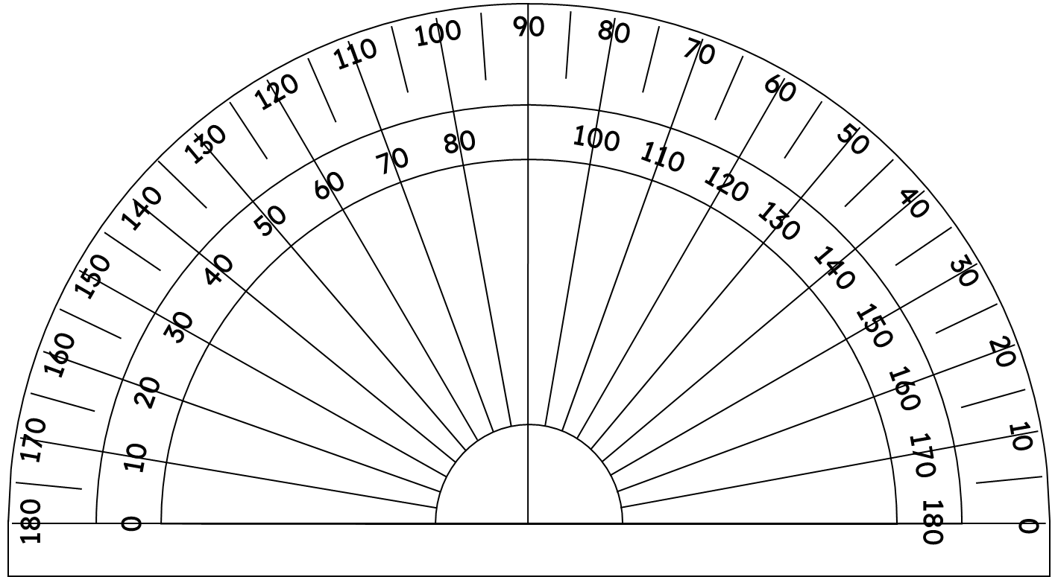
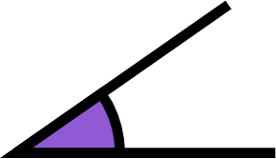
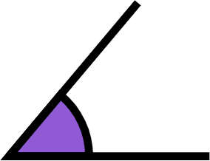
Dhisidda saddexagalyo
Haddii aan rabno in aan dhisno saddexagal leh xagal 50° iyo xagal 35°, sidee ku samayn karnaa?
Waxaan abuuri karnaa labada xagal iyadoo la isticmaalayo protractor.
35°
50°

Slide 7
Dhisidda saddexagalyo
Haddii aan rabno in aan dhisno saddexagal leh xagal 50° iyo xagal 35°, sidee ku samayn karnaa?
Lugaha xagalka, waa shucaacyo ka soo baxa meesha vertex.
35°
50°

Slide 8
Dhisidda saddexagalyo
Haddii aan rabno in aan dhisno saddexagal leh xagal 50° iyo xagal 35°, sidee ku samayn karnaa?
Adigoo safaya mid ka mid ah shucaacyada xagal kasta, tani waxay samaysaa dhinac saddexagalka.
Shucaacyada kale, waxay isku gooyaan vertex saddexaad.
35°
50°
35°

Slide 9
Dhisidda saddexagalyo
Haddii aan rabno in aan dhisno saddexagal leh xagal 50° iyo xagal 35°, sidee ku samayn karnaa?
Saddexagal kala duwan ayaa la samayn karaa adigoo dhaqaajinaya labada xagal midba midka kale ka fog ama isku dhow.
50°
35°
35°
35°

Slide 10
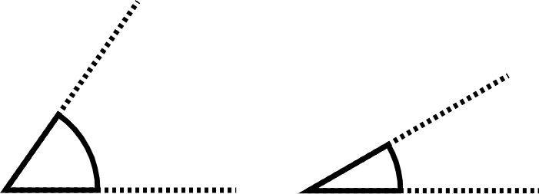
Dhisidda saddexagalka
Immisa saddexagal oo kala duwan ayaa la abuuri karaa iyadoo la isticmaalayo labadan xagal?
55°
30°
tiro aan dhammaad lahayn

Slide 11
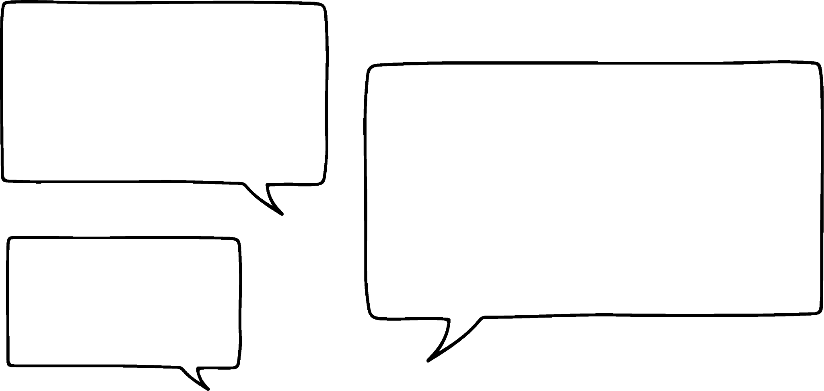


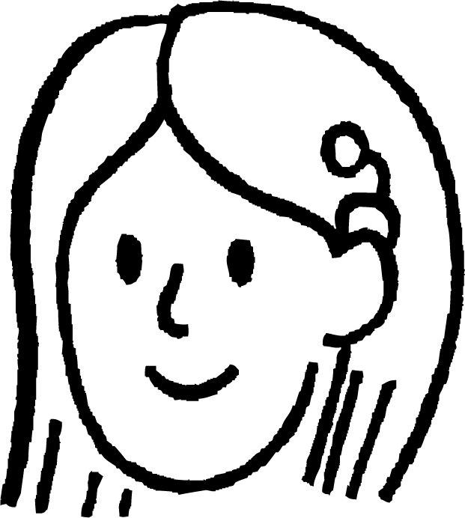



Dhisidda saddexagalka
Haddii dhererka dhinaca u dhexeeya labada gees (vertices) la ogaado, kaliya hal saddexagal ayaa la dhisi doonaa.
Tusaale, dhinaca u dhexeeya labada xagal 50° iyo 35° waa 6 cm.
Miyayna muhiim ahayn dhinaca xagluhu ku yaalliin?
Maya, waxay noqon lahayd milicsi (reflection) saddexagalkan.
50°
Suad
35°
6 cm
Layla

Slide 12
Dhisidda saddexagalka
Saddexagal ayaa la dhisi karaa, haddii aan ognahay xaglaha dhinaca kasta ee dhererka dhinaca la yaqaan.
Dhis saddexagal MNO, halkaasoo MN = 7 cm, ∠OMN = 72° iyo ∠ONM = 43°.
O
72°
43°
M
7 cm
N

Slide 13


Dhisidda saddexagalka
Nuur wuxuu isku dayay inuu dhiso saddexagal PQR, halkaasoo PQ = 9 cm, ∠RPQ = 135° iyo ∠RQP = 20°.
R
Ma samaysmin saddexagal.
135°
20°
P
9 cm
Q
Maxaa khalad ah oo Nuur sameeyay?
Wuxuu u baahan yahay inuu kordhiyo khadadka shucaaca (ray lines), si ay isu gooyaan si loo helo R.

Slide 14
Dhisidda saddexagalka
O
Ma la dhisi karaa saddexagal, haddii aan ognahay dhererka gees iyo laba xagal oo aan ku yaallayn cidhifyada xariiqdaas AAS?
35°
O
🖇 Hagaajinta labada xagal
O
35°
35°
50°
M
6 cm
N

Slide 15
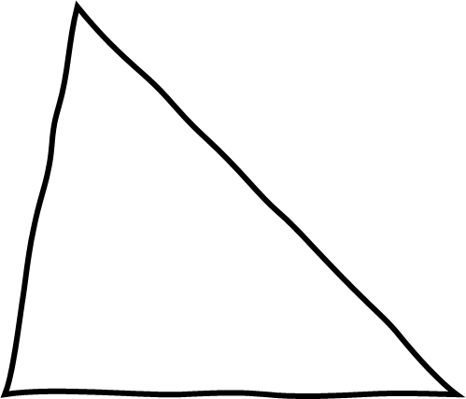
Dhismaha saddexagallada
Ma la dhisi karaa saddexagal, haddii aan ognahay AAS?
Haa, waayo waxaan xisaabin karnaa xagasha saddexaad.
Tusaale ahaan: Dhis saddexagal MNO, halkaasoo MN = 7 cm, ∠MON = 70° iyo ∠ONM = 45°.
qoraal
∠OMN = 180 - (70 + 45) = 180 - 115 = 65°
O
70°
Hadda, waxaan dhisi karnaa, iyadoo la adeegsanayo 7 cm, 65° iyo 45° xagasha.
65°
45°
N
M
7 cm

Slide 16

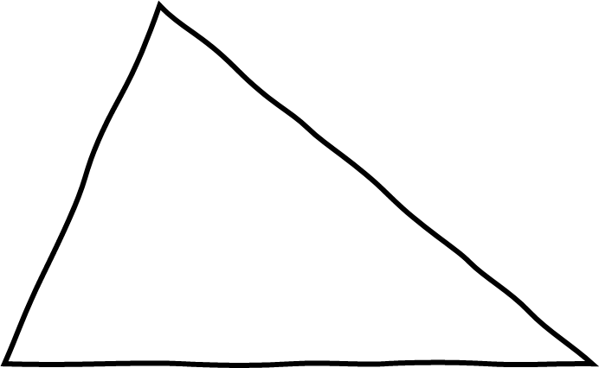
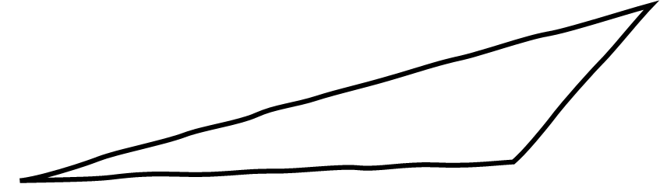

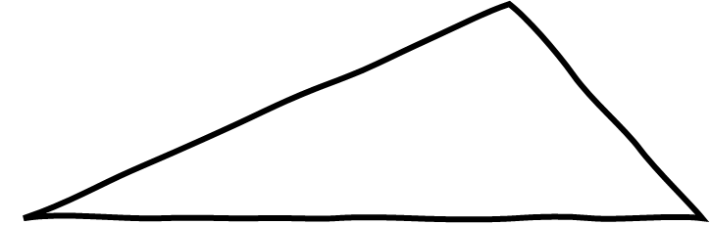
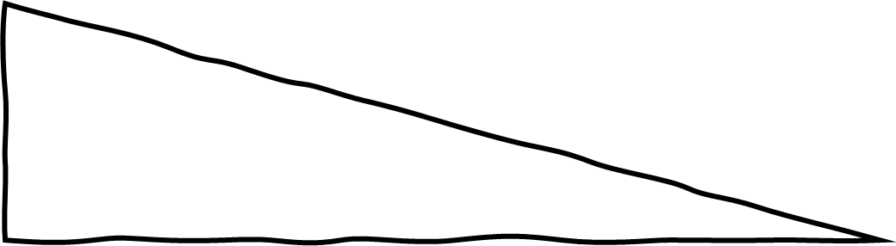
Dhismaha saddexagallada
Kee ka mid ah qoraalladan ayaa leh macluumaad ku filan si loo dhisi karo?
a
b
133°
72°
59°
9.2 cm
7 cm
87 mm
c
d
80°
90°
27°

Slide 17
Dhismaha saddexagallada
1) Dhis saddexagallada soo socda:
a) Saddexagal ABC, halkaasoo AB = 7.5 cm, ∠CAB = 54° iyo ∠ABC = 47°
b) Saddexagal DEF, halkaasoo ∠DEF = 67°, ∠EFD = 25° iyo EF = 8.2 cm
c) Saddexagal GHI, halkaasoo GH = 7.1 cm, ∠GHI = 113° iyo ∠HIG = 42°
d) Saddexagal JKL, halkaasoo ∠JKL = 38°, JL = 5.6 cm iyo KJ = KL

Slide 18
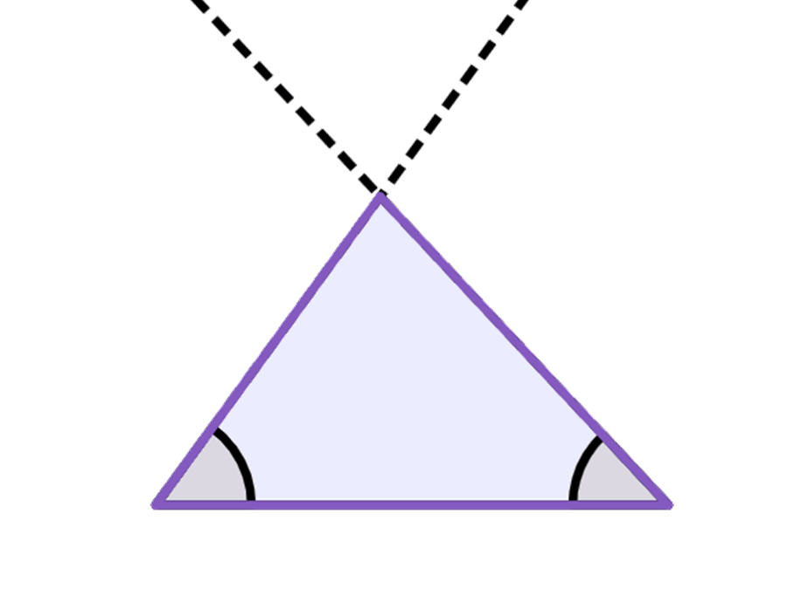
Dhisidda saddex-xagallada
1) Dhis saddexagallada soo socda:
a) Saddex-xagal ABC, halka AB = 7.5 cm, ∠CAB = 54° iyo ∠ABC = 47°
C
Haddii aad qiyaasto ∠ACB waa inay noqotaa 79° iyo BC waa inay noqotaa 6.2 cm
54°
47°
A
B
7.5 cm

Slide 19
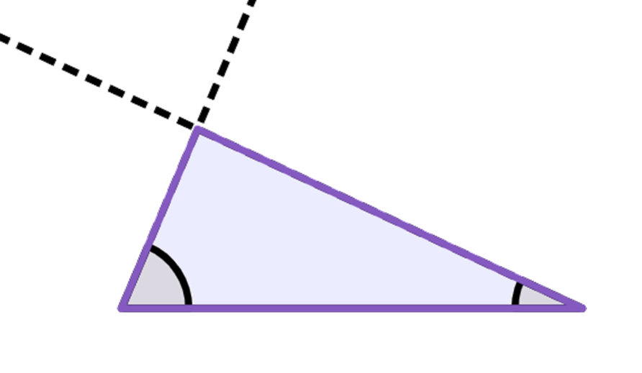
Dhisidda saddex-xagallada
1) Dhis saddex-xagalladan soo socda:
b) Saddex-xagal DEF, halka ∠DEF = 67°, ∠EFD = 25° iyo EF = 8.2 cm
Haddii aad qiyaasto ∠EDF waa inay noqotaa 88° iyo DE waa inay noqotaa 3.5 cm
D
67°
25°
E
F
8.2 cm

Slide 20
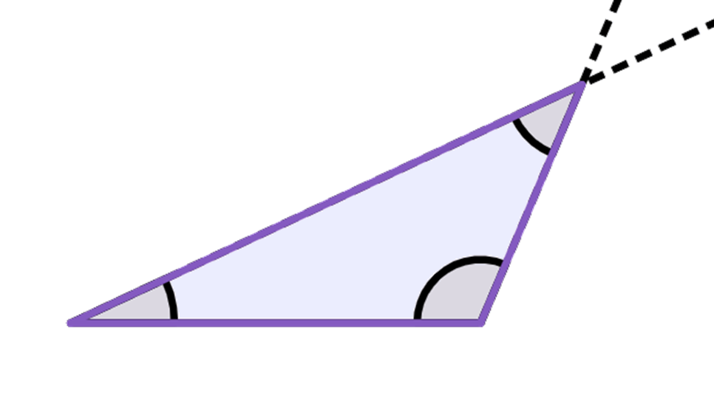
Dhisidda saddex-xagallada
1) Dhis saddex-xagalladan soo socda:
c) Saddex-xagal GHI, halka GH = 7.1 cm, ∠GHI = 113° iyo ∠HIG = 42°
I
Haddii aad qiyaasto GI waa inay noqotaa 9.8 cm iyo HI waa inay noqotaa 4.5 cm
42°
113°
25°
G
H
7.1 cm

Slide 21
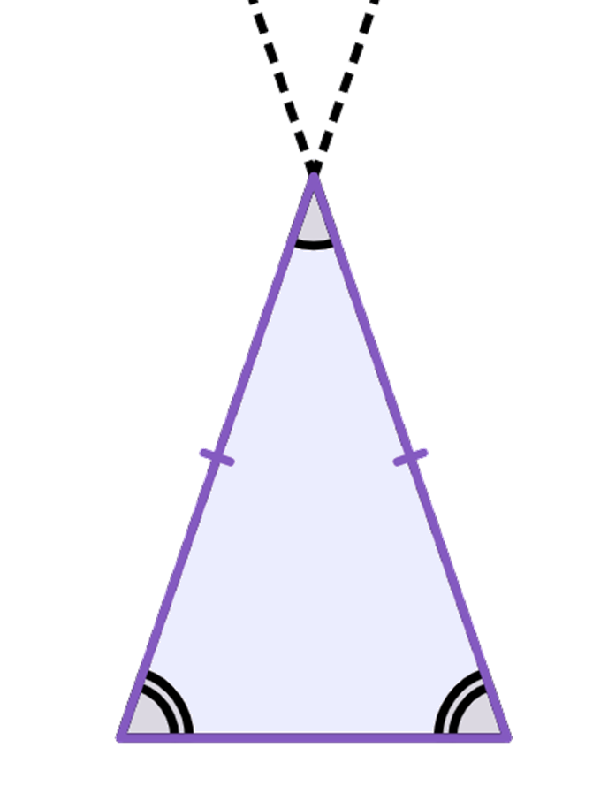
Dhisidda saddex-xagallada
1) Dhis saddex-xagalladan soo socda:
d) Saddex-xagal JKL, halka ∠JKL = 38°, JL = 5.6 cm iyo KJ = KL
K
Haddii aad qiyaasto KJ iyo KL labaduba waa inay noqdaan 8.6 cm
38°
71°
J
L
5.6 cm

Slide 22
Saddex-xagallada isku-xidhan (Congruent triangles) (ASA iyo AAS)
Dhisidda saddex-xagallada
Cadeynta isku-xidhnaanta (congruence) iyadoo la adeegsanayo ASA/AAS

Slide 23
Cadeynta isku midnimada (congruence) iyadoo la adeegsanayo ASA/AAS
Laba saddexagal ayaa la tusi karaa inay isku mid yihiin (congruent) haddii dhammaan geesaha u dhigma ay isku mid yihiin.
Saddexda gees ee saddexagalka, waxay go'aamiyaan xaglaha gudaha sidoo kale.
A
b
b
× k
c
c
× k
kc
kb
B
a
C
a
× k
Ka soo horjeedka ma aha run. Saddexda xagal kuma go'aamiyaan dhererka geesaha.
ka
Weyneyn (Enlargement) waxay yeelan doonaan xaglaha isku midka ah.

Slide 24
Cadeynta isku midnimada (congruence) iyadoo la adeegsanayo ASA/AAS
Si loo hubiyo in saddexagallada aysan kaliya isku mid ahayn (similar), ugu yaraan hal dherer oo gees ah ayaa loo baahan yahay.
A
b
b
c
c
c
B
a
B
a
C
a
Marka laba gees iyo xagasha u dhaxaysa la ogaado, geeska saddexaad waa go'an, taas oo go'aamisa labada xagal ee kale.

Slide 25
Cadeynta isku midnimada (congruence) iyadoo la adeegsanayo ASA/AAS
Si loo hubiyo in saddexagallada aysan kaliya isku mid ahayn (similar), ugu yaraan hal dherer oo gees ah ayaa loo baahan yahay.
A
b
b
c
c
c
B
a
B
a
C
a
Haddii aad taqaan hal dherer oo gees ah, cabbirku waa go'an, iyo adigoo taqaan laba xagal, dhab ahaantii waxaad taqaan dhammaan saddexda.
ama
a
a

Slide 26
Cadeynta isku midnimada (congruence) iyadoo la adeegsanayo ASA/AAS
Si aad u caddeyso in laba saddexagal ay isku mid yihiin (congruent), waa inaad taqaan ugu yaraan hal xagal oo u dhigma.
Ogaanshaha dhammaan saddexda gees ayaa ku filan in lagu caddeeyo in laba saddexagal ay isku mid yihiin (congruent).
Ogaanshaha hal xagal mar walba kumau oggolaanayo inaad xisaabiso labada kale.

Slide 27
Cadaynta isku-simenaanta (congruence) iyadoo la adeegsanayo ASA/AAS
Haddii aan ognahay hal dherer oo gees ah iyo laba xagal oo gudaha ah, markaas waxaan caddeyn karnaa in laba saddexagal ay isku mid yihiin (congruent).
Caddee in saddexagalka ABC uu isku mid yahay (congruent) saddexagalka DEF iyadoo la adeegsanayo ASA/AAS.
F
A
9.2 cm
99°
99°
17°
D
17°
C
E
B
9.2 cm
BC = EF = 9.2 cm, ∠ABC = ∠DFE = 99° iyo ∠ACB = ∠DEF = 17°, marka saddex-xagal (triangle) ABC wuxuu la siman yahay (congruent) saddex-xagal (triangle) DEF iyadoo la adeegsanayo ASA.

Slide 28
Cadaynta isku-simenaanta (congruence) iyadoo la adeegsanayo ASA/AAS
Haddii aan ognahay hal dhinac (side length) iyo laba xagal gudaha (interior angles), markaas waxaan caddayn karnaa in labada saddex-xagal (triangles) ay isku siman yihiin (congruent).
Cadday saddex-xagal (triangle) QPR inuu la siman yahay (congruent) saddex-xagal (triangle) TUV iyadoo la adeegsanayo ASA/AAS.
Q
V
T
97°
38°
97°
38°
P
R
7.1 cm
45°
7.1 cm
U
∠TVU = 180 - (97 + 45) = 180 - 142 = 38°,
PR = UV = 7.1 cm, ∠PQR = ∠UTV = 97° iyo ∠QPR = ∠TVU = 38°, saddex-xagal (triangle) QPR wuxuu la siman yahay (congruent) saddex-xagal (triangle) TUV iyadoo la adeegsanayo AAS.

Slide 29
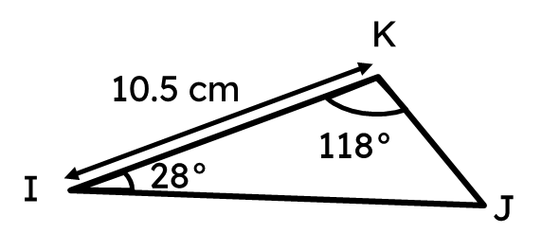
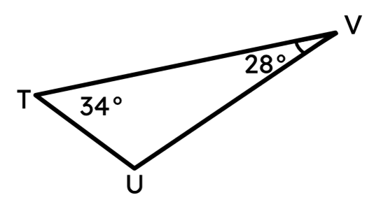
Cadaynta isku-simenaanta (congruence) iyadoo la adeegsanayo ASA/AAS
Saddex-xagal (triangle) IJK iyo saddex-xagal (triangle) TUV waxay isku siman yihiin (congruent) iyadoo la adeegsanayo AAS.
Cidhifkee (edge) ayaa u dhigma (corresponds) IK?
UV

Slide 30
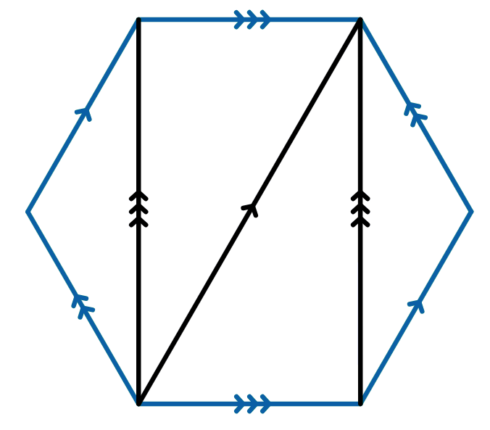


Cadaynta isku-simenaanta (congruence) iyadoo la adeegsanayo ASA/AAS
Qaabab badan (shapes) waxay leeyihiin sifooyin (properties) aan u isticmaali karno si aan u caddayno saddex-xagallo (triangles) isku siman (congruent) oo ku dhex jira.
Halkan waxaa ah lix-geesle joogto ah (regular hexagon) ABCDEF, oo leh saddex geesood (diagonals) oo la sawiray. Saddex-xagallo (triangles) tee ayaa isku siman (congruent) midba midka kale?
A
F
∠ABC = ∠DEF (= 120°) sababtoo ah waa xaglo gudaha (interior angles) oo lix-geesle joogto ah (regular hexagon).
AB = DE sababtoo ah waa cidhifyo (edges) lix-geesle joogto ah (regular hexagon).
B
E
∠BAC = ∠ACF = ∠CFD = ∠FDE sababtoo ah waa xaglo beddel ah oo gudaha (interior alternate angles) oo ku yaal khadadka barbar socda (parallel lines).
C
D
Sidaa darteed, ABC iyo DEF waxay isku siman yihiin (congruent) iyadoo la adeegsanayo ASA.

Slide 31
Caddaynta isku midnimada (congruence) iyadoo la adeegsanayo ASA/AAS
Qaabab badan waxay leeyihiin sifooyin aan u isticmaali karno si aan u caddeyno saddexagallo isku mid ah (congruent triangles) oo ku jira iyaga.
Waa kan laba-geesoodka (hexagon) caadiga ah ABCDEF, oo leh saddex geesood (diagonals) oo la sawiray. Saddexagallooyinka kee baa isku mid ah (congruent)?
A
F
∠AFC = ∠FCD maadaama ay yihiin xaglaha beddelka ah ee gudaha ee xariijimaha isbarbar socda.
∠ACF = ∠CFD maadaama ay yihiin xaglaha beddelka ah ee gudaha ee xariijimaha isbarbar socda.
B
E
AF = CD maadaama ay yihiin geesaha laba-geesoodka caadiga ah.
C
D
Sidaa darteed, AFC iyo FCD waxay isku siman yihiin (congruent) iyadoo la adeegsanayo AAS.

Slide 32
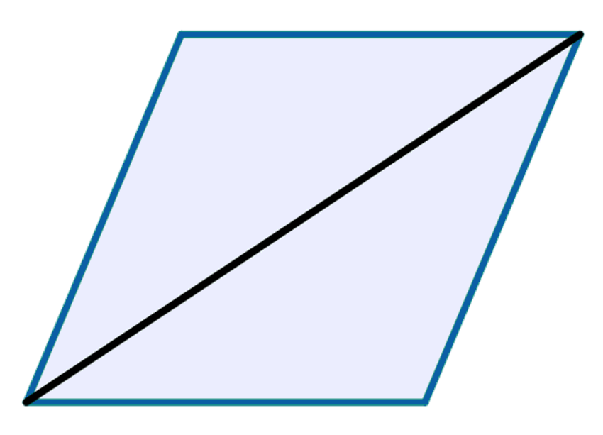
Caddaynta isku midnimada (congruence) iyadoo la adeegsanayo ASA/AAS
Dhammeystir caddaynta in saddexagalka ABD iyo saddexagalka BCD ay yihiin kuwa isku mid ah (congruent) iyadoo la adeegsanayo AAS/ASA. Haddii ABCD ay tahay rhombus.
iska soo horjeeda
A
D
∠DAB = ∠BCD maadaama ay yihiin
xaglaha rhombus.
BDC
∠ABD = ∠BDC maadaama ay yihiin xaglaha beddelka ah ee gudaha ee xariijimaha isbarbar socda.
B
C
AB = DC maadaama ay yihiin geesaha rhombus.
Sidaas darteed, ABD iyo BCD waa kuwo isku mid ah (congruent) iyadoo la adeegsanayo ASA.

Slide 33
Caddaynta isku midnimada (congruence) iyadoo la adeegsanayo ASA/AAS
1) Caddee in labada saddexagal ee kasta ay yihiin kuwa isku mid ah (congruent) iyadoo la adeegsanayo ASA/AAS.
a)
A
D
F
4.5 cm
71°
91°
91°
71°
4.5 cm
B
C
E
b)
G
J
L
34°
74°
H
34°
29 mm
29 mm
72°
I
K

Slide 34
Justifying congruence by ASA/AAS
2) Maxay labadan saddexagal aan ugu ekaan (congruent) ASA?
A
D
4.3 cm
4.3 cm
80°
47°
80°
47°
E
B
C
F
3) Haddii ABCD ay tahay parallelogram, caddee in saddexagalka ABC uu yahay mid isku mid ah (congruent) saddexagalka ACD iyadoo la adeegsanayo ASA ama AAS.

Slide 35
Justifying congruence by ASA/AAS
4) Dhibic E waa bartamaha AC iyo BD. Caddee in saddexagalka AEB uu la ekaado (congruent) saddexagalka ECD iyadoo la adeegsanayo ASA/AAS.
D
A
E
C
B

Slide 36
Justifying congruence by ASA/AAS
1) Caddee labada saddexagal ee la ekaado (congruent) iyadoo la adeegsanayo ASA/AAS.
a)
A
D
F
4.5 cm
71°
91°
91°
71°
4.5 cm
B
C
E
AC iyo EF waa geesaha u dhigma oo isku eg, ∠BAC = ∠DEF iyo ∠ABC = ∠EDF.
Hence, congruent by AAS.

Slide 37
Justifying congruence by ASA/AAS
1) Caddee labada saddexagal ee la ekaado (congruent) iyadoo la adeegsanayo ASA/AAS.
b)
G
J
L
34°
74°
H
34°
29 mm
29 mm
72°
I
K
∠GIH = 180 - (34 + 74) = 72° and ∠KJL = 180 - (34 + 72) = 74°
GI iyo JK waa geesaha u dhigma oo isku eg, ∠HGI = ∠KJL iyo ∠GIH = ∠JKL.
Hence, congruent by ASA.

Slide 38
Caddaynta isku ekaanshaha (congruence) ASA/AAS
2) Maxay labadan saddexagal aan ugu ekaan (congruent) ASA?
A
D
4.3 cm
4.3 cm
80°
47°
80°
47°
E
B
C
F
In kastoo, saddexda xagal gudaha ee labada saddexagal ay isku mid yihiin. Labada cidhif ee 4.3 cm ma aha cidhifyada u dhigma ee saddexagallada.

Slide 39
Caddaynta isku ekaanshaha (congruence) ASA/AAS
3) Marka la eego saddexagal-barbarro ABCD, caddee in saddexagalka ABC uu la mid yahay saddexagalka ACD iyadoo la adeegsanayo ASA/AAS.
A
D
∠DAC = ∠ACB maadaama ay yihiin xaglo gudaha oo isku beddelaya oo isku mid ah.
AC waa dhinac wadaag ah.
B
C
∠DCA = ∠BAC maadaama ay yihiin xaglo gudaha oo isku beddelaya oo isku mid ah.
Sidaas darteed, saddexagalka ABC wuxuu la mid yahay saddexagalka ACD iyadoo la adeegsanayo ASA.

Slide 40
Caddaynta isku ekaanshaha (congruence) ASA/AAS
3) Marka la eego saddexagal-barbarro ABCD, caddee in saddexagalka ABC uu la mid yahay saddexagalka ACD iyadoo la adeegsanayo ASA/AAS.
A
D
AD = BC maadaama ay yihiin dhinacyo iska soo horjeeda ee saddexagal-barbarro.
∠DAC = ∠ACB maadaama ay yihiin xaglo gudaha oo isku beddelaya oo isku mid ah.
B
C
∠DCA = ∠BAC maadaama ay yihiin xaglo gudaha oo isku beddelaya oo isku mid ah.
Sidaas darteed, saddexagalka ABC wuxuu la mid yahay saddexagalka ACD iyadoo la adeegsanayo AAS.

Slide 41
Caddaynta isku ekaanshaha (congruence) ASA/AAS
4) Dhibicda E waa bartamaha AC iyo BD. Caddee in saddexagalka AEB uu la mid yahay saddexagalka ECD iyadoo la adeegsanayo ASA/AAS.
D
DE = EB, maadaama E ay tahay bartamaha BD.
A
∠AEB = ∠DEC maadaama ay yihiin xaglo toos u kala horjeeda.
E
∠ABE = ∠EDC, maadaama ay yihiin xaglo gudaha oo isku beddelaya oo isku mid ah.
C
B
Sidaas darteed, saddexagalka AEB wuxuu la mid yahay saddexagalka ECD iyadoo la adeegsanayo ASA.

Slide 42
Saddax-xagal isku mid ah (ASA iyo AAS)
Laba saddexagal ayaa la caddayn karaa inay isku mid yihiin haddii laba xagal oo u dhigma iyo dhinac u dhigma la ogaado inay isku mid yihiin.
Haddii dhinaca u dhigma uu dhexeeyo labada xagal ee la yaqaan, waxaan dhahnaa waxay isku mid yihiin ASA (xagal-dhinac-xagal).
Haddii dhinaca u dhigma uusan u dhexayn labada xagal ee la yaqaan, waxaynu niraahnaa waa isku mid (congruent) AAS (xagal-xagal-dhinac).

