Slide 1
Saddexagallo isku mid ah (RHS)
Sifooyin joomatari: isku ekaansho iyo aragtida Pythagoras

Slide 2
sida loo isticmaalo darasyada Oak

Slide 3
Waxaan qiimeyn karaa oo isticmaali karaa shuruudaha ay saddexagalladu isku mid ku yihiin (RHS).

Slide 4
Saddexagal qumman wuxuu leeyahay hal xagal gudaha ah oo 90° ah.
Haddii qaab uu si sax ah ugu habboonaado korka qaab kale iyadoo la isticmaalayo wareeg, milicsi ama turjumaad, markaas qaababku waa isku mid.

Slide 5
Hypotenuse waa dhinaca saddexagalka qumman ee ka soo horjeeda xagasha qumman.

Slide 6

Saddexagallo isku mid ah (RHS)
Helista xagasha qumman
Caddaynta isku midnimada RHS

Slide 7
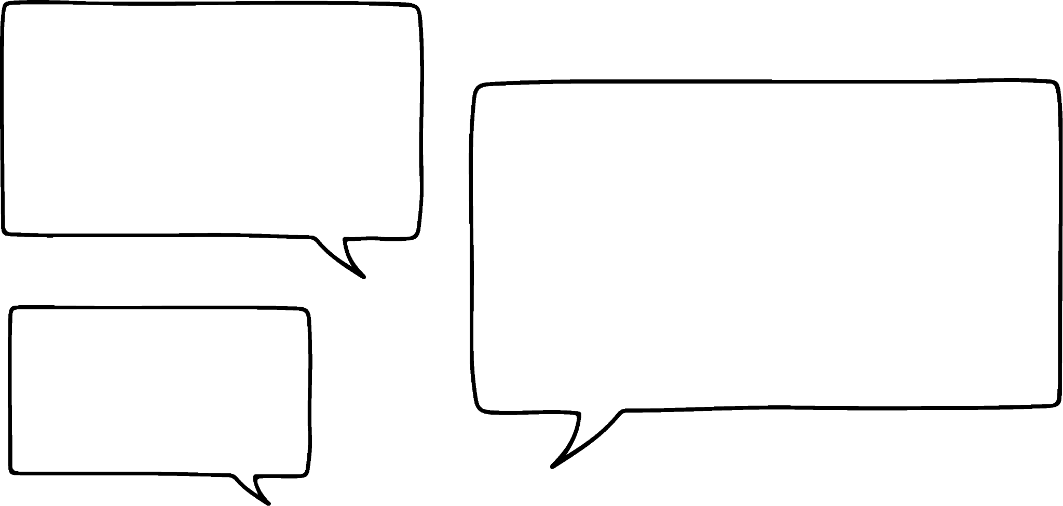

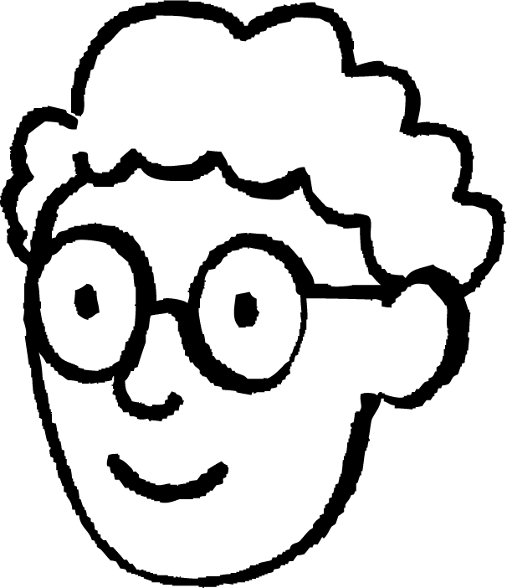

Helista xagasha qumman
Marka laba dhinac iyo xagal (aan dhexdooda ahayn) la ogaado, tani waxay keeni kartaa laba saddexagal oo kala duwan. Sababtan awgeed, kuma filna in lagu caddeeyo isku midnimada laba saddexagal.
Ma macluumaadkani had iyo jeer wuxuu keenayaa laba saddexagal oo kala duwan?
5 cm
5 cm
50°
Axmed
6 cm

Slide 8
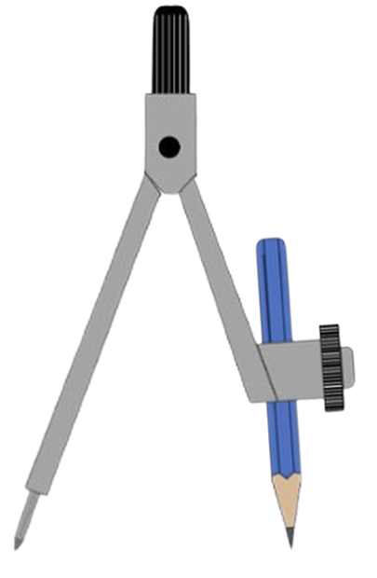
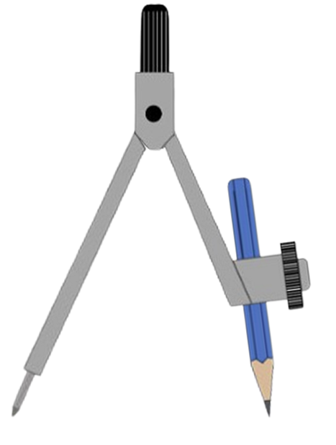
Helista xagasha qumman
Waxaan baari doonnaa su'aasha Axmed, adigoo xagasha iyo hal dhinac isku mid ah ku hayna, oo dhinaca labaad beddelaya.
Vertex C wuxuu jiifsan doonaa meel ku taal khadka rayga.
Waxaan ku bilaabi doonnaa kordhinta dhererka dhinaca ka soo horjeeda xagasha la yaqaan (angle).
Tani weli waxay abuurtaa laba saddex-xagal (triangles).
C₁
C₁
5.5 cm
5 cm
C₂
5.5 cm
5 cm
C₂
5 cm
5.5 cm
50°
50°
A
6 cm
B
A
6 cm
B
5.5 cm
5 cm
5.5 cm
5 cm

Slide 9
Helista xagasha saxda ah (right angle)
Haddii qaanso (arc) dhererkeedu yahay 5.3 cm laga soo qoro B, imisa jeer ayay ku goyn doontaa khadka shucaaca (ray line)?
2 jeer
5.3 cm waa ka yar yahay 5.5 cm kana weyn yahay 5 cm, kuwaas oo labadooduba laba jeer isgooyeen.
C₁
5.3 cm
C₂
5.3 cm
50°
5.3 cm
A
6 cm
B

Slide 10

Helitaanka xagasha saxda ah
Ilaa hadda, laba saddex-xagal (triangles) ayaa la abuuray.
Haddii aan kordhinno dhererka (radius) ilaa 6 cm, ma waxay beddelaysaa wax?
Waxay ka dhigan tahay inay noqon doonto saddexagal isosceles.
C₁
Qodobka labaad waa vertex A, marka tani ma abuuro saddexagal.
6 cm
6 cm
C₂
50°
Kaliya hal saddexagal ayaa la abuuraa.
A
6 cm
B

Slide 11
Helitaanka xagasha saxda ah
Ilaa hadda, laba saddexagal ayaa la abuuray.
Haddii aan kordhinno radius-ka in ka badan 6 cm, maxaa dhacaya hadda?
C₁
6.6 cm
Waxay kaliya ku goysaa ray-ga hal qodob.
6.6 cm
50°
Marka kaliya hal saddexagal ayaa la abuuraa.
A
6 cm
B

Slide 12
Helitaanka xagasha saxda ah
Maxaa dhacaya haddii cidhifkeena ka soo horjeeda xagasha 50° uu ka yar yahay 5 cm?
Waxaan ku bilaabi doonnaa 4 cm.
Tani waxay noqon doontaa kiiska dhammaan dhererka ka yar 4 cm.
Ma goynayo gabi ahaanba.
4 cm
50°
A
6 cm
B

Slide 13

Helista xagasha qumman (right angle)
Dhisiddan, imisa saddex-xagal (triangle) ayaa jiri doona?
0 saddex-xagal (triangle)
1 saddex-xagal (triangle)
5 cm
2 saddex-xagal (triangle)
5 cm

Slide 14
Helista xagasha qumman (right angle)
Dhererka radius-kaas waa masaafada ugu yar (minimum distance).
Wax kasta oo ka yar, kuma ekaan doono xariiqda shucaaca (ray line).
Waan ognahay in 5 cm ay laba jeer isgoysay, 4 cm-na aysan isgoysayn. Markaa waa inay jirtaa dherer uu kaliya taabto xariiqda shucaaca (ray line) hal dhibic.
C₁
C
dhererka ugu yar (minimum length)
5 cm
4 cm
C₂
5 cm
50°
A
6 cm
B

Slide 15
Helista xagasha qumman (right angle)
1) Isticmaal laba xarig (compasses), hel oo calaamadee meesha vertex C, taas oo ka dhigeysa dhererka ugu yar ee BC.
A
a)
b)
c)
B
A
A
B
B
2) Isticmaal protractor (protractor) si aad u cabbirto xagasha BCA jaantus kasta oo ka mid ah su'aasha 1. Maxaad dareemeysaa?

Slide 16
Helista xagasha qumman (right angle)
1) Isticmaal laba xarig (compasses), hel oo calaamadee meesha vertex C, taas oo ka dhigeysa dhererka ugu yar ee BC.
A
a)
b)
c)
B
A
C
C
C
A
B
B
2) Isticmaal protractor (protractor) si aad u cabbirto xagasha BCA jaantus kasta oo ka mid ah su'aasha 1. Maxaad dareemeysaa?
Dhammaantood waa 90°

Slide 17
Saddexagallo isku-xiran (Congruent) (RHS)
Helista xagasha saxda ah
Caddaynta isku-xirnaanta (Congruence) iyadoo la adeegsanayo RHS

Slide 18
Caddaynta isku-xirnaanta (Congruence) iyadoo la adeegsanayo RHS
Waa kuwan laba saddexagal oo xagasha saxda ah leh.
A
F
20 cm
21 cm
D
E
B
C
21 cm
20 cm
Macluumaadka la bixiyay, waxaan muujin karnaa in saddexagalka ABC iyo saddexagalka DEF ay isku-xiran yihiin. Maaddaama AB = DE, ∠ABC = ∠DEF iyo BC = EF, waxay isku-xiran yihiin iyadoo la adeegsanayo SAS (side-angle-side).

Slide 19
Caddaynta isku-xirnaanta (Congruence) iyadoo la adeegsanayo RHS
Haddii la siin lahaa macluumaadkan beddelkiisa, ma wali hubsan karnaa inay isku-xiran yihiin?
A
F
29 cm
29 cm
20 cm
D
E
B
C
20 cm
Caadi ahaan, in la helo laba dherer oo dhinac ah iyo xagal aan ku dhex jirin, kuma filna in lagu caddeeyo isku-xirnaanta (Congruence), sababtoo ah waxaa jiri kara laba saddexagal oo kala duwan.

Slide 20
Caddaynta isku-xirnaanta (Congruence) iyadoo la adeegsanayo RHS
Haddii la siin lahaa macluumaadkan beddelkiisa, ma wali hubsan karnaa inay isku-xiran yihiin?
A
F
29 cm
29 cm
20 cm
D
E
B
C
20 cm
Si kastaba ha ahaatee, hal saddex-xagal oo keliya ayaa suurtogal marka saddex-xagal qumman (right-angled triangle) la sameeyo.

Slide 21
Caddaynta isku-dhigma (congruence) iyadoo la adeegsanayo RHS
Ka fikir inaad sallaanka (ladder) dhigto derbi ku taagan dhul siman.
Sallaanku waa dherer go'an.
Derbiga iyo dhulku waa is-qumman yihiin (perpendicular).
sallaan (ladder)
derbi (wall)
Haddii cagta sallaanka (hoose) la dhigo 6 feet u jirta derbiga.
Immisa meelood oo kala duwan ayay sallaanka sare taaban doonaa derbiga?
sallaan (ladder)
6 ft
dhul siman (level ground)
Hal meel oo keliya. Hal saddex-xagal qumman oo keliya ayaa laga samayn karaa labadaas dhinac oo leh dherer go'an.

Slide 22
Caddaynta isku-dhigma (congruence) iyadoo la adeegsanayo RHS
Saddex-xagal qumman dhexdiisa, 90° waa xagasha ugu weyn gudaha. Dhinaca ka soo horjeeda xagasha qumman ayaa sidoo kale ah cidhifka ugu dheer.
Waxaa loo yaqaan hypotenuse.
hypotenuse
hypotenuse
hypotenuse

Slide 23
Cadeyn ku habboonaanta (congruence) iyadoo la adeegsanayo RHS
Cidhifkee waa hypotenuse saddex-xagalkan qumman?
a
b
c

Slide 24
Cadeyn ku habboonaanta (congruence) iyadoo la adeegsanayo RHS
Cidhifka ugu dheer ee saddexagalka waxaa loo yaqaan hypotenuse
Hypotenuse waa cidhifka ugu dheer ee saddexagalka xagal-qumman
Cidhifka ugu dheer wuxuu had iyo jeer ka soo horjeedaa xagasha ugu weyn

Slide 25
Cadeyn ku habboonaanta (congruence) iyadoo la adeegsanayo RHS
Kiis gaar ah oo ku saabsan caddaynta ku habboonaanta (congruence) iyadoo la ogyahay laba cidhif iyo xagal ayaa ku habboon saddexagalka xagal-qumman.
Waxaan u naqaan RHS (xagal-qumman-hypotenuse-cidhif).
C
M
17 m
17 m
15 m
A
B
15 m
N
O

Slide 26
Cadeyn ku habboonaanta (congruence) iyadoo la adeegsanayo RHS
Waxaan u naqaan RHS (xagal-qumman-hypotenuse-cidhif).
Saddexagalka ABC iyo saddexagalka MNO waa ku habboon yihiin (congruent). Waa maxay dhererka BC?
12 cm
M
C
35 cm
35 cm
A
B
N
O
12 cm

Slide 27
Cadeyn ku habboonaanta (congruence) iyadoo la adeegsanayo RHS
Ma labadan saddexagal waa ku habboon yihiin (congruent)?
K
C
21 cm
29 cm
46°
44°
A
B
29 cm
I
J
21 cm
Marka hore, mid ka mid ah shuruudaha ku habboonaanta (congruence) ma aqbalo.
∠ACB can be calculated using the sum of interior angles in a triangle.
∠ACB = 180 - (46 + 44) = 90°
Sidaas darteed, saddexagalka ABC iyo saddexagalka IJK labaduba waa saddexagal qumman, sidaas darteed waxay isku mid yihiin (congruent) RHS.

Slide 28
Justifying congruence by RHS
How do we know that triangle ABC and triangle DAC are congruent in this rectangle?
∠ABC = ∠ADC = 90° maadaama ay tahay leydi.
A
D
AC waa gees la wadaago waana hypotenuse ee saddexagal kasta.
AB = CD as they are opposite sides of a rectangle.
B
C
Sidaas darteed, saddexagalka ABC iyo DAC waxay isku mid yihiin (congruent) RHS.

Slide 29
Justifying congruence by RHS
ABCD waa dhaan (kite). Caddee in saddexagalka DAC iyo ABC ay isku mid yihiin (congruent) RHS.
Fill the blanks.
90
D
∠ADC = ∠ABC = 90 ° as they are given in the diagram.
hypotenuse
AC waa hypotenuse ee labada saddexagal.
A
C
DC = as they are adjacent sides on a kite.
BC
Sidaas darteed, saddexagalka DAC iyo ABC waxay isku mid yihiin (congruent) RHS.
B

Slide 30
Justifying congruence by RHS
1) Isticmaal RHS si aad u caddeyso in saddexagallada soo socda ay isku mid yihiin (congruent).
a)
C
K
35 cm
0.35 m
12 cm
120 mm
A
M
B
L
F
9 cm
O
b)
D
M
37°
12 cm
15 cm
53°
9 cm
15 cm
E
N

Slide 31
Cadaaladinta isku-dhafka (Congruence) RHS
2) Saddexagalka TUV waa isosceles, halka TU = TV. TW waa qumman (perpendicular) UV.
Caddee saddexagalka TUW iyo TWV waa isku-dhafan (congruent) RHS.
T
U
V
W

Slide 32
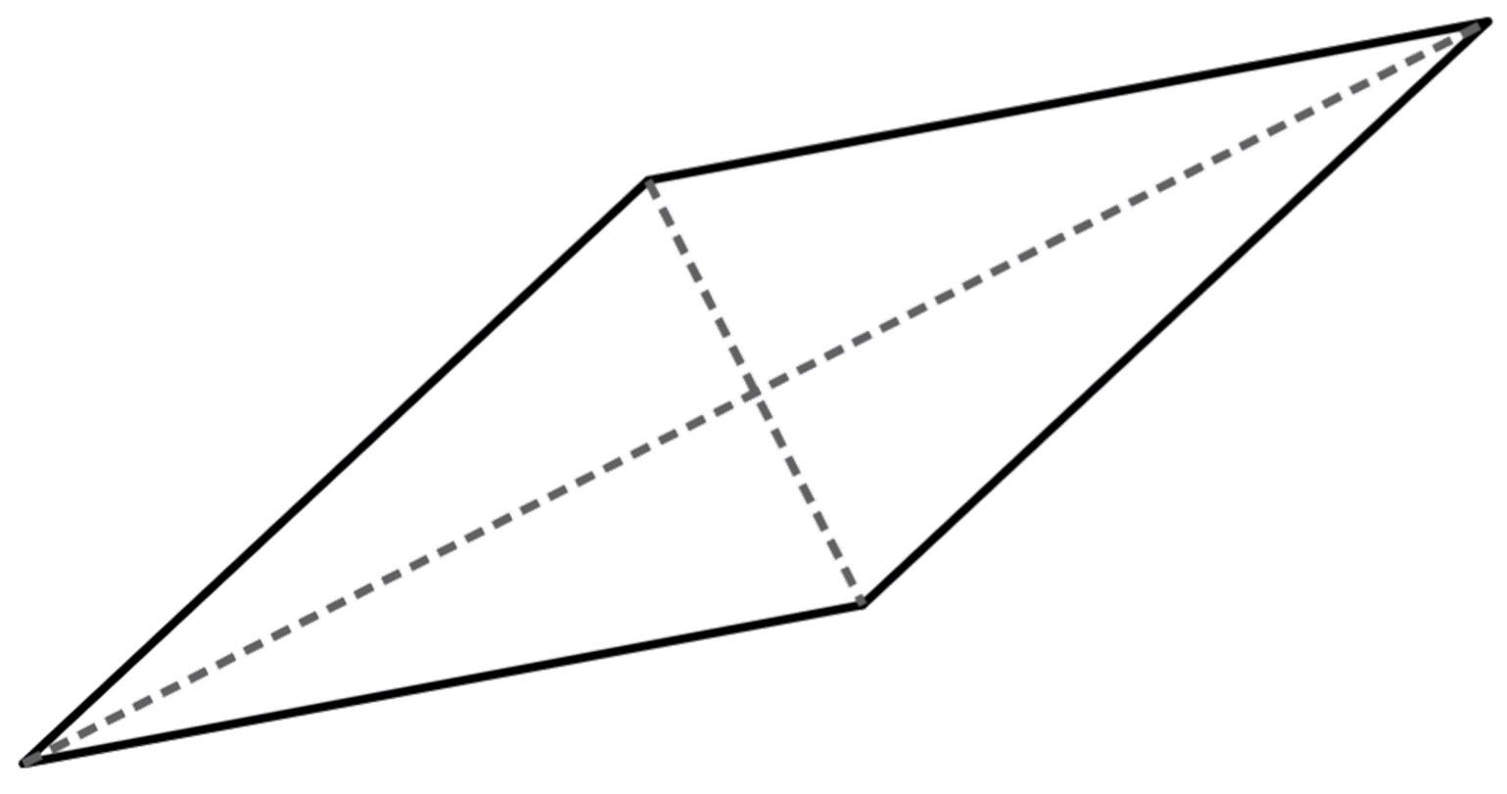
Cadaaladinta isku-dhafka (Congruence) RHS
3) Isticmaal xaqiiqooyinka rhombi iyo diagonalkooda si aad u caddeyso saddexagalka AED waa isku-dhafan BEC RHS.
D
A
E
C
B

Slide 33
Cadaaladinta isku-dhafka (Congruence) RHS
1) Isticmaal RHS si aad u caddeyso lamaanaha saddexagalka ee soo socda waa isku-dhafan.
a)
C
K
35 cm
0.35 m
12 cm
120 mm
A
M
B
L
∠ABC = ∠KLM = 90°
AC iyo KM waa hypotenuse kasta oo saddexagal, waxayna isle'eg yihiin 35 cm = 0.35 m
CB = KL sida 12 cm = 120 mm, sidaas darteed saddexagalka ABC iyo KLM waa isku-dhafan RHS.

Slide 34
Cadaaladinta isku-dhafka (Congruence) RHS
1) Isticmaal RHS si aad u caddeyso lamaanaha saddexagalka ee soo socda waa isku-dhafan.
F
9 cm
O
b)
D
M
37°
12 cm
15 cm
53°
9 cm
15 cm
E
N
∠MON = 180 - (37 +53) = 90° = ∠EDF
EF iyo MN waa hypotenuse (hypotenuse) saddexagal kasta waxayna isle'eg yihiin.
DE = MO sidaas darteed saddexagalka DEF iyo MNO waa isku qaab (congruent) iyadoo la adeegsanayo RHS.

Slide 35
Caddaynta isku qaabnimada (congruence) iyadoo la adeegsanayo RHS
2) Saddexagalka TUV waa isosceles (isosceles), halkaas oo TU = TV. TW waa toosan (perpendicular) UV.
Caddee in saddexagalka TUW iyo TWV ay yihiin kuwa isku qaab (congruent) iyadoo la adeegsanayo RHS.
T
∠TWU = ∠TWV sababtoo ah TW waa toosan (perpendicular) UV.
TU = TV sababtoo ah saddexagalka TUV waa isosceles (isosceles).
TW waa dhinac wadaag ah (common side) labada saddexagal TUW iyo TWV. Sidaas darteed, saddexagalka TUW iyo TWV waa isku qaab (congruent) iyadoo la adeegsanayo RHS.
U
V
W

Slide 36
Caddaynta isku qaabnimada (congruence) iyadoo la adeegsanayo RHS
3) Adigoo adeegsanaya xaqiiqooyinka la yaqaan ee rhombus (rhombus) iyo jaantusyada (diagonals), caddee in saddexagalka AED uu yahay mid isku qaab (congruent) BEC iyadoo la adeegsanayo RHS.
∠AED = ∠BEC = 90° sababtoo ah jaantusyada (diagonals) rhombus (rhombus) waa kuwa isku toosan (perpendicular).
D
A
AD = BC sababtoo ah waa geesaha (edges) rhombus (rhombus).
E
AE = EC sababtoo ah jaantusyada (diagonals) rhombus (rhombus) waxay is qaybiyaan (bisect) midba midka kale. Sidaas darteed, saddexagalka AED iyo BEC waa isku qaab (congruent) iyadoo la adeegsanayo RHS.
C
B

Slide 37
Saddexagalka isku qaab (Congruent triangles) (RHS)
Saddexagalka qumman (right-angled triangle) oo kaliya, waxaad caddayn kartaa isku qaabnimada (congruence) adigoo adeegsanaya hypotenuse (hypotenuse) iyo dhinac kale. Tan waxaa loo yaqaan RHS (xagal qumman - hypotenuse - dhinac).

