Slide 1
Saddexagallo isku mid ah (SAS)
Sifooyinka joomatari: isku ekaansho iyo aragtida Pythagoras

Slide 2
sida loo isticmaalo darasyada Oak

Slide 3
Waxaan qiimeyn karaa oo isticmaali karaa shuruudaha saddexagallada isku midka ah (SAS).

Slide 4
Haddii qaab uu si sax ah ugu habboonaado korka qaab kale iyadoo la isticmaalayo wareeg, milicsi, ama turjumaad, markaas qaababku waa isku mid.

Slide 5

Saddexagallo isku mid ah (SAS)
Caddaynta isku ekaanshaha SAS
Laba dhinac iyo xagal

Slide 6
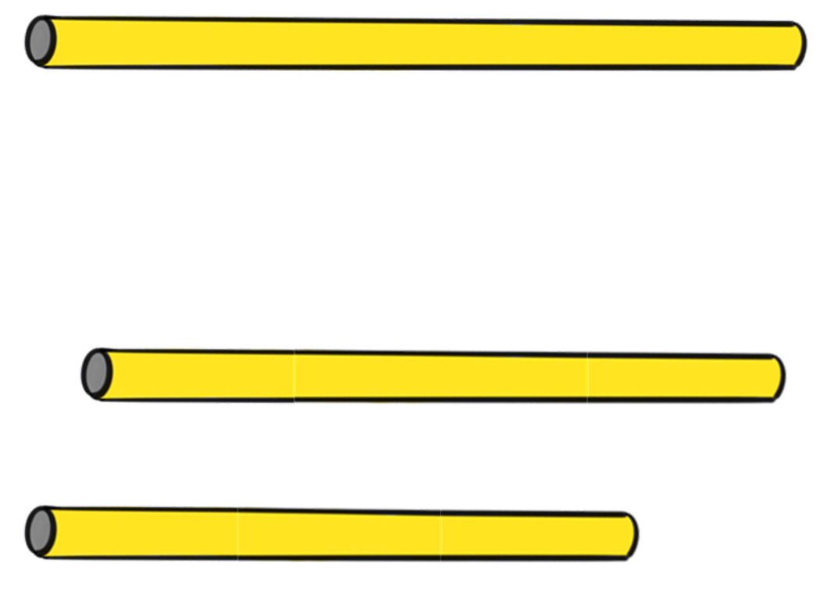

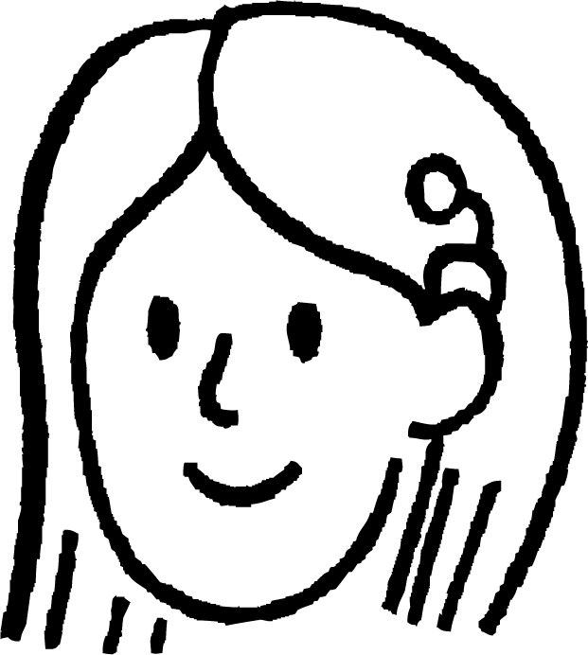

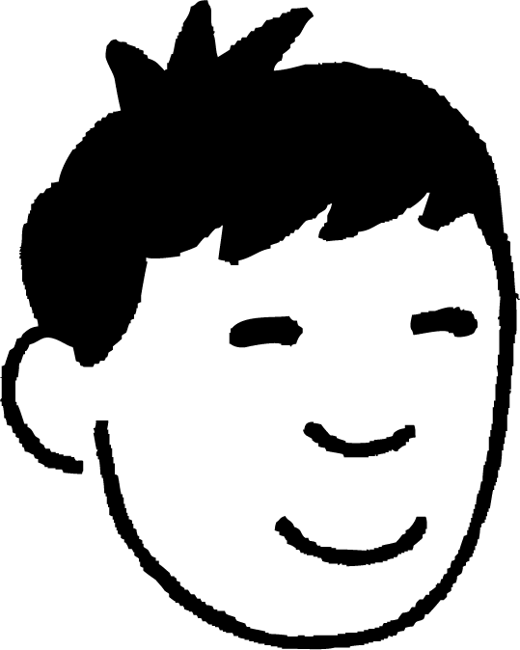
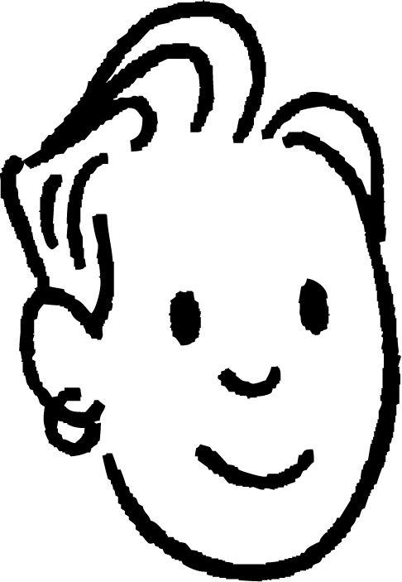
Caddaynta isku ekaanshaha SAS
Nuur, Saciid iyo Suad waxay leeyihiin saddex caws oo dherer kala duwan waxayna samaynayaan saddexagallo.
Waxay ogyihiin inay kaliya samayn karaan hal saddexagal oo gaar ah oo leh saddexdan dherer oo caws ah.

Slide 7
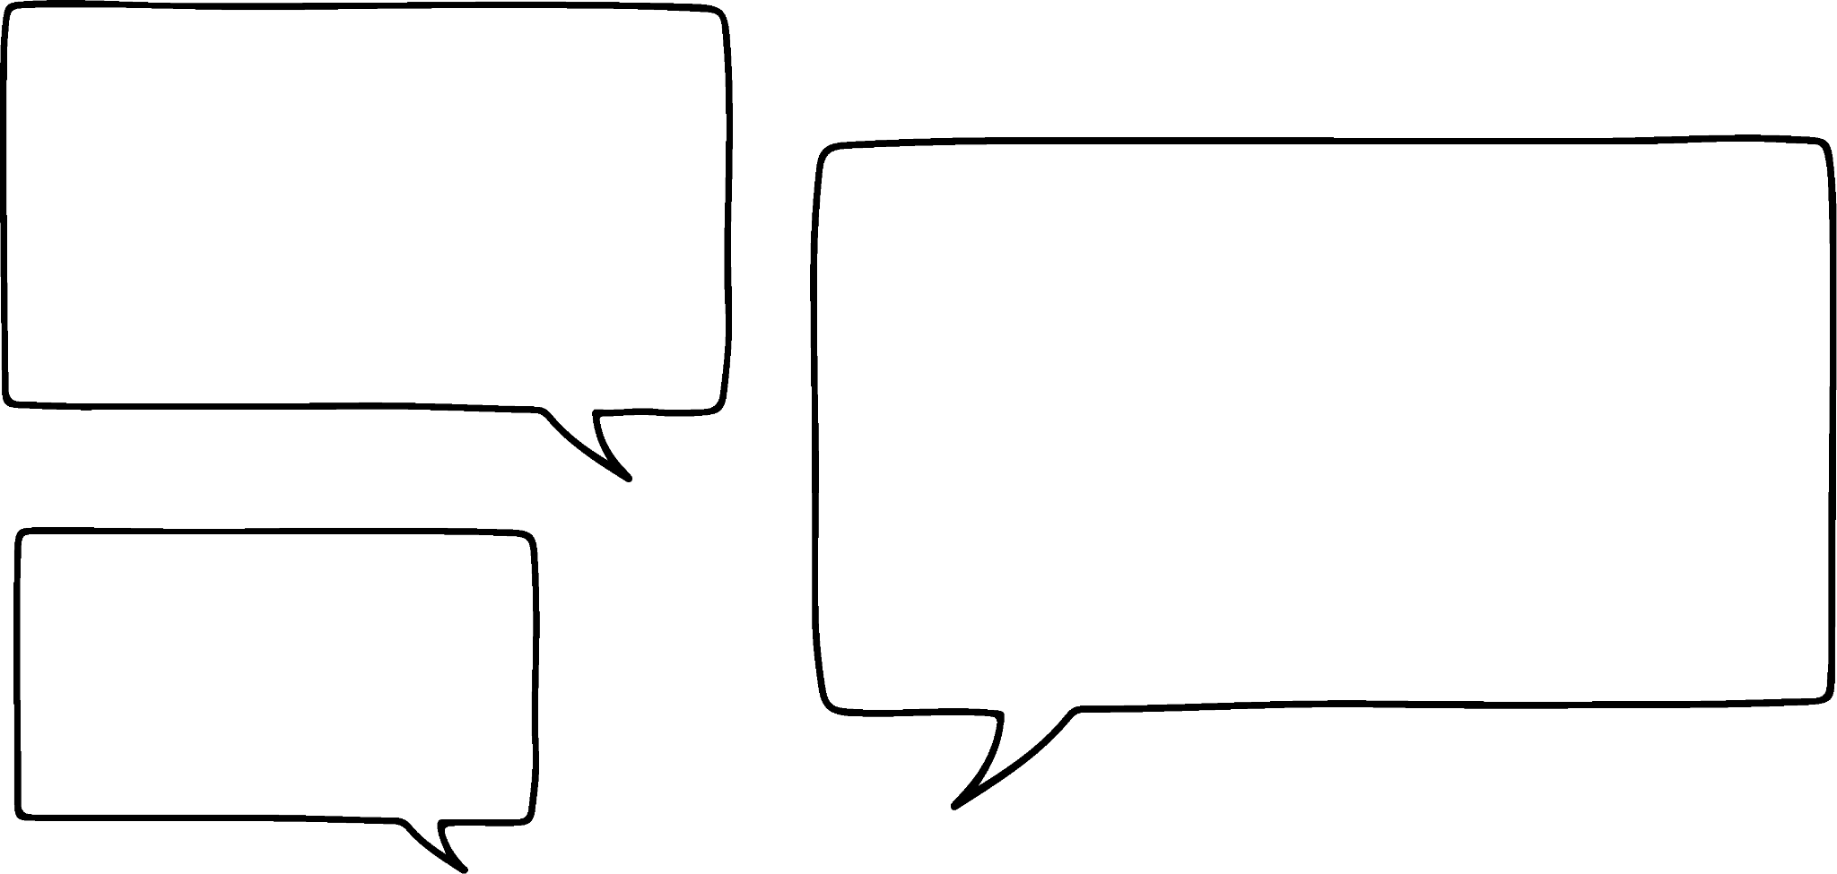
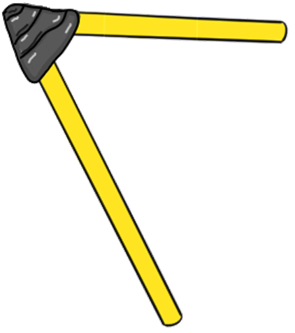
Caddaynta isku ekaanshaha SAS
Laakiin cawsyadu waa dherer go'an.
Haddii aan leenahay laba caws, oo lagu xidhay xagal go'an, imisa saddexagal oo kala duwan ayaan samayn karnaa?
Waxaan u malaynayaa inay jiri doonaan kuwo badan. Waxaa jira saddexagallo qumman oo kala duwan tusaale ahaan.

Slide 8
Caddaynta isku ekaanshaha SAS
Xataa haddii aad hagaajiso hal dherer oo dhinac ah, wali waxaad heli doontaa tiro aan xad lahayn oo saddexagallo ah.
Haddii cawsyadu ay noqon karaan dherer kasta, laakiin xagalku go'an yahay, markaas saddexagallo badan oo kala duwan ayaa la abuuri doonaa?
Haa! Waxaan u malaynayaa inaan ku tusi karno dhismo.
🖇 SAS

Slide 9
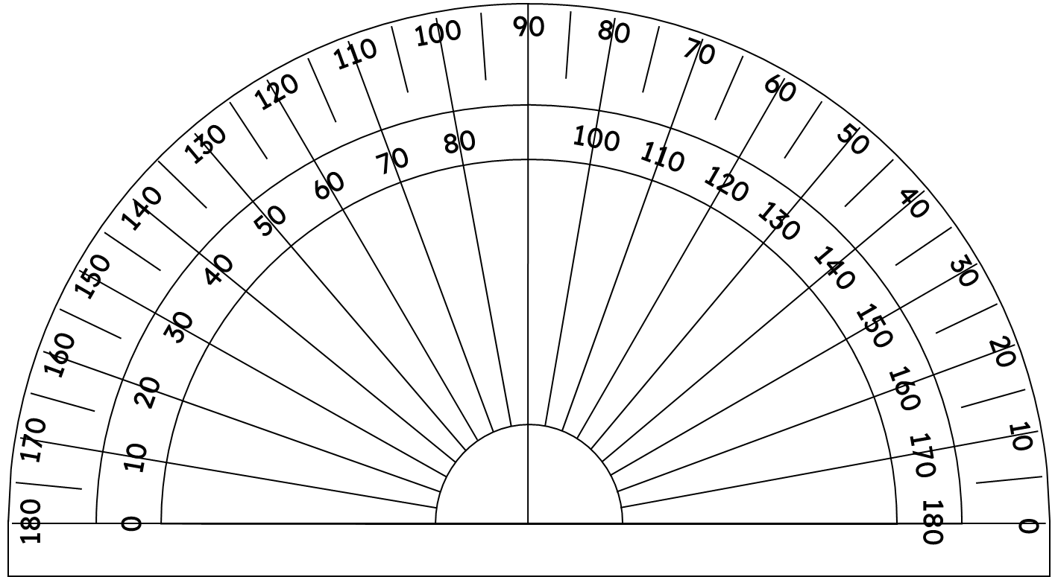
Caddaynta isku ekaanshaha SAS
Haddii xagalka u dhexeeya labada dhinac uu go'an yahay 50°, waxaan ku sawiri karnaa lugaha sida rays, laga bilaabo barta A.
50°
A

Slide 10
Cadeyn ku habboonaanta (congruence) iyadoo la adeegsanayo SAS
Dhibic kasta oo ku taal raysyada, waa la isku xiri karaa si loo sameeyo saddexagal.
Waxaa jira tiro aan xad lahayn oo saddexagallo suurtagal ah.
C
C
C
50°
A
B
B
B

Slide 11
Cadeyn ku habboonaanta (congruence) iyadoo la adeegsanayo SAS
Maxaa dhacaya haddii aan hagaajinno mid ka mid ah dhererka saddexagalka? Aynu hagaajinno AC si uu noqdo 7 cm. B wali wuxuu tagi karaa meel kasta oo ku taal rayga.
Weli waxaa jira tiro aan xad lahayn oo saddexagallo suurtagal ah.
C
7 cm
50°
A
B
B
B

Slide 12
Cadeyn ku habboonaanta (congruence) iyadoo la adeegsanayo SAS
Maxaa dhacaya haddii aan hagaajinno mid ka mid ah dhererka saddexagalka? Markan BC waxaa loo dejiyay inuu noqdo 5 cm.
Tani wali waxay keentaa tiro aan xad lahayn oo saddexagallo suurtagal ah.
C
C
C
5 cm
5 cm
5 cm
50°
A
B
B
B
🖇 Gees hagaagsan oo ka soo horjeeda

Slide 13
Cadeyn ku habboonaanta (congruence) iyadoo la adeegsanayo SAS
Waxaan ognahay in haddii aan hagaajinno labada dherer, kuwaas oo ah lugaha xagasha, markaas waxaan dhisi karnaa hal saddexagal oo keliya.
C
7 cm
5.6 cm
50°
A
B
6.2 cm
🖇 Laba gees oo hagaagsan

Slide 14

Cadeyn ku habboonaanta (congruence) iyadoo la adeegsanayo SAS
Marka la dhisayo, kee ka mid ah shuruudahan ayaa had iyo jeer keeni doona hal saddexagal oo hagaagsan?
8.6 m
8.6 m
3 m
3 m
73°
88°
9 m
9 m

Slide 15
Caddaynta isku ekaanshaha (congruence) iyadoo la adeegsanayo SAS
Labo saddexagal (triangle) waxaa la caddayn karaa inay isku mid yihiin (congruent) haddii dhinacyada u dhigma ay isku mid yihiin. Waxaan dhahnaa waxay isku mid yihiin SSS (dhinac-dhinac-dhinac).
Xagasha ka soo horjeeda (opposite) sidoo kale waa go'an.
C
Haddii aan ognahay labo dhinac iyo xagasha u dhexaysa, waxaa jira hal saddexagal (triangle) oo keliya oo la samayn karo.
Dhammaan saddexagallada (triangles) leh SAS isku mid ah waxay isku mid yihiin (congruent).
7 cm
5.6 cm
50°
A
B
6.2 cm

Slide 16
Caddaynta isku ekaanshaha (congruence) iyadoo la adeegsanayo SAS
Tani waxay ka dhigan tahay in labo saddexagal (triangle) lagu caddayn karo inay isku mid yihiin (congruent) iyadoo la adeegsanayo SAS (dhinac-xagal-dhinac) sidoo kale.
A
P
2.4 cm
5.3 cm
2.4 cm
89°
5.3 cm
89°
B
R
C
Q
Labadan saddexagal (triangle), waxaan arki karnaa in AB = PR, ∠BAC = ∠QPR iyo AC = PQ, sidaas darteed saddexagalladan waxay isku mid yihiin (congruent) SAS.

Slide 17
Caddaynta isku ekaanshaha (congruence) iyadoo la adeegsanayo SAS
Tani waxay ka dhigan tahay in labo saddexagal (triangle) lagu caddayn karo inay isku mid yihiin (congruent) iyadoo la adeegsanayo SAS (dhinac-xagal-dhinac) sidoo kale.
A
X
2.4 cm
5.3 cm
2.4 cm
89°
5.3 cm
89°
B
Z
C
Y
Labadan saddexagal (triangle), waxaan arki karnaa in AB = XZ, AC = XY iyo ∠BAC = ∠XZY, hase yeeshee labadan saddexagal (triangle) ma aha isku mid (congruent). 89° ma aha mid u dhexeysa labada dhinac ee la yaqaan labada saddexagal (triangle).

Slide 18
Cadaynta isku-simenaanta (congruence) iyadoo la adeegsanayo SAS
Saddax-xagalladan midba midka kale ma siman yahay (congruent)?
V
M
6.8 cm
6.1 cm
63°
63°
O
6.8 cm
6.1 cm
68°
T
49°
N
U
Haa, ∠TVU = 180 - (68 + 49) = 63°, marka saddex-xagalka MNO wuxuu la siman yahay (congruent) saddex-xagalka TVU iyadoo la adeegsanayo SAS.

Slide 19
Cadaynta isku-simenaanta (congruence) iyadoo la adeegsanayo SAS
Adeegsiga sifooyinka la yaqaan ee qaababka, waxaa suurtagal ah in la caddeeyo in saddex-xagallada ay isku siman yihiin (congruent) iyadoo la adeegsanayo SAS.
Caddee in saddex-xagalka ABC uu la siman yahay (congruent) saddex-xagalka ACD, marka la eego in ABCD uu yahay rhombus.
A
D
AB = CD sababtoo ah waa geesaha rhombus.
∠ABC = ∠ADC sababtoo ah waa xaglaha iska soo horjeeda ee rhombus.
AD = BC sababtoo ah waa geesaha rhombus.
Sidaa darteed, saddex-xagalka ABC wuxuu la siman yahay (congruent) saddex-xagalka ACD iyadoo la adeegsanayo SAS.
B
C

Slide 20
Cadaynta isku-simenaanta (congruence) iyadoo la adeegsanayo SAS
Marka la eego in ABCD uu yahay rhombus, caddee in saddex-xagalka ABC uu la siman yahay (congruent) saddex-xagalka ACD.
A
D
AB = CD sababtoo ah waa geesaha rhombus.
∠DAC = ∠ACB sababtoo ah waa
AC waa gees la wadaago (shared edge) labada saddex-xagal.
Sidaa darteed, saddex-xagalka ABC wuxuu la siman yahay (congruent) saddex-xagalka ACD iyadoo la adeegsanayo SAS.
gudaha isku-beddelka (interior alternate)
B
C
xaglaha ku yaal khadadka barbaraha (angles in parallel lines)
Buuxi meesha bannaan.

Slide 21
Caddaynta isku midnimada (congruence) iyadoo la adeegsanayo SAS
1) Samee saddexagallada soo socda:
a) Saddexagal ABC, halkaas oo AB = 6 cm, BC = 9 cm iyo ∠ABC = 42°
b) Saddexagal PQR, halkaas oo PQ = 6 cm, QR = 9 cm iyo ∠QPR = 42°
2) Qiyaas cidhifyada iyo xaglaha labada saddexagal ee aad ku dhisay su'aasha 1. Ma waa saddexagallo isku mid ah (congruent triangles)?

Slide 22
Caddaynta isku midnimada (congruence) iyadoo la adeegsanayo SAS
3) Caddee in saddexagalka ABC uu la mid yahay saddexagalka PQR iyadoo la adeegsanayo SAS.
A
P
32°
3.9 cm
128°
3.9 cm
20°
C
Q
R
B
3.9 cm
3.9 cm
4) Marka la eego barbaroodle ABCD, caddee in saddexagalka ABC uu la mid yahay saddexagalka ACD iyadoo la adeegsanayo SAS.

Slide 23
Caddaynta isku midnimada (congruence) iyadoo la adeegsanayo SAS
1) Samee saddexagallada soo socda:
a) Saddexagal ABC, halkaas oo AB = 6 cm, BC = 9 cm iyo ∠ABC = 42°
C
9 cm
42°
B
6 cm
A

Slide 24
Caddaynta isku midnimada (congruence) iyadoo la adeegsanayo SAS
b) Saddexagal PQR, halkaas oo PQ = 6 cm, QR = 9 cm iyo ∠QPR = 42°
R
9 cm
42°
P
6 cm
Q

Slide 25
Cadeynta isku qaabnimada (congruence) iyadoo la adeegsanayo SAS
2) Cabir cidhifyada (edges) iyo xaglaha (angles) labada saddex-xagal (triangles) ee aad ka dhisatay su’aasha 1. Ma waa isku qaab (congruent triangles)?
Saddex-xagalka ABC:
AB = 6 cm
BC = 9 cm
AC = 6.1 cm
∠ABC = 42°
∠BAC = 96.6°
∠ACB = 41.4°
Saddex-xagalka PQR:
PQ = 6 cm
QR = 9 cm
PR = 12.5 cm
∠QPR = 42°
∠PQR = 111.5°
∠PRQ = 26.5°
Maya, isku qaab (congruent) ma aha.

Slide 26
Cadeynta isku qaabnimada (congruence) iyadoo la adeegsanayo SAS
3) Caddee in saddex-xagalka ABC uu isku qaab yahay (congruent) saddex-xagalka PQR iyadoo la adeegsanayo SAS.
A
P
32°
3.9 cm
128°
3.9 cm
128°
20°
C
Q
R
B
3.9 cm
3.9 cm
Xaglaha gudaha ee saddexagalka waa 180°, sidaas darteed ∠PQR = 180 - (32 + 20) = 128°.
AB = PQ, ∠ABC = ∠PQR iyo BC = QR, marka saddexagalka ABC wuxuu la mid yahay saddexagalka PQR iyadoo la adeegsanayo SAS (dhinac-xagal-dhinac).

Slide 27
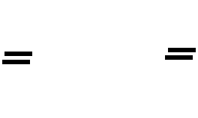
Caddaynta isku midnimada (congruence) iyadoo la adeegsanayo SAS
4) Marka la eego barbaroodle ABCD, caddee in saddexagalka ABC uu la mid yahay saddexagalka ACD iyadoo la adeegsanayo SAS.
A
D
AD = BC sababtoo ah cidhifyada iska soo horjeeda ee barbaroodle waa isku dherer.
∠ABC = ∠ADC sababtoo ah xaglaha iska soo horjeeda ee barbaroodle waa isku cabbir.
B
C
AB = DC sababtoo ah cidhifyada iska soo horjeeda ee barbaroodle waa isku dherer.
Sidaas darteed, saddexagalka ABC wuxuu la mid yahay saddexagalka ACD iyadoo la adeegsanayo SAS.

Slide 28
Caddaynta isku midnimada (congruence) iyadoo la adeegsanayo SAS
4) Marka la eego barbaroodle ABCD, caddee in saddexagalka ABC uu la mid yahay saddexagalka ACD iyadoo la adeegsanayo SAS.
A
D
AD = BC sababtoo ah cidhifyada iska soo horjeeda ee barbaroodle waa isku dherer.
∠DAC = ∠ACB sababtoo ah waa xaglaha gudaha ee isku beddesha (alternate interior angles).
B
C
AC waa dhinac la wadaago.
Sidaas darteed, saddexagalka ABC wuxuu la mid yahay saddexagalka ACD iyadoo la adeegsanayo SAS.

Slide 29
Saddexagallo isku mid ah (SAS)
Caddaynta isku midnimada (congruence) iyadoo la adeegsanayo SAS
Laba dhinac iyo xagal

Slide 30
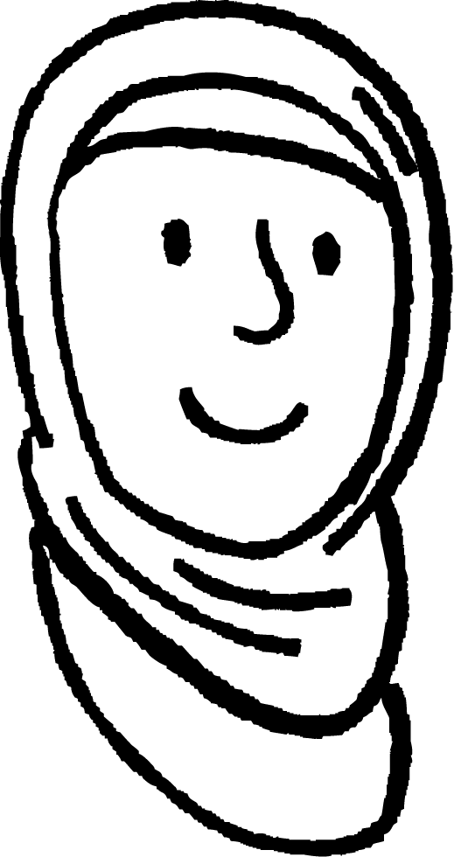
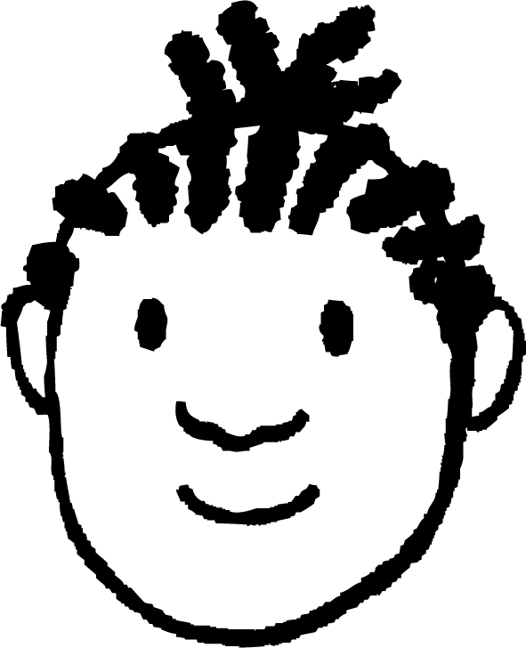
Laba dhinac iyo xagal
Caasha iyo Yacquub waxay ka hadlayaan inta macluumaad ee loo baahan yahay si loo caddeeyo in laba saddexagal ay isku mid yihiin.
c
b
r
q
a
p
Haddii aad ogaato kaliya in saddexda dhinac ee u dhigma ay isku dherer yihiin, markaas waxaad caddayn kartaa inay isku mid yihiin iyadoo la adeegsanayo SSS.
Haa, xaglaha waxaa go'aamiya dhererka dhinacyada. SSS!

Slide 31
Laba dhinac iyo xagal
Caasha iyo Yacquub waxay ka hadlayaan inta macluumaad ee loo baahan yahay si loo caddeeyo laba saddex-xagal oo isku mid ah (congruent).
A
P
c
b
r
q
Haddii aad taqaanid laba dhinac oo isku mid ah (corresponding sides) iyo xagasha u dhaxaysa, waxaad caddayn kartaa in labada saddex-xagal ay isku mid yihiin (congruent).
Haa, iyadoo la adeegsanayo SAS (dhinac-xagal-dhinac)!

Slide 32
Laba dhinac iyo xagal
Caasha iyo Yacquub waxay ka hadlayaan inta macluumaad ee loo baahan yahay si loo caddeeyo laba saddex-xagal oo isku mid ah (congruent).
b
q
B
Q
a
p
Laba dhinac oo isku mid ah (corresponding sides) iyo xagal, ma caddaynayaan inay isku mid yihiin (congruent)?
Ma hubo? Aynu eegno tusaale.

Slide 33
Laba dhinac iyo xagal
Labadan saddex-xagal mid kasta wuxuu leeyahay xagal 50°, cidhif dhererkiisu yahay 5 cm iyo cidhif dhererkiisu yahay 6 cm, laakiin ma aha kuwo isku mid ah (congruent).
5 cm
5 cm
50°
6 cm
50°
6 cm

Slide 34
Laba dhinac iyo xagal
Labadan saddex-xagal, waxay leeyihiin isla xagal iyo laba cidhif oo isku dherer, laakiin ma aha kuwo isku mid ah (congruent).
Tani waxay ugu wacan tahay goobada (circle) leh radius 5 cm, oo ku goysa shucaaca (ray) laba meelood oo kala duwan.
5 cm
5 cm
Ogaanshaha laba dhinac iyo xagal kuma filna in la caddeeyo isku midnimo (congruence). Xagashu waa inay tahay mid u dhaxaysa labada dhinac ee la yaqaan.
50°
6 cm
🖇 SSA

Slide 35
Laba dhinac iyo xagal
Isku mid (Congruent) SSS
Isku mid (Congruent) SAS
c
b
b
c
c
c
B
B
a
a
a
a
Marka waxaan u baahanahay ugu yaraan saddex xog, mid ka mid ah lammaane kasta oo dhinac iyo xagal ah
Laakiin waa inay ahaadaan lammaanaha u dhigma ee saddexagal kasta.

Slide 36
Laba dhinac iyo xagal
Waa kuwan laba saddexagal, saddexagalka MNO iyo saddexagalka XYZ. Ma isku mid (congruent) yihiin?
M
X
8 cm
8 cm
79°
22°
79°
22°
N
Y
8 cm
O
Z
8 cm
Xagalka la bixiyay ma aha mid u dhexeeya labada dhinac ee la yaqaan, marka ma qanciyo SAS.
Ma xisaabin kartaa xagasha u dhexaysa?
Haa, waa saddexagal isku dhinac (isosceles).

Slide 37
Laba dhinac iyo xagal
Goobta (circle) radius 8 cm, oo xarunteedu tahay O, waxay ku goysa laynka (ray) ka bilaabmaya N oo 79° ah NO laba jeer, marka laga reebo mid ka mid ah isgoysyada, oo aan abuurin saddexagal.
M
Tani waa tusaale kiis gaar ah halkaas oo SSA uu abuuri lahaa saddexagal go'an. Maadaama saddexagalku yahay isku dhinac (isosceles), dhammaan xagalaha kale waa la heli karaa. Marka shuruuduhu sidoo kale waxay xaqiijiyaan SAS.
8 cm
79°
N
8 cm
O

Slide 38
Laba dhinac iyo xagal
Waa kee saddexda xog oo ku filan si loo caddeeyo isku midnimada (congruence) laba saddexagal?
Dhammaan xagluhu waxay xaqiijiyaan isu ekaanshaha (similarity) laakiin ma aha isku midnimo (congruence)
Dhammaan saddexda xagal
Dhammaan saddexda dhinac
Laba dhinac iyo xagasha u dhaxaysa
SSA kaligeed dammaanad qaadi karto isku midnimo (congruence).
Laba dhinac iyo xagal kale

Slide 39
Laba dhinac iyo xagal
1) Saddex-xagalladan midkee ayaa hubaal ah inuu la mid yahay (congruent) saddex-xagalka XYZ?
D
A
X
3.4 cm
6.8 cm
3.4 cm
3.4 cm
68°
81°
81°
81°
E
B
C
F
Y
Z
6.4 cm
M
6.4 cm
J
G
3.4 cm
68°
68°
3.4 cm
68°
81°
N
O
31°
6.4 cm
31°
K
L
H
I
6.4 cm

Slide 40

Laba dhinac iyo xagal
1) Saddex-xagalladan midkee ayaa hubaal ah inuu la mid yahay (congruent) saddex-xagalka XYZ?
A
D
X
3.4 cm
6.8 cm
68°
3.4 cm
3.4 cm
81°
81°
81°
B
C
E
F
Y
6.4 cm
Z
6.4 cm
M
J
G
3.4 cm
68°
68°
3.4 cm
68°
81°
N
31°
O
31°
K
L
6.4 cm
H
I
6.4 cm

Slide 41
Saddexagallo isku mid ah (SAS)
Labo saddexagal waxaa lagu caddayn karaa inay isku mid yihiin (congruent) haddii labada dherer oo dhinac iyo xagasha u dhaxaysa ay isku mid yihiin.
Haddii laba dherer oo dhinac iyo xagal, oo aan u dhaxayn, la yaqaan, tani ma caddayso isku midnimada (congruence). Waxaa jiri kara laba saddexagal oo leh faahfaahintan.

