Slide 1
Saddexagallo isku mid ah (SSS)
Sifooyin joomatari: isku ekaansho iyo aragtida Pythagoras

Slide 2
sida loo isticmaalo darasyada Oak

Slide 3
Waxaan qiimeyn (value) karaa oo isticmaali karaa shuruudaha saddexagallada isku midka ah (SSS).

Slide 4
Haddii qaab uu si sax ah ugu habboonaado korka mid kale iyadoo la adeegsanayo wareeg, milicsi ama turjumaad, markaas qaababku waa isku mid (congruent).

Slide 5

Saddexagallo isku mid ah (SSS)
Daminta isku ekaanshaha
Cadeynta isku ekaanshaha iyadoo la adeegsanayo SSS

Slide 6
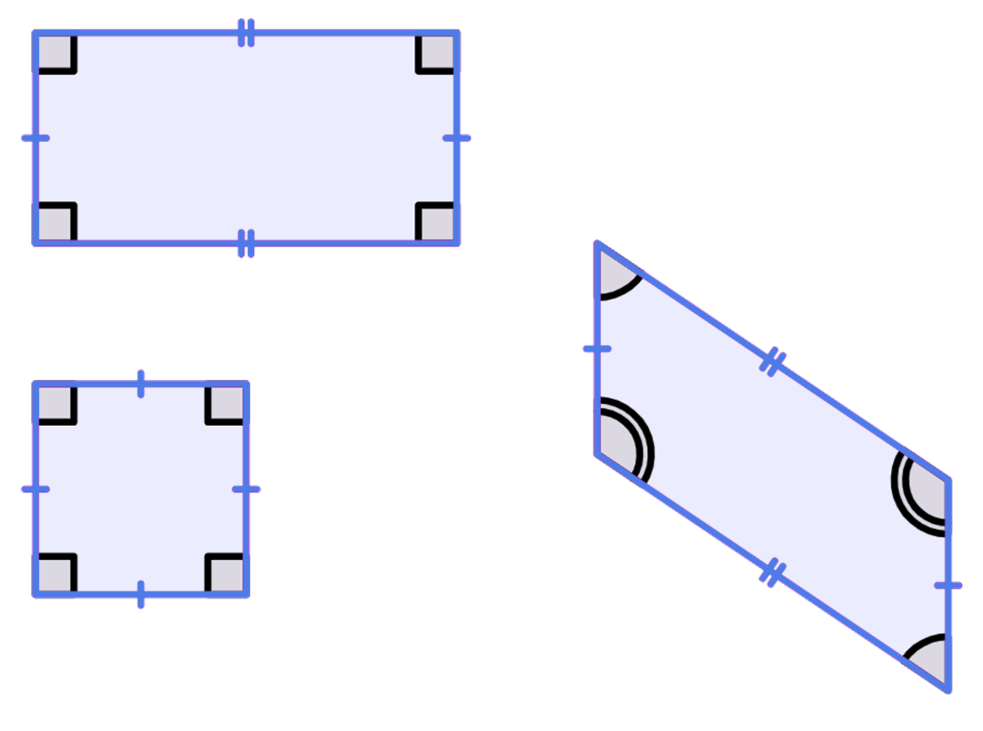
Daminta isku ekaanshaha
Si ay isku mid u noqdaan, laba qaab waa inay awoodaan inay si sax ah isku dul habboonaadaan iyadoo la adeegsanayo wareeg, milicsi ama turjumaad.
Xaglaha iyo geesahoodu waxay noqon doonaan isla cabbir, iyo isla meel marka la eego qaabka.
Labajibbaaranaha iyo leydigu waxay leeyihiin isla xaglaha laakiin waa qaabab kala duwan.
Leydiga iyo barbaroolaha waxay leeyihiin isla dhererka geesaha isku xigga laakiin waxay leeyihiin xaglo kala duwan.
3 cm
6 cm
3 cm
6 cm
124°
56°
3 cm
Midna kama mid aha kuwa isku midka ah.

Slide 7
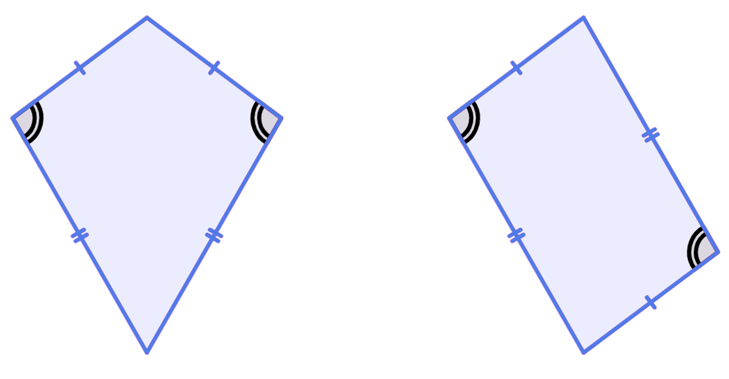
Daminta isku qaabnimo (Guaranteeing congruence)
Labadan afargeesle (quadrilateral) mid kasta wuxuu leeyahay laba gees (edge) oo 5 cm iyo 8.1 cm ah. Labadooduba waxay leeyihiin laba xagal (angle) oo 97.1° ah. Miyay isku qaab (congruent) yihiin?
Maya, labada xagal (angle) ee kale isku mid ma aha, geesaha (edges)na waxay ku kala jiraan meelo kala duwan.
5 cm
5 cm
8.1 cm
97.1°
97.1°
8.1 cm

Slide 8
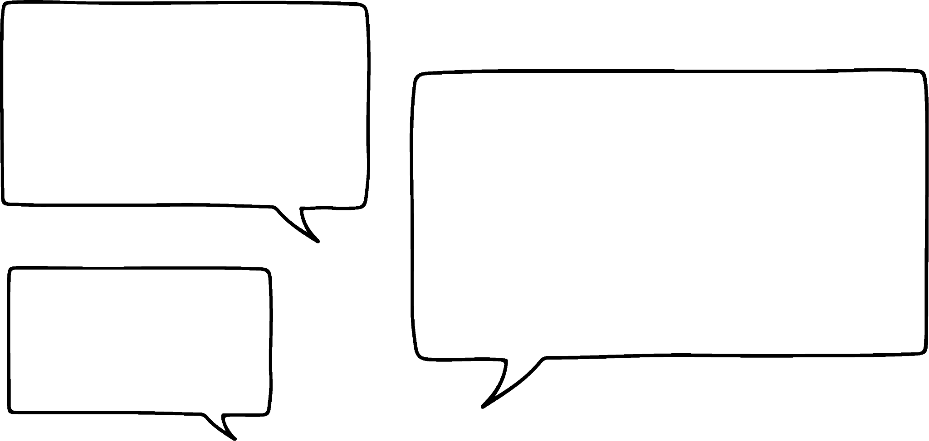

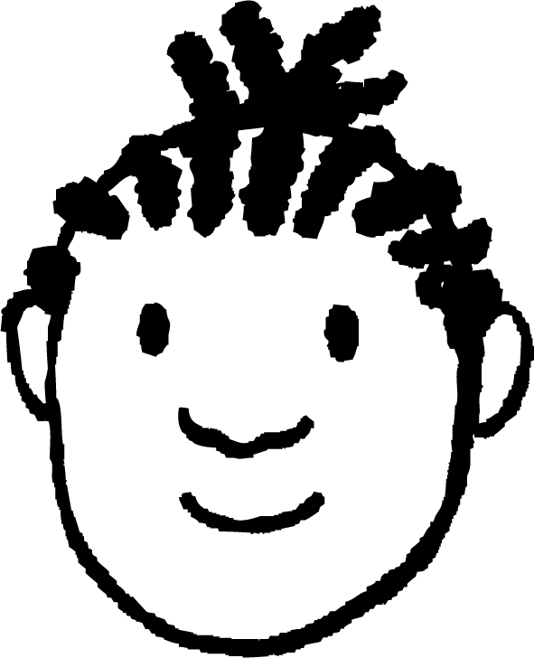
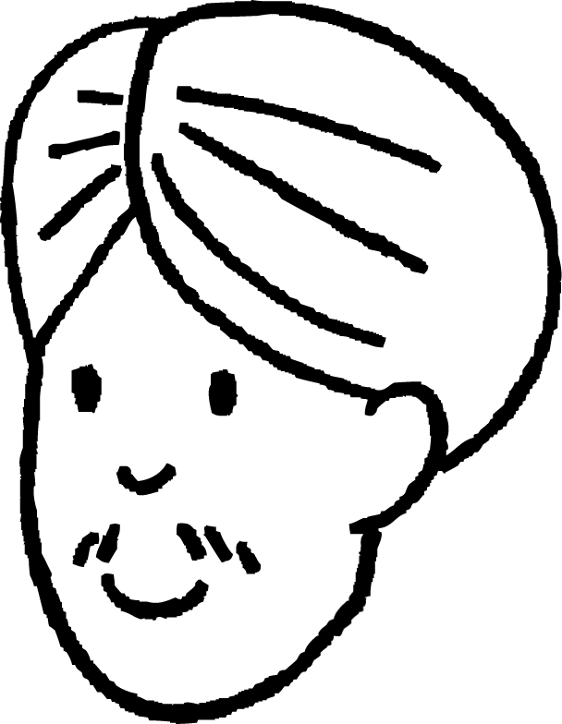
Daminta isku qaabnimo (Guaranteeing congruence)
Si loo hubiyo in laba afargeesle (quadrilateral) isku qaab (congruent) yihiin, waxaad u baahan tahay:
geesaha (edges) u dhigma (corresponding) inay isku mid yihiin
nidaamka (order) geesaha (edges) inuu isku mid yahay
xaglaha (angles) gudaha (interior) ee afargeeslaha (quadrilateral) inay isku mid yihiin
xaglaha (angles) inay ku jiraan isku meel (location)
Mid ama laba ka mid ah kuwan oo keliya, kuma filna.
Miyaan kulligood lagama maarmaan (necessary) u yihiin saddexagallada (triangles)?
Hagaag, nidaamka (order) geesaha (edges) had iyo jeer waa isku mid.
Miyaa taasi run tahay?

Slide 9
Daminta isku qaabnimo (Guaranteeing congruence)
isku beddel (swap) a iyo b
c
Haa! Haddii aad leedahay saddex gees (edge), a, b iyo c. Kadib isku beddel (swap) laba ka mid ah geesaha (edges), nidaamka (order) wali waa isku mid.
Had iyo jeer waxay ku xiga labada dhinac ee kale.
a
b
b
b
c
c
b
c
a
isku beddel (swap) b iyo c
isku beddel (swap) a iyo c
a
a

Slide 10
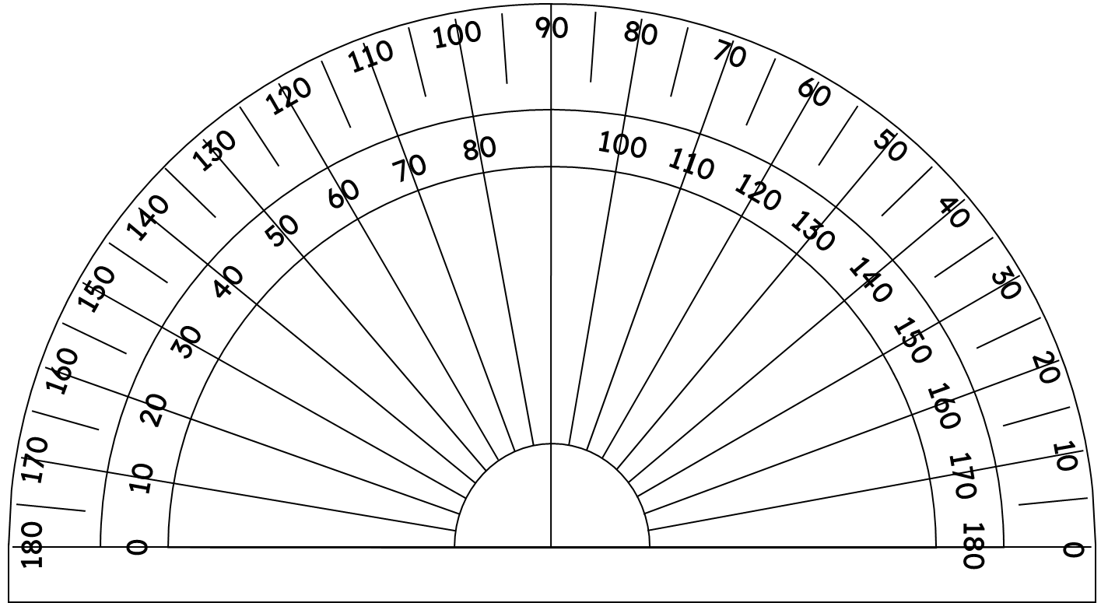
Hubinta isku-dhigmaanshaha (congruence)
Miyay labadan saddexagal (triangle) isku qaab (congruent) yihiin?
60°
60°
60°
60°
60°
60°
Hadda waxaan ognahay inay labadooduba yihiin saddexagallo siman (equilateral triangles).

Slide 11
Hubinta isku-dhigmaanshaha (congruence)
Ma waa laba saddexagal oo isku-dhigma (congruent)?
Waxay leeyihiin xaglaha gudaha isku mid ah, marka waa isku-ekaansho (similar).
60°
60°
60°
60°
60°
60°
6.3 cm
6.5 cm
Dhererka cidhifyadoodu waa kala duwan yihiin, marka ma aha isku-dhigma (congruent).

Slide 12
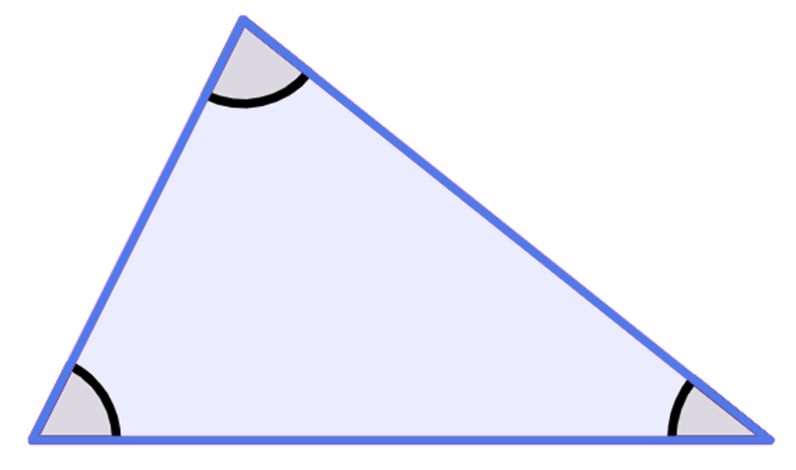

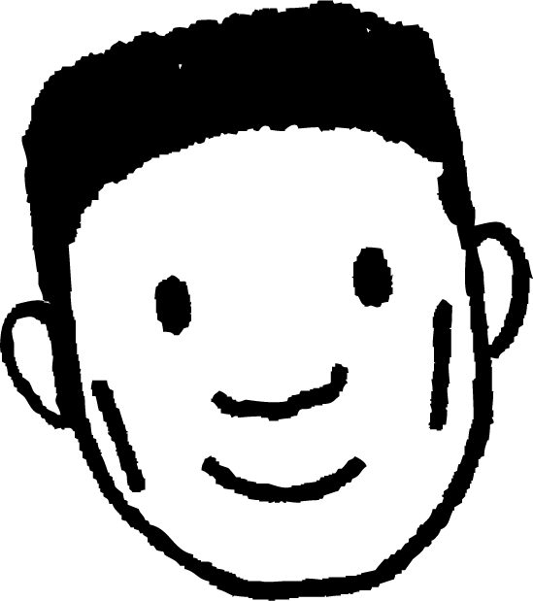
Hubinta isku-dhigmaanshaha (congruence)
Xagluhu waa isku mid. Saddexagalladu waa isku-dhigma (congruent).
A
4.5 cm
78°
6.4 cm
63°
39°
B
C
Ma sax buu yahay Cabdi?
7 cm
Q
Marka xagluhu isku mid yihiin, saddexagalladu waa isku-ekaansho (similar).
Waxaan u baahanahay inaan ogaanno dhererka cidhifyada, si aan u ogaanno haddii ay isku-dhigma (congruent) yihiin.
78°
63°
39°
R
P

Slide 13

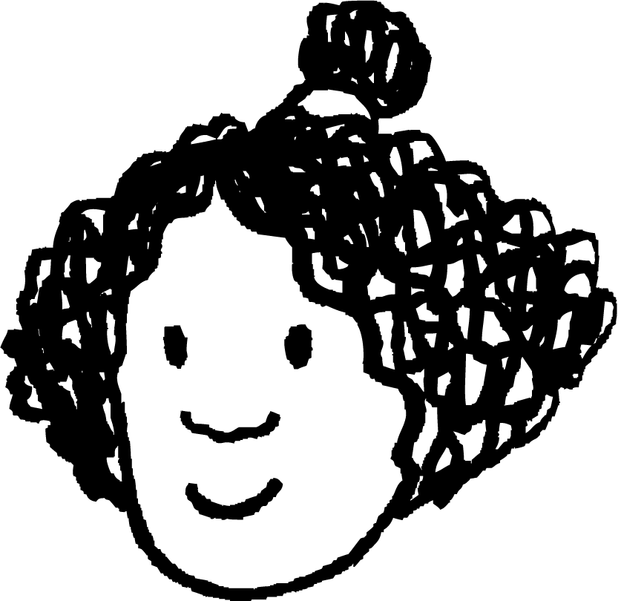
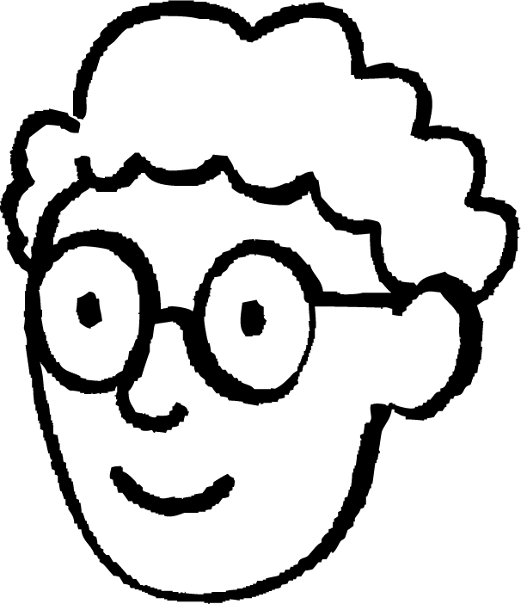


Hubinta isku-dhigmaanshaha (congruence)
Haddii dhinacyada iyo xaglaha u dhigma ay isku mid yihiin, labada saddexagal waa isku-dhigma (congruent).
Haddii laba saddexagal ay leeyihiin xaglo isku mid ah, taasi waxay ka dhigan tahay inay yihiin isku-ekaansho (similar).
Isra
Ma waxaan u baahanahay inaan ogaanno dhammaan macluumaadkaas si aan u hubinno inay isku-dhigma (congruent) yihiin?
Aan eegno …
Axmed

Slide 14
Hubinta isku-ekaanshaha (congruence)
Marka laba dherer oo dhinac ah isku xirmaan meel (vertex), xagal (angle) ayaa abuurmaya.
3.1 cm
3.1 cm
3.1 cm
31°
4.8 cm
85°
98°
4.8 cm
4.8 cm
Adigoo isku xira cidhifyada qaybaha xariiqda (line segments), saddex xagal oo kala duwan ayaa la abuuraa.

Slide 15
Hubinta isku-ekaanshaha (congruence)
Ma laba xagal oo leh saddex dhinac oo isku mid ah ayaa yeelan kara xaglo gudaha oo kala duwan?
Waa kuwan saddex goobo (circles). Gacan-ku-dheere (radius) kasta waa dherer go'an oo dhinac ah.
r3 = 3.9 cm
r1 = 3.2 cm
r2 = 2.1 cm
🖇 SSS

Slide 16
Hubinta isku ekaanshaha (Guaranteeing congruence)
Ma laba xagal oo leh saddex dhinac oo isku mid ah ayaa yeelan kara xaglo gudaha oo kala duwan?
Haddii laba goobo (circles) laga dhigo xarun isku mid ah, xagal (angle) ayaa la sameeyaa labada dhinac.
r3 = 3.9 cm
Marka xagalku (angle) isbeddelo, dhererka saddexaadna wuu isbeddelaa.
r1 = 2.1 cm
🖇 SSS
r2 = 3.2 cm

Slide 17
Hubinta isku ekaanshaha (Guaranteeing congruence)
Ma laba saddexagal oo leh saddexda dhinac oo isku mid ah ayaa yeelan kara xaglaha gudaha oo kala duwan?
Si loo abuuro saddexagal leh cidhifka saddexaad ee goobada ugu dambeysa, waa in lagu xuddunaa daraf ka mid ah radius-ka (radius) iyo radius-ka kale waa inuu ku yaallaa wareegga (circumference) goobada.
3.9 cm
Labadan saddexagal waa isku mid (congruent), waa is-daba-reex (reflections) midba midka kale.
3.9 cm
2.1 cm
2.1 cm
3.9 cm
2.1 cm
3.9 cm
3.2 cm
3.2 cm
r3 = 3.9 cm
3.2 cm
3.2 cm
r1 = 2.1 cm
🖇 SSS
r2 = 3.2 cm

Slide 18
Daminnada isku qaabnaanta (Guaranteeing congruence)
Ma laba saddexagal oo leh saddexda dhinac oo isku mid ah ayaa yeelan kara xaglaha gudaha oo kala duwan?
Maya, dhererka dhinacyada (side lengths) ayaa gooya cabbirka xaglaha (angles).
Marka, laba saddex-xagal oo leh saddex geesood (edges) isku mid ah, ma isku qaab (congruent) bay noqonayaan?
Haa, haddii aan ognahay in dhinacyadu (edges) isku mid yihiin, markaas waxaan ognahay inay isku qaab (congruent) yihiin.
3.9 cm
2.1 cm
3.2 cm
Shardigan (condition) ee isku qaabnaanta (congruence) saddex-xagalka waxaa loo yaqaan dhinac-dhinac-dhinac (side-side-side) ama SSS oo la soo gaabiyo.
Isra
Axmed

Slide 19

Daminnada isku qaabnaanta (Guaranteeing congruence)
Kee ka mid ah kuma isku qaab (congruent) labada kale?
Saddex-xagal ABC, halka AB = 9 cm, BC = 3 cm iyo AC = 10 cm
Saddex-xagal DEF, halka DE = 10 cm, DF = 9 cm iyo EF = 3 cm
Saddex-xagal GHI, halka GH = 10 cm, GI = 3 cm iyo HI = 10 cm

Slide 20
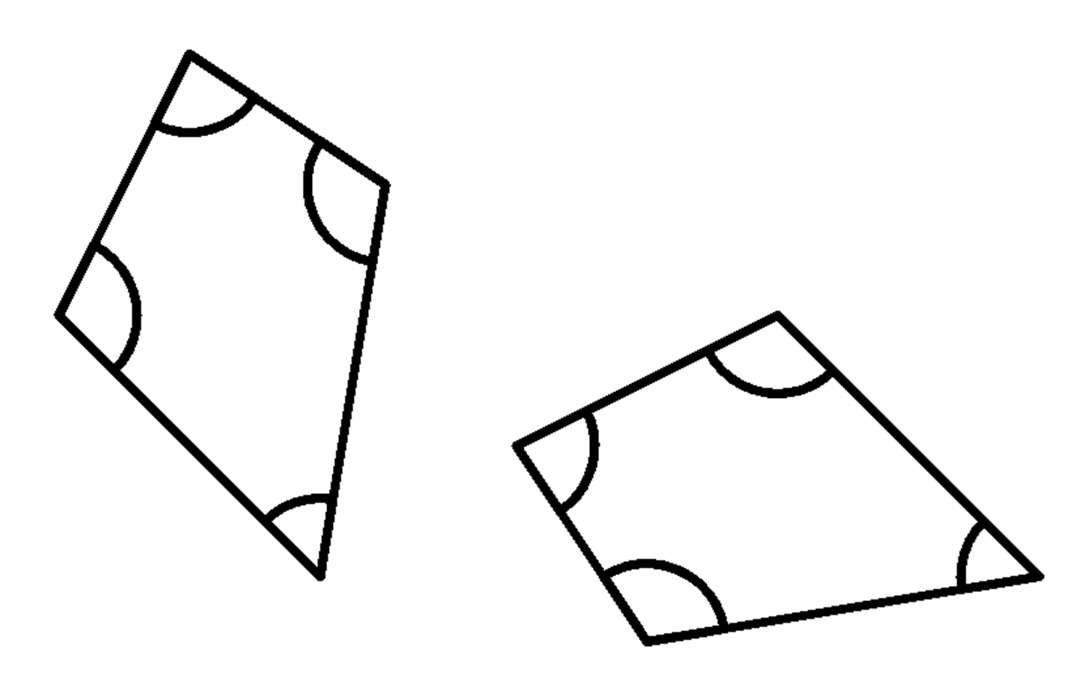
Daminnada isku qaabnaanta (Guaranteeing congruence)
1) Labadan afar-geesood (quadrilaterals) waa isku qaab (congruent). Buuxi meelaha bannaan.
3.6 cm
4.5 cm
83°
114°
83°
108°
55°
3.6 cm
5.7 cm
6.1 cm

Slide 21
Hubinta isku ekaanshaha (Guaranteeing congruence)
2) Bixi tusaale afar geesood oo muujinaya in shuruudahan aysan ku filnayn in lagu caddeeyo isku ekaanshaha (congruence).
a) xagluhu waa isku mid (angles are the same)
b) xagluhu waa isku mid oo isku hagaag (angles are the same and in the same order)
c) geesuhu waa isku dherer (edges are the same length)
d) geesuhu waa isku dherer oo isku hagaag (edges are the same length and in the same order)

Slide 22
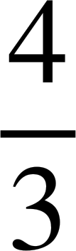
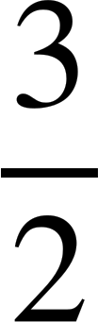
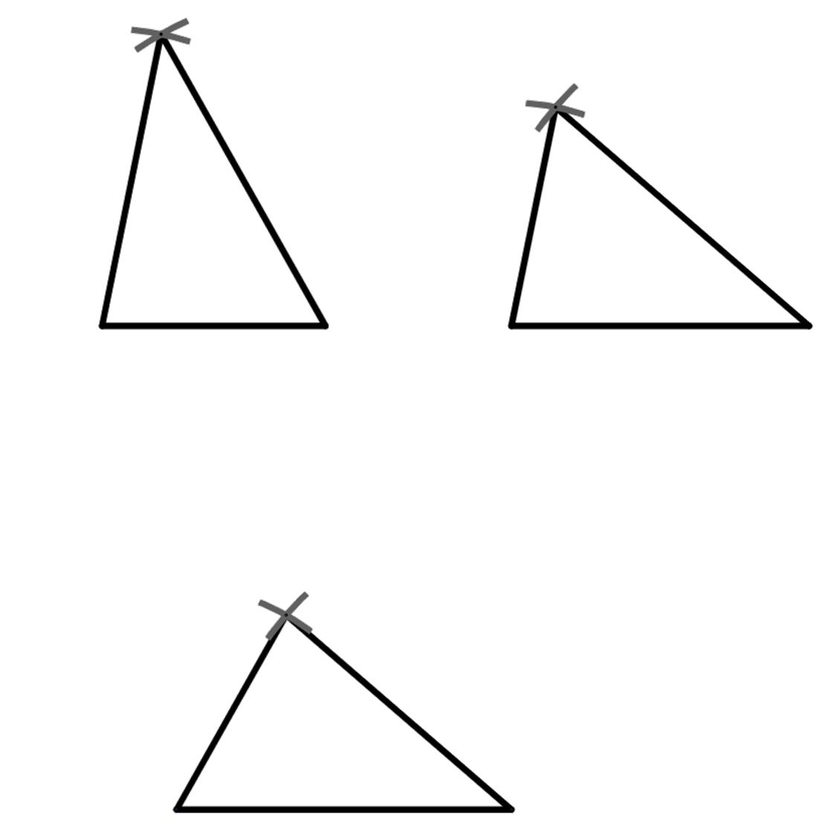
Hubinta isku ekaanshaha (Guaranteeing congruence)
3) Saddexagalka ABC, halkaasoo AB = x cm, AC = x cm iyo BC = x cm, waxaa la dhisay saddex jeer.
C
B
A
A
B
A
C
B
C
a) cabbir xaglaha ABC, BAC iyo BCA ee saddexda saddexagal
b) maxaad dareemiysaa?

Slide 23
Hubinta isku ekaanshaha (Guaranteeing congruence)
1) Labadan afar geesood waa isku mid (congruent). Buuxi meelaha bannaan.
3.6 cm
4.5 cm
4.5 cm
83°
5.7 cm
114°
108°
83°
108°
114°
55°
3.6 cm
55°
5.7 cm
6.1 cm
6.1 cm

Slide 24
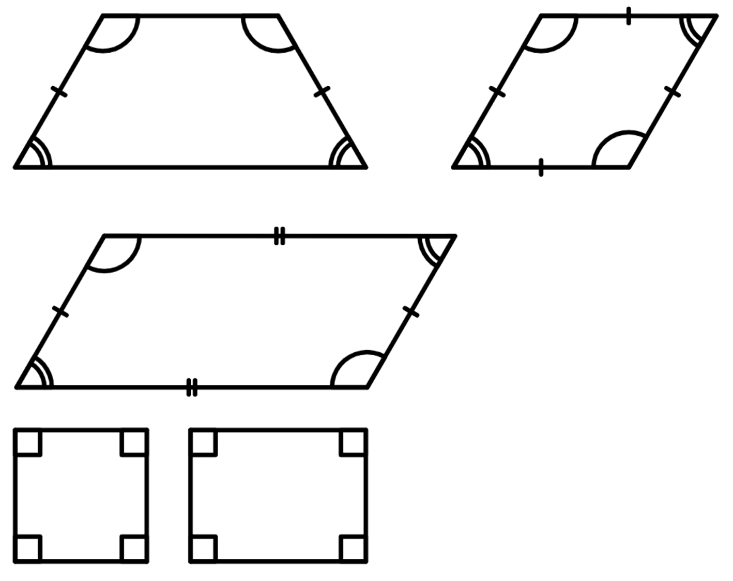
Hubinta isku-dhigmaanta (Guaranteeing congruence)
2) Bixi tusaale afar geesood oo muujinaya in shuruudahan aysan ku filnayn in lagu caddeeyo isku ekaanshaha (congruence).
a) xagluhu waa isku mid (angles are the same)
Trapezium isosceles (isosceles trapezium) iyo barbar-dhac (parallelogram) waxay yeelan karaan xaglo isku mid ah laakiin isku-dhigma (congruent) ma aha.
120°
120°
60°
60°

Slide 25
Hubinta isku-dhigmaanta (Guaranteeing congruence)
2) Tusaale u soo qaad afargeesle (quadrilaterals) oo muujinaya in shuruudahani aan ku filnayn caddaynta isku-dhigmaanta (congruence).
b) xaglo (angles) isku mid ah oo isku nidaam (same order) ah
Labajibbaaranayaal (Squares) iyo leydi (rectangles) waxay leeyihiin afar xagal qumman (right angles) laakiin isku-dhigma (congruent) ma aha.
Barbar-dhacyo (Parallelograms) iyo rhombi (rhombi) waxay yeelan karaan xaglo isku mid ah oo isku nidaam (same order) ah laakiin isku-dhigma (congruent) ma aha.
120°
120°
60°
60°

Slide 26
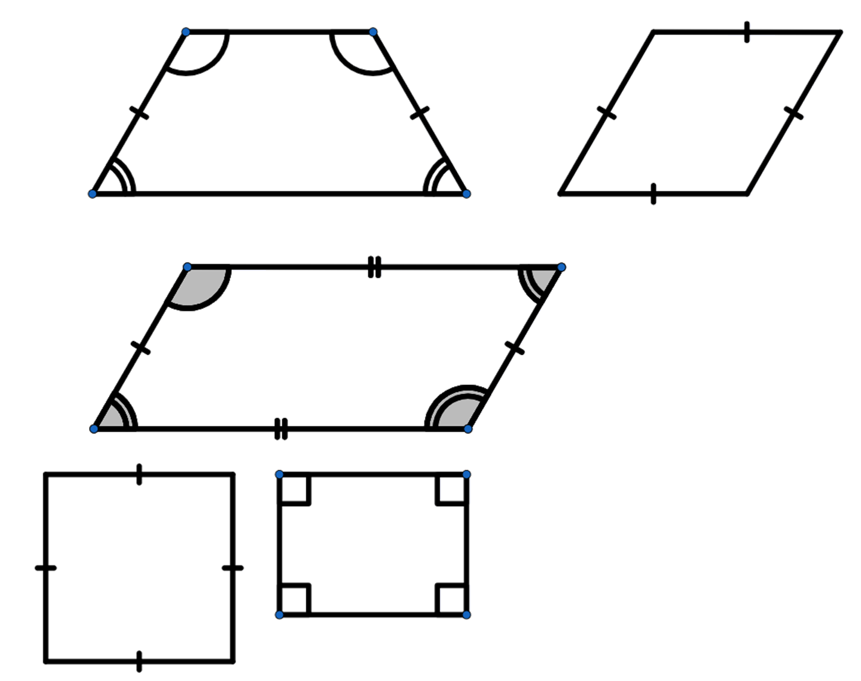
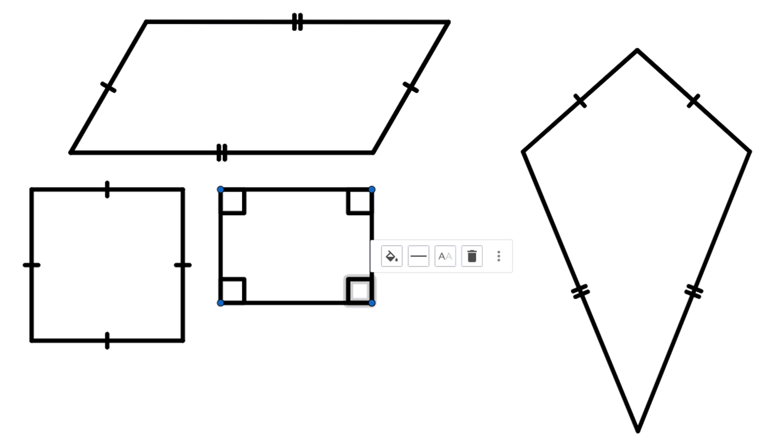
Hubinta isku-dhigmaanta (Guaranteeing congruence)
2) Tusaale u soo qaad afargeesle (quadrilaterals) oo muujinaya in shuruudahani aan ku filnayn caddaynta isku-dhigmaanta (congruence).
c) geeso (edges) isku dherer (same length) ah
Labajibbaaranayaal (Squares) iyo rhombi (rhombi) waxay yeelan karaan dhererka geesaha (edge lengths) isku mid ah laakiin isku-dhigma (congruent) ma aha.
Qaanso-rogrog (Kites) iyo barbar-dhac (parallelograms) waxay yeelan karaan dherer (lengths) isku mid ah laakiin isku-dhigma (congruent) ma aha.

Slide 27
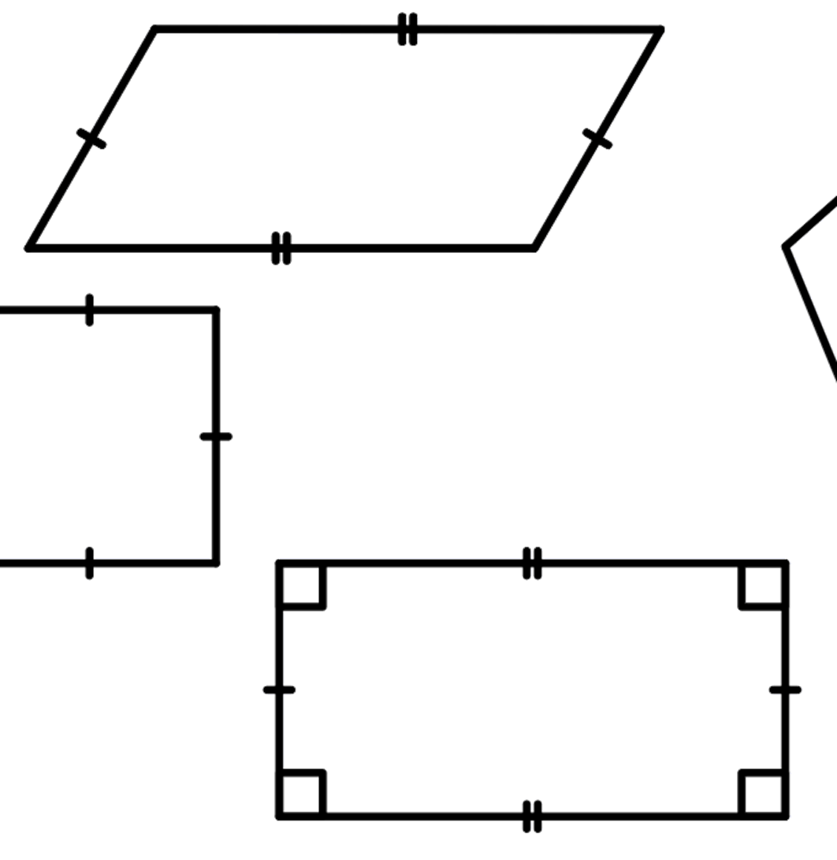
Hubinta isku-dhigmaanta (Guaranteeing congruence)
2) Tusaale u soo qaad afargeesle (quadrilaterals) oo muujinaya in shuruudahani aan ku filnayn caddaynta isku-dhigmaanta (congruence).
d) geeso (edges) isku dherer (same length) ah oo isku nidaam (same order) ah
Leydi (Rectangles) iyo barbar-dhac (parallelograms) waxay yeelan karaan dhererka geesaha (edge lengths) isku mid ah oo isku nidaam (same order) ah laakiin isku-dhigma (congruent) ma aha.

Slide 28
Hubinta isku-dhigmaanta (Guaranteeing congruence)
3) Saddex-xagalka (triangle) ABC, halkaas oo AB = x cm, AC = x cm iyo BC = x cm ah, ayaa saddex jeer la dhisay,
Protractor-yadu (Protractors) waxay sax yihiin ilaa darajada ugu dhow (nearest degree), markaa jawaabtaadu waa inay ku dhowaataa qiimahan (value) la siiyay.
C
40.8°
B
A
60.6°
78.6°
78.6°
60.6°
78.6°
60.6°
40.8°
40.8°
A
B
A
C
B
C
a) cabbir xaglaha (angles) ABC, BAC iyo BCA ee mid kasta oo ka mid ah saddexda saddex-xagal (triangles)
b) maxaad u ogaatay?
Xagluhu (Angles) waa isku mid dhismid kasta.

Slide 29
Saddexagallo isku mid ah (congruent triangles) (SSS)
Sidee ayay isku mid yihiin (congruent)?
Caddaynta isku midnimada (congruence) iyadoo la adeegsanayo SSS

Slide 30
Caddaynta isku midnimada (congruence) iyadoo la adeegsanayo SSS
Waxaan hubsan karnaa in laba saddexagal ay isku mid yihiin (congruent) haddii aan ognahay in saddexda gees (edges) ay isku mid yihiin labada saddexagal.
6.5 cm
3.6 cm
6.5 cm
4.9 cm
4.9 cm
3.6 cm
Jihada (orientation) iyo dareenka (sense) labada saddexagal uma baahna inay isku mid yihiin.

Slide 31
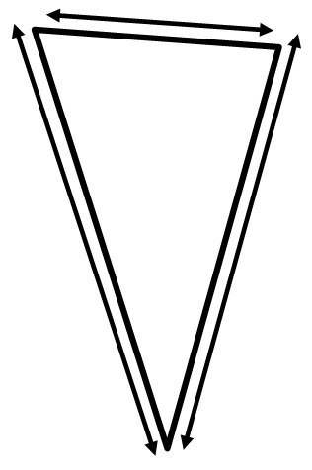
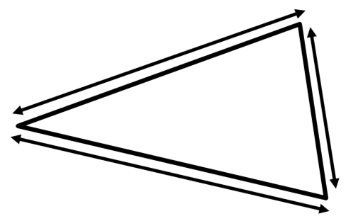
Caddaynta isku midnimada (congruence) iyadoo la adeegsanayo SSS
Adigoo adeegsanaya xaqiiqda ah in labadan saddexagal ay isku mid yihiin (congruent), buuxi meelaha bannaan.
3.6 cm
7 cm
3.6 cm
8.1 cm
8.1 cm
7 cm

Slide 32




Caddaynta isku midnimada (congruence) iyadoo la adeegsanayo SSS
Waa laydi (rectangle) oo leh mid ka mid ah jaantusyada (diagonals) oo la calaamadeeyay.
A
Miyey labada saddex-xagal ee ABC iyo ADC isku mid yihiin (congruent)?
D
Waxaan ku qiyaasi karnaa saddexda gees (edges) iyadoo la isticmaalayo bir-miqyaas (ruler).
B
C
Bir-miqyaas (ruler) ma haysto, xitaa haddii aan haysto kuma qummana (accurate) buuxda. Laakiin waxaan u malaynayaa inaan tusi karo inay yihiin…
Cali
Layla

Slide 33
Cadaynta isku midnimada (congruence) iyadoo la isticmaalayo SSS
Halkan waxaa ah leydi (rectangle) oo lagu calaamadeeyay mid ka mid ah xariijimaha geesaha (diagonals).
A
Miyey labada saddex-xagal ee ABC iyo ADC isku mid yihiin (congruent)?
D
B
C
Maadaama ay tahay leydi (rectangle), AD = BC
Oh, adoo isticmaalaya sifooyinka (properties) qaabka (shape).
iyo AB = DC.
AC waa gees (edge) labada saddex-xagal.
Sidaa darteed saddex-xagalka ABC iyo ADC waxay leeyihiin saddexda gees (edges) oo isku mid ah, marka waxay isku mid yihiin (congruent) iyadoo la isticmaalayo SSS.

Slide 34
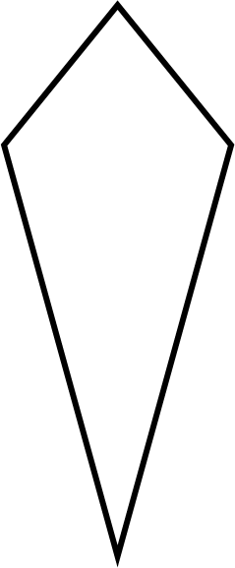
Cadaynta isku midnimada (congruence) iyadoo la isticmaalayo SSS
Caddee in saddex-xagalka ABC iyo saddex-xagalka ACD ay isku mid yihiin (congruent) gogol-xaadhkan (kite).
A
Maadaama ay tahay gogol-xaadh (kite), AB = AD.
B
D
Sidoo kale waa run in BC = DC.
AC waa gees (edge) labada saddex-xagal.
Sidaa darteed saddex-xagalka ABC iyo ACD waxay leeyihiin saddexda gees (edges) oo isku mid ah, marka waxay isku mid yihiin (congruent) iyadoo la isticmaalayo SSS.
C

Slide 35
Cadaynta isku midnimada (congruence) iyadoo la isticmaalayo SSS
1) Adoo ku qiyaasaya dhinacyada (sides) labadan saddex-xagal oo lammaane ah, go'aami inay isku mid yihiin (congruent) iyo in kale.
Z
A
a)
C
Y
B
X
P
V
b)
R
T
Q
U

Slide 36
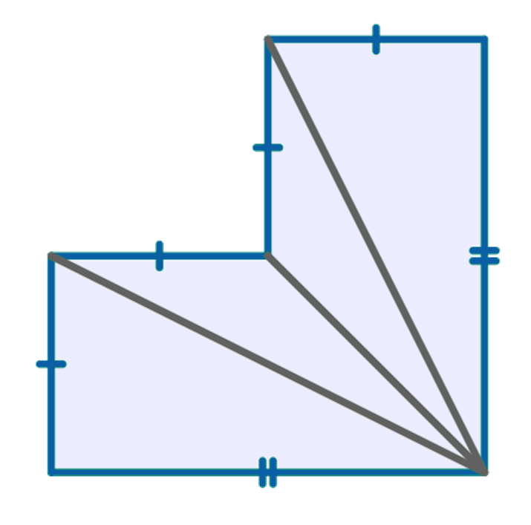
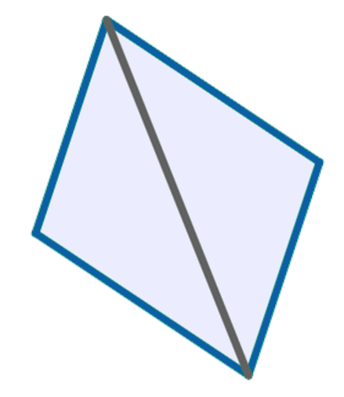
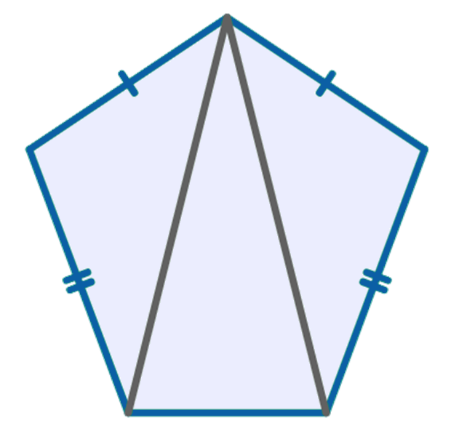
Cadaynta isku midnimada (congruence) iyadoo la isticmaalayo SSS
2) Adigoo isticmaalaya astaamaha (properties) ee qaababka, aqoonso saddexagallada (triangles) isku midka ah (congruent) SSS.
A
T
M
L
a)
b)
c)
P
S
N
D
I
B
Q
R
J
K
C
shangees (pentagon) summetri ah (symmetrical)
shagees (hexagon) summetri ah (symmetrical)
barbaroodle (parallelogram)

Slide 37
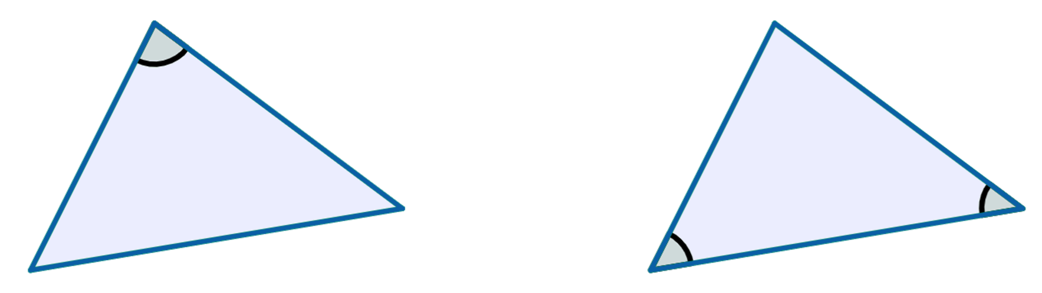
Caddaynta isku midnimada (congruence) SSS
3) Saddexagalladani waa isku mid (congruent). Adigoo isticmaalaya xaqiiqdan, ku dar dhererka geeska (edge) lagu calaamadeeyay x.
80°
5 cm
4.5 cm
46°
54°
x cm
6.1 cm

Slide 38
Caddaynta isku midnimada (congruence) SSS
1) Adigoo cabbiraya dhinacyada lamaanahan saddexagal, go'aanso inay isku mid yihiin (congruent) iyo in kale.
Z
A
a)
Waa isku mid (congruent).
C
Y
B
X
P
V
b)
R
T
Q
Ma aha isku mid (congruent).
U

Slide 39
Caddaynta isku midnimada (congruence) SSS
2) Adigoo isticmaalaya astaamaha (properties) ee qaababka, aqoonso saddexagallada (triangles) isku midka ah (congruent) SSS.
A
T
M
L
a)
b)
c)
P
S
N
D
I
B
Q
R
J
K
C
shangees (pentagon) summetri ah (symmetrical)
shagees (hexagon) summetri ah (symmetrical)
barbaroodle (parallelogram)
⃤ ABC ≅ ⃤ ADC
⃤ TPQ ≅ ⃤ TSR
⃤ IJK ≅ ⃤ MLK
⃤ INK ≅ ⃤ MNK

Slide 40
Cadaynta isku-ekaanshaha (congruence) iyadoo la isticmaalayo SSS
3) Lamaanahan saddex-xagalka (triangles) waa isku-ekaansho (congruent). Adigoo isticmaalaya xaqiiqdan, ku dar dhererka geeska (edge length) lagu calaamadeeyay x.
80°
5 cm
4.5 cm
46°
54°
6.1 cm
6.1 cm

Slide 41
Saddex-xagalka isku-ekaanshaha (Congruent triangles) (SSS)
Labo saddex-xagal (triangles) waxaa loo caddayn karaa inay yihiin isku-ekaansho (congruent), haddii aad ogtahay in dhererada saddexda gees (side lengths) ay isku mid yihiin.
Lamaanaha xaglaha u dhigma (corresponding angle pairs) waa isku mid yihiin qaababka isku-ekaanshaha (congruent shapes).

