Slide 1
Ilaalinta cufka (Conservation of mass) iyo isla'egyada calaamadaha ee dheellitiran (balanced symbol equations)
Fahanka falgalyada kiimikada (chemical reactions)

Slide 2
Sida agabkeena waxbarista loogu talagalay fasalka

Slide 3
Waxaan sharxi karaa ilaalinta cufka (conservation of mass) iyo qori karaa isla'egyada kiimikada ee dheellitiran (balanced chemical equations) si aan u muujiyo sida atom-yada falgalyada (reactants) loo habeeyo si ay u sameeyaan waxsoosaarka (products).

Slide 4
qaacidada kiimikada (chemical formula)
isla'egta erayada (word equation)
isla'egta calaamadaha ee dheellitiran (balanced symbol equation)
tiro-koob (coefficient)

Slide 5
Qaacidada kiimikada (chemical formula) waxay ka dhigan tahay walax iyadoo la adeegsanayo calaamadaha curiyeyaasha (element symbols) iyo tirada / saamiga atom-yada ee curiye kasta (element) oo ku jira walaxda.
Isla'egta erayada (word equation) waa qaab lagu qeexo falgal (reaction) iyadoo la adeegsanayo magacyada kiimikada ee falgalyada (reactants) iyo waxsoosaarka (products).
Isla'egta calaamadaha ee dheellitiran (balanced symbol equation) waxay qeexaysaa falgal (reaction) iyadoo la adeegsanayo isla'eg calaamadeed oo leh tiro-koobyada (coefficients), kuwaas oo hubinaya in ay jiraan tirooyin siman oo atom-yada curiye kasta (element) ah oo labada dhinac ee isla'egta.
Tiro-koob (coefficient) waa tirada la dhigo horteeda qaacidada kiimikada (chemical formula) si loo dheellitiro isla'egta; waxay ku dhufataa dhammaan atom-yada qaacidada waxayna muujinaysaa saamiga walxaha ee falgal (reaction).

Slide 6

Ilaalinta cufka (Conservation of mass) iyo isla'egyada calaamadaha ee dheellitiran (balanced symbol equations)
Ilaalinta cufka (Conservation of mass)
Isla'egyada kiimikada (Chemical equations)

Slide 7
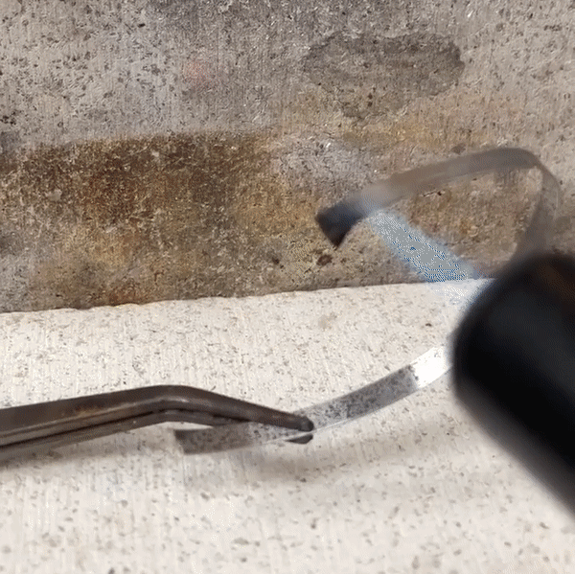
Ilaalinta cufka (Conservation of mass)
Inta lagu jiro falgal kiimikad (chemical reaction):
atom-yo lama abuuro mana la baabbi'iyo
atom-yada waa la habeeyaa si ay u sameeyaan walxo cusub
cufka waxsoosaarka (products) wuxuu la siman yahay cufka falgalyada (reactants).
Tan waxaa loo yaqaan ilaalinta cufka (conservation of mass).
falgal (reaction) ee magnesium iyo oxygen

Slide 8
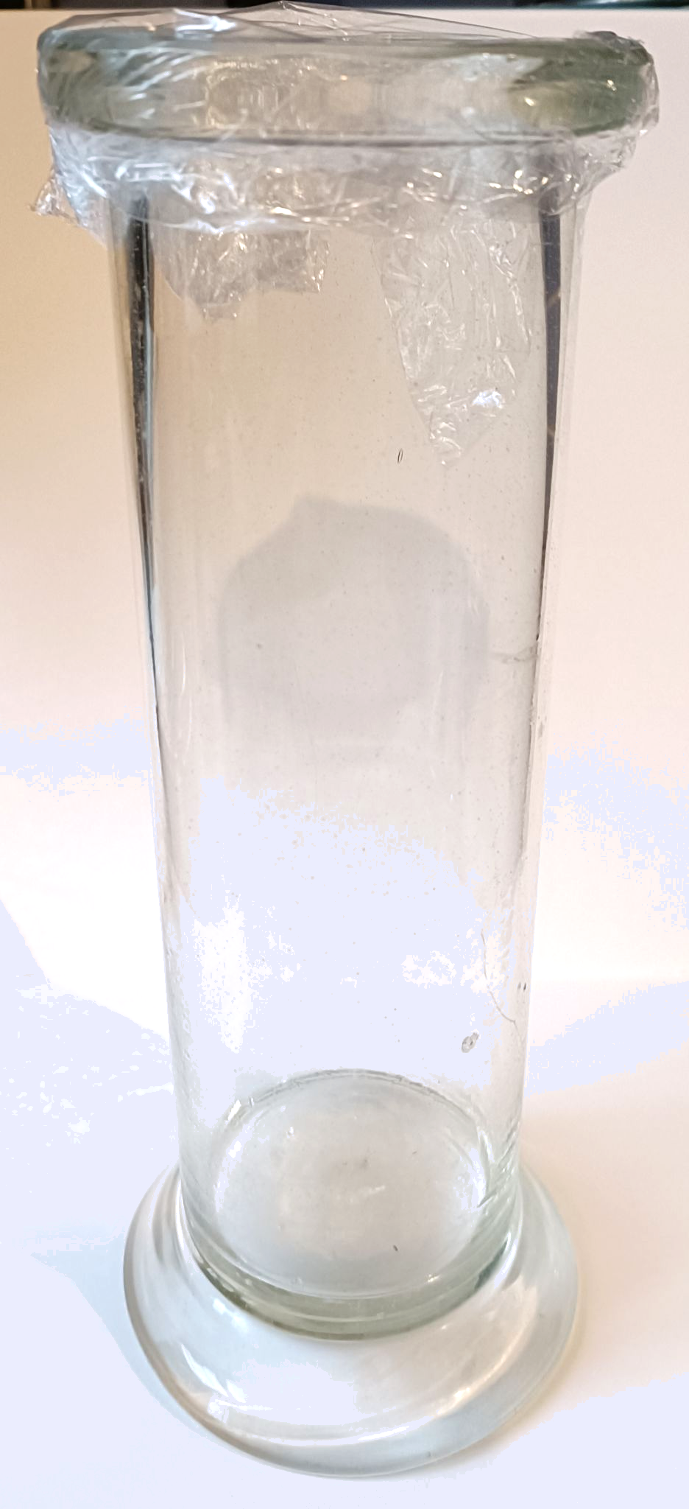
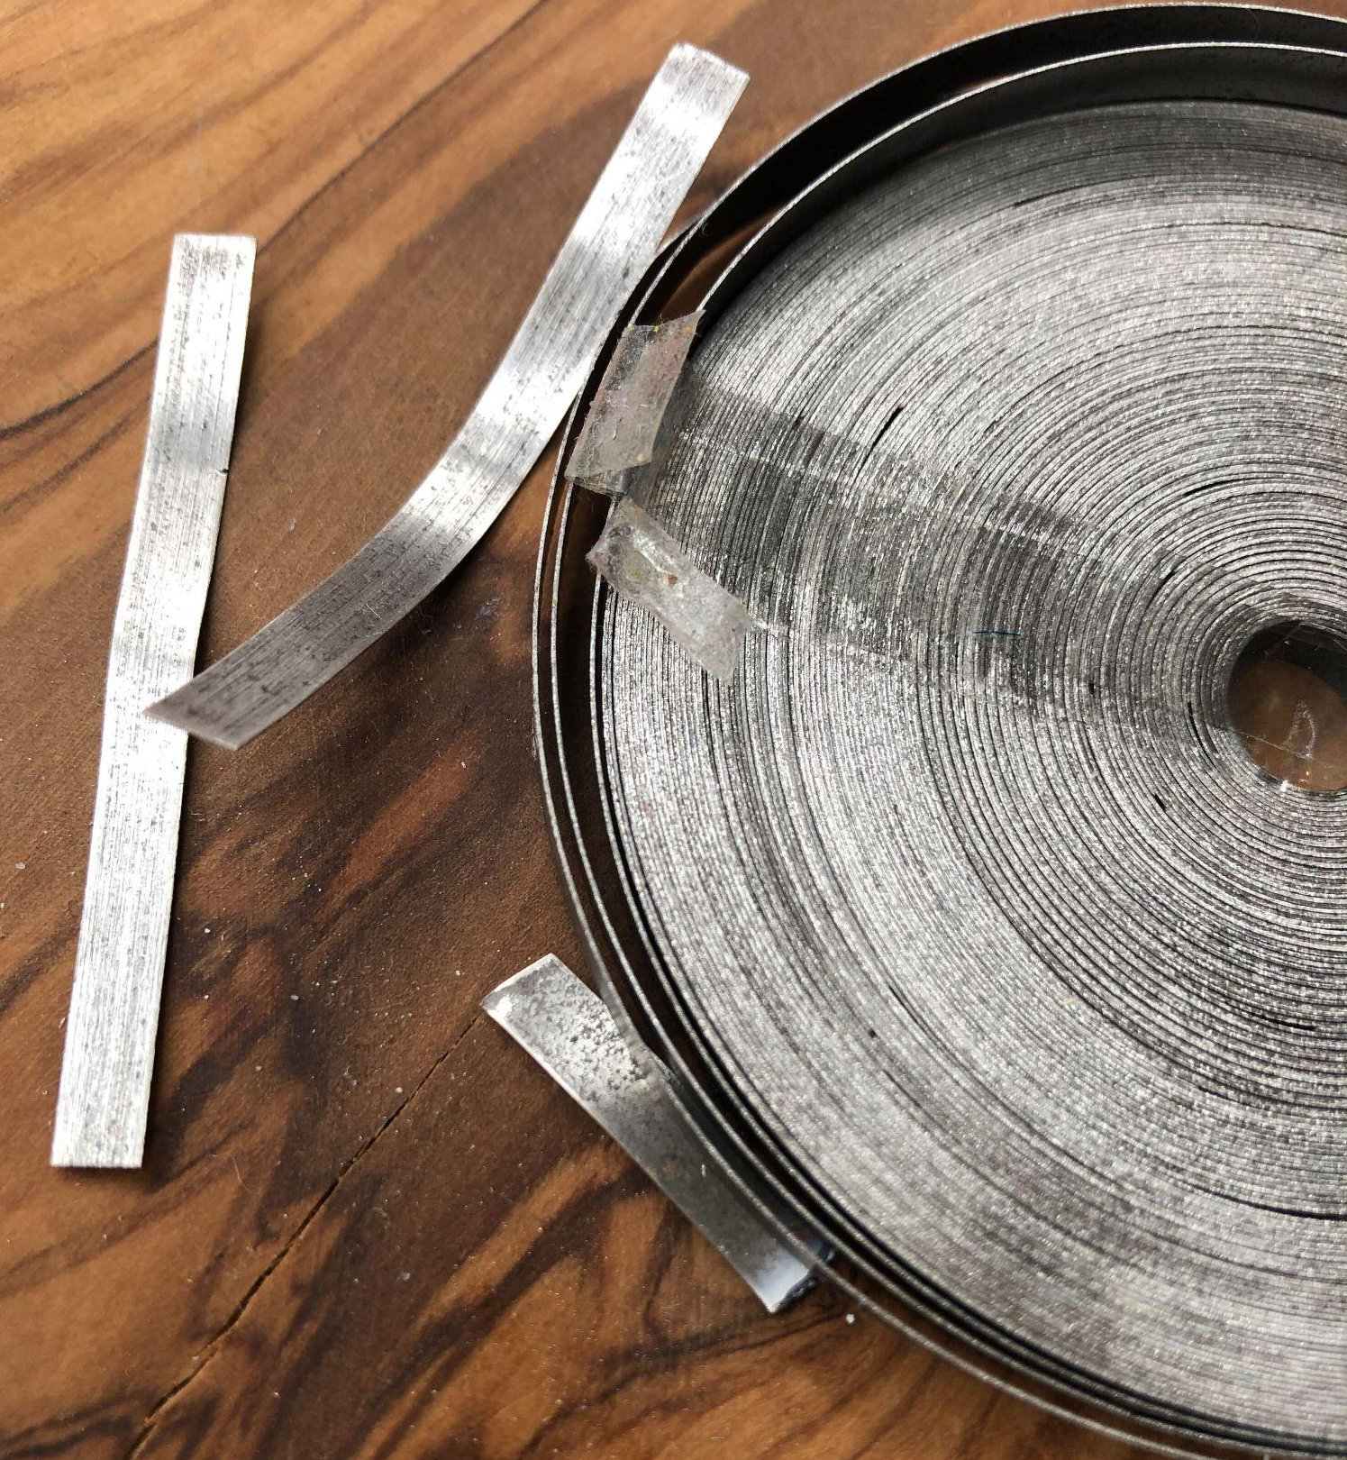
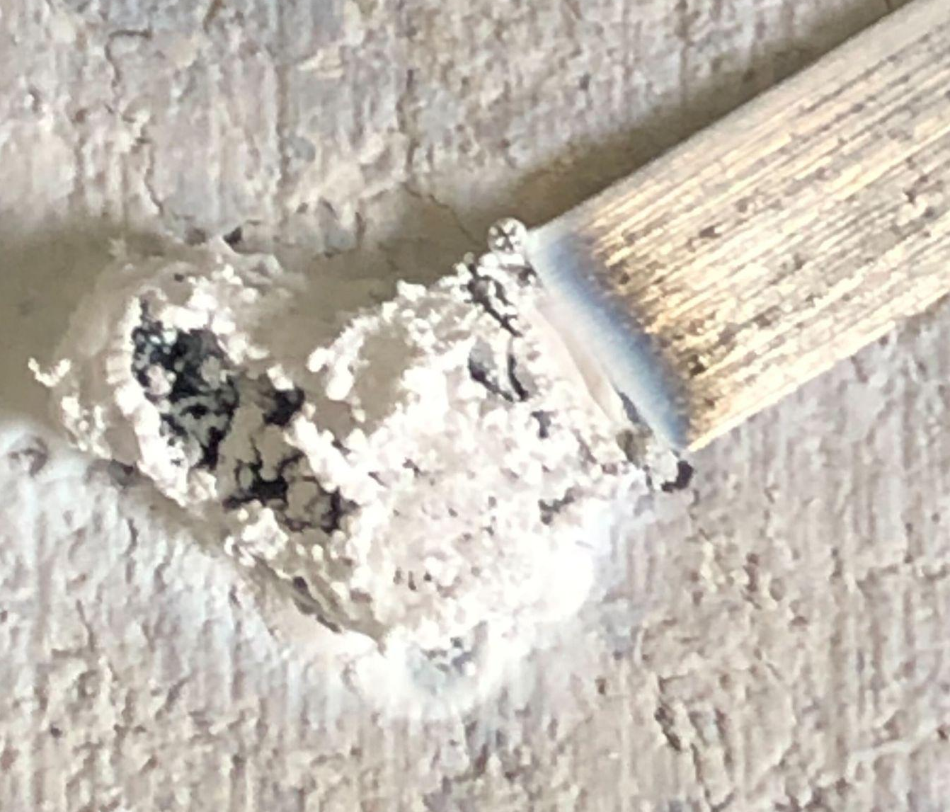
Ilaalinta cufka (Conservation of mass)
isle'eg kiimiko (chemical equation)
fal-celiyayaal (reactants)
badeecad (product)
magnesium (magnesium)
oxygen (oxygen)
magnesium oxide (magnesium oxide)
“magnesium (magnesium) ku dar oxygen (oxygen) isbeddelaa (ie sameeya) magnesium oxide (magnesium oxide)”

Slide 9
Ilaalinta cufka (Conservation of mass)
Fallaarta ku jirta isle'eg kiimiko (chemical equation) waxay u taagan tahay ereyada ‘isbeddelaa’.
fal-celiyayaal (reactants) → badeecado (products)
Isle'egyada ereyada waa qaab fudud oo lagu qeexo falgal (reaction) kiimiko iyadoo la adeegsanayo ereyo keliya.
magnesium oxide (magnesium oxide)
Ku darista oxygen (oxygen) (oxidation) waa tusaale falgal (reaction) kiimiko ah.
magnesium (magnesium) + oxygen (oxygen) →
fal-celiyayaal (reactants)
badeecad (product)

Slide 10
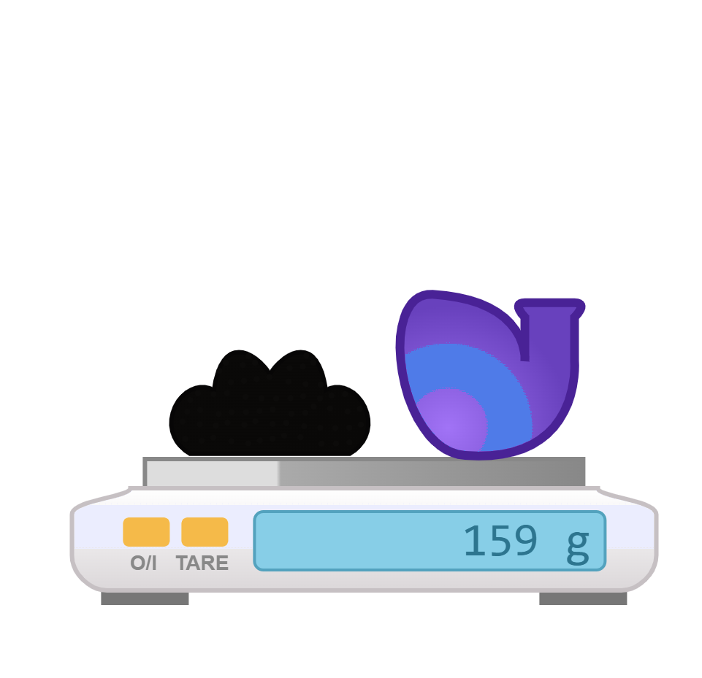
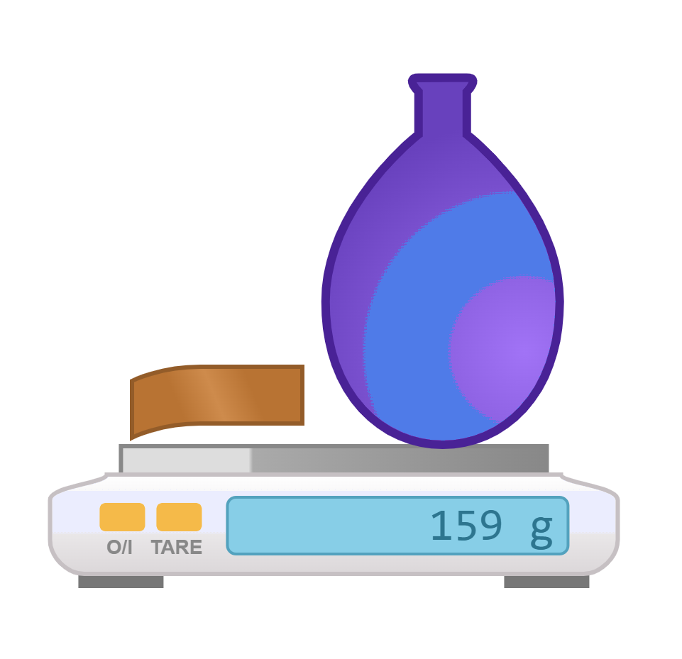
Ilaalinta cufka (Conservation of mass)
∑cufka fal-celiyayaasha (reactants) = ∑cufka badeecadaha (products)
wadarta (sum of)
127 g oo ah bir naxaas ah (copper metal) ayaa la fal-celsa 32 g oo oxygen (oxygen) ah; cufka fal-celiyayaasha (reactants) = 159 g.
copper (copper)
naxaas oxide (copper oxide)
naxaas (copper) + oxygen (oxygen) → naxaas oxide (copper oxide)
oxygen (oxygen)
127 g
32 g
→ 159 g
Wax soo saarka copper oxide wuxuu yeelan doonaa cuf 159 g. Tani waa isla cufka wadarta falgalka (reactants).

Slide 11

Ilaalinta cufka (Conservation of mass)
Kee ka mid ah weedhahan soo socda ayaa sax ah?
∑mass reactants＞∑mass products
∑mass reactants = ∑mass products
∑mass reactants＜∑mass products

Slide 12
Ilaalinta cufka (Conservation of mass)
Bir ayaa la falgasha oxygen (oxygen) weel weyn oo xiran.
Waxa ku jira ayaa lahaa cuf 150 g oo ah falgalayaal (bir iyo oxygen). Waa maxay cufka wax soo saarka (bir oxide)?
50 g
150 g
300 g

Slide 13
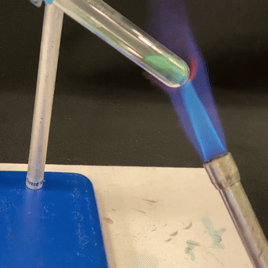
Ilaalinta cufka (Conservation of mass)
Mararka qaarkood, hal falgal (reactant) ayaa soo saara in ka badan hal wax soo saar.
Jebinta isku-dhafka (compound) ee walxo fudud (decomposition) waa tusaale falgal kiimiko (chemical reaction).
copper oxide (copper oxide)
carbon dioxide (carbon dioxide)
→
+
copper carbonate (copper carbonate)
kala-gurasho kulayl (thermal decomposition) ee copper carbonate
falgal (reactant)
wax soo saar (products)

Slide 14
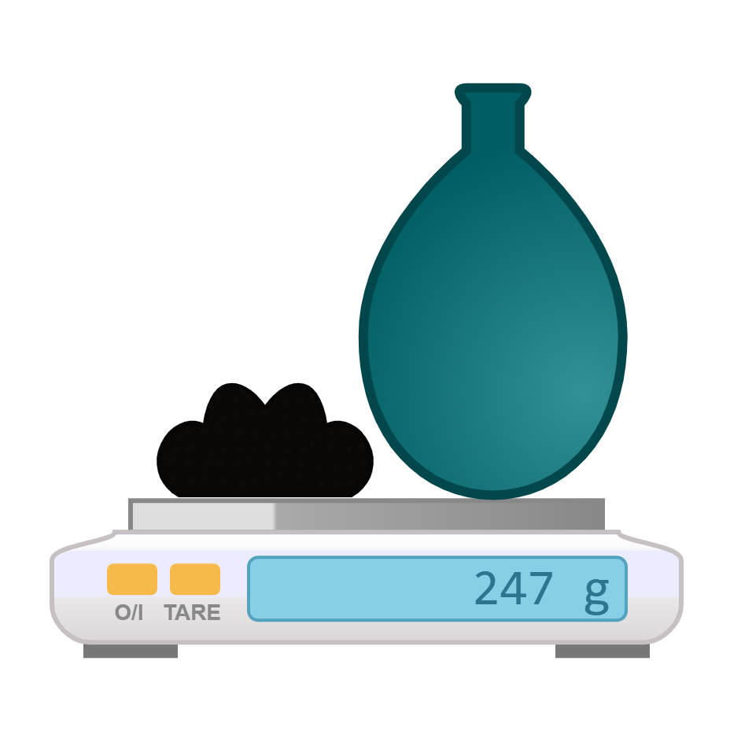
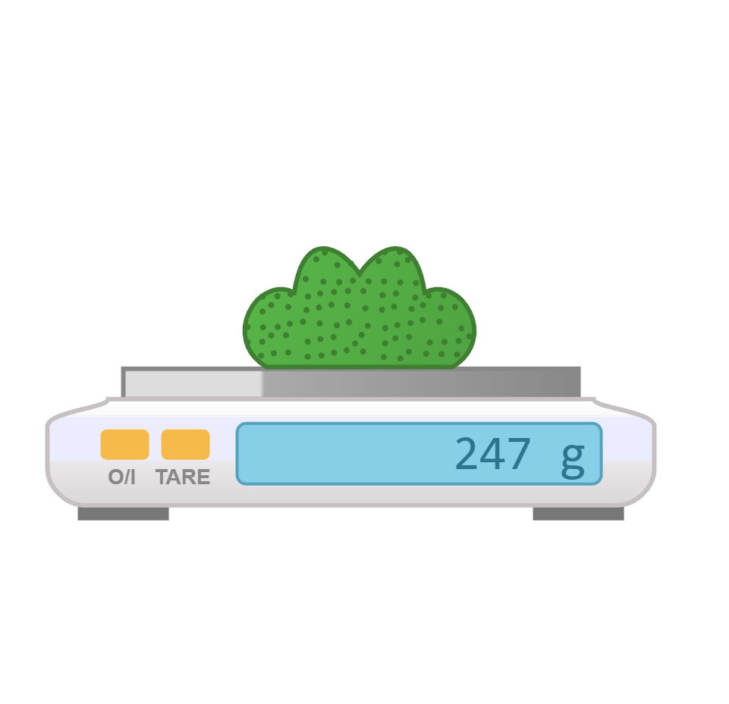
Ilaalinta cufka (Conservation of mass)
∑cufka falgalyaha (reactants) = ∑cufka waxsoosaarka (products)
247 g oo copper carbonate ah ayaa la kululeeyaa oo kala-gurasho (decomposes) si ay u sameeyaan wax soo saar ah 159 g copper oxide iyo 88 g carbon dioxide.
copper carbonate (copper carbonate)
carbon dioxide (carbon dioxide)
copper oxide (copper oxide)
copper carbonate (copper carbonate)
copper oxide (copper oxide)
carbon dioxide (carbon dioxide)
→
+
247 g
→
159 g
+
88 g
Waxsoosaarku (products) wuxuu yeelan doonaa cuf (mass) la mid ah wadarta cufka falgalyaha (reactants).

Slide 15
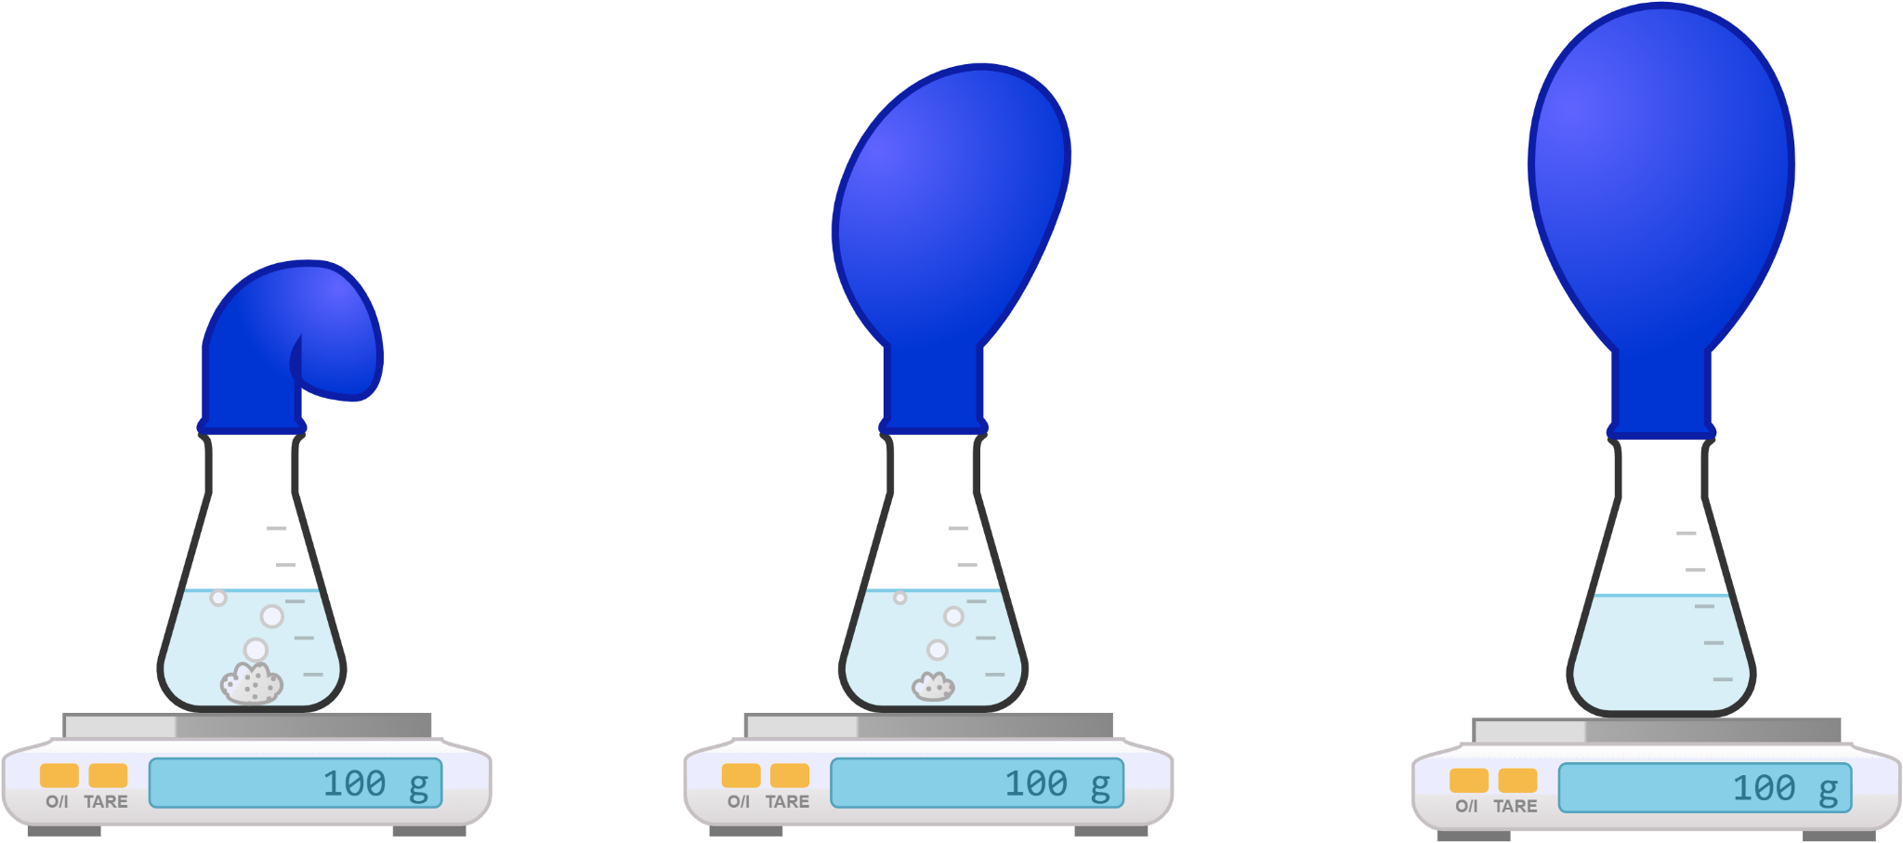
Ilaalinta cufka (Conservation of mass)
Halkan, cufka falgalyaha (reactants) iyo qalabka waa 100 g, oo maadaama aan atam (atoms) laga lumin ama lagu helin, cufka qalabka iyo waxsoosaarka (products) sidoo kale waa 100 g.
buufin (balloon)
hydrochloric acid (hydrochloric acid)
dhamaadka falgalka (end of reaction)
carbon dioxide (carbon dioxide)
calcium carbonate (calcium carbonate)
cufka qalabka iyo falgalyaha (reactants) = 100 g
cufka qalabka iyo waxsoosaarka (products) = 100 g

Slide 16
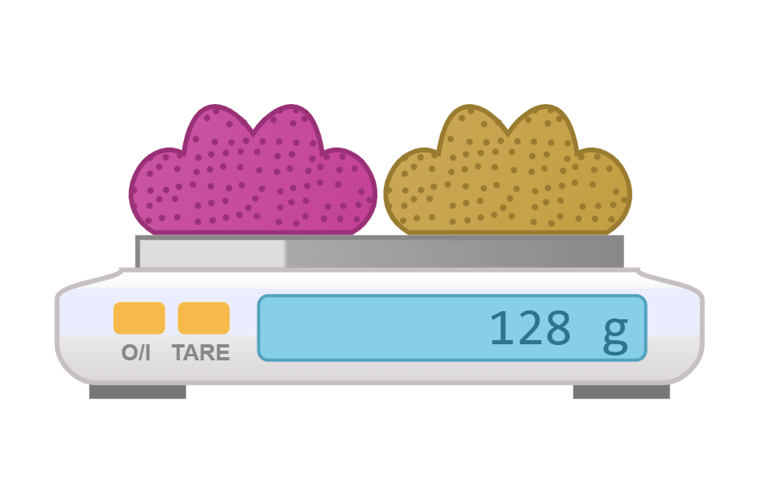

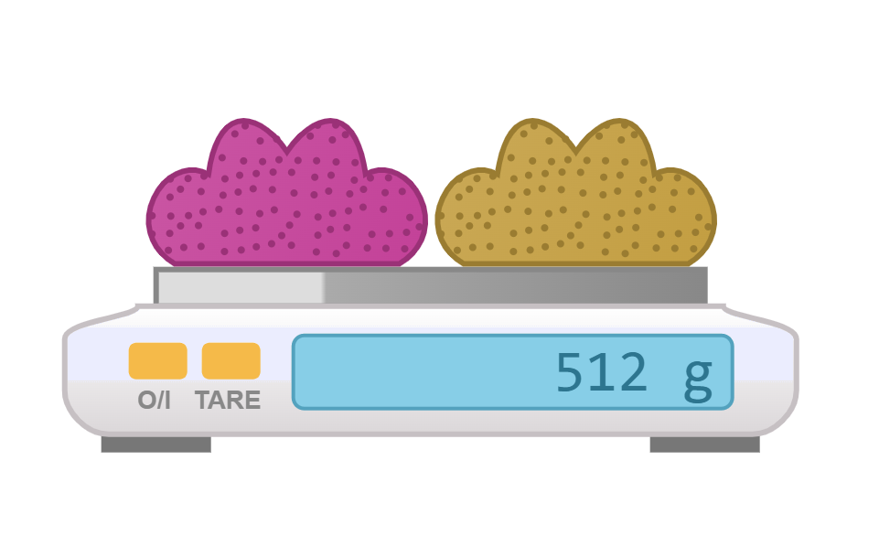
Ilaalinta cufka (Conservation of mass)
Falgal (reaction) u dhexeeya laba kiimiko (chemicals) ayaa dhaca oo soo saara wadar ahaan 256 g oo waxsoosaar (products) ah. Waa maxay wadarta cufka (mass) falgalyaha (reactants)?

Slide 17
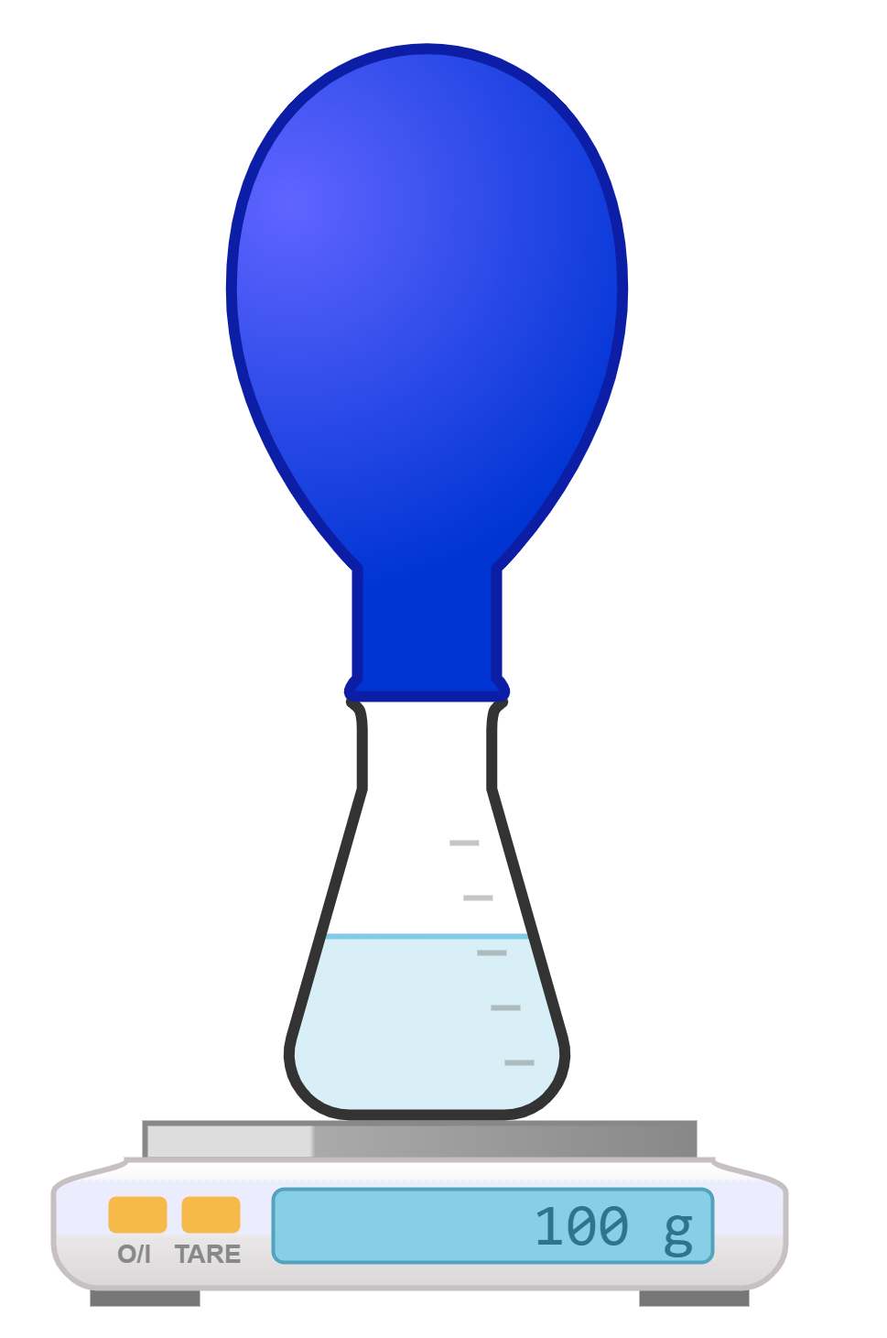
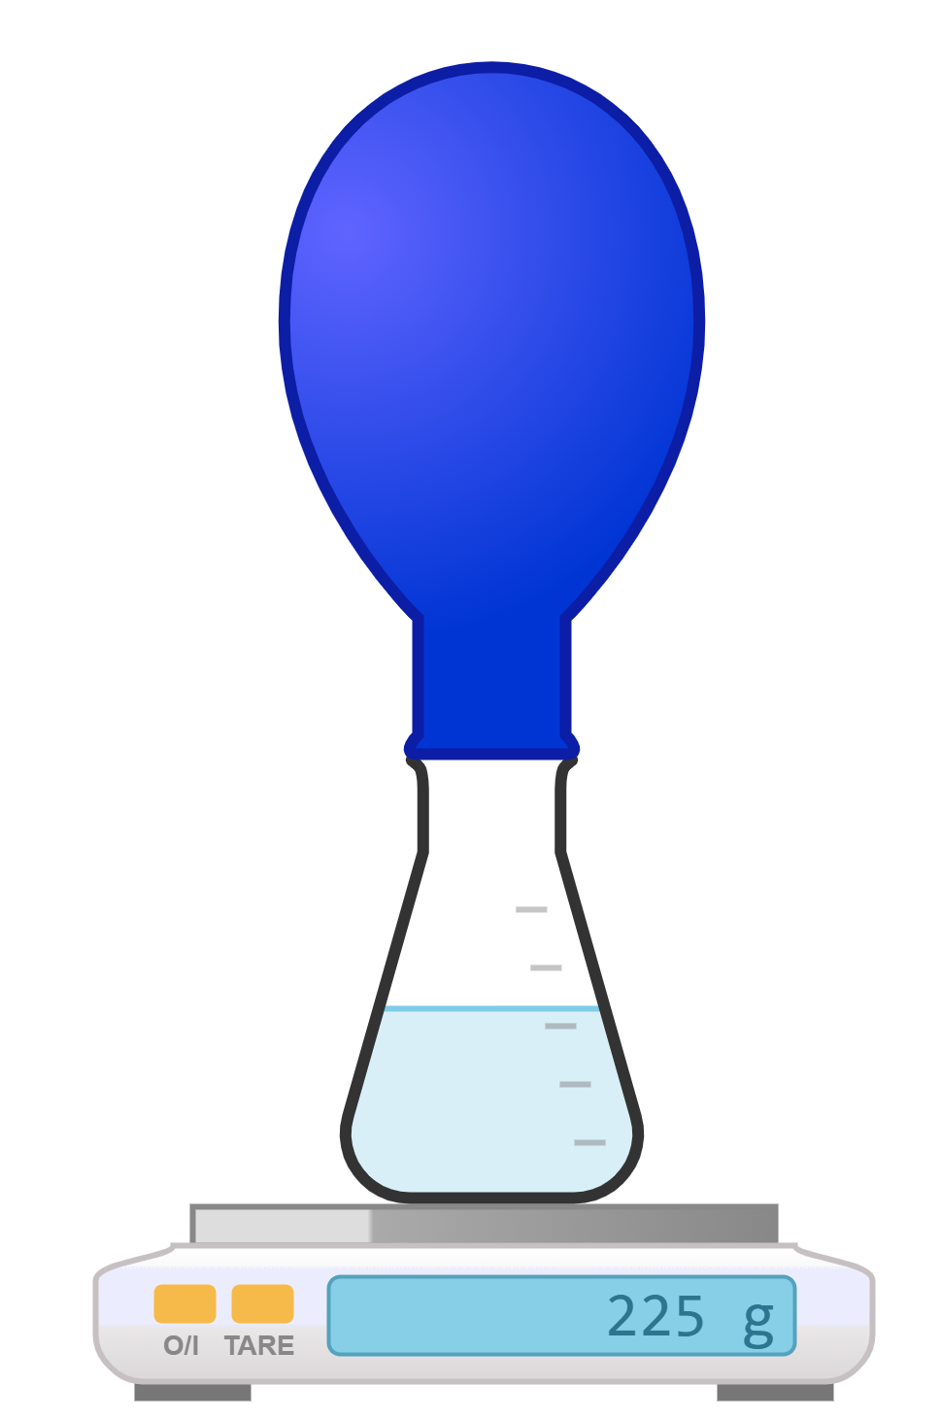
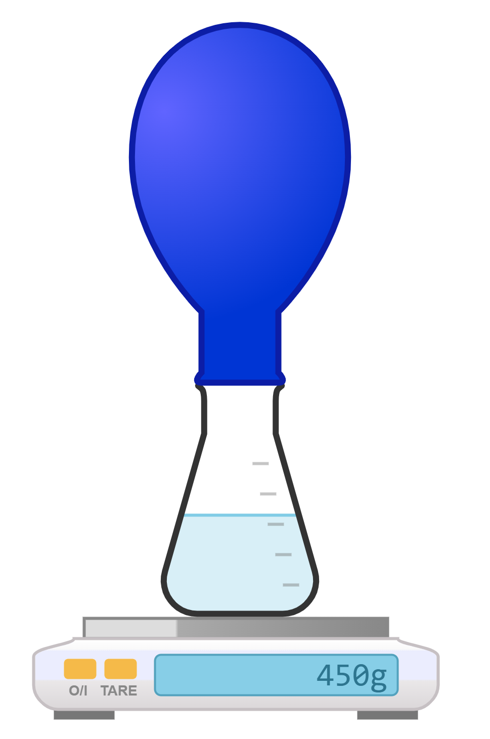
Ilaalinta cufka (Conservation of mass)
Cufka falgalyaha (reactants) iyo qalabka waa 225 g. Waa maxay akhrinta (reading) aad ka filan lahayd miisaanka (balance) dhamaadka falgalka (reaction)?
100 g
225 g
450 g

Slide 18

Ilaalinta cufka (Conservation of mass)
Cufka (mass) sheyga (product) dhamaadka falgal (reaction) waa 300 g. Waxaa jiray laba fal-celin (reactants); mid ka mid ah fal-celinta wuxuu lahaa cuf (mass) ah 120 g, marka waa maxay cufka (mass) fal-celinta kale?
a
120 g
b
180 g
c
300 g
d
420 g

Slide 19






Ilaalinta cufka (Conservation of mass)
Qaar ka mid ah ardayda ayaa ka hadlaya atamka (atoms) falgalyada (reactions). Sax bayaanadooda.
Atamku (atoms) waa soo baxaan oo waa baaba'aan marka falgal (reaction) dhaco.
Walxo cusub (new substances) ayaa laga sameeyaa sheyga (products) marka atamka (atoms) dib loo habeeyo inta lagu jiro falgal (reaction).
Cufka (mass) sheyga (products) mararka qaar wuu ka badan yahay cufka (mass) fal-celiyeyaasha (reactants).
Yacquub
Isra
Saciid

Slide 20
Ilaalinta cufka (Conservation of mass)
Qaar ka mid ah ardayda ayaa ka hadlaya atamka (atoms) falgalyada (reactions). Sax bayaanadooda.
Ma jiraan atam (atoms) la abuuro ama la baabbi'iyo marka falgal (reaction) dhaco.
Walxo cusub (new substances) ayaa laga sameeyaa fal-celiyeyaasha (reactants) marka atamka (atoms) dib loo habeeyo inta lagu jiro falgal (reaction).
Cufka (mass) sheyga (products) had iyo jeer wuxuu la mid yahay cufka (mass) fal-celiyeyaasha (reactants).
Yacquub
Isra
Saciid

Slide 21
Ilaalinta cufka (Conservation of mass)
Dhammeystir shaxda hoose (ha ku qorin sanduuqyada hadhka leh). Waxaad isticmaali kartaa xisaabiyaha (calculator).
cufka (mass) fal-celinta 1 (g) | cufka (mass) fal-celinta 2 (g) | ∑ cufka falgalayaasha (g) | cufka badeecada 1 (g) | cufka badeecada 2 (g) | ∑ cufka badeecadaha (g)
100 | 150 | 250
135 | 85 |  | 65
 |  | 950 |  | 525
127 | 84 |  |  | 12

Slide 22
Ilaalinta cufka (Conservation of mass)
Buuxi shaxda hoose (ha ku qorin sanduuqyada hadhka leh). Waxaad isticmaali kartaa xisaabiyaha (calculator).
cufka falceliyaha 1 (g) | cufka falceliyaha 2 (g) | ∑ cufka falgalayaasha (g) | cufka badeecada 1 (g) | cufka badeecada 2 (g) | ∑ cufka badeecadaha (g)
100 | 150 | 250
135 | 85 |  | 65
 |  | 950 |  | 525
127 | 84 |  |  | 12
220
950
211
Jawaabaha:
250
250
155
220
425
950
199
211

Slide 23
Ilaalinta cufka iyo isleegyada calaamadaha dheellitiran (Conservation of mass and balanced symbol equations)
Ilaalinta cufka (Conservation of mass)
Isleegyada kiimikada (Chemical equations)

Slide 24
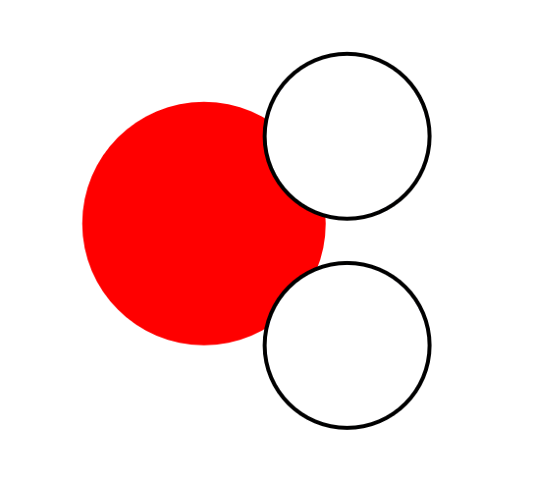
Isleegyada kiimikada (Chemical equations)
Qaaciddada kiimikada (chemical formula) ee walaxdu waxay muujinaysaa tirada nooc kasta oo atom ah oo jooga.
e.g. H₂O
lama baahna nambar hoose (subscript number) haddii uu jiro kaliya 1 atom oo noocaas ah
nambarka hoose (subscript number) waa tirada atomyada curiyaha (element) ee ku jira xarunta (compound)
H
O
H
2 × atomyada haydarojiin (hydrogen atoms)
1 × atom oksijiin (oxygen atom)

Slide 25
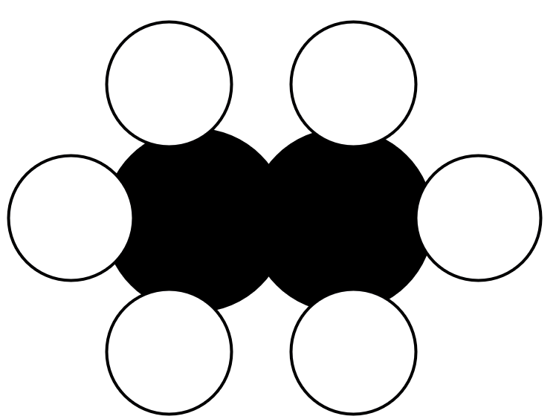
Isleegyada kiimikada (Chemical equations)
Tusaale kale oo qaacidada kiimikada ah.
tusaale ahaan ethane C2H6
3
4
nambarka subscript wuxuu kaliya ku dhufanayaa curiye (element) uu si toos ah u raaco
H
H
2
5
H
C
C
H
H
H
1
6
2 × atamka carbon
6 × atamka hydrogen

Slide 26



Isla'egyada kiimikada (Chemical equations)
Kee ka mid ah jaantusyada walxaha hoose ku habboon qaacidada kiimikada ee carbon dioxide (CO2)?
C
O
O
C
O
C
O
C

Slide 27
Isla'egyada kiimikada (Chemical equations)
Imisa iyo noocee atam ayaa ku jira copper sulfate (CuSO4)?
1 × atamka copper (Cu), 1 × atamka sulfur (S), 4 × atamka oxygen (O)
1 × atamka copper (Cu), 4 × atamka sulfur (S), 4 × atamka oxygen (O)
4 × atamka copper (Cu), 4 × atamka sulfur (S), 4 × atamka oxygen (O)

Slide 28
Isla'egyada kiimikada (Chemical equations)
Phosphoric acid wuxuu ka kooban yahay saddex atam oo hydrogen ah, hal atam oo phosphorus ah iyo afar atam oo oxygen ah.
Buuxi meelaha bannaan si aad u qorto qaacidada phosphoric acid.
H P O__
Citric acid wuxuu ka kooban yahay lix atam oo carbon ah, sideed atam oo hydrogen ah iyo toddoba atam oo oxygen ah.
Buuxi meelaha bannaan si aad u qorto qaacidada citric acid.
C H O__
H3PO4
C₆H₈O₇

Slide 29
Isla'egyada kiimikada (Chemical equations)
Copper carbonate wuxuu ka samaysan yahay hal atam oo copper (Cu) ah, hal atam oo carbon (C) ah iyo saddex atam oo oxygen (O) ah. Qor qaacidada copper carbonate.
Zinc sulfate wuxuu ka samaysan yahay hal atam oo zinc (Zn) ah, hal atam oo sulfur (S) ah iyo afar atam oo oxygen (O) ah. Qor qaacidada zinc sulfate.
Cu
C
O
₃
Zn
S
O
₄

Slide 30
Chemical equations
How many and what type of atoms are in the compound glucose, C₆H₁₂O₆?
6 × carbon (C) atoms, 12 × hydrogen (H) atoms and 12 × oxygen (O) atoms
6 × carbon (C) atoms, 6 × hydrogen (H) atoms and 12 × oxygen (O) atoms
6 × carbon (C) atoms, 12 × hydrogen (H) atoms and 6 × oxygen (O) atoms

Slide 31
Chemical equations
Sulfuric acid contains two hydrogen atoms, one sulfur atom and four oxygen atoms.
Midkee ka mid ah qaaciidooyinka soo socda ayaa matalaya aashitada sulfuric (sulfuric acid)?
H₂S₄O
H₄SO₂
H₂SO₄

Slide 32
Chemical equations
Symbol equations:
waa isla'egyo kiimiko oo isticmaala qaaciidooyin (formulae)
represent how atoms in the reactants rearrange to form products
muuji saamiga (ratio) falgalka (reactants) loo baahan yahay iyo alaabta (products) la sameeyo.
symbol equation
2Mg
O₂
2MgO
1
jaantuska walaxda (substance diagram)
Mg
Mg
O O
Mg O
Mg O

Slide 33

Isla'egyada kiimikada (Chemical equations)
Marka la dheellitiro isla'egyada (balancing equations), waxaa muhiim ah in la xusuusto:
dhammaan atamka falgalka (reactant atoms) waa dib loo habeeyaa si ay u sameeyaan alaabta (products)
atamka (atoms) lama lumin ama lama helin
tirada atamka falgalka (reactant atoms) = tirada atamka alaabta (product atoms)
atamka oksijiinta 'hadhay' (leftover oxygen atom)
Mg + O2 → MgO + O
2 Mg + O2 → 2 MgO

Slide 34
Isla'egyada kiimikada (Chemical equations)
Falalkan (reaction), laba jeer waxaa loo baahan yahay magnesium (magnesium) sida oxygen (oxygen) si loo falgaliyo dhammaan oxygen-ka.
magnesium (magnesium) + oxygen (oxygen) → magnesium oxide (magnesium oxide)
2
Mg + O2 → MgO
1
2

Slide 35
Isla'egyada kiimikada (Chemical equations)
Marka la qorayo isla'eg astaan (symbol equation):
saamiyada (ratios) falgalka (reactants) iyo alaabta (products) waxaa lagu muujiyaa isku-dhufashada (coefficients) ('tirooyin waaweyn') oo la hor dhigo walxaha
habka xisaabinta isku-dhufashada (coefficients) ee isla'eg astaan (symbol equation) waxaa loo yaqaan dheellitirid (balancing).
isla'eg astaan ah oo dheellitiran (balanced symbol equation)
2Na + Br2 → 2NaBr
halka aan la muujin isku-dhufashada (coefficient) waxaa loo qaadanayaa in ay jirto hal 'qayb' oo walaxda ah
isku-dhufashada (coefficients)

Slide 36
Isle'egyada kiimikada (Chemical equations)
Xeerarka qaaciidooyinka iyo isle'egyada:
qaaciidada kiimikada ee walaxdu ma beddelanto
subscripts ('tirooyin yaryar') ee qaaciidooyinka lama beddeli karo lamana kordhin karo
H₂O
H₂O₂
badbaado in la cuno
sun (toxic)
coefficients ('tirooyin waaweyn') had iyo jeer waxay ku hor yaalliin qaaciidooyinka waana beddeli karaan
H2SO4
2 H2SO4
3 H2SO4
haddii qaaciidada kiimikada aysan nambar ku hor qabin, coefficient-keedu waa 1.
O₂ = 1 O₂
H2SO4 = 1 H2SO4

Slide 37
Isle'egyada kiimikada (Chemical equations)
Waa maxay coefficient-ka Na (sodium) ee isle'egta soo socota? 4Na + O2→ 2Na2O ?
1
2
4
6

Slide 38
Isle'egyada kiimikada (Chemical equations)
Waa maxay coefficient-ka O2 (oxygen) ee isle'egta soo socota? C + O2→ CO2
​
0
1
2
4

Slide 39
Isle'egyada kiimikada (Chemical equations)
Kaliya subscripts ('tirooyin yaryar') ayaa la beddelaa si loo dheellitiro isle'eg, tusaale: 2P + 3Cl2 → P2Cl6.
Kaliya coefficients ('tirooyin waaweyn') ayaa la beddeli karaa marka la dheellitiraayo isle'egyada.
Labadaba coefficients ('tirooyin waaweyn') iyo subscripts ('tirooyin yaryar') waa la beddeli karaa marka la dheellitiraayo isle'egyada.

Slide 40
Isle'egyada kiimikada (Chemical equations)
Marka la dheellitiraayo isle'eg calaamadeed, ujeedku waa in la hubiyo in tirada atom-yada curiye (element) kasta ay isku mid tahay labada dhinac ee fallaarta falgal (reaction).
Zn
S
ZnS
Zn
S
Zn
S
Falgal (reaction) waa dheellitiran sida loo qoray.
Zn:
1
Zn:
1
S:
1
S:
1

Slide 41
Isla'egta kiimikada (Chemical equations)
Qaabaynta isla'egta sida hoos ku cad waxay kaa caawinaysaa inaad la socoto atamka ku lug leh.
Mg
O₂
MgO
Mg
O O
Mg
O
Falgal (reaction) ma aha dheellitiran sida loo qoray.
Mg:
1
Mg:
1
O:
2
O:
1

Slide 42
Isla'egta kiimikada (Chemical equations)
Haddii curiye (element) uu aan dheellitirnayn, ku dar walax dhammaystiran oo jaantus ah dhinaca ku habboon ee isla'egta.
Dib u xisaabi tirada atamka ee curiyeyaasha (elements).
Mg
O₂
MgO
Mg
O O
Mg
O
Mg
O
Falgal (reaction)-ku waa mid aan dheellitirnayn sida loo qoray.
Mg:
1
Mg:
1
2
O:
2
O:
1
2

Slide 43
Isleegyada kiimikada (Chemical equations)
Ku sii dar sawirada walxaha ku habboon ilaa curiye (element) kasta uu leeyahay tiro atam oo isku mid ah dhinac kasta oo fallaarta ah.
Xusuusnow inaad dib u xisaabiso tirada atamka ee curiyeyaasha (elements).
Mg
O₂
MgO
Mg
O O
Mg
O
Mg
Mg
O
Falgal (reaction)-ku waa mid dheellitiran sida loo qoray.
Mg:
2
1
Mg:
2
O:
2
2
O:

Slide 44
Isleegyada kiimikada (Chemical equations)
Marka atamka curiye (element) kasta ay isu dheellitiraan, tiriyo tirada sawirada walax kasta. Tani waa isku-dhufashada (coefficient) ee walaxdaas.
Mg
O₂
MgO
Mg
O O
Mg
O
Mg
Mg
O
Mg
2
O₂
1
MgO
2
iska'eg isla'eg calaamadeysan (balanced symbol equation)
uma baahnid inaad qorto 1

Slide 45
Isla'egyada kiimikada (Chemical equations)
Sidee u qori lahayd CaCO3 markaad tirinayso atomo si aad u dheellitirto isla'eg?
a
b
c
Ca C O
Ca C O O O
Ca Ca Ca C C C O O O O
Ca: 1
Ca: 1
Ca: 3
C: 1
C: 1
C: 3
O: 1
O: 3
O: 3

Slide 46
Isla'egyada kiimikada (Chemical equations)
Dheellitir isla'egta calaamadeysan.
Anigu waxaan ... (I do ...)
Adigu waxaad ... (You do ...)
O₂ + H₂ → H₂O
K + Cl2 → KCl
O O
H H
H H O
K
Cl Cl
KCl
H H
H H O
K
KCl
K:
1
2
K:
1
2
O:
2
O:
1
2
Cl:
2
Cl:
1
2
H:
2
4
H:
2
4
O₂ + 2H₂ → 2 H₂O
2K + Cl2→ 2KCl

Slide 47
Isleegyada kiimikada (Chemical equations)
Isku dhig qaaciddooyinka (formulae) iyo sharraxaadaha walxaha hoose (isticmaal shaxda xilliyeed (periodic table) si aad u eegto calaamadaha curiyeyaasha (elements)).
sharraxaad (description)
qaaciddo (formula)
nitrogen dioxide wuxuu ka kooban yahay hal atom oo nitrogen ah iyo laba atom oo oxygen ah
HNO3
ammonia wuxuu ka kooban yahay hal atom oo nitrogen ah iyo saddex atom oo hydrogen ah
N₂O
nitrous oxide wuxuu ka kooban yahay laba atom oo nitrogen ah iyo hal atom oo oxygen ah
NO2
nitric acid wuxuu ka kooban yahay hal atom oo hydrogen ah, hal atom oo nitrogen ah iyo saddex atom oo oxygen ah
NH3

Slide 48
Isleegyada kiimikada (Chemical equations)
Isku dhig qaaciddooyinka (formulae) iyo sharraxaadaha walxaha hoose (isticmaal shaxda xilliyeed (periodic table) si aad u eegto calaamadaha curiyeyaasha (elements)).
Sharaxaad
Formula
nitrogen dioxide wuxuu ka kooban yahay hal atom oo nitrogen ah iyo laba atom oo oxygen ah
HNO3
ammonia wuxuu ka kooban yahay hal atom oo nitrogen ah iyo saddex atom oo hydrogen ah
N₂O
Nitrous oxide wuxuu ka kooban yahay laba atom oo nitrogen ah iyo hal atom oo oxygen ah
NO2
Nitric acid wuxuu ka kooban yahay hal atom oo hydrogen ah, hal atom oo nitrogen ah iyo saddex atom oo oxygen ah
NH3

Slide 49
Isla'egyada kiimikada (Chemical equations)
Dheellitir isla'egyada soo socda, muuji shaqadaada:
Ca + O2 → CaO
Na + I2 → NaI
Ba + O2→ BaO
Na + O2 → Na2O
HgO → Hg + O2
KNO3→ KNO2+ O2
CaCO3​→ CaO + CO2​

Slide 50
Isla'egyada kiimikada (Chemical equations)
Dheellitir isla'egta calaamadda.
Ca + O2 → CaO
Ca
O O
Ca O
Ca
Ca O
Ca:
1
2
Ca:
1
2
O:
2
O:
1
2
2Ca + O2 → 2CaO

Slide 51
Chemical equations
Balance the symbol equation.
Na + I₂ → NaI
Na
I I
Na I
Na
Na I
Na:
1
2
Na:
1
2
I:
2
I:
1
2
2Na + I₂ → 2NaI

Slide 52
Chemical equations
Balance the symbol equation.
Ba + O₂ → BaO
Ba
O O
Ba O
Ba
Ba O
Ba:
1
2
Ba:
1
2
O:
2
O:
1
2
2Ba + O₂→ 2BaO

Slide 53
Chemical equations
Dheellitir isla'egta calaamadda (symbol equation).
Na + O2 → Na2O
Na
O O
Na Na O
Na
Na Na O
Na
Na
Na:
1
4
Na:
2
4
O:
2
O:
1
2
4Na + O2 → 2Na2O

Slide 54
Isla'egyada kiimikada (Chemical equations)
Dheellitir isla'egta calaamadda (symbol equation).
HgO → Hg + O2
Hg O
Hg
O O
Hg O
Hg
Hg:
1
2
Hg:
1
2
O:
1
2
O:
2
2HgO → 2Hg + O2

Slide 55
Isla'egyada kiimikada (Chemical equations)
Dheellitir isla'egta calaamadda (symbol equation).
KNO3 → KNO2 + O2
K N O O O
K N O O
O O
K N O O O
K N O O
K:
1
2
K:
1
2
N:
1
2
N:
1
2
O:
3
6
O:
4
6
2KNO3 → 2KNO2 + O2

Slide 56
Isla'egyada kiimikada (Chemical equations)
Dheellitir isla'egta calaamadda (symbol equation).
CaCO3 → CaO + CO2
Ca C O O O
Ca O
C O O
Ca:
1
Ca:
1
C:
C:
1
Isla'egta hore ayaa u dheellitiran sida qoran.
1
O:
3
O:
3
CaCO3 → CaO + CO2

Slide 57
Ilaalinta cufka (Conservation of mass) iyo isla'egyada calaamadda ee dheellitiran (balanced symbol equations)
Cufka (mass) alaabta soo baxda (products) ee falgalka (reaction) kiimikada wuxuu la mid yahay cufka fal-celiyeyaasha (reactants).
Isla'egyada ereyada (Word equations) waa qaab fudud oo lagu qeexo falgalada (reactions) kiimikada.
Qaaciddooyinka kiimikada (Chemical formulae) waxay matalaan tirada nooc kasta oo atam ah oo ku jira fal-celiye (reactant) ama alaab soo bax (product).
Isla'egyada kiimikada (Chemical equations) waxay matalaan sida atamka ku jira fal-celiyeyaasha (reactants) u dib-u-habeynayaan si ay u sameeyaan alaabta soo baxda (products).
Fallaarta (arrow) ee isla'egta kiimikada waxay mataleysaa ereyada 'isku beddelaa' (changes into).

