Slide 1
Kala duwanaansho joogto ah: maaraynta iyo falanqaynta xogta
Kala duwanaansho (farqiga u dhexeeya noocyada)

Slide 2
sida loo isticmaalo darasyada Oak

Slide 3
Waxaan ku sawiri karaa xogta kala duwanaanshaha joogtada ah ee histogram-ka waxaanan soo jeedin karaa sababaha suurtagalka ah ee kala duwanaanshaha.

Slide 4
kala duwanaansho joogto ah
Kala duwanaansho qaadan kara mid ka mid ah qiimayaal badan oo ku kala duwan xad joogto ah.
garaaf xariiq (line graph)
Garaaf muujinaya xog joogto ah oo loo sawiray dhibco isku xiran xariiq.
histogram
Garaaf muujinaya xog joogto ah oo loo kala saaray xaddiyo oo loo sawiray tiirar taabanaya.
deegaanka (environment)
Qodobo ku xeeran noolaha (organism) saameeya astaamihiisa.
hidde (genetic)
La xidhiidha maaddada hidde-sidaha (DNA) iyo hiddo-wadaha uu qofku leeyahay.

Slide 5

Kala duwanaansho joogto ah: maaraynta iyo falanqaynta xogta
Sawirista xogta joogtada ah
Falanqaynta xogta iyo gabagabada

Slide 6
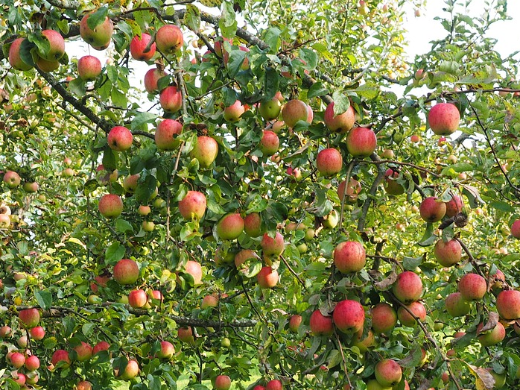
Sawirista xogta joogtada ah
Waxaa jira kala duwanaansho u dhexeeya shakhsiyaadka gudaha noocyada.
Qaar ka mid ah astaamaha waxay leeyihiin kala duwanaansho joogto ah.
Astaamaha leh kala duwanaansho joogto ah waxaa lagu qiyaasaa qiimayaal tiro.
Dhererka iyo cufka waa tusaalayaal.
Waxay qaadan karaan qiyam badan (laga yaabee qiyam aan xad lahayn) oo ku dhex jira kala duwanaansho joogto ah (continuous range).
tufaaxa way ku kala duwan yihiin cufkooda (mass)

Slide 7

Qorsheynta xogta joogtada ah (continuous data)
Waa maxay kala duwanaanshaha joogtada ah (continuous variation)?
Kala duwanaansho qaybsan (categorical) (loo qaybiyey qaybo gaar ah).
Kala duwanaansho dhacda wakhti kasta.
Kala duwanaansho qaadan karta mid ka mid ah qiyam badan oo ku dhex jira kala duwanaansho joogto ah (continuous range).

Slide 8
Qorsheynta xogta joogtada ah (continuous data)
Indho-indhaynta kala duwanaanshaha joogtada ah (continuous variation) waxay ina siinaysaa faafin cabbiro ah oo ku dhex jira kala duwanaansho joogto ah (continuous range).
Tixgeli dhererka shan arday oo Sannadka 8 ah:
Arday | Dhererka (cm)
A | 138
B | 144
C | 161
D | 136
E | 149
Haddii aan cabbirno 100 arday oo Sannadka 8 ah, waxaan heli lahayn qiyam aad u badan oo ku dhex jira kala duwanaanshaha 136 – 161 cm, iyo laga yaabee qaar ka baxsan kala duwanaanshahan.
Haddii aan ku cabbirno saxnaan (precision) weyn, waxaan diiwaangelin karnaa dhererka ilaa mm-ka ugu dhow, taasoo soo saari karta qiyam badan oo suurtagal ah.

Slide 9
Qorsheynta xogta joogtada ah (continuous data)
Way adag tahay in la arko qaababka (patterns) xogta (data) ku jira.
Kooxaynta xogta (data) ee kala duwanaanshaha (ranges) waxay naga caawisaa inaan aragno qaababka (patterns).
Arday | Dhererka (cm)
A | 138
B | 144
C | 161
D | 136
E | 149
Dhererka (cm) | Soo noqnoqoshada (Frequency)
130 – 139
140 – 149
150 – 159
160 – 169
170 – 179
Dhererka waxaa loo kooxeeyay kala duwanaansho (ranges).
2
2
1
Jawaabaha:
0
0

Slide 10
Qorsheynta xogta (data) joogtada ah (continuous data)
Kooxay xogta (data) u kala qaybi (ranges).
Arday | Dhererka (cm)
F | 167
G | 152
H | 149
I | 150
J | 165
K | 156
L | 178
Dhererka (cm) | Inta jeer (Frequency)
130 – 139
140 – 149
150 – 159
160 – 169
170 – 179
Jawaabaha:
0
1
3
2
1

Slide 11
Qorsheynta xogta (data) joogtada ah (continuous data)
Haddii aan haysano xog (data) badan, waxaan ku sawiri karnaa qaybaha (ranges) iyo inta jeer (frequencies) jaantus (graph) si ay u fududaato in la arko isbeddellada (trends) iyo qaababka (patterns).
6
5
Noocan xogta (data) waxaa loo sawiraa jaantus (histogram).
4
Inta jeer (Frequency)
3
2
Jaantuska (histogram) wuxuu muujiyaa qaybaha xogta (data ranges), iyadoo inta jeer (frequencies) loo sawiray tiirar (columns) taabanaya.
1
0
110
120
130
140
150
160
170
180
190
Dhererka (cm)

Slide 12
Qorsheynta xogta (data) joogtada ah (continuous data)
Jaantuska (histogram) wuu ka duwan yahay jaantuska (bar chart).
5
8
4
6
3
Inta jeer (Frequency)
Inta jeer (Frequency)
2
4
1
2
0
0
Buluug Cagaar Bunni
130
140
150
160
170
180
190
Dhererka (cm)
Midabka indhaha (Eye colour)
Jaantuska (histogram) wuxuu muujiyaa xog (data) joogto ah (continuous) oo ku qaybsan tiirar (columns) taabanaya.
Jaantuska (bar chart) wuxuu muujiyaa xog (data) aan joogto ahayn (discontinuous) oo ku qaybsan qaybo (categories) tiirar (columns) aan taabanayn.

Slide 13
Qorsheynta xogta (data) joogtada ah (continuous data)
Isticmaal ereyada sanduuqa ku qor si aad u dhamaystirto jumladaha.
qaybaha (categories) joogtada ah (continuous) kala go'a (discontinuous) kala duwanaanshaha (ranges)
Jaantuska 'histogram' wuxuu muujiyaa xogta __________
oo lagu sawiray __________ sida tiirar istaaban.
Jaantuska 'bar chart' wuxuu muujiyaa xogta __________
oo lagu sawiray __________ sida tiirar aan istaaban.
Jawaabaha:
joogtada ah (continuous)
kala duwanaanshaha (ranges)
kala go'a (discontinuous)
qaybaha (categories)

Slide 14
Sawiridda xogta joogtada ah (continuous data)
Xogta joogtada ah (continuous data) waxaa sidoo kale loo soo bandhigi karaa jaantus xariiq (line graph).
Arday | Dhererka (cm)
1 | 138
2 | 144
3 | 161
4 | 136
5 | 149
6
5
4
Inta jeer (Frequency)
3
2
1
0
135
140
145
150
155
160
165
Dhererka (cm)
Sawiridda xogtan sidan oo kale ma caawinayso marka ay jiraan dhibco xog oo yar.

Slide 15
Sawiridda xogta joogtada ah (continuous data)
Haddii aan haysanno xog badan, jaantus xariiq (line graph) wuxuu noqon karaa mid waxtar leh.
Ku daridda xariiqda ugu habboon (line of best fit) dhex maraysa dhibcaha sawiran waxay fududaynaysaa in la arko isbeddellada iyo qaababka.
Inta jeer (Frequency)
Dhererka (Height)
Tusaalahan:
Dhererka dhexda ee kala duwan ayaa ah kuwa ugu badan.
Dad aad u gaaban ama aad u dheer ayaa aad u yar.

Slide 16
Sawirista xogta joogtada ah (continuous data)
Garaafkee ama garaafyadaas ayaa ku habboon in lagu sawiro xogta joogtada ah (continuous data)?
garaaf xariiq (line graph)
histogram (histogram)
jaantuska (bar chart)
8
8
8
6
6
6
4
4
4
2
2
2
0
0
0
0 1 2 3
0 1 2 3
Buluug Cagaar Bunni

Slide 17
Sawirista xogta joogtada ah (continuous data)
Waxaan u soconaa inaan sawirno histogram (histogram) ee xogta joogtada ah (continuous data).
Dhererka (cm) | Soo noqnoqoshada (Frequency)
130 – 139 | 1
140 – 149 | 4
150 – 159 | 6
160 – 169 | 6
170 – 179 | 2
6
5
4
Soo noqnoqoshada (Frequency)
3
2
1
0
130
140
150
160
170
180
Dhererka (cm)

Slide 18
Sawirista xogta joogtada ah (continuous data)
Si loo habeeyo xogta loogu talagalay sawirista:
Samee jaantus (table) oo ah kala duwanaanshaha xogta, tusaale ahaan:
dhererka oo loo qaybiyay 10 cm oo kala duwan.
2. Xog kasta oo shakhsi ah u gudub oo ku tiri (tally) qaybta saxda ah.
Arday | Dhererka (cm)
1 | 138
2 | 144
3 | 161
Dhererka (cm) | Tiri (Tally)
130 – 139
140 – 149
150 – 159
Dherer (Height) (cm) | Inta jeer (Frequency)
130 – 139 | 2
140 – 149 | 2
150 – 159 | 0
Jawaabaha:
3. U beddel tiriyada (tallies) tirooyin.
//
//
0

Slide 19
Sawiridda xogta joogtada ah (continuous data)
Si loo sameeyo histogram (histogram):
1) Sawir dhidibka x (x–axis) (dherer (height)):
U qoondee tiir (column) qayb kasta. Waa inaysan jirin farqi (gap) u dhexeeya tiirarka.
Ku dar calaamado (labels) tiir kasta, iyo calaamad (label) dhidibka.
2) Sawir dhidibka y (y–axis) (inta jeer (frequency)):
Hubi in tirooyinku kor u kacayaan kordhin isle'eg (evenly–spaced increments).
Sawir tiirarka (columns) ilaa dhererka (height) saxda ah.
Midabee ama hoos ka hadh (shade) tiirarka.
Calaamadee (Label) dhidibka.
3) Ku dar cinwaan (title) garaafka (graph).
Dhererka (Heights) ardayda
6
5
4
Inta jeer (Frequency)
3
2
1
0
130
140
150
160
170
180
Dherer (Height) (cm)

Slide 20
Sawiridda xogta joogtada ah (continuous data)
Calaamadee (label) kee baa dhigi doona dhidibka y (y–axis)?
6
Inta jeer (Frequency)
5
4
3
Dherer (Height)
2
1
0
Kala duwanaansho (Range)
130
140
150
160
170
180

Slide 21

Qorsheynta xogta joogtada ah (Plotting continuous data)
Waxaa laga yaabaa inaad urursatay xogtaada joogtada ah (continuous data) oo aad qorsheyn karto.
Haddii kale, isticmaal xogta ceyriinka ah (raw data) ee ku qoran warqadda shaqada (worksheet).
1) U beddel xogtaada ceyriinka ah xog soo noqnoqota (frequency data) iyadoo la adeegsanayo kala duwanaansho (ranges) ku habboon, adigoo isticmaalaya tirid (tally).
2) Sawir histogram (histogram) si aad u muujiso xogta. Hubi in garaafkaagu uu leeyahay:
dhidibyo calaamadsan (labelled axes);
miisaan ku habboon (appropriate scale);
xariijimo toos ah oo lagu sawiray xisaabiyaha (ruler) iyo qalin (pencil);
cinwaan (title).

Slide 22
Qorsheynta xogta joogtada ah (Plotting continuous data)
Xogtaada soo noqnoqota (frequency data) waxay u ekaan kartaa tusaalooyinkan:
Dhererka ardayda (Heights of students)
Cufisyada tufaaxyada (Masses of apples)
Dherer (cm) | Soo noqnoqosho (Frequency)
130 – 139 | 3
140 – 149 | 6
150 – 159 | 11
160 – 169 | 8
170 – 179 | 2
Cufis (g) | Soo noqnoqosho (Frequency)
100 – 104 | 2
105 – 109 | 4
110 – 114 | 3
115 – 119 | 1

Slide 23
Qorsheynta xogta joogtada ah (Plotting continuous data)
2) Histogram-kaagu (histogram) wuxuu u ekaan karaa tusaalooyinkan:
Dhererka ardayda
11
10
Cufka tufaaxyada
9
8
5
7
4
6
Soo noqnoqosho (Frequency)
5
3
Joogista (Frequency)
4
3
2
2
1
1
0
0
100
105
110
115
120
130
140
150
160
170
180
Dherer (cm)
Cufka (g)

Slide 24
Kala duwanaanshaha joogtada ah: maaraynta iyo falanqaynta xogta
Qorista xogta joogtada ah (Plotting continuous data)
Falanqaynta xogta iyo gabagabada

Slide 25
Falanqaynta xogta iyo gabagabada
Waxaan ku qeexi karnaa xogta histogram-ka anagoo ka bilaabayna kala-dhaca ugu joogista badan (most frequent range) annagoo dibadda uga shaqaynayna:
11 arday oo fasalka ku jira ayaa dhexeeyay 150 iyo 159 cm dherer, taas oo ahayd tan ugu badan.
Dhererka labada dhinacba wuu ka yaraa, iyadoo 130–139 cm (3 arday) iyo 170–179 cm (2 arday) ay ahaayeen kuwa ugu yar.
Dhererka ardayda
11
10
9
8
7
6
Joogista (Frequency)
5
4
3
2
1
0
130
140
150
160
170
180
Dherer (cm)

Slide 26
Falanqaynta xogta iyo gabagabada
Laga soo bilaabo histogram-ka, soo koobiddee ayaa ugu habboon?
Cufka tufaaxa (Mass of apples)
5
Kala-duwanaanta cufka (range) ee la diiwaangeliyay waxay ahayd 19 g.
4
3
Joogista (Frequency)
2
Tufaaxyada badankood waxay miisaankoodu ahaa inta u dhaxaysa 106 g iyo 110 g.
1
0
3 tufaax ayaa ahaa kuwa ugu fudud ama ugu culus.
100
105
110
115
120
Cufka (g)

Slide 27
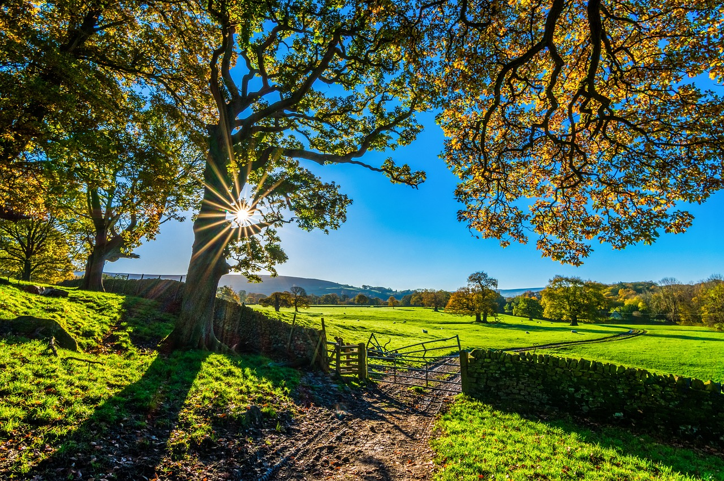
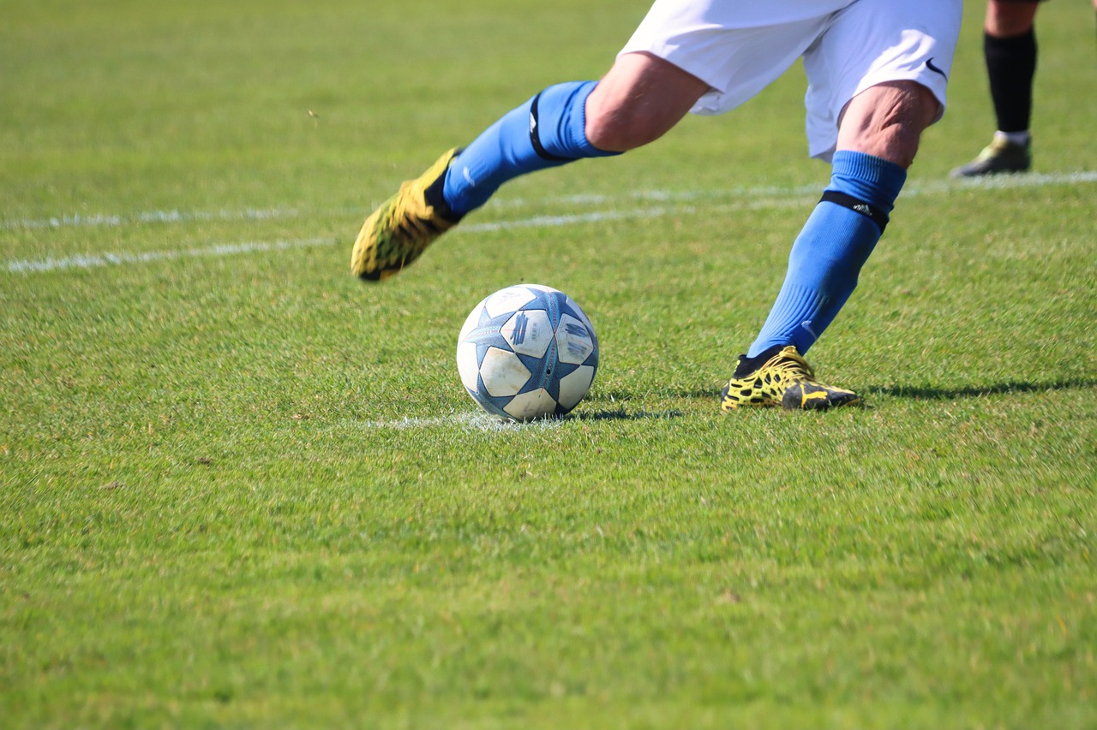
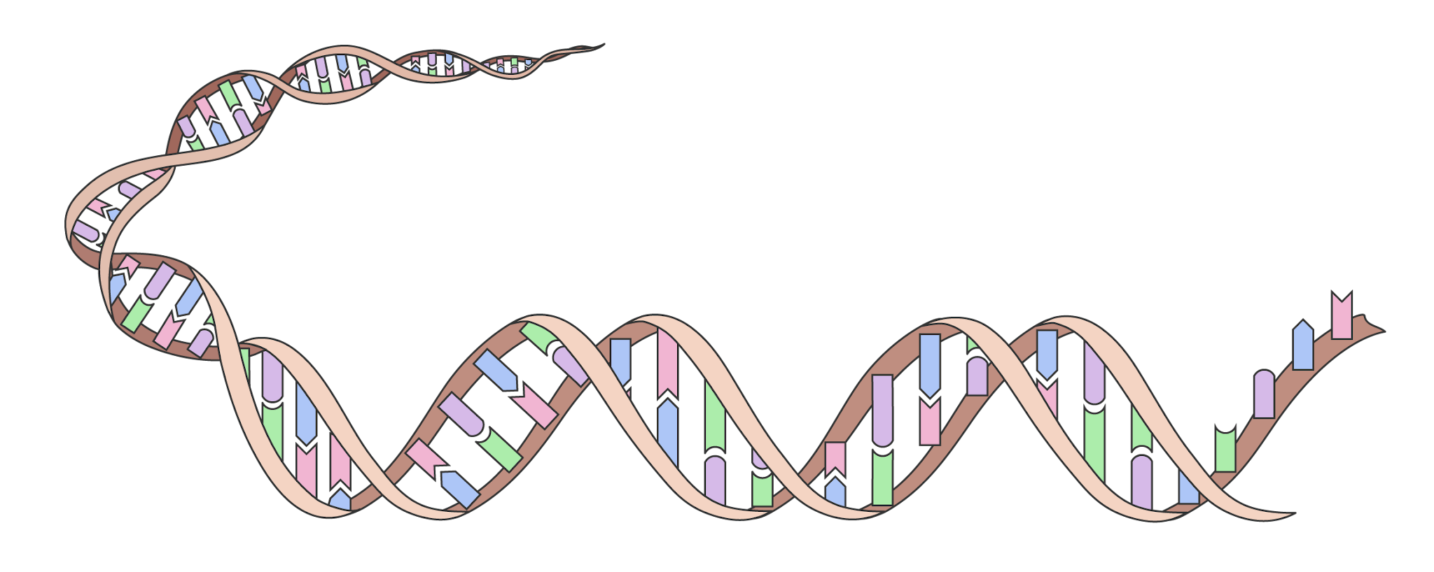
Falanqaynta xogta iyo gabagabada (Data analysis and conclusion)
Waxaa jira arrimo badan oo saameeya astaamaha noole (organism):
hidh-sidaha (genetics)
deegaanka (environment)
doorashada hab-nololeedka (lifestyle choices)

Slide 28
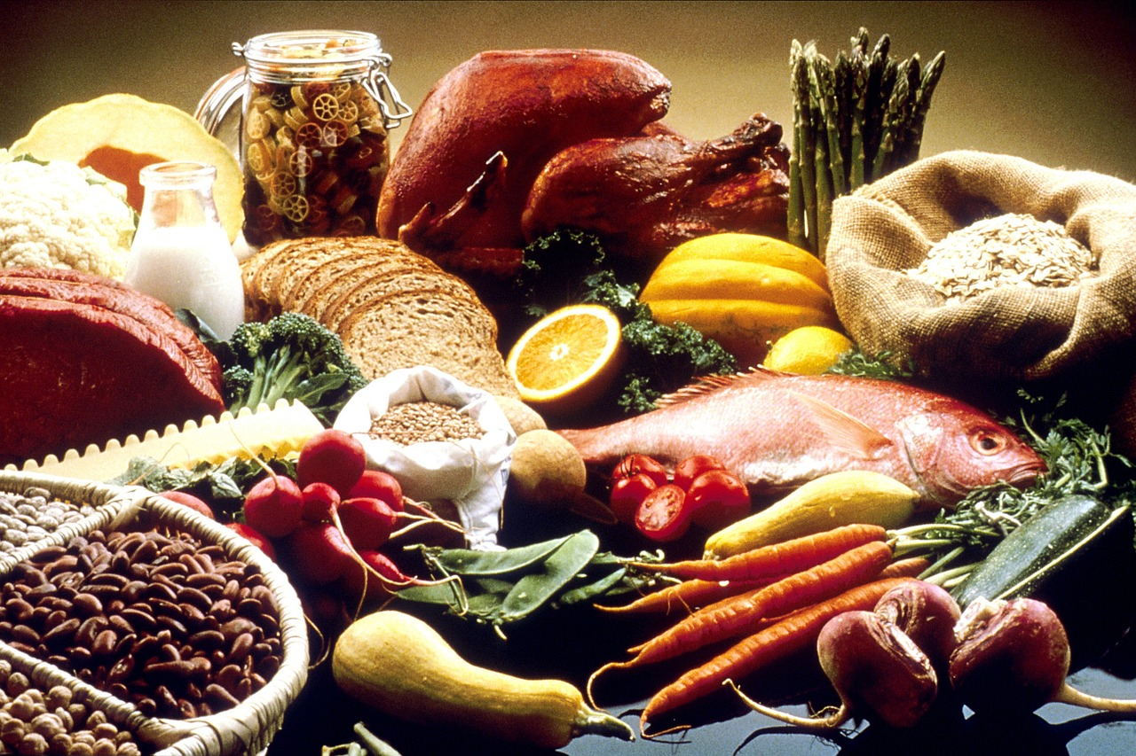
Falanqaynta xogta iyo gabagabada (Data analysis and conclusion)
Kala-duwanaanshaha joogtada ah (Continuous variation) waxaa badanaa saameeya arrimo badan, oo ay ku jiraan hidh-sidaha (genetics) iyo deegaanka (environment) / hab-nololeedka (lifestyle).
Dhererku waa tusaale kala-duwanaanshaha joogtada ah (continuous variation):
Dhererkaaga ugu sarreeya wuxuu ku xiran yahay hidde-yadaada (genes).
Waxaa sidoo kale saameeya hab-nololeedkaaga (lifestyle), gaar ahaan cuntadaada.
Uma badna inaad gaadho dhererkaaga ugu sarreeya haddii aad ku noolaan lahayd aag cuntadu liidato oo cuntada xaddidan tahay.

Slide 29
Falanqaynta xogta iyo gabagabada (Data analysis and conclusion)
Wareegga jirridda geedka waa inuu saameeyaa oo kaliya hidde-yada geedka (genes).
Astaamaha leh kala-duwanaanshaha joogtada ah (continuous variation) waxaa badanaa saameeya arrimo deegaanka (environmental factors).
Astaamaha leh kala-duwanaanshaha joogtada ah (continuous variation) waxaa keena oo kaliya hidh-sidaha (genetics).

Slide 30
Falanqaynta xogta (Data analysis) iyo gunaanad (conclusion)
Falanqee xogtaada oo qor gabagabo.
Gabagabadaadu waa inay:
Sharaxdo isbeddellada xogta (trends).
Soo jeediso nooca kala-duwanaanshaha (variation) ee xogtu muujinayso.
Soo jeediso sababta kala-duwanaanshaha (variation).
Soo jeediso waxa laga yaabo inaanu sabab u ahayn kala-duwanaanshaha (variation).

Slide 31
Falanqaynta xogta (Data analysis) iyo gunaanad (conclusion)
Falanqee xogtaada (data) oo qor gunaanad (conclusion).
Gunaanadkaagu (conclusion) waxaa laga yaabaa inuu u ekaado tan:
11 arday oo fasalka ku jira ayaa dhexyaacay 150 iyo 159 cm, taas oo ahayd tan ugu badan.
Dhererka labada dhinacba wuxuu ahaa mid aan caadi ahayn, iyadoo 130–139 cm (3 arday) iyo 170–179 cm (2 arday) ay ahaayeen kuwa ugu yar.
Ardayga ugu dheer wuxuu ahaa 173 cm, kan ugu gaabanna wuxuu ahaa 136 cm; kala duwanaansho (range) ah 37 cm.
Tani waa tusaale kala duwanaansho joogto ah (continuous variation).
Kala duwanaanshaha dhererka waxaa sababi kara hiddo-wadaha (genetics) shakhsiyaadka iyo qaab nololeedkooda, oo ay ku jiraan cuntada (diet).

Slide 32
Falanqaynta xogta (Data analysis) iyo gunaanad (conclusion)
Falanqee xogtaada (data) oo qor gunaanad (conclusion).
Gunaanadkaagu (conclusion) waxaa laga yaabaa inuu u ekaado tan:
4 tufaax ayaa culeyskoodu ahaa inta u dhaxaysa 106 iyo 110 g, taas oo ahayd tan ugu badan.
Hal tufaax oo kaliya ayaa culeyskiisu ahaa inta u dhaxaysa 116 iyo 120 g, labana inta u dhaxaysa 101 iyo 105 g.
Tufaaxa ugu culus wuxuu ahaa 117 g, kan ugu fududna wuxuu ahaa 101 g; kala duwanaansho (range) ah 16 g.
Tani waa tusaale kala duwanaansho joogto ah (continuous variation).
Kala duwanaanshaha culeyska waxaa sababi kara hiddo-wadaha (genetics) geedka tufaaxa iyo deegaanka (environment), oo ay ku jiraan cimilada (weather) iyo helitaanka biyaha (water).

Slide 33
Kala duwanaansho joogto ah (Continuous variation): maaraynta xogta (data handling) iyo falanqaynta (analysis)
Kala duwanaanshaha joogtada ah (Continuous variation) ee sifada (feature) waa la qiyaasi karaa oo loo sawiri karaa sida histogram (histogram) ama garaaf xariiq (line graph).
Histogram (Histogram) wuxuu soo bandhigaa xog joogto ah (continuous data) oo ku qaybsan xaddiyo (ranges) oo loo sawiray tiirar (columns) taabanaya.
Xog-yaraha (small data sets), histogram (histogram) oo muujinaya joogteynta (frequency) xaddiyada (ranges) xogta ayaa ku habboon garaaf xariiq (line graph).
Kala duwanaanshaha joogtada ah (Continuous variation) wuxuu leeyahay arrimo saameeya oo dhowr ah, oo ay ku jiraan hiddo-wadaha (genetics), deegaanka (environment) iyo qaab nololeedka (lifestyle).
5
4
3
Soo noqnoqosho (Frequency)
2
1
0
130
140
150
160
170
Cuf (Mass) (g)

