Slide 1
Koronto (Current) dhex mara electromagnet-ka
Magnet-yada iyo electromagnet-yada

Slide 2
Sida agabkeena waxbarista loogu talagalay fasalka

Slide 3
Waxaan qorsheyn karaa tijaabo (experiment) si aan u tijaabiyo xoogga electromagnet-ka oo aan u sharaxo sida arrimo kala duwan u saameeyaan xoogga electromagnet-ka.

Slide 4
doorsoomaha madaxa-bannaan (independent variable)
doorsoomaha uu qofka sameynaya tijaabada (experiment) beddelo
doorsoomaha ku-tiirsan (dependent variable)
doorsoomaha uu qofka sameynaya tijaabada (experiment) qiyaaso
doorsoomayaasha xakamaynta (control variables)
doorsoomayaasha saameyn kara doorsoomaha ku-tiirsan (dependent variable) oo waa in la isku midaystaa
tijaabo caddaalad ah (fair test)
tijaabo (experiment) lagu hayo doorsoomayaasha xakamaynta (control variables) isku mid
xudunta birta jilicsan (soft iron core)
xarunta electromagnet-ka xooggan oo noqota mid magnetized

Slide 5

Koronto (Current) dhex mara electromagnet-ka
Arrimaha saameeya xoogga electromagnet-ka
Kordhinta xoogga electromagnet-ka
Xudunta birta jilicsan (soft iron core)

Slide 6
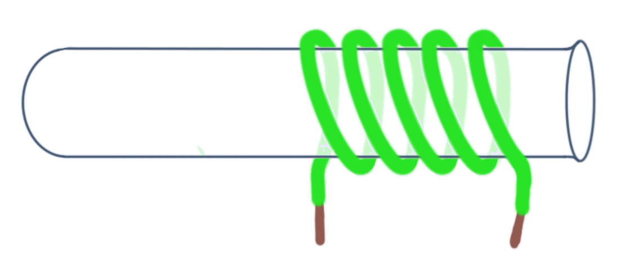
Arrimaha saameeya xoogga electromagnet-ka
Gariiradda electromagnetic-ka waxaa lagu samayn karaa iyadoo la duubo silig dahaaran oo ku wareegsan tuubbo karin.
Marka koronto (current) uu qulqulo gariiradda, waxaa soo bixi doona goob magnetic (magnetic field).

Slide 7
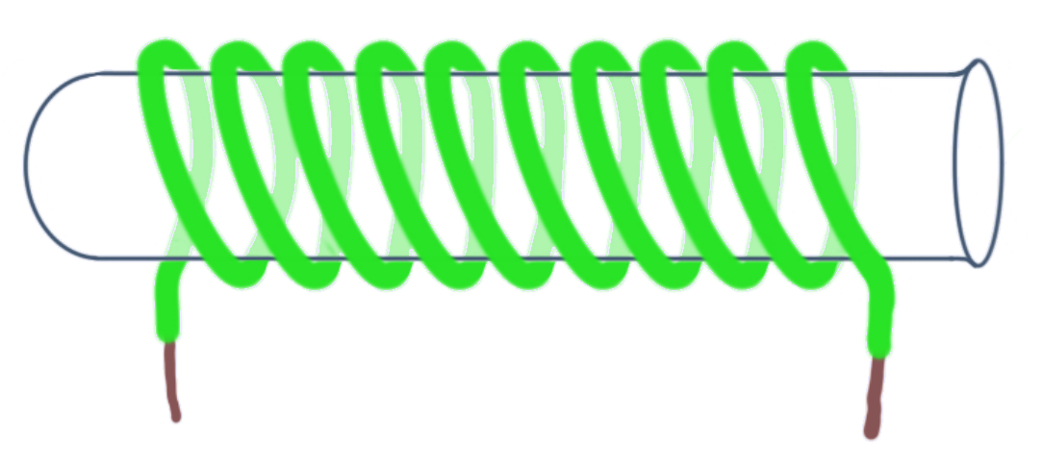
Arrimaha saameeya xoogga electromagnet-ka
Kordhinta tirada wareegyada (turns) ee gariiradda (coil) korantada (electromagnet) waxay kordhinaysaa xoogga (strength) magnet-ka.
koronto-magnet (electromagnet) daciif ah
koronto-magnet (electromagnet) xoog badan

Slide 8
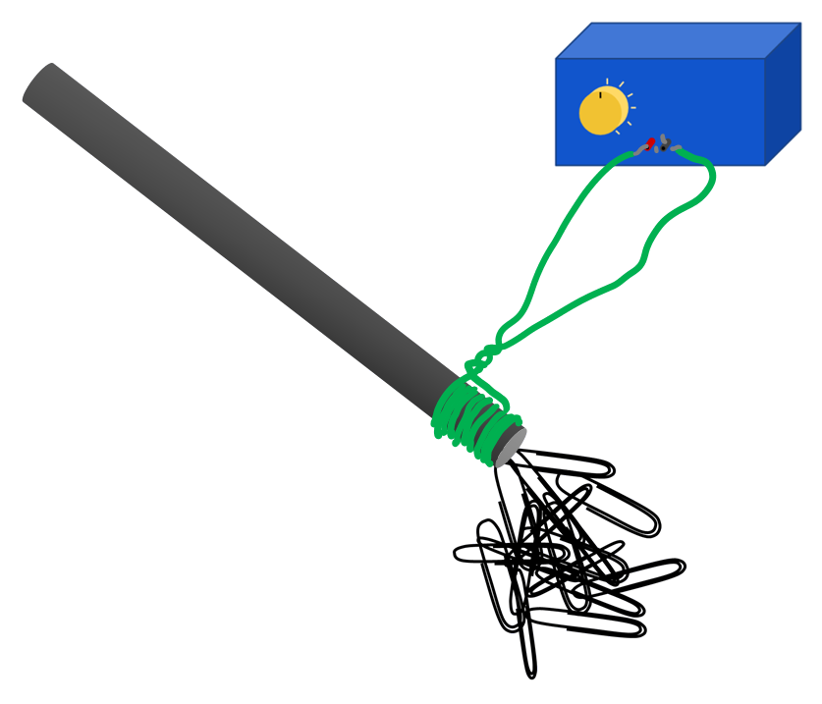
Arrimaha saameeya xoogga (strength) koronto-magnet-ka (electromagnet)
Kordhinta tirada wareegyada (turns) waxay u oggolaaneysaa koronto-magnet-ka (electromagnet) inuu soo qaado warqado (paper clips) dheeri ah.
Wareegyo (turns) dheeri ah
soo qaado warqado (paper clips) dheeri ah.

Slide 9
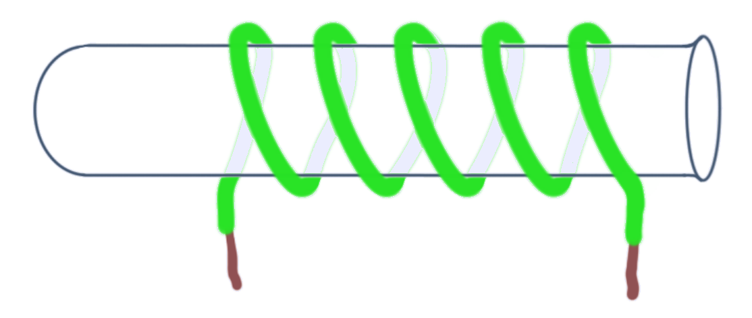
Arrimaha saameeya xoogga (strength) koronto-magnet-ka (electromagnet)
Haddii wareegyada (turns) la kala fidiya, koronto-magnet-ku (electromagnet) wuu daciif noqon doonaa.
koronto-magnet (electromagnet) daciif ah

Slide 10
Arrimaha saameeya xoogga (strength) koronto-magnet-ka (electromagnet)
Waxaa jira dhowr arrimood oo laga beddeli karo koronto-magnet-ka (electromagnet).
kala-fogaanta gariiradda (spacing of coils)
nooca siliga (wire)
dhexroorka (diameter) gariiradda (coil)
walaxda xudunta (core material)
cabirka hadda (current) ee gariiradda (coil)

Slide 11

Arrimaha saameeya xoogga (strength) koronto-magnet-ka (electromagnet)
Mid ka mid ah arrimahan soo socda ma saameyn doono xoogga (strength) koronto-magnet-ka (electromagnet) ee laga sameeyay tuubo karin (boiling tube)?
dhexroorka (diameter) tuubada karinta (boiling tube)
tirada wareegyada (turns) siliga (wire)
kala-fogaanta wareegyada (turns) siliga (wire)
dhererka tuubada karkarinta (boiling tube)

Slide 12
Arrimaha saameeya xoogga electromagnet-ka
Marka magnet la keeno meel u dhow electromagnet-ka, waxaa lagu celin doonaa (ama lagu soo jiidi doonaa) goobta magnetic-ka (magnetic field).
N
S
Jaantuskani wuxuu muujinayaa celin (repulsion). Cabbirka xoogga celinta wuxuu ku xiran yahay xoogga labada magnet.

Slide 13
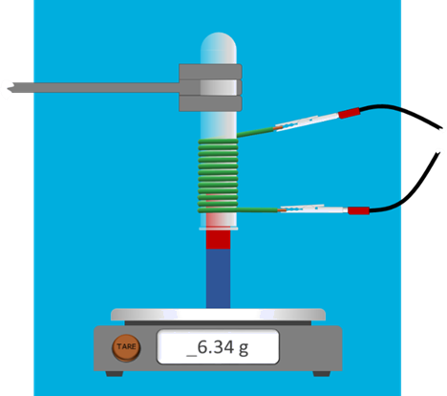
Arrimaha saameeya xoogga electromagnet-ka
Saamaynta current-ka ee xoogga goobta magnetic-ka (magnetic field) waxaa lagu tijaabin karaa iyadoo coil-ka lagu xiro magnet-ka ku yaal miisaanka (balance).
Marka uu jiro current aan ku jirin coil-ka, miisaanka (balance) waa la ‘tari’ karaa (tared) si uu eber u noqdo, marka current la shido, kaliya xoogga magnetic-ka (magnetic force) ayaa la qiyaasaa.

Slide 14
Arrimaha saameeya xoogga electromagnet-ka
Current-ka waxaa beddelaa qofka sameynaya tijaabada (experiment) waxaana loo yaqaan variable madax-bannaan (independent variable).
Akhriska miisaanka (balance) waa la qoraa waxaana loo yaqaan variable ku-tiirsan (dependent variable).
Variables-ka kale ee saameyn kara xoogga electromagnet-ka, sida tirada wareegyada coil-ka, dhexroorka coil-ka, iyo booska coil-ka, waa variables-ka xakamaynta (control variables) waxayna u baahan yihiin in la isku mid keeno si loo sameeyo tijaabo cadaalad ah (fair test).

Slide 15
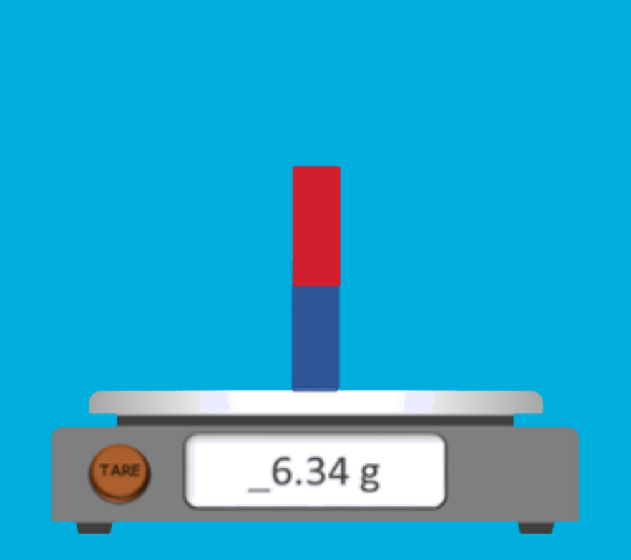
Arrimaha saameeya xoogga electromagnet-ka
Maxaa dhici doona haddii magnet kale la keeno meel u dhow magnet-ka ku yaal miisaanka (balance), kor ka yimid, sida ku cad?
akhrisku wuxuu ahaan doonaa isku mid
akhrisku wuu yaraan doonaa
akhrisku wuu kordhi doonaa
akhrisku wuxuu kordhi doonaa ama yaraan doonaa

Slide 16
Arrimaha saameeya xoogga electromagnet-ka
Qalabka la muujiyay waxaa loo isticmaali karaa in lagu tijaabiyo sida current-ka uu u saameeyo xoogga electromagnet-ka.
Magacaab variable-ka madax-bannaan (independent variable) iyo variable-ka ku-tiirsan (dependent variable).
List variables-ka xakamaynta (control variables) oo sharax sida aad u samayn lahayd tijaabo cadaalad ah (fair test).

Slide 17
Arrimaha saameeya xoogga electromagnet-ka
Magacaab doorsoomayaasha madaxbannaan iyo kuwa tiirsan (independent and dependent variables).
Doorsoomaha madaxbannaan (Independent variable): hadda (current) ku jira gariiradda (coil)
Doorsoomaha tiirsan (Dependent variable): xoogga (force) saaran miisaanka (balance)
2) Liiso doorsoomayaasha xakamaynta (control variables) oo sharax sida aad u samayn lahayd tijaabo (experiment) caddaalad
ah.
Doorsoomayaasha xakamaynta (Control variables): tirada wareegyada (turns) gariiradda (coil), nooca siliga (wire), kala fogeynta wareegyada gariiradda, dhexroorka (diameter) gariiradda iyo walaxda ku jirta gariiradda (xudunta/core).
Doorsoomayaashan waa in la isku mid dhigaa inta lagu jiro tijaabada (experiment) si loo hubiyo inay tahay tijaabo caddaalad ah.

Slide 18
Hadda (Current) dhex mara elektromagnet-ka (electromagnet)
Arrimaha saameeya xoogga (strength) elektromagnet-ka (electromagnet)
Kordhinta xoogga (strength) elektromagnet-ka (electromagnet)
Xudunta (core) birta jilicsan (soft iron)

Slide 19
Kordhinta xoogga (strength) elektromagnet-ka (electromagnet)
Marka hadda (current) gariiradda (coil) la kordhiyo, xoogga (force) ay ku saarto birlabta (magnet) ayaa sidoo kale kordha.
xoogga (force) gariiradda (coil)
hadda (current) gariiradda (coil)

Slide 20

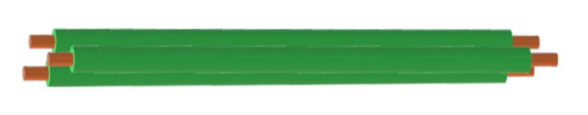
Kordhinta xoogga (strength) elektromagnet-ka (electromagnet)
Wareegyada (loops) siliga (wire) gariiradda (coil) waxay la mid yihiin siligyo (wires) kala duwan, mid kastoo wata hadda (current).
saddex silig (wires) oo wata hadda (current)
Kordhinta tirada wareegyada (turns) gariiradda (coil) waxay keentaa in wadarta hadda (current) qulqulaya ay kordho.

Slide 21
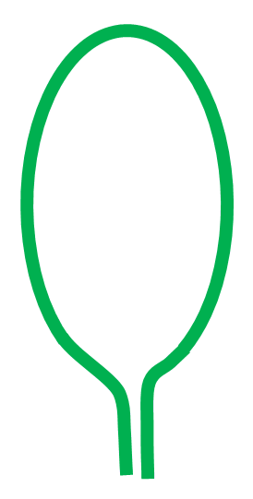
Kordhinta xoogga (strength) elektromagnet-ka (electromagnet)
Gariirad (coil) leh hal wareeg (turn) oo wata 3 A waxay lahaan lahayd saameyn la mid ah gariirad leh saddex wareeg (turns), mid kastoo wata 1 A.
3 × 1 A = 3 A
3 A
Waa wadarta hadda (total current) wareegyada (turns) gariiradda (coil) ee muhiimka ah.

Slide 22
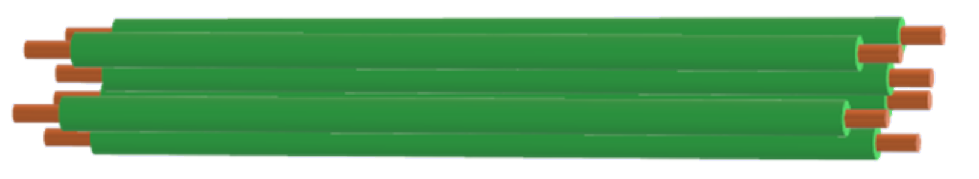
Kordhinta xoogga electromagnet-ka
Fiilooyinka (wires) ama koox fiilooyin, kee bixiyaa xoogga magnetic-ga (magnetic field) ugu xooggan?
current = 4 A
current = 3 A fiilo kasta
current = 1 A fiilo kasta

Slide 23
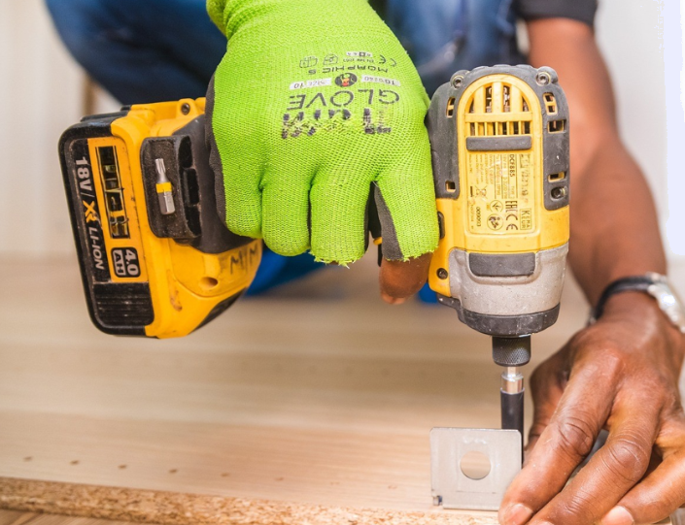
Kordhinta xoogga electromagnet-ka
Qalab sida drill wuxuu isticmaalaa electromagnet.
Bedelida xoogga electromagnet-ka waxaa ugu fudud in lagu beddelo current-ka (current) ee coil-ka.
Bedelida coil-ka laftiisa waxay noqon doontaa mid aad u adag.
Qalabka iyo aaladaha intooda badan ee isticmaala electromagnet waxay beddelaan current-ka si ay u beddelaan xoogga magnetic-ga (magnetic field).

Slide 24
Kordhinta xoogga electromagnet-ka
Kee ka mid ah kuwan soo socda ma beddeli doono xoogga electromagnet-ka?
midabka fiilada coil-ka
current-ka (current) ee coil-ka
tirada wareegyada (turns) ee coil-ka
dhexroorka (diameter) coil-ka

Slide 25
Kordhinta xoogga electromagnet-ka
Tax qodobbada (factors) beddeli kara xoogga electromagnet-ka.
2) Sharax sida fiilo sidaysa current yar (low current) loogu isticmaali karo
in laga dhigo electromagnet xooggan.

Slide 26
Kordhinta xoogga electromagnet-ka
Tax qodobbada (factors) beddeli kara xoogga electromagnet-ka.
Arrimaha bedeli kara xoogga korantada (electromagnet) waa: hadda (current) ku jira gariiradda (coil), tirada wareegyada (turns) gariiradda, kala fogeynta wareegyada gariiradda, dhexroorka (diameter) gariiradda iyo walaxda (material) xudunta (core).
2) Sharax sida silig (wire) sidaya hadd (current) hoose loo isticmaali karo in lagu sameeyo
koronto-birlabeed (electromagnet) xoog leh.
Siligga (wire) waxaa lagu duubi karaa xudun (core) si loo sameeyo koronto-birlabeed (electromagnet). Haddii wareegyo (turns) badan la duubo, hadda hoose (low current) wuu isku daraa, mid kasta oo wareeg ah, wuxuuna sababi doonaa goob birlabeed (magnetic field) xoog leh.

Slide 27
Hadda (current) maraysa koronto-birlabeedka (electromagnet)
Arrimaha saameeya xoogga koronto-birlabeedka (electromagnet)
Kordhinta xoogga koronto-birlabeedka (electromagnet)
Xudun bir jilicsan (soft iron core)

Slide 28
Xudun bir jilicsan (soft iron core)
Xudun bir jilicsan (soft iron core)
Gariirad (coil) silig (wire) sidaya hadda (current) waxay sababi doontaa goob birlabeed (magnetic field).

Slide 29
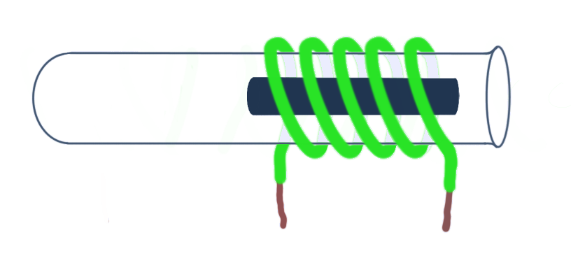
Xudun bir jilicsan (soft iron core)
Ku darista xudun bir (iron core) dhexda gariiradda (coil) waxay ka dhigi doontaa goobta birlabeedka (magnetic field) mid aad u xoog badan.
Birtu (iron) way birlabeysan (magnetised) oo tani waxay ku darsataa goobta birlabeedka (magnetic field) gariiradda (coil).

Slide 30
Xudun bir jilicsan (soft iron core)
Waxaa loo yaqaan 'xudun bir jilicsan' (soft iron core) sababtoo ah bir saafi ah (pure iron) way lumisaa birlabeedkeeda (magnetism) marka hadda (current) joogsato.
Xudun bir jilicsan (soft iron core)
Bir saafi ah (Pure iron) waxaa loo yaqaan walax birlabeed (magnetic material) 'jilicsan' (soft).
Haddii birta (steel) (oo ah daaw (alloy) bir (iron) iyo kaarboon (carbon)) la isticmaalo, waxay sii ahaan doontaa birlabeysan (magnetised) ka dib marka hadda (current) la damiyo.

Slide 31

Xudun bir jilicsan (soft iron core)
Siligga (wire) waxaa si toos ah loogu duubi karaa xudunta birta (iron core) haddii siligga gariiradda (coil wire) uu yahay mid dahaaran (insulated).
Dahaarku (insulation) wuxuu ka hortagaa hadda (current) inuu galo xudunta (core).

Slide 32

Nud bir jilicsan (soft iron core)
Haddii siligu aan la dahaadin, hadda kugu (current) wuxuu si toos ah u dhex mari doonaa nudda (core) isagoon ku wareegin, mana samayn doono electromagnet (electromagnet) xoog leh.
Haddda kugu (current) wuxuu si toos ah u dhex maraa nudda (core) wax-qaada.
Haddii wareegyada siliga qaawan ay istaabtaan, hadda kugu (current) wuxuu qaadan doonaa dariiqa gaaban.

Slide 33
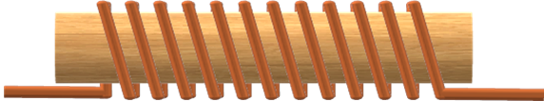
Nud bir jilicsan (soft iron core)
Kee ka mid ah isku-dhafka siligga iyo nudda (core) ee la muujiyey ayaa samayn doona electromagnet (electromagnet) aan shaqayn?

Slide 34
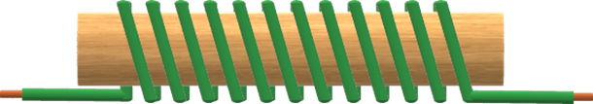
Nud bir jilicsan (soft iron core)
Kee ka mid ah isku-dhafka siligga iyo nudda (core) ee la muujiyey ayaa samayn doona electromagnet-ka (electromagnet) ugu xooggan?

Slide 35
Nud bir jilicsan (soft iron core)
Sharax sida walxaha nudda (core) iyo gariiradda (coil) ay uga dhigi karaan electromagnet-ka (electromagnet) mid ka xoog badan.

Slide 36
Nud bir jilicsan (soft iron core)
Sharax sida walxaha nudda (core) iyo gariiradda (coil) ay uga dhigi karaan electromagnet-ka (electromagnet) mid ka xoog badan.
Nudda (core) ee electromagnet-ka (electromagnet) waa in laga sameeyaa bir 'jilicsan' oo noqon karta magnetised (magnetised). Tani waxay ku dari doontaa goobta magnetic (magnetic field) waxayna ka dhigi doontaa magnet-ka (magnet) mid ka xoog badan. Waa in la isticmaalaa bir 'jilicsan' si electromagnet-ku (electromagnet) u luminayo magnetism-kiisa marka hadda kugu (current) la damiyo.
Gariiradda (coil) waa in laga sameeyaa silig bir ah oo dahaaran si hadda kugu (current) uusan u dhex marin nudda (core) laakiin uu u maro wareegyada ku wareegsan nudda (core).

Slide 37
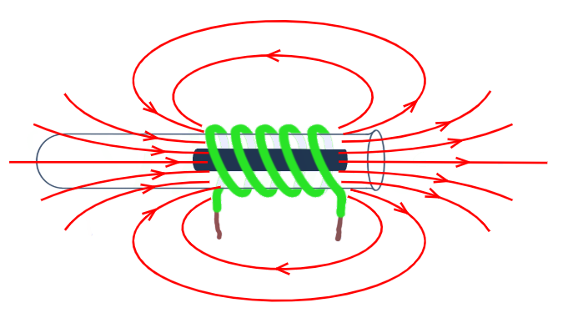
Hadda kugu (current) dhex mara electromagnet-ka (electromagnet)
Electromagnet-ka (electromagnet) waxaa lagu samayn karaa iyadoo silig lagu duubo nudda (core) oo hadda kugu (current) lagu maro wareegyada gariiradda (coil).
Qodobbada saameeya xoogga electromagnet-ka (electromagnet) waxaa ka mid ah: hadda kugu (current) ee gariiradda (coil), tirada wareegyada ee gariiradda (coil), dhererka iyo dhexroorka gariiradda (coil) iyo walxaha nudda (core).
Nud bir jilicsan (soft iron core) waxay kordhisaa xoogga electromagnet-ka (electromagnet) sababtoo ah waxay noqotaa magnetised (magnetised).
Hadda kugu (current) wuxuu dhex maraa gariiradda (coil) laakiin ma dhex maro nudda (core).

