Slide 1
Mashruucyada qaab-dhismeedka xogta (Data structure) ee Python
Barnaamijyada Python ee taxanaha xogta (sequences of data)

Slide 2
Sida ilaha waxbaridda ee aan u qaabaynnay fasalka

Slide 3
Waxaan awoodi karaa inaan fahanka iga ah qaab-dhismeedka xogta (data structures) iyo soo noqnoqoshada (iteration) u adeegsado inaan baadho dhibaato.

Slide 4
baadho (investigate)
si taxaddar leh u eeg xogta si aad u ogaato runta shay
ku wareejin (rounding)
dhimista tirada lambarrada ee nambar iyadoo la eegayo lambarrada ka dambeeya kuwa la tuurayo

Slide 5

Mashruucyada qaab-dhismeedka xogta (Data structure) ee Python
Qorshee sida loo baadho xogta
Xalli dhibaato adigoo isticmaalaya code

Slide 6
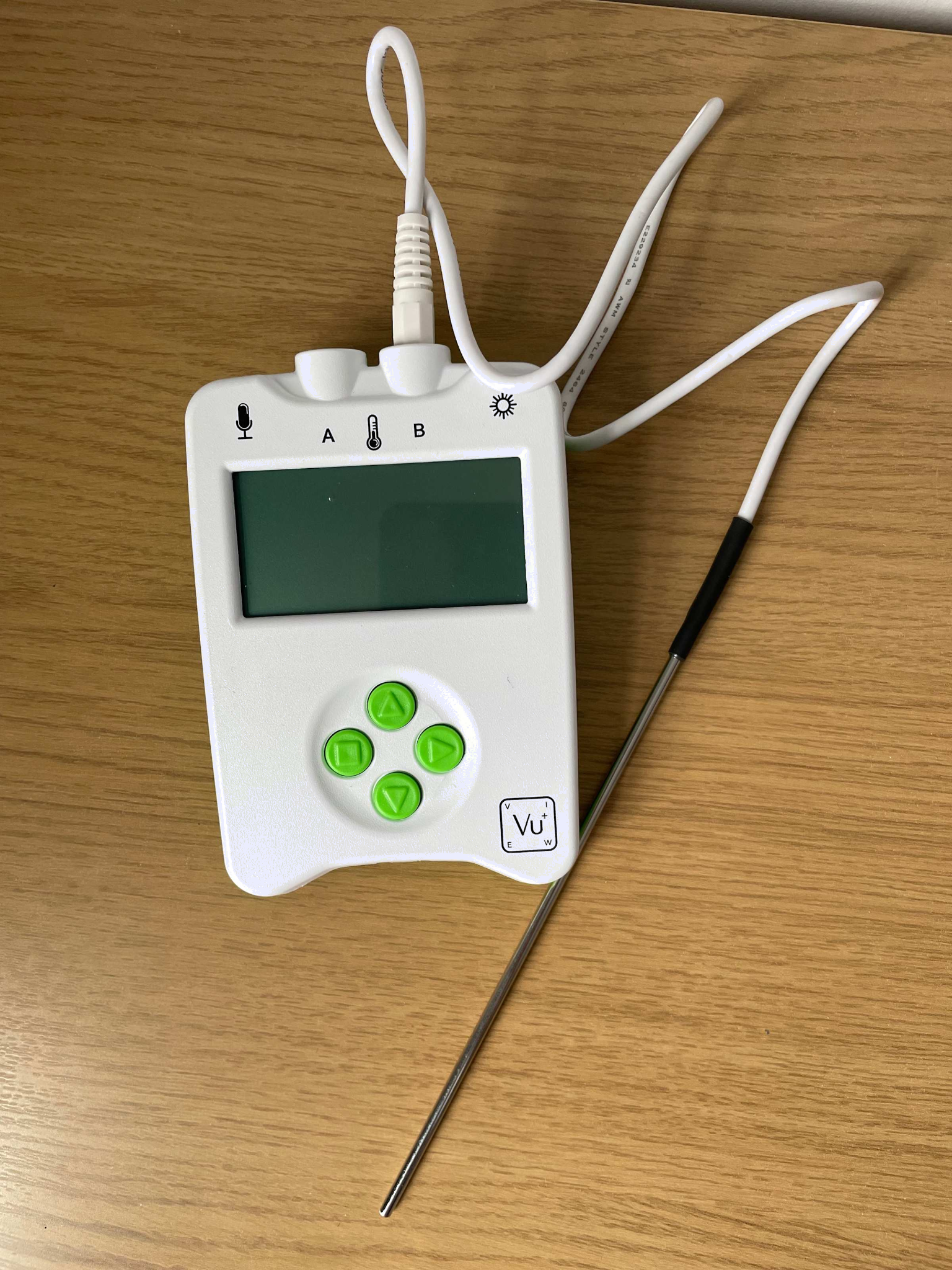
Qorshee sida loo baadho xogta
Qaab-dhismeedka xogta (Data structures), sida liisaska (lists), waxaa loo isticmaali karaa in lagu kaydiyo xog badan oo ay programmers isticmaali karaan.
Tusaale ahaan, liis (list) ayaa lagu kaydin karaa heerkulka (temperatures) uu duubay qalabka xog-duubista (data logger).

Slide 7
Qorshee sida loo baadho xogta
Xogta waa la baadhi karaa si:
loo caddeeyo ama loo beeniyo aragti (theory) ama mala-awaal (hypothesis)
heerarka heerkulka (temperatures) ayaa sii kordhaya
loo garto qaababka (patterns)
heerarka heerkulka (temperatures) ee 20 sano ee la soo dhaafay ayaa kordhay
loo aqoonsado arrimaha ama dhibaatooyinka
isbedelka cimiladu (climate change) wuxuu saameeyaa meeraha — heerarka heerkulka (temperatures) ayaa sii kordhaya
Bixi caddayn (evidence) lagu taageeri karo sabab
Xogtu waxay muujinaysaa in heerkulka celceliska 20 sano ee la soo dhaafay uu kordhay

Slide 8







Qorshee sida loo baaro xogta
Haddii aad haysato liis heerkul, dhibaatooyin noocee ah ayaad baari kartaa?
Waxaan baari karaa sida heerkulku u beddelmay 10 sano ee la soo dhaafay si aan u arko haddii cimiladeenu sii kululaaneyso.
Lucas
I could investigate how much the average temperature has changed in July over the past five years.
Sam

Slide 9
Qorshee sida loo baaro xogta
Markaad baarayso dhibaato lagu xallin doono code, waxaa waxtar leh inaad raacdo wareegga nolosha horumarinta software (software development life cycle).
implementation
planning
Software development life cycle
testing
analysis
development
design

Slide 10
Qorshee sida aad u baari doonto xogta (data)
Planning
Maxaad isku dayaysaa inaad baarto?
Maxaad isku dayaysaa inaad caddayso ama beeniso?
Analysis
Xoggee ayaad u baahan tahay?
Xaggee ayaad ka heli doontaa xogtaada (data)?
Naqshad (Design)
Sidee ayaad u xalin doontaa dhibaatada?
Algorithms (algorithms) kee ayaad horumarin doontaa?

Slide 11
Qorshee sida aad u baari doonto xogta (data)
Qorsheyn (Planning)
Waxaan baarayaa inta heerkulka celceliska (average temperature) uu isku beddelay bisha July ee shantii sano ee la soo dhaafay.
Falanqayn (Analysis)
Waxaan u baahanahay heerkulka maalinlaha ah ee July ee shantii sano ee la soo dhaafay.
Macluumaadkan waxaan ka heli karaa internetka.
Naqshad (Design)
Waxaan abuuri doonaa liisaska (lists) ay ku jiraan heerkulka July ee sano kasta. Kadib waxaan ku dhex wareegi doonaa (iterate) liis kasta si aan u xisaabiyo celceliska (average) sano kasta.
Saciid

Slide 12
Qorshee sida loo baaro xogta (data)
Horumarin (Development)
Qor koodhka (code) si aad u xalliso dhibaatada.
Tijaabin (Testing)
Koodhku (code) si sax ah miyuu u shaqeeyaa?
Ma u baahan tahay inaad saxdo khaladaadka (errors) koodhka (code) ku jira?
Hirgelin (Implementation)
Dhammeystir xalka (solution).
Maxay xalkaagu (solution) kuu sheegaysaa?

Slide 13
Qorshee sida loo baaro xogta (data)
Horumarinta (Development)
Waxaan ku abuuray koodhkayga Python.
Tijaabinta (Testing)
Barnaamijkaygu si sax ah uma shaqeyn markii hore, sababtoo ah waxaan illaaway inaan ku daro qaws (brackets) xisaabta. Waxaan ku daray kuwaas, markaas celceliska (average) si sax ah ayaa loo xisaabiyey.
Hirgelinta (Implementation)
Baaritaankaygu wuxuu muujiyey in heerarka kuleylka (temperatures) ee July ay kordheen shantii sano ee la soo dhaafay.
Saciid

Slide 14

Qorshee sida loo baaro xogta (data)
Marxaladda wareegga nolosha horumarinta software (software development life cycle) ee dheeha ayaad ku qori lahayd koodhkaaga?
tijaabinta (testing)
naqshadaynta (design)
horumarinta (development)

Slide 15
Qorshee sida loo baaro xogta (data)
Liisaskan waxay hayaan xog (data) ku saabsan kaymaha England 10kii sano ee la soo dhaafay.
1
2
3
4
5
planted = [2.43, 0.82, 1.68, 1.50, 1.41,
2.34, 2.05, 2.26, 3.13, 4.55]
cut = [5.47, 3.69, 4.47, 4.29, 3.37,
4.35, 2.86, 4.32, 5.52, 3.88]
Liiska planted wuxuu ka kooban yahay qadarka kaynta cusub ee la beeray (kumannaan hektar) iyo liiska cut wuxuu ka kooban yahay qadarka kaynta la jaray (kumannaan hektar).

Slide 16
Qorshee sida loo baaro xogta (data)
Maxaad ku baari kartaa adigoo isticmaalaya xogtan?
1
2
3
4
5
planted = [2.43, 0.82, 1.68, 1.50, 1.41,
2.34, 2.05, 2.26, 3.13, 4.55]
cut = [5.47, 3.69, 4.47, 4.29, 3.37,
4.35, 2.86, 4.32, 5.52, 3.88]

Slide 17
Qorshee sida loo baaro xogta
Kuwee ka mid ah kuwan soo socda oo aadan ku baari karin adigoo isticmaalaya xogta kaynta?
imisa booqasho ayaa lagu tagay kaynta
imisa hektar (hectares) ayaa la beeray wadarta guud 10ka sano ee la soo dhaafay
sanadkee ayaa la jaray inta ugu badan ee kaynta

Slide 18
Qorshee sida loo baaro xogta
Hawsha B, waxaad u isticmaali doontaa xogta kaynta si aad u caddayso ama u beeniso bayaanka soo socda:
“Meelaha kaynta ee England way sii yaraanayaan.”
Isticmaal su'aalaha hoose si aad u qorsheysato baaritaankaaga.
  Qorshaynta - Maxaad ku baari doontaa adigoo isticmaalaya xogta?
  Falanqaynta - Waa maxay xogta aad u baahan doontid?
  Naqshadaynta - Sidee ku xallin doontaa dhibaatada?

Slide 19
Qorshee sida loo baaro xogta
Hawsha B, waxaad u isticmaali doontaa xogta kaynta si aad u caddayso ama u beeniso bayaanka soo socda:
“Meelaha kaynta ee England way sii yaraanayaan.”
Isticmaal su'aalaha hoose si aad u qorsheysato baaritaankaaga.
a) Qorshaynta
Waxaan u isticmaali doonaa xogta si aan u baaro in wadarta guud ee meelaha kaynta ee England ay kordheen ama yaraadeen.
b) Falanqaynta
Waxaan heli doonaa wadarta guud ee meelaha kaynta la beeray iyo wadarta guud ee meelaha kaynta la jaray sanad kasta.

Slide 20
Qorshee sida loo baaro xogta
c) Naqshadayn (Design)
Waxaan xisaabin doonaa wadarta bedka kaynta saafiga ah (total net forest area) sanad kasta.
Waxaan isticmaali doonaa loop-ka 'for' si aan ugu wareego liiska (list items) oo aan uga jaro bedka kaynta la jaray (forest area cut) bedka kaynta la beeray (forest area planted), kadibna ku daro wadarta (total).
Markaas waxaan si cad u arki karaa haddii wadarta bedka kaynta ay kordheen beerista ama yaraadeen jarista. Sidoo kale waxaan arki karaa sanadaha ugu fiican ee kordhinta bedka kaynta.

Slide 21
Mashaariicda qaab-dhismeedka xogta (Data structure projects) ee Python
Qorshee sida loo baaro xogta (investigate data)
Xalli dhibaato adigoo isticmaalaya code

Slide 22
Xalli dhibaato adigoo isticmaalaya code
Waxaan baarayaa haddii bedka kaynta England uu kordhay 10kii sano ee la soo dhaafay.
Cabdi
Taasi waa fikrad fiican! Waa maxay hababka liiska (list methods) aad isticmaali karto si aad uga hesho jawaabta?
Saciid

Slide 23
Xalli dhibaato adigoo isticmaalaya code
Hawlgallada liiska (list operations) ee Python ee soo socda waxaa loo isticmaali karaa in lagu beddelo xogta ku jirta qaab-dhismeedka xogta (data structure).
list.append(item)
list.insert(index, item)
list.pop(index)
list.remove(item)
Hawlgalladani waxay faa'iido u leeyihiin haddii aad u baahan tahay inaad ku darto ama ka saarto xogta liiska (list).

Slide 24
Xalli dhibaato adigoo isticmaalaya code
Isku dhig hawlgal (operation) iyo sharaxaadda saxda ah.
list.append(item)
list.insert(index, item)
list.pop(index)
list.remove(item)
ka saar shay (item) meel (index) go'an
ku dar shay (item) dhamaadka liiska (list)
ka saar shay (item) gaar ah
ku dar shay (item) meel (index) go'an

Slide 25
Xali (Solve) dhibaato adigoo isticmaalaya code
Hawlahan (operations) liiska (list) Python ee soo socda waxaa loo isticmaali karaa in lagu falanqeeyo xogta (data) ku jirta qaab-dhismeedka xogta (data structure).
list.count(item)
list.index(item)
list.sort()
list.sort(reverse=True)
Hawlahan (operations) waxay kaa caawin karaan inaad ka jawaabto su'aalaha ku saabsan xogta (data).

Slide 26
Xali (Solve) dhibaato adigoo isticmaalaya code
Isku dhig hawsha (operation) tilmaanta saxda ah.
list.count(item)
list.index(item)
list.sort()
list.sort(reverse=True)
raadi index (index) ee shay (item)
hel tirada (number) ee dhacdooyinka (occurrences) ee shay (item)
sort the list items in descending order
sort the list items in ascending order

Slide 27
Solve a problem using code
In Python, numbers with decimal points are stored as floats.
1
2
planted = [2.43, 0.82, 1.68, 1.50, 1.41,
2.34, 2.05, 2.26, 3.13, 4.55]
When performing calculations on floats, you can often end up with numbers with multiple digits after the decimal point. This is because of how floating-point numbers are stored in Python.
Text output
Faafida/khasaaraha kaynta (net forest gain/loss) sanadka 1 wuxuu ahaa -3.0399999999999996
Waxaad yarayn kartaa tirada lambarrada jajab tobanle (decimal) adiga oo ku wareejinaya (rounding).

Slide 28
Solve a problem using code
Wareejinta nambarka waxay yaraynaysaa tirada lambarrada.
1
2
3
4
5
6
7
8
9
10
11
planted = [2.43, 0.82, 1.68, 1.50, 1.41,
2.34, 2.05, 2.26, 3.13, 4.55]
cut = [5.47, 3.69, 4.47, 4.29, 3.37,
4.35, 2.86, 4.32, 5.52, 3.88]
for item in planted:
position = planted.index(item)
total = planted[position] - cut[position]
total = round(total, 2)
print(f"The net forest gain/loss for year {position + 1} was {total}")
In this code, the round() function is rounding the value held by the
variable total to two
decimal places.
Text output
Korodhka/luminta kaynta saafiga ah ee sanadka 1 wuxuu ahaa -3.04

Slide 29

Solve a problem using code
Waxaan bilaabay inaan qoro koodhka (code) si aan u baaro xogta (data), laakiin kuma shaqeynayo sidii aan filayay.
Cabdi
Taasi waa ujeedka tijaabinta (testing)! Ha welwelin. Eeg sadar kasta oo koodhka ah oo arag haddii aad aragto khaladaad.
Saciid

Slide 30
Xalli dhibaato adigoo isticmaalaya koodh (code)
Waa caadi haddii barnaamijku uusan u shaqayn sidii la filayay markii ugu horreysay ee aad ku shubto.
Tijaabintu (testing) waa qayb muhiim ah oo ka mid ah barnaamijyada (programming). Talada ugu sarreysa ee tijaabinta waxaa ka mid ah:
Hubi in barnaamijkaagu uusan ku jirin khaladaadka syntax, tusaale ahaan, maqnaanshaha () ama “”.
Hubi in indentation-ku yahay sidii la filayay, tusaale ahaan, gudaha haddii (if) ama loop.
Hubi in macquulnimada (logic) barnaamijku ay sax tahay. Tusaale ahaan, ma la isticmaalay operator-ka saxda ah?
Hubi in barnaamijku uu gelayo index-ka shayga saxda ah ee liiska (list).

Slide 31
Xalli dhibaato adigoo isticmaalaya koodh (code)
1) Fur barnaamijka bilowga ah oak.link/forestry-data
2) Xogta kaymaha (forestry data) ee sanadkan ayaa la sii daayay. 3.03 kun oo hektar ayaa la beeray, 2.89 kun oo hektar ayaa la jaray. Ku dar qadarkan liisaska saxda ah.
3) Sannad kasta, qor farqiga u dhexeeya wadarta hektarrada la beeray iyo wadarta hektarrada la jaray — kani waa faa'iidada/khasaaraha kaymaha saafiga ah (net forest gain/loss).
sannad | faa'iidada/khasaaraha kaymaha saafiga ah (net forest gain/loss)
1
2
3
4
5
6
7
8
9
10
11

Slide 32
Xalli dhibaato adigoo isticmaalaya koodh (code)
sannad | faa'iidada/khasaaraha kaymaha saafiga ah (net forest gain/loss)
1 | -3.04
2 | -2.87
3 | -2.79
4 | -2.79
5 | -1.96
6 | -2.01
7 | -0.81
8 | -2.06
9 | -2.39
10 | 0.67
11 | 0.14
1
2
3
4
5
6
7
8
9
10
11
12
13
14
planted = [2.43, 0.82, 1.68, 1.50, 1.41,
2.34, 2.05, 2.26, 3.13, 4.55]
cut = [5.47, 3.69, 4.47, 4.29, 3.37,
4.35, 2.86, 4.32, 5.52, 3.88]
planted.append(3.03)
cut.append(2.89)
for item in planted:
position = planted.index(item)
total = planted[position] - cut[position]
total = round(total, 2)
print(f"The net forest gain/loss for year {position + 1} was {total}")
oak.link/forestry-data-solution

Slide 33
Solve a problem using code
4) Xisaabi wadarta korodhka/luminta kaynta saafiga ah ee muddada 11-sano.
5) Tijaabi barnaamijkaaga si aad u hubiso inuu u shaqeeyo sida la filayo. Haddii kale, sax khaladaadka.
6) What does the data tell you about forest areas in England?
7) Maxaad ka ogaataa labada sano ee ugu dambeeya?

Slide 34
Solve a problem using code
Wadarta guud ee faa'iidada/khasaaraha kaymaha waa -19.91
4)
1
2
3
4
5
6
7
8
9
10
11
12
13
14
15
16
17
18
planted = [2.43, 0.82, 1.68, 1.50, 1.41,
2.34, 2.05, 2.26, 3.13, 4.55]
cut = [5.47, 3.69, 4.47, 4.29, 3.37,
4.35, 2.86, 4.32, 5.52, 3.88]
planted.append(3.03)
cut.append(2.89)
net = 0
for item in planted:
position = planted.index(item)
total = planted[position] - cut[position]
wadarta = round(wadarta, 2)
print(f"Wadarta guud ee faa'iidada/khasaaraha kaymaha ee sannadka {position + 1} wuxuu ahaa {total}")
net = net + total
net = round(net, 2)
print(f"Wadarta guud ee faa'iidada/khasaaraha kaymaha waa {net}")
net = net + total
net = round(net, 2)
print(f"Wadarta guud ee faa'iidada/khasaaraha kaymaha waa {net}")

Slide 35
Xali dhibaato adigoo isticmaalaya code
6) Maxay xogtu kuu sheegaysaa oo ku saabsan aagagga kaymaha ee England?
Wadarta guud ee faa'iidada/khasaaraha kaymaha wuxuu ahaa -19.91 kun hektar, taasoo muujinaysa in England, aagag badan oo kaymaha ah laga lumiyay intii la helay.
7) Maxaad ka dareentay labada sano ee ugu dambeeyay?
Labada sano ee ugu dambeeyay waxay ahaayeen sannadaha kaliya ee faa'iidada/khasaaraha kaymaha ay togan tahay, sidaas darteed aagag badan oo kaymaha ah ayaa la beeray sannadahan marka loo eego kuwii la jaray. Waxaa laga yaabaa in tani muujinayso in khasaaraha kaymaha la yareynayo, taasoo noqon doonta wax wanaagsan deegaankayaga.

Slide 36
Mashaariicda qaab-dhismeedka xogta ee Python
Xogta waxaa loo isticmaali karaa in lagu baaro dhibaato.
Qalabka barnaamijyada waxaa loo isticmaali karaa in lagu sameeyo baaritaanno xogta ku jirta qaab-dhismeedka xogta.
Markaad baarayso dhibaato lagu xallin doono code, waxaa faa'iido leh inaad raacdo wareegga nolosha horumarinta software.

