Slide 1
Muujinta aragtida Pythagoras (Pythagoras' theorem)
Sifooyinka joomatari: isku ekaansho (similarity) iyo aragtida Pythagoras (Pythagoras' theorem)

Slide 2
sida loo isticmaalo darasyada Oak

Slide 3
Waxaan qaddarin karaa inay jirto xiriir u dhexeeya dhererka dhinacyada saddexagalka qumman (right-angled triangle).

Slide 4
Aragtida Pythagoras (Pythagoras' theorem) waxay muujinaysaa in wadarta labajibbaaranayaasha (squares) labada dhinac ee gaagaaban ee saddexagalka qumman ay la mid tahay labajibbaaranaha dhinaca ugu dheer (hypotenuse).

Slide 5

Muujinta aragtida Pythagoras (Pythagoras' theorem)
Abuurista saddexagallo (triangles) oo ka kooban isku darka labajibbaaranayaasha (squares)
Sifooyin ka yimaada isku darka aagagga labajibbaaranayaasha (squares)

Slide 6
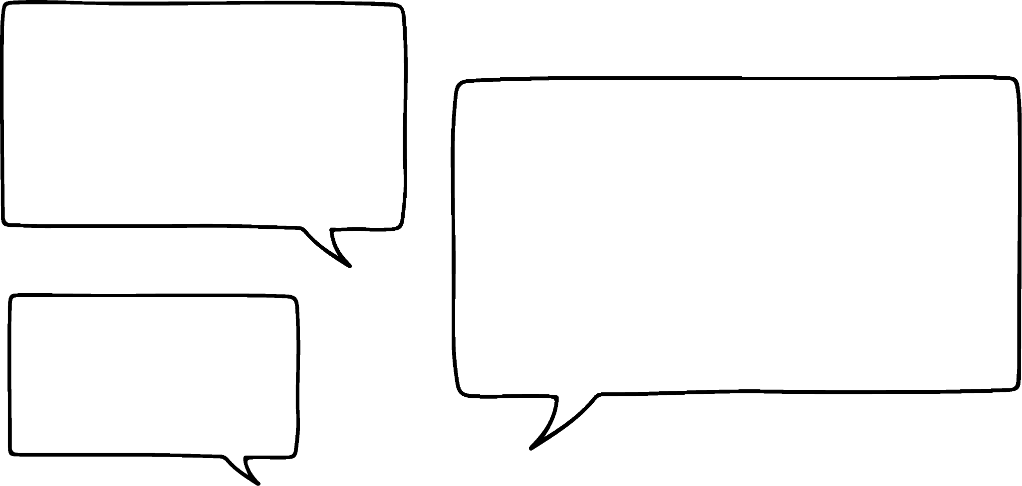
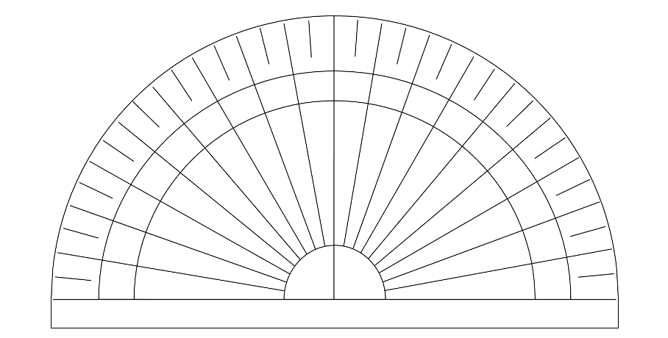


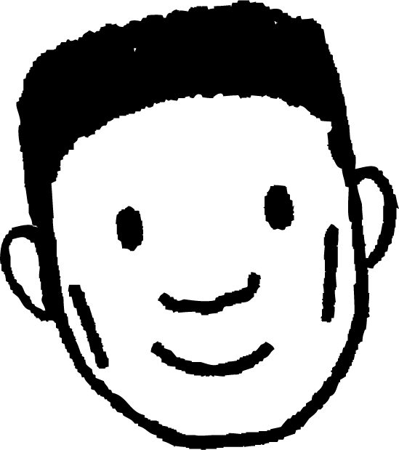
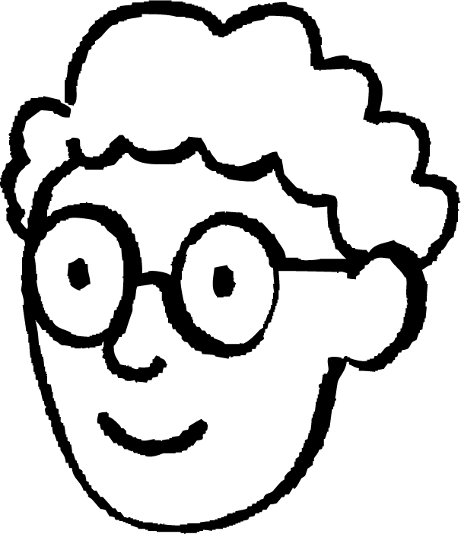


Abuurista saddexagallo (triangles) oo ka kooban isku darka labajibbaaranayaasha (squares)
Waxaan abuuri karaa saddexagal (triangle) adiga oo isku xiraya qaar ka mid ah geesaha (vertices) saddex labajibbaaran (squares), sidaan.
Hmm, aan soo qaado protractor (protractor) si aan u hubiyo!
Waxay u egtahay inay tahay saddexagal siman (equilateral triangle) aniga aragtidayda.
Cabdi
60°
60°
Waan arkay!
Saddexagalku (triangle) wuxuu ku yaal meesha dhexe ee u dhexeysa labajibbaaranayaasha (squares).
Waxaan la yaabanahay noocee ah saddexagalka (triangle) uu yahay.
Axmed

Slide 7



Abuurista saddexagallo (triangles) oo ka kooban isku darka labajibbaaranayaasha (squares)
Waxaan abuuri karaa saddexagal (triangle) adiga oo isku xiraya qaar ka mid ah geesaha (vertices) saddex labajibbaaran (squares), sidaan.
Oh, run! Waxaan la yaabanahay inaad samayn karto saddexagallo (triangles) kala duwan oo leh saddex laba jibbaaran (squares) oo bed (area) kala duwan.
Hmm, aan soo qaado protractor (protractor) si aan u hubiyo!
Waxay u egtahay inay tahay saddexagal siman (equilateral triangle) aniga aragtidayda.
Cabdi
60°
60°
Laakiin ma cada ma aha, maadaama dhammaan saddexda laba jibbaaran (squares) ee aad isticmaashay ay isku mid yihiin (congruent), sidaas darteedna dhammaantood leeyihiin bed (area) isku mid ah!
Waxaad sax tahay, waa saddexagal siman (equilateral triangle)…
Layla

Slide 8
Samaynta saddexagallo (triangles) iyadoo la isku darayo laba jibbaaran (squares)
Saddexagalkan (triangle) wuxuu ka samaysan yahay laba laba jibbaaran (squares) oo bed (area) 20 cm² ah, iyo hal laba jibbaaran (square) oo bed (area) 4 cm² ah.
Cabdi
Noocee ah saddexagal (triangle) ayuu Cabdi sameeyay?
saddexagal isleeg (isosceles triangle)

Slide 9


Samaynta saddexagallo (triangles) iyadoo la isku darayo laba jibbaaran (squares)
Noocee ah saddexagal (triangle) ayaa laga sameeyay saddexdan laba jibbaaran (squares) oo geesahooda (vertices) la isku xidhay?
5 cm²
saddexagal isleeg (isosceles triangle)
5 cm²
Sharaxaad (explanation) keebaa caddaynaysa sida aad u ogaatay?
18 cm²
a
laba jibbaaranka (square) leh bedka (area) ugu weyn wuxuu ka weyn yahay laba jibaar (double) mid ka mid ah laba jibbaaranada (squares) yaryar
b
waxaa jira laba laba jibbaaran (squares) oo leh bed (area) isku mid ah
c
laba jibbaaran kasta (square) wuxuu ka samaysan yahay xaglo qumman (right angles)

Slide 10
Samaynta saddexagallo (triangles) iyadoo la isku darayo laba jibbaaran (squares)
Saddexda xagal (angles) ee saddexagalkan (triangle) waa 115°, 30°, iyo 35°.
Waa noocee saddexagal (triangle) kan?
saddexagal (triangle) aan simanayn (scalene)
Maxaad ka taqaan saddexda laba jibaaran (squares) macluumaadkan?
a
bedka (area) saddexda laba jibaaran (squares) dhammaantood way kala duwan yihiin
b
saddexda laba jibaaran (squares) waa isku mid (congruent)
c
laba jibaar (square) kastaa wuxuu leeyahay dherer dhinac (side length) oo kala duwan
d
laba jibaar (square) kastaa wuxuu leeyahay isku dherer dhinac (side length)

Slide 11

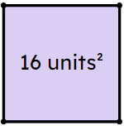

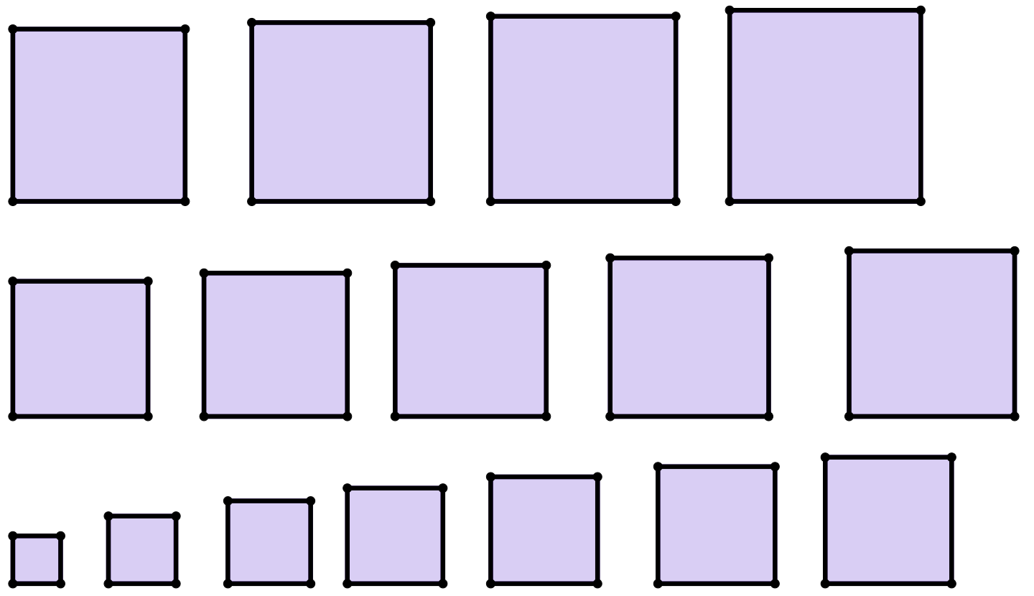
Samaynta saddexagallo (triangles) iyadoo la isku darayo laba jibaaran (squares)
Waxaad u baahan doontaa laba jibaaran (squares) si sax ah loo gooyay.
1) Samee saddexagal (triangle) adoo ku xira cidhifyada (vertices) laba jibaaran (squares) oo leh bed (area) 1 unit², 3 units², iyo 5 units².
Adigoo isticmaalaya protractor, ku qiyaas cabbirka xagal (angle) kasta oo saddexagalkan (triangle) ku yaal.
3 units²
1
5 units²
2) Sharax sababta aadan ugu samayn karin saddexagal (triangle) siman (equilateral) adigoo isticmaalaya isku darka laba jibaaran (squares) ee lagu siiyay.

Slide 12
Samaynta saddexagallo (triangles) iyadoo la isku darayo laba jibaaran (squares)
3) Laba saddexagal (triangle) ayaa la samayn karaa adoo ku xira cidhifyada (vertices) kuwan soo socda:
- laba jibaaran (squares) oo leh bed (area) 2 units², 5 units², 6 units² (saddexagal X)
- laba jibaaran (squares) oo leh bed (area) 4 units², 10 units², 12 units² (saddexagal Y)
a) Samee labadan saddexagal (triangle) oo ku qiyaas xagal (angle) kasta oo ka mid ah adigoo isticmaalaya protractor.
b) Qor waxa aad ka ogaatay xagasha (angles) ee u dhexeysa saddexagalladan (triangles). Ma sharxi kartaa waxa aad aragtay?
4) Samee saddexagal (triangle) la mid ah (similar), laakiin aan isku mid ahayn (congruent), saddexagal (triangle) laga sameeyay laba jibaaran (squares) oo leh bed (area) 21 units², 27 units², 39 units².

Slide 13
Samaynta saddexagallo (triangles) iyadoo la isku darayo laba jibaaran (squares)
5) Samee 3 saddexagal (triangle) laba siman (isosceles) oo ka mid ah kuwan soo socda:
- labajibbaaran (squares) oo leh bed (area) 4 units², 4 units², 12 units² (saddexagal (triangle) A)
- labajibbaaran (squares) oo leh bed (area) 6 units², 6 units², 12 units² (saddexagal (triangle) B)
- labajibbaaran (squares) oo leh bed (area) 1 units², 8 units², 8 units² (saddexagal (triangle) C)
a) Ku qiyaas (measure) xagasha (angle) ugu weyn ee saddexagal (triangle) kasta adigoo isticmaalaya protractor.
b) Saddexagal (triangle) kee ayaa leh xagasha (angle) ugu weyn:
- xagal (angle) af (acute)
- xagal (angle) qumman (right)
- xagal (angle) fidsan (obtuse)

Slide 14
Abuurista saddexagallo (triangles) ka kooban isku darka labajibbaaranada (squares)
bedka (area) saddexda labajibbaaran (squares) | xagasha (angle) ugu weyn
7, 10, 13 | af (acute)
4, 5, 11
4, 9, 13
6) Buuxi jaantuska (table) adigoo isku xira saddex labajibbaaran (squares) oo qor in xagasha (angle) ugu weyn tahay: af (acute), fidsan (obtuse), ama qumman (right).
Kadib markaad doorato saddex labajibbaaran (squares), ma saadaalin kartaa nooca xagasha (angle) aad heli doontid ka hor intaadan ku xirin labajibbaaranada (squares)?

Slide 15
Abuurista saddexagallo (triangles) ka kooban isku darka labajibbaaranada (squares)
1) Abuur saddexagal (triangle) adigoo isku xira cidhifyada (vertices) labajibbaaranada (squares) oo leh bed (area) 1 unit², 3 units², iyo 5 units².
Adigoo isticmaalaya protractor, qiyaas (measure) cabbirka xagal (angle) kasta ee saddexagalkan (triangle).
3 units²
1
5 units²
xaglo (angles) qiyaastii
25°, 48°, iyo 107°
2) Iyadoo la eegayo labajibbaaranada (squares) la siiyay, sharax sababta aadan u abuuri karin saddexagal (triangle) siman (equilateral).
Waxaa jira ugu badnaan laba nuqul oo ka mid ah labajibbaaran (squares) isku bed (area) ah, waxaadna u baahan tahay saddex labajibbaaran (squares) isku mid ah si aad u abuurto saddexagal (triangle) siman (equilateral).

Slide 16
Abuurista saddexagallo iyadoo laga sameynayo isku darka labajibbaaranayaasha (squares)
3) Laba saddexagal ayaa la abuuri karaa isku xirka geesaha kuwa soo socda:
- labajibbaaranayaal (squares) oo leh bed (area) 2 units², 5 units², 6 units² (saddexagal X)
- labajibbaaranayaal (squares) oo leh bed (area) 4 units², 10 units², 12 units² (saddexagal Y)
a) Abuur labadan saddexagal oo ku qiyaas xagal kasta oo ka mid ah iyadoo la isticmaalayo protractor.
b) Qor waxa aad ogaatay ee ku saabsan xaglaha u dhexeeya saddexagalladan. Ma sharxi kartaa indha-indheyntaada?
xaglaha qiyaastii 35°, 64°, iyo 81° labada saddexagal
Saddexagalladu waxay isku mid yihiin (similar) sababtoo ah xaglahoodu waa isku mid. (Farqi yar oo qiyaas ah ayaa dhici kara sababtoo ah saxnaanta qalabka.) Ma ogaatay in labajibbaaranayaasha (squares) ee ka kooban saddexagalka Y ay yihiin laba jibaar bedka (area) kuwa saddexagalka X?

Slide 17
Abuurista saddexagallo iyadoo laga sameynayo isku darka labajibbaaranayaasha (squares)
4) Abuur saddexagal la mid ah (similar) saddexagal laga sameeyay labajibbaaranayaal (squares) oo leh bed (area) 21 units², 27 units², 39 units². Kumaas labajibbaaranayaal (squares) ayaad adeegsatay?
7 units², 9 units², iyo 13 units².

Slide 18
Abuurista saddexagallo iyadoo laga sameynayo isku darka labajibbaaranayaasha (squares)
5) Abuur 3 saddexagal oo isleeg (isosceles) oo ka sameysan labajibbaaranayaasha (squares) soo socda:
- 4 units², 4 units², 12 units² (saddexagal A)
- 6 units², 6 units², 12 units² (saddexagal B)
- 1 units², 8 units², 8 units² (saddexagal C)
a) Ku qiyaas xagasha ugu weyn ee saddexagal kasta iyadoo la isticmaalayo protractor.
b) Saddexagal kee ayaa xagashiisa ugu weyn tahay:
- xagal af (acute angle)?
- xagal qumman (right angle)?
- xagal fidsan (obtuse angle)?
A: 120°
B: 90°
C: 80°
C
B
A

Slide 19
Samaynta saddexagalka iyadoo la isku darayo labajibbaaranayaal (squares)
bedka (areas) saddexda labajibbaaran (squares) | xagasha ugu weyn (largest angle)
7, 10, 13 | xagal fiiqan (acute)
4, 5, 11 | xagal madhan (obtuse)
4, 9, 13 | xagal qumman (right angle)
3, 10, 13 | xagal qumman (right angle)
5, 6, 7 | xagal fiiqan (acute)
6) Buuxi shaxda (table) adigoo isku daraya saddex labajibbaaran (squares) oo qoraya in xagasha ugu weyn (largest angle) tahay: xagal fiiqan (acute), xagal madhan (obtuse), ama xagal qumman (right).
Kadib markaad doorato saddex labajibbaaran (squares), ma saadaalin kartaa nooca xagasha (angle) aad heli doontid ka hor intaadan ku biirin labajibbaaranayaasha (squares)?
Ma la timaadday aragti (theory) ku saabsan xiriirka ka dhexeeya bedka (areas) iyo cabbirka xagasha ugu weyn (largest angle)?
Aynu ogaanno haddii aragtidaadu (theory) sax tahay…
Waxaa jira saddexagallo badan oo laga samayn karo isku-dhisyada kala duwan ee labajibbaaranayaasha (squares).

Slide 20
Muujinta aragtida (theorem) Pythagoras
Samaynta saddexagalka iyadoo la isku darayo labajibbaaranayaal (squares)
Guryaha (Properties) laga helo isku-darka bedka (areas) labajibbaaranayaasha (squares)

Slide 21
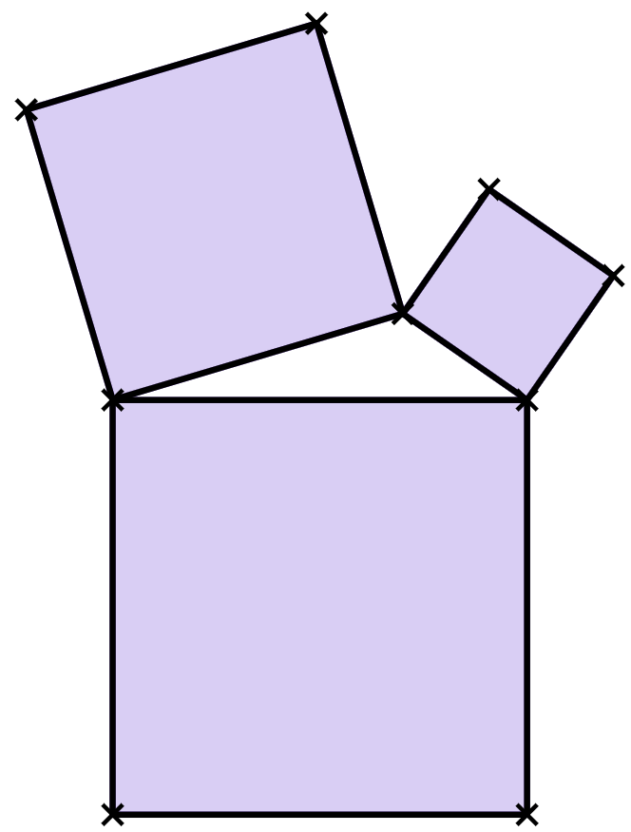
Guryaha (Properties) laga helo isku-darka bedka (areas) labajibbaaranayaasha (squares)
Marka, iyadoo ku xiran labajibbaaranayaasha (squares) aan doorano, waxaan samayn karnaa saddexagallo kala duwan oo leh noocyo kala duwan oo xaglo (angles) ah.
xagal madhan (obtuse angle)
8 units²
2 units²
Cabdi
Waxaan la yaabanahay inuu jiro qaab (pattern) ku jira labajibbaaranayaasha (squares) aan doorano iyo nooca xagasha (angle) ugu weyn saddexagalka!
15 units²
Axmed

Slide 22
Sifooyin ka yimaada isku-darka bedka labajibbaaranada (Properties from summing the areas of squares)
Waxaa laga yaabaa inuu jiro qaab. (Maybe there is a pattern.)
Waa kuwan qaar ka mid ah jawaabahayga hawshii hore. (Here are some of my answers to a previous task.)
bedka saddexda labajibbaaran (areas of the three squares) | xagasha ugu weyn (largest angle)
7, 10, 13 | af-fiiqan (acute)
4, 7, 9 | af-fiiqan (acute)
4, 4, 7 | af-fiiqan (acute)
3, 5, 10 | af-balaadhan (obtuse)
5, 7, 14 | af-balaadhan (obtuse)
1, 3, 7 | af-balaadhan (obtuse)
3, 8, 11 | xagal-qumman (right-angle)
2, 5, 7 | xagal-qumman (right-angle)
4, 8, 12 | xagal-qumman (right-angle)
Layla
Ma arki kartaa qaab ku jira bedka labajibbaaranada ee sameeya nooc kasta oo xagal ah? (Can you spot a pattern in the areas of the squares that make each type of angle?)

Slide 23
Guryaha ka soo baxa isugeynta beddedka (areas) labajibbaaranayaasha (squares)
bedka saddexda labajibbaaran (areas of the three squares) | xagasha ugu weyn (largest angle)
7, 10, 13 | af-fiiqan (acute)
4, 7, 9 | xagal-af (acute)
4, 4, 7 | xagal-af (acute)
3, 5, 10 | xagal-weyn (obtuse)
5, 7, 14 | xagal-weyn (obtuse)
1, 3, 7 | xagal-weyn (obtuse)
3, 8, 11 | xagal-qumman (right-angle)
2, 5, 7 | xagal-qumman (right-angle)
4, 8, 12 | xagal-qumman (right-angle)
7 + 10
= 17
4 + 7
= 11
Haddii aad qaaddo labada bed (area) ee yaryar,
Waxaan u malaynayaa inaan arkay qaab (pattern) ku jira saddexagalka (triangles) xagasha (angle) ugu weyn tahay xagal-af (acute)!
oo aad isku darto,
labajibbaaranaha (square) ugu weyn wuxuu leeyahay bed (area) ka yar wadarta (sum) tan.
Axmed

Slide 24
Astaamaha ka yimaada isku darka bedka (areas) ee labajibbaaranayaasha (squares)
beddedka (areas) saddexda labajibbaaranayaal (squares) | xagasha (angle) ugu weyn
7, 10, 13 | xagal-af (acute)
4, 7, 9 | xagal-af (acute)
4, 4, 7 | xagal-af (acute)
3, 5, 10 | xagal-weyn (obtuse)
5, 7, 14 | xagal-weyn (obtuse)
1, 3, 7 | xagal-weyn (obtuse)
3, 8, 11 | xagal qumman (right-angle)
2, 5, 7 | xagal qumman (right-angle)
4, 8, 12 | xagal qumman (right-angle)
7 + 10
= 17
13 waa ka yar yahay 17.
4 + 7
= 11
9 waa ka yar yahay 11.
Oh waa! Si fiican ayaad u aragtay.
Waxaan la yaabanahay in jiro qaab (pattern) la mid ah haddii xagasha ugu weyn tahay mid fiiqan (obtuse) ama xagal qumman (right-angle).
Ma arki kartaa qaab (pattern)?
Layla

Slide 25
Astaamaha ka yimaada isku darka bedka (areas) ee labajibbaaranayaasha (squares)
Sahmin (Exploration) 🖇
Ma arki kartaa waxa ku dhaca xagasha ugu weyn markaad barbardhigto cabbirka labada bed ee yar iyo cabbirka bedka ugu weyn?
Axmed

Slide 26
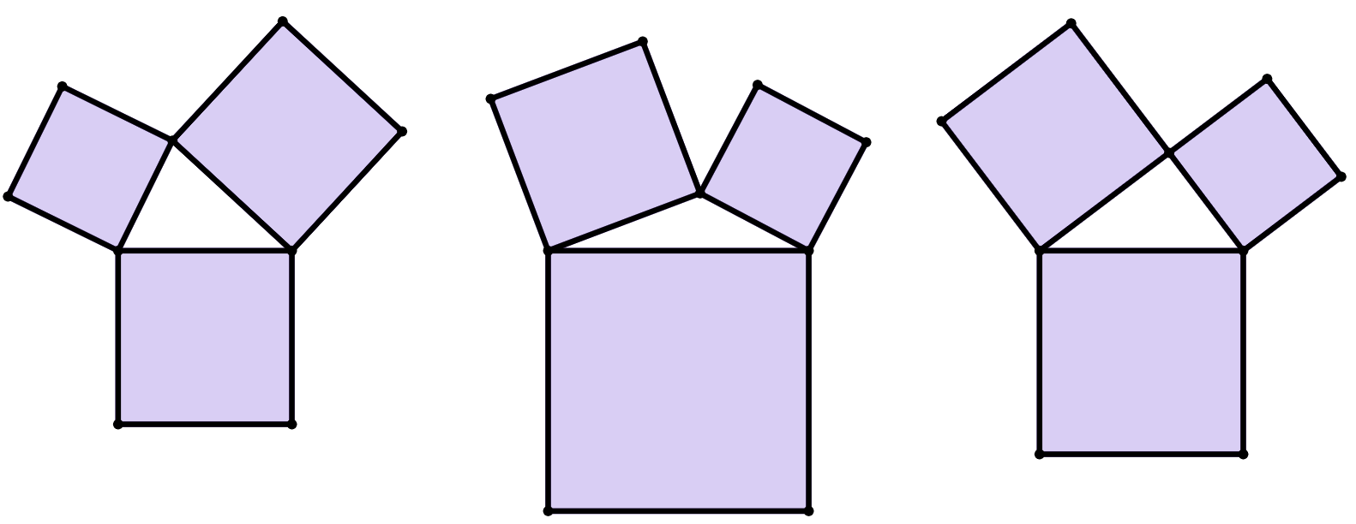
Astaamaha ka yimaada isku darka bedka (areas) ee labajibbaaranayaasha (squares)
7 units²
7 units²
7 + 4 = 11
4
units²
7 + 4 = 11
4
units²
8 waa ka yar yahay 11.
18 waa ka weyn yahay 11.
18 units²
8 units²
xagasha (obtuse)
xagasha (acute)
Haddii bedka labajibbaaranaha ugu weyn uu ka yar yahay wadarta labada bed ee yar…
Haddii bedka (area) labajibbaaranaha ugu weyn uu ka weyn yahay wadarta (sum) labada bedood ee yaryar…
Xagasha ugu weyn had iyo jeer waa xagasha (acute).
Xagasha ugu weyn had iyo jeer waa xagasha (obtuse).

Slide 27
Guryaha (Properties) ka soo baxa isugeynta (summing) bedka (areas) labajibbaaranayaasha
Laakiin ka warran saddex-xagal qumman (right-angled triangle)?
7 units²
4
units²
Waa maxay xiriirka (relationship) u dhexeeya:
bedka (areas) labada labajibbaaran ee yaryar
bedka (area) labajibbaaranaha weyn?
11 units²
Haddii bedka (area) labajibbaaranaha ugu weyn uu la mid yahay wadarta (sum) labada bedood ee yaryar…
7 + 4 = 11
Xagasha ugu weyn had iyo jeer waa xagasha qumman (right-angled).
11 units² waa bedka (area) labajibbaaranaha ugu weyn.

Slide 28
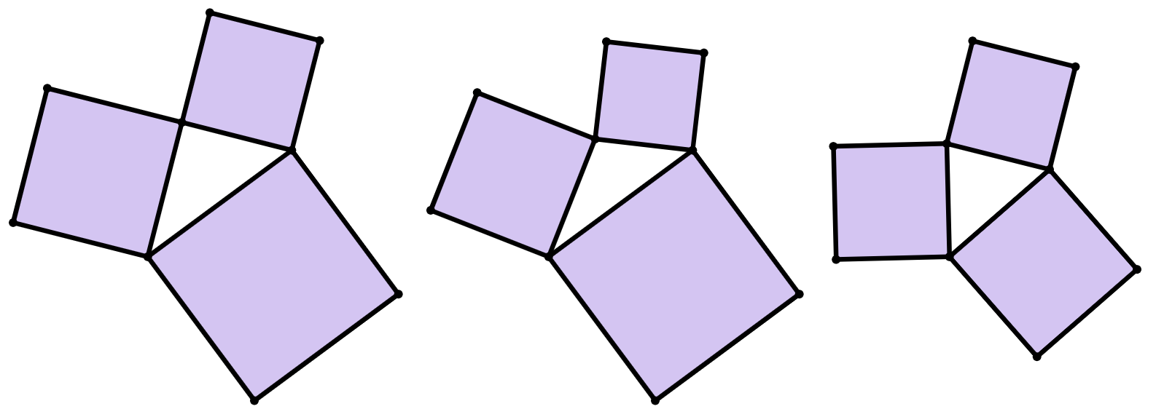
Guryaha (Properties) ka soo baxa isugeynta (summing) bedka (areas) labajibbaaranayaasha
a
8
units²
b
6
units²
7
units²
c
12 units²
10
units²
8
units²
20 units²
20 units²
11 units²
xagal (obtuse)
xagal (acute)
xagal toosan (right-angled)
12 + 8 = 20
10 + 6 = 16
8 + 7 = 15
Saddexagalkee xaggiisa ugu weyn (lagu calaamadeeyay calaamadda xagasha) waa: xagasha (acute), xagasha (obtuse), ama xagasha toosan (right-angled)?

Slide 29
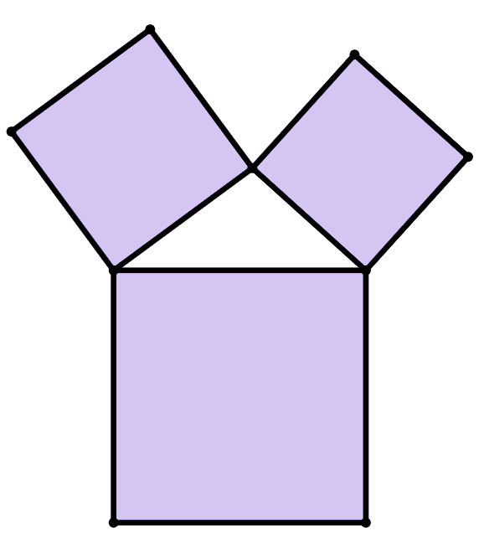
Sifooyin ka soo baxa isku darka bedka (areas) labajibbaaranayaasha
Xagasha ugu weyn ee saddexagalkani waa xagal (obtuse).
Kuwee ka mid ah kuwan ayaa ah qiimayaal (values) suurtagal ah oo x units², bedka (area) labajibbaaranaha ugu weyn?
14 units²
11 units²
a
d
x units²
b
e
c
f
Jawaabaha:
11 units²
25 units²
13 units²
30 units²
14 units²
36 units²

Slide 30
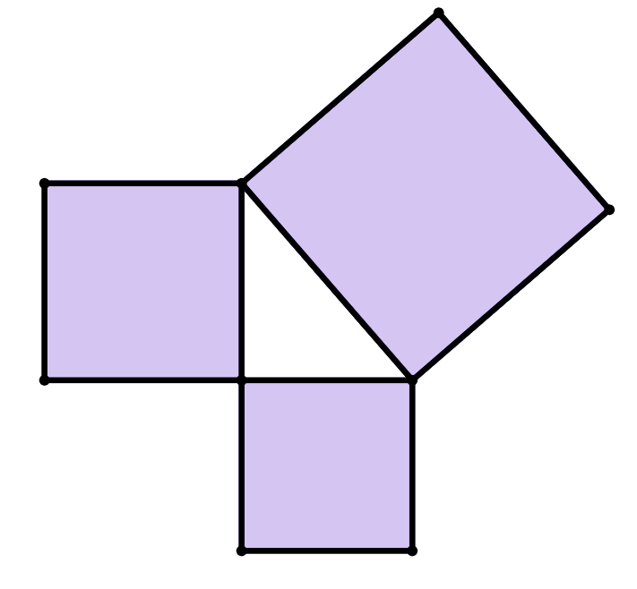
Guryaha ka soo baxa isugeynta bedka (area) labajibbaaranayaasha
Xagasha ugu weyn ee saddexagalkaan waa xagal qumman (right angle).
Waa maxay qiimaha (value) y, halkaas oo y units² uu yahay bedka (area) labajibbaaranaha ugu weyn?
16 units²
y units²
12 units²
28

Slide 31
Guryaha ka soo baxa isugeynta bedka (area) labajibbaaranayaasha
Ma jirtaa hab fudud oo lagu garto halka xagasha ugu weyn ay ku taal saddexagalka?
Xagasha ugu weyn weligeed uma eka inay taabato labajibbaaranaha ugu weyn.
Waxaa laga yaabaa in xagasha ugu weyn ay had iyo jeer ka soo horjeedo labajibbaaranaha ugu weyn.
Waxaan qabaa inaad sax tahay!
Runtii waa run saddexagalkan oo dhan!
Saddexagalka qaarkood, way adag tahay iyada oo aan la isticmaalin protractor (protractor).
Axmed
7 units²
9 units²
5
units²
4
units²
16 units²
Layla
28 units²
8 units²
14 units²
12 units²

Slide 32
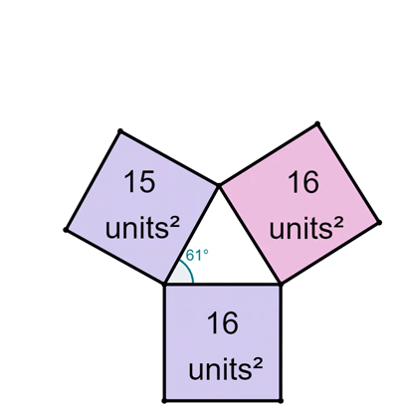
Sifooyin ka yimaada isku darka bedka labajibbaarannada (Properties from summing the areas of squares)
Marka labajibbaaranaha ugu weyn uu weynaado, xagasha ugu weyn ee ka soo horjeeda ayaa sidoo kale weynaata!
Axmed

Slide 33
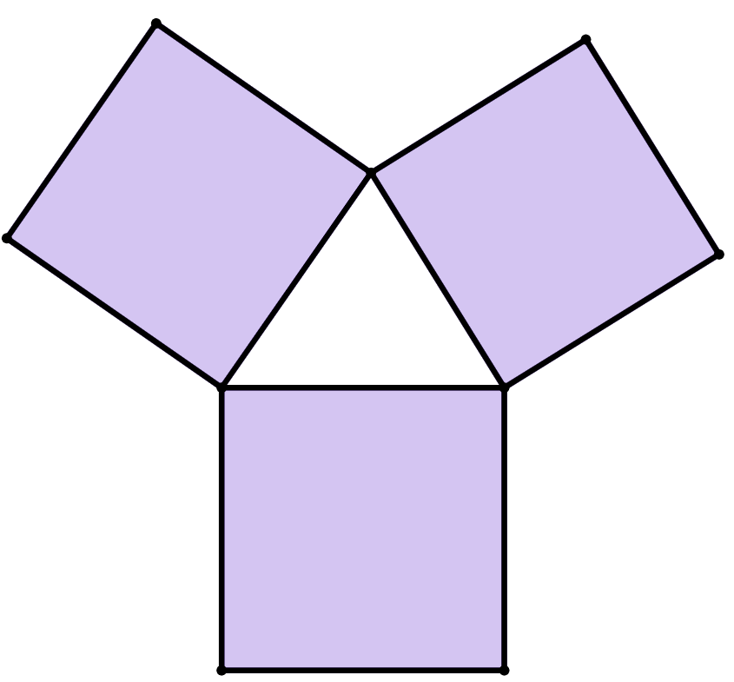
Sifooyin ka yimaada isku darka bedka labajibbaarannada (Properties from summing the areas of squares)
Saddexagalkan, kee ka mid ah saddexda xagal ayaa ugu weyn?
30 units²
b°
c°
b°
35 units²
28 units²
a°

Slide 34
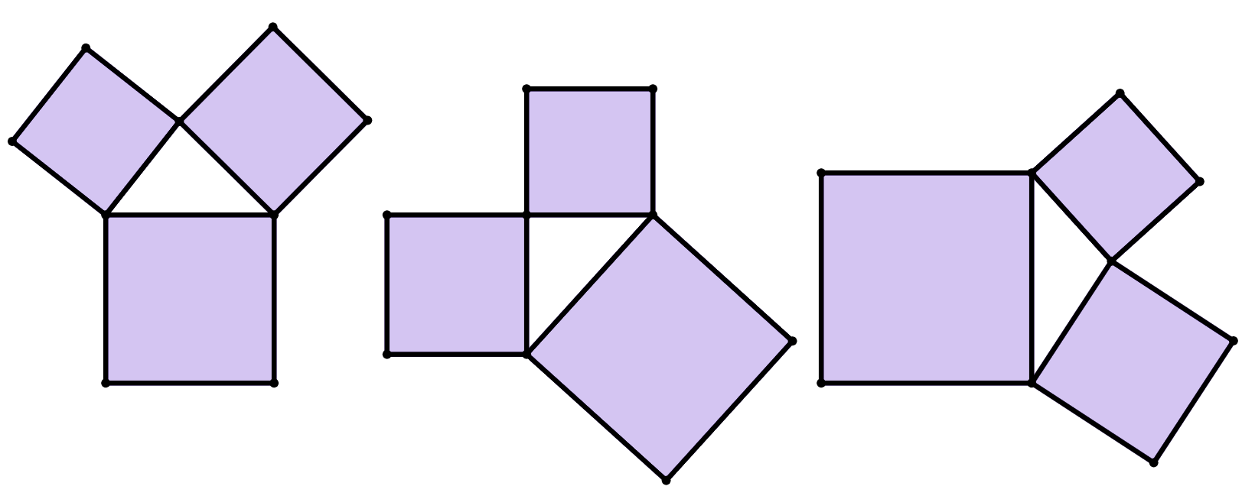
Sifooyin ka yimaada isku darka bedka labajibbaarannada (Properties from summing the areas of squares)
1) Saddexagal kasta, ku calaamadee xagal uu yahay xagasha ugu weyn ee gudaha saddexagalka.
Xagal kasta oo la calaamadeeyay, qor inay tahay mid degdeg ah (acute), qumman (right), ama fiiqan (obtuse).
a)
8
units²
10
units²
9
units²
c)
8
units²
b)
16 units²
11
units²
25
units²
20
units²
12
units²

Slide 35
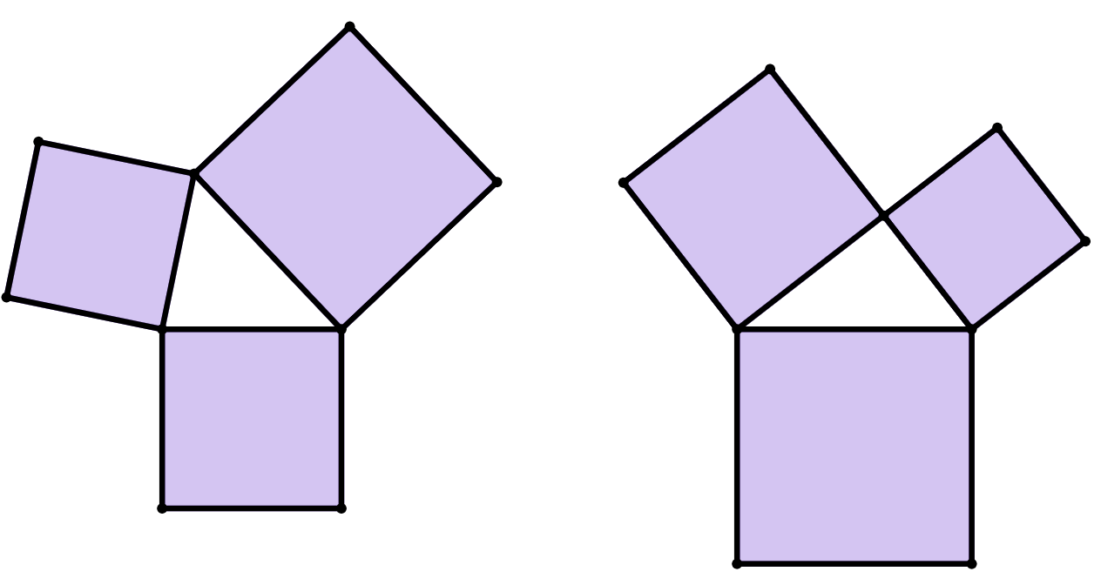
Sifooyin ka yimaada isugeynta bedka (area) labajibbaaranayaasha
2) Xagasha ugu weyn ee saddex-xagalkan waxaa lagu calaamadeeyay calaamad xagal (angle marker) waana xagal fiiqan (acute).
Qor bed (area) suurtagal ah oo labajibbaaranaha ugu weyn.
3) Xagasha ugu weyn ee saddex-xagalkan waa xagal qumman (right angle).
Qor bedka (area) labajibbaaranaha aan la calaamadayn.
15
units²
11
units²
14
units²
24
units²

Slide 36
Sifooyin ka yimaada isugeynta bedka (area) labajibbaaranayaasha
4) Koox kastaa waxay tusaysaa bedka (area) saddex labajibbaaran oo geesahooda (vertices) lagu xidhay si ay u sameeyaan saddex-xagal.
Dhig koox kasta qaybta saxda ah ee shaxda (table) qeexaysa cabbirka xagasha ugu weyn.
xagasha ugu weyn waa xagal fiiqan (acute) | xagasha ugu weyn waa xagal fiiqan (obtuse) | xagasha ugu weyn waa xagal qumman (right)
16, 18, 20 | 9, 13, 26 | 8, 13, 21
3, 3, 5
8, 17, 25
Jawaabaha:
1, 1, 3
4, 7, 10
16, 17, 40
9, 16, 25
5x, 7x, 12x
14a, 19a, 44a

Slide 37
Sifooyin ka yimaada isugeynta bedka (area) labajibbaaranayaasha
1) Saddex-xagal kasta, ku sawir calaamad xagal (angle marker) xagasha ugu weyn ee gudaha (interior angle) saddex-xagalka.
Xagal kasta oo la calaamadeeyay, qor inay tahay xagal fiiqan (acute), xagal qumman (right), ama xagal fiiqan (obtuse).
a)
8
units²
10
units²
9
units²
c)
8
units²
b)
16 units²
11
units²
25
units²
20
units²
12
units²
xagal qumman (right-angled)
xagal fidsan (obtuse)
xagal af (acute)

Slide 38
Sifooyin ka yimaada isku darka bedka (areas) labajibbaaranayaasha
2) Xagasha ugu weyn saddexagalkaan waxaa lagu calaamadeeyay calaamad xagal (angle marker) waana xagal af (acute).
Qor bed (area) suurtagal ah oo labajibbaaranaha ugu weyn.
3) Xagasha ugu weyn saddexagalkaan waa xagal qumman (right angle).
Qor bedka (area) labajibbaaranaha aan la calaamadin.
15
units²
9
units²
11
units²
Bed kasta oo ka weyn 14 units², laakiin ka yar 25 units².
14
units²
24
units²

Slide 39
Sifooyin ka yimaada isku darka bedka (areas) labajibbaaranayaasha
4) Koox kastaa waxay tusaysaa bedka (areas) saddex labajibbaaran oo geesahooda lagu xiro si ay u sameeyaan saddexagal.
Geli koox kasta meeshii ku habboon ee shaxda qeexaysa cabbirka xagasha ugu weyn.
xagasha ugu weyn waa xagasha (acute) | xagasha ugu weyn waa xagasha (obtuse) | xagasha ugu weyn waa xagasha (right)
16, 18, 20 | 9, 13, 26 | 8, 13, 21
3, 3, 5
1, 1, 3
8, 17, 25
4, 7, 10
16, 17, 40
9, 16, 25
14a, 19a, 44a
5x, 7x, 12x

Slide 40
Muujinta aragtida (Pythagoras' theorem)
Saddex labajibbaaran (squares) ayaa lagu xiri karaa meelaha ay ku kulmaan (vertices) si loo sameeyo saddex-xagal (triangle).
Haddii saddex labajibbaaran oo isku mid ah (congruent squares) la isku xiro, saddex-xagalku waa siman (equilateral).
Haddii laba labajibbaaran oo isku mid ah la isku xiro, saddex-xagalku waa laba-geesood (isosceles).
Haddii dhammaan labajibbaaranayaashu leeyihiin bed (areas) kala duwan, saddex-xagalku waa kala-dheer (scalene).
Xagasha ugu weyn ee saddex-xagalka waxay noqon kartaa xagasha (acute), xagasha (right), ama xagasha (obtuse), iyadoo ku xiran in wadarta bedka labada labajibbaaran ee yaryar ay ka weyn tahay, la mid tahay, ama ka yar tahay bedka labajibbaaranaha ugu weyn, siday u kala horreeyaan.
Marka wadarta bedka labada labajibbaaran ee yaryar ay la mid tahay bedka labajibbaaranaha ugu weyn, saddex-xagalku had iyo jeer waa saddex-xagal xagasha (right-angled triangle). Tani waa muujin (visual demonstration) aragtida (Pythagoras’ theorem).

