Slide 1
Naqshadaynta meel cagaaran
Xisaabta iyo deegaanka

Slide 2
Sida agabkeena waxbarista loogu talagalay fasalka

Slide 3
Waxaan naqshadayn karaa meel cagaaran anigoo tixgelinaya bulshada.

Slide 4
Urban (magalo) waa eray lagu qeexo magaalo ama magaalo, ama sifooyinka qaarkood ee magaalooyinka.
Bedka (area) waa cabbirka dusha sare wuxuuna sheegaa tirada labajibbaaranaha halbeegga ah ee loo baahan yahay si buuxda u daboosho dushaas.
Gooyn (Truncation) waa fududaynta tiro adigoo 'gooya' hal ama in ka badan oo ka mid ah lambarrada oo ku beddelaya eber haddii loo baahdo si loo ilaaliyo qiimaha (value). Tusaale: 36.78 oo loo gooyay (truncated) tiro dhammaystiran waa 36

Slide 5

Naqshadaynta meel cagaaran
Qorshaynta beeraha saqafka korka ah
Qorshaynta beerta ama dhul beereed
Naqshadaynta jardiino

Slide 6
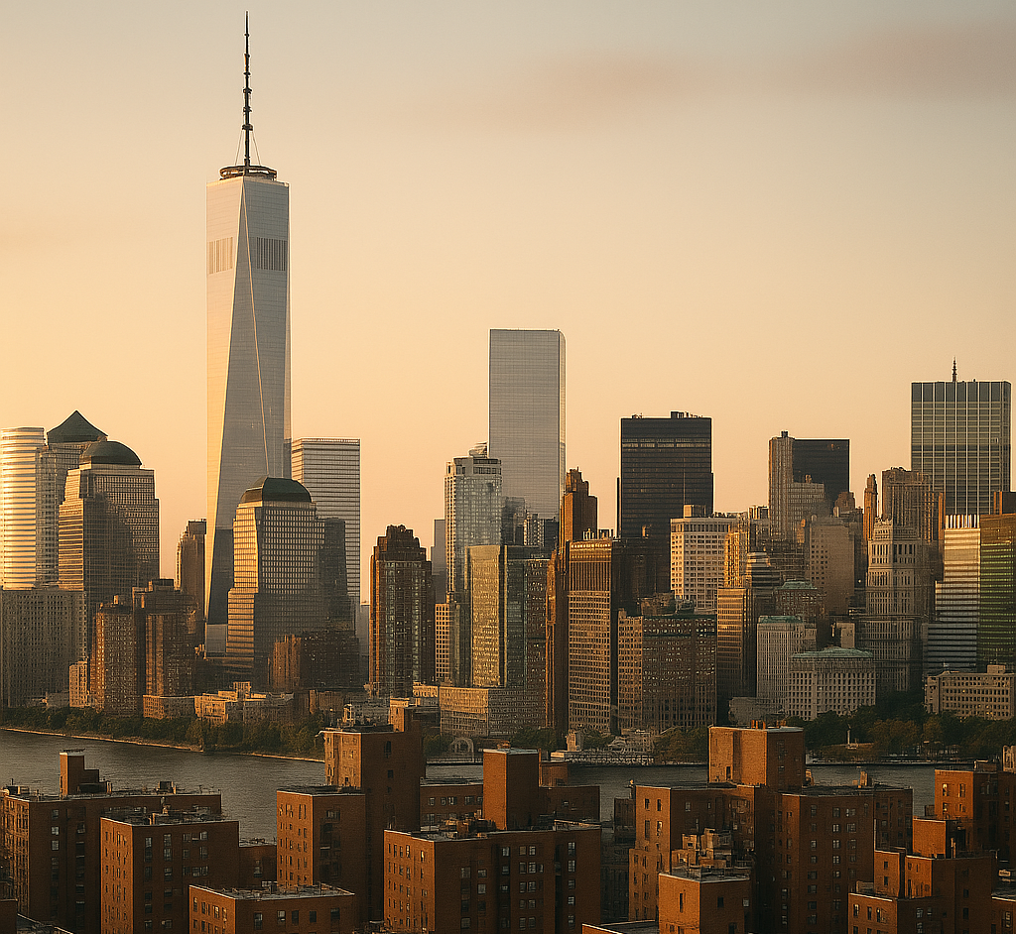
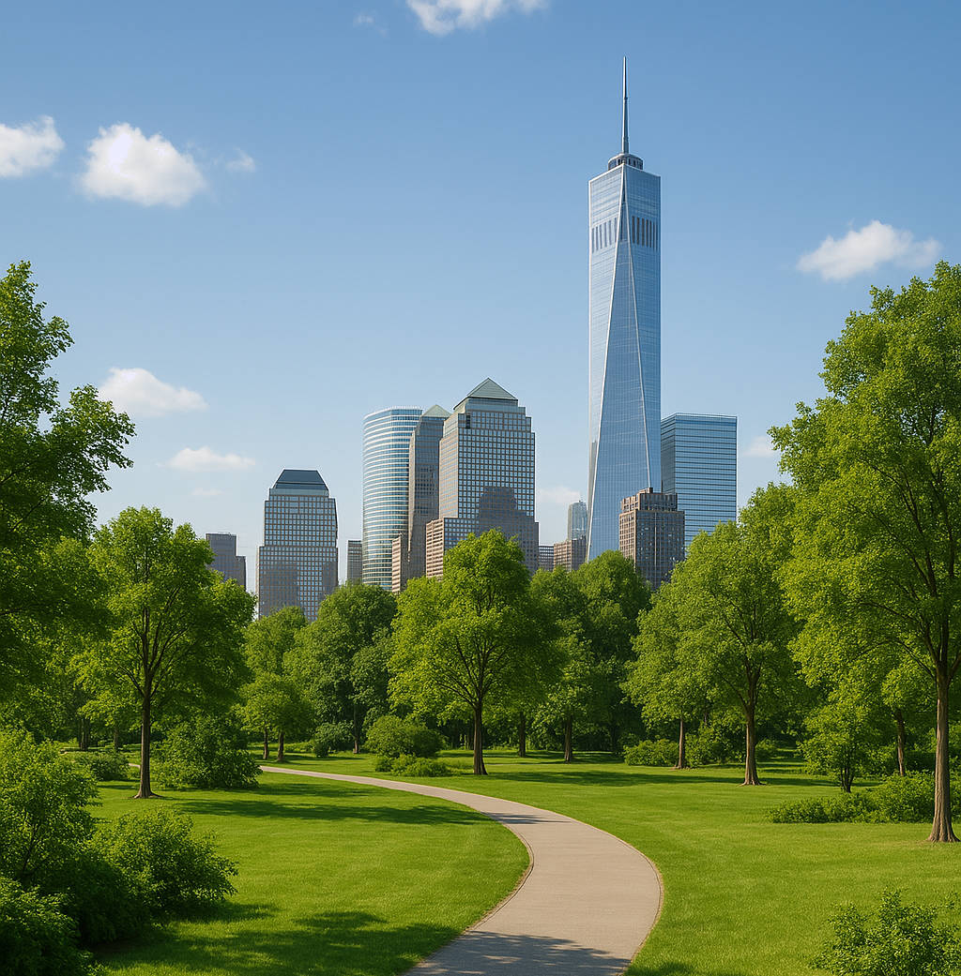
Qorshaynta beeraha saqafka korka ah
Aagga magaalooyinka (urban area) waa gobol leh cufnaan sare oo dadka ah (tusaale magaalo ama magaalo).
Deegaanka magaalooyinka (urban) sida caadiga ah wuxuu leeyahay cufnaan sare oo ah:
dhismayaasha (guryaha, ganacsiga, waxsoosaarka iwm);
waddooyinka (iyo gaadiidka waddooyinka);
bixinta (emission) kaarboon ee gaadiidka, warshadaha, iwm.
Cagaaraynta magaalooyinka (urban greening) waxay ujeedkeedu yahay in lagu daro cagaar badan deegaannada magaalooyinka (tusaale ahaan jardiinooyinka iyo geedaha).
Tani waxay taageeri kartaa kala-duwanaanshaha noolaha (biodiversity), kor u qaadi kartaa sii-jirka (sustainability) waxayna ka dhigi kartaa aagga mid ka fiican dadka.

Slide 7
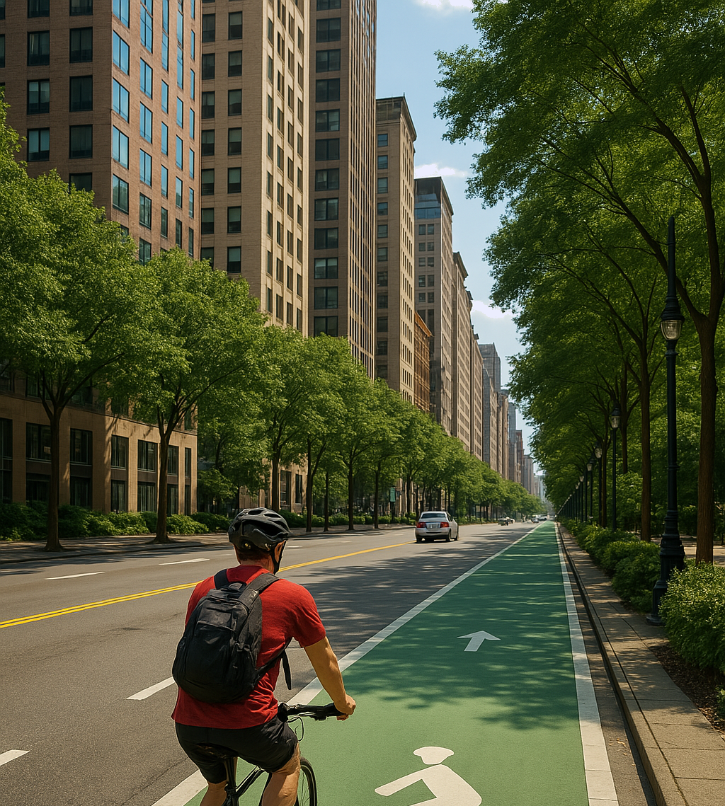
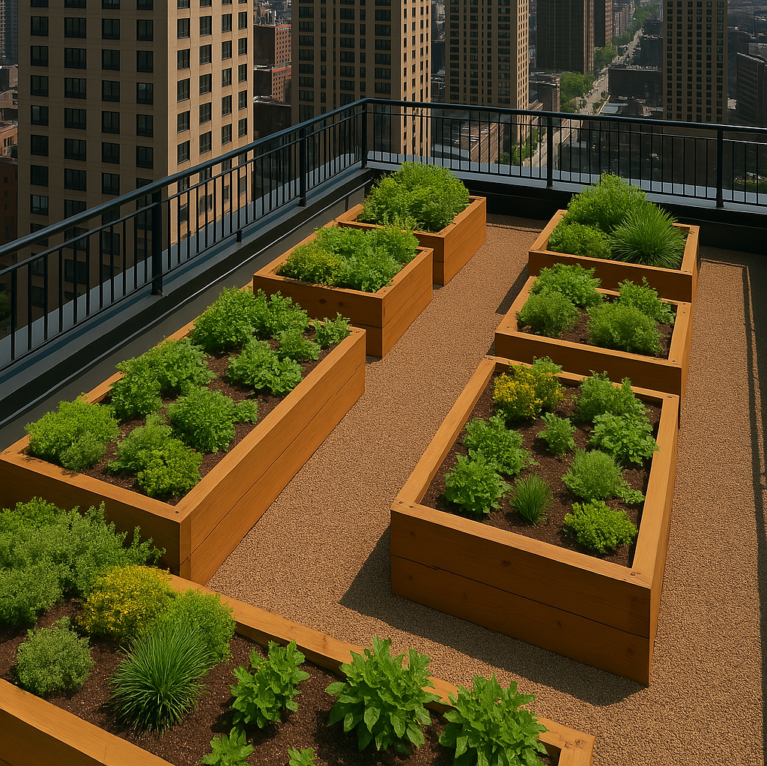
Qorshaynta beeraha saqafka korka ah
Ku rakibidda meelaha cagaaran ee deegaannada magaalooyinka waa dadaal caadi ah oo loogu talagalay cagaaraynta magaalooyinka (urban greening).
Meelaha cagaaran waxaa ka mid ah:
dhirta beerista waddooyinka
beeraha cagaaran ee magaalada
(beeraha magaalooyinka dhexdooda)
beeraha saqafka korka ah
(saagista dhirta saqafka sare)

Slide 8
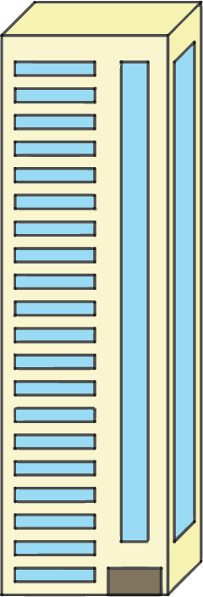
Qorshaynta beerashada saqafka sare
3 m
Jaantusku wuxuu muujinayaa aragtida qorshaysan ee saqaf fidsan oo ku yaal dabaqa guriga.
jaranjaro-
ceel
Jaantuska looma sawirin cabbir (scale).
21 m
2 m
hawada
neefsasho
10 m

Slide 9
Qorshaynta beerashada saqafka sare
3 m
Jaantusku wuxuu muujinayaa aragtida qorshaysan ee saqaf fidsan oo ku yaal dabaqa guriga.
jaranjaro-
ceel
Saqafka waxaa laga dhigi karaa meel cagaaran.
Dhirta waxaa lagu beeri karaa qaybaha aan la isticmaalin ee saqafka sare, maadaama ay si fiican u helaan iftiinka qorraxda iyo biyaha roobka.
21 m
Dhirta laguma beeri karo jaranjaro-ceelka ama hawada neefsashada.
2 m
hawada
neefsasho
10 m

Slide 10
Qorsheynta beeraha saqafka
3 m
Waxaan heli karnaa bedka ugu weyn ee saqafka ee loo isticmaali karo in lagu beero dhirta.
jaranjaro-
ceel
bedka saqafka oo dhan
−
bedka (area) jaranjaro-ceelka
−
bedka hawo-mareenka
10 × 21
−
3²
−
π × 1²
21 m
= 197.8584…
2 m
Xaaladdan, waxaa habboon in la gooyo jawaabta 197 halkii laga soo wareegi lahaa 198 sababtoo ah ma jiro meel ku filan 198 m² oo cagaar ah.
hawada
hawo-mareen
10 m

Slide 11
Qorsheynta beeraha saqafka
3 m
Waxaan heli karnaa bedka ugu weyn ee saqafka ee loo isticmaali karo in lagu beero dhirta.
jaranjaro-
ceel
bedka saqafka oo dhan
−
bedka jaranjaro-ceelka
−
bedka hawo-mareenka
10 × 21
−
3²
−
π × 1²
21 m
= 197.8584…
2 m
Saqafku wuxuu leeyahay qiyaastii 197 m² oo meel la isticmaali karo oo lagu beero dhirta.
hawada
hawo-mareen
10 m

Slide 12
Qorsheynta beeraha saqafka
3 m
Haddii saqafka oo dhan laga buuxiyo dhirta, ma jiri lahaa meel ay dadku ku socdaan saqafka si ay u daryeelaan dhirta.
jaranjaro-
well
Waddo lagu socdo ayaa lagu dhejin karaa saqafka dushiisa.
Tusaale: Waxaa jira 197 m² oo meel la isticmaali karo ah saqafkan. Waddo 1.5 m oo ballaadhan ayaa la dhejiyaa. Intee in yar ayaa u hartay beerista dhirta?
21 m
walkway
2 m
area of walkway: 1.5 × 21 = 31.5 m²
air
vent
area for plants: 197 – 31.5 = 165.5 m²
10 m

Slide 13
Planning rooftop agriculture
Jaantusku wuxuu muujinayaa aragtida qorshaha ee dhismo leh saqaf fidsan.
4 m
Dhirta laguma beeri karo jaranjarooyinka ama balakoonka.
stair-
well
10 m
Waa maxay bedka ugu badan ee loo isticmaali karo beerista dhirta?
2 m
balcony for seating
20 m
10 × 20 – (4² + 2 × 20) = 144 m²

Slide 14
Planning rooftop agriculture
Bedka ugu badan ee loo isticmaali karo beerista dhirta waa 144 m2.
Qorsheeye ayaa soo jeedinaya in la dhejiyo waddo 2 m oo ballaadhan oo dhererka saqafka ah.
4 m
stair-
well
waddo (walkway)
Intee in yar ayaa u hartay beerista dhirta?
10 m
2 m
balcony for seating
144 – 2 × 20 = 104 m²
20 m
Maxaa dhibaato ah oo ka iman kara naqshaddan?
Tusaale: Ma awoodid inaad ka timaaddo jaranjaro (stairwell) ilaa balakoonka (balcony).

Slide 15
Qorshaynta beerista saqafka (rooftop agriculture)
Bedka ugu badan ee loo isticmaali karo in lagu beero dhirta waa 144 m2.
Naqshad kale oo loogu talagalay waddada (walkway) ayaa la soo jeediyay.
4 m
2 m
jaran-
jaro (stairwell)
Intee in le'eg ayaa bedka u haray si loogu beero dhirta?
waddo (walkway)
2 m
10 m
Waddo toosan (Vertical walkway): 16 m²
2 m
balakoon (balcony) fadhiga
Waddo jiif ah (Horizontal walkway): 40 m²
Bedka isgoyska (crossover): 4 m²
20 m
Wadarta bedka waddada: 16 + 40 – 4 = 52 m²
Bedka loogu talagalay in lagu beero dhirta: 144 – 52 = 92 m²

Slide 16
Qorshaynta beerista saqafka (rooftop agriculture)
1) Jaantusku wuxuu muujinayaa aragtida qorshaha (plan view) ee saqafka (rooftop) ee dhismaha xafiiska. Saqafka wuxuu leeyahay laba daaqadood oo isku mid ah (congruent skylight windows).
3.5 m
xuduud bixin (drainage border)
jaran-
jaro (stairwell)
Nashqadeeye (designer) wuxuu doonayaa inuu isticmaalo saqafka (roof-space) intii suurtogal ah si uu u beero cagaar (greenery).
Waxay u baahan yihiin inay ku daraan xuduud (border) hareeraha, si biyuhu u baxaan (drainage). Xuduuddu (border) waa 50 cm ballac (wide) dhammaan hareeraha.
20 m
daaqad iftiin (skylight window)
daaqad iftiin (skylight window)
4 m
6 m
Xisaabi bedka (area) ugu weyn (maximum) ee loo isticmaali karo beerista cagaarka (planting greenery).
30 m
jaantus (diagram) looma sawirin cabbir (scale)

Slide 17
Qorshaynta beerista saqafka (rooftop agriculture)
1) Jaantusku (diagram) wuxuu muujinayaa aragtida qorshe (plan view) ee saqafka (rooftop) dhismaha xafiiska (office building). Saqafka (roof) wuxuu leeyahay laba daaqadood oo iftiin (skylight windows) oo isku mid ah (congruent).
3.5 m
xuduud bixin (drainage border)
jaranjaro-
ceel (well)
Nashqadeeye (designer) wuxuu doonayaa inuu isticmaalo saqafka (roof-space) intii suurtogal ah si uu u beero cagaar (greenery).
Waxay u baahan yihiin inay ku daraan xuduud (border) hareeraha, si biyuhu u baxaan (drainage). Xuduuddu (border) waa 50 cm ballac (wide) dhammaan hareeraha.
20 m
daaqad iftiin (skylight window)
daaqad iftiin (skylight window)
4 m
6 m
Xisaabi bedka (area) ugu weyn (maximum) ee loo isticmaali karo beerista cagaarka (planting greenery).
30 m
jaantus (diagram) looma sawirin cabbir (scale)

Slide 18
Qorsheynta beerista saqafka (rooftop agriculture)
1) Xisaabi bedka ugu weyn ee loo isticmaali karo beerista cagaarka (greenery).
3.5 m
Bedka gudaha xadka:
xuduud bixin (drainage border)
jaranjaro-
ceel (well)
25.5 × 3.5 + 29 × 15.5
25.5 m
= 538.75 m²
3.5 m
3.5 m
Bedka daaqad kasta:
20 m
daaqad iftiin (skylight window)
daaqad iftiin (skylight window)
19 m
4 m
4 × 6
= 24 m²
6 m
15.5 m
29 m
Bedka loogu talagalay beerista cagaarka:
538.75 – 2 × 24
30 m
= 490.75 m²
jaantus (diagram) looma sawirin cabbir (scale)

Slide 19
Naqshadaynta meel cagaaran (green space)
Qorsheynta beerista saqafka (rooftop agriculture)
Qorsheynta beerta ama dhulka beerista (allotment)
Naqshadaynta beerta (park)

Slide 20
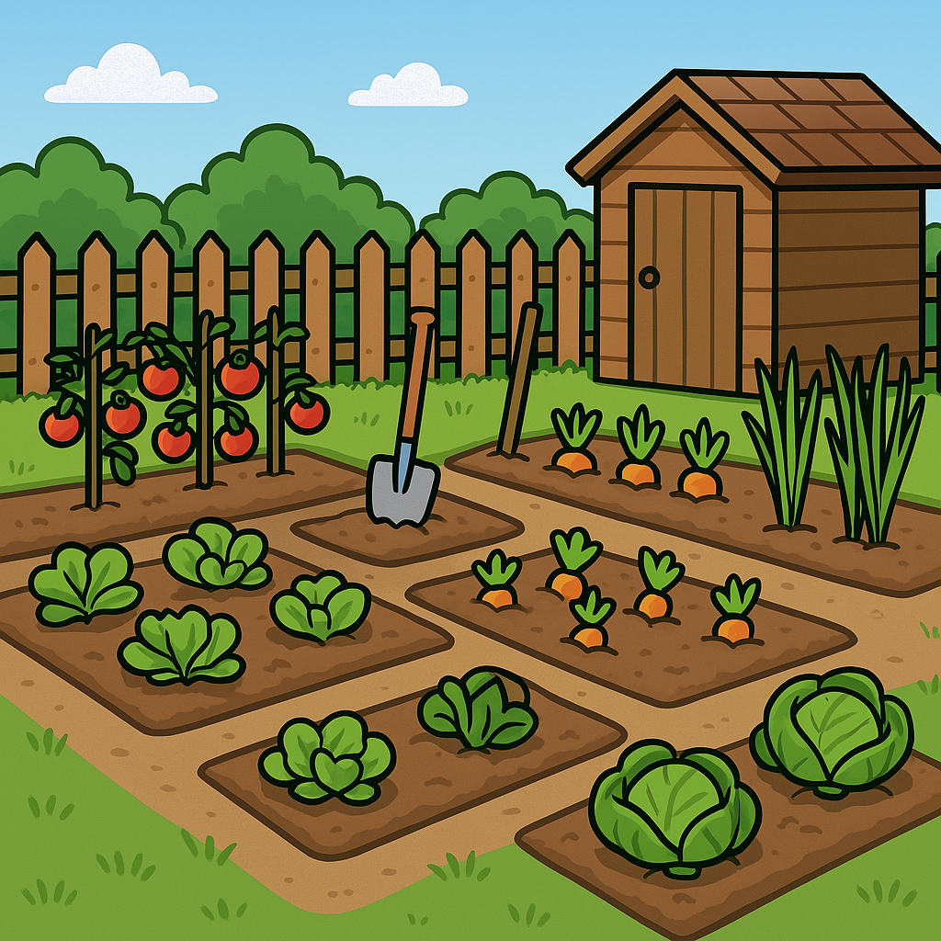
Qorsheynta beerta ama dhulka beerista (allotment)
Khudradda iyo miraha waxaa lagu kori karaa jardiinooyinka, dhulka beerista (allotments) ama meelaha cagaaran ee kale. Qorsheyn ayaa loo baahan yahay si loo kordhiyo booska la heli karo.

Slide 21
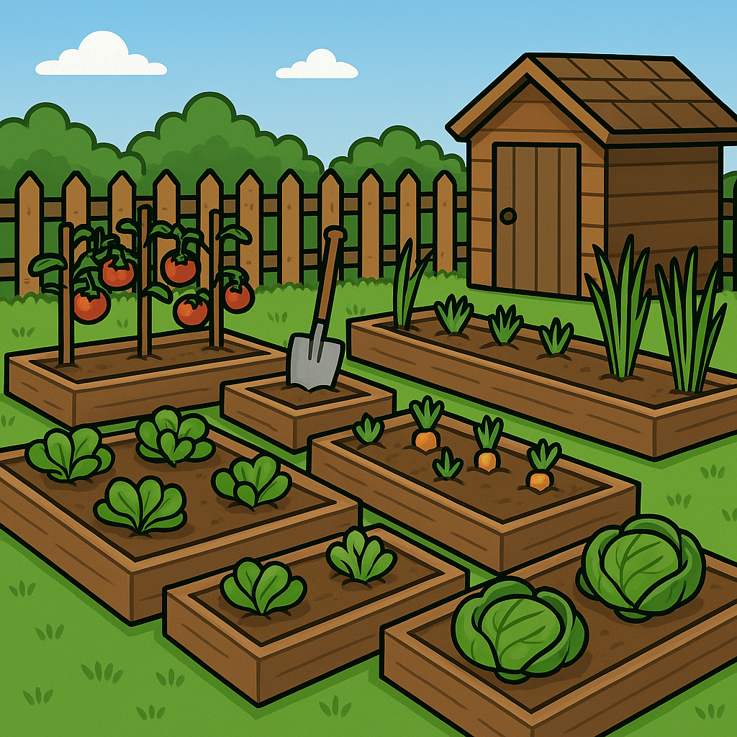
Qorsheynta beerta ama dhulka beerista (allotment)
Qaybaha kala duwan ee meesha cagaaran waxaa loo qoondeyn karaa in lagu beero noocyo kala duwan oo dhir ah.
Mararka qaarkood tan waxaa lagu sameeyaa iyadoo la dhigo caqabado (barriers) agagaarka qaybaha ciidda.
Qaybaha yaryar, sariiraha beerta ee kor u qaadan (raised garden beds) ama weelasha waaweyn (planters) ayaa la isticmaali karaa.

Slide 22
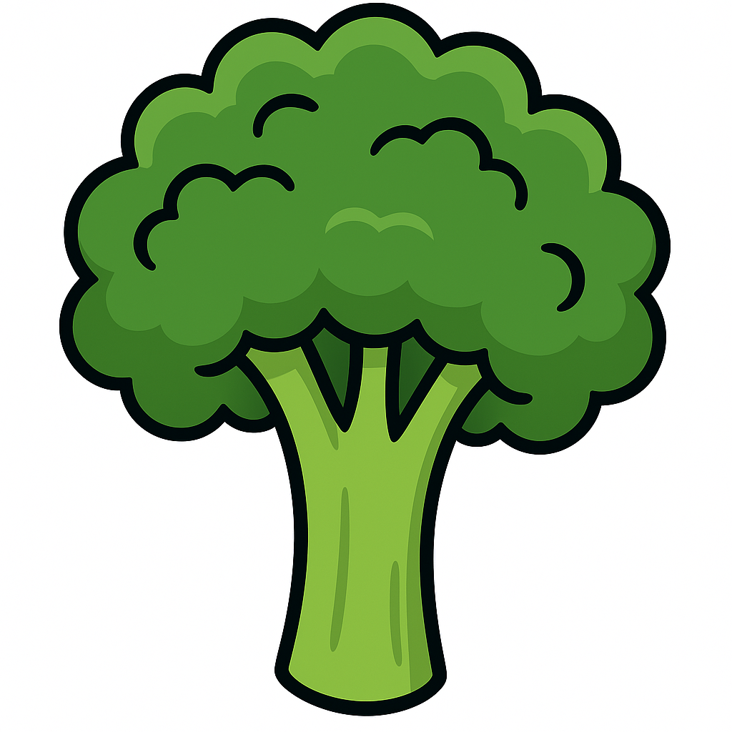
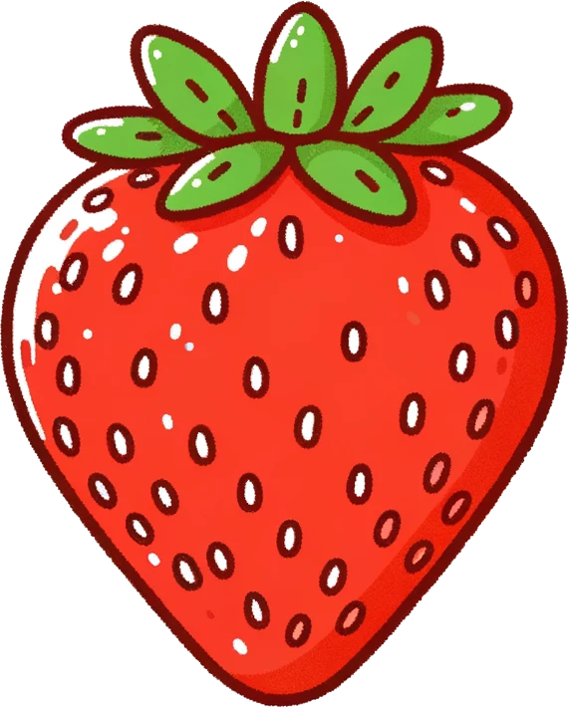
Qorsheynta beerta ama dhulka beerista (allotment)
Waxaa inta badan jira qaddar boos ah oo lagu taliyo in laga tago agagaarka geed kasta si ay u helaan boos ku filan oo ay ku koraan.
Qaddarka booska wuu kala duwanaan karaa noocyada dhirta.
E.g.
Marka la beero broccoli, waxaa lagu taliyaa in la beero ugu yaraan 80 cm kala fog.
Marka la beero geedaha strawberry, waxaa lagu taliyaa in la beero ugu yaraan 30 cm kala fog.

Slide 23
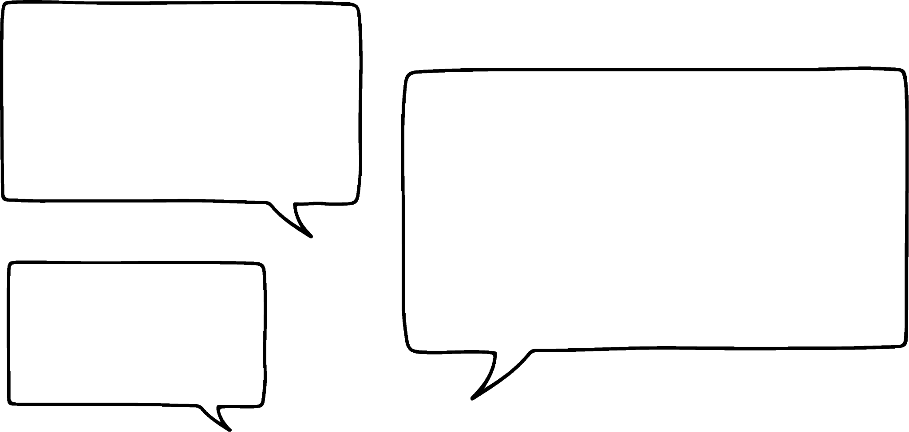

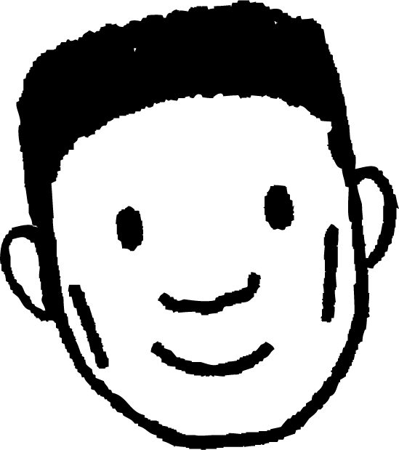
Qorshaynta beerta ama qaybta beerta (allotment)
Cabdi wuxuu beeraa broccoli. Wuxuu rabaa inuu ku beero broccoli safaf iyo tiirar gudaha sariir beereed isku kooban oo ah 4 m by 4.8 m.
Waa inuu beeraa broccoli-ga 80 cm kala fog.
Waa maxay tirada ugu badan ee broccoli uu ku beeran karo booska la heli karo?
Bilow ahaan, waxaan u rogi karaa cabbirada (measurements) si ay isku halbeeg (units) ugu wada jiraan.
4 m
400 cm
480 cm
4.8 m

Slide 24
Qorshaynta beerta ama qaybta beerta (allotment)
Cabdi wuxuu beeraa broccoli. Wuxuu doonayaa inuu ku beero broccoli-ga safaf (rows) iyo tiirar (columns) gudaha sariir beereed (garden bed) oo iskeed u xiran oo ah 4 m x 4.8 m.
Waa inuu beeraa broccoli-ga 80 cm kala fog.
Waa maxay tirada ugu badan ee broccoli uu ku beeran karo booska la heli karo?
Talooyinka ah in la beero 80 cm kala fog waxay soo jeedinayaan in broccoli kasta uu u baahan yahay 40 cm oo boos cad (clear space) ah oo ku wareegsan si uu u koro.
400 cm
fallaadh kastaa waa 80 cm
480 cm

Slide 25
Qorshaynta beerta ama qaybta beerta (allotment)
Cabdi wuxuu beeraa broccoli. Wuxuu doonayaa inuu ku beero broccoli-ga safaf (rows) iyo tiirar (columns) gudaha sariir beereed (garden bed) oo iskeed u xiran oo ah 4 m x 4.8 m.
Waa inuu beeraa broccoli-ga 80 cm kala fog.
Waa maxay tirada ugu badan ee broccoli uu ku beeran karo booska la heli karo?
Talooyinka ah in la beero 80 cm kala fog waxay soo jeedinayaan in broccoli kasta uu u baahan yahay 40 cm oo boos cad (clear space) ah oo ku wareegsan si uu u koro.
400 cm
fallaadh kastaa waa 40 cm
480 cm

Slide 26
Qorsheynta beerta ama dhul beereed
Cabdi wuxuu beeraa broccoli. Wuxuu doonayaa inuu ku beero broccoli-ga safaf (rows) iyo tiirar (columns) gudaha sariir beereed (garden bed) oo iskeed u xiran oo ah 4 m x 4.8 m.
Waa inuu beeraa broccoli 80 cm kala fog.
Waa maxay tirada ugu badan ee broccoli uu ku beeri karo meesha la heli karo?
Goobta dhibcaha 40 cm u jira geedka broccoli waxay sameeyaan goobo (circle) leh radius (radius) 40 cm.
400 cm
radius (radius) kasta waa 40 cm
480 cm

Slide 27
Qorsheynta beerta ama dhul beereed
Cabdi wuxuu korayaa broccoli. Wuxuu rabaa inuu beero broccoli safaf iyo tiirar gudaha sariir beereed isku kooban oo 4 m by 4.8 m.
Waa inuu beeraa broccoli 80 cm kala fog.
radius (radius) = 40 cm
Waa maxay tirada ugu badan ee broccoli uu ku beeri karo meesha la heli karo?
Jaantusku hadda wuxuu muujinayaa barta ugu dhow geeska halkaas oo aan ku beeri karo broccoli.
400 cm
480 cm

Slide 28
Qorsheynta beerta ama dhul beereed
Cabdi wuxuu korayaa broccoli. Wuxuu rabaa inuu beero broccoli safaf iyo tiirar gudaha sariir beereed isku kooban oo 4 m by 4.8 m.
Waa inuu beeraa broccoli 80 cm kala fog.
radius (radius) = 40 cm
Waa maxay tirada ugu badan ee broccoli uu ku beeri karo meesha la heli karo?
Waxaan markaa ku beeri karaa dhir broccoli dheeri ah oo saf ah, iyagoo 80 cm kala fog.
400 cm
Saf kasta waxaa ku yaal 6.
480 cm

Slide 29
Qorshaynta beerta ama qaybta beerta (allotment)
Cabdi wuxuu beerayaa brokoli (broccoli). Wuxuu doonayaa inuu ku beero safaf iyo tiirar gudaha sariir beereed oo iskeed u xiran oo ah 4 m × 4.8 m.
Waa inuu brokoli (broccoli) ka beeraa 80 cm kala fog.
radius (radius) = 40 cm
Waa maxay tirada ugu badan ee brokoli (broccoli) uu ku beeran karo meesha la heli karo?
Waxaan ku celin karaa hab la mid ah anigoo hoos u socda.
400 cm
Tiir kasta waxaa ku yaal 5.
480 cm

Slide 30
Qorshaynta beerta ama qaybta beerta (allotment)
Cabdi wuxuu beerayaa brokoli (broccoli). Wuxuu doonayaa inuu ku beero safaf iyo tiirar gudaha sariir beereed oo iskeed u xiran oo ah 4 m × 4.8 m.
Waa inuu brokoli (broccoli) ka beeraa 80 cm kala fog.
radius (radius) = 40 cm
Waa maxay tirada ugu badan ee brokoli (broccoli) uu ku beeran karo meesha la heli karo?
Brokoli (broccoli)-gu wuxuu samayn lahaa qaab (array) ah 6 × 5.
400 cm
Marka wadarta guud waxay noqonaysaa 30.
480 cm

Slide 31
Qorsheynta beerta ama jardiino (allotment)
Cabdi wuxuu ku beeran karaa 30 geed oo brokoli (broccoli) ah meesha la heli karo.
Sidee Cabdi u ogaan lahaa tan iyadoo lagu salaynayo cabbirrada (dimensions) beerta khudaarta?
80 cm
Goob kasta (circle) wuxuu leeyahay dhexroor (diameter) 80 cm.
Marka tirada dhirta ee saf kasta waxaa lagu xisaabin karaa iyadoo 480 loo qaybiyo 80.
400 cm
480 ÷ 80 = 6
480 cm

Slide 32
Qorsheynta beerta ama jardiino (allotment)
Cabdi wuxuu beeri karaa 30 geed oo broccoli ah meesha la heli karo.
Sidee Cabdi u ogaan lahaa tan iyadoo lagu salaynayo cabbirrada (dimensions) beerta khudaarta?
80 cm
Goob kasta (circle) wuxuu leeyahay dhexroor (diameter) 80 cm.
Tirada dhirta ee saf kasta (column) waxaa lagu xisaabin karaa iyadoo 400 loo qaybiyo 80.
400 cm
480 ÷ 80 = 6
400 ÷ 80 = 5
480 cm

Slide 33
Qorsheynta beerta ama jardiino (allotment)
Cabdi wuxuu beeri karaa 30 geed oo broccoli ah meesha la heli karo.
Sidee Cabdi u ogaan lahaa tan iyadoo lagu salaynayo cabbirrada (dimensions) beerta khudaarta?
80 cm
Tirada guud ee dhirta broccoli ee safafka (array) waxaa markaa lagu xisaabin karaa iyadoo 6 lagu dhufto 5.
400 cm
480 ÷ 80 = 6
400 ÷ 80 = 5
6 × 5 = 30
480 cm

Slide 34
Qorshaynta beerta ama qaybta beerta (Planning a garden or allotment)
Cabdi wuxuu beerayaa dhirta strawberry. Wuxuu rabaa inuu ku beero safaf iyo tiirar gudaha sariir beereed (garden bed) oo iskeed u kooban, cabbirkeedu yahay 1.8 m by 1.2 m.
Qor cabbirrada (dimensions) sariirta beerta sentimitir (centimetres).
180 cm by 120 cm
1.2 m
1.8 m

Slide 35
Qorshaynta beerta ama qaybta beerta (Planning a garden or allotment)
Cabdi wuxuu korayaa dhirta strawberry. Wuxuu doonayaa inuu ku beero safaf iyo tiirar gudaha sariir beereed oo iskeed u xiran oo ah 1.8 m by 1.2 m.
Waa inuu ku beeraa dhirta strawberry 30 cm kala fog.
radius = 15 cm
Intuu ka fogaanayaa kan ugu horreeya xudduudda (border)?
15 cm
120 cm
180 cm

Slide 36
Qorshaynta beerta ama qaybta beerta (Planning a garden or allotment)
Cabdi wuxuu korayaa dhirta strawberry. Wuxuu doonayaa inuu ku beero safaf iyo tiirar gudaha sariir beereed oo iskeed u xiran oo ah 1.8 m by 1.2 m.
Waa inuu ku beeraa dhirta strawberry 30 cm kala fog.
Imisa dhir strawberry (strawberry plants) ayuu ku habin karaa saf kasta?
180 ÷ 30 = 6
120 cm
180 cm

Slide 37
Qorshaynta beerta ama qaybta beerta (Planning a garden or allotment)
Cabdi wuxuu korayaa dhirta strawberry. Wuxuu doonayaa inuu ku beero safaf iyo tiirar gudaha sariir beereed oo iskeed u xiran oo ah 1.8 m by 1.2 m.
Waa inuu ku beeraa dhirta strawberry 30 cm kala fog.
Immisa geed oo strawberry ah ayuu ku habsamin karaa saf kasta?
120 ÷ 30 = 4
120 cm
180 cm

Slide 38
Qorsheynta beerta ama jardiin
Lucas is growing strawberry plants. He wants to plant them in rows and columns inside a self-contained garden bed that is 1.8 m by 1.2 m.
Waa inuu ku beeraa geedaha strawberry 30 cm kala fog.
Immisa geed oo strawberry ah ayuu ku habsamin karaa sariirta beerta?
6 × 4 = 24
120 cm
180 cm

Slide 39
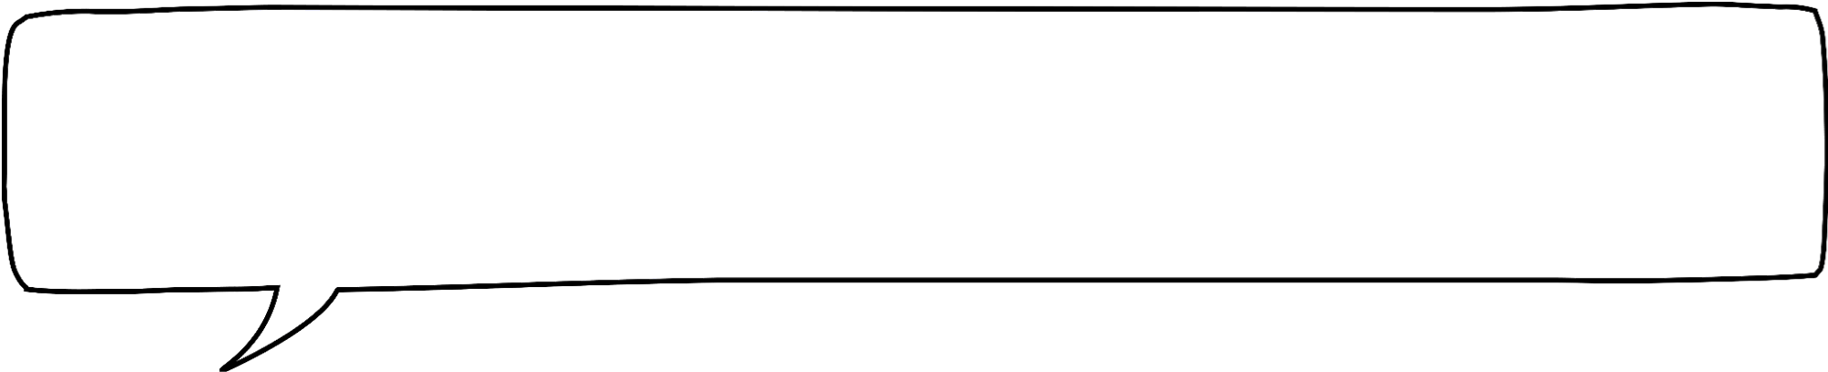
Qorsheynta beerta ama jardiin
Cabdi waa inuu ku beeraa geedaha strawberry 30 cm kala fog.
Haddii sariirta beertu ay tahay 195 cm dherer halkii 180 cm, markaas waxaan awoodi lahaa inaan beero tiir dheeri ah oo geedo strawberry ah.
Cabdi ma sax baa? Sharax jawaabtaada.
Maya, Cabdi waa qaldan.
Tiirka dheeraadka ah kama fogaan doono 15 cm xadka.
120 cm
195 cm

Slide 40
Qorsheynta beerta ama jardiin
1) Jaantusku wuxuu muujinayaa qorshaha qayb ka mid ah beerta bulshada. Waxay leedahay waddo dhererkeedu yahay 80 cm iyo afar sanduuq oo beero ah. Sanduuq kastaa wuxuu ku qoran yahay waxa loogu talagalay in lagu beero.
3.6 m
dubbeed (cauliflower)
geedo strawberry ah (strawberry plants)
3 m
Macluumaadka hoose waxay muujinayaan inta kala fog ee nooc kasta oo dhir ah uu u baahan yahay:
broccoli 80 cm
cabbages: 45 cm
cauliflower: 60 cm
geedo strawberry: 30 cm
brokoli (broccoli)
kobbe (cabbage)
8.6 m
Waa maxay tirada ugu badan ee dhirta laga beeran karo sanduuq kasta?
6.2 m
jaantus laguma sawirin cabbir (diagram not drawn to scale)

Slide 41
Qorshaynta beerta ama goobta beerta (Planning a garden or allotment)
1) Jaantusku wuxuu muujinayaa qorshaha qayb ka mid ah beerta bulshada. Waxay leedahay waddo dhererkeedu yahay 80 cm iyo afar sanduuq oo beerasho ah. Sanduuq kasta waxaa ku qoran waxa loogu talagalay in lagu beero.
3.6 m
dubbeed (cauliflower)
geedo strawberry ah (strawberry plants)
3 m
Macluumaadka hoose waxay muujinayaan inta u dhaxaysa nooc kasta oo dhir ah:
brokoli (broccoli) 80 cm
kobbe (cabbages): 45 cm
dubbeed (cauliflower): 60 cm
geedo strawberry ah (strawberry plants): 30 cm
brokoli (broccoli)
kobbe (cabbage)
8.6 m
Waa maxay tirada ugu badan ee dhirta laga beeran karo sanduuq kasta?
6.2 m
jaantus laguma sawirin cabbir (diagram not drawn to scale)

Slide 42
Qorsheynta beerta ama dhul beereed
1) Jaantusku wuxuu muujinayaa qorshaha qayb ka mid ah
beerta bulshada. Waxay leedahay waddo dhererkeedu yahay 80 cm iyo afar sanduuq oo beerasho ah.
Sanduuq kasta waxaa ku qoran waxa loogu talagalay in lagu beero.
3.6 m
1.8 m
kaluunka (cauliflower)
dhirta strawberry (strawberry plants)
3 m
broccoli
kaabashka (cabbage)
8.6 m
6.2 – (3.6 + 0.8) = 1.8
4.8 m
8.6 – (3 + 0.8) = 4.8
6.2 m
jaantuska looma sawirin qiyaas (diagram not drawn to scale)

Slide 43
Qorsheynta beerta ama dhul beereed
1) Waa imisa tirada ugu badan ee dhirta
lagu beeri karo sanduuq kasta?
3.6 m
1.8 m
kaluunka (cauliflower)
dhirta strawberry (strawberry plants)
Kaluunka (60 cm kala fog):
3 m
360 ÷ 60 = 6
30
60
300 ÷ 60 = 5
6 × 5 = 30
broccoli
kaabashka (cabbage)
8.6 m
Dhirta strawberry (30 cm kala fog):
4.8 m
180 ÷ 30 = 6
300 ÷ 30 = 10
6 × 10 = 60
6.2 m
jaantuska looma sawirin qiyaas (diagram not drawn to scale)

Slide 44
Qorsheynta beerta ama dhul beereed
1) Waa imisa tirada ugu badan ee dhirta
lagu beeri karo sanduuq kasta?
3.6 m
1.8 m
kaluunka (cauliflower)
dhirta strawberry (strawberry plants)
Broccoli (Broccoli) (80 cm kala fog):
3 m
360 ÷ 80 = 4.5
30
60
480 ÷ 80 = 6
4 × 6 = 24
broccoli
cabbage (cabbage)
8.6 m
Cabbage (Cabbage) (45 cm kala fog):
180 ÷ 45 = 4
4.8 m
.
24
40
480 ÷ 45 = 10.6
4 × 10 = 40
6.2 m
jaantus aan loo qaadin cabbir (diagram not drawn to scale)

Slide 45
Naqshadaynta meel cagaaran (Designing a green space)
Qorshaynta beerista saqafka (Planning rooftop agriculture)
Qorshaynta beerta ama dhul beereed (Planning a garden or allotment)
Naqshadaynta beerta (Designing a park)

Slide 46
Naqshadaynta beerta (Designing a park)
Magaalooyinka iyo magaalooyinka yaryar waxay inta badan leeyihiin jardiinooyin. Kuwani way kala duwanaan karaan cabbir ahaan.
Jardiinooyinka qaarkood way ku weyn yihiin si dadku ugu socon karaan socod nasasho leh, u ordaan ama u ciyaaraan kubbadda.
Haddii ay jiraan geedo ku filan, marka gudaha la galo, dadku ma arki karaan waddooyinka iyo dhismayaasha ku xeeran. Tani waxay siin kartaa dadka dareenka ah inay ka fogaadeen aagga magaalada.

Slide 47
Naqshadaynta beerta (Designing a park)
Jardiinooyinka qaarkood waa meelo yaryar oo cagaaran oo ku dhexyaala aagagga la dhisay.
Kuwaan waxaa mararka qaarkood loo yaqaan jardiinooyin laba jibaaran ama jardiinooyin laba jibaaran (inkasta oo qaababkoodu aan daruuri ahayn laba jibaaran).
Waxaa inta badan laga helaa aagagga ay ku hareeraysan yihiin xafiisyo, guryo dabaqyo ah ama guryo magaalo oo aan lahayn jardiinooyin gaar ah.
Waxay bixiyaan meelo bannaan oo qurux badan oo dadku ku fadhiistaan, ku jimicsadaan, ku socodsiiyaan eeyahooda, iwm.

Slide 48
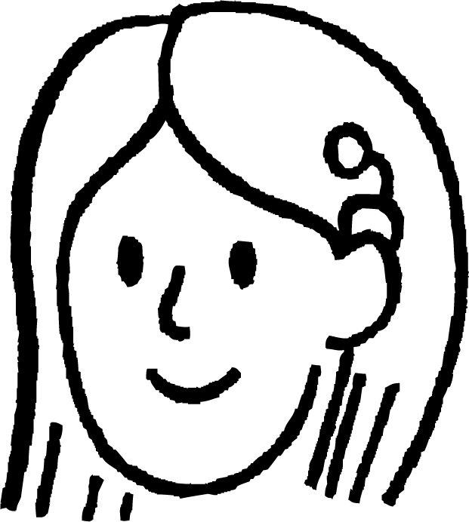
Naqshadaynta beerta (Designing a park)
Magaalo ayaa qorshaynaysa inay dhisto jardiino laba jibaaran oo u dhexeysa afar waddo oo inta badan leh xafiisyo. Meeshu waa leydi 70 m x 100 m.
Golaha magaaladu wuxuu qabtaa tartan uu ku casuumayo carruurta dugsiyada ku dhow inay naqshadeeyaan qaabkeeda, iyagoo soo gudbinaya sawir cabbir leh.
Waxay bixiyaan taladan soo socota:
Geedaha waaweyn waa in la beeraa ugu yaraan 15 m kala fog.
Geedaha yaryar waa inay 5 m kala fogaadaan.
Waddooyinka lugaynta waa inay ugu yaraan 2 m ballaadhaan.
Waddo loogu talagalay baabuurta waa inay ugu yaraan 4 m ballaadhaan.
Suad waxay doonaysaa inay ka qaybgasho tartanka.

Slide 49
Naqshadaynta beer (Designing a park)
Beerdu waa leydi 70 m × 100 m.
Suad waxay qorsheyneysaa inay samayso sawir cabbir (scale drawing) oo beerta ah oo ku yaal warqad A4, taas oo ah 21 cm × 29 cm (ugu dhowaad cm).
Marka hore waxaan u baahanahay inaan go'aansado cabbirka (scale) aan isticmaali doono.
Sawirku waa inuu ku habboonaadaa warqadda, laakiin waa inuusan aad u yarayn.
Cabbir (scale) intee leeg ayay Suad isticmaali kartaa?

Slide 50
Naqshadaynta beer (Designing a park)
Beerdu waa leydi 70 m × 100 m.
Suad waxay qorsheyneysaa inay samayso sawir cabbir (scale drawing) oo beerta ah oo ku yaal warqad A4, taas oo ah 21 cm × 29 cm.
Haddii aan u ogolaado in 1 cm ee sawirka uu u taagnaado 4 m ee beerta, markaa dhererka warqadda wuxuu u taagnaan karaa ilaa 116 m ee beerta.
× 4
1 cm wuxuu u taagan yahay 4 m
× 29
× 4
× 29
29 cm wuxuu u taagan yahay 116 m

Slide 51
Naqshadaynta beer (Designing a park)
Beerdu waa leydi 70 m × 100 m.
Suad waxay qorsheyneysaa inay samayso sawir cabbir (scale drawing) oo beerta ah oo ku yaal warqad A4, taas oo ah 21 cm × 29 cm.
Haddii aan u ogolaado in 1 cm ee sawirka uu u taagnaado 4 m ee beerta, markaa ballaca warqadda wuxuu u taagnaan karaa ilaa 84 m ee beerta.
× 4
1 cm wuxuu u taagan yahay 4 m
× 21
× 4
× 21
21 cm wuxuu u taagan yahay 84 m

Slide 52
Naqshadaynta beerta
Beertu waa le'eg (rectangle) 70 m × 100 m.
Suad waxay qorsheyneysaa inay samayso sawir cabbir (scale drawing) oo beerta ah warqad A4 ah, taas oo ah 21 cm × 29 cm.
Waxaan u qori karaa cabbirkeyga (scale) saami (ratio) anigoo dhererka ku muujinaya halbeeg (unit) isku mid ah.
1 cm wuxuu matalaa 4 m
1 cm wuxuu matalaa 400 cm
1 : 400

Slide 53
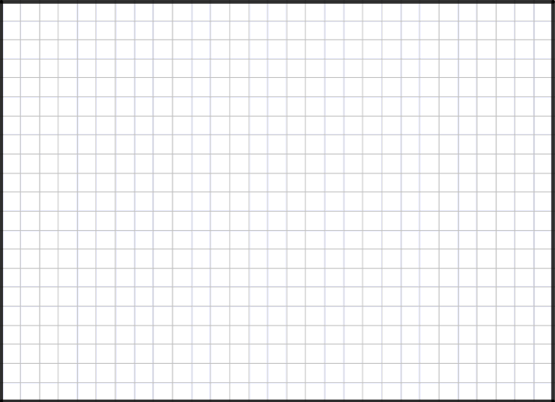
Naqshadaynta beerta
Suad waxay isticmaashaa warqad laba jibaaran (centimetre square paper) iyo cabbir (scale) 1 : 400.
Beertu waa 70 m × 100 m. Warqad A4 ah waa 21 cm × 29 cm.
Waxaan u isticmaali karaa qaybinta (division) si aan u xisaabiyo dhererka sawirkayga.
100 m = 10 000 cm
10 000 ÷ 400 = 25 cm
1 : 400

Slide 54
Naqshadaynta beerta
Suad waxay isticmaashaa warqad laba jibaaran (centimetre square paper) iyo cabbir (scale) 1 : 400.
Beertu waa 70 m × 100 m. Warqad A4 ah waa 21 cm × 29 cm.
Waa maxay ballaca (width) sawirka Suad?
70 m = 7000 cm
7000 ÷ 400 = 17.5 cm
1 : 400

Slide 55
Naqshadaynta beerta
Suad waxay isticmaashaa warqad laba jibaaran (centimetre square paper) iyo cabbir (scale) 1 : 400.
Guddigu (council) wuxuu sheegayaa in dariiqa lugta (footpath) uu yahay ugu yaraan 2 m ballac (wide).
Intee ayay ku noqonaysaa tan sawirka Suad?
2 m = 200 cm
200 ÷ 400 = 0.5 cm
fure (key):
xayndaab (fence)
1 : 400

Slide 56
Naqshadaynta beerta (park)
Suad waxay isticmaashaa waraaq sentimitir laba jibaaran iyo miisaan (scale) 1 : 400.
Suad waxay sawirtaa waddo lugaynta (footpath). Dhererkeedu sawirka waa 20 cm.
Waddada lugaynta (footpath) intee dheer tahay beerta? Jawaabta ku bixi mitir.
20 × 400 = 8000 cm
8000 ÷ 100 = 80 m
fure (key):
xayndaab (fence)
waddo lugaynta (footpath)
1 : 400

Slide 57
Naqshadaynta beerta (park)
Waddadu waa 80 m dheer. Suad waxay rabtaa inay dhigto geedo waaweyn oo dhinac ka mid ah waddada. Waxay u baahan yihiin inay ugu yaraan 15 m kala fogaadaan.
Imisa geed oo waaweyn ayay ku habboon kartaa dhinaca waddada?
.
80 ÷ 15 = 5.3
Ugu badnaan 5 geed.
fure (key):
geed weyn (large tree)
waddo lugaynta (footpath)
1 : 400

Slide 58
Naqshadaynta beerta (park)
Waa kan naqshadda (design) ugu dambeysa ee Suad.
Fure (Key):
il (fountain)
xayndaab (fence)
waddo (path)
geed weyn (large tree)
geed yar (small tree)
miisaan (scale) 1 : 400

Slide 59
Naqshadaynta beerta (park)
1) Magaalo ayaa qorshaynaysa inay beero (park) ka dhisto aag dagmo.
a) Isticmaal macluumaadka hoose si aad u naqshadayso qaabkiisa oo aad u dhisto sawir cabbir (scale drawing).
Waxaad isticmaali kartaa warqad (tusaale A4 ama A3) ama software firfircoon (tusaale GeoGebra ama Desmos) sawirkaaga. Ku dar cabbir (scale) iyo fure (key).
Macluumaadka beerta (park):
Goobtu waa 500 m × 600 m leydi (rectangle).
Geedaha waaweyn waa in lagu beeraa ugu yaraan 15 m kala fog.
Geedaha yaryar waa inay ugu yaraan 5 m kala fog yihiin.
Waddooyinka lugaynta waa inay ugu yaraan 2 m ballaadhan yihiin.
Waddo loogu talagalay gelitaanka baabuurta waa inay ugu yaraan 4 m ballaadhan tahay.
b) Qorshee jid orod (running route) oo raaca waddooyinka beertaada. Waa inuu ka bilaabmaa oo ku dhamaadaa isla meel.
Xisaabi dhererka jidka.

Slide 60
Naqshadaynta beerta (park)
1) Magaalo ayaa qorshaynaysa inay beero (park) ka dhisto aag dagmo.
a) Isticmaal macluumaadka hoose si aad u naqshadayso qaabkiisa oo aad u dhisto sawir cabbir (scale drawing).
Sawirka. Waxaad isticmaali kartaa warqad (tusaale A4 ama A3) ama software firfircoon (tusaale GeoGebra ama Desmos) sawirkaaga. Ku dar miisaan (scale) iyo fure (key).
Macluumaadka beerta:
Meeluhu waa 500 m × 600 m leydi (rectangle).
Geedaha waaweyn waa in lagu beeraa ugu yaraan 15 m kala fog.
Geedaha yaryar waa inay ugu yaraan 5 m kala fog yihiin.
Waddooyinka lugaynta waa inay ugu yaraan 2 m ballaadhan yihiin.
Waddo loogu talagalay gelitaanka baabuurta waa inay ugu yaraan 4 m ballaadhan tahay.
Jawaabuhu way kala duwanaan doonaan. Haddii aad isticmaasho warqad A4, tusaale cabbir (scale) wuxuu noqon karaa 1 : 2500 (1 cm waxay u taagan tahay 25 m). Jawaabuhu waa inay ku daraan cabbir (scale) iyo fure (key).

Slide 61
Naqshadaynta beerta
b) Qorshee waddo orod oo raacda waddooyinka beertaada. Waa inay ka bilowdaa oo
ku dhammaataa isla meel. Xisaabi dhererka waddada.
Jawaabuhu way kala duwanaan doonaan.
Tusaale:
Wareegga (perimeter) beertu waa 2.2 km.
Sidaa darteed, haddii ay jirto waddo gudaha beerta oo ku dhow cidhifyadeeda, waxaa loo isticmaali karaa waddo ka yar 2.2 km.
Haddii waddadu ay sidoo kale ku darayso waddooyin dheeri ah gudaha beerta, markaas waddadu way dheeraan kartaa.

Slide 62
Naqshadaynta meel cagaaran
Cagaaraynta magaalooyinka (urban greening) waa habka lagu daro jardiinooyin cagaaran, geedo, waddooyin baaskiil, iyo hindiseyaal kale oo wanaajiya joogtaynta (sustainability) magaalo, wanaajiya caafimaadka maskaxda ee dadkeeda, oo yareeya raadka kaarboonka (carbon footprint).
Marka la naqshadaynayo meelaha cagaaran, xaddidaadyo ayaa u badan inay jiraan.
Qaabka miisaanka (scale model/map) wuxuu noqon karaa mid faa'iido leh si loo arko natiijada ugu dambaysa ee naqshadda.

