Slide 1
Go'aaminta dhinaca
Sifooyinka joomatari: isku ekaansho (similarity) iyo aragtida Pythagoras (Pythagoras' theorem)

Slide 2
sida loo isticmaalo darasyada Oak

Slide 3
Waxaan aqoonsan karaa dhinaca dhererkiisa (side length) maqan oo waxaan isticmaali karaa qaabka ku habboon ee aragtida Pythagoras (Pythagoras' theorem) si aan u xisaabiyo.

Slide 4
Saddexagalka qumman (right-angled triangle) wuxuu leeyahay hal xagal 90° oo gudaha ah.
Hypotenuse (hypotenuse) waa dhinaca saddexagalka qumman (right-angle triangle) kaas oo ka soo horjeeda xagasha qumman (right-angle).
Aragtida Pythagoras (Pythagoras' theorem) waxay muujinaysaa in wadarta labajibbaaranaha (squares) labada dhinac ee gaagaaban ee saddexagalka qumman (right-angled triangle) ay la mid tahay labajibbaaranaha (square) dhinaca ugu dheer (hypotenuse).

Slide 5

Go'aaminta dhinaca
Aqoonsashada hypotenuse (hypotenuse)
Saddexagalka qumman (right-angled triangles) iyo isku qummanaanta (congruence)
Helista dhererka dhinacyada maqan

Slide 6
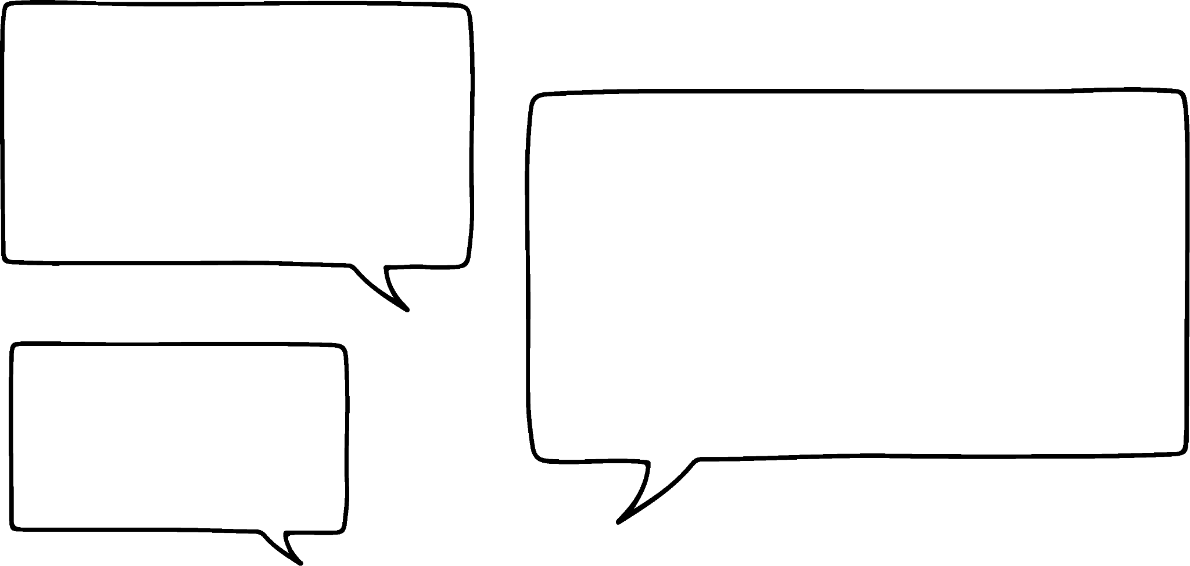


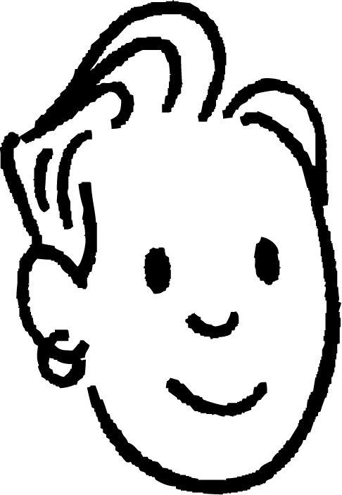
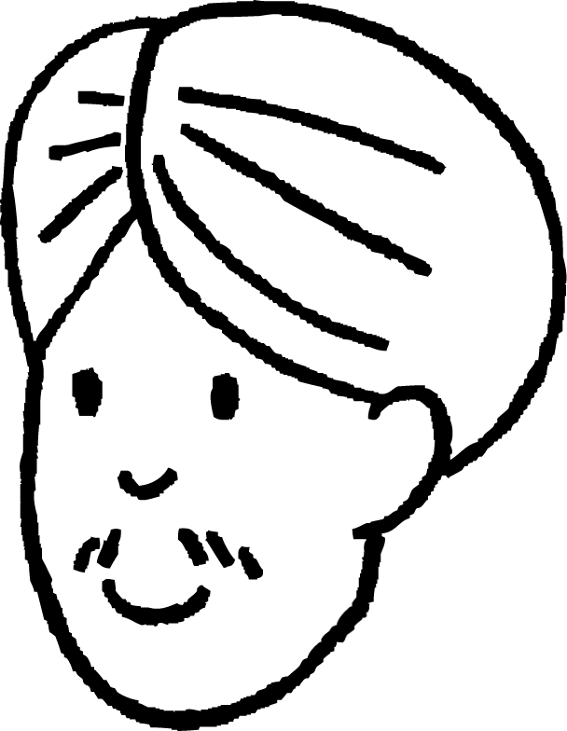


Aqoonsashada hypotenuse (hypotenuse)
Waxaan isticmaali karaa aragtida Pythagoras (Pythagoras' theorem) saddexagalkan sababtoo ah waa saddexagal qumman (right-angled triangle).
28°
15 cm
Saciid
Ma isticmaali karo aragtida Pythagoras (Pythagoras' theorem) saddexagalkan sababtoo ah ma laha calaamad xagal qumman (right-angle marker) oo ku qoran.
62°
8 cm
Yaa runta ka sheegay saddexagalkan?
Cali

Slide 7
Aqoonsashada hypotenuse (hypotenuse)
Saciid waa sax.
Qiyaasta (theorem) ee Pythagoras waxaa loo isticmaali karaa in lagu helo dhererka dhinaca maqan ee saddex-xagal kasta oo qumman (right-angled triangle), iyadoo aan loo eegin in calaamadda xagasha qumman (right-angle marker) la muujiyey iyo in kale.
28°
15 cm
Haddii calaamadda xagasha qumman si cad loo muujin waayo, waxaa faa'iido leh in:
62°
la helo xagasha qumman (right angle)
la aqoonsado dhinaca saddex-xagalka ee ah hypotenuse-ga
8 cm

Slide 8
Aqoonsashada hypotenuse-ga
28°
Sababtoo ah waxaan ognahay in xaglaha saddex-xagalku isku yimaadaan 180°, marka waxaan ognahay in cabbirka xagashani yahay:
hypotenuse
15 cm
62°
Oo tan iyo inta ay tahay xagasha qumman (right-angle), hypotenuse-ga waa dhinaca ka soo horjeeda.
8 cm
Jawaabaha:
180°
– 28°
– 62°
= 90°

Slide 9

Aqoonsashada hypotenuse-ga
Hadda waxaan isticmaali karnaa qiyaasta (theorem) ee Pythagoras si aan u xisaabino dhererka dhinaca maqan - markan waa hypotenuse-ga.
28°
hypotenuse
hypotenuse² = 15² + 8²
15 cm
17 cm
hypotenuse² = 289
hypotenuse = 289 = 17
62°
8 cm

Slide 10


Aqoonsashada hypotenuse-ga
Kee ka mid ah afartan saddex-xagal ayaa ah saddex-xagal qumman (right-angled triangle)?
13 cm
34 cm
78°
b
48°
47°
d
9°
56 cm
42°
72 cm
11°
68 cm
a
c
54 cm
81°
36 cm
48°
12 cm

Slide 11
Aqoonsiga hypotenuse-ga (hypotenuse)
Dhinac ee saddexagalka xagal-qumman ee hypotenuse-ga (hypotenuse) yahay?
Hypotenuse-ga (hypotenuse) had iyo jeer waa dhinaca ka soo horjeeda xagasha qumman.
Tani waxay ka dhigan tahay inuu yahay dhinaca kaliya ee saddexagalka ee aan ahayn lugta xagasha 90°.
9°
d
42°
72 cm
c
a
54 cm
81°
e
36 cm
48°
12 cm
f
b

Slide 12



Aqoonsiga hypotenuse-ga (hypotenuse)
Maxaan looma oggolaan inaan u isticmaalno aragtida Pythagoras (Pythagoras' theorem) saddexagalkan?
46°
Xagashani waxay ka dhintay 1° inay noqoto xagal-qumman (right-angle)!
50 cm
34 cm
43°
180° – 46° – 43° = 91°
Saciid
36 cm
Oo waa laba jibaaranka hypotenuse (hypotenuse) oo la mid ah laba jibaaranka labada dhinac ee kale oo la isku daray.
Waxaan u malaynayaa sababtoo ah hypotenuse (hypotenuse) wuxuu u kala baxaa oo kaliya saddex-xagal xagal-qumman (right-angled triangle).
Layla

Slide 13
Aqoonsiga hypotenuse (hypotenuse)
Haa! Bedka (area) laba jibaaranka ugu weyn wuxuu la mid yahay oo kaliya wadarta (sum) labada laba jibaaran ee yaryar marka xagashaasi tahay xagal-qumman (right angle).
Wadarta (sum) bedka (area) labada laba jibaaran ee yaryar waa:
bed (area) 1156 cm²
bed (area)
2500 cm²
34² + 36²
1156 + 1296 = 2452
46°
50 cm
Maadaama aysan tani la mid ahayn 2500, kani ma aha saddex-xagal xagal-qumman (right-angled triangle), sidaas darteed aragtida Pythagoras (Pythagoras’ theorem) ma shaqeyso.
34 cm
Saciid
43°
36 cm
34² + 36² ≠ 50²
Maadaama saddex-xagalkani uusan ahayn xagal-qumman (right-angled), ma laha hypotenuse (hypotenuse).
bed (area) 1296 cm²
42°
53.5 cm
39 cm
47°
36 cm

Slide 14
Aqoonsiga hypotenuse (hypotenuse)
Saddex-xagalahaas ayaa aragtida Pythagoras (Pythagoras’ theorem) run ku tahay?
jifaarka (hypotenuse)
bed (area)
37 cm²
bed (area)
40 cm²
c
a
b
bed (area)
77 cm²
bed (area)
19 cm²
bed (area)
10 cm²
e
62°
bed (area)
8 cm²
f
45°
d
38°
10 cm

Slide 15
Aqoonsiga jifaarka (hypotenuse)
1) Dhammeystir weedh kasta.
a) Aragtida Pythagoras waxaa kaliya loo isticmaali karaa in lagu xisaabiyo dhererka dhinaca maqan ee saddexagalka haddii mid ka mid ah dhinacyadiisu yahay ____________.
b) Kaliya saddexagalka ____________ ayaa leh jifaar (hypotenuse).
c) Jifaarku (hypotenuse) had iyo jeer wuxuu ka soo horjeedaa ____________.
2) Qor jumlad sharraxaysa sababta aragtida Pythagoras looma isticmaali karo in lagu helo qiimaha (value) k.
44°
k cm
39 cm
47°
37 cm

Slide 16
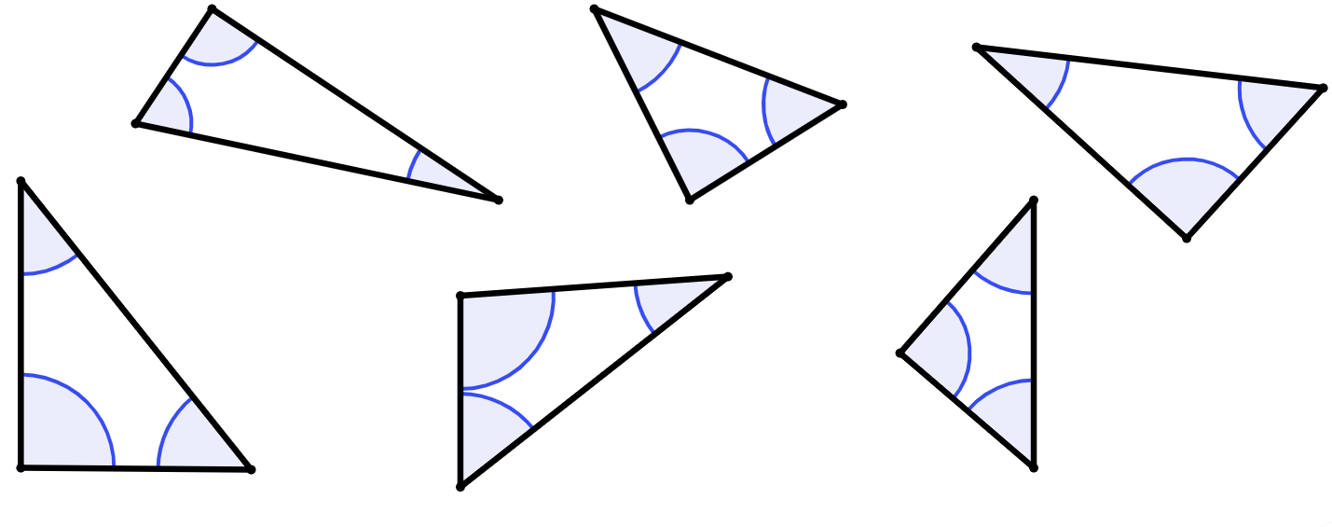
Aqoonsiga hypotenuse-ka (hypotenuse)
3) Saddex-xagal kasta oo ka mid ah kuwan, calaamadee (✔) saddex-xagal qumman (right-angled triangle), iskutallaab (✘) saddex-xagal aan qummanayn (non-right-angled triangle), su'aal calaamad (?) dhig mid kasta oo aadan garan karin.
Saddex-xagal qumman (right-angled triangle) kasta, goobo ama iftiimi hypotenuse-kiisa.
a)
b)
c)
68°
52°
d)
22°
92°
41°
39°
e)
34°
f)
52°
50°
51°

Slide 17
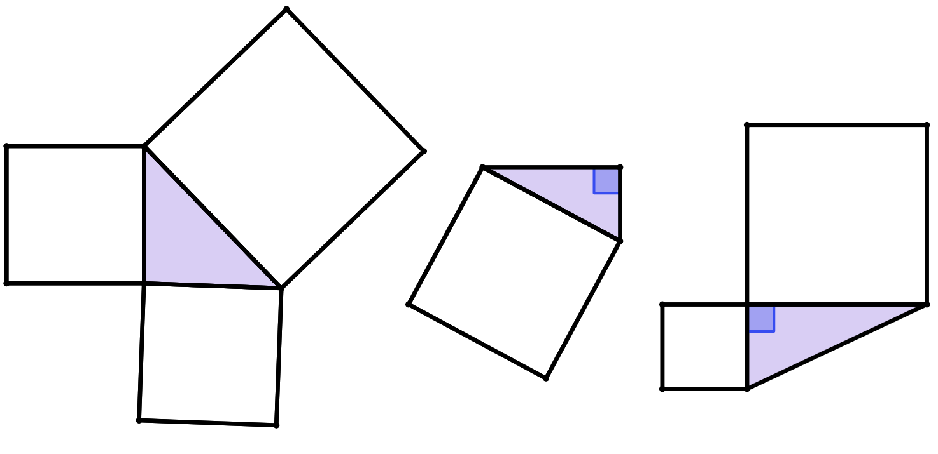
Aqoonsiga hypotenuse-ka (hypotenuse)
4) Saddex-xagal (triangle) yaase aad u isticmaali kartaa aragtida (theorem) Pythagoras?
Halkii suurtagal ah, xisaabi dhererka hypotenuse-ka (hypotenuse) oo calaamadee dhererkiisa.
bed (area)
350 cm²
b)
c)
a)
bed (area)
169 cm²
bed (area)
1201 cm²
bed (area)
7569 cm²
bed (area)
171 cm²
bed (area)
648 cm²

Slide 18
Aqoonsiga hypotenuse-ka
1) Dhammeysti weedh kasta.
a) Aragtida (theorem) Pythagoras waxaa loo isticmaali karaa oo kaliya in lagu xisaabiyo dhererka dhinaca maqan ee saddex-xagal (triangle) haddii mid ka mid ah dhinacyadiisu yahay ____________.
b) Kaliya saddex-xagal (triangle) ________________ ayaa leh hypotenuse (hypotenuse).
c) Hypotenuse-ku (hypotenuse) had iyo jeer waa ka soo horjeedaa ________________.
Jawaabaha:
hypotenuse
xagal-qumman (right-angled)
xagal qumman (right angle)

Slide 19
Aqoonsiga hypotenuse-ka
2) Qor jumlad sharraxaysa sababta aan loo isticmaali karin aragtida Pythagoras si loo helo qiimaha (value) k.
44°
k cm
39 cm
Xagasha maqan waa 89°, sidaas darteed saddexagalkani ma aha mid xagal-qumman (right-angled).
Ma isticmaali kartid aragtida Pythagoras saddexagallo aan xagal-qumman (right-angled) ahayn.
47°
37 cm

Slide 20

Aqoonsiga hypotenuse-ka
3) Saddexagal kasta, calaamadee (✔) saddexagal xagal-qumman (right-angled) kasta, calaamadee (✘) kuwa aan xagal-qumman ahayn, dhig su'aal (?) meesha aadan garan karin.
Saddexagal xagal-qumman (right-angled) kasta, ku wareeji ama iftiimi hypotenuse-kiisa.
a)
b)
c)
68°
?
52°
d)
22°
92°
41°
39°
e)
34°
f)
52°
50°
51°

Slide 21
Aqoonsiga hypotenuse-ka
4) Saddexagalkee ayaad u isticmaali kartaa aragtida (theorem) Pythagoras?
Halkii suurtagal ah, xisaabi dhererka hypotenuse (hypotenuse) oo ku qor dhererkiisa.
bed (area)
350 cm²
b)
c)
a)
bed (area)
169 cm²
bed (area)
1201 cm²
hypotenuse
87 cm
bed (area)
171 cm²
bed (area)
648 cm²
bed (area)
7569 cm²
hypotenuse
43 cm

Slide 22
Go'aaminta dhinaca
Aqoonsiga hypotenuse (hypotenuse)
Saddexagalka xagal-qumman (right-angled triangles) iyo isku-ekaanshaha (congruence)
Helista dhererka dhinacyada maqan

Slide 23
Helista dhererka dhinacyada maqan
Saddexagalladani waa isku mid (congruent), maxaa yeelay labaduba waxay leeyihiin dhinacyo 10 cm iyo 14 cm.
Haa, waan fahmay.
Laakiin maxay taasi uga dhigan tahay inay si cad isku mid ahayn (congruent)?
10 cm
saddexagal A (triangle A)
Cali ma sax baa?
14 cm
Cali
Oh maya, waxaan u malaynayaa inay si cad isku mid ahayn (incongruent).
Maxaa yeelay 14 cm waa hypotenuse (hypotenuse) saddexagalka B, laakiin ma aha saddexagalka A.
14 cm
10 cm
saddexagal B
Layla

Slide 24
Helista dhererka dhinacyada maqan
Hypotenuse (hypotenuse) waa dhinaca ugu dheer ee saddexagalka qumman (right-angled triangle).
Sidaa darteed hypotenuse (hypotenuse)-kan waa inuu ka weyn yahay 14 cm.
Sidaa darteed dhinacan gaaban waa inuu ka yar yahay 14 cm.
y < 14
x > 14
x cm
14 cm
10 cm
10 cm
saddexagal A
saddexagal B
14 cm
y cm

Slide 25
Helista dhererka dhinacyada maqan
Dhinaca x iyo dhinaca y ma lahaan karaan isku dherer.
Labadan saddex-xagal qumman (right-angled triangles) ma aha kuwo isku mid ah (congruent), sababtoo ah kama qancayaan qaanuunka SSS (SSS rule) ee isku midnimada (congruence).
dhererka dhinacyada (side lengths of)
10 cm, 14 cm, x cm
dhererka dhinacyada (side lengths of)
10 cm, 14 cm, y cm
x cm
14 cm
10 cm
10 cm
saddex-xagal A (triangle A)
saddex-xagal B (triangle B)
14 cm
y cm

Slide 26
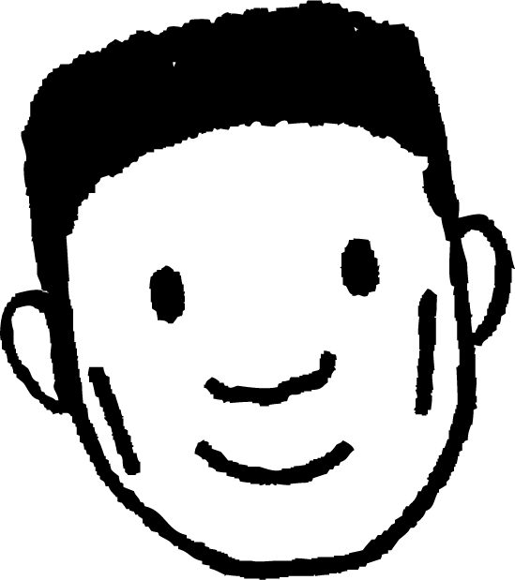
Helista dhererka dhinacyada maqan (Finding the length of missing sides)
Waan arki karaa sababta saddex-xagalladani u kala duwan yihiin isla sababtaas.
Oh, waan ogahay! Sababtoo ah isla'eg kasta oo aad ka dhisatid aragtida Pythagoras waxay noqon doontaa mid xoogaa ka duwan, sidaas darteed xallinta mid kasta waxay ku siin doontaa laba dherer oo kala duwan!
24 cm
9 cm
Saddex-xagalka kore, hypotenuse (hypotenuse) waa 24 cm.
Laakiin ma naqaanno hypotenuse (hypotenuse) kan kale!
Cali
Waan fahmay!
Sababtoo ah 24 cm wuxuu ka soo horjeedaa xagasha qumman (right angle) saddexagalka sare.
Laakiin saddexagalka hoose, 24 cm waa lug (leg) xagasha qumman. Tani waxay ka dhigan tahay in hypotenuse-ka saddexagalkani uu ka dheer yahay 24 cm.
Laakiin maxay tani muhiim u tahay?
Waxaan isticmaali karnaa aragtida Pythagoras (Pythagoras' theorem) labada saddexagalba, haddii ay yihiin kuwa xagasha qumman leh?
9 cm
24 cm
Cabdi

Slide 27
Helista dhererka dhinacyada maqan
x² + 9² = 24²
24 cm
x² = 24² – 9²
9 cm
x² = 495
x² = 495 = 22.25
22.25 cm
Dhererka dhinacan gaaban waa 22.25 cm (2 d.p.)
24² + 9² = y²
657 = y²
25.63 cm
9 cm
y = 657 = 25.63
Dhererka hypotenuse-ka waa 25.63 cm (2 d.p.)
24 cm

Slide 28
Helista dhererka dhinacyada maqan
Dhinac (side) kee (a, b ama c) ayaa ah hypotenuse (hypotenuse) saddex-xagalkan (triangle)?
a
31 cm
c
b
30 cm
Midkee ka mid ah isleegyadan (equations) ayaa sax u ah saddex-xagalkan (triangle)?
44°
46°
31² + 30² = r²
r cm
d
c
e
r² + 31² = 30²
Sidaa awgeed, xisaabi dhererka (length) hypotenuse (hypotenuse) saddex-xagalkan (triangle), oo ku soo koob 1 meel jajab tobanle (decimal place).
f
r² = 31² + 30²
r² = 1861
g
31² = 30² + r²
r = 43.1 cm (1 d.p.)

Slide 29
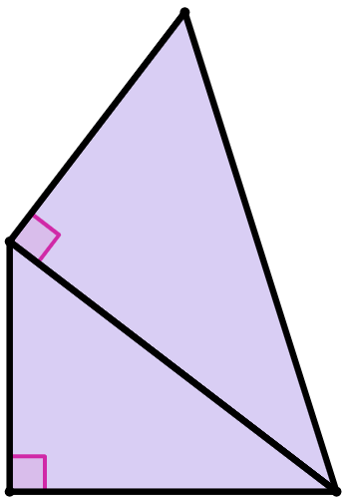
Helista dhererka (length) dhinacyada (sides) maqan
Aragtida (theorem) Pythagoras waxaa loo isticmaali karaa marar badan qaababka (shapes) isku dhafan (composite) ee ka samaysan saddex-xagal quman (right-angled triangles).
Waxaan u isticmaalnaa aragtida (theorem) Pythagoras si aan u xisaabino dhinac (side) ay wadaagaan saddex-xagallo quman (right-angled triangles) badan.
15 cm
B
26 cm
Waa wax badan oo la eego!
Saddex-xagal (triangle) kee ayaan marka hore diirada saaraa si aan u helo dhererka (length) w?
Mise kuma kala duwana?
13 cm
A
w cm
Cabdi

Slide 30
Helista dhererka (length) dhinacyada (sides) maqan
Haddii aan isku dayno inaan ka bilowno saddex-xagalka (triangle) A, waxaan haysannaa hal dherer (side length) oo la yaqaan (13 cm).
Tani waxay ka dhigan tahay inaanan isticmaali karin aragtida (theorem) Pythagoras si aan u xisaabino dhererka (length) dhinaca (side) aan la aqoon ee loo yaqaan w cm.
15 cm
B
26 cm
Si kastaba ha ahaatee, waxaan naqaan laba dherer oo dhinacyada (side lengths) saddex-xagalka (triangle) B (hypotenuse (hypotenuse) 26 cm ah iyo dhinac gaaban (shorter side) 15 cm ah).
13 cm
A
Sidaa darteed waxaan isticmaali karnaa aragtida Pythagoras (Pythagoras’ theorem) si aan u xisaabino dhererka dhinaca saddexaad.
w cm

Slide 31
Helista dhererka dhinacyada maqan
Isla'egta aragtida Pythagoras ee saddexagalka B waa:
x² + 15² = 26²
15 cm
x² + 15² = 26² – 15²
x² + 15² = 451
B
26 cm
x² + 15² = 451 = 21.23676
Dhererka dhinaca gaaban ee saddexagalka B waa 21.23676 cm.
Waa habboon in la bixiyo dhererkan tiro jajab badan si looga fogaado qaladka wareega marka aan mar kale isticmaalno dhererkan.
21.23676 cm
13 cm
x cm
A
w cm

Slide 32
Helista dhererka dhinacyada maqan
Dhinaca dhererkiisu yahay 21.23676 cm waa dhinac wadaag ah oo ah:
a shorter side of triangle B
hypotenuse-ka saddexagalka A
15 cm
B
26 cm
Hadda oo aan ognahay dhererka dhinaca labaad ee saddexagalka A, waxaan hadda isticmaali karnaa aragtida Pythagoras si aan u xisaabino dhererka dhinaca aan la aqoon ee lagu calaamadeeyay w cm.
21.23676 cm
13 cm
A
w cm

Slide 33
Helista dhererka dhinacyada maqan
Isla'egta aragtida Pythagoras ee saddexagalka A waa:
w² + 13² = 21.23676²
15 cm
w² + 13² = 21.23676² – 13²
w² + 13² = 281.9999753
B
26 cm
w² + 15² = 281.9999753 = 16.79
Dhererka dhinaca lagu calaamadeeyay w cm waa 16.79 cm.
21.23676 cm
13 cm
A
w cm

Slide 34
Helista dhererka dhinacyada maqan
Isla'egta aragtida Pythagoras ee saddexagalka A waa:
w² + 13² = 21.23676²
15 cm
w² + 13² = 21.23676² – 13²
w² + 13² = 281.9999753
B
26 cm
w² + 15² = 281.9999753 = 16.79
Wow, taasi waa qurux badan laakiin waxay u egtahay mid qasan oo leh jajab tobanle dheer!
Ma jirtaa hab looga fogaado?
21.23676 cm
13 cm
A
16.79 cm
Cabdi

Slide 35
Helista dhererka dhinacyada maqan
Isla'egta aragtida Pythagoras (Pythagoras’ theorem) ee saddexagalka A waa:
w² + 13² = ( 451 )²
Halkii aan u beddeli lahayn 451 jajab tobanle (decimal), waxaan ku hayn karnaa qaabka surd (surd form).
w² + 13² = 21.23676²
15 cm
B
26 cm
Sidee tani caawinaysaa?
Maxaa dhacaya haddii aan ku qoro ( 451 )² xisaabiyaha (calculator)?
21.23676 cm
13 cm
A
Oh, waxaan helay 451. Taasi ma aha mid qasan!
16.79 cm
Cabdi

Slide 36
Helista dhererka dhinacyada maqan
Isla'egta aragtida Pythagoras (Pythagoras’ theorem) ee saddexagalka A waa:
w² + 13² = ( 451 )²
Maaddaama labajibbaaran (squaring) iyo xidid labajibbaaran (square rooting) ay yihiin hawlo iska soo horjeeda (inverse operations), ( 451 )² = 451.
15 cm
w² + 13² = 451
w² + 13² = 451 – 13²
B
26 cm
w² + 13² = 282
w² + 13² = 282 = 16.79
21.23676 cm
13 cm
Jawaabtan waxay la mid tahay 16.79 cm ee aan ku xisaabinay habka jajab tobanle (decimal method).
A
16.79 cm

Slide 37
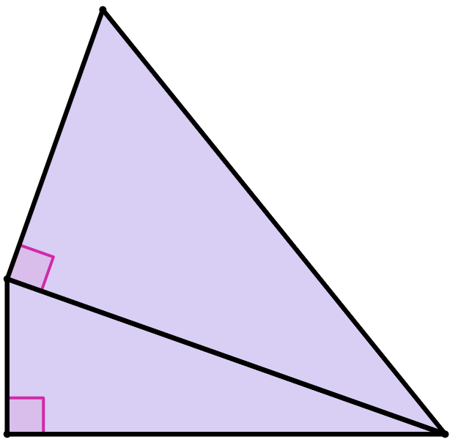
Helista dhererka dhinacyada maqan
Kee ka mid ah kuwan ayaa ah dhererka saxda ah ee dhinaca wadaagga ah ee lagu calaamadeeyay k cm?
39² + 20²
a
39² – 20²
b
20 cm
1921
c
39 cm
1121
d
33.48133809
e
k cm
33.4
f

Slide 38
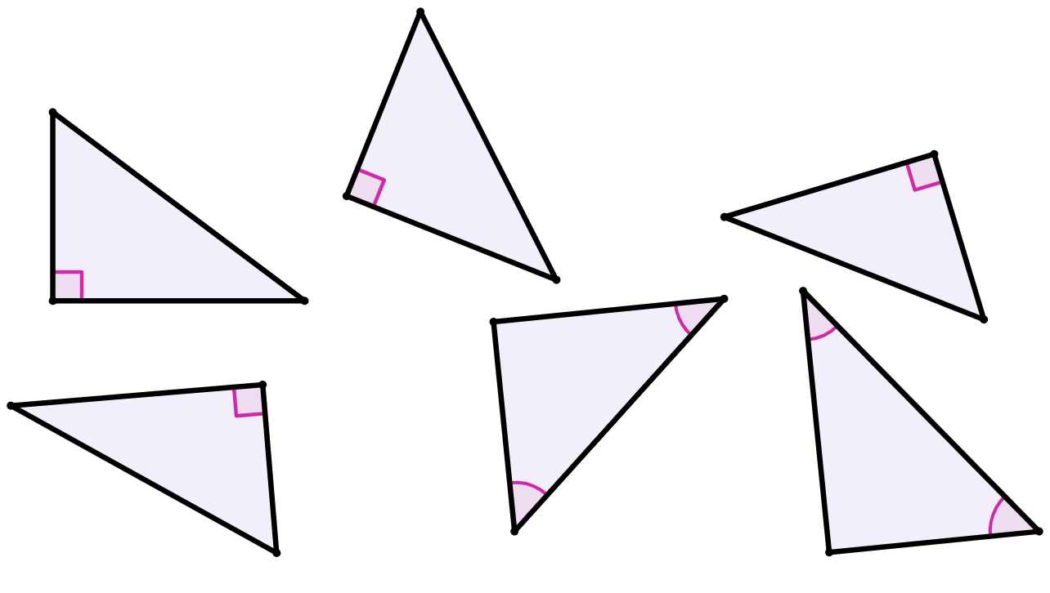
Helista dhererka dhinacyada maqan
1) Isku xidh saddexagalka iyo dhererka dhinaciisa maqan.
g
21.26 cm
16 cm
13 cm
h
25.46 cm
18 cm
a)
20 cm
c)
b)
14 cm
30 cm
i
24 cm
j
49.64 cm
39°
22 cm
42°
15.20 cm
k
58 cm
31.5 cm
l
32.56 cm
e)
24 cm
f)
d)
51°
40.5 cm
30 cm
48°

Slide 39
Helista dhererka dhinacyada maqan
2) Kee ka mid ah saddax-xagalladan ayaa la siman (congruent) saddax-xagalka X?
63 cm
63 cm
63 cm
a)
c)
b)
16 cm
65 cm
16 cm
16 cm
16 cm
saddax-xagal X
f)
63 cm
e)
65 cm
g)
d)
16 cm
67 cm
63 cm
65 cm
16 cm
65 cm

Slide 40
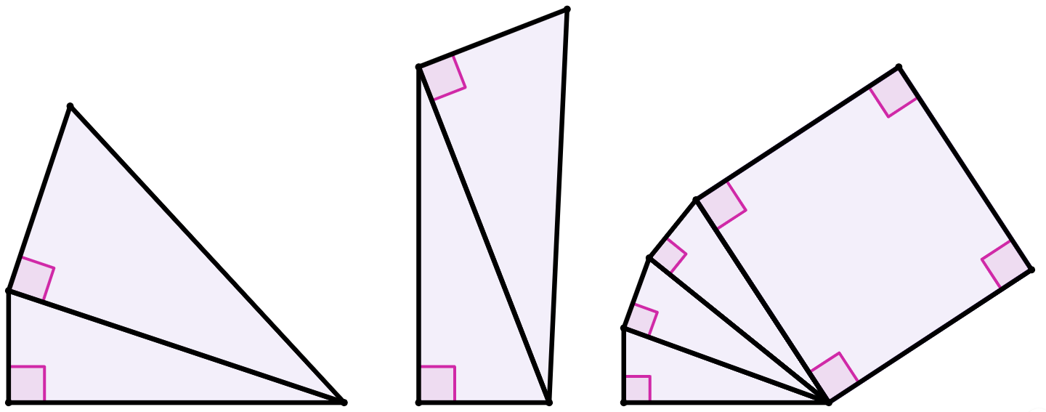
Helista dhererka dhinacyada maqan
3) Xisaabi dhererka dhinac kasta oo aan la garanayn oo ku calaamadsan xaraf, ku soo koob jawaabtaada 2 meelood oo jajab tobanle (decimal places).
18 cm
50 cm
56 cm
18 cm
1 cm
a cm
bedka labajibbaaranaha (area of square)
28 cm²
1 cm
10 cm
1 cm
25 cm
b cm
c cm

Slide 41
Helista dhererka dhinacyada maqan
1) Isku dhig saddax-xagalka (triangle) iyo dhererka dhinaciisa maqan.
g
21.26 cm
16 cm
i
13 cm
h
25.46 cm
18 cm
a)
20 cm
c)
b)
14 cm
30 cm
g
i
24 cm
j
49.64 cm
k
39°
22 cm
42°
15.20 cm
k
58 cm
31.5 cm
l
32.56 cm
e)
j
24 cm
f)
d)
h
l
51°
40.5 cm
30 cm
48°

Slide 42
Helista dhererka dhinacyada maqan
2) Kee ka mid ah saddexagalladan ayaa la mid ah (congruent) saddexagalka X?
63 cm
63 cm
63 cm
a)
c)
b)
16 cm
65 cm
16 cm
16 cm
16 cm
saddexagal X
f)
63 cm
e)
65 cm
g)
d)
16 cm
67 cm
63 cm
65 cm
16 cm
65 cm

Slide 43
Helista dhererka dhinacyada maqan
3) Xisaabi dhererka dhinac kasta oo aan la garanayn oo ku calaamaysan xaraf, adoo ku soo celinaya jawaabtaada 2 meelood oo jajab tobanle ah.
18 cm
50 cm
56 cm
18 cm
1 cm
a cm
bedka labajibbaaranaha (area of square)
28 cm²
1 cm
10 cm
1 cm
25 cm
b cm
c cm
a cm = 32.39 cm
b cm = 17.66 cm
c cm = 5 cm

Slide 44
Go'aaminta dhinaca
Hypotenuse-ga saddexagalka qumman (right-angled triangle) waxaa loo aqoonsan karaa sida:
dhinaca ka soo horjeeda calaamadda xagasha qumman (right angle marker)
dhinaca ku xiga laba xagal oo isku darkoodu yahay 90°
Maadaama isku darka (addition) uu yahay mid is-beddelaya (commutative), wadarta laba jibaaranka (squares) ee labada dhinac ee gaagaaban waxaa loo qori karaa hab kasta, taasoo la macno ah in ay jiraan matallo (representations) badan oo isla'egta (equation) aragtida Pythagoras (Pythagoras’ theorem) ah saddexagal kasta.
Aragtida Pythagoras (Pythagoras’ theorem) waxaa lagu dabaqi karaa si isdaba joog ah (repeatedly) qaababka (shapes) isku dhisan (composite) oo ka samaysan saddexagallo qumman (right-angled triangles).

