Slide 1
Diffusion: dhaqdhaqaaq (movement) particles
Diffusion

Slide 2
sida loo isticmaalo daras (lesson) Oak

Slide 3
Waxaan sharxi karaa in diffusion uu yahay dhaqdhaqaaq (movement) particles of substance ka yimid meel sare ilaa meel hoose oo concentration ah.

Slide 4
Jawaabaha:
passive process
concentration
concentration gradient
net movement
diffusion

Slide 5
Passive process ma u baahna tamar dheeri ah.
Concentration waa tirada particles ee ku jira mugga biyo (water) ama gas.
Concentration gradient waa farqiga u dhexeeya concentration particles ee meel ilaa meel kale.
Net movement waa dhaqdhaqaaq (movement) guud ee particles ee meel ilaa meel kale.
Diffusion waa net movement (dhaqdhaqaaq) ee substance ka yimid meel sare oo concentration ah ilaa meel hoose oo concentration ah.

Slide 6

Diffusion: dhaqdhaqaaq (movement) particles
Substances iyo dhaqdhaqaaqa (movement) particles
Diffusion ee unugyada (cells)
Concentration iyo net movement

Slide 7
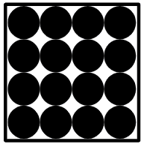
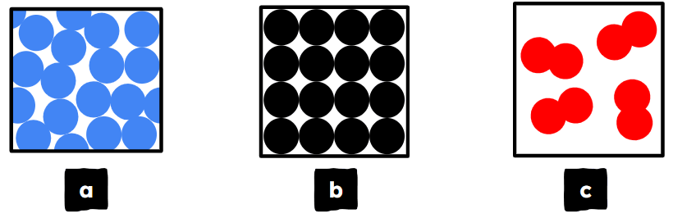
Substances iyo dhaqdhaqaaqa (movement) particles
Substances waxay ka kooban yihiin particles.
Adkaha (solids), dareeraha (liquids) iyo neefaha (gases) waxay ka samaysan yihiin walxaha (particles).
Jawaabaha:
solid
liquid
neef (gas)

Slide 8
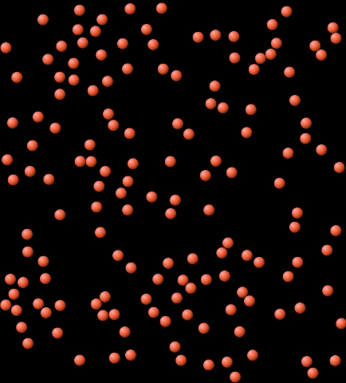
Walxaha (substances) iyo dhaqdhaqaaqa (movement) walxaha (particles)
Dareeraha (liquid) ama neefaha (gas) dhexdooda, walxaha (particles) waxay had iyo jeer u dhaqaaqaan jihooyin kala duwan (random directions).
Walxaha (particles) waxay beddelaan jihada (direction) markay isku dhacaan (collide) midba midka kale, ama weel (container) la.
neef (gas)
PhET Interactive Simulations, University of Colorado Boulder, https://phet.colorado.edu, shatiyaysan CC BY 4.0.

Slide 9
Walxaha (substances) iyo dhaqdhaqaaqa (movement) walxaha (particles)
Dhamaystir weedhaha ku saabsan dhaqdhaqaaqa (movement) walxaha (particles).
Adeegso ereyada liiska:
kala duwan (randomly) isku dhacaan (collide) dhaqaaqaya (moving) dareerayaal (liquids) walxo (particles)
Walxaha (substances) oo dhan waxay ka samaysan yihiin .
__________-ta _________ iyo neefaha (gases) waxay si joogto ah u _________ .
Waxay u dhaqaaqaan _________ waxayna inta badan _________ midba midka kale.
Jawaabaha:
walxo (particles).
walxo (particles)
dareerayaal (liquids)
dhaqaaqaya (moving).
kala duwan (randomly)
isku dhacaan (collide)

Slide 10
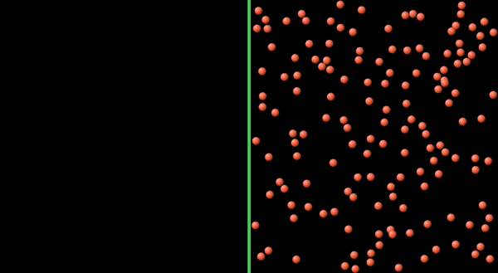
Walxaha (substances) iyo dhaqdhaqaaqa (movement) walxaha (particles)
Dhaqdhaqaaqa (motion) joogtada ah iyo kan kala duwan (random) ee walxaha (particles) wuxuu sababaa inay fidiyaan (spread out).
PhET Interactive Simulations, University of Colorado Boulder, https://phet.colorado.edu, licensed under CC BY 4.0.

Slide 11
Maaddooyinka (Substances) iyo dhaqdhaqaaqa walxaha (particle movement)
Dhaqdhaqaaqan (movement) wuxuu ku dhacaa oo keliya dareerayaasha (liquids) iyo gaasaska (gases). Sababtoo ah walxaha (particles) waa xor inay dhaqaaqaan.
Walxaha (particles) ku jira gaaska (gas) iyo dareeraha (liquid) si joogto ah ayay u dhaqaaqaan oo isku dhacaan.
Adkaha (solid), walxaha (particles) waa ku go'an meel, mana awoodaan inay si xor ah u dhaqaaqaan.
dareere (liquid)
gaas (gas)
adag (solid)

Slide 12
Maaddooyinka (Substances) iyo dhaqdhaqaaqa walxaha (particle movement)
Dhaqdhaqaaqa walxaha (particles) ee dareeraha (liquid) iyo gaaska (gas) wuxuu dhacaa si joogto ah.
Walxaha (particles) uma baahna in lagu daro tamar (energy) kulayl (heat) si ay u dhaqaaqaan.
Sidaa darteed waxaan ugu yeernaa dhaqdhaqaaqan (movement) hab dadban (passive process), sababtoo ah uma baahna tamar (energy) dheeri ah oo ka badan tan walxuhu (particles) horey u haystaan.
dareere (liquid)
gaas (gas)

Slide 13


Maaddooyinka (Substances) iyo dhaqdhaqaaqa walxaha (particle movement)
Calamee hal sanduuq (box) oo mid kasta oo ka mid ah bayaannada.
Waxaan ahay
hubaa inay sax tahay
I
qiyaasaa inay sax tahay
I
waxaan u malaynayaa kani waa qalad
Waxaan ahay
hubi in kani waa qalad
a
Walxaha (particles) waa xor inay dhaqaaqaan dareerayaasha (liquids).
b
Walxaha (particles) waa xor inay dhaqaaqaan adkaha (solids).
c
Walxaha (particles) waa xor inay dhaqaaqaan gaasaska (gases).

Slide 14
Walxaha iyo dhaqdhaqaaqa (movement) walxaha (particle)
Ku calaamadee hal sanduuq (box) hadal kasta.
Waxaan ahay
hubi in kani waa sax
I
waxaan u malaynayaa kani waa sax
I
waxaan u malaynayaa kani waa qalad
Waxaan ahay
hubi in kani waa qalad
d
Dhaqdhaqaaqa (movement) walxaha (particle) wuxuu u baahan yahay tamar (energy) dheeri ah.
e
Dhaqdhaqaaqa (movement) walxaha (particle) waa nidaam (process) dabiici ah (passive).

Slide 15
Walxaha iyo dhaqdhaqaaqa (movement) walxaha (particle)
Deodorant-ka (Deodorant) waa la buufiyaa 1 ilbiriqsi (second). Jaantusyada (diagrams) waxay muujinayaan waxa ku dhaca walxaha (particles) deodorant-ka ka dib 1 iyo 2 daqiiqo (minutes).
Jawaabaha:
1 ilbiriqsi (second)
1 daqiiqo (minute)
2 daqiiqo (minutes)

Slide 16
Walxaha iyo dhaqdhaqaaqa (movement) walxaha (particle)
Macallinku wuxuu buufiyaa deodorant-ka (deodorant) xagga hore ee fasalka (classroom).
Laba ka mid ah kuwan soo socda waa kuwa run ah (true)?
Walxaha (particles) deodorant-ka waxay isku dayaan inay faafaan (spread out) si ay u helaan boos (space) badan.
Qaybaha deodorantu waxay dhaafaan qaybaha hawada (air).
Deodorantu wuxuu u kala go'aa qaybo yaryar si uu ula qasmo biyaha (water).
Qaybaha hawada (air) waxay dhaafaan qaybaha deodoranta.

Slide 17
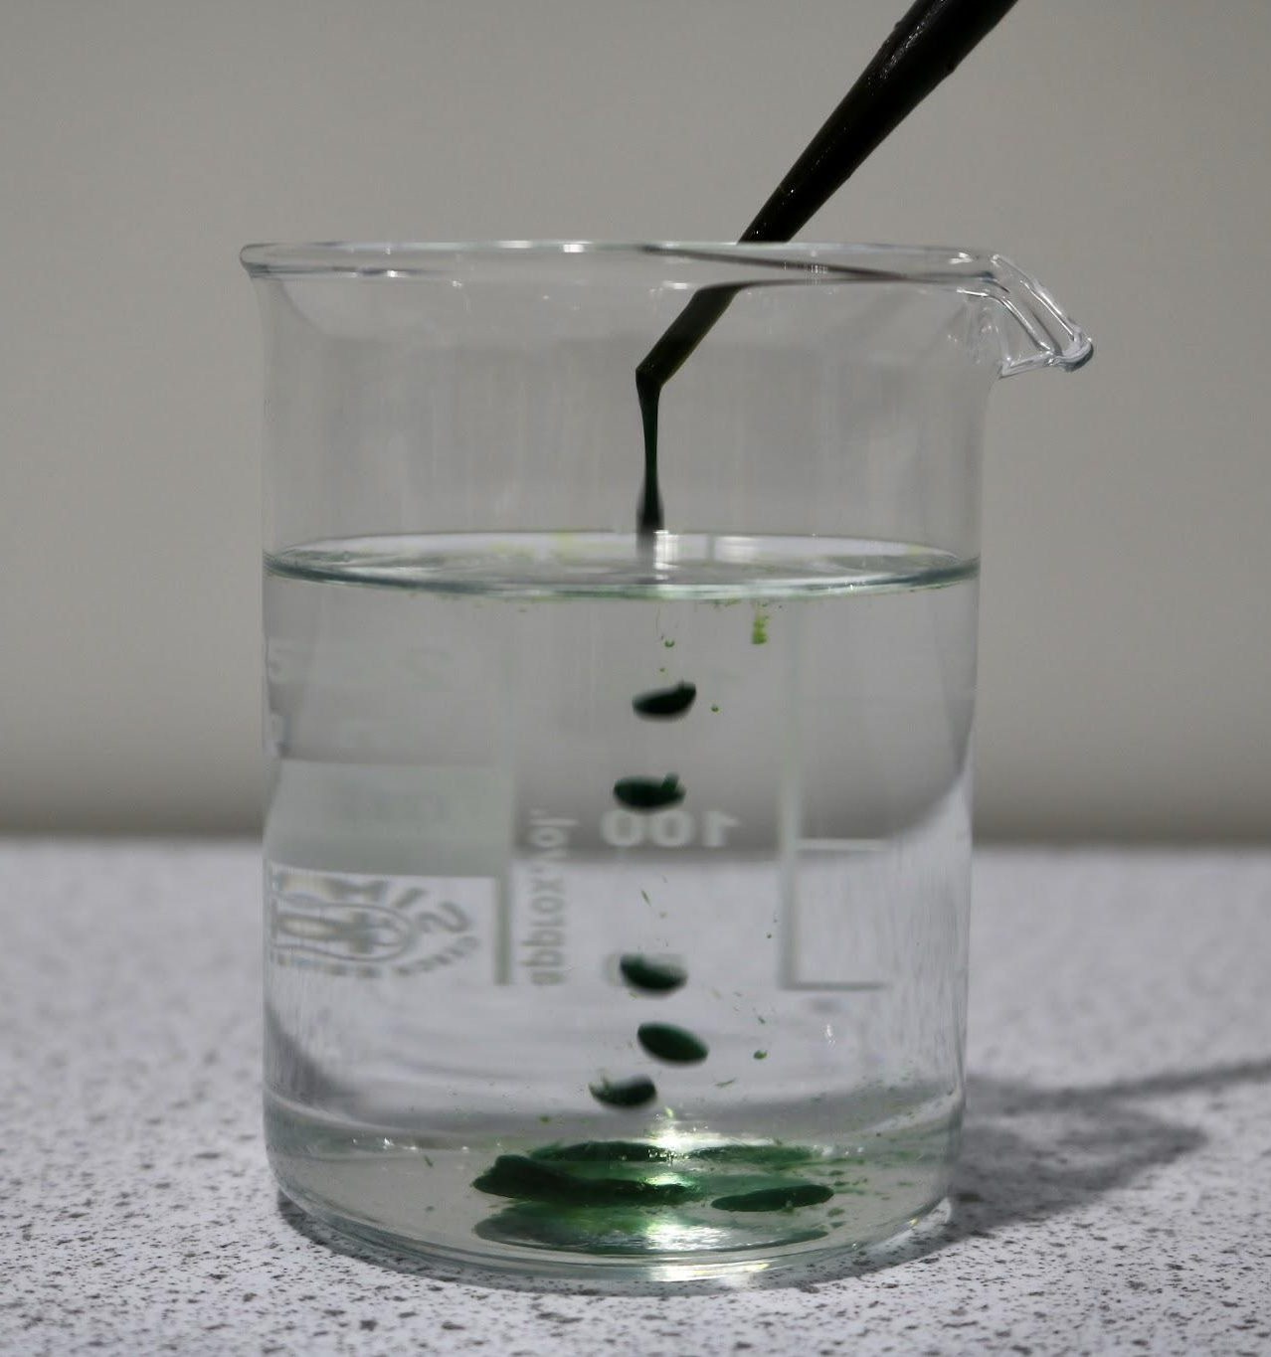
Maaddooyinka iyo dhaqdhaqaaqa (movement) qaybaha
Dhibco midab ah ayaa lagu daray koob biyo (water) ah.
Lama walaaqin.
Waxaa loo daayay inta maalinta ka hartay.
Saadaali waxa dhici doona midabka iyo biyaha (water).
Sharax sababta aad u malaynayso inay tani dhici doonto.

Slide 18
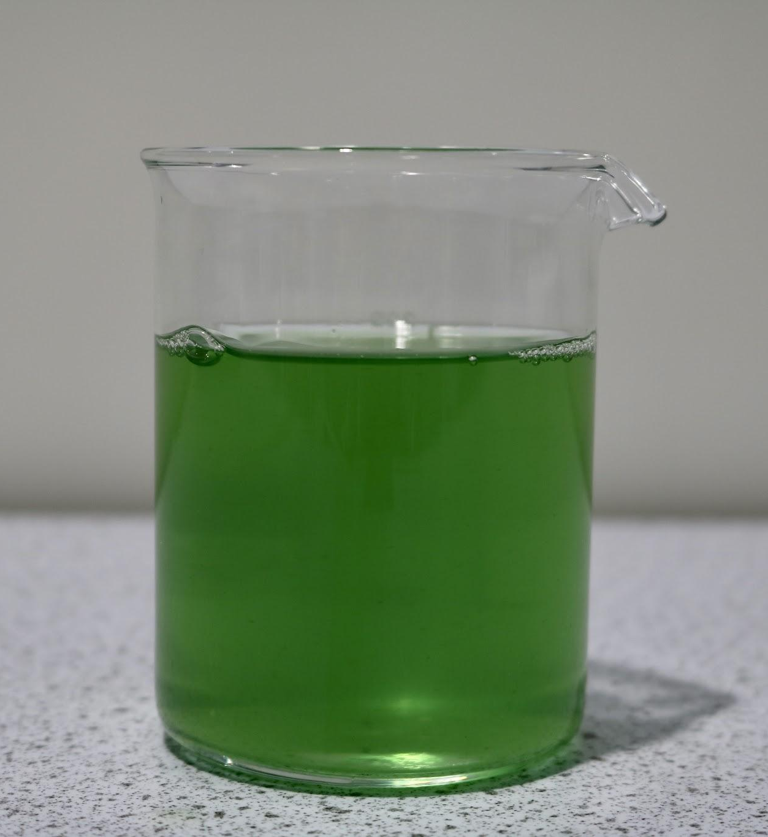
Maaddooyinka iyo dhaqdhaqaaqa (movement) qaybaha
Saadaali waxa dhici doona midabka iyo biyaha (water).
Midabku wuxuu ku faafi doonaa biyaha (water), isagoo sababi doona in biyuhu (water) beddelaan midabkooda.
2. Sharax sababta aad u malaynayso inay tani dhici doonto.
Biyaha (water) iyo midabku waxay ka samaysan yihiin qaybo.
Qaybaha biyaha (water) iyo midabku waxay si joogto ah u dhaqaaqaan.
Qaybaha biyaha (water) iyo midabku waxay si aan kala sooc lahayn ugu dhaqaaqaan dhammaan jihooyinka.
Dhaqdhaqaaqa (movement) qaybaha midabka iyo biyaha (water) ayaa sababa inay isku qasmaan.

Slide 19
Faafinta (Diffusion): qaybaha dhaqaaqaya
Maaddooyinka iyo dhaqdhaqaaqa (movement) qaybaha
Fiiro gaar ah (Concentration) iyo dhaqdhaqaaqa saafiga ah (net movement)
Faafinta (Diffusion) unugyada

Slide 20
Fiiro gaar ah (Concentration) iyo dhaqdhaqaaqa saafiga ah (net movement)
Isku-ururinta (Concentration) waa tirada walxaha (particles) ku jira mugga (volume) biyaha (water) ama neefta (gas).
dareeraha (liquid) ama neefta (gas).
Waxyaalaha (particles) inta badan, ayaa walaxda (substance) u badan tahay isku-ururinta (concentration).
isku-ururinta (concentration) sare ee walxaha (particles)
isku-ururinta (concentration) hoose ee walxaha (particles)

Slide 21
Isku-ururinta (Concentration) iyo dhaqdhaqaaqa (movement) saafiga ah (net)
Haddii walxaha (particles) ay yihiin…
isku-ururin (concentration) badan oo ku taal hal meel
iyo isku-ururin (concentration) yar oo ku taal meel kale
…tani waxay abuurtaa kala-duwanaanshaha isku-ururinta (concentration gradient).
aagga isku-ururinta (concentration) sare
aagga isku-ururinta (concentration) hoose
kala-duwanaanshaha isku-ururinta (concentration gradient)

Slide 22
Isku-ururinta (Concentration) iyo dhaqdhaqaaqa (movement) saafiga ah (net)
Waa maxay kala-duwanaanshaha isku-ururinta (concentration gradient)?
Cabbirrada kala duwan ee walxaha (particles) ee walaxda (substance).
Farqiga isku-ururinta (concentration) ee walaxda (substance) ee aagga.
Tirada walxaha (particles) ee aagga la siiyay.

Slide 23
Isku-ururinta (Concentration) iyo dhaqdhaqaaqa (movement) saafiga ah (net)
Walxaha (Particles) waxay u dhaqaaqaan jihooyin kala duwan (random directions).
Tani waxay ka dhigan tahay in walxaha (particles) ay u dhaqaaqaan labada jiho ee kala-duwanaanshaha isku-ururinta (concentration gradient).
aagga xoojinta sare (area of higher concentration)
aagga isku-ururinta (concentration) hoose
heerka xoojinta (concentration gradient)

Slide 24
Xoojinta iyo dhaqdhaqaaqa guud (Concentration and net movement)
Hase yeeshee:
qaybo badan ayaa dhaqaaqaya…
laga soo bilaabo aagga xoojinta sare…
ilaa aagga xoojinta hoose.
aagga xoojinta sare (area of higher concentration)
aagga xoojinta hoose (area of lower concentration)
heerka xoojinta (concentration gradient)

Slide 25
Xoojinta iyo dhaqdhaqaaqa guud (Concentration and net movement)
Qaybo badan ayaa ku dhaqaaqaya hal jiho marka loo eego kuwa kale.
Tani waxaa loo yaqaan dhaqdhaqaaqa guud (net movement).
aagga xoojinta sare (area of higher concentration)
aagga xoojinta hoose (area of lower concentration)
dhaqdhaqaaqa guud (net movement)

Slide 26
Xoojinta iyo dhaqdhaqaaqa guud (Concentration and net movement)
Dhaqdhaqaaqa guud (net movement) waa:
hoos u dhac ku yimaada heerka xoojinta (concentration gradient)…
laga soo bilaabo aagga xoojinta sare…
ilaa aagga xoojinta hoose.
concentration gradient
net movement
PhET Interactive Simulations, University of Colorado Boulder, https://phet.colorado.edu, licensed under CC BY 4.0.

Slide 27
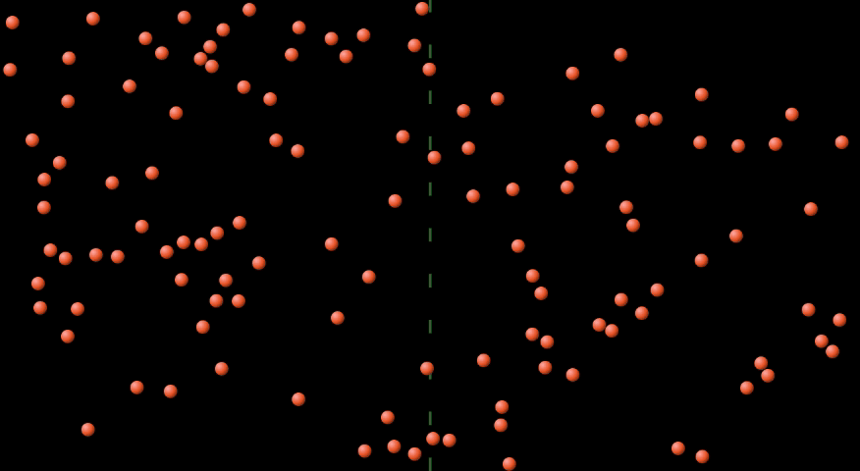
Concentration and net movement
After a while, the particles become evenly mixed.
Halkan, walxuhu way sii socdaan, laakiin ma jiro gradient xaddiga iyo dhaqdhaqaaq saafi ah.
PhET Interactive Simulations, University of Colorado Boulder, https://phet.colorado.edu, licensed under CC BY 4.0.

Slide 28
Concentration and net movement
Dhaqdhaqaaqa saafiga ah ee walxaha hoos u dhaca gradient xaddiga waxaa loo yaqaan diffusion.
area of higher concentration
area of lower concentration
net movement (diffusion)

Slide 29
Concentration and net movement
Waa kuwee labada soo socda ee loo baahan yahay si diffusion u dhaco?
a liquid or gas
a concentration gradient
extra energy
a living organism

Slide 30
Xoogga (Concentration) iyo dhaqdhaqaaqa guud (net movement)
Maxaa dhacaya marka walxuhu si siman isku qasmaan?
The particles slow down or stop.
Walxuhu way sii socdaan laakiin ma jiro dhaqdhaqaaq saafi ah.
The particles continue to move, resulting in net movement of particles.
Diffusion continues to take place.

Slide 31







Xoogga (Concentration) iyo dhaqdhaqaaqa guud (net movement)
Suad iyo Yacquub waxay ka hadlayaan samaynta shaaha baraf leh iyagoo isticmaalaya biyo (water) qabow.
Yaa aad la raacsan tahay?
Sharax jawaabtaada.
Waxaan u malaynayaa inaad samayn karto shaaha baraf leh adigoo ka tagaya xaashi shaaha (tea bag) biyo (water) qabow.
Waxaad u baahan tahay inaad isticmaasho biyo (water) kulul oo aad walaaqdo, haddii kale waxaad ku dambayn doontaa biyo (water) kaliya.
Jawaabaha:
Suad
Yacquub

Slide 32
Xoogga (Concentration) iyo dhaqdhaqaaqa guud (net movement)
Waxaan u malaynayaa inaad samayn karto shaaha baraf leh adigoo ka tagaya xaashi shaaha (tea bag) biyo (water) qabow.
Waxaad u baahan tahay inaad isticmaasho biyo (water) kulul oo aad walaaqdo, haddii kale waxaad ku dambayn doontaa biyo (water) kaliya.
Suad
Yacquub
Shaaha wuxuu ka kooban yahay walxo yaryar (particles).
Walxaha shaaha (tea particles) waxay si joogto ah u dhaqaaqaan, iyagoon u baahnayn tamar dheeri ah oo ka timaadda kuleylka.
Waxaa jira kala duwanaansho xoogeed (concentration gradient) oo u dhexeeya xaashida shaaha (tea bag) halkaasoo walxaha shaaha (tea particles) ay ku yihiin xoog sare (higher concentration), iyo biyaha (water) halkaasoo ay ku yihiin xoog hoose (lower concentration).
Fiditaanka (Diffusion) wuxuu dhici doonaa sababtoo ah waxaa jiri doona dhaqdhaqaaq guud (net movement) oo walxaha shaaha (tea particles) ah oo hoos u dhacaya xagga kala duwanaanshaha xoogeedka (concentration gradient) oo ka yimaada xaashida shaaha (tea bag) una gudbaya biyaha (water).
Walxaha shaaha (tea particles) waxay si siman ugu qaybsami doonaan biyaha (water).
Jawaabaha:
Suad waa sax.
Sababta oo ah:

Slide 33
Diffusion: moving particles
Walxaha (Substances) iyo dhaqdhaqaaqa walxaha yaryar (particle movement)
Concentration and net movement
Diffusion in cells

Slide 34
Diffusion in cells
The cytoplasm in a cell contains many substances.
Examples of substances in the cytoplasm are:
water
oxygen
sugar
carbon dioxide
Dhammaan walxahan iyo cytoplasm waxay ka kooban yihiin walxo.
cytoplasm
cell

Slide 35
Diffusion in cells
The particles in the cell cytoplasm are constantly moving.
cytoplasm
cell
The movement is in all directions and random, which leads to diffusion taking place.
GIF: PhET Interactive Simulations, University of Colorado Boulder, https://phet.colorado.edu, licensed under CC BY 4.0.

Slide 36
Diffusion in cells
Cytoplasm unuggu wuxuu ka kooban yahay walxo. Qiyaas inaad arki karto walxaha. Jaantus iyo sharaxaad kee ayaa ugu fiican waxa aad arki lahayd?
a
b
c
d
Particles
aan dhaqaaqayn (not moving)
Walxaha si xor ah u dhaqaaqaya (Particles moving freely)
Walxaha (Particles)
aan dhaqaaqayn (not moving)
Walxaha si xor ah u dhaqaaqaya (Particles moving freely)

Slide 37
Faafinta unugyada (Diffusion in cells)
Faafintu (Diffusion) aad ayay muhiim ugu tahay unugyada.
Tusaale ahaan, mitochondria waxay u baahan yihiin sahay fiican oo ah:
sonkor (sugar)
oksijiin (oxygen)
…waa neefsashada unugyada (cellular respiration).
dhexda unugyada (cytoplasm)
unug (cell)
Walxaha sonkorta iyo oksijiinta waxay ku faafaan (diffuse) dhexda unugyada (cytoplasm) si ay u gaaraan mitochondria.
mitochondria

Slide 38
Faafinta unugyada (Diffusion in cells)
Walxaha ku jira dhexda unugyada (cytoplasm) waxay ku dhaqaaqaan faafin (diffusion).
Tani waa sababta oo ah unuggu wuxuu si ula kac ah u faafiyaa walxaha (diffuses) qayb ka mid ah una gudbiyaa qayb kale.
Tani waa sababta oo ah walxuhu si joogto ah ayay u dhaqaaqaan dhamaan jihooyinka.

Slide 39
Faafinta unugyada (Diffusion in cells)
Mitochondria waxay u baahan yihiin sahay fiican oo sonkor ah.
Sharax sida walxaha sonkorta ugu gaaraan mitochondria.
qaybo sonkor (particles of sugar)
xuubka unugga (cell membrane)
saytobalasmka unugga (cell cytoplasm)
mitochondria (mitochondria)

Slide 40
Diffusion (Diffusion) ee unugyada
Sharax sida qaybaha sonkorta u gaaraan mitochondria.
Qaybaha sonkorta waxay si joogto ah u dhaqaaqaan jihooyin kala duwan.
Dhaqdhaqaaqa (movement) guud ee qaybaha sonkorta wuxuu ka yimaadaa aagga isku-ururinta sare ee u dhow xuubka unugga (cell membrane) una gudbaa aagagga isku-ururinta hoose ee bartamaha saytobalasmka (cytoplasm).
Iyada oo loo marayo dhaqdhaqaaqan (movement), qaybaha sonkorta waxay ku faafaan (diffuse) saytobalasmka (cytoplasm) ilaa mitochondria.
qaybo sonkor (particles of sugar)
saytobalasm (cytoplasm)
mitochondria (mitochondria)

Slide 41
Diffusion (Diffusion): qaybaha dhaqaaqaya
Walxaha oo dhami waxay ka kooban yihiin qaybo (particles).
Shidaalka iyo gaasaska, dhaqdhaqaaqa (movement) joogtada ah ee qaybaha ayaa sababa diffusion (diffusion), halkaas oo dhaqdhaqaaqa (movement) guud ee qaybuhu uu hoos ugu dhaco heerka isku-ururinta.
Diffusion (Diffusion) waa hab dabiici ah oo aan u baahnin tamar dheeri ah.
Saytobalasmka (cytoplasm) unugga wuxuu ka kooban yahay walxo badan oo ku dhaqaaqa unugga sababtoo ah diffusion (diffusion).
qaybo walax (particles of substance)
saytobalasm (cytoplasm)

