Slide 1
Faafin (Diffusion) iyada oo loo marayo walxo daloola (permeable material): tijaabo (experiment)
Faafin (Diffusion)

Slide 2
Sida agabkeena waxbarista loogu talagalay fasalka

Slide 3
Waxaan sharxi karaa indho-indhaynta faafinta (diffusion) iyada oo loo marayo xabadaha jelly (walxo daloola).

Slide 4
faafin (diffusion)
Faafin (Diffusion) waa dhaqdhaqaaq (movement) guud ee walxaha hoos u dhaca heerka xoojinta (concentration gradient).
dhaqdhaqaaq guud (net movement)
Dhaqdhaqaaqa guud (net movement) waa dhaqdhaqaaqa guud ee walxaha ka yimaada meel ilaa meel kale.
daloola (permeable)
Walax daloola (permeable) waa mid ay walxaha dareeraha awood u leeyihiin inay dhex maraan.
doorsoome (variable)
Tijaabo (experiment) sayniska, doorsoome (variable) waa arrin la beddeli karo, la isku midayn karo, ama la qiyaasi karo.
saadaalin (prediction)
Saadaalin saynis (scientific prediction) waa hadal la tijaabin karo oo ku saabsan natiijo suurtagal ah oo tijaabo (experiment) ah.

Slide 5

Faafin (Diffusion) iyada oo loo marayo walxo daloola (permeable material): tijaabo (experiment)
Faafin (Diffusion) gudaha xabad jelly
Beddelidda doorsoomayaasha (variables)

Slide 6
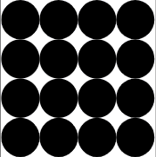
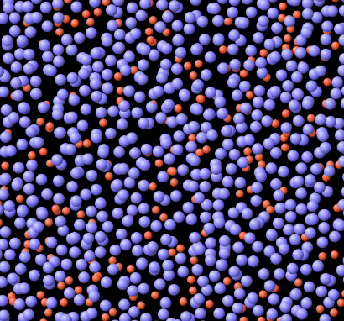
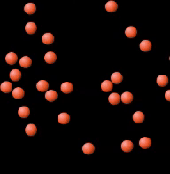
Faafin (Diffusion) gudaha xabad jelly
Dhammaan walxaha waxay ka kooban yihiin walxo yaryar (particles).
Marka walax ku jirto xaalad dareere (liquid) ama gaas (gas), walxaha yaryar (particles) waxay dhaqaaqaan wakhti kasta jihada random.
Dhaqdhaqaaqa (movement) joogtada ah ee walxaha ayaa sababa faafinta (diffusion).
Walxaha adag (solid)
Walxaha dareeraha (Particles of a liquid)
Walxaha gaaska (Particles of a gas)
GIF dhexe: GIF midig: PhET Interactive Simulations, University of Colorado Boulder, https://phet.colorado.edu, shatiyey CC BY 4.0.

Slide 7
Faafinta (Diffusion) gudaha xabad jelly ah
Marka ay jirto kala-saar ururinta (concentration gradient) ...
walxo badan ayaa dhaqaaqa:
laga bilaabo aagga ururinta (concentration) sare ilaa aagga ururinta (concentration) hoose.
Tani waa jihada dhaqdhaqaaqa (movement) saafiga ah (net movement).
kala-saar ururinta (concentration gradient)
aagga ururinta (concentration) sare
aagga ururinta (concentration) hoose
dhaqdhaqaaqa (movement) saafiga ah (net movement) (hoos u dhaca kala-saarka ururinta (concentration gradient))

Slide 8

Faafinta (Diffusion) gudaha xabad jelly ah
Maxaa sababa faafinta (diffusion)?
ururinta (concentration) walxaha
dhaqdhaqaaqa (movement) walxaha
maadada (substance) walxaha

Slide 9
Faafinta (Diffusion) gudaha xabad jelly ah
Faafinta (Diffusion) walxaha hoos u dhaca kala-saarka ururinta (concentration gradient) waxaa loo yaqaan …
dhaqdhaqaaqa (movement) ururinta (concentration).
dhaqdhaqaaqa (movement) kala-saarka (gradient).
dhaqdhaqaaqa (movement) saafiga ah (net movement).

Slide 10
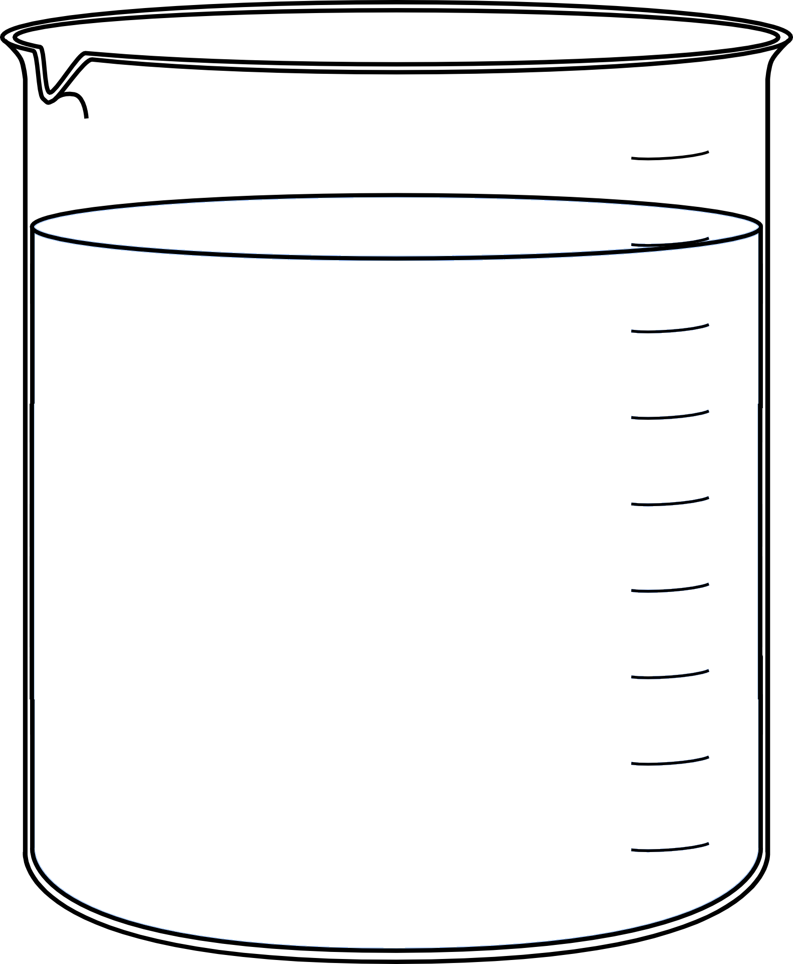
Faafitaanka (Diffusion) gudaha cube jelly ah
Qaar ka mid ah agabyada waa kuwo dhex mari kara (permeable).
Dareerayaashu waxay awood u leeyihiin inay dhex maraan agabyada dhex mari kara (permeable).
Cube jelly ah waa agab dhex mari kara (permeable).
Haddii aan jelly-ga gelinno dareere, qaybaha (particles) dareeraha ayaa ku faafi doona (diffuse) jelly-ga.

Slide 11
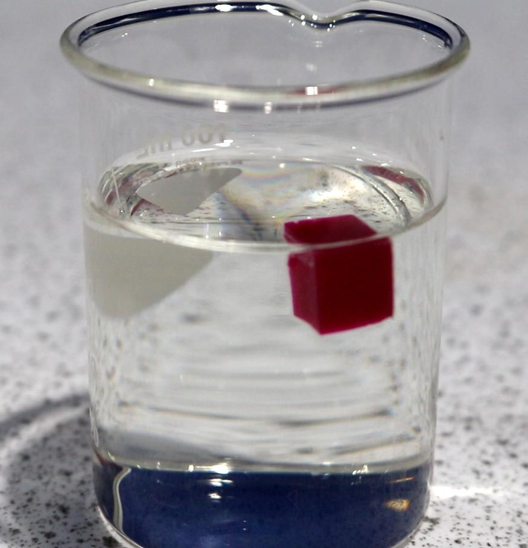

Faafitaanka (Diffusion) gudaha cube jelly ah
Waxaan gelin karnaa cube jelly midab leh oo gudaha acid ah.
Qaybaha (particles) acid-ka ayaa ku faafi doona (diffuse) jelly-ga dhex mari kara (permeable).
Qaybaha (particles) acid-ka ayaa sababa in jelly-gu noqdo mid aan midab lahayn.
Maxaad u malaynaysaa inaad arki doonto?
Sidee muuqaalka cube jelly-gu isu beddeli doonaa waqti ka dib?
Daawo muujinta (demonstration) si aad u aragto waxa dhacaya.

Slide 12
Faafitaanka (Diffusion) gudaha cube jelly ah
Qaybaha (particles) acid-ka ayaa awood u leh inay galaan jelly-ga sababtoo ah waa …
cube ah.
agab ah.
faafi (diffuse).
dhex mari kara (permeable).

Slide 13
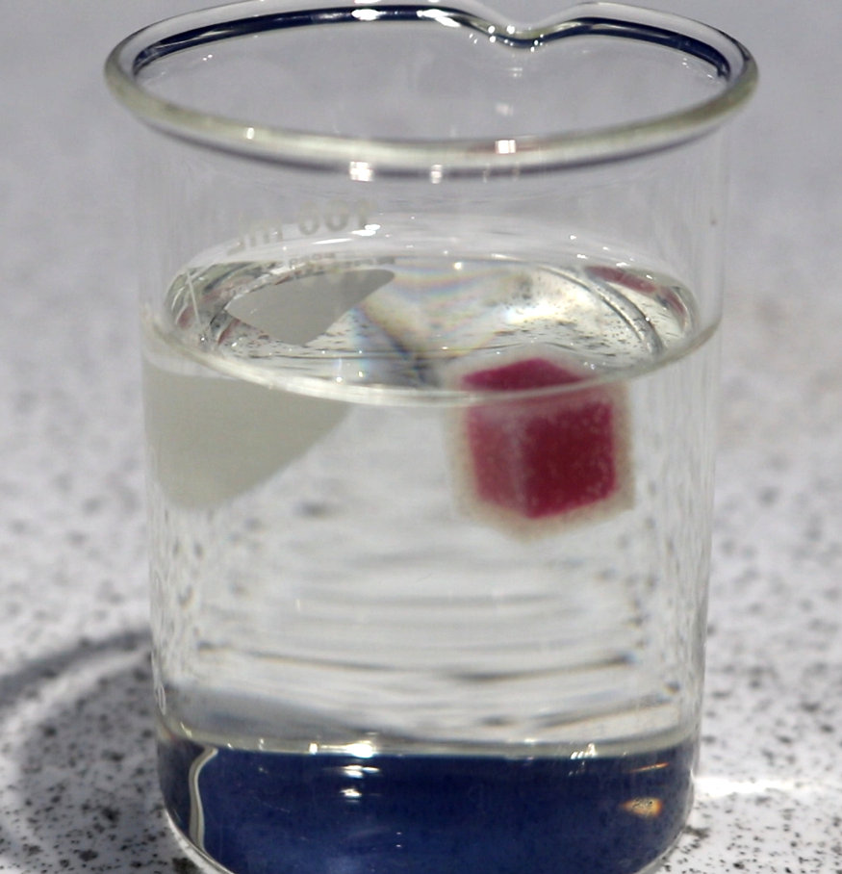
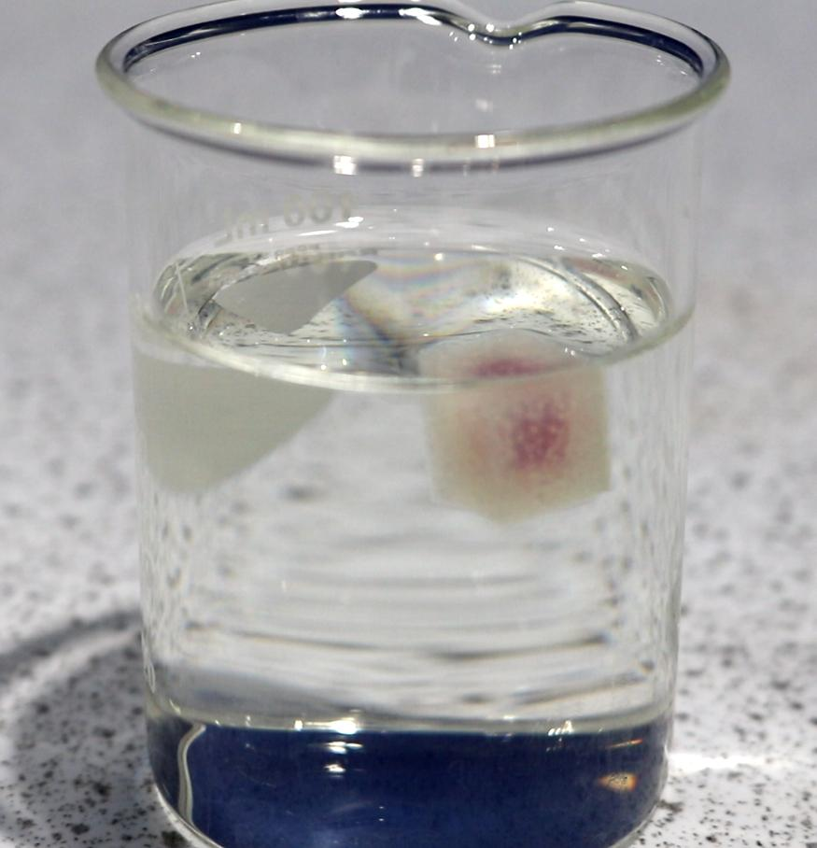
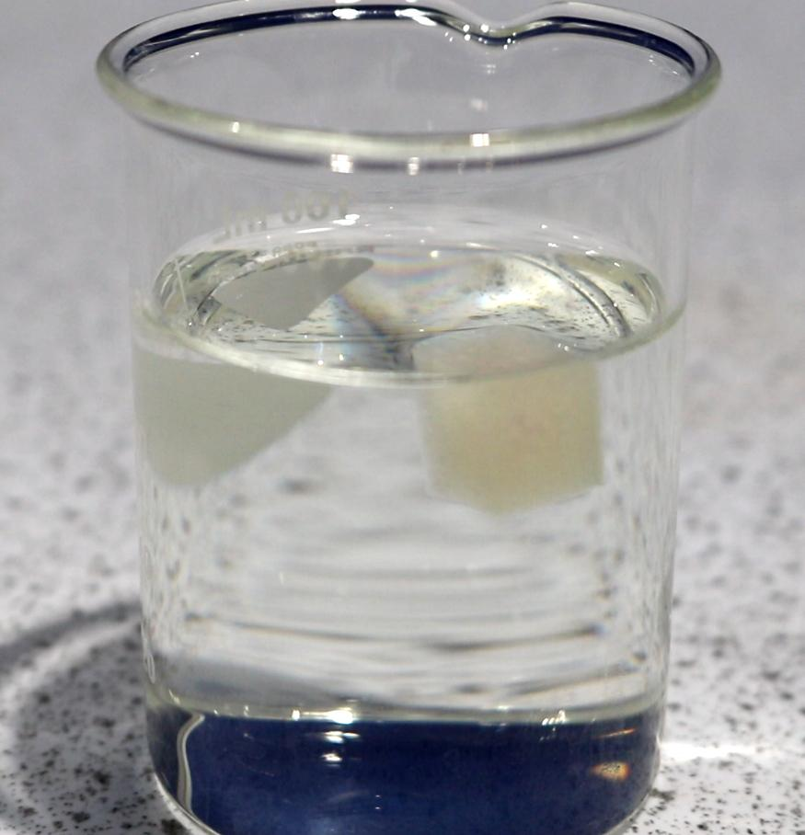
Faafitaanka (Diffusion) gudaha cube jelly ah
Sawirradu waxay muujinayaan waxa dhacaya marka cube jelly midab leh la geliyo acid.
Qor sharaxaad sababta muuqaalka cube-ga isu beddelo.
Isticmaal ereyadan soo socda sharaxaadaada:
walxaha (particles) dhexmara (permeable) dhaqdhaqaaq saafi ah (net movement)
heerka uruurinta (concentration gradient) faafin (diffusion)

Slide 14
Faafin (Diffusion) gudaha cube jelly ah
Qor sharaxaad sababta muuqaalka cube-ga u beddelmo. Isticmaal erayadan soo socda sharaxaaddaada:
walxaha (particles) dhexmara (permeable) dhaqdhaqaaq saafi ah (net movement)
heerka uruurinta (concentration gradient) faafin (diffusion)
Walxaha aashitada waxay u dhaqaaqi karaan gudaha cube-ga sababtoo ah waa dhexmara (permeable).
Waxaa jira uruurin sare oo ah walxaha aashitada bannaanka cube-ga.
Dhaqdhaqaaqa saafi ah (net movement) ee walxaha aashitada wuxuu hoos ugu socdaa heerka uruurinta (concentration gradient) laga bilaabo bannaanka ilaa gudaha cube-ga.
Walxaha aashitada waxay u dhaqaaqaan gudaha cube-ga sababtoo ah faafin (diffusion) oo ka imanaysa dusha kasta ee cube-ga una socota xaruntiisa.
Walxaha aashitada waxay sababaan in jelly-ku u beddelo midab la'aan, laga bilaabo dusha kasta ee cube-ga ka dibna u dhaqaaqo gudaha xagga xarunta.

Slide 15
Faafin (Diffusion) iyada oo loo marayo walax dhexmarta (permeable): tijaabo (experiment) wax ku ool ah
Faafin (Diffusion) gudaha cube jelly ah
Beddelidda doorsoomayaasha (Changing variables)

Slide 16
Beddelidda doorsoomayaasha (Changing variables)
Tijaabo (experiment) saynis ah, doorsoome (variable) waa qodob la beddeli karo, la isku mid yeeli karo, ama la qiyaasi karo.
Doorsoome madaxbanaan (Independent variable):
Qodobka la beddelayo.
Doorsoome ku-tiirsan (Dependent variable):
Qodobka la qiyaasayo.
Doorsoome xakameyn (Control variable):
Qodobka isku midka loo hayo.
Kontorool doorsoomayaasha (Control variables) waa la isku mid dhigaa si isbeddelka doorsoomaha madaxbannaan (independent variable) kaliya uu u saameeyo natiijada.

Slide 17

Doorsoomayaasha isbeddelaya (Changing variables)
Isku xir nooc kasta oo doorsoome (variable) tilmaantiisa saxda ah.
Qodob si isku mid ah loo hayo.
Doorsoome madaxbannaan (Independent variable)
a
Qodobka la beddelayo.
Doorsoome ku-tiirsan (Dependent variable)
b
Qodobka la qiyaasayo.
Doorsoome kontorool (Control variable)
c

Slide 18
Doorsoomayaasha isbeddelaya (Changing variables)
Ka hor inta aanan samayn tijaabo (experiment) saynis, waxaan samayn karnaa saadaal saynis.
Saadaal saynis (Scientific prediction):
Saadaasha saynisku waa hadal la tijaabin karo oo ku saabsan natiijada suurtagalka ah ee tijaabo (experiment).
Tusaale ahaan:
Saadaalinta saameynta
isbeddelka doorsoomaha madaxbannaan (independent variable)
ee ku yeelan doono doorsoomaha ku-tiirsan (dependent variable).
Saadaal saynis (Scientific prediction) had iyo jeer waa la tijaabin karaa iyadoo la adeegsanayo tijaabo (experiment).

Slide 19
Doorsoomayaasha isbeddelaya (Changing variables)
Kee yahay saadaal saynis (Scientific prediction) la tijaabin karo?
Diffusion waxaa keena qaybo dhaqaaqaya (movement).
Sharaxaad (Sharraxaad)
Waqtigii loo qaaday in cube jelly uu midabkiisa ku beddelo acid wuxuu ahaa 13 m 45 s.
Indho-indhayn (Observation)
Isticmaalka aashito (acid) xoog leh ayaa ka dhigi doonta in xabagta jelly midabkeedu uu si dhakhso leh u lumo (turn colourless).
Saadaal (Prediction)

Slide 20

Beddelidda doorsoomayaasha (Changing variables)
Marka la baarayo faafinta (diffusion) aashitada (acid) gudaha xabagta jelly midabka leh, doorsoome (variable) aan beddeli karno waa heerkulka (temperature).
Doorsoome madaxbannaan (Independent variable):
Heerkulka (Temperature) aashitada (acid).
Doorsoome ku-tiirsan (Dependent variable):
Waqtiga loo qaato in midabka xabag kasta laga tirtiro (decolourise).
Jawaabaha:
Doorsoome xakameyn (Control variable):
Cabbirka (size) xabagta.
20 °C
40 °C
60 °C

Slide 21
Beddelidda doorsoomayaasha (Changing variables)
Uma baahna inaan kululeyno dareere (liquid) si faafintu (diffusion) u dhacdo.
Faafintu (Diffusion) waxay had iyo jeer ka dhacdaa dareere (liquid) sababtoo ah walxuhu (particles) si joogto ah ayuu u dhaqdhaqaaqaan (movement).
Laakiin kordhinta heerkulka (temperature) waxay kordhisaa xawaaraha (speed) ay walxuhu (particles) ku dhaqdhaqaaqaan (movement).
Walxaha (Particles) dareeraha (liquid)
Jilitaan (Simulation) by PhET Interactive Simulations, University of Colorado Boulder, licensed under CC-BY-4.0 (https://phet.colorado.edu).

Slide 22
Beddelidda doorsoomayaasha (Changing variables)
Saadaasha (Prediction) sayniska (scientific) ee ugu badan ee saxda ah waa kee?
Heerkulka (Temperature) sare, waqtiga loo qaato in midabka xabagta laga tirtiro (decolourise) wuu dheeraan doonaa.
Heerkulka (Temperature) sare, waqtiga loo qaato in midabka xabagta laga tirtiro (decolourise) wuu gaaban doonaa.
Kordhinta heerkulka saameyn kuma yeelan doonto waqtiga lagu qaato in midabka ka baxo cube-ka (decolourise).
20 °C
40 °C
60 °C

Slide 23
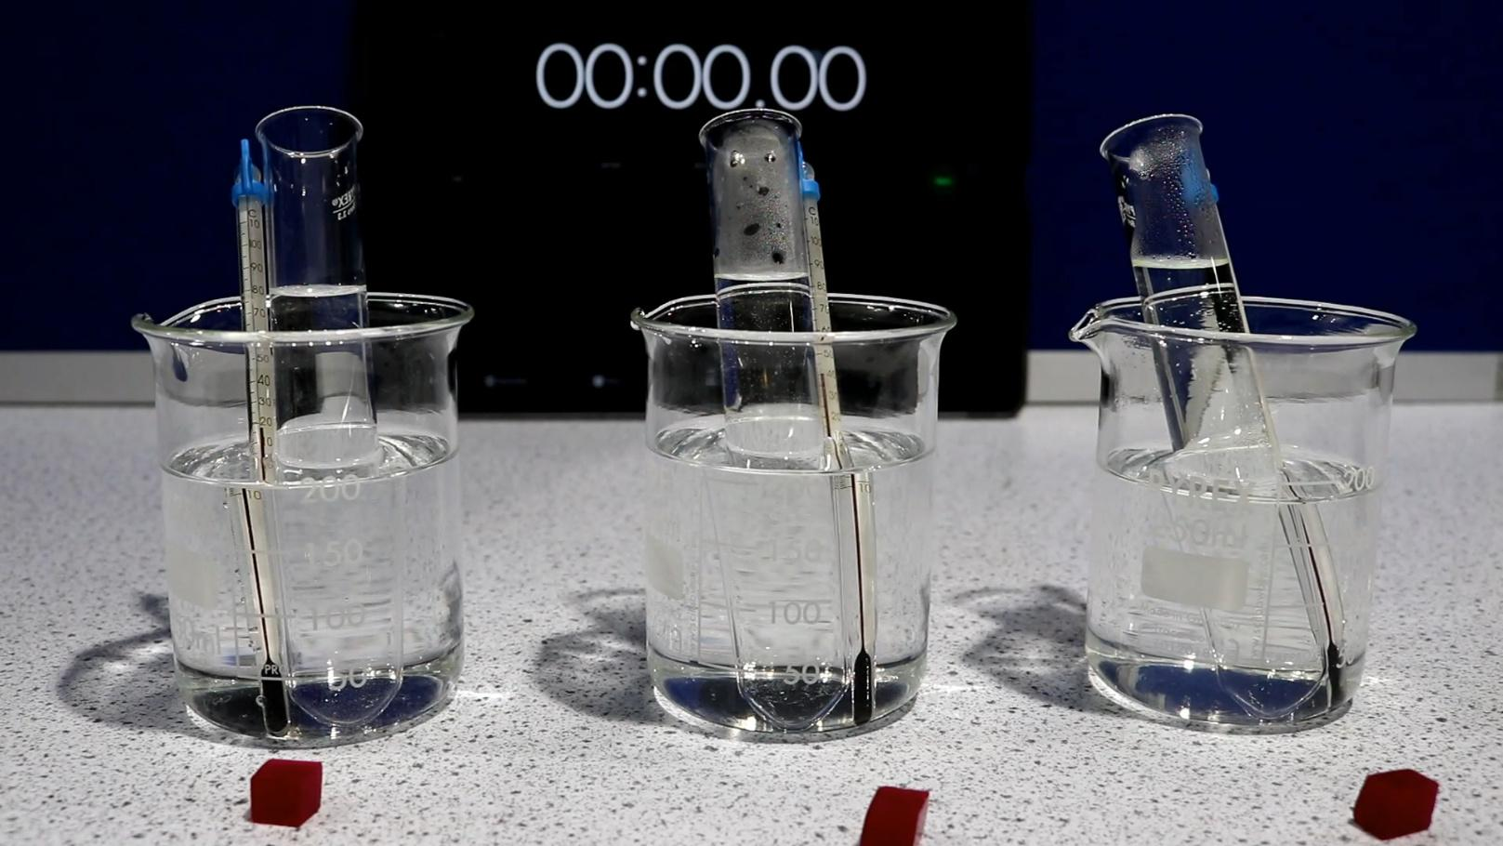
Beddelidda doorsoomayaasha (variables)
Saadaal cilmiyeed (scientific prediction):
Heerkulka sare, waqtiga lagu qaato in midabka ka baxo cube-ka wuu gaaban doonaa.
Daawo muujinta (demonstration) si aad u aragto waxa dhacaya.
Ma taageeray indho-indhayntii (observations) tijaabada (experiment) saadaashii?

Slide 24
Beddelidda doorsoomayaasha (variables)
Yaa qeexaya indho-indhaynta (observations) tijaabada (experiment)?
Heerkulka (°C) | Waqtiga lagu qaato in midabka ka baxo cube-ka (s)
20 | 602
40 | 566
60 | 380
Heerkulka sare, waqtiga lagu qaato in midabka ka baxo cube-ka wuu dheeraa.
Heerkulka sare, waqtiga lagu qaato in midabka ka baxo cube-ka wuu gaabnaa.
Heerkulka sare, waqtiga lagu qaato in midabka ka baxo cube-ka wuxuu la mid ahaa kii heerkulka hoose.

Slide 25
Beddelidda doorsoomayaasha (variables)
Yaa sharxaya indho-indhaynta (observations) tijaabada (experiment)?
Heerkulka (°C) | Waqtiga lagu qaato in midabka ka baxo cube-ka (s)
20 | 602
40 | 566
60 | 380
Heerkulka sare, qaybaha (particles) aashitada waxay si dhakhso leh ugu faafaan (diffuse) xarunta cube-ka.
Heerkulka sare, qaybaha (particles) aashitada waxay si gaabis ah ugu faafaan (diffuse) xarunta cube-ka.
Heerkulka sare, qaybaha (particles) aashitada waxay ugu faafaan (diffuse) xarunta cube-ka isku heer (rate) sida heerkulka hoose.

Slide 26
Beddelidda doorsoomayaasha (variables)
Marka la baarayo faafinta (diffusion) aashitada gudaha cube-ka jeliga midabka leh, doorsoome (variable) aan beddeli karno waa cabbirka cube-ka.
1) Aqoonso (Identify) doorsoomaha madaxbanaan (independent variable), doorsoomaha ku-tiirsan (dependent variable), iyo doorsoome ay tahay inaan xakameyno (control variable).
2) Qor saadaal cilmiyeed (scientific prediction) tijaabada (experiment) darsiga.
Ballaci (Width)
1.0 cm
Ballaci (Width)
1.5 cm
Ballaci (Width)
2.0 cm

Slide 27
Doorsoomayaal beddelaya (Changing variables)
1) Aqoonso (Identify) doorsoomaha madaxbanaan (independent variable), doorsoomaha ku-tiirsan (dependent variable), iyo doorsoome ay tahay inaan xakameyno (control variable).
Doorsoomaha madaxbanaan (Independent variable):
cabirka (size) cubes-ka.
Doorsoomaha ku-tiirsan (Dependent variable):
wakhtiga (time) loo qaato in midabka ka baxo (decolourise) cube kasta.
Doorsoome xakameyn (Control variable):
heerkulka (temperature) aashitada (acid).
2) Qor saadaal cilmiyeed (scientific prediction) tijaabada (experiment) darsiga.
Wakhtiga (time) loo qaato in midabka ka baxo (decolourise) cube-ka wuxuu dheeraan doonaa cube ballaciisu (width) weyn yahay.

Slide 28
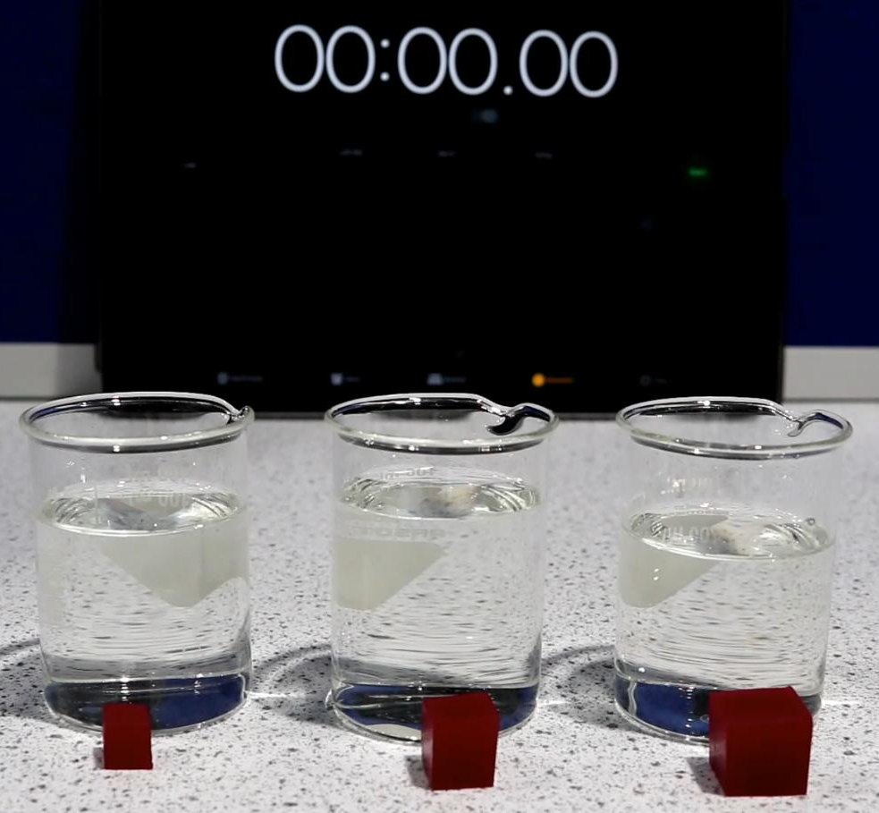
Doorsoomayaal beddelaya (Changing variables)
Daawo (Watch) muujinta (demonstration) si aad u aragto waxa dhaca.
3) Ma taageertay (support) indho-indhaynta (observations) tijaabada (experiment) saadaashaada (prediction)?
4) Sidee u sharxi lahayd (explain) indho-indhaynta (observations) tijaabada (experiment) darsiga?

Slide 29
Beddelidda doorsoomayaasha (Changing variables)
3) Ma taageereen indho-indheyntii tijaabada (experiment) saadaalintaada?
Haddii aad saadaalisay in waqtiga loo qaato in midabka ka baxo (decolourise) uu dheeraan doono cube ballaciisu weyn yahay, indho-indheyntu waxay taageertay saadaalinta.
4) Sidee u sharxi lahayd indho-indheynta tijaabada (experiment)?
Waqtiga loo qaato in midabka ka baxo (decolourise) cube ballaciisu weyn yahay waa dheer, sababtoo ah qaybaha asiidhka (acid) waa inay sii faafaan (diffuse) ka fog xagga sare ee cube si ay u gaaraan bartamihiisa.

Slide 30
Faafinta (diffusion) iyada oo loo marayo agab dhexmara (permeable material): tijaabo (experiment) wax ku ool ah
Qaybaha dareeraha (liquids) waxay awood u leeyihiin inay dhaqaaqaan (movement) iyagoo sii maraya agabyo dhexmara (permeable materials) iyagoo faafaya (diffusion).
Dhaqdhaqaaqa (movement) saafiga ah ee qaybaha dareeraha (liquid) wuxuu hoos u socdaa jihada xaddiga (concentration gradient) laga bilaabo dibadda agabka dhexmara (permeable material) ilaa gudihiisa.
Saadaalin cilmiyeed (scientific prediction) waa bayaan la tijaabin karo oo ku saabsan natiijo suurtagal ah oo tijaabo (experiment) ah.
Waxaan samayn karnaa saadaal ku saabsan saamaynta isbeddelka doorsoomaha madaxbannaan (independent variable) (tusaale: cabbirka cube) uu ku yeelan doono doorsoomaha ku-tiirsan (dependent variable) (tusaale: waqtiga midab-ka-baxa (decolourisation)) ee tijaabada (experiment).

